Slide 1
eGEW
Enhanced Google Earth Web
Ben van der Pluijm – vdpluijm@umich.edu
Josh Williams - jwilliams@geteach.com

Slide 2
Google Earth is increasingly focused on the platform's web version (GEW), instead of the resource-intensive desktop version (GED)
Google Earth Web (GEW) is browser based, and loads and unloads information as needed. Thus, it is lighter and much faster, and can also be used on smaller portable devices, like tablets and smartphones. However, functionality is very limited compared to the powerful desktop version
In response, we developed two approaches that offer enhanced Google Earth Web functionality: GeoTrips and GeoExplorations

Slide 3
GeoTrips replaces the standard info panel with a panel that supports animations, videos, StreetView, GigaPan, voice-overs, text with embedded images, linked activities and weblinks
eGEW-GeoTrips allows a mix of standard GEW pages and enhanced GEW pages, offering easy implementation

Slide 4
GeoExplorations adds globe overlays for points, lines, polygons and images with embedded information and hotlinks
Georeferenced point overlays (like real-time earthquakes), line/text overlays (like plate boundaries) and image overlays (like geologic maps) can be used. Also, locations on hotlinked overlays or a specific points can be queried and link to more detailed information
Because GEW’s globe layer is altered, GeoExplorations requires that all pages in a module are similarly modified, so is a more involved application

Slide 5
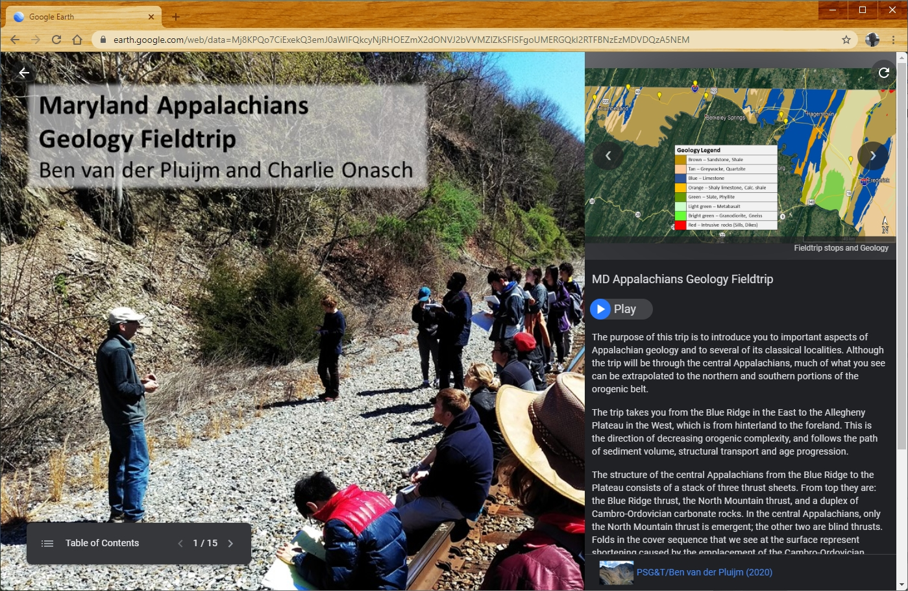
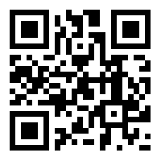
Example eGEW-GeoTrips:
Maryland Appalachians Geology Fieldtrip
Scan QR code to open activity on your phone, tablet or PC
(use camera app)
https://bit.ly/2E8vqSt

Slide 6
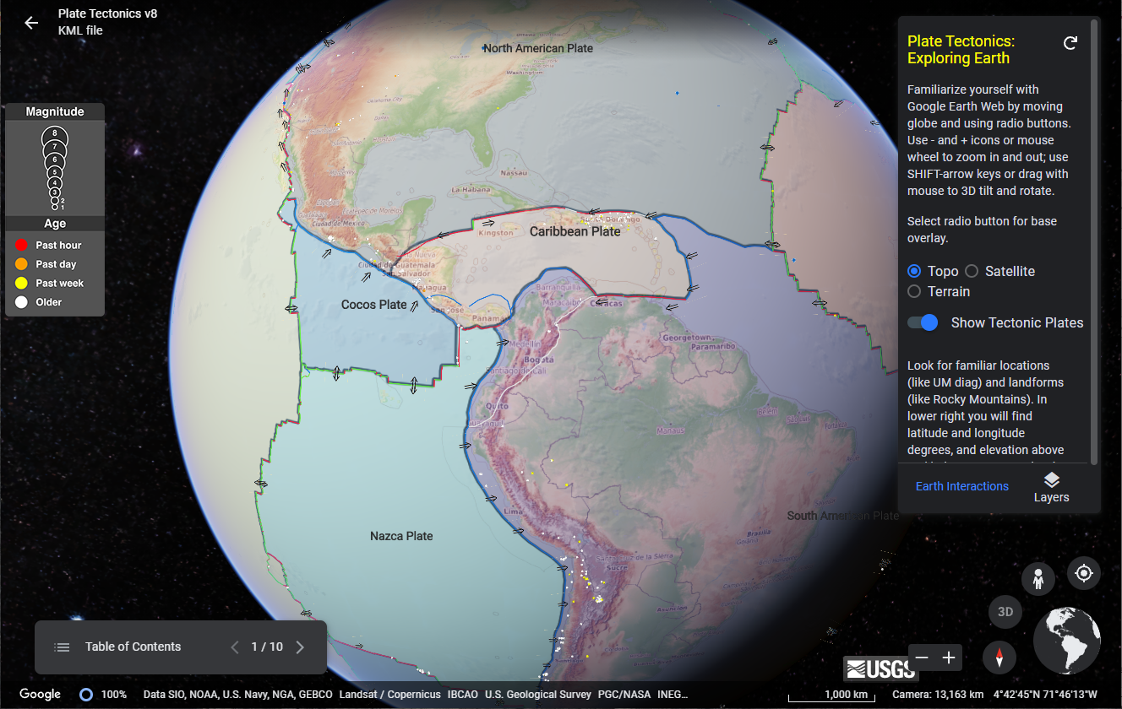
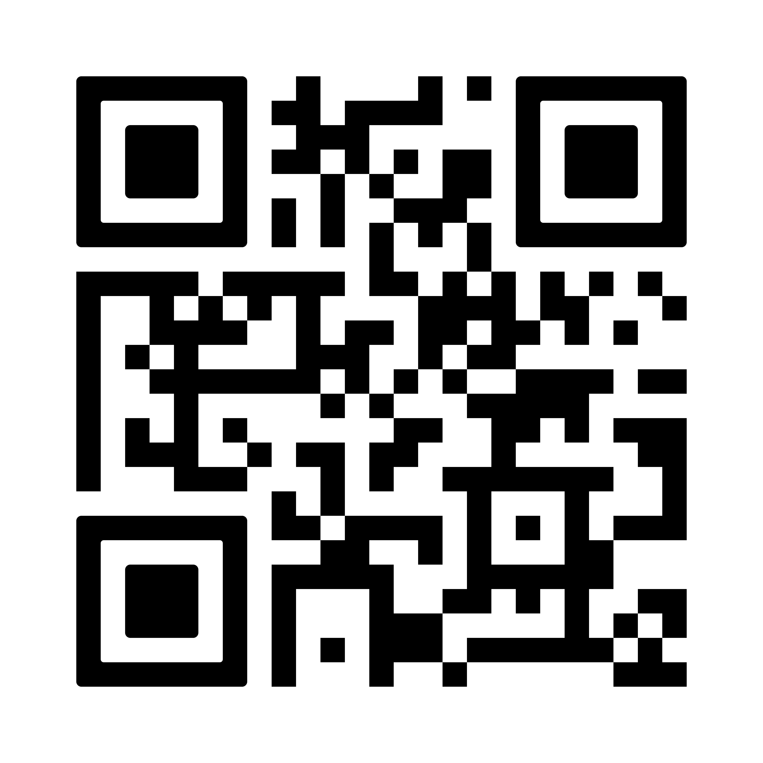
Example eGEW-GeoExplorations:
Plate Tectonics
Scan QR code to open activity on your phone, tablet or PC
(use camera app)
https://bit.ly/341H2RN

Slide 7
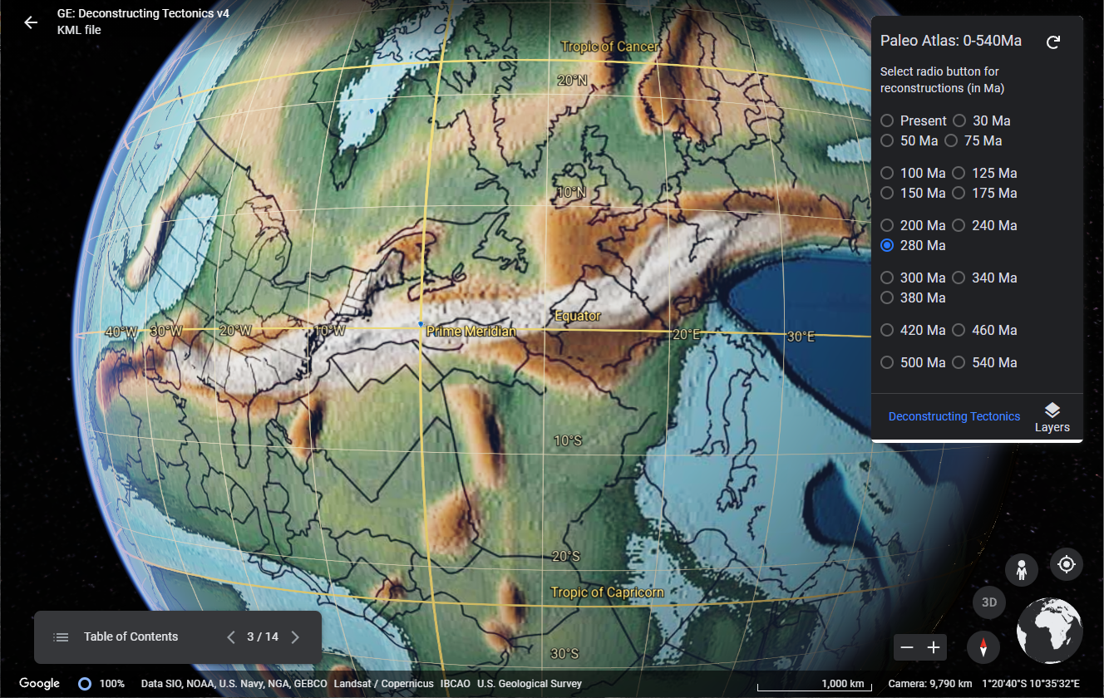
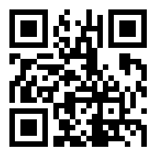
Teaching Module:
eGEW-GE: Deconstructing Tectonics
Scan QR code to open activity on your phone, tablet or PC
(use camera app)
https://bit.ly/2WQV4BL

Slide 8
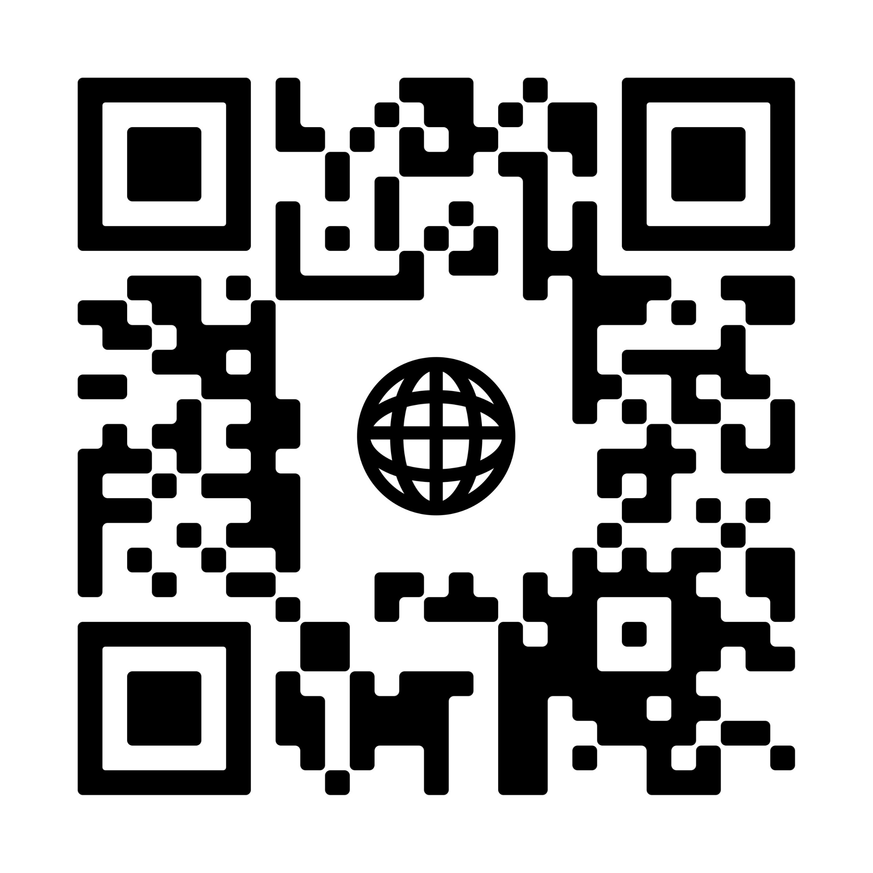
Do-It-Yourself
Instructions at:
vanderBlog: enhanced Google Earth Web
https://vdpluijm.blogspot.com/2021/07/ enhanced-google-earth-web.html

