Slide 1
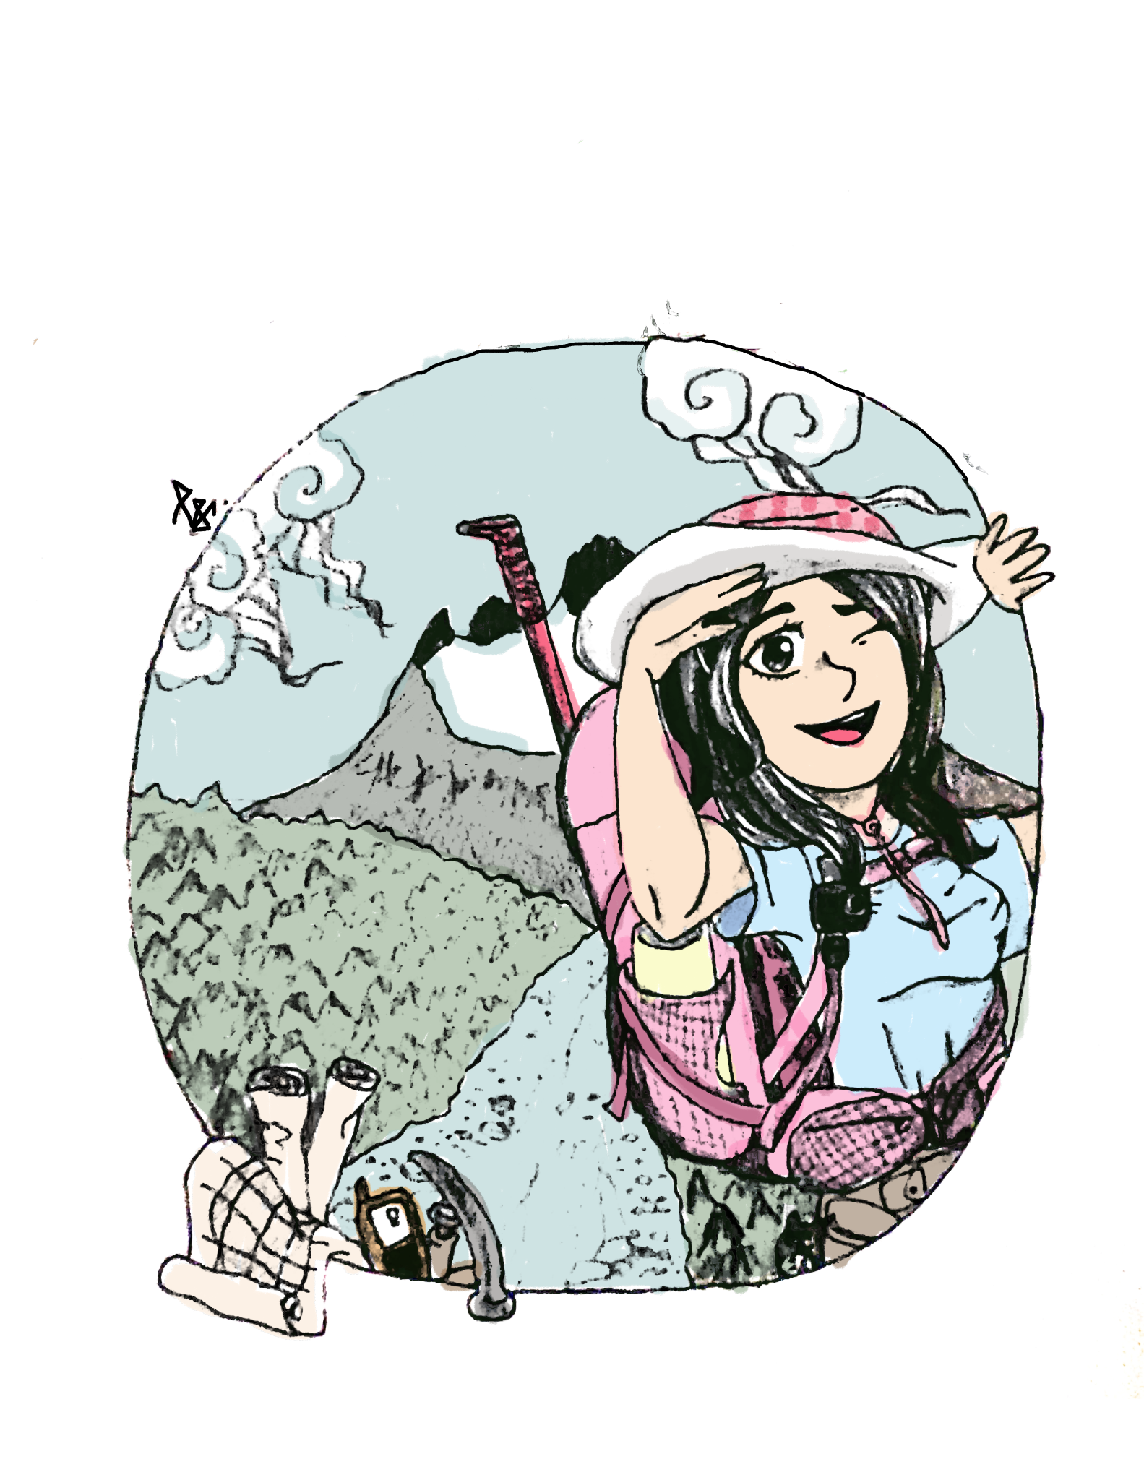



Understanding Glacier Thinning and Retreat During the Last Glacial Maximum in Yosemite to Predict Contemporary Deglaciation
Yueyi Che, Alyssa Abbey, David Shuster, Greg Balco, Greg Stock, Kurt Cuffey
Notes:
Hello, I am Yueyi Che, I use she/her pronoun and I am an undergraduate senior geology major from the University of California, Berkeley. Today my talk is on understanding glacier thinning and retreat during the last glacial maximum in Yosemite to predict contemporary deglaciation. My advisors are Alyssa Abbey, David Shuster, Greg Balco, Greg Stock, Kurt Cuffey.

Slide 2
Land Acknowledgement
We acknowledge the land on which we conducted fieldwork in Yosemite National Park area, which is the home of the Me-Wuk, Western Mono/Monache, Eastern Mono/Monache, Numu, Chukchansi, Wašišiw Ɂítdeʔ, and Yokuts people. We take this opportunity to thank the original caretakers of this land.
Notes:
We acknowledge the land on which we conducted fieldwork in Yosemite National Park area, which is the home of many Native American people. We take this opportunity to thank the original caretakers of this land.

Slide 3
01
Introduction
Notes:
First, I want to introduce some background of our research.

Slide 4
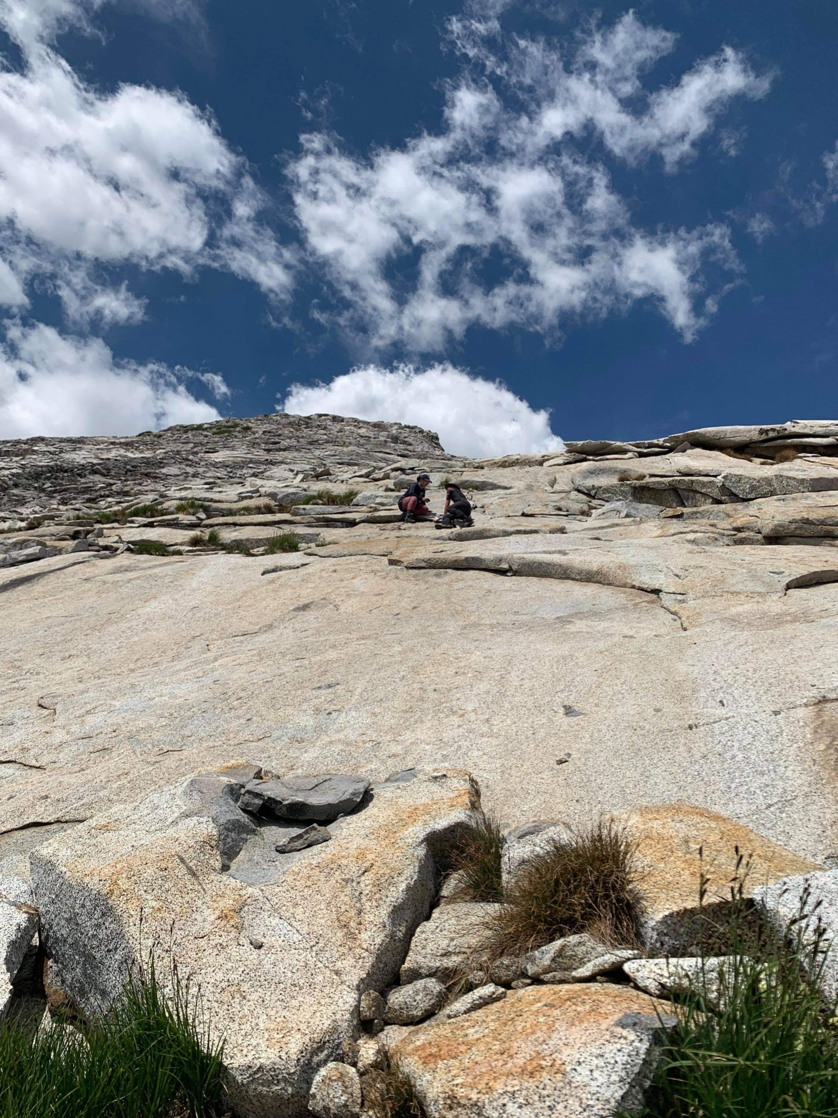
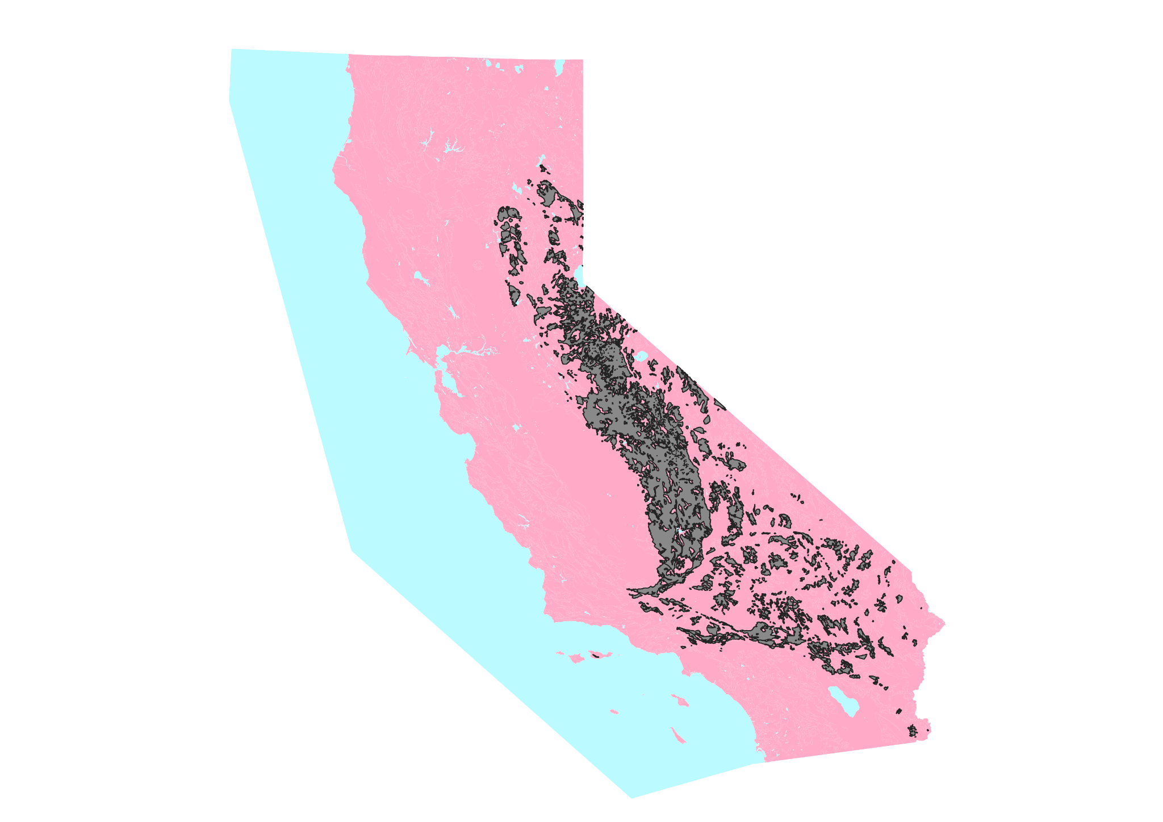
PC: Gus Tovalin
(Jennings et al., 1977)
Notes:
Our study site Lyell Canyon is in the east of Yosemite National Park in California. Yosemite is sitting in the middle of the granitic Sierra Nevada batholith, depicted in gray on this map and shown in the field photo. This area was extensively glaciated around 33 thousand years ago to 20 thousand years ago, which people refer to as the Last Glacial Maximum, or the LGM.

Slide 5
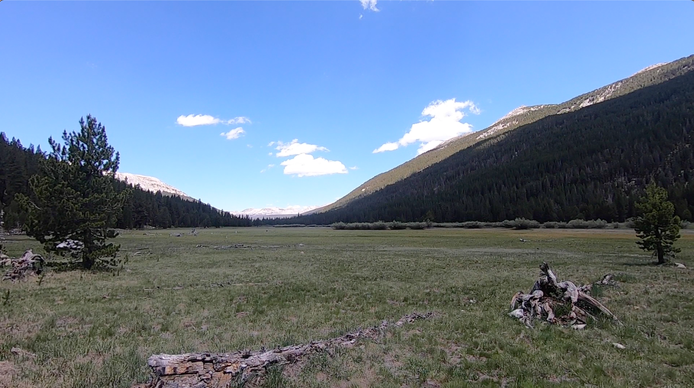
Notes:
Standing in Lyell Canyon, we can see this very beautiful symmetric U-shaped glacial valley.

Slide 6
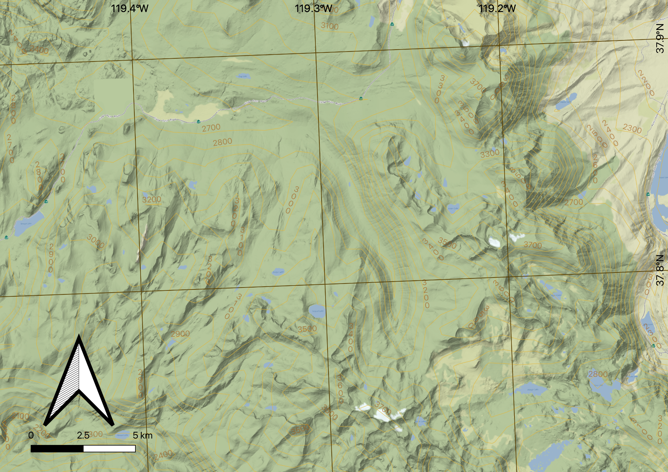
Notes:
And on this map, we have Lyell Canyon right, here [click for animation].
The goal of our study is to provide more insights into the unsolved glacier melting patterns in Yosemite after the LGM, around 20 thousand years ago to 13 thousand years ago.

Slide 7
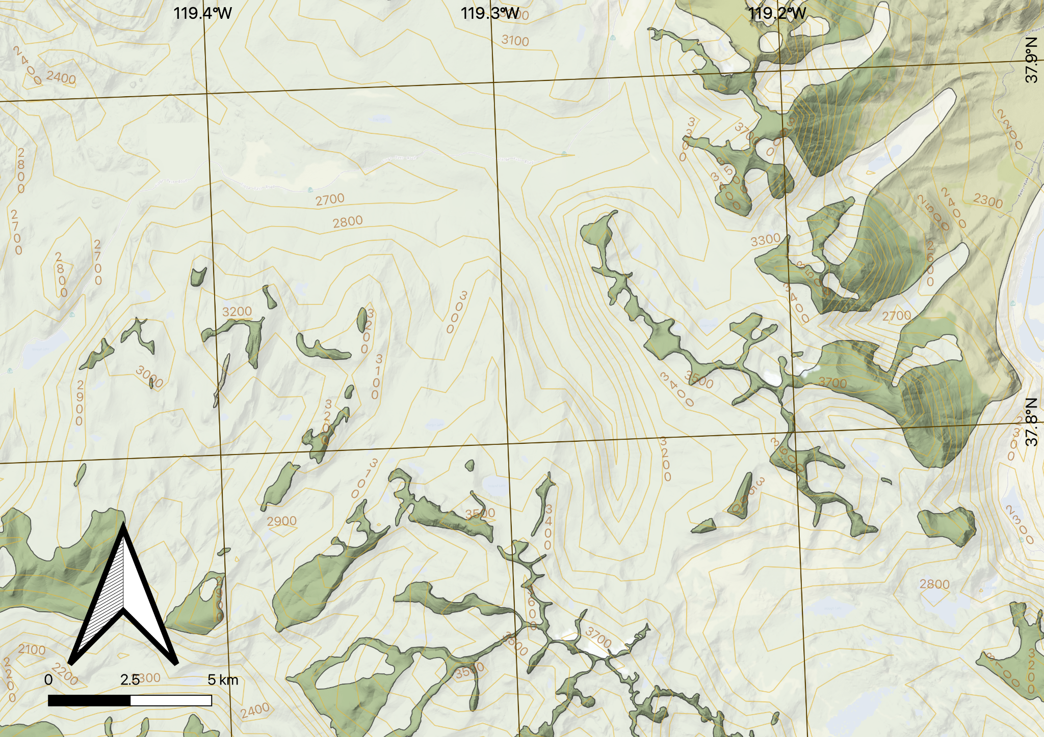
Glacier Extent (Wahrhaftig et al., 2019)
Notes:
The white polygon in the map is the glacial maximum extent in LGM.

Slide 8
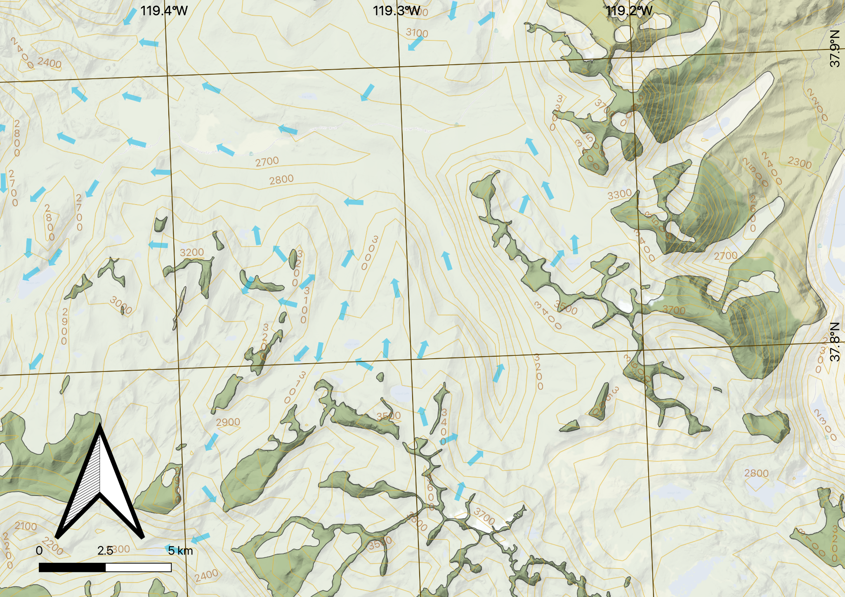
Glacier Extent and Glacier Flow Direction (Wahrhaftig et al., 2019)
Notes:
the blue arrows are the reconstructed glacier flow directions.

Slide 9
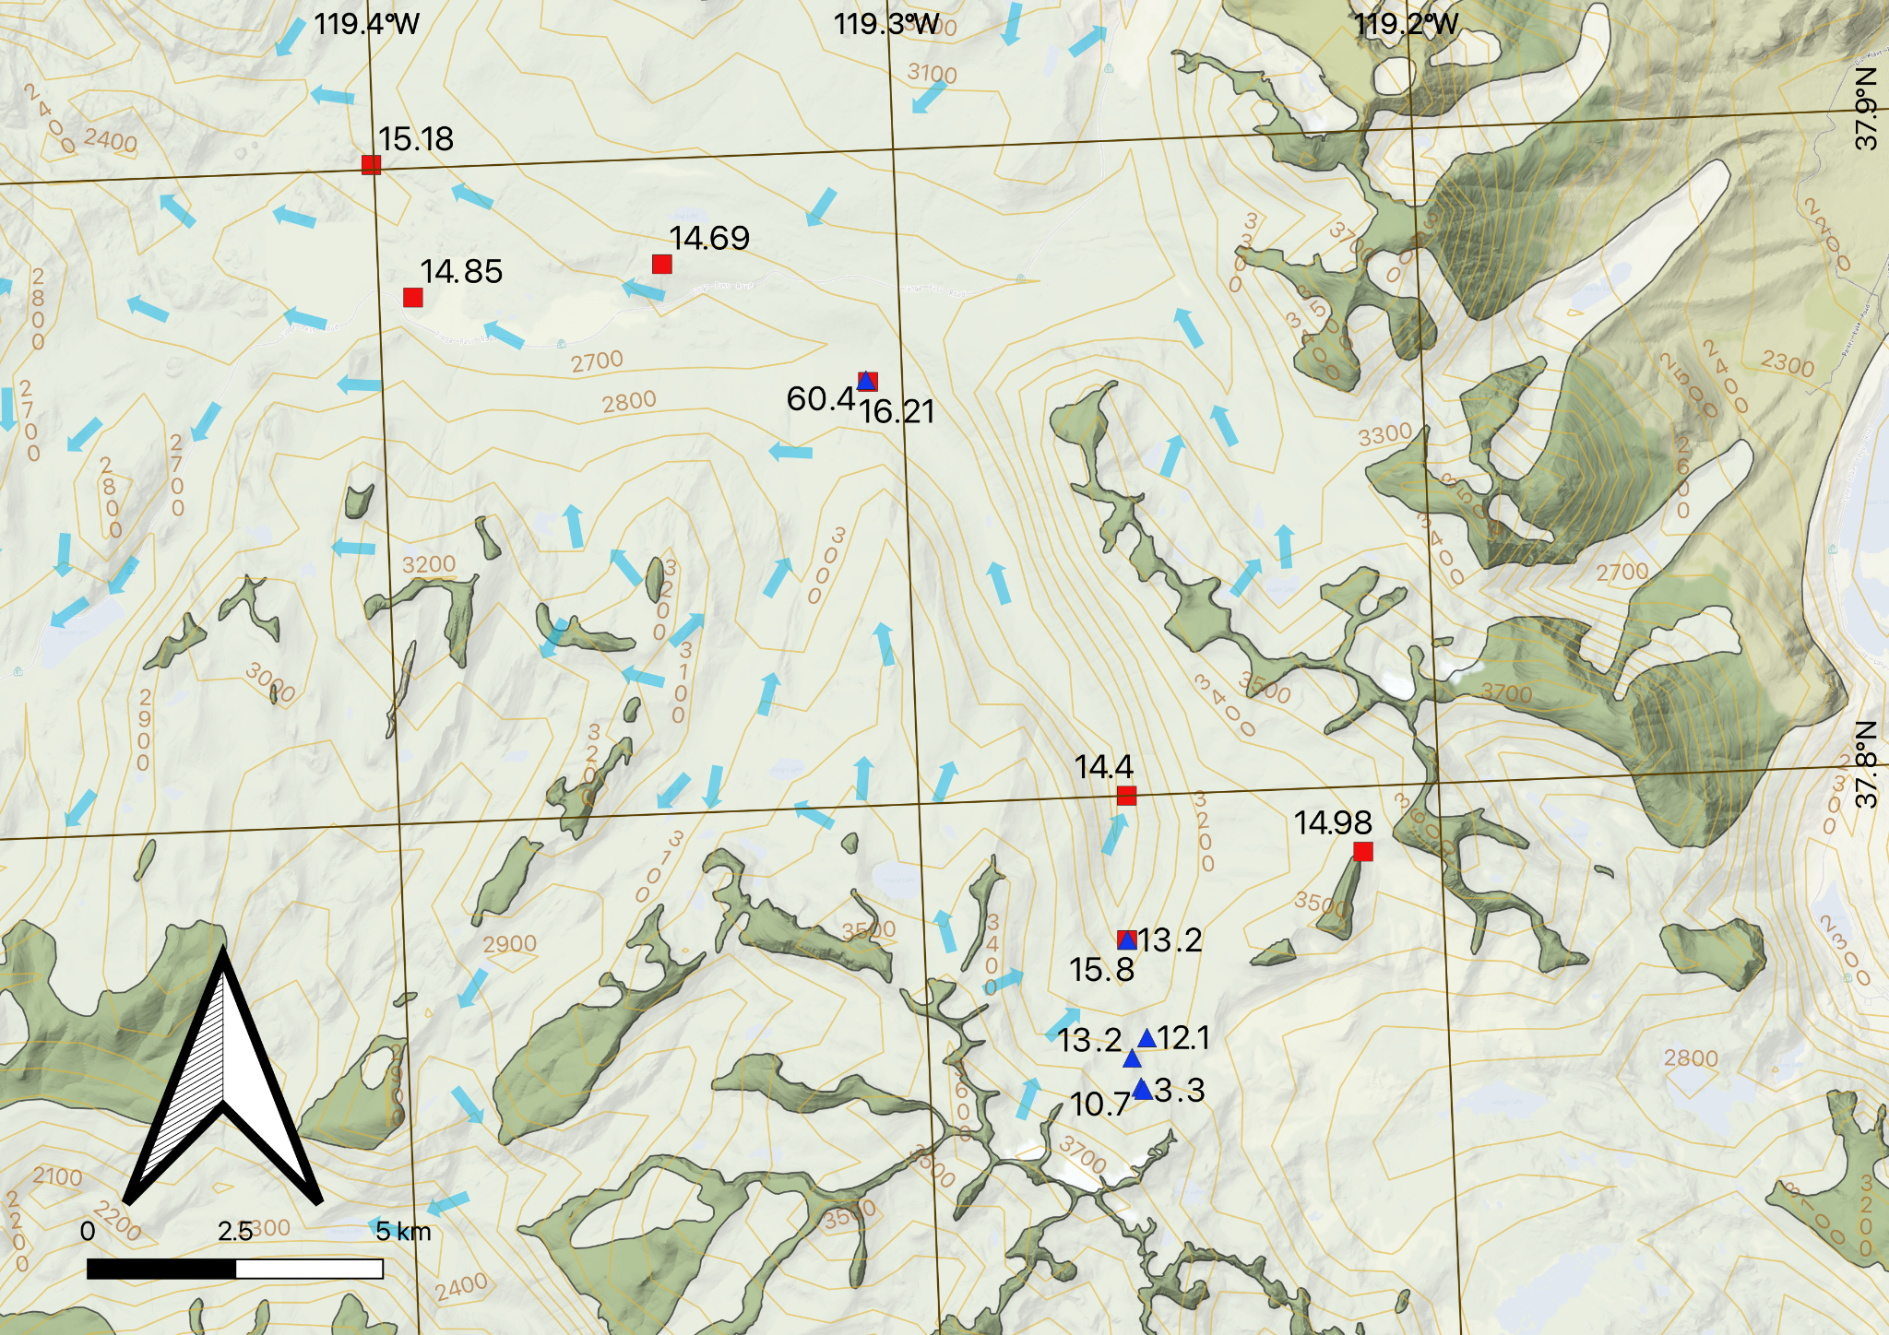
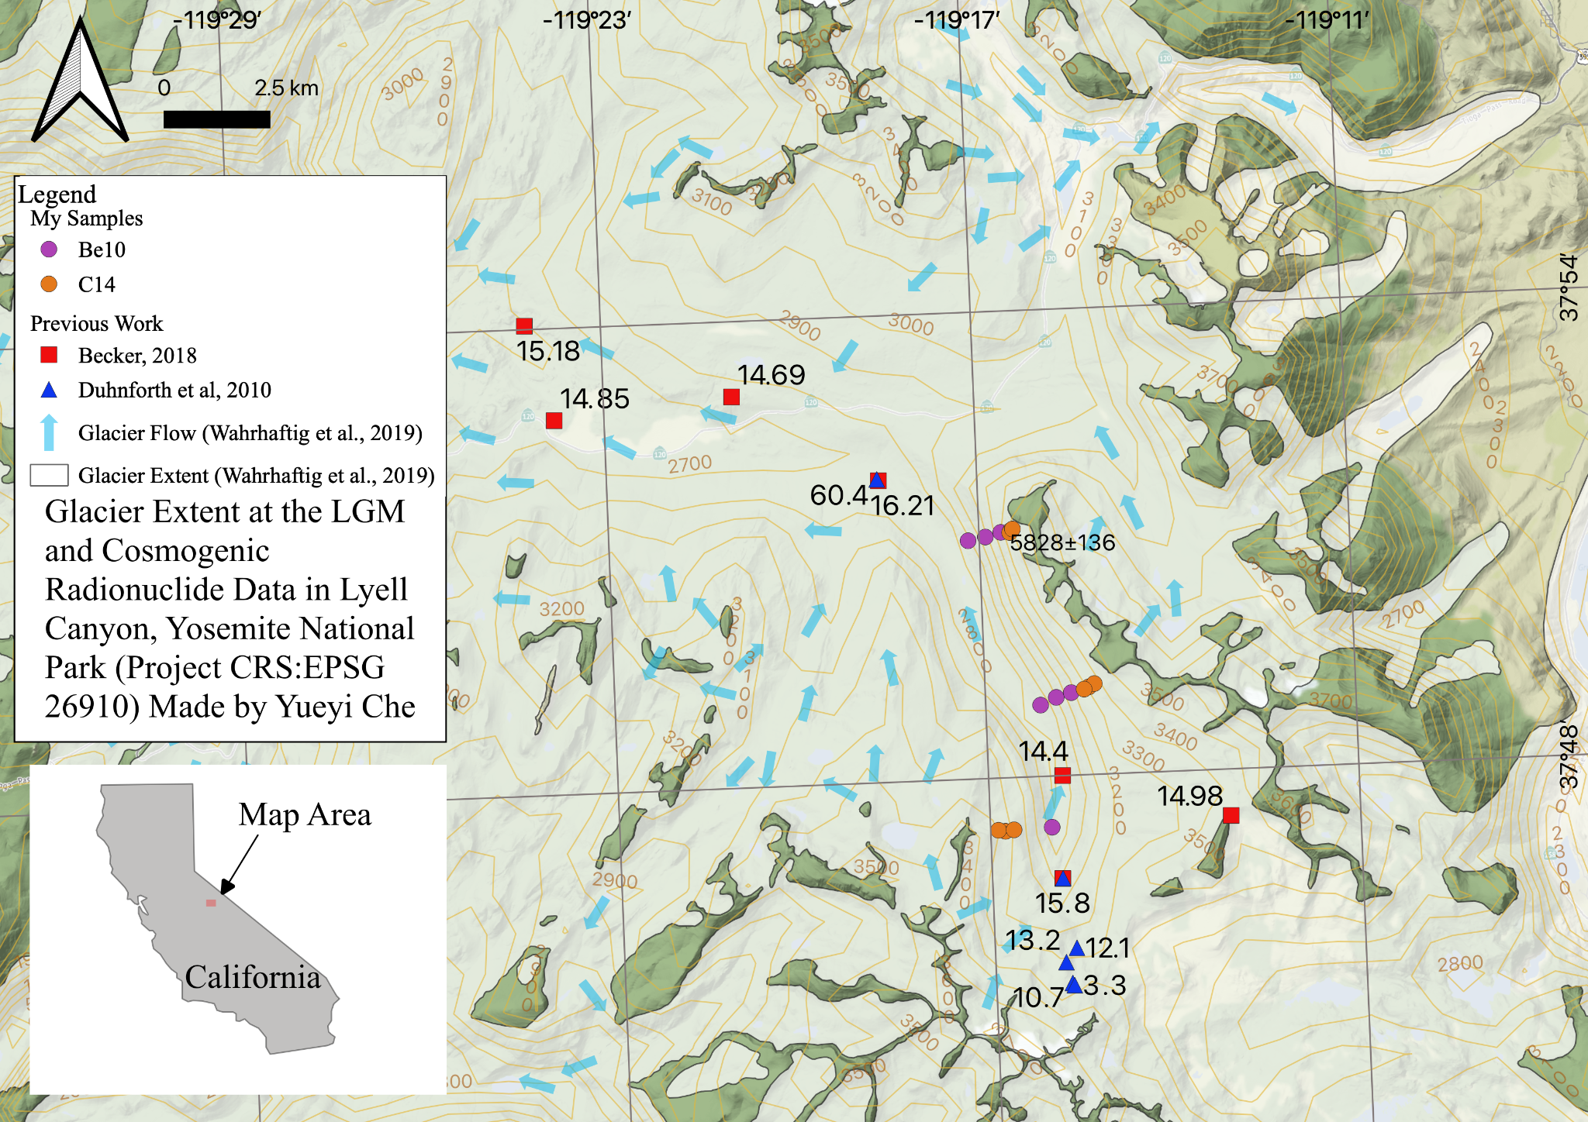
Glacier Extent and Glacier Flow Direction (Wahrhaftig et al., 2019)
Notes:
the red squares and blue triangles are cosmogenic Be10 exposure ages of boulders. Previous studies shows similar Be10 exposure ages on the valley floor, and both Becker and Dunhforth interpreted this as a rapid glacier retreat around 16 to 13 thousand years ago. Today, there are only two little glaciers at the south end of Lyell Canyon.

Slide 10
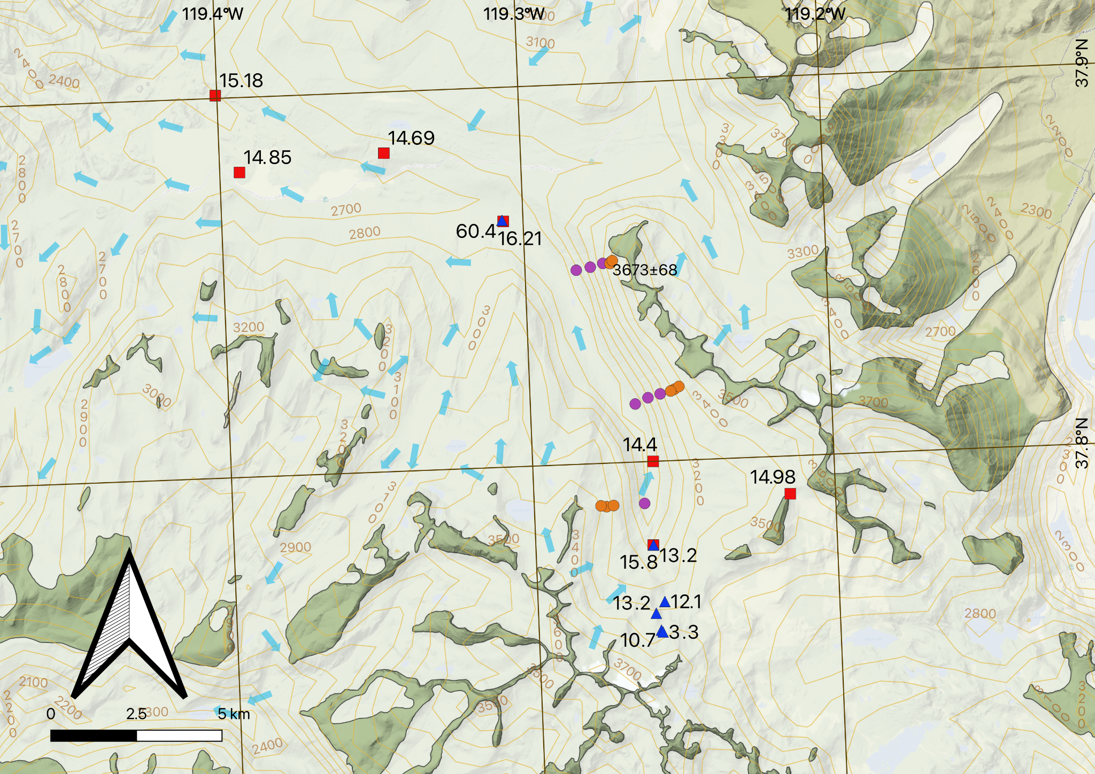
Glacier Extent and Glacier Flow Direction (Wahrhaftig et al., 2019)
Notes:
For my study, we sampled three transects on the vertical valley wall, here, here, and here in fall 2020 and summer 2021, and applied in situ cosmogenic C14 exposure age dating at higher elevations, and cosmogenic Be10 at the lower elevations.

Slide 11
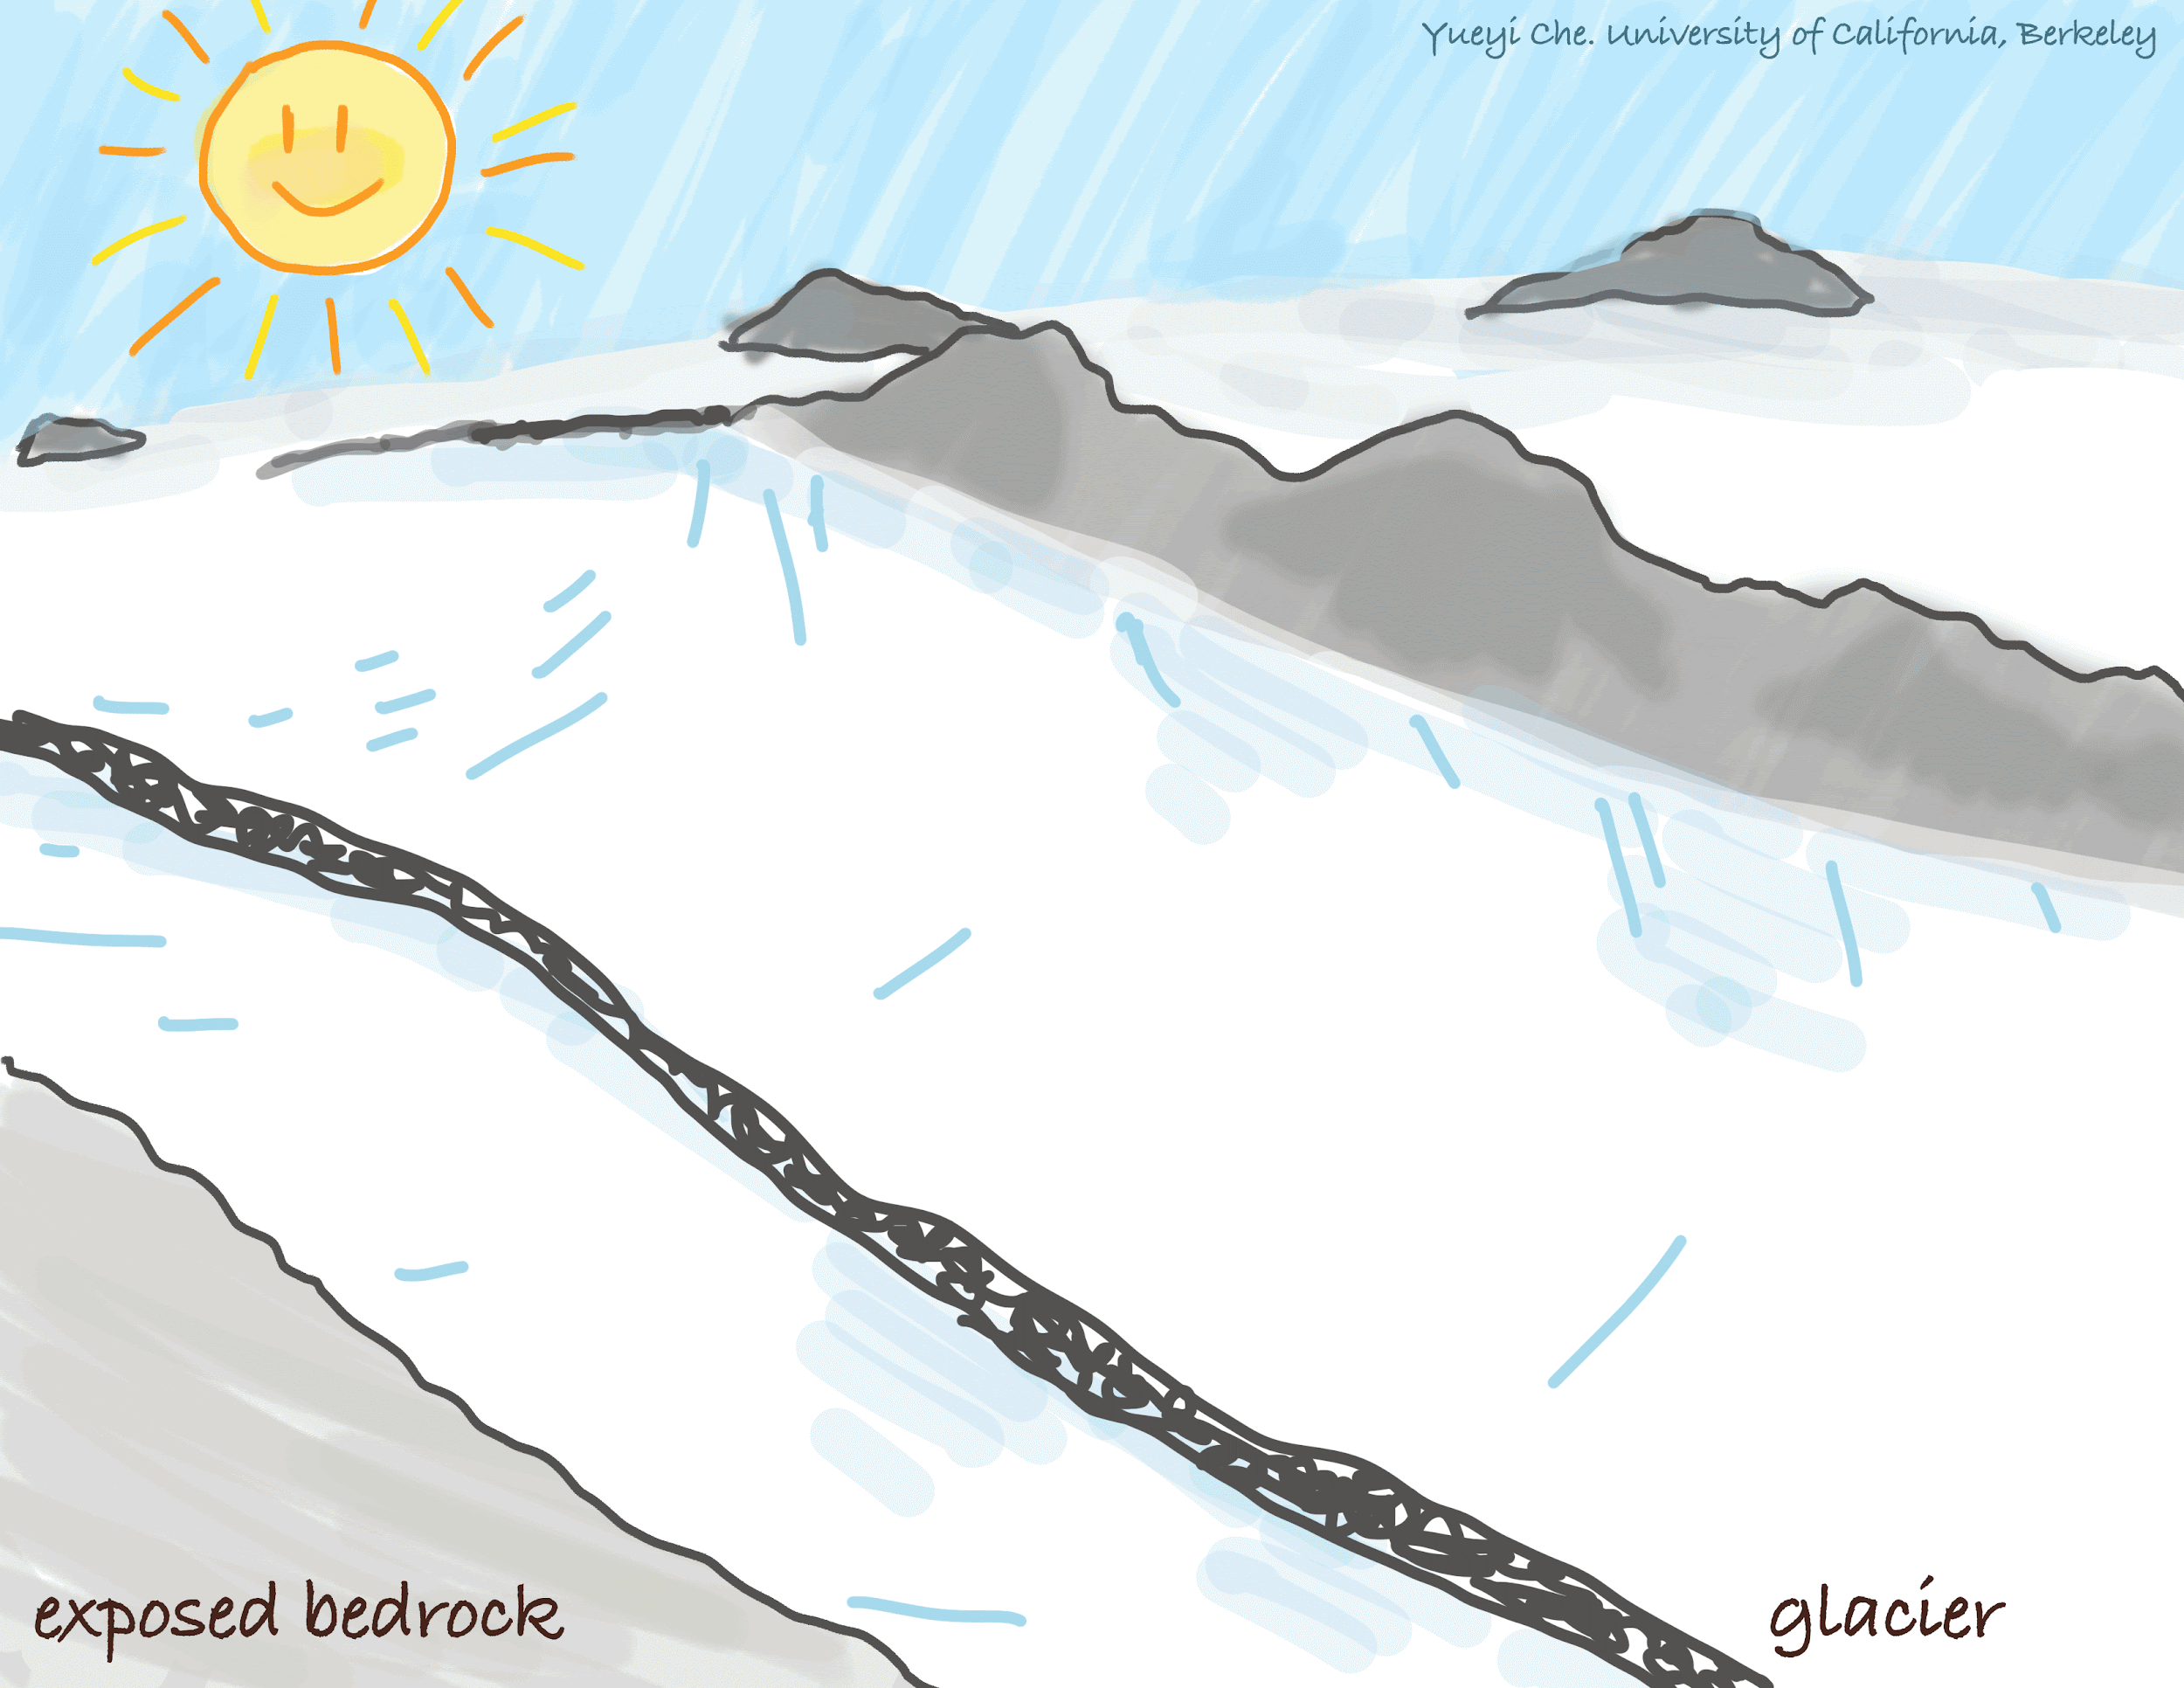
Notes:
Before we dive into our study, I want to quickly refresh us on the geochemical method we are using, in situ cosmogenic exposure age dating. When the glacier is not covering the bedrocks, the exposed rocks will react with cosmic rays coming from the sky and accumulate certain cosmogenic nuclides, in our case Be-10 or C-14. The longer the rock has been exposed, the more cosmogenic nuclides are in the rock. By looking at the nuclide concentration, we know how long ago glacier melts away from a certain location to expose the rock beneath.

Slide 12
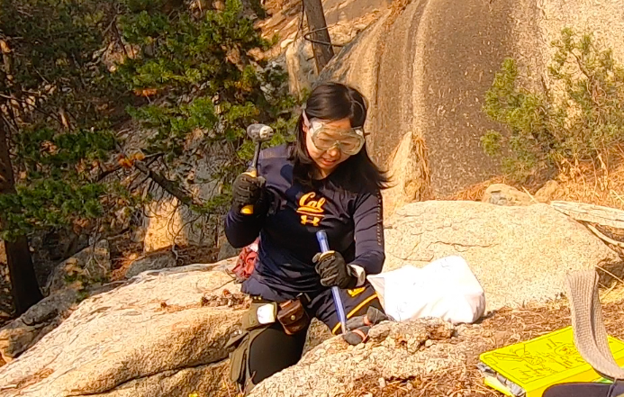
Why C14 and Be10?
Notes:
Why do we use cosmogenic C14 and Be10 in our study?
C14 at higher elevations can avoid the inheritance of cosmogenic nuclide from before the LGM glaciation. Samples at higher elevation experiences lower glacial erosion rate, allowing them to inherit nuclides at the bedrock surface. By the time our post-LGM deglaciation started, because C14 has such short half-life compared to Be10, there will be no C14 inherited from before the LGM.
We choose Be10 for lower elevation samples because it is more accurate for our timeframe. Be10 is also what used in previous studies, which serves a bridge for us to compare our study to previous ones. Using two nuclides in one elevation transect and also inform us about the burial history during the thinning process.

Slide 13
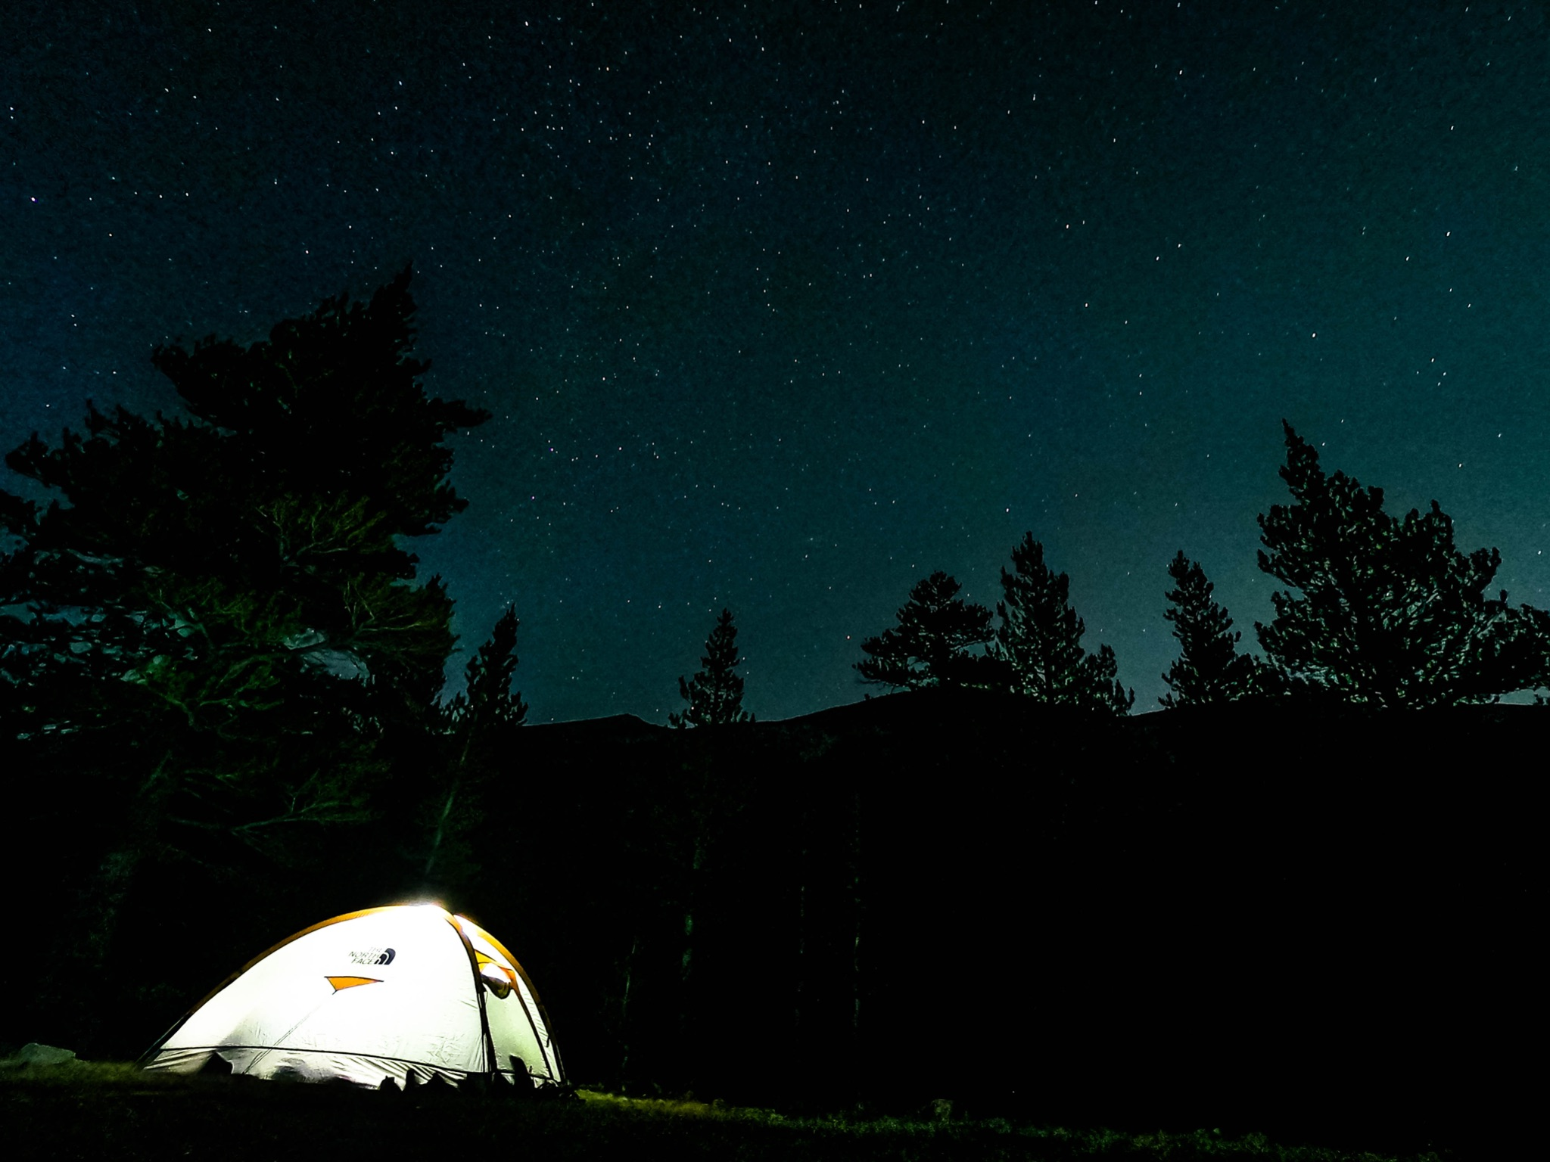
Hypothesis:
Thinning & Retreating
Timing
Rate
Pattern
Notes:
For our study, we aim to use cosmogenic exposure age dating to address the timing, rate, and pattern of glacier thinning and retreating in Lyell Canyon, which may help us understand today’s mountain glacier melting.

Slide 14
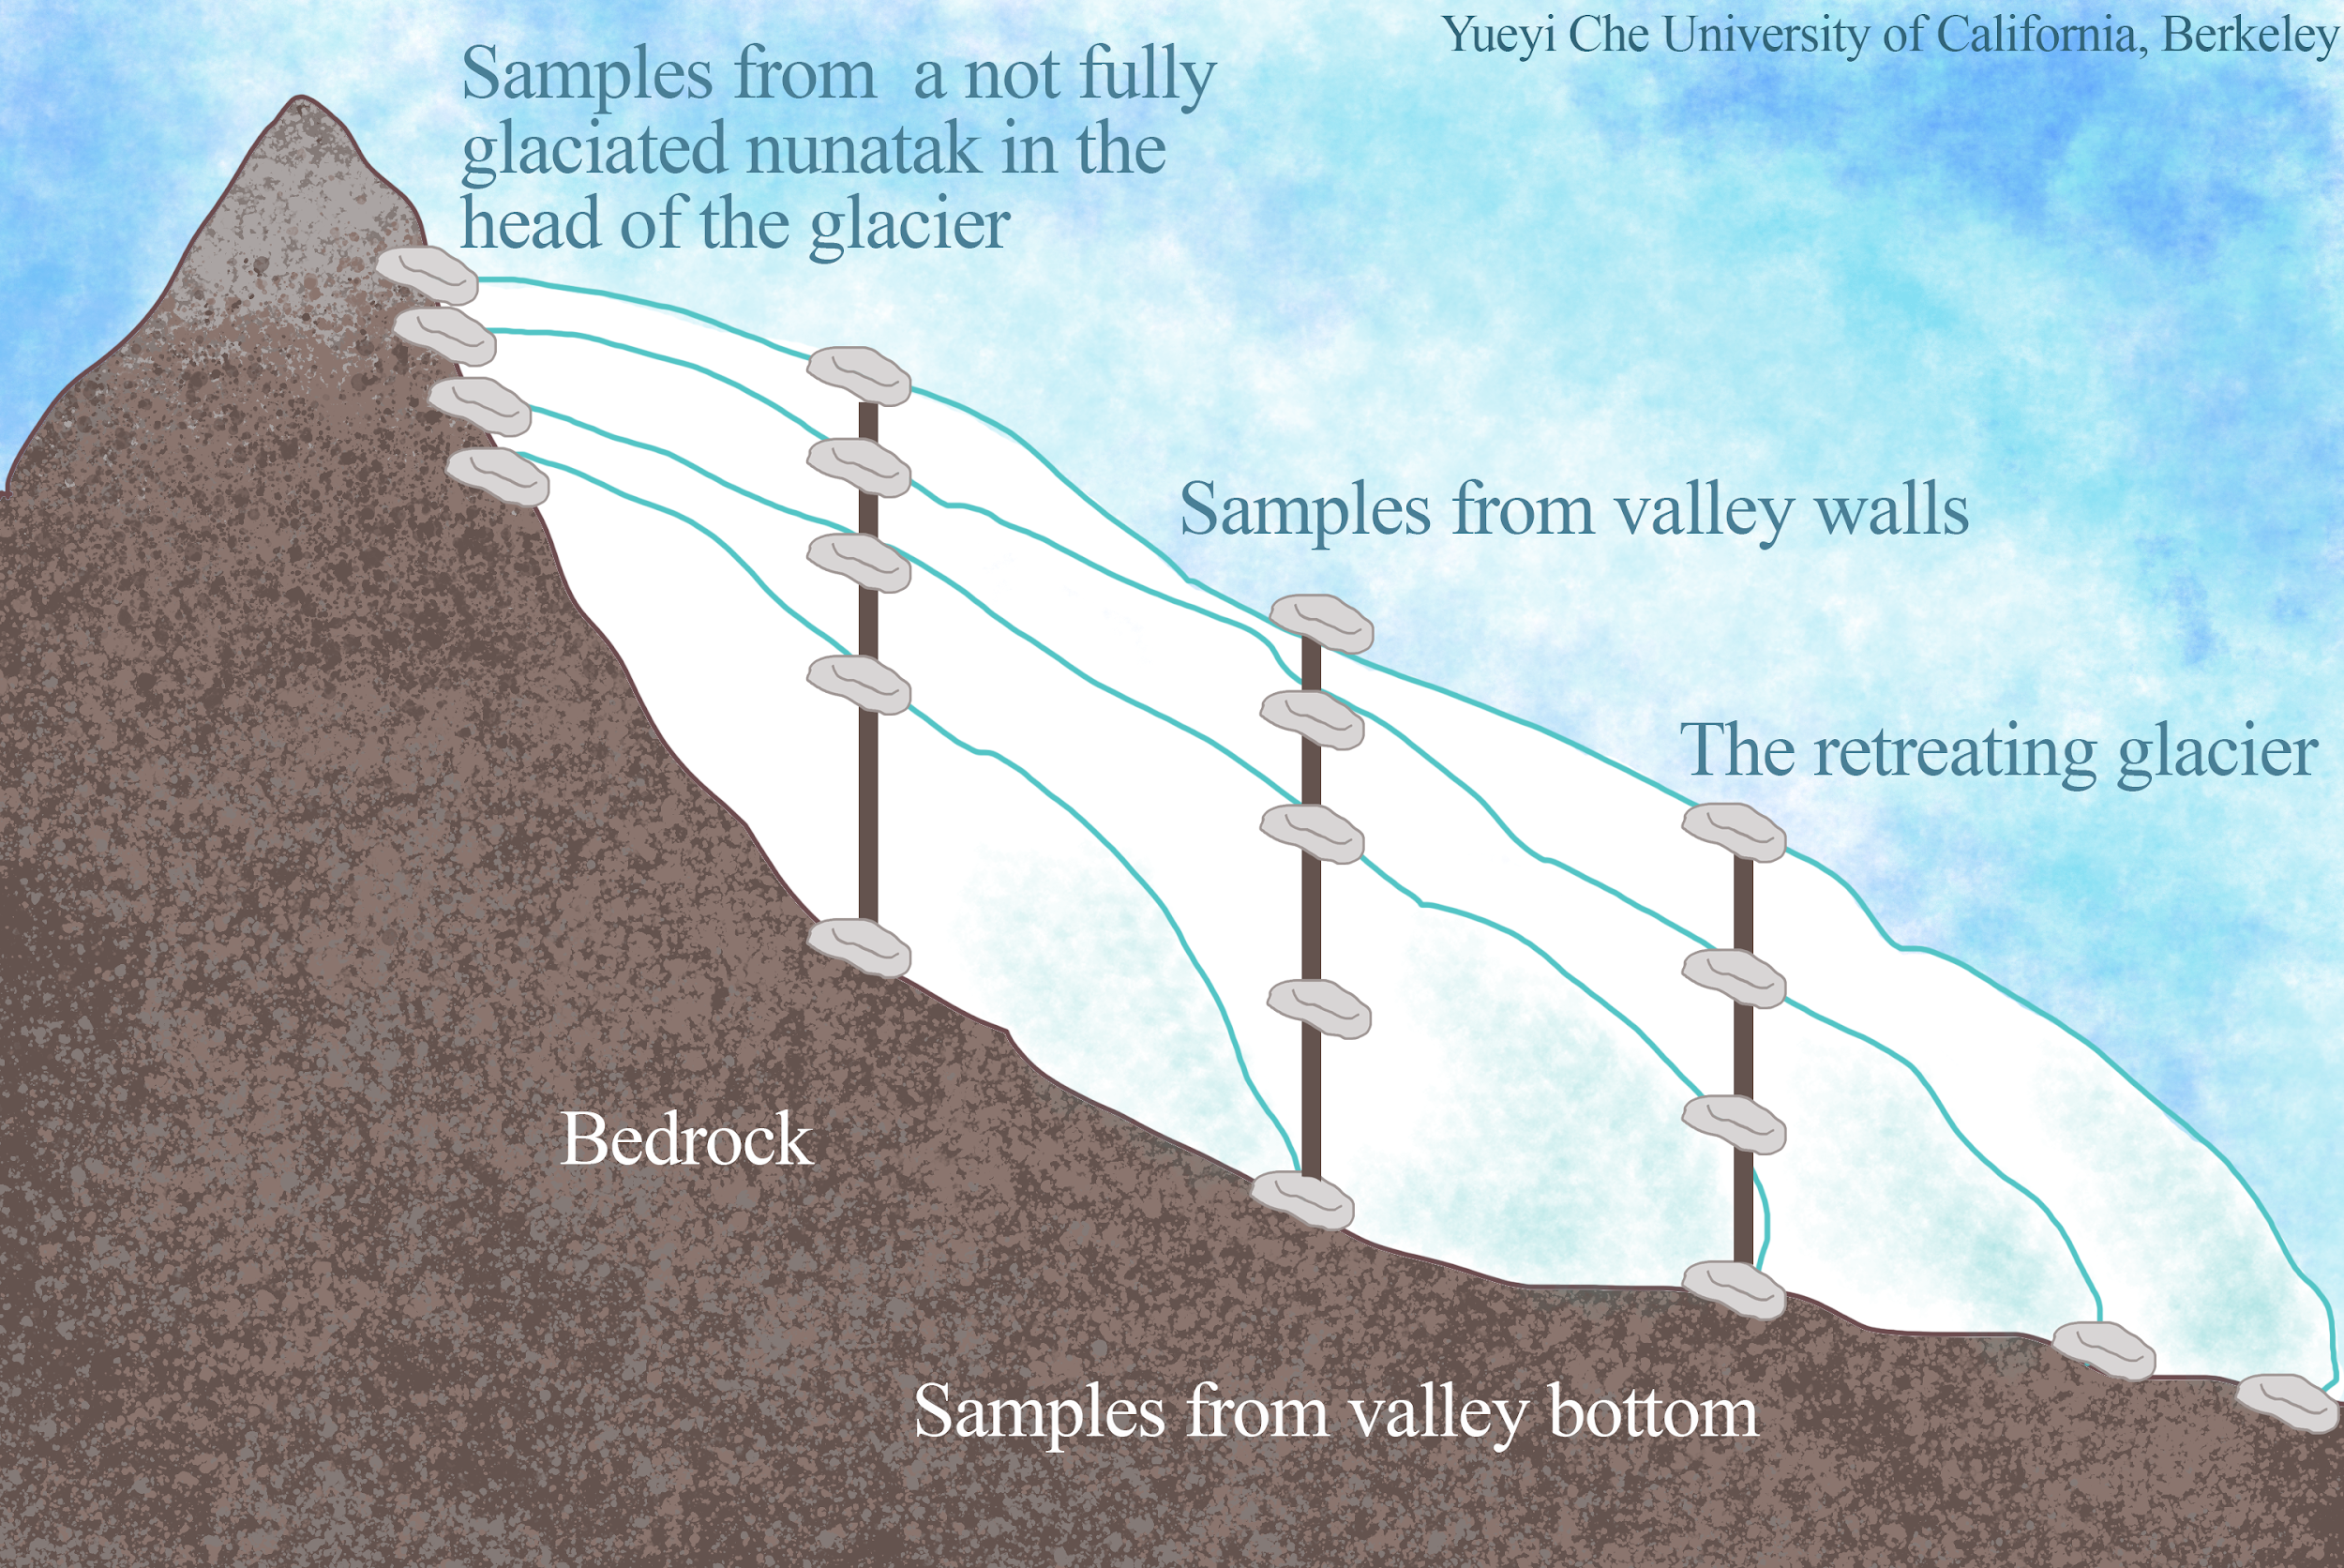
Notes:
As shown in this figure, our samples on the valley walls reflects glacier thinning, and the previous studies’ samples on the valley bottom reflects glacier retreat. We are interested in combining the two sample dimensions to analyze the relationship between thinning and retreating.

Slide 15
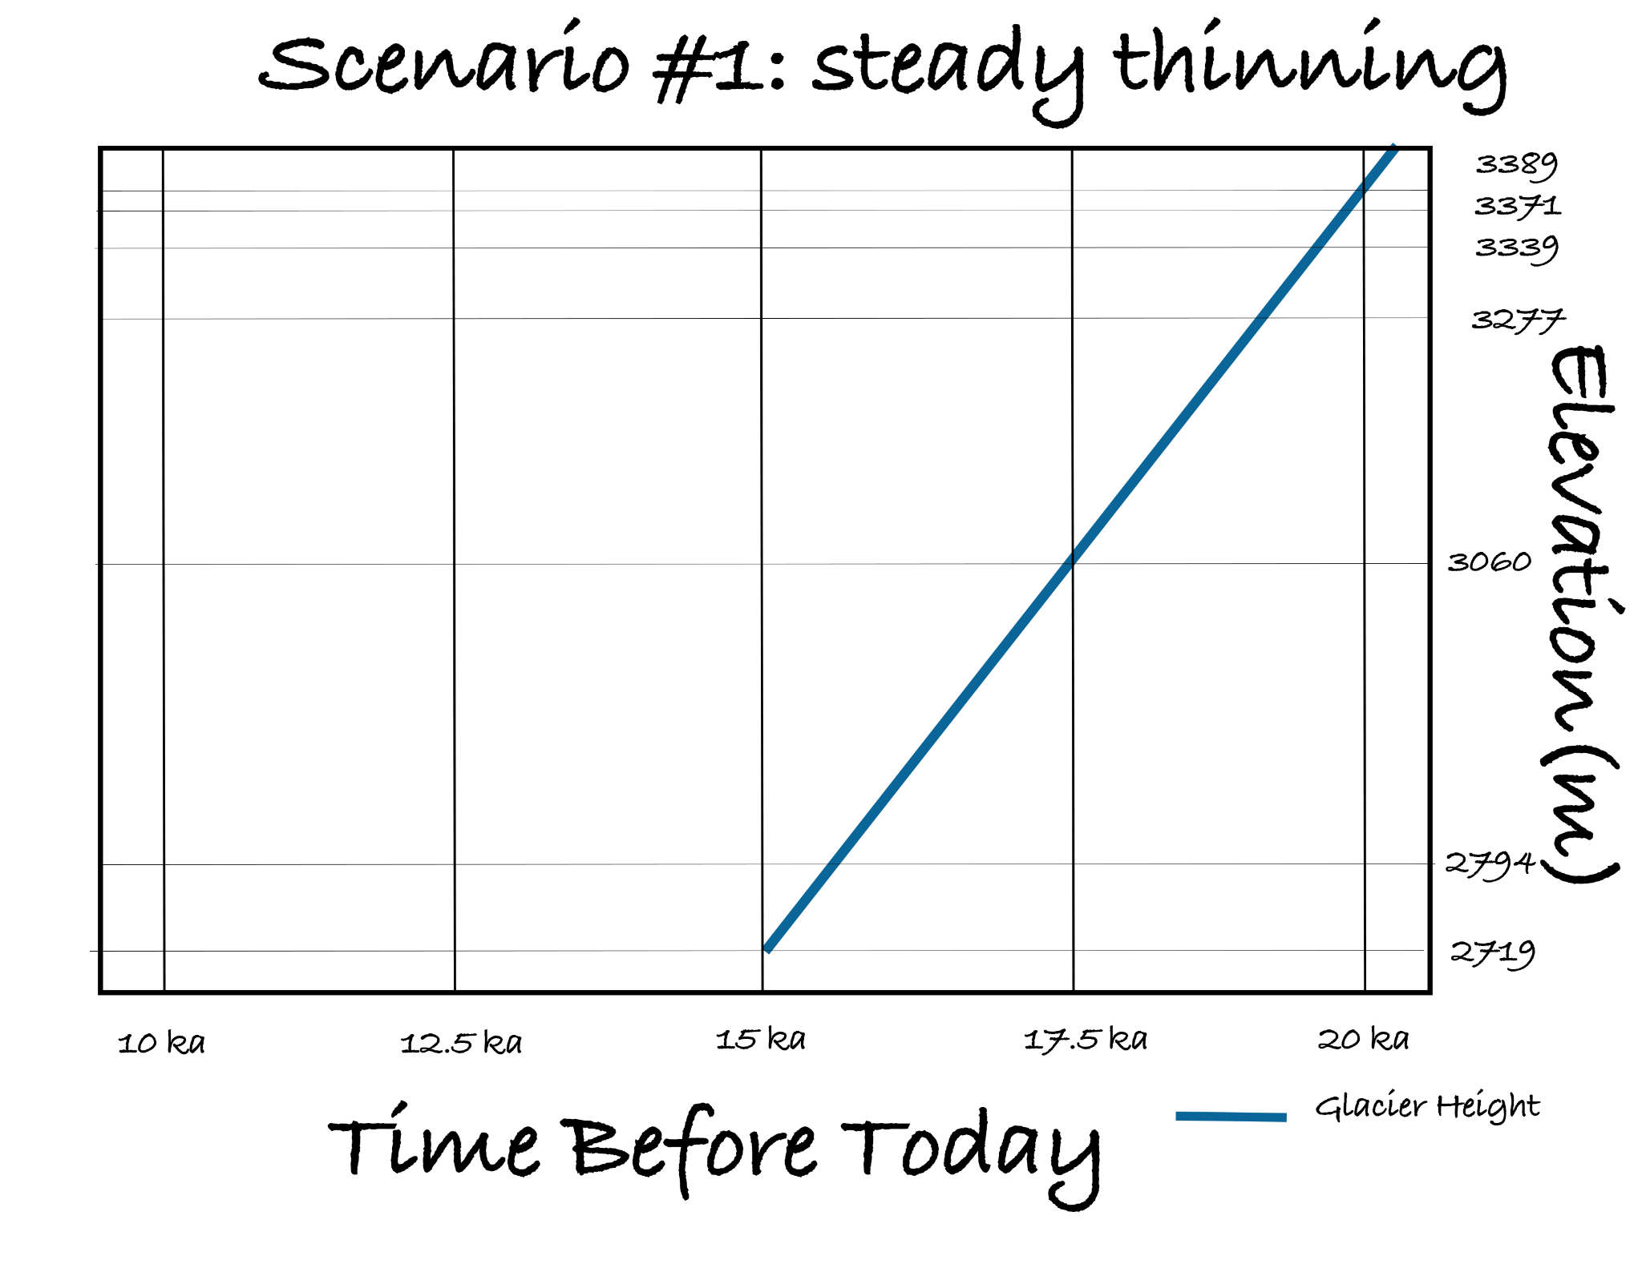
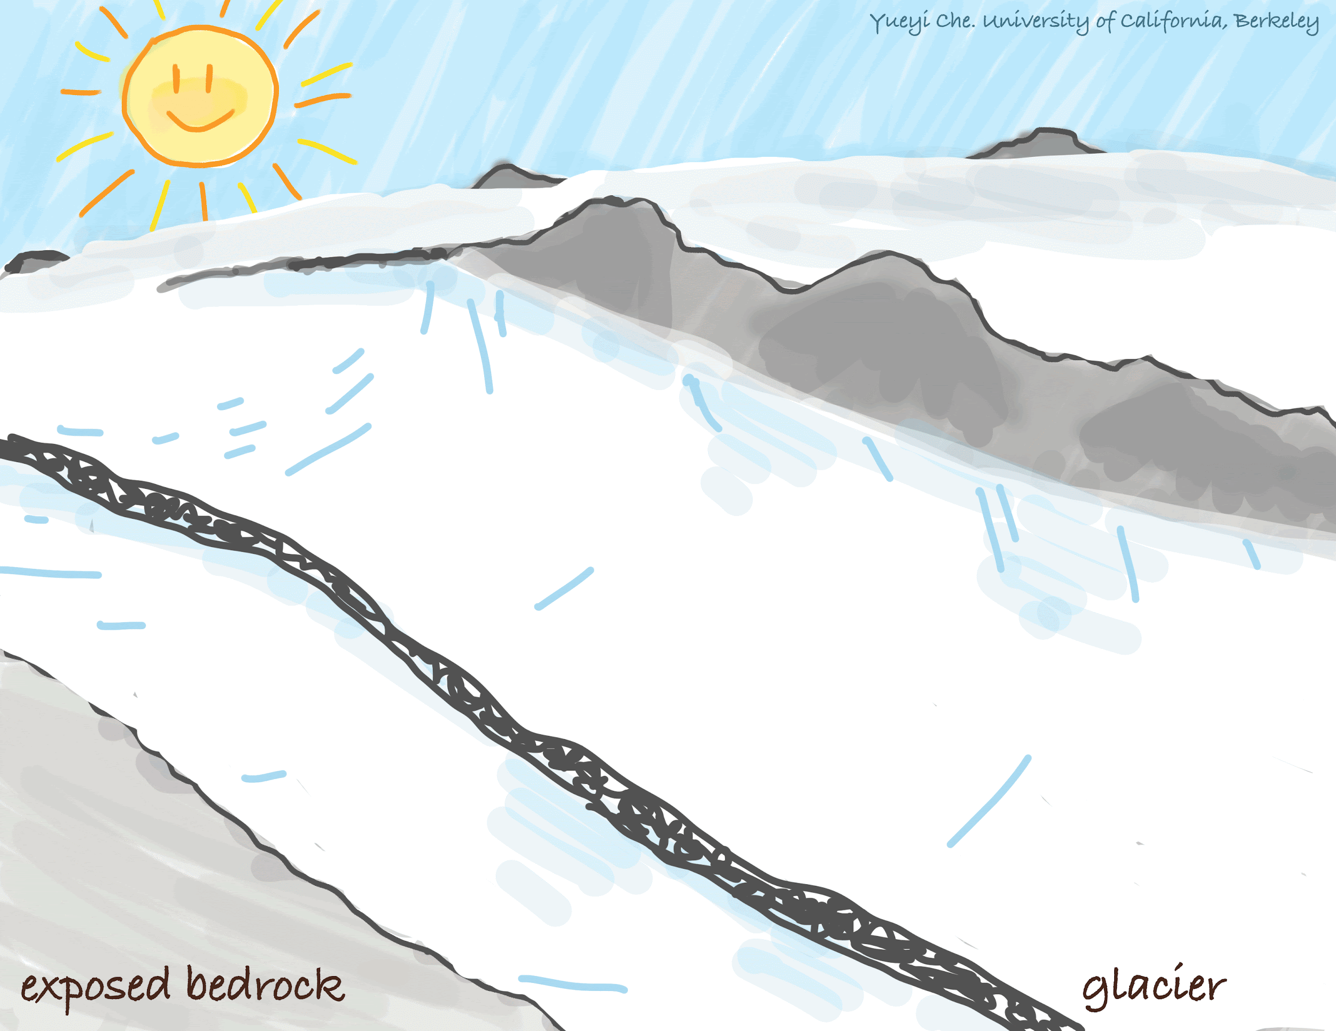
Notes:
Shown here is the ideal glacier thinning scenario we imagined going into the study. The x-axis is the time before today, and y-axis is the sample elevation on the valley wall. The blue line shows the glacier height at certain time during the thinning, from the upper right corner to the lower left corner. The constant slope of this graph represents a constant thinning rate.

Slide 16
02
Data Analysis
Notes:
Now let’s take a look at the data we so far.

Slide 17
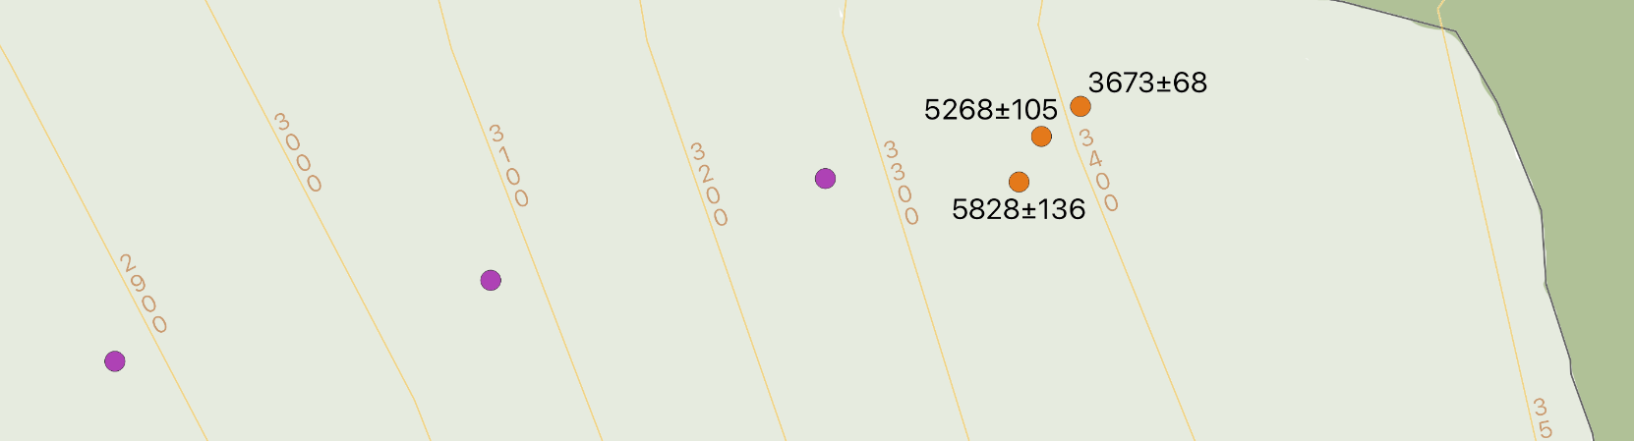
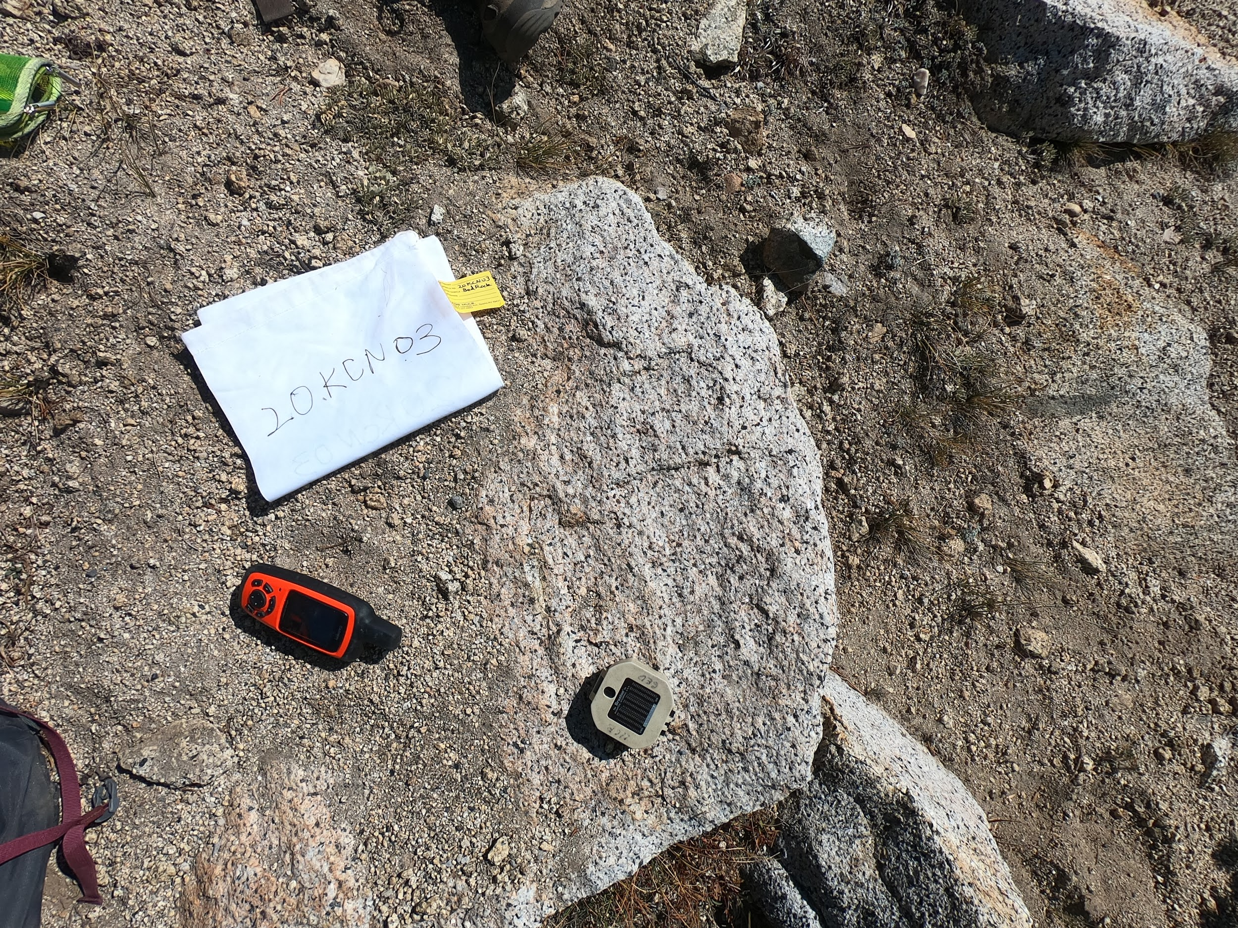
Notes:
As indicated by the arrow, the zoomed-in transect is from the north side of the Lyell Canyon away from today’s Lyell glacier. Right now we only have the three C14 data at the higher elevation. The numbers near the sample location on the zoomed-in map are the exposure ages of bedrocks in years. The exposure ages are all around five to three thousand years, with the oldest exposure at the lowest elevation sample and decrease when the elevation moves up. The photo at the lower right is one of the sample sites. This tell us that:
First, glacier has indeed covered this elevation during the LGM, since the ages are significantly less than 20 thousand years.
Second, we are surprised to see that all three ages are way younger than expected, which means there’s still coverage after the initial melting, such as snow field, boulders, or glacier.
It couldn’t be boulders from rockfall because the three ages shows a consistent trend of decreasing upwards around a similar age scale, which is unlikely for the random event of boulders sitting on top of all our sample sites.
Snow shielding is significant in this area, but it cannot completely explain why these ages are so young. If the sites were exposed 16 ka and the reason the exposure age is too young is only because of seasonal snow cover, it would require 1.5 meters of water equivalent, which, if the snow season is 6 months long, we would need 6 m of snow for 6 months. It is not impossible for Lyell Canyon since it could be this snowy in some year and we do expect some underestimate due to seasonal snow, however, the correction could probably not be any more than 20%.
Finally, a permanent snowfield or glacier at our sample sites is the most likely explanation, since these they will be there for a while and the topography to the south seems like a cirque. However, the cirque glacier can also occur separately after the LGM, for example the Little Ice Age.

Slide 18
03
Forward Modeling
Notes:
We made six forward models to predict what the cosmogenic nuclide concentrations would look like under different glacier thinning scenarios. Our model expect no inheritance for the Be10 and C14 thanks to our sampling strategy.

Slide 19
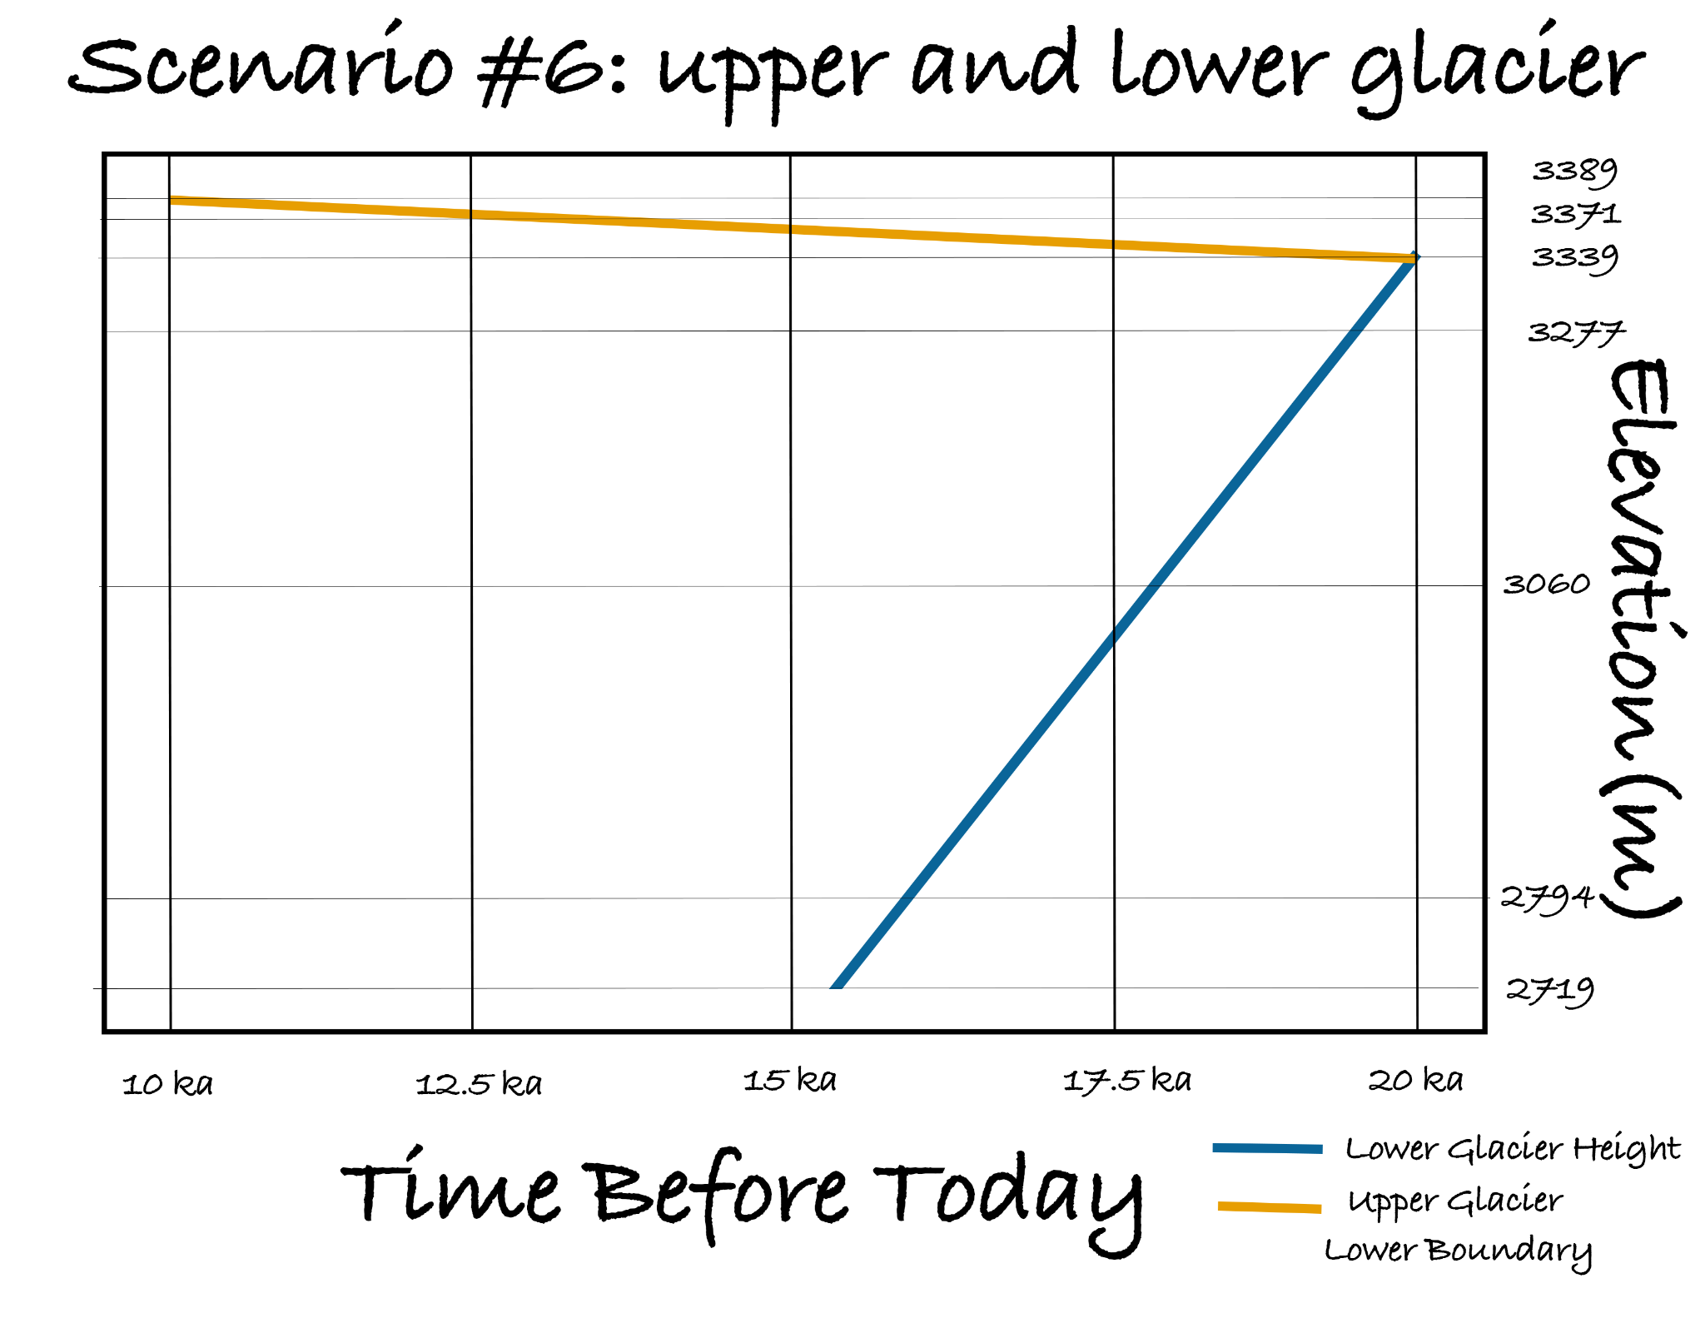
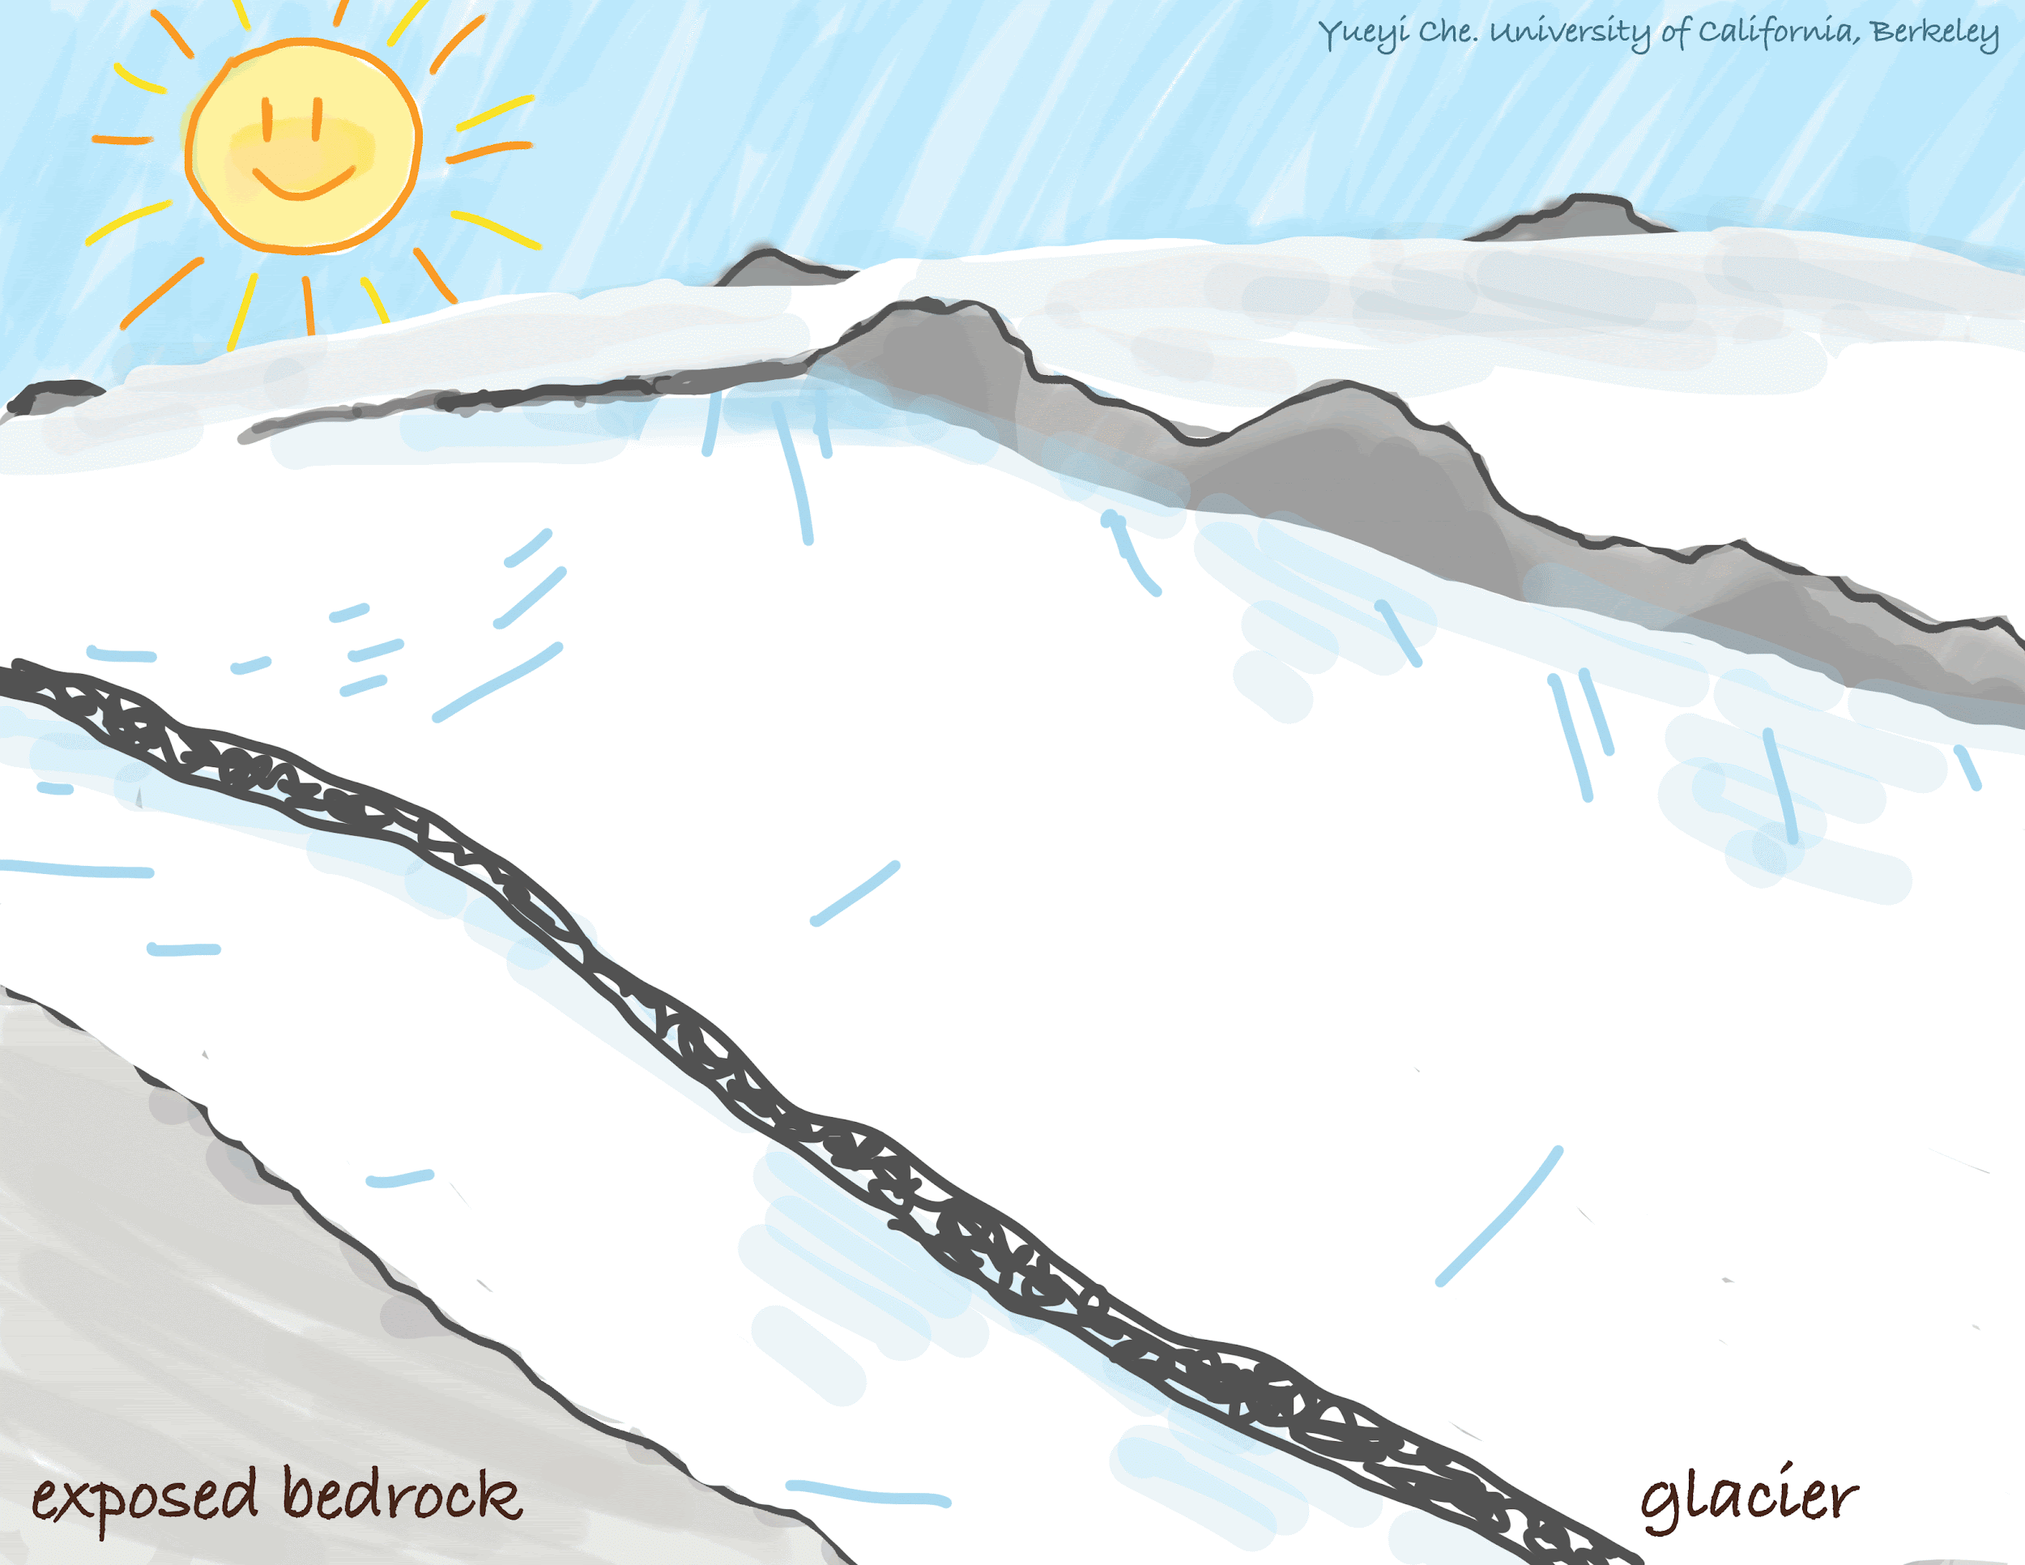
Notes:
Here we want to focus on scenario 6 because this model matches our interpretation of the northern transect C14 data. As shown in the animation, it broke off an upper glacier at the earlier stage of thinning and retreats upwards, while the lower main glacier thinned steadily downwards. Again in our time and elevation graph, the yellow line indicates the lower boundary of the upper glacier, and the blue line indicates the top of the lower glacier.

Slide 20
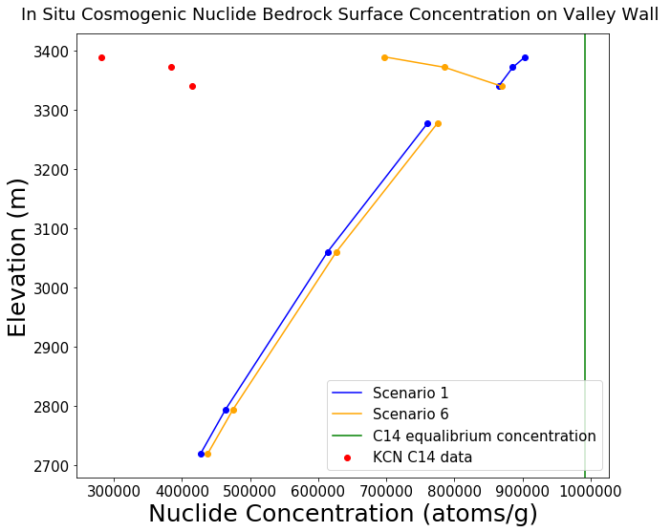
C14
Be10
Notes:
This graph is generated by my Python model, given the exposure ages of bedrock at various elevations of the valley wall. The input elevations are the actual sample elevations of my samples. The x-axis represents in situ cosmogenic nuclide concentrations in atoms per gram, and the y-axis represents the elevation in meters. The upper three samples are measured in C14 and the lower four samples are measured in Be10. We have our actual data in red, scenario 1 the original steady thinning in blue, scenario 6 the breaking into upper and lower glacier in yellow, and the nuclide concentration C14 reaches at equilibrium in green.
Cosmogenic C14 in our case reaches equilibrium at almost one million atoms per gram, which is significantly higher than what we get for 20 thousand years of exposure, which is the oldest exposure age of scenario 1 samples. If our samples were exposed before and during the LGM, they would have C14 concentration that reached equilibrium.
The trend of our data and that of scenario 6 which breaks off into upper and lower glacier have a similar pattern. Our conclusion from our data matches with the pattern predicted by the model. Nevertheless, we cannot be sure until we have the lower elevation Be10 bedrock exposure ages back.
The similarity in the yield nuclide concentration also reflects the similarities among assumptions such as rapid thinning at lower elevations shown here. Other scenarios has different case for the lower elevation glaciers and they behave differently than these three. The different scenarios are helpful for interpreting the other two transects, which may be different than the northern transect.

Slide 21
04
Conclusion and Future Work
Notes:
Finally, let’s summarize what we have now and where we are moving forward in the future.

Slide 22
Conclusions
Glacier coverage suggested
Thinning differences
Data similar to scenario 6
Notes:
Here are three conclusions.
Our data suggests glacier coverage at our sample sites during the LGM.
The variation of nuclide concentration from the model means that we have leverage to eliminate some thinning scenarios.
Although current data for northern transect shows similarity towards scenario 6 for a upper and lower glacier, we cannot be sure until we have all the data back.

Slide 23
Future Work
More Data!
Mass Balance
Compare
More Art!
Notes:
For future work:
We will first expect the rest of the Be10 and C14 data and see which model they fit in.
Second, with the data and melting pattern describe in the model, we will use the three vertical transects, previous studies’ data on valley floor, and DEM to reconstruct the glacier volume. We will also look at the relationship between glacier volume change and the temperature and precipitation change in the western US after the LGM.
After that, we will compare the melting pattern and climate change after the LGM to those of today, and inform the prediction of current glacier’s mass balance change.
Lastly, we will continue produce science communication contents such as videos and comics to share our work at Yosemite with the general public.

Slide 24
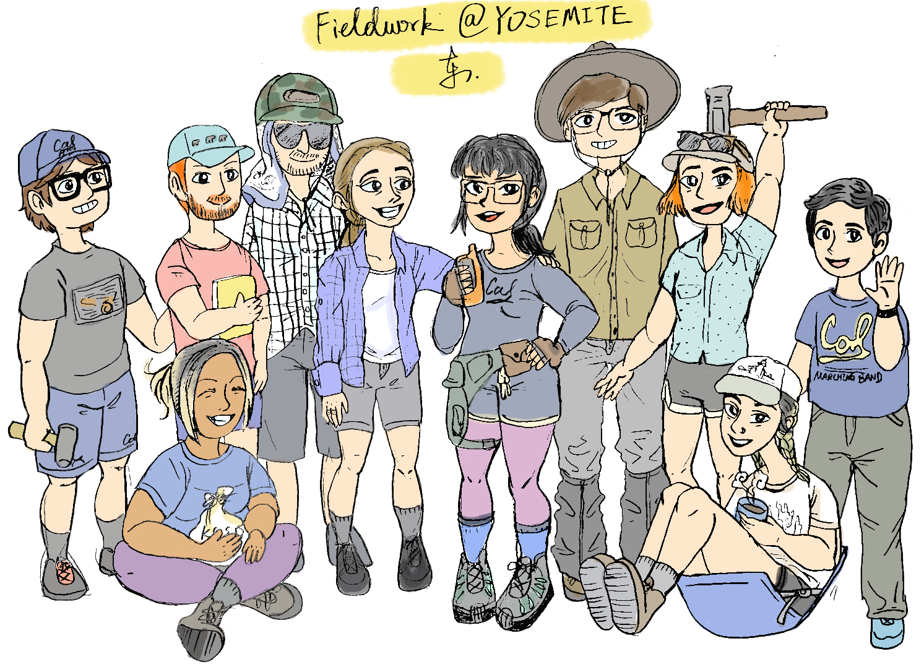
Acknowledgement
Charles H. Ramsden Endowed Scholarship Fund Research Fellowship
Free Seed Sample Analyses at PRIME Lab
GSA On To the Future Program (OTF)
Sigma Xi Berkeley Chapter Grants-in-Aid Research
Summer Undergraduate Research Fellowships - L&S
Tulane University Cosmogenic Nuclide Lab
Notes:
Finally, I want to say thank you to all the grants, labs, programs, Yosemite National Park, and all the people that supported our research.

Slide 25

Thanks!
Do you have any questions?
yueyiche@berkeley.edu
Notes:
Thank you, and I welcome any questions.

