Slide 1


Intracontinental rifting to orogeny: Insights from the Songpan–Garzê Terrane, northeastern Tibetan Plateau, China
Songnan Liu (liusongnan @cugb.edu.cn), Yu Wang, Jingchao Wang
China University of Geosciences (Beijing)
Oct 13th, 2021 GSA

Slide 2
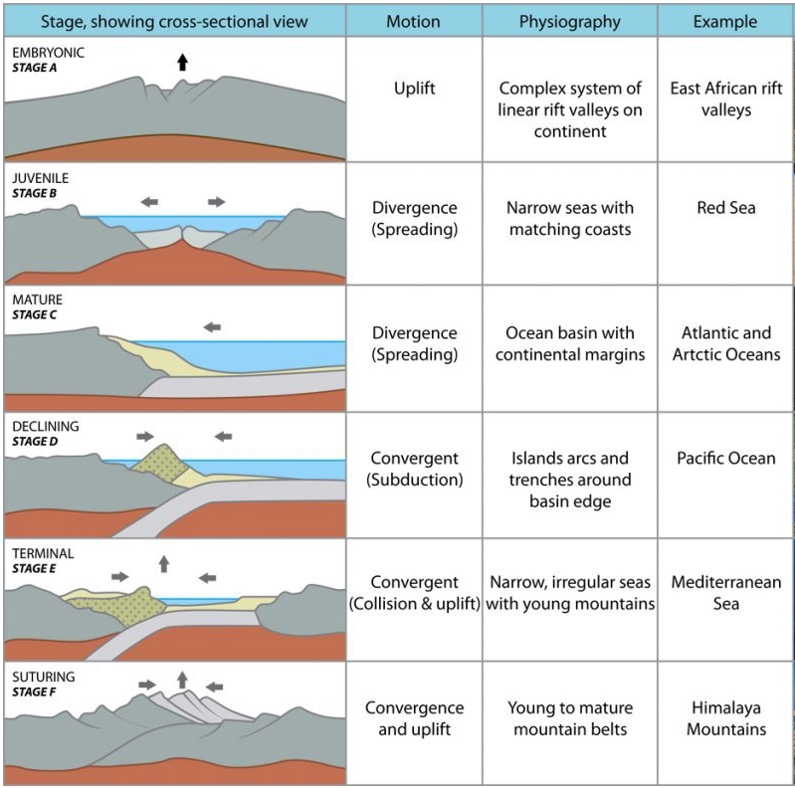
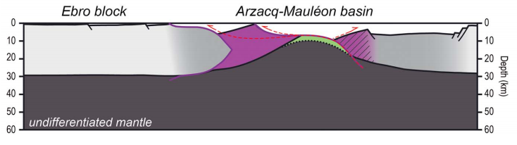
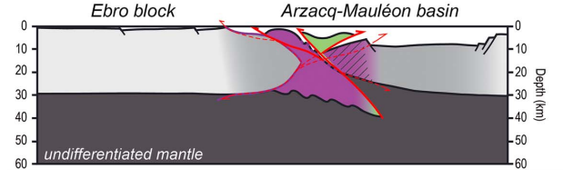
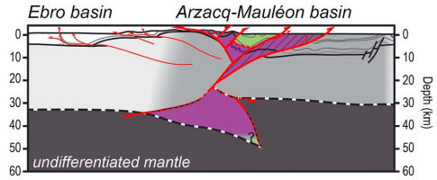
Plate tectonics and Wilson cycle
Cretaceous
Paleogene
Nowadays
(Tugend et al., 2014)
(Wilson, 1973)

Slide 3
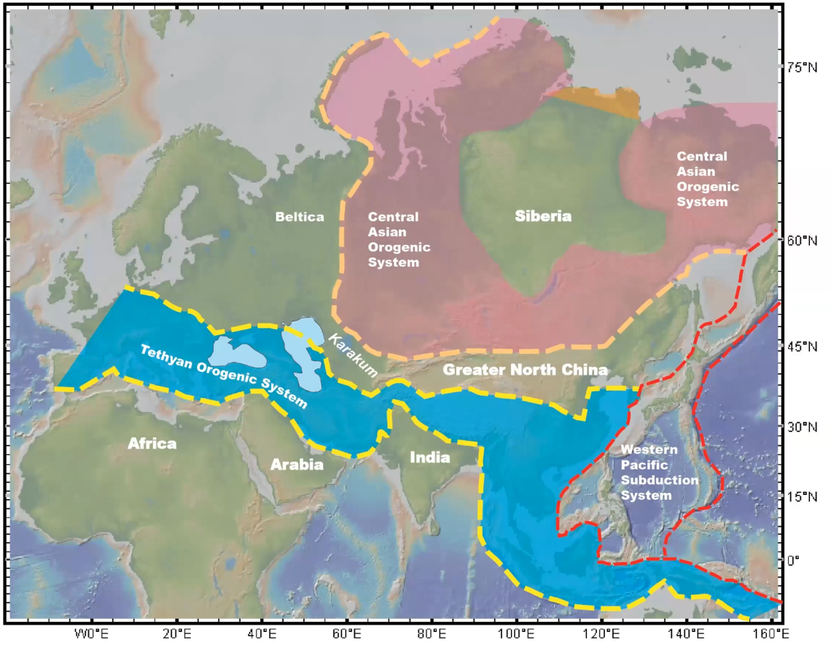
Existence of the Tethys Ocean
Tethyan orogenic system is a long and narrow tectonic belt run through Eurasia. While it is a long-lived Phanerozoic ocean between Laurasia and Gondwana befor the terminal orogeny.
(Wu et al., 2016)

Slide 4
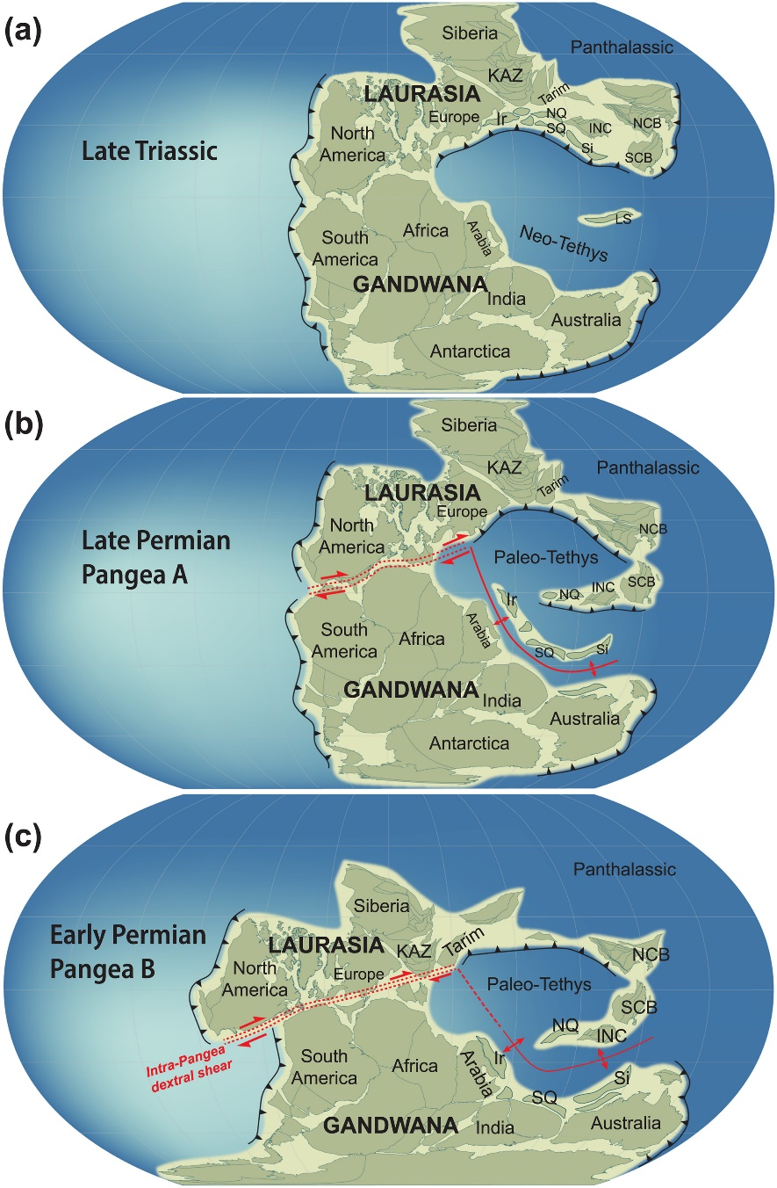
Closure of Paleo-Tethys and Pangea supercontinent
Tethys Ocean was divided into Paleo-Tethys and Neo-Tethys according to their evolutionary time. Diachronous closure of Paleo-Tethys result in the collage of Pangea. The western segment had closed during Hercynian while the closure of the eastern part is prolonged and controversial during Permian-Triassic.
(Yan et al., 2020)

Slide 5
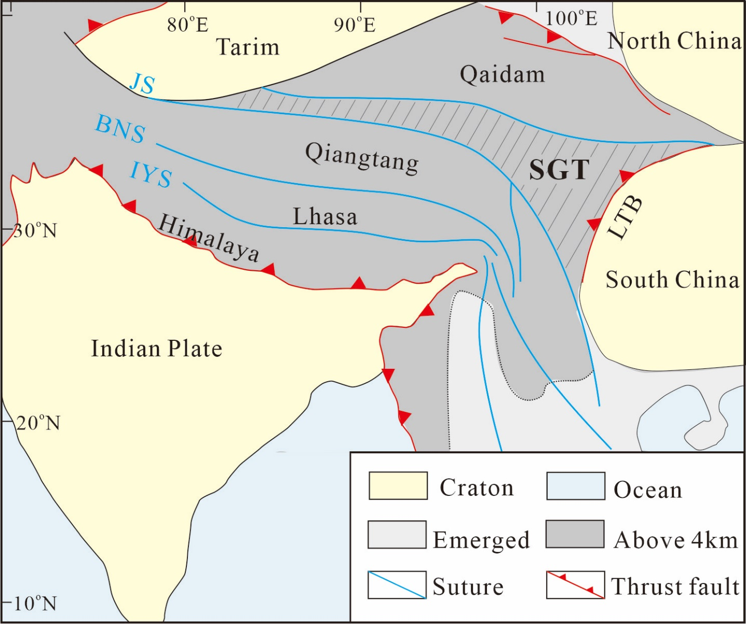
Location of study area
Study area
(Wu et al., 2016)

Slide 6
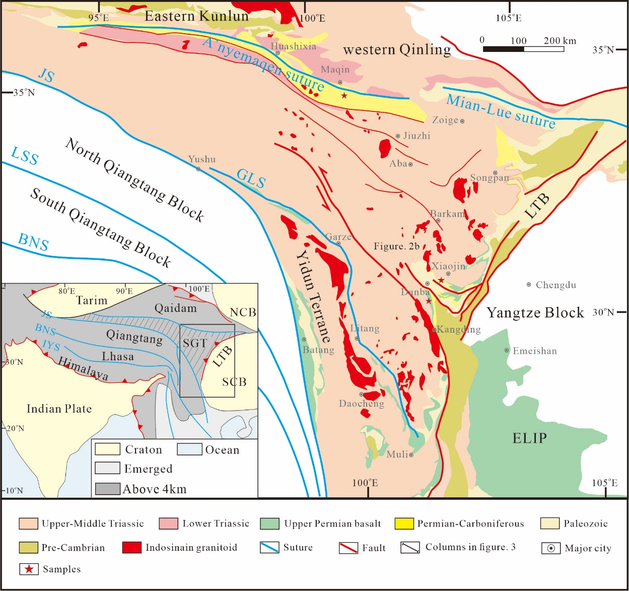
Geologic background of Songpan-Garze Terrane
Songpan-Garze is a triangle-shape terrane covered by 5-15 km-thick, 2.2*10⁵ km² Triassic sedimentary layers. Paleozoic and Proterozoic strata sporadically around it. Indosinian granitoid intrusions in Triassic layers are widespread. Monotonous strata result in a relatively low degree of research in this area.

Slide 7
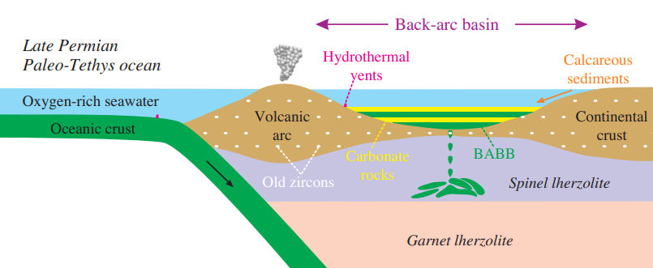
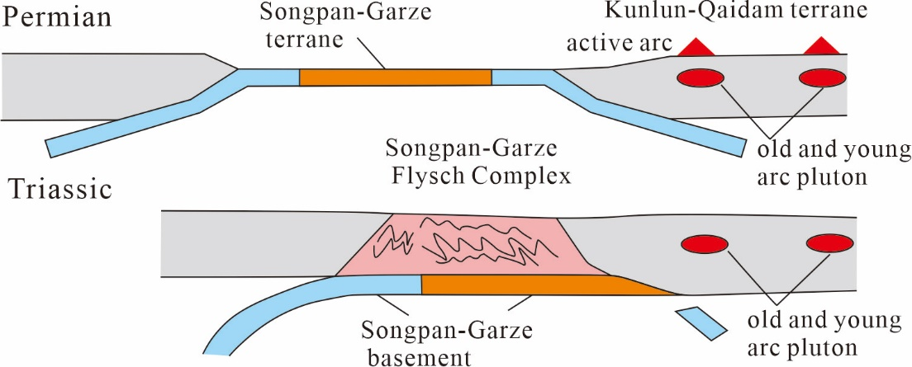
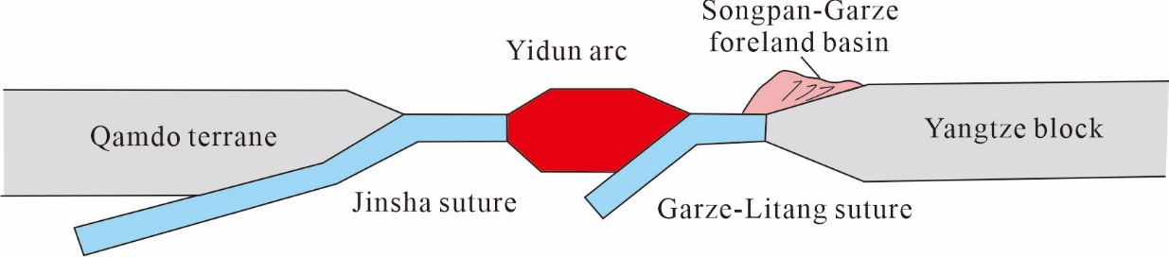
Different models
(1) Remnant ocean (Yin and Harrison , 2000)
(2) Back-arc basin (Zhu et al., 2020)
(3) Fore-land basin (Pan et al., 2001)

Slide 8
Scientific issues
Whether Songpan-Garze Terrane initiated from a continental rift or a branch of Paleo-Tethys ocean? Is it related to the huge eruption of Emeishan LIP?
How the Songpan-Garze Terrane reversed from a basin to orogenic belt? Tectoic inversion or continuous compression

Slide 9
Methods of multidisciplinary analyses
Sedimentology: Compile regional geologic data (field relationships and lithology) to construct continuous stratigraphic columns and divide sedimentary facies.
Geochronology: Detrital zircon U-Pb ages are used to constrain the time and provenances of deposition.
Geochemistry: Major and trace elements analysis were used to explain the tectonic setting of basalt eruption and granitoid intrusion.

Slide 10
Part one
Intra-continental rifting in Middle Permian – Late Triassic

Slide 11
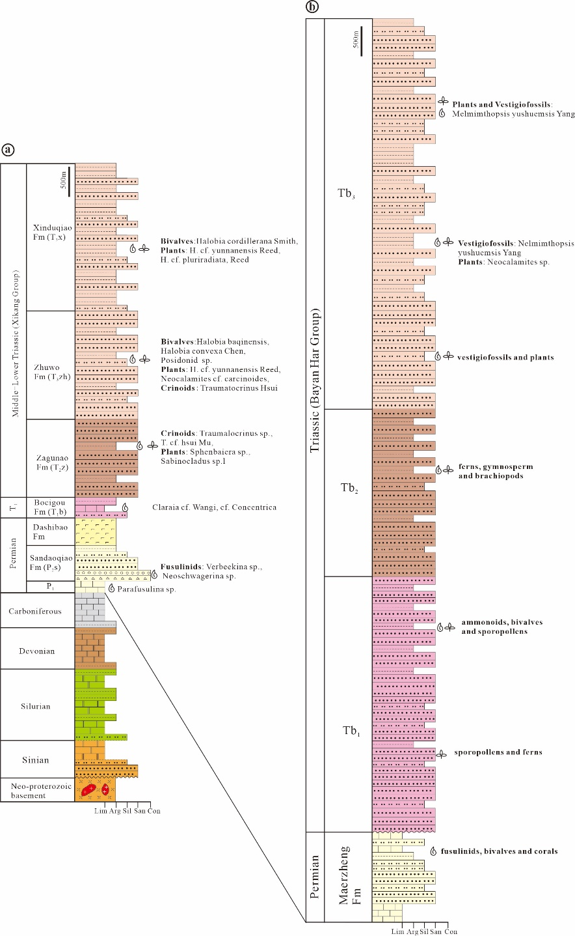
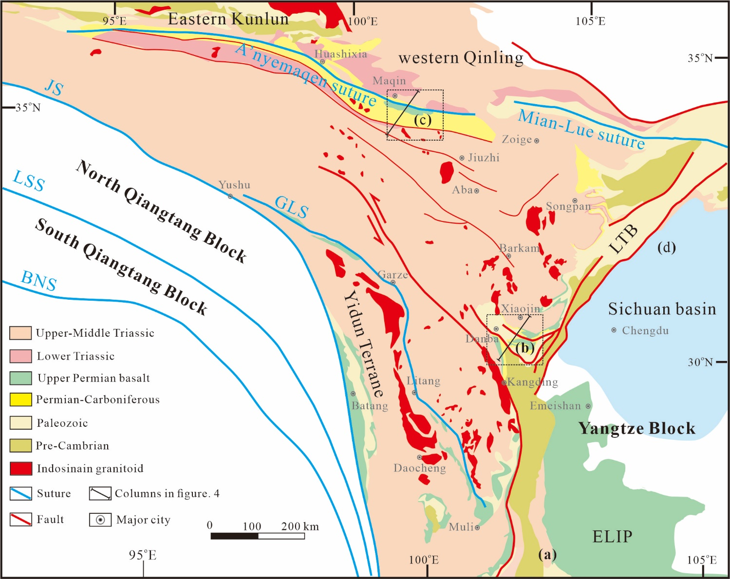
Sedimentary analyses
Strata and sedimentary sequences
(c)
(b)
(d)
(a)

Slide 12
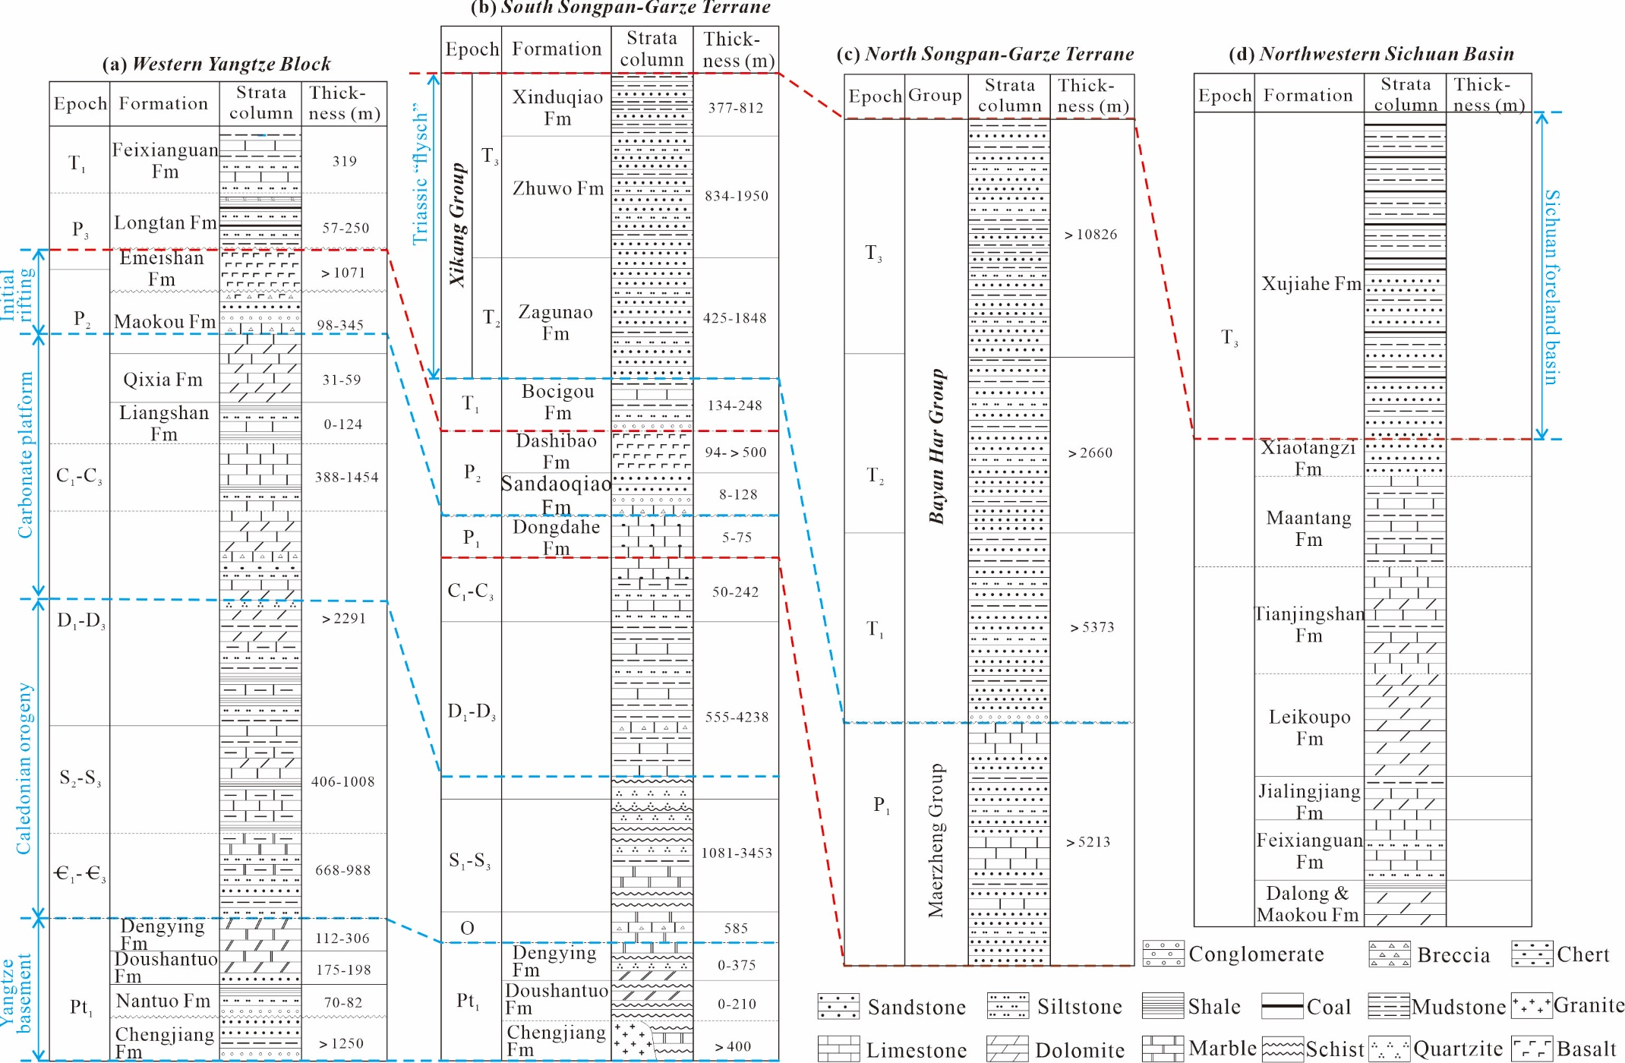

Slide 13
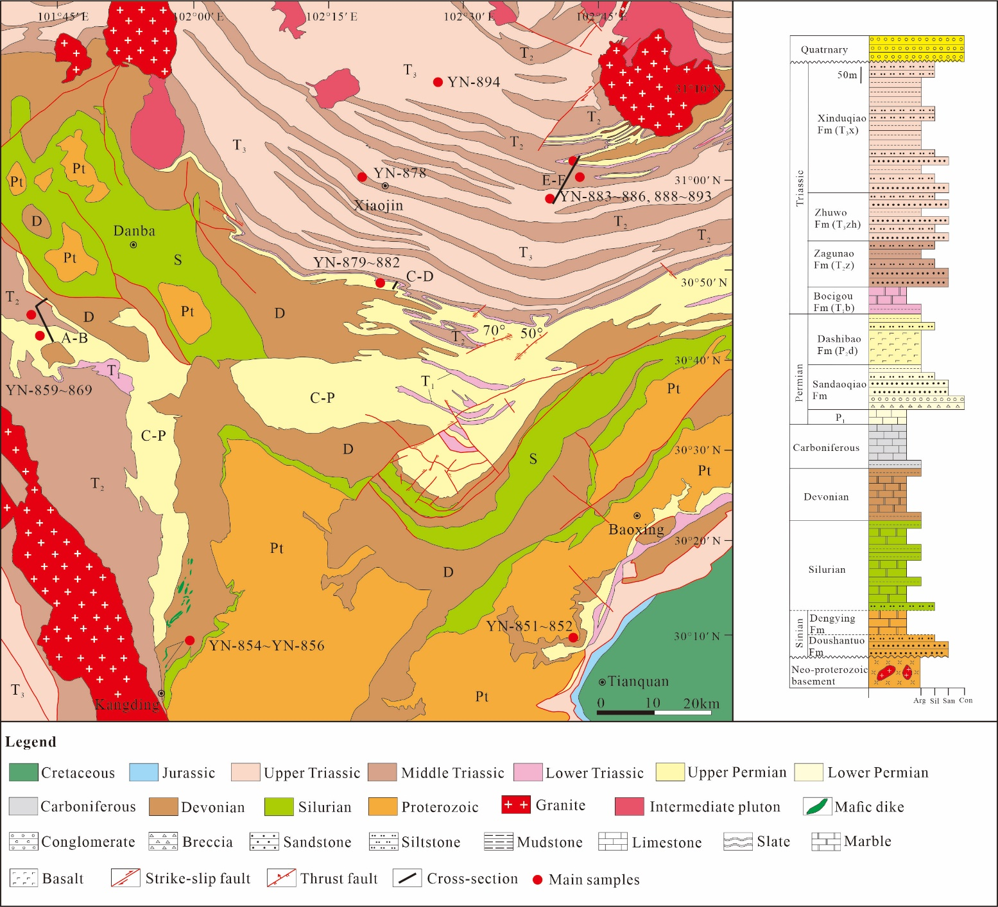
Sedimentary analyses
Strata and sedimentary sequences

Slide 14
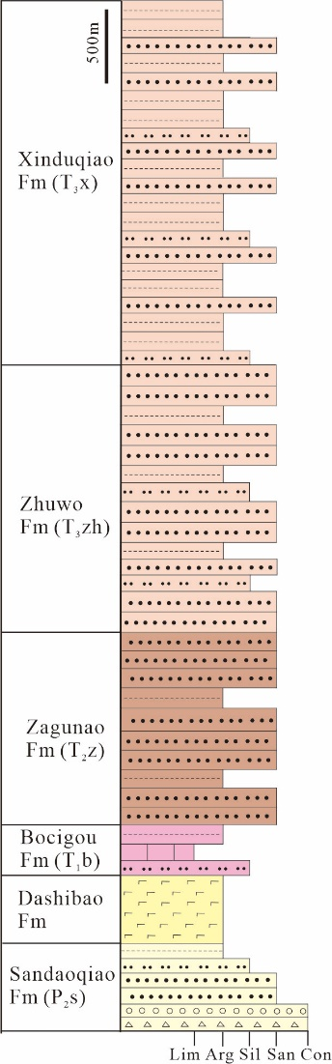
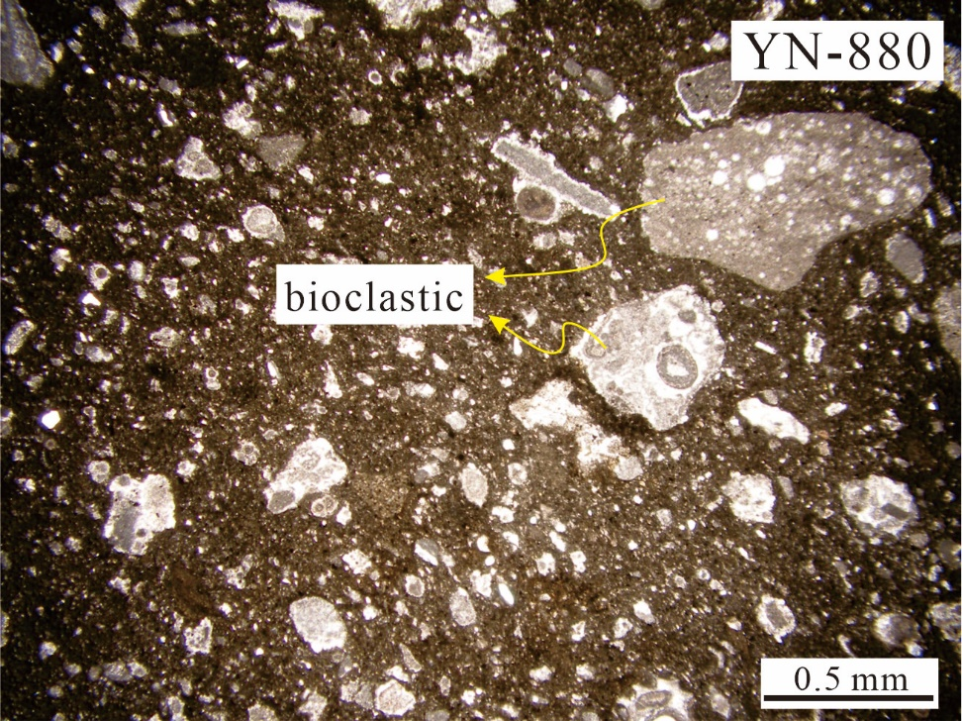
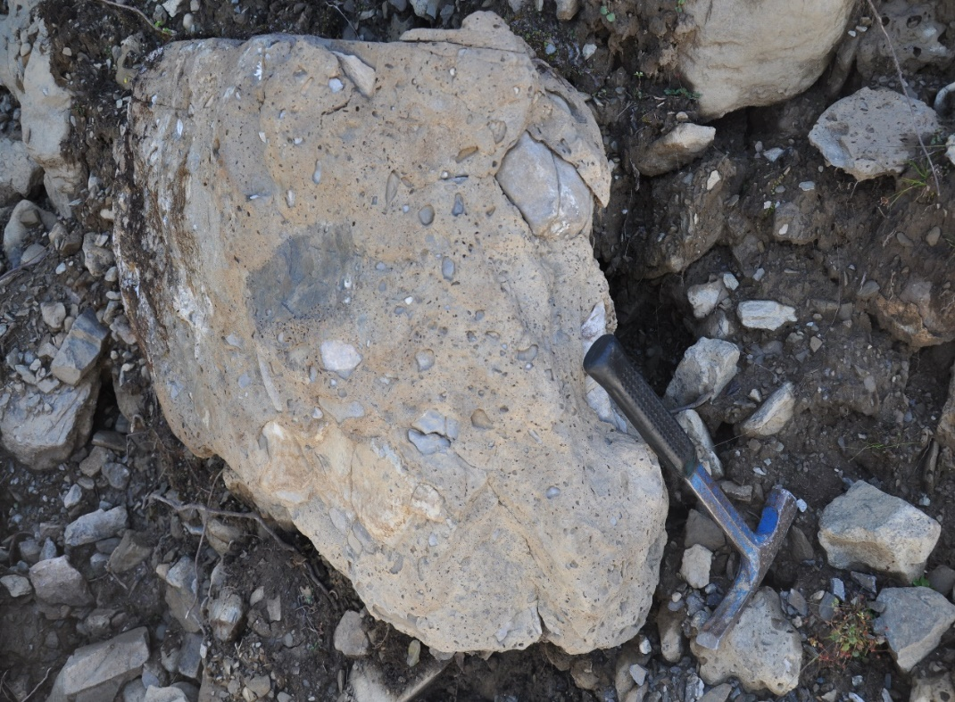
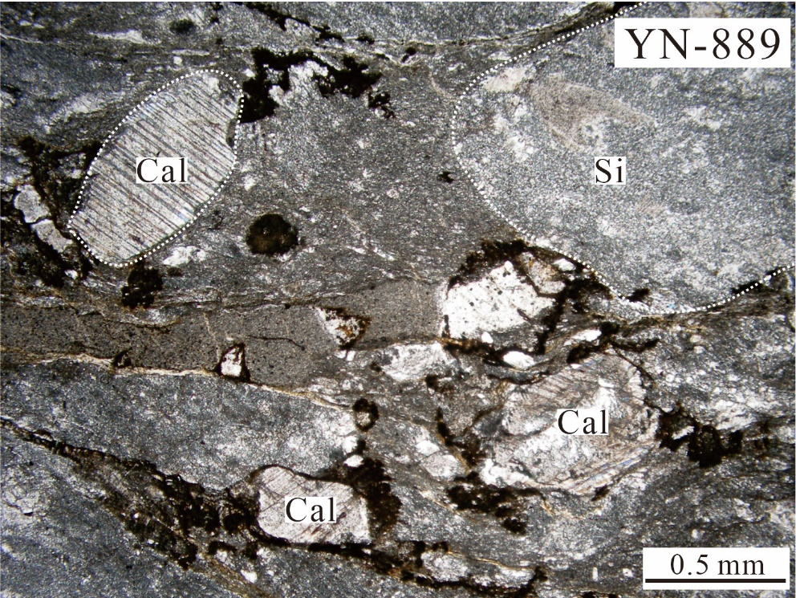
Sedimentary analyses
Lithofacies – Sandaoqiao Fm (P₂s)
Location: 30°48′13″N, 102°22′25″E (Section A-B)
P₂s: breccia

Slide 15
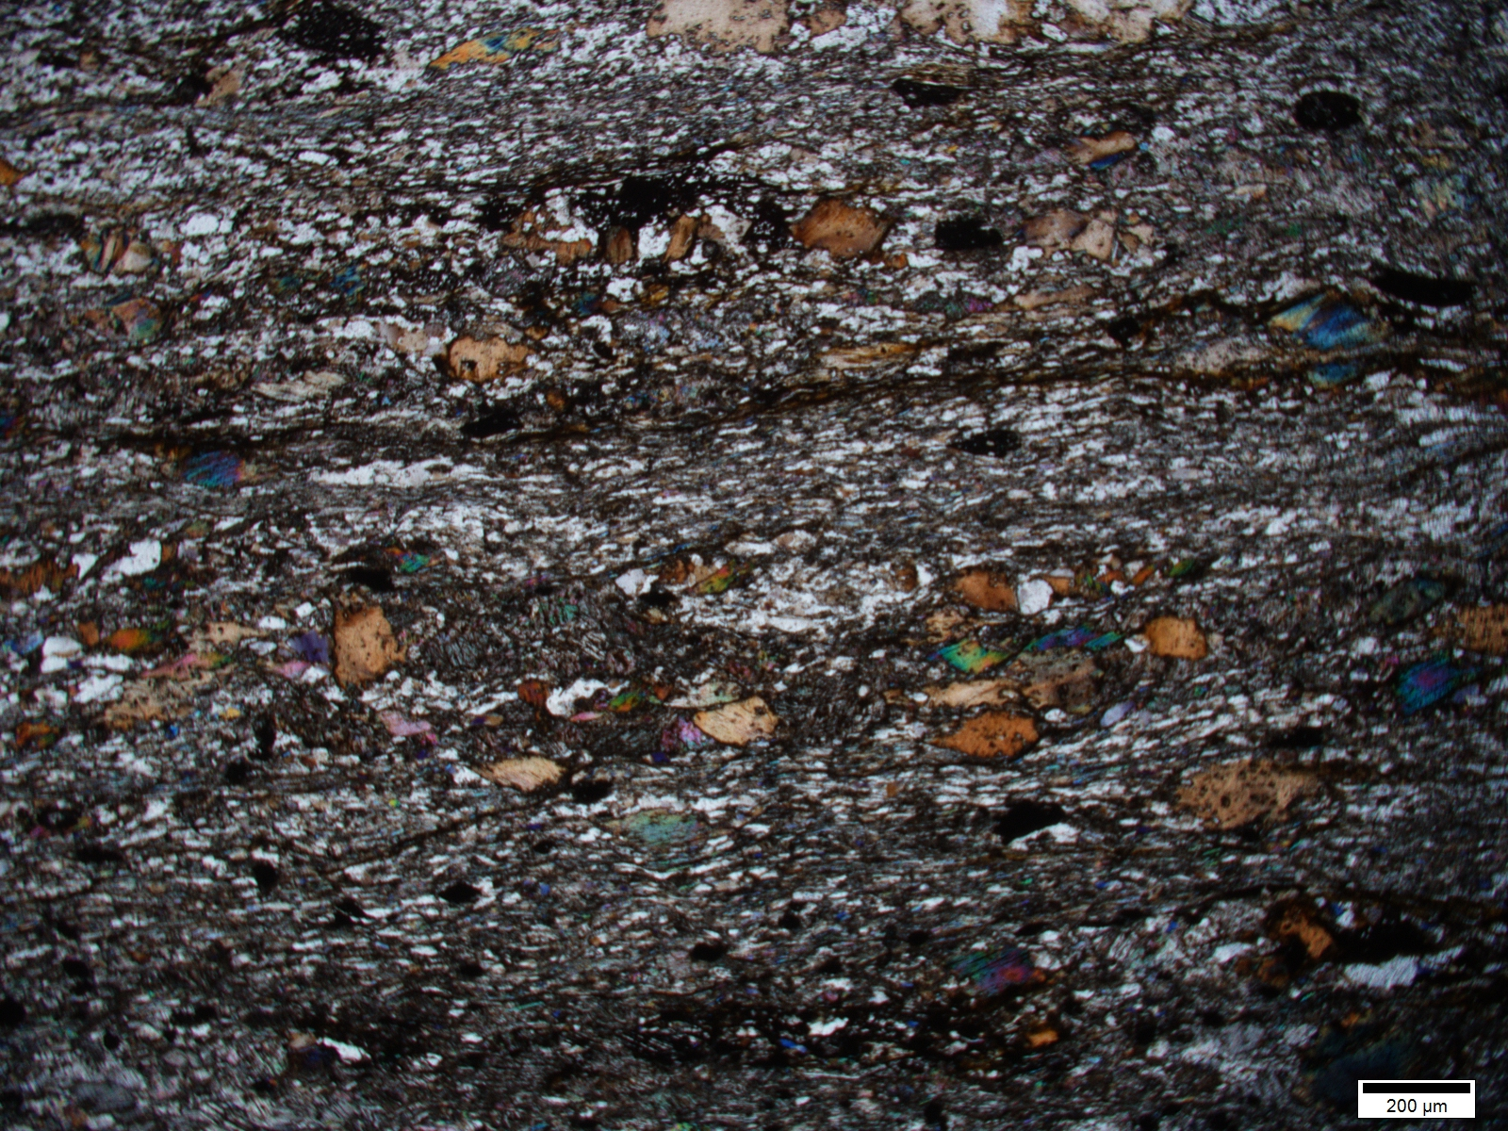
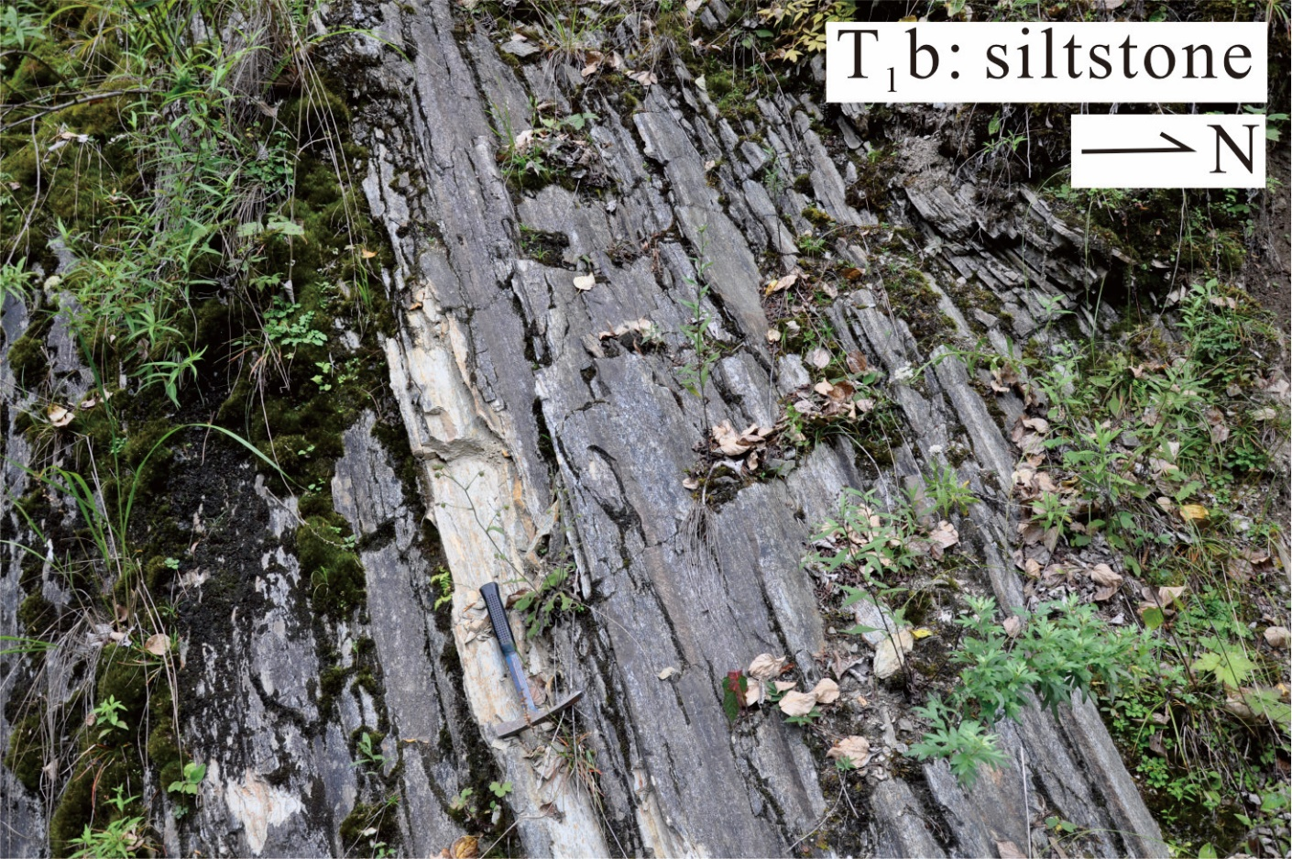
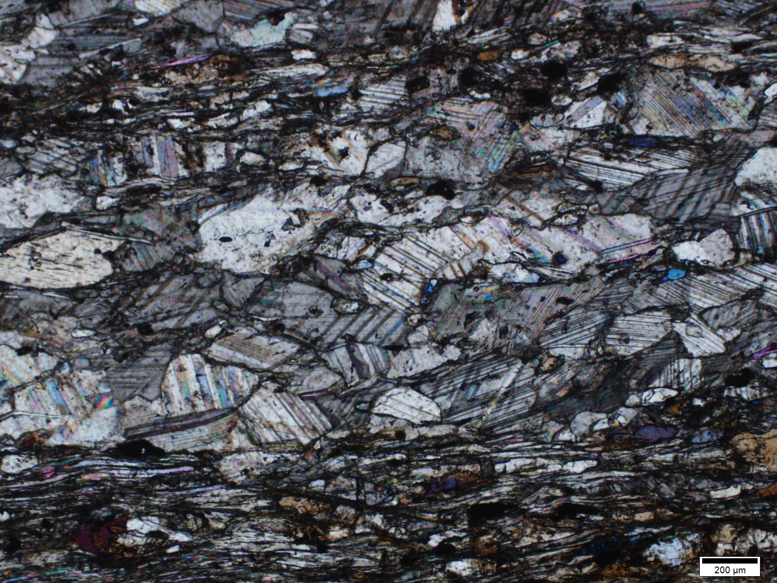
Sedimentary analyses
Lithofacies – Bocigou Fm (T₁b)
Location: 30°44′20″N, 101°44′20″E (Section A-B)
T₁b: siltstone
200μm

Slide 16
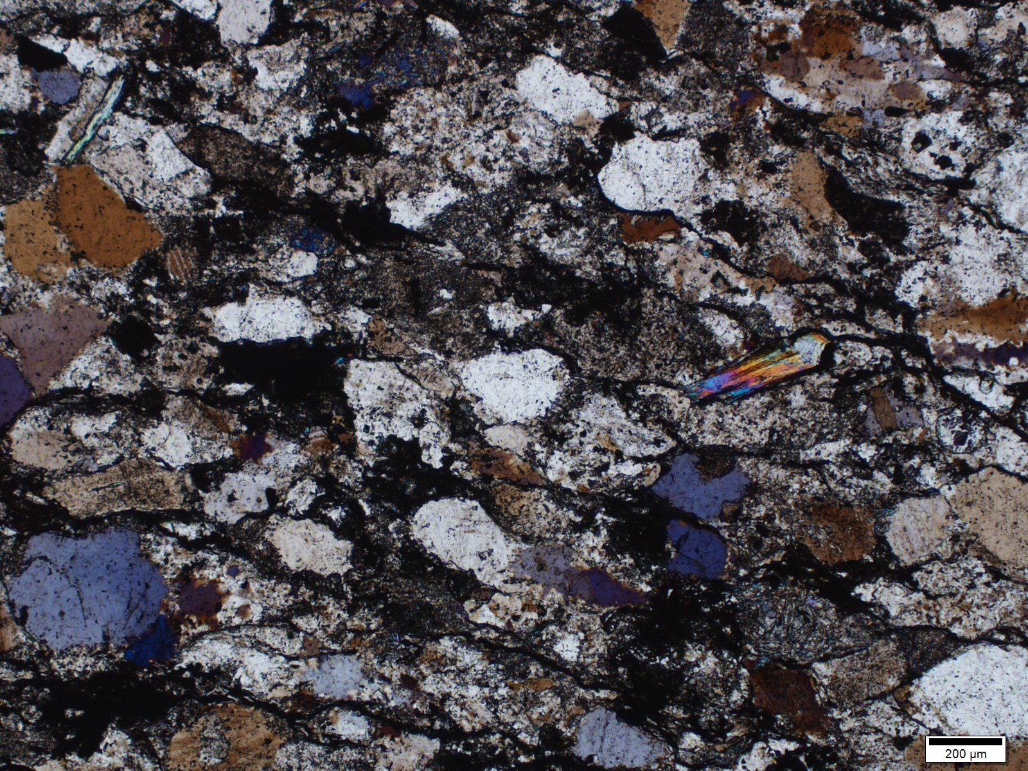
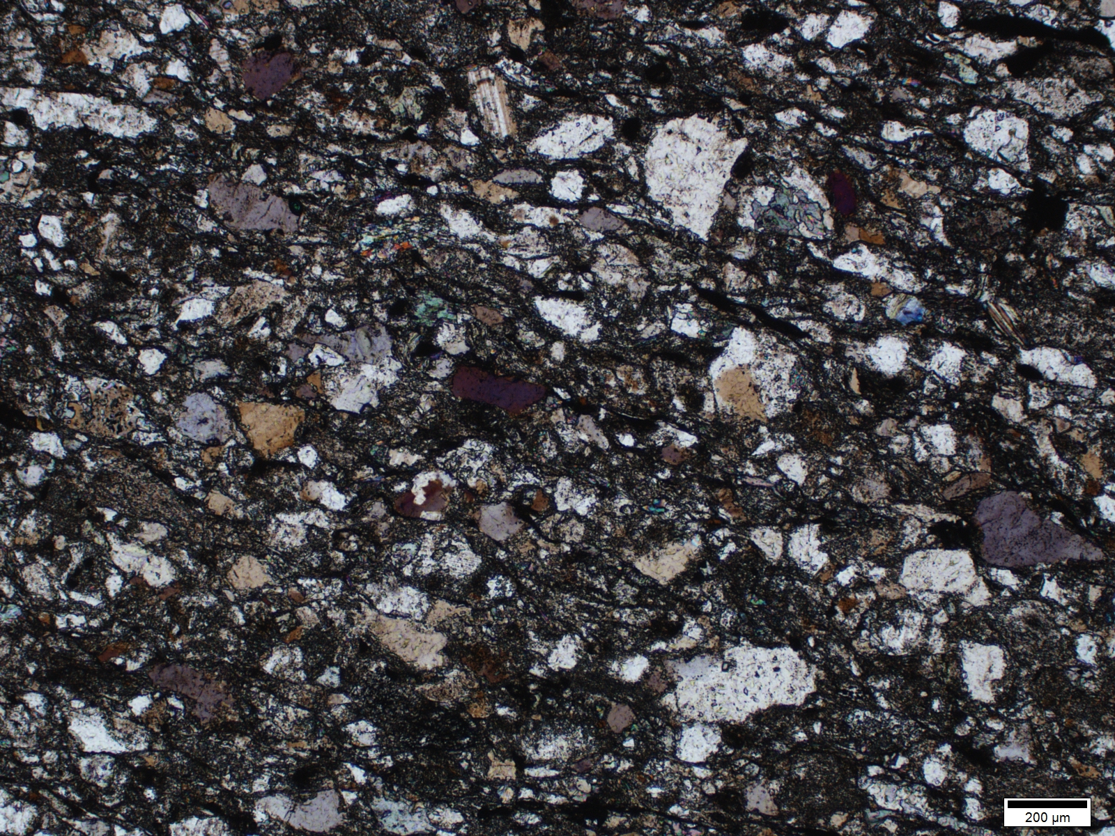
Sedimentary analyses
Lithofacies – Zagunao, Zhuwo Fm
Location: 30°46′45″N, 101°44′09″E (Section E-F)
T₃zh: sandstone
Thick alternated sandstone and mudstone layers
T₂z: sandstone

Slide 17
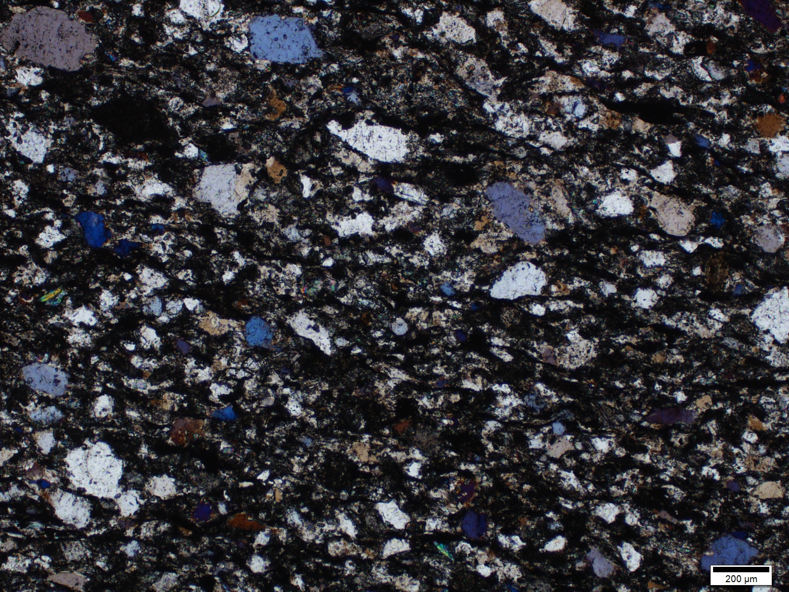
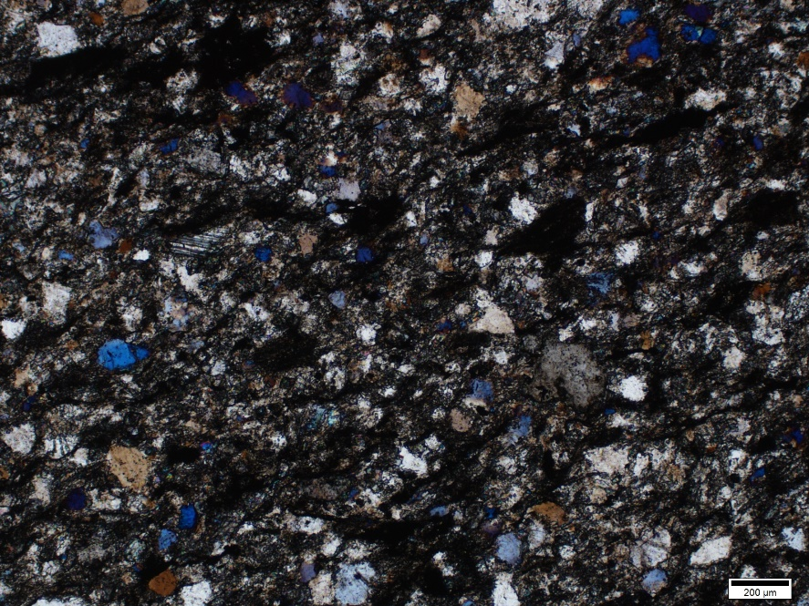
Sedimentary analyses
Lithofacies –Zhuwo Fm, Xinduqiao Fm
Location: 31°28′25″N, 102°26′45″E (Section E-F)
T₃x: sandstone
T₃x: sandstone
Thick alternated sandstone and mudstone layers
T₃zh: sandstone

Slide 18
Sedimentary analyses
Litholfacies – A brief summary
Middle Permian – Lower Triassic: Fining upward sequences with coarse-grained clastic rocks in basal layers. Portion of calcareous debris decreased upward and Lower Triassic was dominated by siliceous composition.
Middle-Upper Triassic: Thick alternated sandstone and mudstone. Composition of sedimentary rocks are similar and mainly consists of siliceous debris.
NO pelagic records such as chert, abyssal ooze or pelagic fossils were preserved.

Slide 19
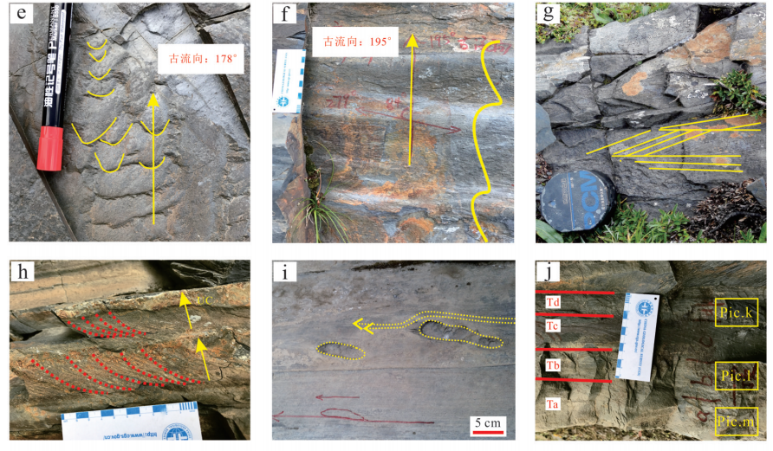
Sedimentary analyses
Sedimentary structure
a
b
c
ripple marks
flute cast
d
e
f
(Gong et al., 2019, 2021)

Slide 20
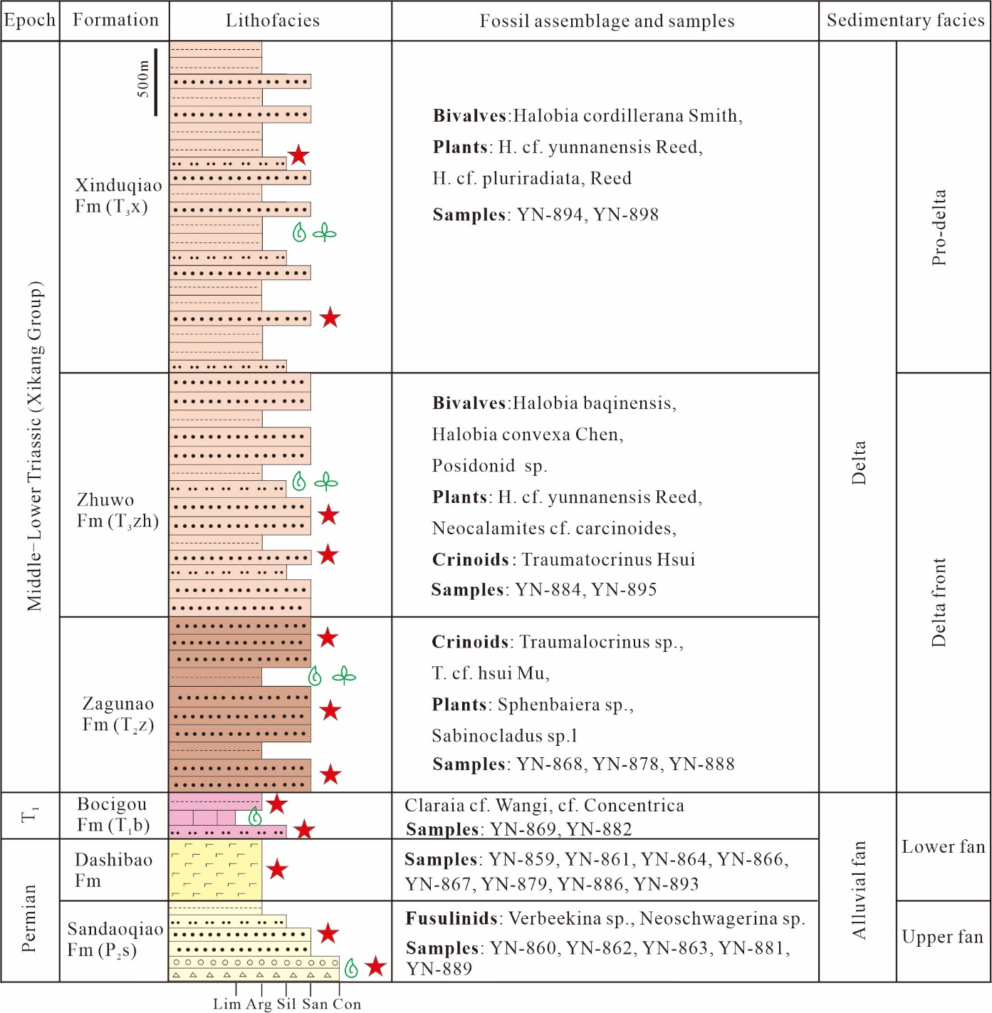
Sedimentary analyses
Sedimentary environment
Stage 2: retrogradation of subaqueous delta in deeper water.
Terrestrial-neritic environment
Stage 1: Alluvial facies in shallow water environment.

Slide 21
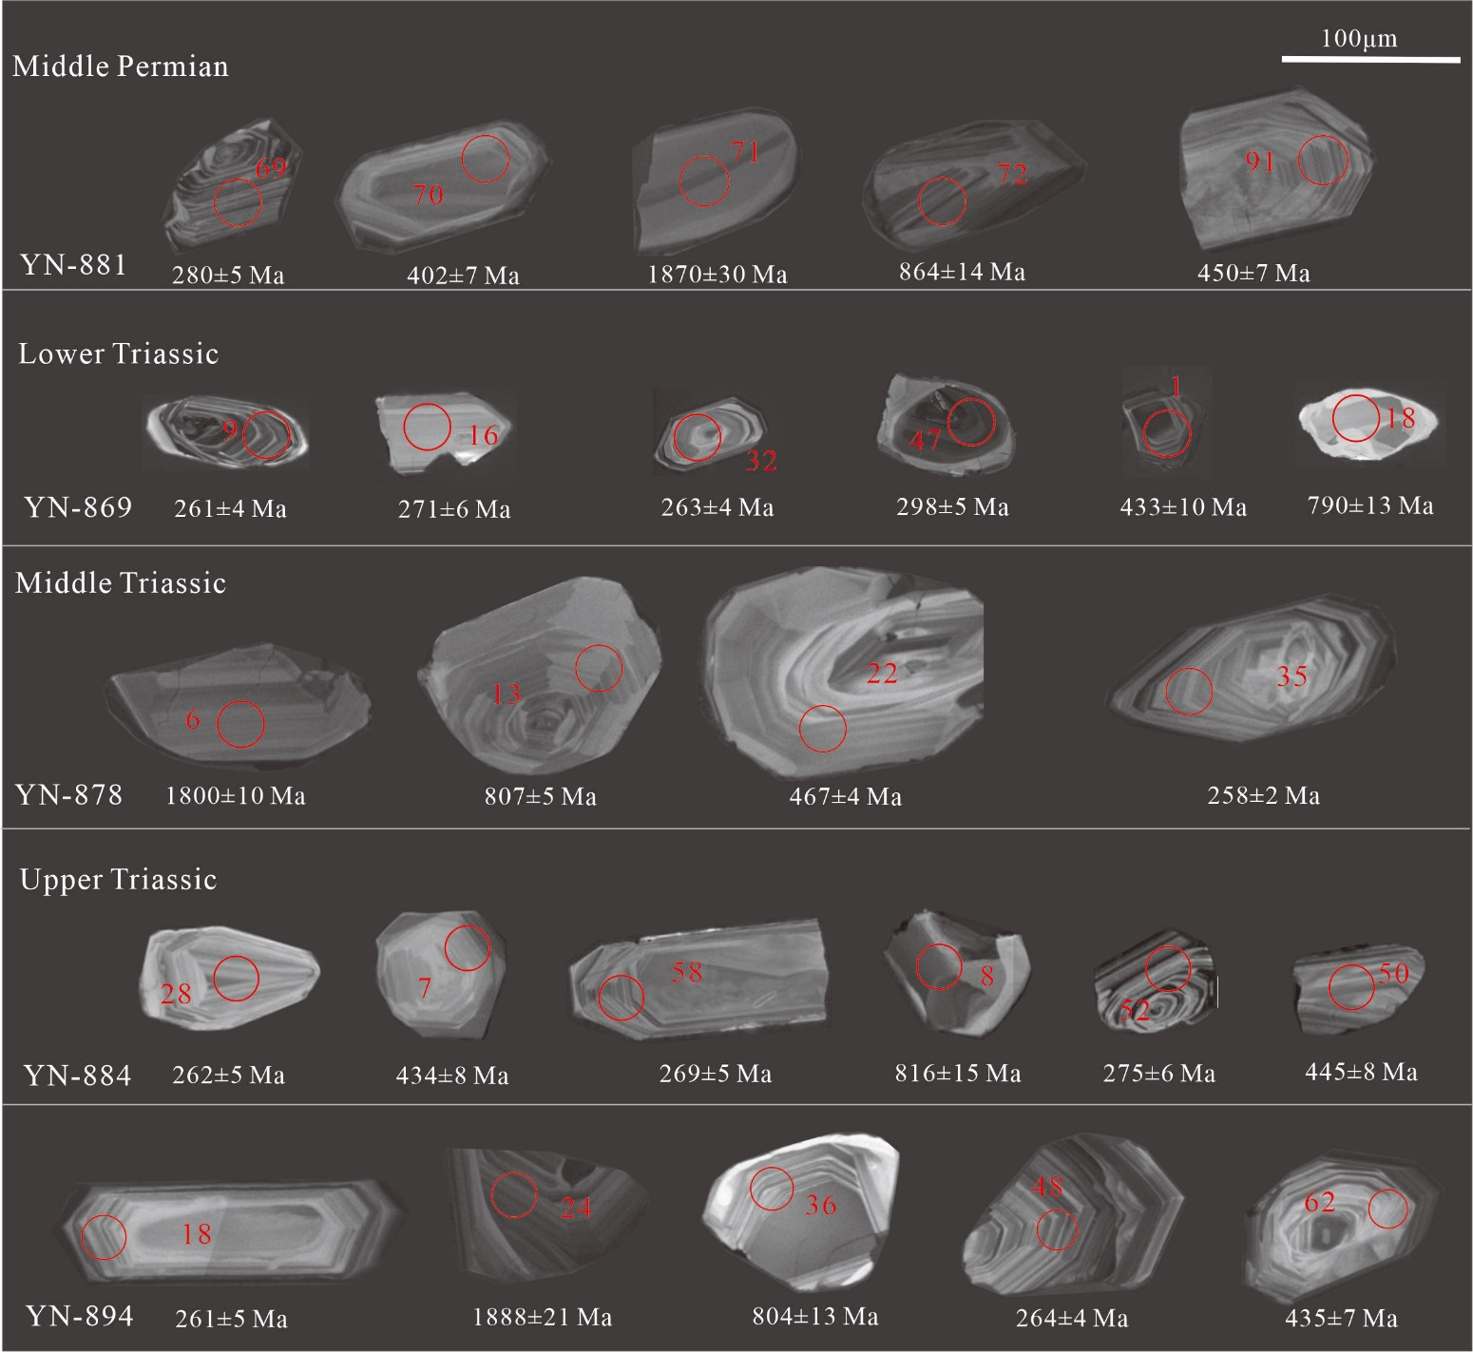
Sedimentary analyses
Detrital zircon and provenances

Slide 22
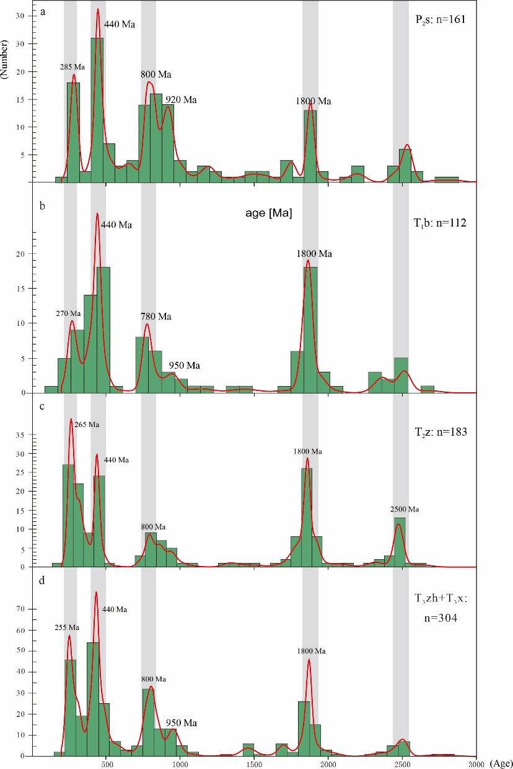
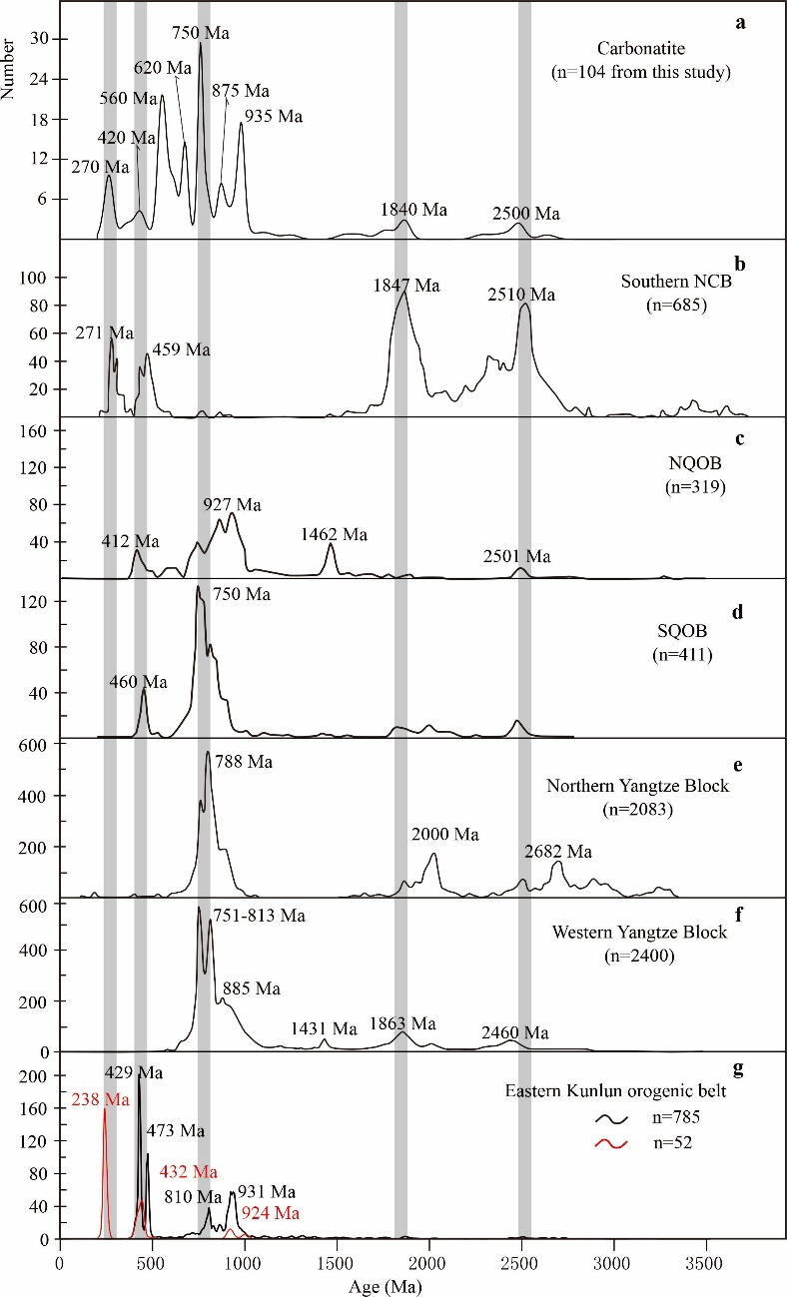
Detrital zircon and provenances
Sedimentary analyses
Major age clusters: 230-290 Ma, 420-480 Ma, 750-900 Ma, 1750-1900 Ma, 2400-2600 Ma

Slide 23
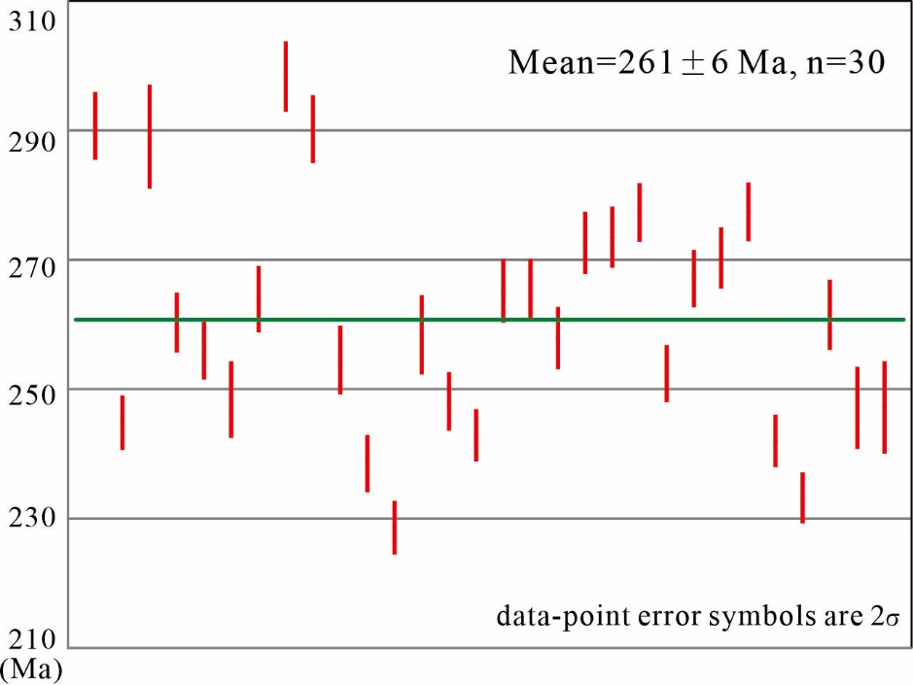
Timing constrain
Timing of initial rifting
Intrusion of gabbros imply the initial stage of continental rifting. The youngest zircon age cluster (mean age= 261 Ma) represented their intrusive time and constrained the timing of initial rifting.

Slide 24
Geochemical analyses
Sample No | Period | Petrology | Sample site
YN-854 | Permian | Gabbro | 30°06′02″N, 101°56′48″E
YN-855 | Permian | Gabbro | 30°06′02″N, 101°56′48″E
YN-859 | Permian | Basalt | 30°46′42″N, 101°44′03″E
YN-861 | Permian | Basalt | 30°46′42″N, 101°44′03″E
YN-864 | Permian | Basalt | 30°42′27″N, 101°44′54″E
YN-865 | Permian | Gabbro | 30°42′27″N, 101°44′54″E
YN-866(1) | Permian | Basalt | 30°42′27″N, 101°44′54″E
YN-866(2) | Permian | Basalt | 30°42′27″N, 101°44′54″E
YN-866(3) | Permian | Diabase | 30°42′27″N, 101°44′54″E
YN-867 | Permian | Basalt | 30°43′57″N, 101°44′32″E
YN-879(1) | Permian | Basalt | 30°48′07″N, 102°22′22″E
YN-879(2) | Permian | Basalt | 30°48′07″N, 102°22′22″E
YN-879(3) | Permian | Basalt | 30°48′07″N, 102°22′22″E
YN-879(4) | Permian | Basalt | 30°48′07″N, 102°22′22″E
YN-879(5) | Permian | Basalt | 30°48′07″N, 102°22′22″E
YN-886 (1) | Permian | Basalt | 30°59′39″N, 102°48′16″E
YN-886 (1) | Permian | Basalt | 30°59′39″N, 102°48′16″E
YN-886 (1) | Permian | Basalt | 30°59′39″N, 102°48′16″E
YN-893 | Permian | Basalt | 31°01′49″N, 102°41′56″E

Slide 25
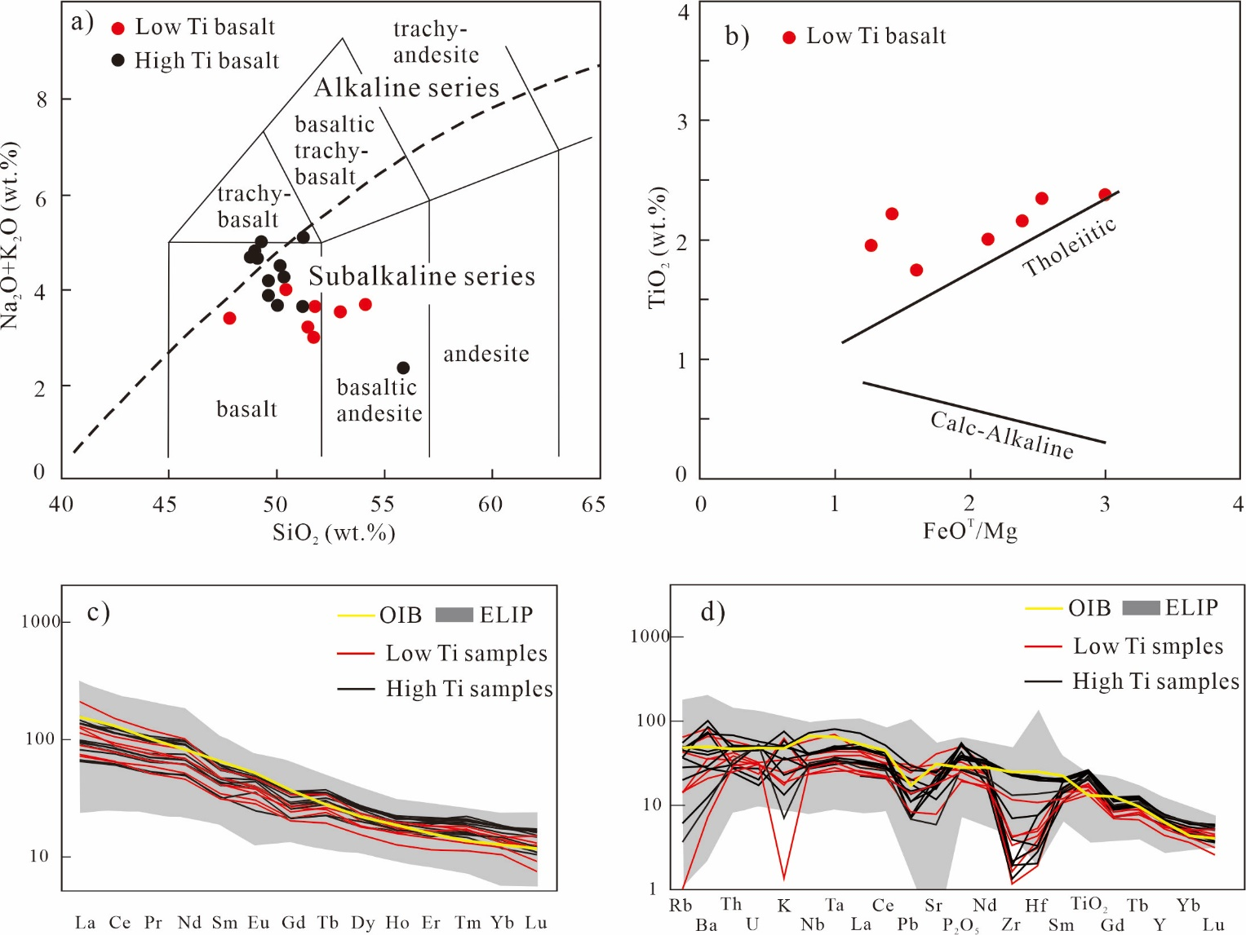
Geochemistry analyses
Geochemical data of Middle Permian mafic rocks show typical OIB-type, and are similar to ELIP within Yangtze Plate.

Slide 26
A Summary
Middle Permian - Late Triassic: Songpan-Garze Terrane is characterized by terrestrial and neritic deposits, OIB-type basalt and developed as intra-continental rift basin in Yangtze Block.
Intra-continental rifting initiated from 261 Ma constrained from gabbro age.

Slide 27
Part two
Intra-continental orogeny in Latest Triassic

Slide 28
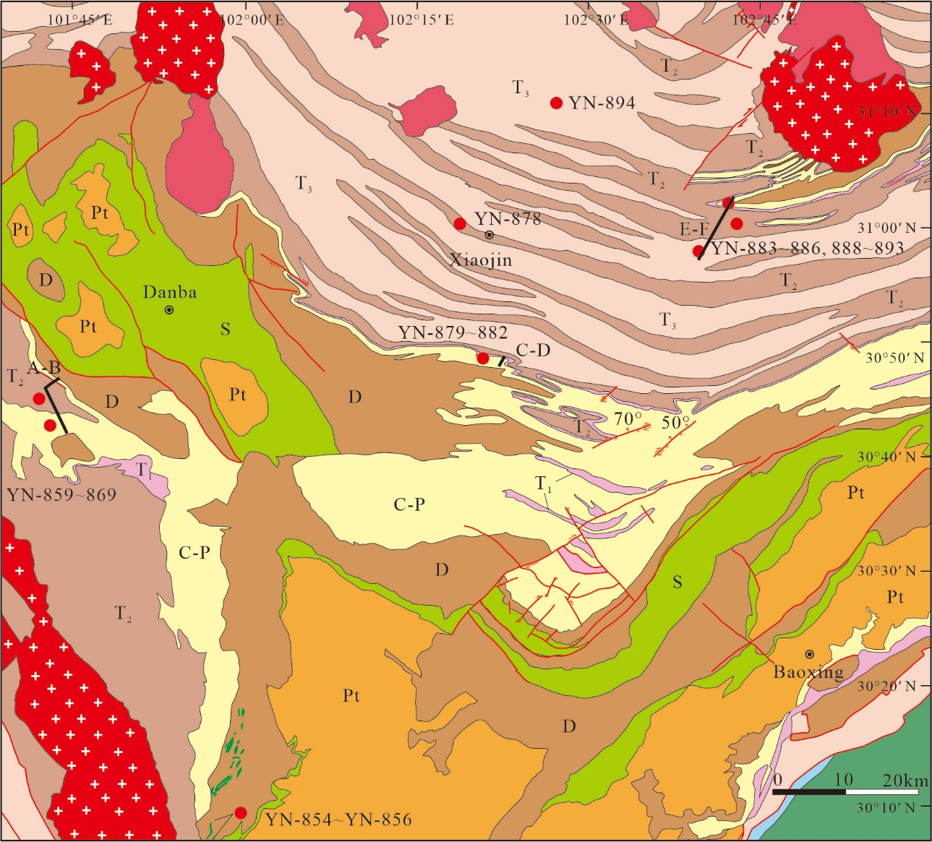
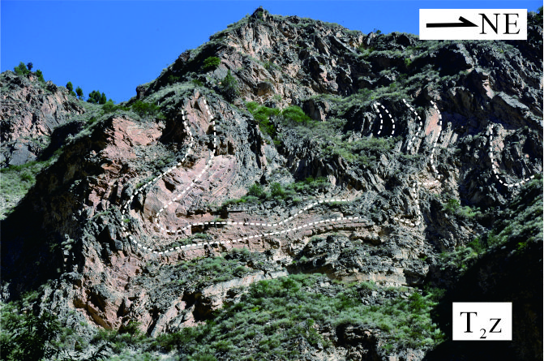
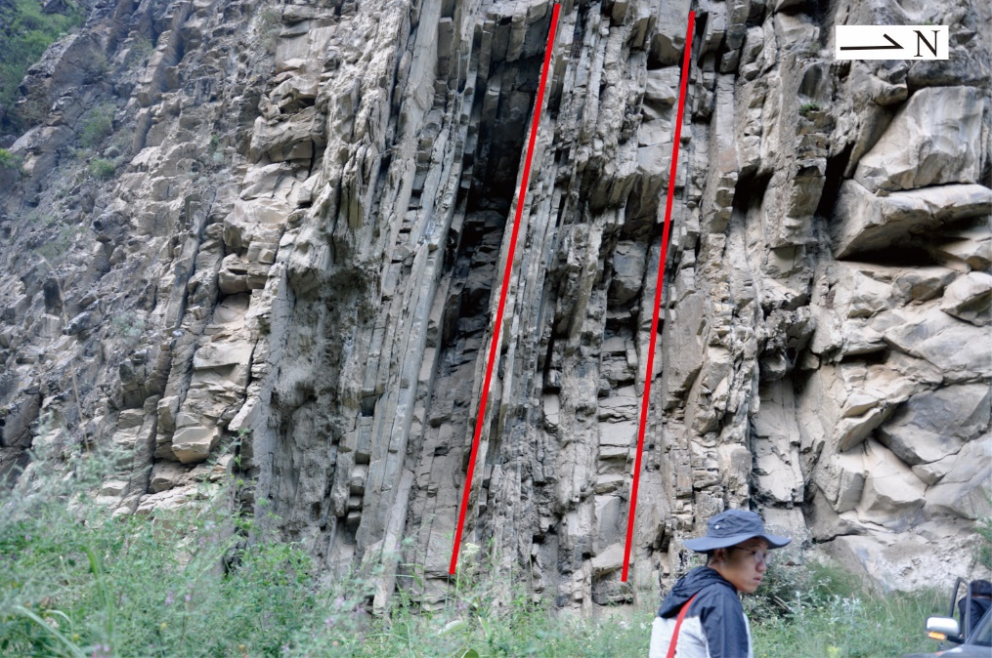
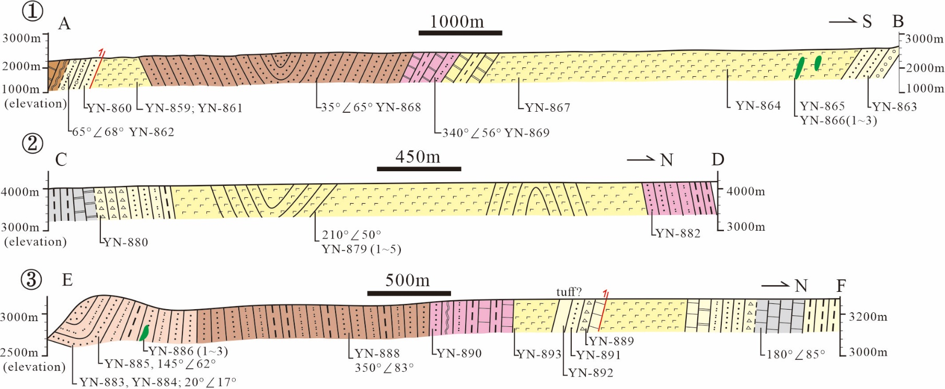
Intracontinental orogeny

Slide 29
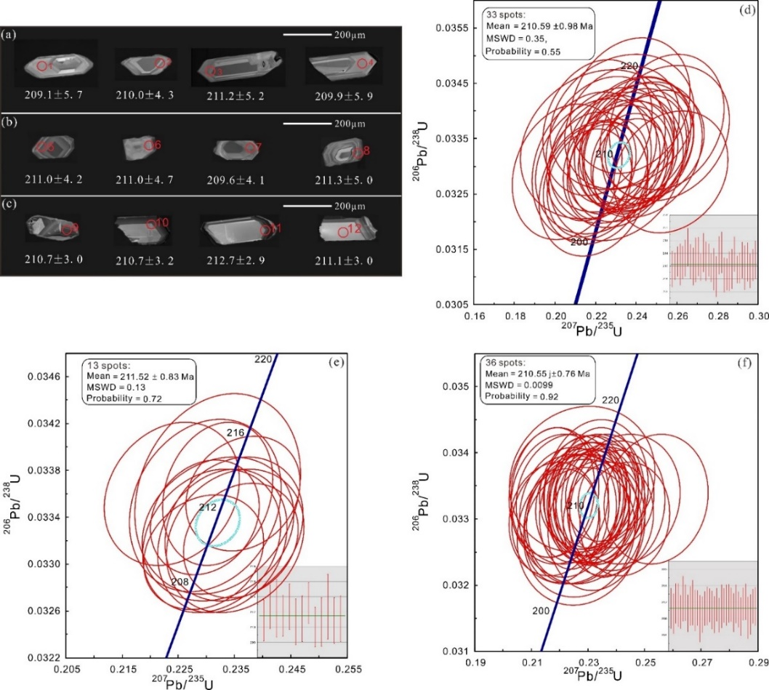
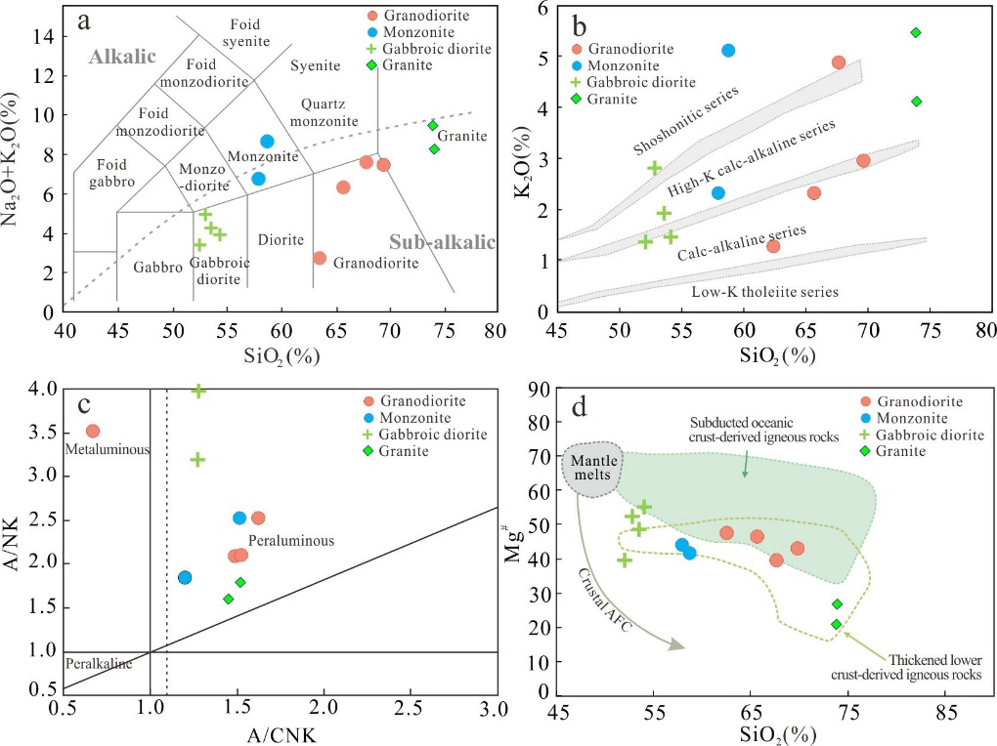
Syn-orogeny intrusion
Geochemical data show that the magma derived from partial melting of thickened lower crust, which indicate intracontinental syn-orogeny intrusion.
Geochronology data show 210.6-211.5 Ma which constrain the timing of orogeny.

Slide 30
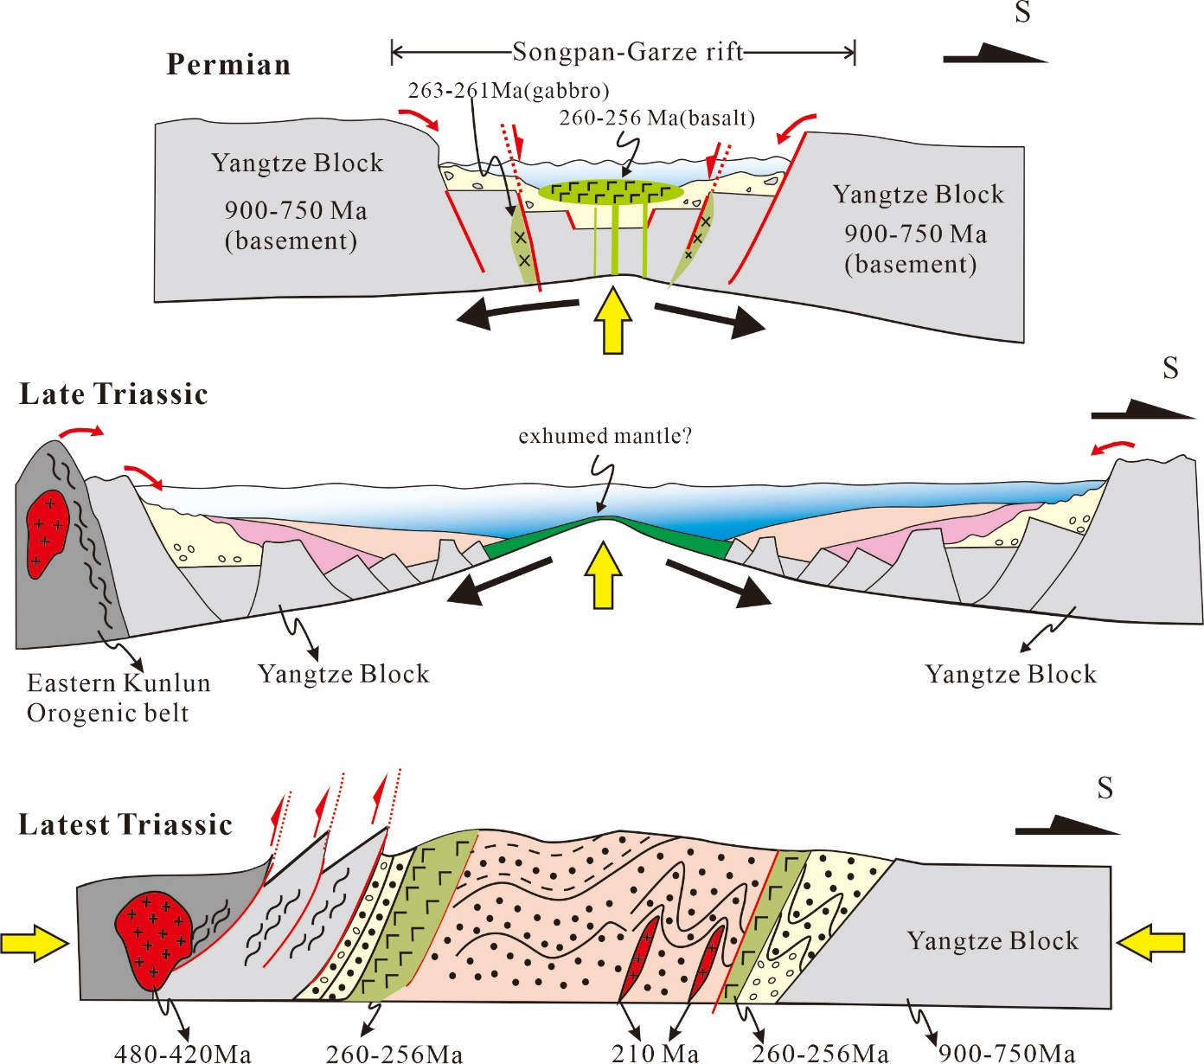
Evolution from rifting to orogeny

Slide 31
Conclusions
Songpan-Garze Terrane developed under intracontinental tectonic setting since Middle Permian. The real suture marked the closure of Paleo-Tethys should be more south.
Intracontinental rifting was divided into two stages: 1) Middle Permian - Lower Triassic alluvial fan facies, which may be derived from uplifted footwall of normal faults and caused by continuously rifting. 2): Middle-Upper Triassic display a retrogradation of subaqueous delta.
Reversal from rifting to orogeny approximaly happened from 211 Ma.

Slide 32
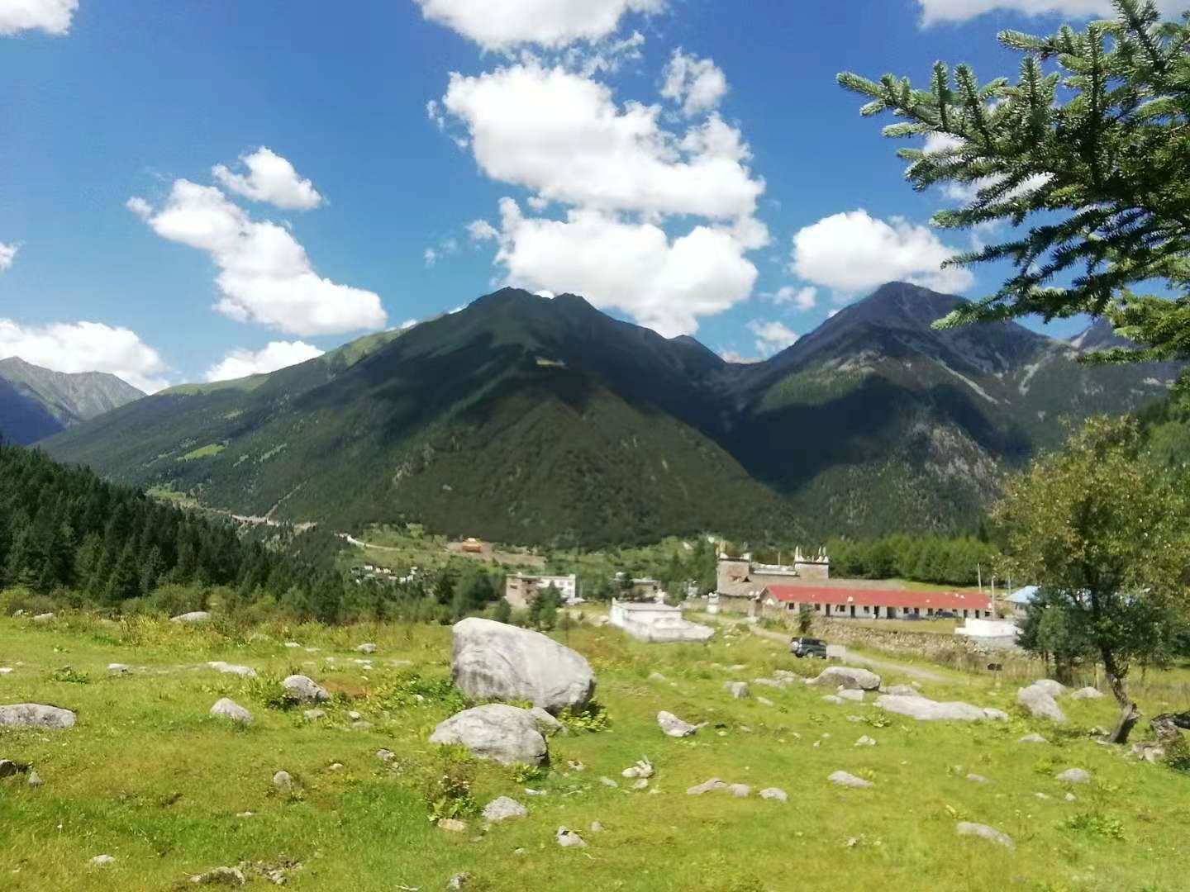
Thank you

