Slide 1


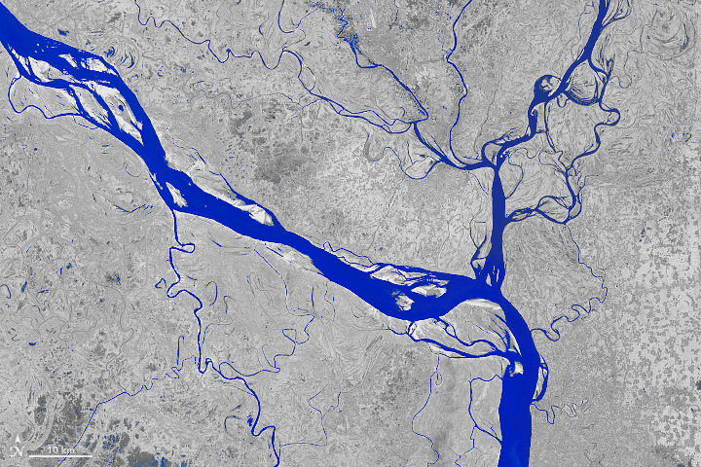
Tectonic Terraces at the Triple Junction:
How can this help with seismic hazards?
https://giphy.com/explore/abcnews
Jason “Jay” R. Patton Ph.D. PG 9758
Engineering Geologist
Tsunami Unit/CGS Seismic Hazards Program
Jason.Patton@conservation.ca.gov
https://earthobservatory.nasa.gov/images/92529/the-most-erosive-area-on-the-padma
Notes:
Thanks for having me in this Greatest session. Today I will be discussing our knowledge about prehistoric earthquakes that impact coastal northern California.
I would be happy to share this presentation as I won’t be able to describe everything in each slide.

Slide 2
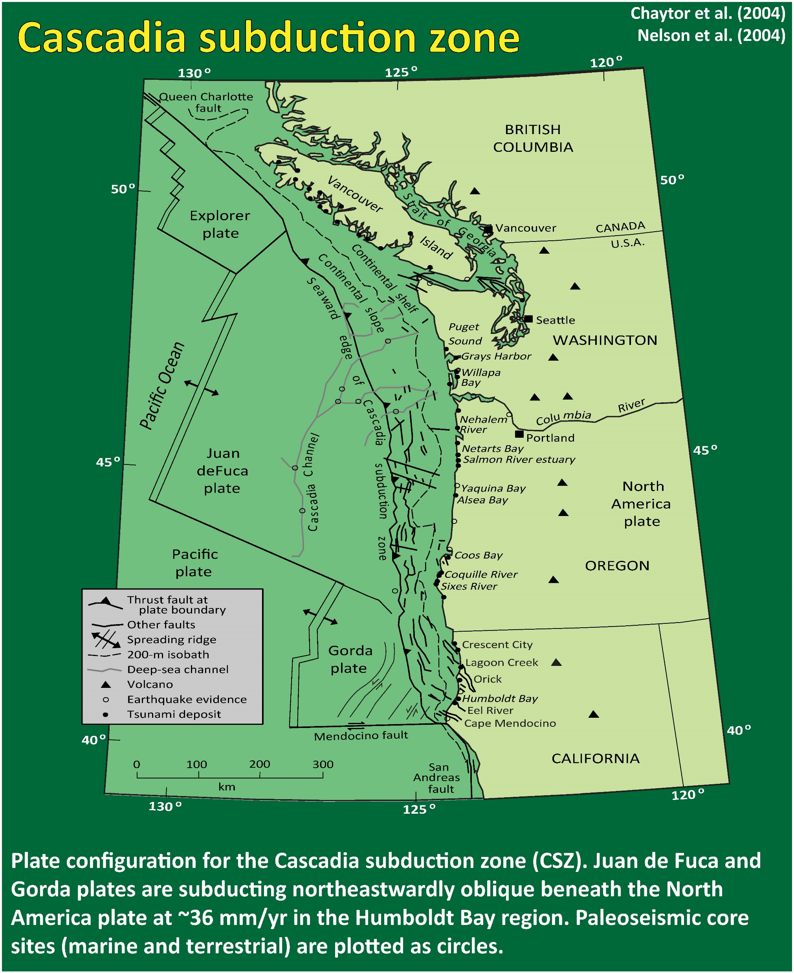
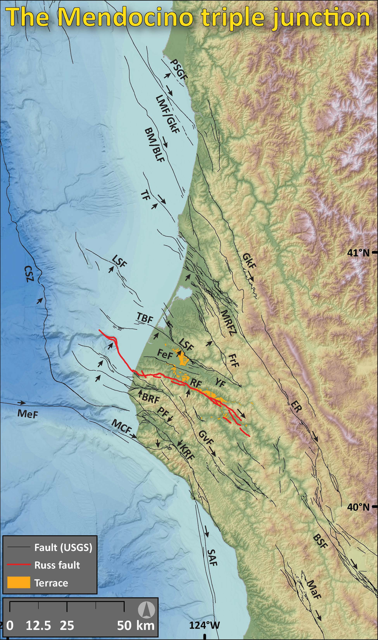
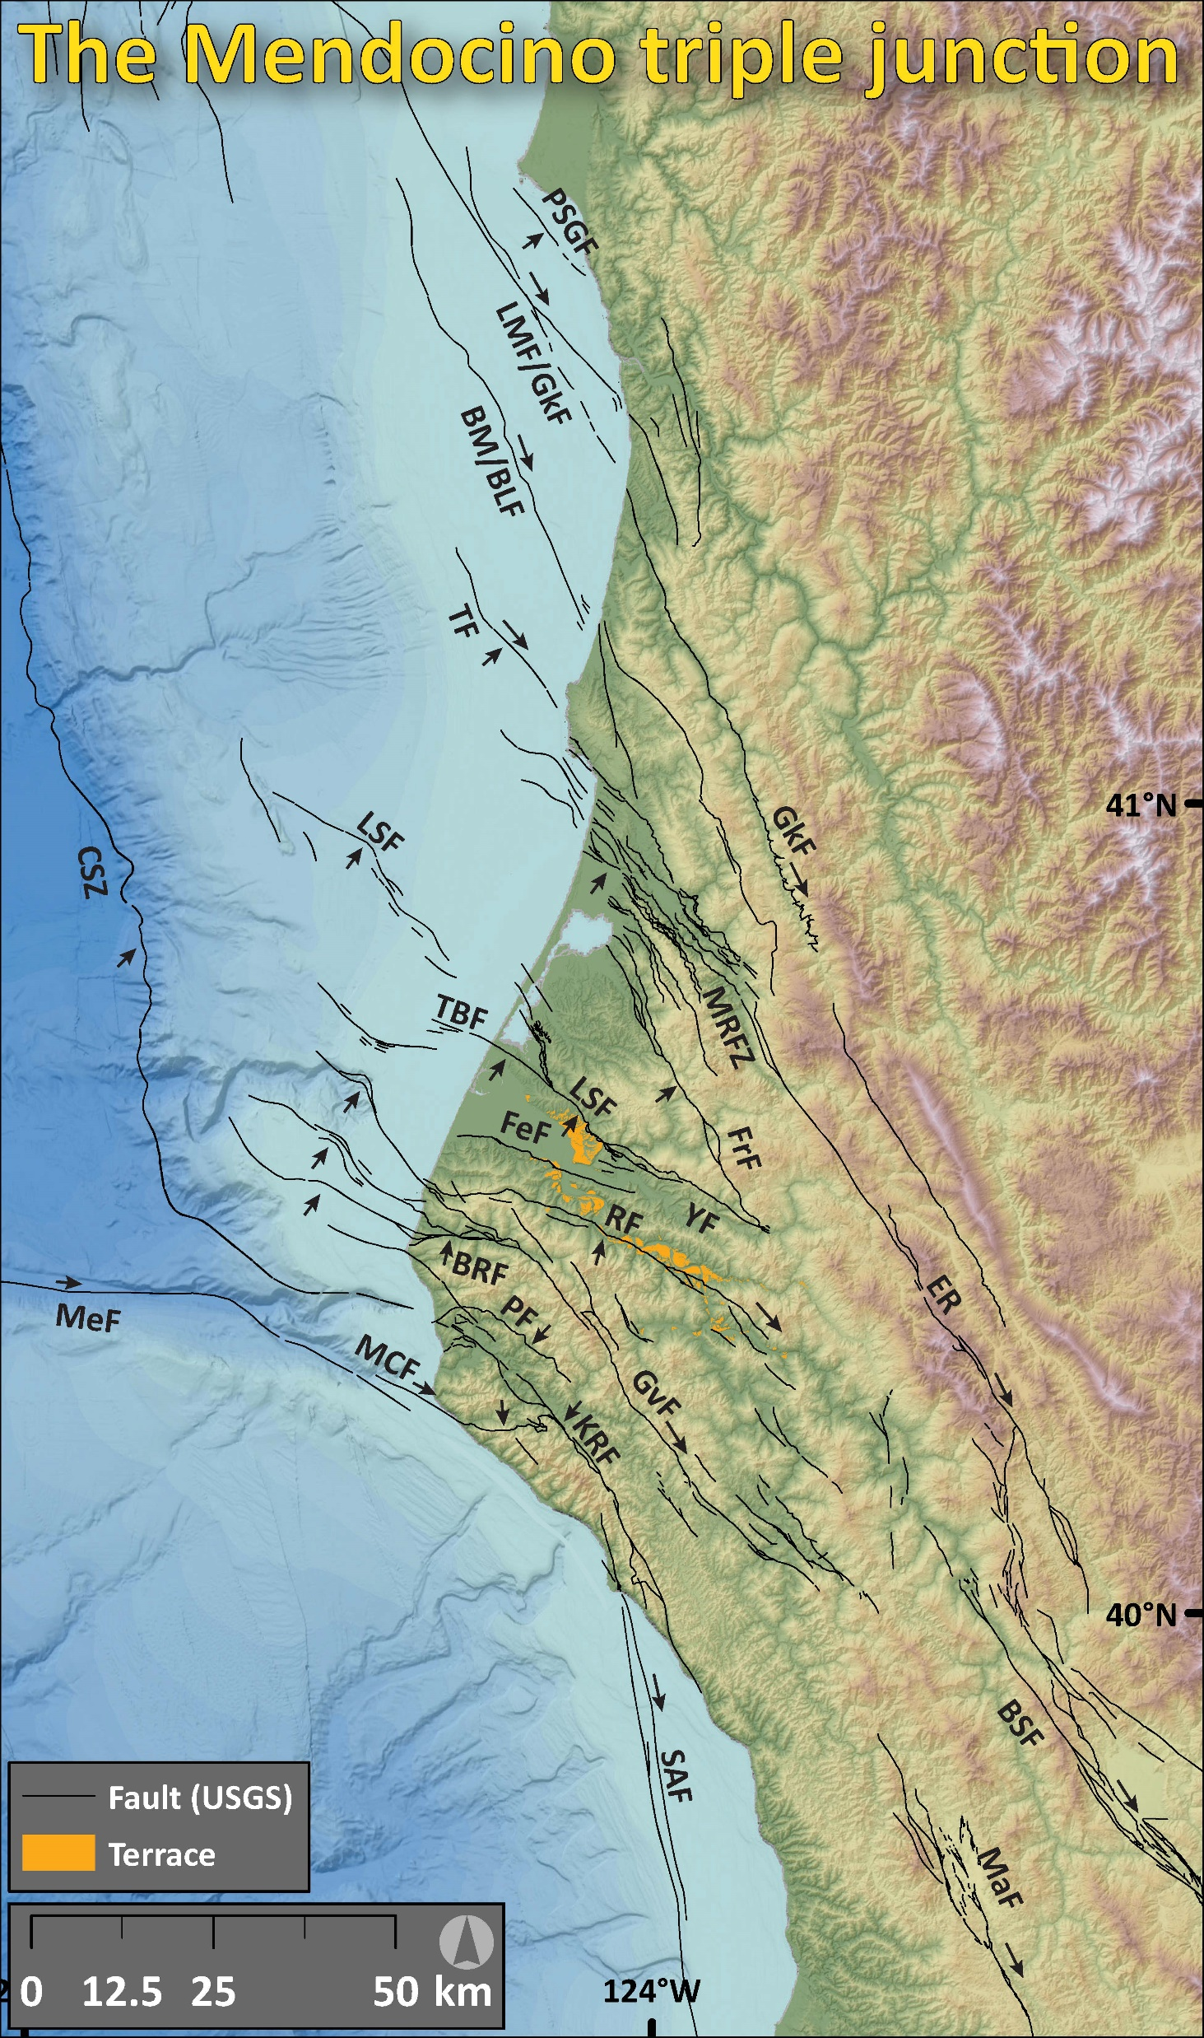
Faults from the USGS Quaternary Fault & Fold Database >>>
Arrows show sense of motion.
Note the overlap of strike-slip and thrust/reverse faults in the MTJ region.
Mapped terraces are plotted in orange.
Notes:
The Mendocino triple junction (MTJ) in California has overlapping tectonic regimes; the San Andreas fault (SAF) to the south and Cascadia megathrust to the north.
Late Pleistocene northward migration of the MTJ juxtaposes north-south compression from northern on-shore termination of the SAF with E-W compression from the Juan de Fuca-North America relative plate motion.
Active N-NW striking faults, like the Mad River fault zone may represent Cascadia convergence.
Structures striking ~E-W, like the Table Bluff fault may represent deformation related to PAC-NAM N-S convergence.
These crustal faults contribute to regional seismic hazard and may comprise one-third of the tectonic strain in coastal northern California.

Slide 3

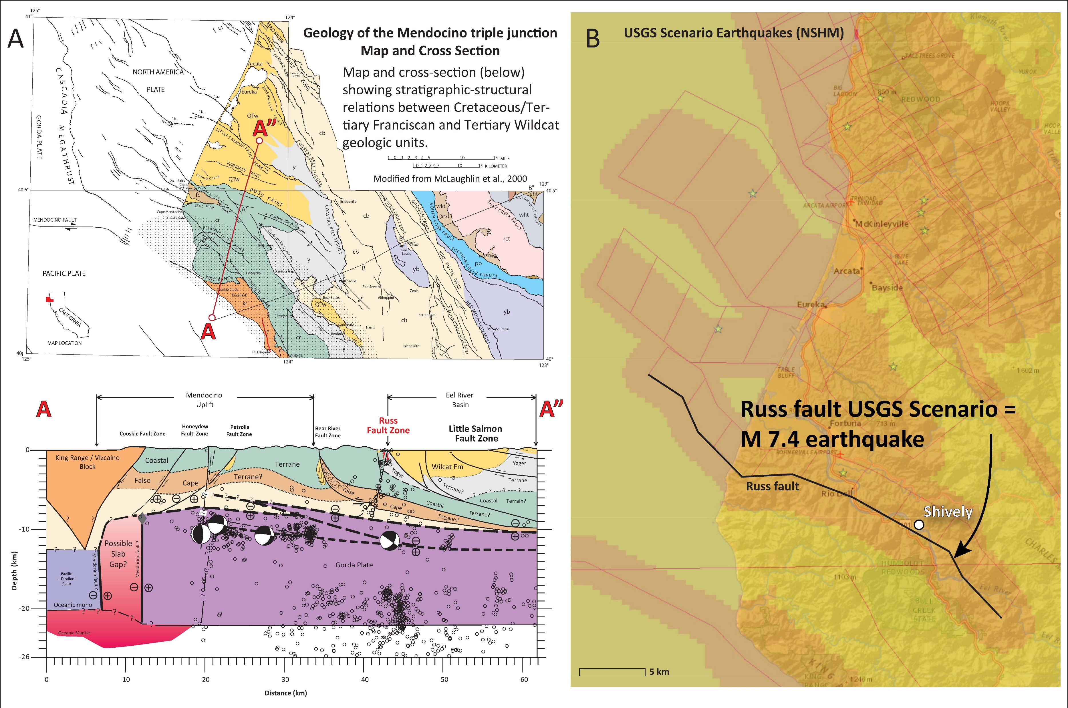
Notes:
Geologists like Bob McLaughlin have used their geologic mapping to construct stratigraphic-structural interpretations of how tectonic faults are oriented and interconnected in the subsurface.
The Russ fault shown here accommodates north-south convergence.
The Russ fault is included in the USGS National Seismic Hazard Map as a source of seismic hazard, yet is poorly characterized for sense of motion, slip rate, slip per event, and recency of activity.
Note how close Shively is to the Russ fault.

Slide 4
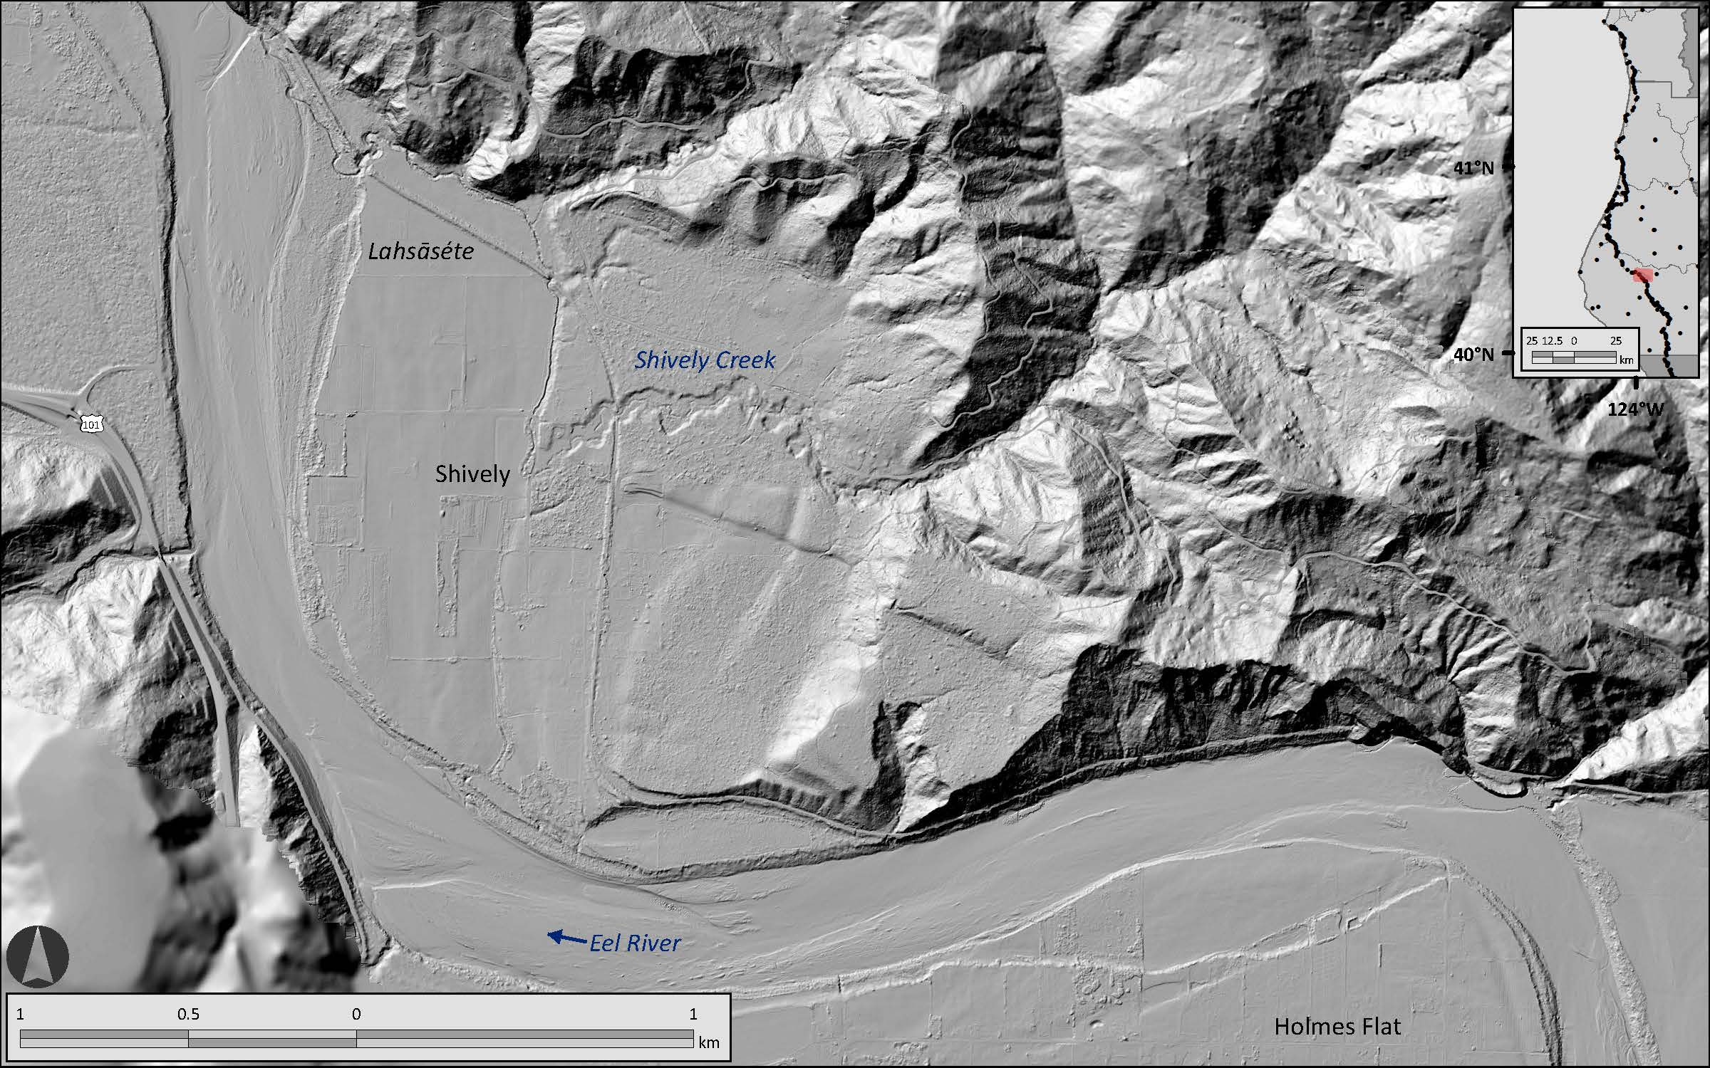
Topographic Scarp
Notes:
This is a shaded relief map for the river terraces at Shively
Click.
Let’s zoom in.
Click.
Here we can see a topographic scarp that I interpret to have formed from sequential offset across a thrust or reverse fault, dipping to the north.
We don’t yet know how this fault may be related to the Russ fault.

Slide 5
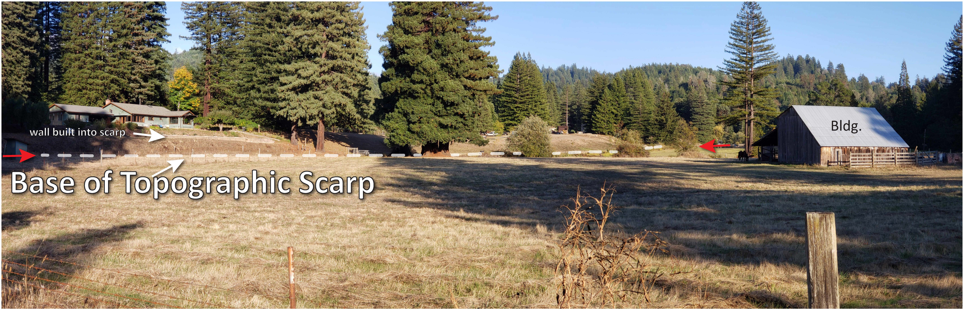
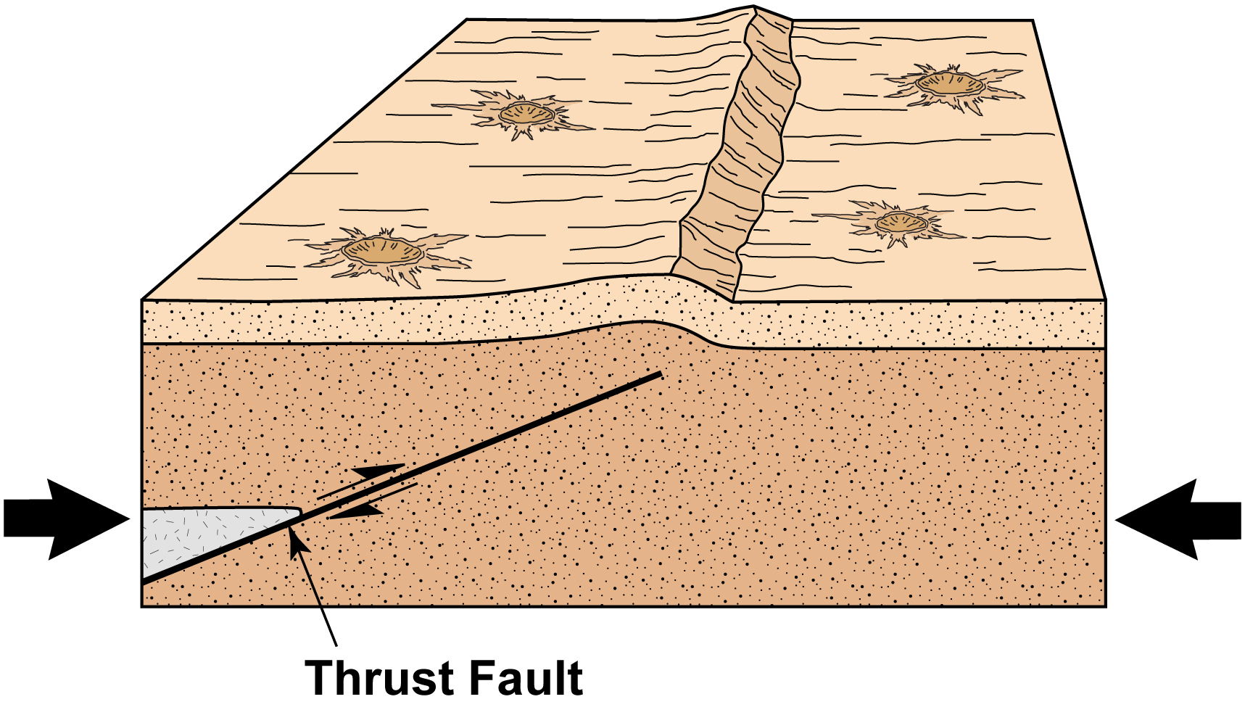
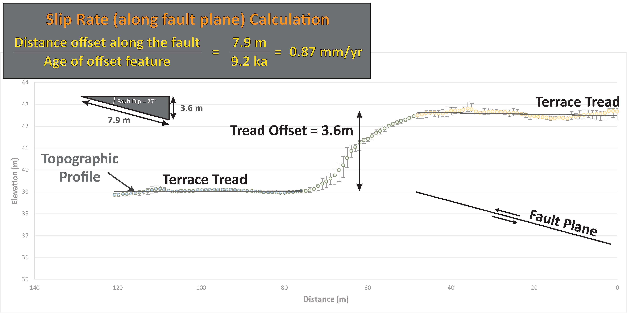

Notes:
Here is a view of the topographic scarp. All buildings in this photo are constructed on the same terrace tread.
Earthquake fault slip rates are the distance that a fault slips over time.
To calculate the slip rate, we measure the offset of a geologic feature and divide that offset by the time when the feature was created. This example is about 0.9 mm/yr.
https://airandspace.si.edu/multimedia-gallery/web11574-2010hjpg

Slide 6
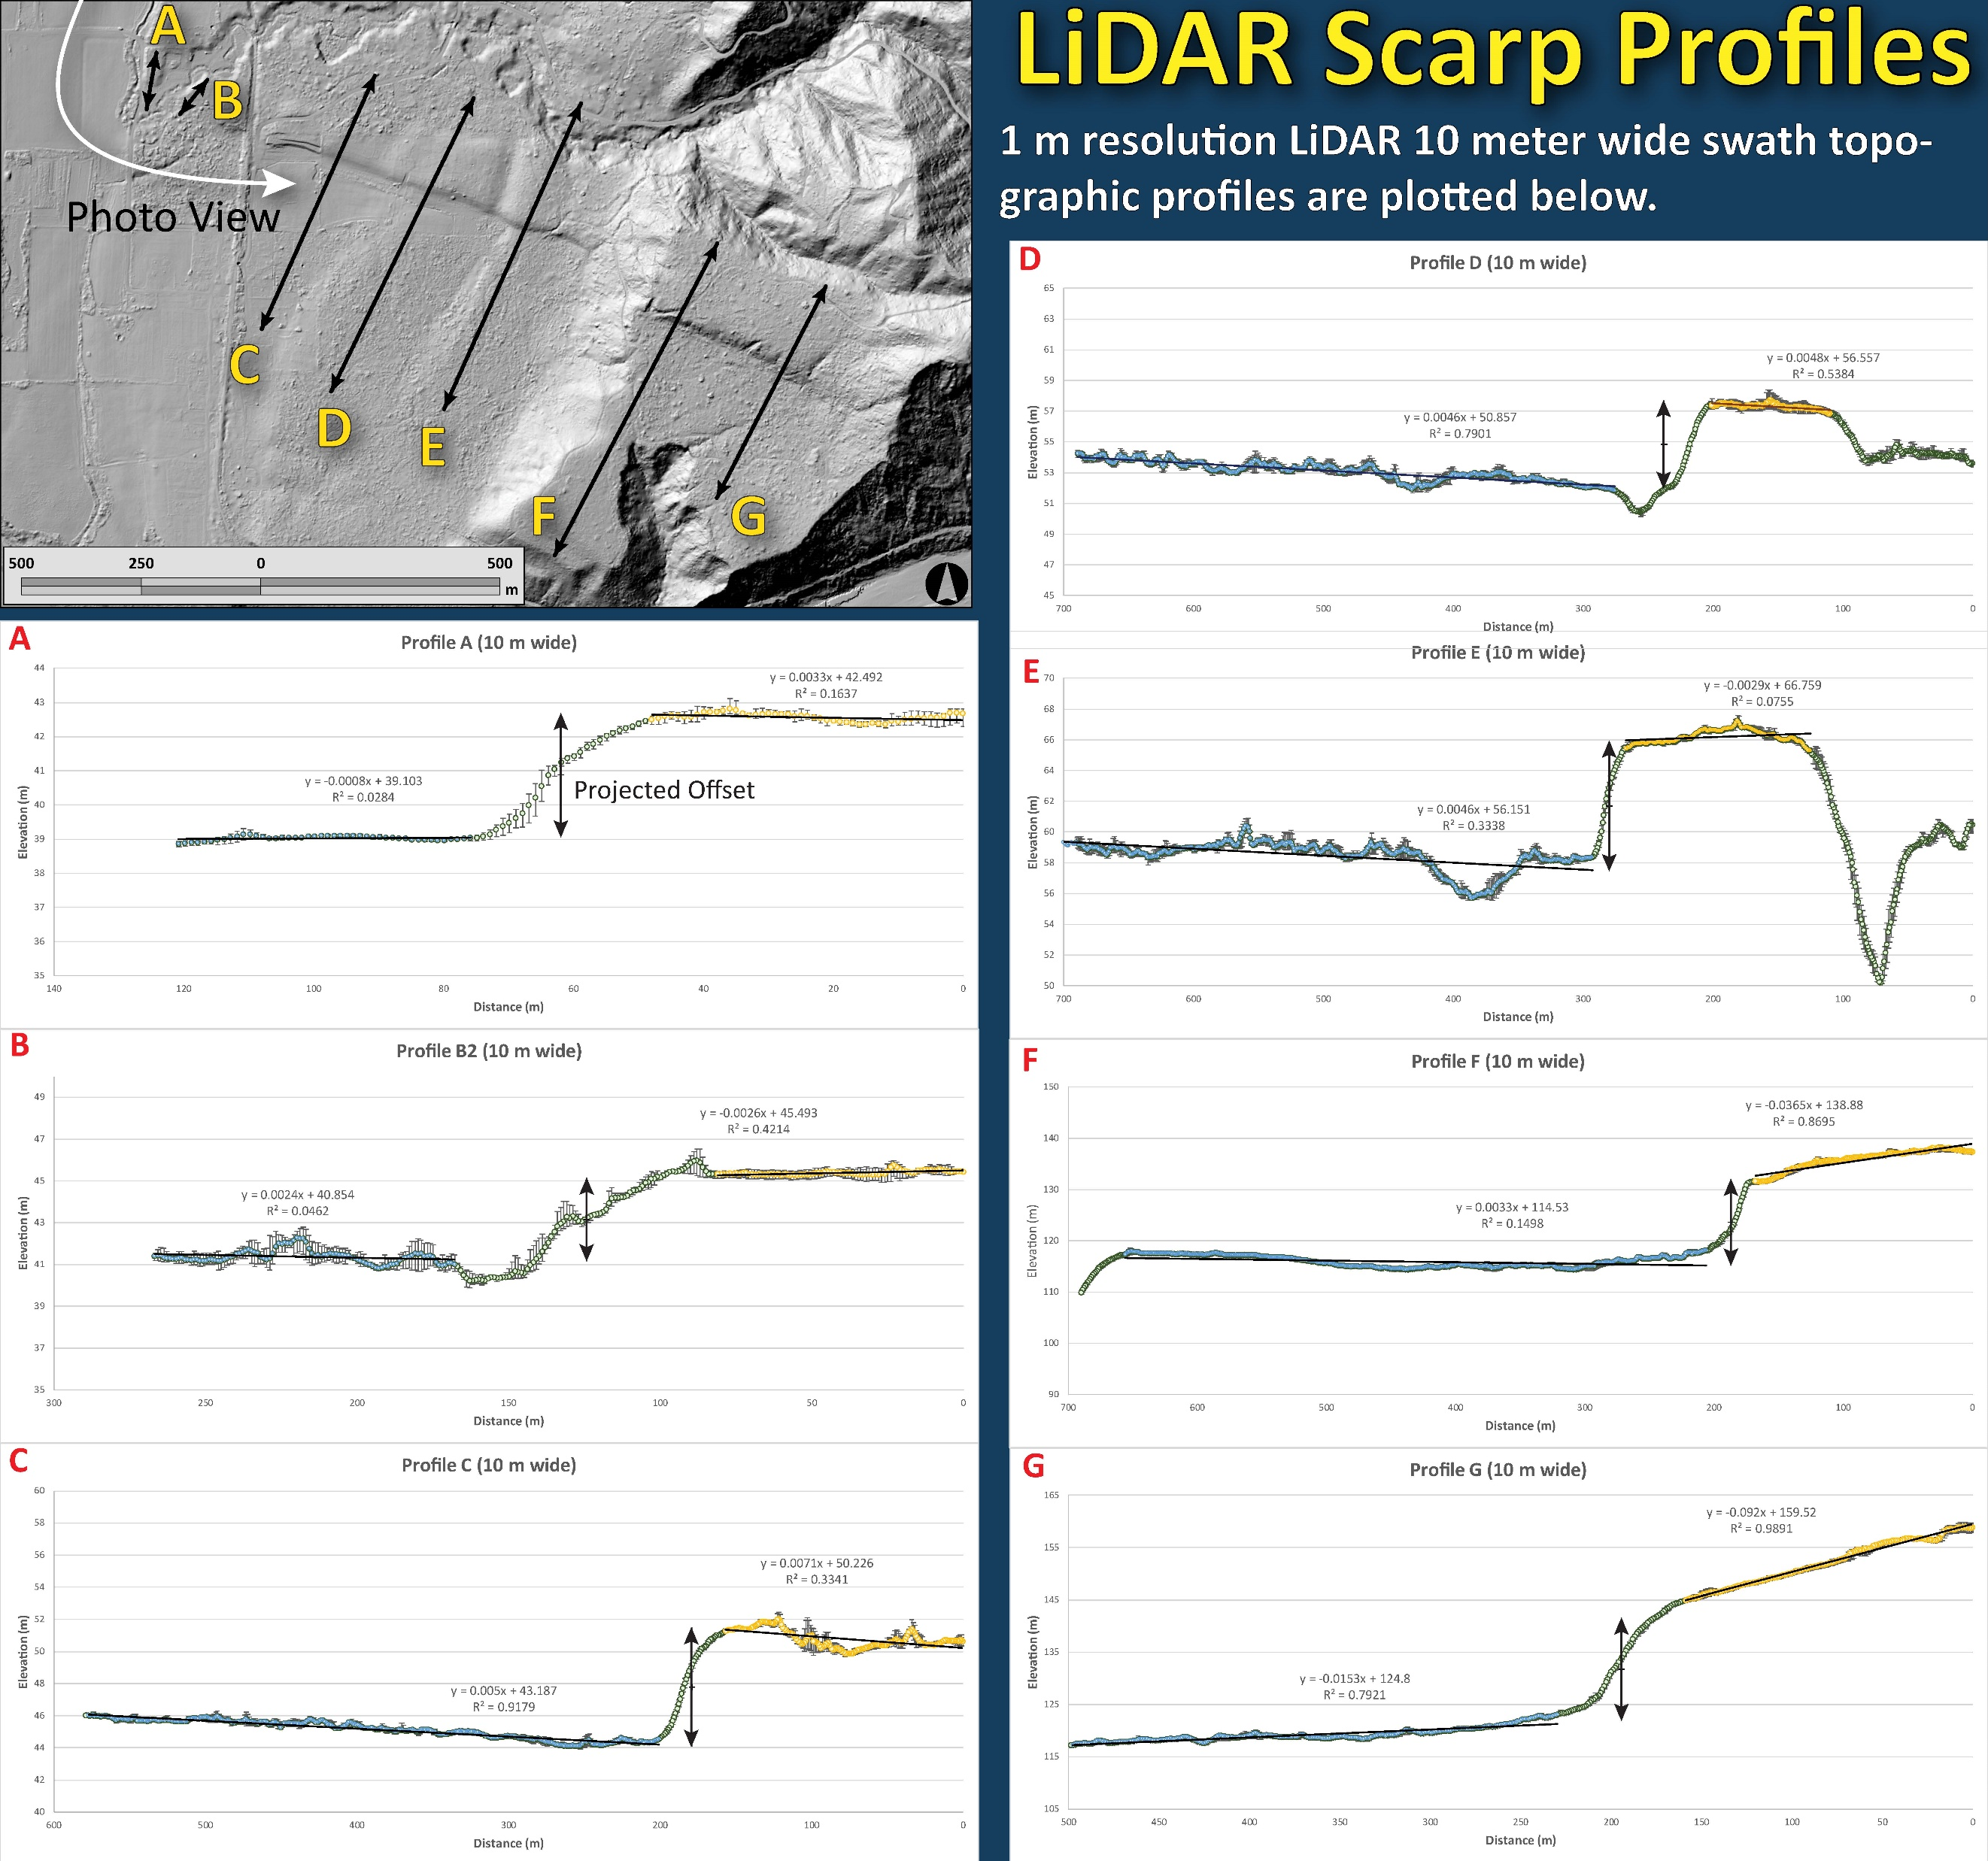
Thrust Fault
Slip Rate Calculations
Topographic swath profiles provide slip amount for each terrace.
Regional incision rates provide an age estimate for each terrace.
Distance/Time = Rate
Notes:
I used GIS software to measure topographic profiles of the scarp height in different locations. These profiles are 10-meter-wide swatch profiles.
We project terrace treads across the fault to measure the vertical separation across the fault.

Slide 7
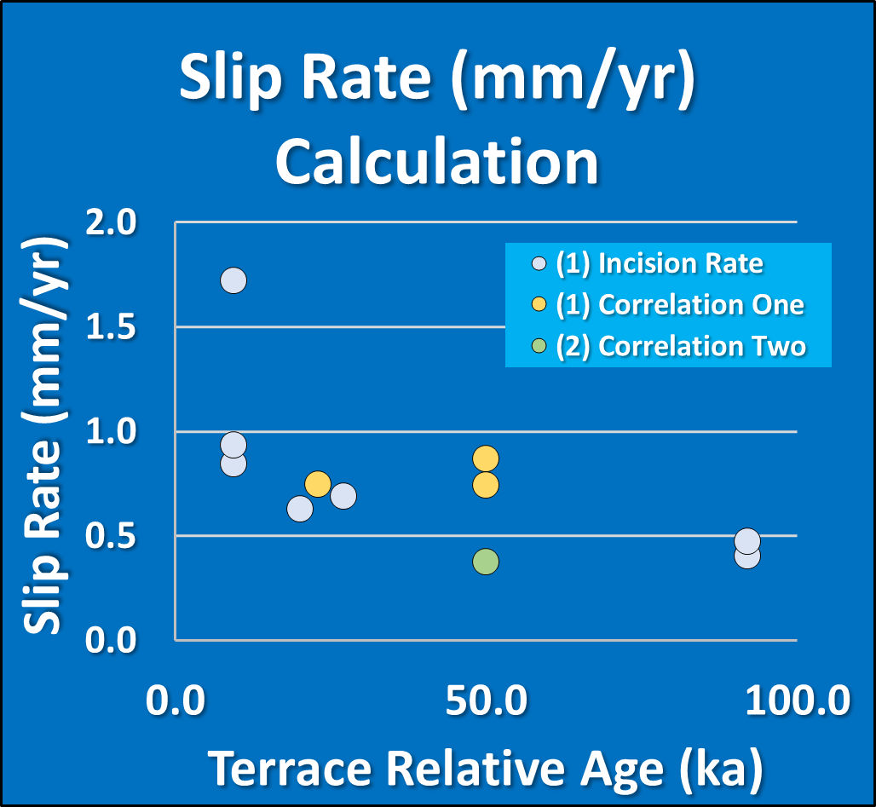
These terrace ages are based on regional incision rates.
My colleagues have numerical ages for other terraces in a nearby area.
My goal is to map river terraces between the two areas so I can correlate them and apply the numerical ages from my colleagues' study to the terraces at Shively.
This may improve these slip rate estimates and help us learn about what structures are active during the latest Quaternary through the Holocene.
Notes:
These terrace ages are based on regional incision rates.
My colleagues have numerical ages for other terraces in a nearby area.
My goal is to map river terraces between the two areas so I can correlate them and apply the numerical ages from my colleagues' study to the terraces at Shively.
This may improve these slip rate estimates and help us learn about what structures are active during the latest Quaternary through the Holocene.
The mean slip rate over the past 100k years is 0.8 mm/yr.

Slide 8
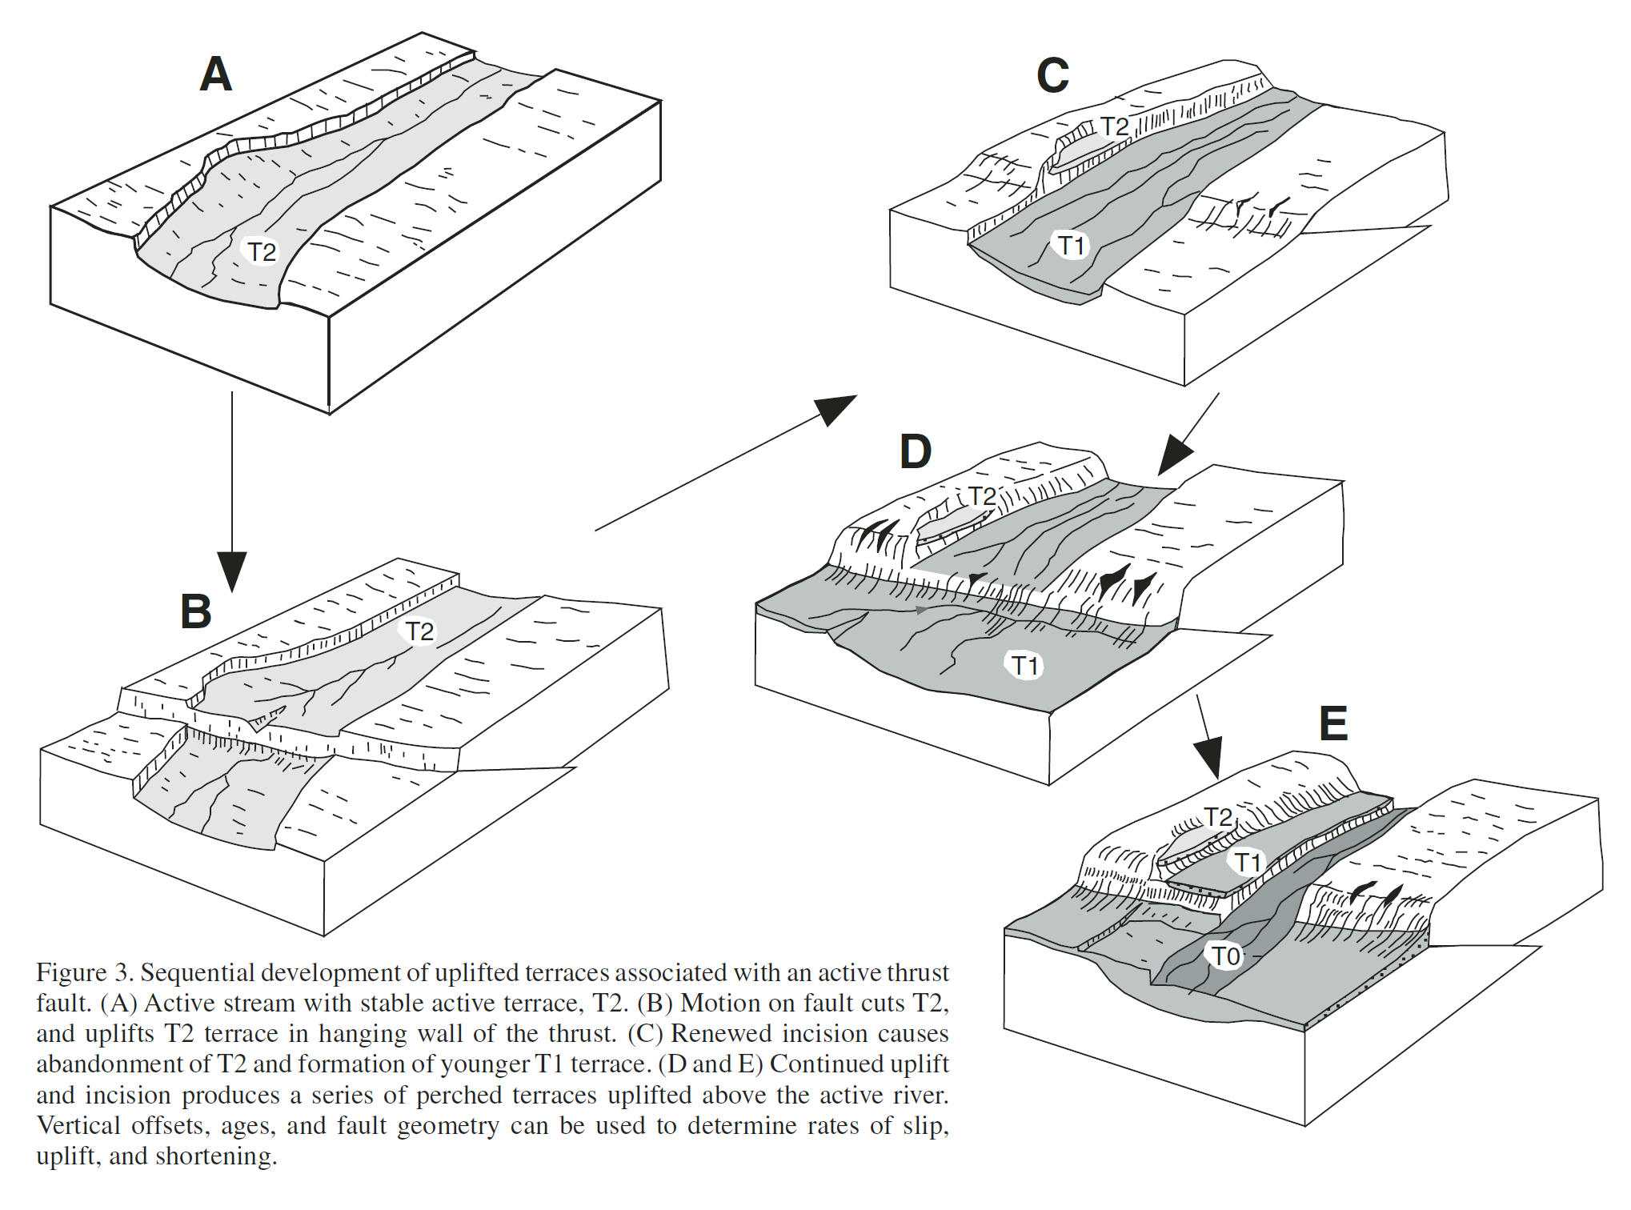
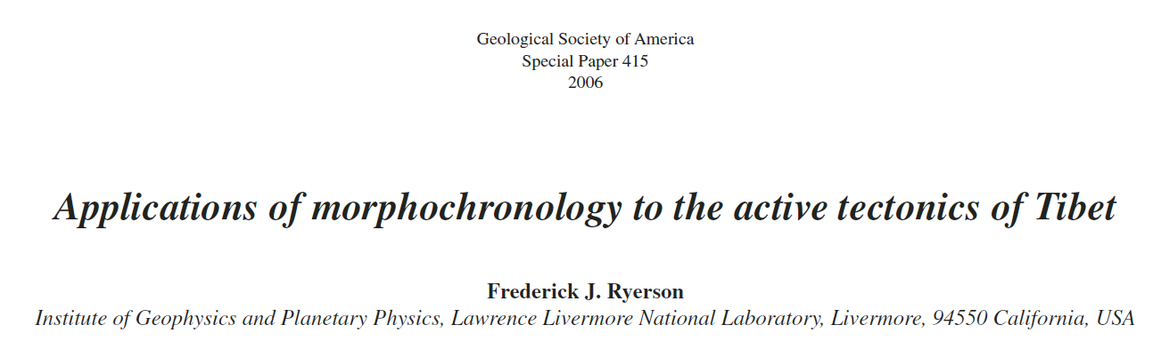
Terraces and Tectonics
River terraces can be displaced/offset by thrust faults
Step 1: floodplain/terrace (T2) formation
Step 2: earthquake on thrust fault displaces/offsets T2 terrace
Step 3: prolonged incision leads to terrace T1 formation
Step 4: earthquake on thrust fault displaces/offsets T1 terrace
Terrace formation
Terrace formation
Earthquake offsets terrace
Earthquake offsets terrace
Notes:
This is a brief visualization of how earthquake ruptures can offset river terraces or floodplains.
https://doi.org/10.1130/2006.2415(05)
Applications of morphochronology to the active tectonics of Tibet
Author(s)
Frederick J. Ryerson ; Paul Tapponnier ; Robert C. Finkel ; Anne-Sophie Mériaux ; Jérôme Van der Woerd ; Cécile Lasserre ; Marie-Luce Chevalier ; Xi-wei Xu ; Hai-bing Li ; Geoffrey C.P. King
Abstract
The Himalayas and the Tibetan Plateau were formed as a result of the collision of India and Asia, and provide an excellent opportunity to study the mechanical response of the continental lithosphere to tectonic stress. Geophysicists are divided in their views on the nature of this response, advocating either (1) homogeneously distributed deformation with the lithosphere deforming as a fluid continuum or (2) highly localized deformation with the lithosphere deforming as a system of blocks. The resolution of this issue has broad implications for understanding the tectonic response of continental lithosphere in general. Homogeneous deformation is supported by relatively low decadal, geodetic slip-rate estimates for the Altyn Tagh and Karakorum faults. Localized deformation is supported by high millennial, geomorphic slip rates constrained by both cosmogenic and radiocarbon dating on these faults. Based upon the agreement of rates determined by radiocarbon and cosmogenic dating, the overall linearity of offset versus age correlations, and the plateau-wide correlation of landscape evolution and climate history, the disparity between geomorphic and geodetic slip-rate determinations is unlikely to be due to the effects of surface erosion on the cosmogenic age determinations. Similarly, based upon the consistency of slip rates over various observation intervals, secular variations in slip rate appear to persist no longer than 2000 yr and are unlikely to provide reconciliation. Conversely, geodetic and geomorphic slip-rate estimates on the Kunlun fault, which does not have significant splays or associated thrust faults, are in good agreement, indicating that there is no fundamental reason why these complementary geodetic and geomorphic methods should disagree. Similarly, the geodetic and geomorphic estimates of shortening rates across the northeastern edge of the plateau are in reasonable agreement, and the geomorphic rates on individual thrust faults demonstrate a significant eastward decrease in the shortening rate. This rate decrease is consistent with the transfer of slip from the Altyn Tagh fault to genetically related thrust mountain building at its terminus. Rates on the Altyn Tagh fault suggest a similar decrease in rate, but the current data set is too small to be definitive. Overall, the high, late Pleistocene–Holocene geomorphic slip velocities on the major strike-slip faults of Tibet suggest that these faults absorb as much of India's convergence relative to Siberia as the Himalayan Main Frontal Thrust on the southern edge of the plateau.

Slide 9
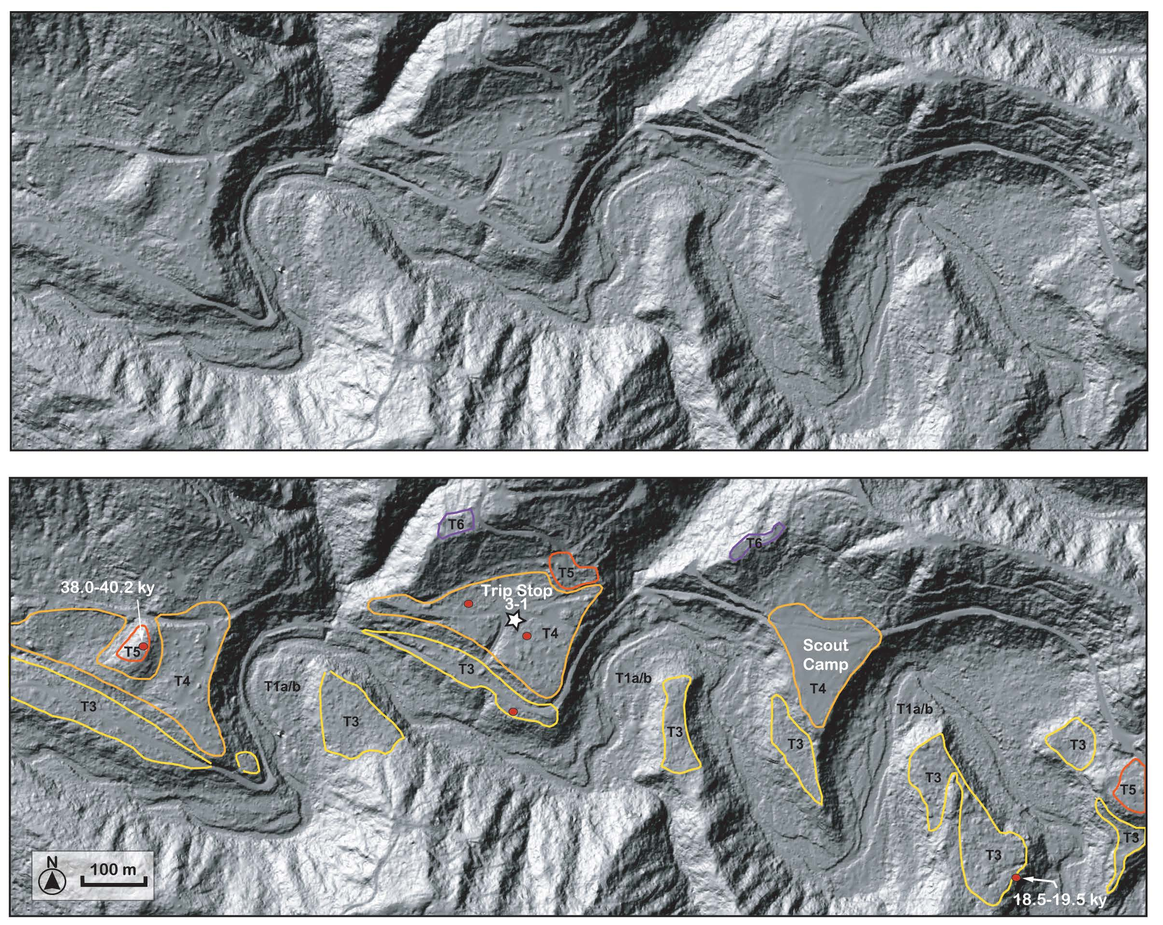
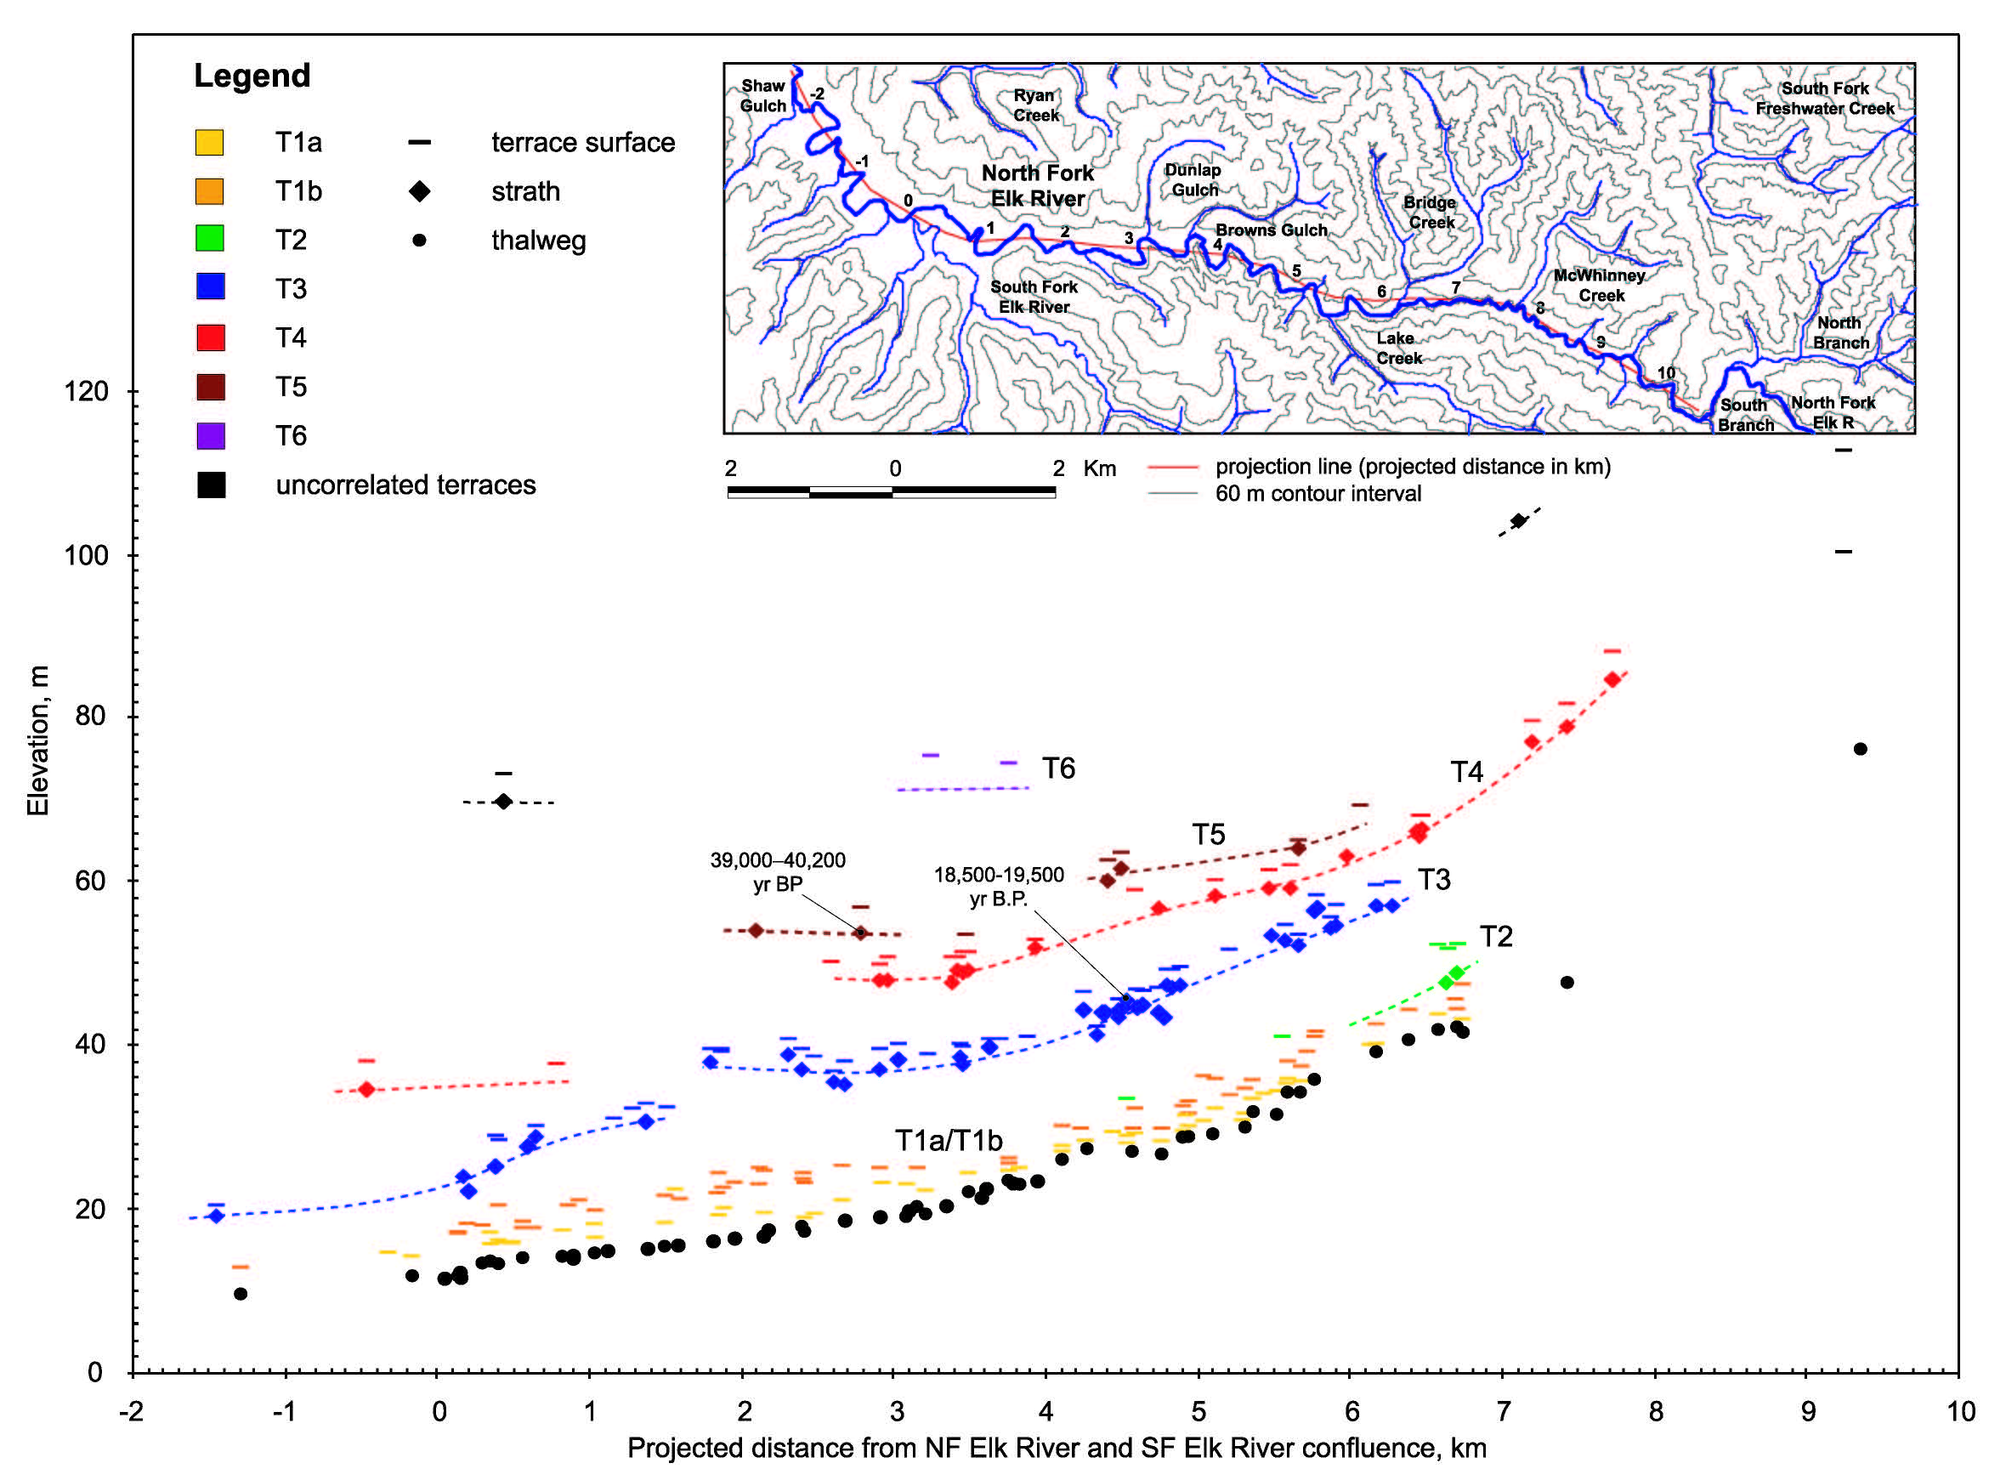
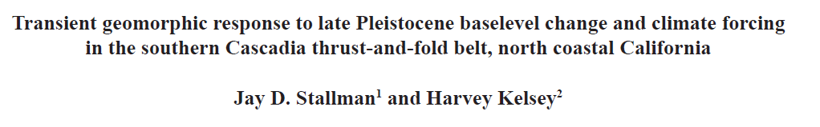
Minimum age estimates for strath cutting, provided by AMS dates from the channel facies on T3 (18.5–19.5 ky) and T5 (39.0– 40.2 ky) terraces, give incision rates of 0.85 ±0.05 m ky-1 and 0.89 ±0.09 m ky-1.
Terrace Profiles
Note Offsets
Notes:
Here is an example of river terraces mapped in the region by Jay Stallman for his master’s thesis at Humboldt state.
the map in the upper left shows his mapping.
On the right are his river profiles. Click. Note that in this location. Click, click. There are offsets of 2 terraces that Stallman and Kelsey interpret to have been offset by an unmapped fault.

Slide 10
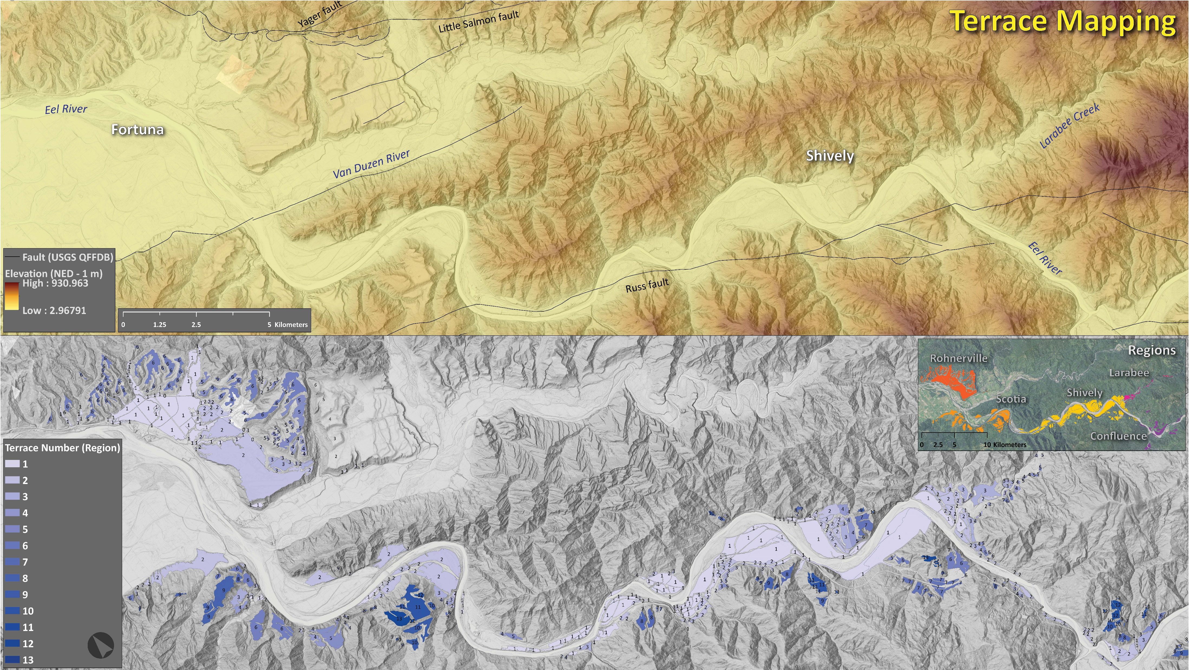
Notes:
I used 1-meter USGS LiDAR at a large scale to map terrace treads along the lower Eel River from near Fortuna upstream to the confluence with the South Fork.
I subdivided the area into regions and correlated terraces within each region, giving them terrace numbers using the convention that T-1 is the youngest terrace.
Let’s look closer at these two areas, Click, Rohnerville, and Click, Shively.

Slide 11
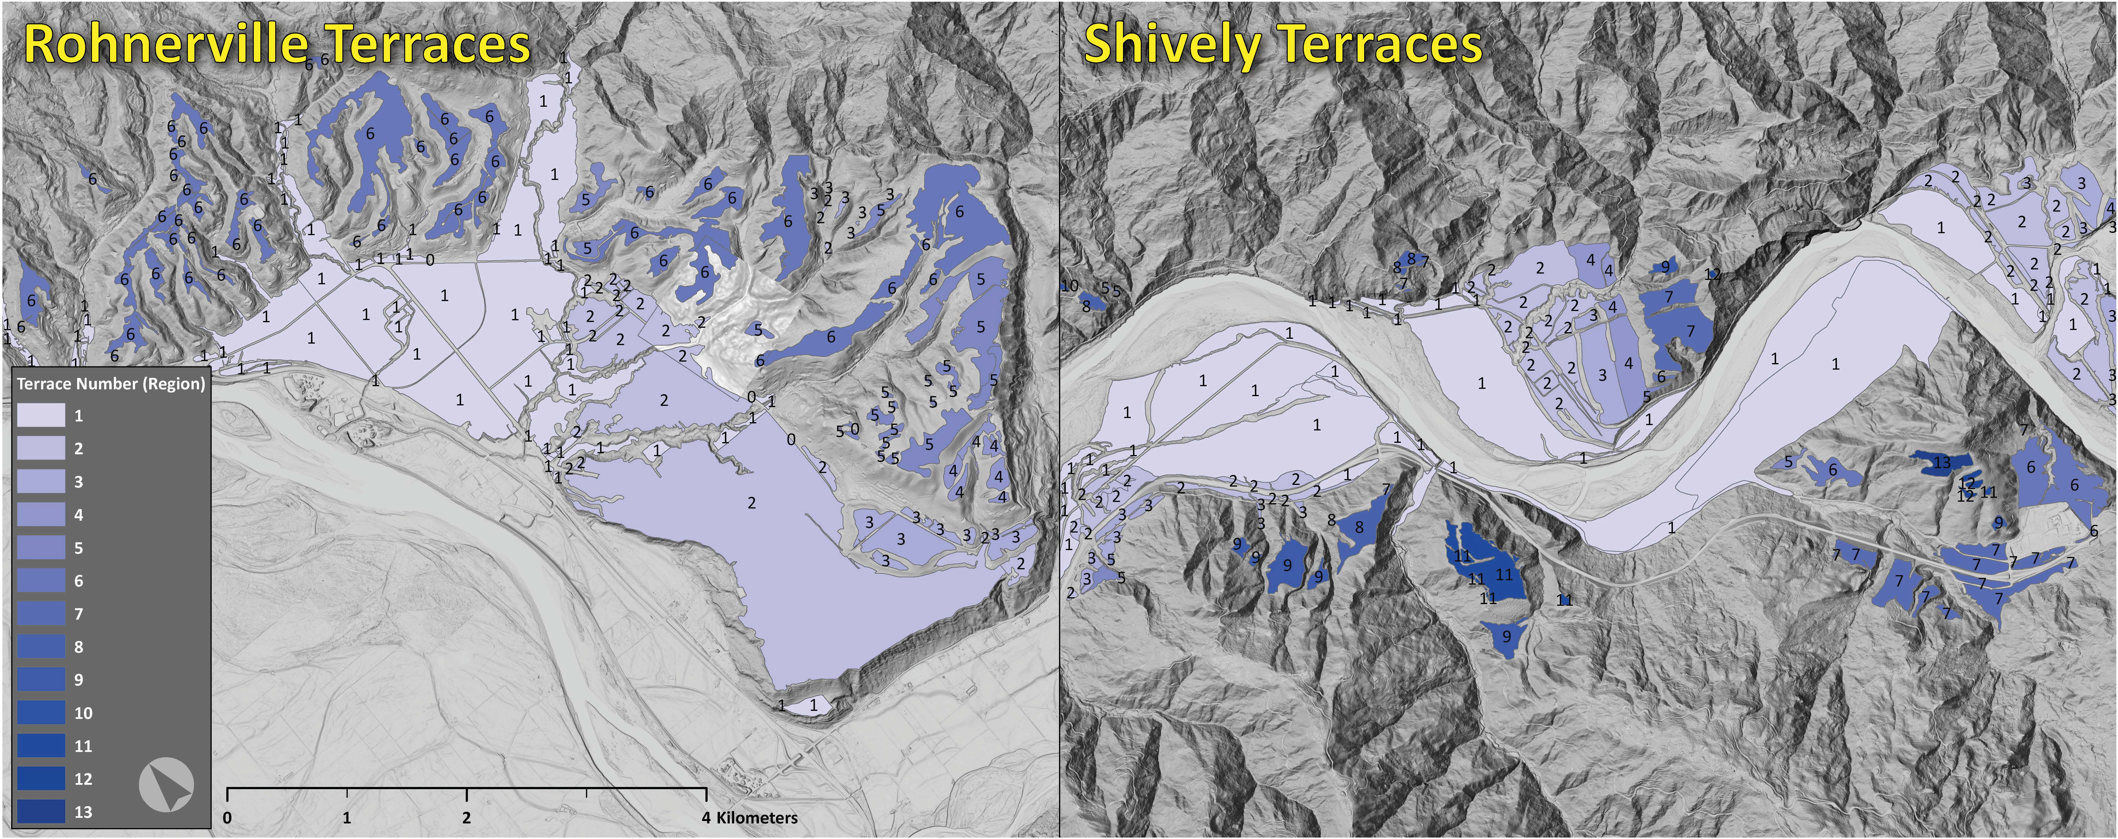
Notes:
This is a large-scale view of terraces mapped in Rohnerville and in Shively.
The 2 most broadly representative terraces in Rohnerville are T-5 and T-6. In Shively they are T-6 and T-7. This may be the same terrace pair.

Slide 12
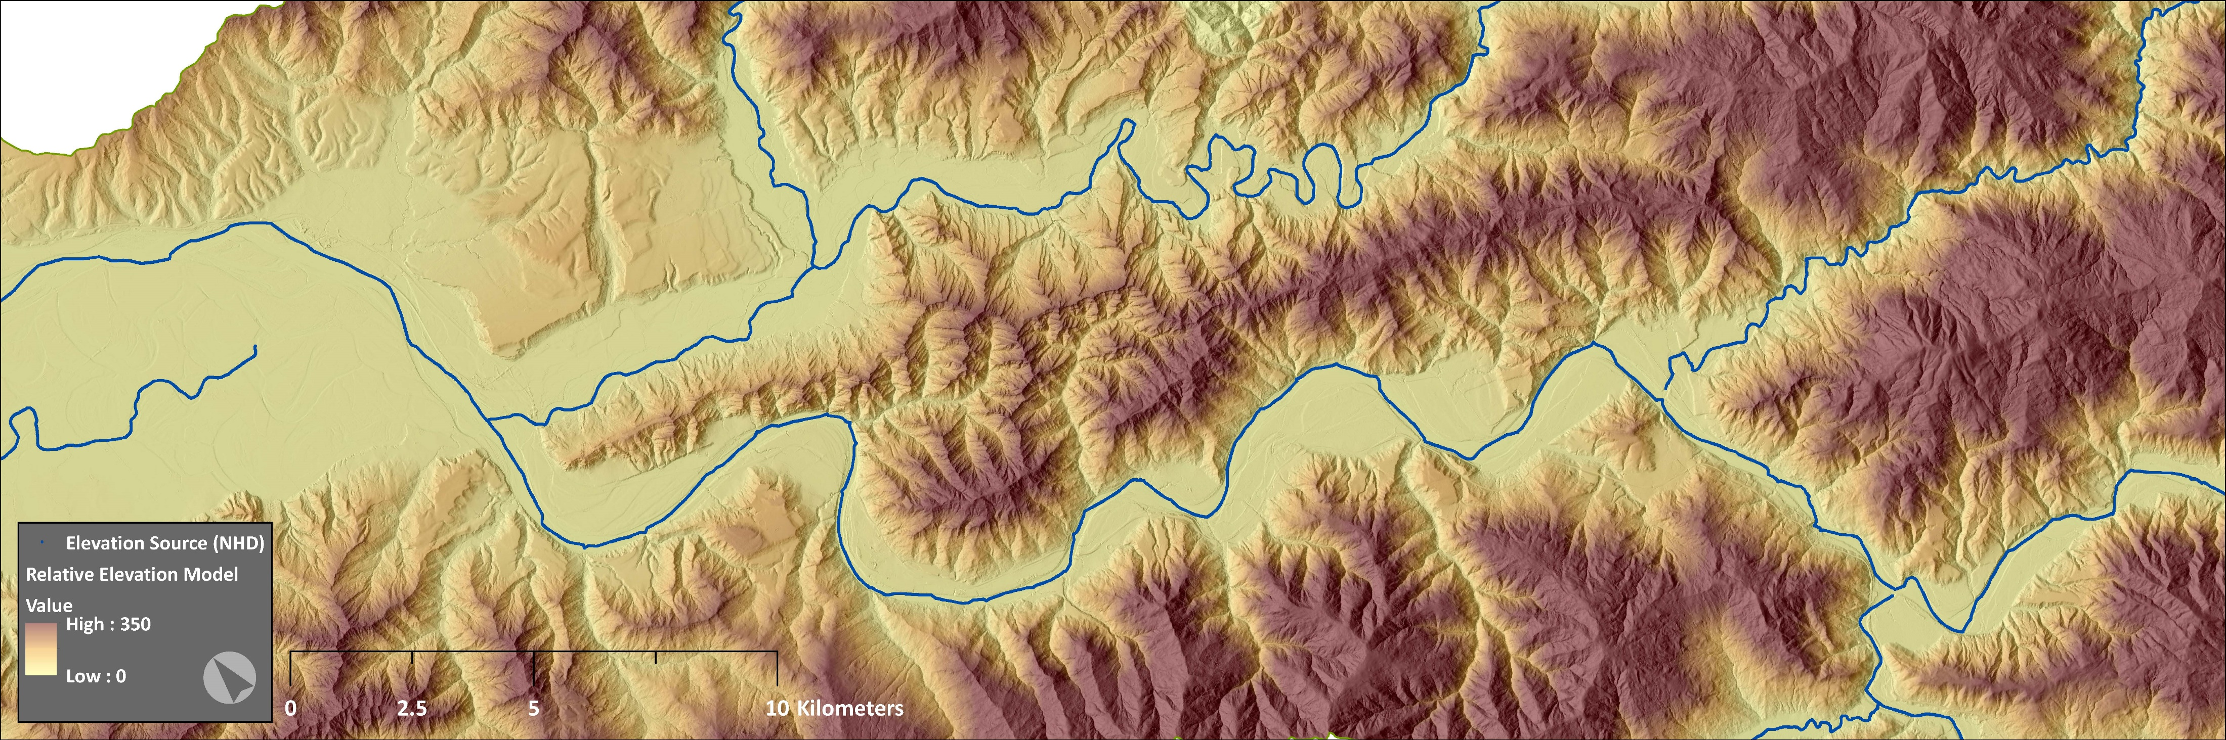
Relative Elevation represents the elevation of landforms relative to the water surface elevation of the modern river channel.
Relative Elevation Model
Step 1: Use modern active channel to create a “baselevel” elevation model (BLEM) that extends the active
channel elevation beneath the adjacent terraces and hillsides. This example uses SPLINE extrapolation.
Step 2: Subtract the BLEM from the modern topography (DEM to calculate the Relative Elevation Model (REM).
Notes:
I constructed a Relative Elevation Model so that at every location along a terrace tread, I have an estimate of that location relative to the water surface elevation of the modern river channel.
The challenge is to incorporate tribs like Yager Creek that have their own terrace systems. Also, a challenge is to do this for the entire Eel River basin.
I tried dozens of configurations and settled with a SPLINE extrapolation.

Slide 13
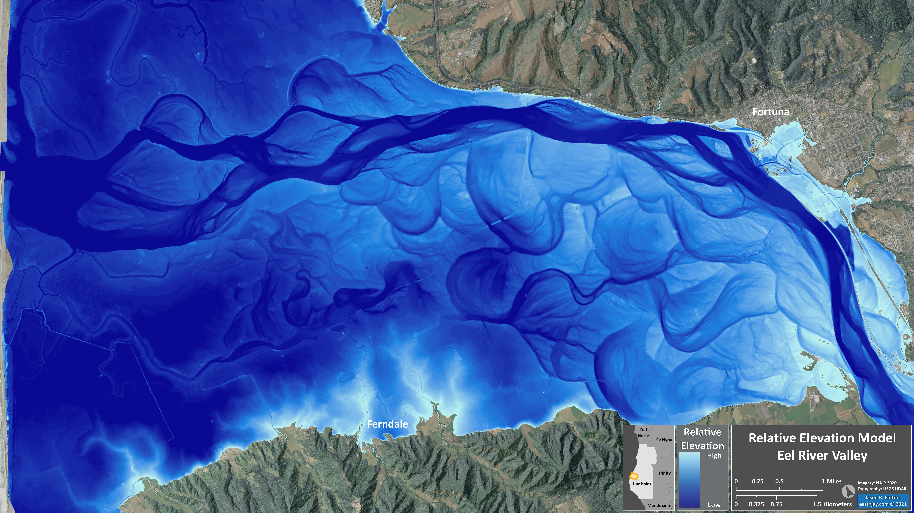
Notes:
This REM will be useful for other purposes, but can just be used to make a pretty map.

Slide 14
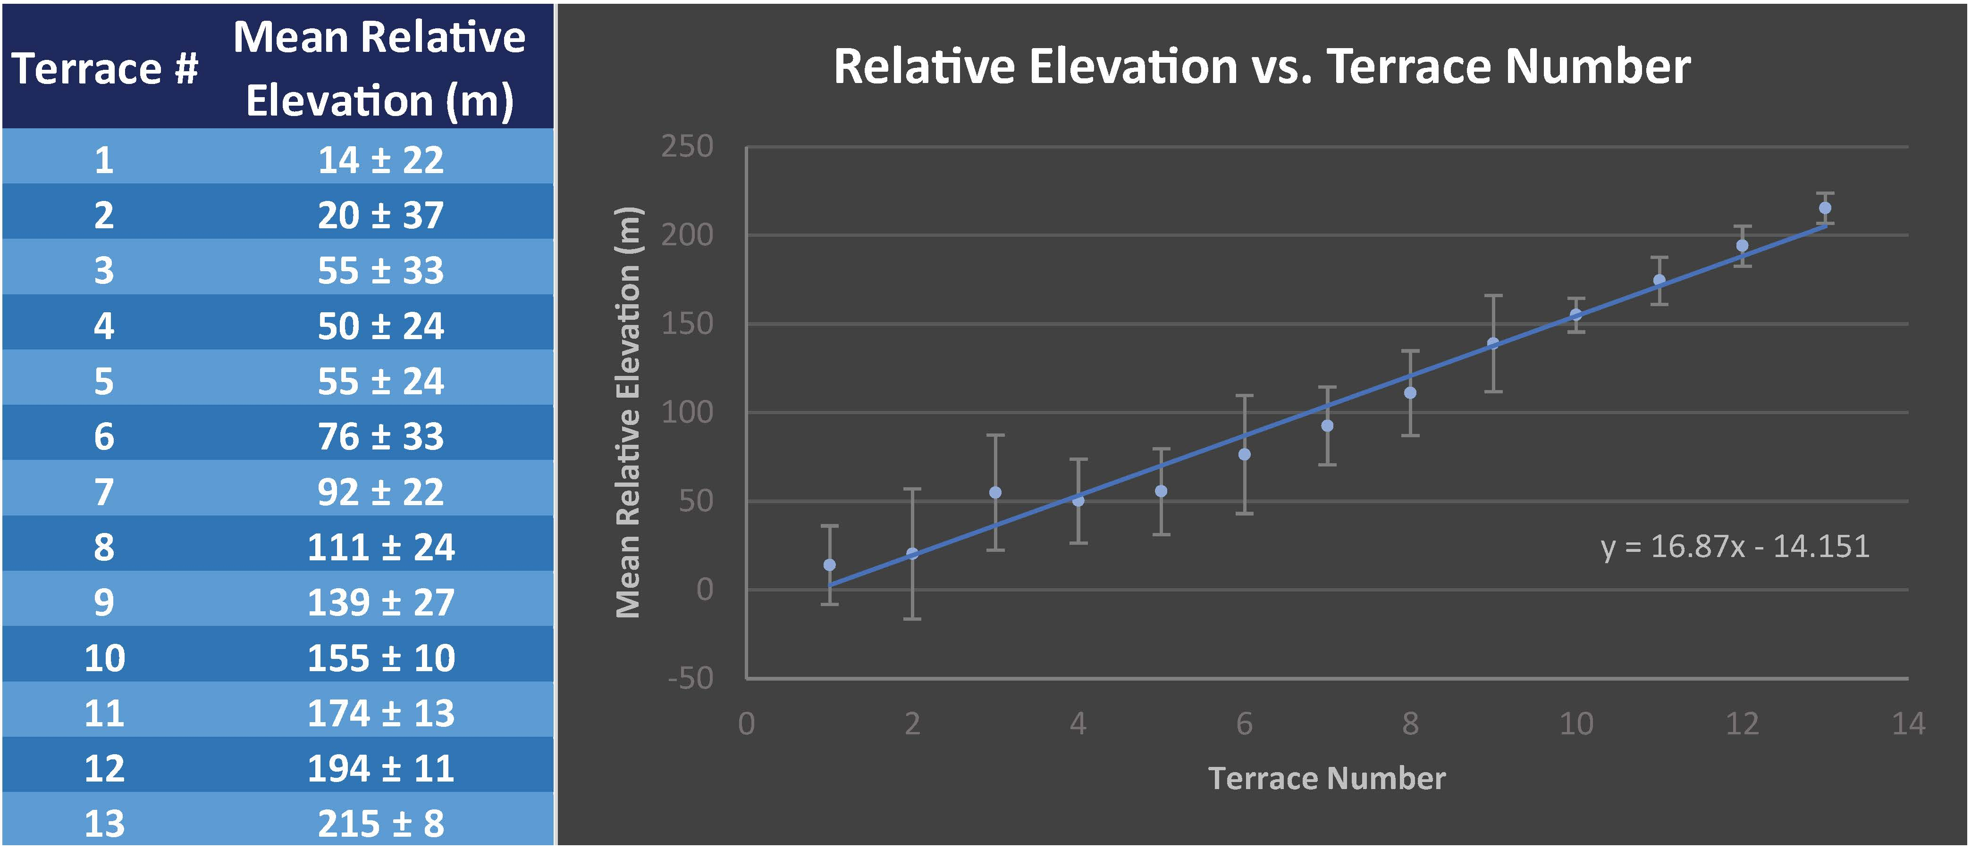
Notes:
Here I plot the terrace relative elevations for each terrace vs. the terrace number. There is still lots of variability and some inversions.
So, I need to get better at characterizing the elevations of these terraces.

Slide 15
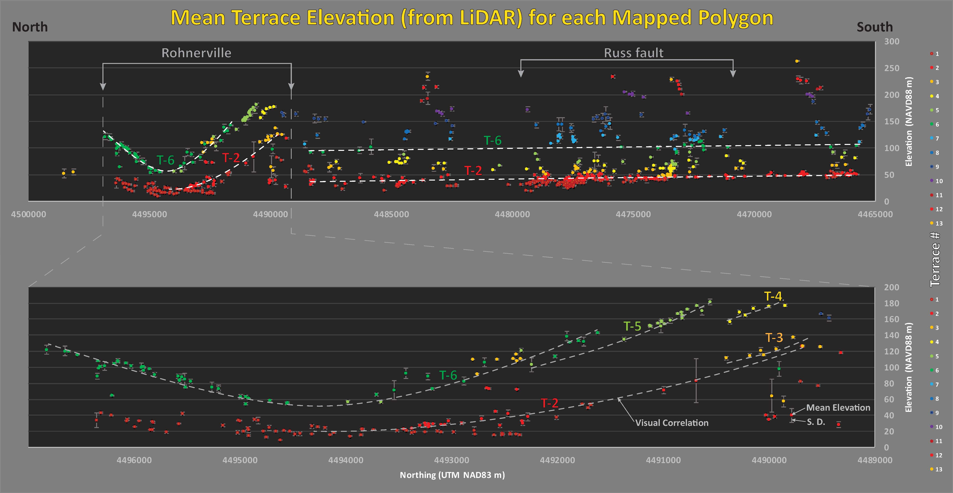
Terrace Profiles - DEM
Notes:
Here are the terrace profiles for most terraces in the region, elevation on the vertical axis and northing on the horizontal axis.
For the Rohnerville area, note the terraces have been warped upwards in a synform. The terrace correlation lines are not parallel, what do you think this may tell us? (syntectonic formation?)
This north-south convergence is likely from north-south compression from the stepwise termination of the San Andreas fault system.

Slide 16
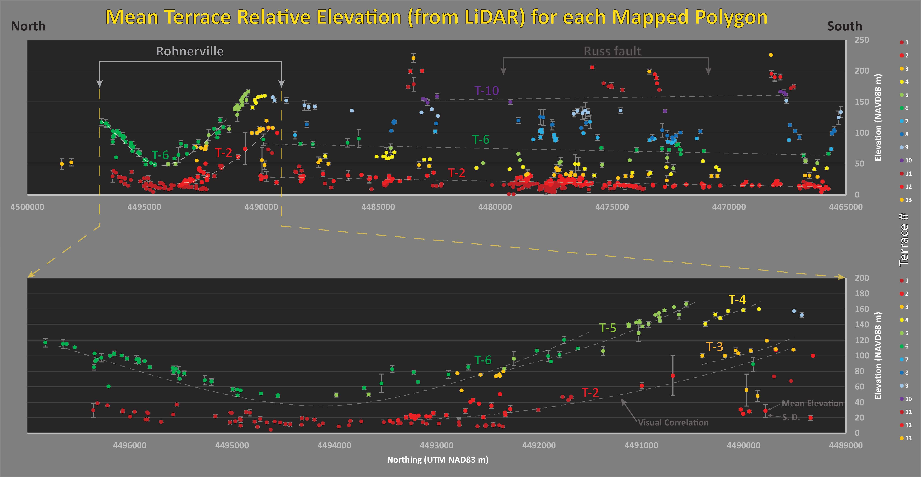
Terrace Profiles - REM
Notes:
Here are the terrace profiles using the REM elevations.
The next step is to better choose representative elevations for each tread. These data points represent mean elevations for entire treads and this needs more work.

Slide 17
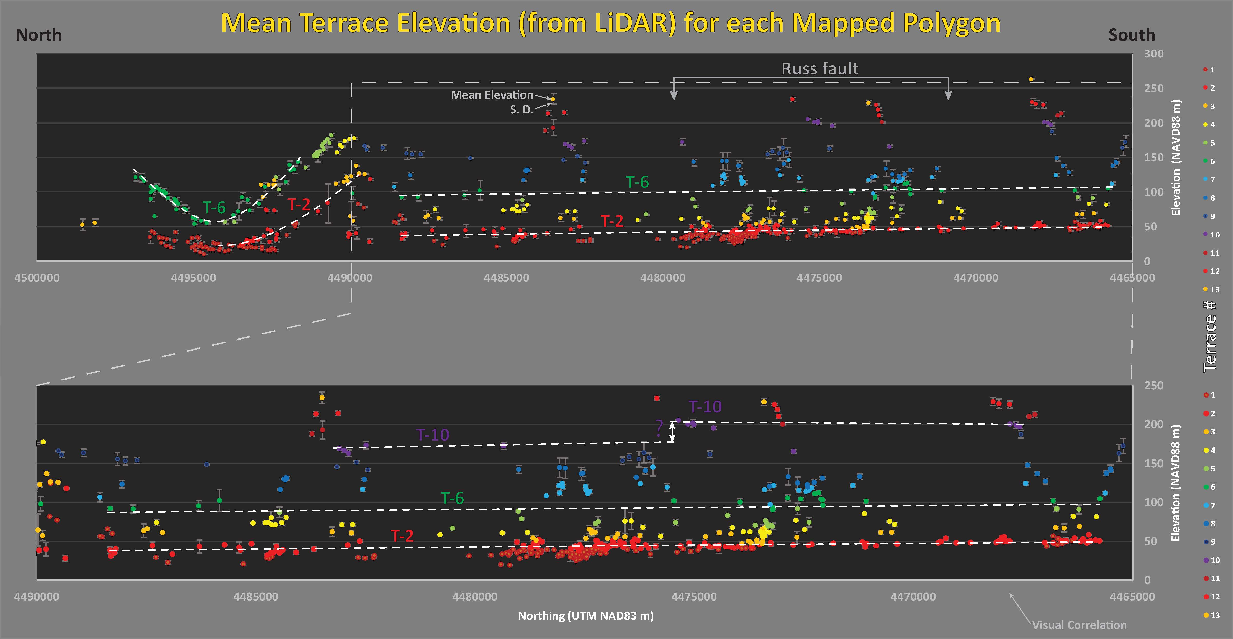
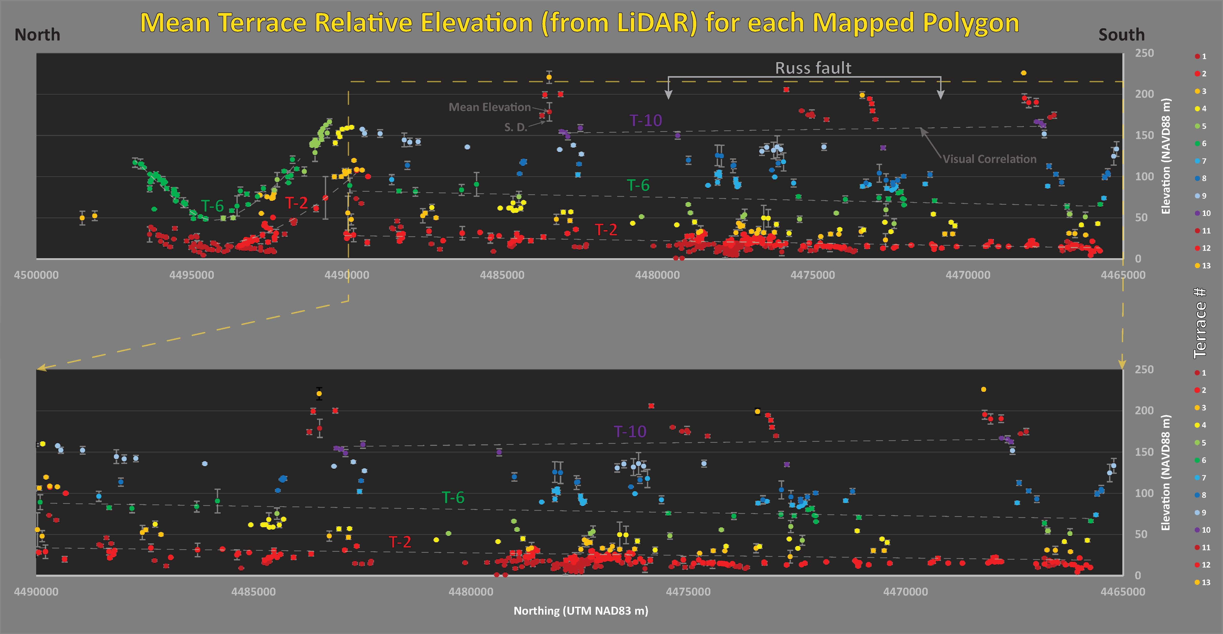
Terrace Profiles - REM
Notes:
Here are the terraces to the south of Rohnerville. There does not appear to be any large scale folding here.

Slide 18
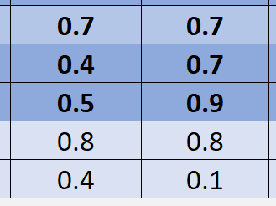
Using a preliminary correlation, I update the slip rates.
Incision Rate
mm/yr
Correlated
Rate mm/yr
T-4
T-7
T-7
Mean
Std D
Notes:
Using two possible correlations with the terraces that have geochron in the Rohnerville area, I calculate slightly different slip rates.
The light blue circles are slip rates using incision rate based ages, while the yellow and green circles are from these correlations.
The mean slip rate over the past 100k years is 0.8 mm/yr.

Slide 19
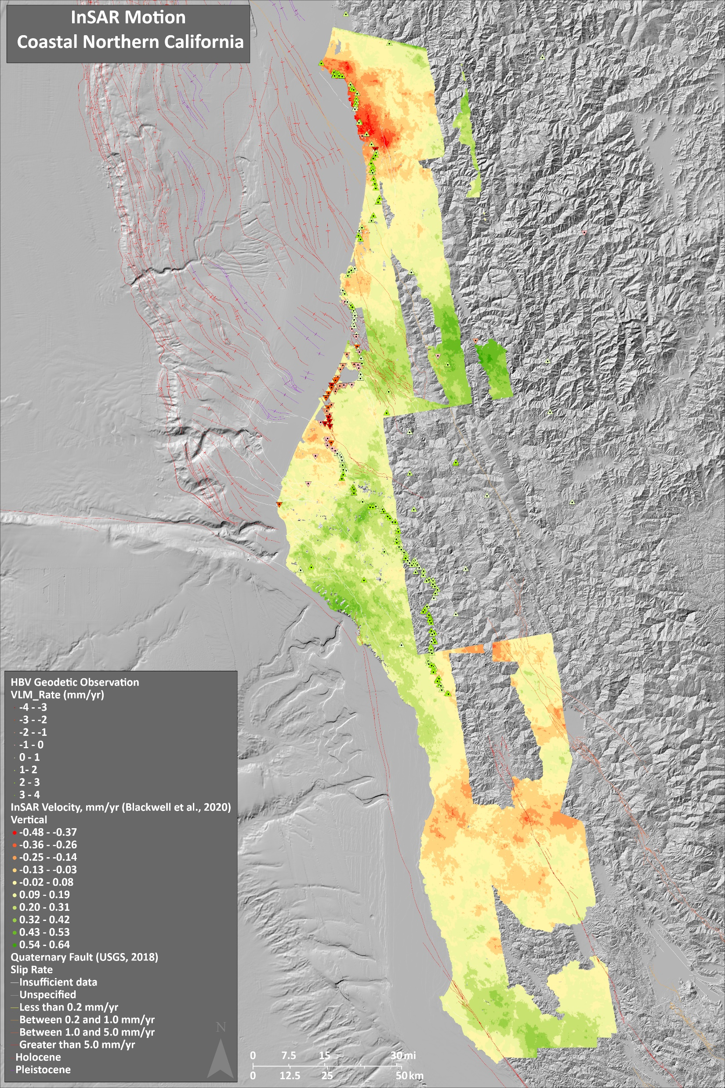
What is Next?
Terraces:
  field mapping and stratigraphy work
  additional geochron analysis
Tectonics:
  fault trenching
Geodesy:
  reviewing Blackwell 2020 InSAR data>>>
  revisit campaign GPS sites from Todd Williams’ work
  install new geodetic transects across mapped faults
California Department of Conservation | tsunami.ca.gov
List of Partners
    California Geological Survey
    California Governor's Office of Emergency Services
    County and City Officials in Humboldt County
    Redwood Coast Tsunami Work Group
    National Weather Service
    Humboldt State University
    University of Southern California
    AECOM
    National Tsunami Hazard Mitigation Program

Slide 20

Thank You!
Are there
any questions?
https://creativecloud.adobe.com/discover/article/moving-pictures-rebecca-mock-has-turned-gifs-into-an-art-form
Jason “Jay” R. Patton Ph.D. PG 9758
Engineering Geologist
Tsunami Unit/CGS Seismic Hazards Program
Jason.Patton@conservation.ca.gov
This animation accompanied an article about an Italian earthquake. Mock based the movements on CCTV footage of a Mexican department store during a quake.
California Department of Conservation | tsunami.ca.gov
List of Partners
    California Geological Survey
    California Governor's Office of Emergency Services
    County and City Officials in Humboldt County
    Redwood Coast Tsunami Work Group
    National Weather Service
    Humboldt State University
    University of Southern California
    AECOM
    National Tsunami Hazard Mitigation Program

