Slide 1
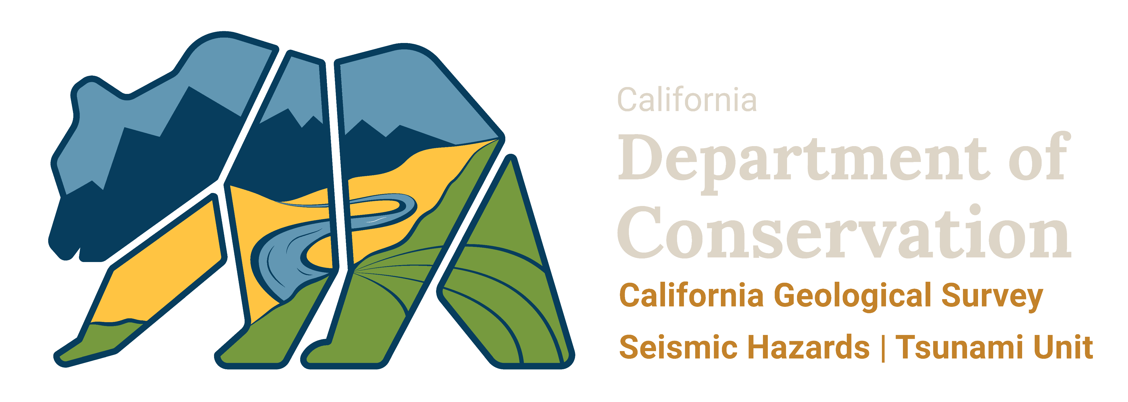
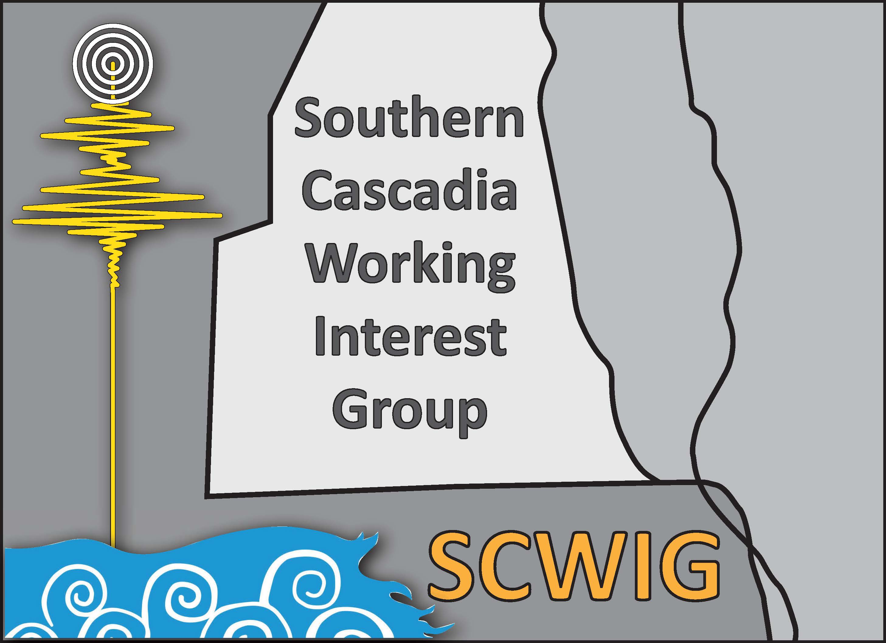


scwig.wordpress.com
Seeking Consensus –
The Southern Cascadia Working Interest Group SCWIG
Jason “Jay” R. Patton – California Geological Survey, Humboldt State University
Lori Dengler – Humboldt State University
Troy Nicolini – NOAA National Weather Service
Rick I. Wilson – California Geological Survey
Geological Society of America Abstracts with Programs. Vol 53, No. 6, 2021
doi: 10.1130/abs/2021AM-366790

Slide 2
The impetus for this workshop:
There is a major difference in how tsunami hazards are treated relative to the state border of California and Oregon. We want to understand these differences.
We need to have some way to justify this to the public and to emergency managers (EMs). EMs need to understand these differences so that they can communicate this difference to the public.
A sub-parallel impetus:
The three states of California, Oregon, and Washington use different methods to evaluate tsunami hazards. There is a need for unified local and distant source models that are anchored by geologic data. There is a need for a unified way to evaluate tsunami hazards (e.g., PTHA).
Notes:
We held a workshop in June 2021. The impetus for the workshop is inspired by the difference in how tsunami hazards are treated relative to the state border of California and Oregon.
We need to have a way to justify these differences to the public. Emergency Managers need to understand these differences so that they can communicate this difference to the public.
Also, the 3 stats use different methods to evaluate tsunami hazards. There is a need for unified local and distant source models anchored by the geologic data. We also need to have a unified way to evaluate tsunami hazards.

Slide 3
We need expert input to determine the parameters that make the southern CSZ unique compared to the subduction zone further to the north.
Is SCSZ different? Why?
Some of these parameters include:
Source (rupture patch, slip distribution, structural controls, etc.)
Factors that may control tsunamigenesis ^^^
Factors that control ground shaking (may affect tsunamigenesis)
Differences in travel time (e.g. Oregon currently includes a 20-minute travel time for a CSZ tsunami, which is much longer that we expect for coastal northern California)
Notes:
We wanted to bring together subject matter experts to determine the parameters that make southern Cascadia different. These parameters may include information about
Sources and constraints that control earthquakes, especially when it comes to tsunamigenesis. Also, factors that may control ground shaking. Also, differences in travel time to the coast.

Slide 4

The purpose of this workshop (in the form of questions)
What does the southern CSZ look like?
How does it behave through time?
How might this affect tsunamigenesis?
Are there differences in tsunamigenesis within the southern CSZ near the border of CA and OR?
What consensus statements can be made to help tsunami communication across state lines?
Notes:
The purpose for this initial workshop, in the form of questions, include:
What does southern Cascadia look like?
How does it behave through time?
How might this affect tsunamigenesis?
Are there actual differences in tsunamigenesis within southern Cascadia near the state border?
Finally, what consensus statements can be made to help tsunami communication across state lines?

Slide 5

What we have done so far:
We held the first two-day virtual workshop
What we plan on doing:
We will put together a white paper summarizing the results of this workshop, focusing on a review of supporting material for a consensus statement about southern Cascadia.
Notes:
We held a 2 day virtual workshop.
We will prepare a white paper summarizing the results of this workshop, focusing on supporting material for a consensus statement for southern Cascadia.

Slide 6
Invitees (not all were able to attend)
John Allen (State of Oregon Department of Geology and Mineral Industries)
Tom Brocher (USGS Menlo Park)
Reed Burgette (New Mexico State University)
Rui Chen (CGS)
Jason Chaytor (USGS Woods Hole)
Art Frankel (USGS)
Chris Goldfinger (Oregon State University)
Sean Gulick (University of Texas)
Eileen Hemphill-Haley (Humboldt State University, Department of Geology)
Mark Hemphill-Haley (Humboldt State University, Department of Geology)
Peggy Hellweg (operations manager for the Berkeley Seismological Laboratory)
Jenna Hill (USGS Santa Cruz)
Harvey Kelsey (Humboldt State University)
Patrick Lynett (USC)
Jefferey McGuire (USGS)
Bob McPherson (Humboldt State University retired)
Alan Nelson (USGS)
Nora Nieminski (USGS)
Mark Petersen (USGS)
George Priest (State of Oregon Department of Geology and Mineral Industries)
Stephanie Ross (USGS)
Hong Kie Thio (AECOM)
Anne Trehu (Oregon State University
Kelin Wang (Geological Survey of Canada)
Janet Watt (USGS Santa Cruz)
Ray Weldon (University of Oregon)
Doug Wilson (U.C. Santa Barbara)
Rob Witter (USGS Anchorage)
Notes:
Here is the long list of invitees, though not everyone was able to attend.

Slide 7

Southern Cascadia Working Interest Group – SCWIG
… Workshop to focus on the state of knowledge for earthquake sources, tsunami hazard, and tsunami risk in southern Cascadia.
Day 1: Tectonic Differences
Planning Committee:
Rick Wilson – California Geological Survey
Troy Nicolini – NOAA National Weather Service
Lori Dengler – Humboldt State University
Jason “Jay” R. Patton – California Geological Survey
Notes:
For the first day of the workshop, we reviewed the literature and discussed the tectonic differences in southern Cascadia.
We prepared a draft consensus statement.

Slide 8

Southern Cascadia Working Interest Group – SCWIG
… Workshop to focus on the state of knowledge for earthquake sources, tsunami hazard, and tsunami risk in southern Cascadia.
Day 2: Tsunami Risk
Planning Committee:
Rick Wilson – California Geological Survey
Troy Nicolini – NOAA National Weather Service
Lori Dengler – Humboldt State University
Jason “Jay” R. Patton – California Geological Survey
Notes:
For the second day, we reviewed our draft consensus statement and focused on the differences in tsunami risk assessment across the sate line.

Slide 9
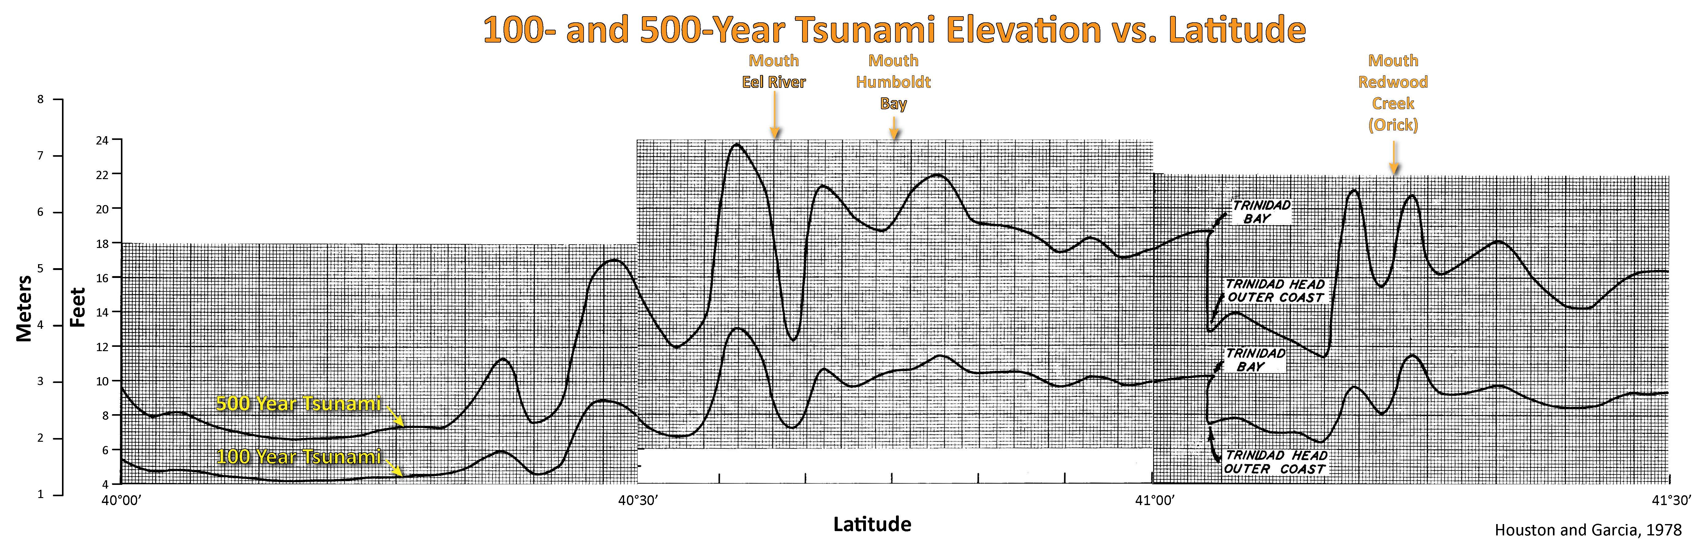
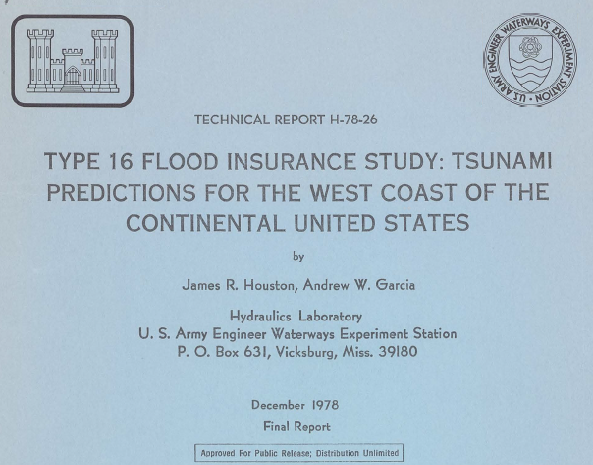
prepared for flood insurance rate calculations
based on historic distant tsunami wave data (1900-1977)
relative to MSL
incorporates astronomical tides (effect = ~0.5 ft/0.3048m)
Model Resolution = 2 miles (3.2 km)
Notes:
First I reviewed the history of tsunami modeling for northern California. This was the first attempt, published in 1978. Cascadia was not included, and the model resolution was quite coarse at 3.2 km.
The grids had square grid cells 2 miles on a side.
7. The purpose of this study was to establish 100— and 500—year tsunami runup elevations on the west coast of the continental United States produced by distantly generated tsunamis. Two earlier reports established these runup elevations for Southern California, Monterey Bay, San Francisco Bay, and Puget Sound. The 100— and 500-year tsunami runup elevations are required by the Federal Insurance Administration (FIA) of the Department of Housing and Urban Development for use in flood insurance rate calculations.

Slide 10
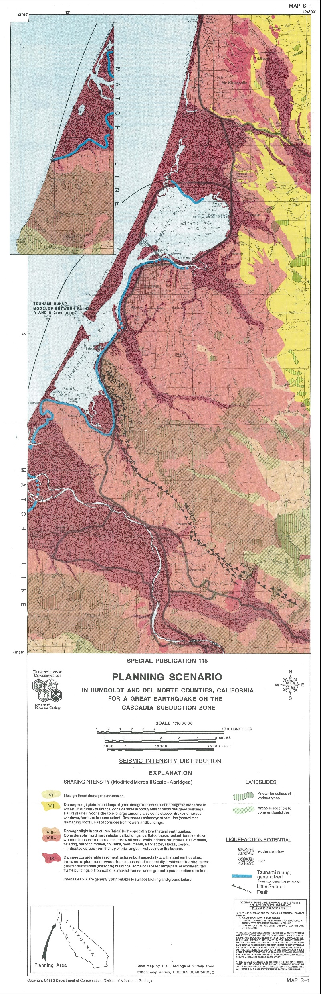
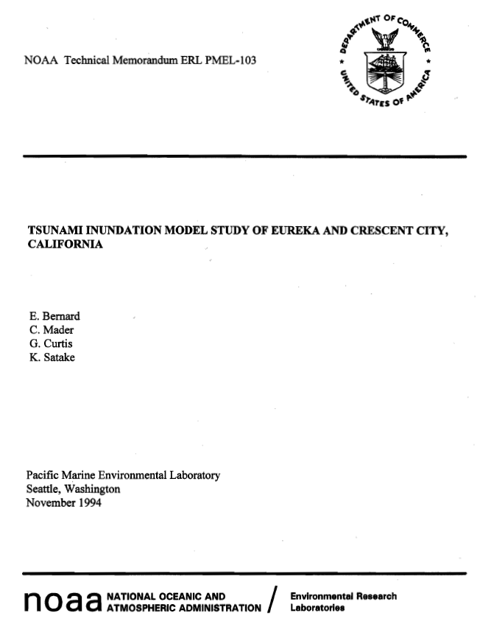
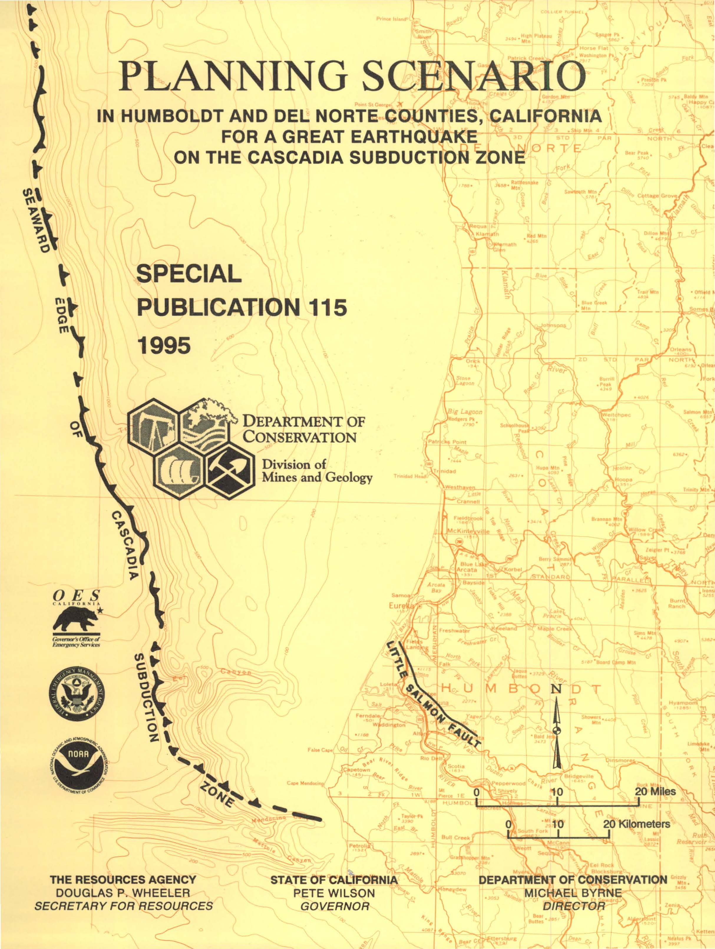
Bernard et al., 1994
Model Resolution = 1,600 m
Notes:
Following the 1992 M 7.2 Cape Mendocino Earthquake, which highlighted the nascent knowledge that Cascadia could produce earthquakes and tsunami, CDM&G, NOAA, and FEMA worked together on a planning scenario for earthquake and tsunami hazards associated with Cascadia. The study stopped at the stateline, so the earthquake magnitude was limited. Also, the model resolution was still coarse at 1.6 km.
On May 9, 1992, the Federal Emergency Management Agency (FEMA) hosted an after-action discussion meeting with the scientific community at the Presidio of San Francisco, California. From these discussions, eight recommendations were formulated, including one to produce tsunami inundation maps for northern California. The tsunami inundation study was ranked number two of the eight and was identified as time-sensitive. NOAA responded to this recommendation by offering to cost-share the study with FEMA and transmitted a proposal to FEMA on August 24, 1992. On December 22, 1992, FEMA decided to fund the project, and funds were delivered to NOAA on May 5, 1993. The project was completed on May 4, 1994, with this report representing a summary of the study.
FEMA also funded the California Office of Emergency Services to examine other effects of a larger Cascadia Subduction Zone earthquake-such as' ground shaking, liquefaction, and landslides. A report entitled "Planning Scenario in Humboldt and Del Norte Counties for a Great Earthquake on the Cascadia Subduction Zone" by Toppozada et al. includes hazards maps for emergency planning purposes. This tsunami study was coordinated with the earthquake study through discussions and meetings between Eddie Bernard and Tousson Toppozada of the California Division of Mines and Geology. The tsunami effects described in the Toppozada et al. report were based on the tsunami inundation maps described in this report.

Slide 11
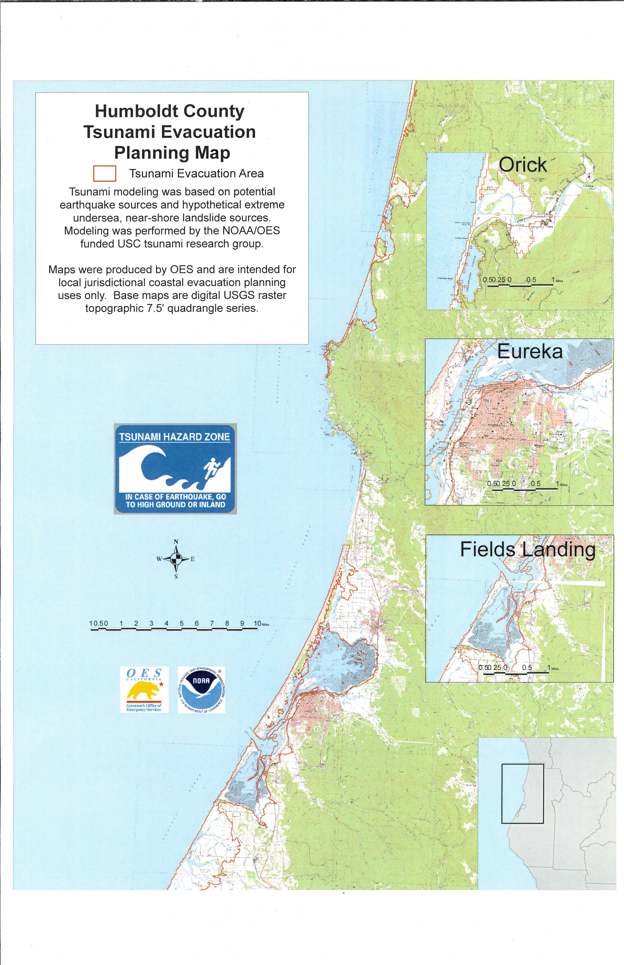
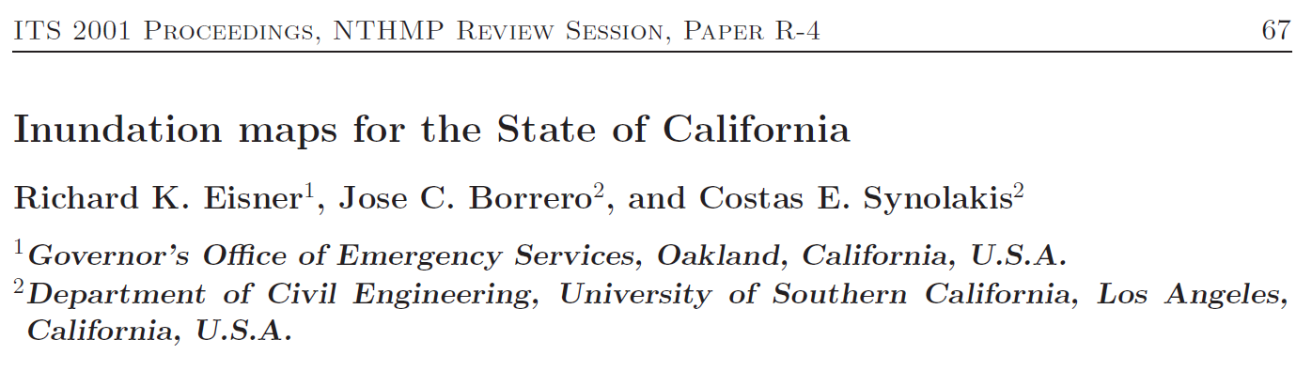
Humboldt Bay
Tsunami Inundation
The maps do not represent the inundation from any particular event or characteristic earthquake, but the best estimate of the modelers for the largest inundation height within a given region.
Model Resolution = 125 m
Following the 1992 Cape Mendocino Earthquake and almost a dozen tsunamigenic earthquakes in the Pacific from 1992-1999, CalOES and USC prepared deterministic tsunami inundation models for select locations around the state (Eisner et al., 2001).
Notes:
Shortly after that, CalOES and USC worked together for deterministic modeling, still with a coarse resolution.

Slide 12
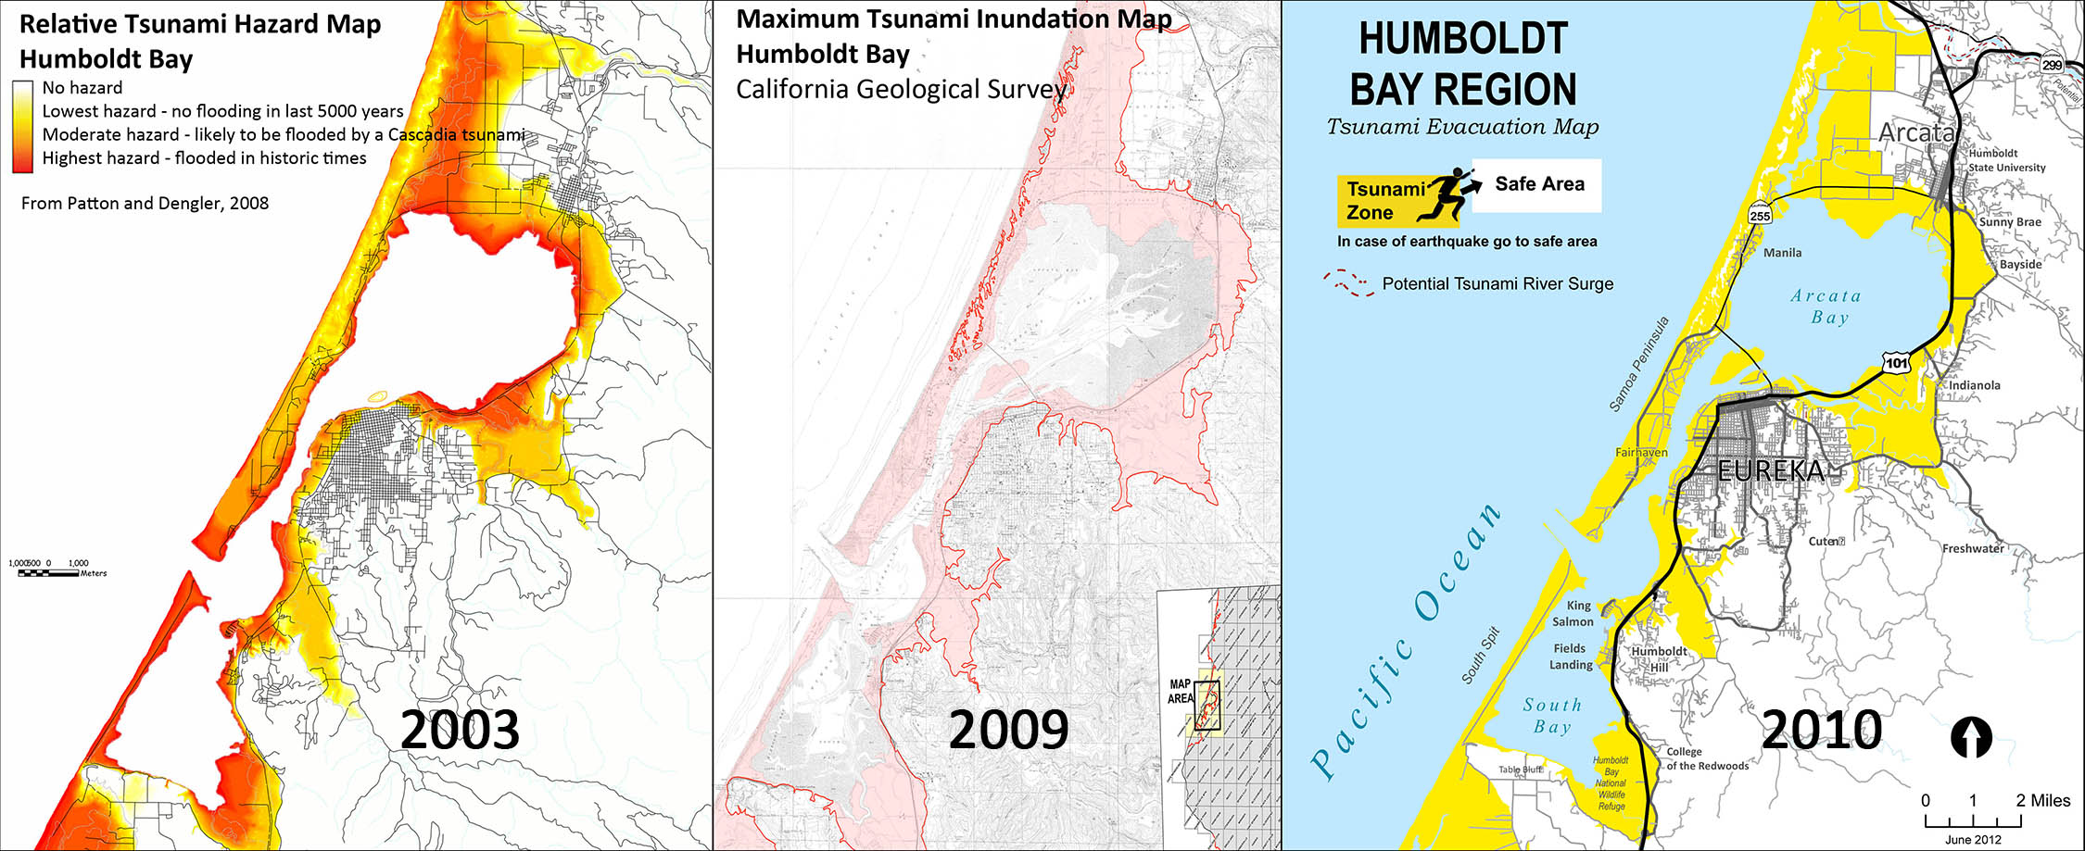
Humboldt Bay Tsunami Hazard – Map History
2006
2009
2010
Polynomial regression:
elevation
distance to coast
Numerical Modeling (90/30m):
local sources
distant sources
Evacuation Interpretation:
extend from inundation area to easily identifiable geographic features
Notes:
In 2003 Lori Dengler, an HSU geography student, and I started working on a relative tsunami hazard model. I developed a model for local and distant tsunami hazards based on regression of elevation and distance to the coast.
In 2009 CGS worked with Cal OES to prepare the first statewide deterministic tsunami inundation maps for planning purposes.
The following year, the Redwood Coast Tsunami Work Group prepared the first tsunami evacuation maps.

Slide 13
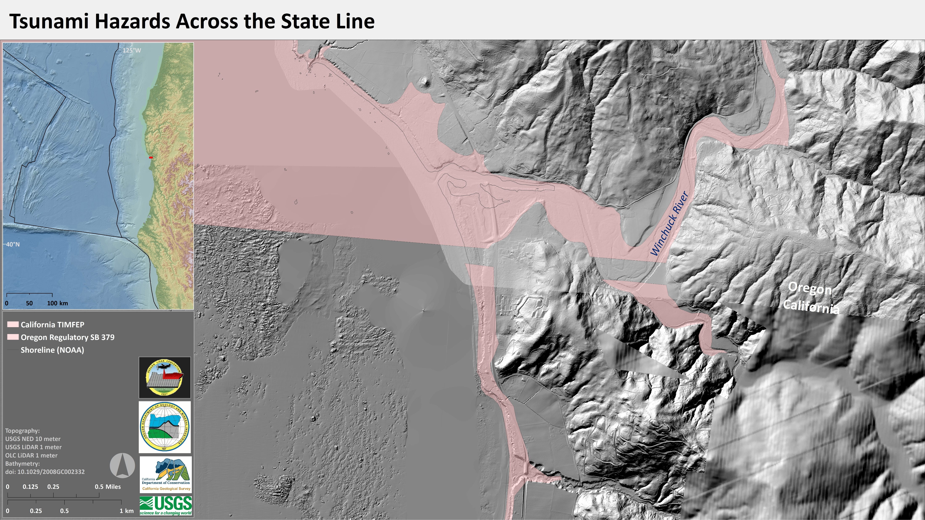
We all care about tsunami and the hazards that they pose upon society.
Previous Deterministic Tsunami Inundation Maps
Notes:
I then reviewed the previous deterministic tsunami inundation model maps at the stateline.
Both versions were subjective interpretations of potential tsunami inundation across the landscape.

Slide 14
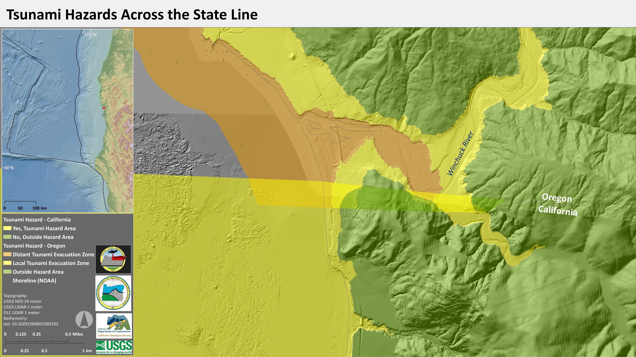
We all care about tsunami and the hazards that they pose upon society.
Existing Tsunami Evacuation/Hazard Maps
Notes:
Finally, I presented a comparison of the existing tsunami hazard maps from Oregon and California.
Based on colors used by Oregon and Washington, California represents the tsunami hazard area in yellow and the save area in green. This is based on the 975 PTHA tsunami modeling from AECOM. So, basically the 1000-year tsunami.
Oregon subdivides the hazard area into local and distant sources. The local Cascadia source is based on their XXL t-shirt size, a longer return period compared to California mapping. The M sized tsunami matches the California mapping.
We want to emphasize that there is no correct answer about the level of hazard to use. This is purely subjective and largely based on hazard levels also subjectively chosen for other hazards.

Slide 15
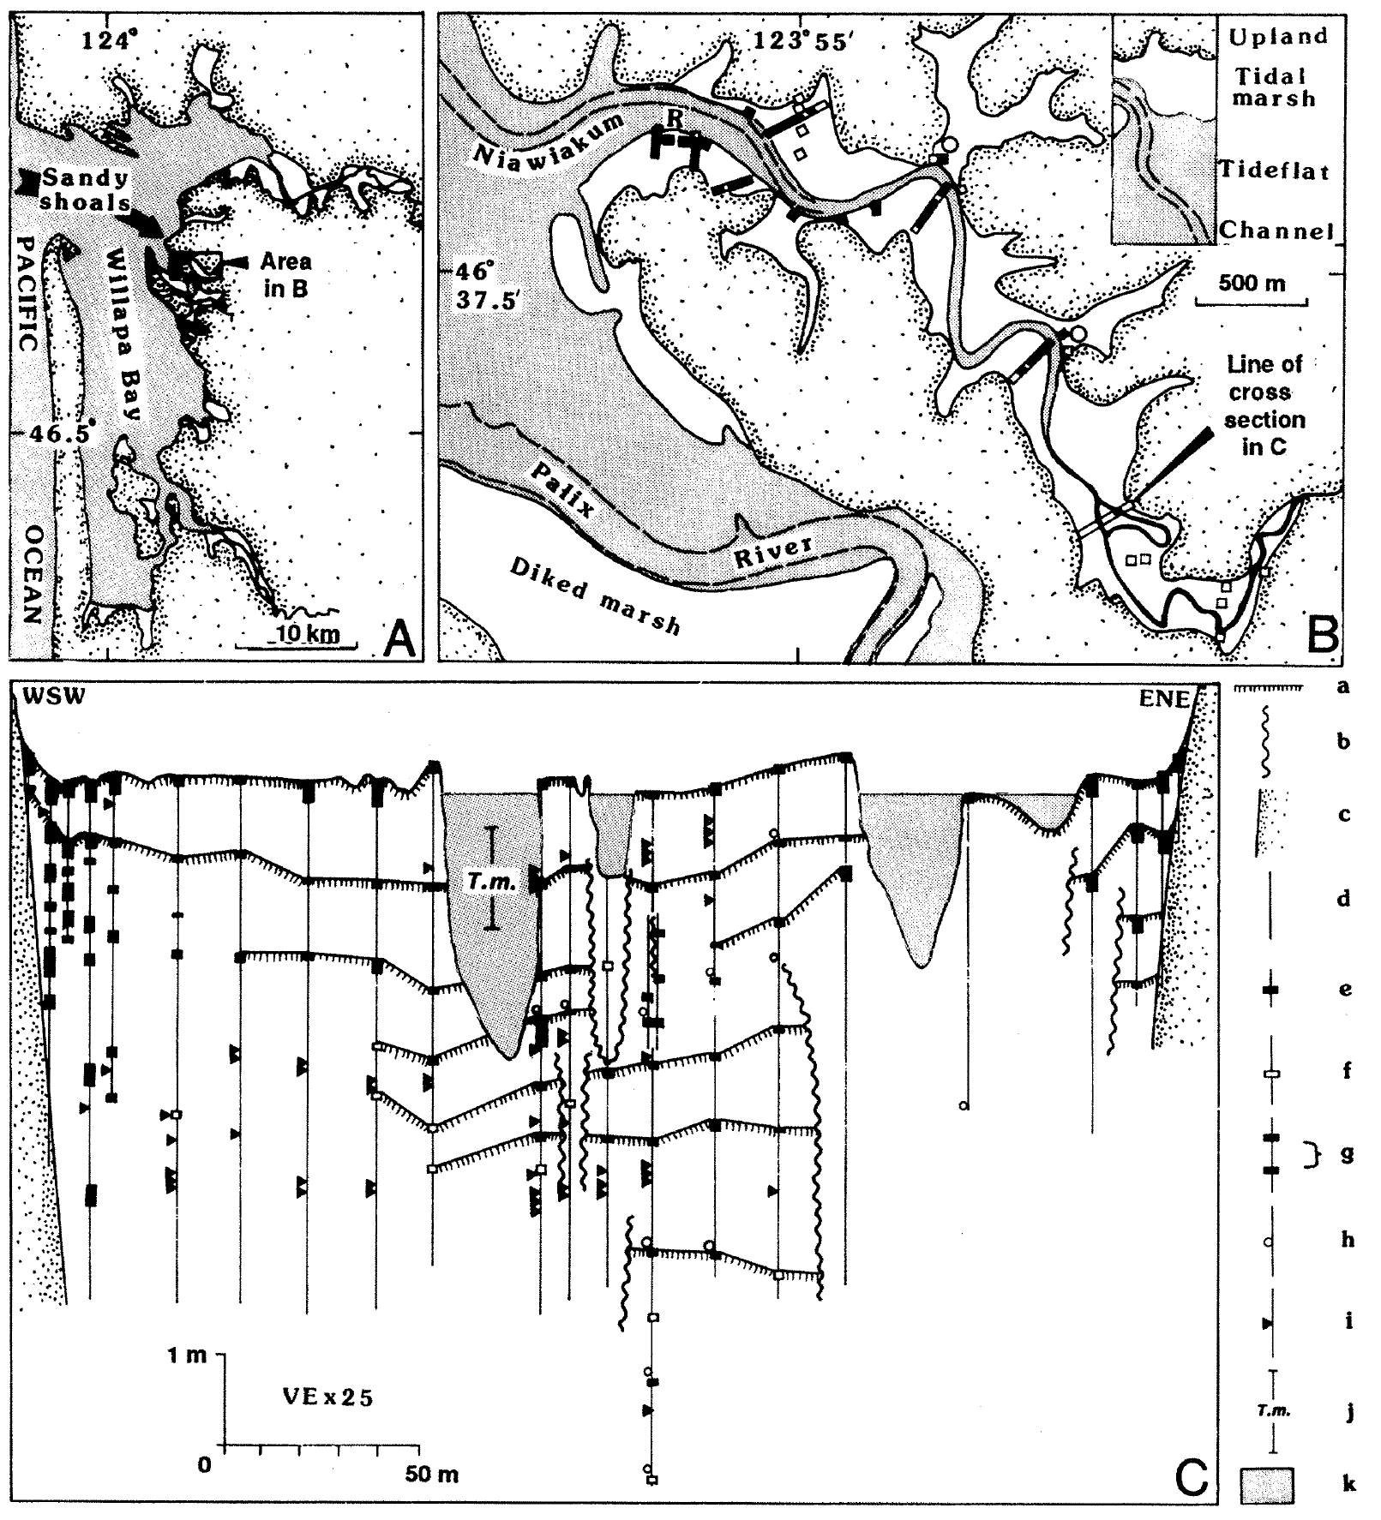
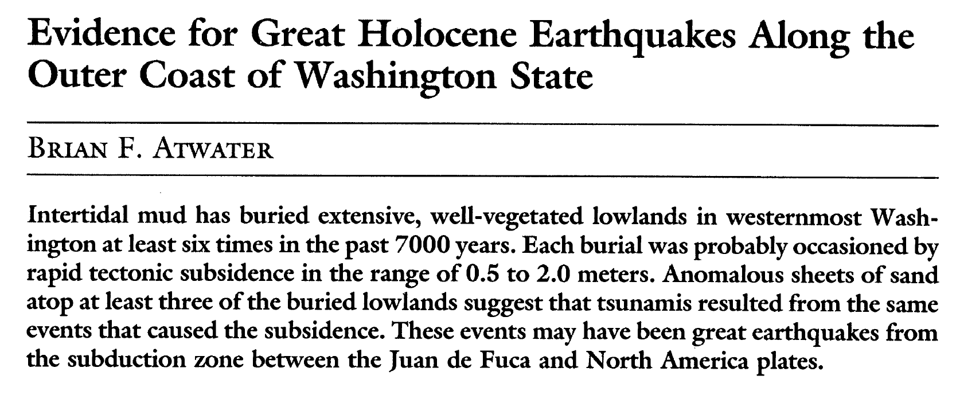
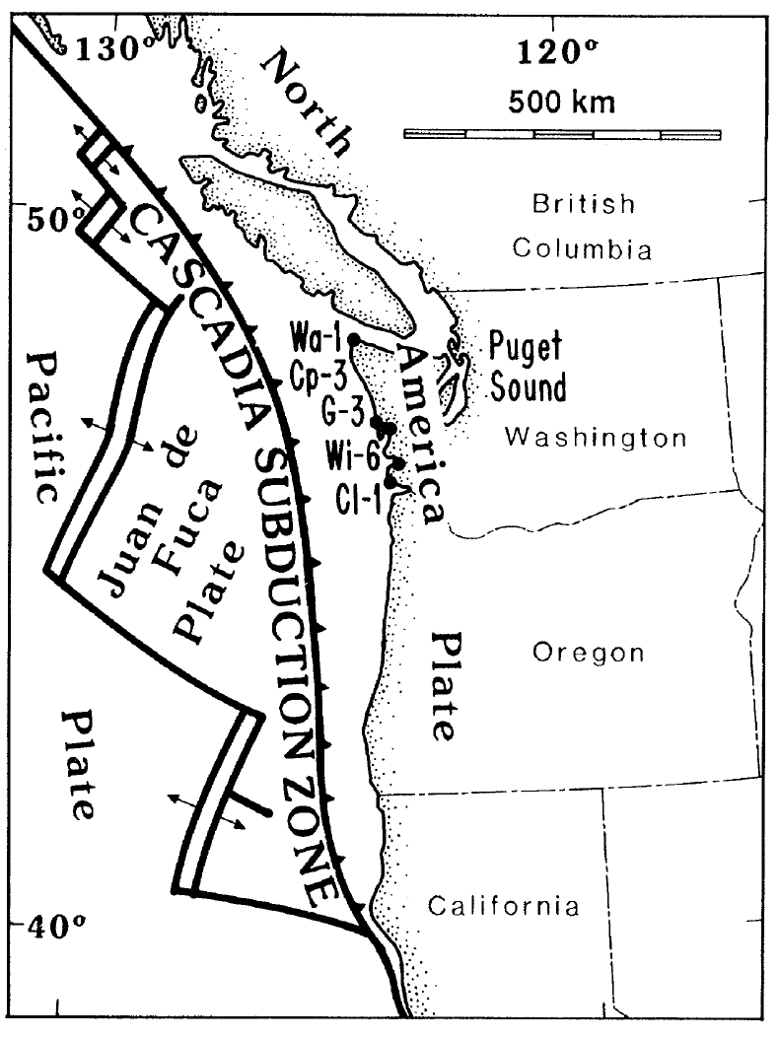
(1987)
This was the first geologic record of prehistoric earthquakes in Cascadia, published by Brian Atwater, 1987.
Prior to this publication, there was still debate about Cascadia: was it capable of producing subduction zone earthquakes or was the fault “aseismically” slipping?
Earthquake Buried Soils
Notes:
We reviewed Brian Atwater’s 1987 seminal paper, the first paper to present paleoseismic evidence that Cascadia could produce earthquakes via sedimentary evidence for coseismic subsidence in coastal Washington.
As I mentioned, as late as the 1980s (even in to the 90s), there was considerable debate about the potential for the CSZ to generate large earthquakes. There was strong evidence on both sides of this debate.
In 1987 Dr. Brian Atwater published his seminal paper where he presented the secondary evidence for prehistoric CSZ earthquakes in the form of earthquake buried soils.
The lower right figure shows a profile across a series of his cores and streambank exposure mapping. The black horizontal lines represent how he correlated these buried soils across the area.
Subduction zone paleoseismology is fundamentally based on these types of correlations and inferences.

Slide 16
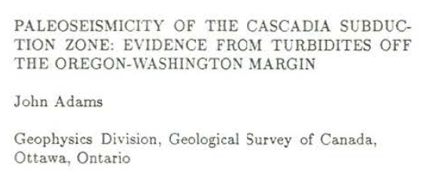
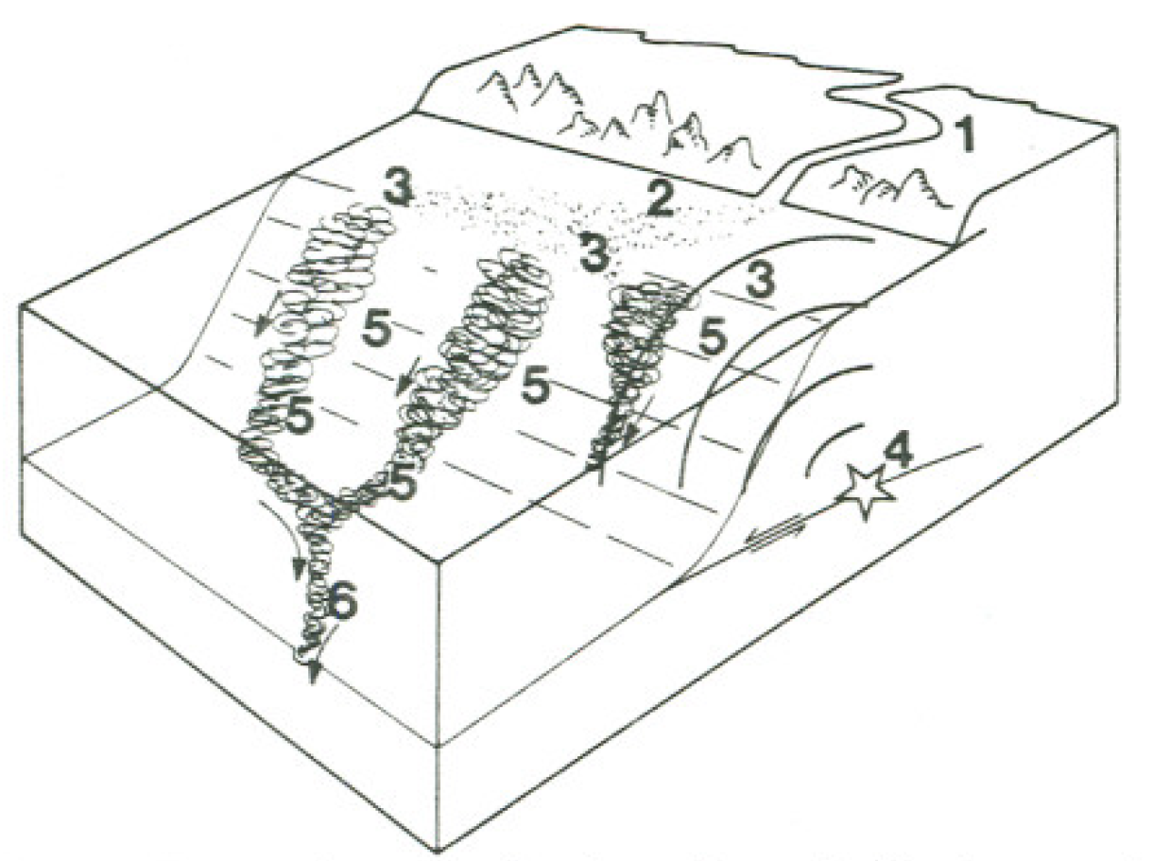
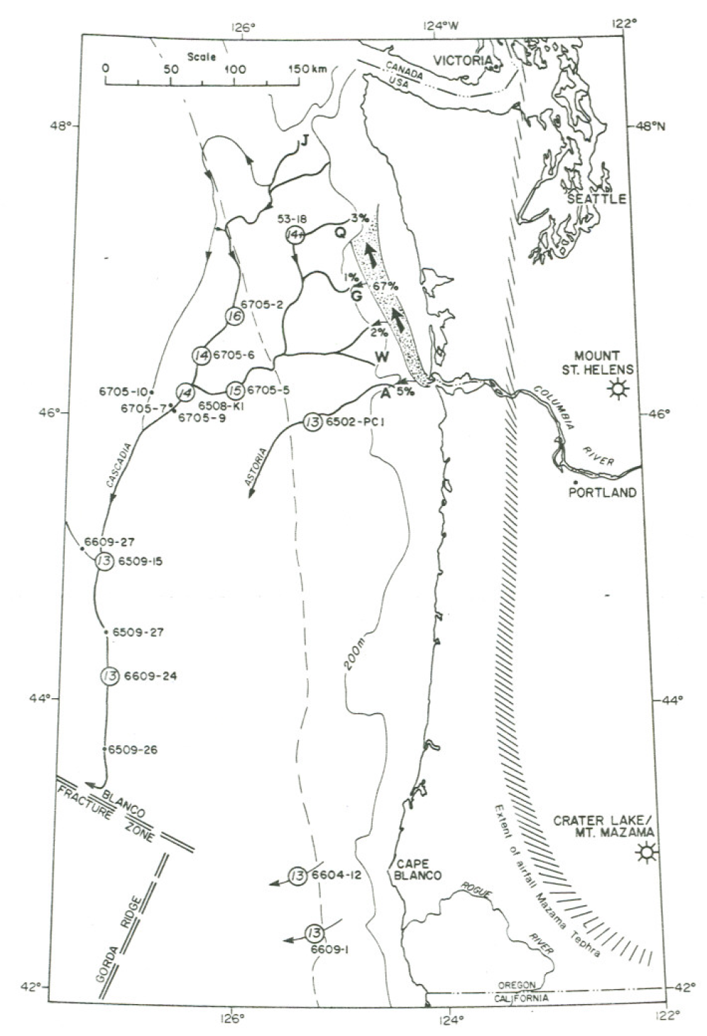
Adams: 1960s Turbidites
Confluence test: highest age precision (minutes to hours), low age accuracy (decades)
(1990)
TECTONICS. VOL. 9. No. 10. PAGES 569-583. August 1990
Early Researchers relied on counting turbidites above or below a stratigraphic datum (layer). Some still do this, but there are better methods now.
In this case, Adams used turbidite counts above the Mazama Ash (deposited following the eruption forming Crater Lake, Oregon ~7,300 years ago).
Adams devised the “confluence test.”
First, we count the turbidites above and below channel confluences.
Because we know these turbidites were deposited during a short time (hours), if there are the same number of deposits above and below the confluence, then that tells us that the turbidites in the different channels upstream of the confluence, are from the same source (triggering) mechanism. IF there were more turbidites below the confluence, then the deposits upstream would have been from different sources.
Adams found that, in most cores, there were 13 turbidites above the Mazama Ash, both above and below channel confluences.
Notes:
3 years after Atwater’s paper, Dr. John Adams published his interpretation of an earthquake history offshore of Cascadia. Adams used a rudimentary approach, by counting the number of turbidites above a stratigraphic datum (a layer of known identity, found in all the cores). In this case it was the Mazama ash, deposited following the eruption that formed Crater Lake, Oregon, about 7,300 years ago.
We would eventually learn that this method is the most precise method of all paleoseismic methods (precision of minutes to hours), yet it still has a low accuracy due to radiocarbon uncertainty (decades).
Adams based his interpretation on a powerful tool called the confluence test, which looks at deposits from submarine channels upstream and downstream of a confluence for these channels.
First, we count the turbidites in cores from above and below channel confluences.
Because we know these turbidites were deposited during a short time (hours), if there are the same number of deposits in each core, above and below the confluence, then that tells us that the turbidites in the different channels upstream of the confluence, are from the same source (triggering) mechanism. As for age control, the confluence test provides possibly the highest precision of any age control method, yet has considerably low accuracy as the absolute age is based on radiocarbon (or other numerical age), with uncertainty of decades to centuries.
IF there were more turbidites below the confluence, then the deposits upstream would have been from different sources.
Adams found that, in most cores, there were 13 turbidites above the Mazama Ash, both above and below channel confluences.
And, because these channels were sourced from a very large area, we can interpret an earthquake to be the triggering source because earthquakes are one of the few mechanisms that can act across such a large area over a period of minutes to hours.
Fig. 1. Map of the Oregon-Washington margin showing the extent of the air-faII Mazama tephra [Fryxell, 1965], the pattern of sediment dispersal north from the Columbia River (with amounts of sediment as percentage of the river input, after Sternberg [1986]), canyons on the Washington continental slope (J, Juan de Fuca, Q, Quinault, G, Grays, W, Willapa, and A, Astoria), submarine channels leading to the deep-sea floor, the location of cores mentioned (all from Oregon State University except core 53-18 which is University of Washington), and (within large circles) the number of post-Mazama turbidites as discussed in the text. The base of the continental slope ( dashed line) and the 200-m isobath, marking the edge of the shell, are also shown.
Fig. 2. Perspective view showing schematically the genesis of turbidity currents in the Cascadia Channel. Sediment is carried down the Columbia River (1), drifts north along the shelf (2), and accumulates at the top of the continental slope in the heads of deep-sea canyons (3). According to the hypothesis presented in this paper, a great thrust earthquake on the subduction zone (4) causes strong shaking of the shelf and slope. The shaking causes sediment liquefaction and slumping simultaneously at many places along the margin. The resultant massive under-sea debris flows mix with the water to become a series of turbidity currents travelling synchronously down the channels ( 5). At junctions, the tributary turbidity currents coalesce to travel down the Cascadia Channel as one large turbidity current (6).

Slide 17
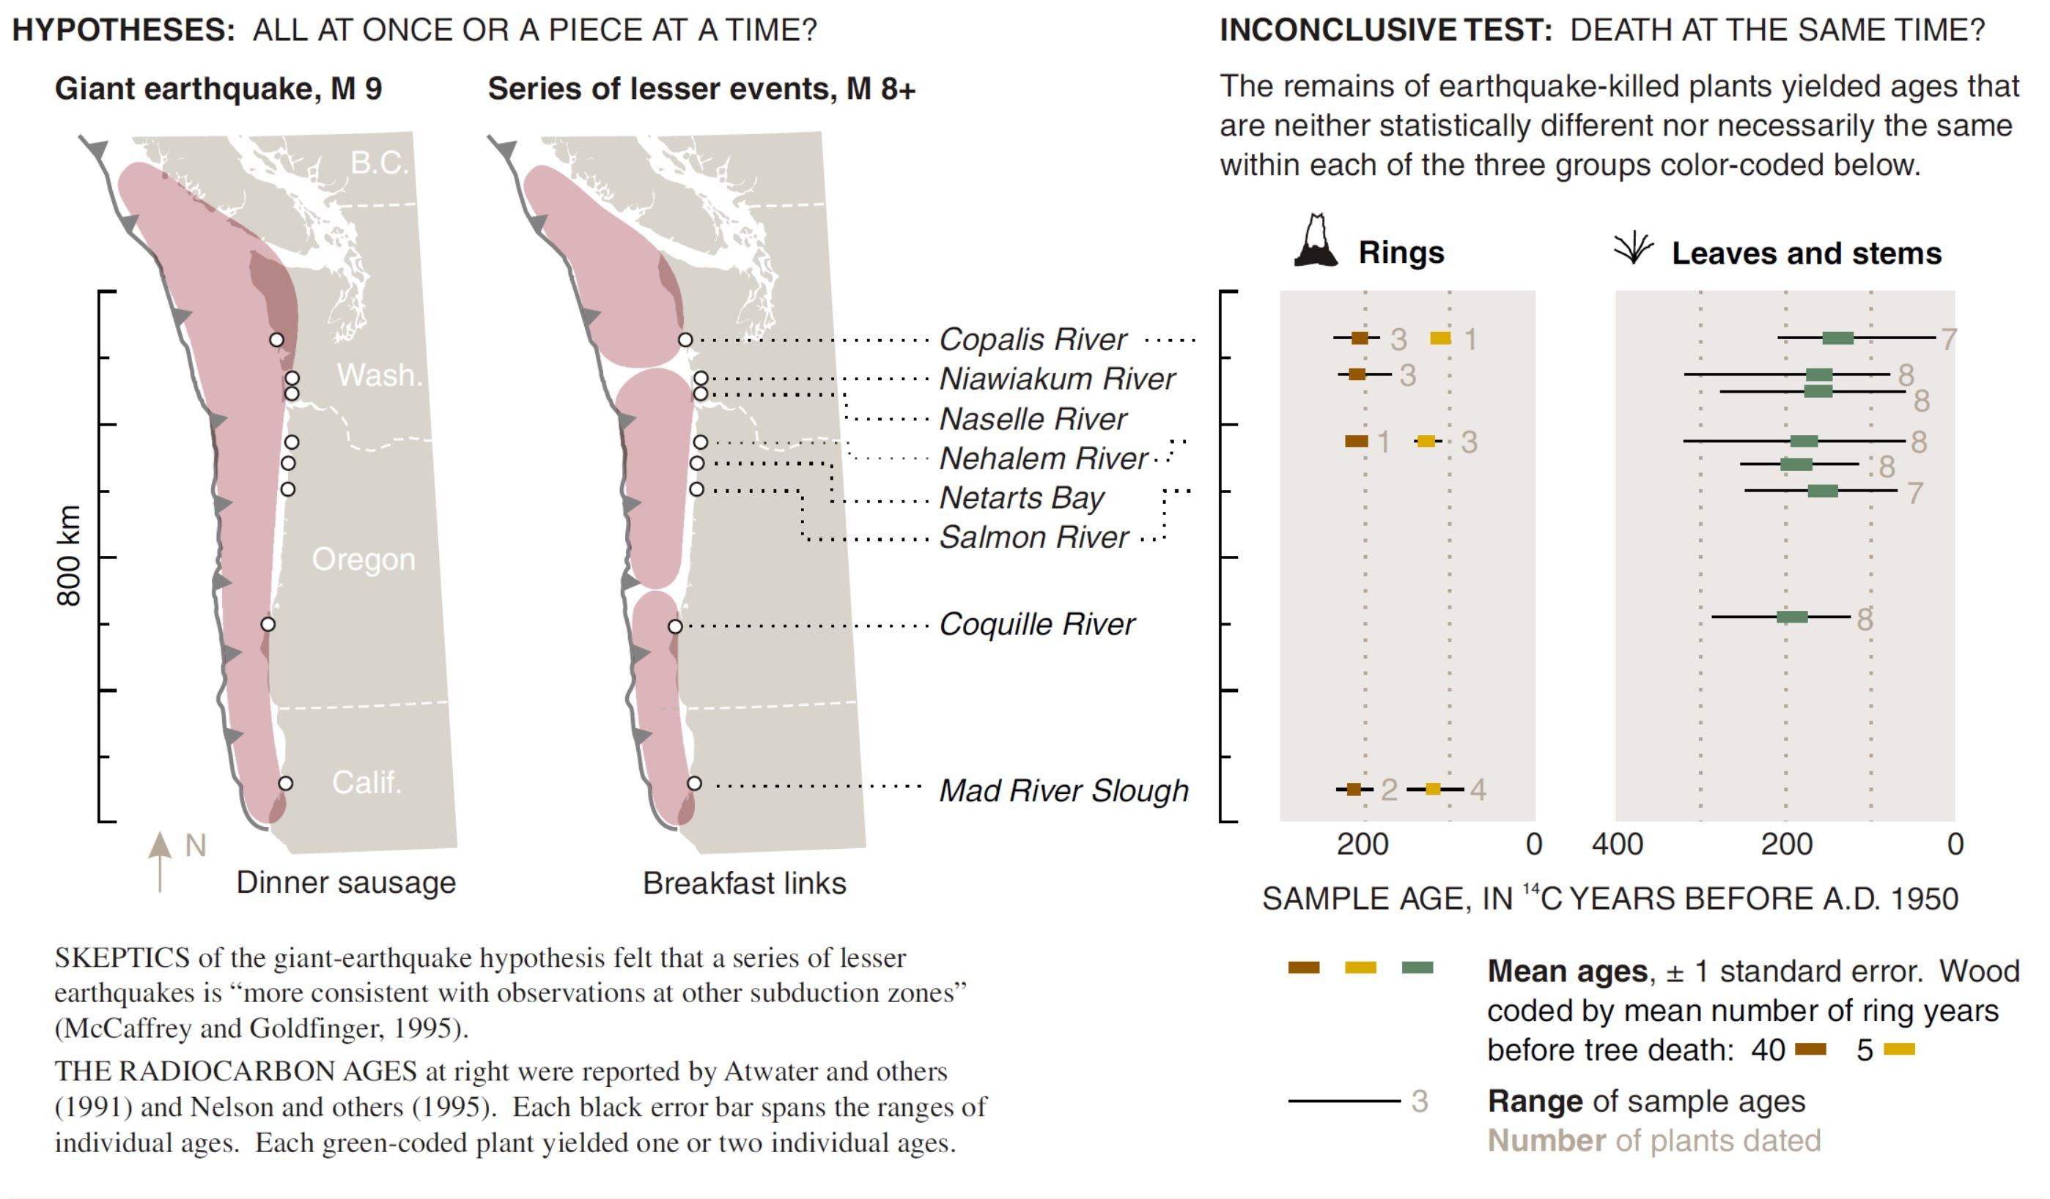
Atwater: Breakfast Links or Dinner Sausage?
Dinner Sausage
Dinner Sausage
Breakfast Links
Atwater et al., 2005
Notes:
Then we reviewed the literature about how the Cascadia earthquake source has evolved through time.
Based solely on land records of coseismic subsidence, which cannot be directly correlated, we got the Dinner Sausage or Breakfast Link debate.

Slide 18
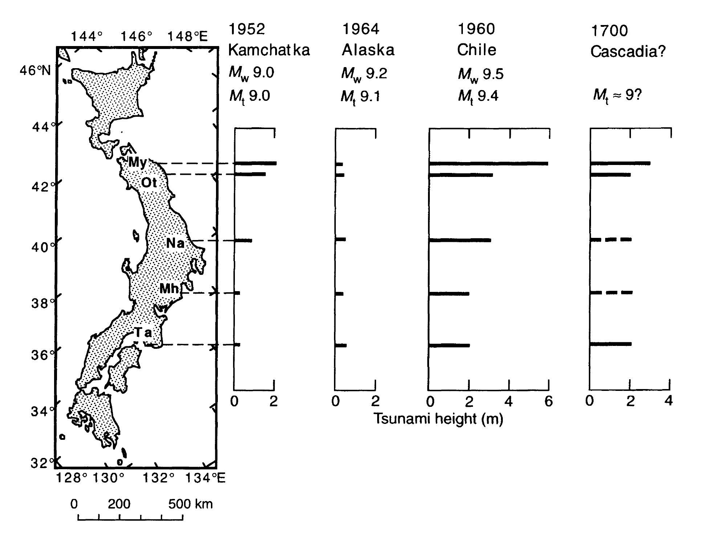
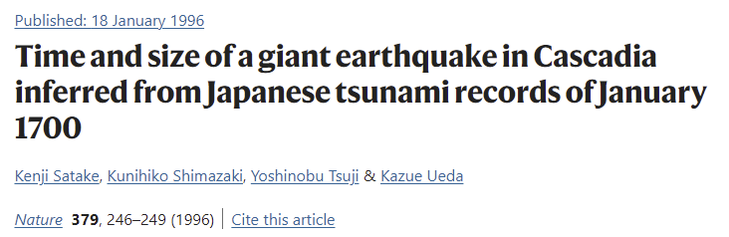
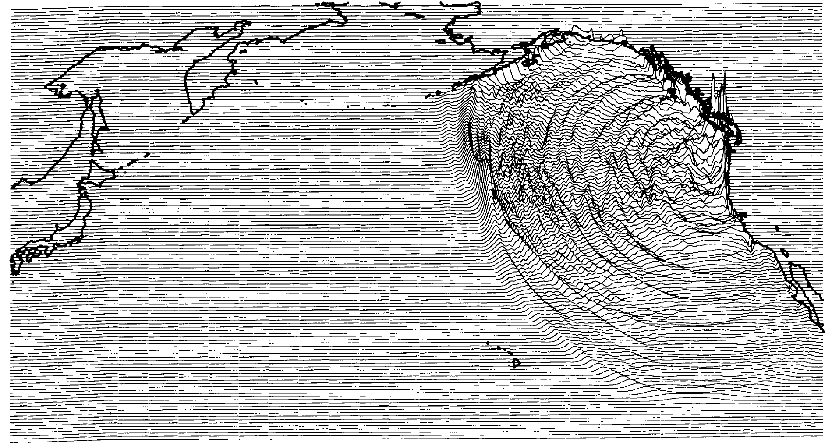
Satake: 1700 = Dinner Sausage
https://doi.org/10.1038/379246a0
Notes:
Satake san presented in 1996 the first evidence that for the 1700 earthquake, we ate a dinner sausage.

Slide 19
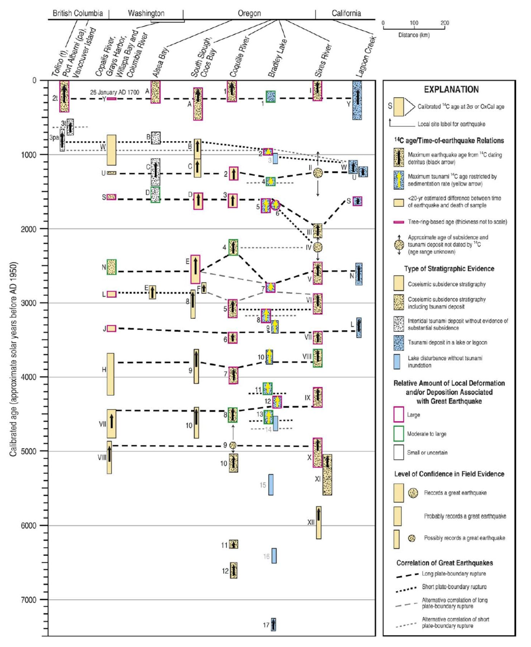
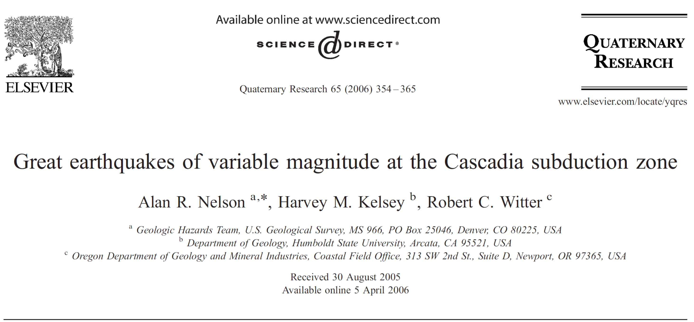
Nelson: Along Strike Variability = Breakfast Sausage before 1700 AD
North
South
… “Rupture patterns suggest that the plate boundary in northern Cascadia usually breaks in long ruptures during the greatest earthquakes. Ruptures in southernmost Cascadia vary in length and recurrence intervals more than ruptures in northern Cascadia.”
Notes:
About a decade later Alan Nelson and colleagues used the land record to show that before 1700, we ate both dinner sausage and breakfast links. Sorry if you are getting hungry, the break is coming up shortly.

Slide 20
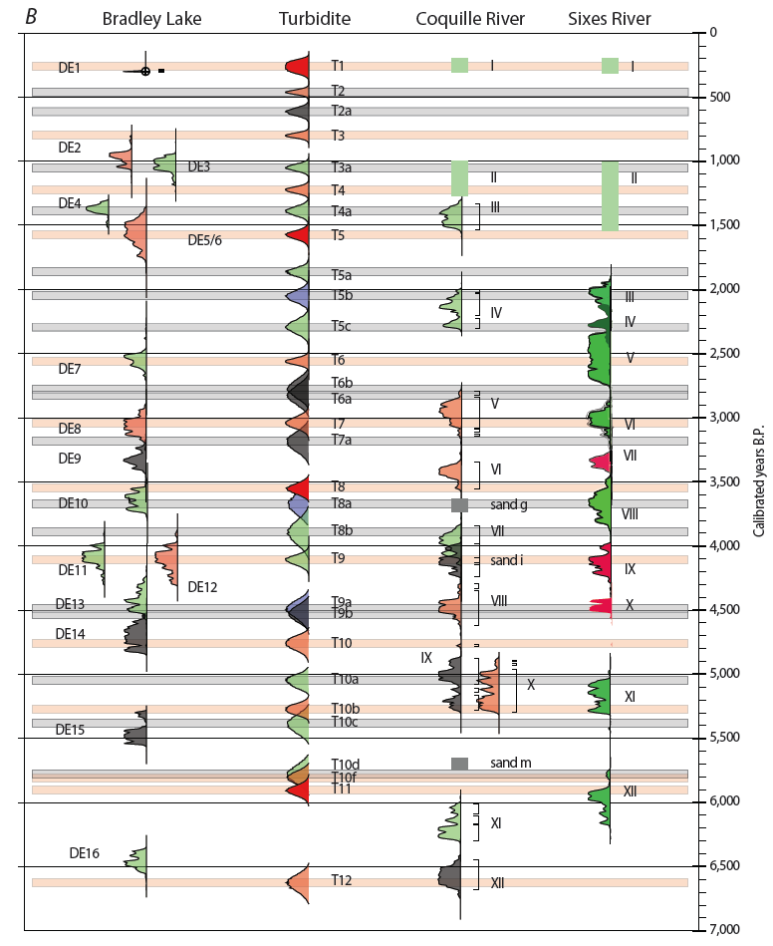
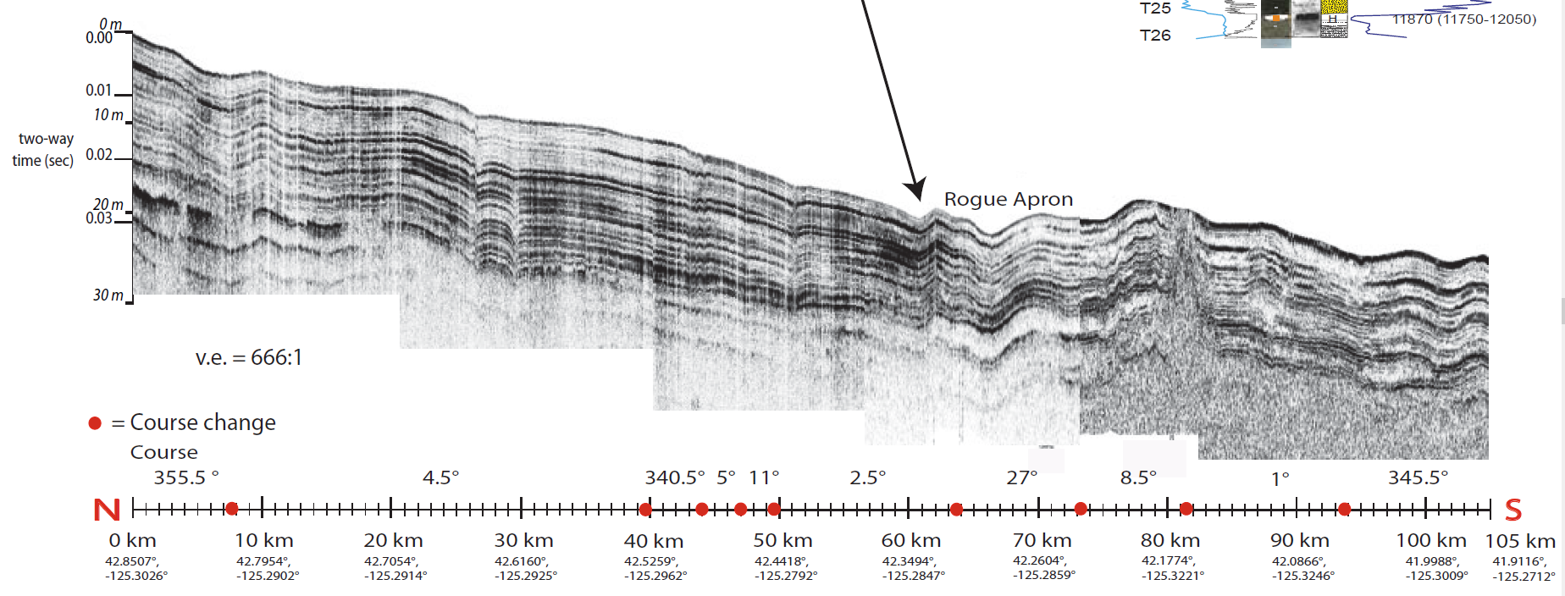
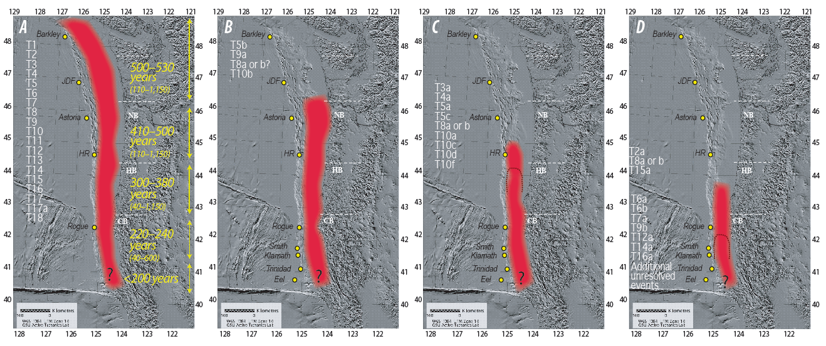
Goldfinger: Both Breakfast and Dinner
1st to be able to definitively correlate events along strike, tied to one of the best land records in the world.
Not all turbidity currents are channelized.
Earthquake History is Based on Radiocarbon Ages
Rupture Modes for Cascadia subduction zone
Notes:
Then, in an attempt to disprove Adams’ 1990 paper, Goldfinger failed in an epic manner.
We could finally directly correlate earthquake records along strike and we learned that Nelson was correct, sometimes we eat dinner sausage and sometimes we only eat breakfast links.
Possibly Skip to Save Time:
Some take away messages from this study, as well as an updated paper from 2017:
Not all turbidity currents are channelized (we learned this in Sumatra and in Cascadia). The figure in the upper right is a seismic reflection profile along the trench along a 100km stretch. The layers of dark and light gray represent the layers of turbidites from the past 10,000 years or more.
Earthquake history is based on radiocarbon ages and we use these ages to correlate the offshore record to the onshore record. This is a space time diagram (remember that from earlier?) where turbidite ages are compared with tsunami and earthquake buried soil ages (not as rectangles, but probability density functions representing the age).
There are different rupture modes for the Cascadia subduction zone. Turbidite correlation limits provide constraints to the spatial extent of past megathrust earthquakes.

Slide 21
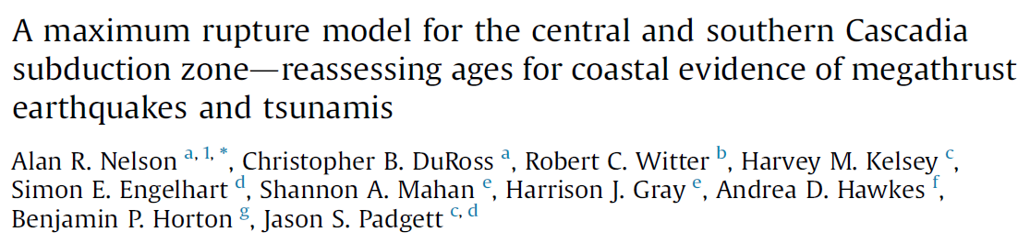
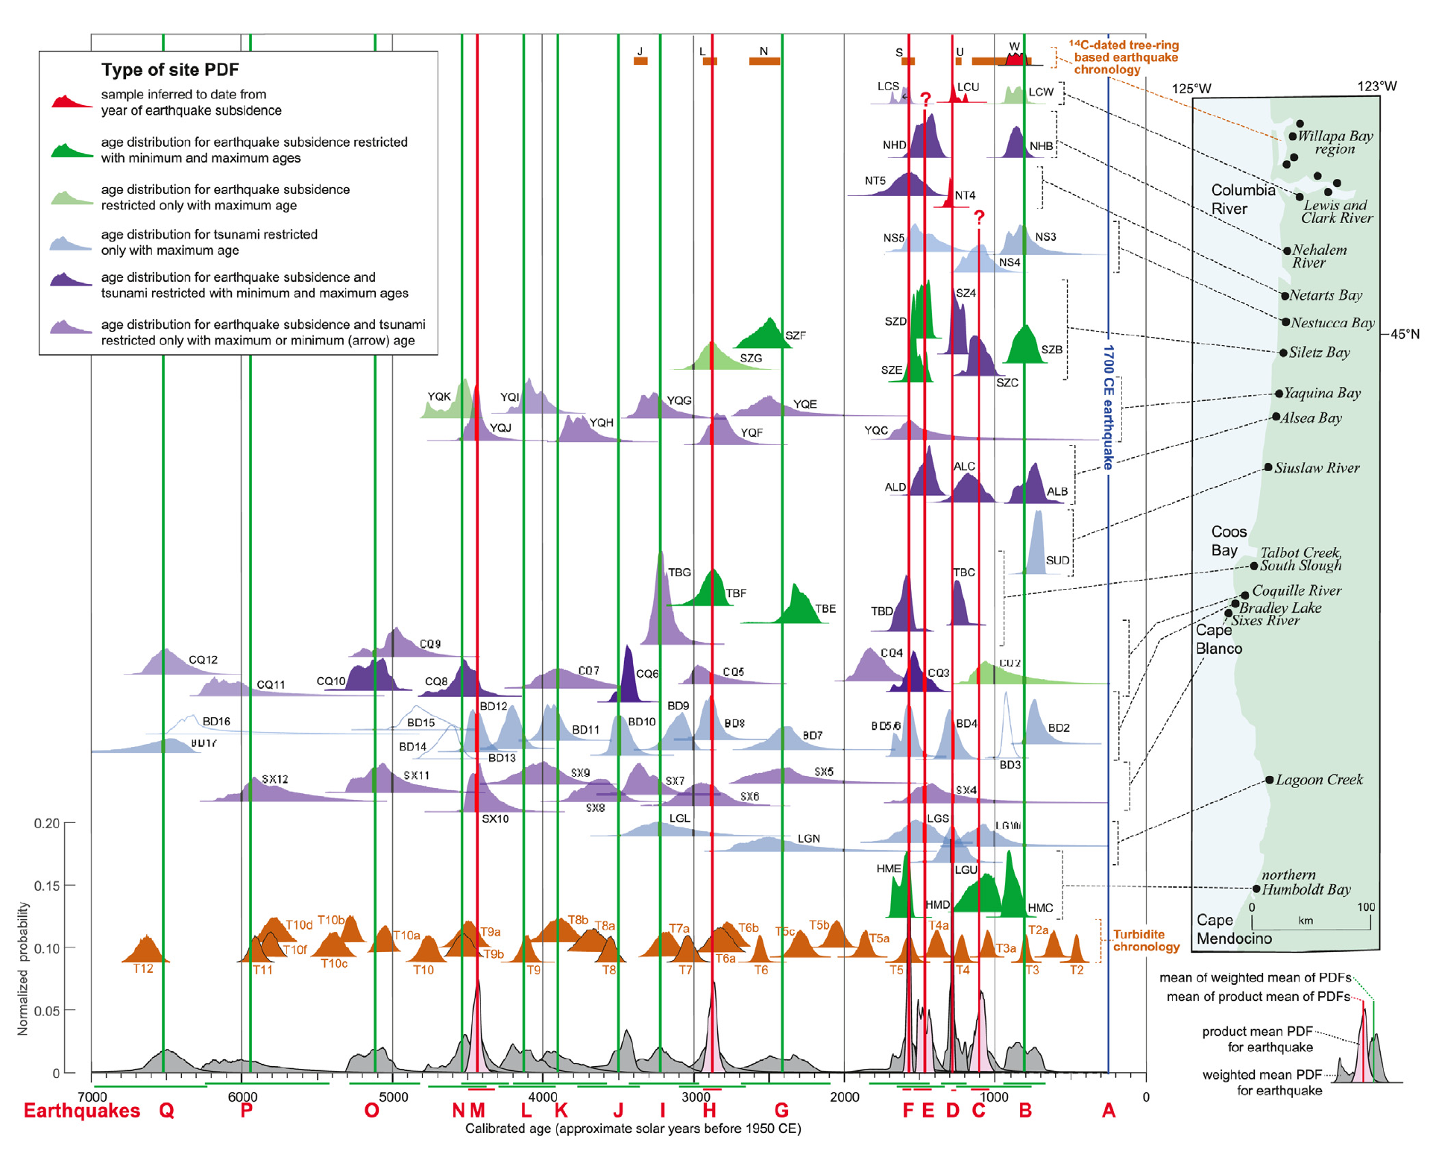
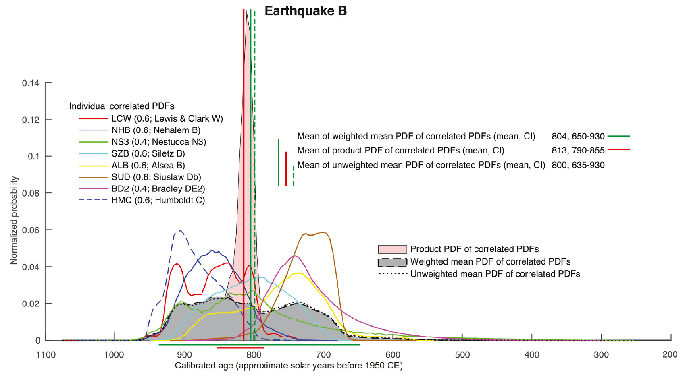
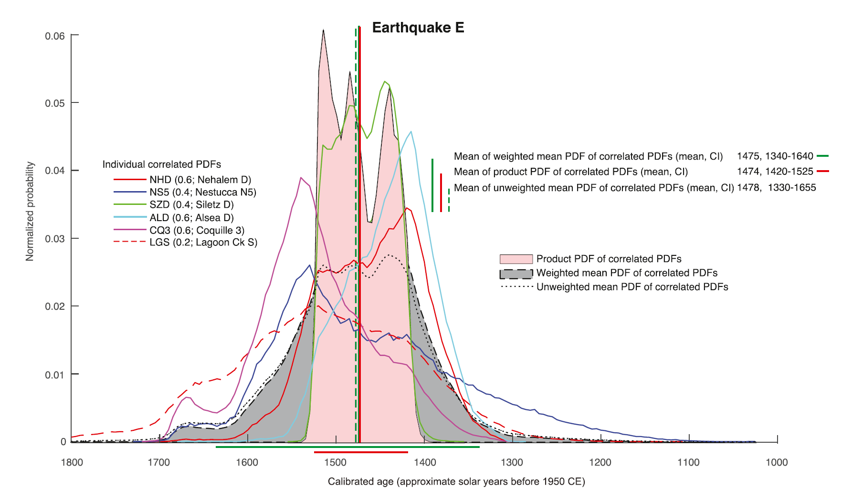
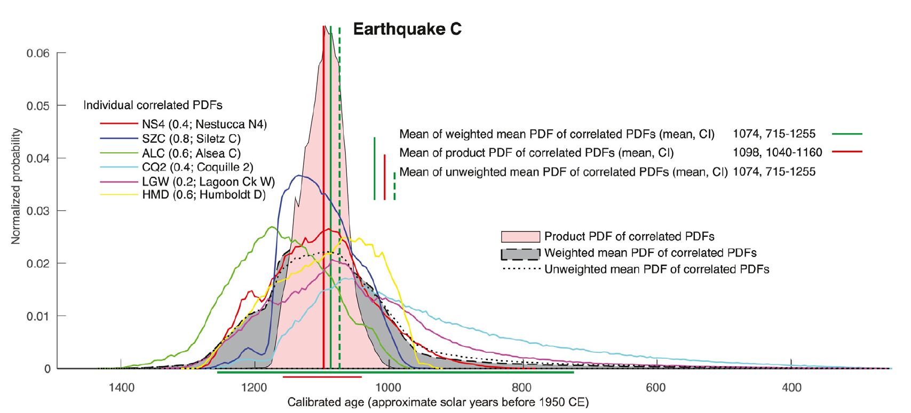
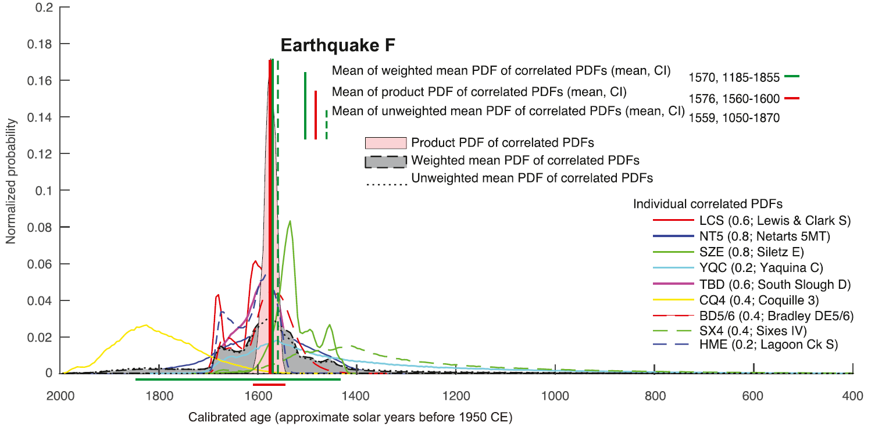
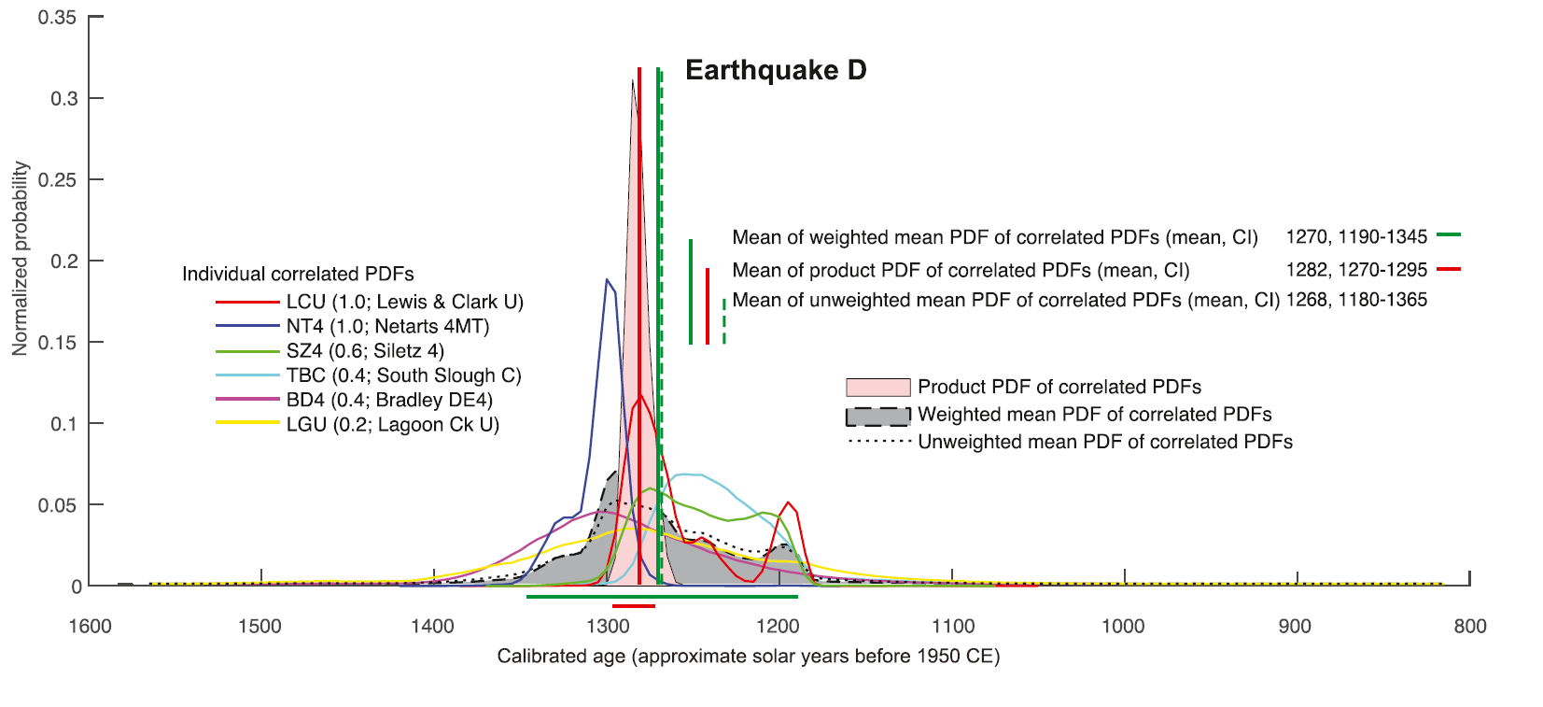
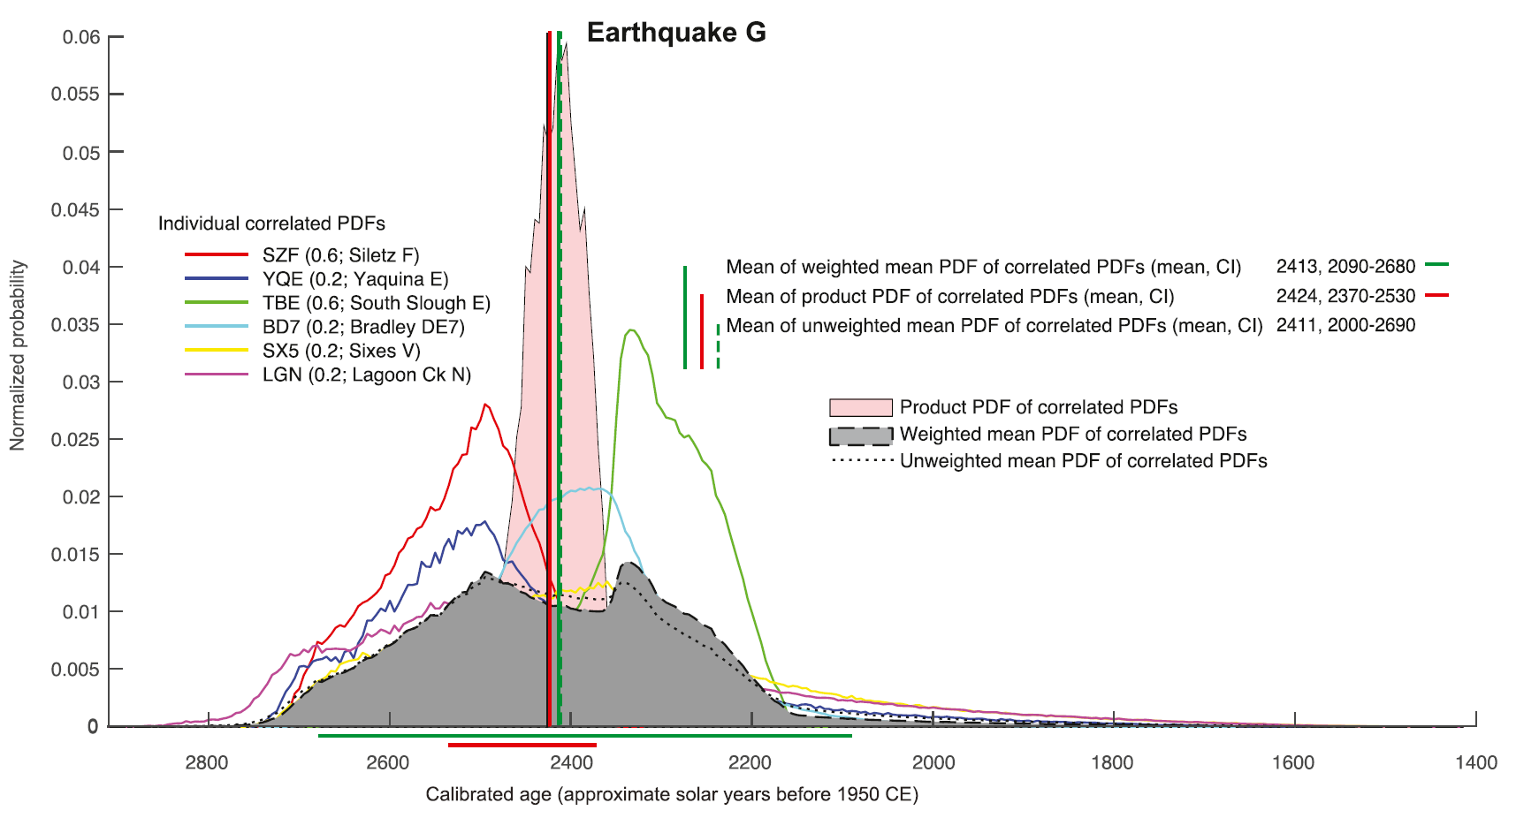
Nelson: 1700 = Dinner Sausage with greater certainty, plus SCSZ Breakfast Links
A new history of great earthquakes (and their tsunamis) for the central and southern Cascadia subduction zone shows more frequent (17 in the past 6700 yr) megathrust ruptures than previous coastal chronologies.
The history is based on along-strike correlations of Bayesian age models derived from evaluation of 554 radiocarbon ages that date earthquake evidence at 14 coastal sites.
Eq B
Eq E
Eq C
Eq F
Eq D
Eq G
Notes:
Just this year, Nelson and colleagues come on the scene again with the Greatest paper of all, suggesting that 1700 was indeed a dinner sausage, but that there were some pre-1700 breakfast links.
A new history of great earthquakes (and their tsunamis) for the central and southern Cascadia subduction zone shows more frequent (17 in the past 6700 yr) megathrust ruptures than previous coastal chronologies. The history is based on along-strike correlations of Bayesian age models derived from evaluation of 554 radiocarbon ages that date earthquake evidence at 14 coastal sites. We reconstruct a history that accounts for all dated stratigraphic evidence with the fewest possible ruptures by evaluating the sequence of age models for earthquake or tsunami contacts at each site, comparing the degree of temporal overlap of correlated site age models, considering evidence for closely spaced earthquakes at four sites, and hypothesizing only maximum-length megathrust ruptures. For the past 6700 yr, recurrence for all earthquakes is 370–420 yr. But correlations suggest that ruptures at ∼1.5 ka and ∼1.1 ka were of limited extent (<400 km). If so, post-3-ka recurrence for ruptures extending throughout central and southern Cascadia is 510–540 yr. But the range in the times between earthquakes is large: two instances may be ∼50 yr, whereas the longest are ∼550 and ∼850 yr. The closely spaced ruptures about 1.6 ka may illustrate a pattern common at subduction zones of a long gap ending with a great earthquake rupturing much of the subduction zone, shortly followed by a rupture of more limited extent. The ruptures of limited extent support the continued inclusion of magnitude-8 earthquakes, with longer ruptures near magnitude 9, in assessments of seismic hazard in the region.
Fig. 2. Radiocarbon-based age models (probability density functions, or PDFs) for evidence of great earthquakes and their accompanying tsunamis that predate the great earthquake of 1700 CE (blue vertical line; Atwater et al., 2005) at 14 sites (site map at right) between the Columbia River and Cape Mendocino, California. PDFs for earthquakes at each site calculated through evaluating 554 ¹⁴C ages (Tables S3A-S3G) with the sequence feature of OxCal (Bronk Ramsey 2008; 2009a). Labels used by original investigators for PDFs (dated contacts) at each site are listed in Table 2. We developed a maximum rupture model (MRM) for this region by assigning site PDFs to 16 earthquakes (B-Q, red labels at base), and then calculating weighted (based on the quality of ¹⁴C ages, Table 2) mean PDFs (gray distributions at base) and product PDFs (pink distributions) for each earthquake (Fig. 4, Fig. 5, Fig. 6, and S4A-S4E; e.g., Biasi and Weldon, 2009; DuRoss et al., 2011). We show product PDFs only for earthquakes (C, D, E, F, H, and M) whose site PDFs closely coincide (Table 1), from which we infer that all site PDFs for those earthquakes are equally valid estimates of earthquake age. For other earthquakes, with broader less coincident site PDFs, we infer only that the times of earthquakes are within the range of their weighted mean PDFs. Vertical lines mark means of the weighted mean PDFs (green) and product PDFs (red). Bars below earthquake PDFs are 95% confidence limits for mean PDFs (upper green row) and product PDFs (lower red row). The PDFs at Lewis and Clark River are calibrated distributions for a single age for each of three earthquakes, not an OxCal-modeled PDF as at other sites. Age intervals shown only for visual comparison for earthquakes in the Willapa Bay region (upper brown bars), are mostly based on the ages of rings from tree stumps inferred to have died shortly after earthquake subsidence (Atwater et al., 2004). The probability distribution in front of interval W (red), is a more precise estimate calculated from the average of three ages reported by Atwater and Griggs (2012, p. 22; Atwater, 2020). PDFs for marine turbidites offshore (lower brown PDFs, not to same vertical scale as other PDFs) are those of Goldfinger et al. (2012; from their Fig. 54B), calculated by combining distributions for ¹⁴C ages for the correlated turbidites in many cores. (For interpretation of the references to colour in this figure legend, the reader is referred to the Web version of this article.)

Slide 22
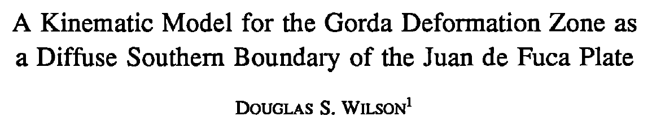
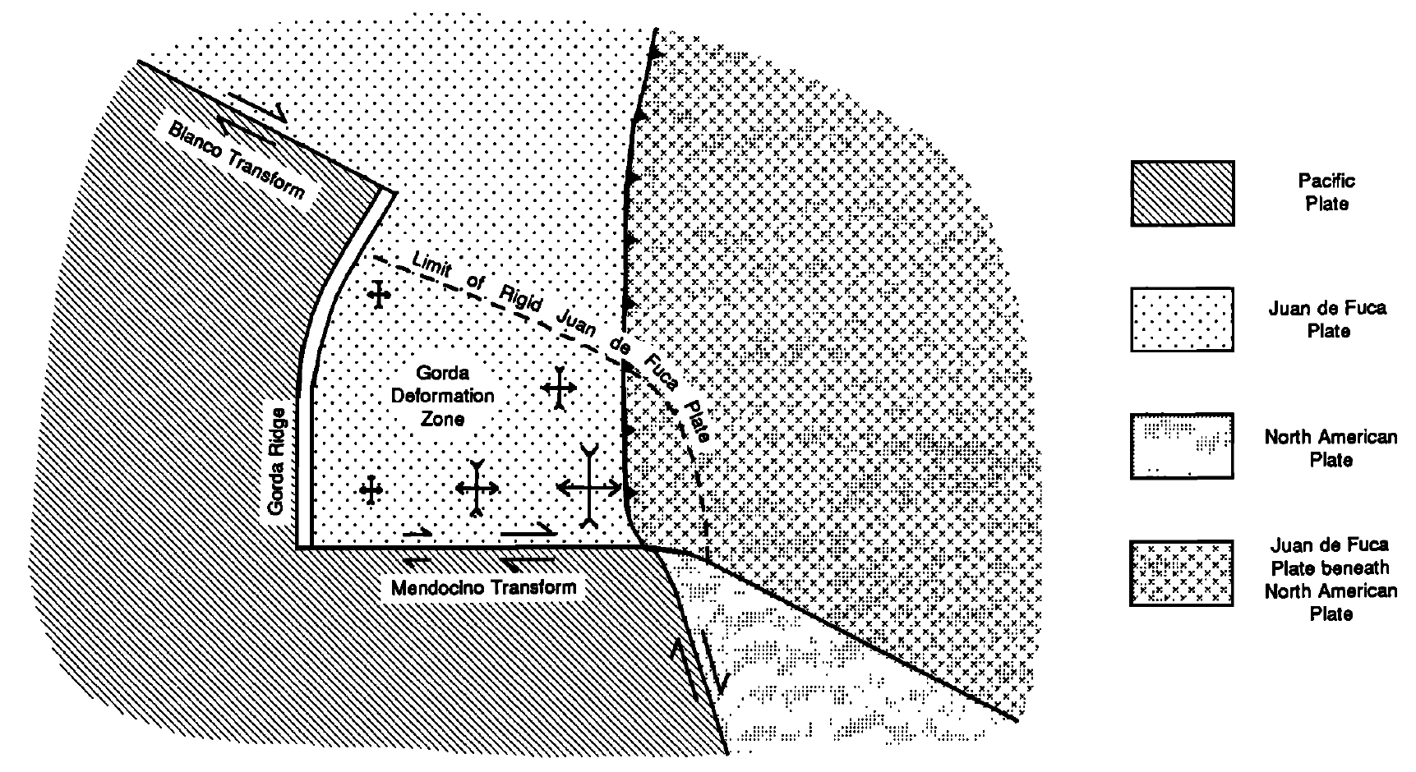
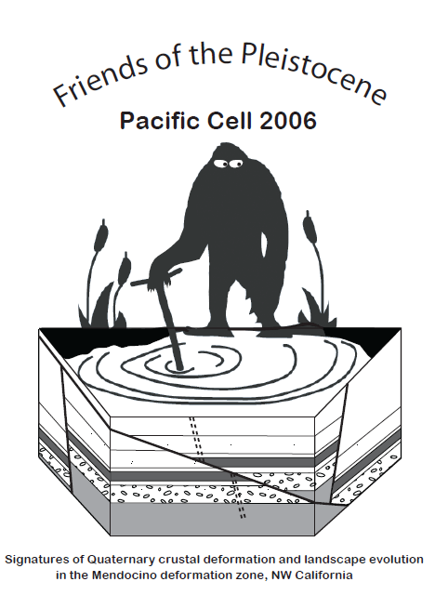
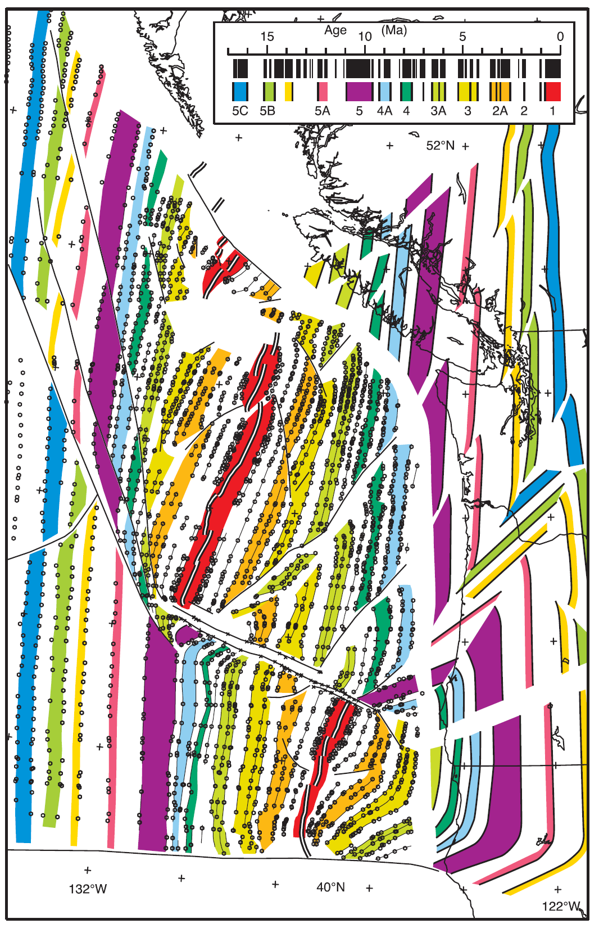
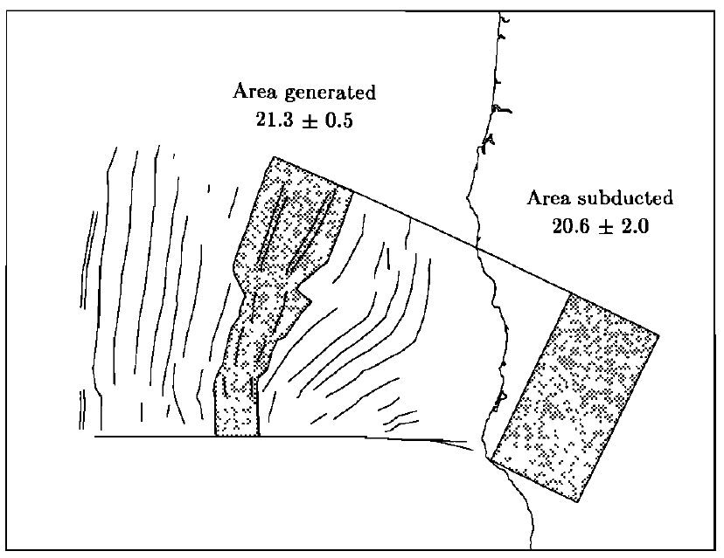
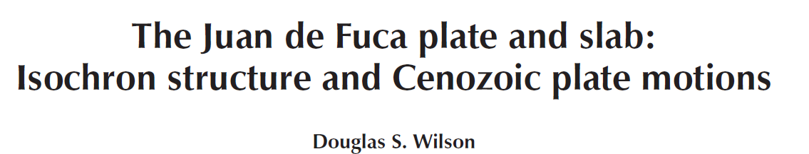
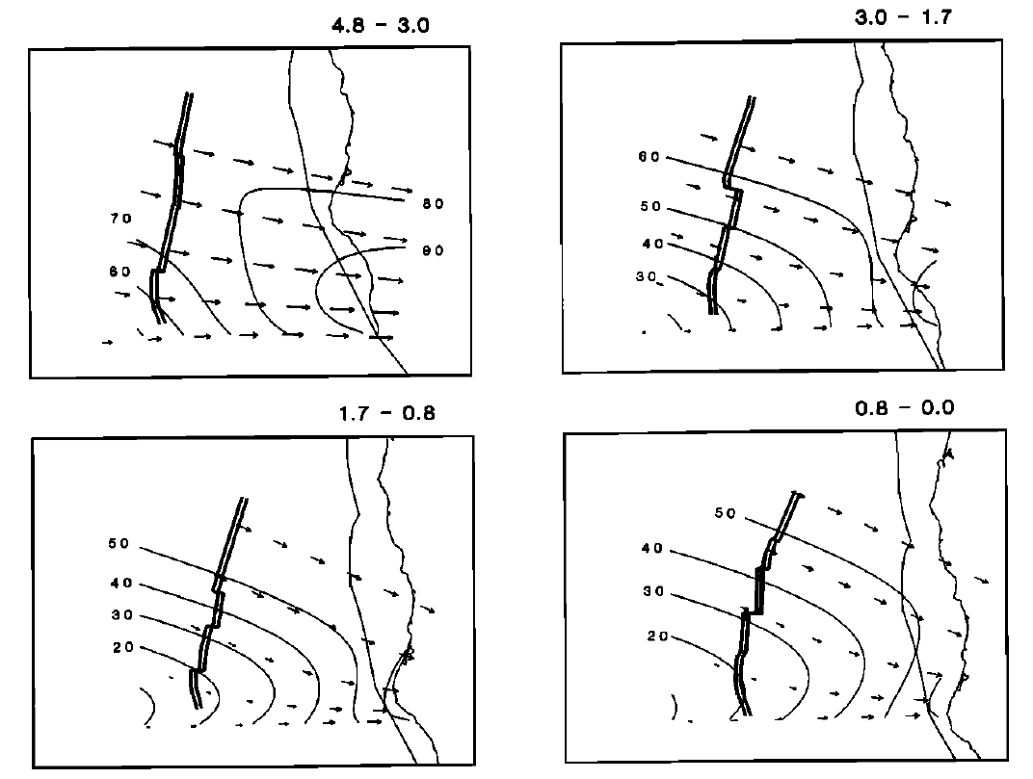
Several lines of evidence indicate that the space problem caused by southeastward motion of the Juan de Fuca plate toward the east-west Mendocino transform is resolved by distributed deformation of the oceanic crust north of the transform.
Tectonic Structures
Wilson, 1986, 2002:
Comparison of area generated since chron 2 (1.77 Ma), with a calculation of how much area can be subducted past the comer of the Pacific plate
Seafloor age map, modified from Wilson [1988; 1993], and prediction of slab age, modified from Wilson [1988] to include nonrigid plate behavior.
^^^ Cartoon of proposed tectonic model for the Gorda deformation zone (previously known as the Gorda plate). Schematic strain symbols show direction and relative magnitude of extension (outward arrows) and compression (inward arrows).
Speed contours
Notes:
We then reviewed the complicated structures in the Mendocino deformation zone, aka the “Triangle of Doom.”
Doug Wilson’s seminal work from the 1980s was where we started.
Abstract 1986
Several lines of evidence indicate that the space problem caused by southeastward motion of the Juan de Fuca plate toward the east-west Mendocino transform is resolved by distributed deformation of the oceanic crust north of the transform. A kinematic model for this deformation based on the assumption of nondivergent flow (conservation of area) within the area known as the Gorda plate, and on the assumption of no subduction along the Mendocino transform, successfully matches the isochron pattern inferred from magnetic anomalies. The model assumes strain rate decreasing to zero approaching the rigid Juan de Fuca plate, with no sharp boundary or separate rigid area that would imply a discrete Gorda plate. This interpretation allows magnetic anomalies from south of the Blanco Fracture Zone to be used to constrain the kinematics of the Juan de Fuca plate. These anomalies imply a substantial change in the distance to the rotation pole at roughly 3 Ma, in addition to the clockwise shift in motion direction at 5 Ma.
https://agupubs.onlinelibrary.wiley.com/doi/10.1029/JB091iB10p10259
Fig. 2. Cartoon of proposed tectonic model for the Gorda deformation zone (previously known as the Gorda plate). Motion along the Mendocino transform is assumed to be strike slip and parallel to the preexisting trend of the transform, while the Blanco transform and the edge of the subducted slab are assumed to record the direction of Juan de Fuca-Pacific relative motion. Schematic strain symbols show direction and relative magnitude of extension (outward arrows) and compression (inward arrows).
Fig. 6. Speed contours and velocity vectors from Figure 5, with ridge location, coastline, and continental margin for reference.
Fig. 9. Comparison of area generated since chron 2 (1.77 Ma), with a calculation of how much area can be subducted past the comer of the Pacific plate under a nondivergent flow model (units HP lcm2). The agreement of the areas supports the nondivergence assumption.
2002
FIGURE 2: Seafloor age map, modified from Wilson [1988; 1993], and prediction of slab age, modified from Wilson [1988] to include nonrigid plate behavior. No correction for slab dip has been applied. Areas in the slab with north–south isochron strikes should be undeformed; other areas experienced significant shear prior to subduction.

Slide 23
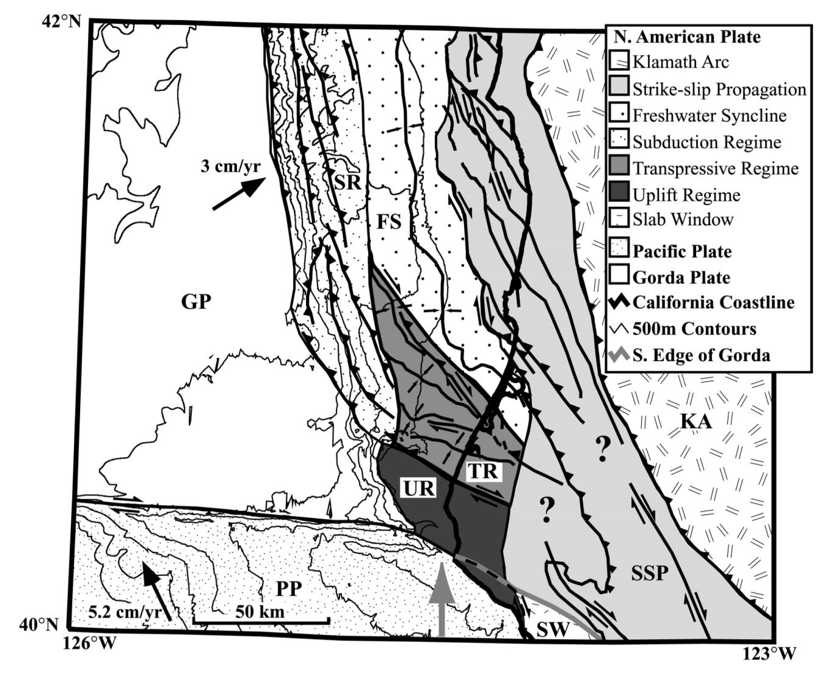
Tectonic Structures
Gulick & Meltzer., 2002:
KA is the Klamath arc. GP is the Gorda plate, which is subducting northeastward in the direction of the black arrow. PP is the Pacific plate, whose northwestward movement causes increasing strike-slip offset on Gorda/Pacific plate boundary with an increasing component of north-south convergence (represented by gray arrow) toward the coast. SW is the slabless window, located south of the southern edge of the Gorda plate (shown as a gray line). SSP is the area of possible strike-slip propagation that may be caused by northward continuation of Pacific-North American transform motion. SR is the subduction regime where thrusting within the accretionary prism due to Gorda subduction is relatively unaffected by triple-junction tectonics. FS is the relatively undeformed Freshwater syncline. UR is the actively uplifting and eroding region that extends as far as 20 km north of the triple junction (Gulick et al., 2002). TR is the transpressive regime in transition amid uplift to the south, subduction to the northwest, and possible strike-slip propagation to the east. Faulting in the transpressive regime varies from thrusting in the northwest to transpressive structures in the nearshore and to thrusting onshore.
Notes:
Then we took at look at Sean’s work. Sean and Anne proposed different structural domains in the triple junction.
The exciting thing is that this workshop inspired Gulick to begin reprocessing the lines he used 20 years ago and he and his students are already having positive results!
Abstract
Offshore northern California, the Gorda plate is subducting obliquely beneath North America; the resulting complicated tectonic setting forms the southern end of the Cascadia subduction zone. The southern Cascadia subduction zone and overlying Eel River forearc basin lie just north of the unstable Mendocino triple junction. The Neogene strata of the Eel River basin record structural deformation caused by the underthrusting of the Gorda plate as well as deformation generated by northward migration and encroachment of the Mendocino triple junction. Three distinct deformation regimes are present in the Eel River forearc basin. (1) Along the western margin of the forearc basin and within the foreslope of the accretionary prism, thrust faults and anticlines record Pliocene– Pleistocene shortening caused by subduction of the Gorda plate. (2) The southern part of the basin rotated counterclockwise in the late Pleistocene, resulting in modern transpressional deformation offshore Humboldt Bay. The rotation and deformation are caused by north-south convergence across the boundary between the Pacific plate and the southernmost part of the forearc basin at the triple junction. (3) The northeastern margin of the Eel River basin is deformed by high-angle faults with a component of strike-slip motion that may represent the incipient northward propagation of the Pacific–North American transform system north of the triple junction.
Figure 3. Interpreted offshore faults, folds, and basement geology, together with onshore structures and surficial geology. Fault abbreviations: MTF—Mendocino transform fault, FCSZ—False Cape shear zone, TBF—Table Bluff Fault, LSF—Little Salmon Fault, FWF— Freshwater fault, CBF—Coastal Belt fault, MRFZ—Mad River fault zone, TF—Trinidad fault, BLF—Big Lagoon Fault, BMF—Bald Mountain fault, GF—Grogan fault, LMF—Lost Man fault, PSGF—Point Saint George fault; NE1–NE3 and SE1–SE3—fault zones in northeastern and southeastern Eel River basin, respectively. Location abbreviations: PG—Punta Gorda, CM—Cape Mendocino, TH— Trinidad Head, and PSG—Point Saint George. The dashed-line structures offshore have been inactive since the early Pleistocene, whereas solid-line structures have deformed strata at least as young as the middle Pleistocene. (a) Observed deformation throughout Eel River basin study area. Dashed gray box in upper center is area of b. (b) Blow-up of deformation in northeastern part of the forearc basin.
Figure 7. Summary of interpreted tectonic regimes for northern California. KA is the Klamath arc. GP is the Gorda plate, which is subducting northeastward in the direction of the black arrow. PP is the Pacific plate, whose northwestward movement causes increasing strike-slip offset on Gorda/Pacific plate boundary with an increasing component of north-south convergence (represented by gray arrow) toward the coast. SW is the slabless window, located south of the southern edge of the Gorda plate (shown as a gray line). SSP is the area of possible strike-slip propagation that may be caused by northward continuation of Pacific-North American transform motion. SR is the subduction regime where thrusting within the accretionary prism due to Gorda subduction is relatively unaffected by triple-junction tectonics. FS is the relatively undeformed Freshwater syncline. UR is the actively uplifting and eroding region that extends as far as 20 km north of the triple junction (Gulick et al., 2002). TR is the transpressive regime in transition amid uplift to the south, subduction to the northwest, and possible strike-slip propagation to the east. Faulting in the transpressive regime varies from thrusting in the northwest to transpressive structures in the nearshore and to thrusting onshore.

Slide 24
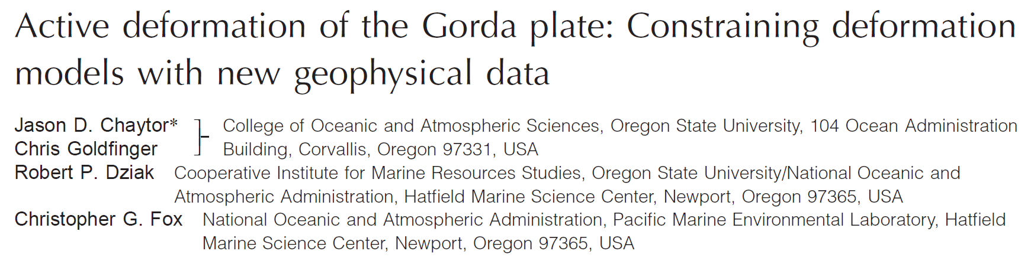
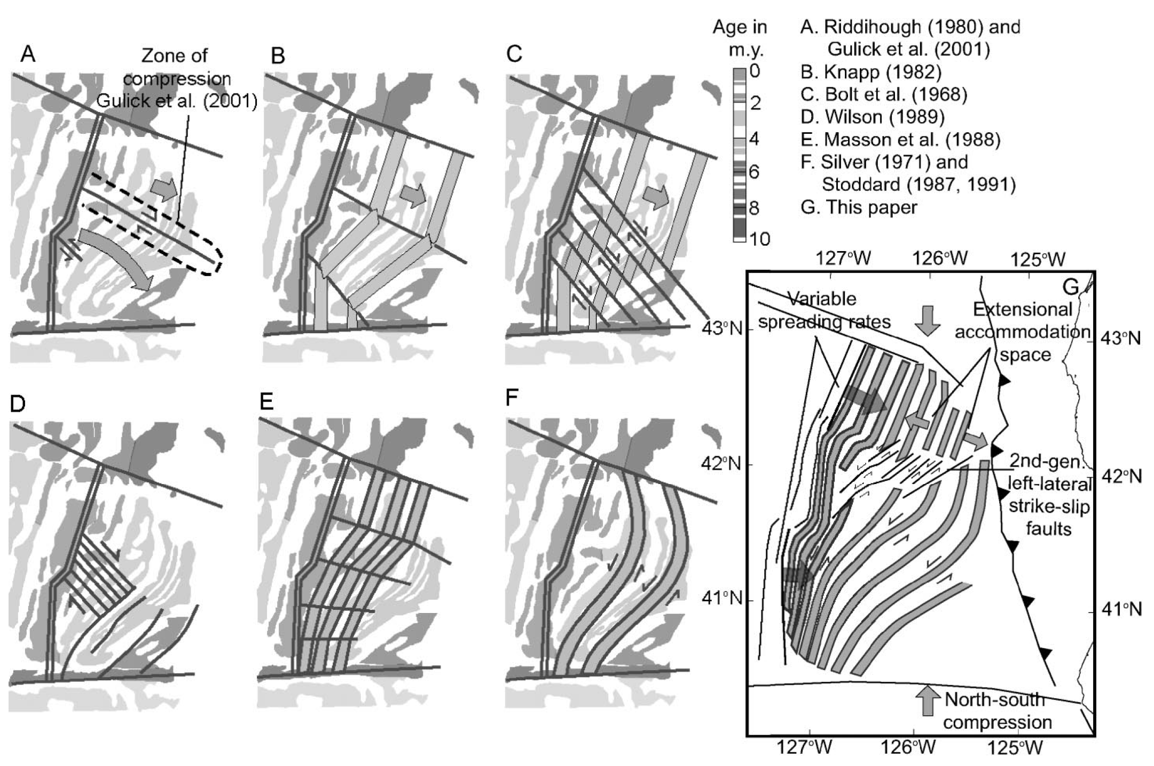
Tectonic Structures in the Gorda “plate”
Chaytor et al., 2004:
The Gorda “plate,” the southernmost fragment of the larger Juan de Fuca plate system, is an example of a nonrigidly deforming tectonic accommodation zone or buffer plate, absorbing deformation and allowing the surrounding larger plates to act in a more rigid fashion.
Models of brittle deformation for Gorda plate overlain on magnetic anomalies modified from Raff and Mason (1961). Models A–F were proposed prior to collection and analysis of full-plate multibeam data. Deformation model of Gulick et al. (2001) is included in model A. Model G represents modification of Stoddard's (1987) flexural-slip model proposed in this paper. >>>
Notes:
Finally, we took at look at Jason Chaytor’s overview of tectonic interpretations for the Gorda plate. We briefly debated about whether Gorda is even a plate (based on Doug Wilson and Bob McPherson’s advice, we chose to attempt to stop calling it a plate).
Abstract
The Gorda plate, the southernmost fragment of the larger Juan de Fuca plate system, is an example of a nonrigidly deforming tectonic accommodation zone or buffer plate, absorbing deformation and allowing the surrounding larger plates to act in a more rigid fashion. Here we present a new structural analysis of the plate based on full-plate bathymetric coverage, augmented by seismic reflection data and earthquake moment tensors and locations. We interpret internal deformation of the Gorda plate as an asymmetrical flexural-slip buckle with a vertical axis, utilizing reactivation of spreading-ridge fabric normal faults as strike-slip faults. Newly formed second-generation faults crosscutting the structural grain overprint the reactivated structures. The spreading fabric faults finally begin a second phase of extension as the plate approaches the subduction zone. This model, based on fault constraints, has allowed investigation of ridge-plate–subduction interactions, and suggests that spreading-rate variations along the Gorda Ridge may be controlled by internal deformation of the plate rather than the reverse, as previously hypothesized.
https://pubs.geoscienceworld.org/gsa/geology/article/32/4/353/29451/Active-deformation-of-the-Gorda-plate-Constraining
Figure 3. Models of brittle deformation for Gorda plate overlain on magnetic anomalies modified from Raff and Mason (1961). Models A–F were proposed prior to collection and analysis of full-plate multibeam data. Deformation model of Gulick et al. (2001) is included in model A. Model G represents modification of Stoddard's (1987) flexural-slip model proposed in this paper.

Slide 25
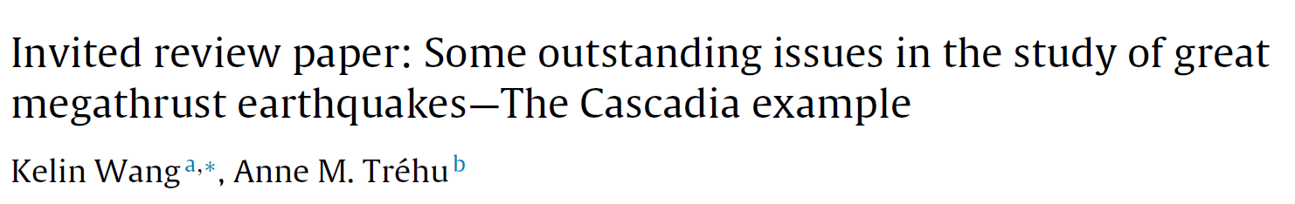
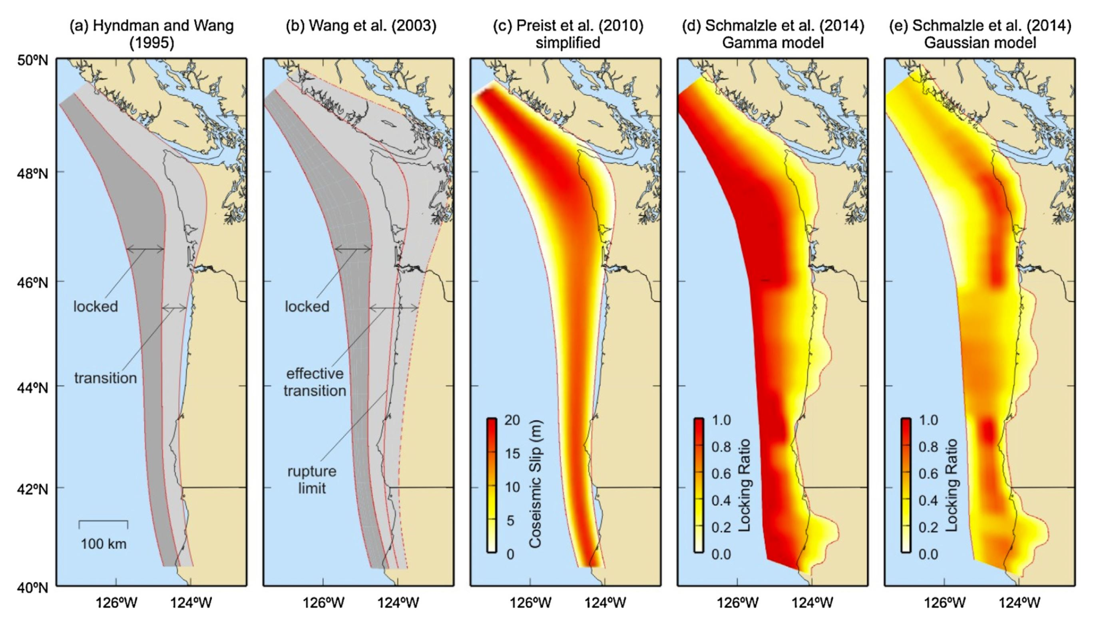
Known Unknowns
Wang & Trehu, 2019:
Representative elastic dislocation models of Cascadia megathrust interseismic locking or coseismic rupture published over the last two decades.
(a) Hyndman and Wang (1995): Uniform locking with linear downdip transition. There are various modified versions (e.g., Flück et al., 1997; Burgette et al., 2009). (b) Wang et al. (2003):Uniform locking with an effective transition zone (ETZ) to compensate for the missing effect of viscoelasticity. For modeling the AD 1700 trans-Pacific tsunami, coseismic rupture was assumed to have extended to the middle of ETZ (Satake et al., 2003). (c) Priest et al. (2010): Bell-shape downdip distribution of coseismic slip used as a tsunami source scenario. The apex of the “bell” is equivalent to 500 years of slip deficit. Shown is a simplified version in which the downdip rupture limit is the same as in (b). (d)Schmalzle et al. (2014) “Gamma” model: Full interseismic locking at deformation front with locking ratio monotonically decreasing landward. (e) Schmalzle et al. (2014)“Gaussian” model: Interseismic creep is allowed at the deformation front. Both (d) and (e) are updated versions of McCaffrey et al. (2013).
Notes:
Lastly, we reviewed some locking models and how they may show a difference in southern Cascadia.
Abstract
Because of a combination of new observational tools and a flurry of large megathrust earthquakes, tremendous progress has been made in recent years towards understanding the process of great subduction earthquakes at Cascadia and other subduction zones around the world. This review article attempts to clarify some of widely used geodynamic concepts and identify the most important scientific questions for future research related to megathrust behaviour. It is important to specify how the megathrust seismogenic zone has been defined when comparing data and models. Observations and concepts currently used to define the seismogenic zone include: (A) the stability transition in rate-and-state dependent friction; (B) the slip zone of large interplate earthquakes; (C) the distribution of small-medium earthquakes; and (D) the geodetically-determined zone of fault locking. Land-based geodetic measurements indicate that the Cascadia megathrust is locked to some extent, but the degree of locking is not well constrained. The near absence of detectable interplate seismicity, with the exception of a segment near 44.5°N and near the Mendocino Triple Junction, is presently interpreted to indicate full locking along most of Cascadia. Resolving the locking state requires seafloor geodetic measurements. The slip behaviour of the shallowest segment of the megathrust and its tsunamigenic potential are complex and variable. Structural studies combined with modeling have the potential to improve our understanding of the signature left in the structure by the slip history. For several reasons, but mostly because of interseismic viscoelastic stress relaxation, the downdip limit of megathrust locking cannot be reliably constrained by geodetic data. Independent information is needed on the composition and thermal state of fault zone materials. The spatial relationship between the seismogenic zone and the zone of Episodic Tremor and Slip (ETS) remains controversial. Observations from the Nankai subduction zone and the San Andreas Fault suggest that ETS does not mark a simple spatial transition from seismic to aseismic behaviour and that multiple transitions may be present because of petrological and rheological changes with depth. Coseismic rupture in the AD 1700 Cascadia earthquake has been shown to vary along strike, and it is important to investigate whether the position of boundaries between high slip and low slip are stationary with time (and therefore probably geologically controlled) and are reflected in current interseismic locking of the megathrust.
https://doi.org/10.1016/j.jog.2016.03.010
Fig. 1. Four definitions of the seismogenic zone in the context of rate-state friction as discussed in Section 2.1. The zone of velocity-weakening (a–b < 0), commonly regarded as the “theoretical” seismogenic zone, is where earthquakes may nucle-ate. The actual seismic rupture, the “observed” seismogenic zone, may go far into the velocity-strengthening area due to low degrees of strengthening or dynamic weakening. Low-magnitude interplate seismicity may or may not occur over a broader depth range. The downdip width of the interseismically locked zone is difficult to constrain using geodetic observations and is seen to decrease with time in rate-state earthquake cycle models (Section 5.1). Red-dashed line shows possible downdip variations in (a–b) in Cascadia and some other subduction zones, to be discussed in Section 6.
Fig. 2. Representative elastic dislocation models of Cascadia megathrust interseismic locking or coseismic rupture published over the last two decades. (a) Hyndman and Wang (1995): Uniform locking with linear downdip transition. There are various modified versions (e.g., Flück et al., 1997; Burgette et al., 2009). (b) Wang et al. (2003):Uniform locking with an effective transition zone (ETZ) to compensate for the missing effect of viscoelasticity. For modeling the AD 1700 trans-Pacific tsunami, coseismic rupture was assumed to have extended to the middle of ETZ (Satake et al., 2003). (c) Priest et al. (2010): Bell-shape downdip distribution of coseismic slip used as a tsunami source scenario. The apex of the “bell” is equivalent to 500 years of slip deficit. Shown is a simplified version in which the downdip rupture limit is the same as in (b). (d)Schmalzle et al. (2014) “Gamma” model: Full interseismic locking at deformation front with locking ratio monotonically decreasing landward. (e) Schmalzle et al. (2014)“Gaussian” model: Interseismic creep is allowed at the deformation front. Both (d) and (e) are updated versions of McCaffrey et al. (2013).
Fig. 4. Locking/creeping scenarios and resultant surface deformation based on a 2Delastic dislocation model, illustrating the importance of making seafloor geodetic observations. All the shown scenarios are difficult to differentiate using land-based geodetic observations, but they produce drastically different horizontal deformation signals around the “trench” (zero distance). Vertical rates seaward of the trench are sensitive to model artefacts and have been removed.
Fig. 5. Scenarios of shallowest part of megathrust rupture in great earthquakes. (a)Buried rupture as seen in the 2005 Mw= 8.8 Sumatra earthquake and assumed in the Cascadia model shown in Fig. 2c. (b) Mega-splay rupture as speculated for the 1946Mw= 8.1 Nankaido earthquake and assumed in some Cascadia models of Satake et al.(2003), Priest et al. (2010), and Witter et al. (2013). (c) Trench-breaching rupture as seen in the 2011Mw= 9 Tohoku-oki earthquake. (d) Difficulty in determining shallow rupture behaviour in a system of complex frontal structure as observed in most of the Cascadia margin.
Fig. 7. Nankai leveling data over a subduction earthquake cycle based on Thatcher(1984), with survey time spans shown colour coded. Data have been hand-smoothed to accentuate long-wavelength patterns. Both lines start from the coast (left end on figure). However, at Cascadia, the coast line would be located much farther landward as shown. (a) Line K (along west shore of Kii Peninsula), used by Thatcher and Rundle(1984) to represent the subduction earthquake deformation cycle in general. (b) LineS2 (through the island of Shikoku), used by Hyndman et al. (1995) and Hyndman and Wang (1995) for comparison with Cascadia.
Fig. 8. Proposed and observed relationship between the seismogenic zone and the ETS zone. (a) Northern Cascadia. The coseismic rupture scenario is that of Fig. 2c. Tremor locations (red circles) and slow slip distribution (contoured at 1 cm interval) for the 2008 ETS episode are as shown in Dragert and Wang (2011). Dashed lines are depth contours of the plate interface (McCrory et al., 2004). (b) Nankai. The downdip rupture limit of the 1944/1946 Mw∼ 8.2 megathrust earthquakes is based on Ichinose et al.(2003), Baba and Cummins (2005), and Baba et al. (2006). Tremors (red circles) are from the period of 2004–2005; this pattern has been stable to date. Short-term slowslip events occur along the tremor band (e.g., Sekine et al., 2010). Locations of long-term slow slip events are based on (from west to east) Ozawa et al. (2013), Takagi et al.(2015), and Kobayashi (2010, 2012, 2014). Thin dashed lines are depth contours of the plate interface (Wang et al., 2004). (c) San Andreas Fault (modified from Shelly and Hardebeck, 2010), where no geodetically resolvable slow slip accompanying tremor has been reported. The shading shows the area of combined coseismic slip of the 2004M = 6 Parkfield earthquake and first 230 days of postseismic slip (Murray and Langbein 2006). Blue dots represent the hypocenters of regular earthquakes. Red and green circles are ambient and teleseismically triggered tremors from Waldhauser and Schaff (2008) and Peng et al. (2009), respectively. The Moho depth is about 25 km.
Fig. 9. Different proposals for the relation of ETS with the mantle wedge corner.(a) The commonly held view in Japan based on studies of the Nankai subduction zone (e.g., Obara, 2011; Kato et al., 2010), in which the ETS zone (the zone of tremor and short-term slow slip) is downdip of the mantle wedge corner. (b) A widely referenced view in North America (Audet et al., 2009; Peng and Gomberg, 2010), in which the ETS zone is entirely updip of the wedge corner. (c) A hybrid view that is consistent with observations from several subduction zones (Wang and Gao, 2016).
Fig. 10. Proposed variations in megathrust slip behaviour along the Cascadia margin. Estimated megathrust slip in AD 1700 earthquake is based on microfossil studies of coseismic coastal subsidence (Wang et al., 2013). Red box is the area of earthquake clusters as shown in Fig. 3 and suspected seamounts (Tréhu et al., 2012). Black dashed lines are segment boundaries of ETS activity from Brudzinski and Allen (2007), more or less consistent with offshore forearc basin distribution (Wells et al., 2003). White dashed lines indicate rupture extents of past Cascadia megathrust earthquakes based on analyses of turbidity deposits. These are the most recent estimates from Goldfinger(personal communication, 2015) modified from those in Goldfinger et al. (2012) using new data. Each line is an average of a number of events with variable lengths; rupture termination at the southern end of the subduction zone is not well defined. The southern area is thought to rupture more frequently but with less slip in each event.

Slide 26
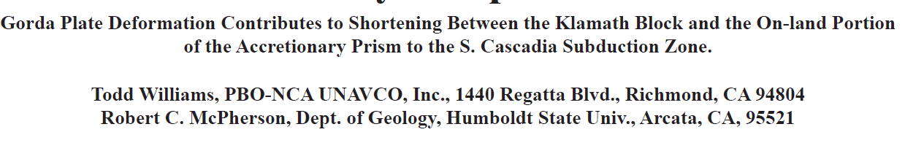
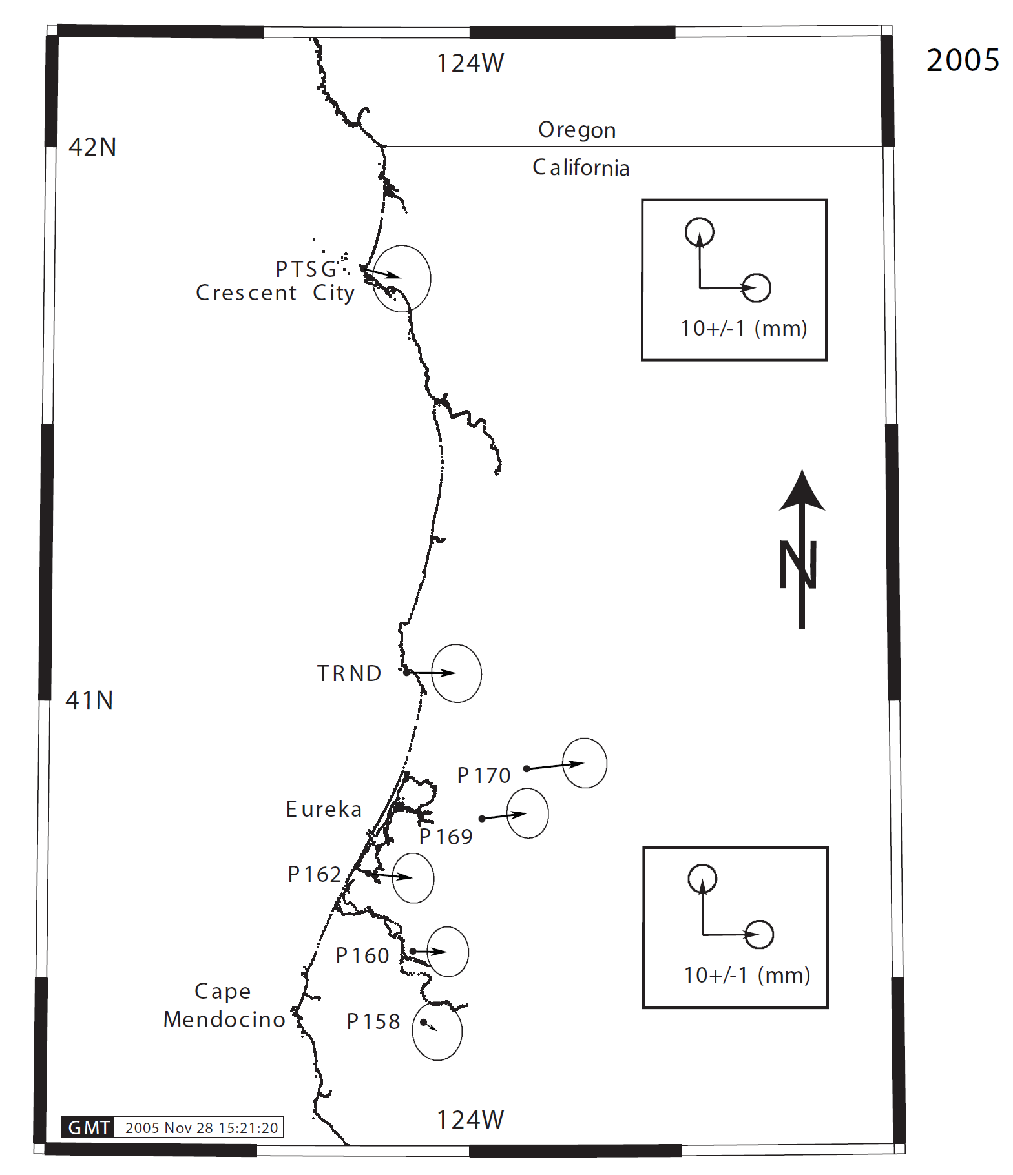
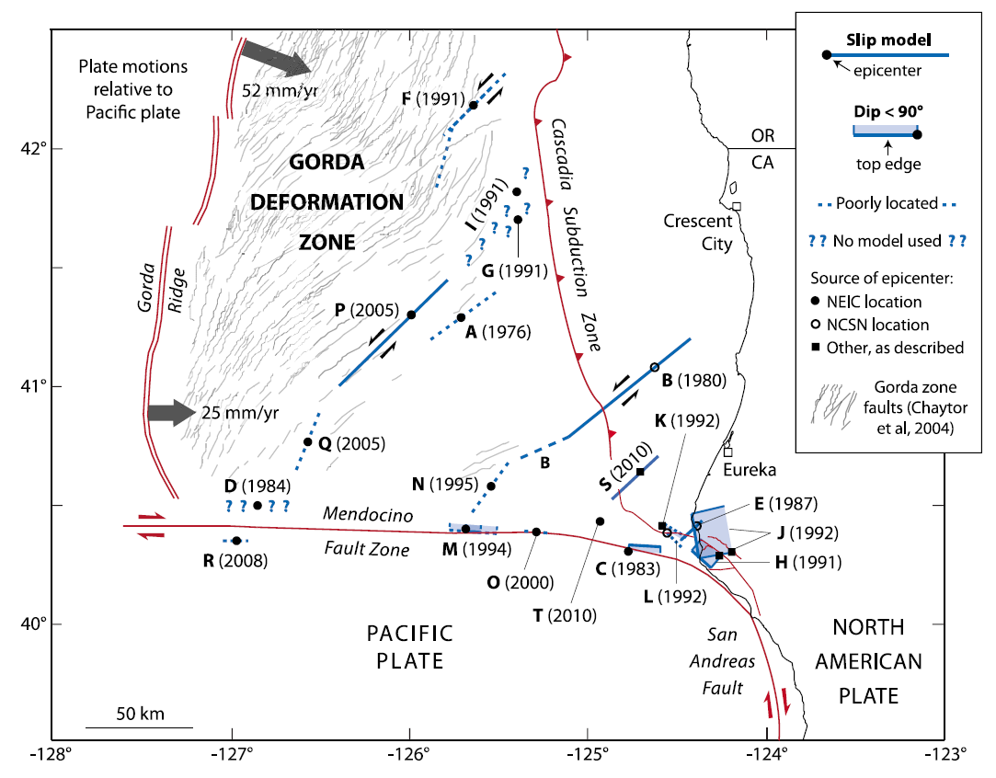
Known Unknowns
Williams & McPherson, 2006
Coseismic displacements from the 15-Jun-2005 M7.2 Gorda plate earthquake located (off the map) 156 km (97 miles) W (280°) from Trinidad, CA and 157 km (98 miles) WSW (251°) from Crescent City, CA. Note the similarity to the deformation pattern of the 1994 event. >>>
Rollins & Stein, 2010 doi:10.1029/2009JB007117
Notes:
We took a look at some geodetic data that reveal details about how the locked zone extends onshore in southern Cascadia, which is different than further north. This affects tsunamigenesis as there is less deformation to initiate the gravitational oscillation that generates tsunami waves and that the water depth above this deformation is shallower.
ABSTRACT
Recent GPS studies (Williams et al., 2006) indicate that observed convergence (2-6 mm/yr) between the Sierra Nevada-Great Valley (SNGV) block and the eastern San Andreas Fault Zone (SAFZ), near the latitude of Cape Mendocino, continues into the Southern Cascadia Subduction Zone (SCSZ). Along strike, the northernmost segment of the eastern SAFZ transitions into the convergent boundary between the Klamath Mts. and the backstop to the on-land portion of the accretionary prism to the SCSZ. Earthquakes that accommodate N-S compression in the Gorda plate are commonly SW-NE striking left-lateral strike slip events. These events are documented as having permanently deformed the on-land portion of the accretionary prism ~ 10 mm/event towards the east. The observed displacements confi rm that portions of the accretionary prism are coupled to the Gorda plate, and, that these displacements will contribute to convergence with the Klamath Mts at the eastern boundary of the backstop to the accretionary prism of the SCSZ.
Figure 4. Coseismic displacements from the 15-Jun-2005 M7.2 Gorda plate earthquake located (off the map) 156 km (97 miles) W (280°) from Trinidad, CA and 157 km (98 miles) WSW (251°) from Crescent City, CA. Note the similarity to the deformation pattern of the 1994 event. Continuously operating GPS stations shown here are operated and maintained through the Plate Boundary Observatory component (pboweb.unavco. org) of the National Science Foundation’s EarthScope project (www.earthscope.org).

Slide 27



West
East
All geodetic data provide evidence for westward down warping of the crust associated with Cascadia subduction zone tectonics.
Patton et al., 2015
Notes:
Also, here is a West-East cross section of these data with vertical land motion on the vertical axis. Click All geodetic data provide evidence for westward down warping of the crust. We attribute this phenomena to the locked megathrust subduction zone fault. However, upper plate crustal faults also appear to be controlling vertical land motion.

Slide 28
Some Consensus Statements from SCWIG Workshop #1, Day 1
What we agree about:
1) We agree that the Southern Cascadia subduction zone (CSZ) (the Gorda segment), where it meets the unstable Mendocino triple junction (MTJ), differs from the Central and Northern CSZ (Juan de Fuca segment) in a number of ways.
Dissent against this statement: “In terms of the observed coseismic vertical displacement at the coastal sites where there is a record, the southern Cascadia subduction zone is not fundamentally different from further north along the margin.”
Notes:
This all culminated in some consensus statements.

Slide 29
Some Consensus Statements from SCWIG Workshop #1, Day 1
Uncertainties/questions related to what we agree/disagree about:
2) Things are more complicated, so there are gaps in our knowledge that make a consensus statement appear unobtainable to some. Also, there may be some differences, but do these differences make a difference when it comes to tsunamigenesis (how might we address this)?

Slide 30
Some Consensus Statements from SCWIG Workshop #1, Day 2
Differences in tsunami hazard/risk across the stateline: Philosophical and Physical:
3) Oregon and California use different levels of exposure as a basis for their tsunami hazard mapping

Slide 31
Philosophical
There are different users of tsunami hazard data and they use these data differently. Some prefer to use the worst-case scenario (e.g., fire chiefs in Oregon), others want to consider more realistic maximum scenarios (emergency managers and fire chiefs in California).
Some users prefer probabilistic data (e.g., engineers) and others don’t (e.g., some emergency managers).
Oregon uses an extra conservative model for tsunami hazards, to save lives.
California uses the 1000-year “plus” tsunami model, and 2500-year model in some places, to save lives.
Some modeling is probabilistic, and some is not.

Slide 32
Physical
Tsunami source models are different (in each region, California, Oregon, Washington, and Canada), but we don’t fully know how they are different.
Other differences in tsunami model inputs, like surface roughness, will greatly influence inundation amounts/differences.

Slide 33

Thank You!
scwig.wordpress.com
giphy.com/gifs/starwars-3ornk03njkdi5mNKJG
Are there
any questions?
Geological Society of America Abstracts with Programs. Vol 53, No. 6, 2021
doi: 10.1130/abs/2021AM-366790

