Slide 1



The use and value of descriptive analysis to improve the system of geoscience education
Anne E. Egger, NAGT and Central Washington University
Karen Viskupic, Boise State University
Ellen Iverson, Science Education Resource Center (SERC), Carleton College
GSA Annual Meeting, 2021, Portland, OR
T164. Making Sense of Methodologies and Theoretical Frameworks in Geoscience Education Research
This work was supported by the NSF under grants 1125331 and 1022844. Any opinions, findings, and conclusions or recommendations expressed in this material are those of the authors and do not necessarily reflect the views of the NSF.

Slide 2
Geoscience education is a complex system
Background, culture, and experiences of instructor
Background, culture, and experiences of students
Teaching and learning in the undergraduate geoscience classroom
Instructor preparation in research-based teaching practices
Student preparation in previous educational settings
Professional development
Facilities and resources
Graduate preparation
Value placed on teaching
University and department funding
Demographics of communities

Slide 3
In order to know what types of interventions might be useful—what problems need to be solved—we must understand the landscape of needs and opportunities.
Loeb et al., 2017, Descriptive analysis in education: A guide for researchers
Notes:
The concept of “understanding the landscape really resonates with me, and, I suspect, many geoscientists.

Slide 4
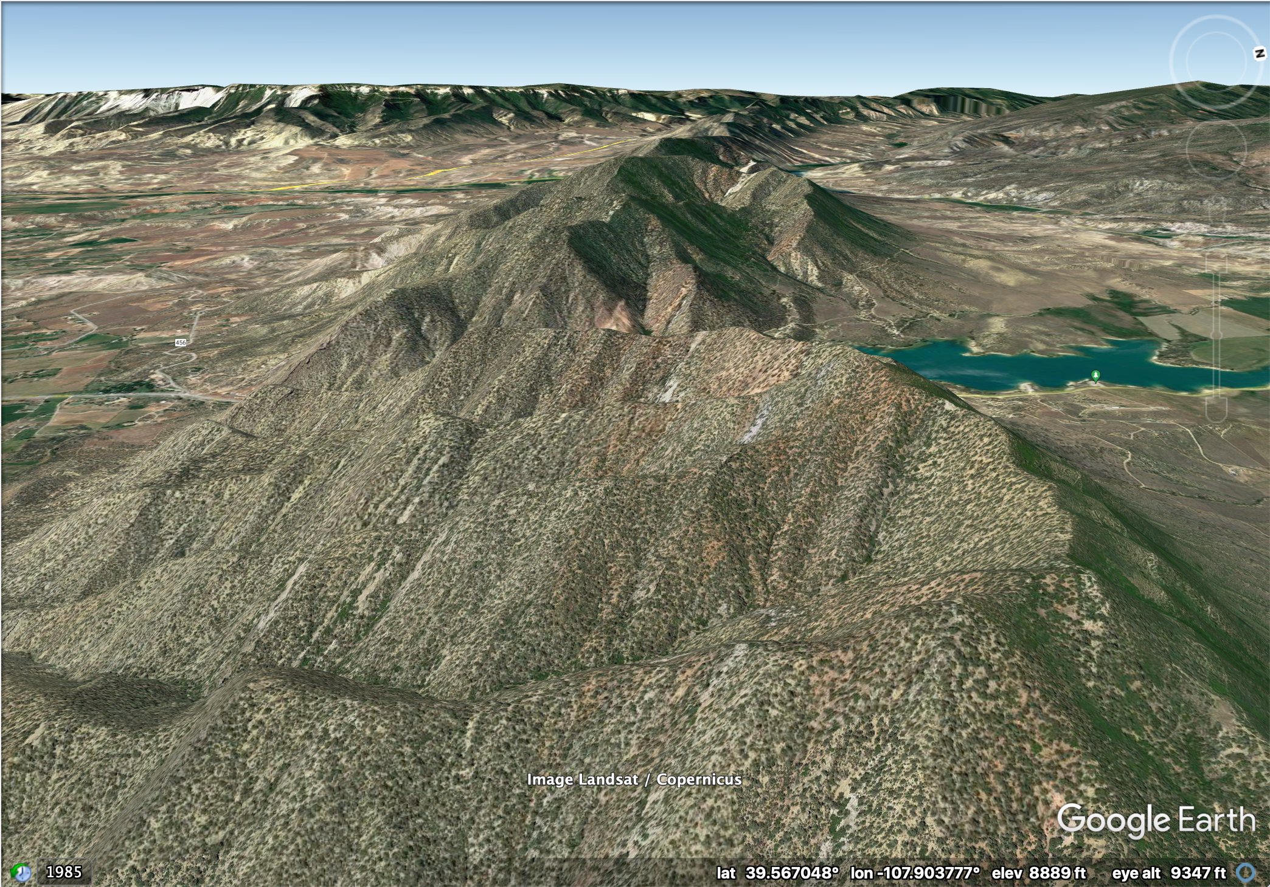
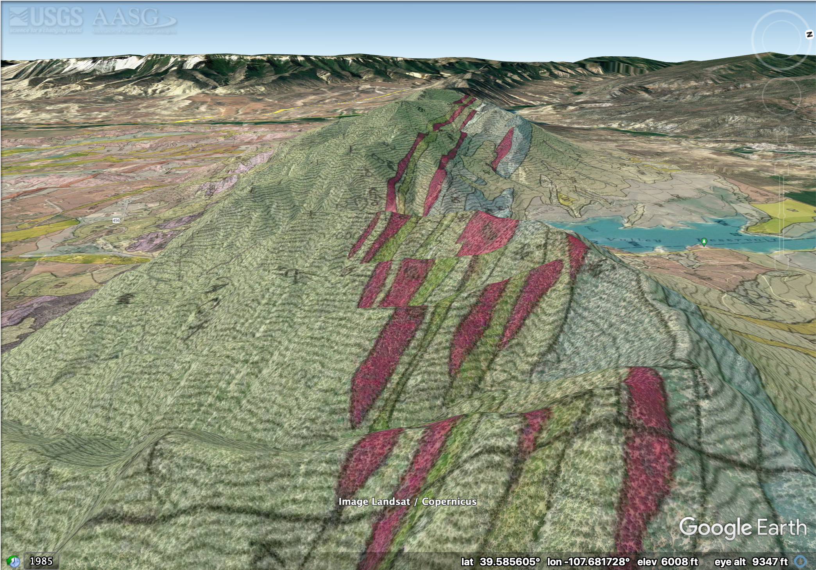
Notes:
Analogous to geologic mapping, and surveying the topography and geology in order to understand what the important issue are.

Slide 5


How do we map the education landscape?
Long-running, repeated, wide-reaching surveys with publicly available reports and data
Modification of surveys to address evolving needs and interests
Quantitative descriptive analysis characterizes the world or a phenomenon by identifying patterns in data to answer questions about who, what, where, when, and to what extent.
Loeb et al., 2017
Not “why.”

Slide 6
How do we use the map?
Good description presents what we know about capacities, needs, methods, practices, policies, populations, and settings in a manner that is relevant to a specific research or policy question.
Loeb et al., 2017
2018 NSSME+ research questions
To what extent do computer science, mathematics, and science instruction reflect what is known about effective teaching?
What are the characteristics of the computer science/mathematics/science teaching force in terms of race, gender, age, content background, beliefs about teaching and learning, and perceptions of preparedness?
…
Notes:
Again, can make the analogy to geologic and topographic maps, which are made for a purpose – in the case I showed you, the research questions centered around landslides and development along the I-70 corridor in Colorado.

Slide 7
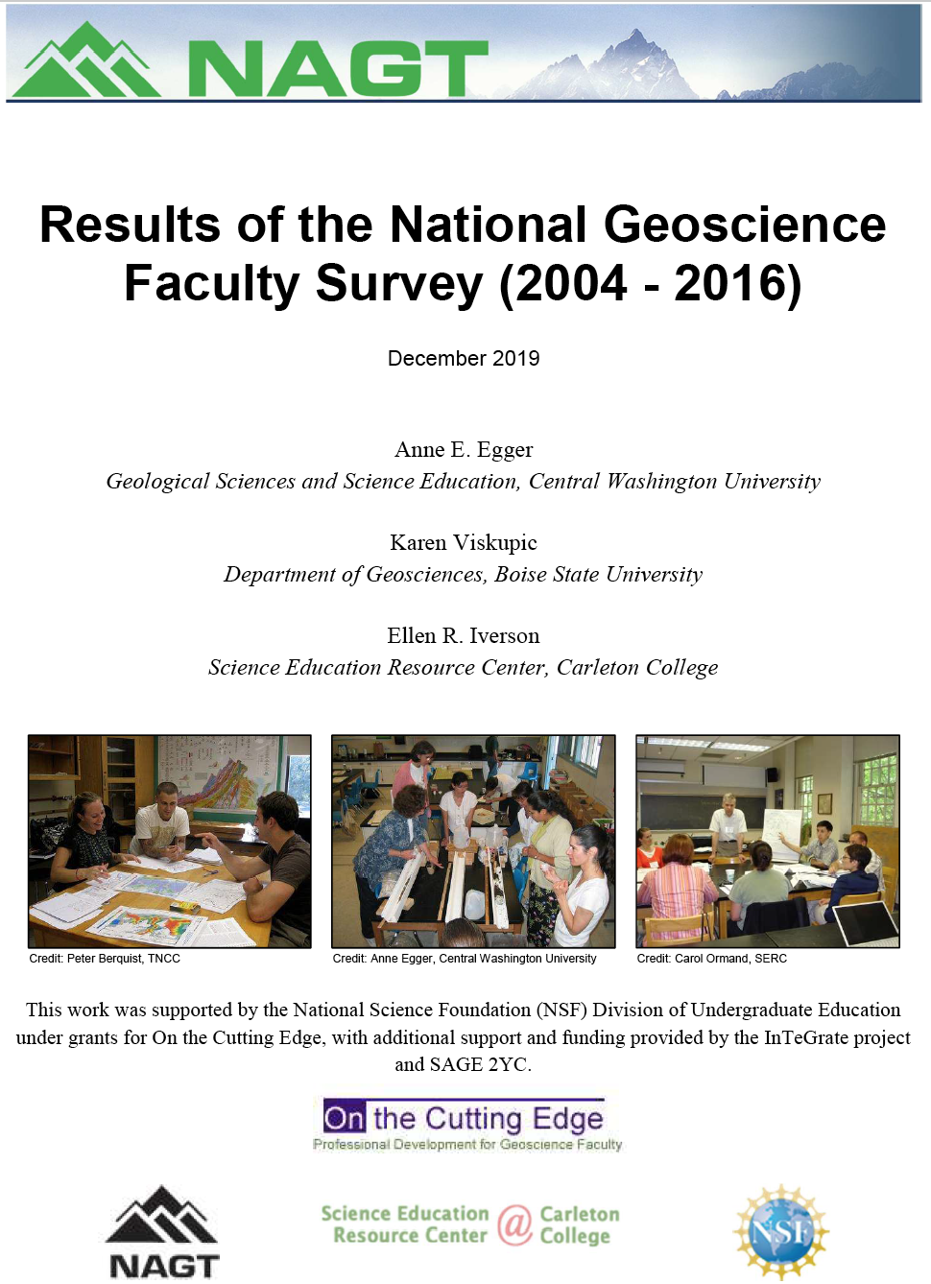
National Geoscience Faculty Survey
Designed to gather information about how faculty…
Teach in undergraduate geoscience courses,
Learn about pedagogy and content, and
Participate in the geoscience education and research communities
https://serc.carleton.edu/181940
Notes:
To what extent does undergraduate geoscience instruction reflect what is known about effective teaching?

Slide 8
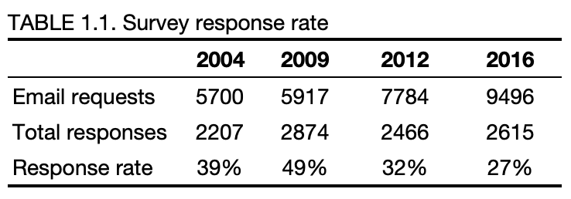
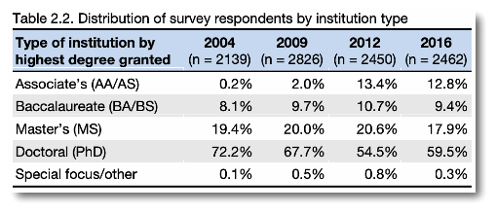
National Geoscience Faculty Survey
Administered in 2004, 2009, 2012, and 2016
Responses represent 20-25% of the geoscience faculty in the United States
Plans for continued administrations that expand the reach

Slide 9
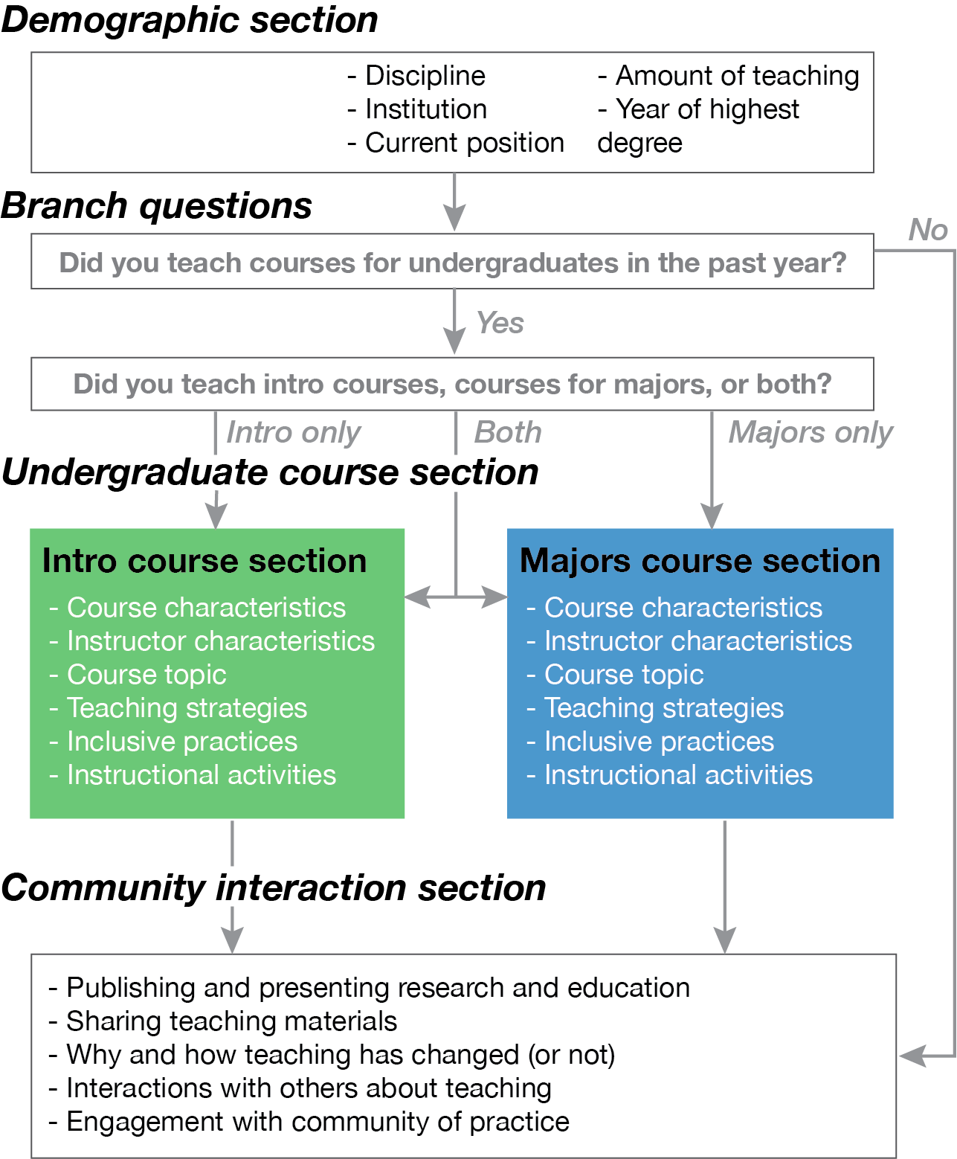
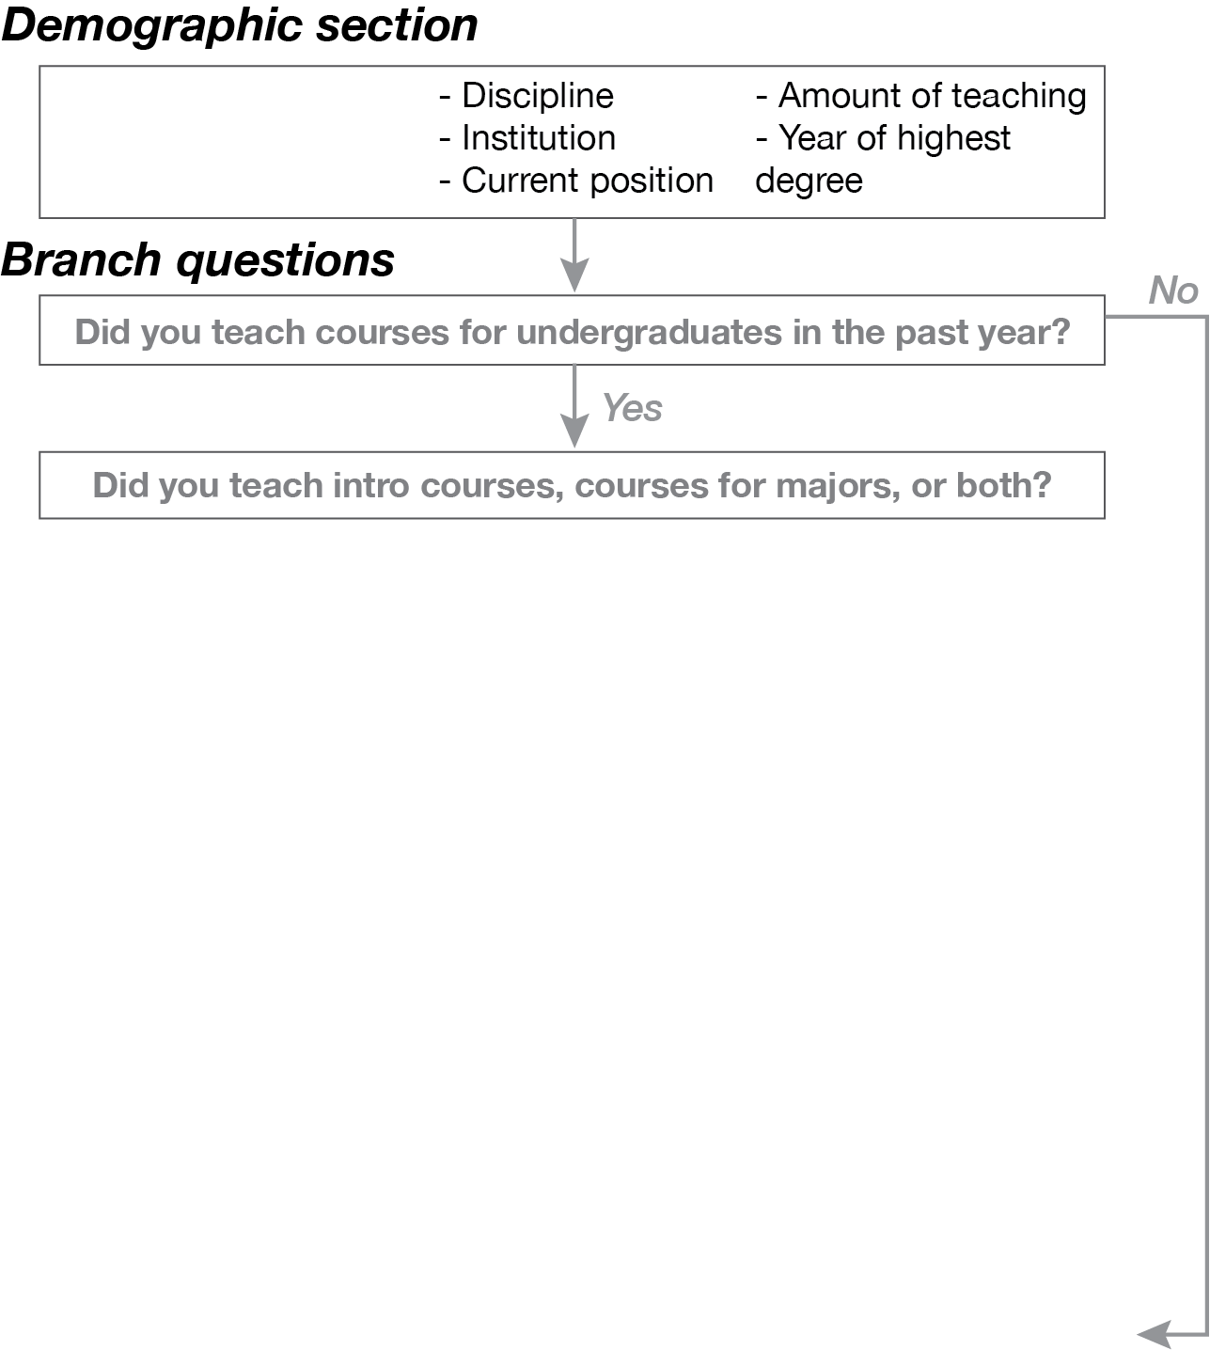
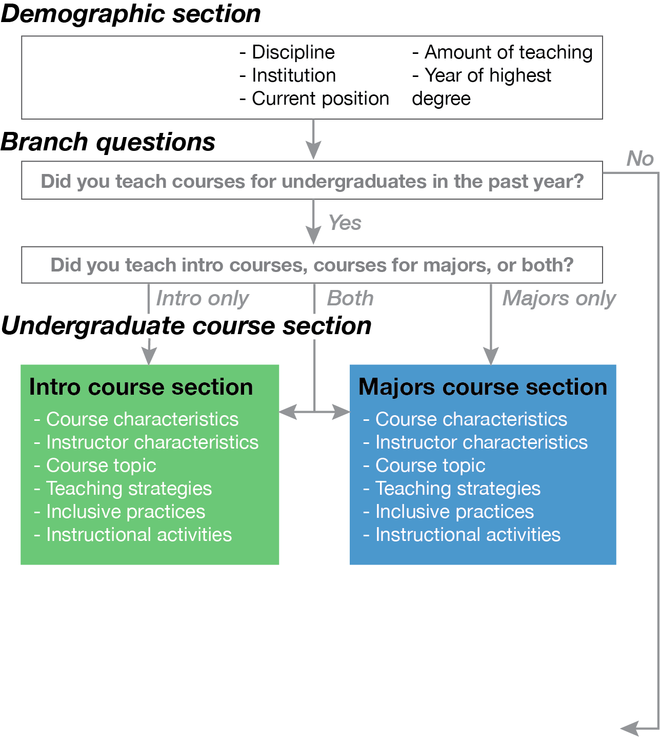
Survey questions and flow
Notes:
Survey schematic

Slide 10
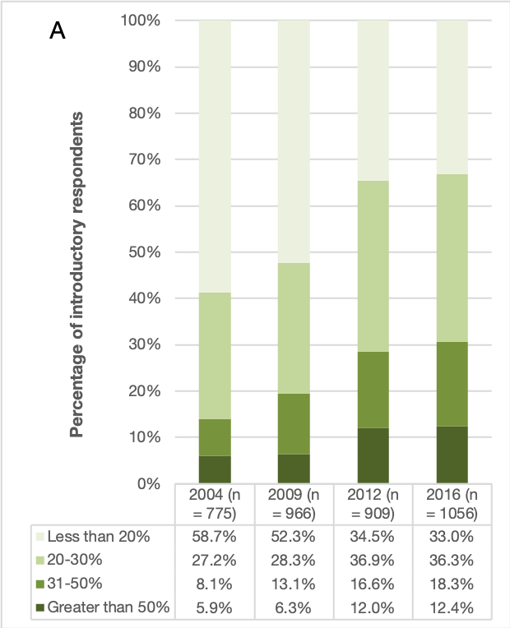
Example finding:
Amount of time spent on student activities, questions, and discussion
Notes:
Karen will talk more about results

Slide 11
Triangulation with other data sets
Representation of geoscience faculty tested by comparing respondents with AGI database (Egger et al., 2019)
Reliability of self-reported data tested by comparing results with classroom observations (Teasdale et al., 2017)
Alignment of self-reported data with learning outcomes and assessment methods tested by comparing results with syllabi (Egger, 2019)

Slide 12
…description can help researchers understand a phenomenon of interest and use that knowledge to … generate hypotheses and intervention strategies, interpret the findings of causal research, diagnose problems for practitioners and policymakers to address, and identify new issues to study.
Loeb et al., 2017, Descriptive analysis in education: A guide for researchers
Notes:
The concept of “understanding the landscape really resonates with me, and, I suspect, many geoscientists.

Slide 13
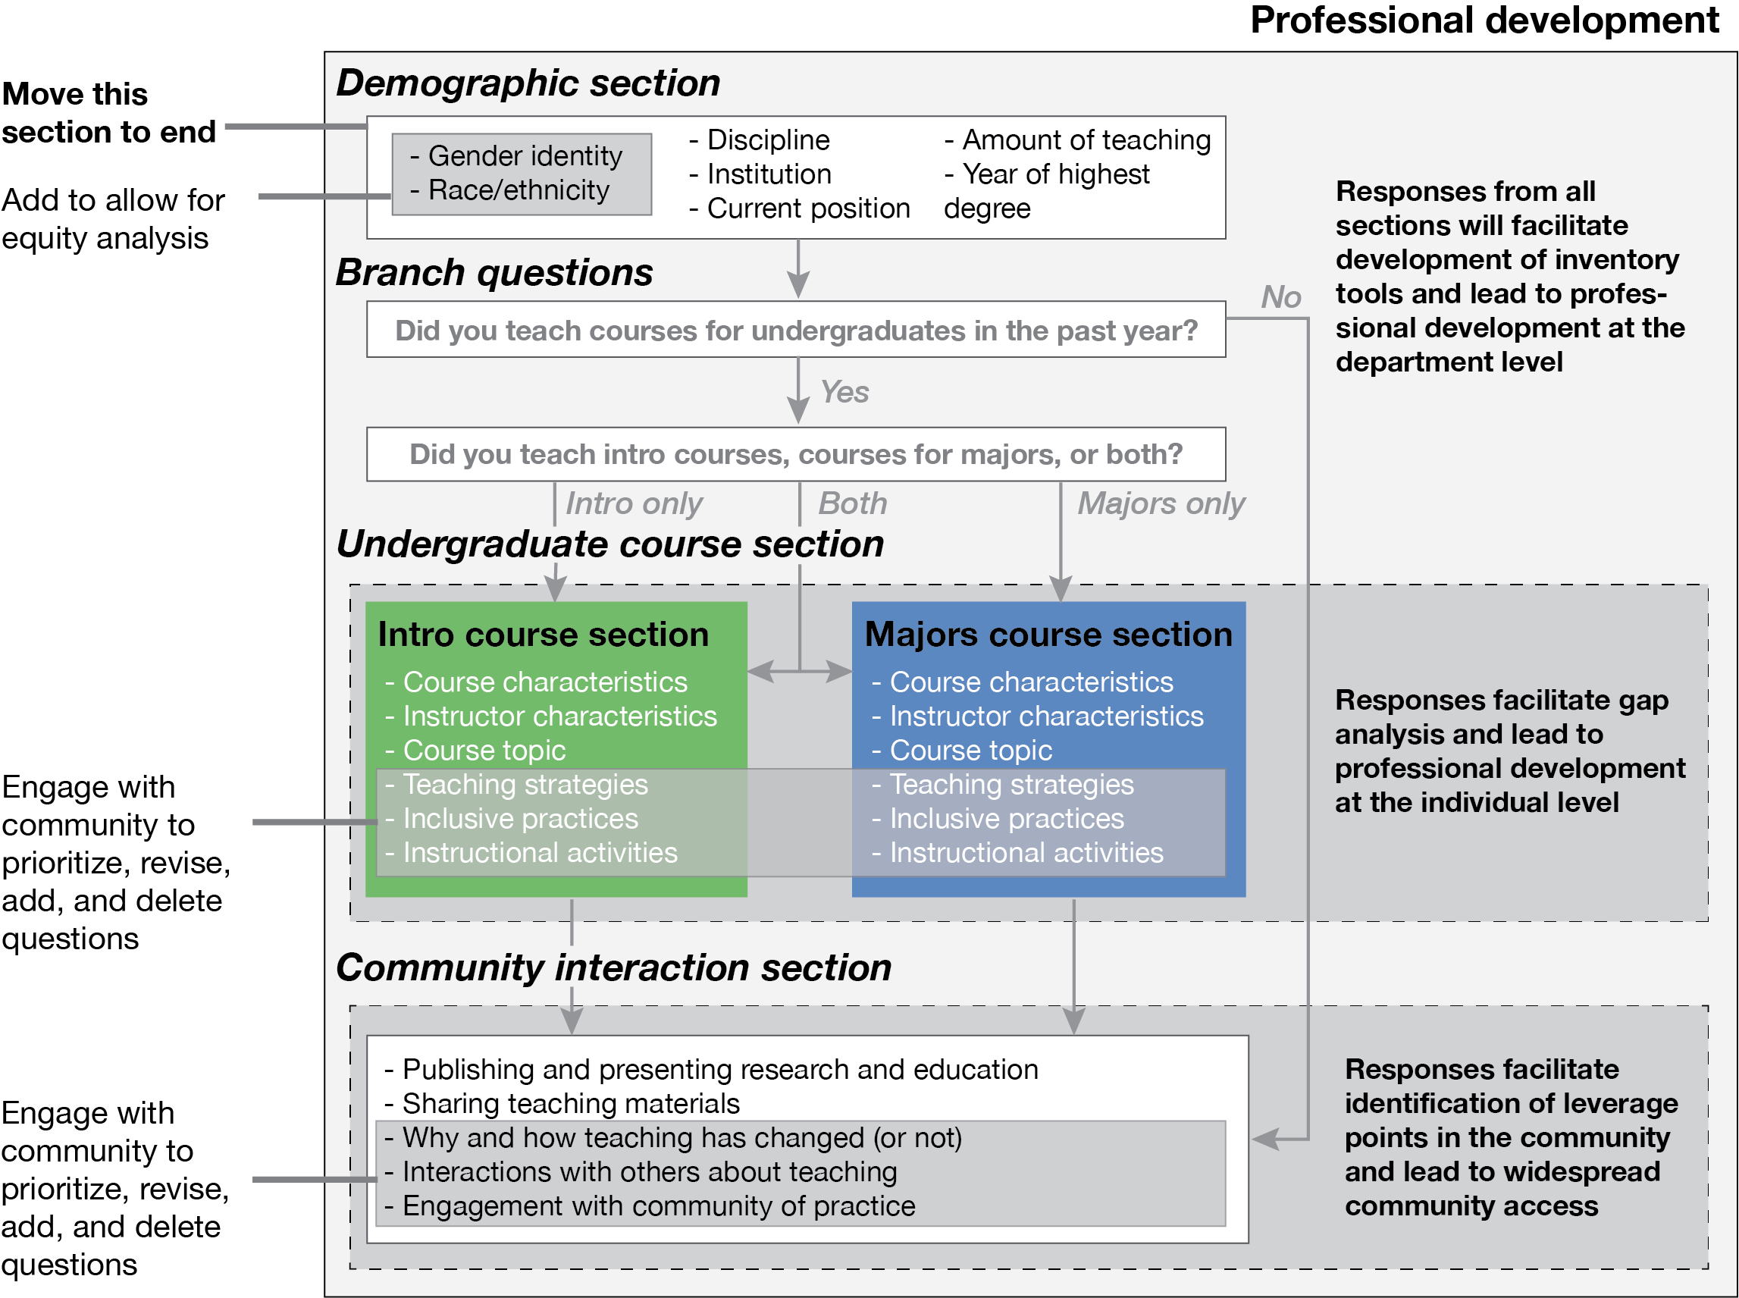
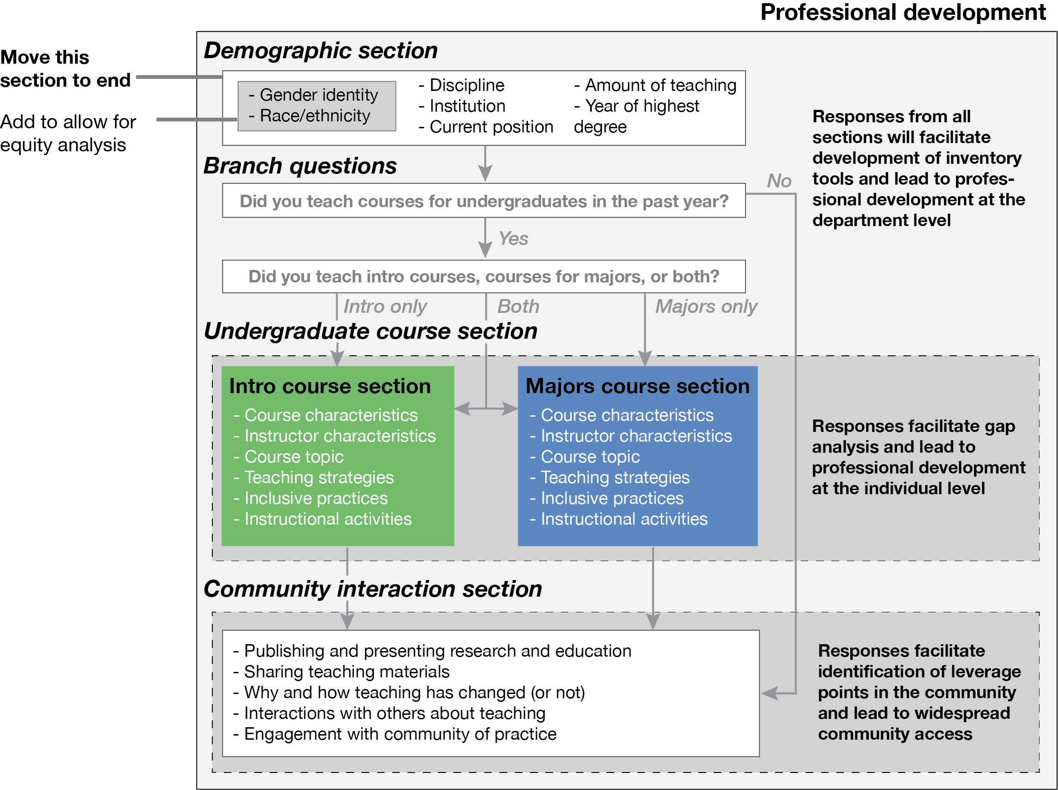
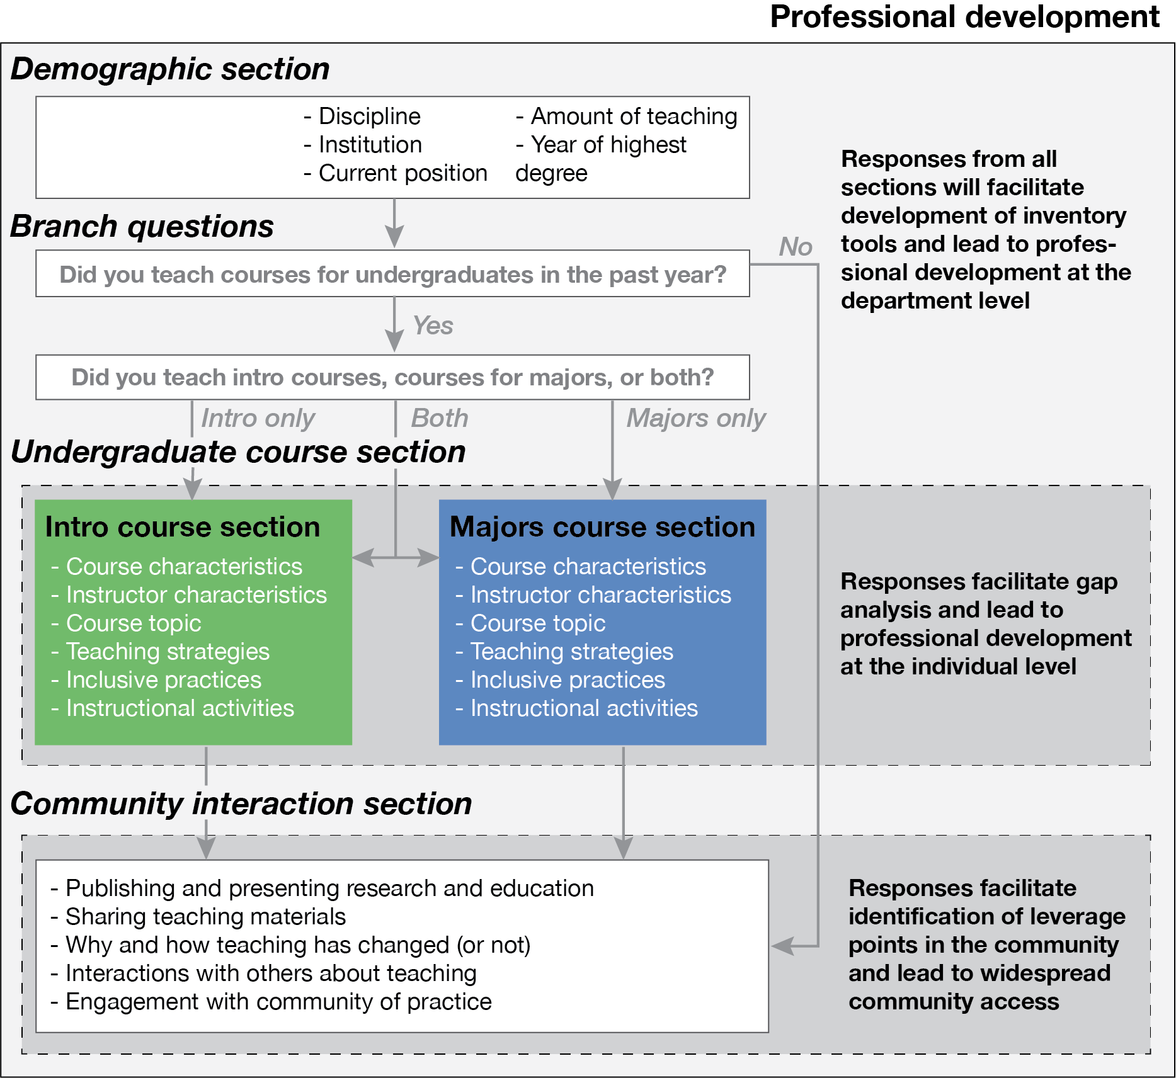
Interventions and next steps
Notes:
Survey schematic

Slide 14
Future surveys: We need you!
Descriptive analysis is an iterative process, with each step building upon others and requiring reconsideration and modification as the researcher’s understanding of the phenomenon and the study unfolds.
Loeb et al., 2017
The value of the dataset increases with increased participation at all stages: refining the questions, responding to the survey, conducting research with the results
Download the report: https://serc.carleton.edu/181940
Get in touch: Anne.Egger@cwu.edu

