Slide 1
Coarse-Grained Sediments As Potential Microbial Factories for Methane Generation in Marine Sediments
Kehua You
Peter B. Flemings
GSA Annual Meeting
Oct. 12th, 2021

Slide 2
Key Points
We develop a model of microbial methane generation where methane is produced in marine sands/silts at deep depth.
Dissolved organic carbon (DOC) diffuses from the bounding muds to sands/silts to feed the microbes.
This model simulates a methane hydrate distribution that matches field observations.

Slide 3
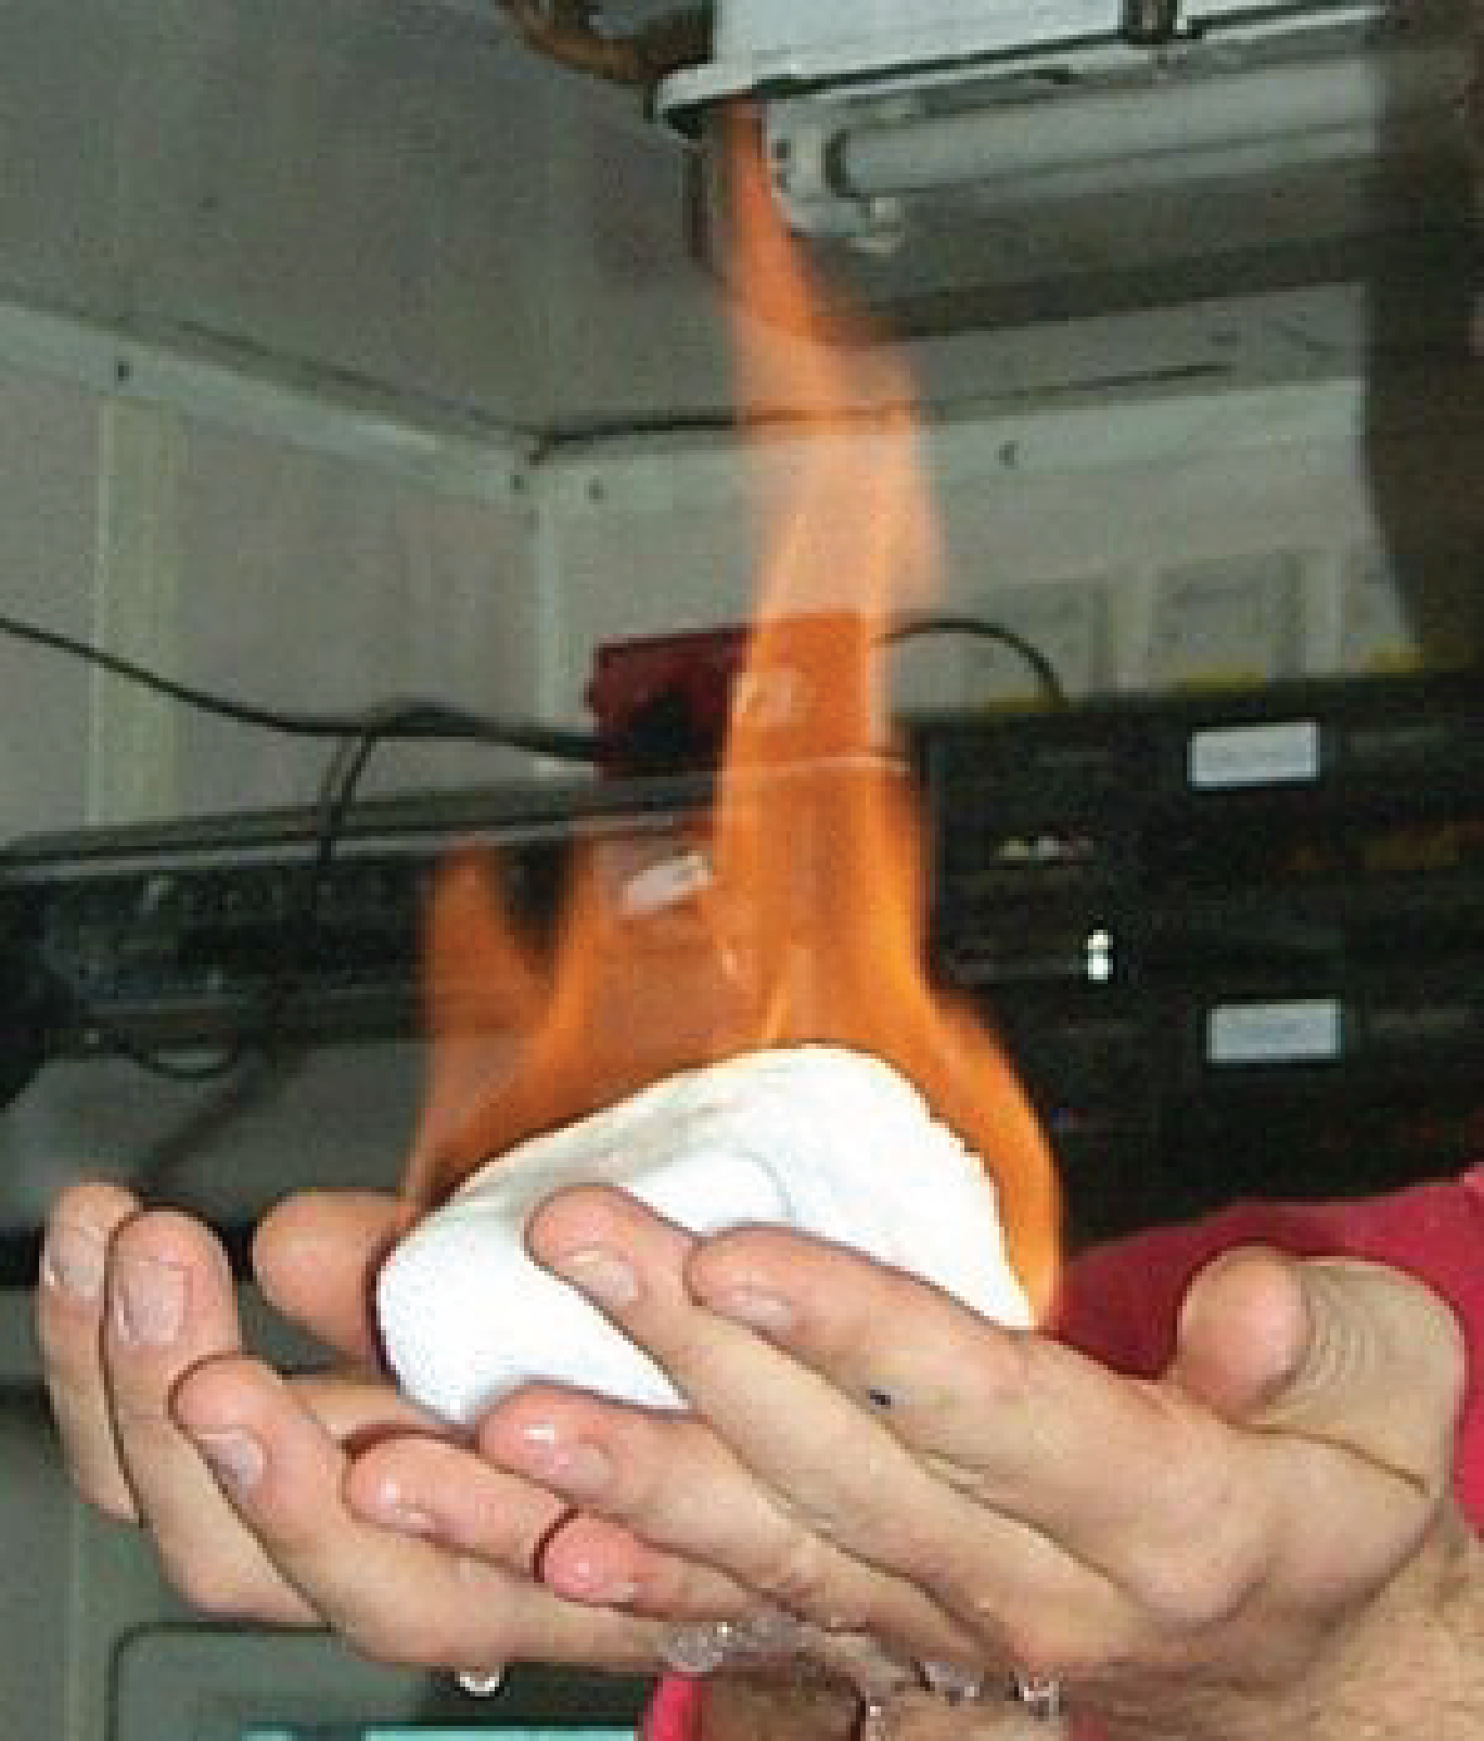
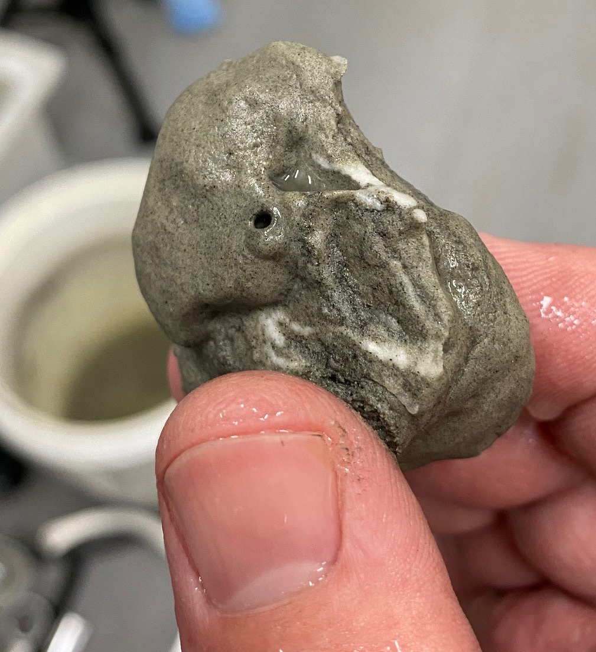
Vast majority of hydrate deposits are of a microbial source
Methane Hydrate
Offshore Japan
GC955, Gulf of Mexico
Offshore India
(Fujii et al., 2015; Kumar et al., 2016;
Santra et al., 2020)
Notes:
Hydrocarbons in the upper 1 km of marine sediments are concentrated in methane hydrate hydrates. Methane hydrate is ice like substatnce that is composed of methane and water moleculars, looks like this. It is flammable, when we burn it it release fresh water from the bottom. Here is a sample we collected from 2000 m water depth in the gulf of Mexico. Methane hydrate is widely found along the continental margins with very high concentrations at 200 to 1000 m b sf, such as . Recently we have a general recognition that the methane in hydrate is primarily microbial in origin.

Slide 4
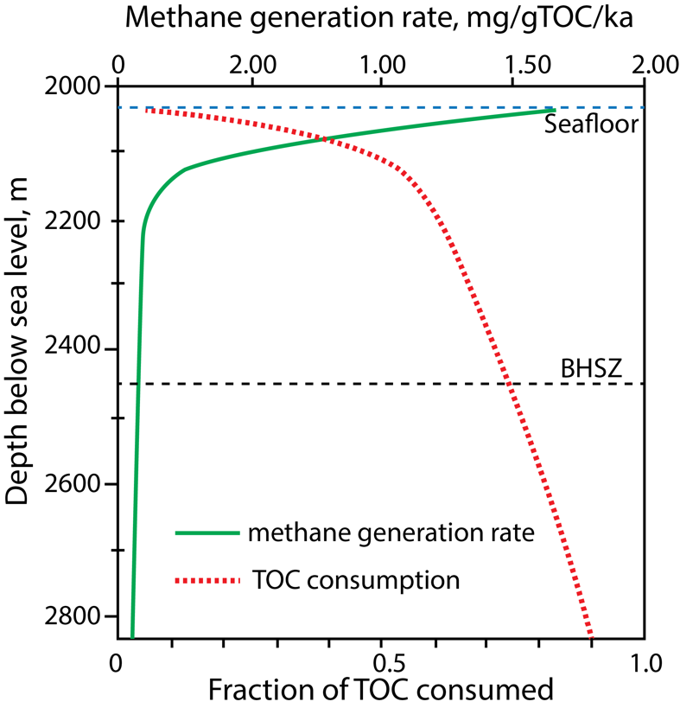
Microbial methane is commonly thought to be generated in muds
Methanogens
Collected from 247 mbsf at 950 m water depth of Nankai Trough
(Middelburg, 1989; Malinverno, 2010; Mikucki et al., 2013)
Notes:
This microbial methane is generated by biodegradation of organic carbon in marine sediments by microbes looks like this. Traditional models assumes that microbial methane is generated in muds and the rate decreases sharply with depth. As a result, Most microbial methane is generated near the seafloor.

Slide 5
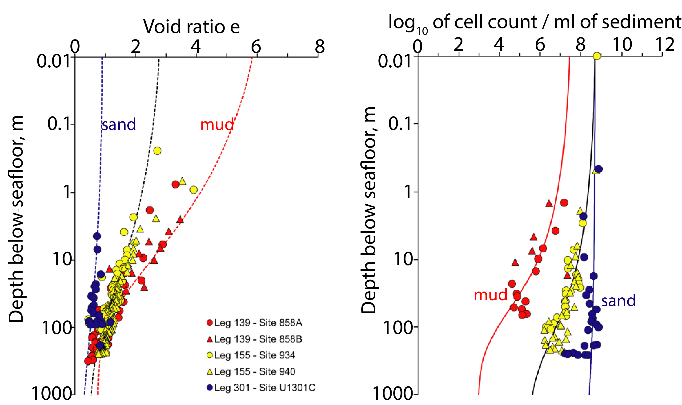
Microbes counts decrease rapidly with depth in muds
(Rebata-Landa & Santamarina, 2006 ; Park & Santamarina, 2021)
Notes:
However, recent study by … brings some challenge to the traditional model. They showed with lab experiments and field data that the pore volume and pore sizes in muds decrease rapidly with depth during burial, the red markers and line in the left figure. At the same time, the microbes counts in muds decreases significantly with depth. On contrary, both the pores and the microbes counts stays almost the same during burial.

Slide 6
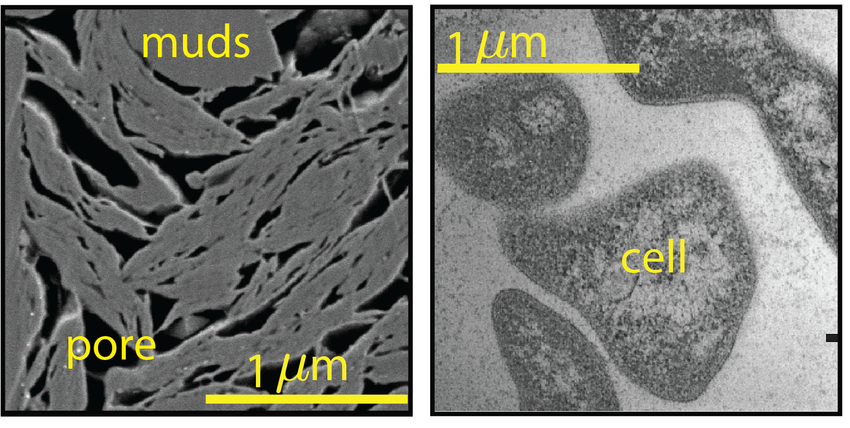
Pores in muds are not large enough to house cells
Scanning electron microscopy of resedimented mudrock at 100 m below the seafloor of Gulf of Mexico
Electron micrograph of strain Nankai-1 collected at 247 mbsf offshore Japan
(Casey, 2014;
Mikucki et al., 2003;
Rebata-Landa & Santamarina, 2006)
Notes:
Here in the left figure, I am showing you the pores in the muds at 100 m below the seafloor of GOM, the dark color here. In the right, I am showing you the cells of methanogens collected from offshore Janpan. Obviously the pores in muds are too small to house the cells.

Slide 7
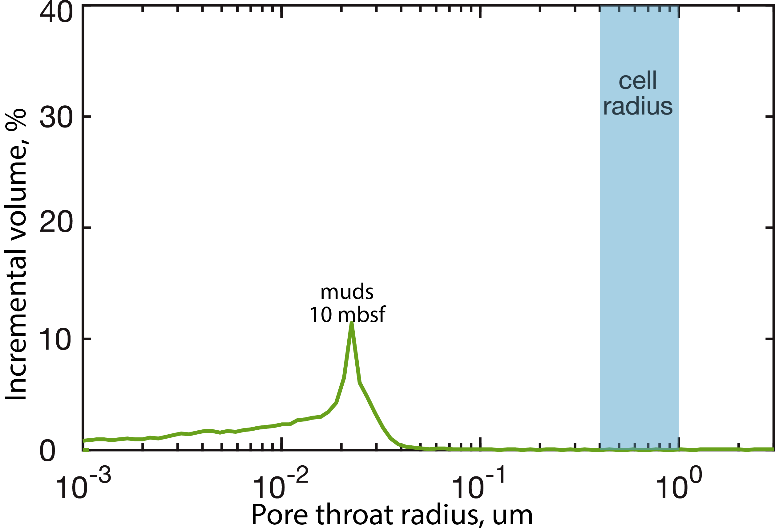
Pore throats of muds are too narrow to allow cells to move
MICP
measurement
(Casey, 2014;
Mikucki et al., 2003)
Notes:
Even if bugs live in mud, the pore throat sizes of muds are smaller than the bugs even near the seafloor where the pore throats are widest, as a result, the microbes will be trapped and cannot move freely to access the food in muds.

Slide 8
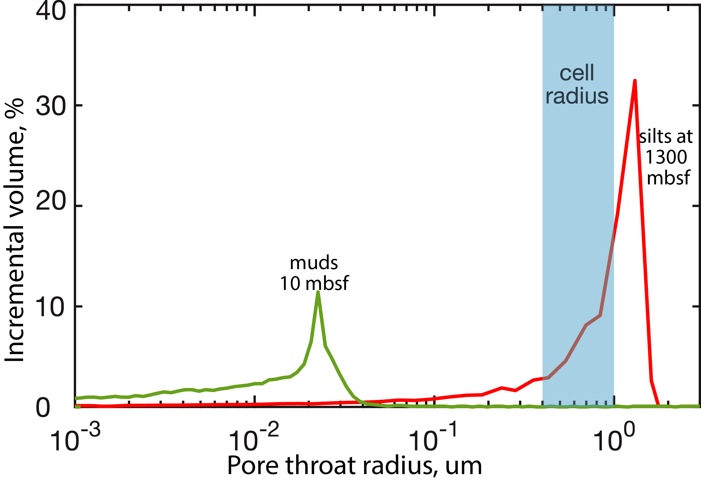
Marine sands/silts are more habitable for microbes
MICP
MICP
Notes:
On contrary, Even at 1 km, >70% of the pore throats in silts or sands are larger than bugs for the bugs to move freely to access food. Therefore, we propose that silts are more likely to be the home of these microbes.

Slide 9
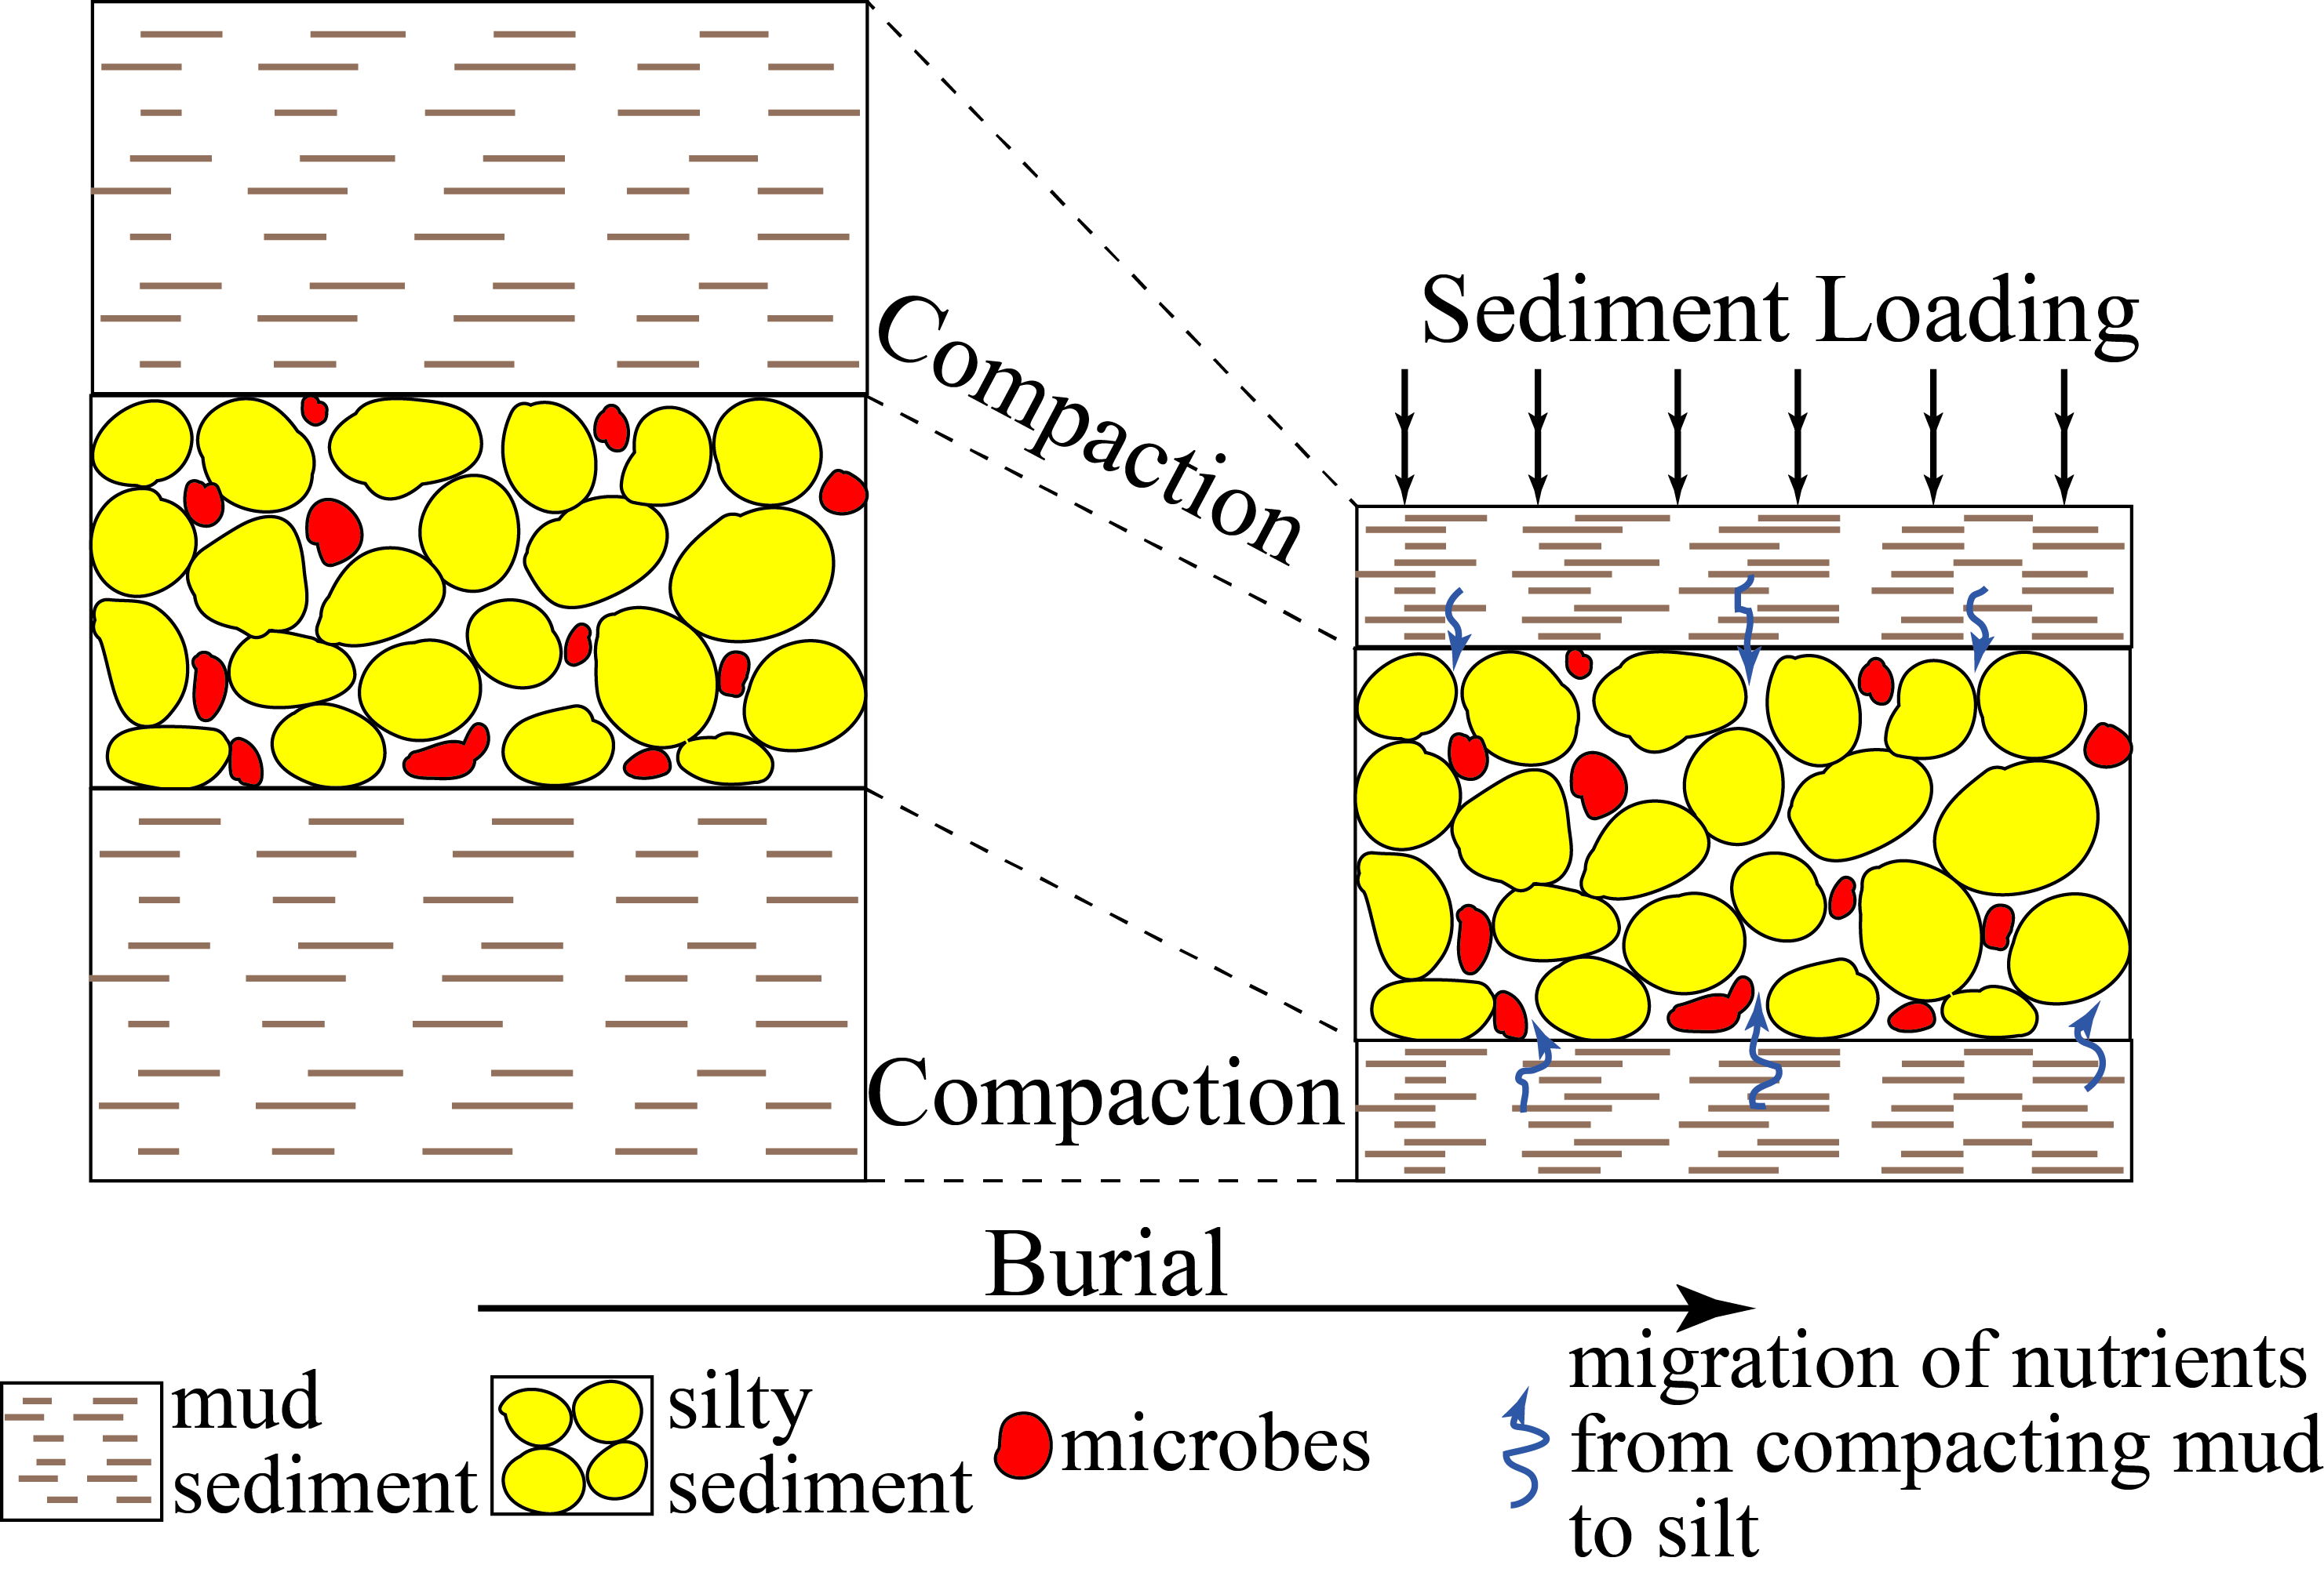
Sands/silts are favorable microbial factories in deep depth
Factory:
Interbedded muds & sands/silts
Methane department: Sands/silts
Food department: Muds
Notes:
Based on such observations we hypothesize that marine sands/silts, yellow, may act as refugia for microbes during burial, the red. So microbes mainly live in sands/silts at depth. During sedimentation, diffusion transports the food, dissolved organic carbon, from muds to sands to feed these bugs and generate methane. So our microbial methane factory is a interbedded mud and sand system where the bugs live and methane is generated in sands; the food for bugs is provided from muds.
Therefore, in addition to marine muds, marine sands could be a bioreactor to promote methane generation at higher rates than would be possible in muds of a similar deep depth.

Slide 10
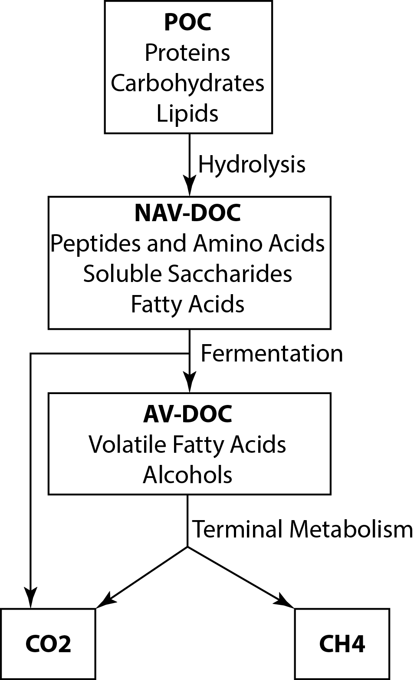
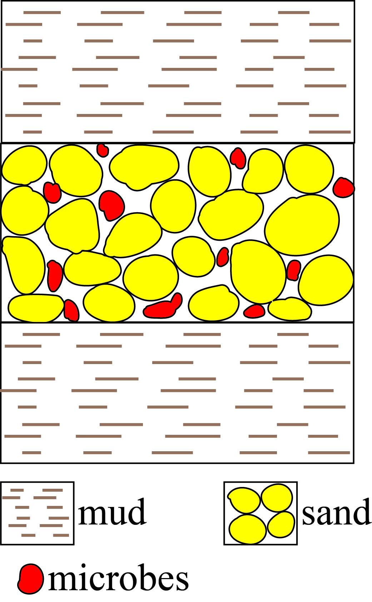
Process-1 : Particulate organic carbon (POC) degradation to dissolved organic carbon (DOC) in muds
Conceptual model of organic matter degradation in anoxic sediment (Alperin et al., 1994)
Notes:
There are three key processes in our model. The first process is the degradation of particulate organic carbon to dissolved organic carbon through hydrolysis as in the left figure. This happens in muds in our model because marine muds is usually rich in organic carbon.

Slide 11
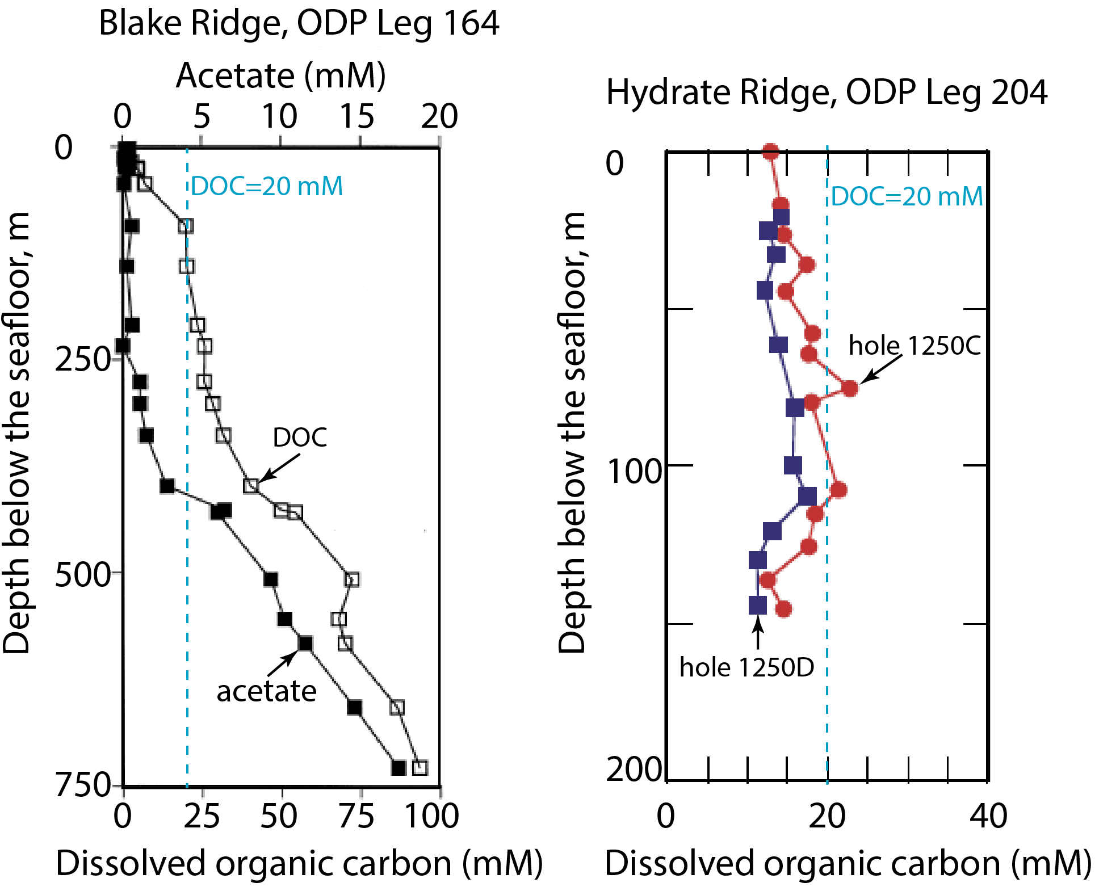
Process-1 : Particulate organic carbon (POC) degradation to dissolved organic carbon (DOC) in muds
DOC = 20 mM
DOC = 20 mM
(Egeberg & Barth, 1998; Trehu et al., 2003; Smith, 2005)
Notes:
POC degradation to DOC is poorly understood now. DOC concentration changes from less than 1 mM to more than 80 mM in the field. However, there is no correlation between DOC concentration and POC, or lithology, or depth with the existing field data. DOC concentration at two hydrate locations Blake Ridge and Hydrate Ridge is high. At Blake Ridge, it increases from several mM near the seafloor to more thane 80 at 700 mbsf. At Hydrate Ridge, it changes slightly with depth around 15 mM. For a first order approximation, we assume the DOC concentration in muds is constant 20 mM.

Slide 12
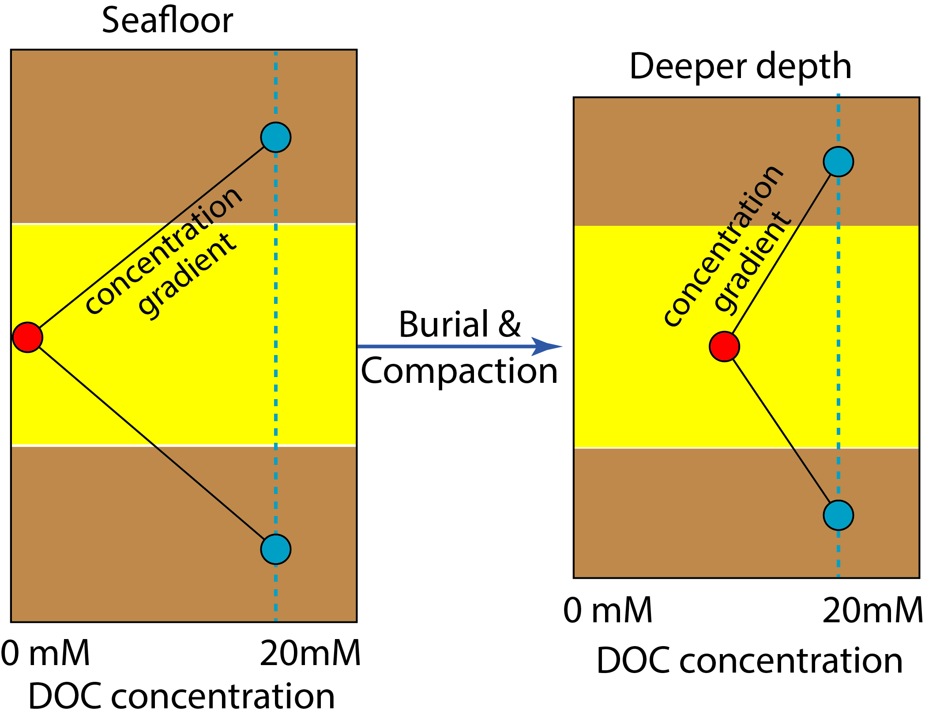
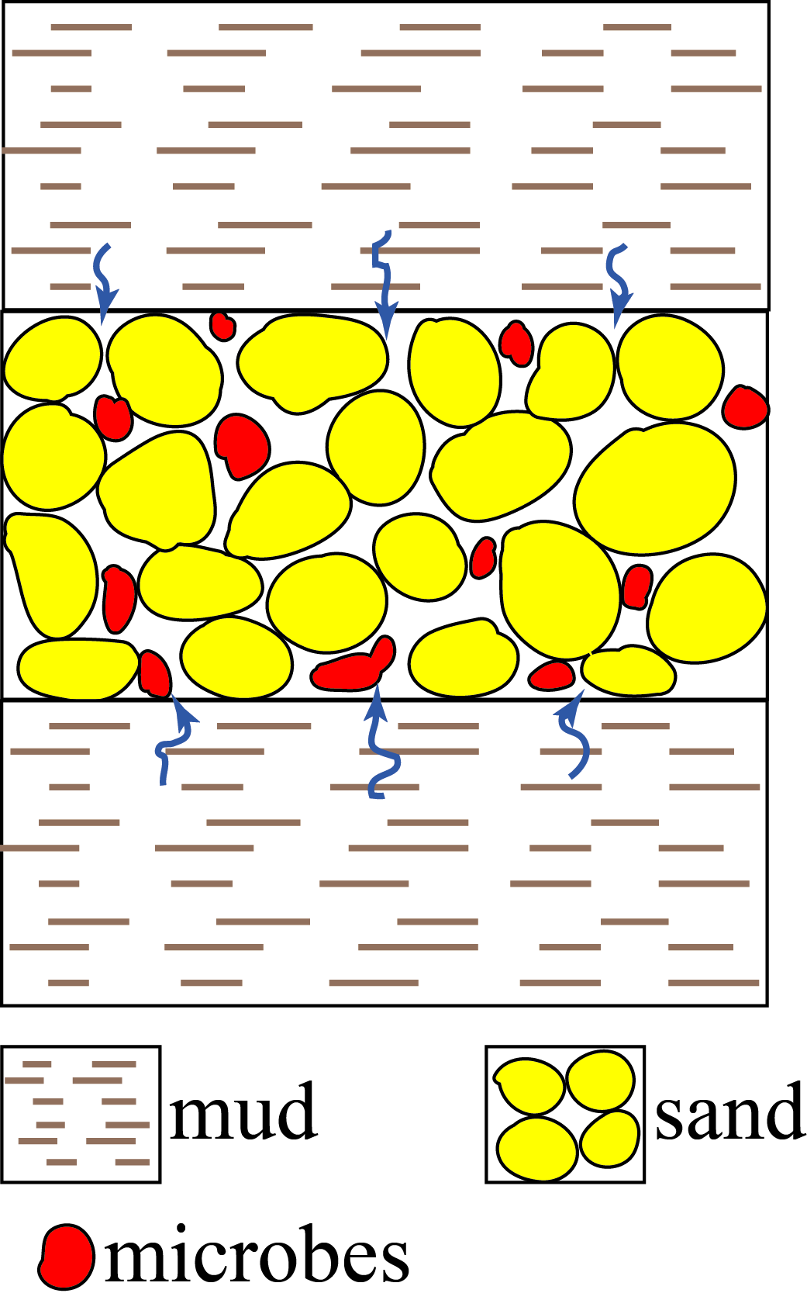
Process-2: DOC diffuses from muds to sands/silts
Notes:
The second process is transport of DOC from bounding muds to sands or silts. This is achieved mainly by diffusion. When sand is deposited from the seafloor, it has a very low DOC concentration as the seawater, during burial, the DOC in muds gradually diffuses into sands and increases the DOC concentration in sands.

Slide 13
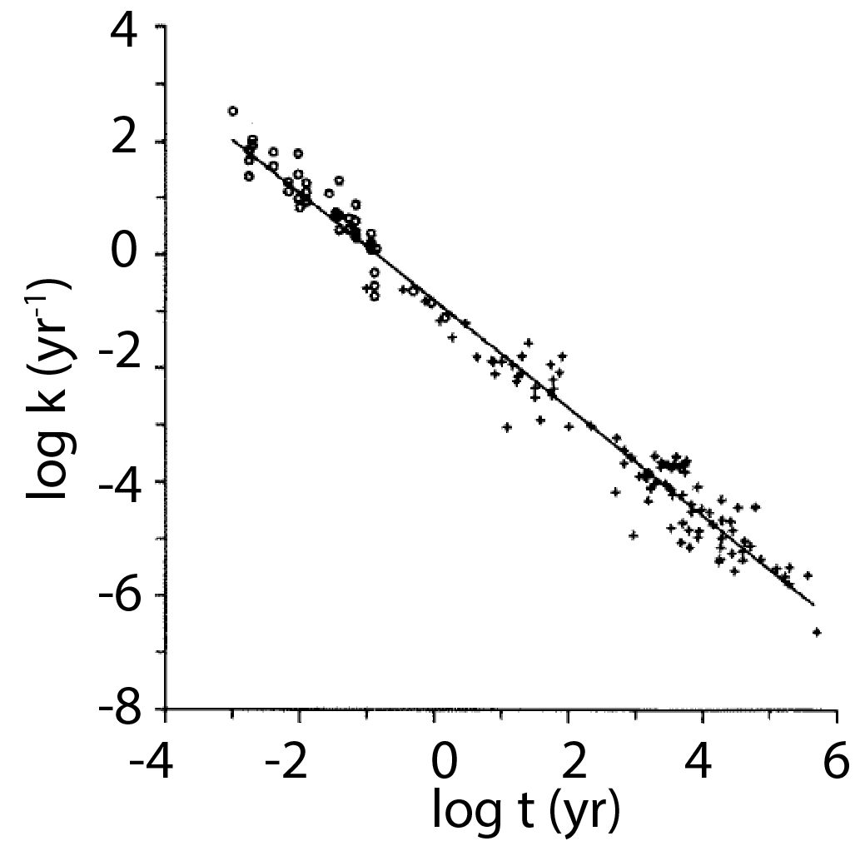

Process-3: Methane generation in sands/silts
Methane generation rate R_{CH4}:
$$R_{CH4}=A k\left(t\right)C_{doc}$$
(Alperin et al., 1994; Middelburg, 1989)
Notes:
The third process is methane generation in sands. This is a complicated process as in the middle figure. I approximate it with a one step conversion to DOC to CH4 with the rate directly by this equation. Here k(t) is the reactivity of DOC It decreases with the age as the more labile DOC is consumed preferentially. We describe it by the Middelburg in this figure. Cdoc is the doc concentration in sands; A is a scaling factor.

Slide 14
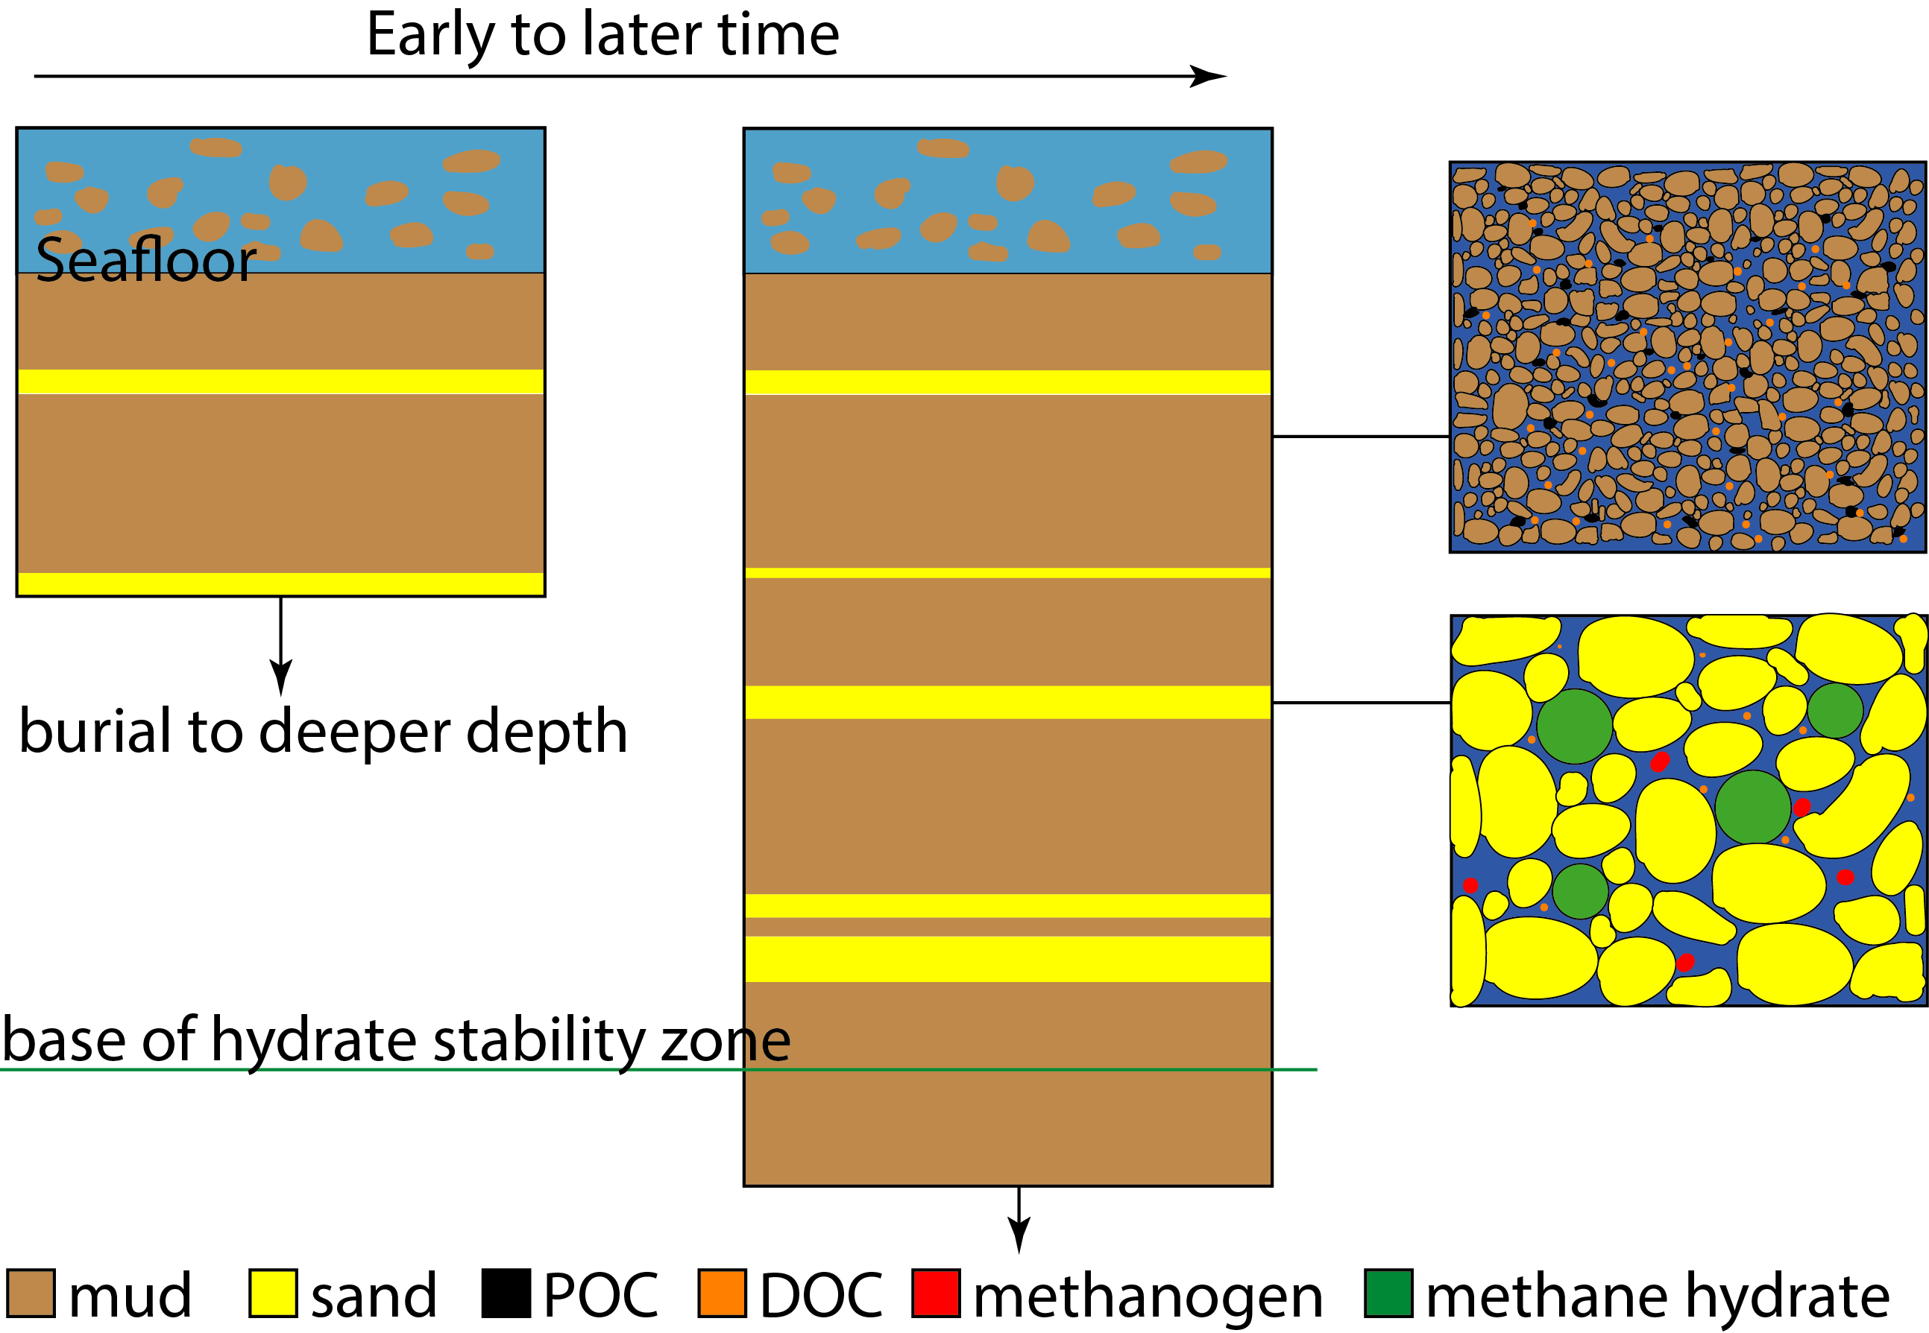
Microbial methane generation and hydrate formation during burial
Deposition and sedimentation
Microbial methane generation in muds
Methane diffusion from muds to sands
Methane hydrate formation in sands
Burial of hydrate
(You & Flemings, 2021)
Notes:
We then integrate this model to our geological model of sedimentation and compaction with microbial methane generation and methane hydrate formation. We initially have a short pile of sediment that is consist of muds brown, and sands, yellow from the seafloor. With time, more sediment is deposited from the seafloor and buried. At the same time, organic carbon is buried with muds, POC is degraded in muds to DOC. Then DOC is diffused from mounds to sands, where microbes live. The methanogens then take the DOC and generate methane. When enoguth methane is generated, methane hydrate precipate out, the green and buried with sands.

Slide 15
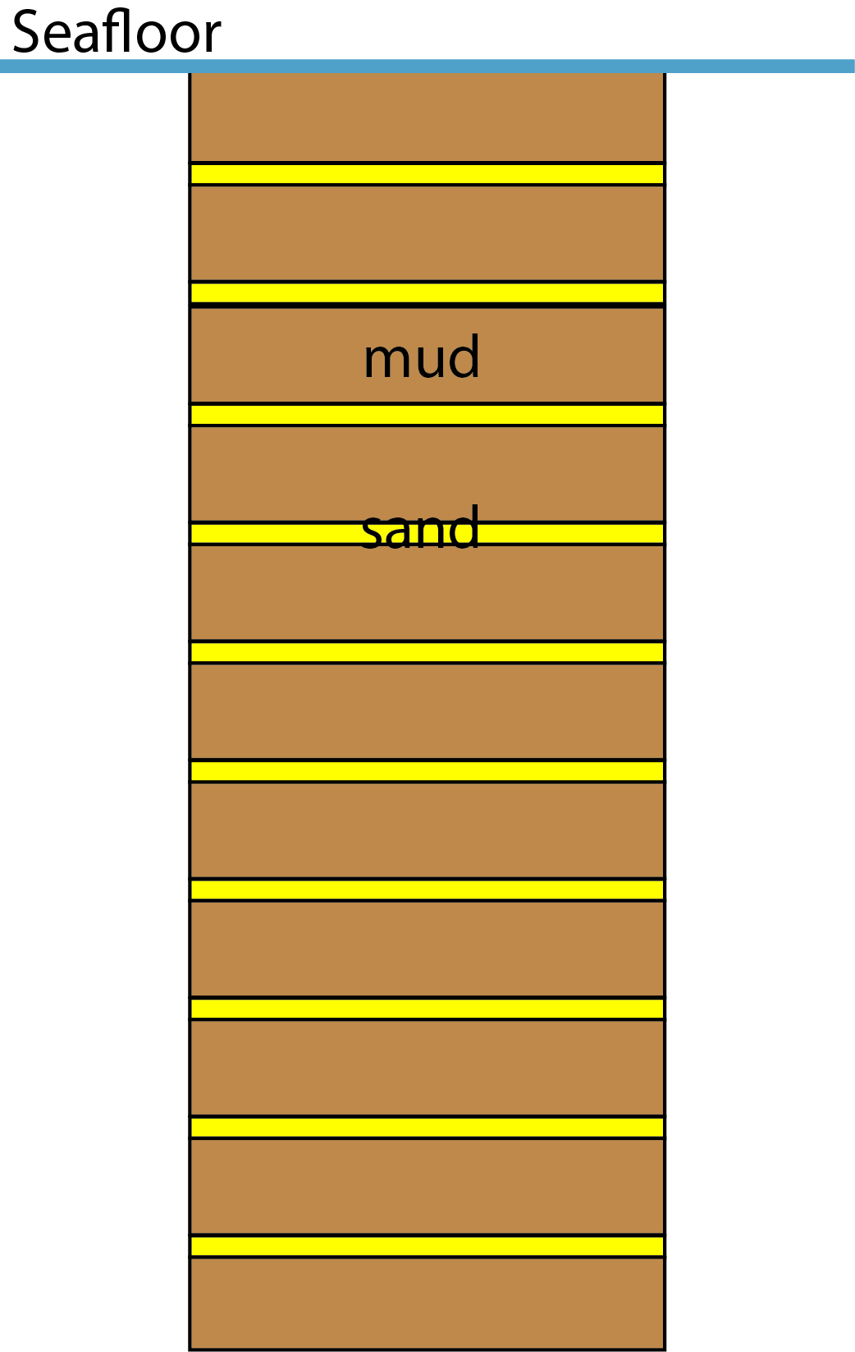
Predicted hydrate saturation and distribution matches measurements at northern Cascadia margin
Saturation
IODP Site U1325
Depth below the seafloor, m
(Riedel et al., 2010; Malinverno, 2010; You & Flemings, 2021)
Notes:
We then apply this model to predict the methane hydrate distribution at IODP site U1325. The sediment below the seafloor is composed of interbedded layers of muds, the brown, and sands, the yellow, with the thickness ratio of 50:1. Methane hydrate is found to have a saturation as high as 60% at 200 mbsf. In addition, methane hydrate is only present in sands. We predict a hydrate concentration and hydrate distribution, the green bar here, that matches the field observation very well.

Slide 16
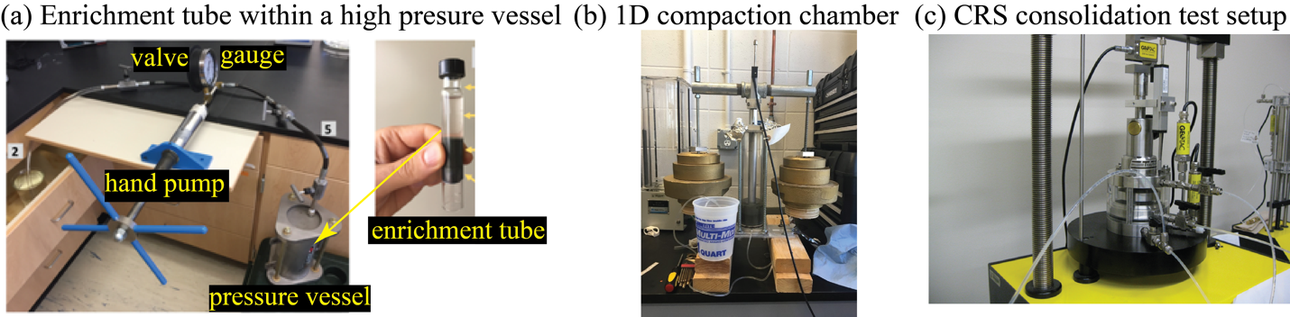
We are testing the methanogenesis model in laboratory
Notes:
Currently, we are testing our new methanogenesis model in lab where we cultivate methanogens collected from offshore Japan, we mix it with either muds or sands, and compact the sample to different levels of stress, and measure the cells number and the activitivy.

Slide 17
Summary
We develop a model of microbial methane generation where methane is produced in marine sands/silts at deep depth.
Dissolved organic carbon (DOC) diffuses from the bounding muds to sands/silts to feed the microbes.
This model simulates a methane hydrate distribution that matches field observations.
Notes:
To summarize

Slide 18
Thanks for your attention !
Questions ?

Slide 19
Predicted hydrate saturation and distribution matches measurements at northern Cascadia margin
IODP Site U1325
(Riedel et al., 2010; Malinverno, 2010; You and Flemings, 2021)
Notes:
We then integrate this new methanogenesis model into a multiphase flow multicomponent hydrate simulator to predict the methane hydrate distribution at IODP site U1325. The sediment below the seafloor is composed of interbedded layers of muds, the brown, and sands, the yellow, with the thickness ratio of 50:1. Methane hydrate is found to have a saturation as high as 60% at 200 mbsf, and methane hydrate is only present in sands. We predict a hydrate concentration and hydrate distribution that matches the field observation.

