Slide 1

U.S. Minerals Policy and the Rise of the Critical Minerals Agenda
David Spears
Virginia Department of Energy
energy.virginia.gov

Slide 2

Definitions of “public policy”
“…the sum total of government actions from signals of intent to the final outcomes.” (Cairney, 2012)
“…a system of laws, regulatory measures, courses of action, and funding priorities concerning a given topic promulgated by a governmental entity or its representatives.” (Kirkpatrick, 2000)
“… the means by which a government maintains order or addresses the needs of its citizens through actions defined by its constitution.”(White, 2015)
“…whatever the government decides to do or not to do.” (Dye, 2005)
energy.virginia.gov
Notes:
When there’s a problem, citizens expect the government to DO SOMETHING about it.

Slide 3
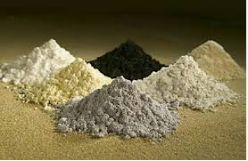
Definitions of “critical minerals”
“… mineral resources that are essential to the economy and whose supply may be disrupted.” (American Geosciences Institute)
“Minerals…essential to the economic and national security of the United States and [for which] the U.S. is dependent on imports…for most if not all of our domestic supply.” (Society for Mining, Metallurgy, and Exploration)
a mineral (1) identified to be a nonfuel mineral or mineral material essential to the economic and national security of the United States, (2) from a supply chain that is vulnerable to disruption, and (3) that serves an essential function in the manufacturing of a product, the absence of which would have substantial consequences for the U.S. economy or national security” (Presidential Executive Order No. 13817)
energy.virginia.gov
Notes:
We heard a lot about this yesterday in the Critical Metals session.

Slide 4
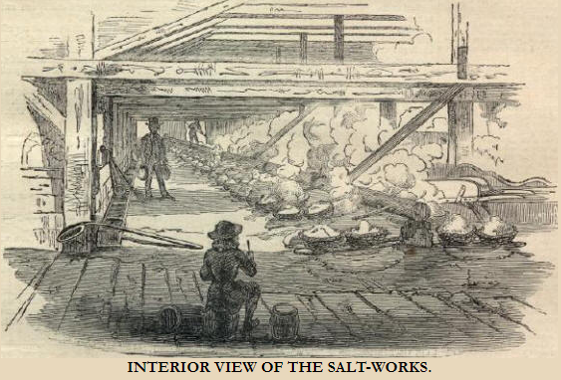
A brief history of U.S. minerals policy I – The 19th Century
The American Civil War 1861-65
  Stop the flow of iron, lead, niter, and salt to the Confederate States of America
  Conducted through direct military engagement
General Mining Law of 1872
  Regulated mineral claims on federal lands
  Emphasis on access to resources
  Minimal strategic concerns
  Little emphasis on revenue
energy.virginia.gov
Notes:
The American Civil War was arguably the first U.S. war of the INDUSTRIAL REVOLUTION. The combatants consumed large quantities of materiel. Military engagement is a POLICY decision.
The GML of 1872 was a response to the CHAOS of the mid-19th century – California gold rush & the Civil War – which saw PELL MELL development of minerals deposits.

Slide 5
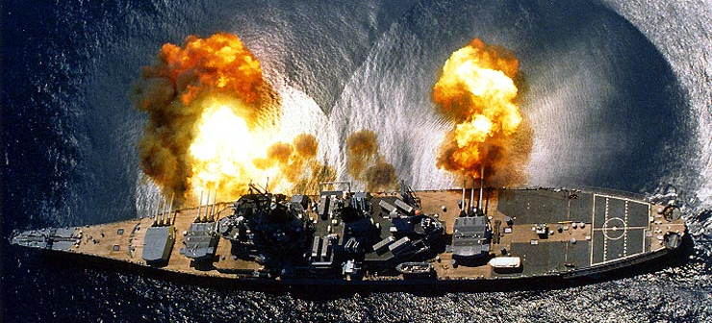
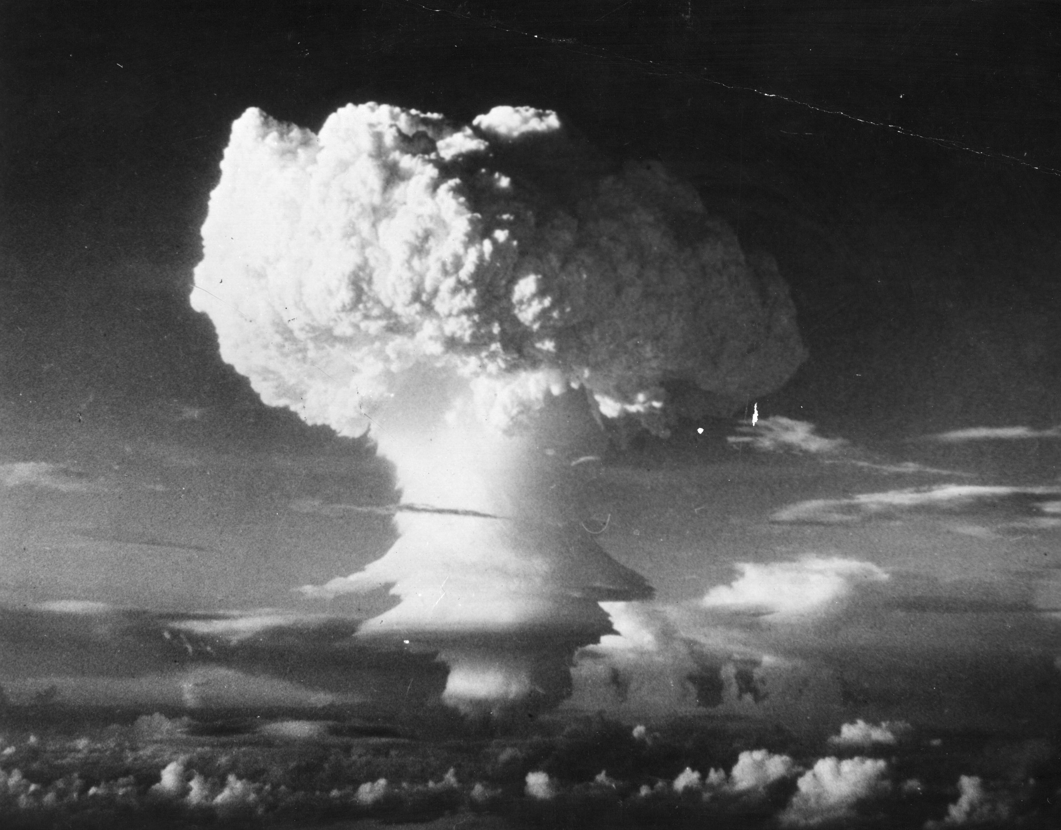
A brief history of U.S. minerals policy II –
First half of the 20th century
1910 - U.S. Bureau of Mines established
Mineral Leasing Act of 1920
Strategic Minerals Act of 1939*
Strategic and Critical Minerals Stockpiling Act of 1946
Defense Production Act of 1950
*domestic stockpiles were quickly depleted when the U.S. joined the conflict in 1941
energy.virginia.gov
Notes:
Aggressive U.S. minerals policy driven by military conflict (two World Wars). Note the term, “Critical Minerals” appears for the first time in 1946.

Slide 6
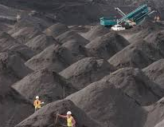
A brief history of U.S. minerals policy III –
Second half of the 20th century
1951 – President’s Materials Policy Commission
Mining and Mineral Policy Act of 1970
1979 – Strategic and Critical Minerals Stockpiling Revision Act
National Materials and Minerals Policy, Research, and Development Act of 1980
National Critical Materials Act of 1984
energy.virginia.gov
Notes:
Continued U.S. Minerals Policy driven by the Cold War. These policies were largely ineffective. Environmental policy resulted in land withdrawals (Wilderness Act), regulation of air and water emissions.

Slide 7

A brief history of U.S. minerals policy IV –
End of the Cold War
1991 - Collapse of Soviet Union greatly reduced threat of large-scale military conflict
1992 – DoD determined most of National Defense Stockpile was no longer needed
1993 - Congress ordered liquidation of much of NDS and applauded the budget implications of liquidating the stockpile
1996 - U.S. Bureau of Mines abolished
energy.virginia.gov
Notes:
USGS picked up some of the slack from abolishment of U.S. Bureau of Mines -

Slide 8
Thus, the 20th century was a period of aggressive U.S. minerals policy, driven by war and the threat of war.
This period ended with the end of the Cold War.
energy.virginia.gov

Slide 9


The 21st Century – A New Era of Energy-Critical Elements
Increased manufacture of cell phones, solar panels, wind turbines, high-efficiency lighting, new-tech batteries
U.S. minerals industry poorly positioned to meet need
At-risk global supplies
U.S. federal minerals policy inadequate to assure low-risk supplies
energy.virginia.gov
Notes:
We especially needed (and still need) METALS – battery metals, magnet metals, photovoltaic metals. This is during the period of U.S. complacency (non-action) on minerals policy.

Slide 10
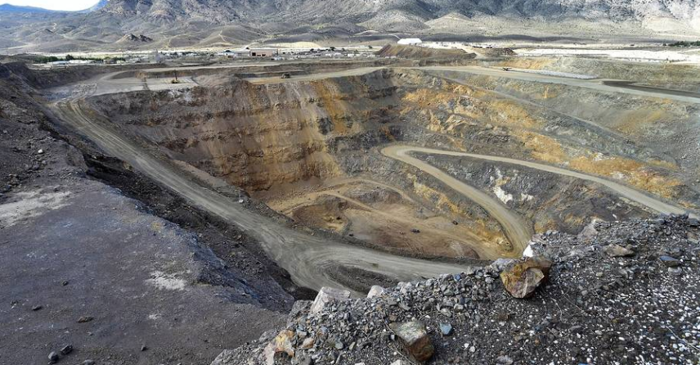
2002 – Mountain Pass, the only U.S. REE mine, shuts down
World’s dominant source of REEs, 1960s-1980s
Shutdown due to cost and environmental compliance issues
1990s - China responds with expanded REE production at very low cost
energy.virginia.gov

Slide 11

The Rare Earths Trade Dispute of 2010
China restricts exports of REEs
60 Minutes TV segment
World Trade Organization case against China
Storyline in Season 2 of House of Cards
energy.virginia.gov
Notes:
So we had scientists ringing the fire bell about potential supply disruption and then an actual supply disruption occurs

Slide 12

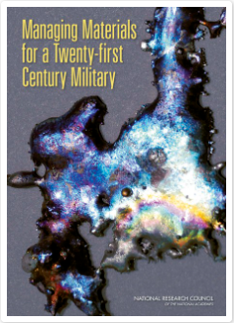

The Wake-up Call – 2008 - 2012
2008 – Managing Materials for a Twenty-first Century Military (National Materials Advisory Board)
2008 – Minerals, Critical Minerals, and the U.S. Economy (Committee on Earth Resources, National Research Council)
2009 – Reconfiguration of the National Defense Stockpile Report to Congress (DoD Strategic and Critical Minerals Working Group)
2011 – Energy Critical Elements: Securing Materials for Emerging Technologies (American Physical Society/Materials Research Society)
2012 – Critical Minerals Shortage: The need for a long-term sustainable domestic supply – Session at the first AGU Science Policy Conference
energy.virginia.gov
Notes:
These reports were primarily the work of SCIENTISTS. As we’ll see, they had a profound impact on U.S. government policy.

Slide 13

Thus, the period 2008-2012 saw a great deal of signaling on the issue of critical minerals, both from the science community and from current events.
energy.virginia.gov
Notes:
So we had scientists ringing the fire bell about potential supply disruption and then an actual supply disruption occurs

Slide 14
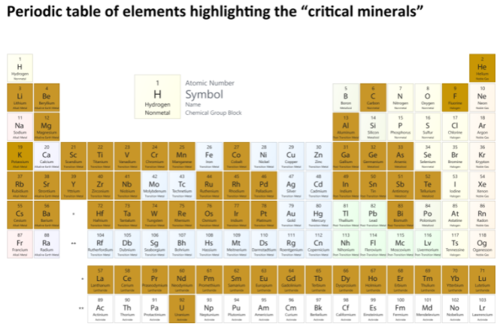
The Federal Response I –
Rebirth of a U.S. Minerals Policy
2017 – E.O. 13817 – A Federal Strategy to Ensure Secure Supplies of Critical Minerals
2018 – USGS issues final list of 35 critical minerals
2019 - Defense Production Act Title III – Presidential Determinations to Strengthen the Domestic Industrial Base and Supply Chain for Rare Earth Elements
energy.virginia.gov

Slide 15
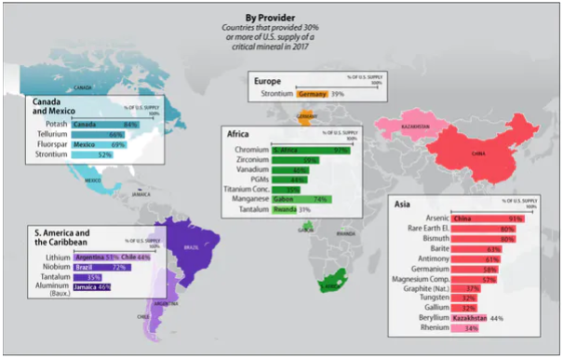
The Federal Response II –
Rebirth of a U.S. Minerals Policy
2020 – E.O. 13953 – Addressing the Threat to Domestic Supply Chains from Reliance on Foreign Adversaries and Supporting the Domestic Mining and Processing Industries
2020 – Energy Act , Section 7002 – Mineral Security
2021 – E.O. 14017 – America’s Supply Chains
energy.virginia.gov
Notes:
Trump White House, Congress, Biden White House

Slide 16

Federal Response III –
The Consolidated Appropriations Act of 2021
Budget action to support initiatives in Presidential Executive Orders and Acts of Congress
Aimed at:
  Department of the Interior
  Department of Energy
  Department of Labor
  National Science Foundation
  National Academies of Sciences, Engineering, and Medicine
energy.virginia.gov
Notes:
So this is Congress speaking with MONEY

Slide 17
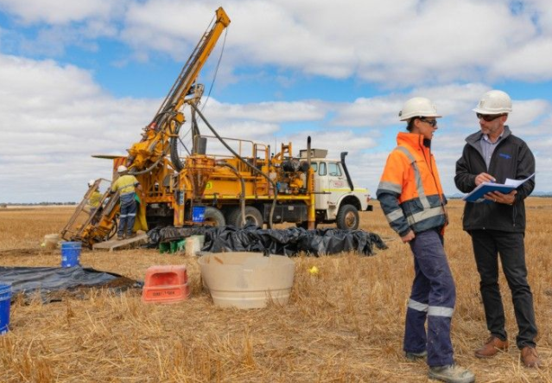

The U.S. Critical Minerals Agenda
Reduce risk by strengthening the supply chain
Maintain and update the list of critical minerals
Identify potential domestic sources with inventory, mapping, and geophysics
Increase domestic exploration, production, manufacturing, R&D, alternatives, and recycling
Streamline mine permitting
Develop a critical minerals workforce
energy.virginia.gov
Notes:
The agenda is supported by acts of Congress, by Presidential Executive Orders, and most importantly, by the federal BUDGET.

Slide 18
To summarize…
The U.S. has a mixed history of effective minerals policy
In the 20th century, periods of effective minerals policy were driven by outside forces such as military conflict & the Cold War
The current critical minerals issue arose during a period of post-Cold War policy complacency, ca. 1995 – 2015
Recent U.S. federal policy actions were largely driven by a call to action from scientists
The U.S. is now in a period of aggressive policy actions aimed at ensuring a stable supply of critical minerals
energy.virginia.gov

Slide 19
Thank you! david.spears@energy.virginia.gov
energy.virginia.gov

