Slide 1
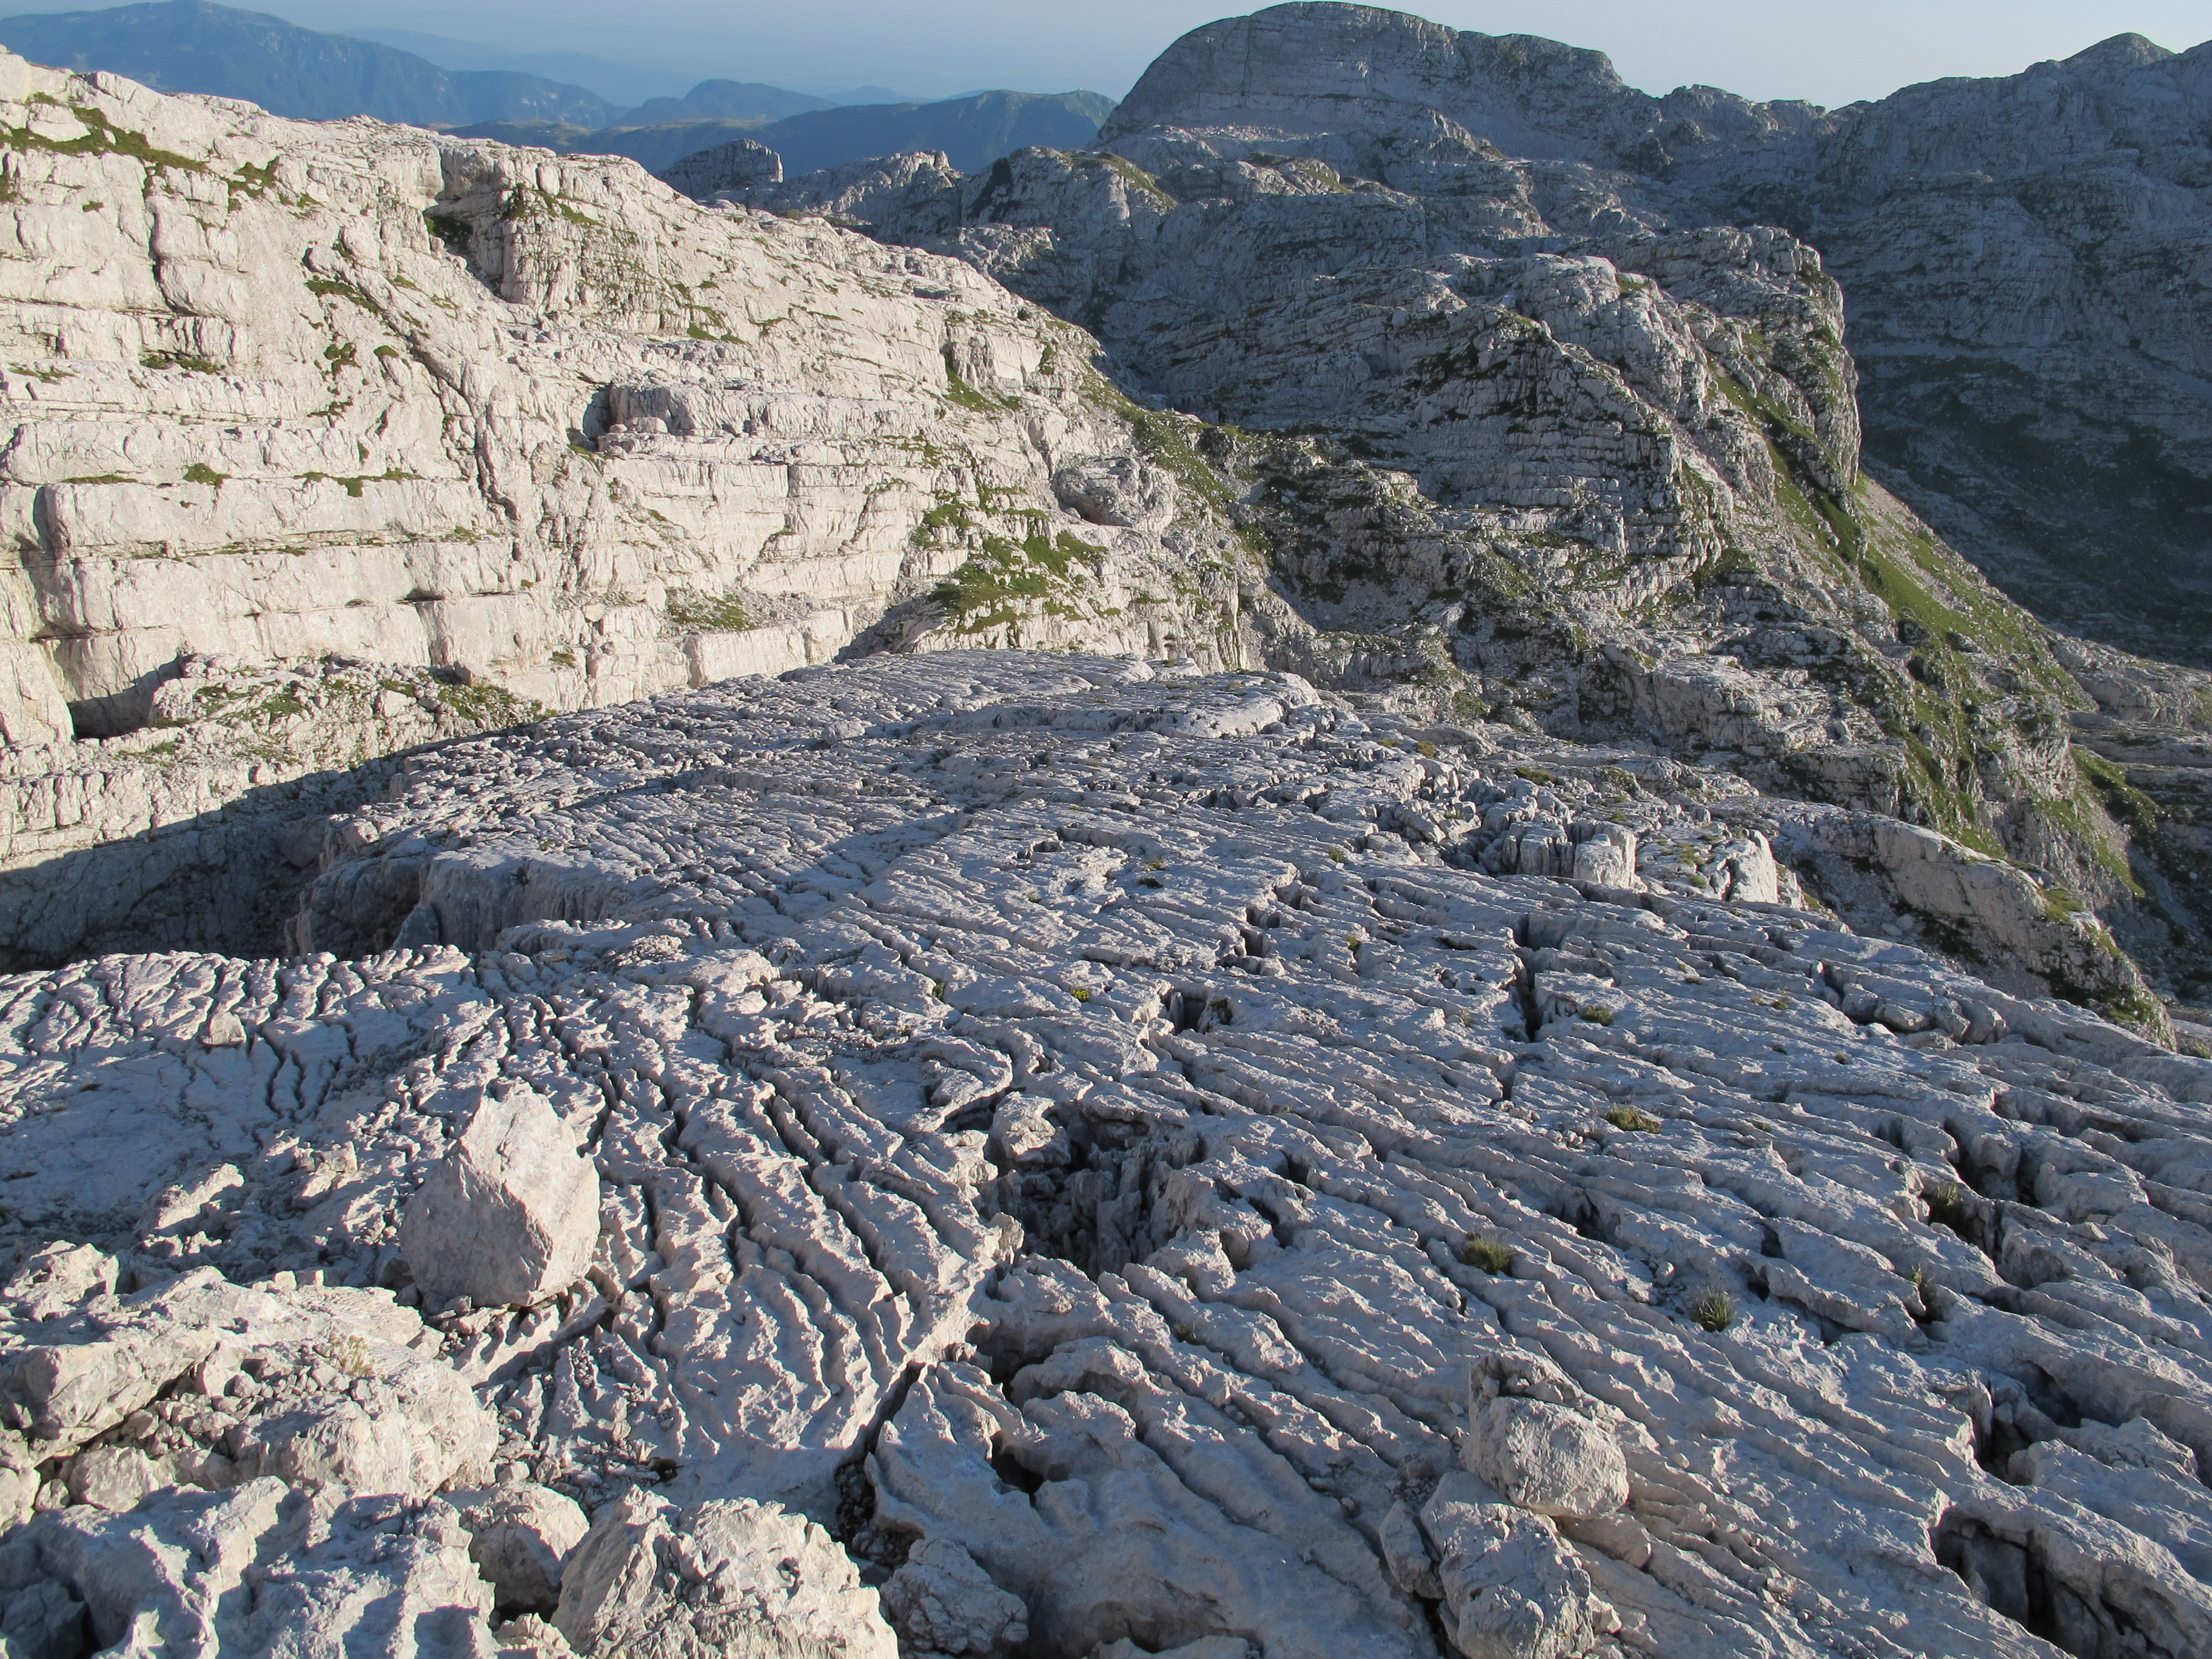

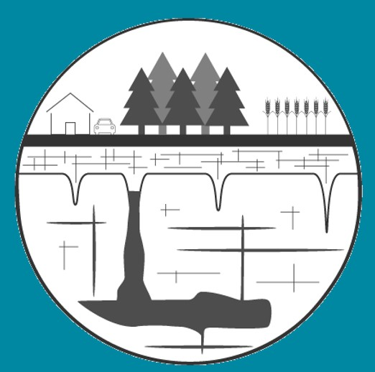
Defining the need for carbonate critical zone research
Matt Covington¹, Jon Martin², Laura Toran³, Jim Heffernan⁴, Pam Sullivan⁵, Àngel Garcia Jr.⁶, Jenn Macalady⁷, and Wendy Graham^{2,8}
1 – University of Arkansas; 2 – University of Florida; 3 – Temple University; 4 – Duke University; 5 – Oregon State University; 6 – James Madison University; 7 – Pennsylvania State University; 8 – Water Institute, University of Florida​

Slide 2
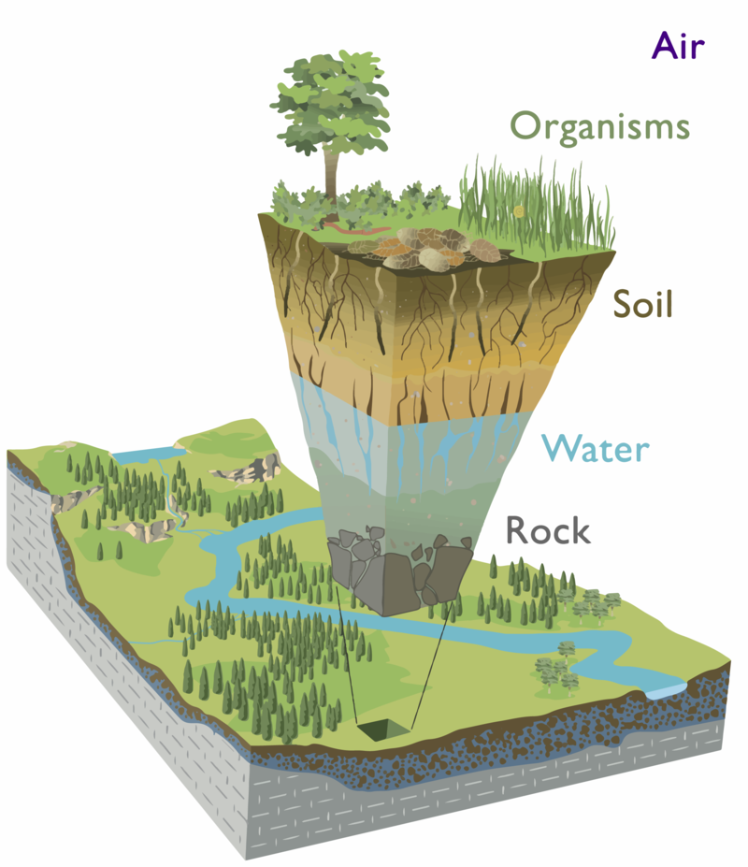
Earth's Critical Zone develops through interactions among geological, biological, chemical, hydrological and climate processes

Slide 3
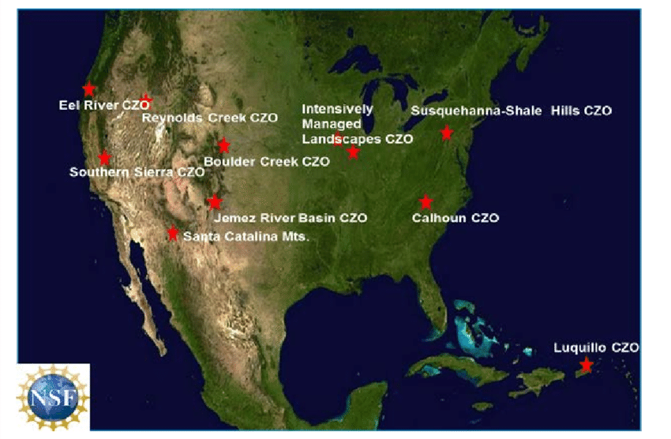
Earth's Critical Zone develops through interactions among geological, biological, chemical, hydrological and climate processes
Critical Zone Observatories

Slide 4
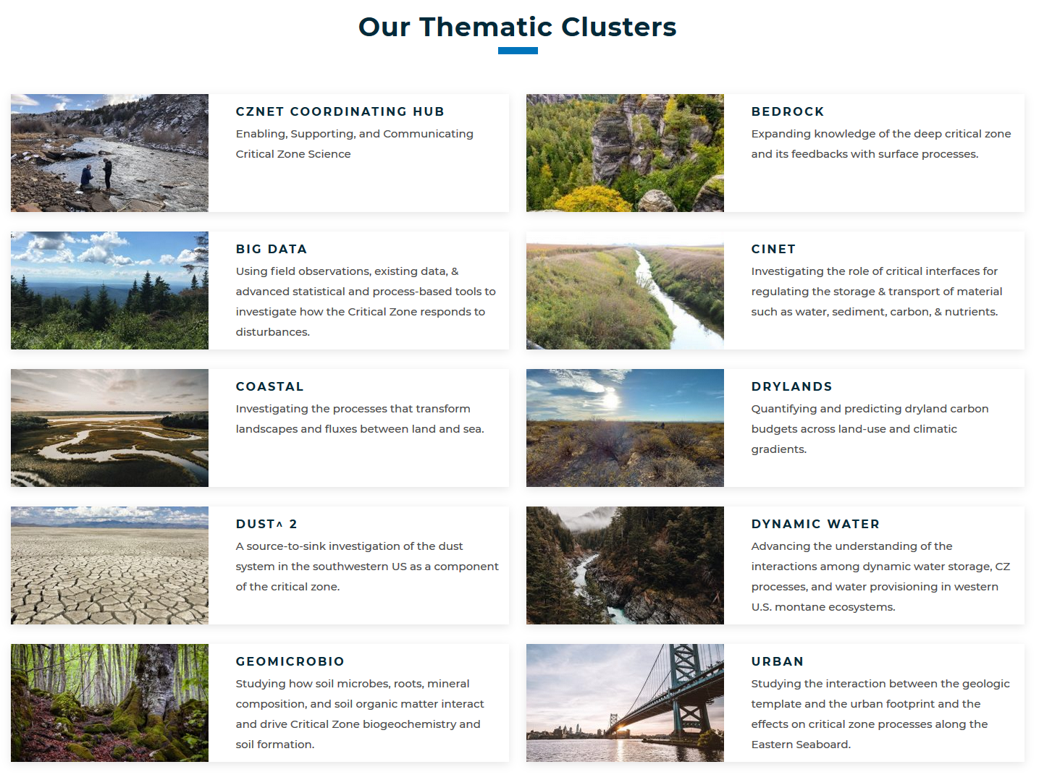

Slide 5
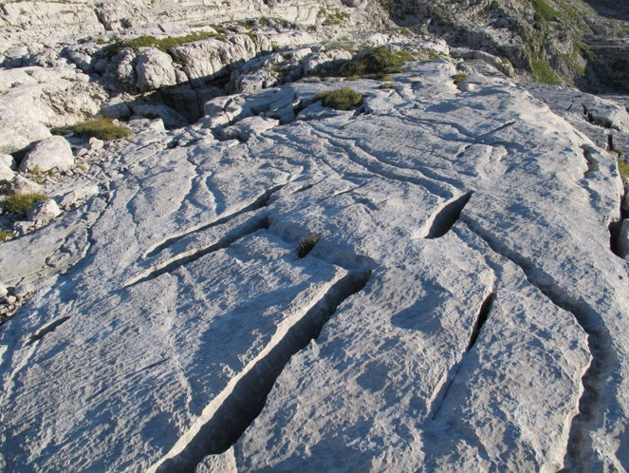
Why is it important to understand critical zone dynamics in carbonate settings?

Slide 6
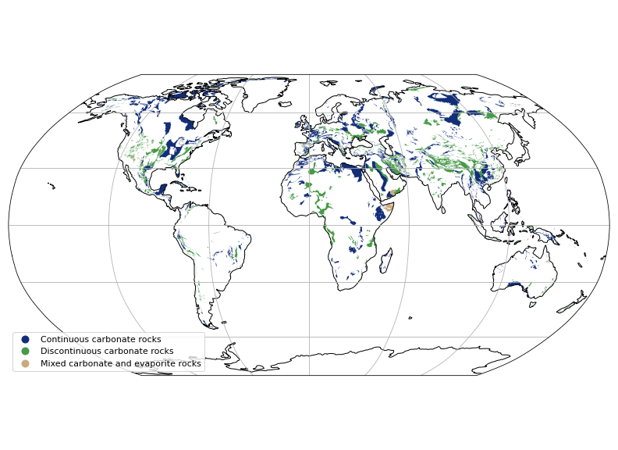
Approximately 15% of Earth's ice-free continental surface contains carbonates
From the World Karst Aquifer Map (Goldscheider et al. 2020).

Slide 7
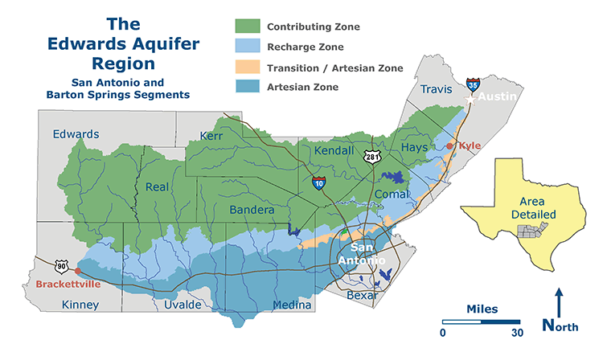
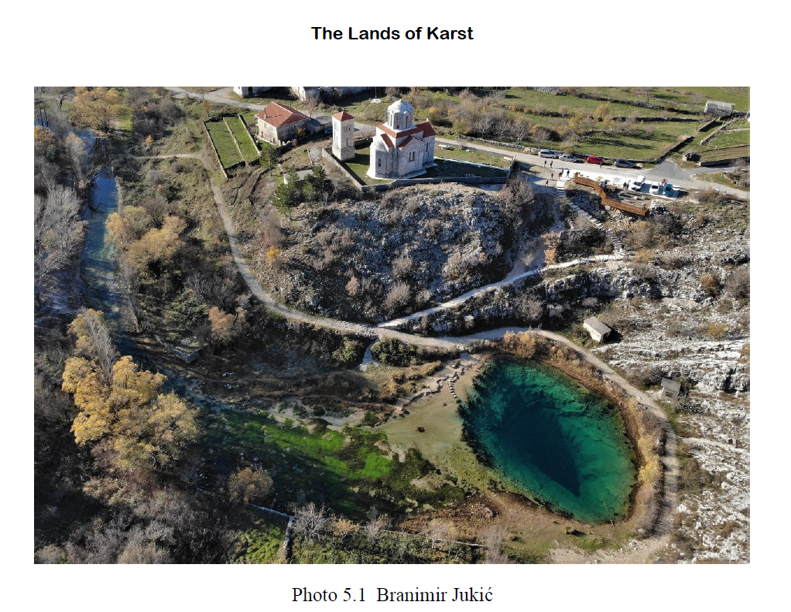
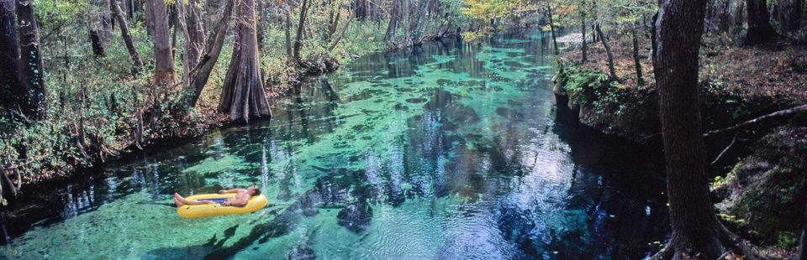
Carbonate water resources are globally important.
Photo: John Moran

Slide 8
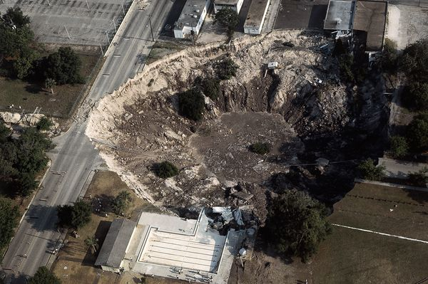
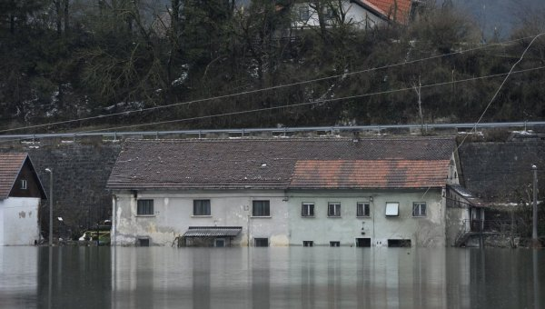
Karst terrains, which develop within carbonates, host a range of unique geohazards.

Slide 9
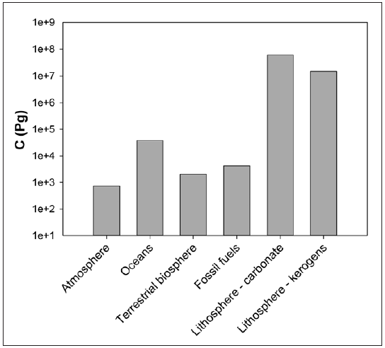
Carbonate minerals are Earth's largest carbon reservoir and may influence the global carbon cycle on timescales relevant for anthropogenic climate change.
Martin et al. (2013)

Slide 10
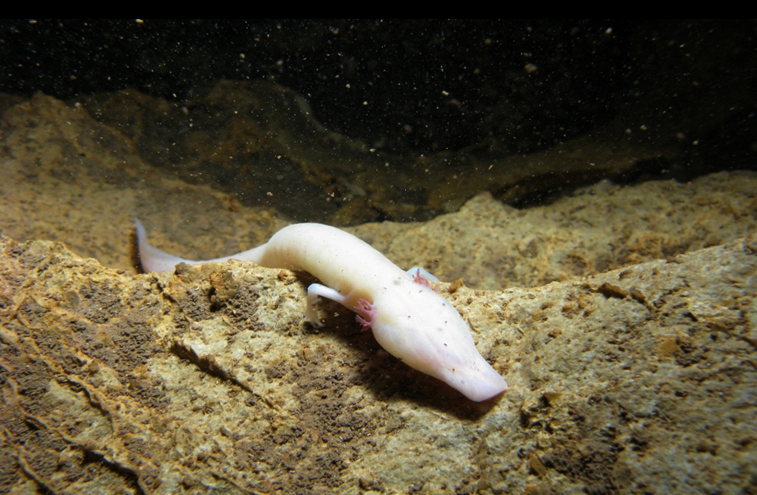
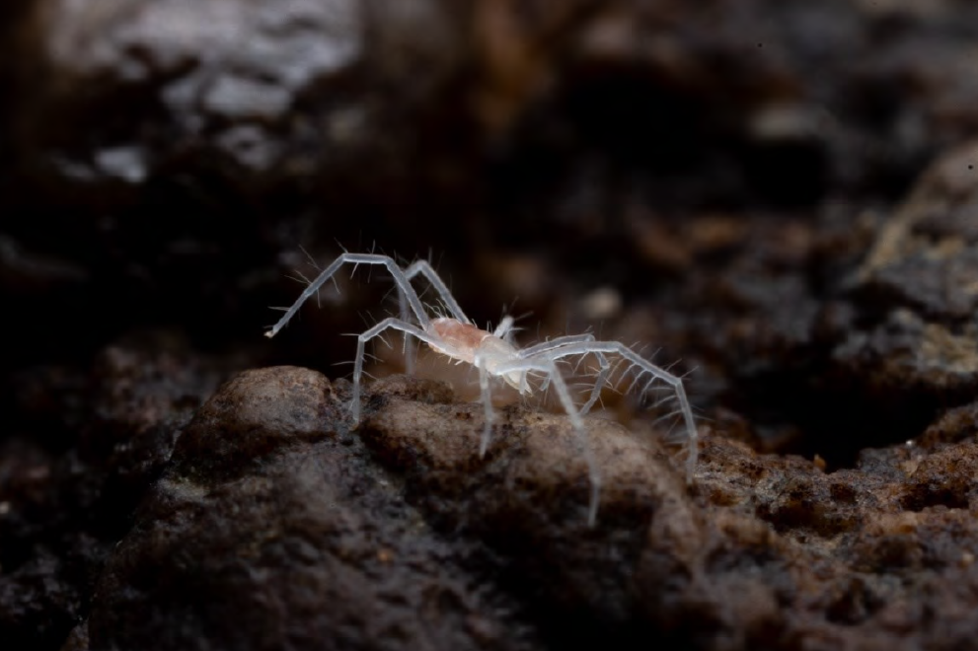
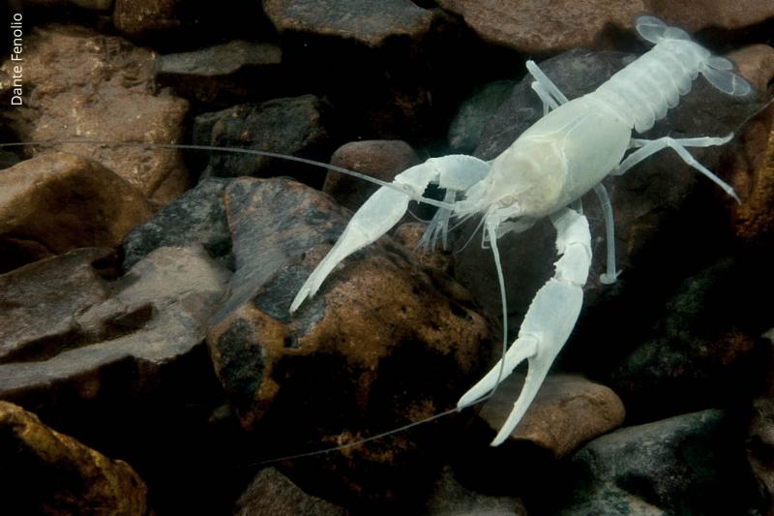
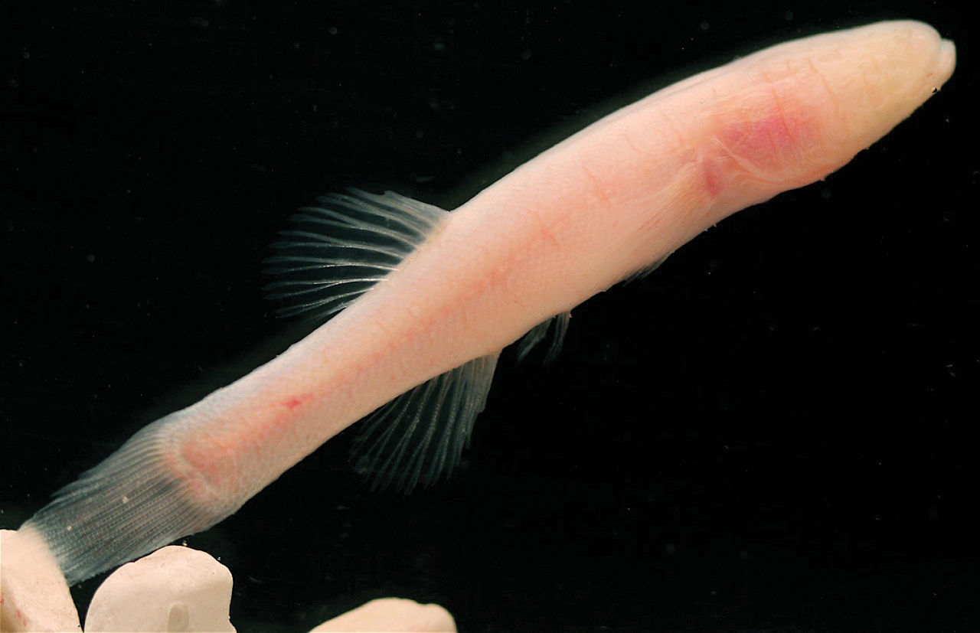
The carbonate critical zone is host to a wide variety of endemic, endangered, and vulnerable species, most of which are under increasing pressure due to climate change and other anthropogenic impacts.
Photo: Teo Delić, from The Lands of Karst​
Photo: Gergő Balázs​
Photo: Matthew Niemiller
Photo: Dante Fenolio

Slide 11
Why are critical zone dynamics different in carbonate settings?

Slide 12


Carbonate minerals have much more rapid reaction kinetics than silicate minerals
Silicates
Carbonates

Slide 13




Silicate minerals weather incongruently, leaving behind residual mineral phases
Silicates
Silicates
Carbonates

Slide 14
Carbonate minerals weather congruently, leaving behind only void space.
Silicates
Carbonates

Slide 15
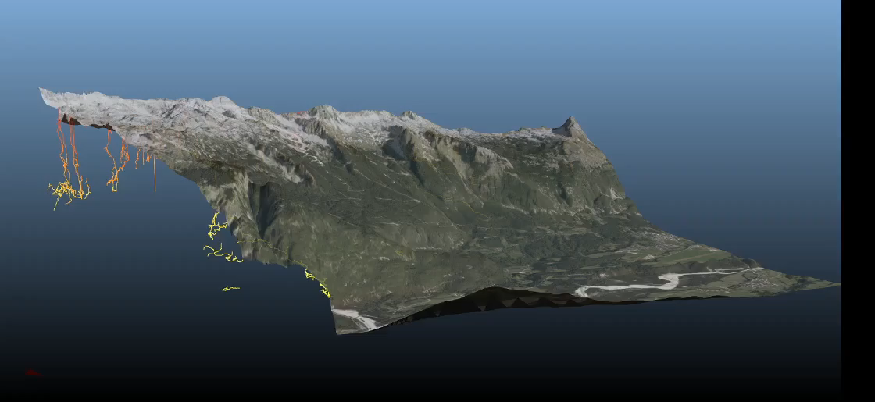
The critical zone may be much deeper in carbonates in comparison to silicates.

Slide 16
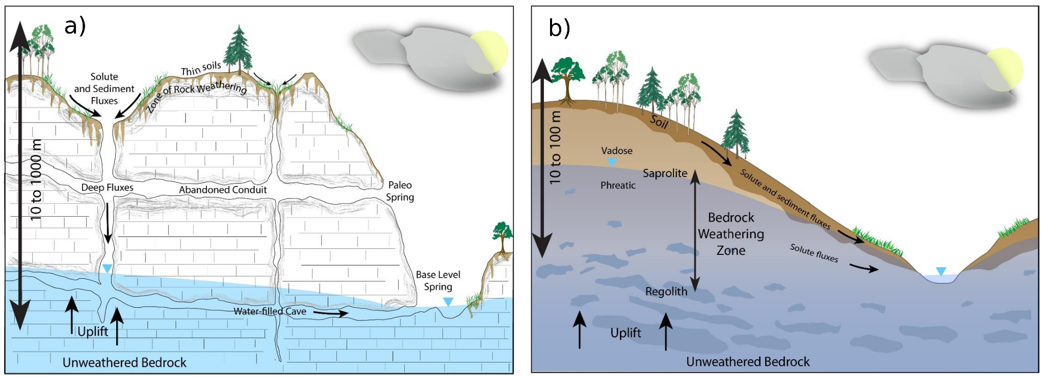
The Conveyor Model of the critical zone

Slide 17
Uplift brings fresh unweathered rock toward the surface.

Slide 18
Meteoric water circulates through the rock producing weathering reactions that generate regolith and soil.

Slide 19
Weathering products leave the system via solute and sediment fluxes toward the stream channel network.

Slide 20
This system is attracted toward a steady state, where topography and regolith thickness adjust such that uplift is counter-balanced by the solute and sediment fluxes.

Slide 21
This system is attracted toward a steady state, where topography and regolith thickness adjust such that uplift is counter-balanced by the solute and sediment fluxes.

Slide 22
This system is attracted toward a steady state, where topography and regolith thickness adjust such that uplift is counter-balanced by the solute and sediment fluxes.

Slide 23
How might the conveyor model break down in carbonate settings?

Slide 24

In pure carbonates, there's no governor.

Slide 25
Without insoluble residue to collect on the surface, weathering rates may decouple from topography.

Slide 26
Without insoluble residue to collect on the surface, weathering rates may decouple from topography.
Dust input

Slide 27




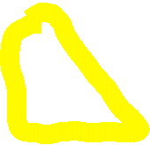




The conveyor model envisions the weathering surfaces as planar, but in carbonates they are often far from planar.

Slide 28
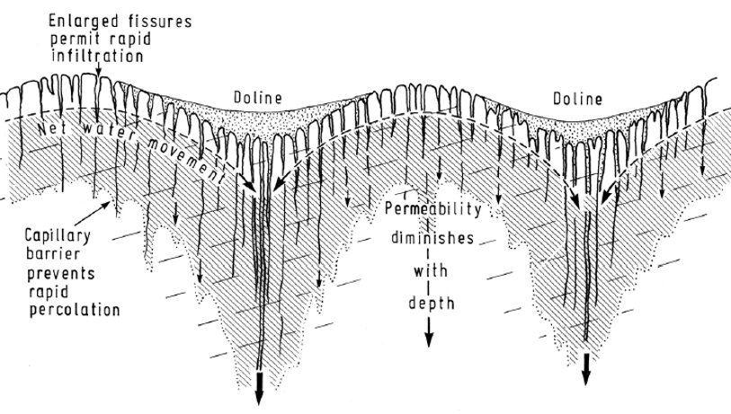
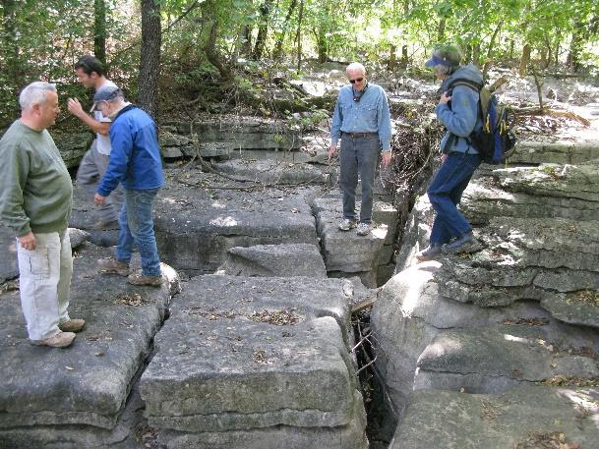

The conveyor model envisions the weathering surfaces as planar, but in carbonates they are often far from planar.
Williams (2008)

Slide 29

Stream channels and hillslopes can become decoupled within karst terrains, as sediment and solutes are routed sub-vertically into conduits.
"Hillslopes"

Slide 30


Subsurface channels within karst conduits may respond to base level lowering by developing new levels rather than knickpoint propagation.
"Hillslopes"

Slide 31
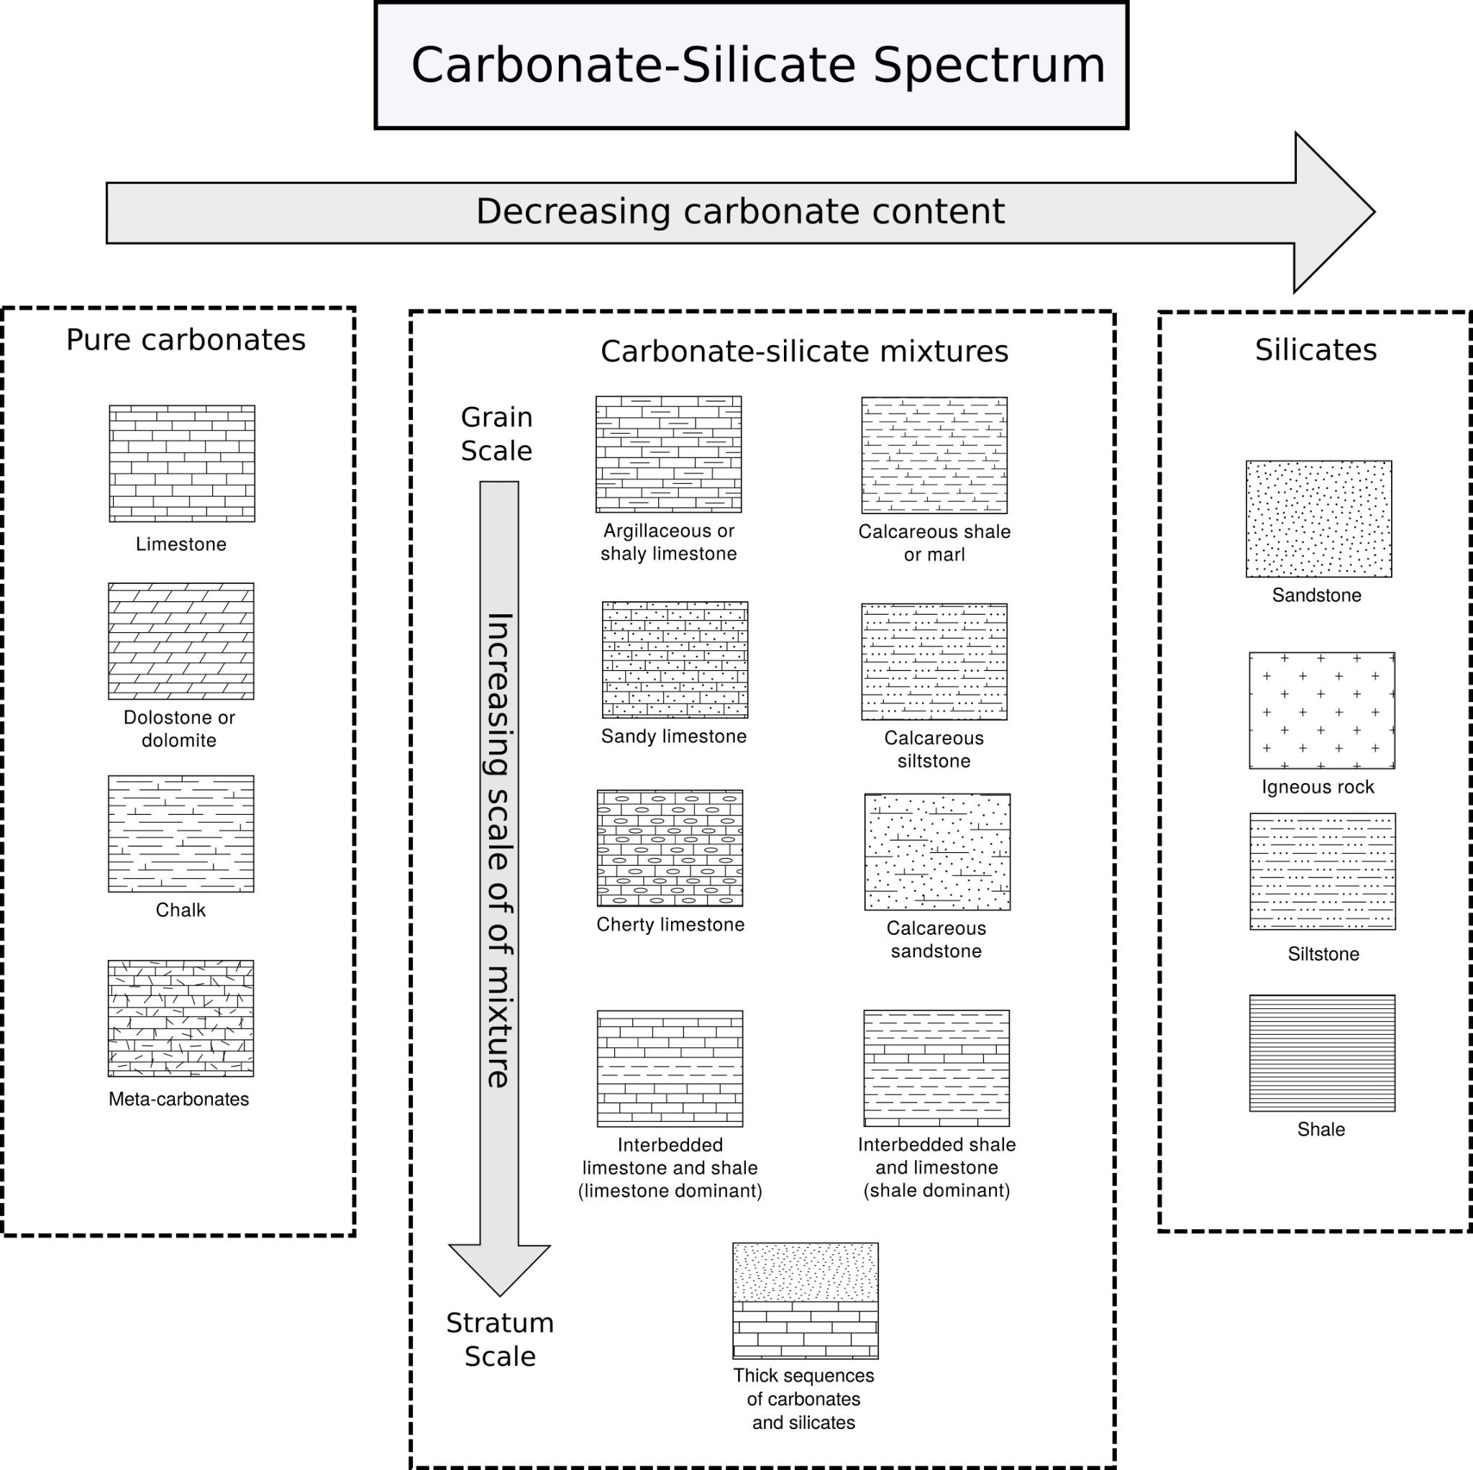

Slide 32
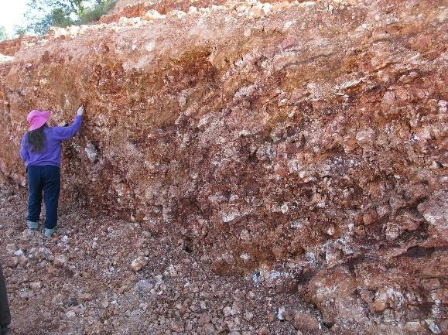

Slide 33
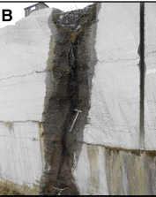

Slide 34
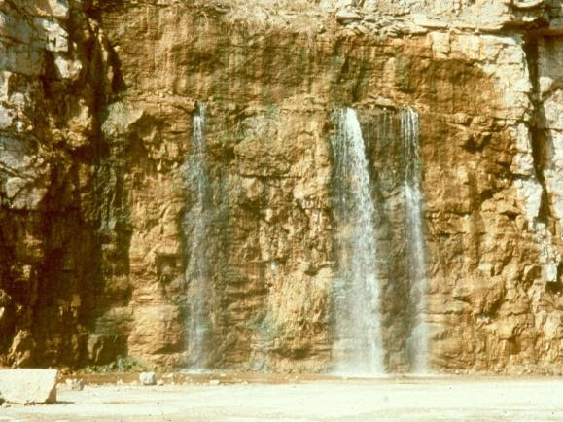

Slide 35
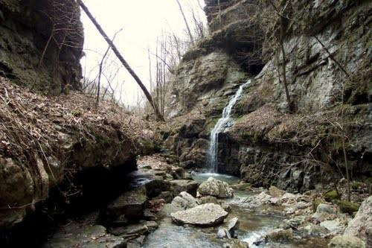
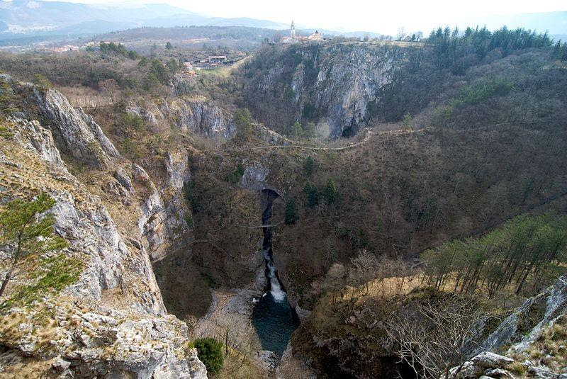

Slide 36
Carbonate-Silicate Spectrum

