Slide 1
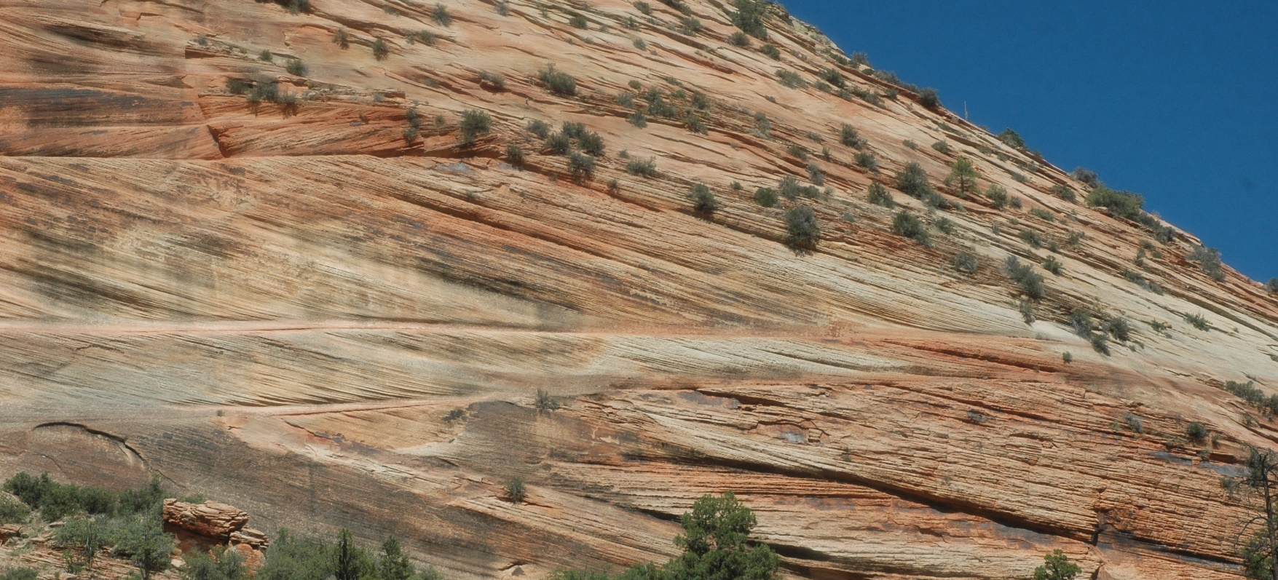
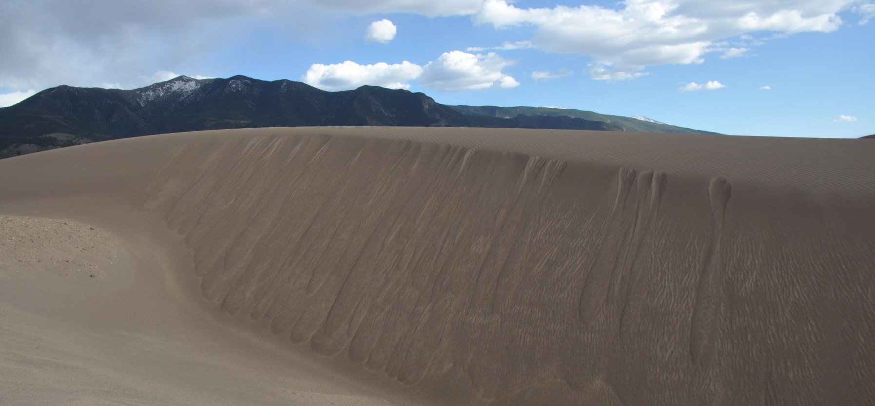

A COMPARISON OF DIP ANGLES FROM ANCIENT CROSS-BEDDED SANDSTONES AND MODERN EOLIAN DUNES
Geological Society of America Meetings
Portland, Oregon
Tuesday, October 12, 2021, 9:35 AM PST
131-7: Recent Advances in Sediments, Clastic
© John H. Whitmore
Department of Science and Mathematics
Cedarville University, Cedarville, Ohio 45314
johnwhitmore@cedarville.edu
Navajo Sandstone, UT
Geological Society of America Abstracts with Programs 53(6),
doi: 10.1130/abs/2021AM-369476
Great Sand Dunes, CO
Notes:
Hi Everyone. My name is John Whitmore. I appreciate GSA giving us the opportunity to present our oral abstracts by pre-recorded video this year. I have been looking at cross-bed dip angles in both cross-bedded sandstones and in modern eolian dune settings. I’d like to share some results which are rather interesting and quite unexpected, at least to me. Most of the literature regards sandstones like the Navajo from Utah (shown here) as eolian-deposited. Yet, I’ve found from my own measurements, and confirmed it with the published literature, that angle of repose cross-bed dips in these and other sandstones are quite rare. The explanation has often been that the cross-bed dip angles are lower because of compaction, which on the surface, seems like a reasonable idea.

Slide 2
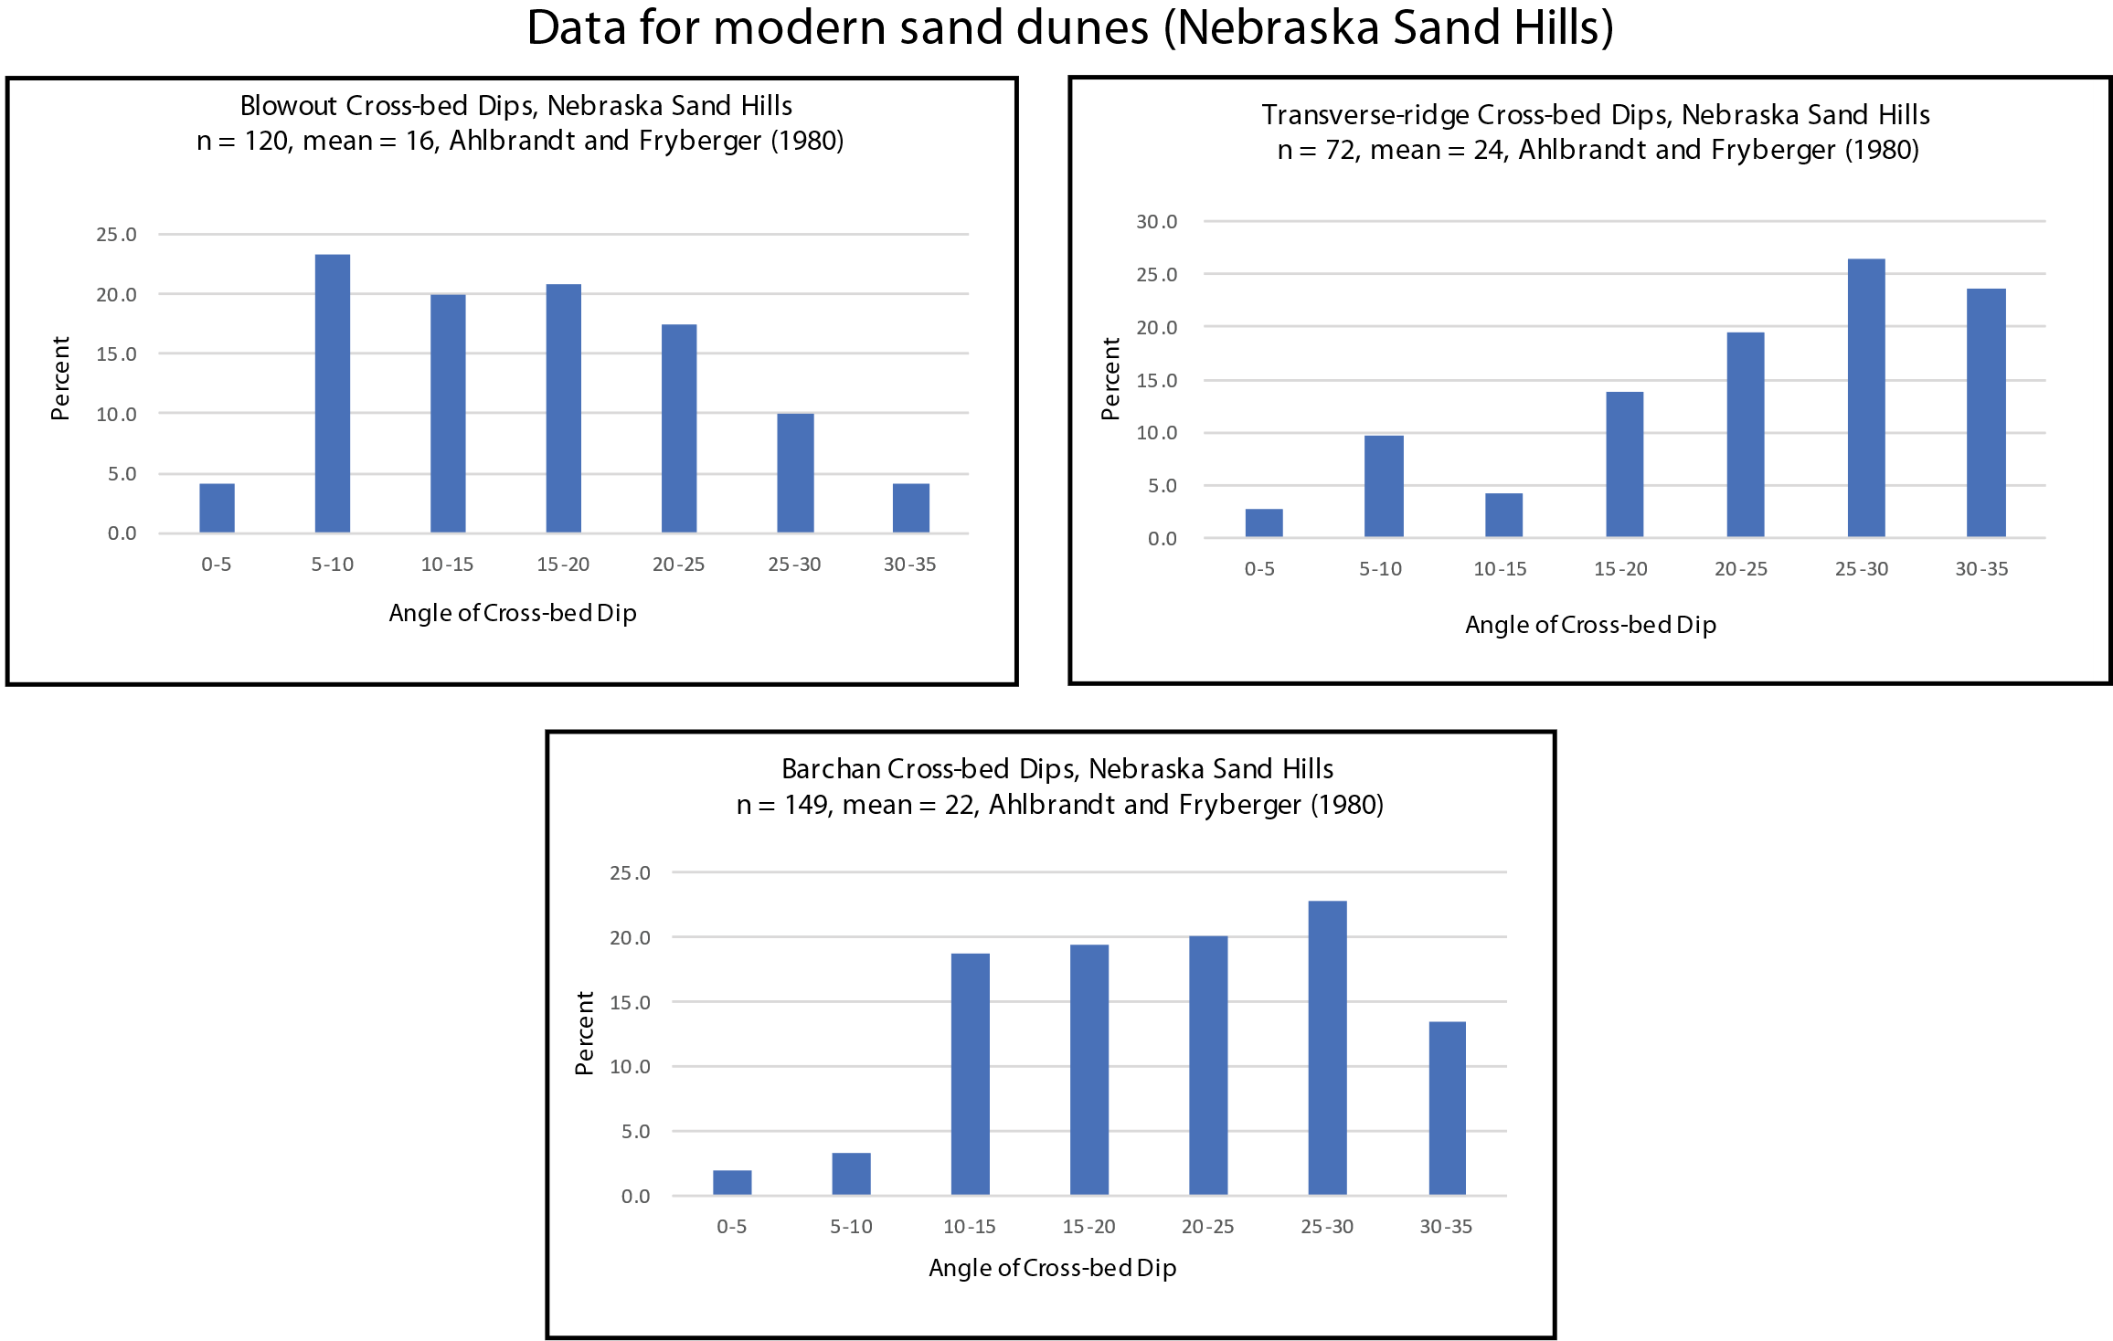
Background: Comparison of Coconino and Nebraska Sandhills dip angles
% of dips < 10°
% of dips > 30°
Whitmore’s Coconino data
23.6%
12.5%
27.5%
4.2%
4.7%
1.9%
13.4%
What percentage of cross-bed dips are less than 10°and greater than 30°?
5.4%
Notes:
As many of you know, I have worked on the Coconino Sandstone for many years. During this time, I have collected over 200 strike and dip measurements at many different outcrops all over northern Arizona. Here is my data plotted against some Nebraska Sandhills data collected by Ahlbrandt and Fryberger in 1980. On the left is my data divided into 5-degree bins so I could compare it with the same way the sandhills data was published—the three graphs on the right. The sandhills data is divided into three dune types: blowout, transverse-ridge, and barchan. Percentages of dips <10 degrees are highlighted in yellow and those >30 degrees are highlighted in orange.
Notice that only about 5% of Coconino dips are less than 10 degrees. But, depending on dune type, many of the dips in the sandhills are less than 10 degrees. The same is true with dips greater than 30 degrees. Only about 2% of my Coconino data is greater than 30 degrees, but high percentages of the dips in the sandhills are greater than 30 degrees.

Slide 3
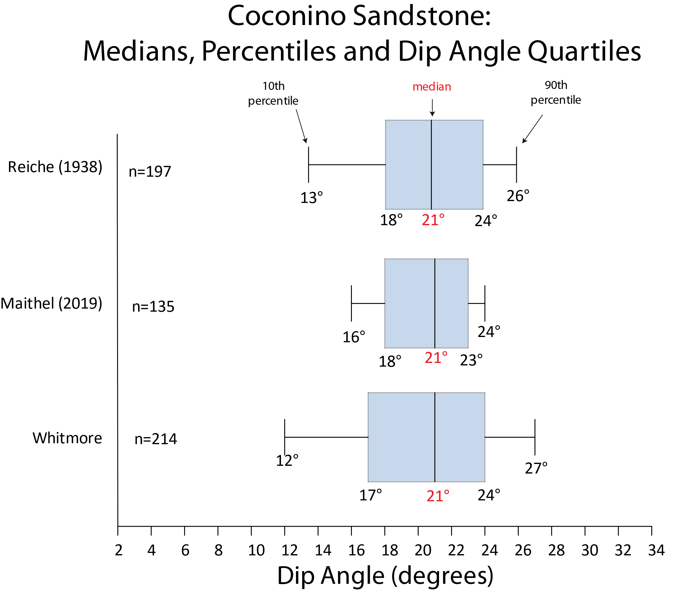
Background
n=546
Mean=20.1
Median=21.0
Stdev=5.0
Actual data
17-24°
McKee’s claim
25-30°
McKee reported “most dips in the Coconino were in the 25-30° range,” but did not cite data (1979, p. 199)
Coconino measurements show a median dip of 21°, with most dips in the 17-24° range
Notes:
Another interesting observation that I’ve run across is the perception of what the cross-bed dip angles actually are in the Coconino. Edwin McKee published the first comprehensive paper on the Coconino in 1934, yet curiously he did not publish any cross-bed dips from the formation, despite publishing cross-bed dips on many other formations in the Grand Canyon throughout his career. Late in his career, he stated in 1979, in the USGS Professional paper, A Study of Global Sand Seas, that “most dips in the Coconino were in the 25–30-degree range.” Yet when this claim is analyzed against actual cross-bed dips from the Coconino (shown in blue), it does not appear to be accurate. Box plots from Reiche (1938, which McKee cites), Maithel (2019) and my own data are almost identical. Yet most of the cross-bed dips in McKee’s claim would be beyond the 90th percentile of the actual Coconino dips. The actual data shows that about 50% of the cross-bed dips are in the 17–24-degree range, not in the 25–30-degree range as McKee claimed. The mean dip of 546 Coconino measurements is 20 degrees and the median is 21 degrees, far below McKee’s 25–30-degree claim.

Slide 4
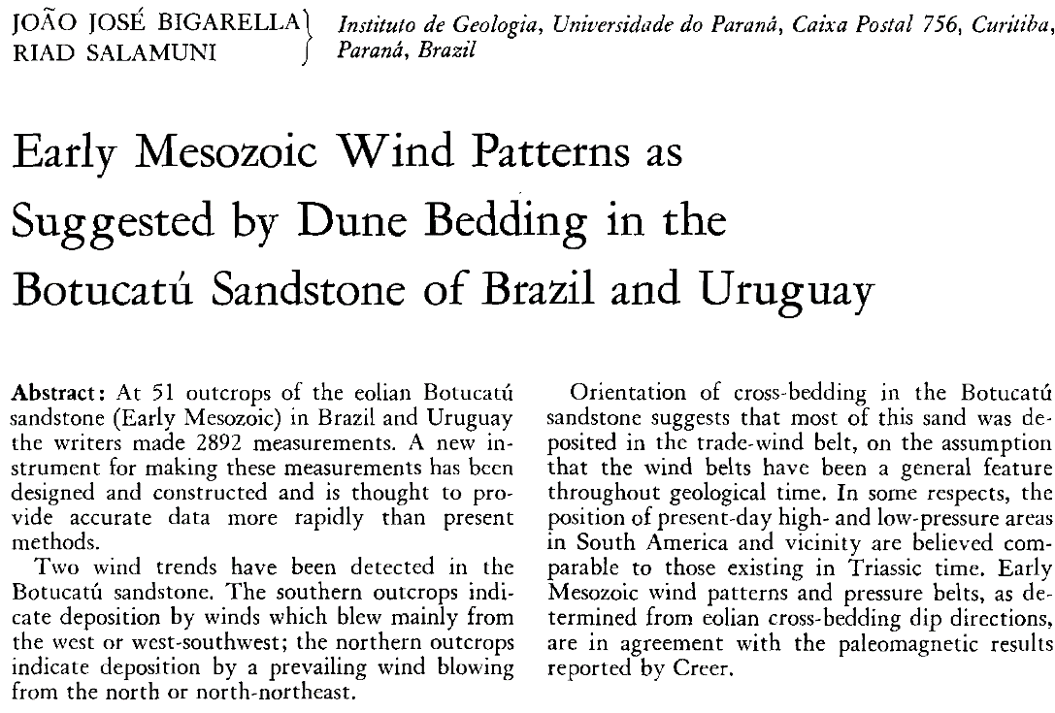
Data: Sandstones
5,242 Direct measurements, mostly polar plots
13 Sandstones, 88 localities
Botucatú Sandstone of Brazil
Casper Sandstone
Cedar Mesa Sandstone
Coconino Sandstone
De Chelly Sandstone
Esplanade Sandstone
Manakacha Formation
Navajo Sandstone
Tacuarembó Sandstone of Uruguay
Tapeats Sandstone
Tensleep Sandstone
Wescogame Formation
Wingate Sandstone
Literature
Bigarella and Salamuni 1961
Kiersch 1950
Maithel 2019
McKee 1940
McKee and Gutschick 1969
McKee 1982
Reiche 1938
GSA Bulletin 72:1089-1106, July 1961
Notes:
So here is what I did in this particular study. I searched the literature for cross-bed dips of sandstones. I was able to find data for 13 different sandstones, spread between 88 unique localities for a total of over 5,200 measurements. Most of this data was reported in the form of polar plots and came from 7 papers. An example is from this 1961 paper in the GSA Bulletin by Bigarella and Salamuni.

Slide 5
Data: Eolian dunes
5,785 total measurements (855 direct measurements, 4930 weighted means)
Sets of data ranged from 6 to 676 measurements (mean=67, mode=30, median=34)
Dune fields, 76 localities
Brazil
White Sands, NM
Literature
Bigarella 1972
Bigarella et al. 1969
McKee 1966
McKee 1971
McKee and Bigarella 1979
Tables
(number of measurements, mean dip)
Histograms
Nebraska Sandhills
There are more data, but it is in the form of histograms, which is not very useful in extracting data for this project.
Direct measurements
Bigarella et al. 1969
Ahlbrandt and Fryberger 1980
Notes:
Data for eolian cross-bed dips was a little more difficult to obtain. The problem is that most eolian workers publish data in the form of histograms and not polar plots—which show all the individual data points. We see an example of this here, with one of the plots from the Nebraska Sandhills referenced earlier. A histogram of barchan measurements is shown along with an average dip of 22 degrees. The problem is that we don’t know the individual data points that make up each bin on the histogram. A second related problem is that many workers publish their data in table form. They show the number of measurements and an average dip, but again, don’t show the individual measurements. I was able to find 855 direct measurements either plotted in a polar plot or as a sketch with measurements reported directly on the drawing. Of the almost 5,800 measurements I found, I had to use weighted means for most of the data.
The dune data that I used was mostly from Bigarella and McKee in their studies of dunes in Brazil and New Mexico. The data includes 76 localities from 5 papers.

Slide 6
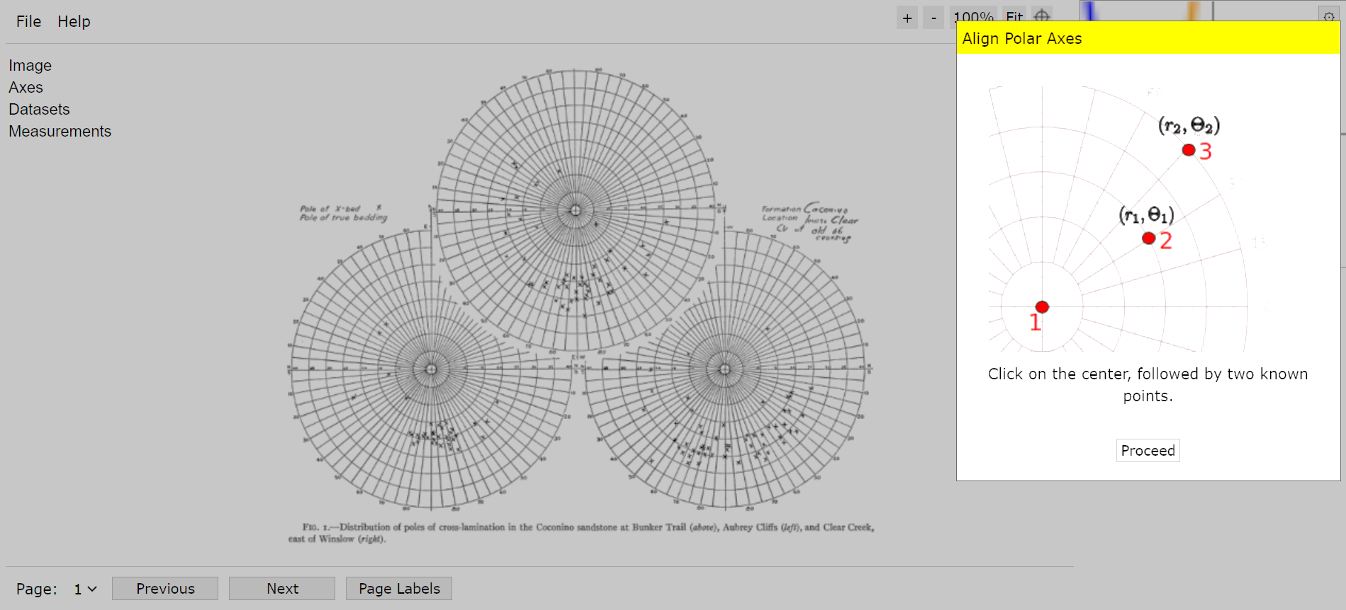
Methods—when data are presented as polar plots
Software used:
WebPlotDigitizer
Excel
Grapher
plots from Reiche 1938
Notes:
Much of the data that I used was plotted as polar plots as shown from Reiche (1938). Initially I tried reading and recording the data directly from the plots, but this was time consuming and prone to some error. I was able to find this neat web-based program called WebPlotDigitizer that is handy for extracting data from these kinds of plots and many other types of plots. You are viewing a screenshot of what the program looks like. Basically, you fix an origin and two other known points on the screen. Then you click on the data points in the plot, and it will store the data for you in a spreadsheet.
I kept and analyzed the data with Microsoft Excel and plotted the data with a program called Grapher.

Slide 7
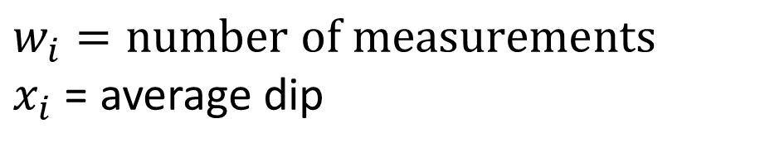
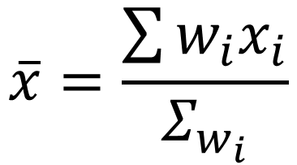

Methods—data reported as number of measurements and a mean: calculate a weighted mean
$$w_{i}=number of measurements$$
$x_{i}$ = average dip
Tables
(number of measurements, mean dip)
$$\overline{x}=\frac{\sum{w_{i}x_{i}}}{Σ_{w_{i}}}$$
$$Σ=161$$
$$\frac{\left(64×22.7°\right)+\left(57×18.5°\right)+\left(40×25.8°\right)}{161}=\frac{6044}{161}={ 22.0}^{°}$$
Notes:
When the data was reported as a number of measurements and a mean, I would calculate a weighted mean for the data. A simple example is shown from this table of cross-bed dips. Data was collected from three areas (n=64, 57, and 40) with respective average dips of 22.7, 18.5 and 25.8 degrees) for a total of 161 measurements. The calculation shows the weighted mean would be 22 degrees. A calculation like this was done for about 4,900 of the dune measurements.

Slide 8
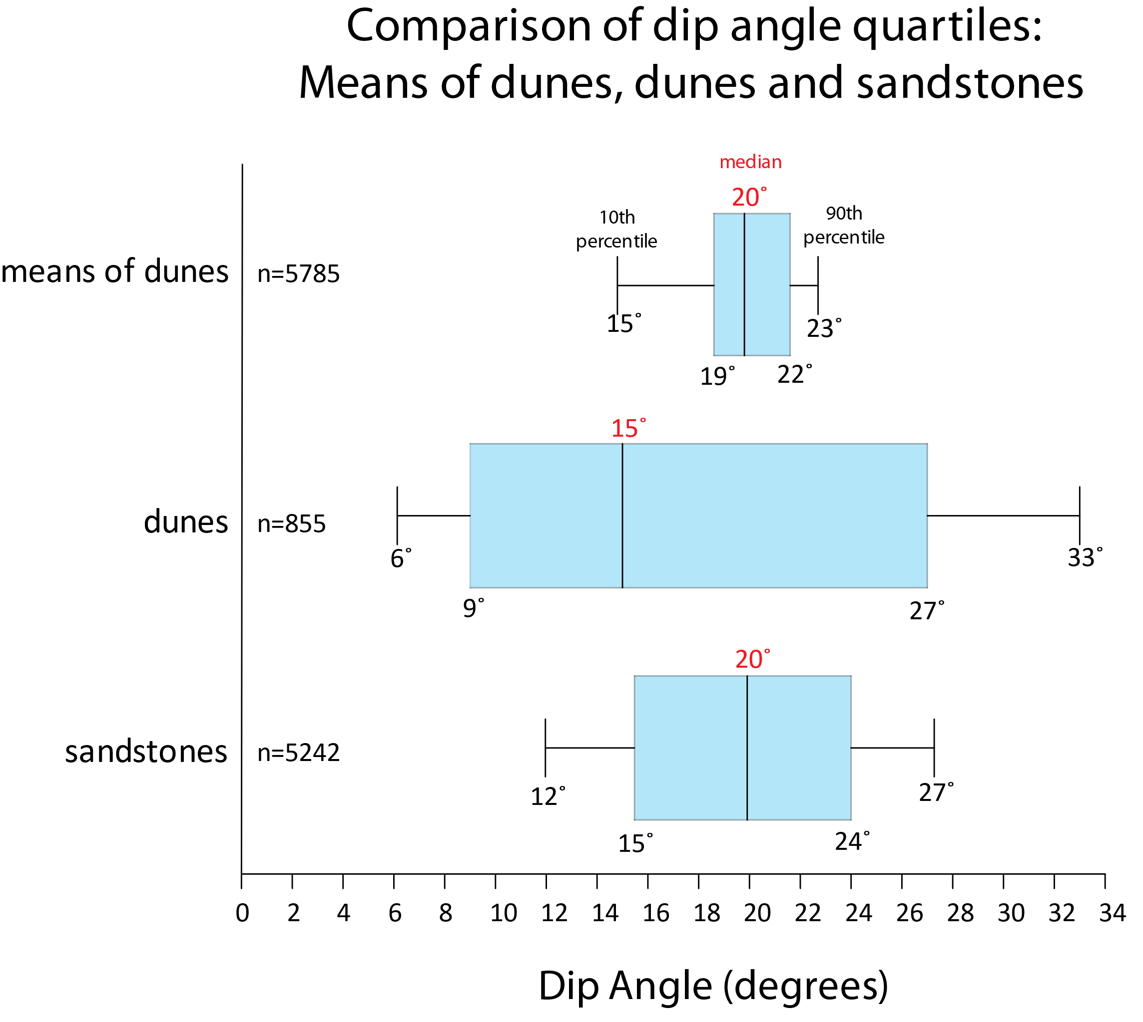
Results: 1) Sandstones and eolian dunes have similar central tendencies
 | n | Mean | Median
Weighted means of dunes | 5785 | 19.8 | 19.8
Dunes | 855 | 17.8 | 15.0
Sandstones | 5242 | 19.8 | 19.9
Notes:
I have 5 results, or observations of the data that I’d like to share with you. First, sandstones and eolian dunes have similar central tendencies. In the box plots of the data that we are going to examine, the whiskers indicate the 10th and 90th percentiles. The 50th percentile (or the median) is near the center of most plots and the blue boxes show the middle two quartiles (25th, 50th, and 75th percentiles). From examining the bottom two plots, we can see that dunes have a much wider range of measurements than sandstones. We might expect the top plot, the means of dunes, to have a narrower distribution because of the type of data that was collected for the plot. Examining the top and bottom plots, and the table, we can see the means of dunes and sandstones have nearly the same mean and median.

Slide 9
Results: 2) Sandstones and eolian dunes have different standard deviations
Dip angles of sandstones, n = 5,242, stdev = 5.7
Dip angles of eolian dunes, n = 855, stdev = 10.1
8
7
6
5
Percent of Measurements
4
3
2
1
0
Dip Angle
9
17.8
27
{
Quartiles and means of dunes and sandstones
dunes
sandstones
15.5
19.8
24
Notes:
This histogram is a plot of the 5,242 sandstone measurements (in blue) and the 855 individual dune measurements (in orange). Note that the spread of the data is very different between the two plots. The spread of the data can be expressed with standard deviation, which is 5.7 for the sandstones and nearly double at 10.1 for the dunes. Note that the distribution of dune dips also appears to be bimodal. We can say that dune dips have a much wider range of values than sandstone dips. Now, some of you might be thinking compaction for the sandstones; we’ll get to that in a moment.

Slide 10
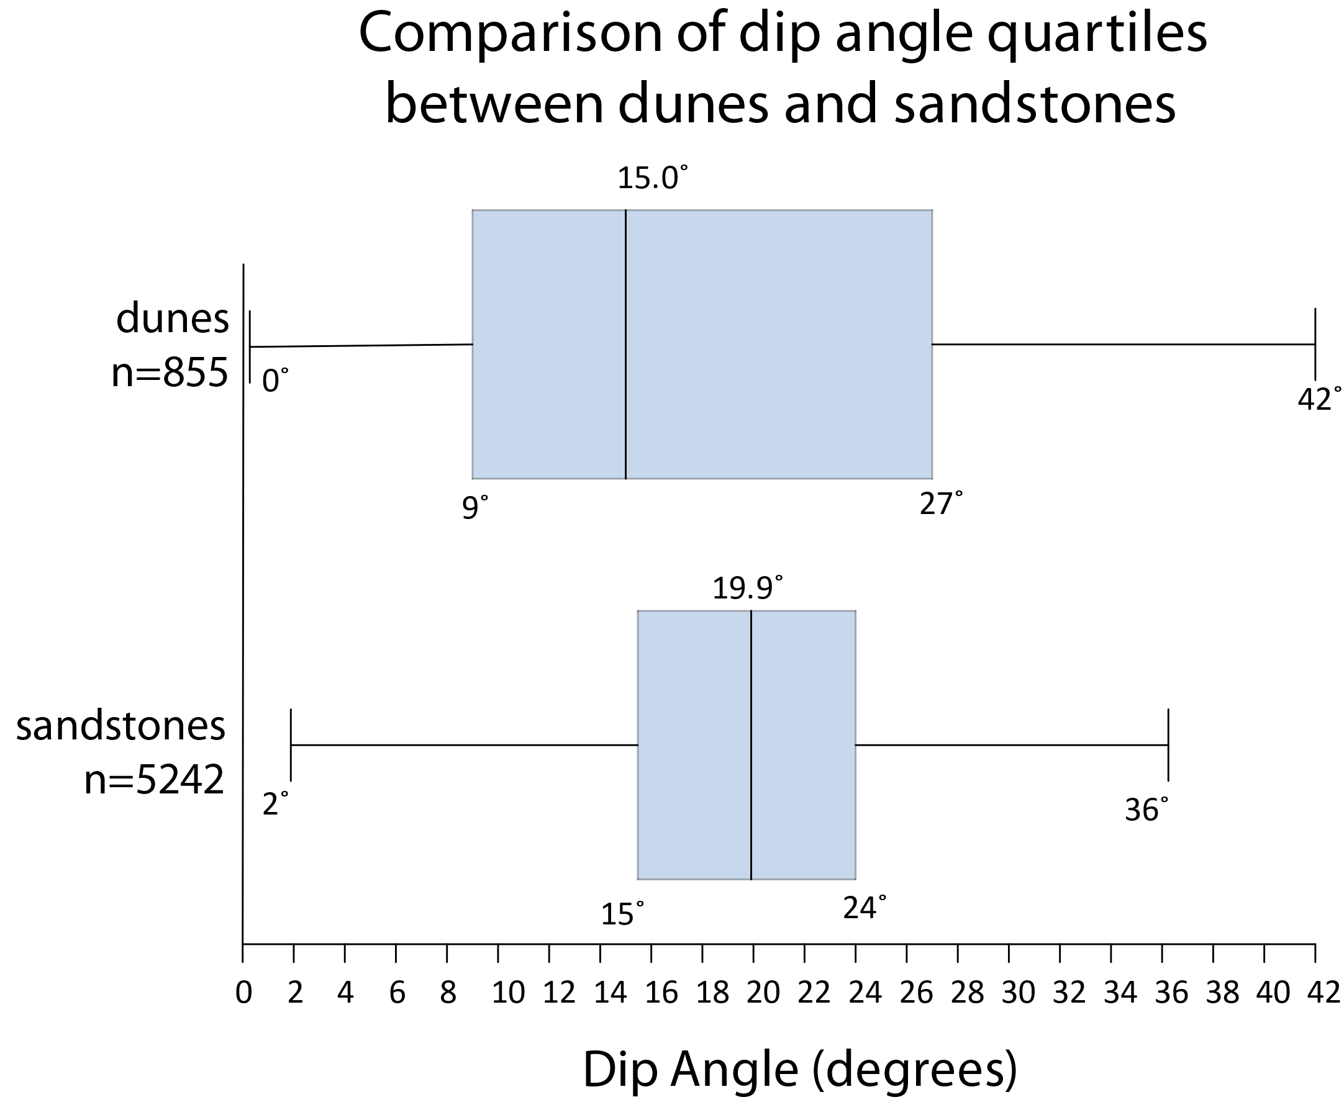
Results: 3) Sandstones rarely have dips < 10° and >30°; they are common in eolian dunes
10°
30°
25.5% of measurements in dunes are <10 °
17.3% of measurements in dunes are >30°
25.5% < 10°
17.3% > 30°
3.0% > 30°
Only 1.4% of measurements in sandstones are <10°
Only 3.0% of measurements in sandstones are >30°
1.4% < 10°
Notes:
Thirdly, sandstones rarely have dips of less than 10 degrees and more than 30 degrees; 1.4 and 3.0% respectively. This is not true for dune measurements. In dunes, more than a quarter of measurements are less than 10 degrees and about 17% of measurements are greater than 30 degrees. This can be seen graphically in the plot. Note that the 10- and 30-degree values are indicated by the blue dashed lines.

Slide 11
Compaction/erosion can’t explain the differences in dip angles between dunes and sandstones
Compaction of the orange bars (dunes) will not yield the blue bars (sandstones)
Erosion of high-angle dune tops (orange bars) will not yield blue bars (sandstones)
8
7
sandstones
6
5
Percent of Measurements
4
dunes
3
2
1
0
Dip Angle
9
17.8
27
{
dunes, n=855
Quartiles and means of dunes and sandstones
sandstones, n=5242
15.5
19.8
24
Notes:
Now, let’s come back to compaction. If we take the dune measurements (in orange) and compact all of them to the same degree, or even different degrees if you wish, it would be impossible to get the sandstone data (in blue). The problem is the large percentage of dune measurements that we find with low angles. Those measurements don’t appear to be represented in the sandstone data that I collected for this project. Additionally, some have argued that the steeper upper portions of sandstone dunes were eroded away and not preserved, and that is why the steeper angles are missing in sandstones. Although this might explain the lack of high angles in sandstones, it does not explain the near absence of low angles in cross-bedded sandstones.

Slide 12
Results: 4) Sandstone cross-bed dips are similar, despite set thickness
Sandstone | Author | Date | Place | n | Mean | Median | Max | St. Dev.
Botucatú | Bigarella and Salamuni | 1961 | Paraná, Brazil | 626 | 19.5 | 19.1 | 33.3 | 6.2
Botucatú | Bigarella and Salamuni | 1961 | Rio Grande do Sul, Brazil | 598 | 20.5 | 20.2 | 32.5 | 6.2
Botucatú | Bigarella and Salamuni | 1961 | São Paulo, Brazil | 650 | 20.1 | 20.0 | 32.5 | 6.2
Cedar Mesa | Reiche | 1938 | Utah | 67 | 18.7 | 18.5 | 33 | 5.7
Coconino | Reiche | 1938 | Arizona | 197 | 20.3 | 20.8 | 33.8 | 4.7
Coconino | Maithel | 2019 | Arizona | 135 | 19.8 | 21.0 | 27 | 4.0
Coconino | Whitmore | unpubl | Arizona | 214 | 20.2 | 21.0 | 32 | 5.7
Esplanade | McKee | 1982 | Arizona | 505 | 19.0 | 19.3 | 32.7 | 4.7
Manakacha | McKee | 1982 | Arizona | 250 | 19.5 | 19.2 | 31.4 | 4.4
Navajo | Reiche | 1938 | Utah | 33 | 22.1 | 23.1 | 36.2 | 5.4
Navajo | Kiersch | 1950 | Utah | 229 | 17.2 | 18.5 | 31.2 | 5.3
Navajo | Whitmore | unpubl | Utah | 44 | 21.5 | 23.0 | 26.0 | 3.8
Tapeats | McKee | 1940 | Arizona | 183 | 20.3 | 20.9 | 27.9 | 4.8
Wescogame | McKee | 1982 | Arizona | 619 | 19.9 | 19.8 | 30.3 | 4.5
small sets
large sets
small sets
Notes:
I wondered if large or thick cross-bed sets of sandstones had higher dips than sandstones with small or thin cross-bed sets. We routinely say, and see in the literature, that sandstones like the Navajo or Coconino have “steep” cross-bed sets. But I’ve never said or seen that kind of terminology used for the Tapeats sandstone that often has < 1 m thick cross-bed sets. It turns out, that all of these sandstones, irrespective of set thickness, have cross-bed dips that are about the same. They all measure about 20 degrees.

Slide 13
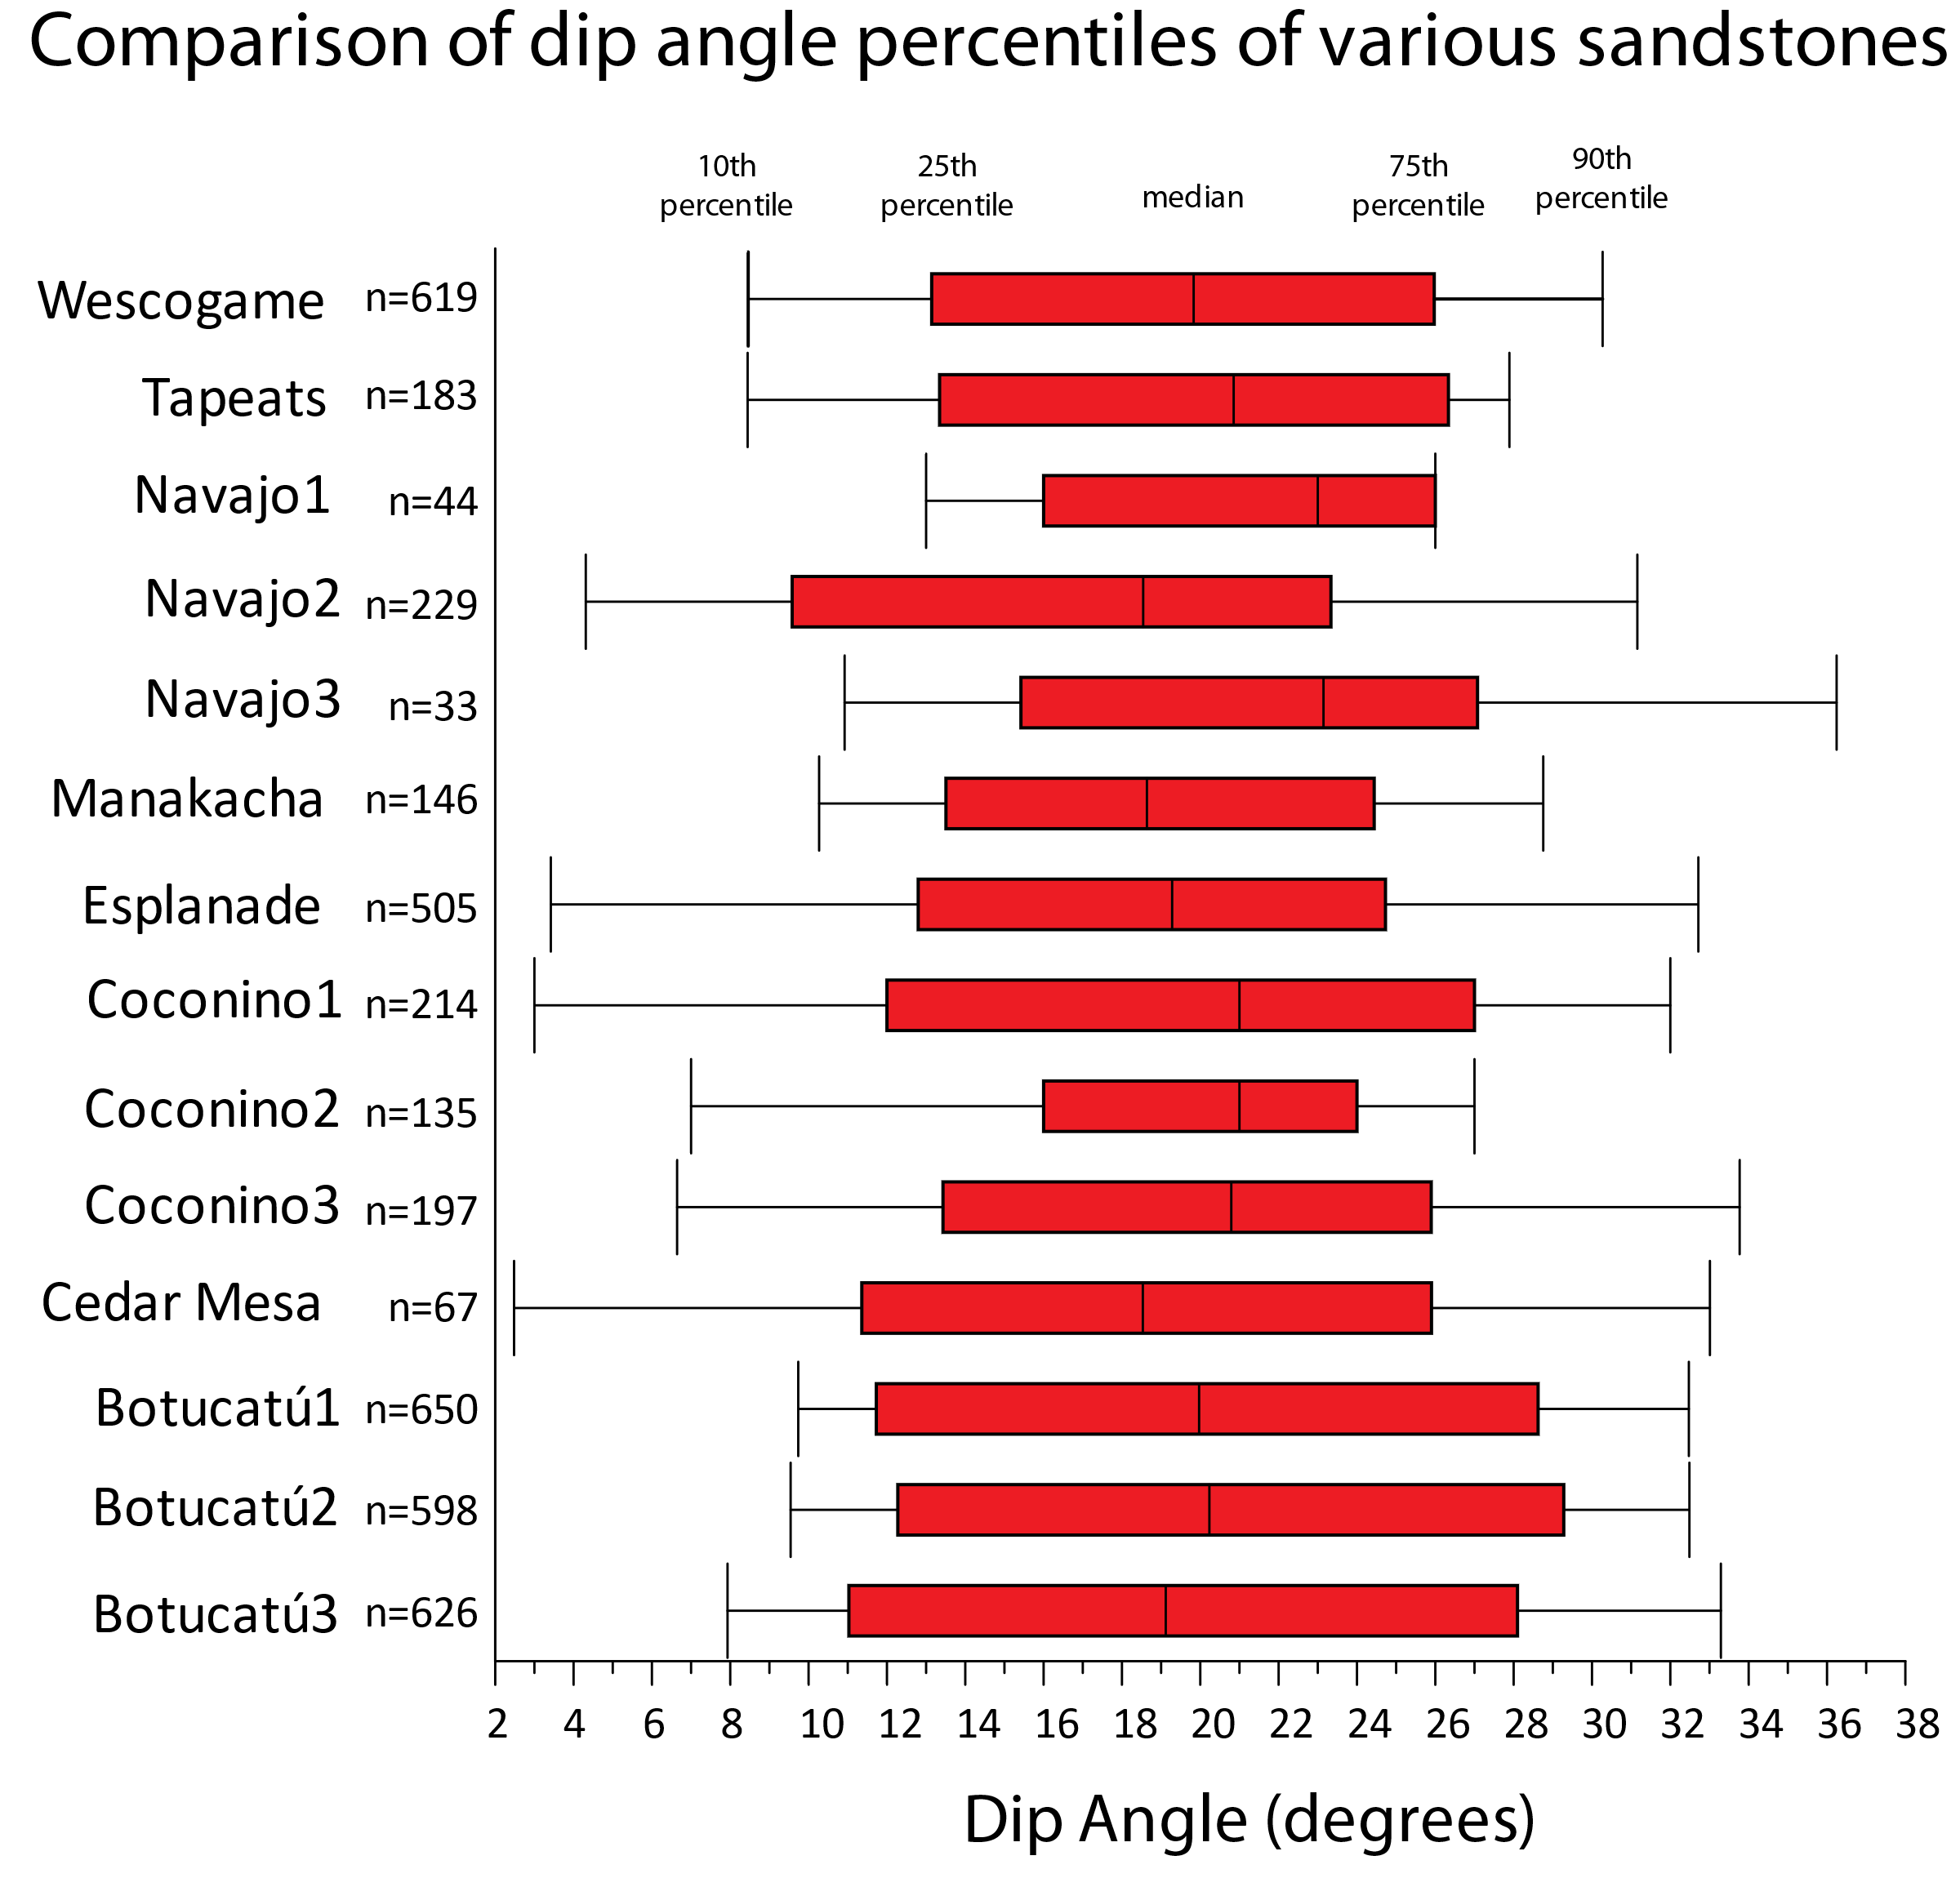
small sets
large sets
small sets
large sets
Navajo1: Whitmore
Navajo2: Kiersch
Navajo3: Reiche
Coconino1: Whitmore
Coconino2: Maithel
Coconino3: Reiche
Notes:
Here is a plot of some of the sandstones used in this study. The dashed blue line is 20 degrees. As in the other plots, the whiskers are the 10th and 90th percentiles and the red boxes represent the middle two quartiles. Note that the medians of all these sandstones are close to 20 degrees, irrespective of set thickness.

Slide 14
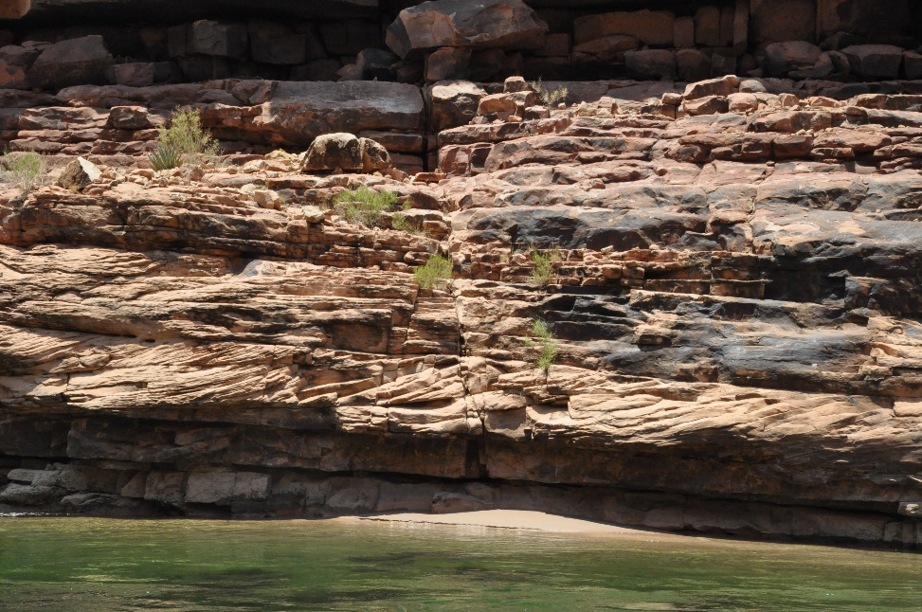
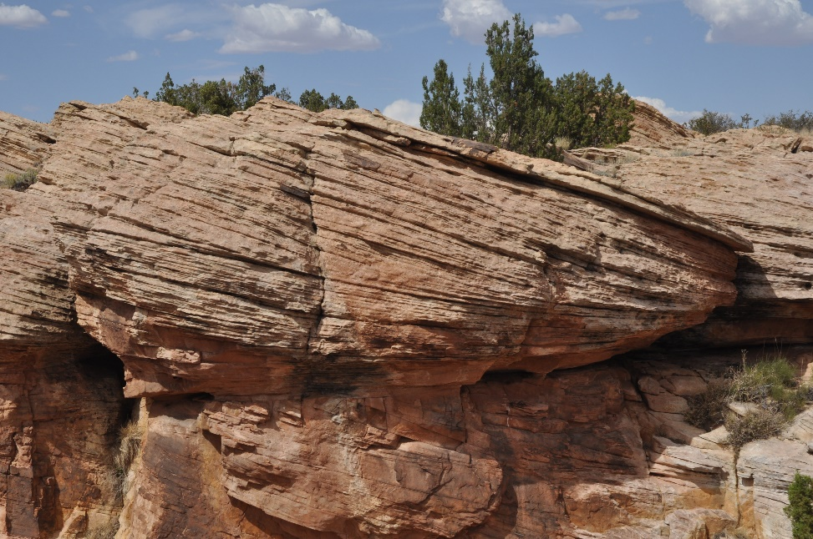
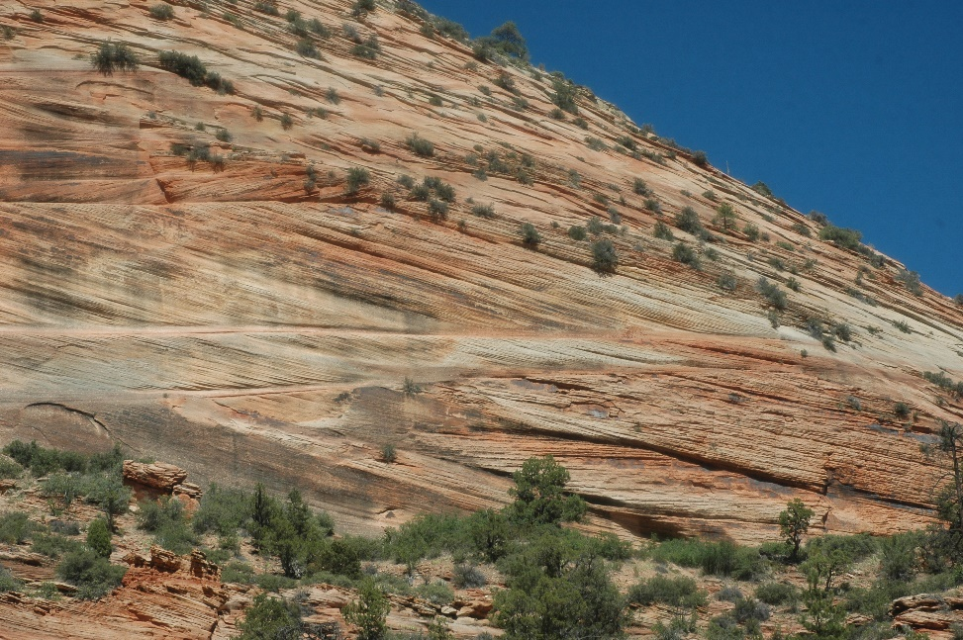
Is “steep” an optical illusion if cross-bed sets are thick?
20.3° average, n=182
20.1° average, n=546
18.6° average, n=301
Tapeats Sandstone
(small sets)
McKee: 1m thick foresets
Coconino Sandstone
(medium to large sets)
McKee: foresets 9-24m long
~3.0-8.2m thick
Navajo Sandstone
(large sets)
McKee: foresets 4.5-33m long
~1.4-10.5m thick
Notes:
Shown are outcrop photos of the Tapeats, Coconino and Navajo; which have small, medium and large foresets. I used McKee’s description of set thickness to standardize comparison. Note that here, the Tapeats has higher angle sets than the Coconino, which has higher angle sets than the Navajo! This was a completely unexpected result and could change with some more data. But nonetheless, the results were surprising. So, is “steep” an optical illusion if we are “eyeballing” dip angles? I think the case could be made that it is. The important lesson here is to measure!

Slide 15
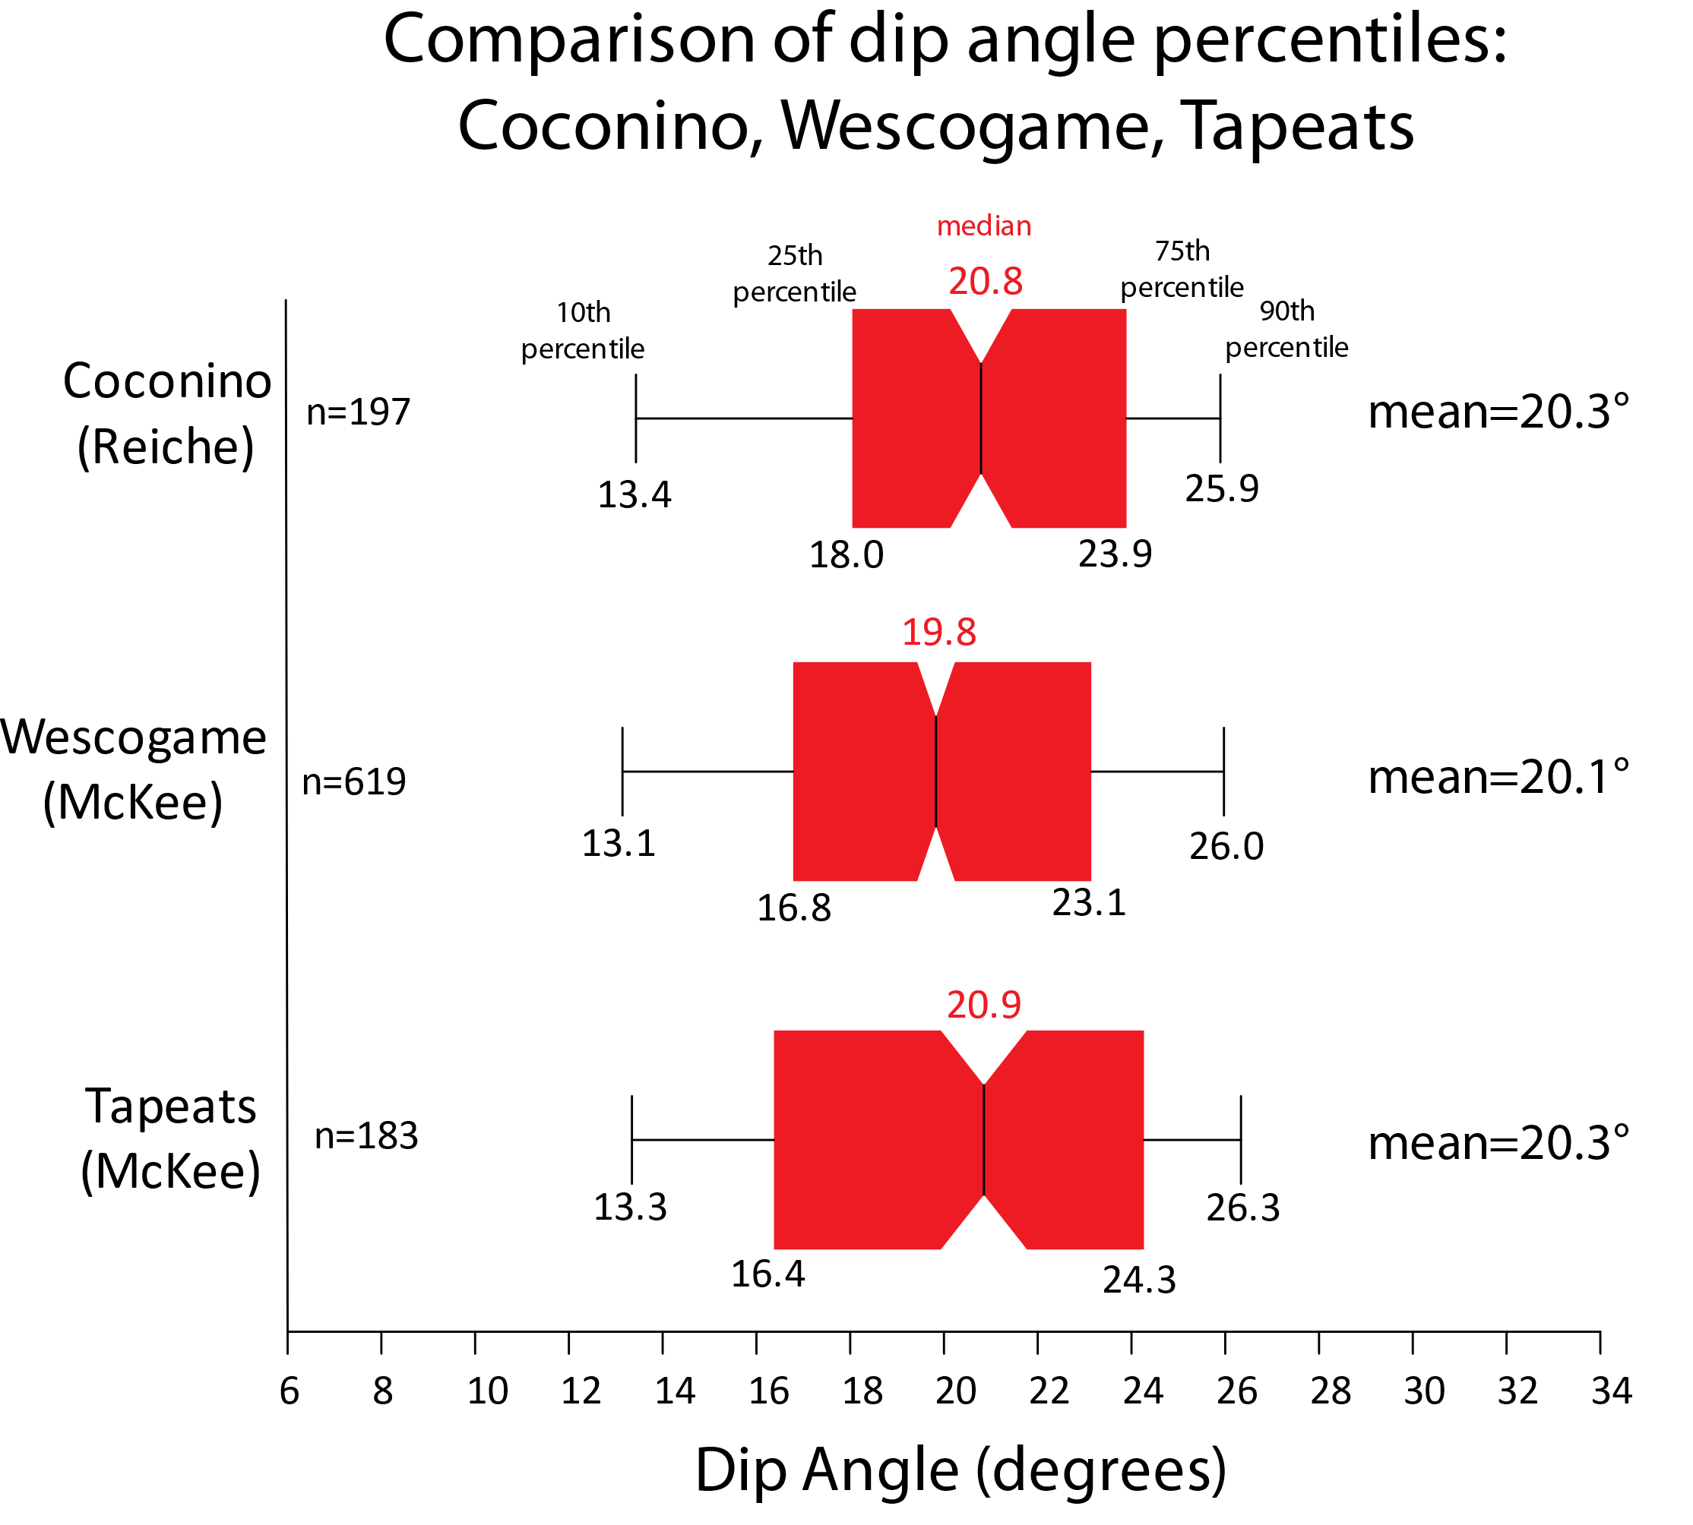
Results: 5) Coconino, Wescogame and Tapeats means cannot be differentiated
Presumed depositional environments:
Coconino: eolian
Wescogame: fluvial
Tapeats: shallow marine
Excel ANOVA
p > 0.05, so we reject the hypothesis that there is a difference between the means of the three groups.
Notes:
This graph shows something that was quite unexpected. Plotted are the cross-bed dips of the Coconino (from Reiche 1938), the Wescogame (from McKee 1982), and the Tapeats (from McKee 1940). All three of the formations are from the Grand Canyon area. Plotted are the 10th and 90th percentiles, the middle two quartiles, and the medians. Note that the distribution of the cross-beds for each rock unit is about the same and the means are about the same. An ANOVA analysis of the means from these sets of cross-bed dips showed the means could not be differentiated from each other. This was surprising to me because it is often thought each of these formations have totally different depositional environments: Coconino (eolian), Wescogame (fluvial), and Tapeats (shallow marine). In other words, dip angle in these formations does not distinguish between depositional environments.

Slide 16



Concluding Remarks
Tapeats Sandstone
Of course, more data will be helpful, especially for eolian dunes!
“Steep” is an optical illusion, probably caused by set thickness.
It’s not that sandstone cross-bed angles are less than eolian ones (the means are about the same); sandstones have a smaller range (standard deviation).
You can’t simply compact eolian dune angles or remove the upper parts of dunes to get the observed sandstone angles
Coconino Sandstone
Navajo Sandstone
Notes:
In conclusion, of course more data would be helpful in a study like this, especially individual measurements from eolian dunes. It would be helpful to have more data besides the number of measurements and an average. If any of you is aware of data sets, or have data sets from such settings, I would appreciate knowing about them.
We need to measure cross-bed angles before we say the angles are “steep.” We often see the word “steep” being used for formations with thick cross-bed sets but see no such adjectives used on sets that are thinner, but may actually have steeper angles. In other words, let’s make sure that our statements can be underpinned with data.
It appears eolian dune angles have a much greater standard deviation than the sandstones I’ve analyzed for this study. The means of dunes and sandstones is about the same, the biggest difference is in the spread of the angles, with eolian dunes having many more measurements less than 10 degrees and greater than 30 degrees compared to sandstones.
Compaction and erosion of the upper parts of dunes are not viable hypotheses to explain the differences in the data sets between eolian dunes and sandstones. The problem is you can’t compact or eliminate some of the dune data to get the observed distributions of sandstone cross-beds.
Thank you very much for your attention today. I would very much appreciate any of your comments and any data that I may not be aware of.
The following two slides show my references and my abstract.
Thank you.

Slide 17
References
Maithel, S.A. 2019. Characterization of Cross-Bedded Depositional Processes in the Coconino Sandstone. Loma Linda, California: Loma Linda University [Dissertation].
McKee, E.D. 1966. Structures of dunes at White Sands National Monument, New Mexico (and a comparison with structures of dunes from other selected areas). Sedimentology 7:1-69.
McKee, E.D. 1982. The Supai Group of the Grand Canyon. Washington, D.C.: United States Geological Survey Professional Paper 1173.
McKee, E.D., and C.E. Resser. 1945. Cambrian history of the Grand Canyon Region. Washington DC: Carnegie Institution of Washington Publication 563.
McKee, E.D., and J.J. Bigarella. 1979. Ancient Sandstones considered to be eolian. In, E.D. McKee (editor): A Study of Global Sand Seas. U.S. Geological Survey Professional Paper 1052, pp. 187-238.
McKee, E.D., and J.J. Bigarella. 1979. Sedimentary structures in dunes. In, E.D. McKee (editor): A Study of Global Sand Seas. U.S. Geological Survey Professional Paper 1052, pp. 83-134.
McKee. E.D. 1940. Three types of cross-lamination in Paleozoic rocks of northern Arizona. The American Journal of Science 238:811-824.
Reiche, P. 1938. An analysis of cross-lamination the Coconino Sandstone. The Journal of Geology 46:905-932.
Whitmore, J.H. 2019. Lithostratigraphic Correlation of the Coconino Sandstone and a Global Survey of Permian “Eolian” Sandstones: Implications for Flood Geology. Answers Research Journal 12:275-328.
Ahlbrandt, T.S., and S.G. Fryberger. 1980. Eolian deposits in the Nebraska Sand Hills. U.S. Geological Survey Professional Paper 1120A: 1–24.
Bigarella, J.J. 1972. Eolian environments: Their characteristics, recognition and importance. In: J.K. Rigby and W.K Hamblin (editors), Recognition of Ancient Sedimentary Environments, pp. 12-62.
Bigarella, J.J., and R. Salamuni. 1961. Early Mesozoic wind patterns as suggested by dune bedding in the Botucatú Sandstone of Brazil and Uruguay. Geological Society of America Bulletin 72:1089-1106.
Bigarella, J.J., R.D. Becker, and G.M. Duarte. 1969. Coastal dune structures from Paraná (Brazil). Marine Geology 7:5-55.
Fryberger, S.G., N. Jones, M. Johnson, and C. Chopping. 2016. Stratigraphy, exploration and EOR potential of the Tensleep/Casper Formations, SE Wyoming. Search and Discovery Article #10851. Wyoming Geological Association, Casper, Wyoming.
Kiersch, G.A. 1950. Small-scale structures and other features of Navajo Sandstone, northern part of San Rafael Swell, Utah. Bulletin of the American Association of Petroleum Geologists 34:923-942.

Slide 18
Abstract
Geological Society of America Abstracts with Programs 53(6), 2021
doi: 10.1130/abs/2021AM-369476
Cross-bed dip inclinations of ancient cross-bedded sandstones are often reported as “steep” in the literature, especially if the cross-bed sets are thick, or if the sandstone is presumed to be eolian. Only rarely are data referenced in making this assessment. This preliminary study examines published data from ancient sandstones and compares them with published measurements from modern eolian cross-beds. The goal was to see what differences existed between the two sets of data.
Published dip angles were collected from 13 sandstones (most interpreted as eolian) from 88 localities consisting of 5,242 measurements (Bigarella and Salamuni 1961, Fryberger et al. 2016, Kiersch 1950, Maithel 2019, McKee 1940, McKee 1982 and Reiche 1938). Sandstones included the Botucatú (Brazil); Casper and Tensleep (Wyoming); Cedar Mesa and Navajo (Utah); Coconino, De Chelly, Esplanade, Manakacha, Wescogame, and Tapeats (Arizona); Tacuarembó (Uruguay); and the Wingate (New Mexico). Additionally, 5,785 dip measurements were collected from 76 eolian localities (Bigarella 1972, Bigarella et al. 1969, McKee 1966, McKee and Bigarella 1979). Sets of data ranged from 6 to 676 measurements (mean=67, mode=30, median=34). In all cases, it was assumed authors were reporting representative examples of inclinations without bias. Data were analyzed and plotted with Excel and Grapher.
Mean dips from sandstones, eolian dunes, and weighted means of eolian dunes are similar, with dips of 19.8°, 17.8°, and 19.8°, respectively. The main difference occurred in the spread of the data. Ancient sandstones have a standard deviation of 5.7, while those from modern eolian deposits have a value of 10.1. The data show that the middle two quartiles of sandstone dips cluster between 15.5 - 24.0° and often lack values >30°, while the middle two quartiles of modern eolian dips are more widespread, clustering between 9.0 – 27.0°, with many values >30°. Sandstones that are often considered to have “steep” cross-beds have central tendencies that were not very different from non-eolian sandstones. A surprise was that the set of data from the Coconino, Tapeats, and Wescogame (of the Grand Canyon area) could not be statistically distinguished from one another, despite having different cross-bedding styles, set thicknesses, and paleoenvironmental interpretations.

