Slide 1
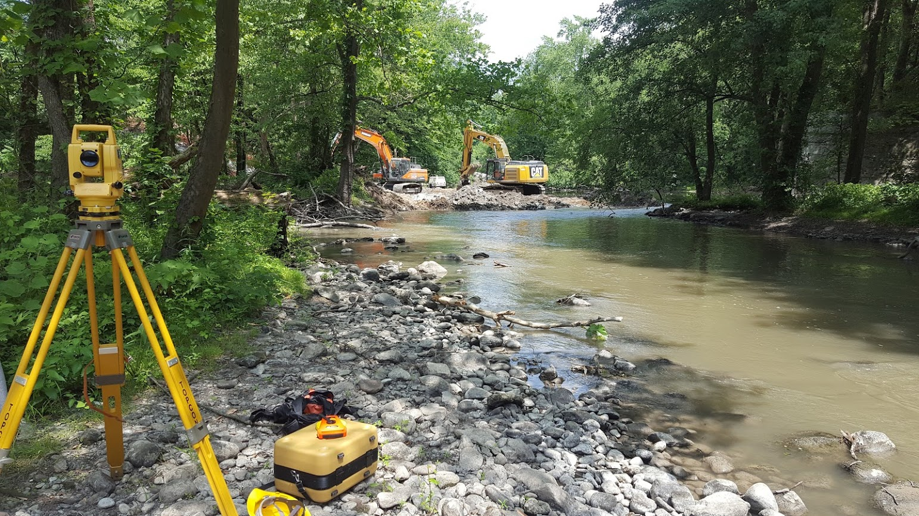
Dam removals and environmental justice
Josh Galster, Montclair State University
George Galster, Wayne State University
GSA 2021

Slide 2
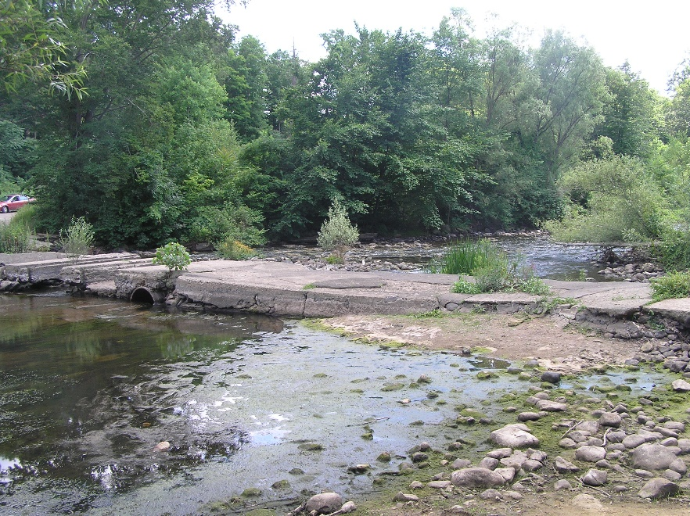
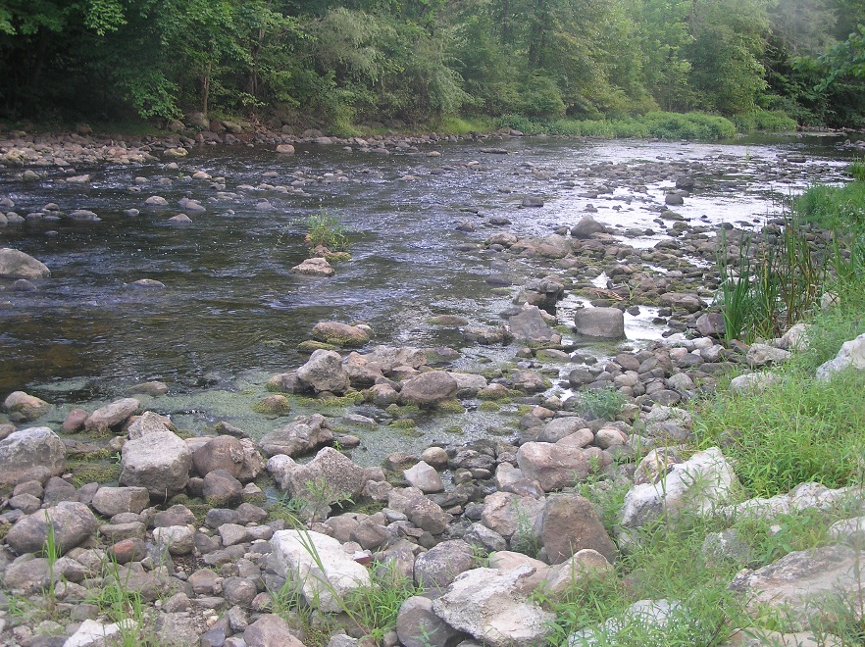
Dam removals are important, deliberate disturbances to fluvial systems with (ideally) net benefits
Improve various biological, physical, and chemical metrics in the river.
But, who are the local populations benefiting from these dam removals?

Slide 3
Dam removals and environmental justice issues
Communities of color are disproportionately exposed to environmental burdens such as contaminated soil, air, and water.
If dam removals are a net benefit… how are they distributed?
Who are the local populations that are benefitting?
Dam removals, and river restoration efforts in general, have not sufficiently included environmental justice issues.

Slide 4
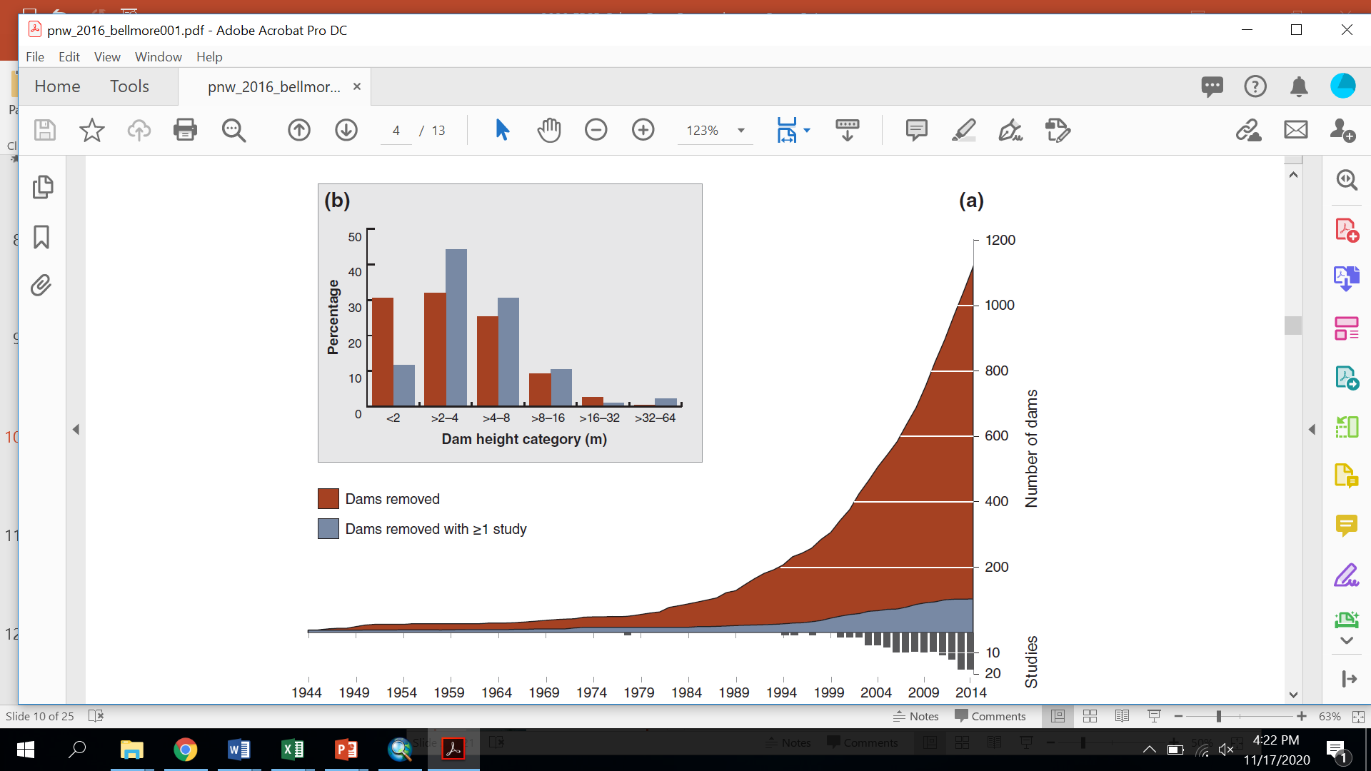
More dams are being removed recently, and most are small and not studied
Bellmore et al. 2017
Bellmore et al. (2017)

Slide 5
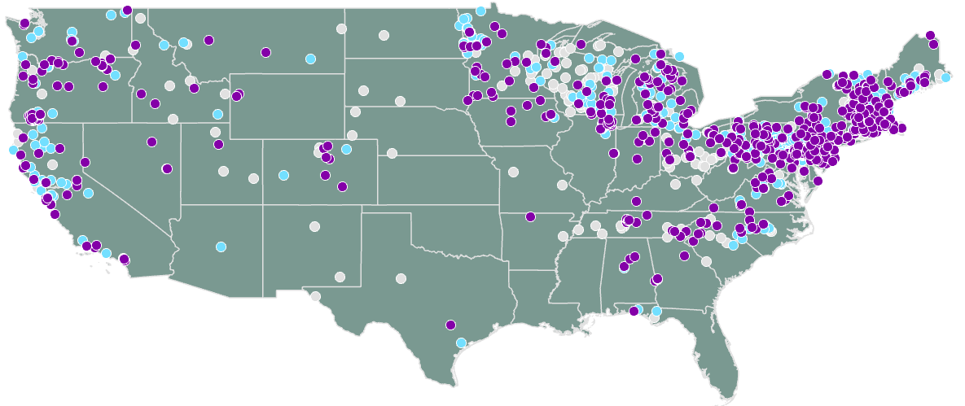
Dam removals in US: not evenly distributed
American Rivers Dam Removal Database (includes Hawaii and Alaska)
Year of Removal
Before 2000
2000-2009
2010-2018

Slide 6
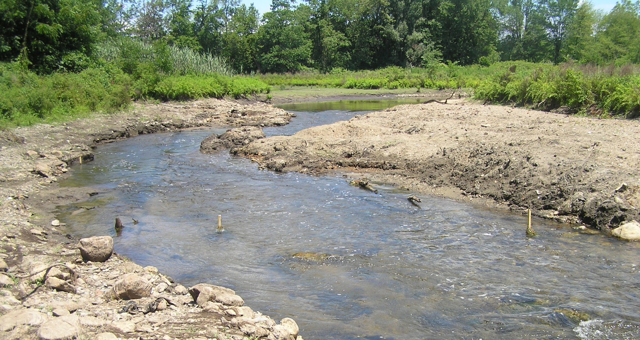
Research question 1
Is the racial / ethnic composition where dams have been removed since 2010 significantly different from those where dams have not been removed?
Musconetcong River, NJ shortly after dam removal

Slide 7
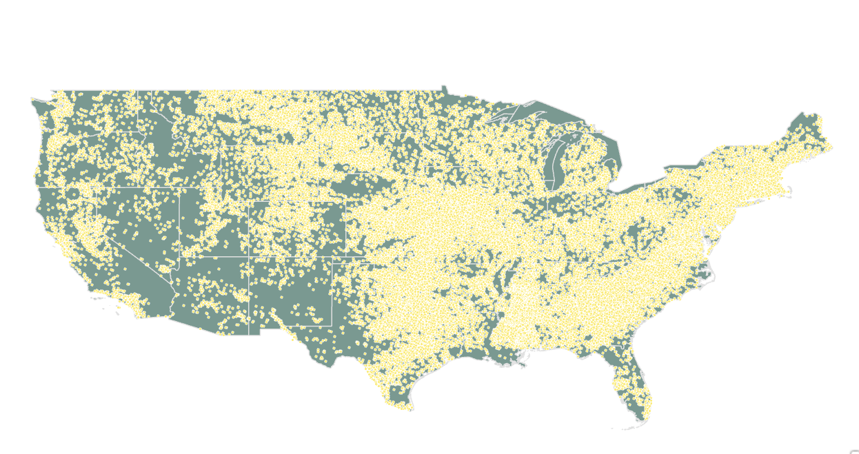
Where are the dams in the US?
91,468 dams (yellow dots)
National Inventory of Dams from the USACE
Also Hawaii & Alaska

Slide 8
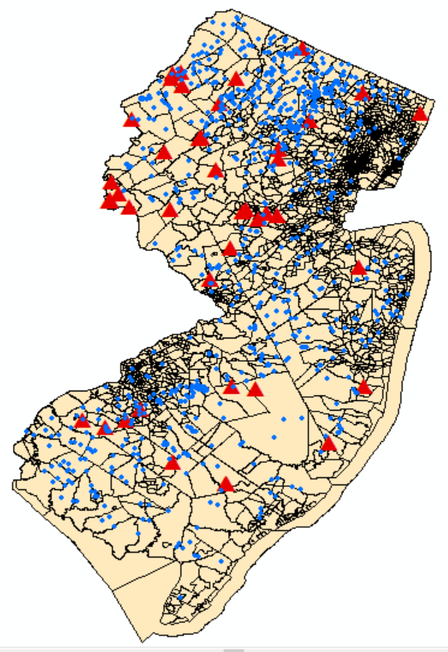
2010 Census tract data
Each tract has 1,200-8,000 people, with 4,000 being the goal.
Size varies with population density.
Racial characteristics self-identified.
Dam removals (triangles)
Existing Dams (dots)
Census tracts

Slide 9
Nationally dams have been removed from whiter areas
 | Population in Census Tract, 2010
Racial-Ethnic Group | Dams Removed 2010-2018 (n=669) | Existing Dams 2018 (n=91,090) | Total U.S. Population 2019
White^ | 85.2%* | 81.2%* | 63.4%
Black^ | 3.4%* | 8.3%* | 13.4%
Hispanic (any race) | 6.1% | 5.9% | 15.3%
Asian^ | 2.4%* | 0.9%* | 5.9%
Native American^ | 0.9%* | 2.0%* | 1.3%
Other/Multi-races^ | 2.1%* | 1.6%* | 2.9%
^ non-Hispanic
* difference in means significant at p<.01
This difference is environmental racism.

Slide 10
OK, but could these differences be explained by differences in dam characteristics?
Age
Height
Purpose
Construction material
As in, what if all the smaller or older dams are in predominantly white neighborhoods? And regional differences?
Ordinary Least Squares (OLS) to estimate the parameters of a linear model of the probability that a dam is removed from 2010 to 2018
OLS produces linear coefficients for each variable. + is more likely to be removed, - is less likely to be removed.

Slide 11
Northeast leading the way in removals, South lagging behind
Number of U.S. Dams and Dams Removed, by Region
 | Number of Dams
Region | Total | % Share of Total | Not Removed 2010-2018 | Removed 2010-2018 | % 2010 Dams Removed
Northeast | 8,598 | 9.4 | 8,289 | 309 | 3.6
South | 40,521 | 44.2 | 40,456 | 65 | 0.2
Midwest | 29,690 | 32.4 | 29,540 | 150 | 0.5
West | 12,950 | 14.1 | 12,805 | 145 | 1.1
Total | 91,759 | 100.0 | 91,090 | 669 | 0.7

Slide 12
Nationwide data from Ordinary Least Squares
MORE likely to be removed if:
  Hydroelectric
  Made from Masonry; Concrete; Concrete w/other
  Older dams
  Shorter dams
LESS likely to removed if:
  Irrigation; Flood control; or Recreation
  Made from Earth

Slide 13
When controlling for dam characteristics:
Northeast had no racial differences in dam removals
Midwest and West had dam removals in slightly less white areas compared to where dams are.
South had dam removals from areas with more white residents.
Controlling for dam age, height, construction material, and purpose.

Slide 14
Southern dam removal ownership
Federal, private, and utility-owned dam removals (n = 23) in the South are not demographically different from the remaining dams.
The dam removals (n =19) by state and local governments account for the racial difference in the South.
Southern states have few law regulating dam removal, and local decision-makers have a lot freedom when deciding which dams to remove. Even if the disparate impact is unintentional it is still discrimination.

Slide 15
Conclusions
Nationally dam removals have occurred in areas with whiter populations.
Particularly true of state & locally-owned dams in the South.
Dam removals, as a subset of the larger topic of river restoration, be more mindful of environmental justice factors such as the local populations near our projects.

Slide 18
Nationwide data
When only racial/ethnic data is used, dam removals occur in whiter areas.
This has been used to demonstrate a disparate impact. (Banzhaf, La & Timmins, 2015)
Adding other variables can suggest regional differences or differences in dam characteristics
Adding variables can also potentially explain WHY there are disparate racial impacts.

Slide 19
Research question 2
Does the association between the racial / ethnic composition of the census tract and the probability of a dam being removed persist after dam age, height, type, and purpose are controlled?
Dam variables: purpose, height, age, construction material

Slide 20
