Slide 1
Paired Cognitive and Affective Self-assessment Measures* Seem to Render Solely Cognitive Assessment Instruments Archaic
Nuhfer, Edward, Geology & Faculty Development California State Universities (retired),
Fleisher, Steven, Psychology, California State University Channel Islands
Wirth, Karl R., Geology Department, Macalester College (pre-retired)
Watson, Rachel, Microbiology and Chemistry, University of Wyoming
Cogan, Christopher, Geography, Memorial University of Newfoundland
Scharff, Lauren, Behavioral Science and Leadership, United States Air Force Academy
* From about 9300 participants from 37 institutions & workshops

Slide 2
Thanks to our session’s advocates, Virginia and Argenta, for enabling our coordination of 3 presenters in sequence!
(Ed) – Background on the value of paired measures and the validity of self-assessment
(Steve) – A psychological deep-dive into using measures of self-assessment and mindset in teaching
(Karl) – Using the new knowledge about self-assessment in undergraduate research

Slide 3
Existing tests measure cognitive competence. We added measures of affective feelings of self-assessed competence, and discovered unanticipated benefits. Let’s see more.
Cognitive competence from a validated 25-item Science Literacy Concept Inventory (SLCI) to measure understanding science as a way of knowing (a common general-education outcome).
Self-assessed competence from two items.
Predicted self-assessment
Postdicted self-assessment
All participants who voluntarily furnish an email get a detailed feedback letter about both.

Slide 4
We frequently hear: “Students can’t self-assess.” Can they? Are self-assessments valid and useful?

Slide 5
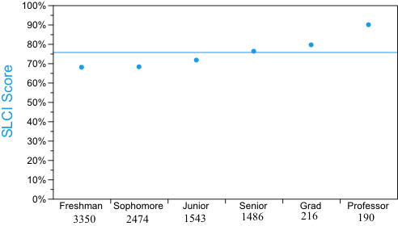
Here, we see the average cognitive competence change through the academic ranks. How does that accord with how students feel about their competence, on average?

Slide 6
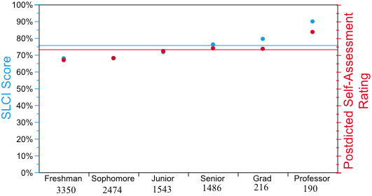
Most people self-assess pretty well. Groups of people are astounding in how well their self assessed competence tracks their competency scores on a validated instrument.
See Nuhfer et al.
https://digitalcommons.usf.edu/numeracy/vol10/iss1/art4/

Slide 7
Why measure both?
Becoming educated involves developing an understanding of self along with acquiring the knowing of “stuff” (knowledge and skills).

Slide 8
Clarifying three “selfie” terms
Self-assessed competence
“Given a challenge, here’s what I can do here and now with what I’ve got.”
Self-efficacy is about future challenges
Belief that I can learn to succeed. “With study and instruction, I can use what I’ve got to get what I need.”
“If I have the belief that I can do it, I shall surely acquire the capacity to do it, even if I may not have it at the beginning.” Mahatma Gandhi
Self-regulation – Capacity for life-long learning
I understand myself as a learner, and I understand how to learn.

Slide 9
Self-efficacy: “I can use what I’ve got to get what I need.”
However, much of what I’ve “got” to address the here and now, I likely owe to some history of experienced privilege.

Slide 10

The privileged have years of relevant experiences. Some have acquired a veritable truckload of them without realizing it.
Those of lesser privilege have years of less relevant experiences.
Relatively speaking, these experiences might fit into a backpack. Groups may not “know” this, put they surely do “feel” it.

Slide 11
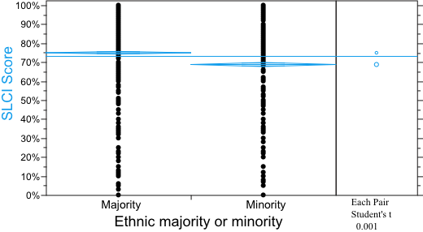
With just a test, we can see that majority privilege affects cognitive test scores.

Slide 12
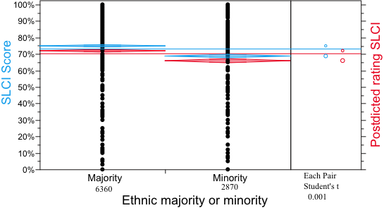
But paired measures reveal not just how a group scores, but also how it FEELS.

Slide 13
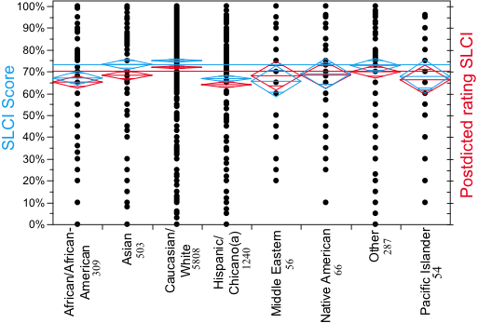
Privilege isn’t spread equitably. It affects different people and diverse groups in different ways
See Watson et al. 2019, https://digitalcommons.usf.edu/numeracy/vol12/iss2/art2/

Slide 14
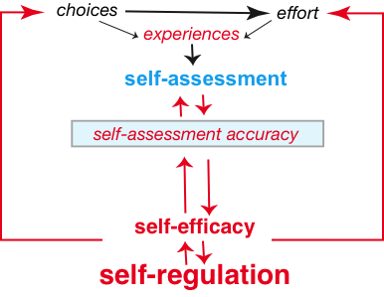
Relationships of the three:
Consider K-12 (Ross, 2006)
Largely trial and error
Feedback by design
Knowledge
Surveys!
(Karl)
Transition from just “learning stuff” to developing a system of mindful learning
(Steve)
Life-Long Learning?
“I know how to do this!”

Slide 15
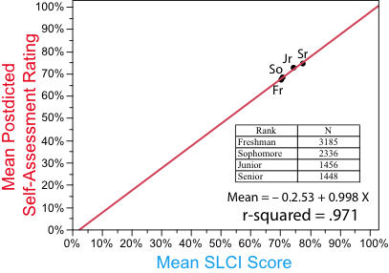
Consider program and institutional assessment.
How are students growing as people as they are growing as content experts through the undergraduate ranks?
Correlations of undergraduate class
ranks for institutions with adequate
data are commonly around r = .9.
The order of ranks and line slopes
appear to be unique and
signature for each
institution. Next,
let’s have a look
at how institutions
differ.
Internal Development – Knowing Self
External Development Gaining Knowledge & Skills

Slide 16
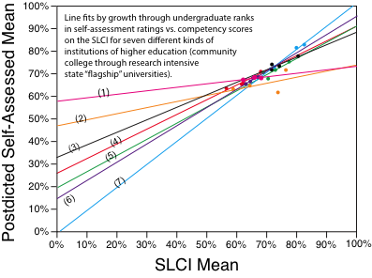
ALL INSTITUTIONS ARE NOT ALIKE. The line slopes differ and in some the class ranks graph out of rank order. You’d never see this from an ordinary test or concept inventory without a paired measure.

Slide 17
Takeaway: STUDENTS CAN SELF-ASSESS! But 22 years of behavioral scientists’ proclaiming most people cannot self-assess (Dunning-Kruger effect) bring collateral damage.
“Since most people are unskilled and unaware of it, I probably shouldn’t trust myself or aspire to too much high level thinking.”
“Since only a few people can be skilled and accomplished; I should defer to their authority.”
“Since people don’t know what they think they know, all opinions are probably equally valid.”
Harms development of healthy self-efficacy
Encourages appeal to authority
Arrests intellectual development at Perry Stage 3.
Our work shows such messages should be rejected because the premises are false.
Reasons they are false are detailed in our three published papers in Numeracy,
with more to come

Slide 18
Peer-reviewed resources for those who will download this ppt file later from GSA archives
https://journals.asm.org/doi/10.1128/jmbe.v16i2.986
https://digitalcommons.usf.edu/numeracy/vol12/iss2/art2/
https://digitalcommons.usf.edu/numeracy/vol10/iss1/art4/
https://digitalcommons.usf.edu/numeracy/vol9/iss1/art4/
https://www.youtube.com/watch?v=oRuGd9I-Hzw
https://books.aosis.co.za/index.php/ob/catalog/book/279 Chapter 6
https://www.improvewithmetacognition.com/metacognitive-self-assessment/
https://www.improvewithmetacognition.com/paired-self-assessment-competence/
END

