Slide 1




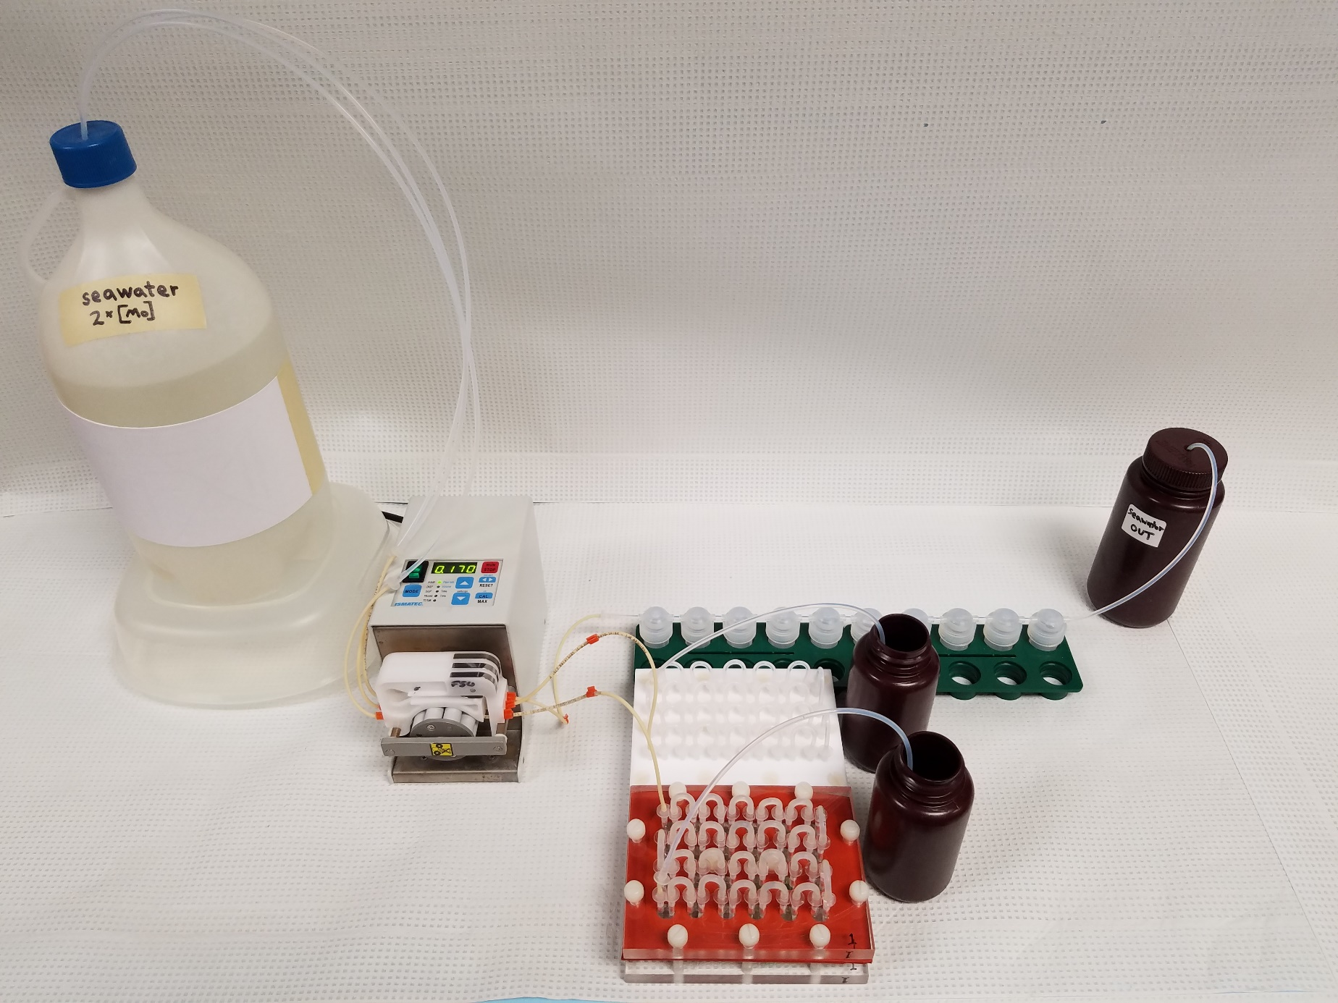
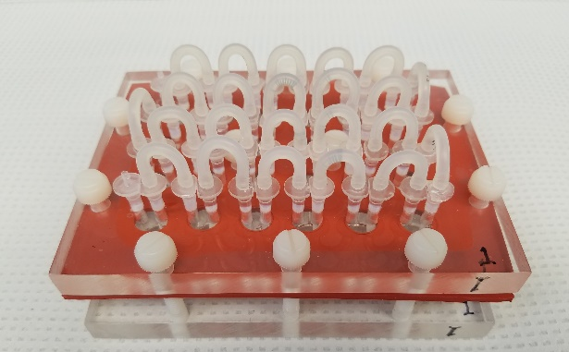
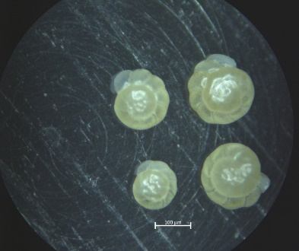
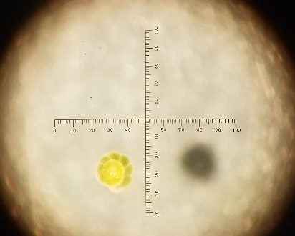
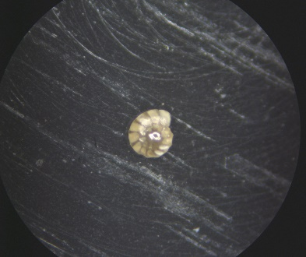
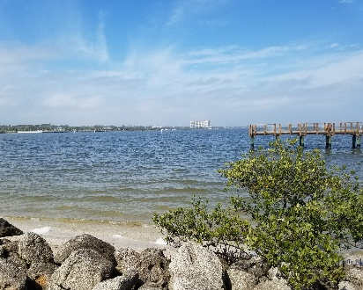
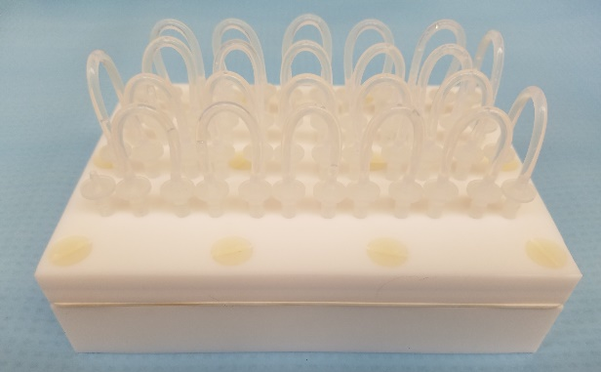
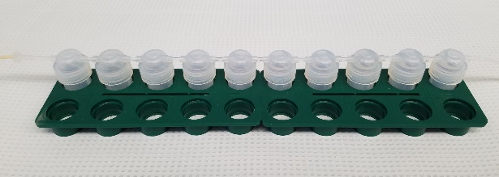
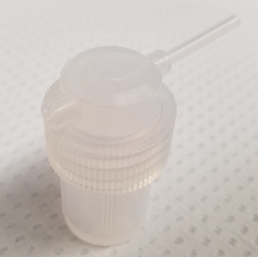
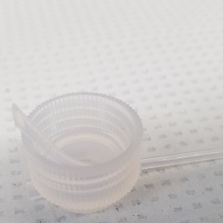
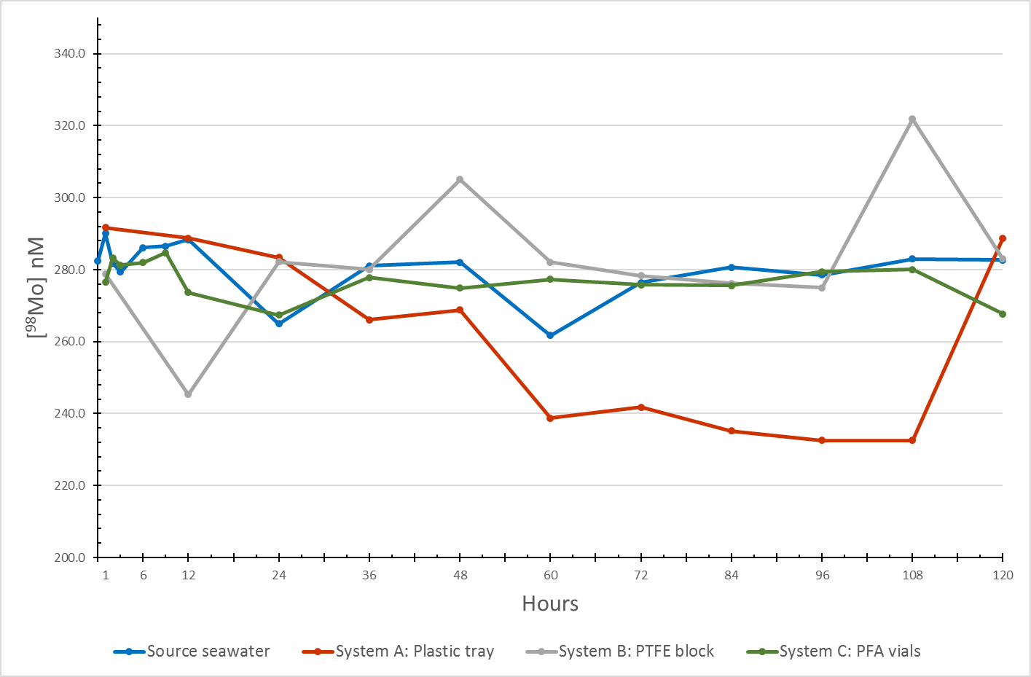
Assessing trace metal incorporation using a flow
through culturing system for benthic foraminifera
Christian H. Gfatter¹ and Jeremy D. Owens¹
¹Department of Earth, Ocean and Atmospheric Science | National High Magnetic Field Laboratory, Florida State University, Tallahassee, FL
I. Background
Many redox‑sensitive micronutrients and trace metals have been constrained for punctuated events indirectly as they are inferred from black shale enrichments¹⁻³. Paleoclimate studies have utilized foraminiferal elemental concentrations that were incorporated during original precipitation⁴, but redox‑sensitive trace metal research has been limited. We are testing the utility of foraminifera to track the global seawater trace metal inventory using controlled culture experiments in order to assess the viability of using well preserved foram tests as a proxy to reconstruct the marine trace metal concentration of redox‑sensitive elements. First, we must determine the best method that does not impact the trace metal uptake by these forams.
Figure 1. Configuration of components and culturing systems employing:
a) plastic culture tray, b) PTFE block with wells, and c) PFA vials.
Ammonia tepida spiral side | Ammonia tepida after consuming algae, Dunaliella quartolecta | Ammonia sp. collected from the east coast of Florida near Daytona | Sediment sampling site Port Orange, FL
a)
Figure 3. Benthic foraminifera.
b)
V. Future Research
Foraminiferal culturing work:
• Collect and culture Ammonia tepida
• Analyze molybdenum (Mo) incorporation
• Investigate vanadium (V) incorporation
• Evaluate responses of other species
Paleoceanography analyses:
• Collect benthic foraminiferal fossils
conspecific with or analogous to modern species
• Analyze concentrations of Mo, V, and similar redox‑sensitive trace elements
c)
II. Hypothesis
Our flow through culturing system design, utilizing the specified fabricated components, does not significantly incorporate Mo into the system.
IV. Results and Discussion
VI. Acknowledgements
For their contributions, we thank Sean Newby, Lindsi Allman, Dr. Michael Martínez-Colón, and Dr. Seth A. Young. Financial support was provided by Phi Kappa Phi and the Cushman Foundation for Foraminiferal Research. A portion of this work was performed at the National High Magnetic Field Laboratory, which is supported by the National Science Foundation Cooperative Agreement No. DMR-1644779 and the state of Florida.
III. Methods
• Three flow through culturing systems (Fig. 1) were evaluated for use in following experiments:
a) Apparatus using a plastic culture tray⁵;
b) Modified scheme utilizing a customized block of polytetrafluoroethylene (PTFE) instead⁶; and
c) Serial system of synthetic perfluoroalkoxy alkane (PFA) vials connected by PTFE tubing.
• Source seawater was filtered to 0.22 µm and spiked with molybdenum (≈280 nM). Samples were collected at variable intervals at the onset and then every 12 hours (Fig. 2).
• Subsequent experiments will utilize living benthic foraminifera to measure the uptake of Mo.
• System A displayed a decline in [Mo] until hour 120 before returning to the source level.
• System B seemed to reach equilibrium at hour 24 or 60, but a few outliers were present.
• In contrast, system C reached equilibrium with the source seawater at hour 1 where no significant difference, t(14) = 1.52, p = .15, was reported in [Mo] from the source through the entire time period.
• Preliminary results suggest lower [Mo] variability when the pump pulls the seawater into the systems.
VII. References
Gill, B.C., T.W. Lyons, S.A. Young, L.R. Kump, A.H. Knoll, and M.R. Saltzman. 2011. Geochemical evidence for widespread euxinia in the Later Cambrian ocean. Nature 469 (7328):80-83.
Owens, J.D., C.T. Reinhard, M. Rohrssen, G.D. Love, and T.W. Lyons. 2016. Empirical links between trace metal cycling and marine microbial ecology during a large perturbation to Earth's carbon cycle. Earth and Planetary Science Letters 449:407-417.
Reinhard, C.T., N.J. Planavsky, L.J. Robbins, C.A. Partin, B.C. Gill, S.V. Lalonde, A. Bekker, K.O. Konhauser, and T.W. Lyons. 2013. Proterozoic ocean redox and biogeochemical stasis. Proceedings of the National Academy of Sciences of the United States of America 110 (14):5357-5362.
Katz, M.E., B.S. Cramer, A. Franzese, B. Honisch, K.G. Miller, Y. Rosenthal, and J.D. Wright. 2010. Traditional and Emerging Geochemical Proxies in Foraminifera. Journal of Foraminiferal Research 40 (2):165-192.
de Nooijer, L.J., G.J. Reichart, A. Duenas-Bohorquez, M. Wolthers, S.R. Ernst, P.R.D. Mason, and G.J. van der Zwaan. 2007. Copper incorporation in foraminiferal calcite: results from culturing experiments. Biogeosciences 4 (4):493-504.
Martínez-Colón, M. 2016. Pollutants and Foraminiferal Assemblages in Torrecillas Lagoon: An Environmental Micropaleontology Approach. Doctor of Philosophy (Ph.D.) Doctoral dissertation, College of Marine Science, University of South Florida.
Figure 2. ⁹⁸Molybdenum concentration of seawater after flowing through each culturing system.
.
System C was chosen for the uptake experiments due to consistency, interchangeable parts, and configuration flexibility. These results advocate incorporating fluoropolymer products when conducting trials that culture calcifying organisms to study their incorporation of trace metals.

