Slide 1
Sudden vs. Drawn-Out Pleistocene Extinction: Preliminary Results from the American Southwest
James C. Hartley
Contract Archaeologist, Tulsa, OK 74114
© 2021 Geological Society of America (Cordilleran Section)

Slide 2

Introduction
Pleistocene extinction
  Sudden vs. drawn-out
  Megafauna alone vs. with other vertebrates
American Southwest
  Deserts of southwestern USA and northern Mexico
  Great Salt Lake-Baja Peninsula (north-south)
  Pecos River-Imperial Valley (east-west)
Image credit: Hartley 2020:7

Slide 3
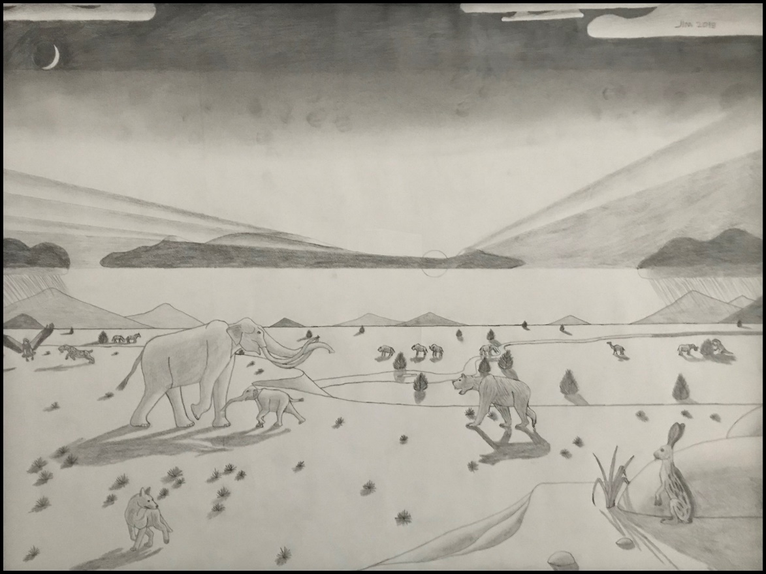
Background
Pleistocene megafauna
  Pleistocene mammals 45+ kg adult body mass
    Mammoths, bison, saber-toothed cats, ground sloths, humans, etc.
  Extinct by 12,800 CALYBP
    Overkill vs. climate change vs. other
Image credit: Hartley 2018:Fig. 2

Slide 4
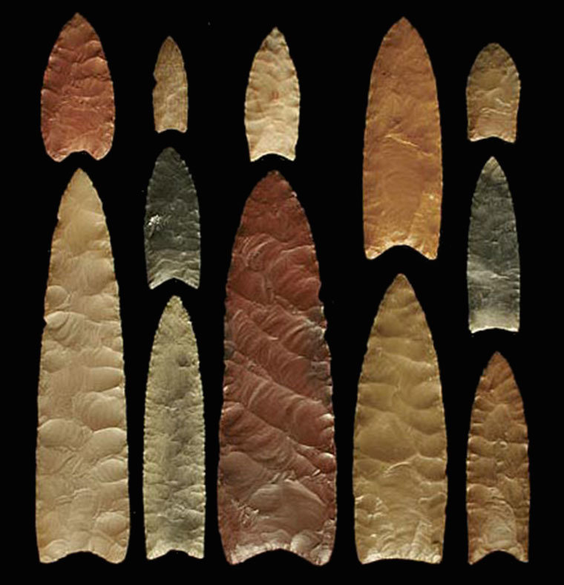
Background
Overkill
  Hunted to extinction by First Americans
  Clovis (13,400-12,800 CALYBP [max])
    Big game hunters
    Fluted points
    Replaced by later Paleoindian and/or Archaic groups
Image credit: O’Brien et al. 2015:127

Slide 5
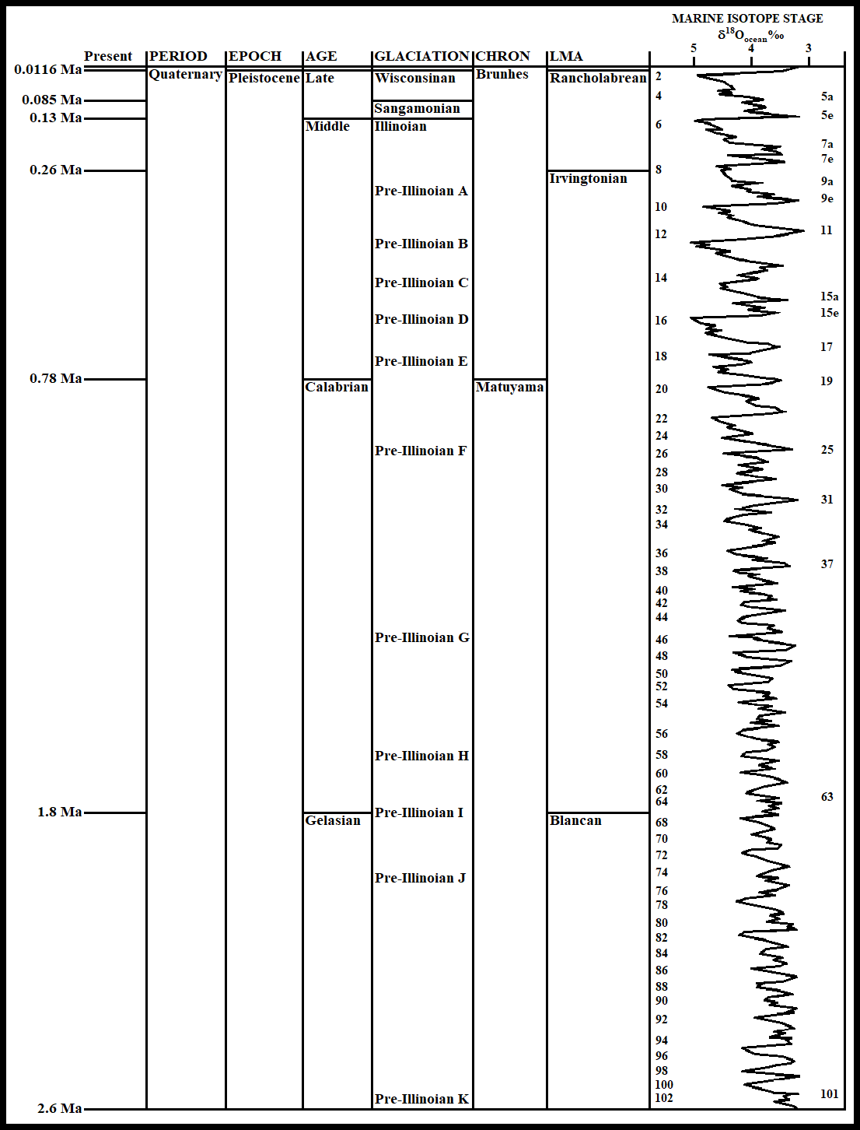
Background
Climate change
  Cold
    Low temperatures, high water table, more C3 plants
  Warm
    High temperatures, low water table, more C4 plants
  Cold (LGM, before 14,800 CALYBP) to warm (BA, 14,800-12,900 CALYBP) to cold (YD, 12,900-11,600 CALYBP)
Image credit: Hartley 2021 [current presentation]

Slide 6
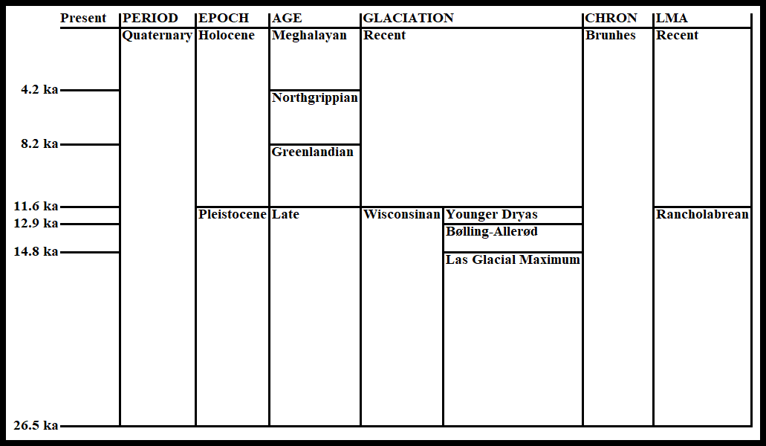
Background
Climate change
  Cold
    Low temperatures, high water table, more C3 plants
  Warm
    High temperatures, low water table, more C4 plants
  Cold (LGM, before 14,800 CALYBP) to warm (BA, 14,800-12,900 CALYBP) to cold (YD, 12,900-11,600 CALYBP)
Image credit: Hartley 2021 [current presentation]

Slide 7
Methods
Pleistocene vertebrate sites in American Southwest
  Primary texts and secondary databases
  Genus-level IDs (at least)
  Extinct vs. extant (but now absent)
  Last appearance dates
    Radiocarbon dates calibrated (as needed)
  Clovis-age vs. pre-Clovis-age (cutoff at 13,400 CALYBP)

Slide 8
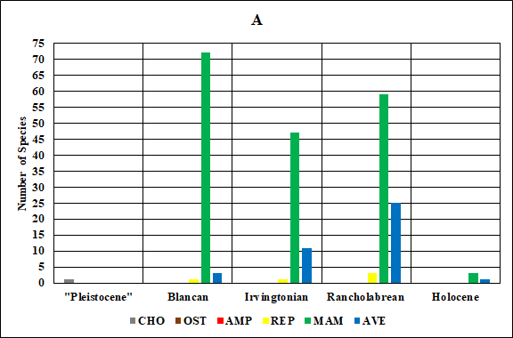
Results
279 vertebrates total
  Almost 90% before humans
  Over 72% mammals and over 22% birds
  227 extinct vertebrates
    181 mammals, 40 birds, 5 reptiles, and 1 shark
    Most gone during Blancan (most mammals), Irvingtonian, and Rancholabrean (most birds)
    14 Clovis-age mammals (6 with artifacts)
    “Pleistocene”-age shark
Image credit: Hartley 2021 [current presentation]

Slide 9
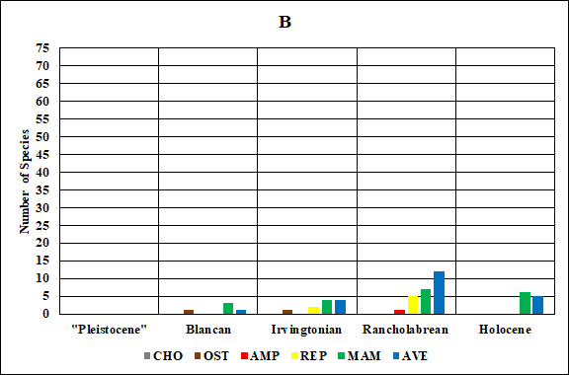
Results
279 vertebrates total
  52 extant vertebrates
    20 mammals, 22 birds, 7 reptiles, 1 amphibian, and 2 fish
    Most gone during Rancholabrean (mammals, birds, and reptiles) and Holocene (mammals and birds)
    Rancholabrean-age leopard frog
    1 fish each from Blancan and Irvingtonian
Image credit: Hartley 2021 [current presentation]

Slide 10
Discussion
Mostly mammals (not just megafauna) and birds affected in Southwest
  Most losses before humans in Southwest
  Drawn-out extinction
Complications
  Sources
    Mostly databases
    No library access
  Imprecise dates
    Just within LMA
    Clovis vs. pre-Clovis

Slide 11
Conclusion
Pleistocene extinction drawn-out in Southwest
  Mostly before humans
  Mammals and birds most affected
Further research
  More access to libraries and museums
  Compare fossils from different deserts
  Compare other regions

Slide 12
References
Albright III, L. B. 2000. Biostratigraphy and Vertebrate Paleontology of the San Timoteo Badlands, Southern California. University of California Publications in Geological Sciences No. 144. Berkeley: University of California Press.
Allen, J. A. 1913. “Ontogenetic and Other Variations in Muskoxen, with a Systematic Review of the Muskox Group, Recent and Extinct.” Memoirs of the American Museum of Natural History 1: 101-226.
Alroy, J. 2019. “Fossilworks.” Accessed March 2, 2021. http://www.fossilworks.org.
Asmerom, Y., V. J. Polyak, and S. J. Burns. 2010. “Variable Winter Moisture in the Southwestern United States Linked to Rapid Glacial Climate Shifts.” Nature Geoscience 3: 114-117.
Ayer, M. Y. 1936. “The Archaeological and Faunal Material from Williams Cave, Guadalupe Mountains, Texas.” Proceedings of the Academy of Natural Sciences of Philadelphia 88: 599-619.
Baker, J. K. 1963. “Fossilization of Bat Skeletons in the Carlsbad Caverns.” Bulletin of the National Speleological Society 25: 37-44.
Becker, J. J., and J. A. White. 1981. “Late Cenozoic Geomyids (Mammalia: Rodentia) from the Anza-Borrego Desert, Southern California.” Journal of Vertebrate Paleontology 1: 211-218.
Behler, J. L., and F. W. King. 1979. National Audubon Society Field Guide to Reptiles and Amphibians. New York: Alfred A. Knopf.
Bell, C. J., E. L. Lundelius, Jr, A. D. Barnosky, R. W. Graham, E. H. Lindsay, D. R. Ruez, Jr, H. A. Semken, Jr, S. D. Webb, and R. J. Zakrzewski. 2004. “The Blancan, Irvingtonian, and Rancholabrean Mammal Ages.” In Late Cretaceous and Cenozoic Mammals of North America: Biostratigraphy and Geochronology, edited by M. O. Woodburne, 232-314. New York: Columbia University Press.
Betancourt, J. L. 1990. “Late Quaternary Biogeography of the Colorado Plateau.” In Packrat Middens: The Last 40,000 Years of Biotic Change, edited by J. L. Betancourt, T. R. Van Devender, and P. S. Martin, 259-292. Tucson: University of Arizona Press.
Bradley, R. S. 1999. Paleoclimatology: Reconstructing Climates of the Quaternary. 2nd ed. San Diego: Academic Press.
Brakenridge, G. R. 1981. “Terrestrial Paleoenvironmental Effects of a Late Quaternary-Age Supernova.” Icarus 46: 81-93.
Brakenridge, G. R. 2011. “Core-Collapse Supernovae and the Younger Dryas/Terminal Rancholabrean Extinctions.” Icarus 215: 101-106.
Brasso, R. L., and S. D. Emslie. 2006. “Two New Late Pleistocene Avifaunas from New Mexico.” Condor 108: 721-730.
Bright, J., D. S. Kaufman, S. L. Forman, W. C. McIntosh, J. I. Mead, and A. Baez. 2010. “Comparative Dating of a Bison-Bearing Late-Pleistocene Deposit, Térapa, Sonora, Mexico.” Quaternary Geochronology 5: 631-643.
Bull, J., and J. Farrand Jr. 1994. National Audubon Society Field Guide to Birds: Eastern Region. Revised ed. New York: Alfred A. Knopf.
Cannon, M. D., and D. J. Meltzer. 2004. “Early Paleoindian Foraging: Examining the Faunal Evidence for Large Mammal Specialization and Regional Variability in Prey Choice.” Quaternary Science Reviews 23: 1955-1987.
Cannon, M. D., and D. J. Meltzer. 2008. “Explaining Variability in Early Paleoindian Foraging.” Quaternary International 191: 5-17.
Carraway, L. N. 2010. “Fossil History of Notiosorex (Soricomorpha: Soricidae) Shrews with Descriptions of New Fossil Species.” Western North American Naturalist 70: 144-163.
Cassiliano, M. L. 1999. “Biostratigraphy of Blancan and Irvingtonian Mammals in the Fish Creek-Vallecito Section, Southern California, and a Review of the Blancan–Irvingtonian Boundary.” Journal of Vertebrate Paleontology 19: 169-186.
Cohen, K. M., and P. L. Gibbard. 2020. “Global Chronostratigraphical Correlation Table for the Last 2.7 Million Years v. 2020b.” Accessed March 3, 2021. http://www.stratigraphy.org/upload/QuaternaryChart.pdf.

Slide 13
References
Cohen, K. M., D. A. T. Harper, P. L. Gibbard, and J.-X. Fan. 2020. “International Chronostratigraphic Chart v. 2020/03.” Accessed March 3, 2021. http://www.stratigraphy.org/ICSchart/ChronostratChart2019-05.pdf.
Cole, K. L. 1990. “Late Quaternary Vegetation Gradients through the Grand Canyon.” In Packrat Middens: The Last 40,000 Years of Biotic Change, edited by J. L. Betancourt, T. R. Van Devender, and P. S. Martin, 240-258. Tucson: University of Arizona Press.
Cracraft, J. 1968. “The Whooping Crane from the Lower Pleistocene of Arizona.” Wilson Bulletin 80: 490.
Croxen III, F. W., C. A. Shaw, and D. R. Sussman. 2007. “Pleistocene Geology and Paleontology of the Colorado River Delta at Golfo de Santa Clara, Sonora, Mexico.” In Wild, Scenic and Rapid: A Trip down the Colorado River Trough, edited by R. E. Reynolds, 84-89. Fullerton: California State University Desert Studies Consortium.
Czaplewski, N. J., J. I. Mead, C. J. Bell, W. D. Peachey, and T.-L. Ku. 1999. Papago Springs Cave Revisited, Part II: Vertebrate Paleofauna. Occasional Papers of the Oklahoma Museum of Natural History No. 5. Norman: Sam Noble Museum of Natural History.
Dalquest, W. W., and F. B. Stangl Jr. 1984. “Late Pleistocene and Early Recent Mammals from Fowlkes Cave, Southern Culberson County, Texas.” In Contributions in Quaternary Vertebrate Paleontology: A Volume in Memorial to John E. Guilday, edited by H. H. Genoways and M. R. Dawson, 432-455. Carnegie Museum of Natural History Special Publication No. 8. Pittsburgh: Carnegie Museum of Natural History.
Dooley Jr, A. C., E. Scott, J. Green, K. B. Springer, B. S. Dooley, and G. J. Smith. 2019. “Mammut pacificus sp. nov., a Newly Recognized Species of Mastodon from the Pleistocene of Western North America.” PeerJ 7: e6614.
Eiseley, L. C. 1943. “Archaeological Observations on the Problem of Post-Glacial Extinction.” American Antiquity 8: 209-217.
Emslie, S. D. 1987. “Age and Diet of Fossil California Condors in Grand Canyon, Arizona.” Science 237: 768-770.
Emslie, S. D., and N. J. Czaplewski. 1999. “Two New Fossil Eagles from the Late Pliocene (Late Blancan) of Florida and Arizona and Their Biogeographic Implications.” Smithsonian Contributions to Paleobiology 89: 185-198.
Ferring, C. R. 1995. “The Late Quaternary Geology and Archaeology of the Aubrey Clovis Site, Texas: A Preliminary Report.” In Ancient Peoples and Landscapes, edited by E. Johnson, 273-281. Lubbock: Museum of Texas Tech University.
Fiedel, S. J., and Y. V. Kuzmin. 2010. “Is More Precise Dating of Paleoindian Expansion Feasible?” Radiocarbon 52: 337-345.
Firestone, R. B., A. West, J. P. Kennett, L. Becker, T. E. Bunch, Z. S. Revay, P. H. Schultz, T. Belgya, D. J. Kennett, J. M. Erlandson, O. J. Dickenson, A. C. Goodyear, R. S. Harris, G. A. Howard, J. B. Kloosterman, P. Lechler, P. A. Mayewski, J. Montgomery, R. Poreda, T. Darrah, S. S. Que Hee, A. R. Smith, A. Stich, W. Topping, J. H. Wittke, and W. S. Wolbach. 2007. “Evidence for an Extraterrestrial Impact 12,900 Years Ago that Contributed to the Megafaunal Extinctions and the Younger Dryas Cooling.” Proceedings of the National Academy of Sciences of the United States of America 104: 16016-16021.
Geist, V. 2005. “Periglacial Ecology, Large Mammals, and Their Significance to Human Biology.” In Ice Age Peoples of North America: Environments, Origins, and Adaptations of the First Americans, edited by R. Bonnichsen and K. L. Turnmire, 78-94. College Station, Texas: Center for the Study of the First Americans.
Gilbert, C. R., and J. D. Williams. 2002. National Audubon Society Field Guide to Fishes. Revised ed. New York: Alfred A. Knopf.
Gillespie W. B. 1985. “Holocene Climate and Environment of Chaco Canyon.” In Environment and Subsistence of Chaco Canyon, New Mexico, edited by F. J. Mathien, 13-45. National Park Service Publications in Archeology No. 18E. Albuquerque: National Park Service.
Graham, R. W., and E. L. Lundelius Jr. 2010. “FAUNMAP: A Neotoma Constituent Database.” Accessed March 2, 2021. https://ucmp.berkeley.edu/faunmap/index.html.

Slide 14
References
Grant IV, U. S., and L. G. Hertlein. 1938. The West American Cenozoic Echinoidea. Publications of the University of California in Mathematical and Physical Sciences Vol. 2. Berkeley: University of California Press.
Grayson, D. K. 1987. “An Analysis of the Chronology of Late Pleistocene Mammalian Extinctions in North America.” Quaternary Research 28: 281-289.
Grayson, D. K. 1989. “The Chronology of North American Late Pleistocene Extinctions.” Journal of Archaeological Science 16: 153-165.
Grayson, D. K. 1991. “Late Pleistocene Mammalian Extinctions in North America: Taxonomy, Chronology, and Explanations.” Journal of World Prehistory 5: 193-231.
Grayson, D. K., and D. J. Meltzer. 2002. “Clovis Hunting and Large Mammal Extinction: A Critical Review of the Evidence.” Journal of World Prehistory 16: 313-359.
Grayson, D. K., and D. J. Meltzer. 2003. “A Requiem for North American Overkill.” Journal of Archaeological Science 30: 585-593.
Grayson, D. K., and D. J. Meltzer. 2015. “Revisiting Paleoindian Exploitation of Extinct North American Mammals.” Journal of Archaeological Science 56: 177-193.
Harris, A. H. 1984. “Two New Species of Late Pleistocene Woodrats (Cricetidae: Neotoma) from New Mexico.” Journal of Mammalogy 65: 560-566.
Harris, A. H. 1987. “Reconstruction of Mid-Wisconsin Environments in Southern New Mexico.” National Geographic Research 3: 142-151.
Harris, A. H. 1989. “The New Mexican Late Wisconsinan–East versus West.” National Geographic Research 5: 205-217.
Harris, A. H. 1993. “Quaternary Vertebrates of New Mexico.” New Mexico Museum of Natural History and Science Bulletin 2: 179-197.
Harris, A. H. 2003. “The Pleistocene Vertebrate Fauna from Pendejo Cave.” In Pendejo Cave, edited by R. S. MacNeish and J. G. Libby, 36-65. Albuquerque: University of New Mexico Press.
Harris, A. H. 2019. “Pleistocene Vertebrates of Southwestern USA and Northwestern Mexico.” Accessed March 2, 2021. https://www.utep.edu/leb/pleistnm/default.htm.
Harris, A. H., and L. N. Carraway. 1993. “Sorex preblei from the Late Pleistocene of New Mexico.” Southwestern Naturalist 38: 56-58.
Harris, A. H., and C. R. Crews. 1983. “Conkling’s Roadrunner–A Subspecies of the California Roadrunner?” Southwestern Naturalist 28: 407-412.
Harris, A. H., R. A. Smartt, and W. R. Smartt. 1973. “Cryptotis parva from the Pleistocene of New Mexico.” Journal of Mammalogy 54: 512-513.
Hartley, J. C. 2015. “Environmental Causes of the Extinction of the Pleistocene Megafauna in the Desert Southwest.” MA thesis, Department of Anthropology and Applied Archaeology, Eastern New Mexico University, Portales.
Hartley, J. C. 2018. “Faunal Excavation Bias in the Clovis Archaeological Record: Preliminary Results from the American Southwest.” Poster presented at the Cordilleran/Rocky Mountain Joint Section Meeting of the Geological Society of America, Flagstaff.
Hartley, J. C. 2019. “Date Precision and Faunal Distribution from Pleistocene Sites (Archaeological vs. Paleontological) in the American Southwest.” Poster presented at the 84th Annual Meeting of the Society for American Archaeology, Albuquerque.
Hartley, J. C. 2020. “Pleistocene Extinction in the American Southwest: Sudden vs. Drawn-Out Event.” Quaternary Times 42 (1): 7-8.
Haynes Jr, C. V., and B. B. Huckell, eds. 2007. Murray Springs: A Clovis Site with Multiple Activity Areas in the San Pedro Valley, Arizona. Anthropological Papers of the University of Arizona No. 71. Tucson: University of Arizona Press.
Haynes, G. 2002. “The Catastrophic Extinction of North American Mammoths and Mastodonts.” World Archaeology 33: 391-416.
Haynes, G. 2007. “A Review of Some Attacks on the Overkill Hypothesis, with Special Attention to Misrepresentations and Doubletalk.” Quaternary International 169-170: 84-94.
Haynes, G., and J. M. Hutson. 2013. “Clovis-Era Subsistence: Regional Variability, Continental Patterning.” In Paleoamerican Odyssey, edited by K. E. Graf, C. V. Ketron, and M. R. Waters, 293-309. College Station, Texas: Center for the Study of the First Americans.
Holman, J. A. 1970. “A Pleistocene Herpetofauna from Eddy County, New Mexico.” Texas Journal of Science 22: 29-39.

Slide 15
References
Howard, H. 1931. “Cryptoglaux funerea in New Mexico.” Condor 33: 216.
Howard, H. 1962. “Bird Remains from a Prehistoric Cave Deposit in Grant County, New Mexico.” Condor 64: 241-242.
Howard, H. 1963. “Fossil Birds from the Anza-Borrego Desert.” Natural History Museum of Los Angeles County Contributions in Science 73: 1-33.
Howard, H. 1964. “A New Species of the “Pigmy Goose,” Anabernicula, from the Oregon Pleistocene, with a Discussion of the Genus.” American Museum Novitates 2200: 1-14.
Howard, H. 1971. “Quaternary Avian Remains from Dark Canyon Cave, New Mexico.” Condor 73: 237-240.
Howard, H., and A. H. Miller. 1933. “Bird Remains from Cave Deposits in New Mexico.” Condor 35: 15-18.
Hutchison, J. H. 1987. “Moles of the Scapanus laminatus Group (Talpidae, Insectivora), from the Pliocene and Pleistocene of California.” Natural History Museum of Los Angeles County Contributions in Science 386: 1-15.
ITIS. 2020. “Integrated Taxonomic Information System.” Accessed March 2, 2021. https://www.itis.gov.
Jefferson, G. T. 1987. “The Camp Cady Local Fauna: Paleoenvironment of the Lake Manix Basin.” San Bernardino County Museum Association Quarterly 34 (3-4): 3-35.
Jefferson, G. T. 1991a. A Catalogue of Late Quaternary Vertebrates from California. Part One, Nonmarine Lower Vertebrate and Avian Taxa. Natural History Museum of Los Angeles County Technical Reports No. 5. Los Angeles: Natural History Museum of Los Angeles County.
Jefferson, G. T. 1991b. A Catalogue of Late Quaternary Vertebrates from California: Part Two, Mammals. Natural History Museum of Los Angeles County Technical Reports No. 7. Los Angeles: Natural History Museum of Los Angeles County.
Jefferson, G. T. 2006. “The Fossil Birds of Anza-Borrego.” In Fossil Treasures of the Anza-Borrego Desert, edited by G. T. Jefferson and L. Lindsay, 151-158. San Diego: Sunbelt Publications.
Jefferson, G. T., H. G. McDonald, and S. D. Livingston. 2015. Catalogue of Late Quaternary and Holocene Fossil Vertebrates from Nevada. Nevada State Museum Occasional Papers No. 6. Carson City: Nevada State Museum.
Jefferson, G. T., and A. E. Tejada-Fiores. 1993. “The Late Pleistocene Record of Homotherium (Felidae: Machairodontinae) in the Southwestern United States.” PaleoBios 15: 37-46.
Johnson, N. M., N. D. Opdyke, and E. H. Lindsay. 1975. “Magnetic Polarity Stratigraphy of Pliocene-Pleistocene Terrestrial Deposits and Vertebrate Faunas, San Pedro Valley, Arizona.” Geological Society of America Bulletin 86: 5-12.
LaViolette, P. A. 1987. “Cosmic-Ray Volleys from the Galactic Center and Their Recent Impact on the Earth Environment.” Earth, Moon, and Planets 37: 241-286.
LaViolette, P. A. 2011. “Evidence for a Solar Flare Cause of the Pleistocene Mass Extinction.” Radiocarbon 53: 303-323.
Logan, L. E. 1981. “The Mammalian Fossils of Muskox Cave, Eddy County, New Mexico.” Proceedings of the Eighth International Congress of Speleology 1: 159-160.
Logan, L. E. 1983. “Paleoecological Implications of the Mammalian Fauna of Lower Sloth Cave, Guadalupe Mountains, Texas.” National Speleological Society Bulletin 45: 3-11.
Lucas, S. G., T. E. Williamson, and J. Sobus. 1993. “Plio-Pleistocene Stratigraphy, Paleoecology, and Mammalian Biochronology, Tijeras Arroyo, Albuquerque Area, New Mexico.” New Mexico Geology 15: 1-8.
MacPhee, R. D. E., and P. A. Marx. 1997. “The 40,000-Year Plague: Humans, Hyperdisease, and First-Contact Extinctions.” In Natural Change and Human Impact in Madagascar, edited by S. M. Goodman and B. D. Patterson, 169-217. Washington: Smithsonian Institution Press.
Madden, C. T. 1986. “Stegomastodon Associated with Mammuthus in Arizona during the Quaternary.” Quaternary Research 26: 266-271.
Mallouf, R. 2001. “CBBS Continues Search for Early Paleoindians in the Big Bend.” La Vista de la Frontera 14: 1-2.
Martin, P. S. 1967. “Prehistoric Overkill.” In Pleistocene Extinctions: The Search for a Cause, edited by P. S. Martin and H. E. Wright, 75-120. New Haven: Yale University Press.

Slide 16
References
Martin, P. S. 1984. “Prehistoric Overkill: The Global Model.” In Quaternary Extinctions: A Prehistoric Revolution, edited by P. S. Martin and R. G. Klein, 354-403. Tucson: University of Arizona Press.
Martin, P. S. 1994. “Who or What Destroyed Our Megafauna?” Proceedings of the Fossils of Arizona Symposium 2: 91-102.
Martin, P. S. 2005. Twilight of the Mammoths: Ice Age Extinctions and the Rewilding of America. Berkeley: University of California Press.
Mawby, J. E. 1967. “Fossil Vertebrates of the Tule Springs Site, Nevada.” Nevada State Museum Anthropological Papers 13: 106-128.
McDonald, H. G., L. D. Agenbroad, and C. M. Haden. 2004. “Late Pleistocene Mylodont Sloth Paramylodon harlani (Mammalia: Xenarthra) from Arizona.” Southwestern Naturalist 49: 229-238.
McDonald, H. G., and G. S. Morgan. 2011. “Ground Sloths of New Mexico.” New Mexico Museum of Natural History and Science Bulletin 53: 652-663.
Mead, J. I., A. Baez, S. L. Swift, M. C. Carpenter, M. Hollenshead, N. J. Czaplewski, D. W. Steadman, J. Bright, and J. Arroyo-Cabrales. 2006. “Tropical Marsh and Savanna of the Late Pleistocene in Northeastern Sonora, Mexico.” Southwestern Naturalist 51: 226-239.
Mead, J. I., and N. J. Czaplewski. 2009. “New Caprine Artiodactyl (Bovidae, Caprinae) from the Late Blancan (Earliest Pleistocene) of Arizona, North America.” Museum of Northern Arizona Bulletin 65: 557-566.
Mead, J. I., N. J. Czaplewski, and L. D. Agenbroad. 2005. “Rancholabrean (Late Pleistocene) Mammals and Localities of Arizona.” Mesa Southwest Museum Bulletin 11: 139-180.
Mead, J. I., P. S. Martin, R. C. Euler, A. Long, A. J. T. Jull, L. J. Toolin, D. J. Donahue, and T. W. Linick. 1986. “Extinction of Harrington’s Mountain Goat.” Proceedings of the National Academy of Sciences of the United States of America 83: 836-839.
Mead, J. I., E. L. Roth, T. R. Van Devender, and D. W. Steadman. 1984. “The Late Wisconsinan Vertebrate Fauna from Deadman Cave, Southern Arizona.” Transactions of the San Diego Society of Natural History 20: 247-276.
Mead, J. I., S. L. Swift, R. S. White, H. G. McDonald, and A. Baez. 2007. “Late Pleistocene (Rancholabrean) Glyptodont and Pampathere (Xenarthra, Cingulata) from Sonora, Mexico.” Revista Mexicana de Ciencias Geológicas 24: 439-449.
Meltzer, D. J. 1986. “Pleistocene Overkill and the Associational Critique.” Journal of Archaeological Science 13: 51-60.
Meltzer, D. J. 2009. First Peoples in a New World: Colonizing Ice Age America. Berkeley: University of California Press.
Messing, H. J. 1986. “A Late Pleistocene-Holocene Fauna from Chihuahua, Mexico.” Southwestern Naturalist 31: 277-288.
Miller, A. H. 1932. “An Extinct Icterid from Shelter Cave, New Mexico.” Auk 49: 38-41.
Miller, R. R. 1982. “First Fossil Record (Plio-Pleistocene) of Threadfin Shad, Dorosoma petenense, from the Gatuña Formation of Southeastern New Mexico.” Journal of Paleontology 56: 423-425.
Miller, W. E. 1990. “A Rhynchotherium Skull and Mandible from Southeastern Arizona.” Brigham Young University Geology Studies 36: 57-67.
Minckley, T. A., O. K. Davis, C. Eastoe, and D. W. Blinn. 1997. “Analysis of Environmental Indicators from a Mastodon Site in the Prescott National Forest, Yavapai County, Arizona.” Journal of the Arizona-Nevada Academy of Science 30: 23-29.
Moodie, K. B., and T. R. Van Devender. 1979. “Extinction and Extirpation in the Herpetofauna of the Southern High Plains with Emphasis on Geochelone wilsoni (Testudinidae).” Herpetologica 35: 198-206.
Morgan, G. S., and A. H. Harris. 2015. “Pliocene and Pleistocene Vertebrates of New Mexico.” New Mexico Museum of Natural History and Science Bulletin 68: 233-427.

Slide 17
References
Morgan, G. S., and S. G. Lucas. 2003. “Mammalian Biochronology of Blancan and Irvingtonian (Pliocene and Early Pleistocene) Faunas from New Mexico.” American Museum of Natural History Bulletin 279: 269-320.
Morgan, G. S., and S. G. Lucas. 2005. “Pleistocene Vertebrate Faunas in New Mexico from Alluvial, Fluvial, and Lacustrine Deposits.” New Mexico Museum of Natural History and Science Bulletin 28: 185-248.
Morgan, G. S., P. L. Sealey, and S. G. Lucas. 2011. “Pliocene and Early Pleistocene (Blancan) Vertebrates from the Palomas Formation in the Vicinity of Elephant Butte Lake and Caballo Lake, Sierra County, Southwestern New Mexico.” New Mexico Museum of Natural History and Science 53: 664-736.
Morgan, G. S., and R. S. White, Jr. 2005. “Miocene and Pliocene Vertebrates from Arizona.” New Mexico Museum of Natural History and Science Bulletin 29: 114-135.
Murray, L. K. 2006. “The Smaller Artiodactyls: Peccaries, Oxen, Deer, and Pronghorns.” In Fossil Treasures of the Anza-Borrego Desert, edited by G. T. Jefferson and L. Lindsay, 273-287. San Diego: Sunbelt Publications.
Murray, L. K. 2008. “Effects of Taxonomic and Locality Inaccuracies on Biostratigraphy and Biochronology of the Hueso and Tapiado Formations in the Vallecito Creek-Fish Creek Station, Anza-Borrego Desert, California.” Ph.D. diss., Department of Geology, University of Texas, Austin.
NeotomaDB. 2021. “Neotoma Paleoecology Database.” Accessed March 2, 2021. https://www.neotomadb.org.
O’Brien, M. J., B. Buchanan, M. T. Boulanger, A. Mesoudi, M. Collard, M. I. Eren, R. A. Bentley, and R. L. Lyman. 2015. “Transmission of Cultural Variants in the North American Paleolithic.” In Learning Strategies and Cultural Evolution during the Palaeolithic, edited by A. Mesoudi and K. Aoki, 121-143. Tokyo: Springer Japan.
Pasenko, M. R. 2011. “A Specimen of Mammut americanum (Proboscidea, Mammalia) from Yavapai County, West-Central Arizona.” Journal of the Arizona-Nevada Academy of Science 42: 61-64.
PBDB. 2021. “The Paleobiology Database.” Accessed March 2, 2021. https://paleobiodb.org.
Plog, S. 2008. Ancient Peoples of the American Southwest. 2nd ed. London: Thames and Hudson.
Polyak, V. J., Y. Asmerom, S. J. Burns, and M. S. Lachniet. 2012. “Climatic Backdrop to the Terminal Pleistocene Extinction of North American Mammals.” Geology 40: 1023-1026.
Polyak, V. J., J. B. T. Rasmussen, and Y. Asmerom. 2004. “Prolonged Wet Period in the Southwestern United States through the Younger Dryas.” Geology 32: 5-8.
Ramsey, C. B. 2021. “Oxford Radiocarbon Accelerator Unit – OxCal 4.4.” Accessed March 2, 2021. https://c14.arch.ox.ac.uk/oxcal/OxCal.html.
Rea, A. M. 1980. “Late Pleistocene and Holocene Turkeys in the Southwest.” Natural History Museum of Los Angeles County Contributions in Science 330: 209-224.
Rea, A. M., and L. L. Hargrave. 1984. “The Bird Bones from Stanton’s Cave.” In The Archaeology, Geology, and Paleontology of Stanton’s Cave: Grand Canyon National Park, Arizona, edited by R. C. Euler, 77-91. Grand Canyon Natural History Association Monograph No. 6. Grand Canyon: Grand Canyon Natural History Association.
Reed, E. K. 1964. “The Greater Southwest.” In Prehistoric Man in the New World, edited by J. D. Jennings and E. Norbeck, 175-191. Chicago: University of Chicago Press.
Reynolds, R. E., R. L. Reynolds, C. J. Bell, N. J. Czaplewski, H. T. Goodwin, J. I. Mead, and B. Roth. 1991a. “The Kokoweef Cave Faunal Assemblage.” In Crossing the Borders: Quaternary Studies in Eastern California and Southwestern Nevada, edited by R. E. Reynolds and J. Reynolds, 97-103. Redlands, California: San Bernardino County Museum Association.
Reynolds, R. E., R. L. Reynolds, C. J. Bell, and B. Pitzer. 1991b. “Vertebrate Remains from Antelope Cave, Mescal Range, San Bernardino County, California.” In Crossing the Borders: Quaternary Studies in Eastern California and Southwestern Nevada, edited by R. E. Reynolds and J. Reynolds, 107-109. Redlands, California: San Bernardino County Museum Association.
Rogers, K. L., C. A. Repenning, F. G. Luiszer, and R. D. Benson. 2000. “Geologic History, Stratigraphy, and Paleontology of SAM Cave, North-Central New Mexico.” New Mexico Geology 22: 89-100, 113-117.

Slide 18
References
Sánchez, M. G., E. P. Gaines, V. T. Holliday, and J. Arroyo-Cabrales. 2009. “El Fin del Mundo.” Archaeology Southwest 23 (3): 6-7.
Sánchez, M. G., V. T. Holliday, E. P. Gaines, J. Arroyo-Cabrales, N. Martínez-Tagüeña, A. Kowler, T. Lange, G. W. L. Hodgins, S. M. Mentzer, and I. Sanchez-Morales. 2014. “Human (Clovis)-Gomphothere (Cuvieronius sp.) Association ~13,390 Calibrated yBP in Sonora, Mexico.” Proceedings of the National Academy of Sciences of the United States of America 111: 10972-10977.
Santucci, V. L., J. Kenworthy, and R. Kerbo. 2001. An Inventory of Paleontological Resources Associated with National Park Service Caves. Geologic Resources Division Technical Report No. NPS/NRGRD/GRDTR-01/02. Lakewood, Colorado: National Park Service, Geological Resources Division.
Schultz, C. B., and E. B. Howard. 1935. “The Fauna of Burnet Cave, Guadalupe Mountains, New Mexico.” Proceedings of the Academy of Natural Sciences of Philadelphia 87: 273-298.
Schultz, C. B., L. D. Martin, and L. G. Tanner. 1970. “Mammalian Distribution in the Great Plains and Adjacent Areas from 14,000 to 9,000 Years Ago.” Paper presented at the 1st Biennial Meeting of the American Quaternary Association, Bozeman.
Scott, E. 2006. “Extinct Horses and Their Relatives.” In Fossil Treasures of the Anza-Borrego Desert, edited by G. T. Jefferson and L. Lindsay, 253-271. San Diego: Sunbelt Publications.
Shaw, C. A., and S. M. Cox. 2006. “Mammalian biostratigraphy in the Vallecito Creek-Fish Creek Basin.” In Fossil Treasures of the Anza-Borrego Desert, edited by G. T. Jefferson and L. Lindsay, 177-191. San Diego: Sunbelt Publications.
Smartt, R. A., S. G. Lucas, and D. J. Hafner. 1991. “The Giant Bison (Bison latifrons) from the Middle Rio Grande Valley of New Mexico.” Southwestern Naturalist 36: 136-137.
Spaulding, W. G. 1990. “Vegetational and Climatic Development of the Mojave Desert: The Last Glacial Maximum to the Present.” In Packrat Middens: The Last 40,000 Years of Biotic Change, edited by J. L. Betancourt, T. R. Van Devender, and P. S. Martin, 166-199. Tucson: University of Arizona Press.
Steadman, D. W., and J. I. Mead. 2010. “A Late Pleistocene Bird Community at the Northern Edge of the Tropics in Sonora, Mexico.” American Midland Naturalist 163: 423-441.
Thompson, R. S. 1990. “Late Quaternary Vegetation and Climate in the Great Basin.” In Packrat Middens: The Last 40,000 Years of Biotic Change, edited by J. L. Betancourt, T. R. Van Devender, and P. S. Martin, 200-239. Tucson: University of Arizona Press.
Tomida, Y. 1985. “Small Mammal Fossils and Correlation of Continental Deposits, Safford and Duncan Basins, Arizona.” Pd.D. diss., Department of Geosciences, University of Arizona, Tucson.
Tomida, Y. 1987. Small Mammal Fossils and Correlation of Continental Deposits, Safford and Duncan Basins, Arizona. Tokyo: National Museum of Nature and Science.
Udvardy, M. D. F., and J. Farrand Jr. 1994. National Audubon Society Field Guide to Birds: Western Region. Revised ed. New York: Alfred A. Knopf.
Van Devender, T. R. 1990a. “Late Quaternary Vegetation and Climate of the Chihuahuan Desert, United States and Mexico.” In Packrat Middens: The Last 40,000 Years of Biotic Change, edited by J. L. Betancourt, T. R. Van Devender, and P. S. Martin, 104-133. Tucson: University of Arizona Press.
Van Devender, T. R. 1990b. “Late Quaternary Vegetation and Climate of the Sonoran Desert, United States and Mexico.” In Packrat Middens: The Last 40,000 Years of Biotic Change, edited by J. L. Betancourt, T. R. Van Devender, and P. S. Martin, 134-165. Tucson: University of Arizona Press.
Van Devender, T. R., P. S. Martin, A. M. Phillips III, and W. G. Spaulding. 1977. “Late Pleistocene Biotic Communities in the Guadalupe Mountains, Culberson County, Texas.” In Transactions of the symposium on the biological resources of the Chihuahuan Desert region, United States and Mexico, edited by R. H. Wauer and D. H. Riskind, 107-113. National Park Service Proceedings and Transactions Series No. 3. Washington: National Park Service.
Van Devender, T. R., K. B. Moodie, and A. H. Harris. 1976. “The Desert Tortoise (Gopherus agassizi) in the Pleistocene of the Northern Chihuahuan Desert.” Herpetologica 32: 298-304.
Van Devender, T. R., A. M. Rea, and M. L. Smith. 1985. “The Sangamon Interglacial Vertebrate Fauna from Rancho La Brisca, Sonora, México.” Transactions of the San Diego Society of Natural History 21 (2): 23-55.
Van Devender, T. R., and N. T. Tessman. 1975. “Late Pleistocene Snapping Turtles (Chelydra serpentina) from Southern Nevada.” Copeia 1975: 249-253.

Slide 19
References
Wagner, H. M., and D. R. Prothero. 2001. “Magnetic Stratigraphy of the Late Pliocene Mammal-Bearing Deposits from Gypsum Ridge, San Bernardino County, California.” In Magnetic Stratigraphy of the Pacific Coast Cenozoic, edited by D. R. Prothero, 369-376. Pacific Section SEPM Book No. 91. Tulsa: Society for Sedimentary Geology.
Walker, J. D., J. W. Geissman, S. A. Bowring, and L. E. Babcock. 2018. “GSA Geologic Time Scale v. 5.0.” Accessed March 3, 2021. http://www.geosociety.org/science/timescale/timescl.pdf.
Walker, M. 2005. Quaternary Dating Methods. Chichester, United Kingdom: John Wiley and Sons.
Wetmore, A. 1925. “Fossil Birds from Southeastern Arizona.” Proceedings of the United States National Museum 64: Article 5, 18 pp.
Wetmore, A. 1932. “Additional Records of Birds from Cavern Deposits in New Mexico.” Condor 34: 141-142.
Whistler, D. P., and S. D. Webb. 2005. New Goatlike Camelid from the Late Pliocene of Tecopa Lake Basin, California. Natural History Museum of Los Angeles County Contributions in Science No. 503. Los Angeles: Natural History Museum of Los Angeles County.
Whitaker Jr, J. O. 1996. National Audubon Society Field Guide to Mammals. Revised ed. New York: Alfred A. Knopf.
White, R. S., Jr, J. I. Mead, A. Baez, and S. L. Swift. 2010. “Localidades de Vertebrados Fósiles del Neógeno (Mioceno, Plioceno y Pleistoceno): Una Evaluación Preliminar de la Biodiversidad del Pasado.” In Diversidad Biológica de Sonora, edited by F. E. Molina Freaner and T. R. Van Devender, 51-72. Mexico City: Universidad Nacional Autónoma de México.
Whitney-Smith, E. 2004. “Late Pleistocene Extinctions through Second-Order Predation.” In The Settlement of the American Continents: A Multidisciplinary Approach to Human Biogeography, edited by C. M. Barton, G. A. Clark, D. R. Yesner, and G. A. Pearson, 177-188. Tucson: University of Arizona Press.
Woodburne, M. O., and D. P. Whistler. 1991. “The Tecopa Lake Beds.” In Crossing the Borders: Quaternary Studies in Eastern California and Southwestern Nevada, edited by R. E. Reynolds and J. Reynolds, 155-157. Redlands, California: San Bernardino County Museum Association.

