Slide 1

Professional Licensure Requirements and the ASBOG® National Geology License Examinations
Craig R. Smith P.G.

Slide 2
What is ASBOG®?
A national association created to serve as a connecting link between individual State Geological Licensing Boards.
Through its committees, ASBOG® evaluates and provides guidance on matters of common interest to Member Boards including criteria for registration (such as formal education, work experience, ethics, etc.), testing, examination waivers, “grandfathering”, and reciprocity.
We create and rigorously maintain national examinations to evaluate minimum competency to practice geology.
Via a “Model Law” and direct contact, ASBOG® assists those states wishing to formulate licensing legislation and regulations.
ASBOG® promotes cooperative licensure throughout the United States through the equalization of registration and licensing requirements.

Slide 3
What is ASBOG® (con’t)?
ASBOG® should perhaps be known as the National Association of INDIVIDUAL State Boards of Geology to emphasize our role as the link between independent state geology boards.
Today, ASBOG® consists of 32 member states and Puerto Rico.
Our member boards have issued over 45,000 licenses (some geologists hold licenses in more than one state).
ASBOG® coordinates and cooperates with international organizations interested in reciprocal relationships.
All activities of the national association are coordinated by the ASBOG® Executive Committee at its Douglasville, Georgia, headquarters.

Slide 4
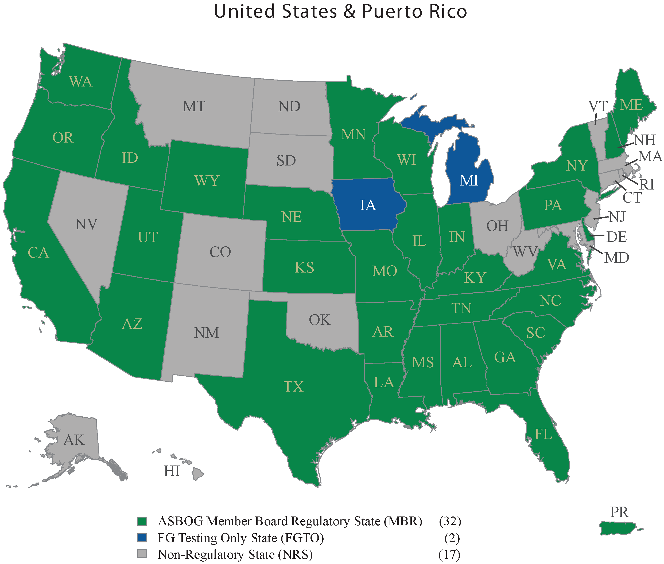

Slide 5
The ASBOG® Competency Examinations
ASBOG®’s mission is to promote professional geological competence and ethical practice to ensure that the health, safety, and welfare of the public are protected.
Our licensure examinations provide the cornerstone quantitative metrics to accomplish that mission.
Through its Council of Examiners (COE) and statisticians, ASBOG® has independently created two national geoscience examinations: the Fundamentals of Geology Exam (FG) and the Practice of Geology Exam (PG).
ASBOG® maintains, administers, scores, and continually validates these examinations for the benefit of our member states.

Slide 6
Geologic Licensure
“Public practice of geology" means providing geological services. Geological services include consultation, investigation, including the collection, removal and analysis of samples of minerals, rocks, fluids, gases and paleontological specimens, survey, evaluation, planning, mapping, inspection of work in the field of geology and the responsible supervision of work in the field of geology.
The practice of geology means the practice of any branch of the profession of geology.
Exemptions:
Academia
State and Federal Government
Oil and Gas

Slide 7
Why States License Geologists Public Protection
Information from geoscience investigations is increasingly important to the public, industry, and local, state and federal government agencies
Licensure helps assure that geoscientists offering their services to the public are adequately trained, experienced, and competent
Many other professions with the potential to impact the physical, social or financial welfare of the public are regulated through licensure

Slide 8
General Requirements for Licensure by ASBOG® Member States
A minimum of 30 semester hours (45 quarter hours) in geological course work and a formally conferred degree in the geology;
Scaled score (70% or greater) on the Fundamentals of Geology Exam (FG) created and maintained by ASBOG®;… Geologist-in-Training
Scaled score (70% or greater) on the Practice of Geology Exam (PG) created and maintained by ASBOG®
Notes:
First step, appropriate course work and passing FG

Slide 9
Licensure Path
Process for licensure varies by state
26 licensing boards require a degree in geoscience or related field
5 states provide a path to licensure for applicants without a degree
30 licensing boards specify 30 semester or 45 quarter hours/units geology coursework
2 states allow for “applied geoscience courses under departments other than geology”
16 states provide lists of either required courses and elective courses
Passing the ASBOG® Fundamentals of Geology (FG) examination

Slide 10
Licensure Path
Four to five years of professional experience under the direct supervision of a PG or PE
Many states allow for graduate experience to substitute for work experience, up to 2-years
Passing the ASBOG® Practice of Geology (PG) examination
Twelve (12) licensing boards require some form of continuing education for license renewal
One (1) licensing board has a voluntary continuing education program

Slide 11
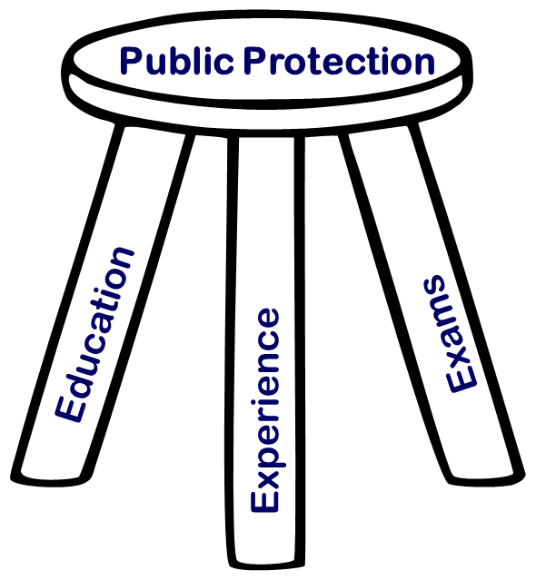
Public Protection
Valid criteria to achieve professional licensure includes equal parts
Education
Work experience
Passing the appropriate examinations

Slide 12
The ASBOG® Competency Examinations
ASBOG®’s mission is to promote professional geological competence and ethical practice to ensure that the health, safety, and welfare of the public are protected.
Our licensure examinations provide the cornerstone quantitative metrics to accomplish that mission.
Through its Council of Examiners (COE) and statisticians, ASBOG® has independently created two national geoscience examinations: the Fundamentals of Geology Exam (FG) and the Practice of Geology Exam (PG).
ASBOG® maintains, administers, scores, and continually validates these examinations for the benefit of our member states.

Slide 13
ASBOG® Task Analysis Surveys (TAS)
Task analysis research defines the practice of geology by identifying the tasks that are performed by practicing geologists.
Every five years ASBOG® conducts a Task Analysis Survey of geologists
Results are used to create test blueprints.
Test blueprints list the geologic tasks and the number of questions for each task for the Fundamentals of Geology (FG) and the Practice of Geology (PG) Exams.

Slide 14
ASBOG® Task Analysis Survey (TAS) 2015
Purpose: to maximize the relevance of the FG and PG Examinations to the practice of the geological profession.
History: Task Analysis Surveys were completed in 1995, 2000, 2005, 2010, & 2015.
TAS 2015 Procedures:
The TAS Subcommittee updated and refined the TAS 2010 task statements (n = 43).
ASBOG® mailed the TAS to a random sample of 200 licensed/registered geologists/geoscientists in each participating jurisdiction (USA = 5,800; Canada = 1,890; Academia = 2,000).
Geologists/geoscientists rated the importance of the 43 task statements to the practice of geology as it is applied to the protection of the public.
The TAS Subcommittee reviewed and evaluated the TAS 2015 results which define the content scope of the FG and PG Examinations (i.e., Test Blueprints).

Slide 15
Synopsis of the 2015 Task Analysis
Questionnaire included 43 tasks distributed across eight content domains.
Questionnaire addressed 13 ethical issues that geologists often encounter.
5800 Questionnaires mailed to a random sample in the USA (3800 to licensed geologists in the 30 ASBOG® Member jurisdictions and 2000 to academicians; total=5800)
Canadian administration completed on the Internet using SurveyMonkey to random samples of ~200 geoscientists from each of the 10 provinces (total=1890)
2332 completed/returned in USA (40% return rate)
399 completed in Canada (21% return rate)
42.9% of USA respondents indicated primary area of practice in Environmental Geology and 24.1% indicated Hydrogeology as their primary area of practice.
19.3% of Canadian Geoscientists indicated Economic Geology and Energy Resources as their primary area of practice.

Slide 16
Content Domains/Test Blueprints
Percent of
Content Domains Items by Domain
FG% PG%
A. General Geology: Field Geology, Geophysics, Imagery, Modeling, & Graphical Methods 21 20
B. Mineralogy, Petrology, & Petrography 11 5
C. Sedimentology, Stratigraphy, & Paleontology 12 6
D. Quaternary Geology, Geomorphology, & Surficial Processes 13 8
E. Structure, Tectonics, & Seismology 11 8
F. Hydrogeology & Environmental Geochemistry 12 19
G. Engineering Geology 9 15
H. Economic Geology & Energy Resources 9 15 ____ ____
Totals 100% 100%

Slide 17
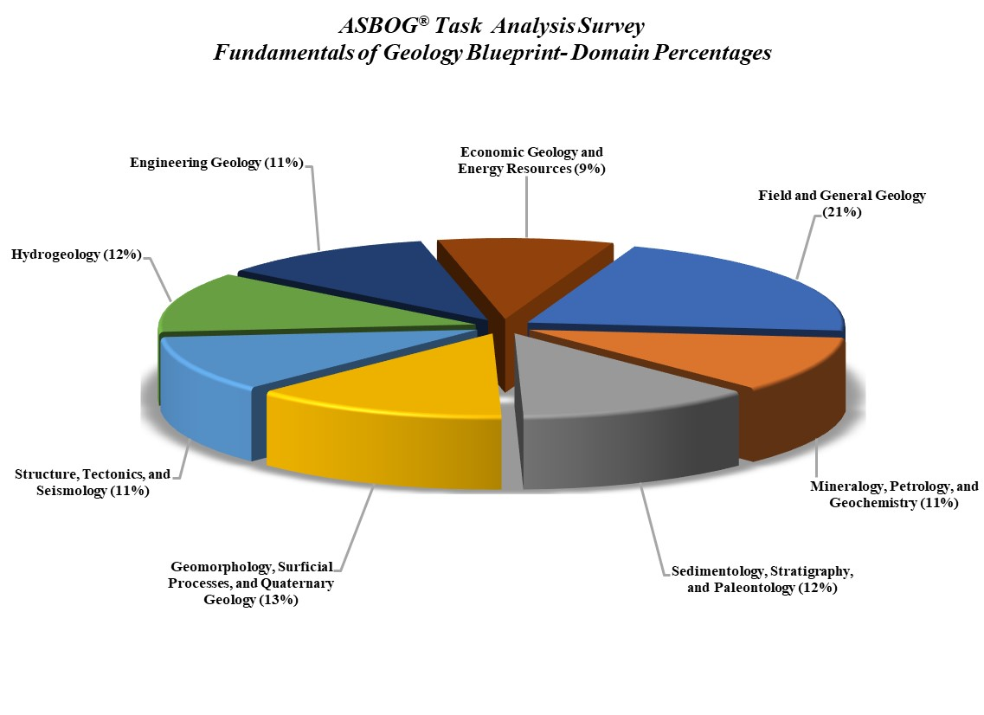

Slide 18
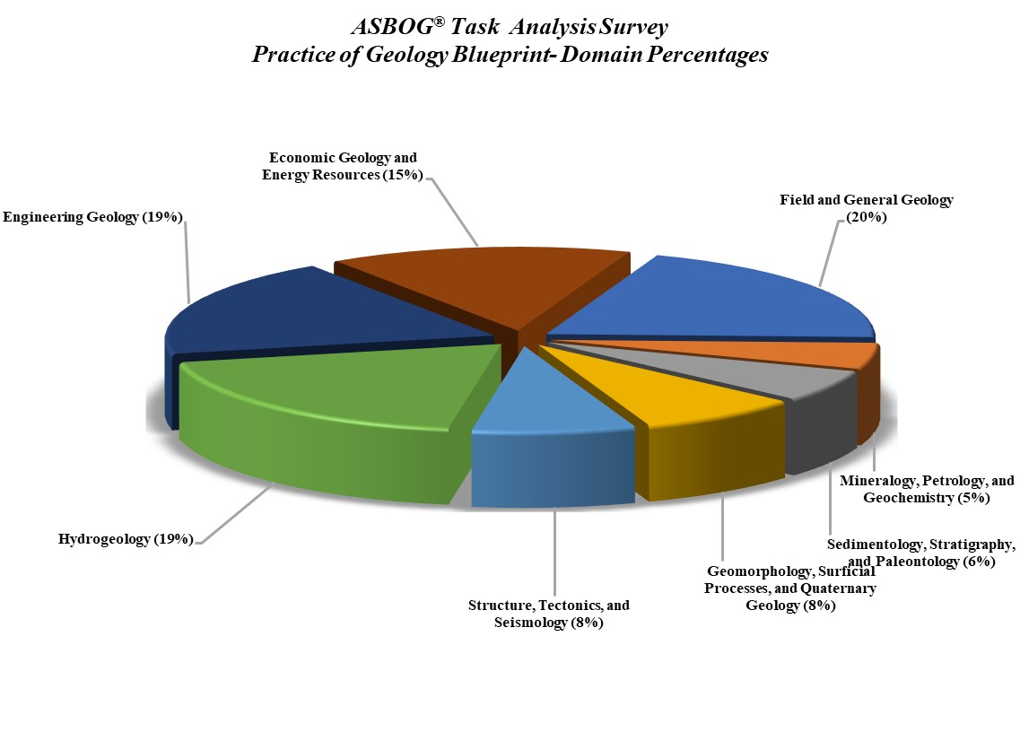

Slide 19
The Examination Process
Council of Examiners (COE) convenes; Subject Matter Experts (SMEs) work with psychometricians to re-evaluate examination and examination question statistics and to select and edit examination questions.
Test administration --- Spring and Fall (March and October)
Individual examination re-grade done by psychometricians.
Examination scores reported to Member States.

Slide 20
ASBOG® Test Development Process Cut-off Scores
The passing scores on the FG and PG Examinations reflect minimum competency and are determined using a criterion-referenced procedure.
The COE evaluates the difficulty levels of the examination items in relation to minimum competency in establishing cut-off scores that reflect minimum competency.
Passing scores are adjusted (scaled) based on the difficulty level of each examination so that candidates have approximately the same probability of passing any version of the examinations.

Slide 27
Using the FG as an Assessment Tool
Program Review with Accrediting Agencies
Curriculum Development
Curriculum Assessment
Curriculum Modifications
Exit Exam vs. Assessment Exam?

Slide 28
Curriculum Performance Assessment Tool (CPAT)
Demographic data collected on bubble sheet starting in March 2008
CPAT is an assessment graphic application that streamlines the statistical analysis of the FG examination data
ASBOG® cannot release candidates' scores because these are confidential material that can only be released to the ASBOG® Member Boards. However, ASBOG® can provide aggregate data (not individual candidate scores) to schools that have 10 or more exams (March 2008 – March 2021)
Currently there are more than 250 colleges/universities that have a large enough number of examinations (>10) to have statistically valid datasets

Slide 29
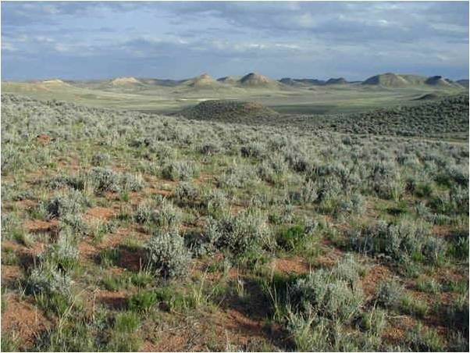
Questions?

