Slide 1

Impacts of well pumping on trace metals in the Central Oklahoma Aquifer, Norman, OK
Zachary Tomlinson, Kato dee, andy Elwood madden
Other contributors:
Geri Wellborn, Scott Aynes, Neal Engleman, Rachel Croft (City of Norman)
Chris Adams (Oklahoma Water Resources Board)

Slide 2
Why study this?
Trace metals like As, Cr, and U can cause various cancers and other ailments
Pumping has been shown to affect trace metal concentrations in other aquifers
The Central Oklahoma Aquifer (COA) has high concentrations of U, Se, Cr, and As
Therefore, understanding how trace metals respond to pumping in the COA has major implications for future groundwater extraction

Slide 3
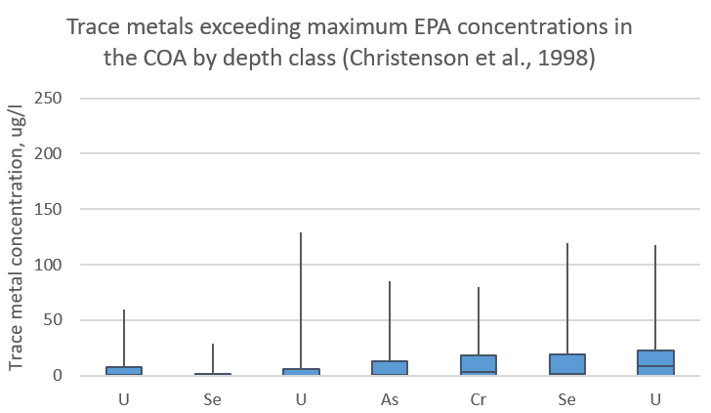
Trace metals in the COA
Maximum concentration sampled
EPA maximum concentration
Shallow
(< 30 m)
Intermediate
(30-91 m)
Deep (> 91 m) n = 27
n = 25
n = 35

Slide 4
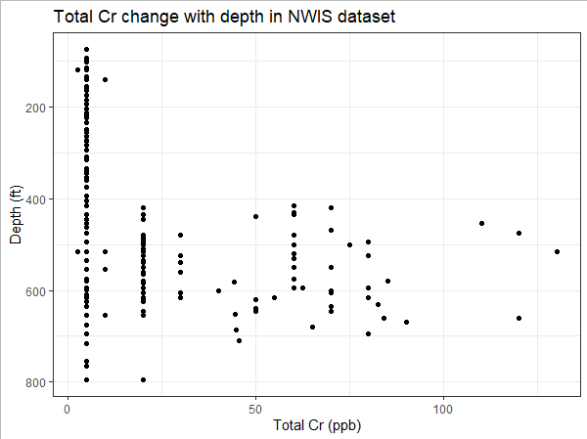
Trace metals in the COA
Total Cr concentrations with depth in NWIS dataset (1989-2008)

Slide 5
Methods
Gathered all available City of Norman groundwater sampling records (41 wells) from 1989 – 2019
Gathered COA data from the USGS NWIS database (National Water Information System) for select wells corresponding to Norman wells
Used R to combine/format the data and correlate each record with the volume of water taken out of the well on the same day (volume/24 hours)
Calculated Kendall’s Tau correlation coefficients between pumping rates and other parameters (element concentrations, pH, etc. )
Selected 16 wells that had the most data for groundwater sampling and chemical analysis (ongoing)

Slide 6
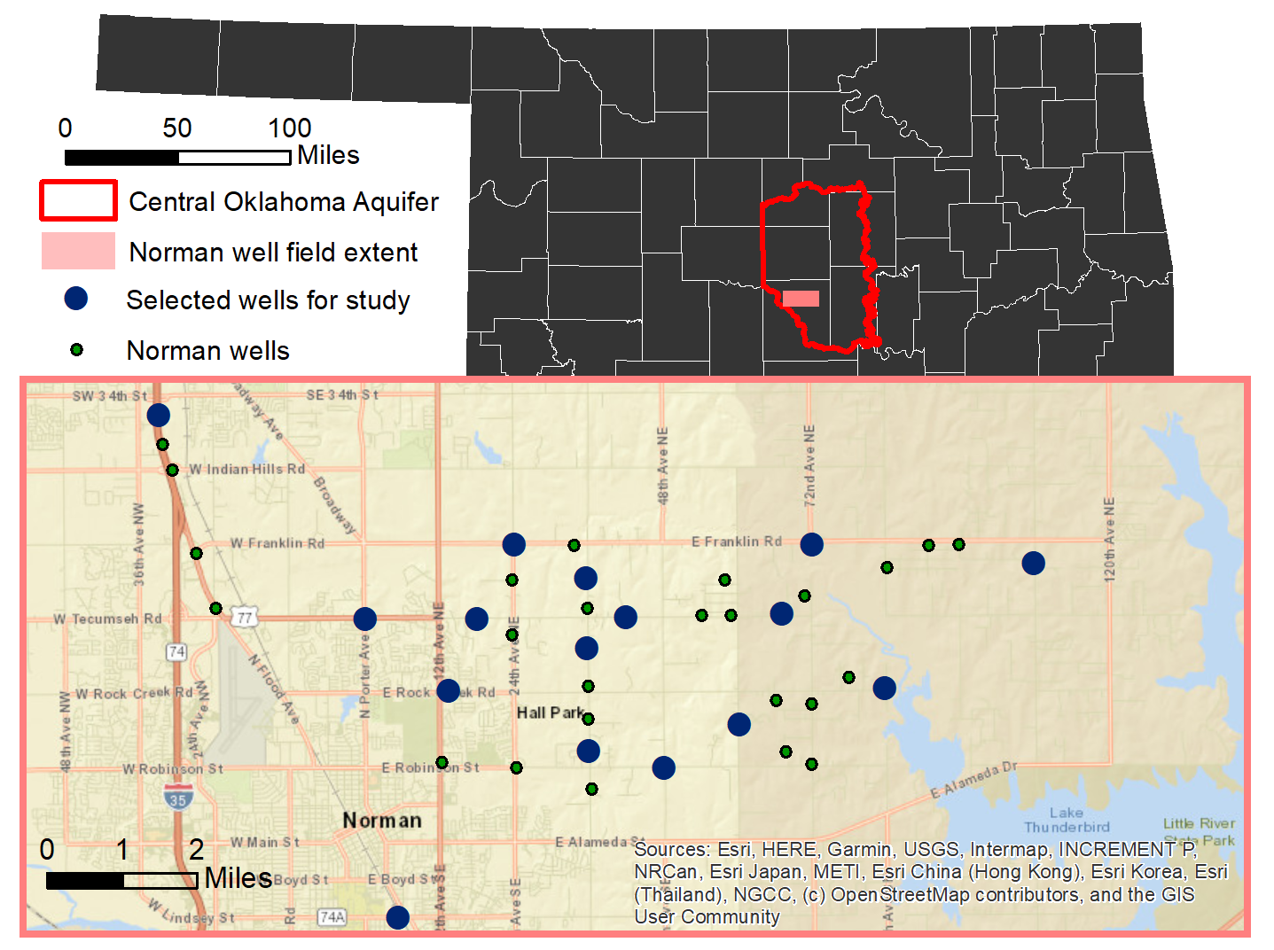
Study Area
Green and blue points represent wells used in the correlation analysis study (41)
Blue points represent wells that were chosen for sampling (16)

Slide 7
Hypothesized Conceptual Model
W
E
In order for Cr, As to increase with pumping:
Confining clay layer
The well must be screened in a deep sand body with high Cr and As
Either:
the proportion of water coming from the high Cr, As interval must increase with pumping relative to other intervals
OR increased flow through the sand interval releases more As, Cr into the groundwater through desorption or dissolution
Ion exchange with clay, high pH
High Cr, As
Dolomite diss ->Mn⁺² ->Mn^{+3/+4} ->(Cr⁺³ ->Cr⁺⁶)
As desorption from iron oxides (pH > 8.5)
Brine

Slide 8
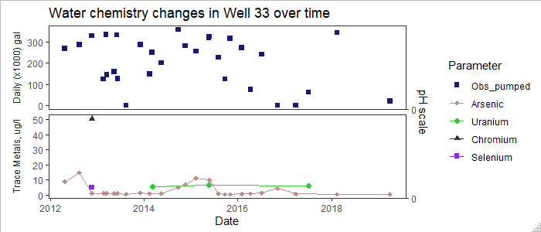
Correlation coefficient analysis
Computed Kendall's Tau Correlation Coefficients between various water quality parameters and the pumping rate
Pumping test indicates very little delay time between pumping stress and hydraulic head response, so we used the volume of water pumped on the same day that each sample was collected

Slide 9
Correlation coefficient analysis
Trace metal concentrations correlate with pumping rates for 3 wells at a = 0.05
Not suitable for increased pumping
Trace metal concentrations inversely correlate with pumping rates for 9 wells at a = 0.05
Most suitable for increased pumping (with caution)
The significance of these results are severely limited by small sample sizes
32/41 wells had positive correlations between pumping and pH
25 of those correlations were statistically significant at a = 0.05
3 of the wells had insufficient data
None of the 6 wells that had negative correlations between pumping and pH had statistically significant results.

Slide 10
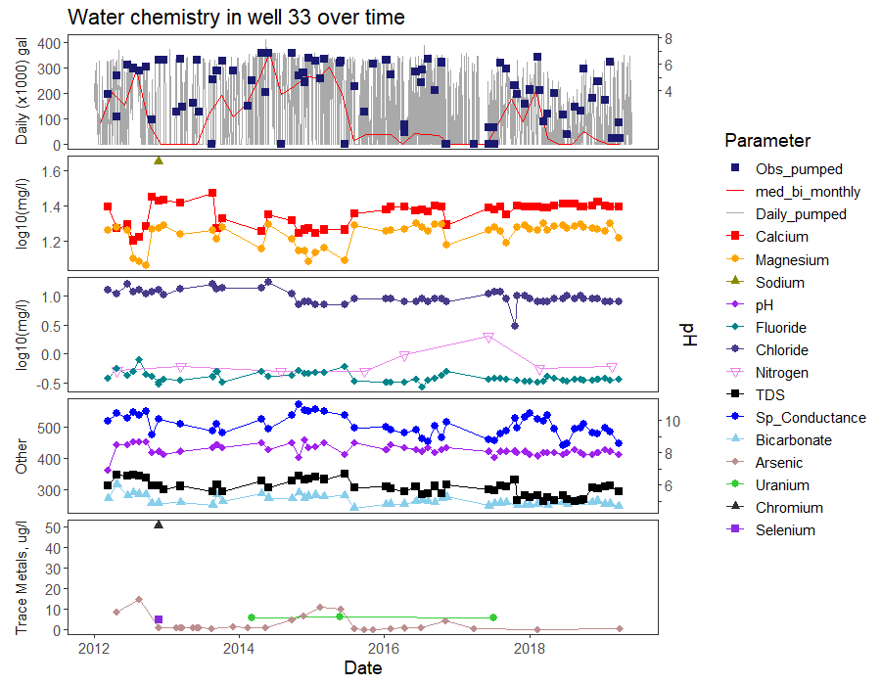
μS/cm
pH
mg/l
mg/l

Slide 11
Conclusions
Increased pumping does not seem to increase the water volume coming from the shallow COA (pH increases with pumping)
Pumping increases the influence of layers generating high trace metal concentrations (Layer A) in 3 wells
Pumping increases the influence of layers generating low trace metal concentrations (Layer B) in 9 wells
Confining clay layer
Ion exchange with clay, high pH
A
High Cr, As
Dolomite diss ->Mn⁺² ->Mn^{+3/+4} ->(Cr⁺³ ->Cr⁺⁶)
As desorption from iron oxides (pH > 8.5)
B
Brine

Slide 12
Future Work
How to improve the robustness (sample size) of the correlation analysis?
We are currently sampling groundwater around Norman, OK to increase our sample sizes and to improve modeling capabilities
Further work will also be done with permutation statistical tests
Is pumping changing the mixing proportions or changing the hydrogeochemical reactions?
Further work with chemical modeling and correlation analysis will help determine which of the mechanisms are causing drops/rises in trace metal concentrations with pumping
Does pumping affect freshwater-brine interactions?
Chemical modeling will help determine brine influence
Well screen/perforation data and lithology logs will help determine interaction feasibility

Slide 13
Implications
Freshwater needs are increasing worldwide – this work provides recommendations for wells that would be most and least suitable to help meet that demand in Norman
Mechanisms which produce high and low concentrations of trace metals in wells can help make recommendations for suitable well locations elsewhere in the COA
The methods and code used here can be used to determine correlations between trace metals and pumping in any aquifer

