Slide 1

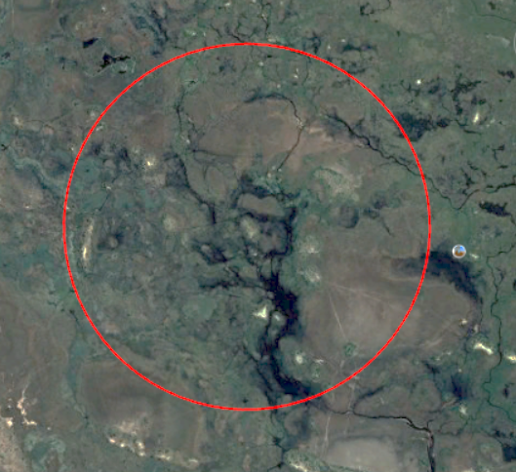
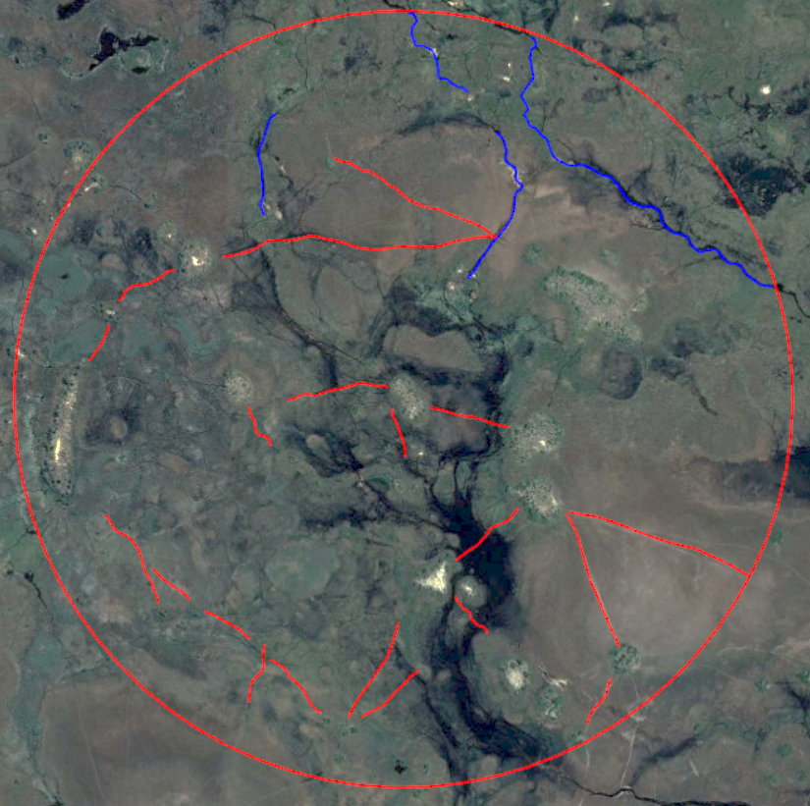
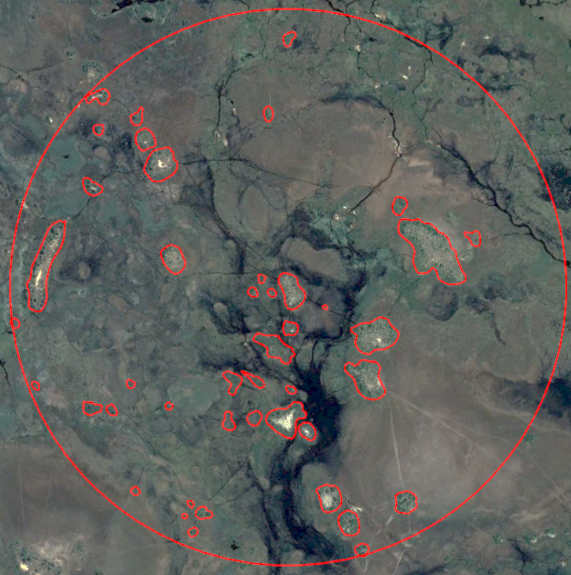
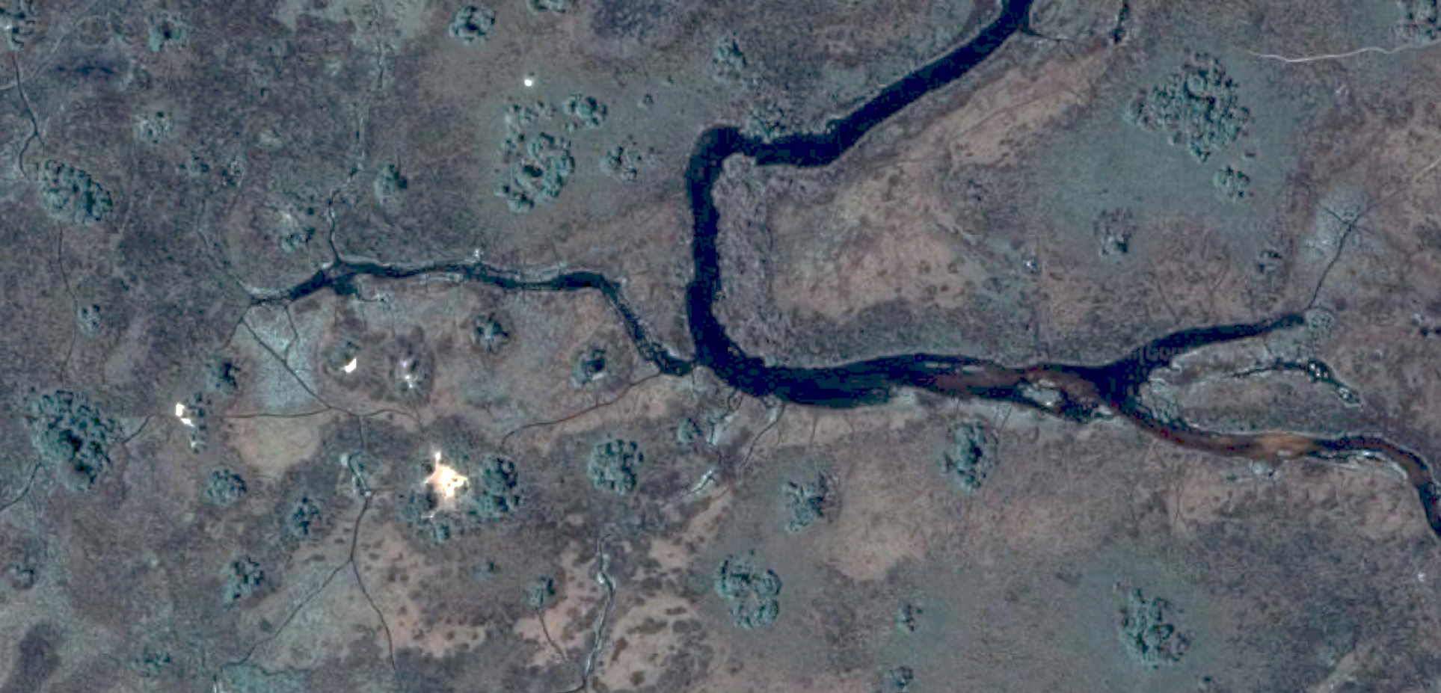
15-8
GEOMORPHOLOGICAL IMPACT OF HIPPOPOTAMUS ON THE NORTHERN OKAVANGO DELTA, BOTSWANA: SPATIAL ANALYSIS OF FORAGING TRAILS AND ISLANDS
hippo zoogeo
morphology
research group
TEMPLE
UNIVERSITY®
Joseph MARTINA, Bella KLINE, Crystal SZABO, Nolan BARRETTE, Ilya BUYNEVICH
Department of Earth and Environmental Science, Temple University, Philadelphia, PA, 19122
ABSTRACT
STUDY SITE
METHODS
The common hippopotamus (Hippopotamus amphibius) is a large semi-aquatic animal that produces a diverse suite of traces, including those with substantial zoogeomorphic impact. In the Okavango Delta of northern Botswana, the hippopotami act as key ecosystem engineers, creating networks of channels and trails that branch from primary wading pools to nearby foraging islands. This study used satellite imagery (GoogleEarth ProTM) to document and quantify the zoogeomorphic impact of H. amphibius over an area of 7.1 km2. Twenty temporally persistent trails (length: 150-750 m; width: <5 m) were nearly straight (average sinuosity of 1.03), whereas the delta distributary channels were wider (>10 m) and had a mean sinuosity of 1.17. In addition to the main trails, 122 secondary trails were mapped with a total surface area of ~56,300 m2 (0.8% of the total study area). These were subdivided into four categories based on the context of their termini: island to island (57% of total trail area), island to trail (22%), wading pool to island (13%), and trail to trail (8%). In the summer of 2007, hippopotamus trails led to 49 islands, which had a near-round planimetry and a total area of ~565,600 m2 (8% of the study site). By the late fall of 2018, the total foraging island area decreased to ~445,900 m2. This study demonstrates that hippopotami may be potentially responsible not only for the formation (avulsion) and maintenance (long-term connectivity) of multiple inter-distributary hydraulic pathways, but may also affect the size and morphology of the emergent landforms within the delta through trampling and consumption of vegetation, as well as active sediment reworking.
Using Google Earth ProTM, a study site with a radius of 1.5 km and surface area of 7.1 km² was established with center coordinates 19°17'55.65"S, 22°40'42.42"E.
The path measuring tool was used to calculate the length and average width of 122 hippopotami branch trails, allowing for surface area of the various trails to be calculated.
The polygon tool was used to measure the surface area of the 49 islands identified in the 2018 imagery.
Historical imagery was used to calculate the surface area of the same 49 islands in 2007. In order to determine the sinuosity of the water bodies, the circle tool was used to measure the curvature of the 20 main trails as well as the main river channels.
1 km
The Okavango Delta, Botswana, a prime hippopotamus habitat, is an alluvial fan that was formed in a graben of the East African Rift. In this region, hippopotami spend their days submerged in permanent swamps. These large herbivores leave the swamps and travel throughout an intricate network of trails to nearby islands to feed on vegetation. These trails have been formed by the constant, habitual use of the resident hippopotami and would not exist without persistent re-use. The study area (red circle) is consistent with previous research of home range averages of ~8±3 km².
1 km
RESULTS
SUMMARY
Main hippopotamus trails are substantially straighter than river channels, with an average sinuosity of 1.03, whereas river channels meandered and had an average sinuosity of 1.17.
Using another morphometric parameter, the river channels identified in the study area had a much smaller average radius of curvature (R_{C}= 44.5m) than that of the main trails (R_{C}= 165.7m), which were characteristically straight.
Most of the identified H. amphibius trails (57%) extended from island to island, revealing a strong preference for travel during foraging.
The island area decreased by nearly 2% (from ~565,545 m² to ~445,877 m²) between 2007 and 2018 suggesting vegetation loss, likely related to zoogeomorphic impact.
There is a weak linear correlation between an increase in island size and the number of trails emanating from it
The main trails had a much smaller average sinuosity than the river channels identified in the study area
Bibliography
Deocampo, Daniel M., 2002. Sedimentary Structures Generated by Hippopotamus Amphibius in a Lake-Margin Wetland, Ngorongoro Crater, Tanzania.” PALAIOS, vol. 17, p. 212–217.
Ellery, W.N., Ellery, K., Rogers, K.H., McCarthy, T.S. & Walker, B.H. (1993) Vegetation, hydrology and sedimentation processes as determinants of channel form and dynamics in the northeastern Okavango Delta, Botswana. Afr. J. Ecol 31, 10–25.
Inman, Victoria L., et al. "Drone-Based Effective Counting and Ageing of Hippopotamus (Hippopotamus Amphibius) in the Okavango Delta in Botswana." PLoS One 14.12 (2019) ProQuest. 12 Oct. 2020.
McCarthy, T.S., Ellery, W.N., Stainstreet, I.G., 1992. Avulsion mechanisms on the Okavango fan, Botswana: the control of a fluvial system by vegetation. Sedimentology, 39, 779-795.
McCarthy, T.S., Ellery, W.N., And Bloem, A., 1998, Some observations on the geomorphological impact of hippopotamus (Hippopotamus amphibius L.) in the Okavango Delta, Botswana: African Journal of Ecology, v. 36, p. 44-56.
Mladenov, N. & Mcknight, Diane & Macko, Stephen & Feder, Marnie & Cory, Rose & Ramberg, Lars. (2007). Chemical characterization of DOM in channels of a seasonal wetland. Aquatic Sciences. 69. 456-471.
Stanistreet, I.G., Cairncross, B. & McCarthy, T.S. (1993) Low sinuosity and meandering bedload rivers of the Okavango fan: channel confinement by vegetated levees without fine sediment. Sediment. Geol. 85, 135–156.
Stears, Keenan, et al., 2020. "Spatial Ecology of Male Hippopotamus in a Changing Watershed." Scientific Reports (Nature Publisher Group) 9 (2019): 1-13. ProQuest. 12.
More than half (57%) of trails measured traveled from island to island, revealing a strong preference for travel directly from food source to food source.
Main hippo trails were nearly straight, whereas the river channels had higher sinuosity (low radius of curvature, R_{C}).
The total area of the islands within the study site (n=49) decreased by ~1.7% between 8/24/2007 and 11/1/2018.
Acknowledgments:
This research was funded by the College of Science and Technology, Temple University

