Slide 1
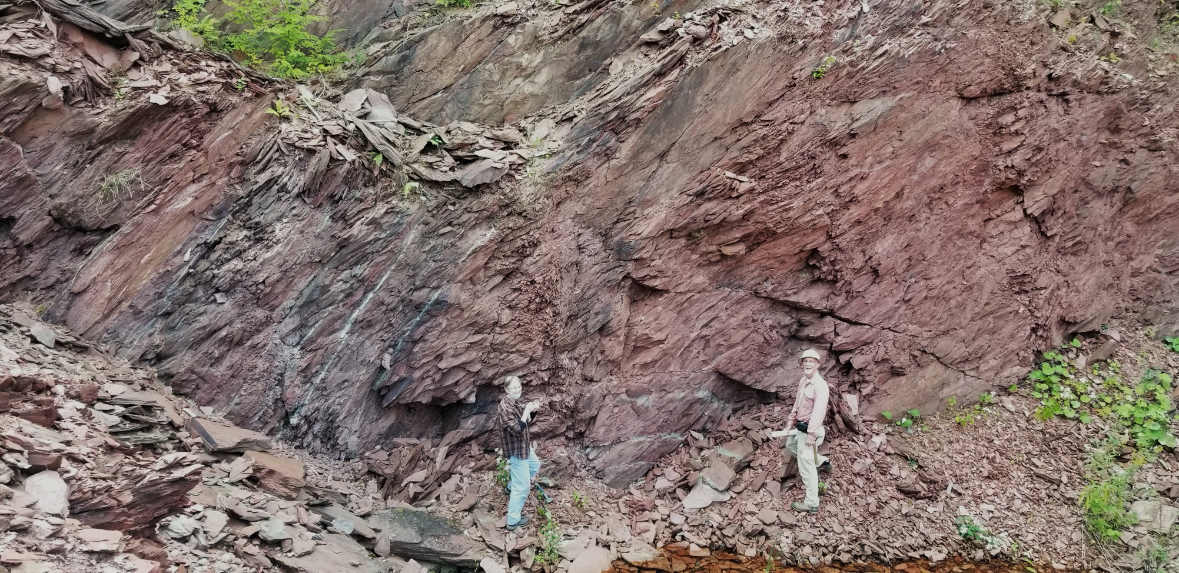
What’s up with the Taconic Sequence Indian River Formation?
Charles E Mitchell &
Robert D. Jacobi,
SUNY Buffalo;
Margaret D. Thompson,
Wellesley College

Slide 2
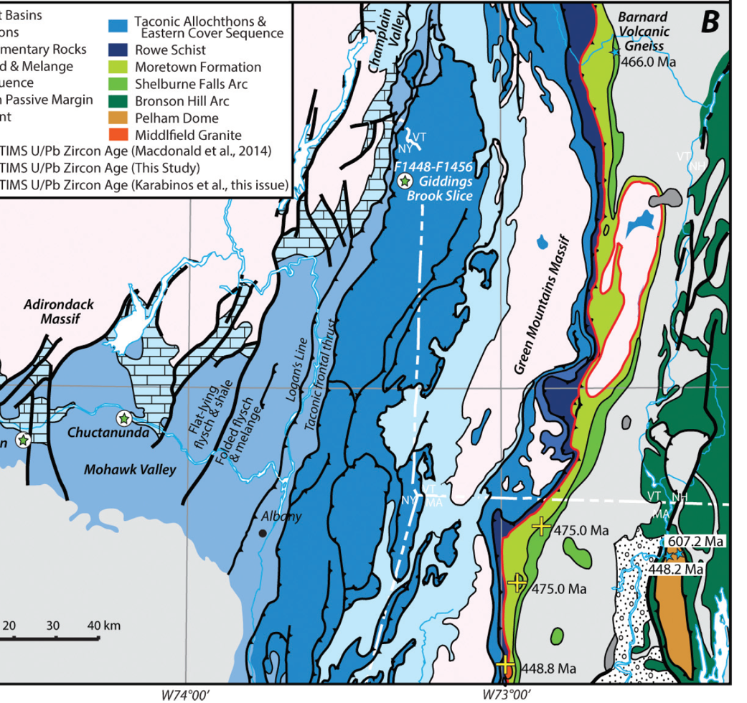
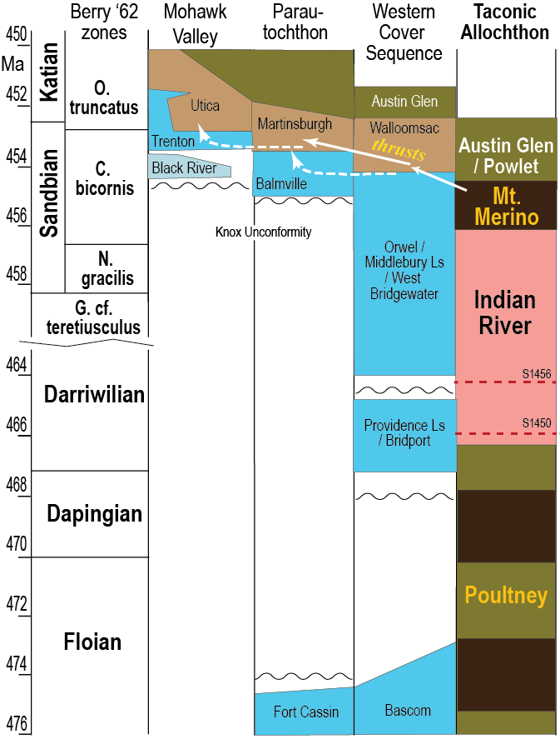

Lawrentian sequences
Peri-Gondwanan sequences
modified from Macdonald et al. 2017
modified from Jacobi & Mitchell, 2018

Slide 3
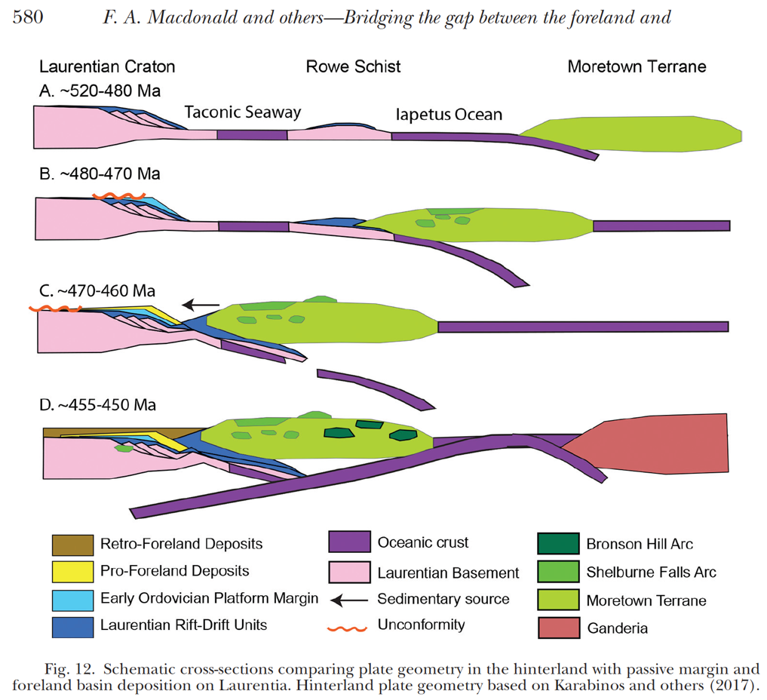
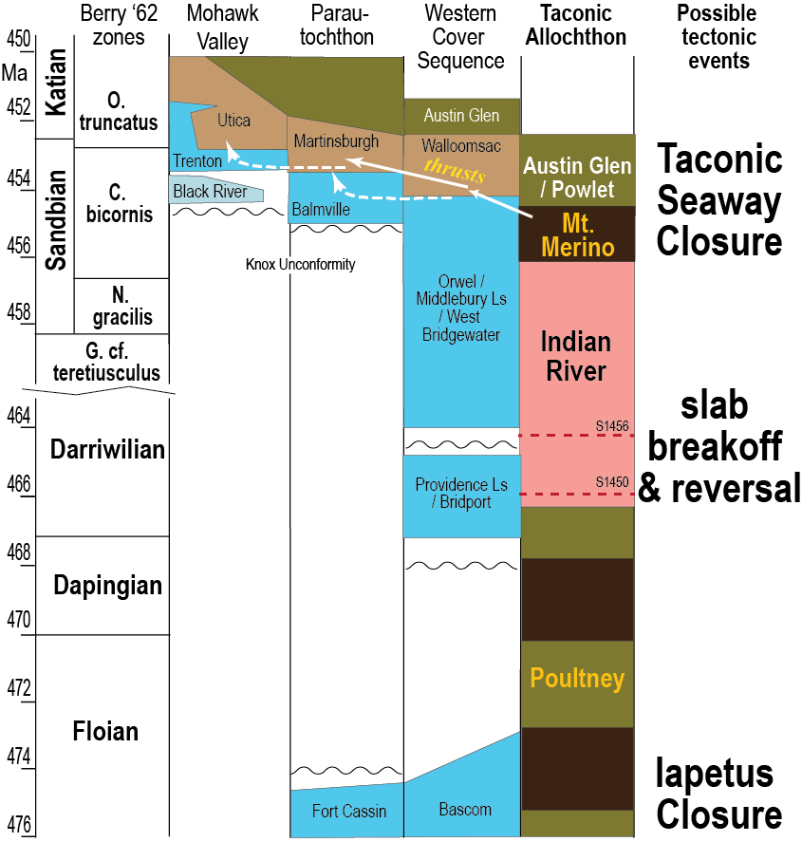

Slide 4
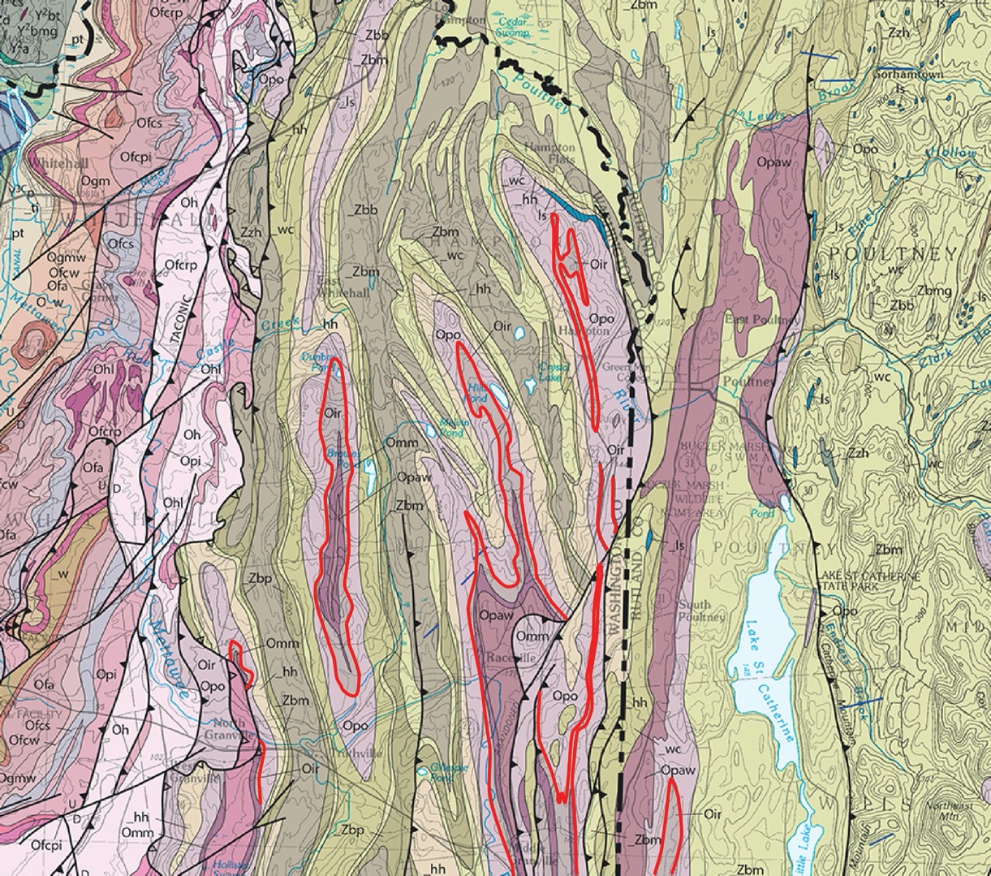




Washington & Rutland counties, NY-VT
Map from Ratcliffe et al., 2011; USGS & VT Geological Survey
N
Mid to Late Ordovician rocks of the Giddings Brook Allochthon
Pawlet (= Austin Glen) Fm.
Normanskill Gr.
Mount Merino Fm.
Indian River Fm.
Study sites
Poultney Fm.
0
5
10 km

Slide 5
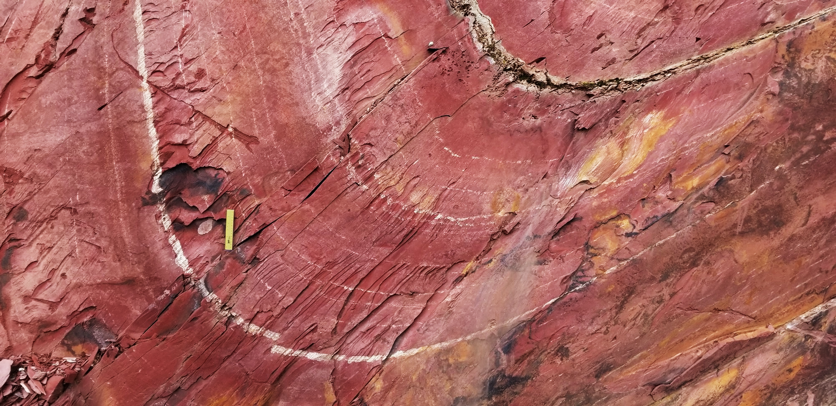
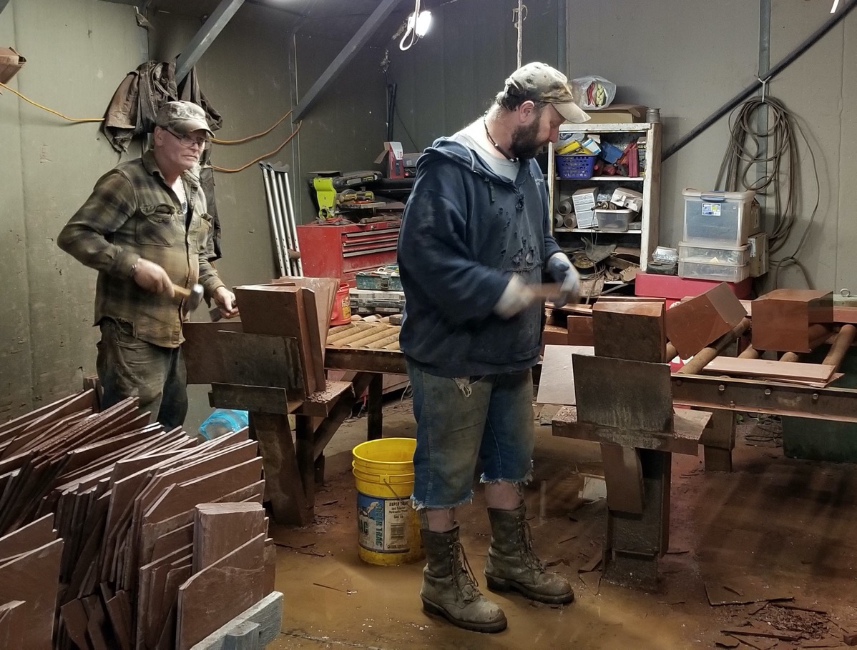
Indian River Formation
Deep red, finely laminated, silty slates with numerous tuff beds

Slide 6
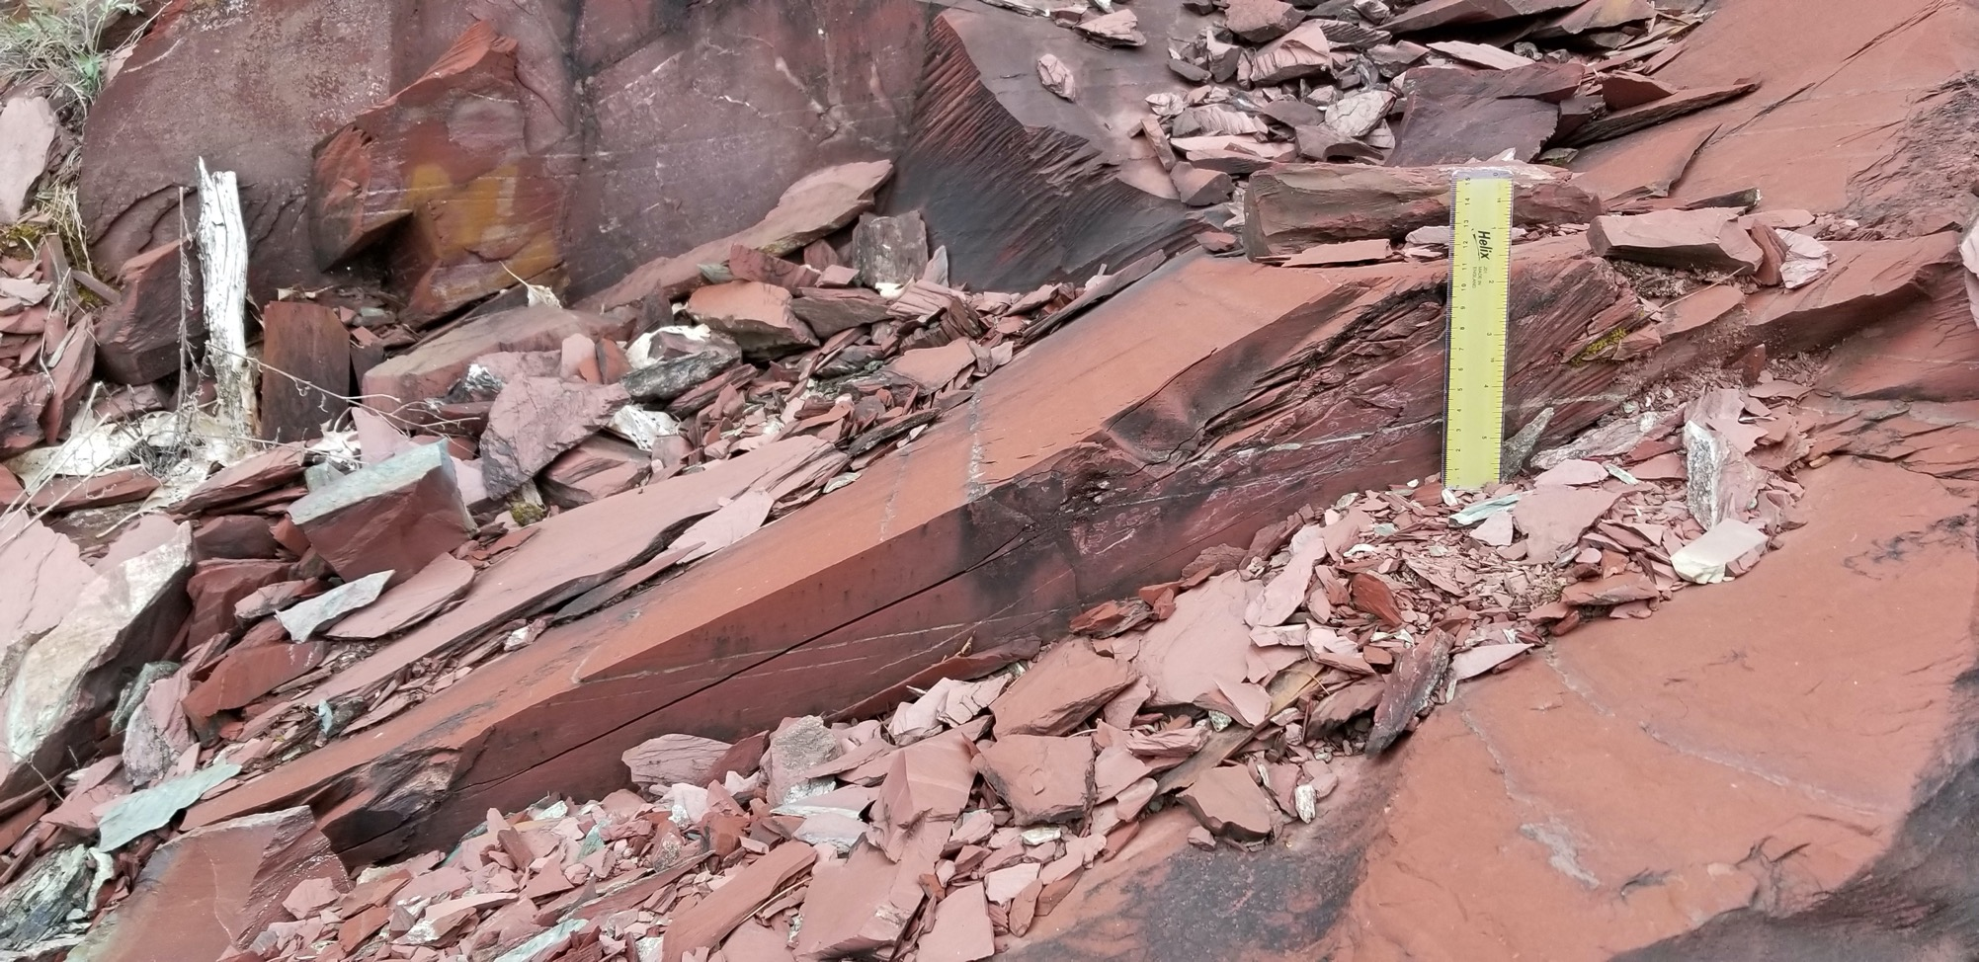
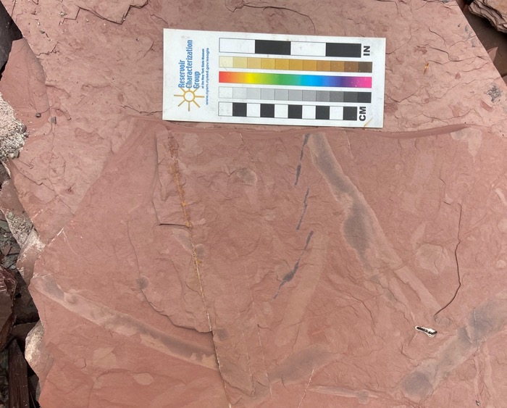

Slide 7
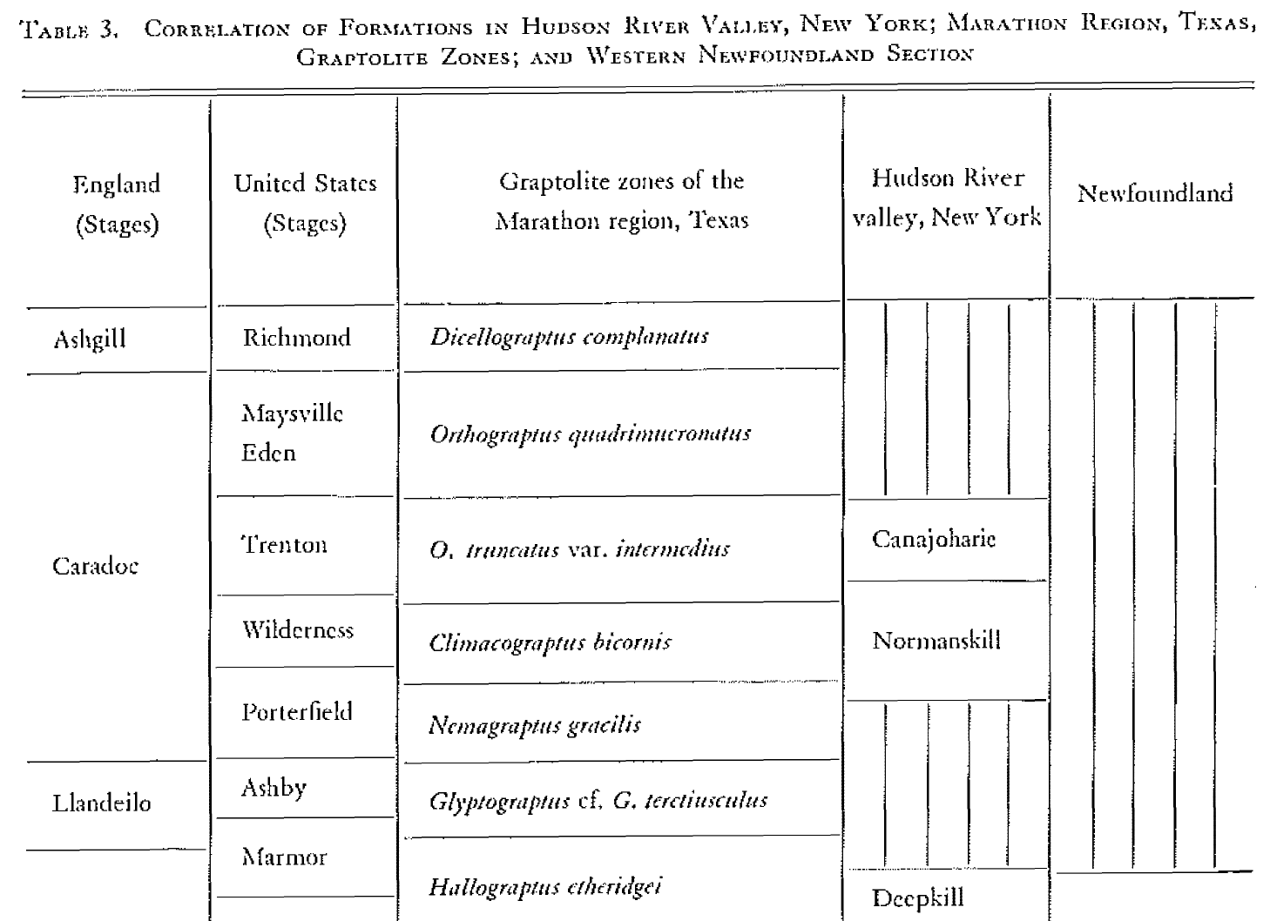
WBN Berry, 1962, Stratigraphy, Zonation, and Age of Schaghticoke, Deepkill, and Normanskill Shales, Eastern New York, GSA Bull, 73:695-718
Recognized 4 members in the Normanskill Shale, of which the lowermost (first) is equivalent to the Indian River Formation.
“In Washington County, the {first} unit is composed of interbedded green and red argillites which have a waxy-appearance and weather white. A few lenses of black shale or slate, which commonly bear graptolites, occur with the argillite or slate.” Berry, 1962, pg. 111.
“Identical assemblages of species were obtained from all members of the formation with the exception of … the highest beds. “
Katian
Sandbian
Darriwilian

Slide 8
Map from Ratcliffe et al., 2011; USGS & VT Geological Survey
Berry reported graptolite faunas from Indian River strata at three localities in this area
N
Poultney
North Granville
0
5
10 km

Slide 9
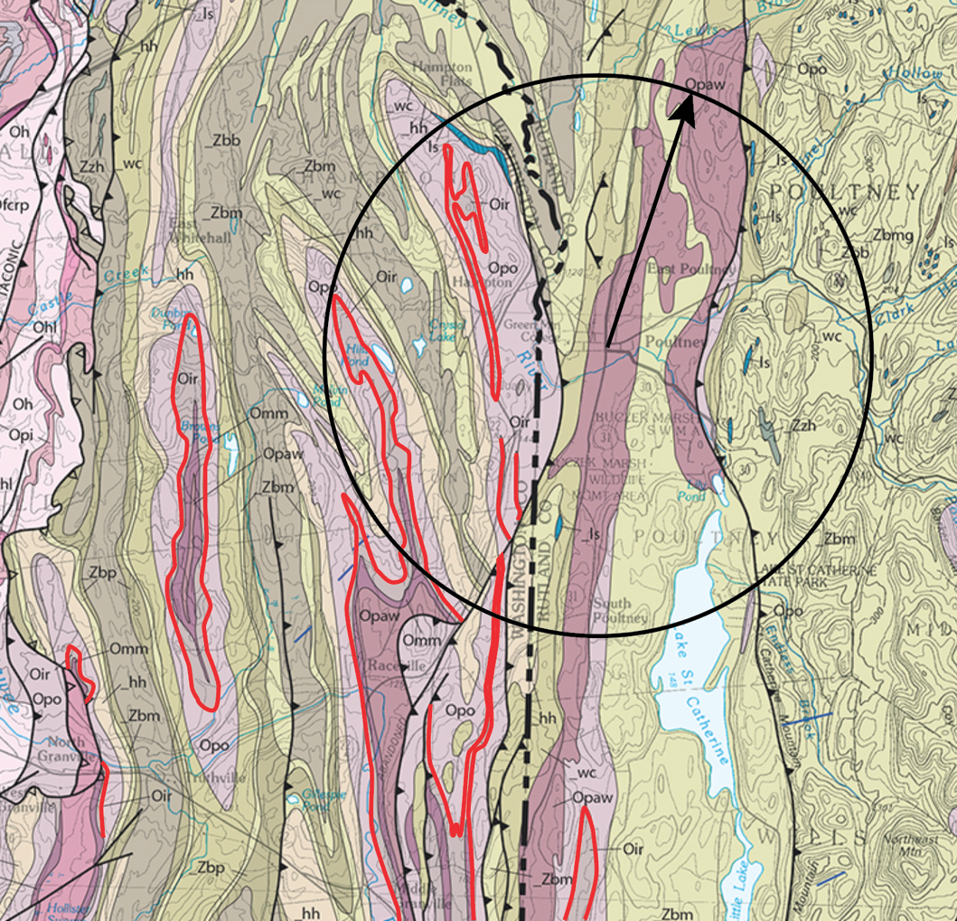
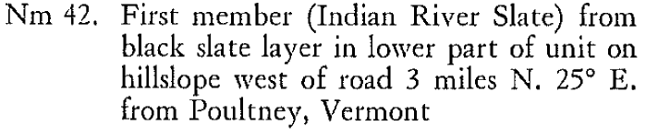
Example: Berry Site 42
From Berry (1962):
POULTNEY
Vermont geological map places this site within Pawlet rather than the Indian River.
The other two have been removed by expanded quarrying operations

Slide 10
Berry’s reported Normanskill graptolite faunas
All IR samples belong to the lower part of the C. bicornis Zone

Slide 11
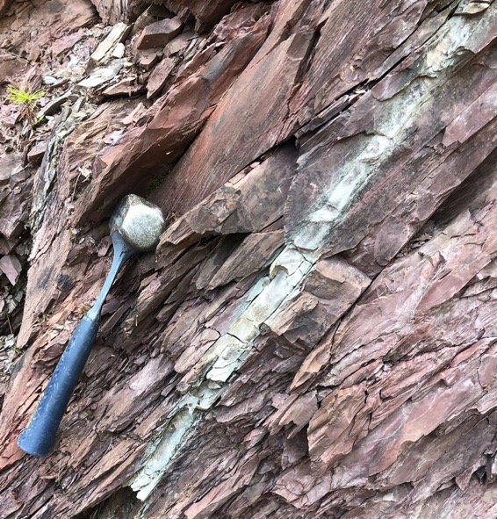
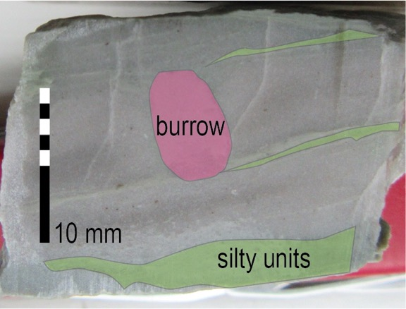
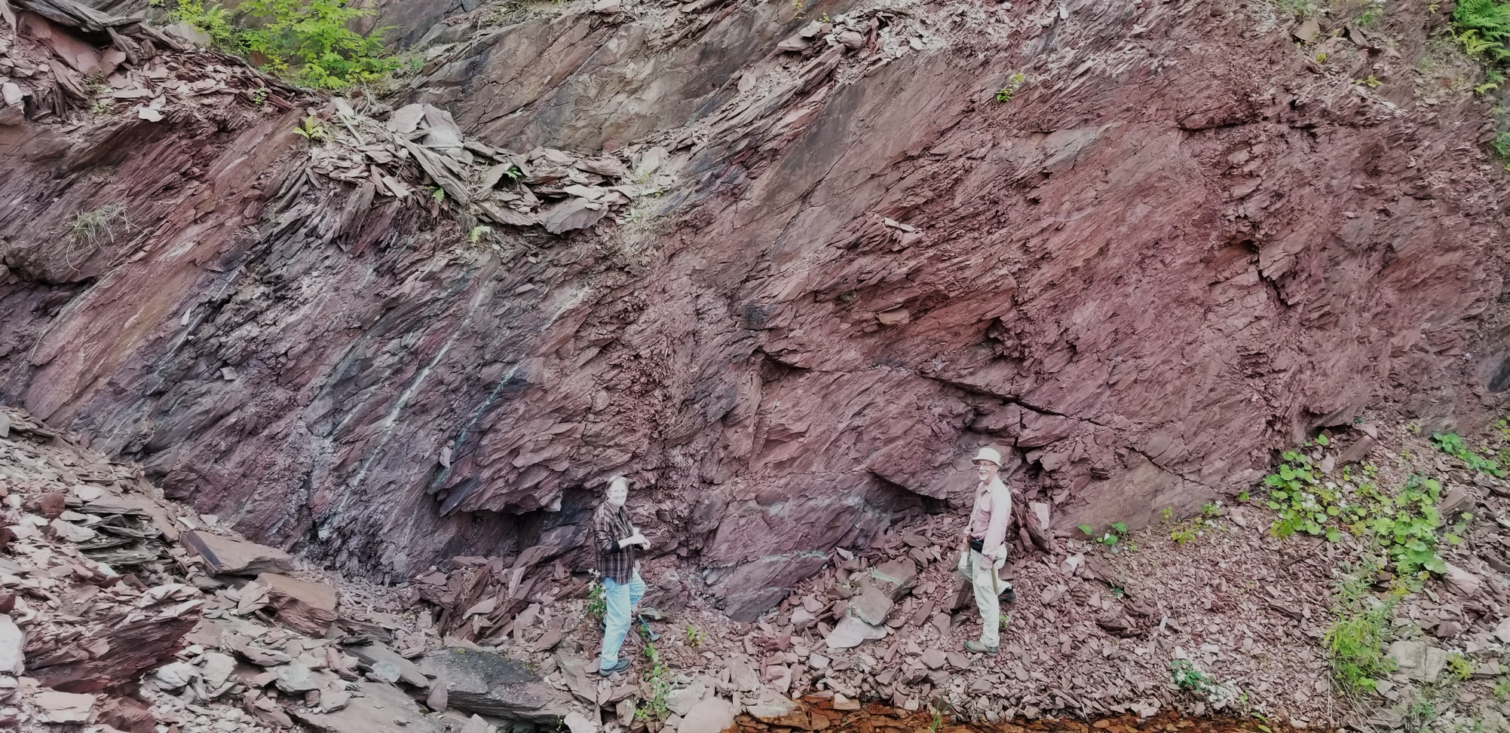
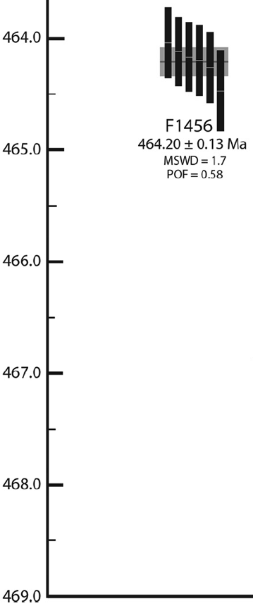

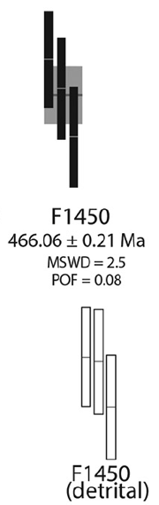
Tuff beds &
Macdonald et al. (2017) dates
F1456
464.20±0.13
F1450
466.06±0.21
eruptive ages
Macdonald et al. F1450

Slide 12
Biostratigraphic vs. tuff-derived ages in the IRF
Katian
452.8
bicornis
BIOZONAL AGE
Macdonald et al. (2017)
tuff bed eruptive ages
(quasi depositional ages?)
Sandbian
456.1
456.8
457.5
457.5
458.2
458.9
F1456
464.20±0.13
Darriwilian
Tuffs > 6-10
my too old
F1450
466.06±0.21
468.5
469.4
470.3
GTS2020 spline age (MA)

Slide 13
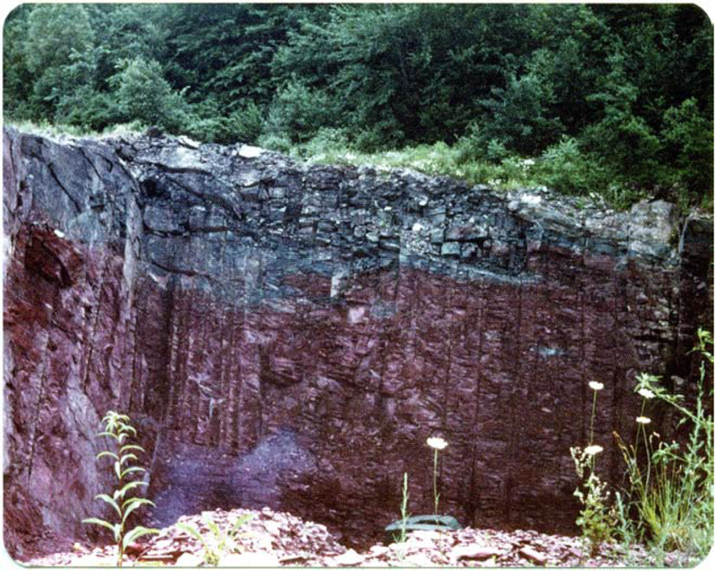
Perhaps both ages are correct?
Abrupt but conformable contact and
shared graptolite fauna
suggest depositional continuity with overlying Mt. Merino
Mt M
IR
Mt Merino above Indian River
Hilltop Quarry; L. Delano 1977, Fig. 33.

Slide 14
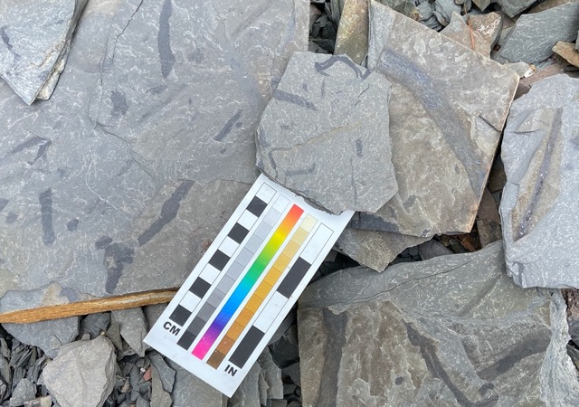
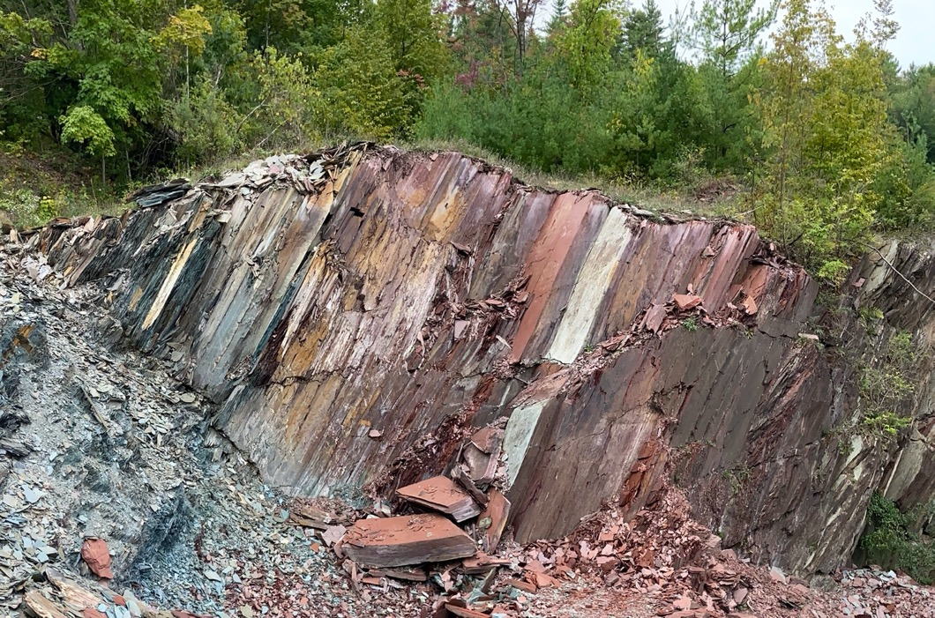

Gradational contact with underlying Poultney Fm.
Similar burrowed shales in both units
up
Again indicates depositional continuity at lower contact
Poultney
Indian
River

Slide 15
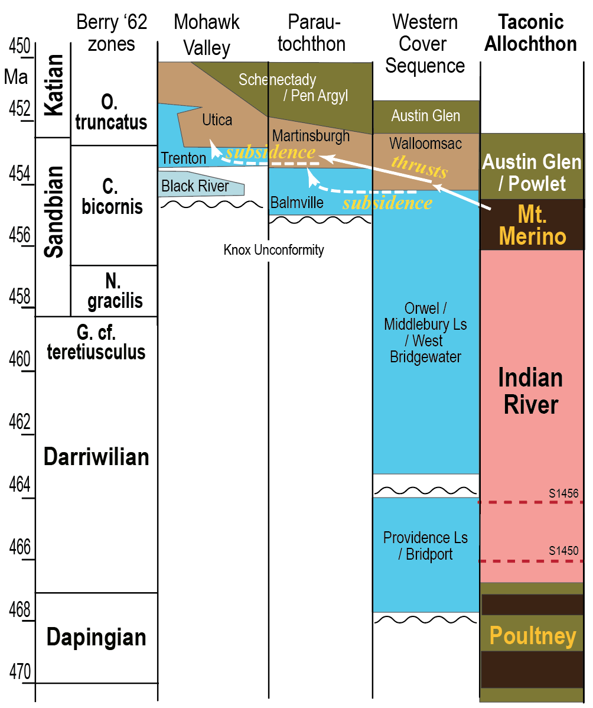
Suggests
Indian River may span ~ 10 my of slow deposition
located out of reach of large detrital influx from Laurentia, Ganderia, the Rowe and Moretown/Hawley terranes
dust-derived sediments deposited in oceanic setting with slow oxic bottom currents
What might this imply about the character of the Taconic Seaway and its closure in the late Sandbian to early Katian?

Slide 16
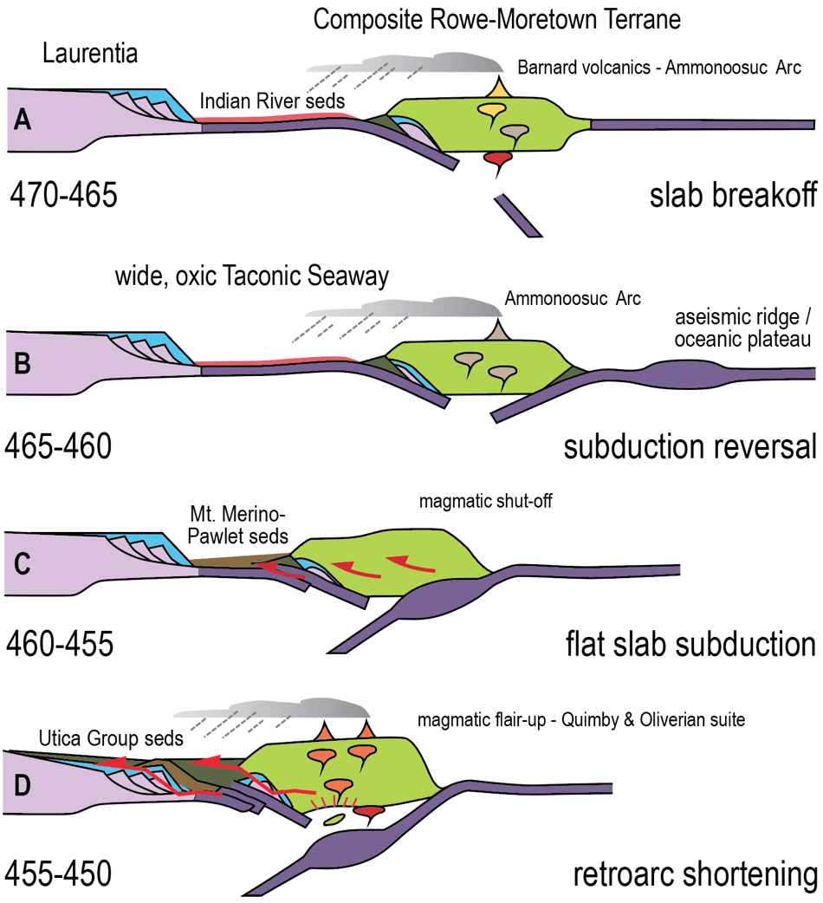
Tectonic model (modified from the Karabinos et al. and Macdonald et al., 2017 model)*
Flat slab subduction drove the closure of the relatively wide, oxic, and sediment starved Late Ordovician Taconic Seaway
*Other tectonic models, including sustained eastward-subduction, remain in consideration, but this one is convenient for the present discussion

