Slide 1
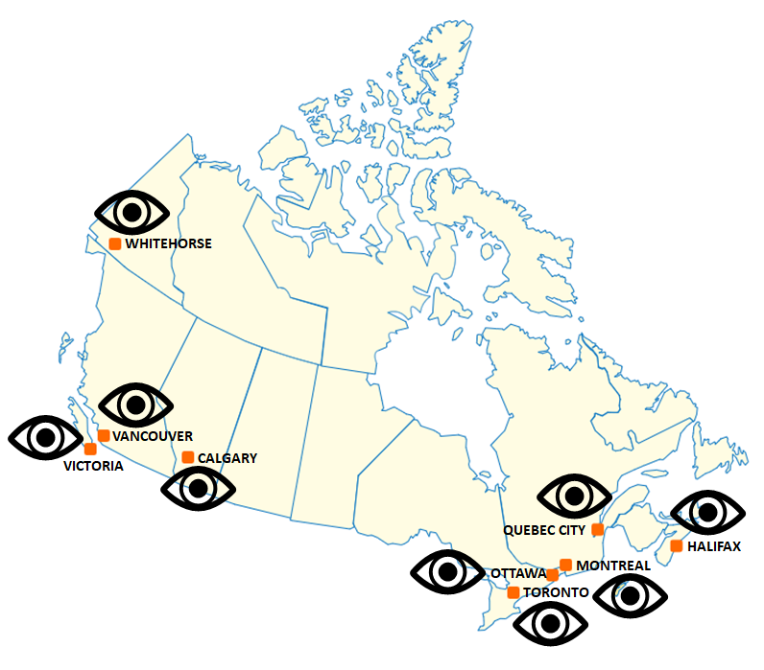

USING COVID19, OPEN DATA AND PYTHON AS AN OPPORTUNITY TO BRING GEOSCIENCE PROJECTS TO STUDENTS
Artash Nath
MonitorMyLockdown.com
Toronto, Canada
Artash.nath@gmail.com
www.twitter.com/wonrobot
https://www.linkedin.com/in/artash-nath
C A N A D A
14 March 2021
Seismic stations monitored

Slide 2
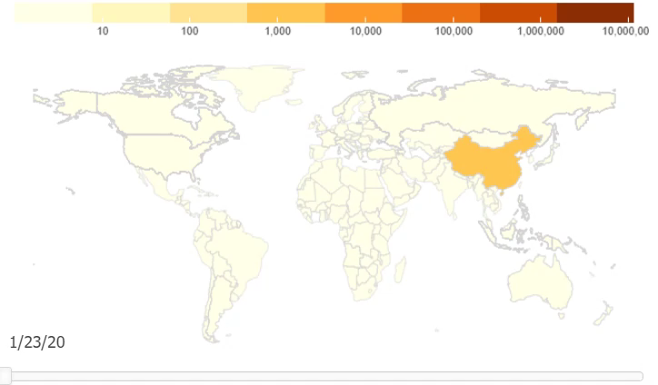
Spread of COVID19 Across the World

Slide 3
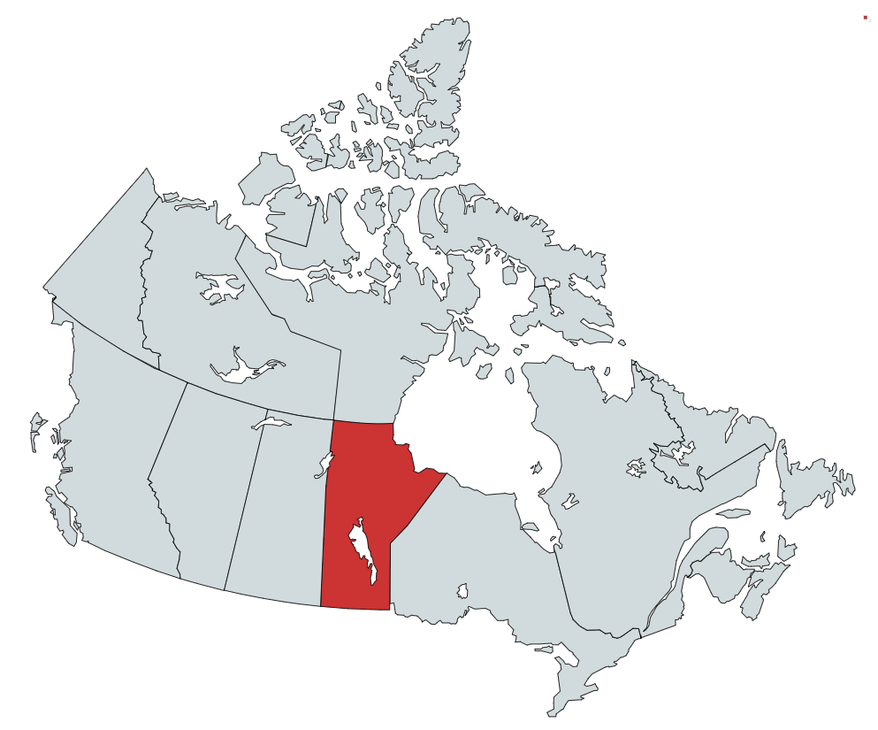
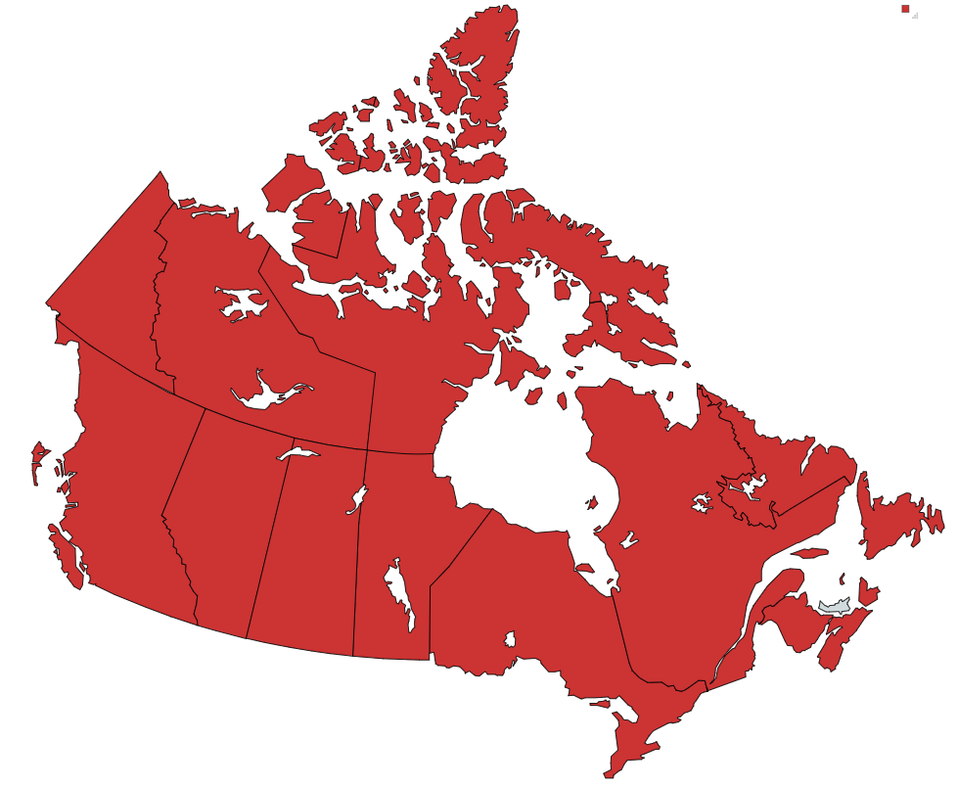

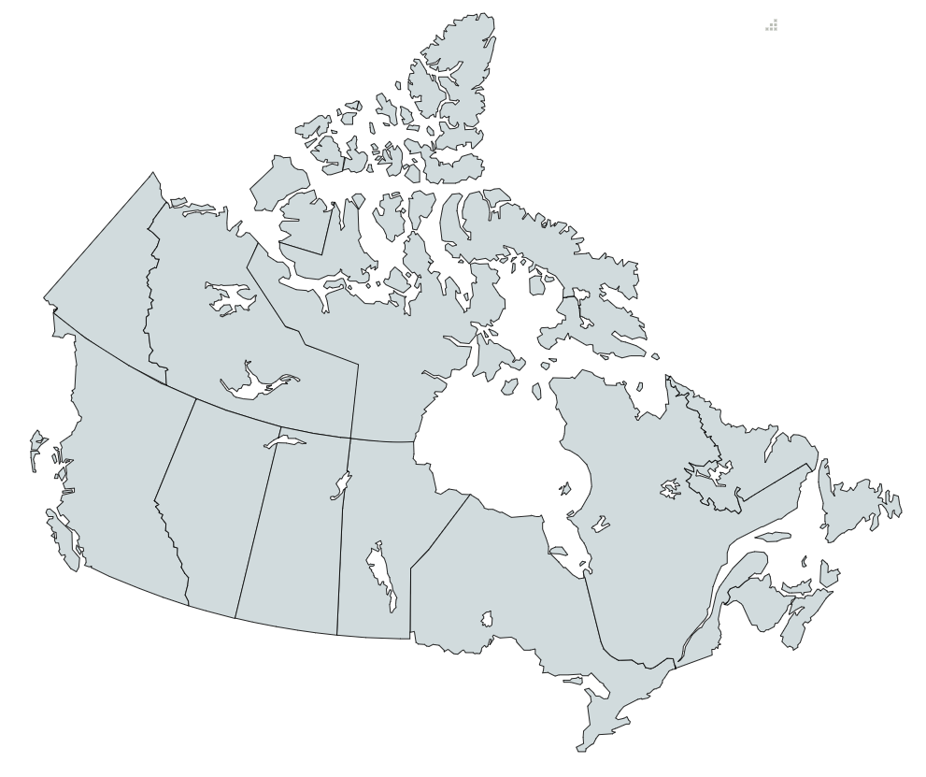
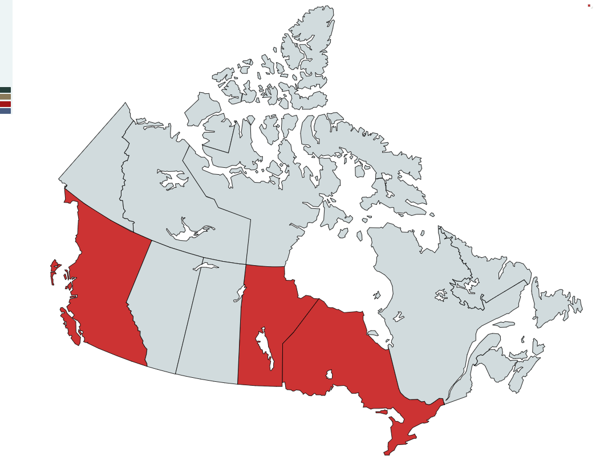


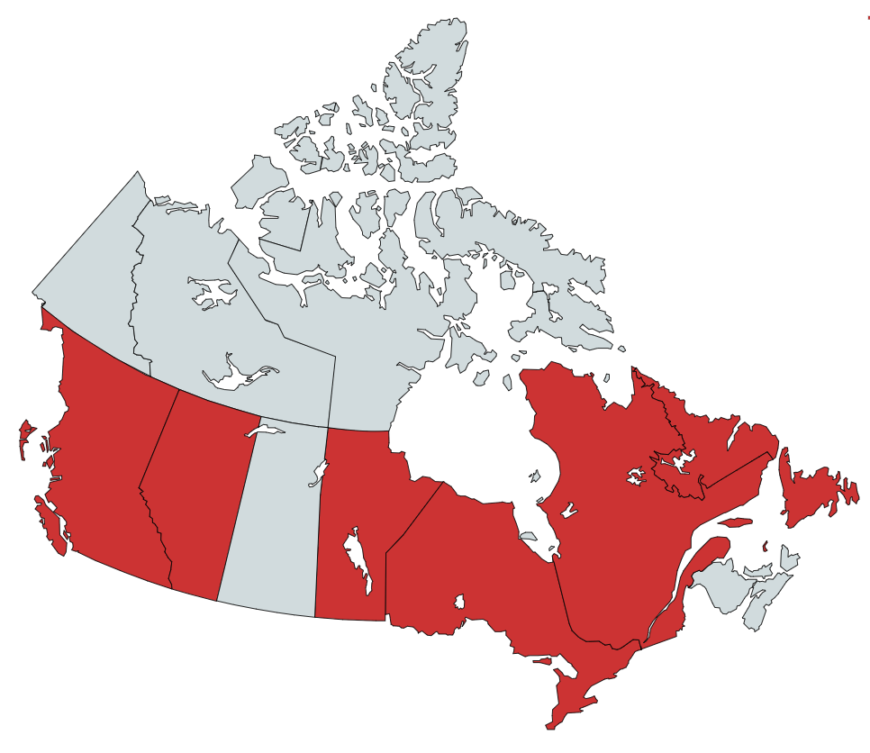
Canada: Timeline of Periodic COVID-19 Lockdowns
11 March 2020:
COVID19 declared a pandemic
First Lockdown
Mar 2020 – May 2020
Second Lockdown
Nov 2020 – Feb 2021
Canada - US Border Closed
Not Under Lockdown
Under Lockdown
Notes:
Lockdowns are essential to check the spread of COVID-19

Slide 4
PROBLEM: Measuring the Effectiveness of Pandemic Lockdowns
Lockdowns are essential to stop human-to-human transmission of the virus but are only effective if citizens comply with the restrictions.
Lockdowns come with huge economic, political, and social costs.
Why measure effectiveness of lockdown in reducing human movement in real-time?
To find out if the legislation actually kept people home.
To make rapid decisions and enforce surgical lockdowns based on time and location.
Reduce costs associated with lockdowns, save lives, and better manage future pandemics.

Slide 5
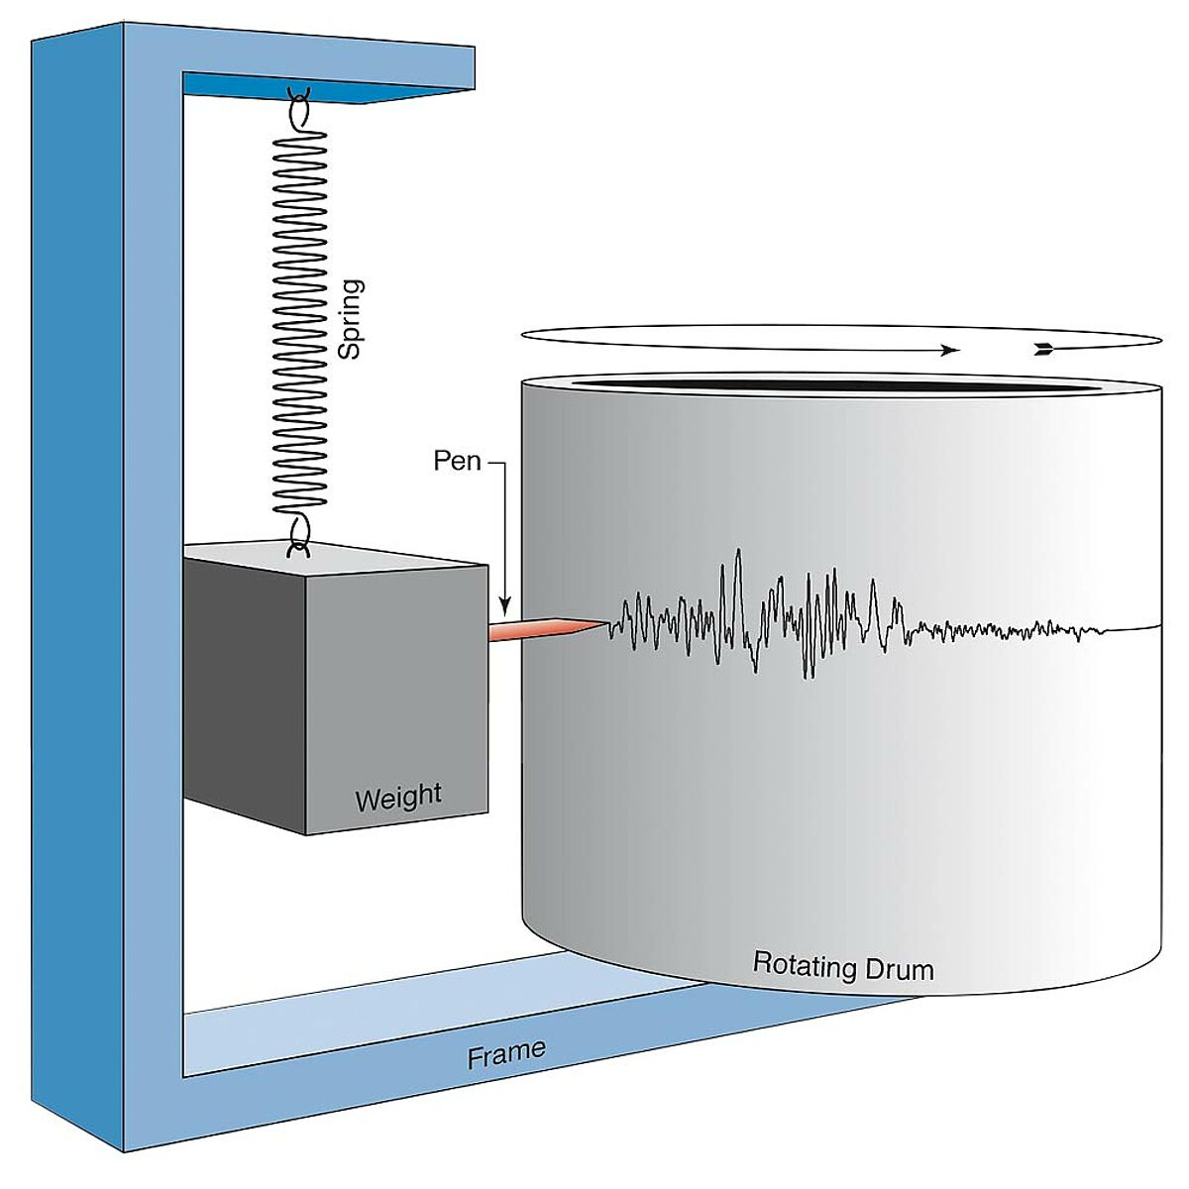
IDEA: Use Data from Canadian Seismic Stations to Measure Changes in Human Activities during COVID-19 Lockdowns
Seismic stations are extremely sensitive to ground movements.
They can record urban noises such as from trains, traffic, construction, mining, subways, sports and musical events, tourism, and cultural noises that are associated with human activities.
Challenge:
To extract changes in urban noises from seismic vibrations during the lockdowns.
Why Seismic Data?
Seismic data is free, open-source and available at all times.
It does not impinge on privacy by tracking individual human movement.

Slide 6


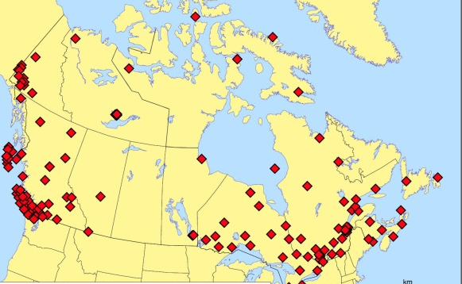
Selection Criteria for Seismic Stations
Proximity: be located within 50 kms of a city center to record anthropogenic activities: construction, transportation, entertainment…
Operational: should be active before and during the lockdown period
Open Data: should be transmitting live data accessible to all
Representation: locations should be spread over Canada
Canadian National Seismograph Network
Seismic stations selected
Source: https://earthquakescanada.nrcan.gc.ca/

Slide 7
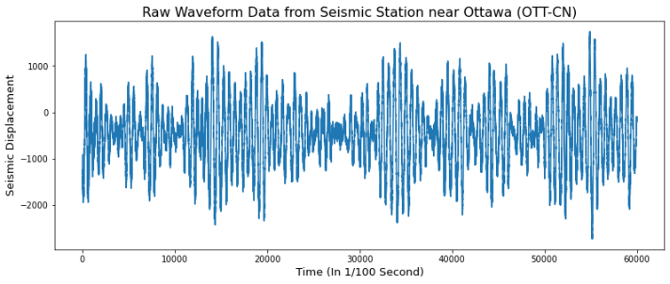
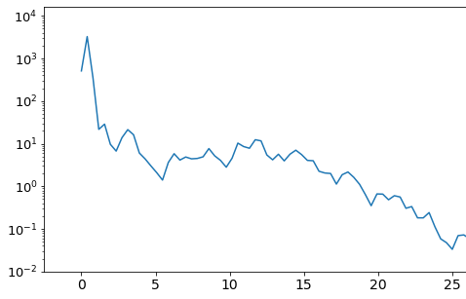

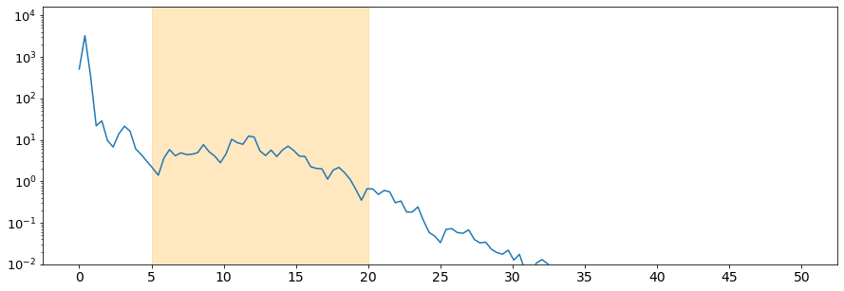
METHODOLOGY:
1. Obtained raw seismic data from 9 seismic stations across 6 provinces from the Canadian National Seismograph Network (CNSN).
2. Calculated ‘Power Spectral Density’ or intensity of seismic vibrations at different frequencies by doing Fast-Fourier transformations (FFTs) using Python.
3. Separated higher-frequency vibrations related to human activities (5Hz - 20Hz) from lower frequency natural vibrations (0Hz – 2Hz) and compared them to pre-lockdown period.
Power Spectral Density of seismic vibrations
Intensity of Vibrations (Log Scale)
Frequency (Hz)
Seismic Vibrations related to Human Activities
Intensity of Vibrations (Log Scale)
Natural Vibrations
2
Frequency (Hz)

Slide 8





PYTHON AND LIBRARIES USED
PYTHON 3

Slide 9
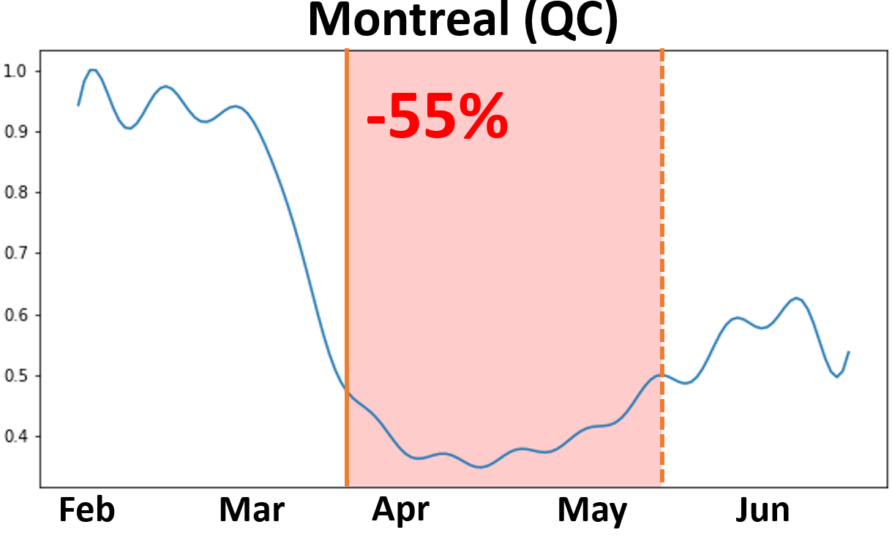
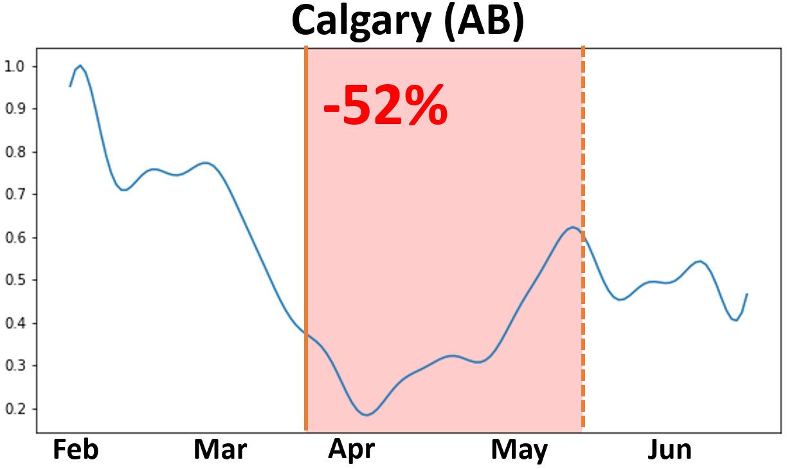
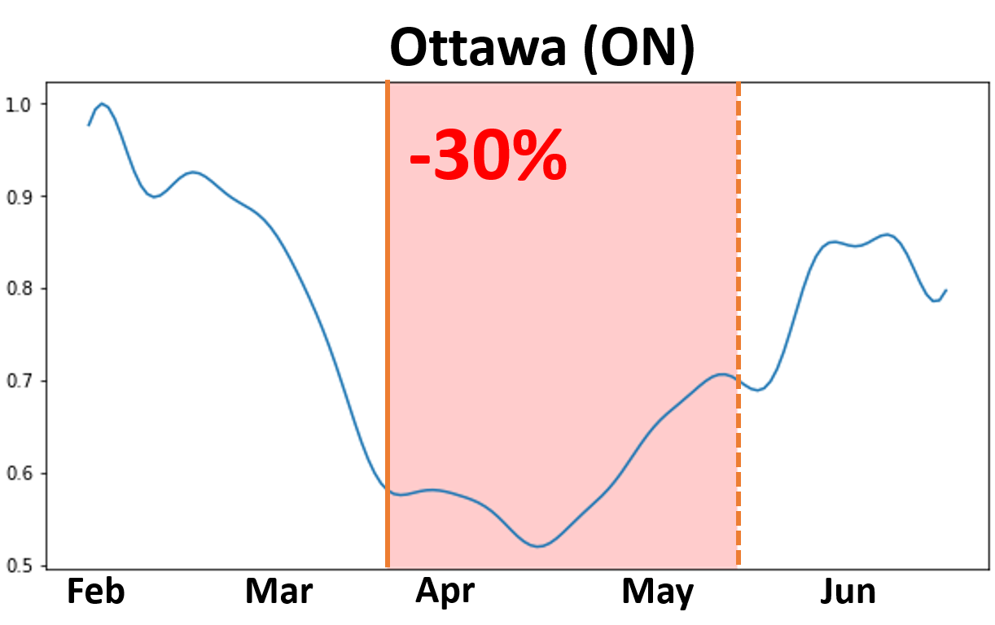
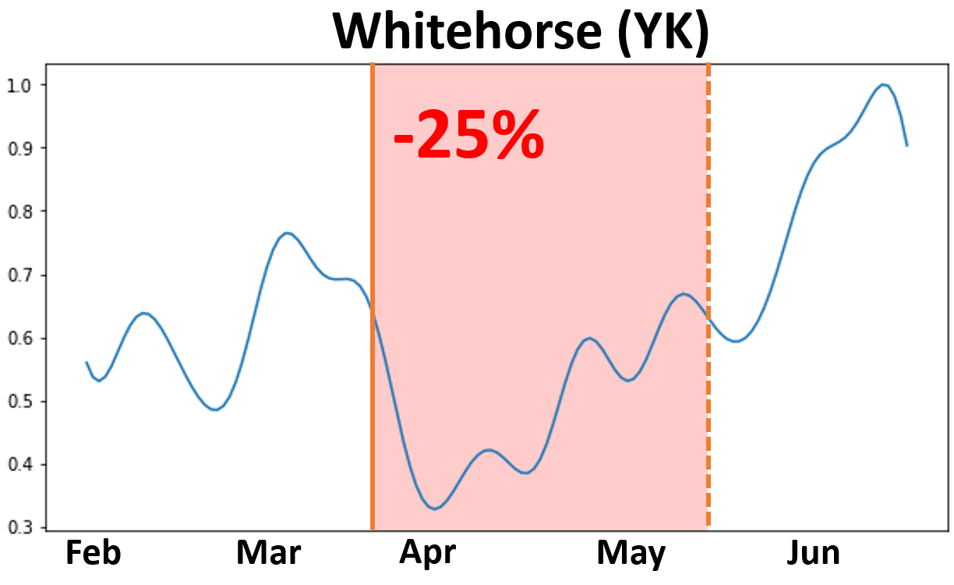
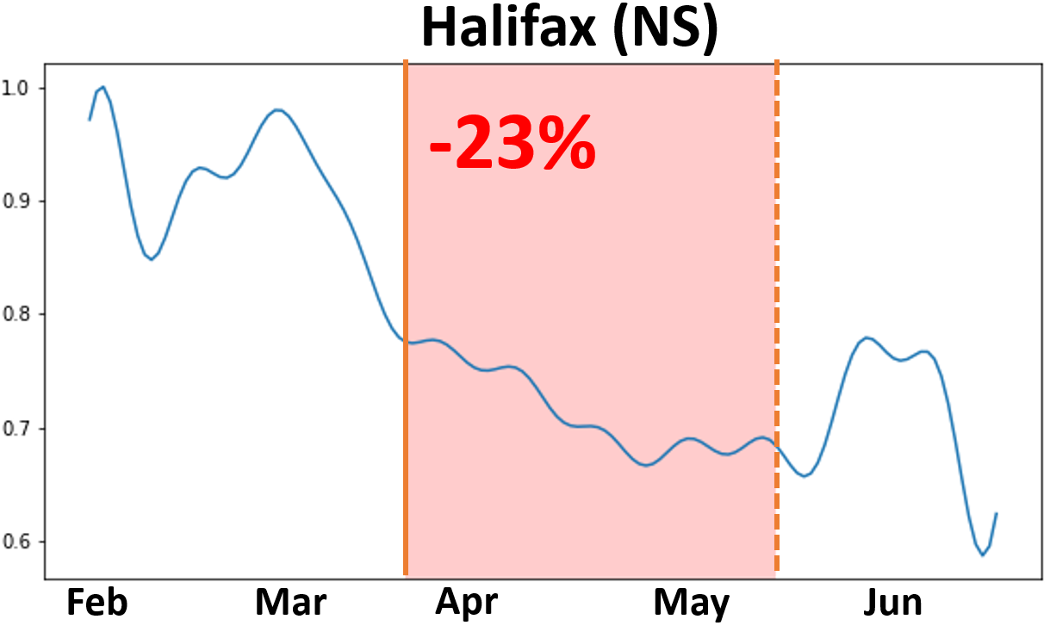
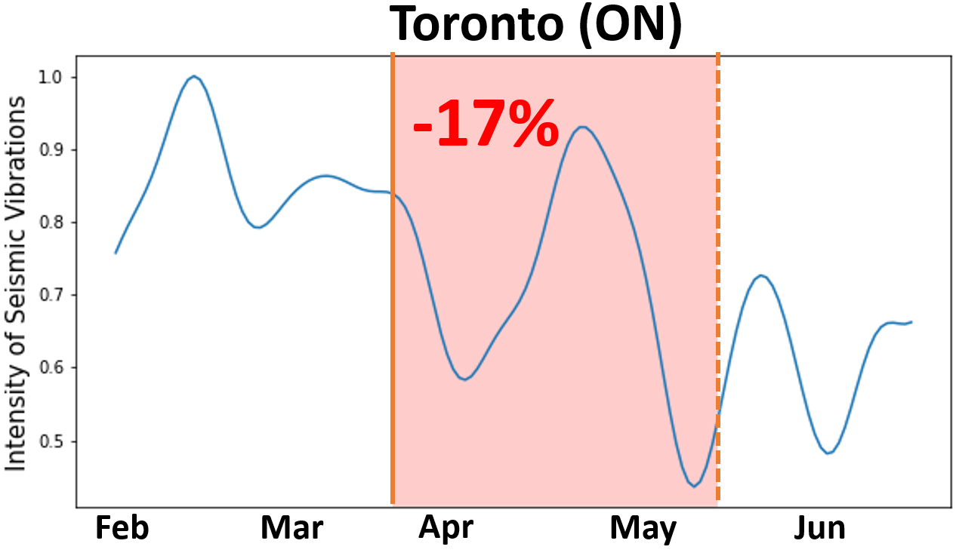
RESULT 1: Seismic Vibrations Decreased During the Lockdowns
First Lockdown Period (mid March 2020 – mid May 2020)
Intensity of Vibrations
Seismic vibrations related to human activities decreased for all cities during the first lockdown. Montreal, Calgary, Ottawa, Whitehorse, Halifax saw a drop between (20% - 55%). Toronto, Quebec City, Vancouver and Victoria saw a drop between (12% - 20%) compared to the pre-lockdown levels.

Slide 10
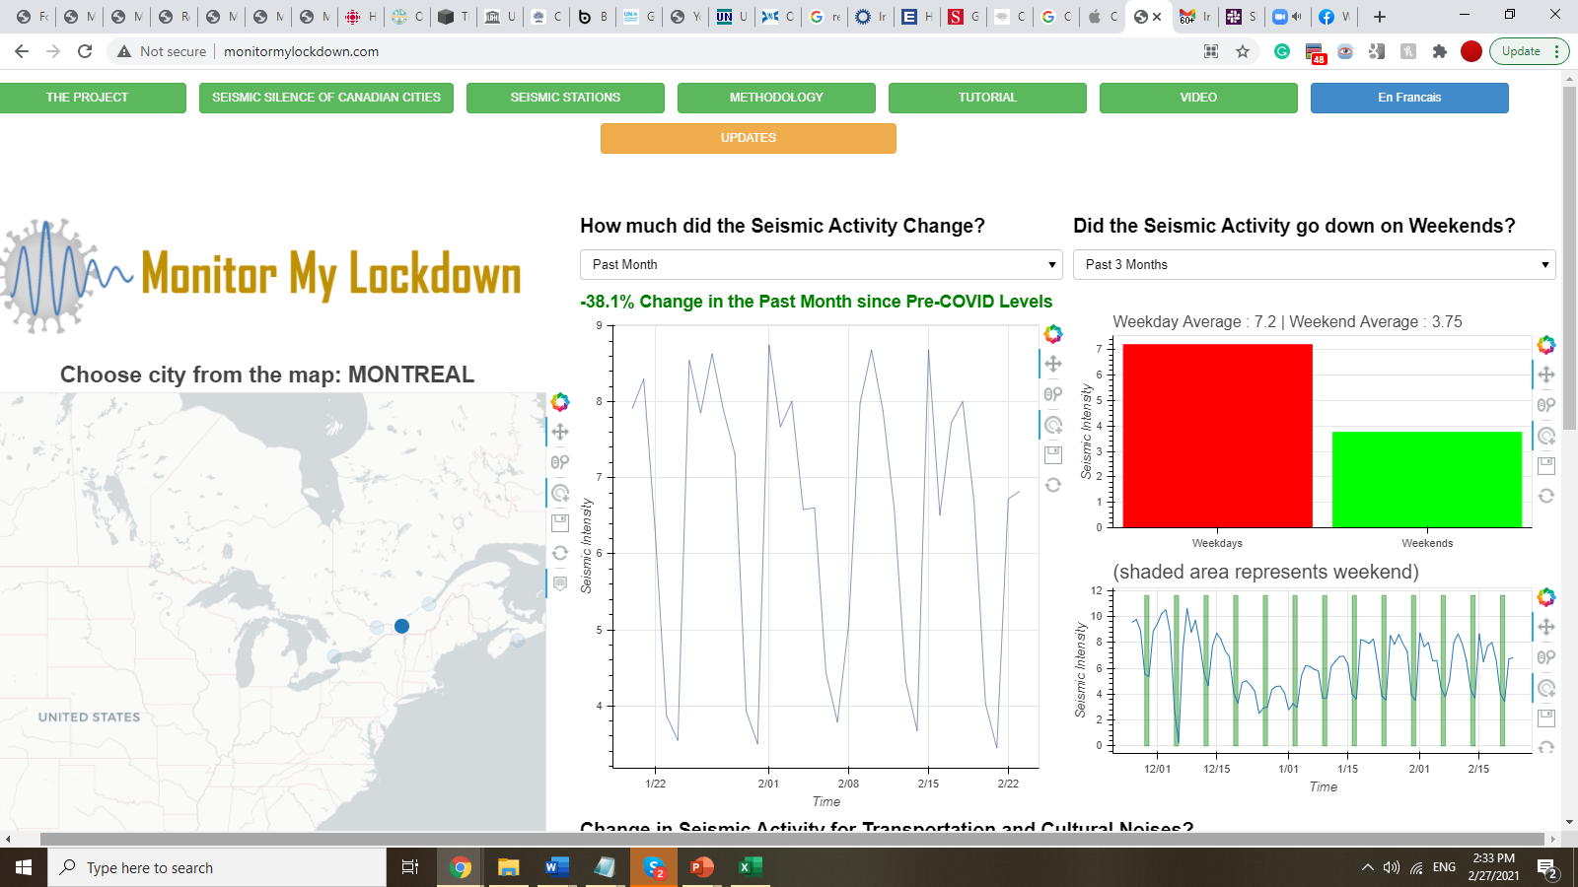
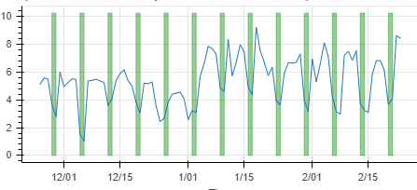
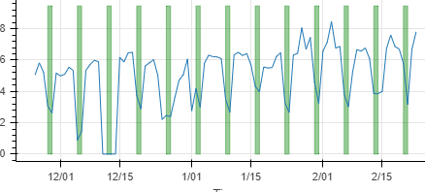
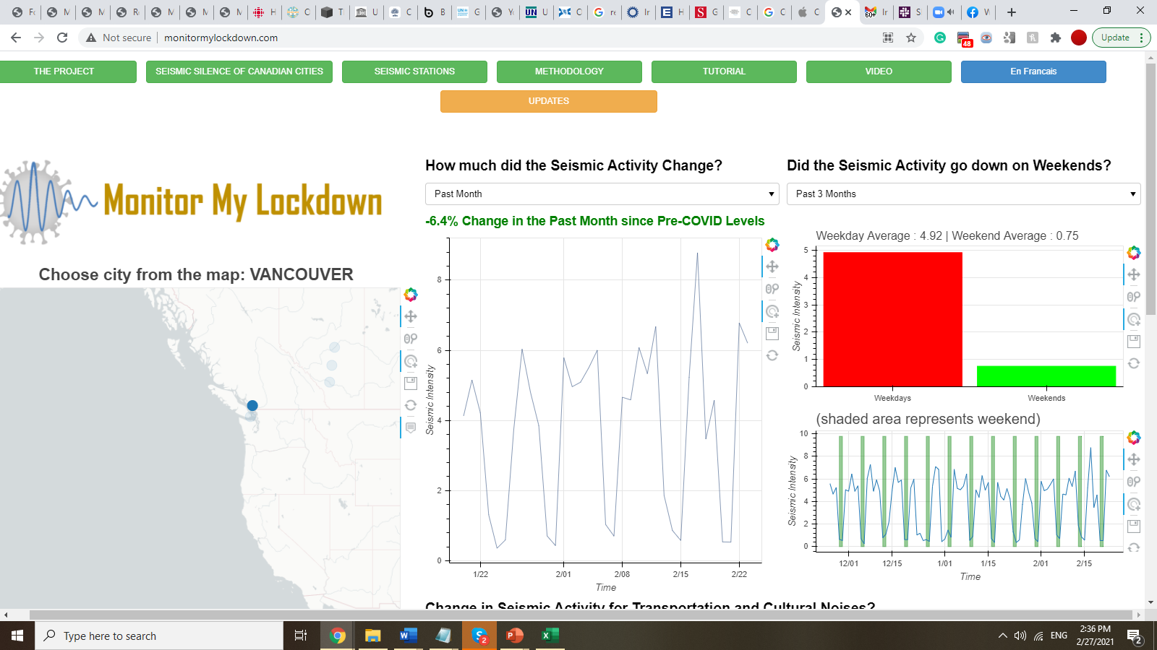
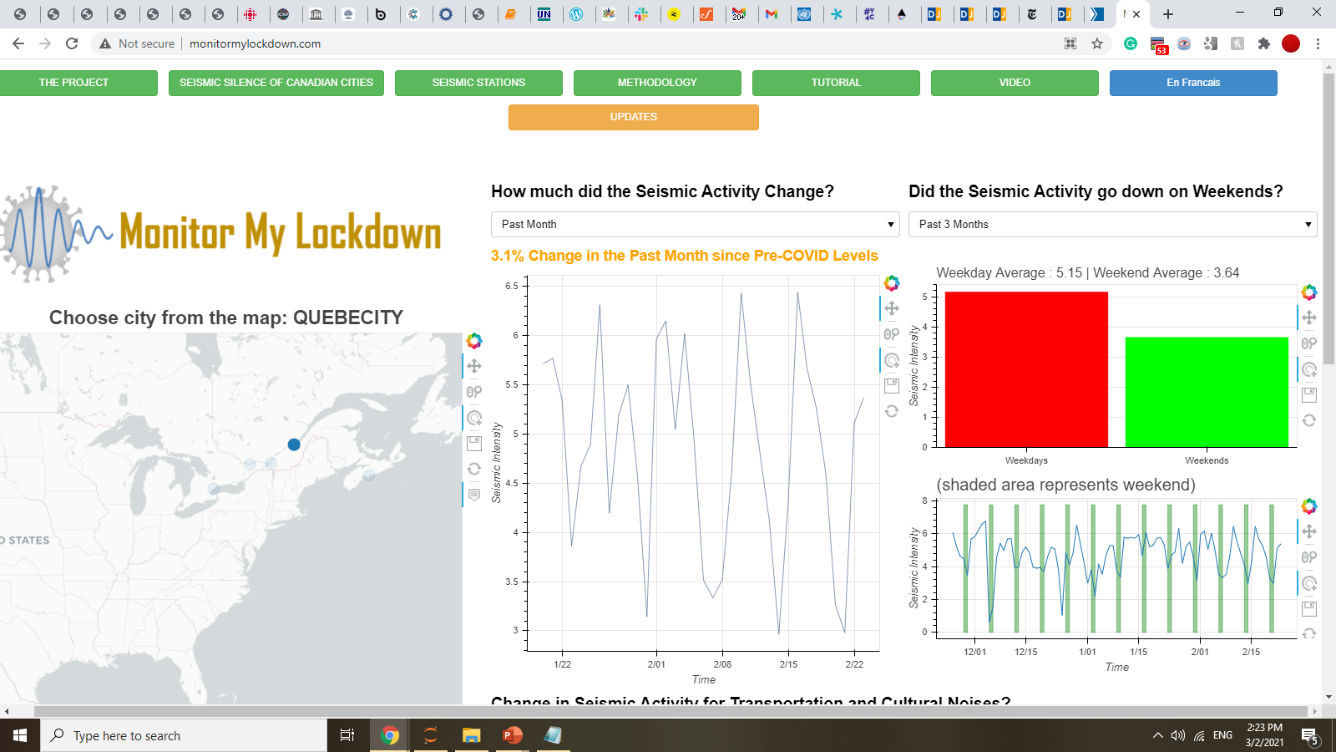
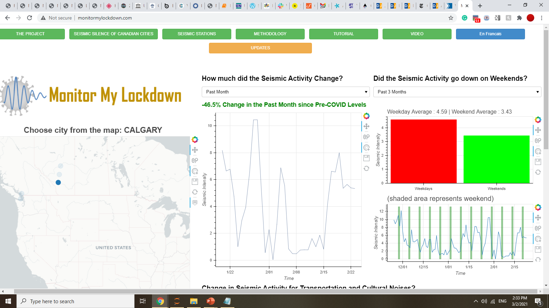
RESULT 2: Seismic Vibrations were Lower during the Weekends
Second Lockdown Period (December 2020 – February 2021)
Montreal (Quebec)
Halifax (Nova Scotia)
Ottawa (Ontario)
Intensity of Vibrations
Intensity of Vibrations
Intensity of Vibrations
Time
Time
Time
Vancouver (British Columbia)
Quebec City (Quebec)
Calgary (Alberta)
Intensity of Vibrations
Intensity of Vibrations
Intensity of Vibrations
Time
Time
Time
Shaded lines represent weekends
Seismic vibrations related to human activities dropped substantially during the weekends compared to weekdays for most Canadian cities.

Slide 11
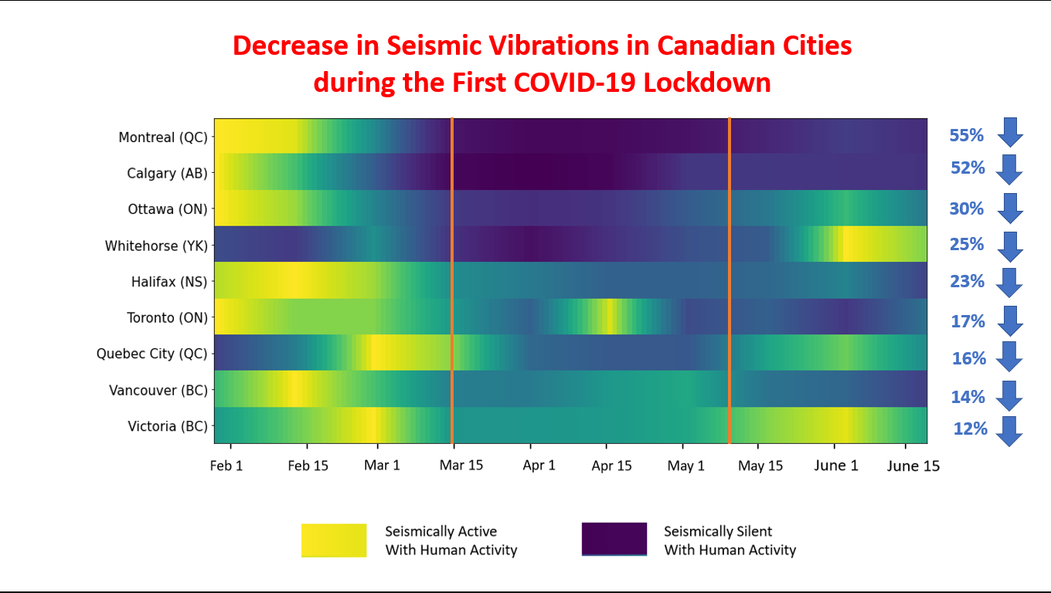
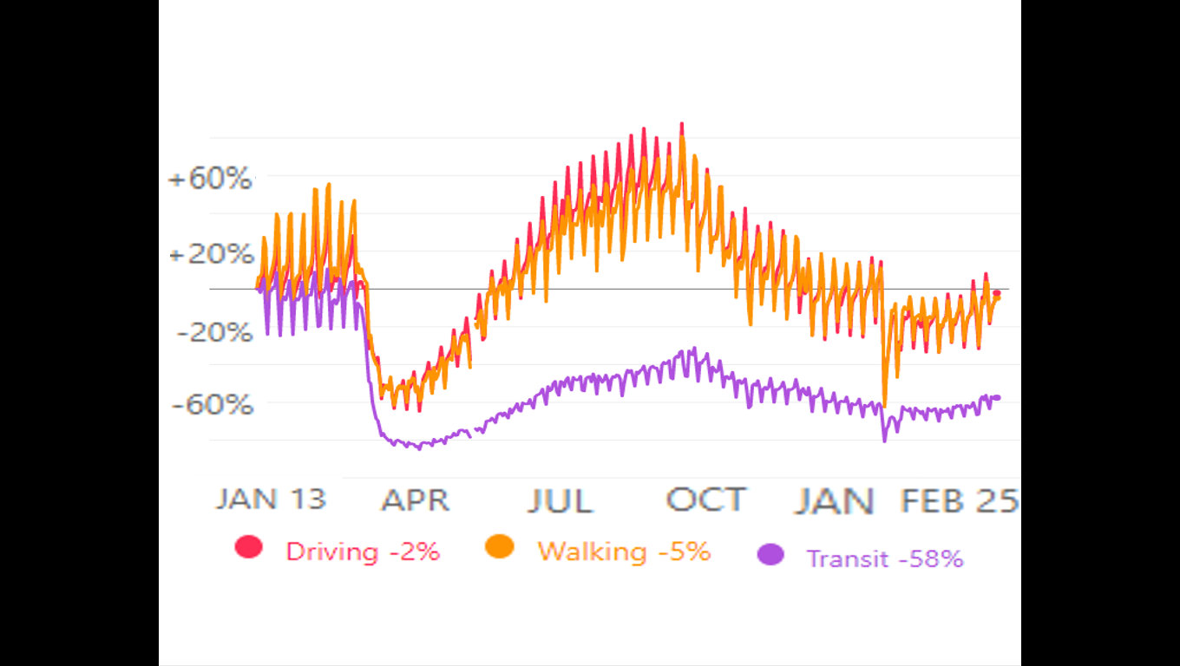

DISCUSSION
Anthropogenic seismic vibrations decreased during pandemic lockdowns
Canadian cities started to become seismically silent: seismic vibration decreased between 12% to 55% compared to the pre-pandemic levels.
First Lockdown in Canada (mid March 2020 – mid May 2020)
Mobility Trends (Canada)
Lockdown
Period
Seismic Silence
(Lockdown Period)
https://covid19.apple.com/mobility
Seismically Active with Human Activity
Seismically Silent with Human Activity
2. Seismic data serves as a proxy for measuring changes in human activities
The reduction in human movement was validated by ‘Mobility Trends’ data published by the ‘Apple’ company.

Slide 12
DISCUSSION
3. Seismic vibrations can identify possible sources of human activities
Anthropogenic vibrations were lower during weekends for most cities. Malls, restaurants, sports stadium, and cultural events that draws traffic during weekends were shutdown during lockdowns.
Seismic Vibrations Were Lower During Weekends (Feb 2020 – Feb 2021)
4. Decrease in seismic vibrations for Canada matched with other countries
Globally, anthropogenic seismic noise dropped as much as 50% during the lockdown between March and May 2020 in 77 countries (“Science” Journal. 23 July 2020). My study measured the drop for Canadian cities to be between 12% - 55%.
5. Errors
Some seismic stations were far from city centres and made them less sensitive to urban noise.
Seismic data arrives at a high sampling rate (100 data points/second). To calculate the ‘Power Spectral Density’ on 80 billion data points, there was some trade-off between accuracy and speed.

Slide 13
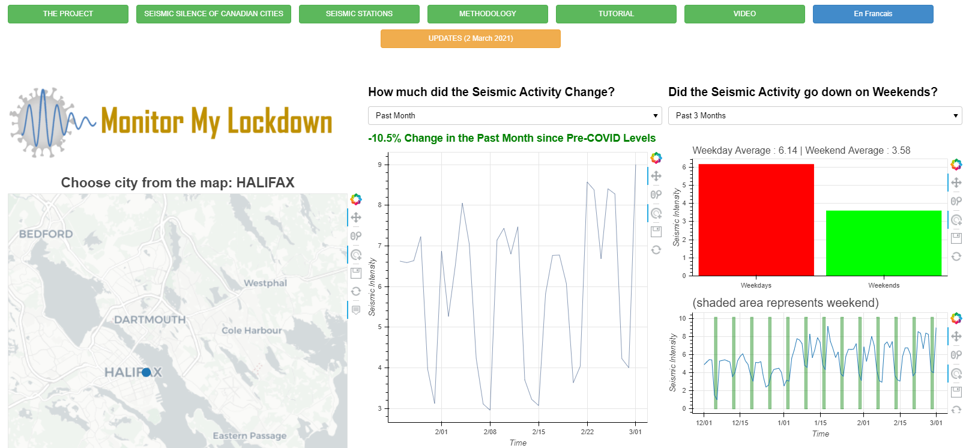
WebApp Demo: www.MonitorMyLockdown.com Monitor real-time reduction in human movement during lockdowns

Slide 14

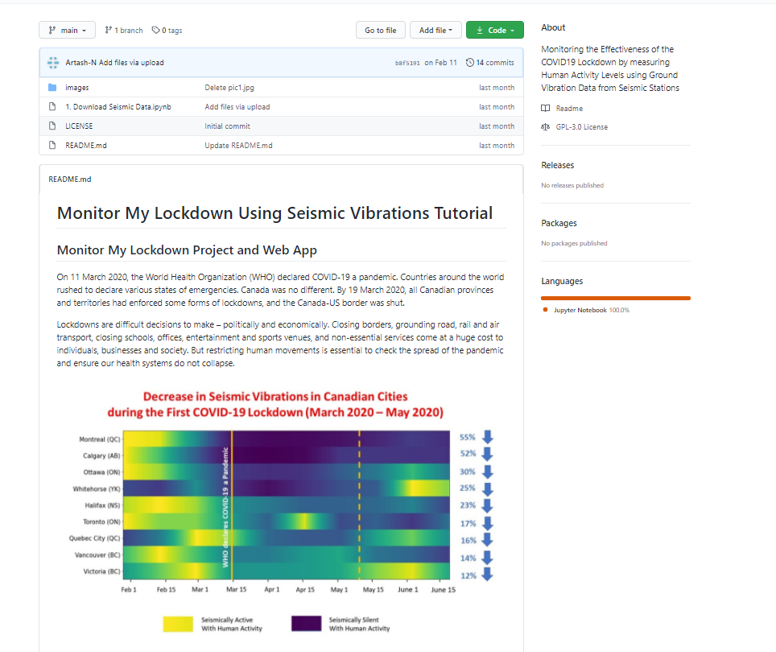
Online Tutorial for Students
https://github.com/Artash-N/Monitor-My-Lockdown-Using-Seismic-Vibrations
To Calculate Changes in Seismic Vibrations for any city

Slide 15
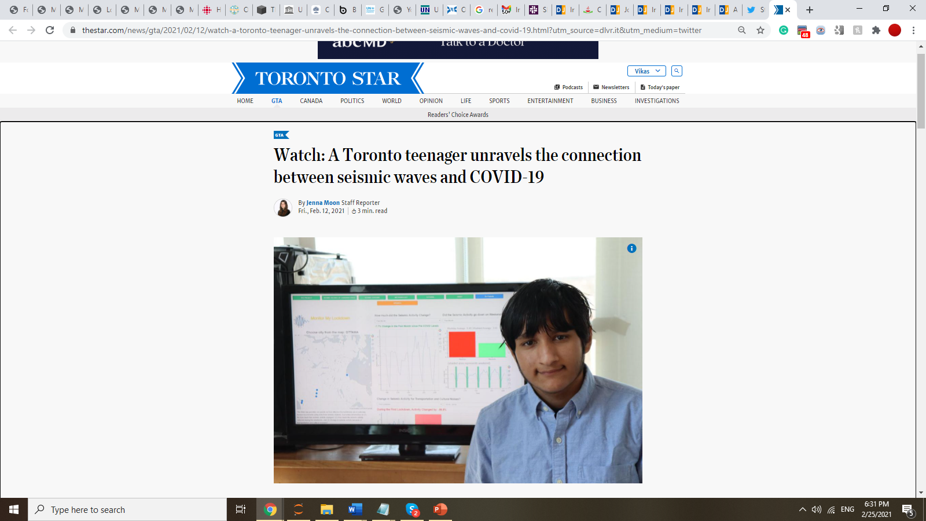

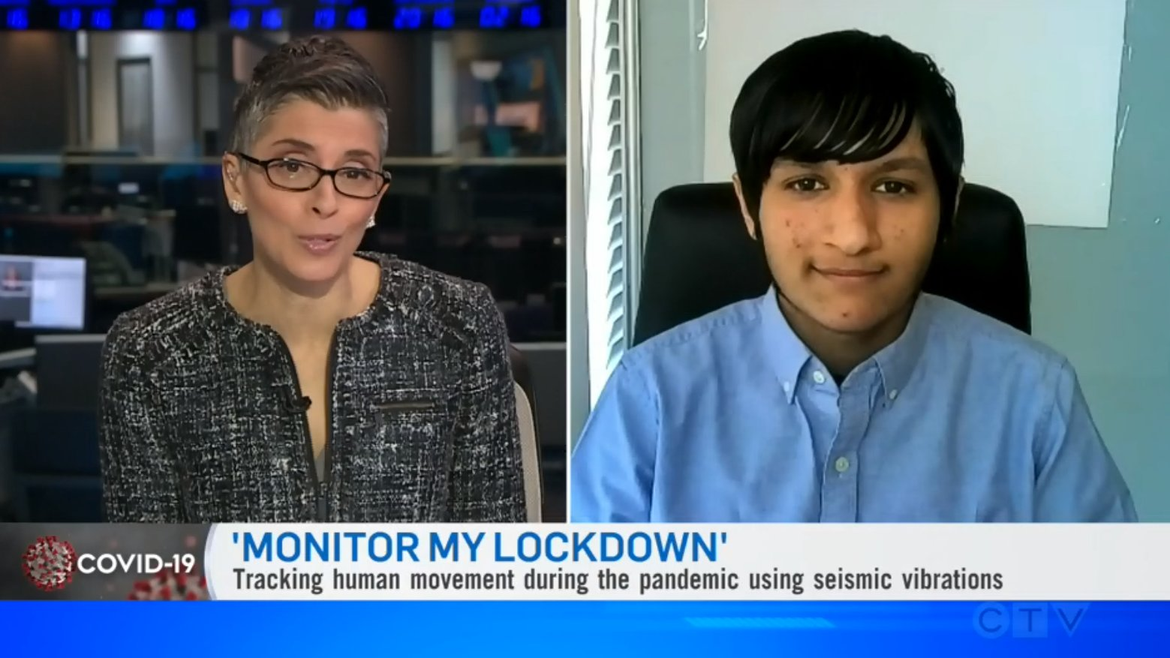


IMPACT:
12 Feb 2021
Canada
Weekly human movement updates sent to media and Members of Provincial Parliament (MPP).
The research and WebApp featured in the Toronto Star newspaper and on CTV National News.
Online presentations and workshops given at various platforms.
20 Feb 2021
World
Open Source: Code and free tutorials posted on GitHub.
Talks with researchers at York University to expand the project to South Africa.

Slide 16
CONCLUSIONS
COVID-19 lockdowns reduced seismic vibrations in Canada. The reduction in major Canadian cities were comparable to reductions observed in other countries.
Open seismic data can serve as a proxy for measuring changes in human movement in real-time without impinging on people’s privacy.
Comparing changes in seismic vibrations during weekdays and weekends makes it possible to identify sources of human activities.
Limitations
Seismic stations far from city centres will show minimal effects of the COVID-19 lockdowns.
Spread of COVID-19 depends on other factors apart from human movement, including wearing of masks, following social distancing rules, age of population and vaccination rates.
Application: Better managing ongoing and future pandemics
Investing in urban seismology can be a low-cost tool for pandemic management.
Policymakers will be able to enforce surgical lockdowns. Frontline health workers will be able to predict when and where cases are likely to spike.
Tool could be expanded to developing countries as we are safe only when everyone is safe.
Similar studies could be done by students for acoustics data from the Oceans.

Slide 17
USING COVID19, OPEN DATA AND PYTHON AS AN OPPORTUNITY TO BRING GEOSCIENCE PROJECTS TO STUDENTS
Artash Nath
MonitorMyLockdown.com
Toronto, Canada
Artash.nath@gmail.com
www.twitter.com/wonrobot
https://www.linkedin.com/in/artash-nath
C A N A D A
14 March 2021
Seismic stations monitored

