Slide 1
Gadgets and Apps and Online Resources, Oh My! Educational Technology for the Geosciences
T18. Technology-Driven Active Learning in the Geosciences
Tarin Weiss,
Department of Chemical & Physical Science
Westfield State University
March 14, 2021
NE-GSA annual meeting (online)

Slide 2
Educational Technology for the Geosciences: An overview
Digital trends in geoscience teaching & practice:
the argument & key benefits for using digital technologies
Teacher Ed 101: Teachers’ Knowledge Structures
Digital Technology & our Content Knowledge
Digital Technology & our Pedagogical Content Knowledge
2 themes & available resources

Slide 3
Recent digital technology trends in geoscience teaching and practice (K.L. Gunderson, R. C. Holmes, & J. Loisel, GSA Today, 2019)
The geoscientists that are most likely to thrive in this new technological environment are those willing to be agile and remain in a state of continuous learning. Maintaining static methods of teaching and practice will be insufficient. (authors)
Argument:
Innovations in technology are accelerating & the powerful tools once only available to some now embedded into everyday software our students use
An urgent need for more “digitally fluent” graduates (to follow industry expectations)
Imperative to incorporate computational geoscience skills into secondary & UG programming (co-degrees in GIS, data science)
Instructors need to increase students’ technical competencies as they teach key & current concepts

Slide 4
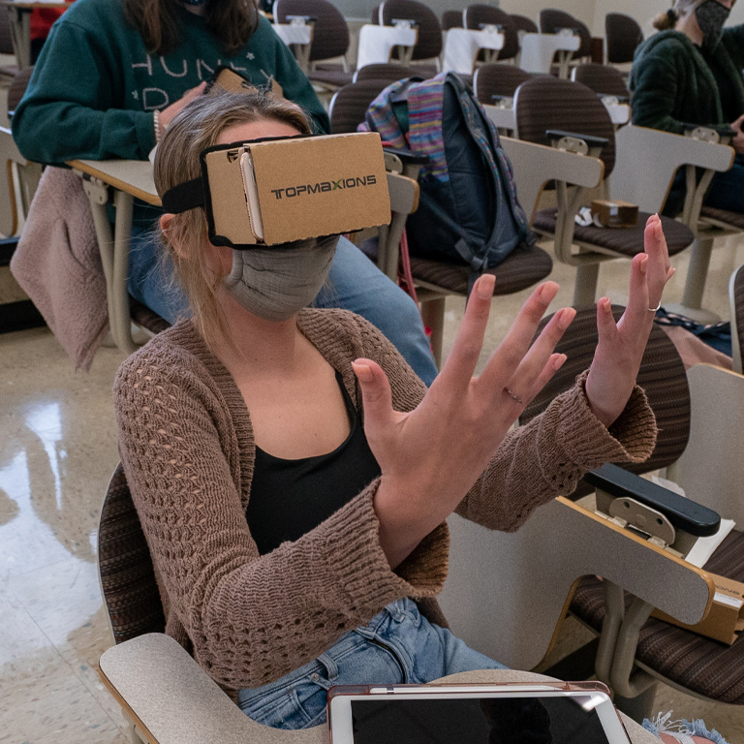

Key Benefits of using Digital Technologies for the Geosciences
How classroom technology is holding students back
Natalie Wexler, MIT Review, Dec 2019
The dark side of educational technology
Matthew Lynch, theedadvocate.org Oct 2016
Four Ways Technology Has Negatively Changed Education
Khadija Alhumaid, Journal of Educational and Social Research Oct 2019
The problem with technology in schools
Alfonzo Porter, the Washington Post, Jan 2013
Increase students’ digital literacy: “having the knowledge and ability to use a range of technology tools for varied purposes.” (NY Dept. Educ)
Allow students behave as scientists (role playing): use of real data to grapple over authentic, complex problems
Force students to consider multiple hypotheses/explanations
Enhances Interactivity: students learn about & can contribute to the wider scientific community (peers, experts)
Complex processes are effectively illustrated
Assistive technologies support students with disabilities
https://newsroom.iuk.edu/2020/november/around-the-world-field-trip-peeks-at-tourism-technology.htmlwww.edutopia.org/article/value-digital-tools-science-classes

Slide 5
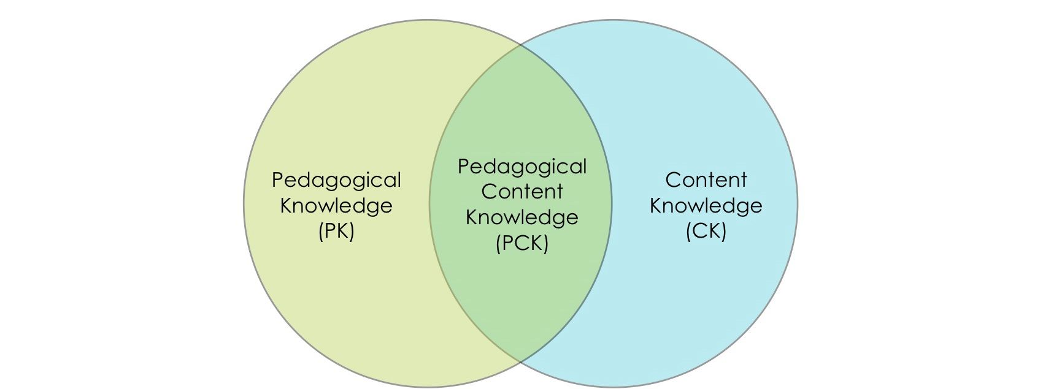
CK Substantive structures: the ways concepts & principles are organized to incorporate the facts of a discipline
Digital CK: In what ways has technology impacted the substantive and syntactic structures our discipline?
Digital PK:
How does technology support student learning?
PK: How my students learn &
the pre- and misconceptions they hold about concepts
CK Syntactic structure: the ways information is deemed valid and worth knowing; “the rules for determining which claims have greater warrant” (Schwab,1978)
PCK: How you teach your subject (the instructional strategies, and materials you choose to use).
Digital PCK: What are the best ways to teach using technology? (instructional strategies, materials, resources, devices, management systems)
Teacher Knowledge
(Shulman, 1987)
Image:https://kstatelibraries.pressbooks.pub/

Slide 6

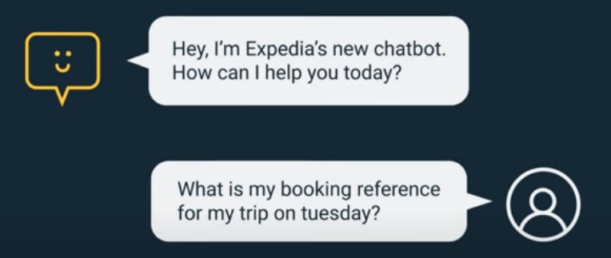
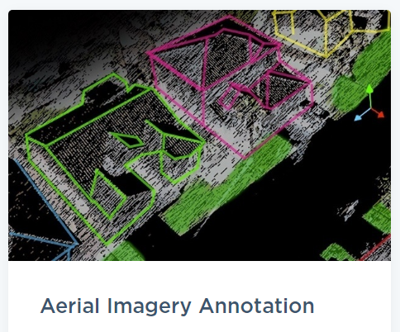
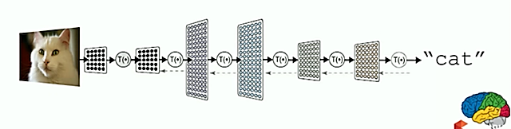
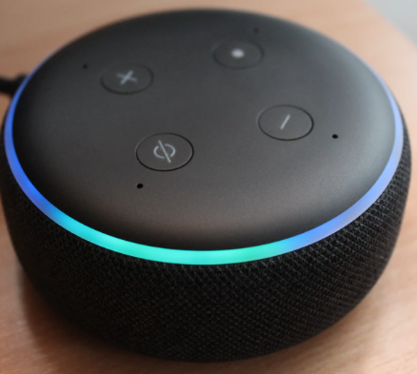

“Digital” Content Knowledge
Planning the Future of
GeoCyber Education:
2010 Arlington, VA
AI & ML behind:
Self-driving cars (Tesla FSD Beta)
Chatbots (to solve our problems)
Alexa, Siri (Voice User Interface)
Artificial Intelligence (AI; a 1950s term)
The science of training a machine to interpret and calculate about the world as we do
Machine Learning (ML; a subset of AI)
A method behind how machines learn from data; use alogrithms to build neurol networks
Ex; image annotation to recognize/classify objects
Sources: sas.com/en_us, deepai.org/machine-learning-glossary-and-terms/neural-network, mashable.com, expedia.com, resource.esriuk.com/blog/, www.cloudfactory.com www.jsg.utexas.edu/events/files/geocybereducation.pdf; okepscor.org
Notes:
Give the machine examples bc it’s easier to do than to write code; they learn what to do (ask question, collect data, train algorithm, try it out, collect feedback, use feedback; to make algorithm better (increasing accuracy) & performance)
Google car (lasers on top where it is, radar in front telling speed/motion around it) all data figures out how to drive car and to predict what drivers around car are going to do (almost a Gigabyte of data/sec that car is processing)
Continuous streaming info IOT understand our environment, large volumes, diverse, find patterns learn
Chatbot? Interpret info about world (news) chatbot is a computer program that simulates and processes human conversation (either written or spoken), allowing humans to interact with digital devices as if they were communicating with a real person. Interacts through human messaging artificially replicating the patterns of human interactions

Slide 7
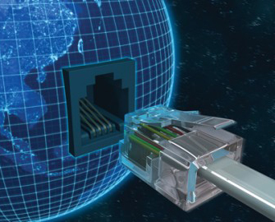
“Digital” Content Knowledge
Cyberlearning
Learning mediated by networked computing and technologies (NSF def)
How learners at all levels interact with data/information and
develop knowledge & a type of learning educators need to support
Cyberinfrastructure
High‐performance computing/telecommunications networks that enable access and use of remote data/infor. resources and services (visualizations/analysis/modeling tools)
Geoinformatics
Used to identify the community of geoscience data archival and management efforts maintained by research facilities (e.g., IRIS, UNAVCO, USGS, NOAA) and funded data management projects (e.g., EarthChem, GeoStrat, Marine Geoscience Data System).
Cloud computing
IoT, UI, UX
Augmented reality
Social engineering
HTML, CSS
Encryption
Website front end, back end
Big data
Operating system
KB, MB, GB
URL, ISP
Download, Upload

Slide 8
Recent digital technology trends in geoscience teaching and practice
K.L. Gunderson, R. C. Holmes, & J. Loisel identified 2 themes:
Digital Pedagogical Content Knowledge (PCK):
How do students learn science using technology, what are the best digital ways to represent topics, & what materials/ instructional strategies are available?
Updated curriculum that caters to current research and practice
New information delivery methods in the classroom, field, and online
(from Groundwork GSA Today, 2019)

Slide 9
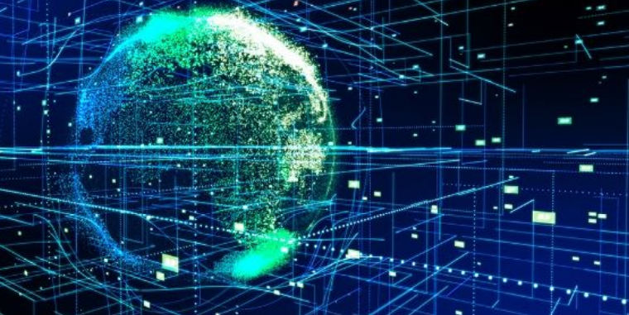
“Digital” PCK:
Updated curriculum that caters to current research and practice
OER (Open Educational Resources)
https://www.oercommons.org/browse?f.search=Geology
https://libguides.humboldt.edu/openedu/geol
MOOCs (massive open online courses) for geology
Open courseware platforms (MIT)
Free online geology courses (via OpenCourseWare platform). Course topics include igneous petrology, trace element geochemistry, field geology, medical geology, landscape evolution.
Big data resources
EarthChem (www.earthchem.org/)
Marine Geoscience Data System (www.marine‐ geo.org/)
GEOSS Global Earth Observation System of Systems earthobservations.org/geoss.php
MARGINS/GeoPRISMS Data Portal (http://geoprisms.org/geoprisms-data-portal/
NASA WORLD VIEW https://worldview.earthdata.nasa.gov/
IEDA overall repository of geoscience data from the Ocean, Earth, and Polar Sciences. https://www.iedadata.org/
IRIS seismological data. https://www.iris.edu/hq/
Image: bigdataframework.org

Slide 10
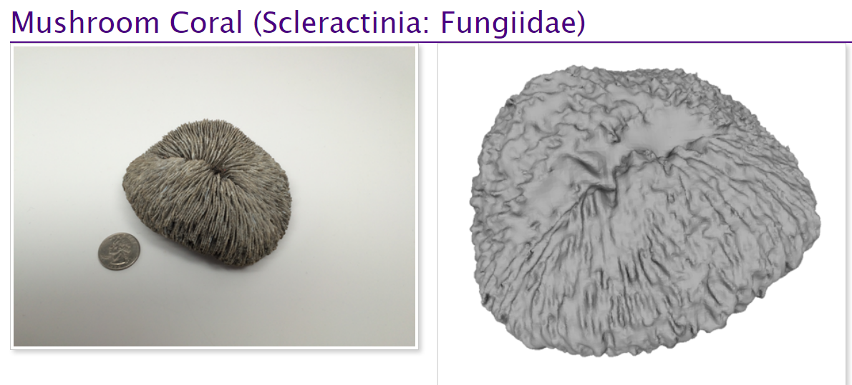
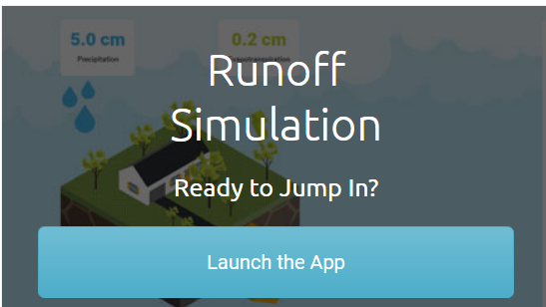

“Digital” PCK
New information delivery methods
in the classroom, field, and online
Technology-enlightened teaching resources
SERC (Sci Ed Res Center at Carleton Coll.) Using Data in the Classroom
Micro My Earth (site)
Webinars, Podcasts, Simulations, Labs, Activities, Modeling apps, Data Explorations
3D Printing
Topography, Xstals, fossils, rocks, structures
Teaching with data, simulations, & models (SERC)

Slide 11
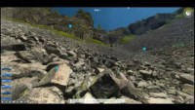
Virtual Field Trips: Column of the Giants video
“Digital” PCK
Field trips: virtual
AGUs blogosphere trips
Siccar Point
Column of the Giants video

Slide 12



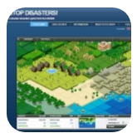


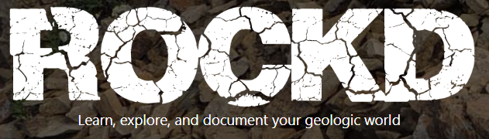

“Digital” PCK
Apps as Resources
WWW Free Rivers Android, iPhone, iPad, iPod
Esri GeoInquiries Website
Stop Disasters! Mac, Windows Slick sim game explores global natural disasters
NASA iPhone, iPad, iPod & NASA Global Climate Change website
EarthViewer iPad, iPhone, iPod Touch, Kindle Fire Deep geologic history and real science
Google Earth VR Windows, HTC Vive Explore the world with an incredible new perspective and sense of scale
ROCK’D Apps store Googleplay Curious what you're standing on? Instant access to more than 155 geologic maps
Learning Management Systems
To develop course content, tracking student progress, measuring and reporting student performance
Blackboard, Moodle, Canvas, D2L

Slide 13
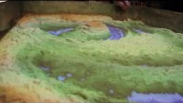
Augmented reality resources
Sandbox news.stonybrook.edu
“Digital” PCK

Slide 14

Augmented reality resources
GeoXplorer app
Wash. Univ (St. Louis)
“Digital” PCK

Slide 15
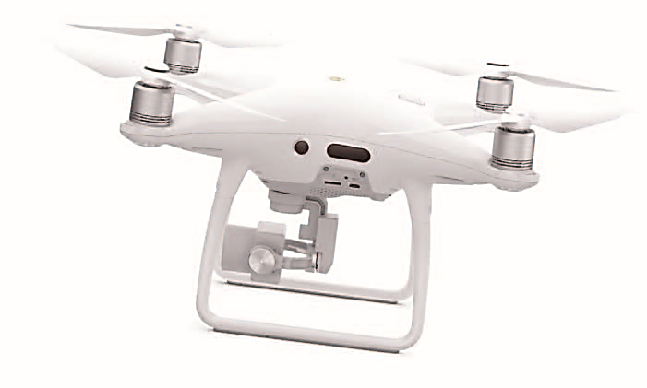
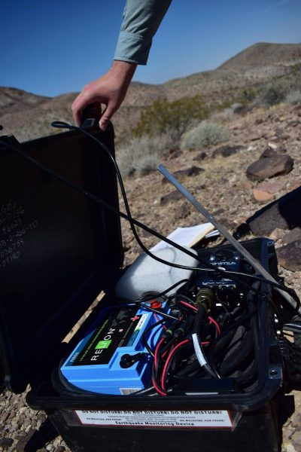
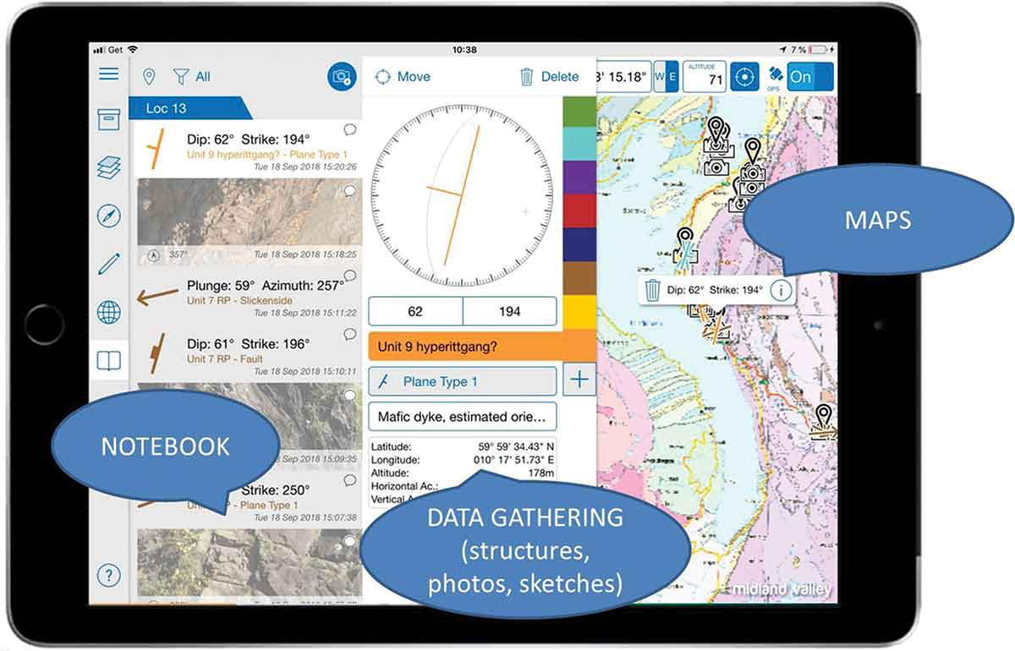
Digital Equipment resources for use in the field
“Digital” PCK
“These new tools have encouraged the development of new approaches to field mapping and data collection, including the use of digital compasses to measure geologic features, crowdsourcing field data collection, and the assembly and analyses of very large field datasets.” S. Whitmeyer 2018
Smartphones & iPads (with built in accelerometers, gyroscopes, and magnetometers)
Apps (Fieldmove Clino, Stereonet Mobile)
Drones (for high res imagery)
Digital outcrop models assembled with LIDAR and/or photogrammetry
Pint-sized seismometers
https://www.jsg.utexas.edu/news/2018/12/technology-in-the-field/; S. Whitmeyer, James Madison Univ, Modern Approaches to Digital Technologies for fieldwork SERC: 2018

Slide 16
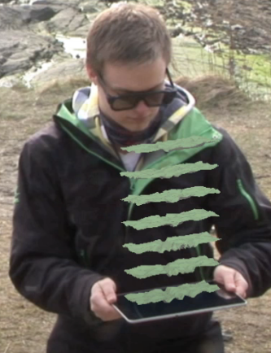
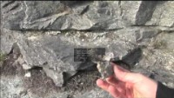
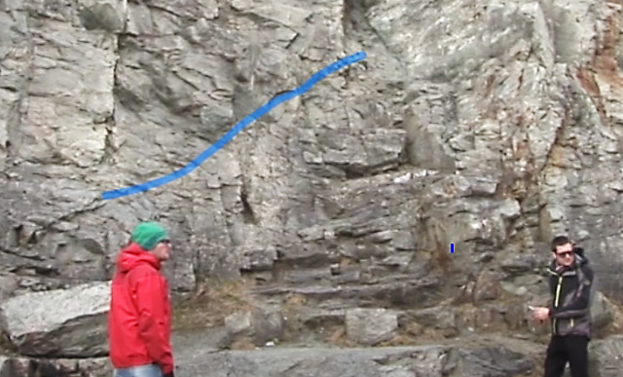
“Digital” PCK
Augmented Reality in the field (video) Norwegian Univ of Sci & Tech

Slide 17
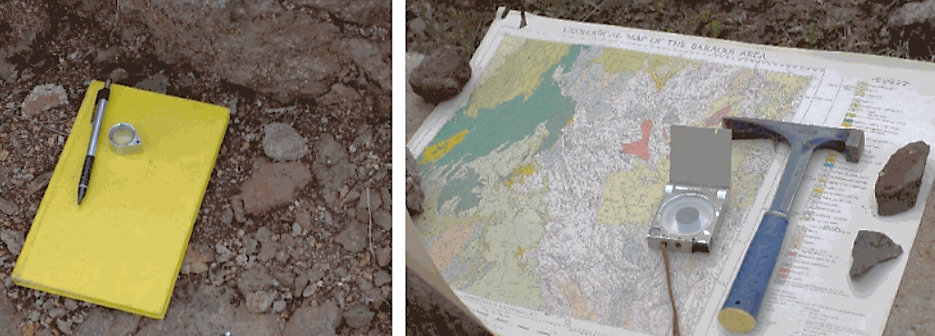
K.L. Gunderson, R. C. Holmes, & J. Loisel, GSA Today, 2019
The importance of the “old” & the “new”
Paradoxically, despite the need for digital comprehension and capability, the most important functional knowledge and skills that any geoscientist should possess will likely remain the same. These include a deep understanding of fundamental Earth processes, an ability to creatively integrate data from various sources, the clarity to communicate difficult concepts, and a passion for their work.
Technological dexterity will certainly bring additional value to our field, but we believe it will be the combination of deep fundamental geoscience knowledge and digital fluency that will be the foundation for the next era of geoscience innovation and discovery.

