Slide 1
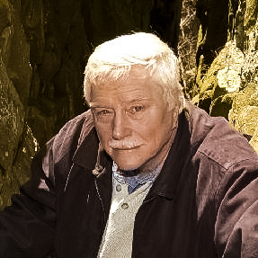
A student remembers Jelle De Boer and his legacy: Finding a way
from
geophysics and geology
toward
transdisciplinarity and complexity
Tim Lutz
Dept. of Earth & Space Science
West Chester University
West Chester, PA
Notes:
Hi! I’m Tim Lutz, Dept. of Earth and Space Sciences at West Chester University. I studied at Wesleyan University from 1969 to 1973, and was a student of Jelle de Boer’s. I’ll tell you about some of Jelle’s earlier connections to archaeology– 25 years before the Delphic oracle -- and my experiences with him at Wesleyan. I’ll close with a look at how Jelle’s teaching and mentorship influenced my career in geoscience.

Slide 2
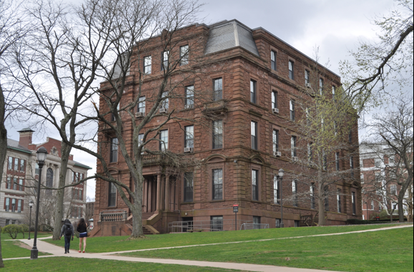
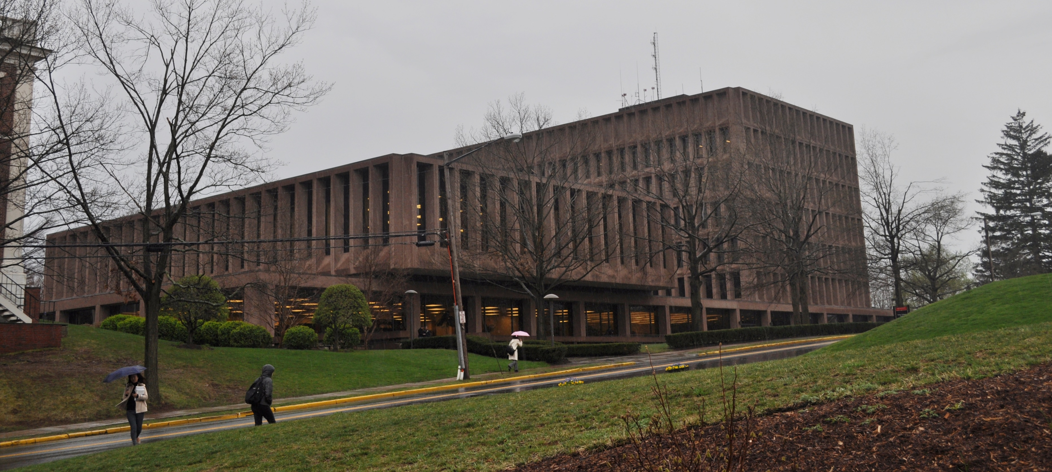
Exley Science Center and Science Library, completed 1971.
Judd Hall, completed 1909.
Notes:
I arrived at Wesleyan in 1969 to study physics. After my first year I realized I needed fewer equations and more time outdoors. My advisor in the physics department had a straightforward solution: take Geophysics! So, my first course in the geology department was Geophysics, taught in 1970 by Jim Balsley. At that time Geology had space in Judd Hall, I particularly remember the library; I think Balsey’s course was actually taught out a room in a house on Lawn Ave. I loved the experience of using a magnetometer, gravimeter, and seismic equipment in the field and it motivated me to fashion an interdepartmental major that combined curriculum from physics and geology. Jelle became my advisor on the geology side. In 1971 the department moved into the newly-complete Exley Science Center.

Slide 3
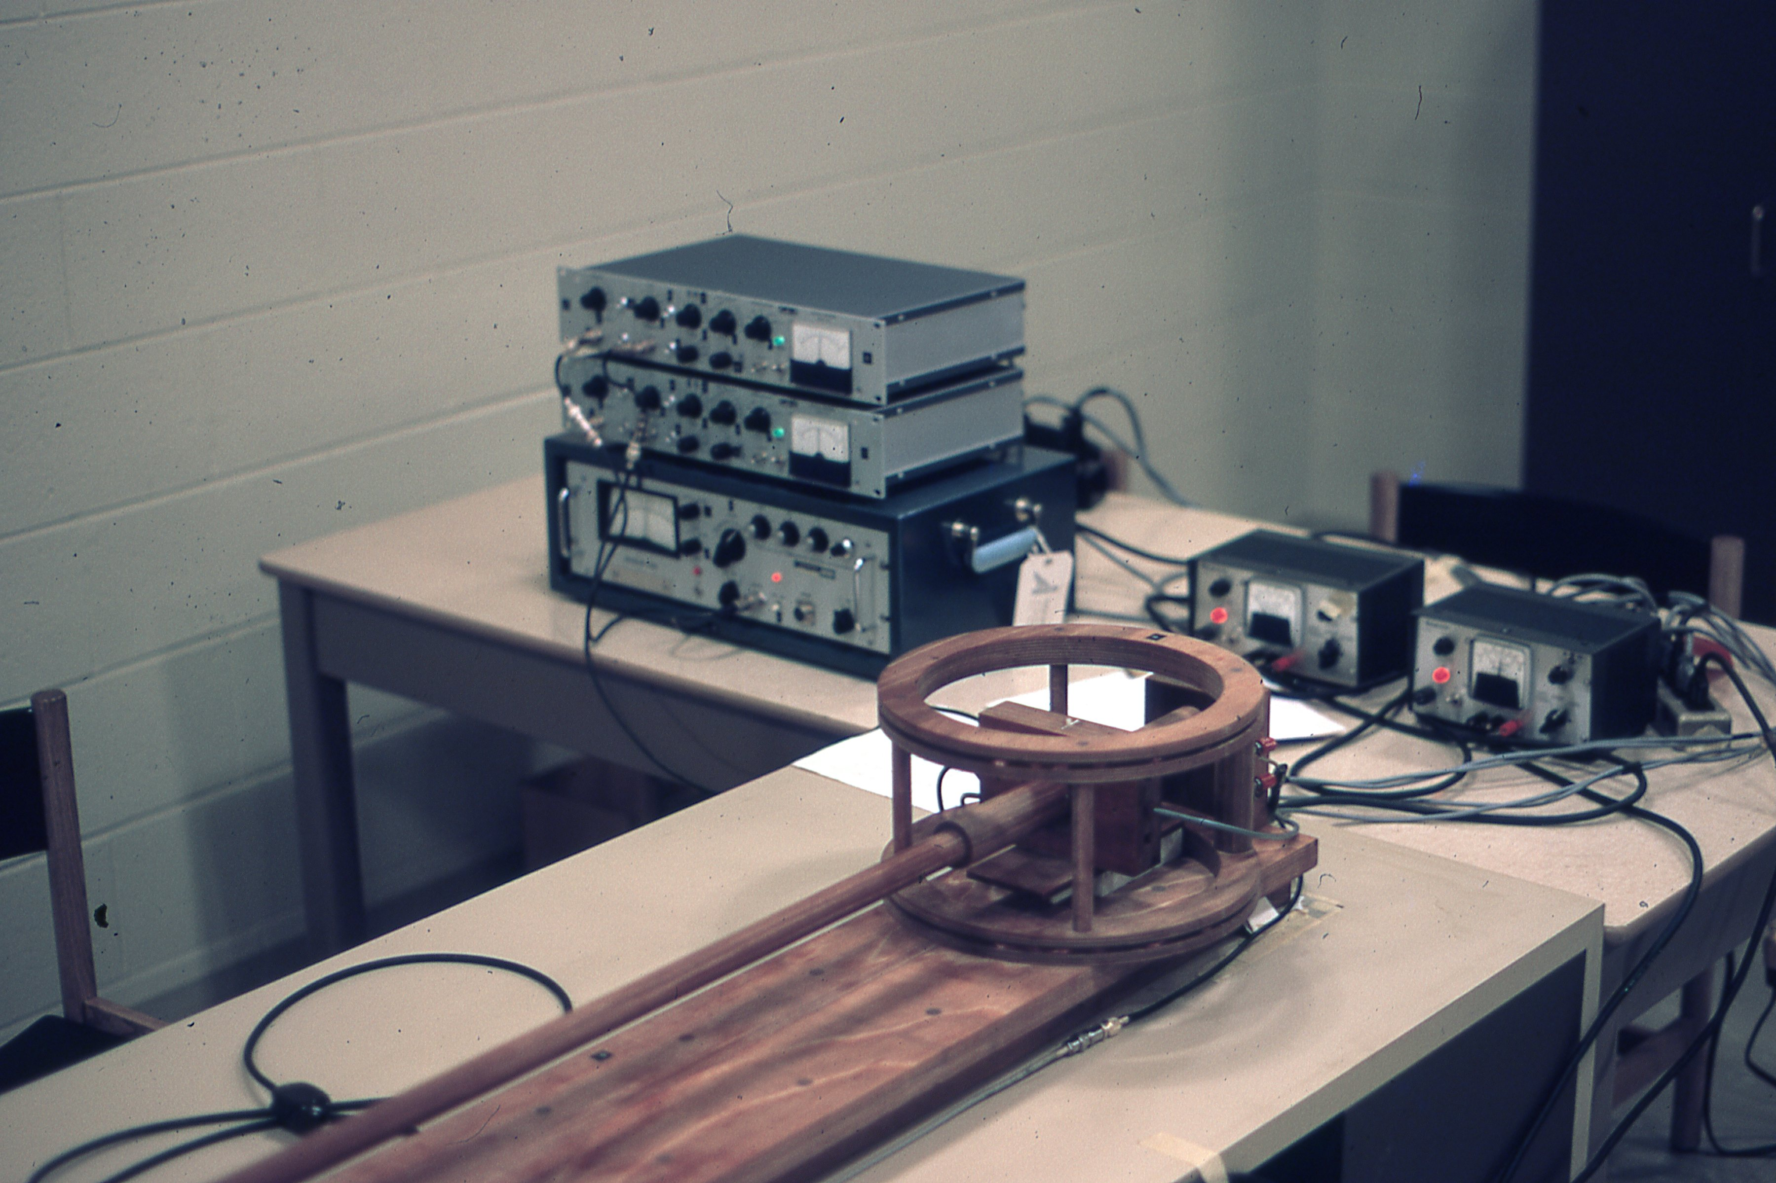
1971-72: Spinner magnetometer in Jelle’s paleomagnetics lab, Exley Science Center.
Notes:
I had a work-study position in Jelle’s basement lab, running core samples through the magnetometer and the AF demagnetizer. I suspect that for people running similar labs today, this machine and its electronics look like the Model T Ford of magnetometers! This was my first exposure to research science and where I first learned the responsibility of meticulous procedure and reliable note-taking. There was also the challenge and excitement of learning about vector data and the methods of spherical statistics that let us put all the numbers into a bigger picture. From this start, statistical analysis became a consistent aspect of much of my research over several decades.

Slide 4
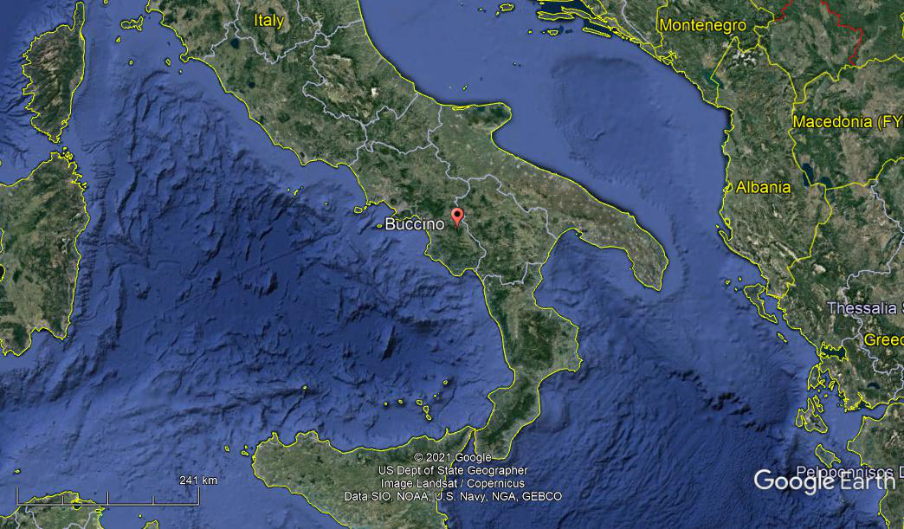
Summer 1972: Via Jelle’s collaboration with Classics professor Stephen Dyson I was engaged to do a magnetometer survey at a Wesleyan dig at Buccino, in Campania, southern Italy.
Notes:
In spring of 1972 Jelle sounded me out about taking our proton magnetometer on an archaeological dig with a Prof. Stephen Dyson, four other students, and a small professional staff. Dyson, now at Buffalo, enjoyed working with Jelle. Trained in classical archaeology, Dyson feels he learned landscape archaeology from Jelle. He told me recently: “Jelle educated me on the centrality of geology. I think I got him thinking more about man as well as geology in reconstructing ancient landscapes. Also he was a great colleague to work with.”
I needed to get more experience using the magnetometer. Fortunately, Jelle seemed to know a surprising number of people around Middletown who’d lost track of drainage pipes and sewer lines, so we’d go out in the afternoon so I could practice finding them. In summer I stowed the magnetometer in a 747’s overhead bin and was off to Rome, Naples, and ultimately, Buccino, in southern Campania.

Slide 5
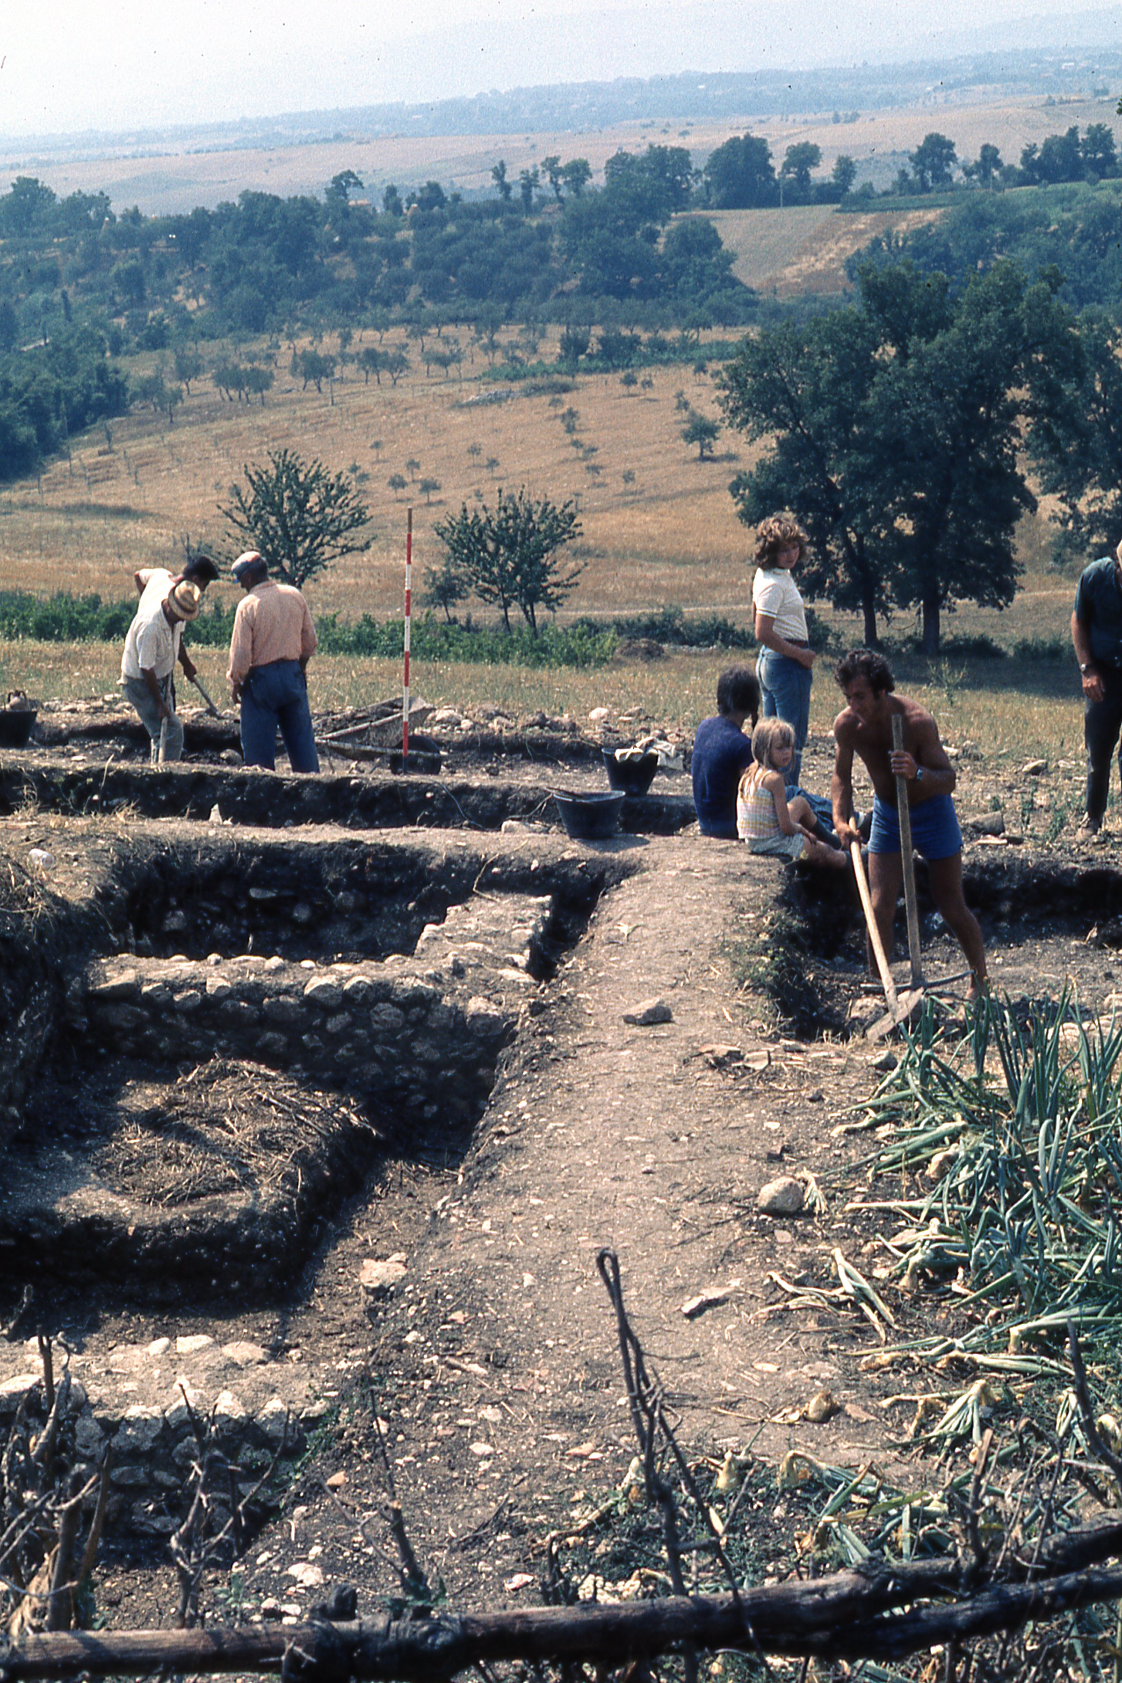
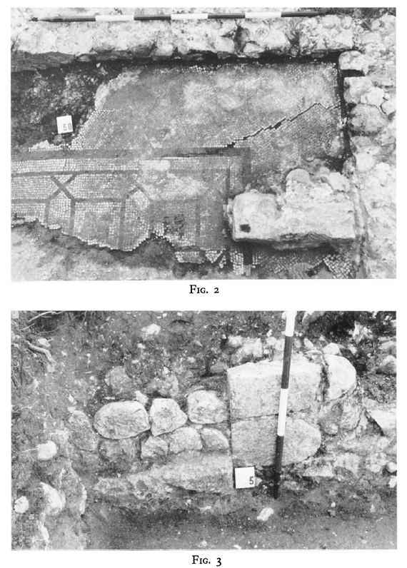
The bedrock, surface materials, and buried Roman and post-Roman structures offered little contrast in magnetic susceptibility.
Dyson, S.L., 1973, Excavations at Buccino: 1972: American Journal of Archaeology 77(4), 405-409.
Notes:
In the field I discovered that most of the rocks, soils, and materials of archaeological interest had little to no contrast in magnetic susceptibility. The structures and artifacts being excavated – the walls and mosaic in these photos – were invisible to the magnetometer. Mostly – but with one important exception!

Slide 6
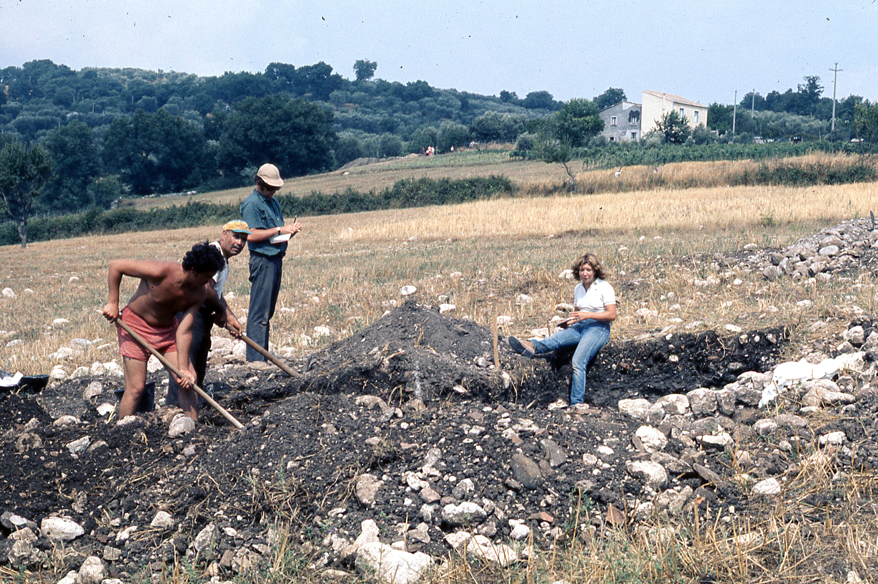
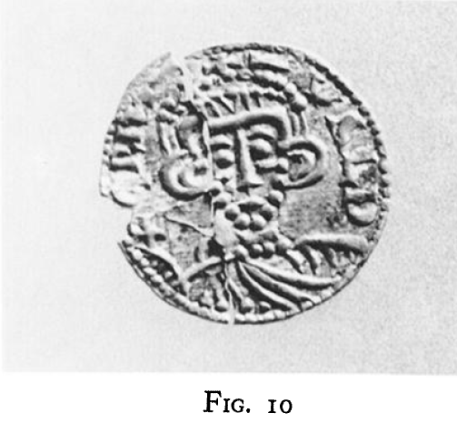
A magnetic anomaly caused by a concentration of tile and pottery led to the discovery of a gold coin.
Notes:
The magnetometer did find an anomaly outside the main Roman villa, and we dug, revealing tile and pottery with a higher susceptibility in a medieval dump. One of the archaeological laborers flipped over a shard and a small gold coin glittered in the sun. The coin was distinctive and helped date the site to the early ninth Century. That discovery was satisfying enough. Dr. Dyson, in the green shirt, is taking notes.

Slide 7
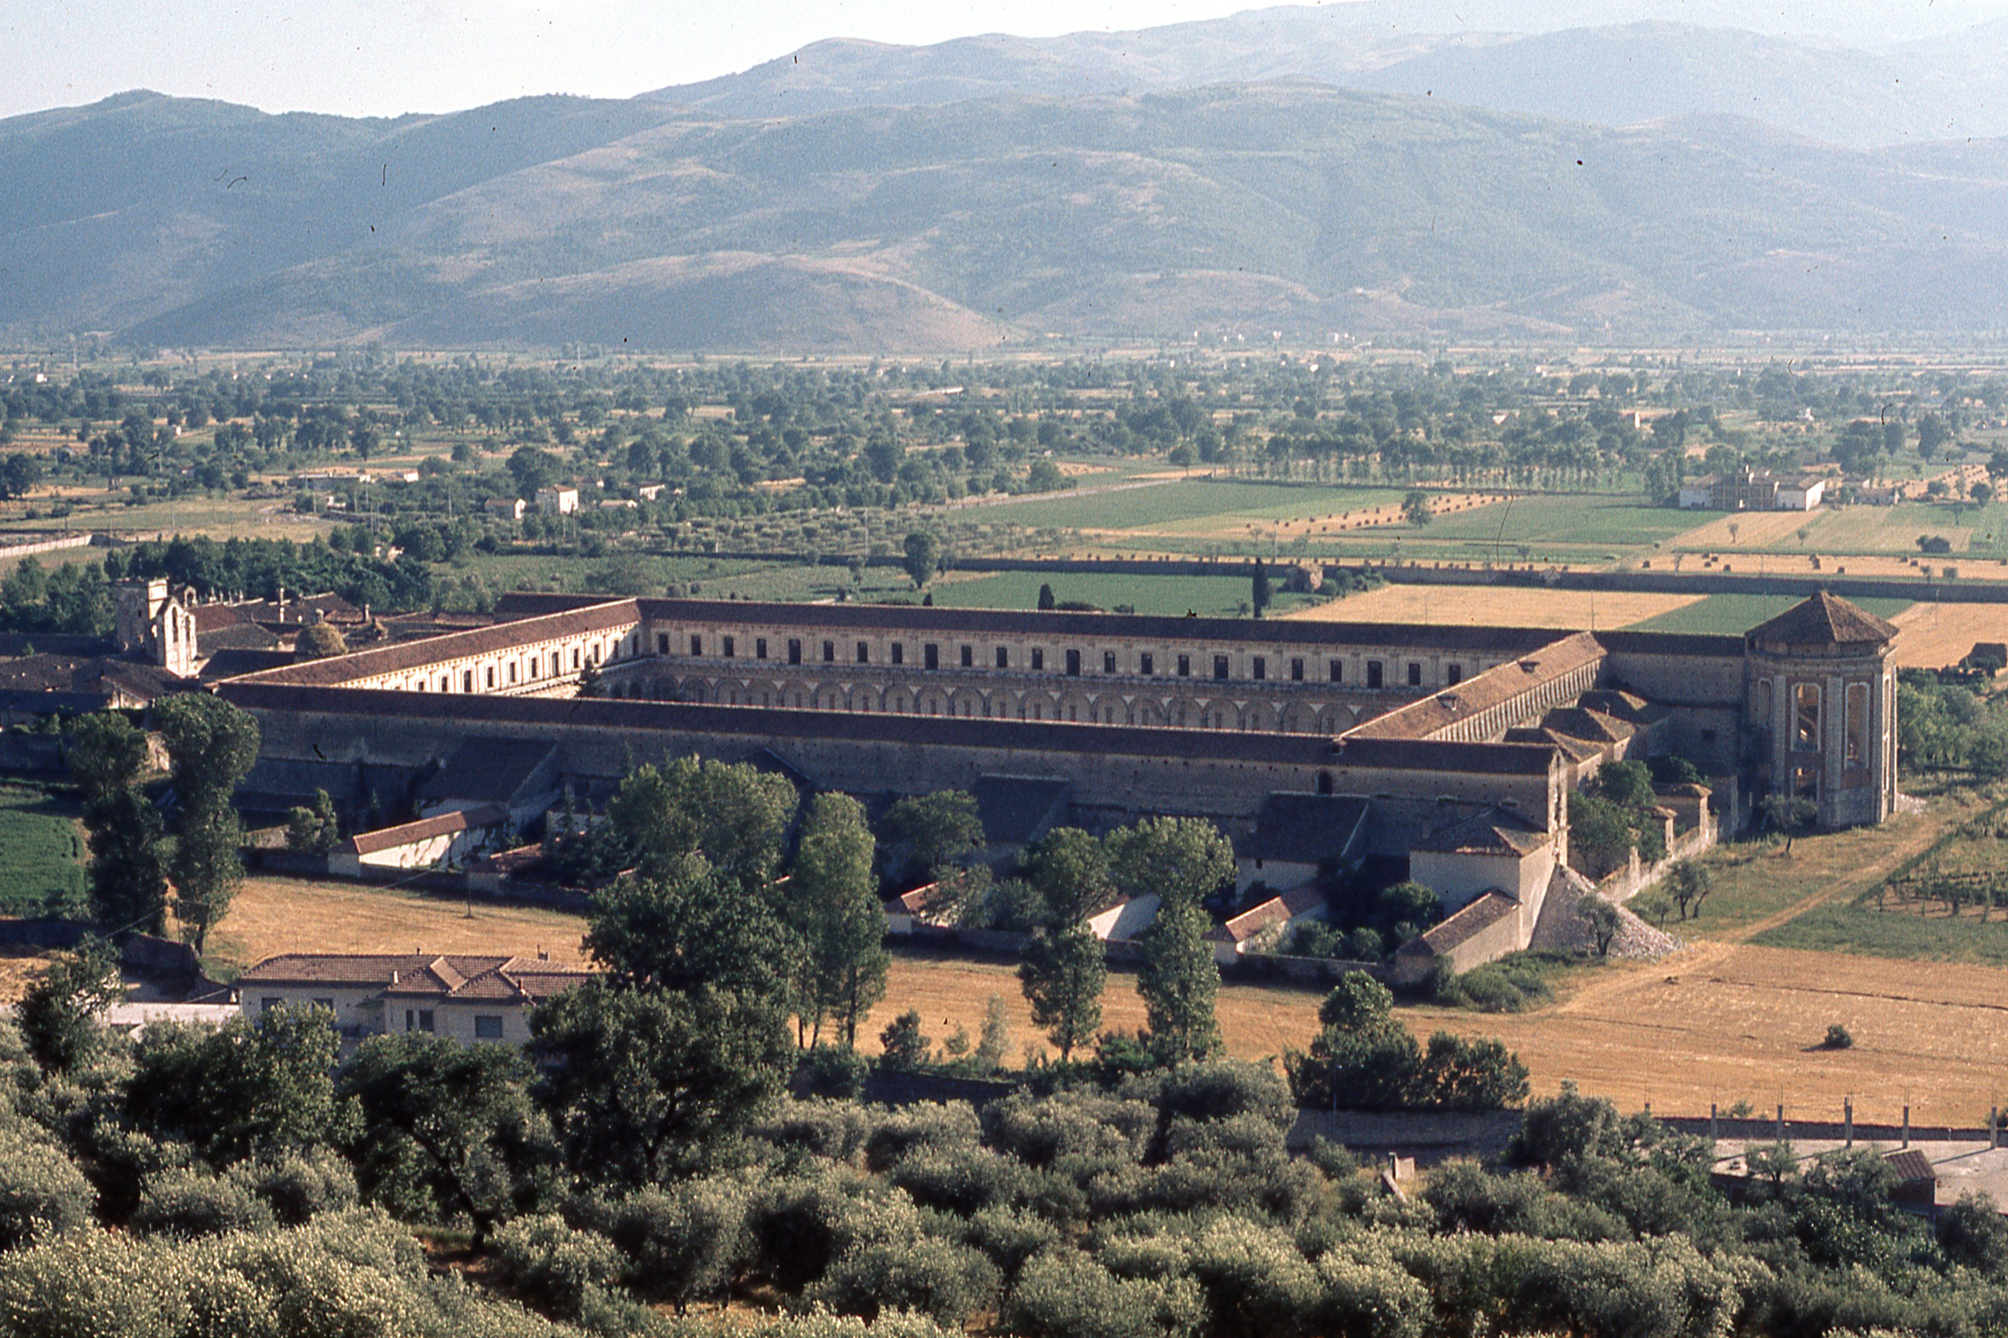
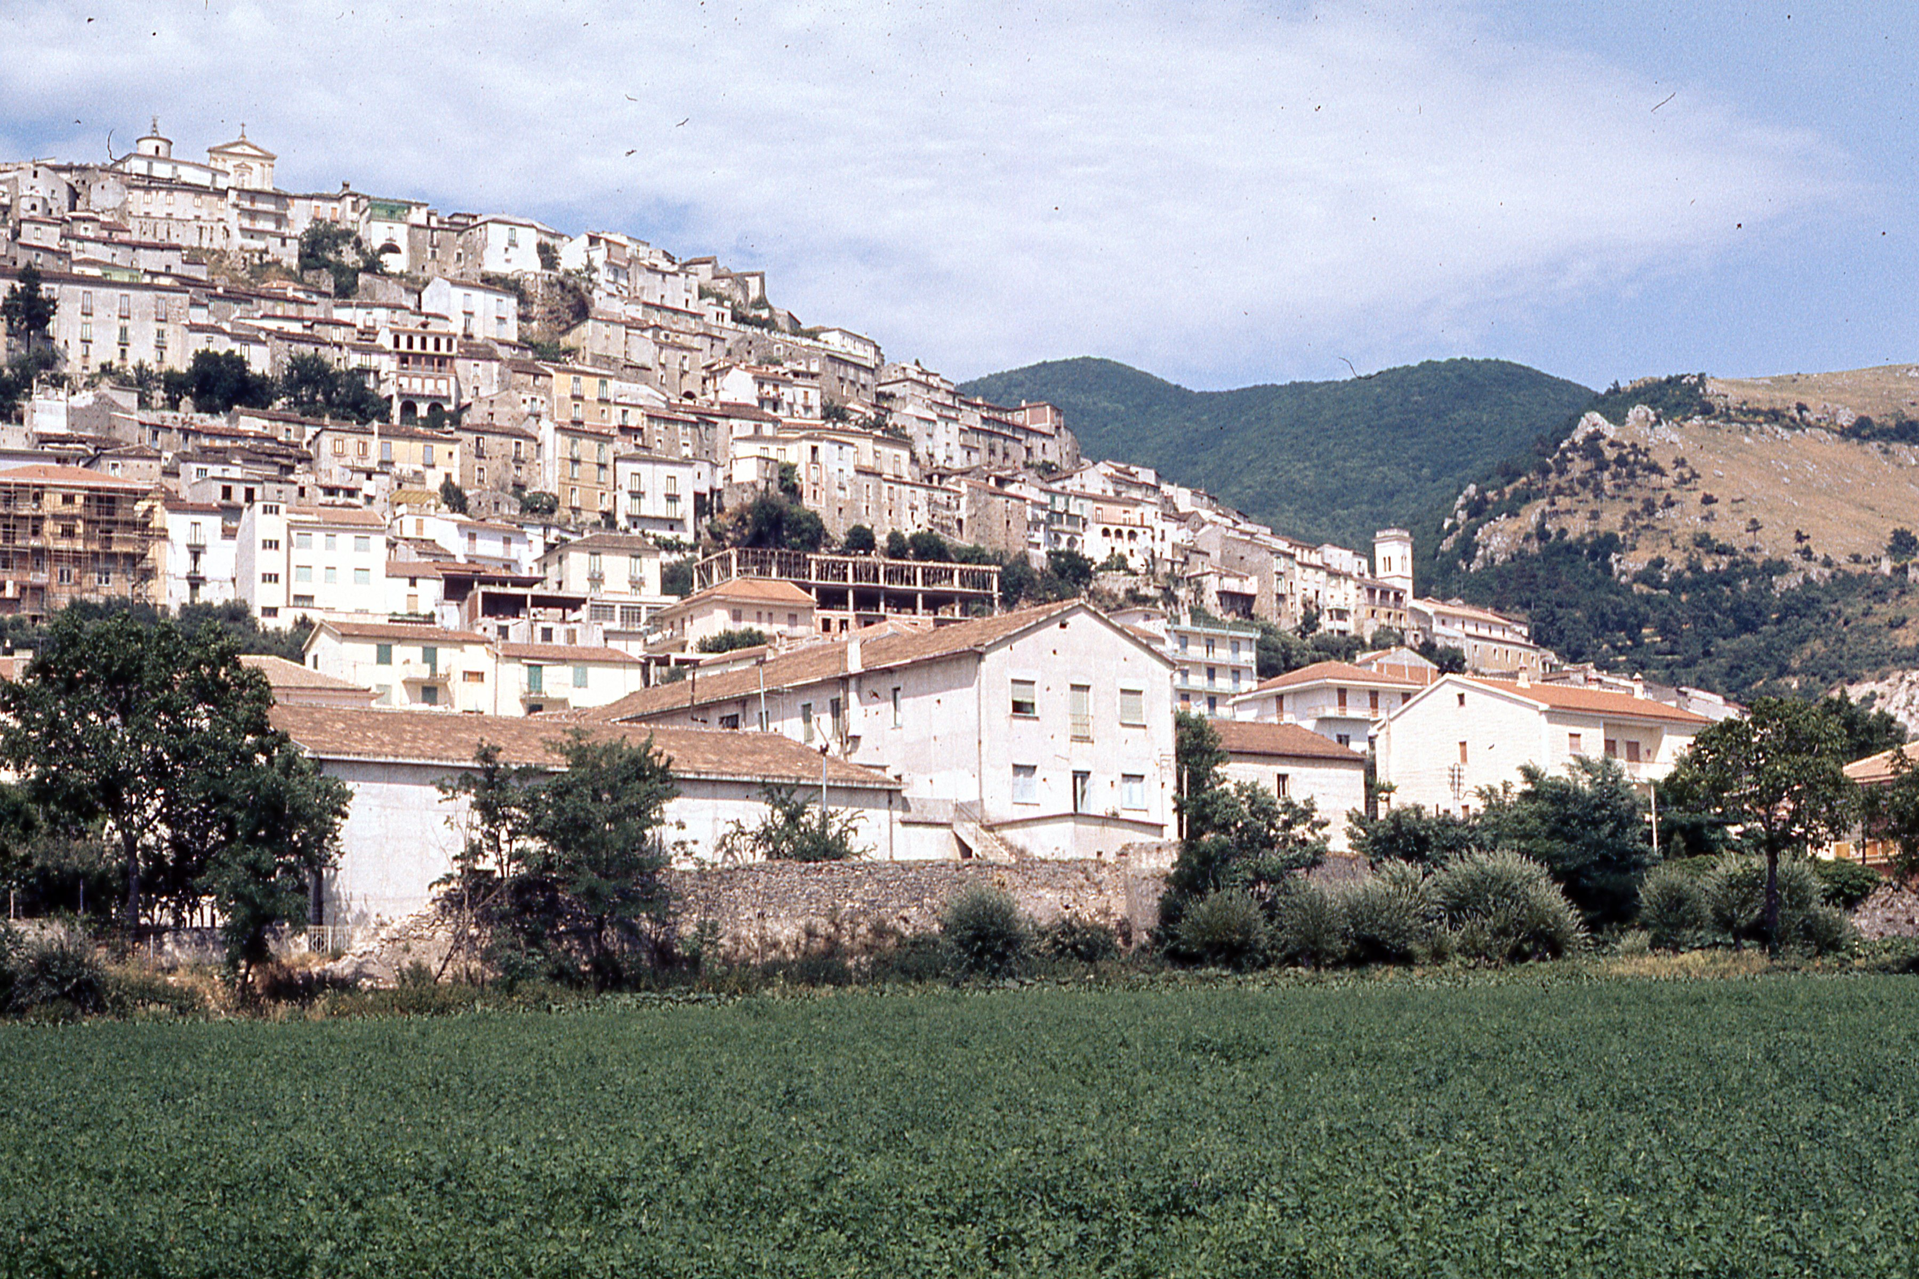
Aside from the scientific aspects of field work, de Boer believes in it as a great aid to student maturity… “…you send them out in a small group... They have time to think. They have to get along with the others. Perhaps they don’t learn so much geology, but they find out about themselves.”
From “A Change in Environment” by Alphonsus J. Mitchell, The Wesleyan University Alumnus, LXI (2), 1978, p. 17.
Notes:
The dig was headquartered at the spectacular Certosa di San Lorenzo, now a World Heritage site, located at the base of the hill town of Padula. Though the magnetometer survey wasn’t overall as useful as hoped, it was a great experience for all us students, and certainly had the maturing effects Jelle recognized when he said in an interview a few years later, “They have time to think. They have to get along with the others. Perhaps they don’t learn so much geology, but they find out about themselves.”

Slide 8
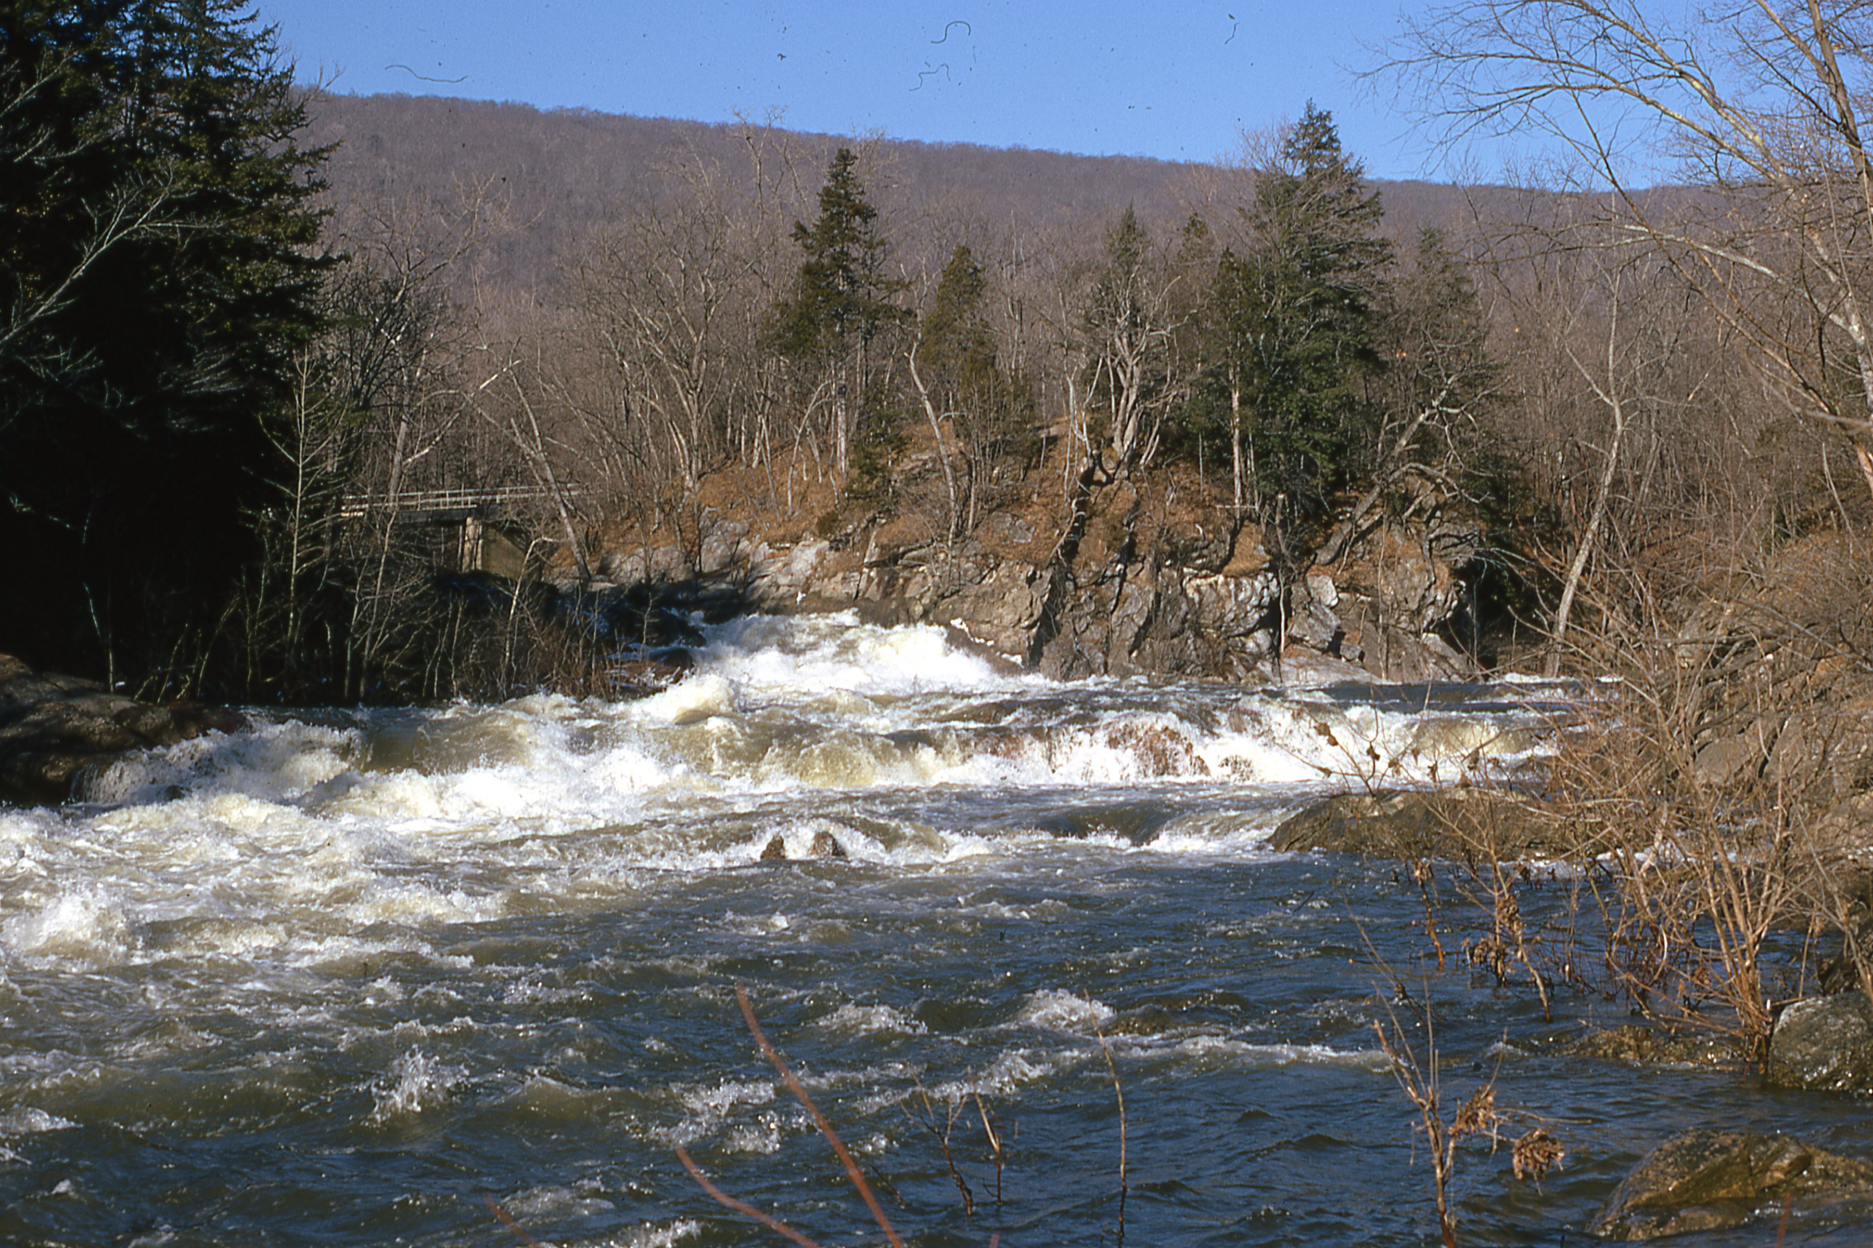
Fall 1972: semester research project on an iron furnace in western Connecticut, at Bulls Falls on the Housatonic River.
Notes:
Change of scenery! Back in Connecticut for fall semester senior year, I was looking for another geophysics-based research project. Jelle suggested that I work on an iron furnace along the Housatonic River. The high gradient of the stream provided water power for 18th and 19th century industries. And if you’ve been there when the Housatonic is flowing strong, as in this picture, you can really appreciate the power of flowing water, which provided the blast of forced air, required at a furnace.

Slide 9
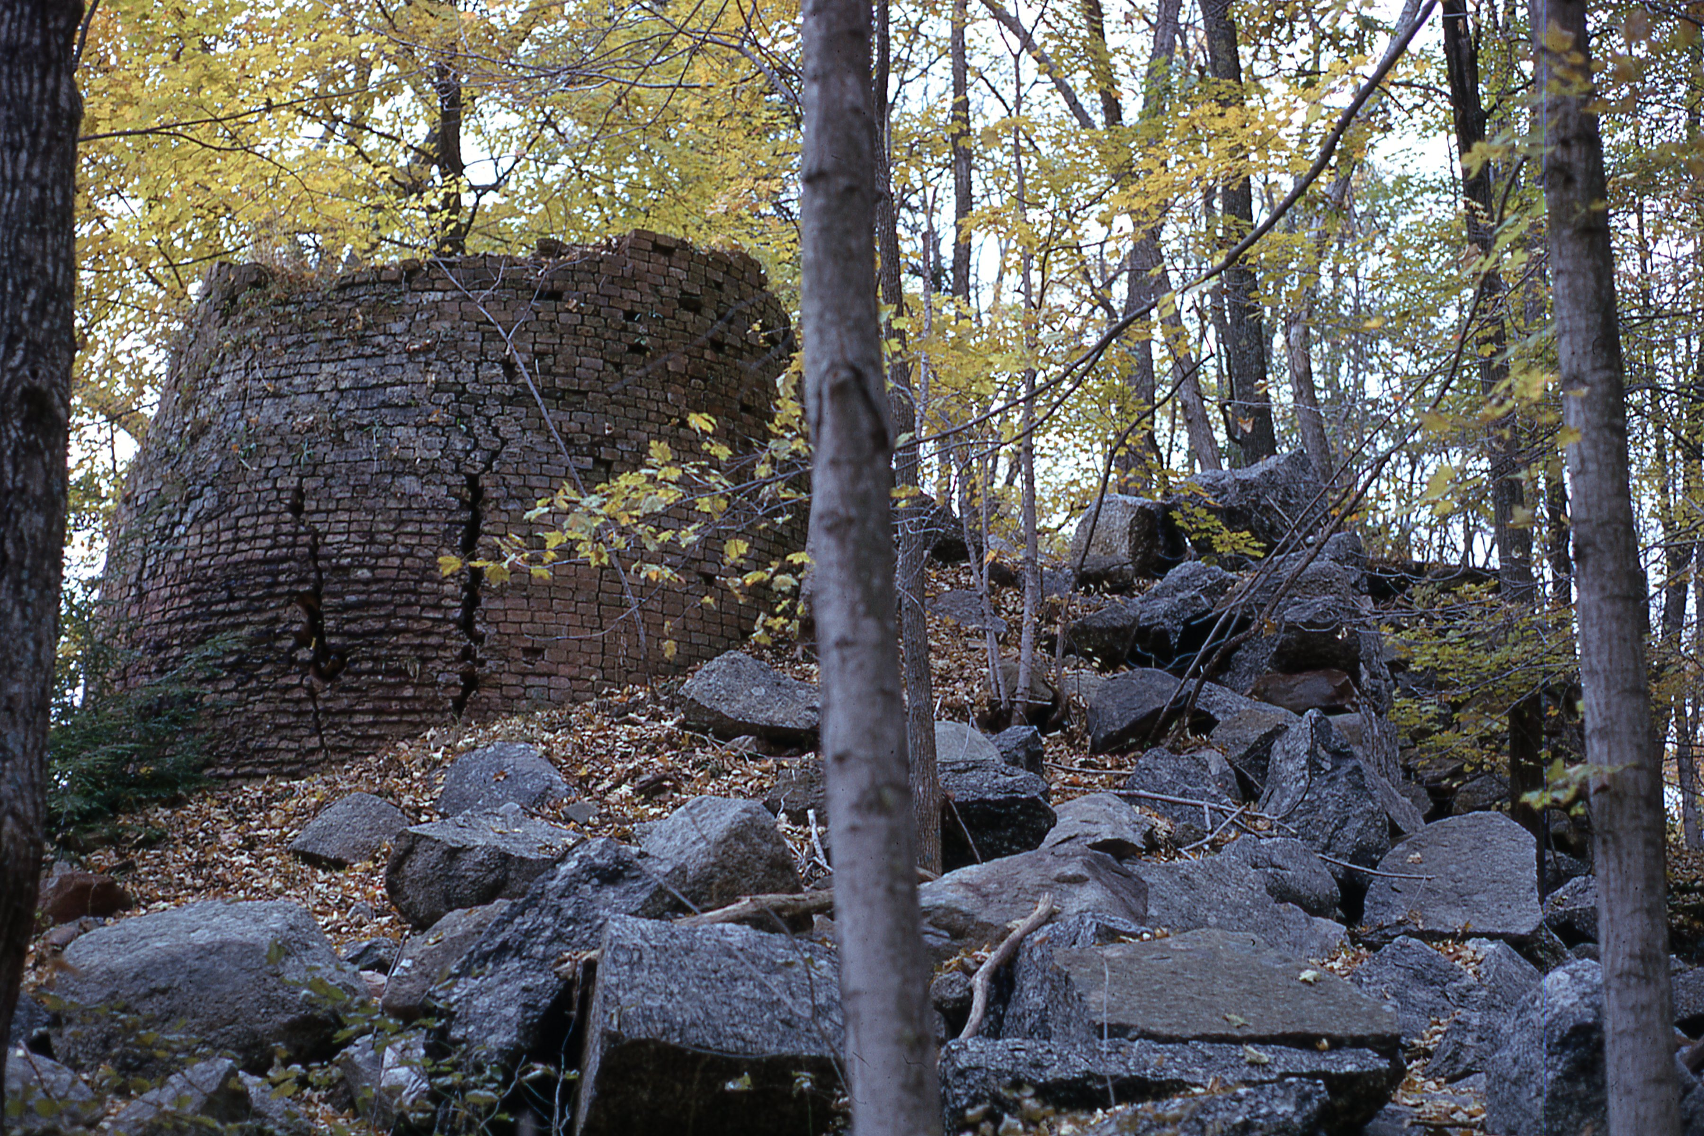
Fall 1972: semester research project with Jelle on an iron furnace in western Connecticut, at Bulls Falls: archaeomagnetism.
Notes:
Jelle proposed the idea of extracting bricks from the stack of the Bulls Falls furnace, taking cores, and using paleomagnetic techniques to determine inclination and declination paths – archaeomagnetics. These paths could then be compared with measurements of magnetic field orientation made at various times in New Haven and Albany to pin down the blast history of the furnace.

Slide 10
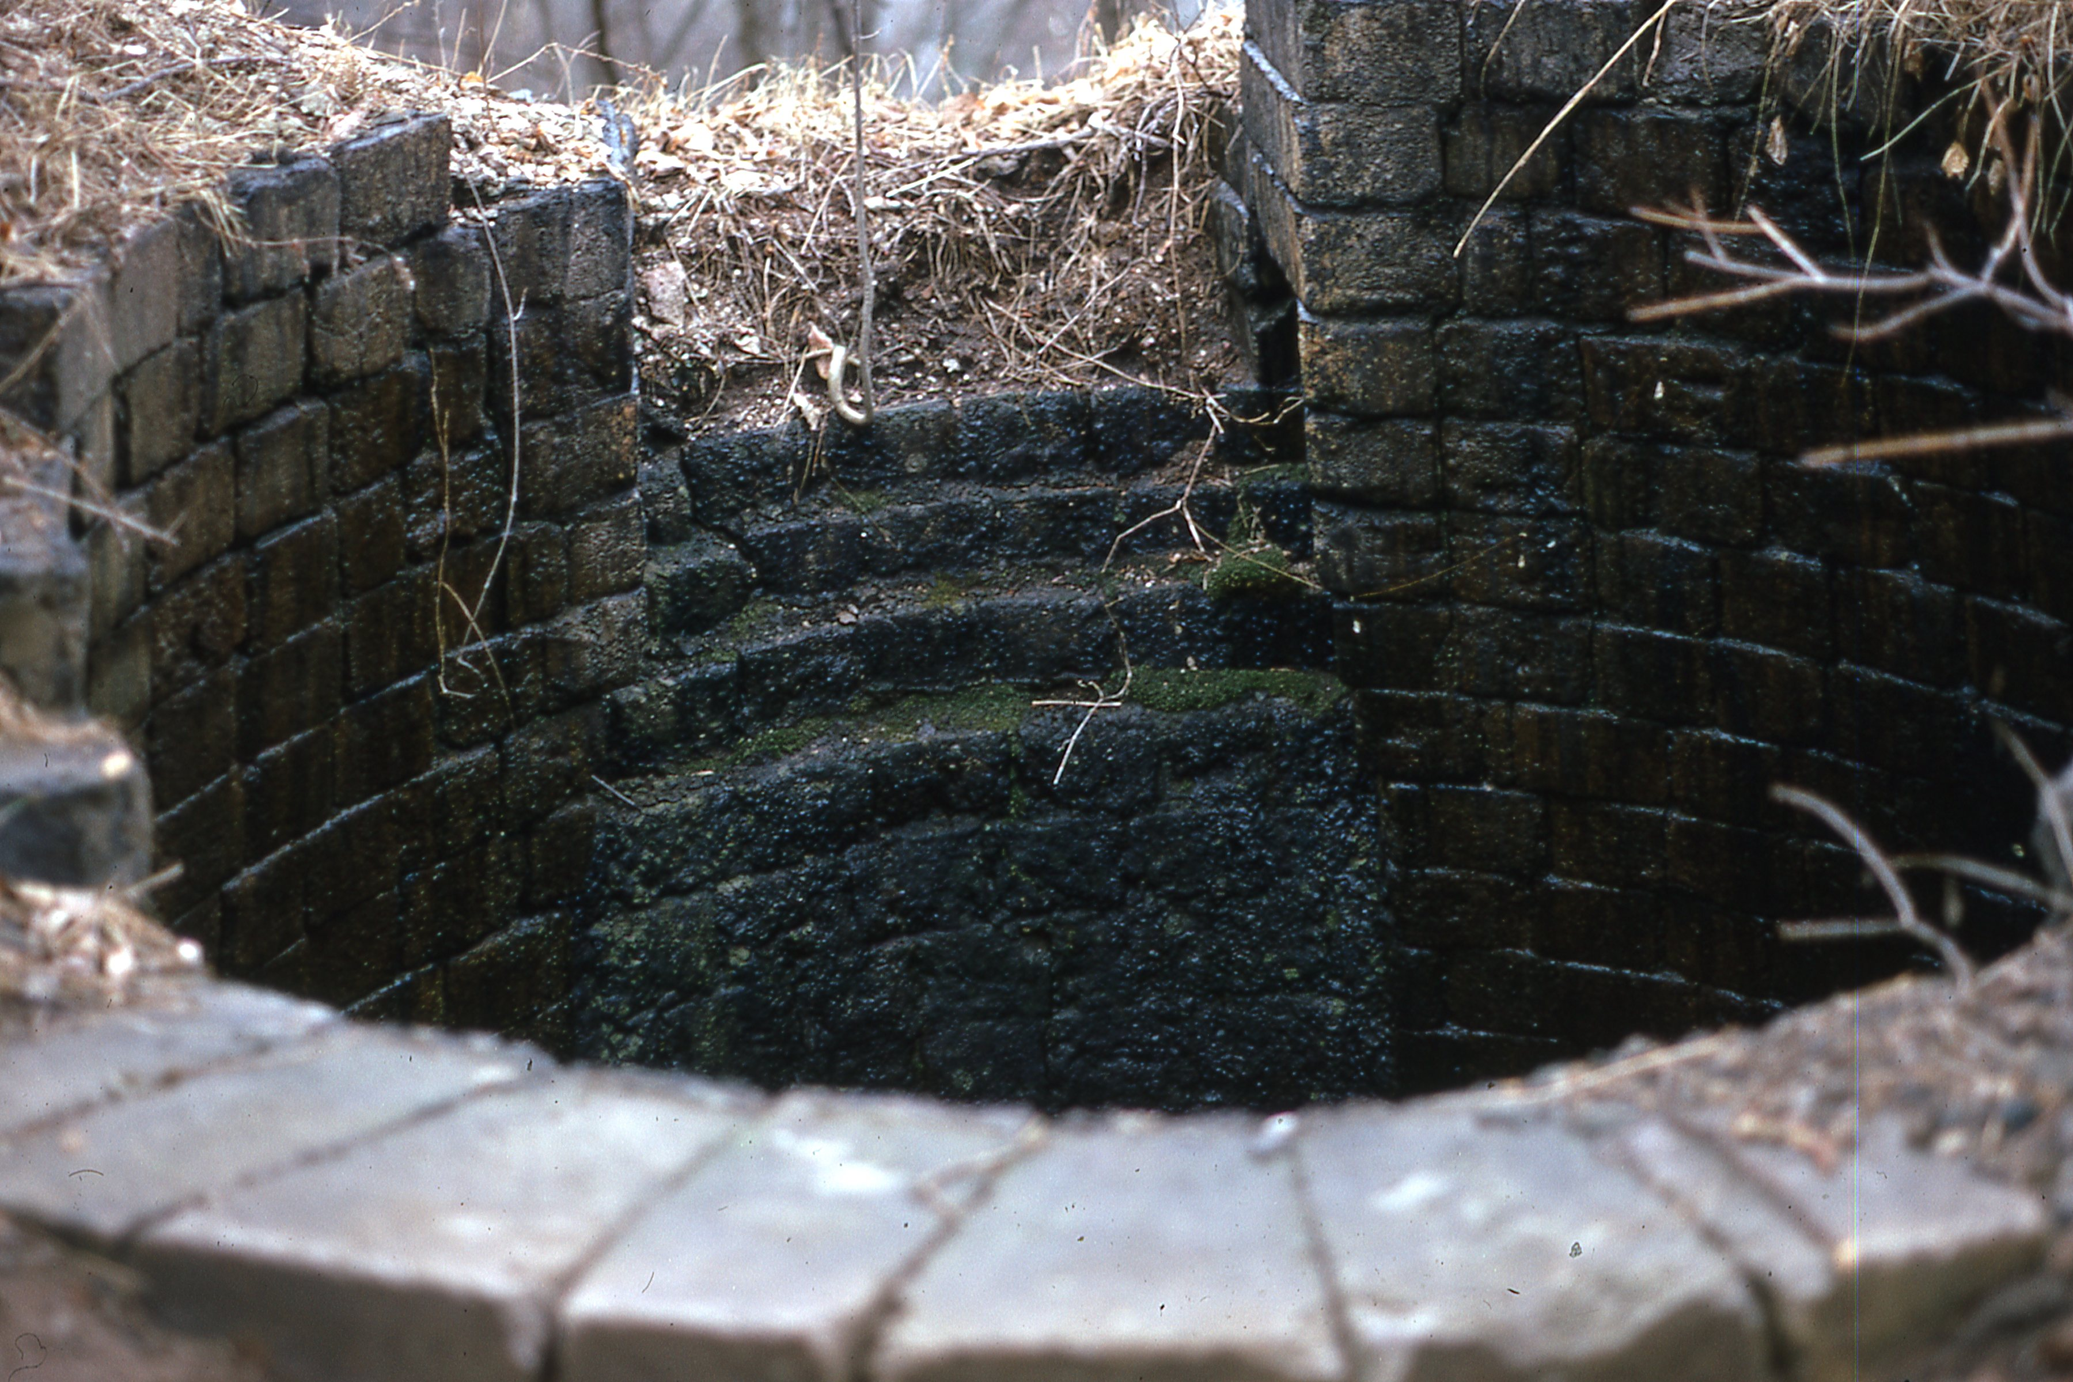
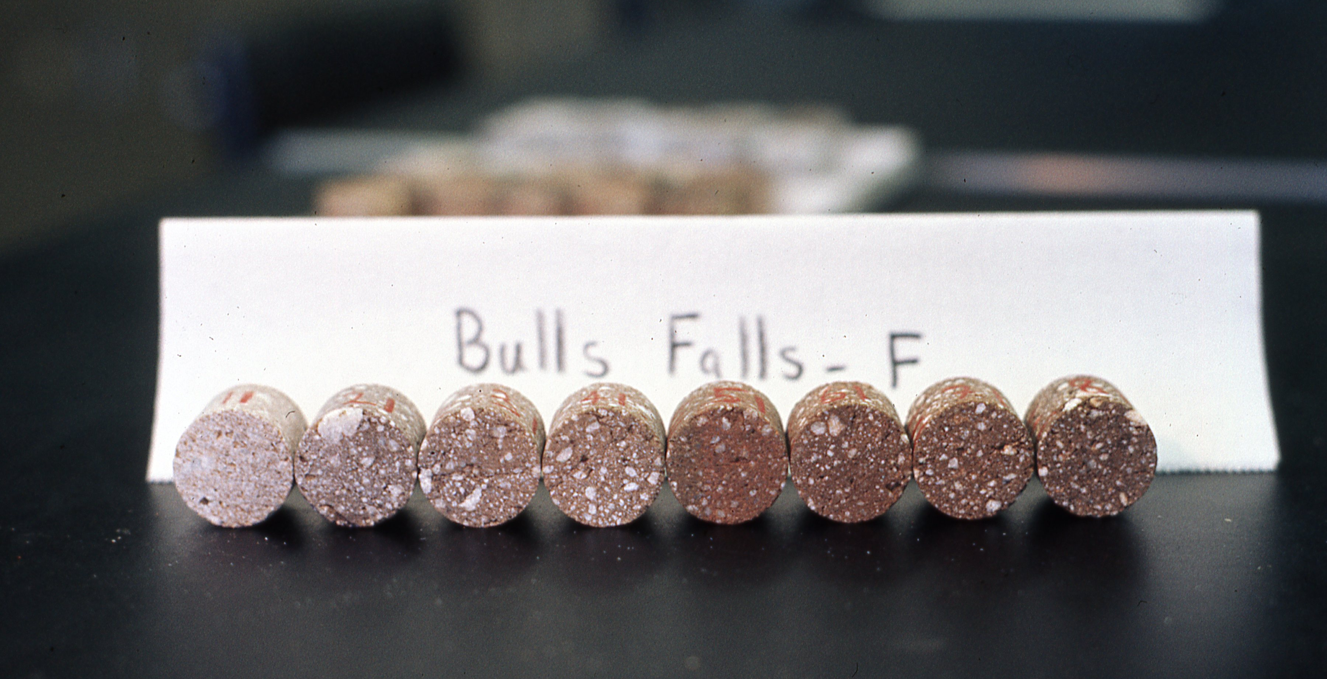
The bosh of the Bulls Falls furnace and some of the cores taken along the length of a brick.
Notes:
The project was based on the idea that the bricks in the stack, and bordering on the “bosh” or interior opening of the stack, would acquire a thermoremanence on cooling through the Curie temperature when the furnace went out of blast – ceased operation either accidently or purposely. The direction of the field at that time could be compared to inclination and declination measurements. One of the cool things we discovered was the strong gradient in oxidation state along each brick, from light gray next to the interior to a dark red-brown at the other end.

Slide 11
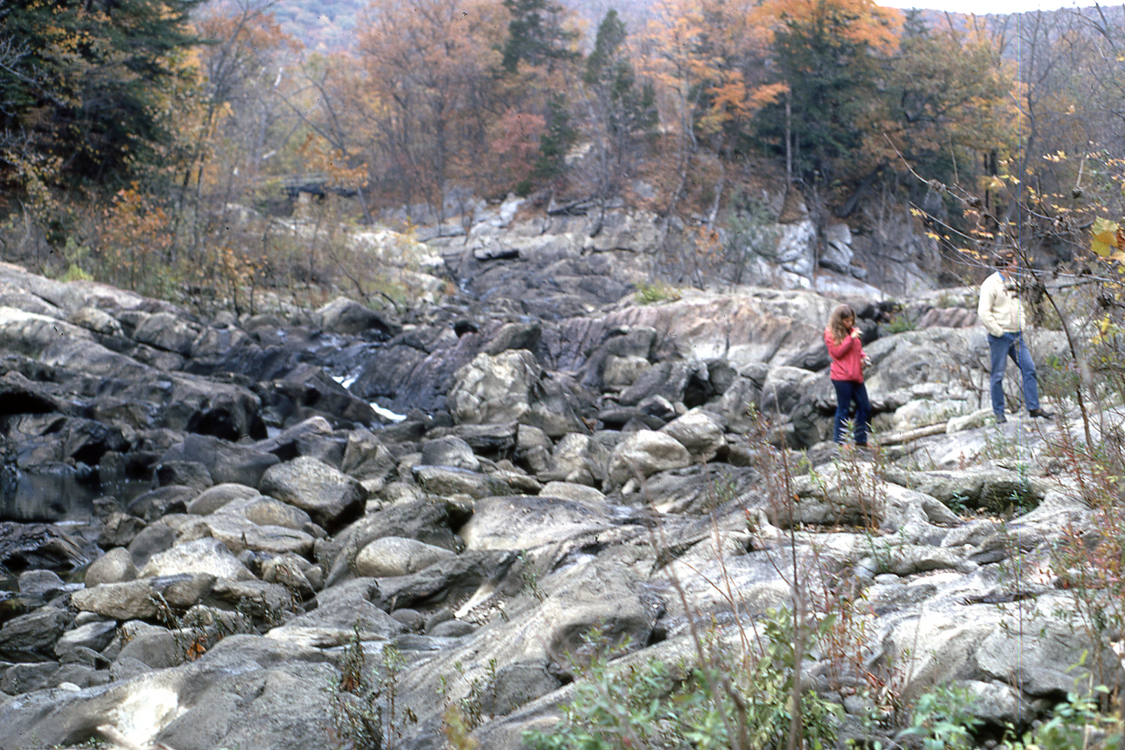
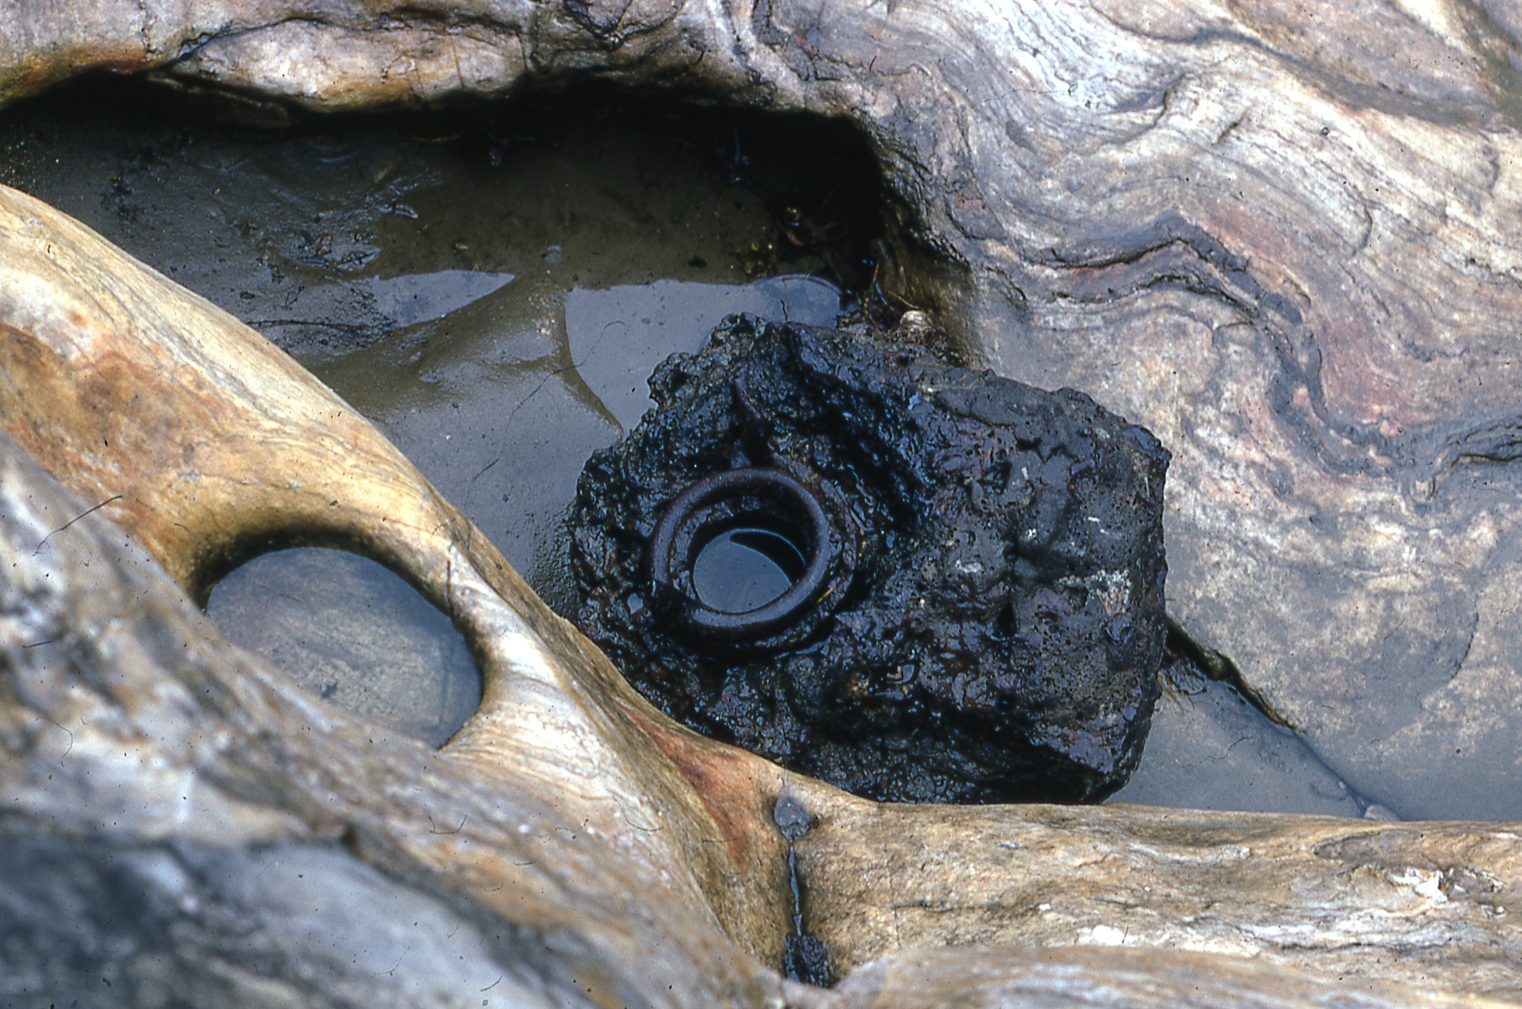
Fall 1972: Housatonic River at Bulls Falls with flow diverted.
Tuyere trapped by a salamander.
Notes:
Exploring the furnace site revealed lots of evidence relating to furnace operation. Just upstream from Bulls Falls the modern-day Housatonic still makes power when the flow of the river is diverted into a canal to create hydroelectricity. The right-hand picture shows Jelle and one of his daughters walking in the channel during one of these diversions. To 19th century minds the stream was also a perfect place to dispose of salamanders – solid masses of iron – that resulted when molten iron escaped into the furnace workings, catastrophically halting operations. This salamander shown here contains the remains of a tuyere – a water-cooled nozzle to deliver blast to the furnace. A furnace going out of blast in this way it was an economic disaster.

Slide 12
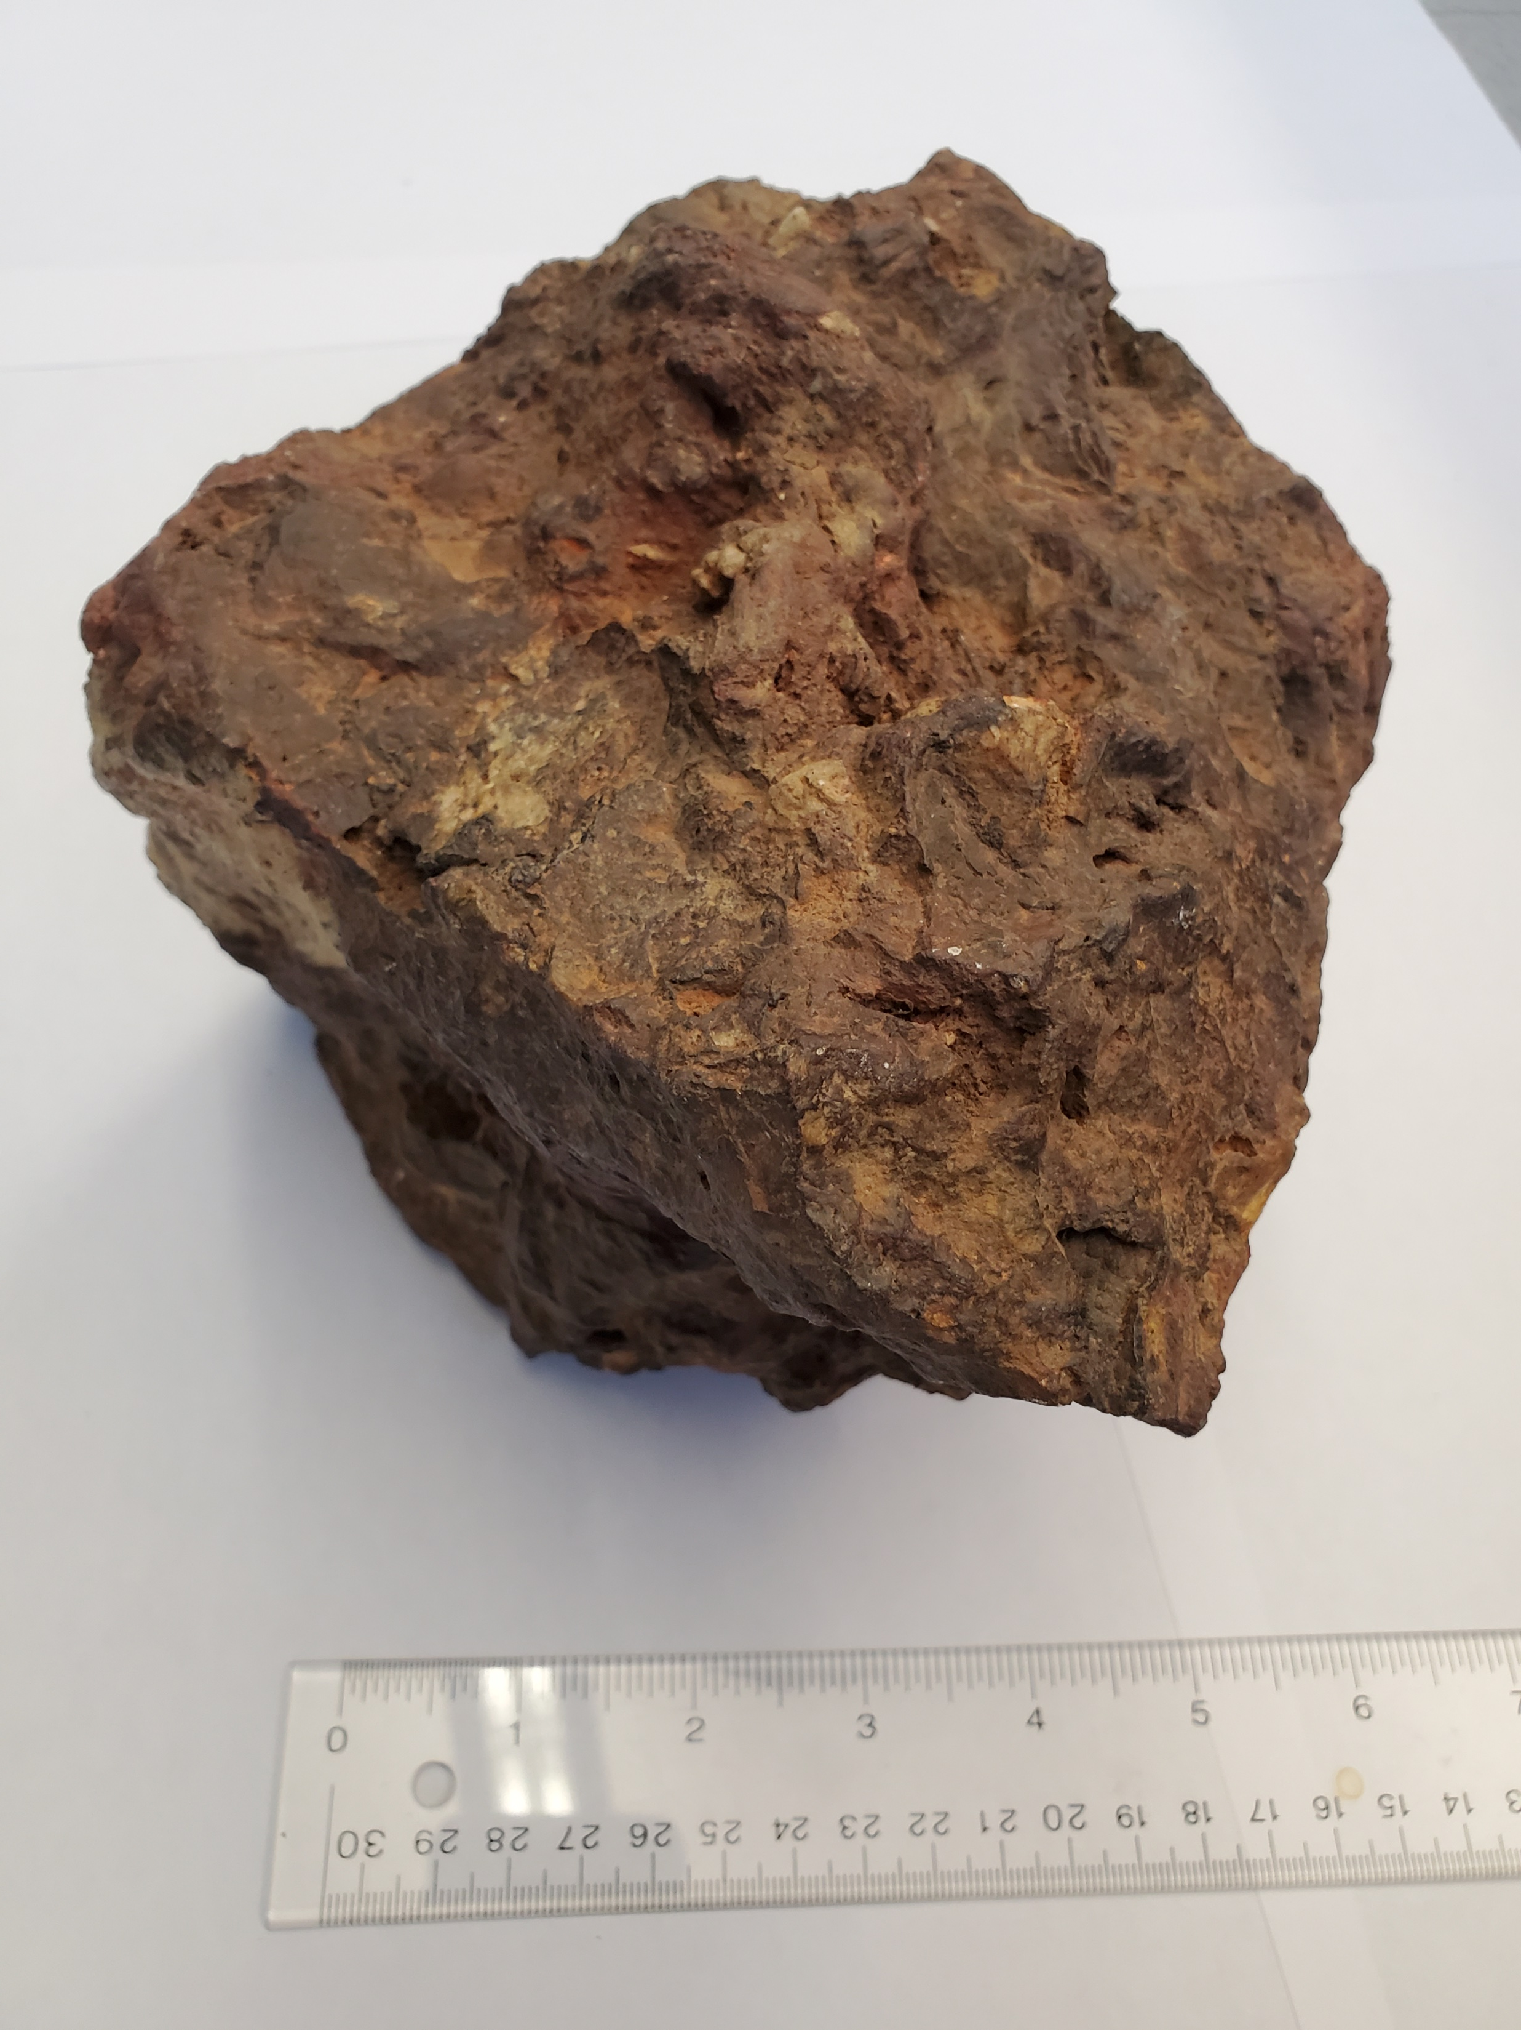
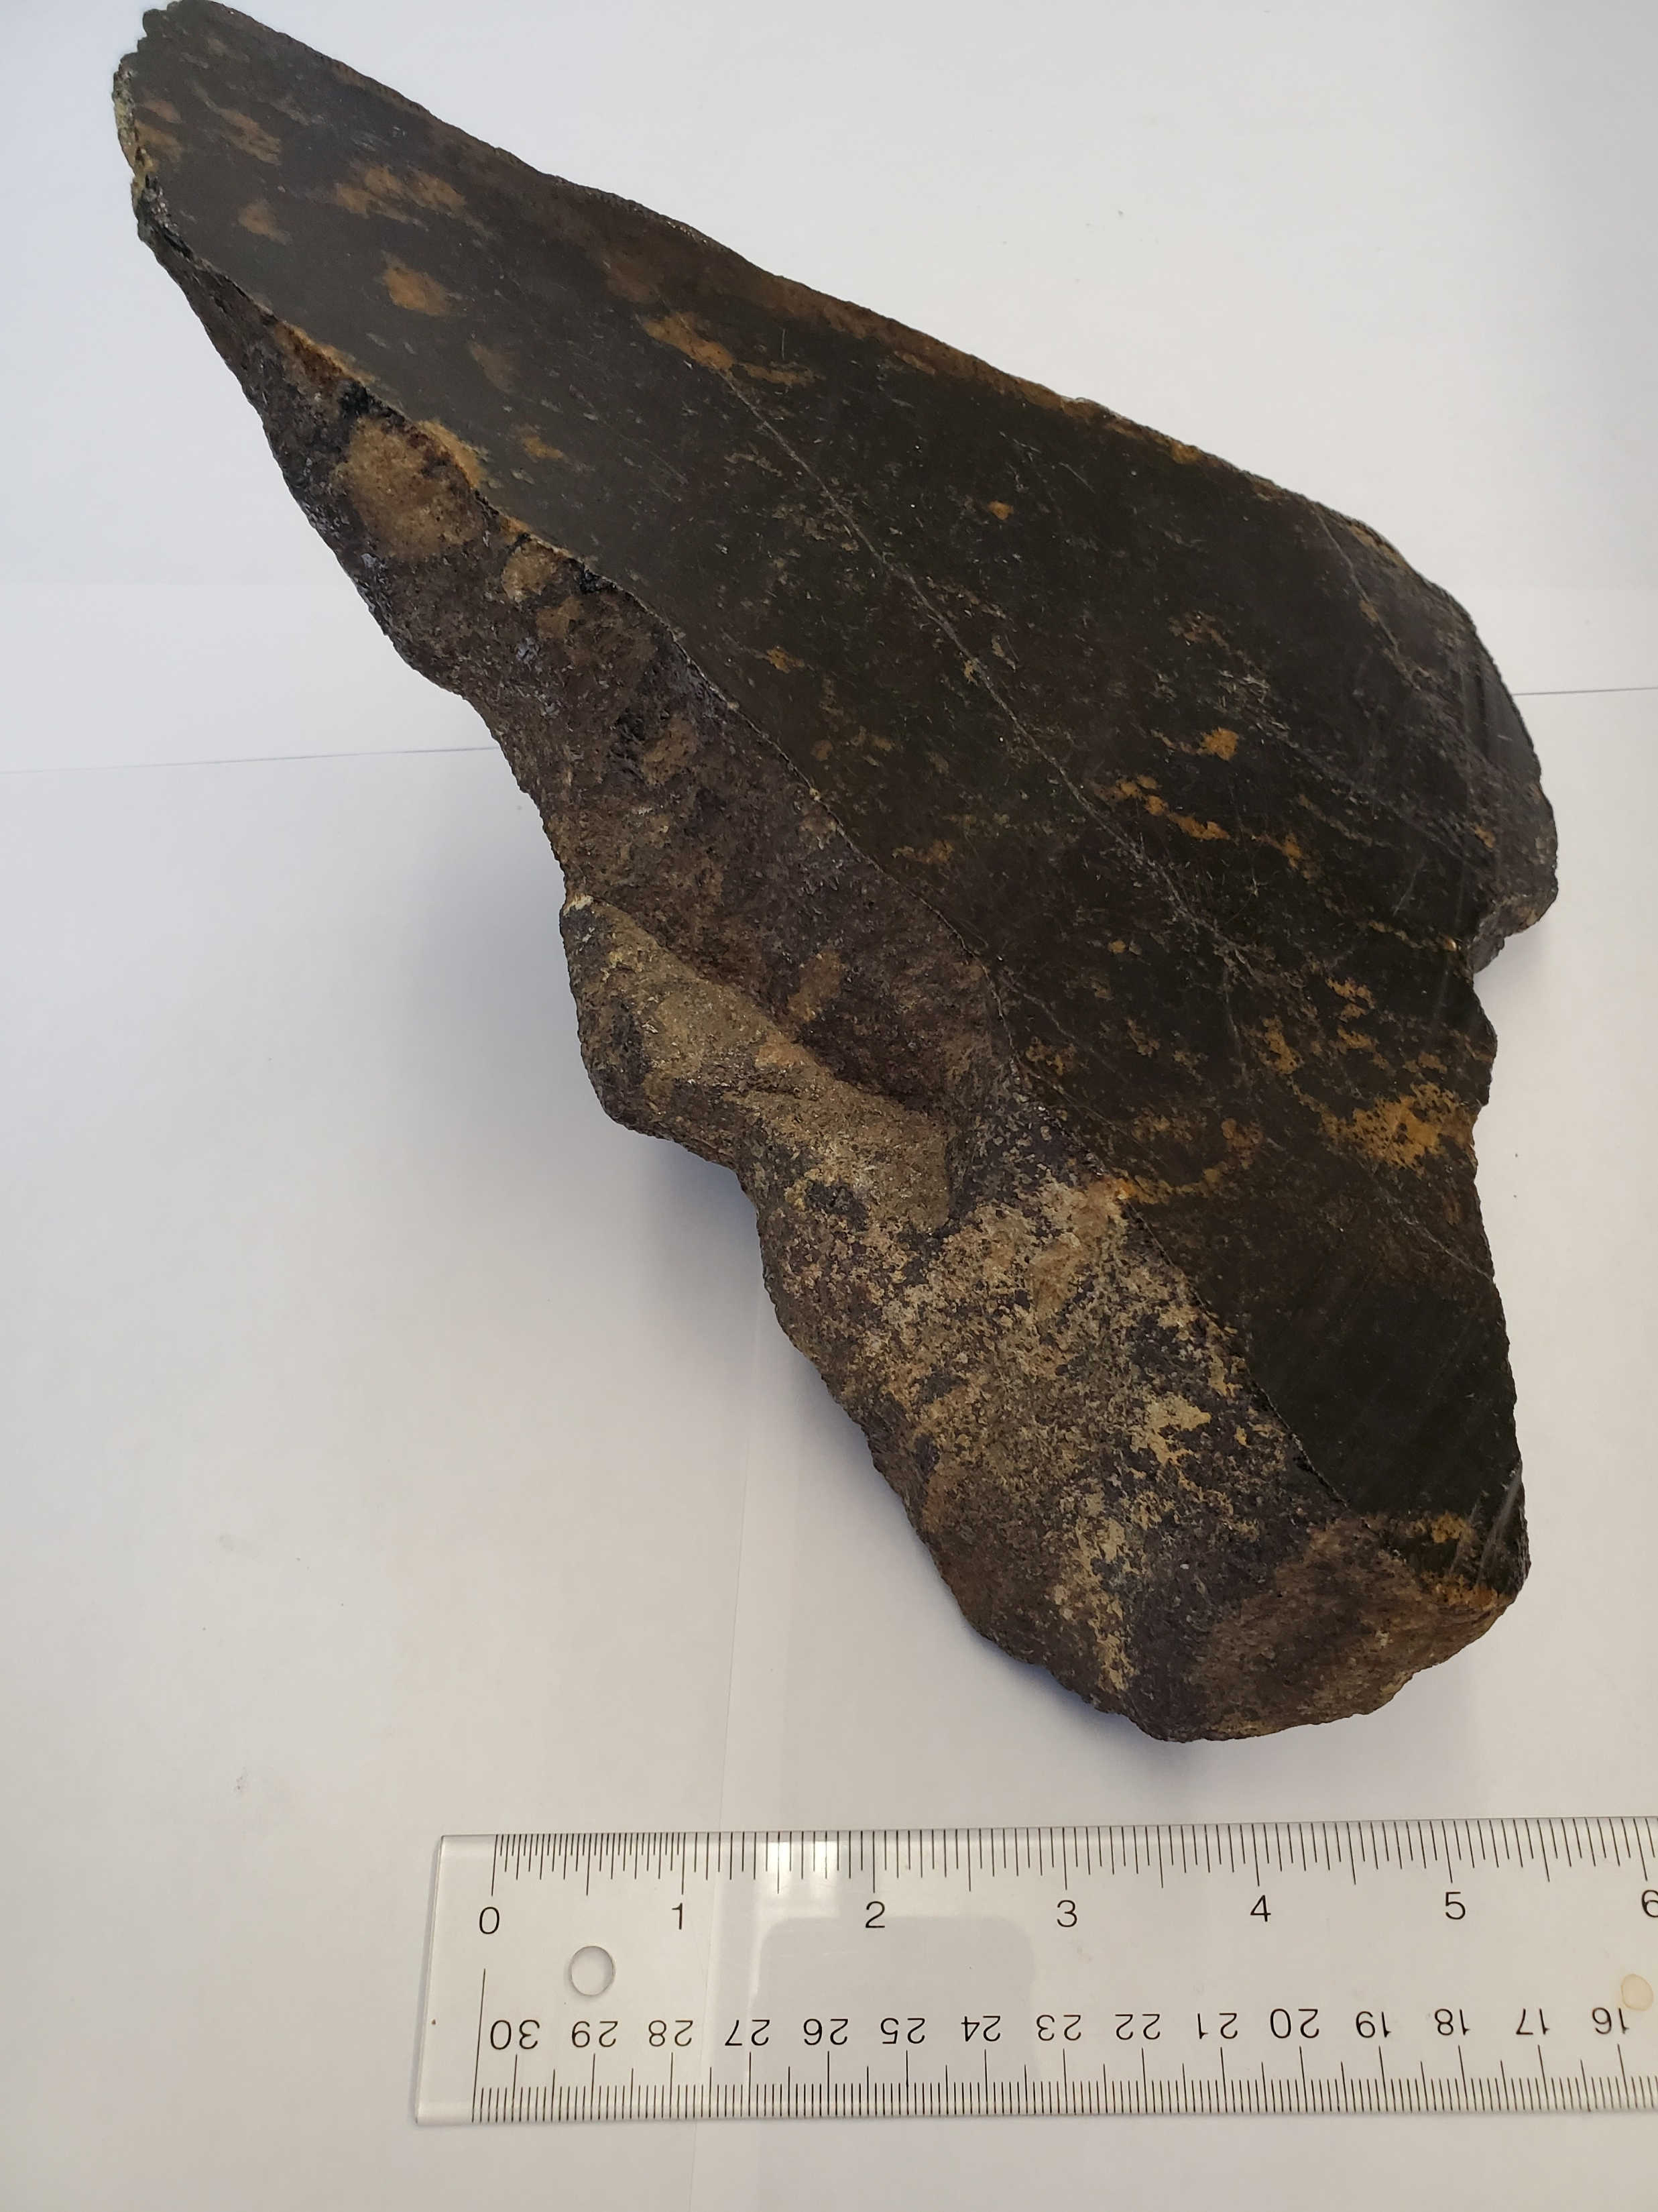
Two of the types of iron ore found at the Bulls Falls furnace.
“Bog” ore
Magnetite (∼ 95%) ore
Notes:
Other discoveries, around the furnace’s loading bank, included various types of ore. Bog ore was common locally; magnetite-rich ore would have required longer transportation; and using it would have required significant changes to the blast technology. Optical and x-ray analyses of minerals in the ore suggested that it might have originated in the Tilly Foster mine near Brewster, NY, 25 miles by road from Bulls Falls.

Slide 13
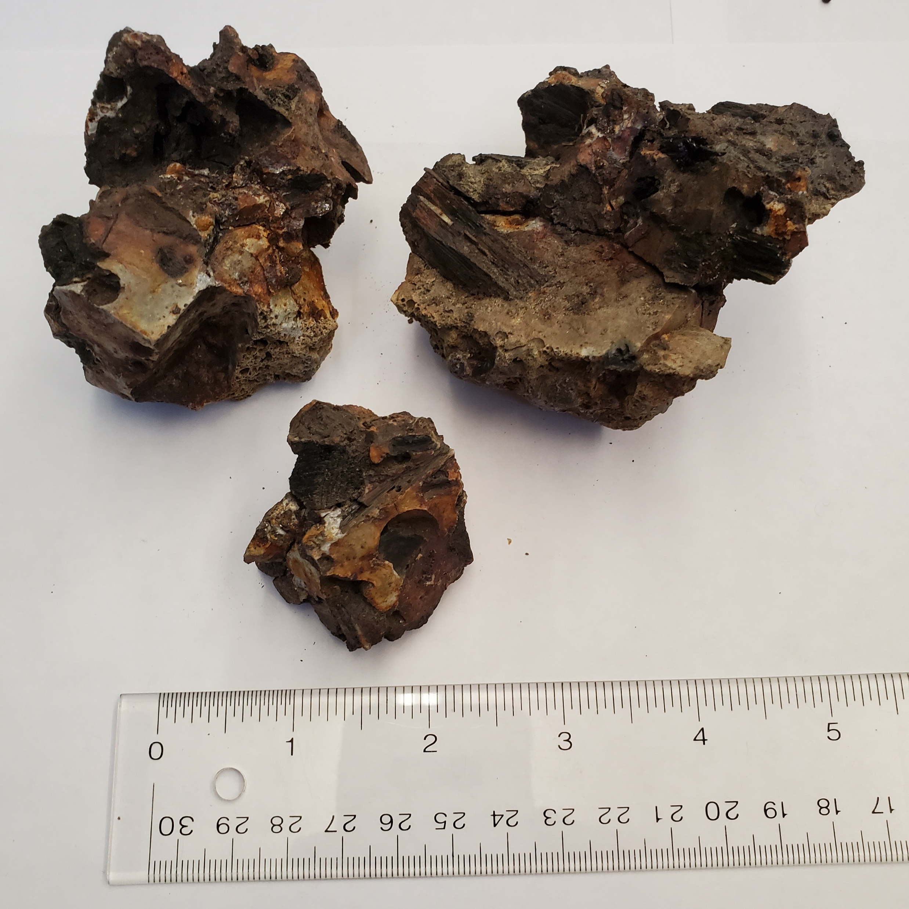
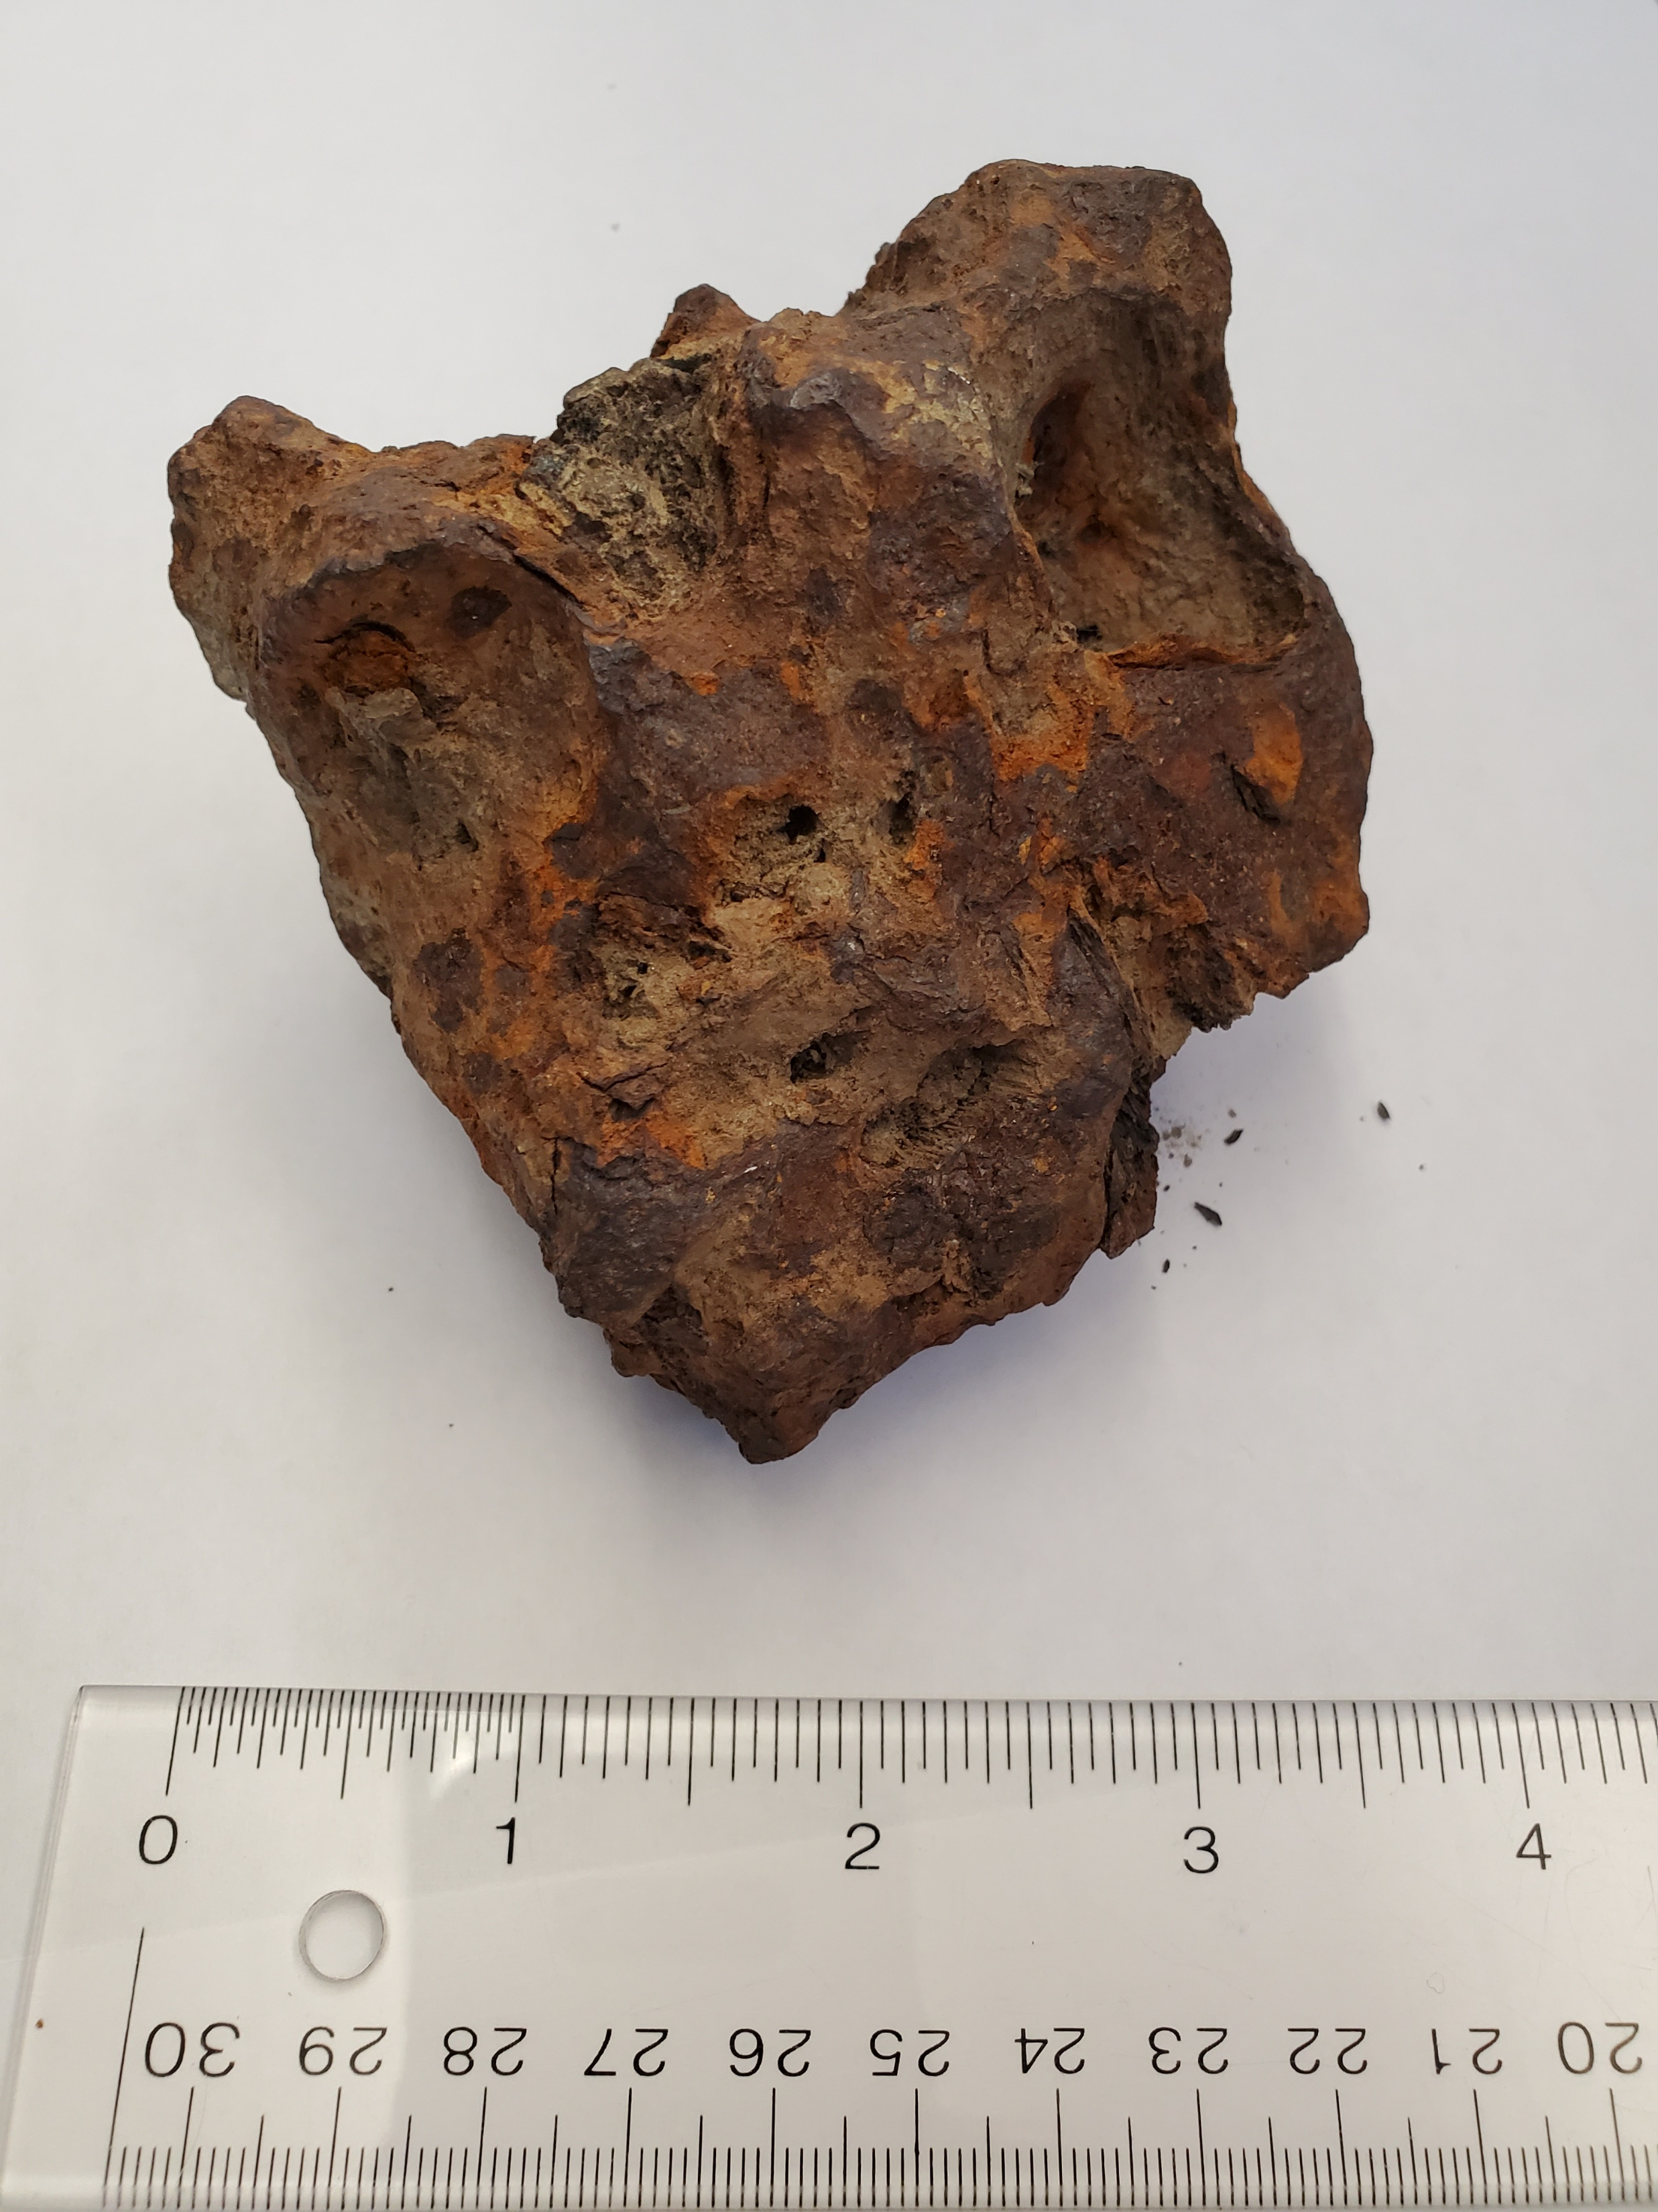
Slag contains chunks of two fuels: charcoal & anthracite.
Iron-rich slag
Notes:
Slag from the site contained evidence for two different fuels: charcoal, made locally, and anthracite from Pennsylvania. Such finds suggested all kinds of connections to the geography and economics of ores and fuels, the development of furnace technologies, the history of the Bulls Falls and of the iron industry in New England, and to the methods of historical and industrial archaeology.

Slide 14
The introduction to my 1973 Honors thesis, “The Bulls Falls Iron Furnace: An Archaeological Reconnaissance” explains the transformation of
“…an archaeomagnetic study of brick samples taken from the Bulls Fall Furnace…”
in fall 1972 to a thesis by spring 1973:
“…it became apparent to the author, and to his advisor, Jelle de Boer,… that there was a lot more of interest at Bulls Falls than the bricks.”
Notes:
My one semester project turned into an Honors thesis as the scope of my research expanded from a project on a few bricks into a story that extended through many dimensions of 19th century life. Jelle connected me to a local historian in Kent, CT, Mrs. Albert Jack, who provide additional historical background. Other Wesleyan students helped me with various aspects of the field work. Susan Soule helped with plane table mapping; Kat Hoff with photography. With 21st century eyes, I can see the progress of my thesis research as a transdisciplinary journey, based on following the story of the furnace, using all the perspectives from the disciplines that were needed to keep the story going. This was a turn toward a type of thinking that later blossomed into a transdisciplinary approach to teaching and research.

Slide 15
Thesis complete, I graduated from Wesleyan in 1973!
1978 – Ph.D. from University of Pennsylvania
1979 – postdoc at the Geological Museum in Oslo, Norway
1980-1989 – lecturer and assistant professor, UPenn
1989-1991 – adjunct professor, Ohio Wesleyan University
1991-June 2021 – professor at West Chester University
Notes:
With mentoring and supervision from Jelle, geology professor Jim Gutmann, and archeologist Steve Dyson I completed my thesis. After a few further flirtations with archaeology, [Click] I followed what, when reduced to a few lines, looks like a pretty standard path through an academic career. The announcement of this symposium encouraged me to look back along this path. It brought to full consciousness something I have felt for a long time… the profound influence that Jelle and those few years at Wesleyan had on my life.

Slide 16
Looking back, what did I learn from Jelle de Boer?
1. Patterns in orientation and space (n =2, 3); multivariate statistics (n > 3)
T. Lutz & K. Foland, 1978, Meridional pattern of the oceanic rift system, Geology
T. Lutz & J. Gutmann, 1995, An improved method for determining and characterizing alignments of pointlike features and its implications for the Pinacate volcanic field, Sonora, Mexico, JGR
L. Srogi & T. Lutz, 1990, Three-dimensional morphologies of metasedimentary and mafic enclaves from Ascutney Mountain, Vermont, JGR
T. Lutz, 1991, Trace element and isotopic zoning in minerals: Models of compositional fractionation by mineral separation, Lithos
T. Lutz & G. Boyajian, 1995, An analysis of the fractal geometry of ammonoid sutures, Paleobiology
Notes:
I have to remember that what I learned from Jelle is probably not entirely equivalent to what he was trying to teach me!
The first point I’ll make is the importance of developing familiarity with spherical statistics – basically a specialized form of multivariate statistics. You couldn’t be a paleomagician without it! Statistics are often used to hedge in a result by finding the confidence with which it is known. I learned that data didn’t have to lead to a simple, bounded answer; the recognition of patterns is significant in itself. My first paper as a grad student was a straightforward application of spherical statistics to suggest a symmetrical distribution of tectonic boundaries, a pattern in their organization. [Click]
Developing methods to analyze point patterns was special because I got to collaborate with Wes professor Jim Gutmann on the Pinacate volcanic field. [Click]
Other spatial projects included diverse subjects such as the morphologies of mafic enclaves, the comminution – or breakage – of zoned minerals, and the fractal geometry of ammonite sutures.

Slide 17
Looking back, what did I learn from Jelle de Boer?
1. Patterns in orientation and space (n =2, 3); multivariate statistics (n > 3)
T. Lutz & G. Omar, 1991, An inverse method of modeling thermal histories from apatite fission-track data, EPSL
L. Srogi & T. Lutz, 1996, The role of residual melt migration in producing compositional diversity in a suite of granitic rocks, EPSL
M.D. Dyar et al., 1998, Inclusive chemical characterization of tourmaline: Mössbauer study of Fe valence and site occupancy, American Mineralogist
K.V. Willis et al., 2017, Phase composition maps integrate mineral compositions with rock textures from the micro-meter to the thin section scale: Computers and Geosciences
Notes:
Extending my interests to more conventional multivariate methods led to projects in thermochronology, igneous petrology, and mineral chemistry. Collaboration with other researchers was essential for such work, which covered many different geological specialties.

Slide 18
What did I learn from Jelle de Boer?
2. Entertain outrageous hypotheses.
T. Lutz, 1985, The magnetic reversal record is not periodic, Nature
T. Lutz, 1987, Limitations to the statistical analysis of episodic and periodic models of geologic time series, Geology
T. Lutz & G.S. Watson, 1988, Effects of long-term variation on the frequency spectrum of the geomagnetic reversal record, Nature
Notes:
I remember hearing Jelle talking to grad students in the Judd Hall geology library about the wild ideas of the day, mantle convection making plates move, the role of Milankovich cycles in changing climate. Jelle never shied away from considering outrageous hypotheses but he also understood that they need to be rigorously and skeptically investigated. He followed this approach himself in addressing the archaeological controversy over the Oracle at Delphi. I found myself in this role when periodicity theories were proposed to explain the timing of mass extinctions, large volcanic eruptions, and fluctuations in the frequency of magnetic reversals, by pointing out the actual weakness of the data to support the hypothesis.
Sagan’s dictum: extraordinary claims require extraordinary proof. “Unconventional ideas and outrageous hypotheses” – Warren Hamilton session at GSA in 2019. William Davis, 1926, “The value of outrageous geological hypotheses,” Science 63(1636), 463-468.

Slide 19
What did I learn from Jelle de Boer?
3. Transdisciplinary research
See previous slides.
Notes:
With Jelle’s guidance my Honors thesis allowed me to move from the magnetics of bricks to geography, economics, history, technology, industrial archaeology – and gave me an intuitive understanding of a concept central to transdisciplinary thought and complex systems: that every boundary we draw between one thing and another is an opportunity for both separation and connection. [Click]
This is clear to me when I consider what we’ve seen in the previous few slides on research. Perhaps one of the most common questions we’re asked at meetings is, “What’s your specialty?” I’ve given up trying to answer that one except to say, “My specialty is generalization.” I think Jelle might have liked this answer!

Slide 20
What did I learn from Jelle de Boer?
3. Transdisciplinary research
See previous slides.
4. Transdisciplinary teaching and complexity thinking
ESS 102 – Humans and the Environment
Transdisciplinary – study defined by relations, not by disciplines, but which may rely on disciplinary knowledge
Complexity thinking – thought processes aligned with the dynamic relationship between natural complexity and human need for simplicity and certainty
Boundaries (e.g., disciplines) separate and connect
Living sustainably is a balance between complexity and simplicity.
Notes:
At West Chester University the focus of my “job” changed from researcher to teacher. One of my first courses at WCU, one I’ve been teaching for nearly twenty-five years, is Humans and the Environment, an introductory, interdisciplinary course. Taken seriously, the purpose of this course is for students to develop a capacity to live sustainably. This is a transdisciplinary goal, far broader than can be informed by any single discipline or set of disciplines. [Click] The complexity of the natural world and its patterns of sustainable existence are vital… But we also need to bring these patterns into our thought processes. Though at the 100-level, Humans and the Environment is not a large lecture course; it’s been run in sections no larger than 32 and is oriented toward small and large group discussion. Over a career, that amounts to over 4,000 students.

Slide 21
What did I learn from Jelle de Boer?
4. Transdisciplinary teaching and complexity thinking
T. Lutz & L. Srogi, 2010, A values framework for students to develop thoughtful attitudes about citizenship and stewardship, Journal of Geoscience Education
S. Burian et al., 2015, Integrating Geoscience into Education about Environment, Society, and Sustainability Using Place-Based Learning: Three Examples: Journal of Environmental Studies and Sciences
T. Lutz, 2021, Adventuring into complexity by exploring data: From complicity to sustainability, Northeast Journal of Complex Systems
Notes:
As I’ve found my own way through these new ideas I’m trying to write about them in academic journals. I’m not sure what Jelle would have made of trandisciplinarity and complexity… but looking at his books – Volcanoes in human history, Earthquakes in human history, Stories in stone, and New Haven’s sentinels I think he would have appreciated the concepts because he was starting on a similar path.
Aside from this intellectual take on Jelle’s influence, I am most appreciative of the qualities he shared with me and others fifty years ago; his enthusiasm, generosity and imagination. And I only hope I brought these qualities to my students as successfully as Jelle did. I’ve been so impressed at how similar ideas have been expressed throughout this symposium by other students of Jelle’s. Thank you all!

