Slide 1
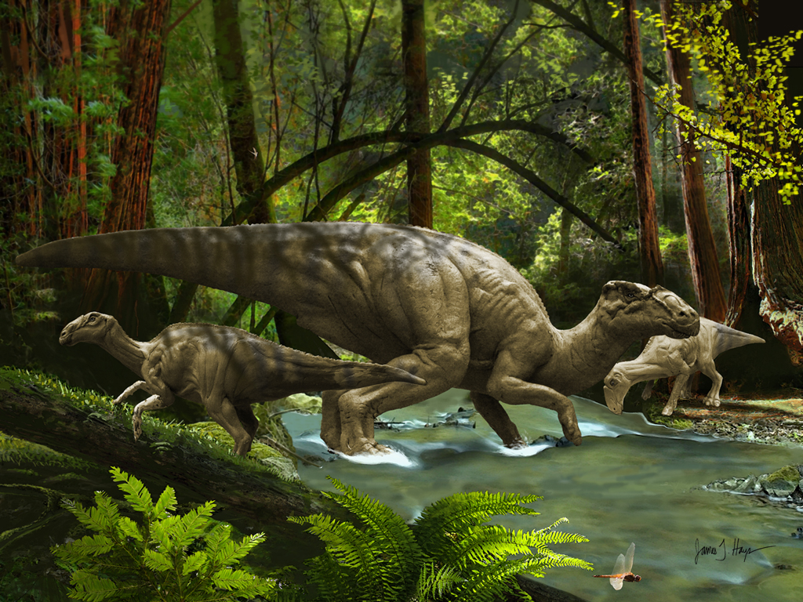

Current synopsis of Late Cretaceous non-avian dinosaur diversity in the Southeast
David Schwimmer
Department of Earth
and Space Sciences

Slide 2
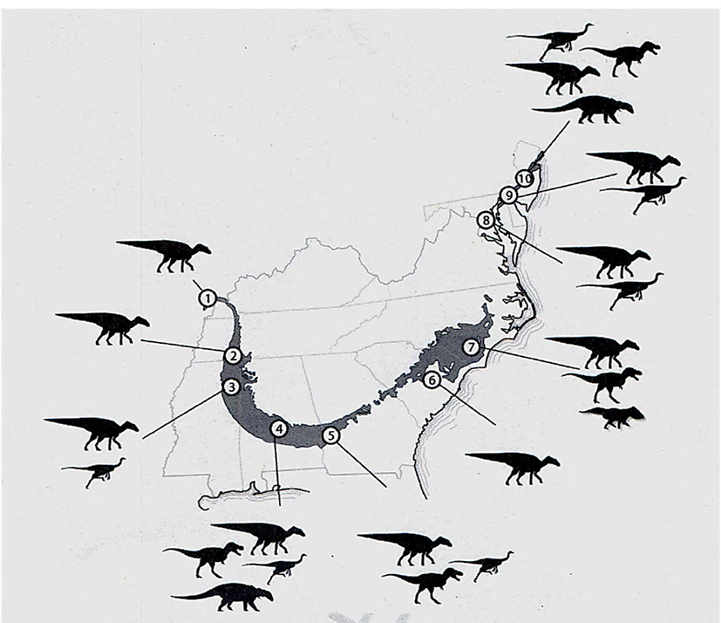
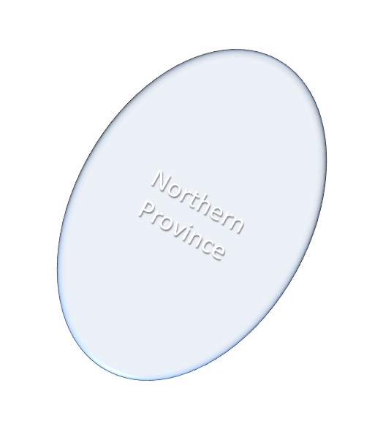
Southern Province
From Longrich, 2015, Schwimmer, 1997

Slide 3
Chronology of systematic reports of dinosaurs in Southeastern
USA, prior to ~ 1990
AL: Lophorhothon atopus (Hadrosauridae)
Theropoda (“Carnosauria”) indet.
Ornithomimosauria indet.
Nodosauridae indet,
Mooreville Fm. , Santonian-Campanian, Langston, Jr. 1960
MS: Hadrosauridae, indet., Mc Shan Fm., Santonian Kaye and Russell, 1973
NC: Theropoda (Albertosaurus?)
Hadrosauridae indet.
Hypsibema crassicaudata (Harosauroidea?)
Black Creek Fm., Miller, 1966; Baird and Horner, 1979

Slide 4
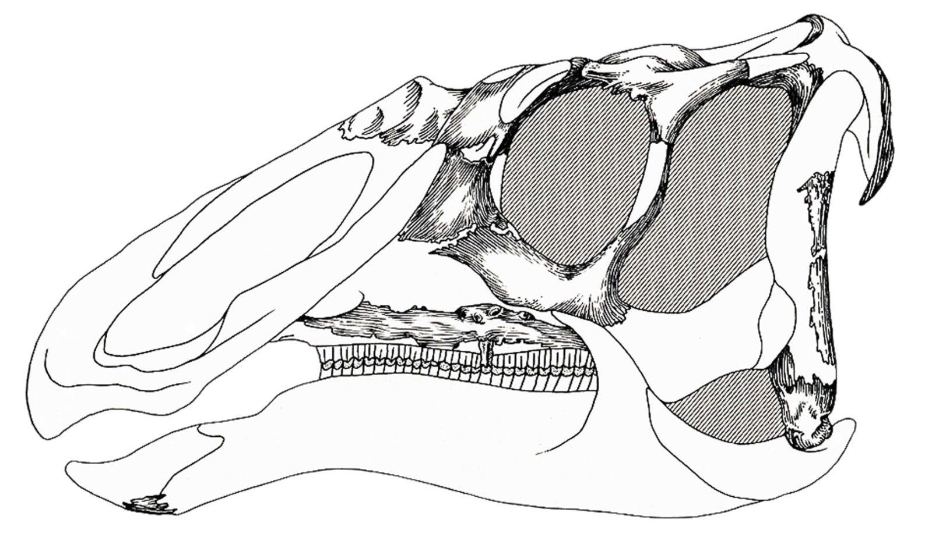
Lophorhothon atopus, holotype skull reconstruction (Langston, 1960). Current update on a new specimen is in press (Gates, T. and Lamb, J., 2021)
The only published associated dinosaur cranial specimen <2005

Slide 5
Systematic reports of dinosaurs in Southeastern
USA, 1990-present
TN: Hadrosauridae, indet. Coon Creek Fm., Campanian,
Bryan et al. 1991
AL: cf. Saurornitholestes langstoni, Mooreville Fm.,
Santonian-Campanian, Kiernan and Schwimmer, 2004
Appalachiosaurus montgomeriensis, Demopolis Fm., Campanian,
Carr et al. 2005
Eotrachodon orientalis, Mooreville Fm, Santonian,
Prieto-Márquez et al. 2015
GA: Tyrannosaurida, indet.,
cf. Lophorothon atopus
Ornithomimosauridae indet.
Blufftown Fm., Campanian, Schwimmer et al. 1993
SC: Dromaeosauridae indet.
Ornithomimosauria indet.
Appalachiosaurus montgomeriensis
Hadrosauridae indet.
Black Creek Gp., Campanian, Schwimmer et al. 2015
MS: Ceratopsidae, indet., Owl Creek Fm., Maastrichtian,
Farke and Phillips, 2017

Slide 6
Southeastern dinosaur taxa arranged by age and geography
AGE Santonian Campanian Maastrichtian
undiff. E M L E M L
____________________________________________________________________
NC-SC
Black Creek Fm. X
Hypsibema crassicaudata
GA-AL-MS-TN
Eutaw Fm. X
Hadrosauridae, gen. et sp. Indet.
Mooreville Fm. ? X
Lophorhothon atopus
Hadrosauridae, gen et sp. Indet.
Ornithomimisauridae, gen. et sp. Indet.
cf. Saurornitholestes langstoni
Demopolis Fm. X
Appalachiosaurus montgomeriensis
Coon Creek Fm. X
Hadrosauroiodea, gen. et sp. Indet.
Ripley Fm. X
Hadroauroidea, gen. et sp. Indet.
Owl Creek Fm.
Neoceratopsia, gen. et sp. Indet. X

Slide 7
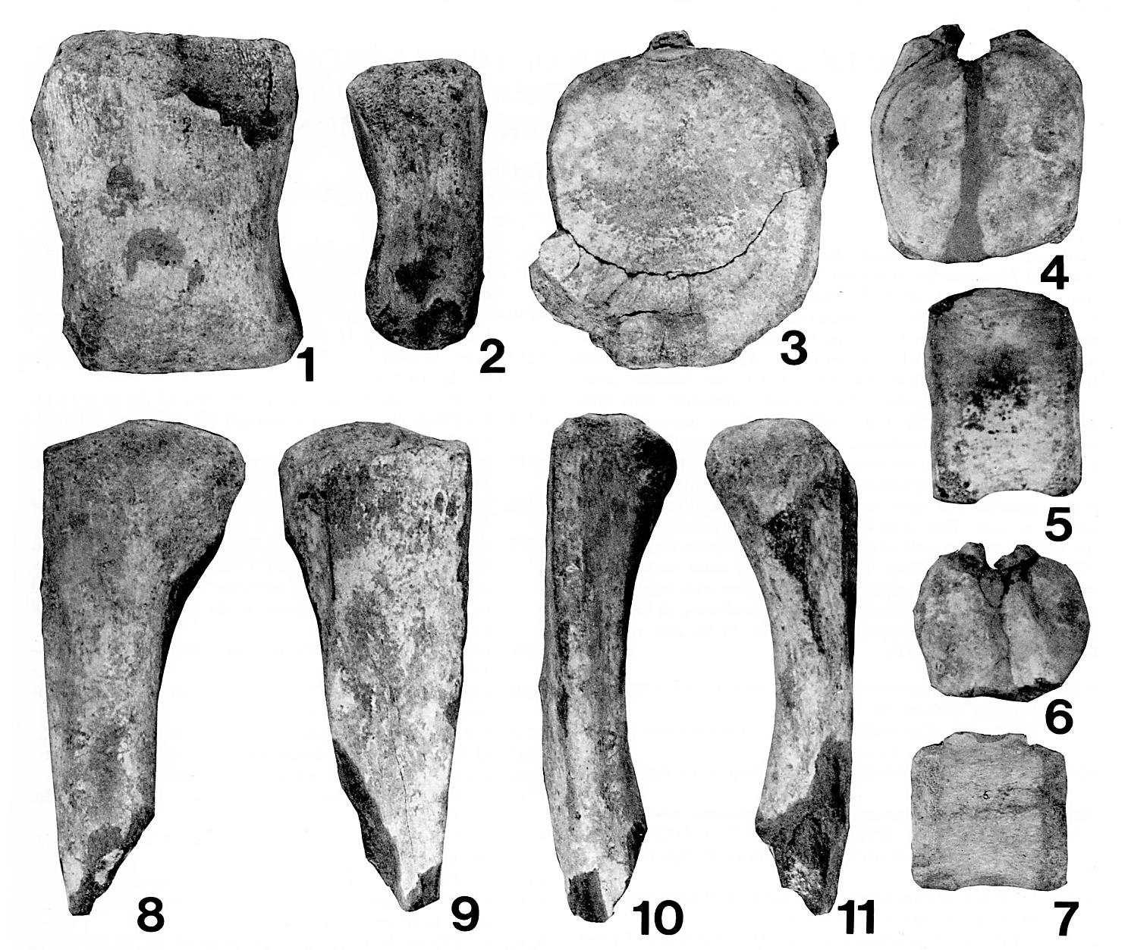
First dinosaur fossils reported from Tennessee, Coon Cr. Fm.
Campanian, SW TN, Bryan et al. 1991
Bryan, J.R., Frederick, D.L.,
Schwimmer, D.R., and
Siesser, W.G., 1991, Jour.
Paleo., 65(4): 696-697
Hadrosauridae, gen. et sp. indet

Slide 8
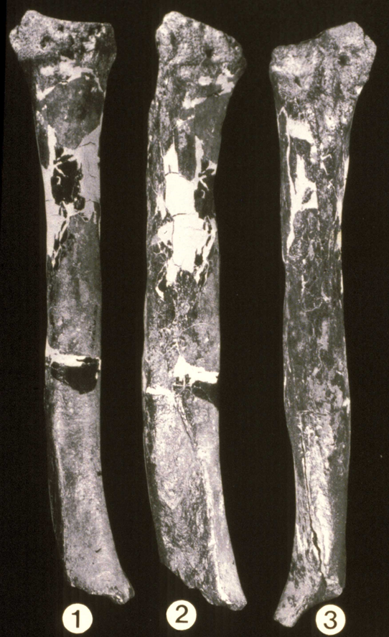
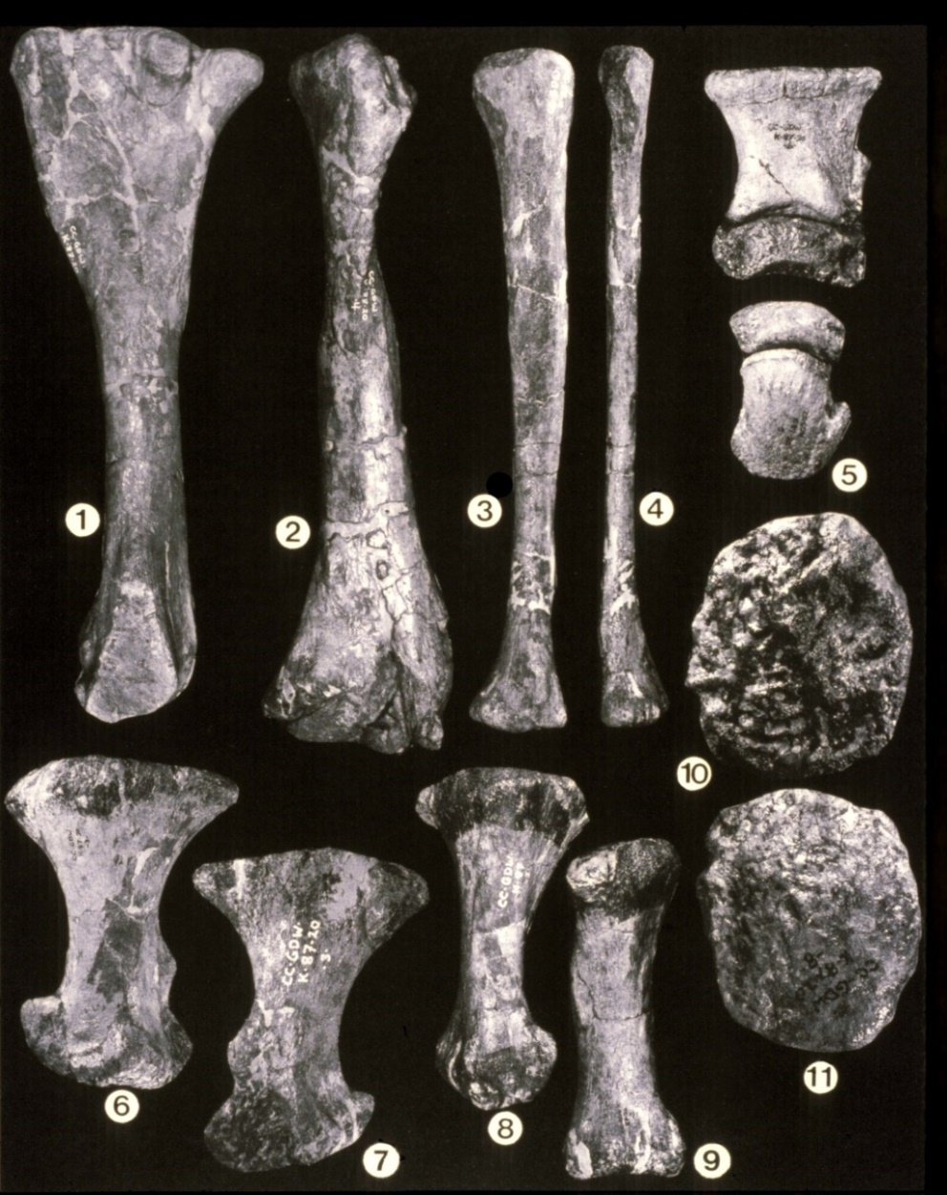
First dinosaurs reported from Georgia, Blufftown Fm., W. GA,
E. AL, Schwimmer et al., 1993
Tyrannosauridae, Albertosaurus sp?
Schwimmer, D.R., Williams, G.D., ,Dobie, J.L. and Siesser, W.G., 1993. Jour. Paleo. 67(2):
288-296
Hadrosauridae, cf. Lophorhothon atopus

Slide 9
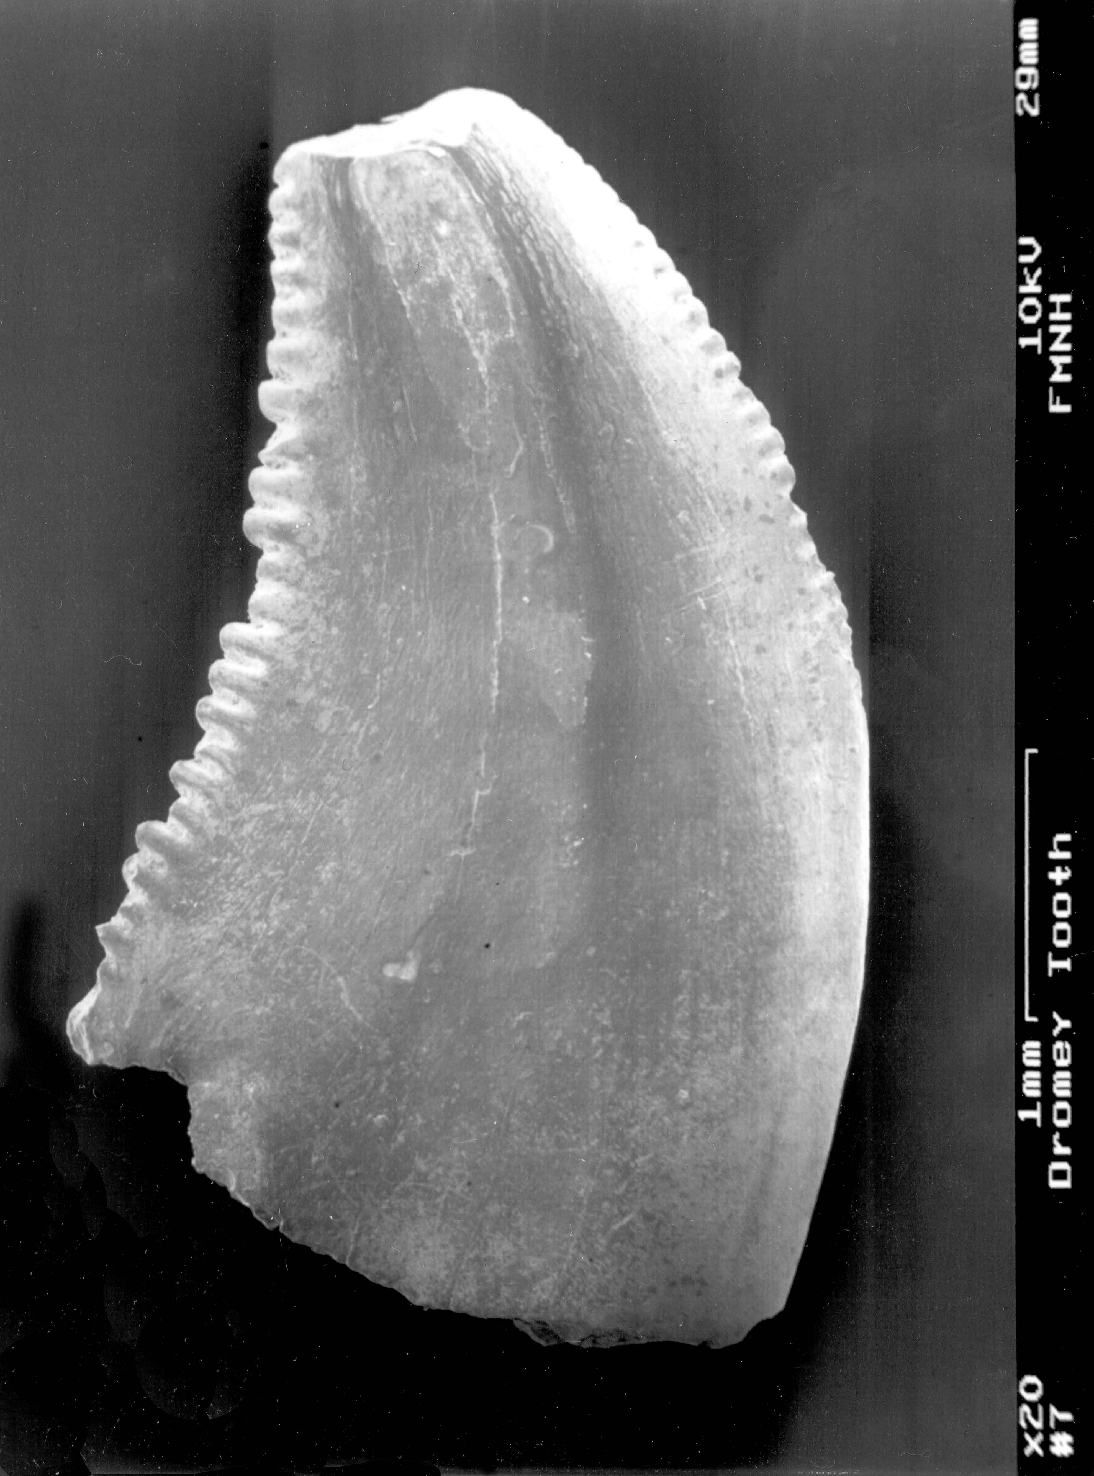
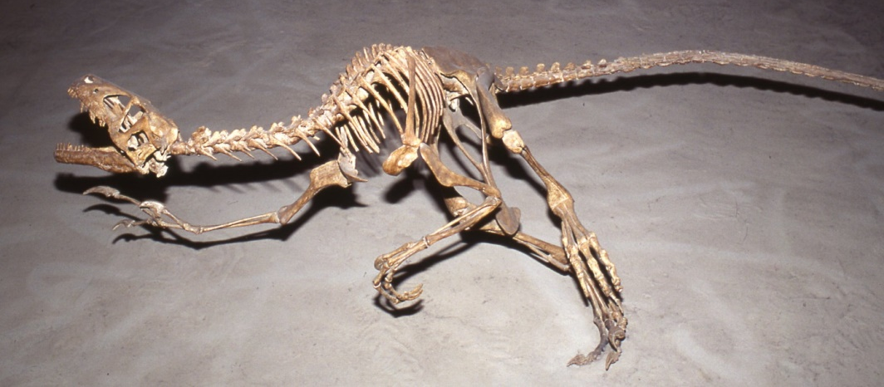
First dromaeosaur fossil report:
Velociraptorinae cf. Saurornitholestes langstoni,Mooreville Fm., AL
(early Campanian),
Kiernan and Schwimmer, 2004
Kiernan, C. and Schwimmer, D.R.,
2004. The Mosasaur, 7: 89-93

Slide 10
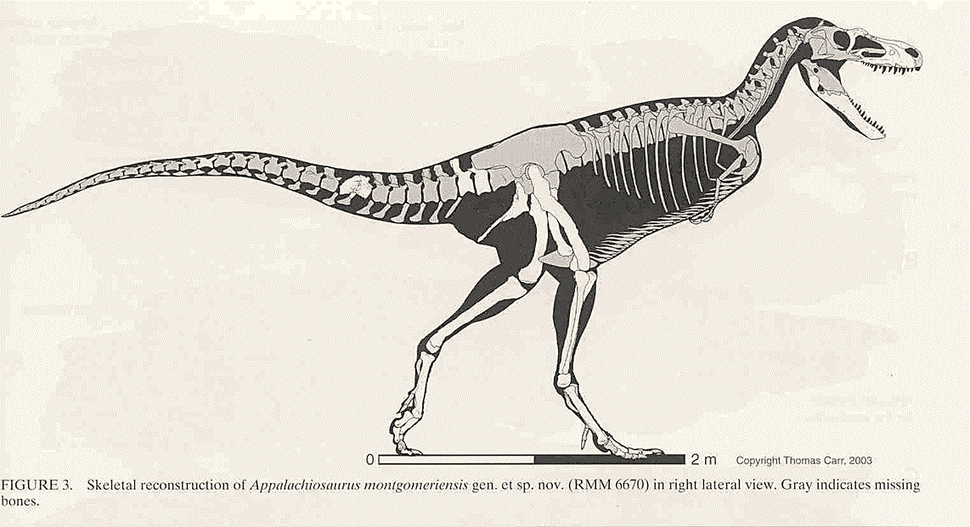
Appalachiosaurus montgomeriensis Demopolis Fm., Campanian AL, Carr et al. 2005
Carr, T.D., Williamson,T.E. and Schwimmer, D.R., 2005, Jour. Vert. Paleo. 25(1): 119-143.

Slide 12
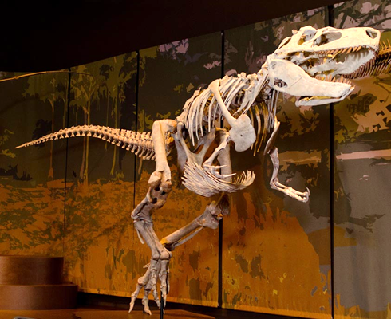
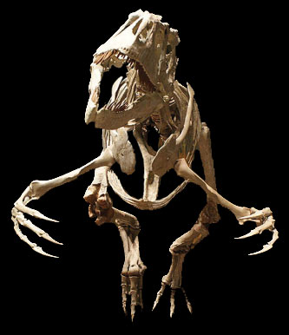
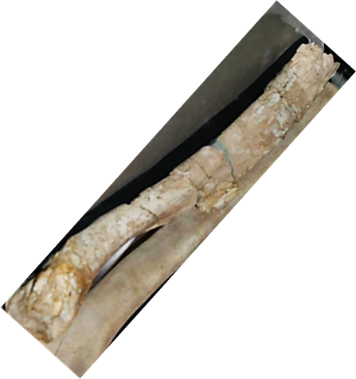

Appalachiosaurus
original recostruction
Carr et al., 2005
Short-arm reconstruction
fide Carr et al. 2005
Alternate
reconstruction of
Appalachioisaurus

Slide 13
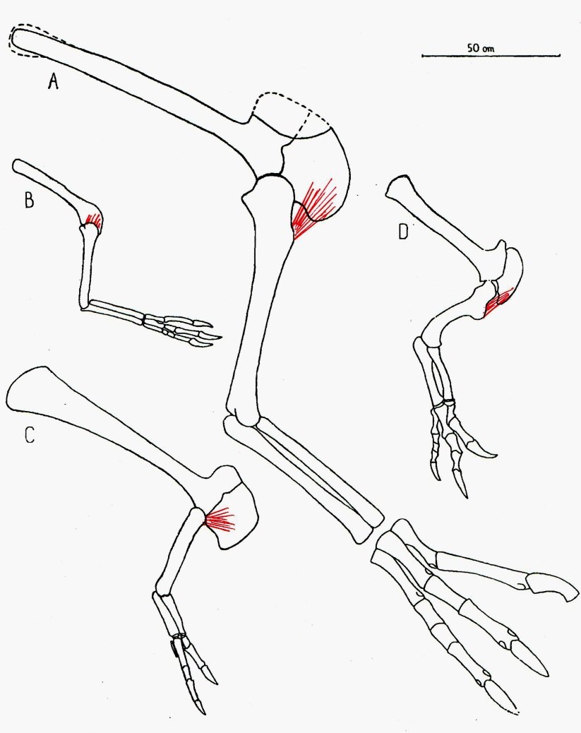

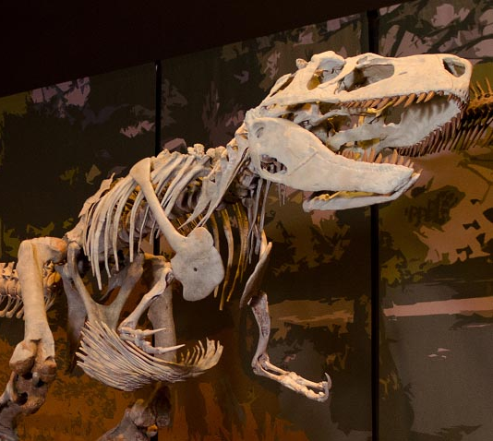


Slide 14
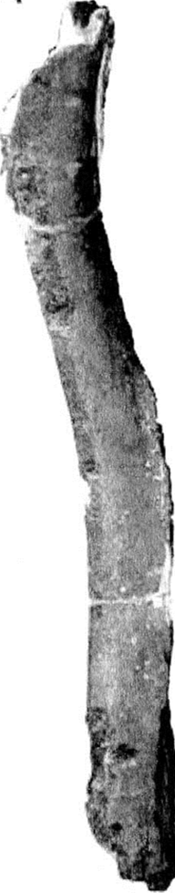
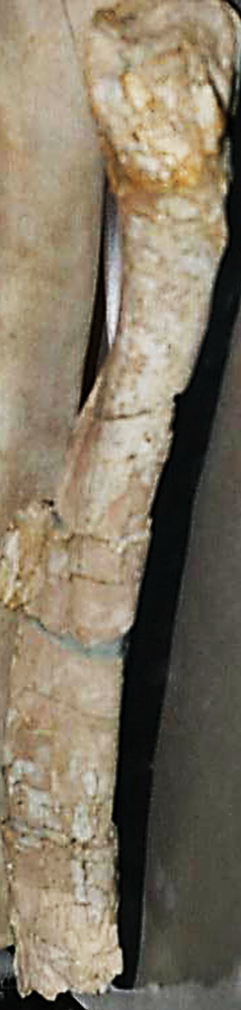
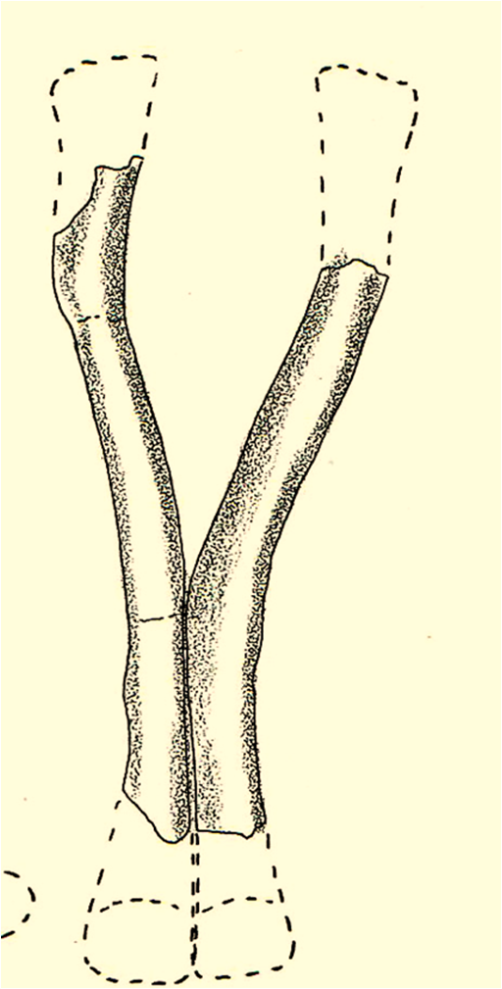
Pubic bone
of Dryptosaurus
“Humerus” of Appalachiosaurus

Slide 15
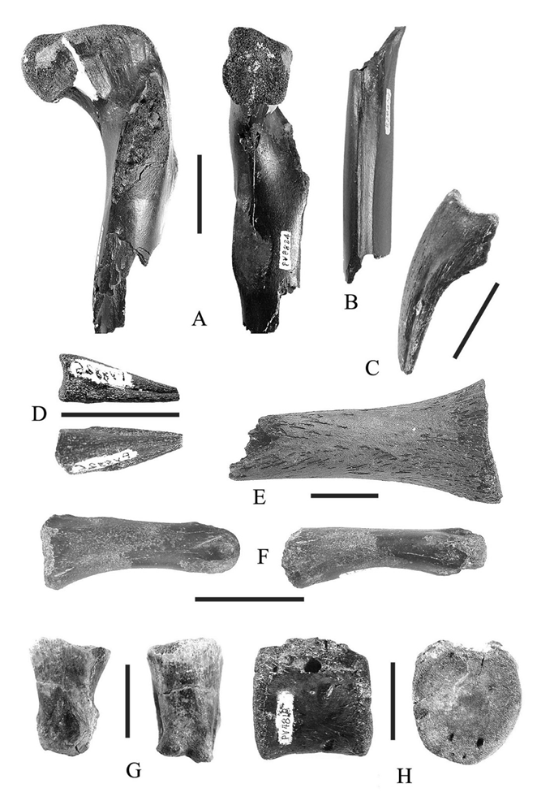
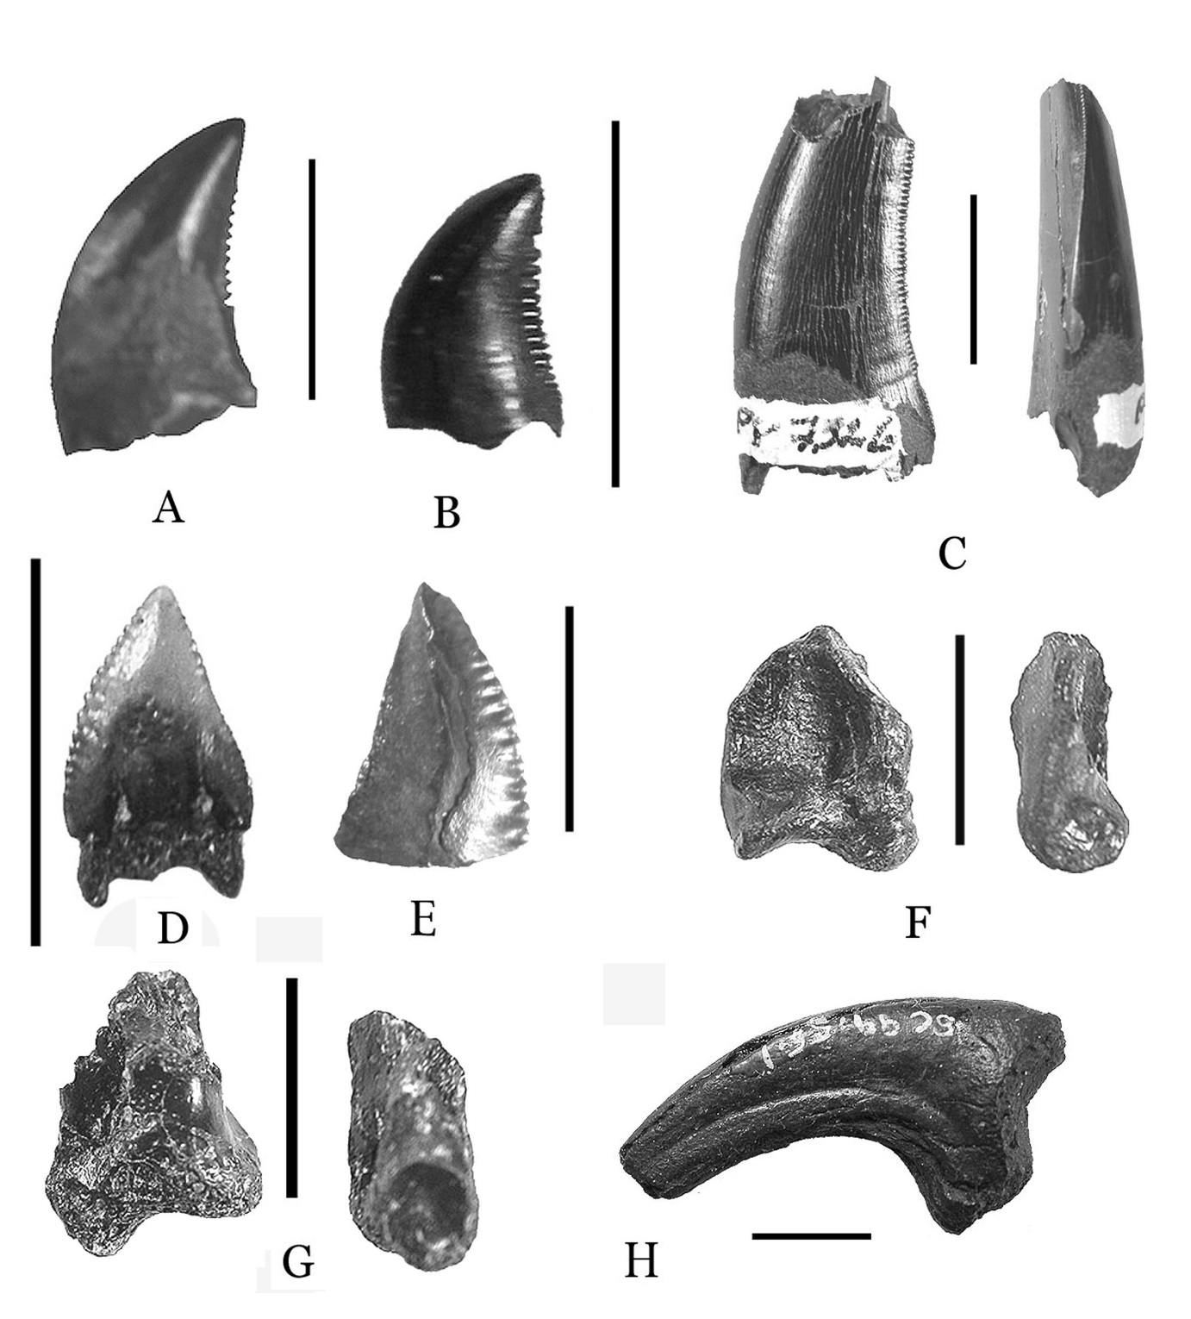
Cretaceous dinosaurs from South Carolina Black Creek Gp.,
Campanian, Schwimmer, et al. 2015
Ornithomimosaur post-cranials
cf. Saurornitholestes teeth
Schwimmer, D.R., Sanders, A.E., Erickson, B.R.,
and Weems, R.E. 2015, Am. Phil. Soc Trans.
105(2), 157 p.

Slide 16
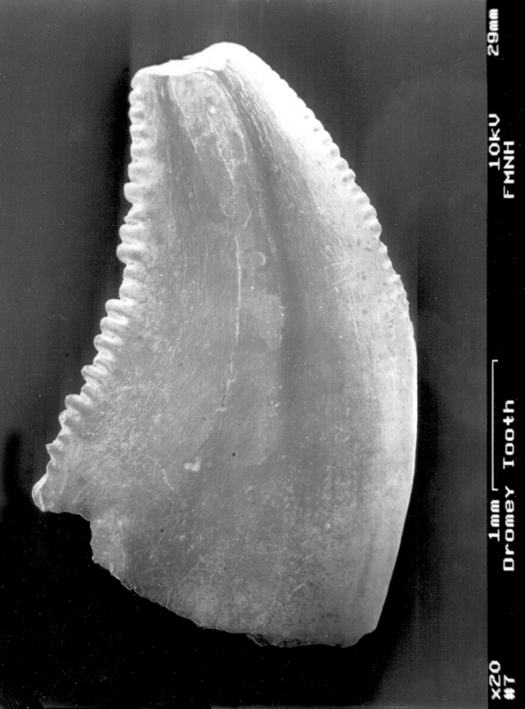
Comparison of cf. Saurornitholestes langstoni teeth from SC and AL
Teeth from Coachman Fm. (Black Creek Gp.) SC
Tooth from Mooreville Fm. AL

Slide 17
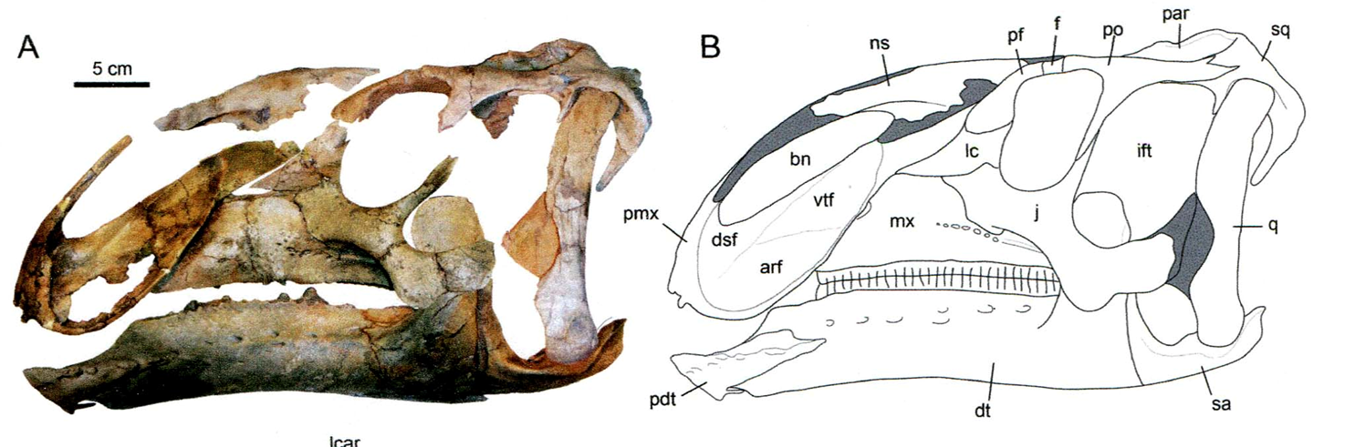
Eotrachodon orientalis, Mooreville Fm., AL, Santonian. Prieto-Màrquez et al., 2016
Prieto-Màrquez, Erickson, G.M. and Ebersole, J. A., 2016.
PeerJ 4:e1872; DOI 10.7717/peerj.1872,

Slide 18

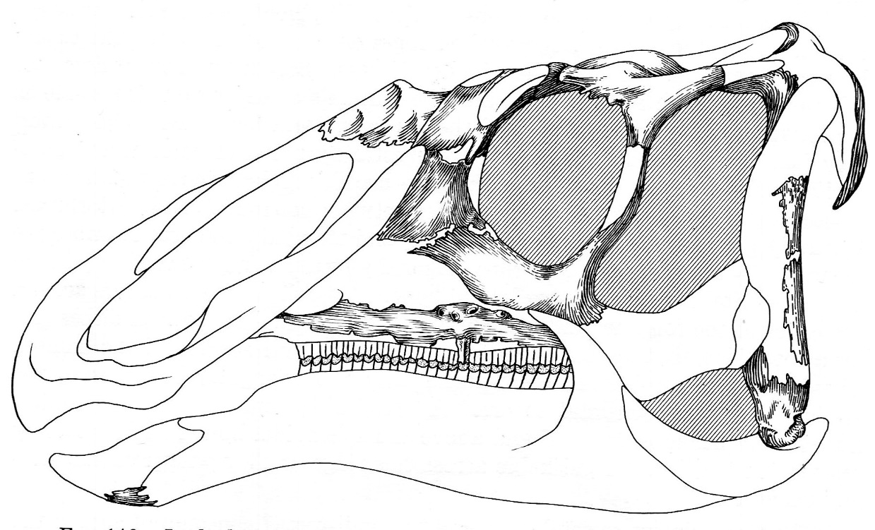
Eotrachodon orientalis
Prieto-Marquez et al., 2016
Lophorothon atopus
Langston 1960

Slide 19
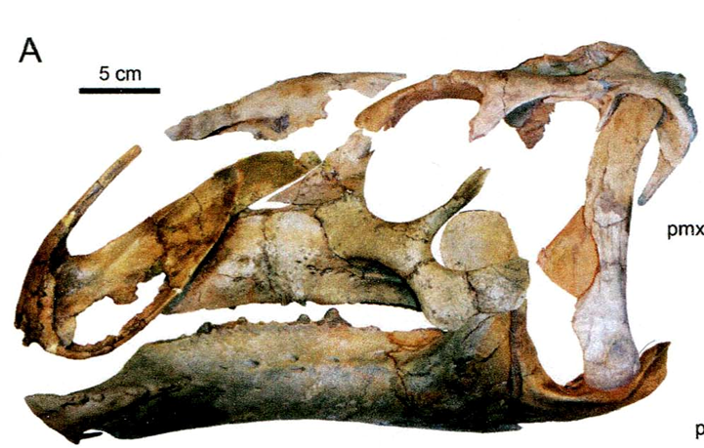
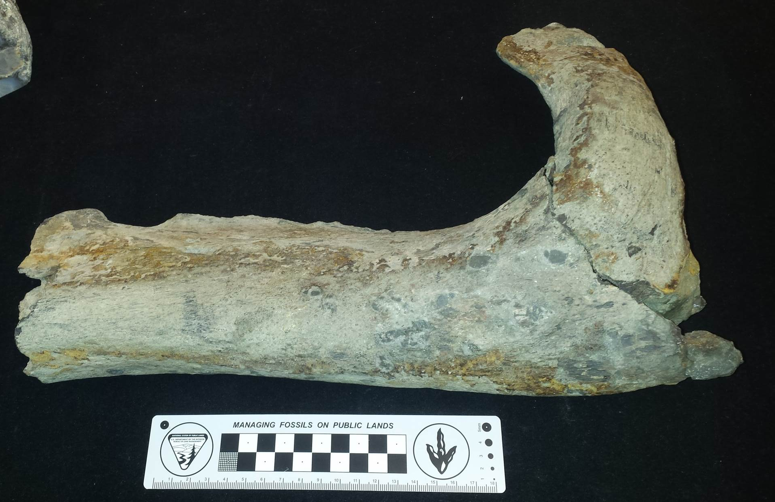
Hadrosauromorph mandible,
Coon Cr. Fm. TN

Slide 20
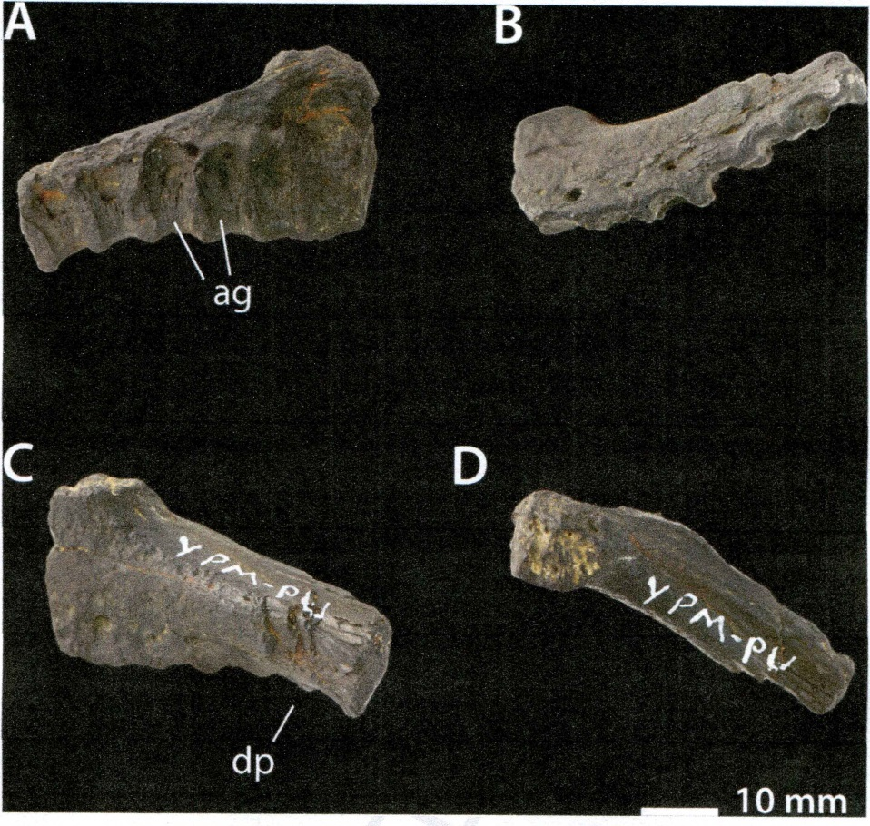
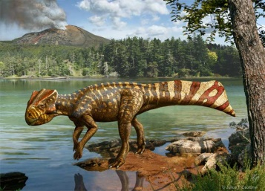
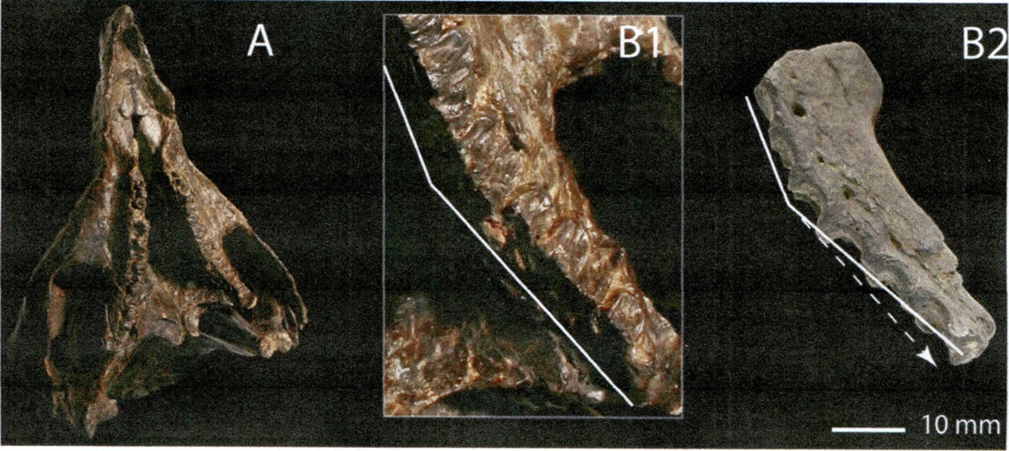
First Eastern North American Ceratopsian?
Leptoceratopsidae sp. , indet. Black Creek” (Tarheel Fm.) Samson Co. NC, Longrich, 2016
“
Longrich, N., 2016.,
Cretaceous Research
57:199-207

Slide 21
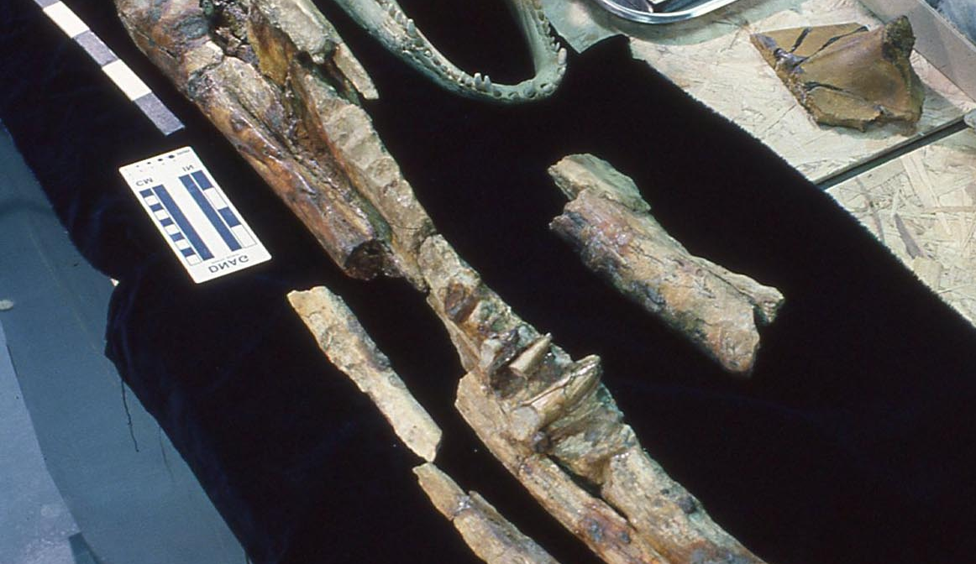
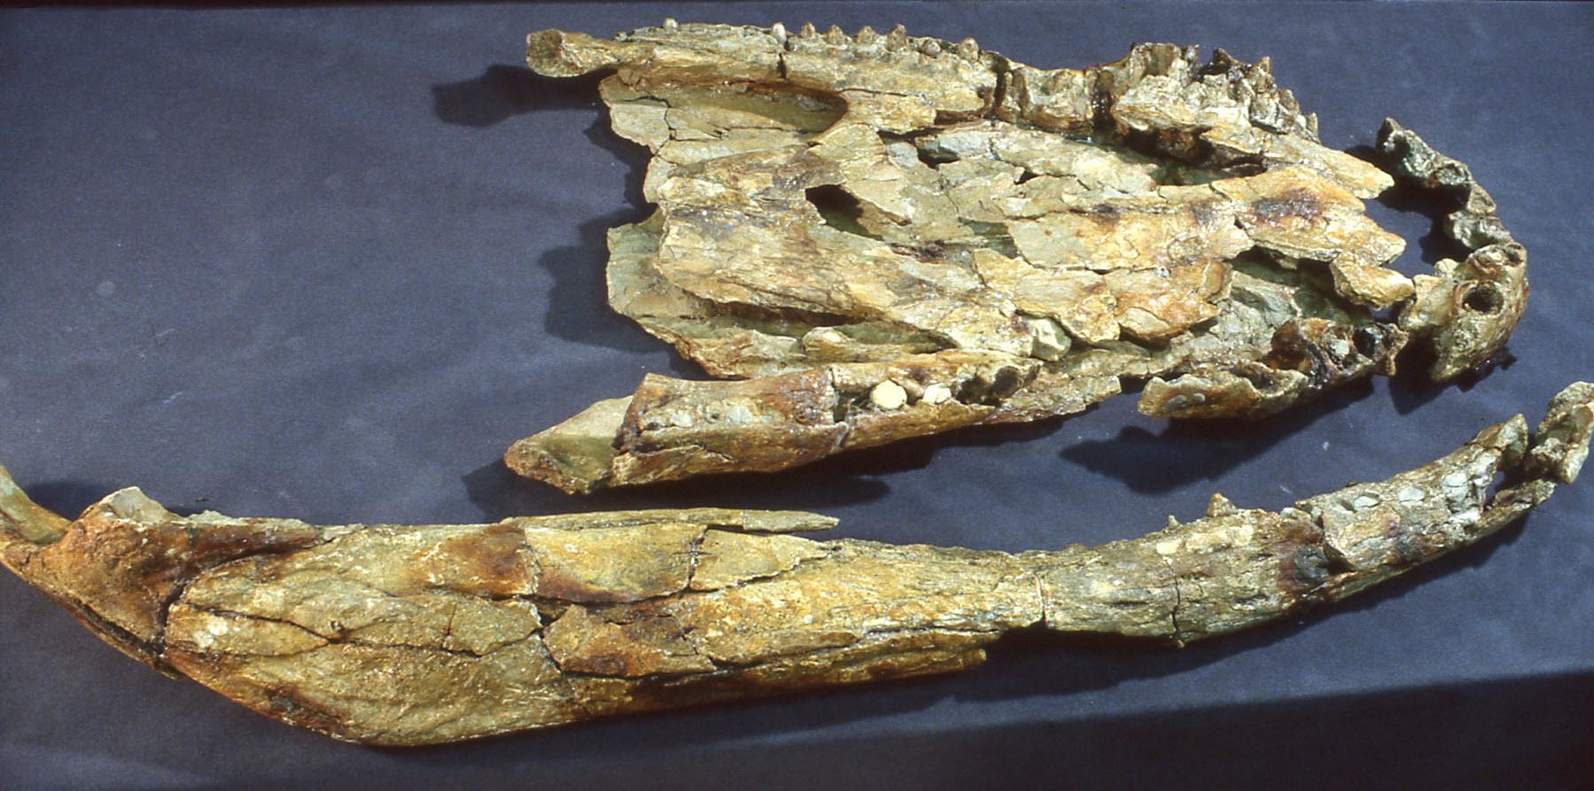


Slide 22
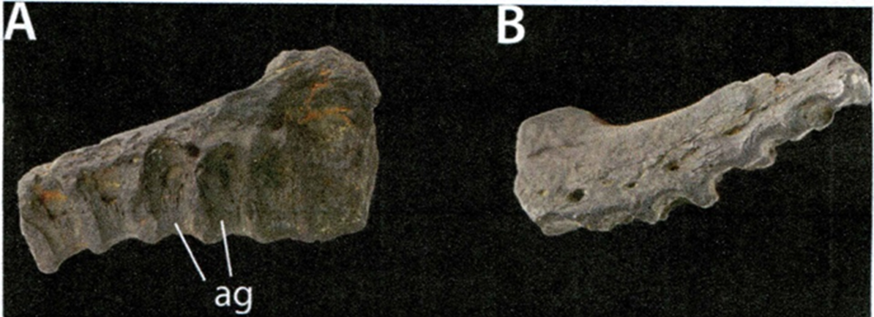
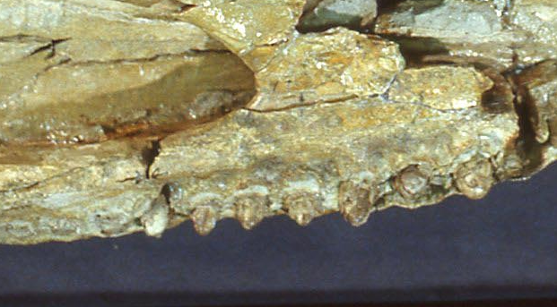
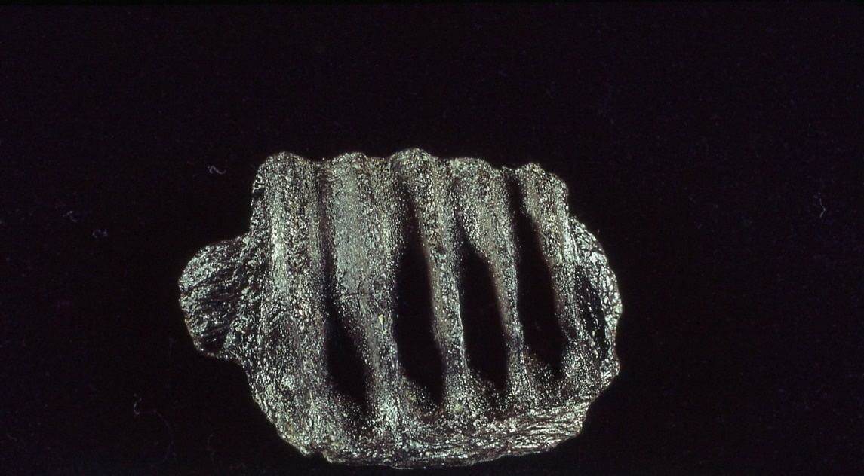
Hadrosaur maxillary fragment
Crocodylian maxillary fragment

Slide 23
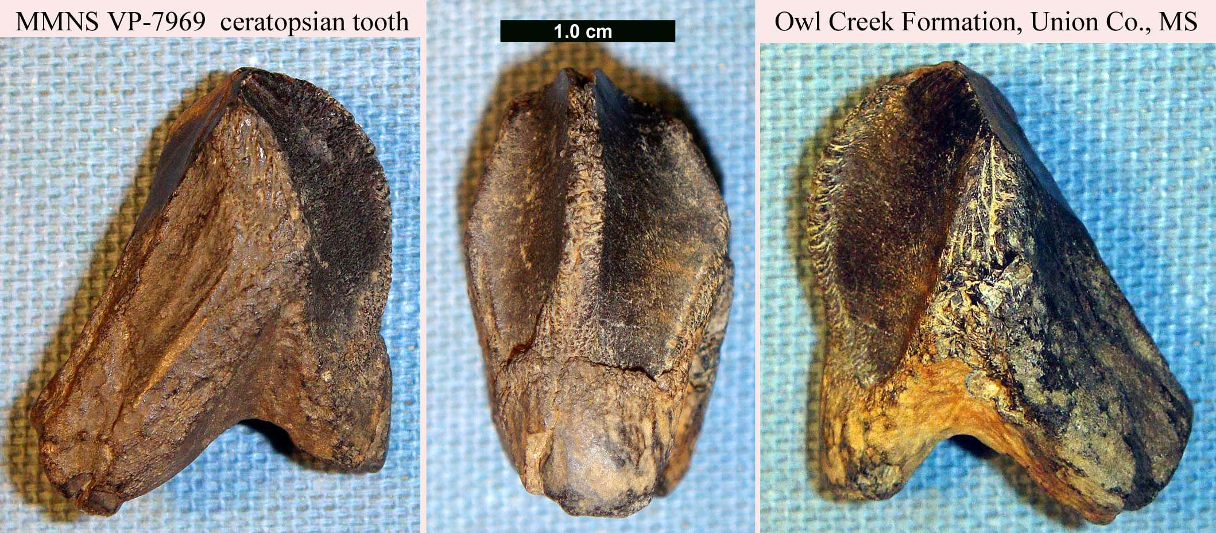
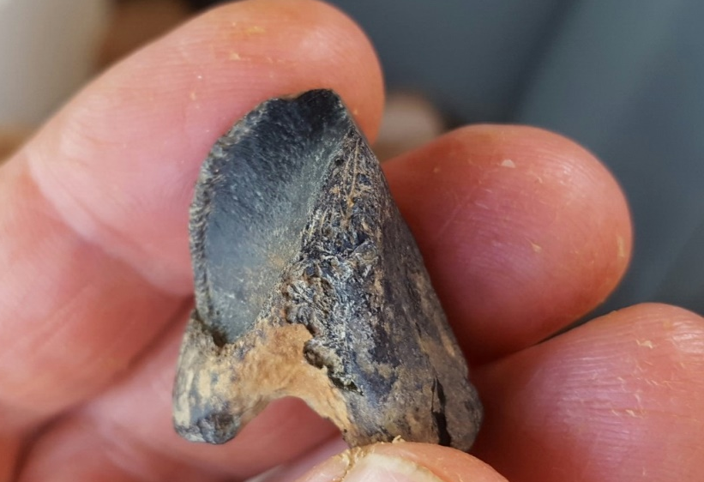
Neoceratopsian tooth, Owl Creek Fm., MS, Upper Maastrichtian, MS. Farke and Phillips, 2017
Farke, A.A. and Phillips, G.E., 2017
PeerJ 5:e3342; DOI 10.7717/peerj.3342

Slide 24
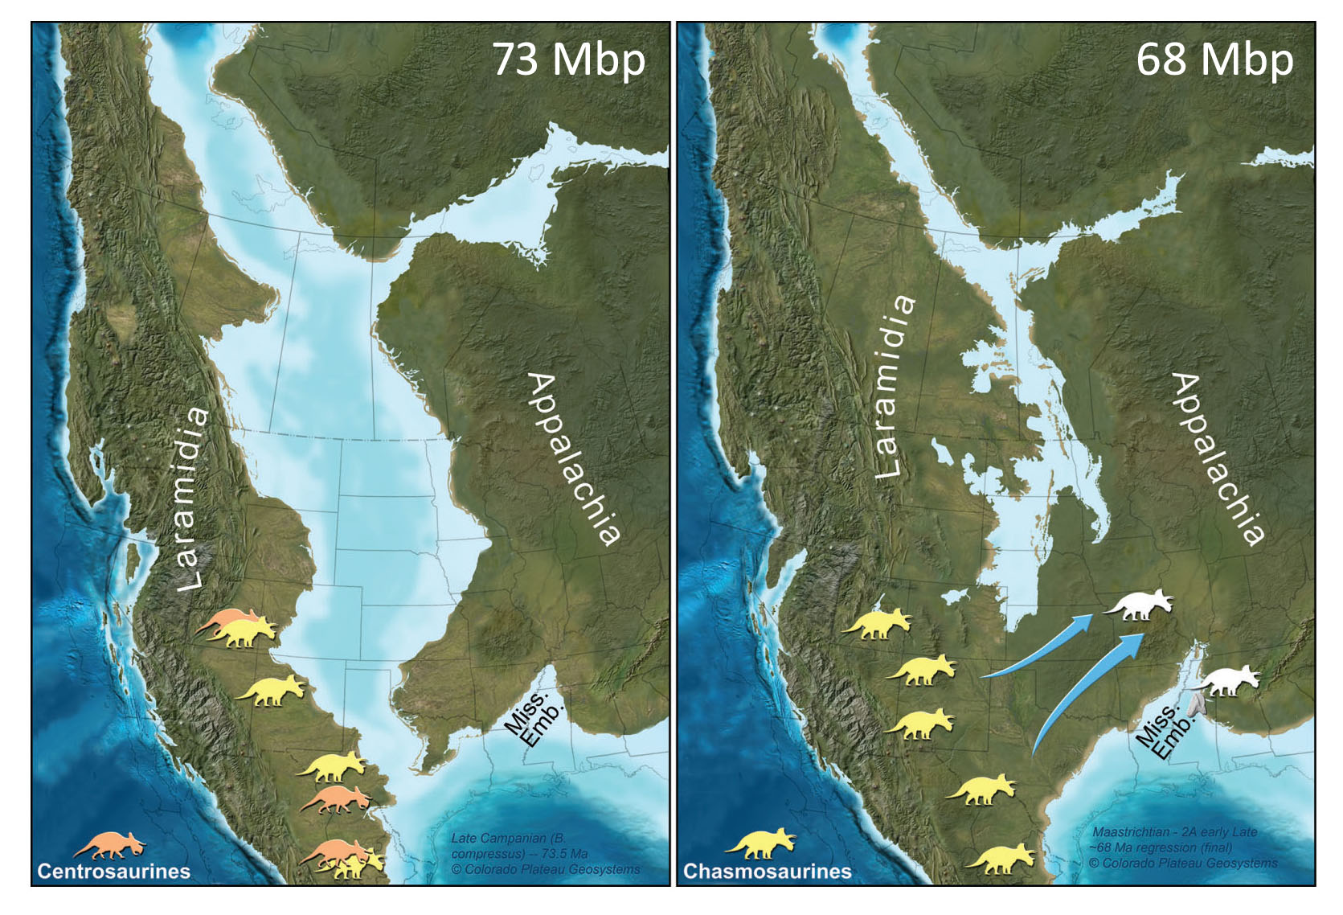
Late Campanian
Late Maastrichtian
From Farke and Phillips, 2017

Slide 25
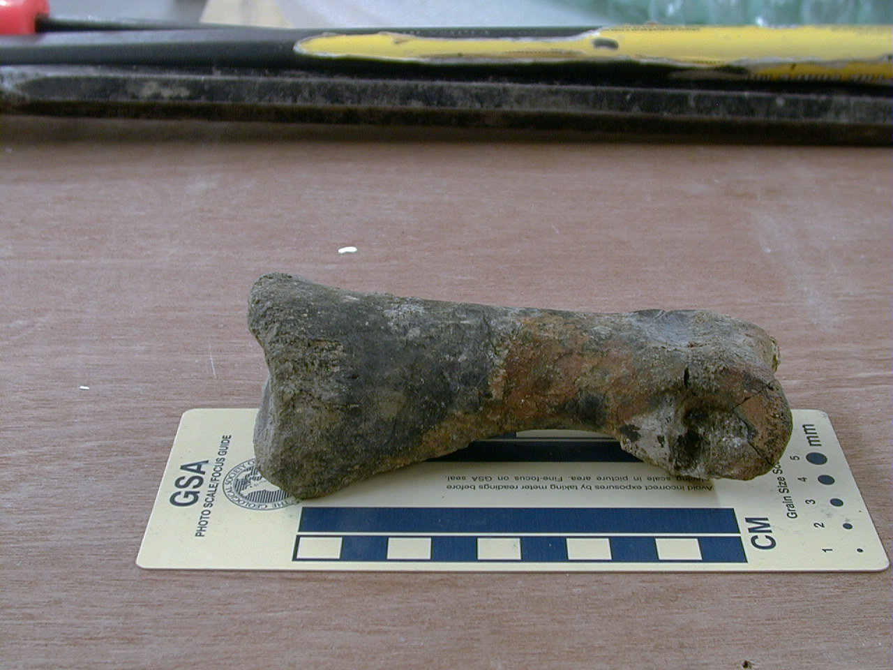
Large theropod pedal phalanx, McShan Fm. (Santonian), MS
Southeastern dinosaur material not published or
available for description

Slide 26
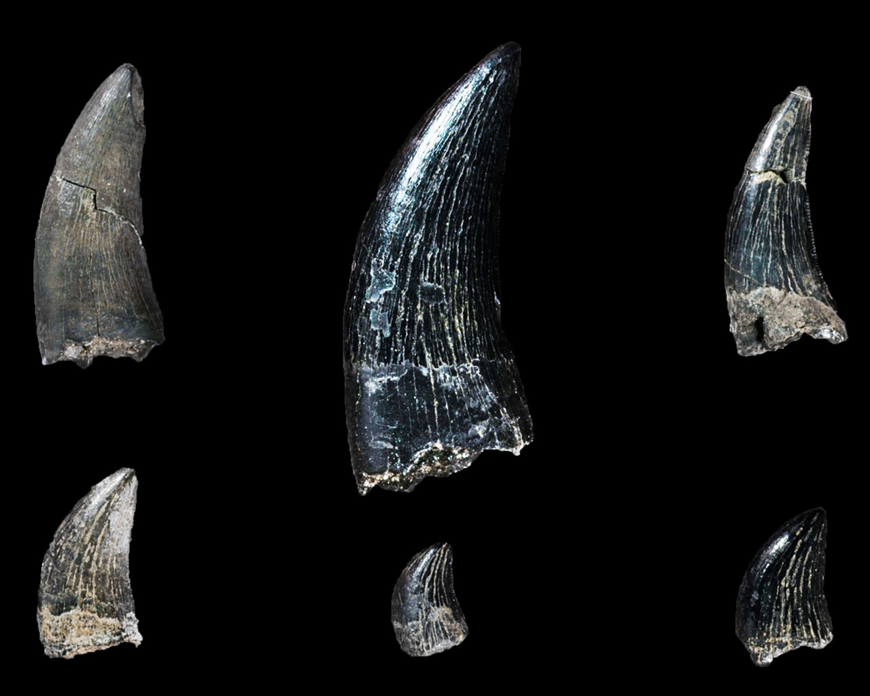
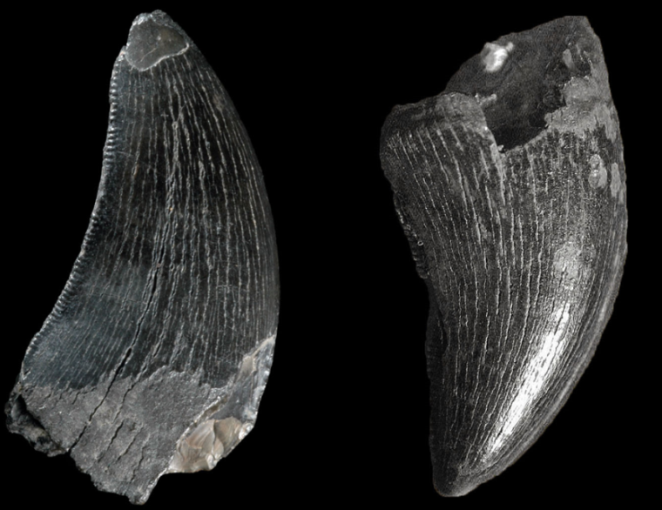
Theropod teeth in amateur collections, Phoebus Landing (Black Creek Gp.). NC
1 cm

Slide 27
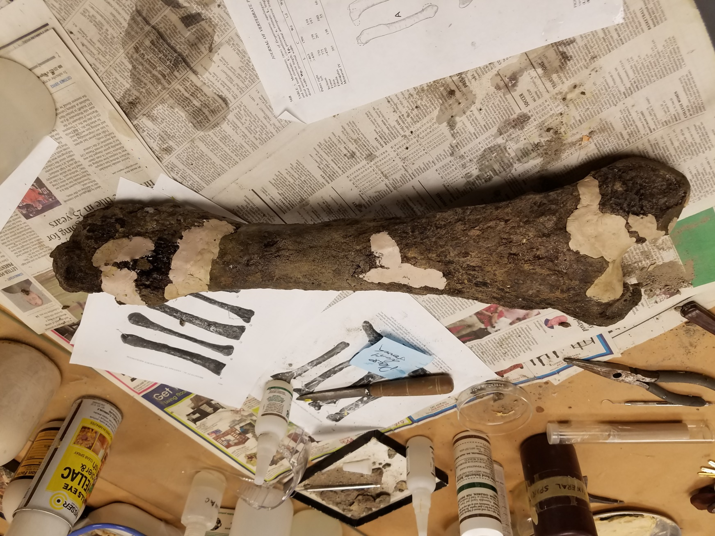
Juvenile hadrosauromorph bone in prep.,
Ripley Fm. (Maastrichtian), Stewart Co. GA,
Now in private collection

Slide 28
Conclusions:
In the past three decades the number of published systematic reports of dinosaurs in the Southeast has more than doubled the diversity of known taxa.
2. The geographic range of dinosaur sites in the southeast has
expanded from three to six states, and within those, the
regional reports have expanded (e.g. central and eastern
Alabama now have known occurrences)

Slide 29
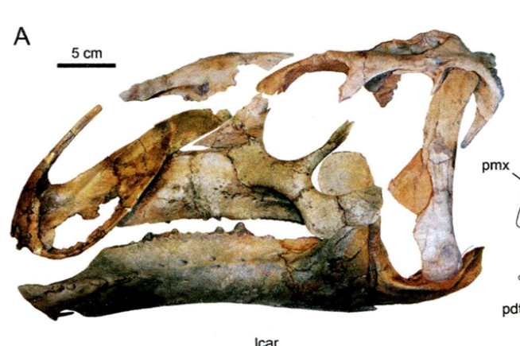
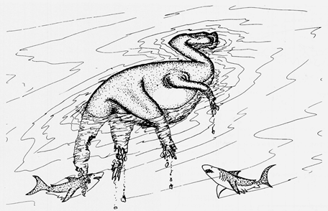
The number of new species based on associated cranial
specimens has tripled. All three come from western
Alabama chalks, indicating that bloat-and-float marine
specimens will comprise the likely source of new species.
Given the large volume of unpublished material, especially
in amateur collections, and the number of smaller
theropod teeth, the regional dinosaur diversity was much
greater than the formal record has so far shown.

Slide 30
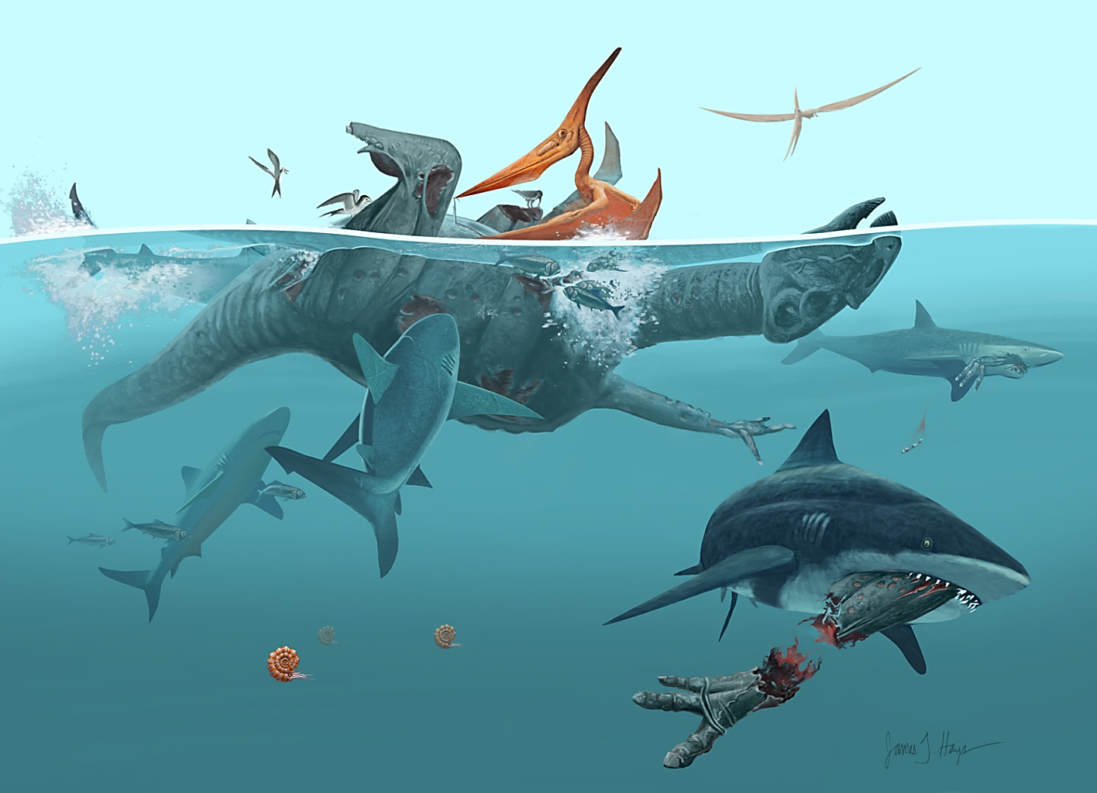

Thanks to colleagues,
collaborators and artists
for specimens, data
and graphics :
George Phillips
Bill Montante
Nick Longrich
Mike Gibson
James Hays
Cait Kiernan
Henry (Tad) Rust
Thanks for
support from:

