Slide 1


A new technique for visualizing undergraduate geoscience student involvement
EVELYN ABAGAYLE BOYD
KELLY BEST LAZAR

Slide 2
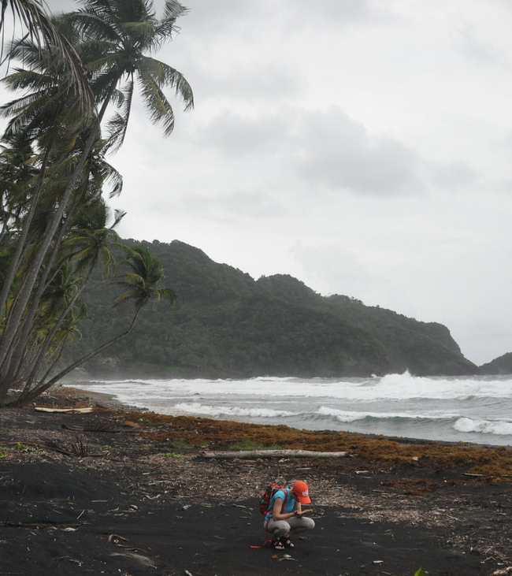
Involvement and Persistence
Field experiences are typically high-involvement activities
Important to understand student experiences at the individual level to best understand how these kinds of activities impact students
Application of Astin’s Theory of Involvement can be used to better understand the relationship between involvement and geoscience persistence

Slide 3
Astin’s Theory of Involvement (1984)
A student’s inputs and environment lead to outputs
Inputs - Background, demographics, previous experiences
Environment – Skills encountered in college
Outputs - Knowledge, beliefs, personal characteristics, attitudes, and values that exist after they exit their degree programs
Inputs
Environment
Outputs

Slide 4
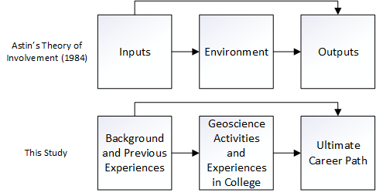
Applications of Astin’s Theory to this Study

Slide 5
Five Assumptions
1) Involvement requires an investment of both psychosocial and physical energy
2) Involvement is continuous, and the amount of energy invested varies from student to student
3) Aspects of involvement may be qualitative and quantitative
4) A student’s development is directly proportional to the extent to which they were involved
5) Academic performance is correlated with the student involvement

Slide 6
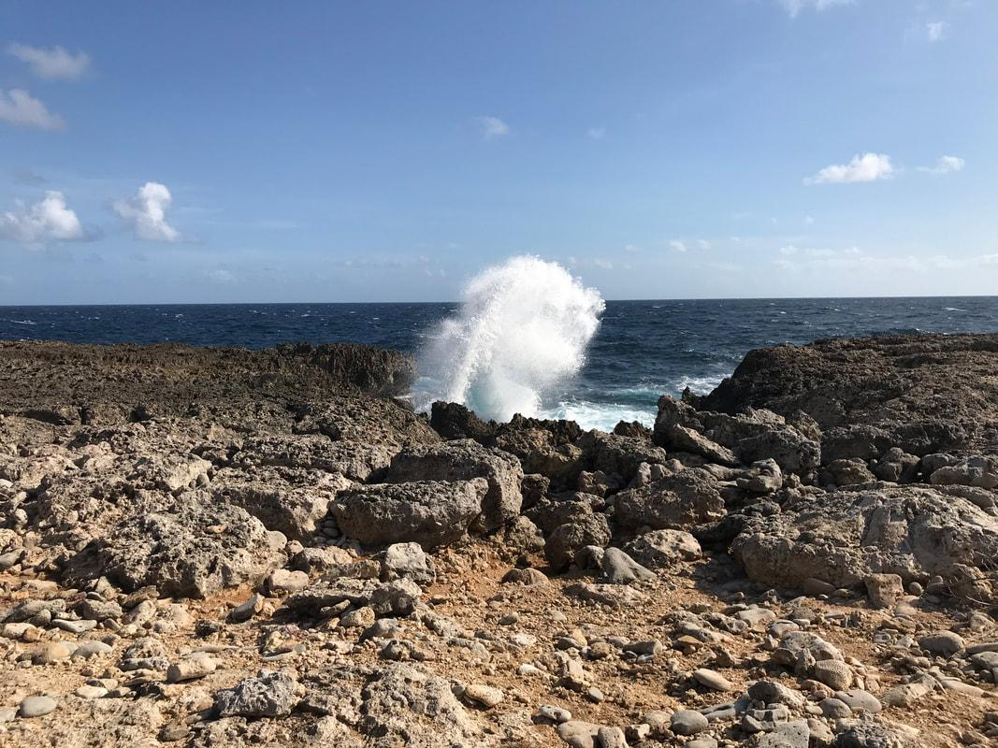
The Experience
One week study abroad field experience in the Caribbean.
Students were exposed to geoscience research techniques
Learned about the various geological processes that take place on the island
Collected data for a geoscience project

Slide 7

The Interviews
Interviews took place the Fall following the experience
Questions were focused on experience with geoscience in general, not just the field experience which is how many of the critical incidents were identified
A check-in took place with participants two years after the experience

Slide 8
The Participants
Geoscience Major
Transfer student
First research experience
Woman
Third-year
White
Hispanic/Latina
Geoscience Major
Woman
Fourth-year
White
QUINN
TAYLOR
Geoscience Major
Woman
Third-year
White
STEM Major
Woman
First-year
White
ANNA
PEYTON

Slide 9
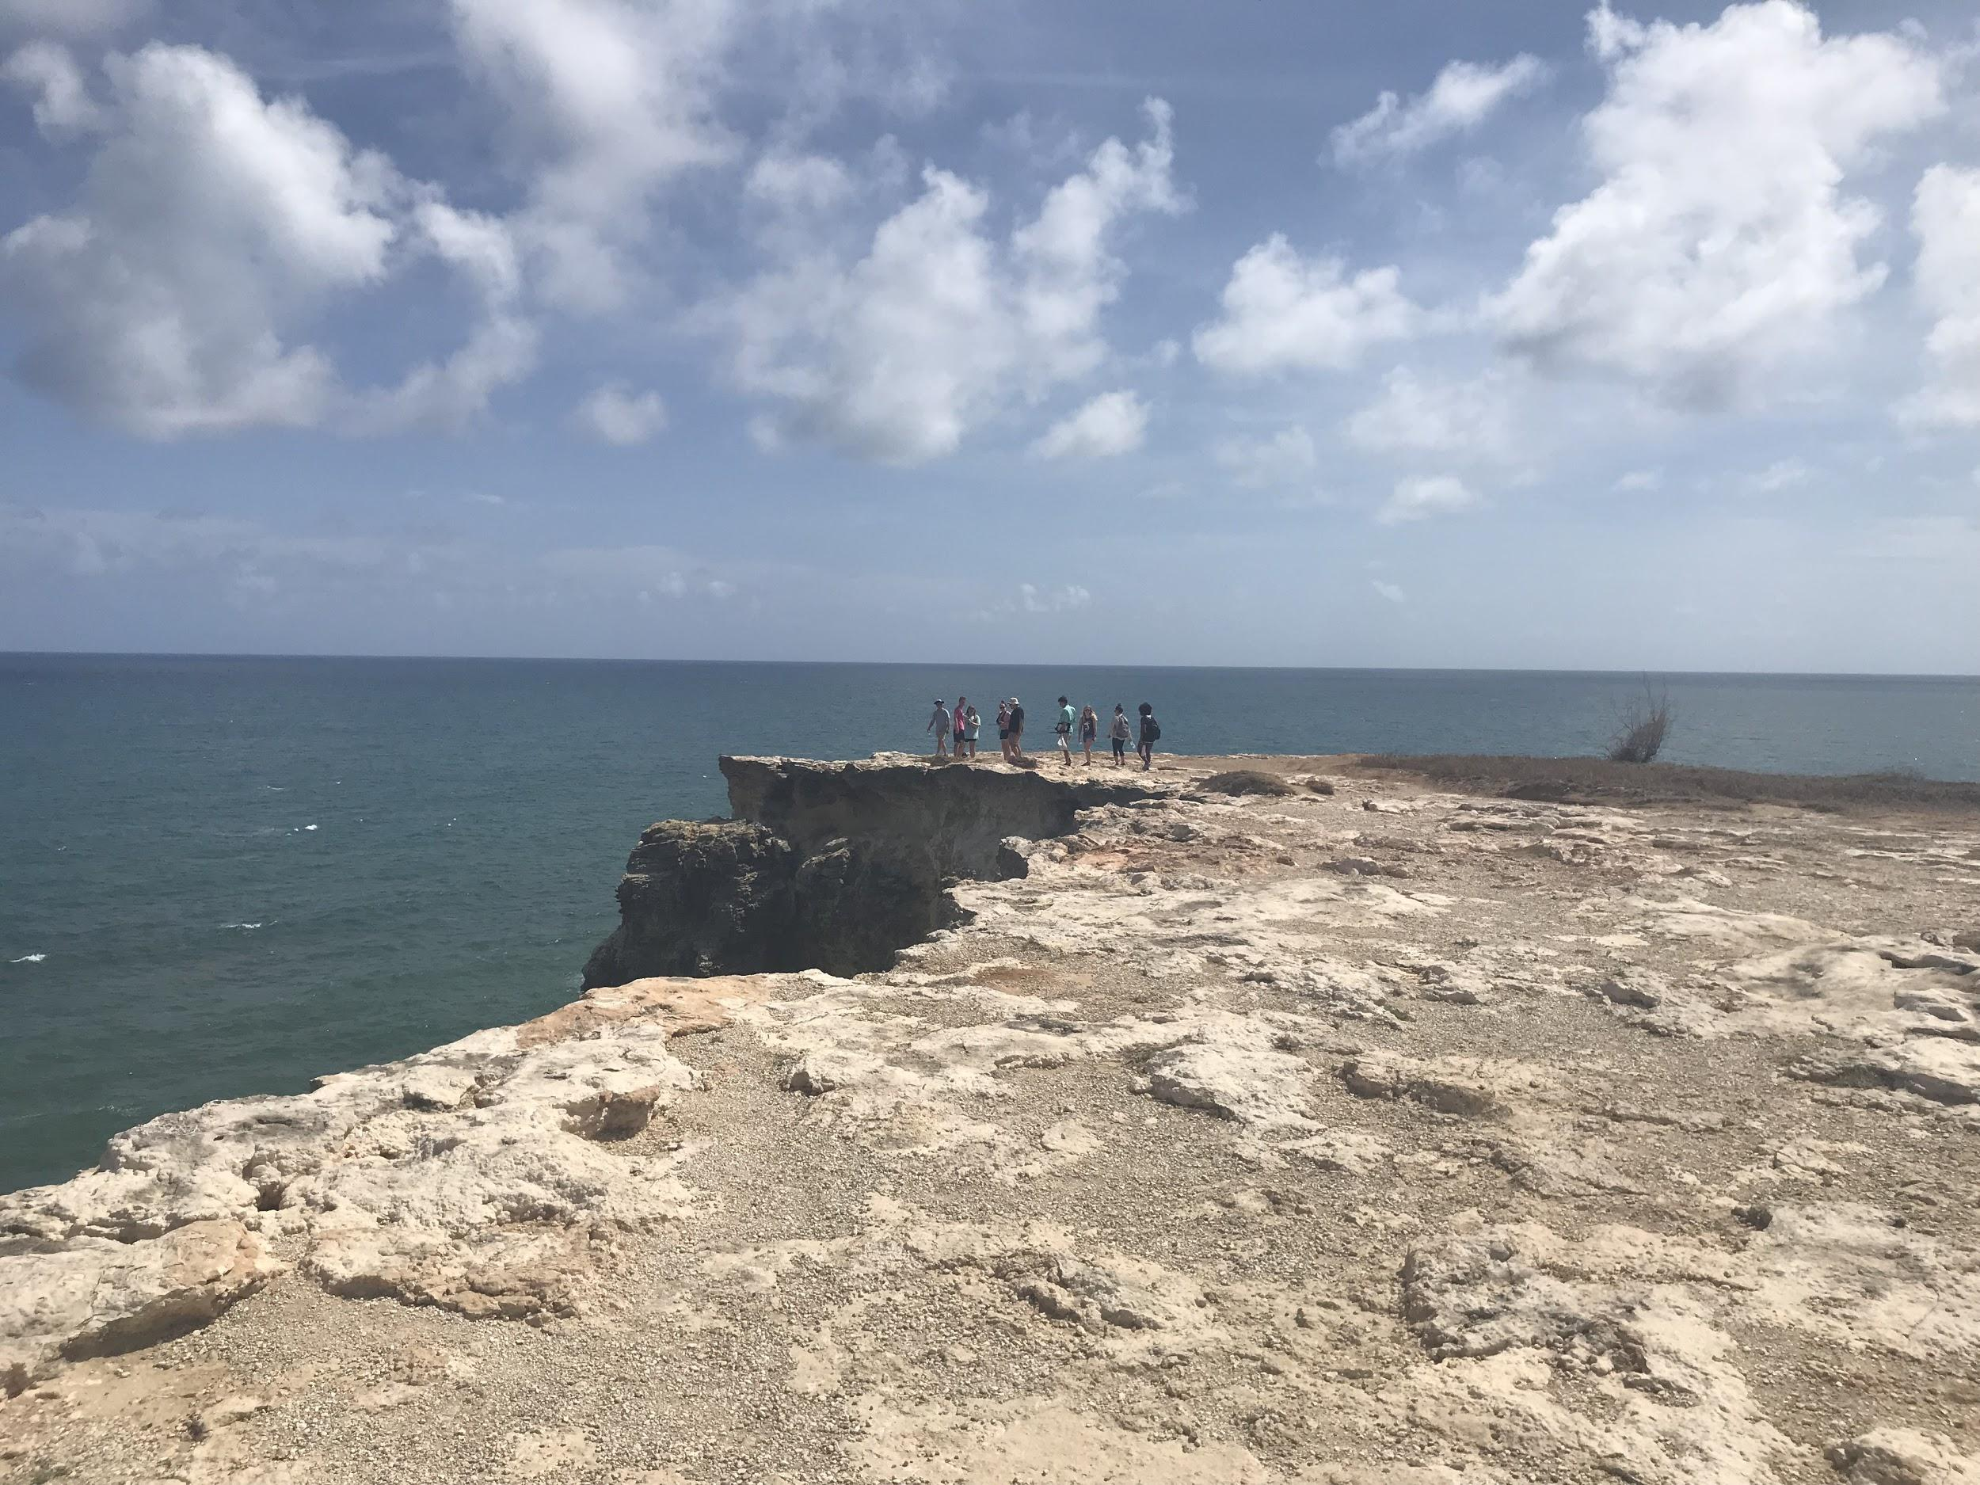
Visualizing Student Involvement
Pipeline models often show where students enter and programs but do not depict students’ involvement throughout
Participants were interviewed the fall following the experience and critical incidents identified in their interviews were coded
Baselines were created from identified incidents that were not events (professor influence, love of nature, geoscience major)

Slide 10
Scoring
Events were scored on a four-point scale and added to baselines in the semester which they took place
Involvement Code Scoring | Pre-College | College | Career
1 | Science/Nature Interest |  | Departure from higher education
2 | Teacher influence; Geoscience Courses | Friends; Clubs; Geoscience courses; Professor Influence | Non-STEM undergraduate degree
3 | Family influence | Research experiences | STEM undergraduate degree; STEM career
4 | Geo-Focused Summer Camp | Field experience | Geoscience career, Geoscience graduate school

Slide 11
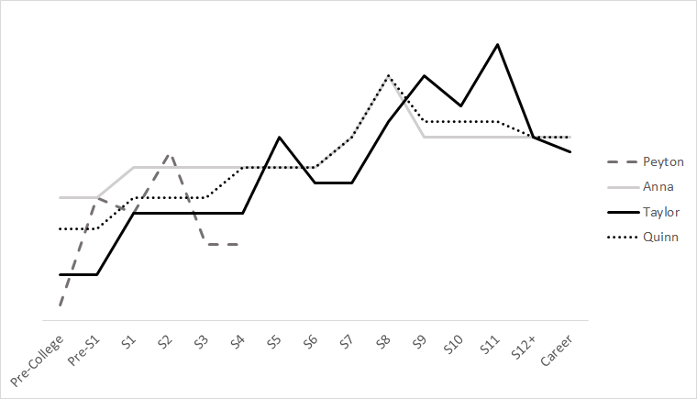
T
High
A
Q
Field Experience for
this study
P
Peyton
Anna
Taylor
Quinn
Mid
Relative Involvement Level
Low
Pre-College
Year 1
Year 2
Year 3
Year 4
Career
Relationship to Astin’s Theory of Involvement (1984)
INPUTS
ENVIRONMENT
OUTPUTS

Slide 12
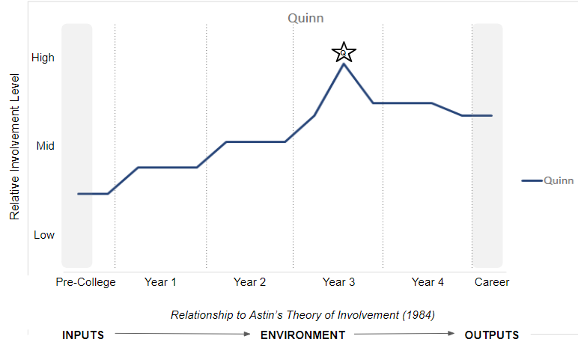
Quinn
K-12 geoscience experiences resulted in a mid-range baseline
A transfer student, became a geoscience major in her second year
Pursuing a geoscience career

Slide 13

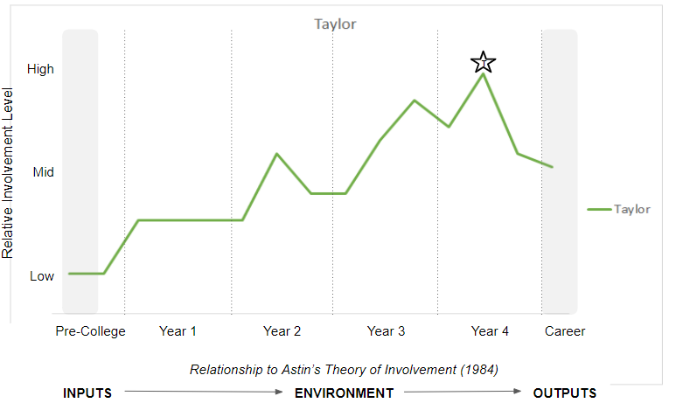
Taylor
Moderately low baseline, expressed K-12 teacher influence in geoscience
Friend influence early in college career
Became a geoscience major during her second year
Multiple field experiences
Pursuing a geoscience Master’s degree

Slide 14
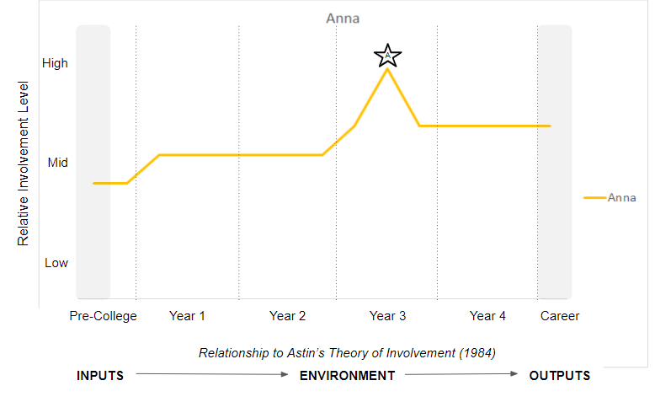
Anna
K-12 geoscience experience leaving her with the highest of the four baselines
Entered college a geoscience major
Pursuing a geoscience Master’s degree

Slide 15

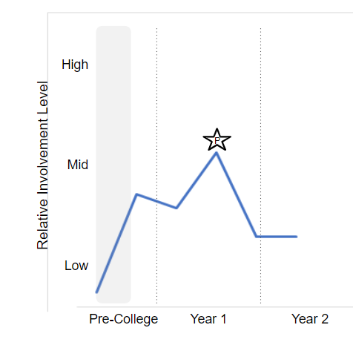
Peyton
Low baseline characterized by involvement in a STEM club and professor influence
Pre-college geoscience research experience
Participated in the field experience in year one
Non-geoscience STEM major
Interview and check in took place before completion of college career

Slide 16
T
High
A
Q
Field Experience for
this study
P
Peyton
Anna
Taylor
Quinn
Mid
Relative Involvement Level
Low
Pre-College
Year 1
Year 2
Year 3
Year 4
Career
Relationship to Astin’s Theory of Involvement (1984)
INPUTS
ENVIRONMENT
OUTPUTS

Slide 17
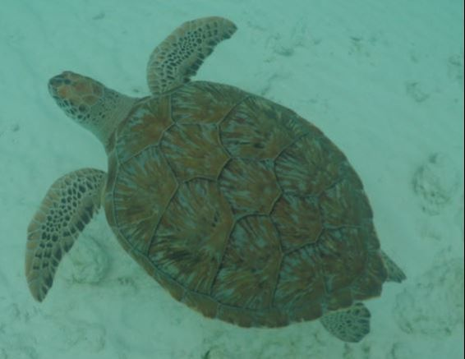
Future Work
Incorporation of student grades as a measure of involvement’s impact on student performance
Inclusion of future cohorts of this experience, as well as adaptation for other forms of involvement within the geosciences and beyond

Slide 18

Acknowledgements
Photo Credits: Kelly Lazar and class members
This material is based upon work supported by the National Science Foundation under Grant No.1540702. Any opinions, findings, and conclusions or recommendations expressed in this material are those of the author(s) and do not necessarily reflect the views of the National Science Foundation.
Thanks to our participants, Dr. Lisa Benson, Dr. Matt Voigt, Dr. Victoria Sellers, and Leah Wiitablake

Slide 19
References
Astin, A. W. (1984). Student Involvement: A Development Theory for Higher Education. Journal of College Student Development, 40, 518–529.

