Slide 1
DISCOVERFRAMEWORK: A FREEWARE TOOLKIT FOR SPATIO-TEMPORAL ENVIRONMENTAL DATA VISUALIZATION AND DIGITAL STORYTELLING
Misty E. Porter (University of Kansas)
Mary C. Hill (University of Kansas)
Andrea E. Brookfield (University of Waterloo)
Ted D. Harris (Kansas Biological Survey)
Xingong Li (University of Kansas)
GSA Connects 2022
12 October 2022

Slide 2
Outline
Big Picture Overview
The DiscoverFramework
Discover Applications
Summary
Application Links

Slide 3
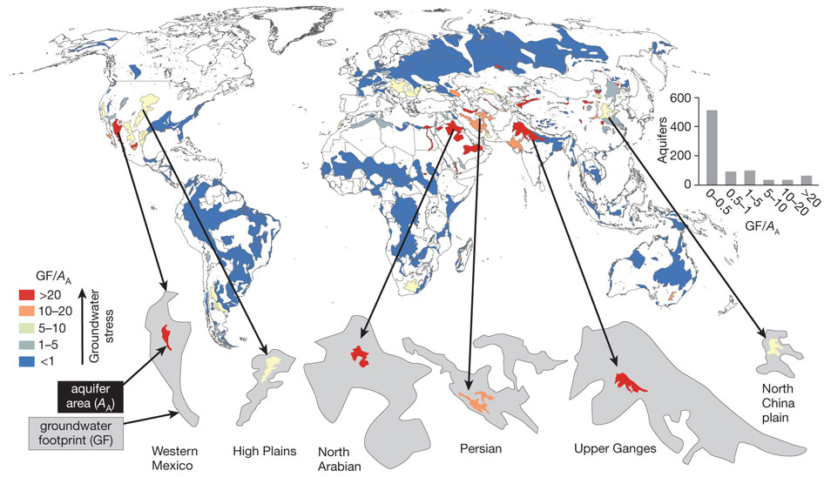
Groundwater Decline
Excessively pumping aquifers puts stress on the groundwater supply
Adaptive measures have been slow due to a lack of understanding hydrology
The situation is critical – agricultural production and livelihoods are threatened
Vast amounts of scientific data available but not presented in a way to support making the necessary decisions
Water balance of global aquifers revealed by groundwater footprint
Adapted from Gleeson et al. 2012
Notes:
*** Point these out *** Uley South Basin in South Australia; North China Plain; Krishna and Gadavari in India; The High Plains aquifer in North America

Slide 4
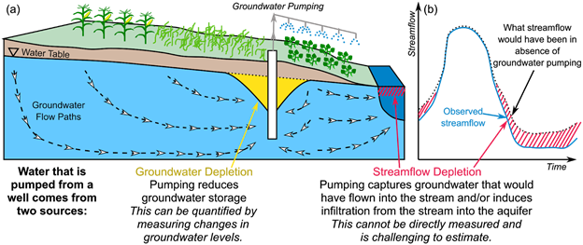
Stream Depletion
Groundwater declines lead to separation of baseflow in streams from water table resulting in streams no longer flowing perennially
Minimum desired flow requirements for water rights and ecosystems not being met
Adapted from Zipper et al. 2022

Slide 5
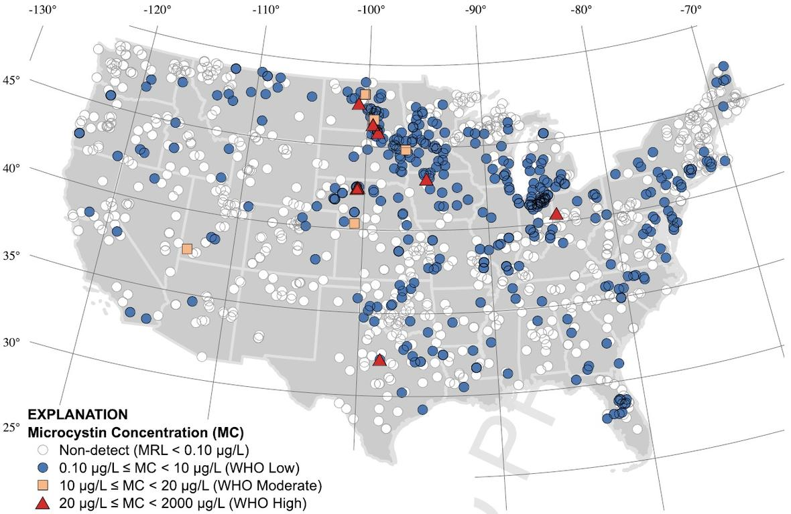
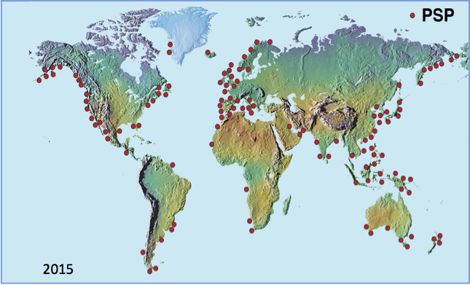
Harmful Algal Blooms
2007
Many different parameters can contribute to a bloom under various conditions. Exact cause is still not 100% certain
Challenging to compare combinations of parameters simultaneously
Economic and public safety concerns
Need sustainable stewardship of resources to prevent harmful consequences
Adapted from Loftin et al. 2016
Adapted from Zohdi and Abbaspour 2019
Notes:
*** Point these out *** Uley South Basin in South Australia; North China Plain; Krishna and Gadavari in India; The High Plains aquifer in North America

Slide 6
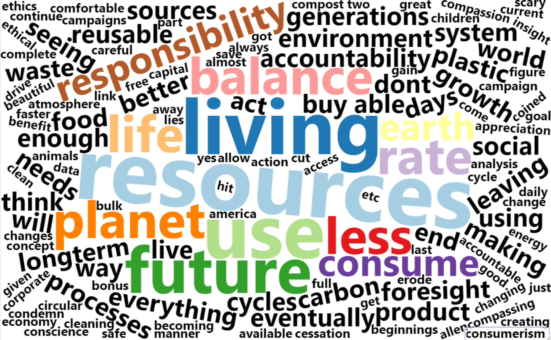
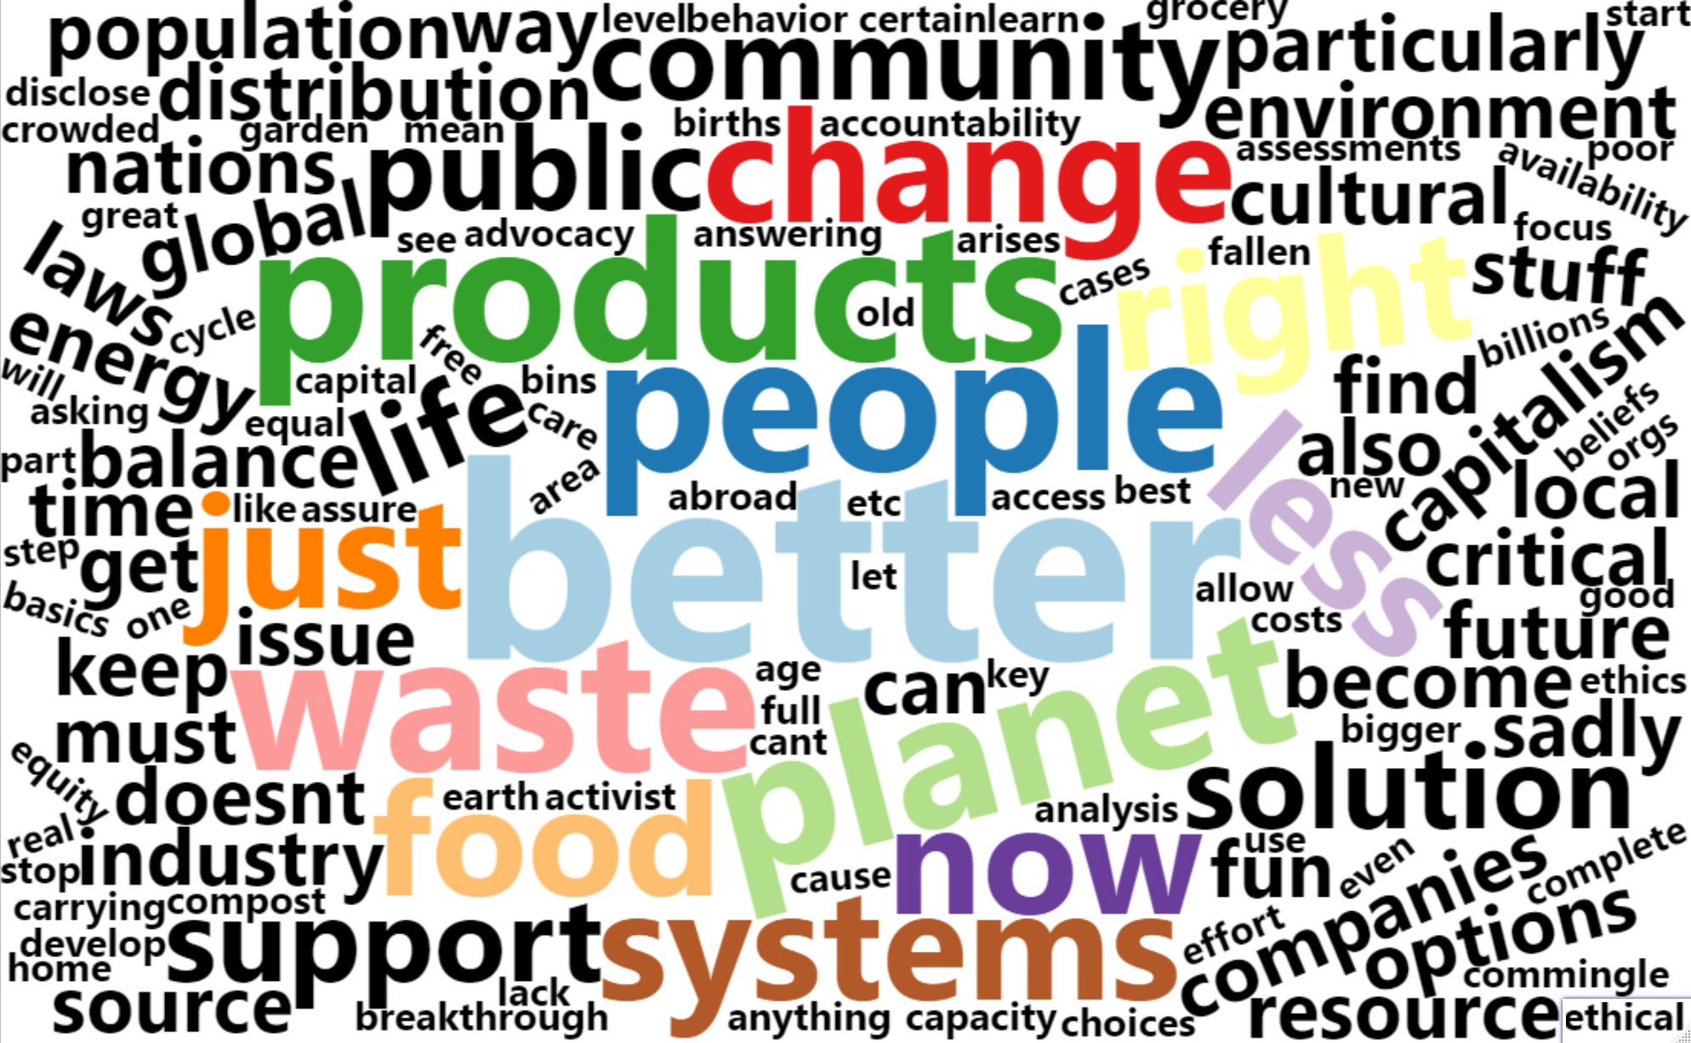
How can data visualization with DiscoverFramework help?
What does Sustainability mean to you?
PLANET: multi-scale analysis (local to global)
RATE: look at the rate of CHANGE through historical data
FUTURE: understanding the past is the key to the future (predictive statistics)
SYSTEMS: use multiple data sources to look at systems as a whole
RESOURCES: water is a key environmental resources necessary for LIFE
WASTE: learn where waste is happens so we can CONSUME LESS and work towards BALANCE with the Earth
COMMUNITY: inspire collaboration through knowledge discovery
What Do you need to be more sustainable?

Slide 7
Objective
Knowledge gap
The variability of natural systems is confusing. Need ways for people to envision slowly evolving crises. Data and the insights the data contain are largely inaccessible to most stakeholders.
Develop a toolkit for scientists that provides them with a way to build applications able to facilitate qualitative and quantitative data analysis, science communication with the public, and a resource to better inform policy.

Slide 8
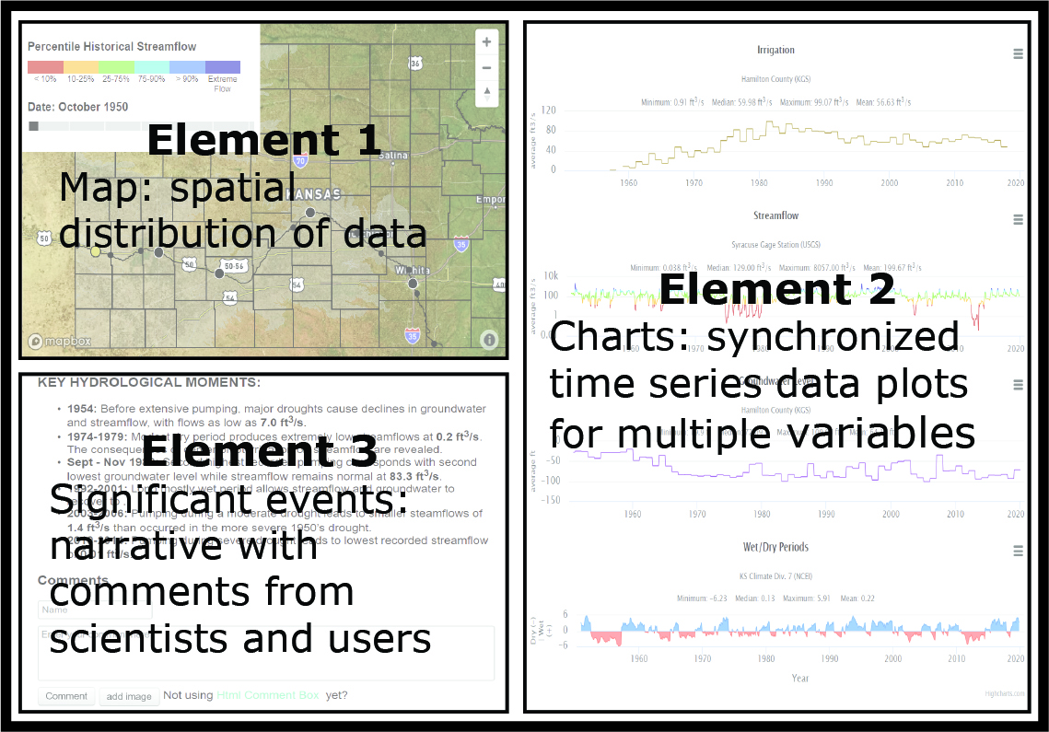
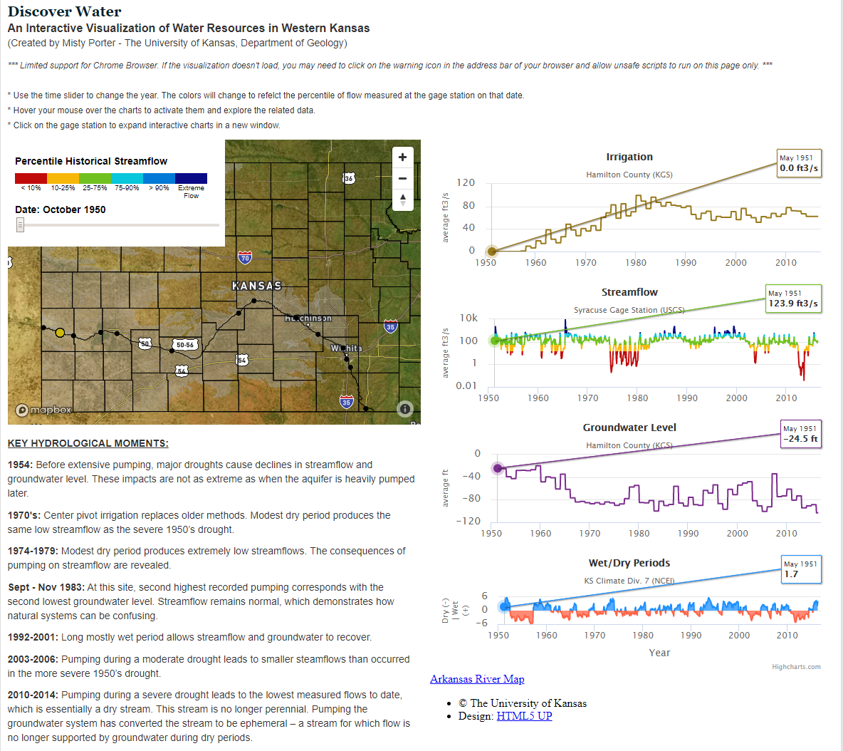

Slide 9
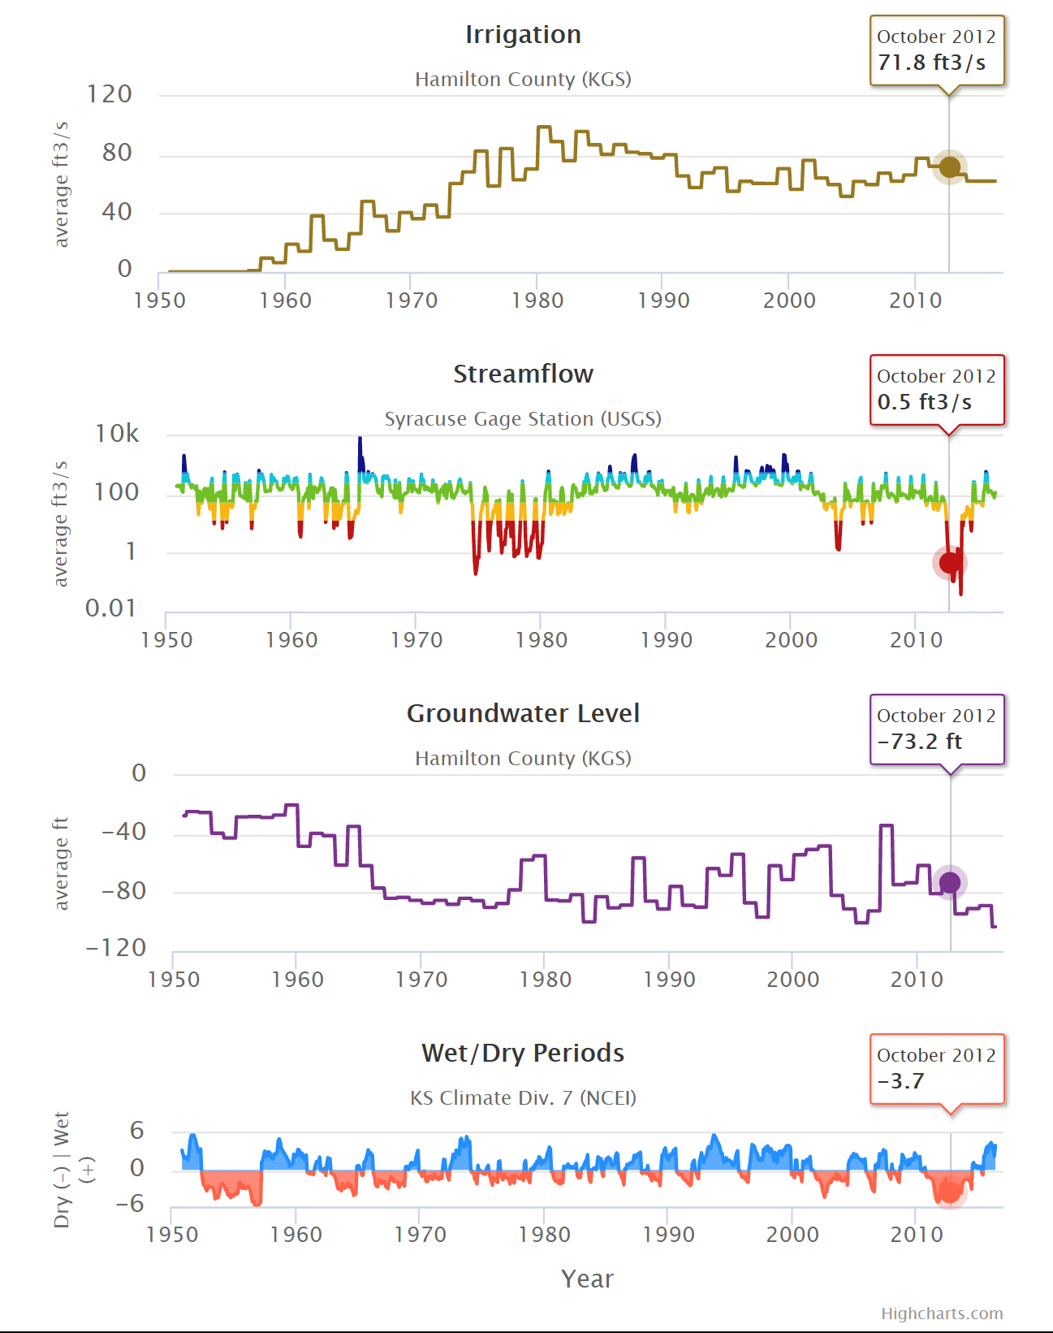
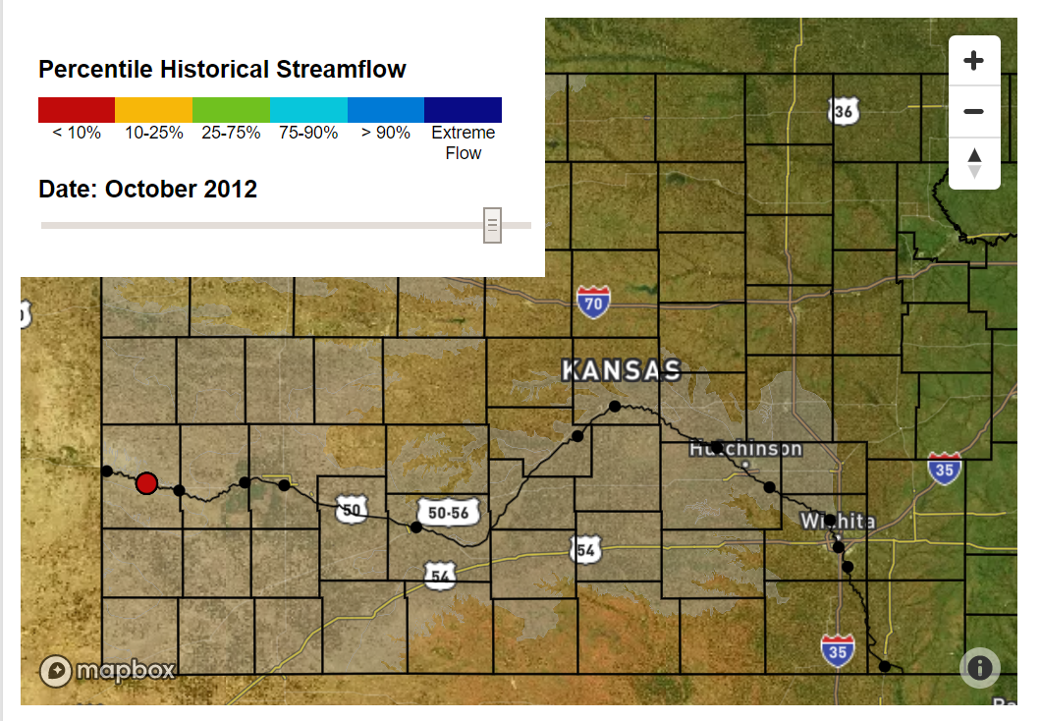
DiscoverWater along the Arkansas River, KS
2.0 m3/s
0.01 m3/s
22.3 m
Base flow during droughts decline precipitously with groundwater pumping.
Hidden for 20 years; huge impact in 2012-2013
Notes:
From now on, we will only look at one date at a time. The map has been advanced 10 more years to October 2012 to another intense dry period with a PDSI of -3.7 during which the aquifer was pumped at an average of 72 ft³/s (2 m³/s) throughout the year. Streamflow was barely flowing at 0.5 ft³/s (0.01 m³/s), and groundwater was 73.2 ft (22.3 m) below the surface before dropping to 94.5 ft (28.5 m) the following year.
This shows that the impacts of pumping the aquifer are compounded by dry climate.
Looking at a trend for one month showing aquifer & stream response to dry seasons
Looking at trends across multiple decades shows aquifer & stream response to dry seasons in addition to pumping emphasizing human impact / compound effect of pumping and dry climate

Slide 10
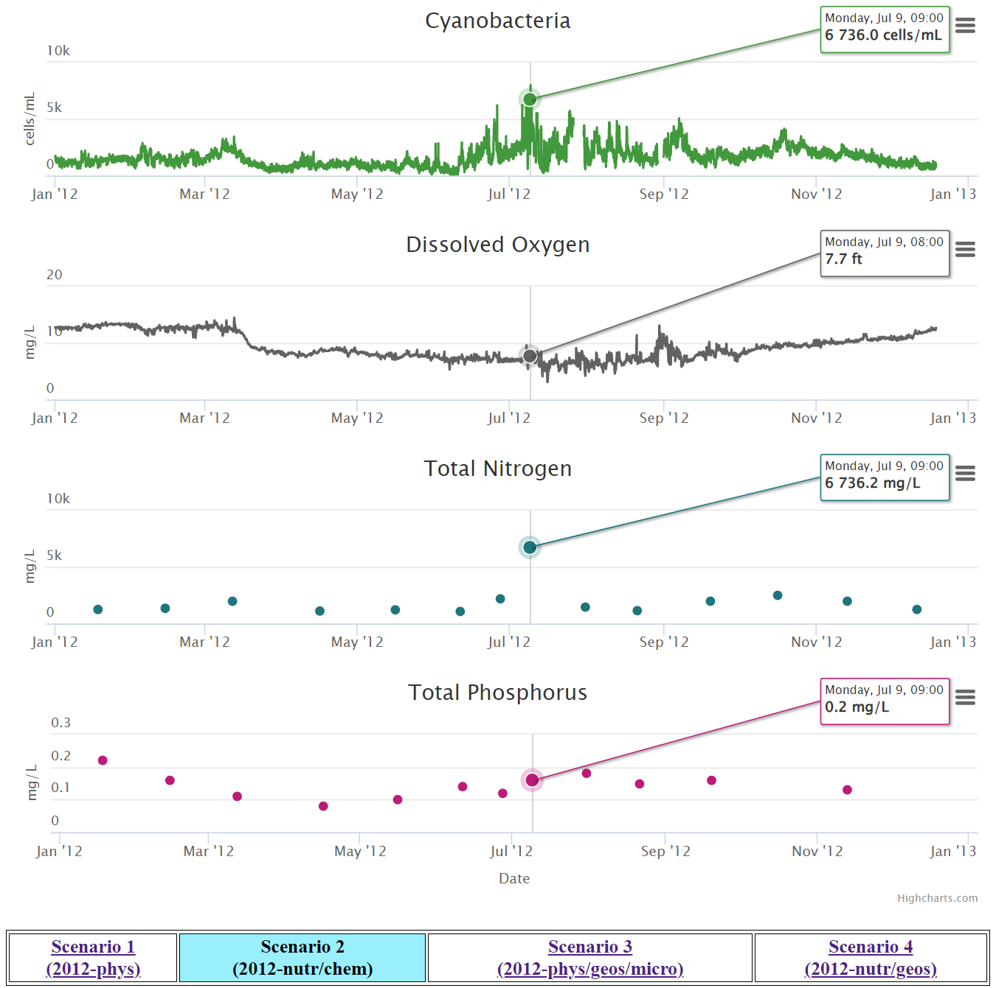
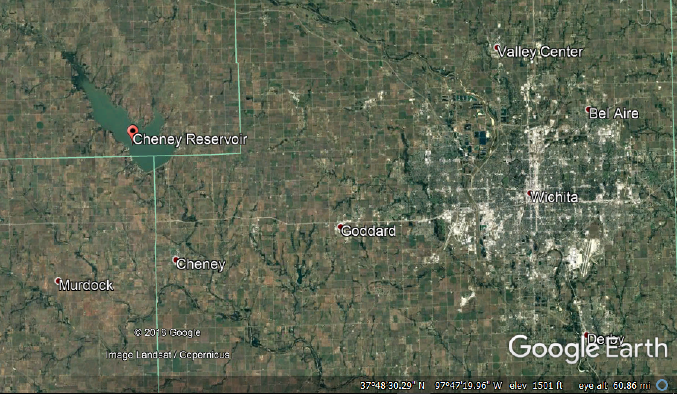
DiscoverHABs Cyanobacteria Harmful Algal Blooms (HABs) at Cheney Reservoir, KS
Cheney Reservoir
Wichita
Challenge: many potential explanatory variables.
Added scenario capability to DiscoverWater to focus on selected questions, such as nutrient loading vs environmental factors

Slide 11
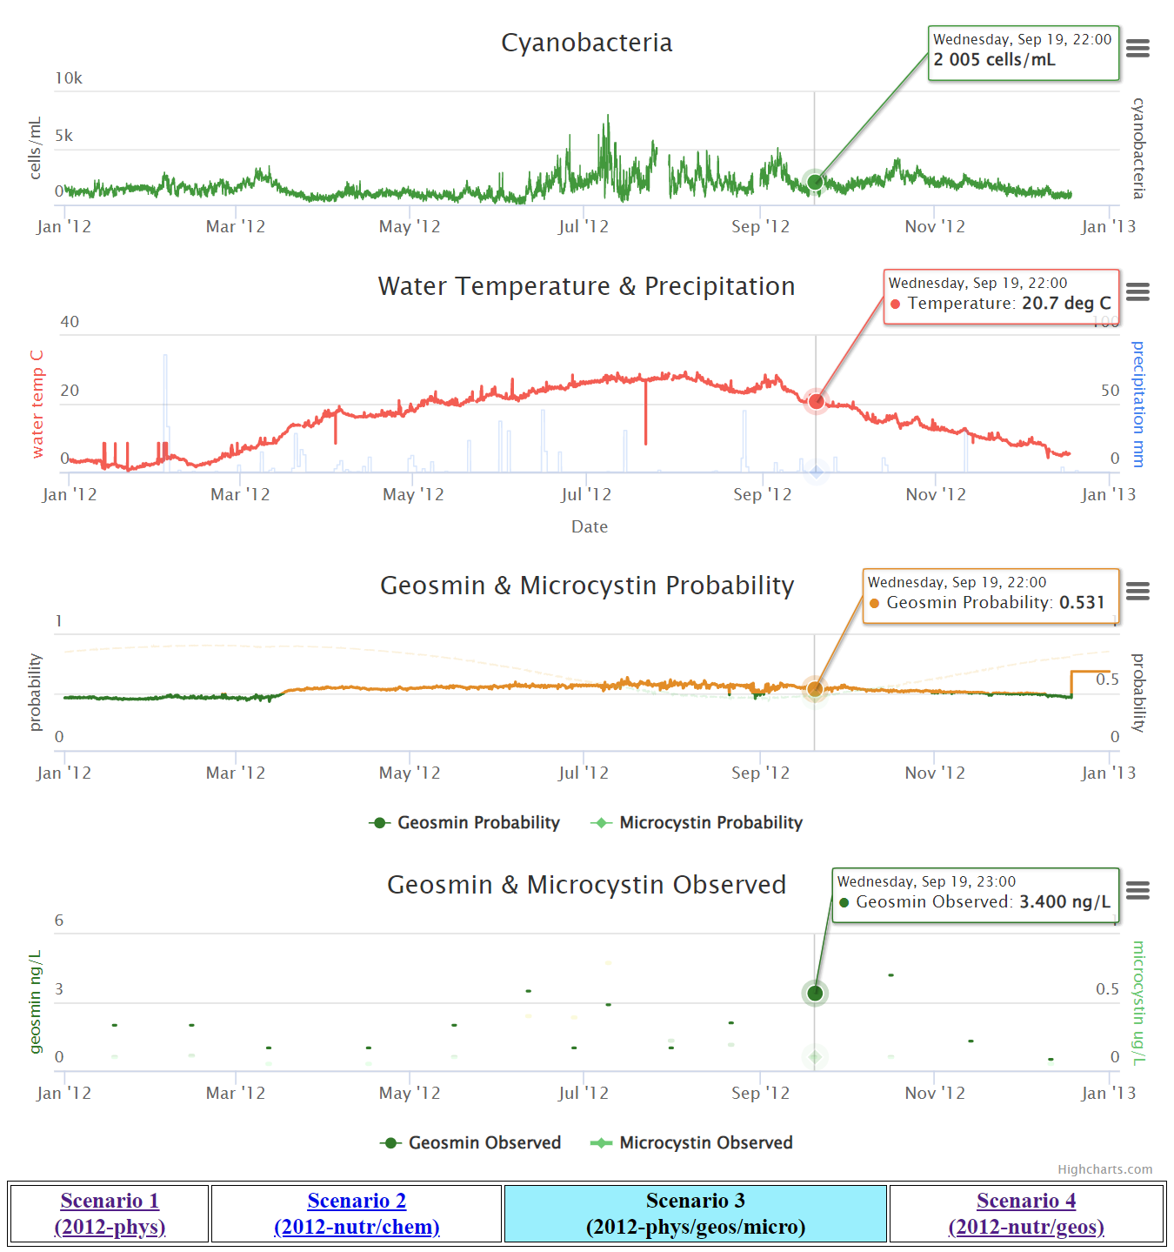
DiscoverHABs Cyanobacteria Harmful Algal Blooms (HABs) at Cheney Reservoir, KS
Cheney Reservoir
Wichita
Challenge: many potential explanatory variables.
Added scenario capability to DiscoverWater to focus on selected questions, such as nutrient loading vs environmental factors

Slide 12
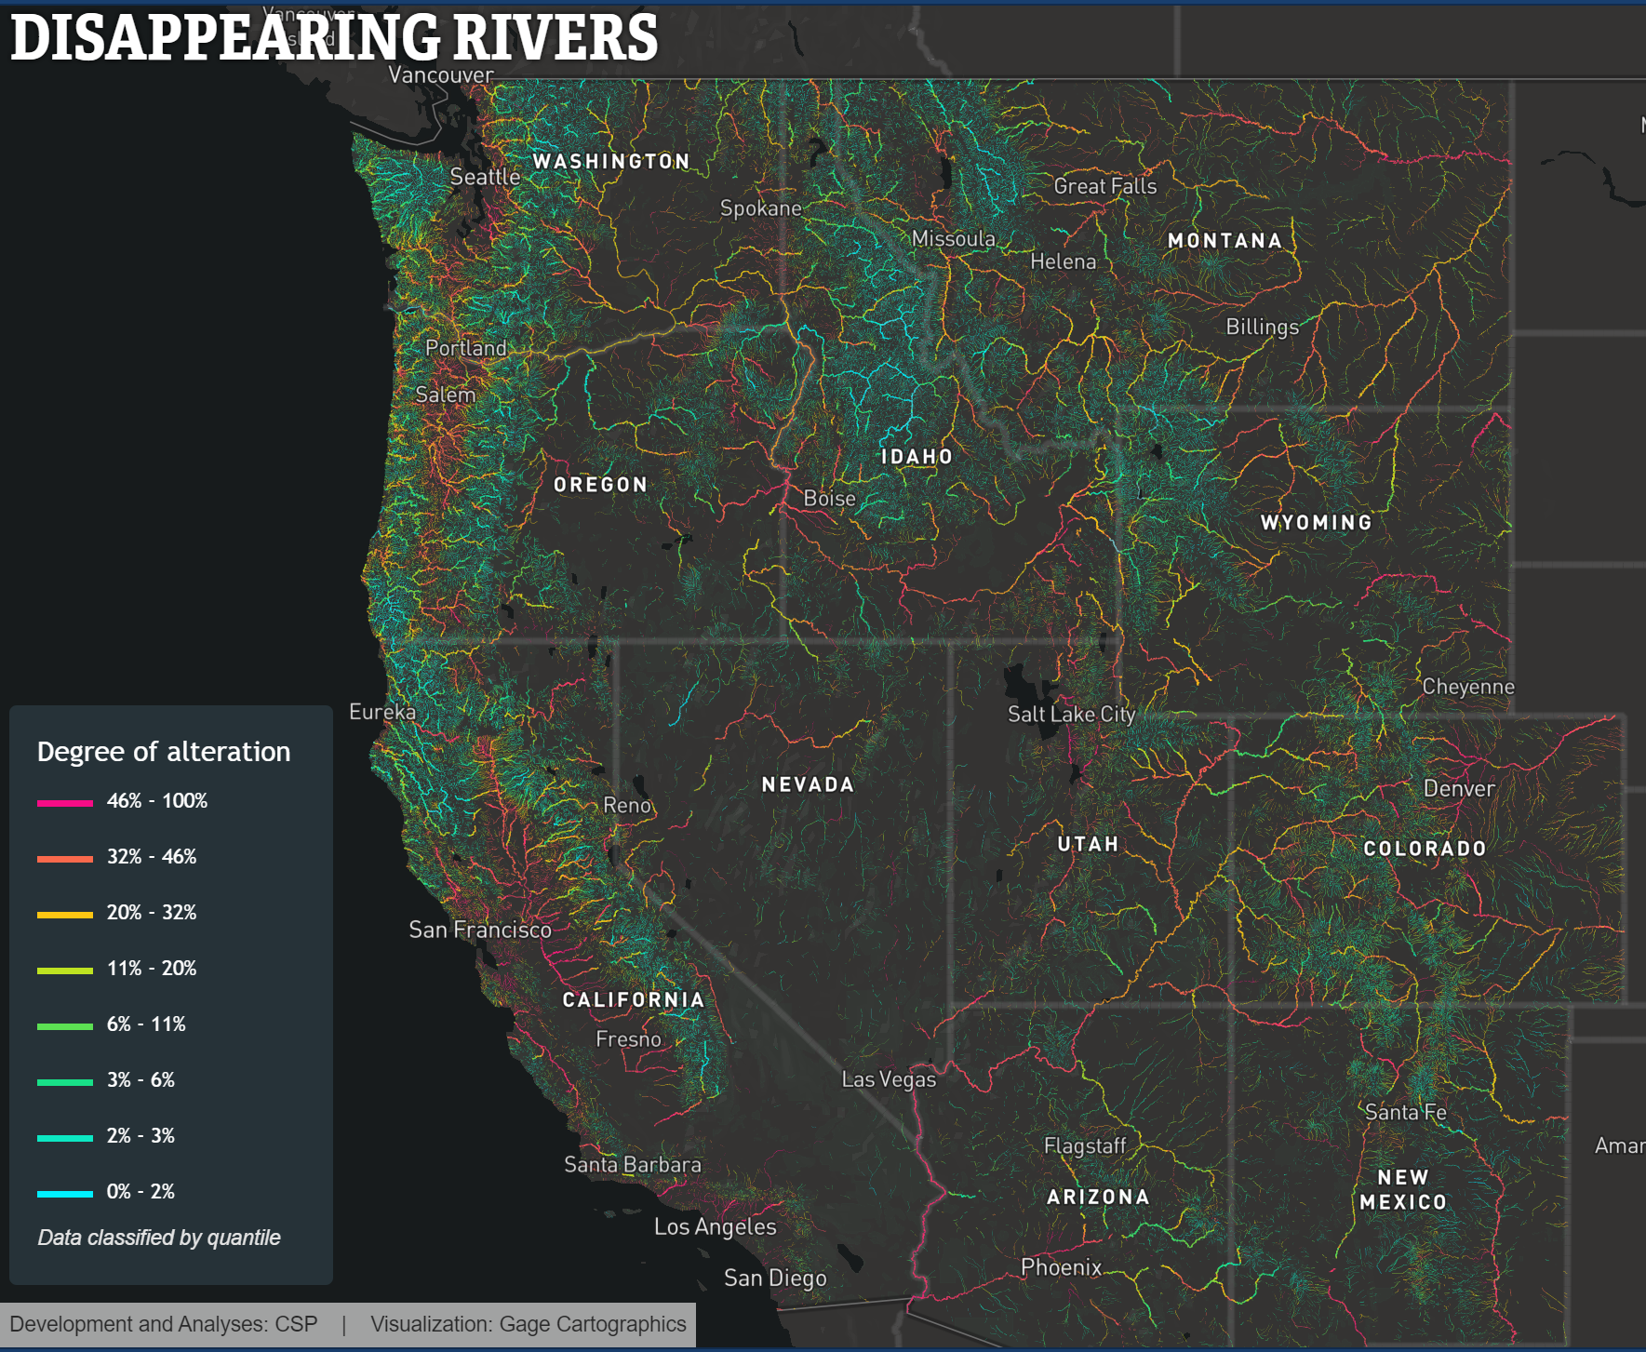
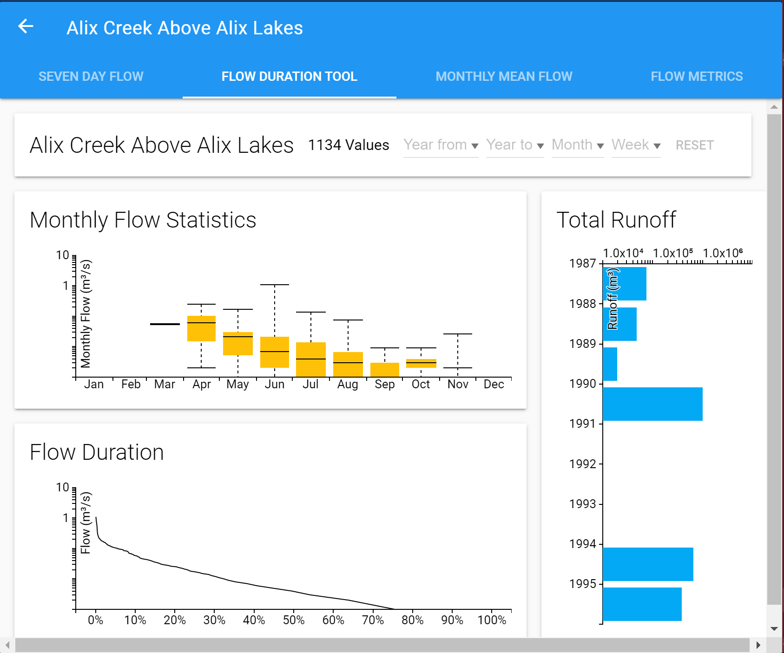
DiscoverStreams – Concept Design + DiscoverFramework Groundwater impacted streamflow across the U.S.A.
https://disappearingwest.org/rivers/map/index.html
http://cariboo.bcwatertool.ca/stream
Notes:
However, the aquifer was being pumped at an average of almost 100 ft³/s (2.83 m³/s) throughout the year, which is the same as the overall average streamflow measured at the Syracuse gage station highlighted by the blue line. With groundwater at 85 ft (26 m) below the surface, the hydrologic system is unable to support this much pumping and streamflow drops down to at an average of 21.5 ft³/s (0.6 m³/s).

Slide 13
FEATURE SUMMARY
Combine data and map displays to establish context
Examine the data behind the changes observed across the landscape
Elucidate trends across multiple datasets
Microscale & macroscale (Local & regional) trends
Wet & dry seasons
Groundwater & surface water interactions
Water quantity & quality
Identify anthropogenic, climate, & combined impacts
Scenarios for combinations of parameters
Visualize time-series data
Illustrate the past to explain the present to improve the future
Notes:
- Maybe only have bullet points

Slide 14



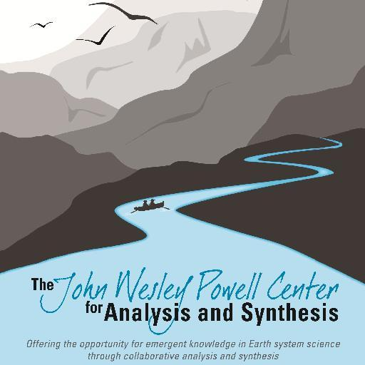
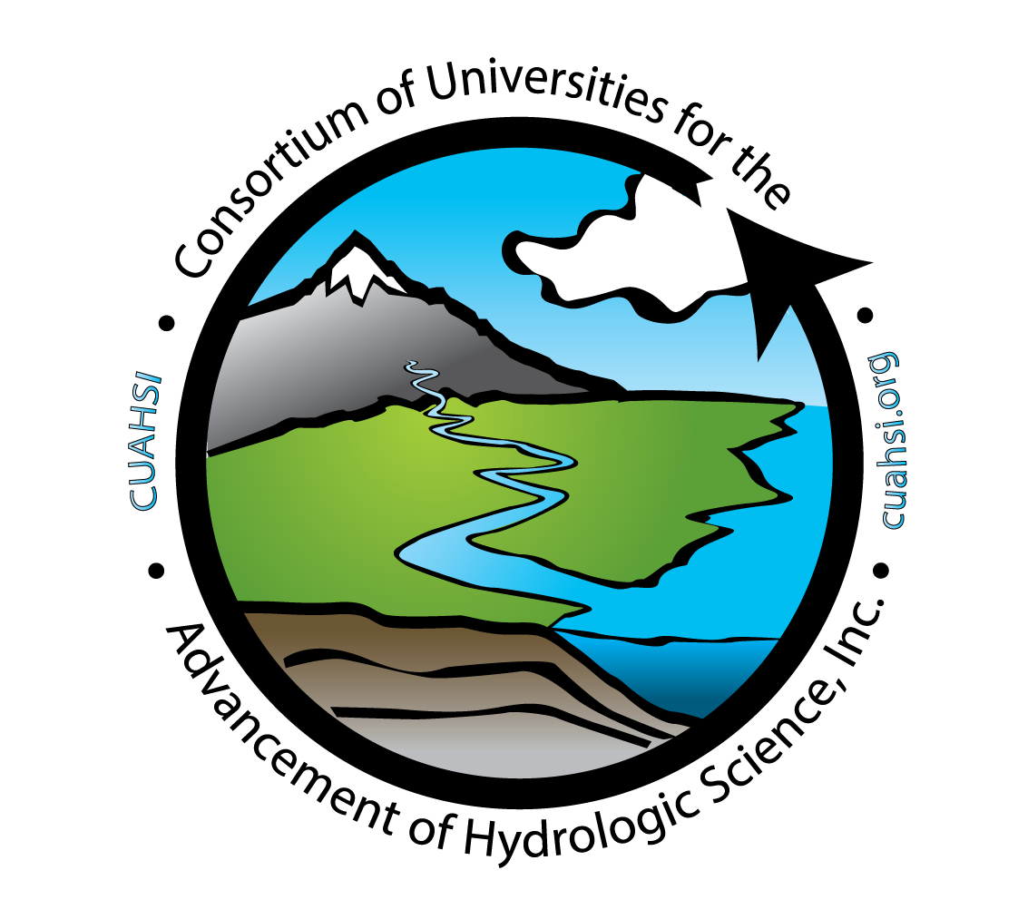
Acknowledgements
FUNDING
University of Kansas Center for Research
University of Kansas Research Excellence Grant
University of Kansas Department of Geology
USGS Powell Center
Collaborations
Intelligent Systems for Geoscience (IS-GEO) RCN
Information Sciences Institute – University of Southern California
EarthCube
Consortium of Universities for the Advancement of Hydrologic Science, Inc (CUAHSI)
Published 18 JUN 2021 in Environmental Modeling & Software
https://doi.org/10.1016/j.envsoft.2021.105104

Slide 15
DiscoverWater
Thank You!
https://interactiveviz.ku.edu/DiscoverWater/
DiscoverHABs –
Cheney Reservoir
https://interactiveviz.ku.edu/DiscoverCheney/Scenario1/
DiscoverFramework
https://github.com/mistyblue17/DiscoverFramework
Notes:
DiscoverWater has the potential to become and even more powerful tool with future work. However, if you are interested in playing with the current version of DiscoverWater, please visit this URL. Thank you for your time.

