Slide 1
THE TIMING OF RIFT INITIATION BETWEEN THE NORTH AUSTRALIA AND
GAWLER/ SOUTH AUSTRALIA CRATONS
Daniel P. Connelly
March 20, 2011
Notes:
Welcome Geologists and guests

Slide 2
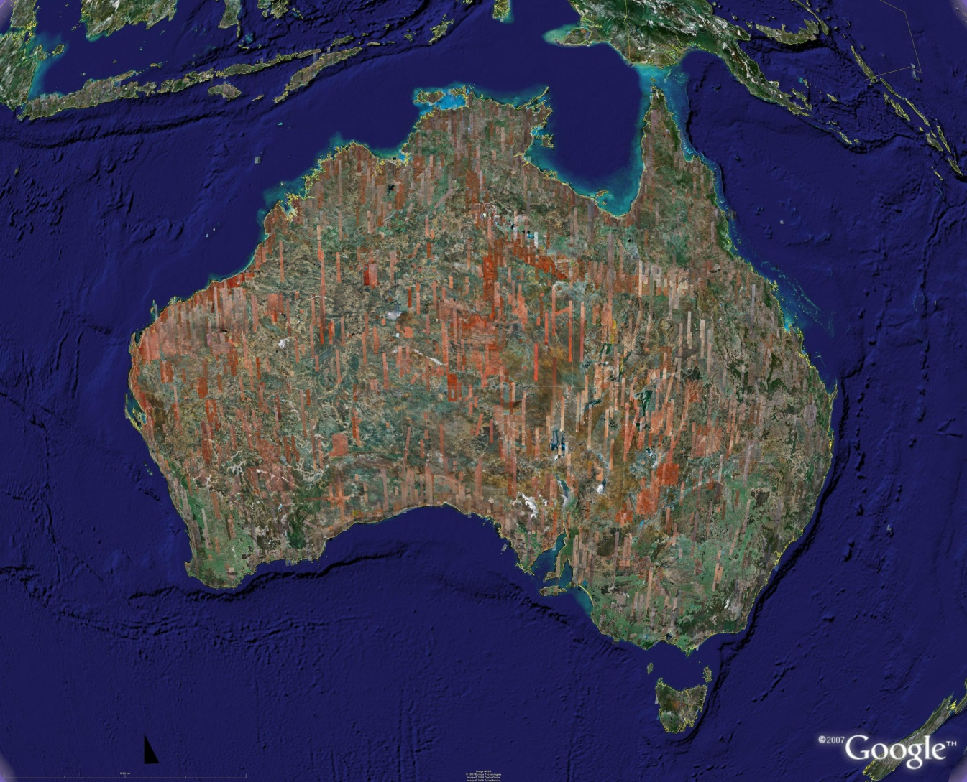
Reconciling the ring
2007 post rain event desert bloom image
Far-field ring is beyond radius of classic impact ring, possibly due to tectonic stresses from the impact.
Notes:
Why ask the question: The starting point of this investigation was the need to reconcile the visible far field ring with the proposed age of impact which is thought to be ~545ma. If the impact is ~545ma then logically the ring structure must be imprinted on rock older than 545Ma. This is not a problem for most of the ring as it is part of rock that is clearly older than Precambrian in the North and Western part of the ring. If the ring exists under the ice in Antarctica, that location is also older than Precambrian. The problem arises in the Eastern part of the ring. There appears to be a gap and the radius from the center is longer.
The impact is known as MAPCIS( Massive Australian Precambrian/Cambrian Impact Structure)

Slide 3
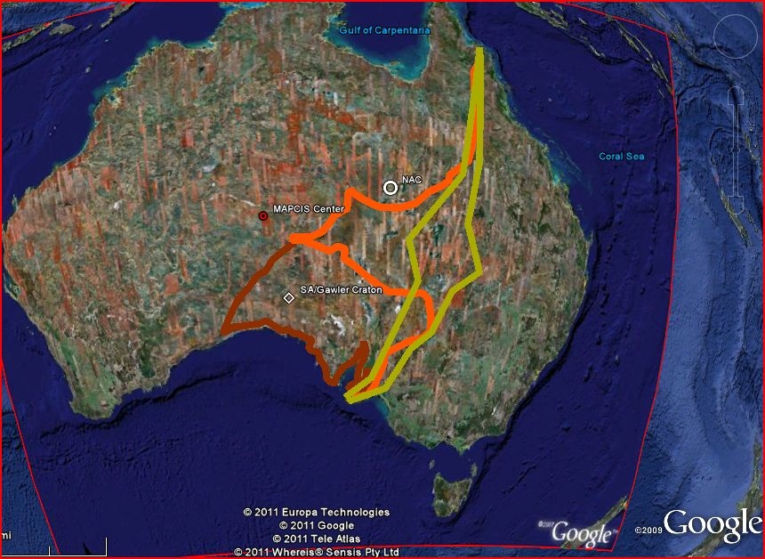
Problem of the Tasman Line and Gawler/SA Craton
Tasman line variation
Notes:
The much debated Tasman Line divides the Precambrian rock of Australia to the West from the younger Phanerozoic rock to the East. The location of the Tasman line and even the definition, depends on individual geologist. The area within the green lines represents early variations of the Tasman line. You can see that the location of this geologic boundary matters for the East and southeast sections of the Ring. As there was no consensus, I stayed with the simplest definition , Precambrian rock to the west and Phanerozoic to the East. This allowed for the ring but, without a satisfactory conclusion.
This is when I came across statements in the literature that the Gawler/SA Craton was once attached to the NAC as universally accepted. If these two now separate cratons were once attached, when did they separate. A search of the literature was silent on this point. The orange line defines the gap between these two cratons.

Slide 4
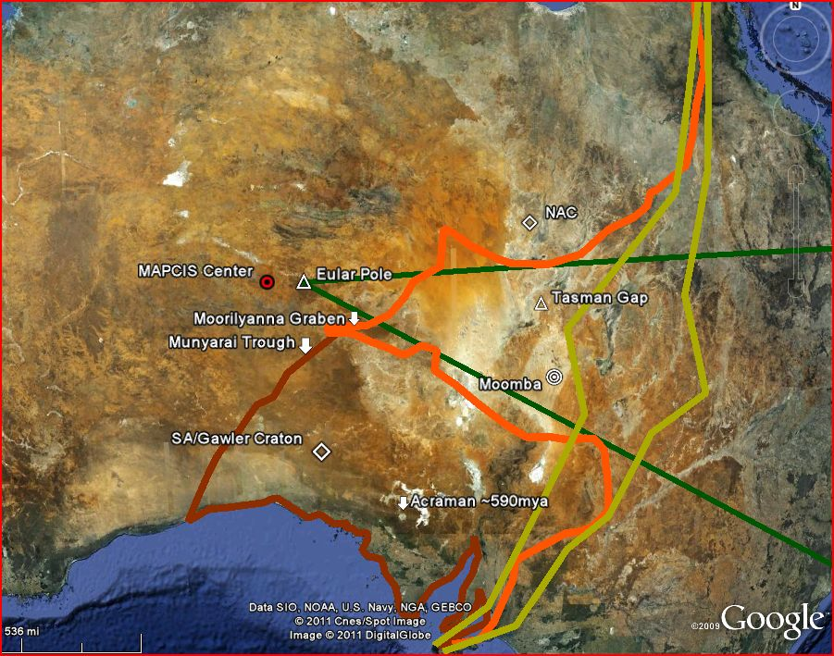
Landmarks and Moomba
The Eular pole is a best physical fit representation for the opening of the Tasman Gap and is not based on
Paleopole data.
Notes:
Here we have some important reference points: The Eular pole at 132 deg 30 Min E and 25 deg 30min S decided with a best fit angle based on the Tasman Gap. The center of MAPCIS is to the West of the Eular Pole. The Moorilyanna Graben dropped ~550Ma. Munyarai Trough thicken to 10km where the Gawler Craton contacts the Musgrave Block. Acraman ~590Ma the 8th largest known impact at 90km diameter is within the SA/Gawler Craton. Moomba drill core is within the gap and west of previous Tasman lines.

Slide 5
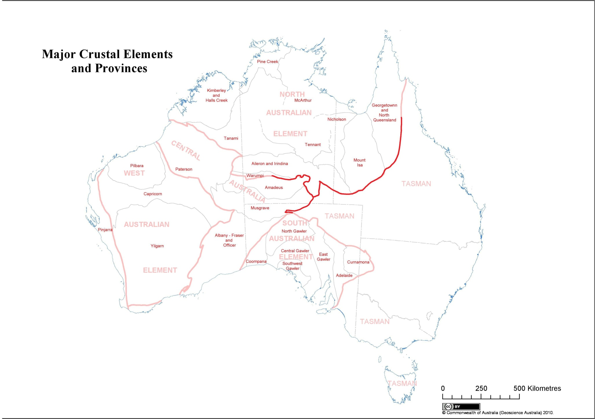
Crustal Elements
Notes:
Here we see this same gap on this latest 2010 map of Crustal elements published by Geoscience Australia , that the Tasman line forms a deep embayment that reaches west to the Musgrave Province. It looks as if the Gawler/SA cratons could be rotated counterclockwise to reconnect with the NAC.

Slide 6
Notice the Proterozoic events do not cross the gap
Notes:
The cartographers have added all the known Proterozoic mafic-ultramafic magmatic events to the crustal elements map. From this map , one can is able to find corresponding events in the separated cratons. This map can be downloaded from the Geoscience Australia website in high resolution.

Slide 7
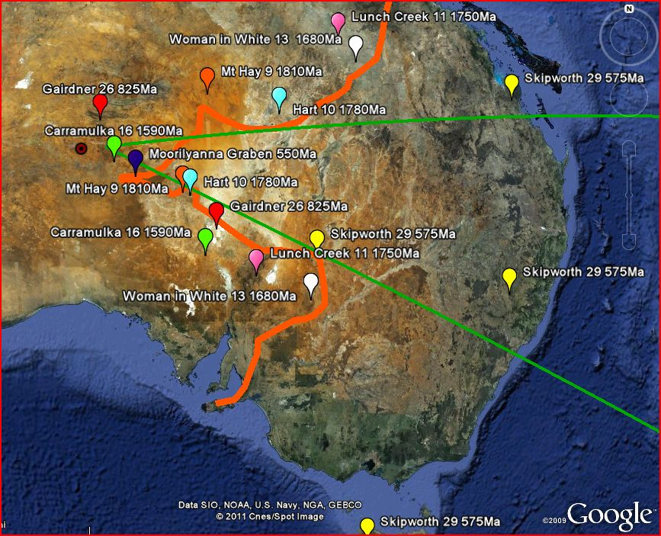
Divided Mafic Events
Delamarian orogen ~515-500ma
Notes:
I simplified the previous map to more easily show the corresponding events. From Left to right in NAC and the SA/Gawler craton the events are Mt. Hay 9, Hart 10, Lunch Creek 11, and Woman in White 13. All of these are over 1.5 Ga. Although it is not in the NAC , The Skipworth Event 29 is the youngest separated event at ~575Ma. It doesn’t fit the Tasman Line definition as three areas are East of the line. We also have events in Central Australia that correspond to events in the Gawler/SA Craton, the Carramulka 16 and Gairdner 26. You can see that these two events stay in order East to West in the pre rotation Australia. I suggest that the Delamarian Orogen ~515-500Ma may mark the end of the rotation as the Gawler/SA craton would be colliding with Antartica.

Slide 8
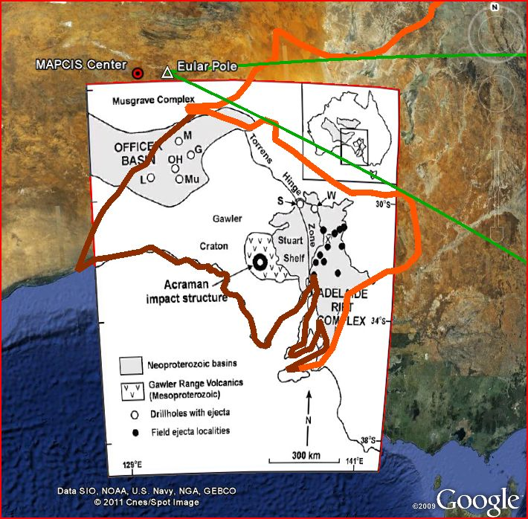
Acraman impact and Ejecta
Moomba
A.Hill, P.Haines, K.Grey, S.Willman
2007
Notes:
The Acraman Impact ~590Ma raised this question. If the rotation was after 545Ma, is there any evidence of the path or original location Acraman. Is there any evidence of ejecta in the gap? There is no mention of Acraman ejecta, outside of the Gawler/SA Craton in the reviews of drill cores both to the North and West of the Gawler /SA Craton by these same geologists. There was no ejecta in the Moomba drill core which reached the basement rock. One would expect to find Acraman ejecta in the Tasman Gap, if the gap opened before the impact. The lack of ejecta suggests that the opening of the rift must be after the impact. What of the Acraman impact crater itself, as it is embedded in the Gawler/SA Craton?

Slide 9
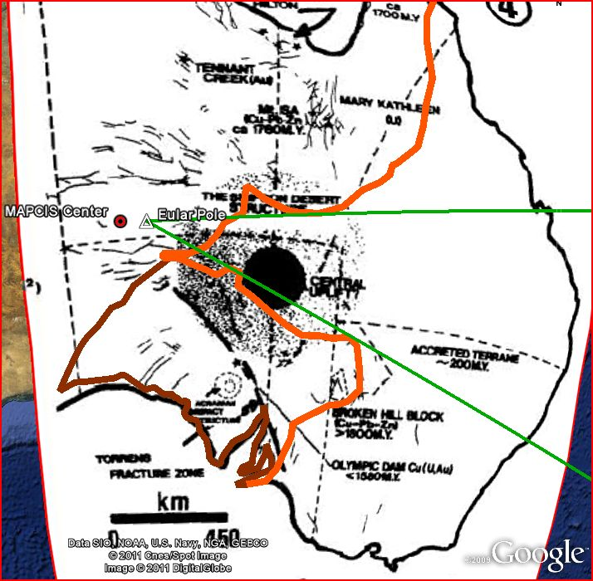
Simpson Desert Structure and Acraman?
M.J. Duane and W.U. Reimold
1990
Notes:
This was a pleasant surprise. Duane and Reimold found evidence of a large impact in the Simpson Desert. The wide variety of data they collected(Seismic, gravity, chemical, structural. Etc.) suggested there should be an impact in this location, but there wasn’t. When one rotates the Gawler/SA craton counterclockwise back to it’s original position, Acraman the 8th largest impact, overlaps the site of the Simpson Desert Structure. I believe Duane and Reimold found evidence of the original location for Acraman where the relict imprint remains.

Slide 10
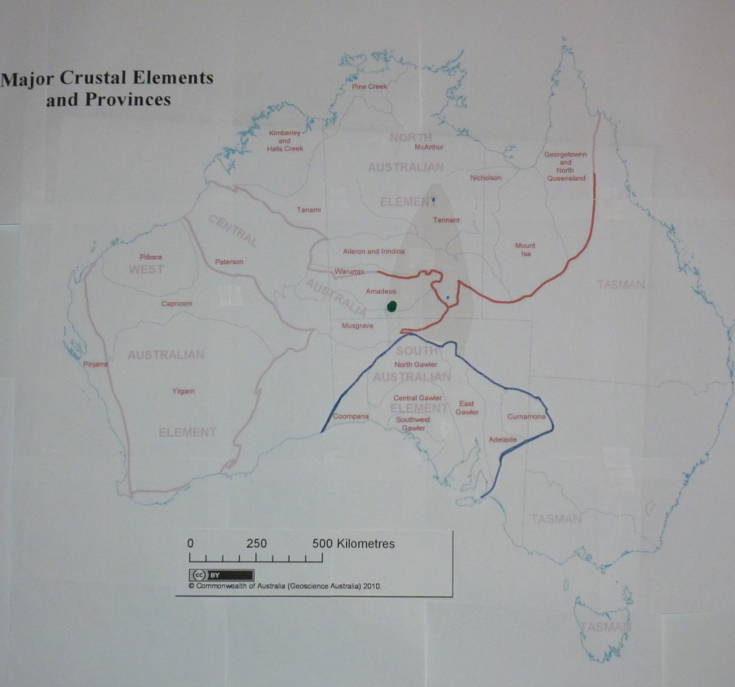
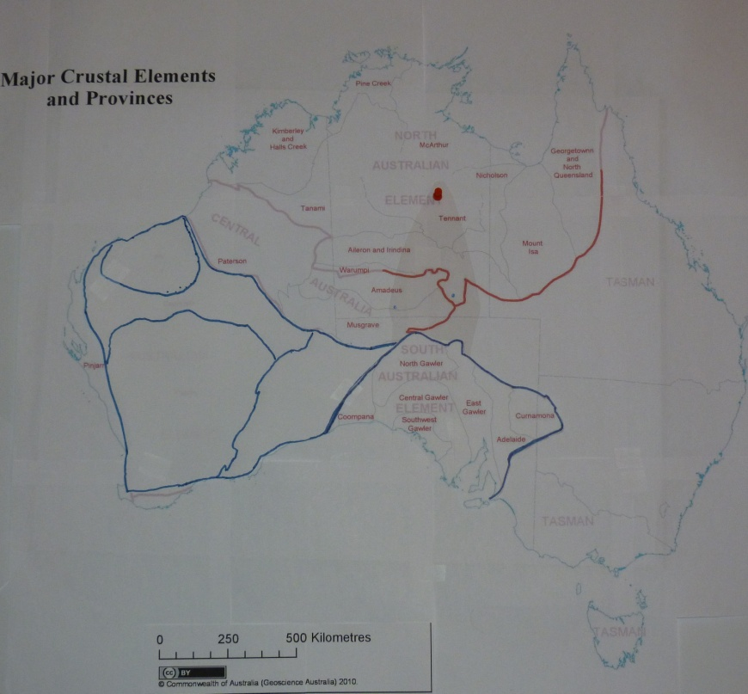
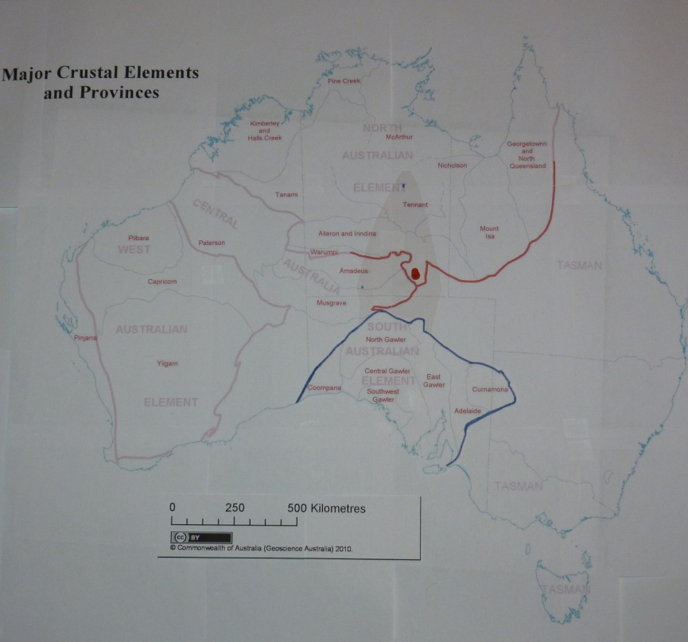
3 Eular Poles
Connelly 2010
~132deg 30’ E & 25deg 30’ S
~545Ma-500Ma
Li & Evans 2011
Giles, Betts &Lister 2003
~135deg E & 20deg S
~136deg E & 25deg S
650Ma-550Ma
1.5Ga -1.3 Ga
Notes:
I this point I thought I had enough, confident that I was the first to seriously address this question and sent in my abstract for this conference. There is always one more thing to be found. In December, an indirect search found that Giles, Betts, and Lister had addressed the question of the Gawler/SA rotation in 2003, but with a very different conclusion. Then this January 2011, Li and Evans addressed the question in “Geology” with conclusions that differed also. Both Li, Evans and Giles, Betts, Lister used paleopoles to find the Eular pole location. My Eular pole is based solely on the best physical fit of the Tasman Gap.
Li and Evans= 40deg rotation to reconcile paleopoles and Gondwana configurations. Giles Betts & Lister 52Deg rotation to reconcile paleopoles and early to middle Proterozoic continental configurations.
I made a model to include the three rotations based on the Eular Pole locations. Forgive my primitive animation
A Eular pole to the west of Giles betts and Lister would also satisfy paleopoles with a 30Deg rotation. Connelly 30deg Rotation

Slide 11
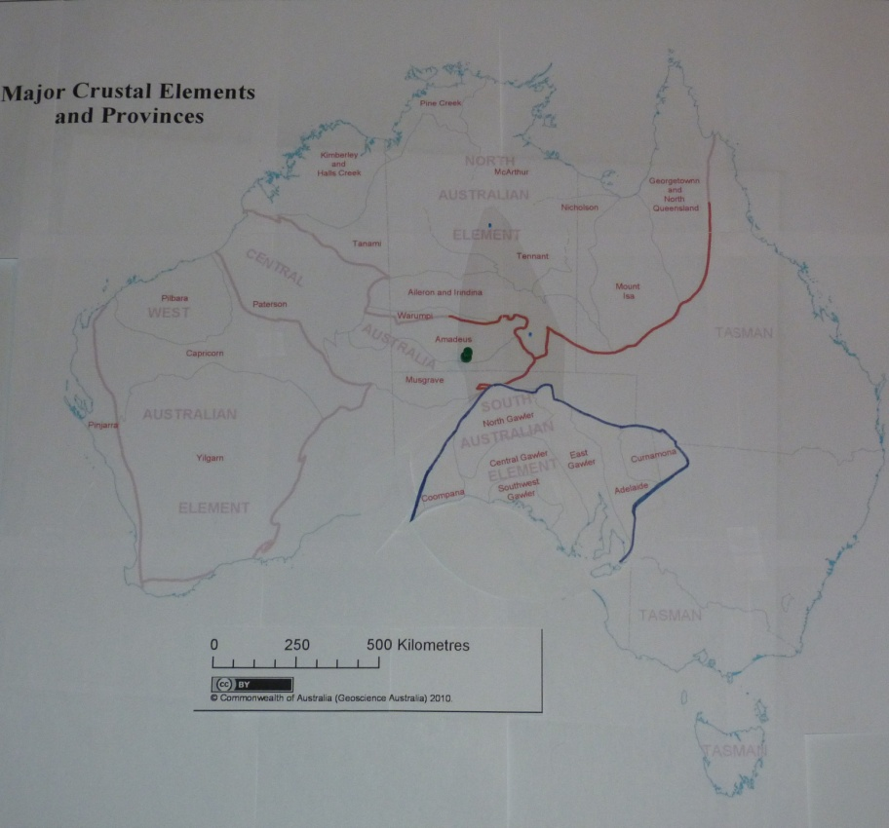
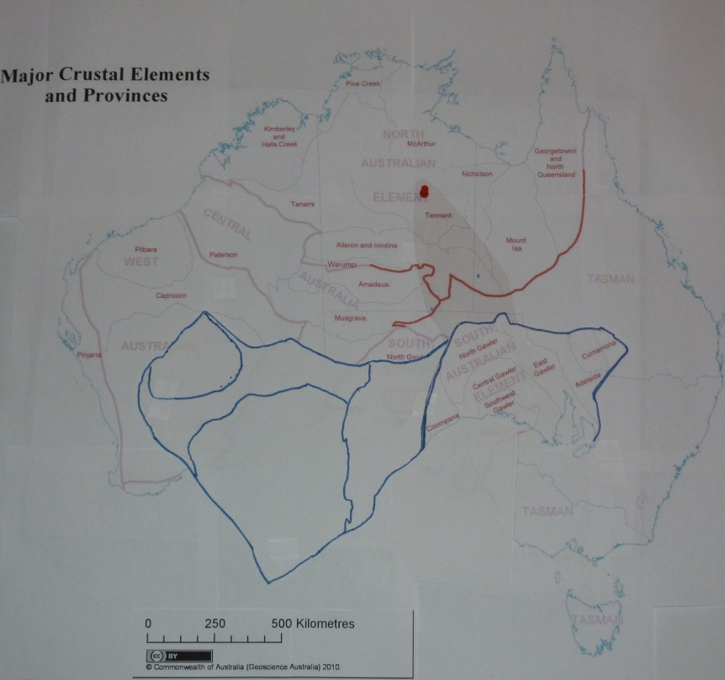
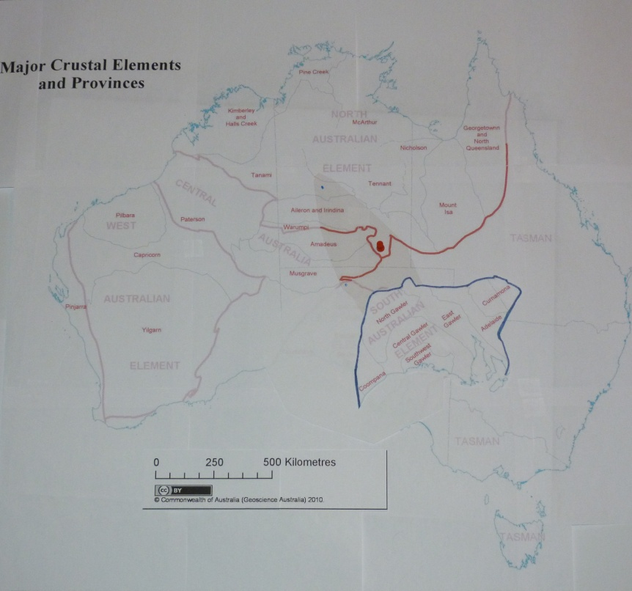

Slide 12
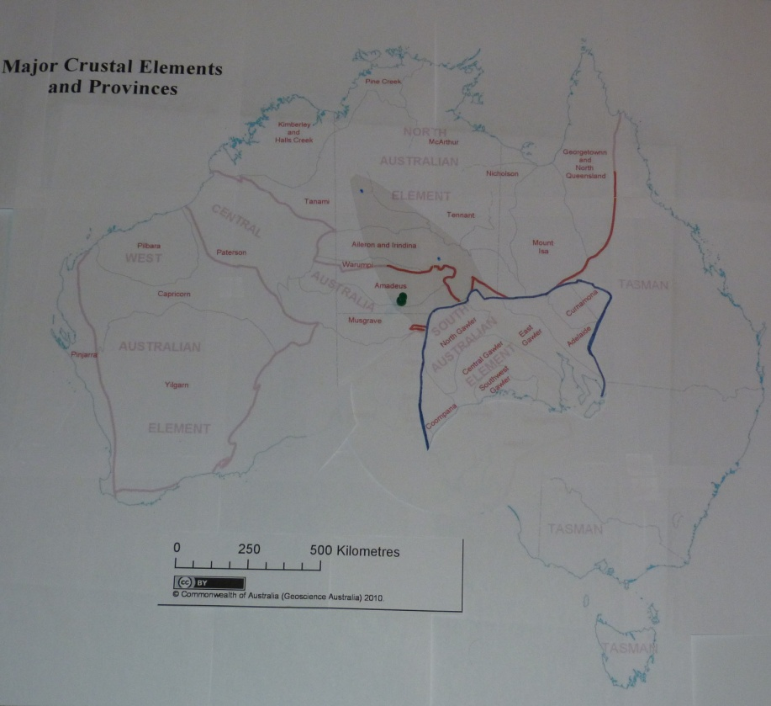
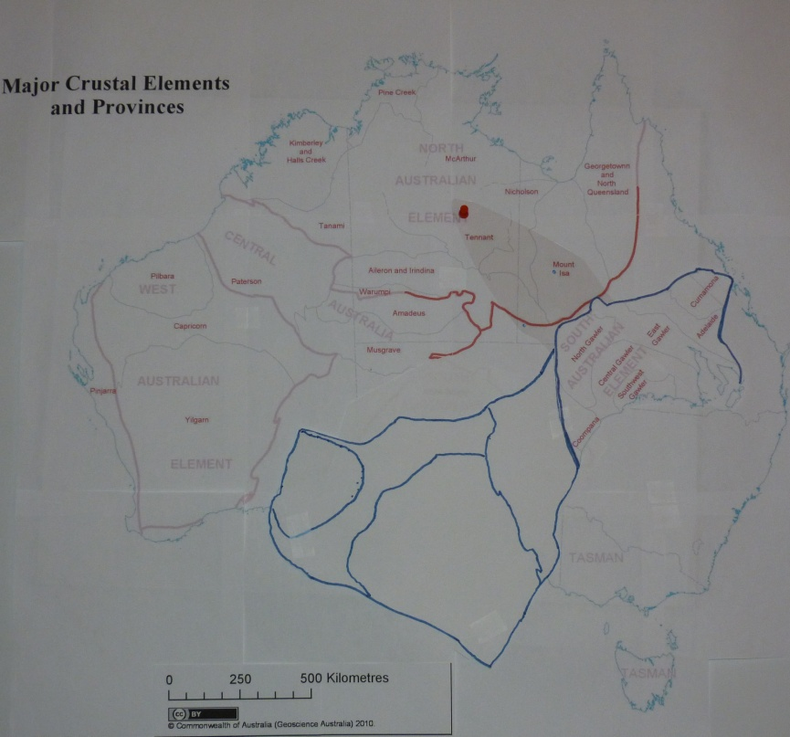
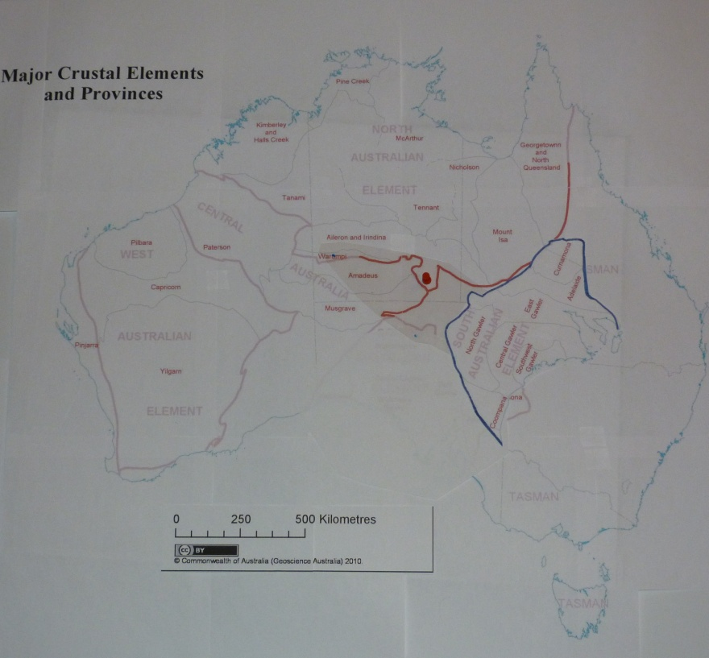
Original positions based on Eular poles
Notes:
After comparing the alternatives, I think the results support my conclusions. Best fit. Unexplained gaps, especially the Li and Evans model in which this area must be ejected into the Indian Ocean. Remember these positions when we look at the final slide.

Slide 13
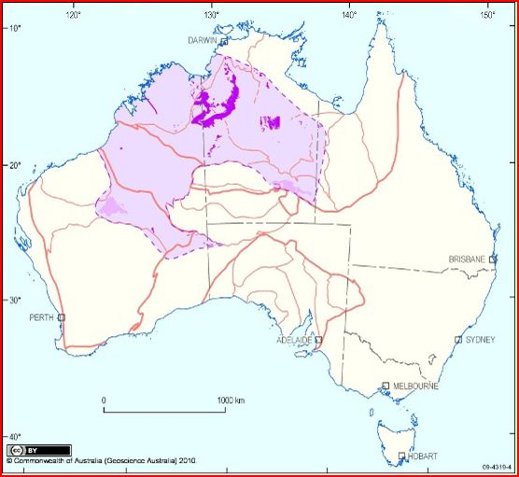
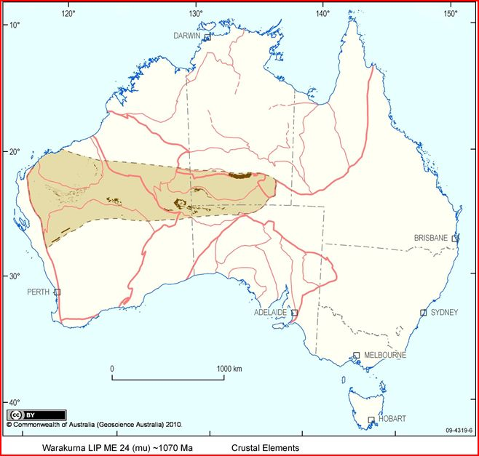
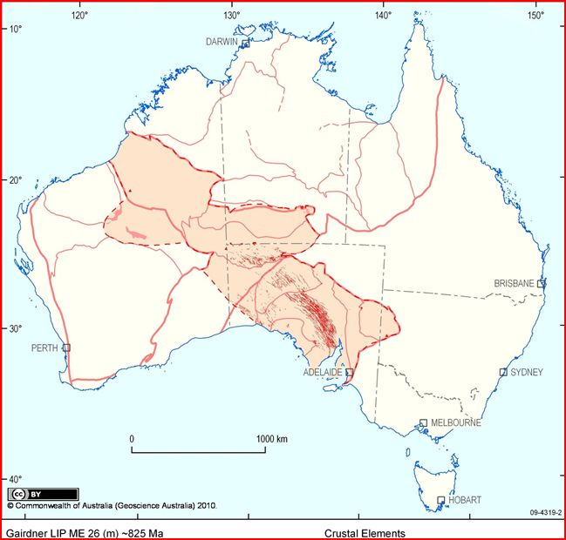
Kalkarindji LIP
~540-500Ma
Warakurna LIP ~1070Ma
Gairdner LIP ~825 Ma
Notes:
We have the Geoscience Australia 2010 maps of the LIPs on the template of the crustal elements map. If the Li and Evans Eular pole is true, then both the Warakurna LIP and the Gairdner LIP would be awkwardly displaced. If the Giles, Betts and Lister Eular pole is true then only the Gairdner would be awkwardly displaced. Neither model addresses the Cambrian and younger rock that exists in the gap between the cratons.
My Eular pole location and timing of the separation appear to hold up well in comparison.
There is a consensus that there was rapid crustal movement, rotations and True Polar Wander at the Precambrian to Cambrian transition which would be consistent with the movement of the Gawler SA craton.
I added the Kalkarindji LIP which would be coeval with the Gawler/SA craton movement. You can see that there would be no interference.
I would also like to point out the star. It is the location of the center of MAPCIS which stands for the Massive Austrian Precambrian Cambrian Impact Structure

Slide 14
Conclusions
Where the mind comes to rest…for awhile.
The timing constraint for the initiation of the rift between the NAC and the G/SAC is consistent with the Neoproterozoic to Cambrian transition. The stimulus for rift initiation may be related to the coeval Neoproterozoic Petermann Orogeny (~550-535ma) or MAPCIS~545ma which are located west of the rift near to the Eular point. Field research is needed to validate these findings.

Slide 15
If true, what do I think ?
It would link for the first time the movement of a craton to an impact.
Understanding the nature of the movement of the Gawler/SA Craton will help to better understand the events surrounding the Precambrian/Cambrian boundary and the movement of continents at that time.

Slide 16
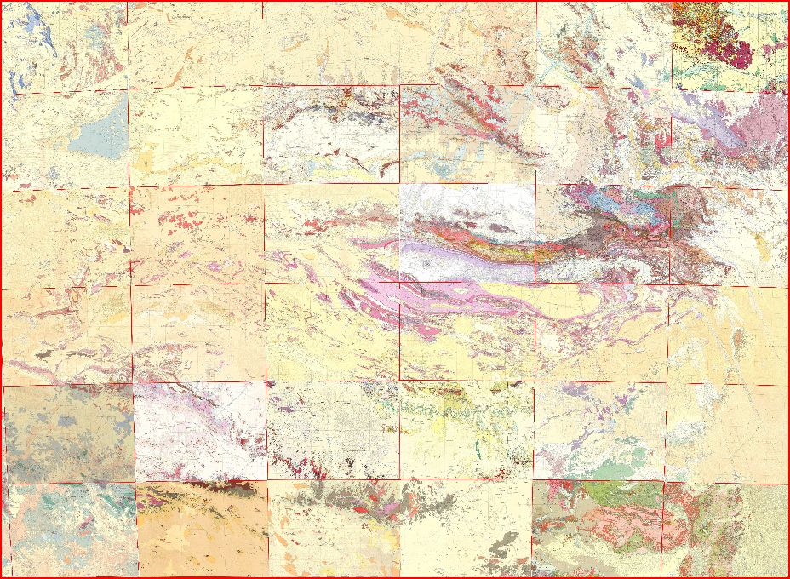
Mosaic Map of Central Australia, made from 36, 1:250,000 GA Geology Maps showing an inner ring approximately 550km in diameter
D. P. Connelly 2011
Notes:
Map is ~900km EW by 650km NS

Slide 17
References
Haines, P.W., Impact Cratering and Distal Ejecta: the Australian record, Australian Journal of Earth Science(2005) 52:4 481-507
Hoatson, D.M., Claoue-Long, J.C., Jaireth, S,.2008 Australian Proterozoic Mafic-Ultramafic Magmatic Events: Sheet 1, Geoscience Australia, Canberra
PIRSA Mining Reports, Primary Industries and Resources South Australia, 2009
Rajmon, David, SEIS-Suspected Earth Impact Sites, Department of Earth and Planetary Sciences,University of Tennessee, Knoxville
Wingate Michael T.D., Pirajno Franco, Morris Paul A. 2004-Warakurna large lgneous province: A new Mesoproterozoic large igneous province in west –central Australia, Geological Society of America
Sandiford M. , Hand M., McLaren S. 2001-Tectonic feedback, intraplate orogeny and the geochemical structure of the crust: a central Australian perspective, continental Reactivation and Reworking. Geological Society, London Special Publications, 184, 195-218
Zheng-Xiang Li and David Evans. 2011-Late Neoproterozoic 40deg intraplate rotation within Australia allows for a tighter fitting and longer lasting Rodinia, Geology , January 2011, Vol 39, #1, Pg 39-42
David Giles, Peter G. Betts, and Gordon S. Lister. 2004 1.8-1.5-Ga links between the North and South Australian Cratons and the Early-Middle Proterozoic configuration of Australia. Technophysics 380 (2004) 27-41
Graham M. Jeffress, First annual Report Moomba Project GEL 185, Eden Energy Ltd. 23rd July 2006
Andrew Y. Glikson and I. Tonguc Uysal, 2010-Evidence of impact shock metamorphism in basement granitoids Cooper, South Australia, Australian Geothermal Conference 2010
Linda M Glass and David Phillips. 2006 The Kalkarindji continental flood basalt province: A new Cambrian Large igneous province in Australia with possible links to faunal extinctions. Geology, June 2006, v. 34, no. 6, p. 461-464
Tobias Payenberg, Simon Lang, Kerrie Deller, Nathan Ceglar, Mark Reilly, Tim Cotton and Carmen Krapf. Reducing critical uncertainties for deepwater stratigraphic architecture in the Officer Basin- the significance of outcrop analogues in the Flinders Ranges. 2005 Australian School of Petroleum
Doug Finlayson, IGCP Project 559 - Seismic Images Crustal Images from the Tasman Orogen, Eastern Australia Nov 20, 2008
Foden J., Elburg M.A., Smith P.B., Dougherty-Page J. and Burtt A. 2006. The timing and duration of the Delamerian orogeny: correlation with the Ross Orogen and implications for Gondwana assembly. The Journal of Geology, 114, 189-210.
2009 Portland GSA Annual Meeting (18-21 October 2009) Paper No. 159-4 AGE DATING MAPCIS (MASSIVE AUSTRALIAN PRECAMBRIAN/CAMBRIAN IMPACT STRUCTURE) A MULTI-MODAL INDIRECT APPROACH CONNELLY, Daniel, MAPCIS Research Project
(22–24 March 2009) NE GSA Meeting, Paper No. 26-4 THE CASE FOR A MASSIVE AUSTRALIAN PRECAMBRIAN CAMBRIAN IMPACT STRUCTURE (MAPCIS) CONNELLY, Daniel P.
M.J. Duane and W.U. Reimold. The Simpson Desert Depression. An ancient Giant Impact Basin Part 2. LPSC XXI 301
Andrew C. Hill, Peter Haines, Kathleen Grey, and Sebastian Willman. 2007-New records of Ediacaran Acraman ejecta in drillholes from the Stuart Shelf and Officer Basin, South Australia. Meteoritics &Planetary Science 42, Nr 11. 1883-1891
Shaw, R.D., Wellman, P., Gunn, P., Whitaker, A.J., Tarlowski, C. and Morse, M., 1995. Australian Crustal Elements (1:5,000,000 scale map) based on the distribution of geophysical domains (version 1.0, November 1995). Australian Geological Survey Organisation, Canberra
J.J. Veevers 2003-Pan-African is Pan-Gonwanaland: Oblique convergence drives rotation during 650-500Ma assembly, Geology June 2003, V31, no 6, pg 501-504
Ross N. Mitchell, David A.D. Evans and Taylor M. Kilian 2010-Rapid Early Cambrian rotation of Gondwana Geology August 2010 V.38;No8 p755-758
Notes:
Gene Harvey, Bert Cramer

Slide 18
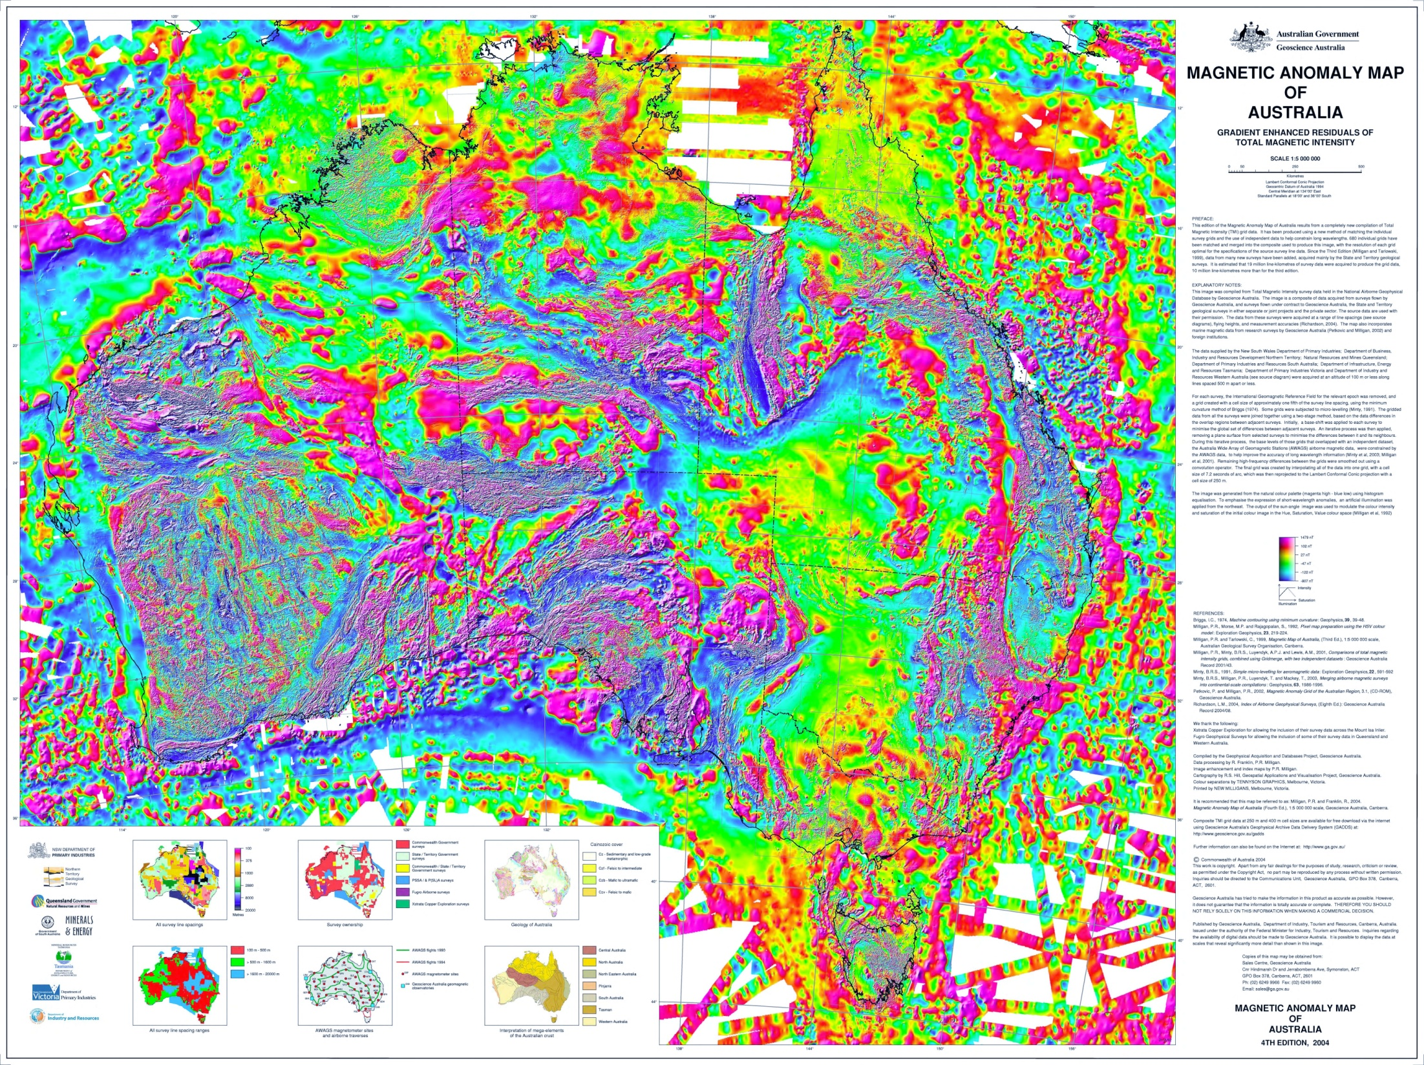
Notes:
Here is a another representation of the gap as seen on the Magnetic Anomaly MAP of Australia. These maps show the location of the cratons and the gap, but give little clue to the age of separation.

Slide 19
Abstract
The timing of rift initiation between the North Australia and Gawler/ South Australia Cratons
There is a consensus among geologists that the North Australia and Gawler/South Australia Cratons had common origins and were attached. This presentation explores the timing of this angular separation by examining the ages of the separated Mafic-Ultramafic events of each Craton along with events in the Musgrave Province of Central Australia. The age of the rift floor and the timing of the effects of Craton movement are also examined.
This retrospective study searched for dated markers that might be aligned across the rift between the G/SAC and the NAC. The “Hoatson, D.M., Claoue-Long, J.C., Jaireth, S, Australian Proterozoic Mafic-Ultramafic Magmatic Events: Sheet 1, GA, Canberra” map, demarcates a deep westward embayment of the Tasman Line that delineates the rift, separating Cambrian basement from Precambrian basement, with the labeled magmatic events on either side of the rift. This is the core of the study. When the research pointed towards a PC/C boundary date, the Acraman Impact ~585ma, an integral part of the G/SAC was researched for evidence of movement.
It was found that seven Mafic-Ultramafic events realign when G/SAC is rotated counterclockwise to a position adjacent to the NAC. The Skipworth Event ~575ma was the youngest separated event. The age of the Moorilyanna Graben dropping at the narrow angle of the rift is ~550ma, coeval to the Petermann Orogeny ~550-535ma. The age of the rift floor as defined by the Tasman Line is Cambrian age or younger and confirmed by drill cores. Evidence was found that the Acraman Impact ~585ma moved with the Gawler Craton equal to the distance of the rift movement. A best fit angle finds the pivot point of the G/SA Craton movement centered in the Amadeus Basin near both the Musgrave Province, the focus of the Petermann Orogeny and a proposed large impact MAPCIS ~545ma.
Conclusions: The timing constraint for the initiation of the rift between the NAC and the G/SAC is consistent with the Neoproterozoic to Cambrian transition. The stimulus for rift initiation may be related to the coeval Neoproterozoic Petermann Orogeny (~550-535ma) or MAPCIS~545ma which are located west of the rift near to the pivot point. Field research is needed to validate these findings.

