Slide 1


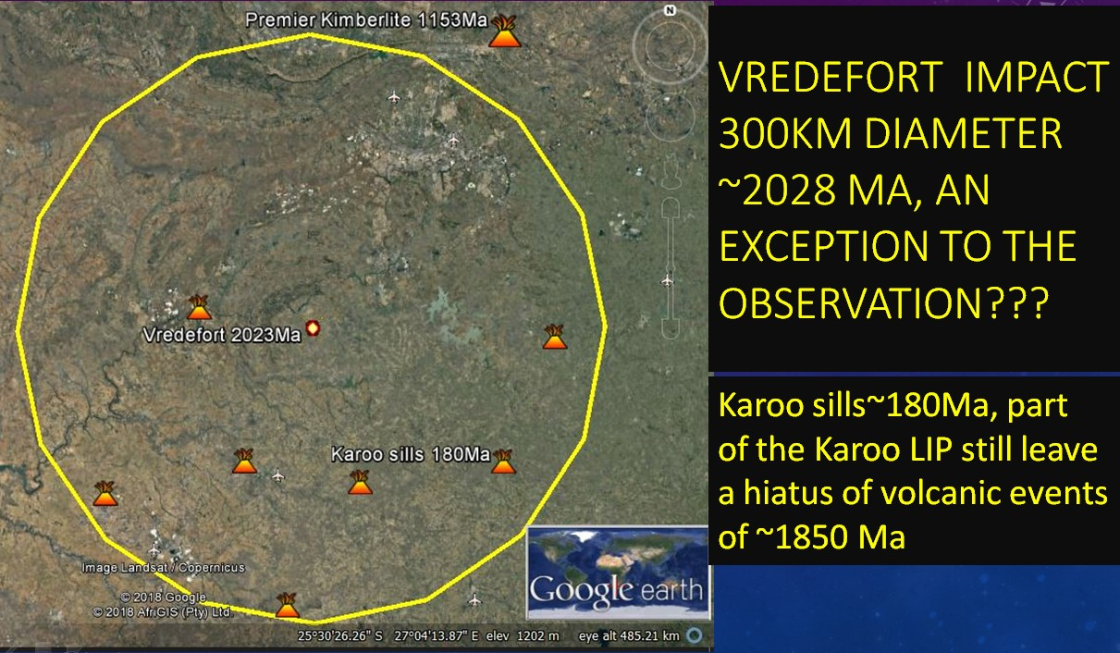
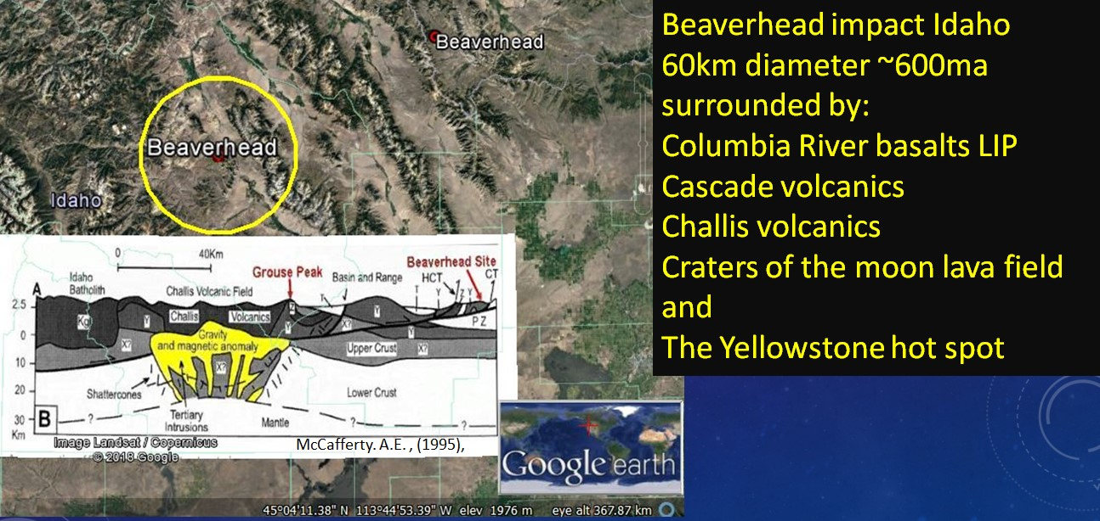
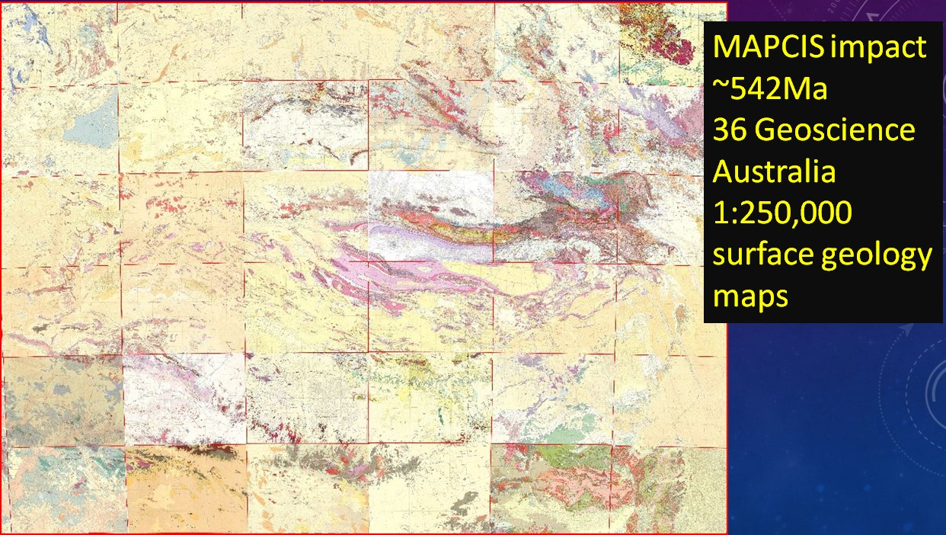
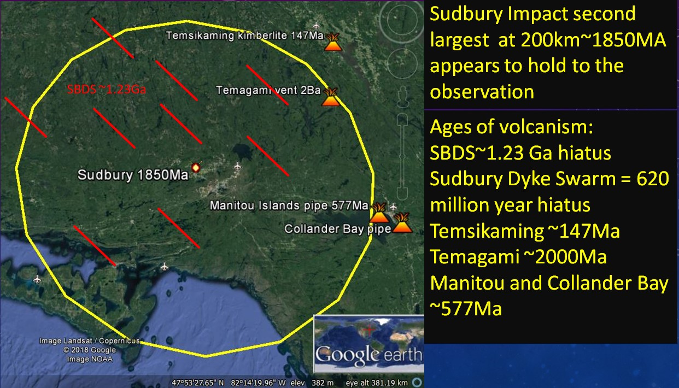
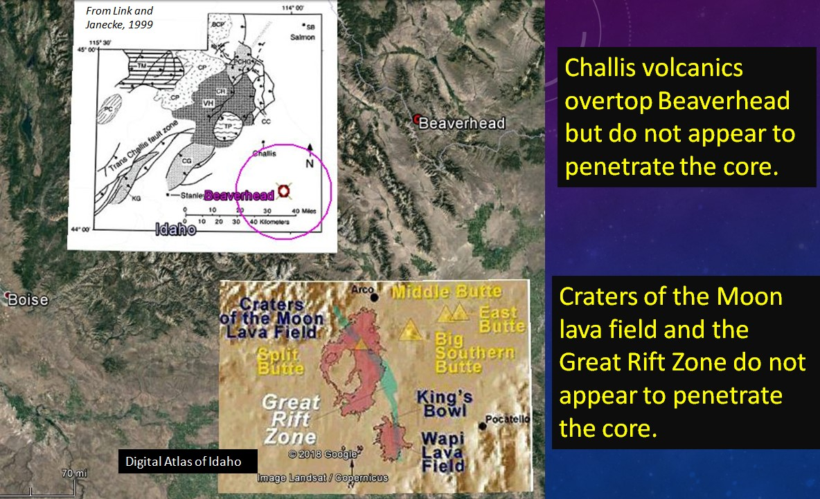
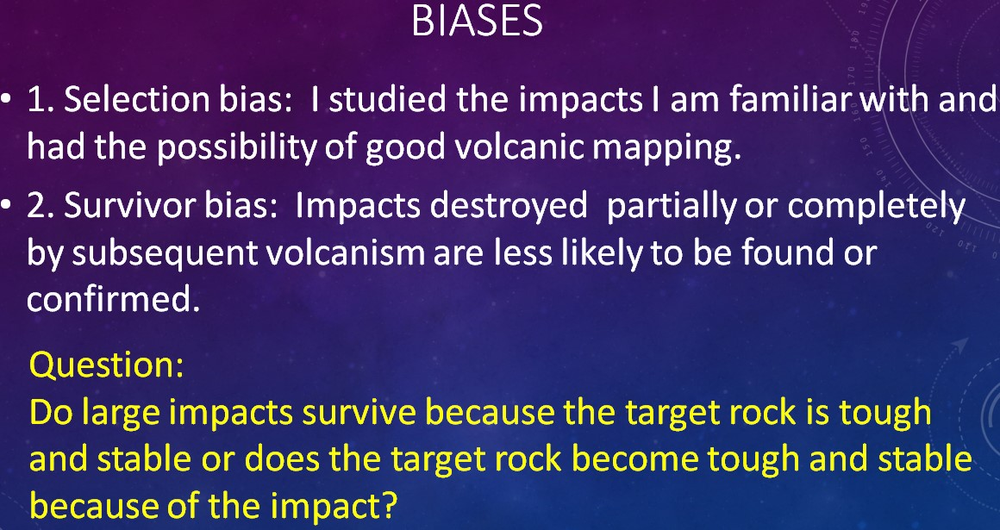
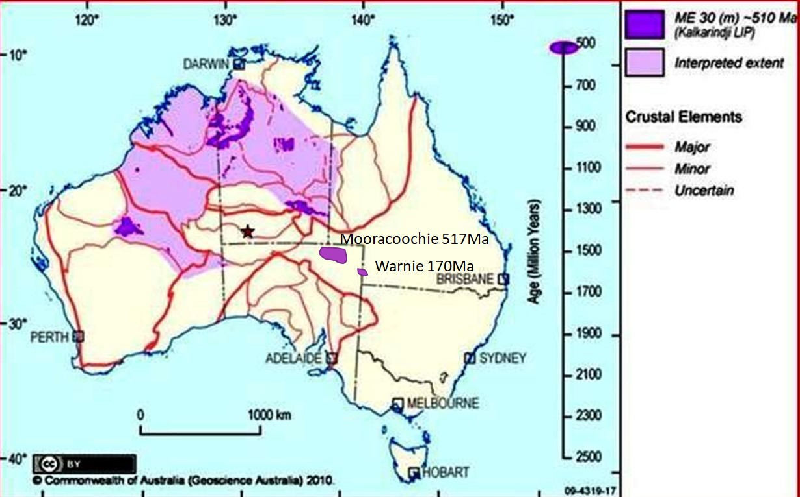
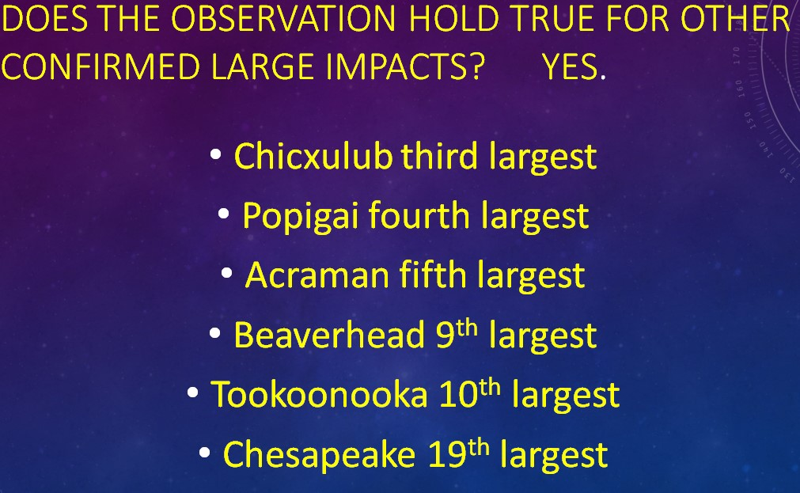
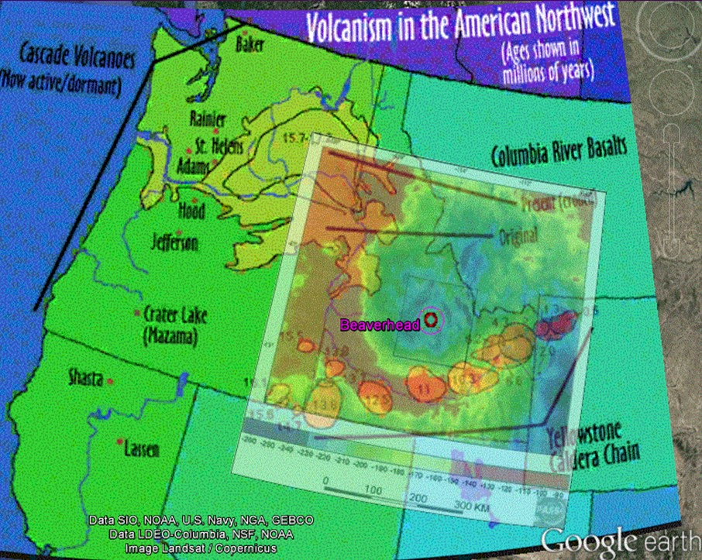
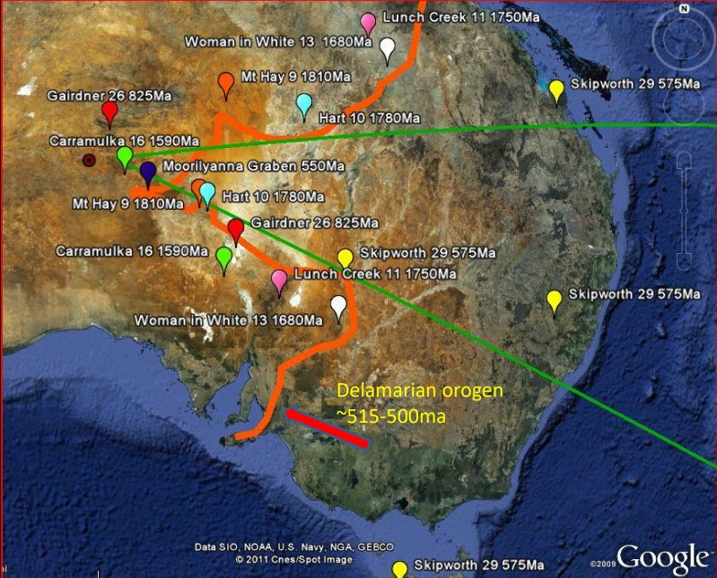
LARGE EARTH IMPACTS: ACTIVATING PLATE TECTONICS AND CONSTRAINING VOLCANISM?
Daniel Connelly
MAPCIS Research Project danielconnelly@comcast.net
Abstract
. The Interplay of Volcanism, Tectonism, and Impacts across the Solar System 11-T99 session
Was asking for this
Other large Impacts
Beaverhead Impact and Northwest Volcanics
Discussion
The interplay between impacts, tectonism and volcanism is a lot for one presentation. I show one impact MAPCIS ~542Ma, is the Eular point for rotation of the South Australia Element/Cratons from the North Australia Element/Cratons. Rift initiation coeval to the Petermann orogeny ~550-535Ma is well dated through divided matching mafic provinces north and south of the Tasman Line as well as drill cores which map the extent of Acraman impact ~590Ma missing ejecta layer and the existence of Mooracoochie volcanics ~517ma within the rift. The rifting appears to have ended with the Delamarian orogeny ~514-490Ma collision of the South Australia Element with Antarctica. Post impact volcanism is hotly debated. The Kalkarindji LIP ~510Ma and Mooracoochie volcanics ~517Ma dated after MAPCIS, form an almost complete ring around the crater. Besides defining MAPCIS structure and constraining age, the lack of Kalkarindji volcanics as well as no known volcanism within the 300,000 km² crater for the last 542 million years raises questions. Is volcanism suppressed in other large impacts? A review of the known largest confirmed impacts of Vredefort 2023Ma, Chicxulub 65Ma, and Acraman 590Ma as well as others such as Chesapeake Bay 35Ma and Beaverhead 600Ma suggest an absence or significant hiatus of volcanism post impact within the presumed crater rims. Beaverhead impact in Idaho is particularly interesting as it surrounded by volcanic events of the Northwest USA including the Yellowstone hotspot. Gravity images suggest that hotspot volcanism may have been deflected around the area of Beaverhead impact.
These falsifiable observations shed light on post impact effects on tectonism and volcanism. Are large impacts part of the process of formation of stable buoyant continental crustal core? Do large impacts play an active part in plate tectonics? More questions than answers, but there are now places to look.
The movement of the north American plate has moved the core of the Beaverhead impact westward bringing it into proximity to several active and recently active volcanic zones
This is a fun poster. All of this information is too much for one sheet of paper and would be better served by an oral presentation. These are interesting observations that came through years of study of the MAPCIS impact, but this poster is not as important as second poster approved for the same time slot today. I can only be at one. You can find me two boards away at 128. LONSDALEITE IN MUSGRAVE PSEUDOTACHYLITES: THE PETROGRAPHIC EVIDENCES OF IMPACT The finding of lonsdaleite (hexagonal diamond) at the microscopic level gives credence to the very existence of this impact known as MAPCIS.
This poster is based on several presentations an papers going back to 2009
Impact: Massive Australian Precambrian/Cambrian Impact Structure ~542Ma Peripheral post impact volcanism: Kalkarindji LIP ~510 Ma + Mooracoochie Volcanics ~517Ma Craton movement: Rifting of South Australia Craton from the North Australia Craton ~542Ma ending with the Delamarian orogeny ~514-490Ma Hiatus of volcanism within the MAPCIS crater rim since ~542Ma Similar hiatus observation in other large impacts.
The post MAPCIS volcanics from the above image fill part of the Tasman gap even as older mafic provinces are divided by the rifting. MAPCIS center is the Eular point for the rotation which ends with the collision with Antarctic during the Delamarian orogeny. This suggests large impacts might stimulate plate movement.
References on request
I would like to thank my wife Dr. Malgorzata Piszcz-Connelly for financing this endeavor and tons of moral support.
Contact
danielconnelly@comcast.net Like MAPCIS IMPACT CRATER on Facebook
The overlay shows that volcanic events including the Yellowstone hotspot appear to be defected by the core of the ~600Ma Beverhead impact

