Slide 1


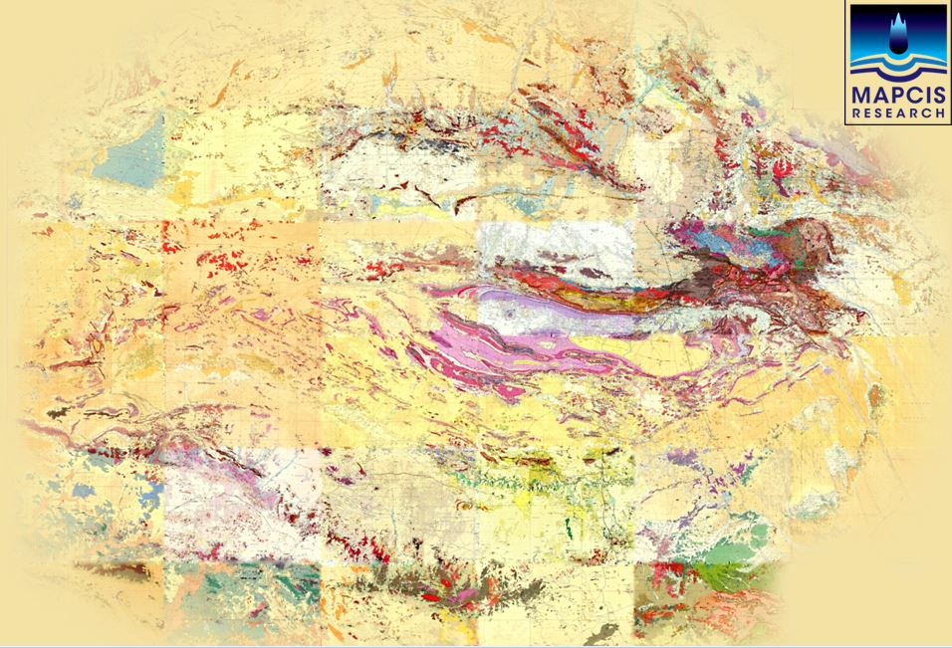
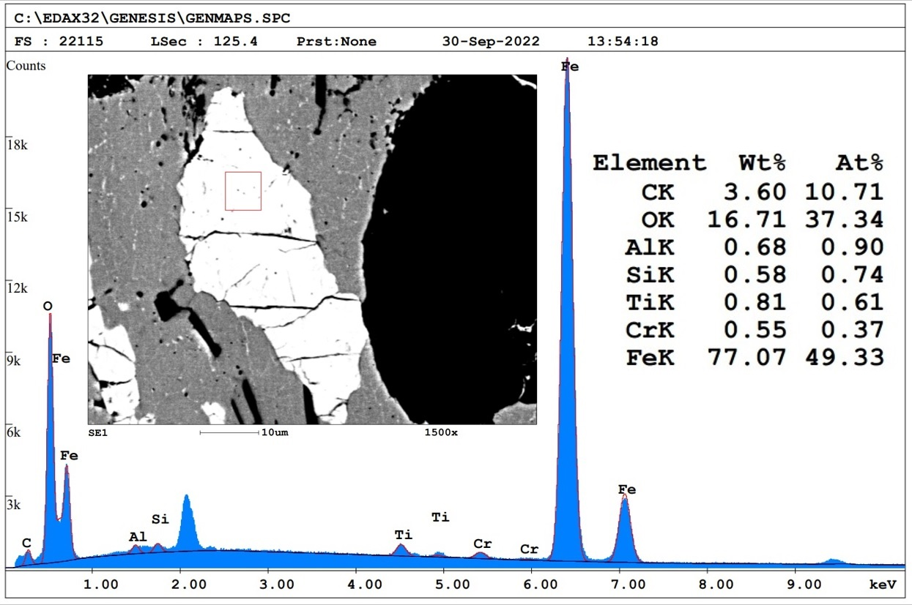
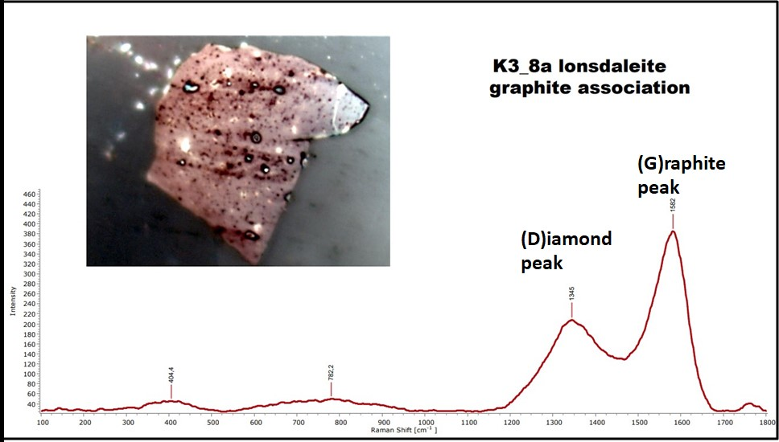

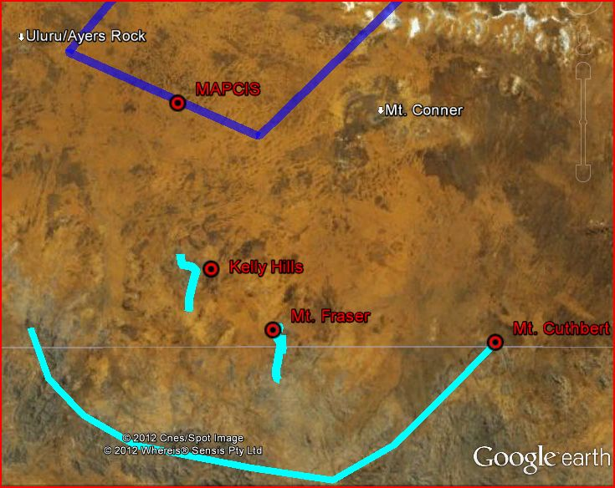
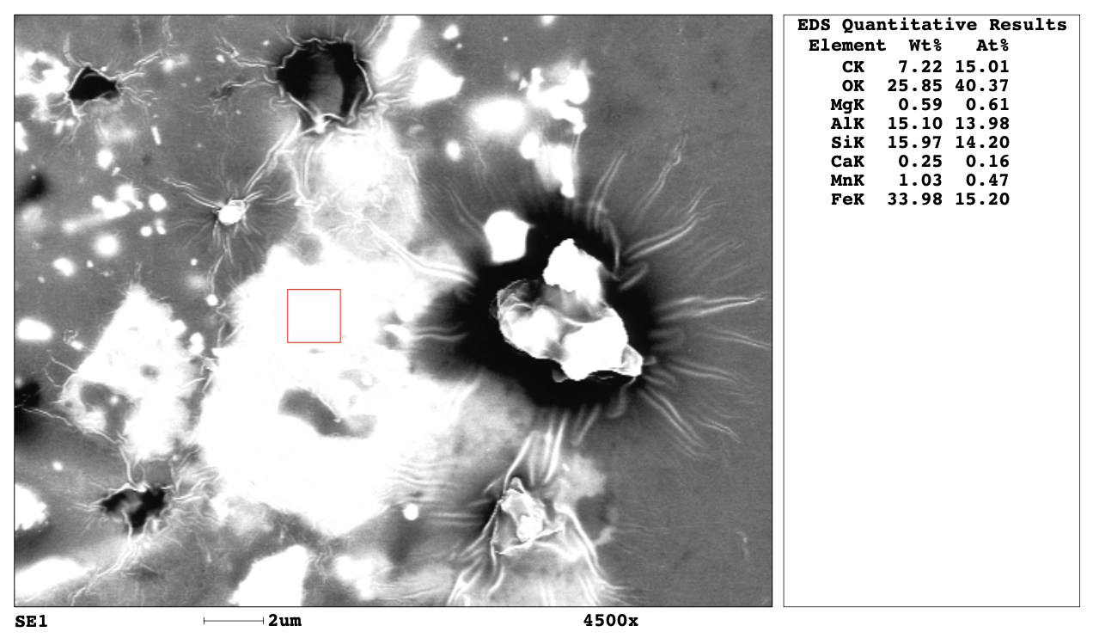
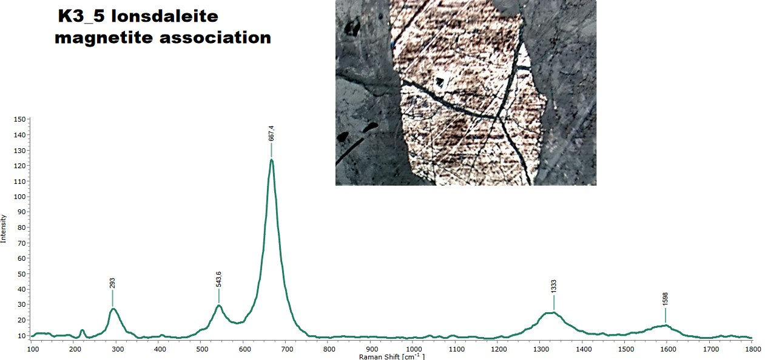
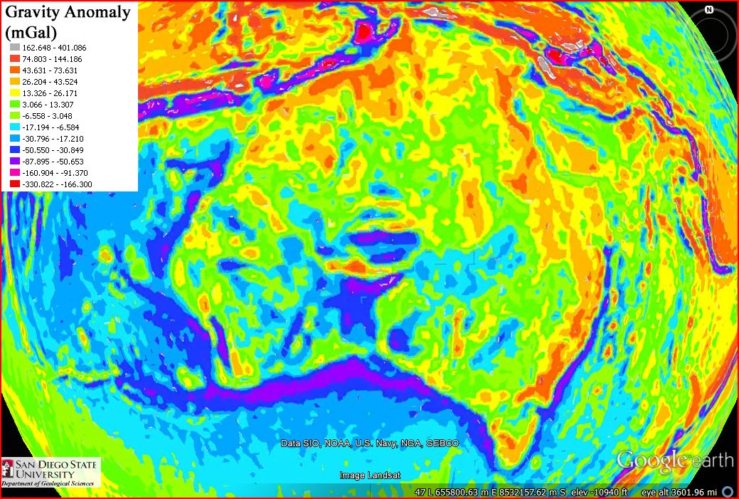
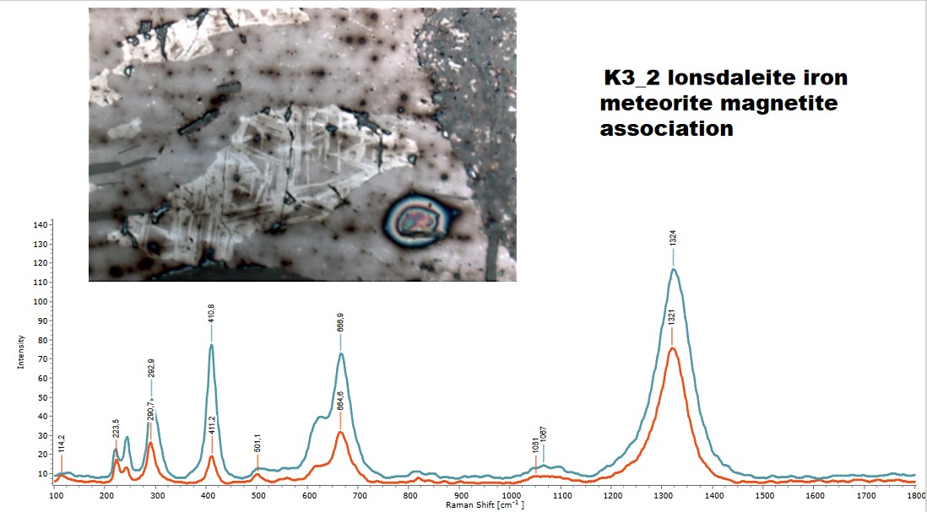
LONSDALEITE IN MUSGRAVE PSEUDOTACHYLITES: THE PETROGRAPHIC EVIDENCES OF IMPACT
Daniel P. Connelly, MAPCIS Research Project danielconnelly@comcast.net Jaime L.B. Presser, JP-Explorations, Asuncion-Paraguay presserjaime@gmail.com
Arif M. Sikder, Center for Environmental Studies (CES) Virginia Commonwealth University (VCU) amsikder@vcu.edu
Abstract
The circular anomaly in central Australia as seen on surface geology maps
Raman Analysis
SEM-EDS Analysis
Musgrave province of Central Australia illustrates a wide zone (~5 km) of pseudotachylite breccia intermittently for 300 km with up to 10% veining. The hanging wall of Woodroffe Thrust is characterized with over a hundred meters sheared pseudotachylites and overprinted by undeformed injection veins. The veins are measured on the ground in width from a few centimeters up to 4 m and can even be traced for up to 10 m. Though the petrographic analysis with optical and electron microscopy revealed very thin veins in scale of microns and spread through the host rocks. As the wide distribution, volume and thickness (micron to meter) pose a dilemma on the genesis of pseudotachylites, a more detailed petrographic analysis was conducted with optical, Raman, electron microscopy and XRD.
The mineralogical compositions of the separated pseudotachylites veins were determined with Empyrean Multipurpose X-Ray Diffractometer as Anorthite (48.01%), Augite (27.69%), Pargasite (17.72%), Quartz (3.22%), Biotite (2.45%) and Magnetite (0.91%). The presence of significant amount of Pargasite [NaCa₂ (Mg₄Al)(Si₆ Al₂)O₂₂(OH)₂] in the veins rule out the anhydrous origin of the Musgrave pseudotachylites.
Furthermore, petrographic analysis also identified diaplectic glass and multiple sets of planar deformation features (PDFs) and partial isotropization of quartz in samples from Mount Frazer, along with shocked feldspar and thetomorphs, diaplectic glass that retain their original shape, at even higher pressures.
Addendum: Recent discovery finds evidence of lonsdaleite a hexagonal high pressure diamond within the melt samples from the Kelly Hills, Northern Territory. This poster will focus on these newer discoveries. The Kelly Hills pseudotachylite deposits are the closest exposed outcrops being about 40 km from the presumed center of the impact.
Discussion
To validate the higher concentration of carbon (C), Raman spectra were obtained from the microlites of the pseudotachylite veins in the range from 100 to 1800 cm -1 , with a 300-second acquisition time, by using the Horiba LabRAM HR Evolution Confocal micro-Raman spectrometer with a 20 mW, 532 nm He-Ne- laser excitation system, a grating with 600 grooves/mm, and a thermoelectrically cooled CCD array detector at the Nanomaterial Core Characterization Facility (NCCF) of Virginia Commonwealth University (VCU), USA. Long working distance lenses at 100×, 50×, or 10× magnification, were used for permitting analysis of inclusions as deep as a few millimeters.
SEM-BSE analysis of the polished samples of Musgrave pseudotachylite with Field Emission Scanning electron microscope (FE-SEM, Hitachi SU 70) equipped with Energy Dispersive Spectrum Analyzer (EDAX).
The results suggest an impact origin for the Musgrave pseudotachylite breccias, thus replacing the seismic origin hypothesis which appears to be a misinterpretation due to the proximity of the pseudotachylite breccias to a prominent and well known thrust fault.
Both the pseudotachylite and host rocks contains meteoritic iron with higher concentration of carbon (C).
Raman analysis revealed that those carbons are Lonsdaleite (Hexagonal Impact Diamond?) and Graphite.
Most probably the graphite altered to lonsdaleite
Musgrave pseudotachylites are most impact in origin and most probably inject melts than pseudotachylite?
----------------------------------------------------------------------------
The importance of the londaleite can not be overestimated in the confirmation process. It allows for the reproducibility of the evidence. Whether new samples are collected from the Kelly Hills or from our current samples, londaleite should be found and verified. Kelly Hills site: 25°49'34.55"S 131°29'38.13"E is on private land and may be accessed with permission of the owners.
KH
Kelly Hills is about 40km from the putative impact center
References on request
The circular anomaly in central Australia
Acknowledgements
Location of the pseudotachylite melts in relation to MAPCIS/ impact center The Kelly Hills location is on private land and can be driven to with permission of the owners. It is a low mound outcrop with abundant pseudotachylite 25°49'34.55"S 131°29'38.13"E
The iron blebs (Magnetite/Hematite) embedded in the pseudotachylite melt contain a very high amount of Carbon (>10%) supporting the existence of Lonsdaleite, which is identified with micro-raman analysis.
I would like to thank Dr. Arif Sikder from Virginia Commonwealth University and his team for preparing the samples and encouragement and Jaime Presser for his insights on lonsdaleite I would like to thank my wife Dr. Malgorzata Piszcz-Connelly for financing this endeavor and tons of moral support.
Contact
danielconnelly@comcast.net Like MAPCIS IMPACT CRATER on Facebook

