Slide 1
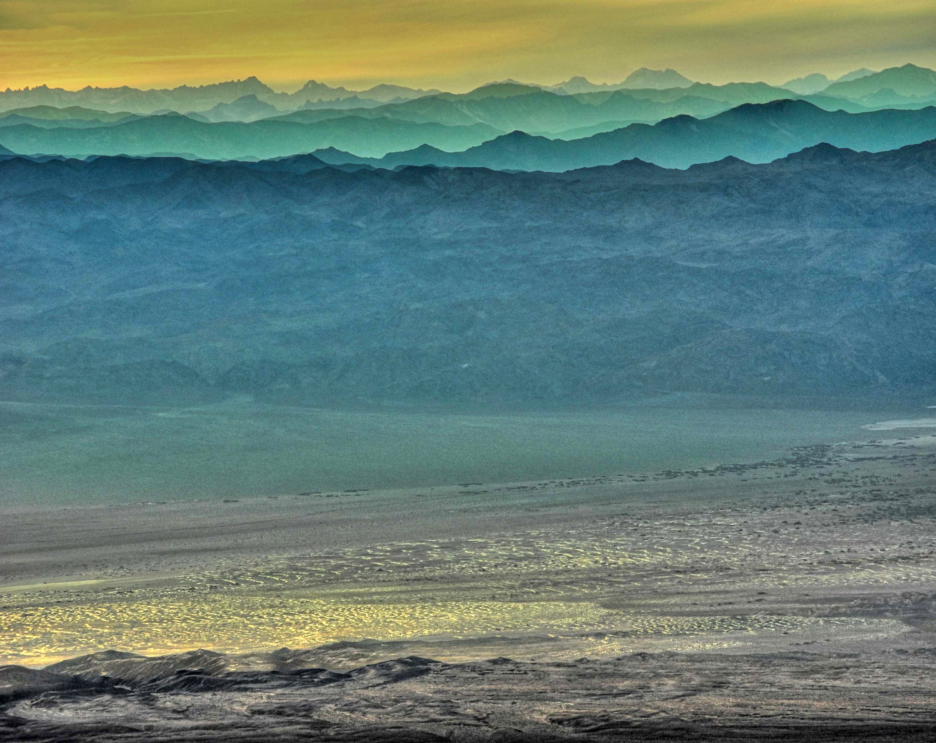
EARLY EVOLUTION OF TECTONIC CONCEPTS IN THE BASIN AND RANGE PROVINCE
Jerry Osborn, University of Calgary
Martin Griffith, Reno, Nevada
Notes:
Talking not about evol of B and R, but early evolution of thinking about it.

Slide 2

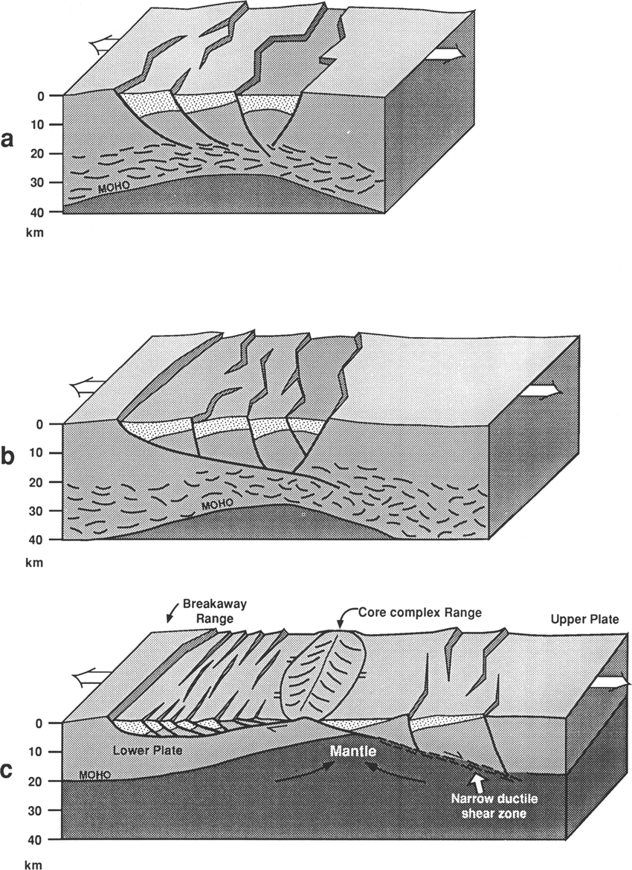
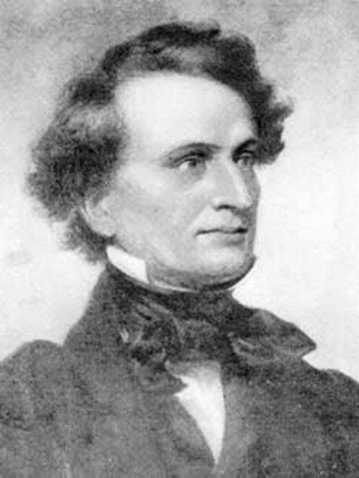
Extension?
Huh?
Christopher
Morley
Notes:
I’ll start off with my theme….the conclusion that the B and R is one of the world’s great examples of extensional tectonics did not come easily.

Slide 3
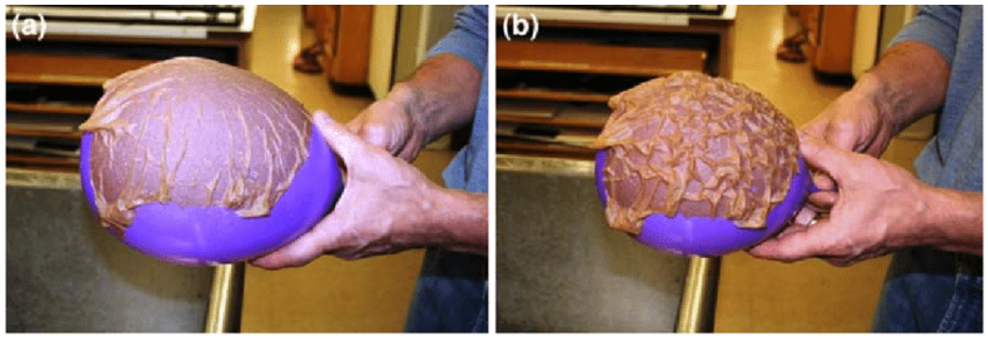
PROLOG
Tectonics in 1850…..
balloon and wet paper towel
Dolphin, 2009
Notes:
Gonna set the stage with this ballon: , the prevailing tectonic paradigm in the middle 19th century was that mtns are created by wrinkling of the earth’s crust as the earth shrinks. Earth is shrinking because it’s losing heat…had lot of heat to start with, there’s no heat source by which it can gain heat (radioactivity wouldn’t be discovered until roughly 1900)_so earth must be cooling. You can simulate the wrinkling crust with a wet paper towel over a balloon….deflate the balloon and mountains are created.

Slide 4
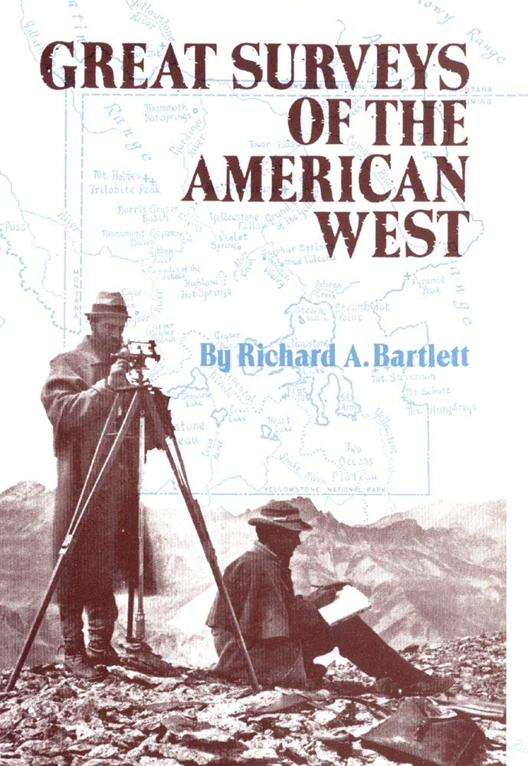
Geological and Geographical Survey of the 40th Parallel Clarence King
Geographical Surveys West of the 100th Meridan- George Wheeler
Geological Survey of Nebraska and Wyoming Ferdinand Hayden
Geographical and Geological Survey of the Rocky Mountain Region John Wesley Powell

Slide 5
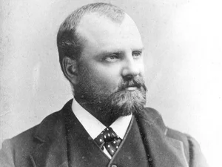
Clarence King
Survey of the 40th Parallel
USGS Photographic Library

Slide 6
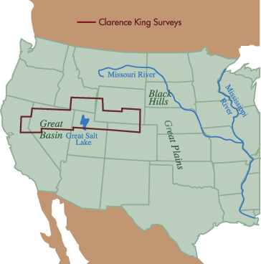
Kansas Historical Society

Slide 7
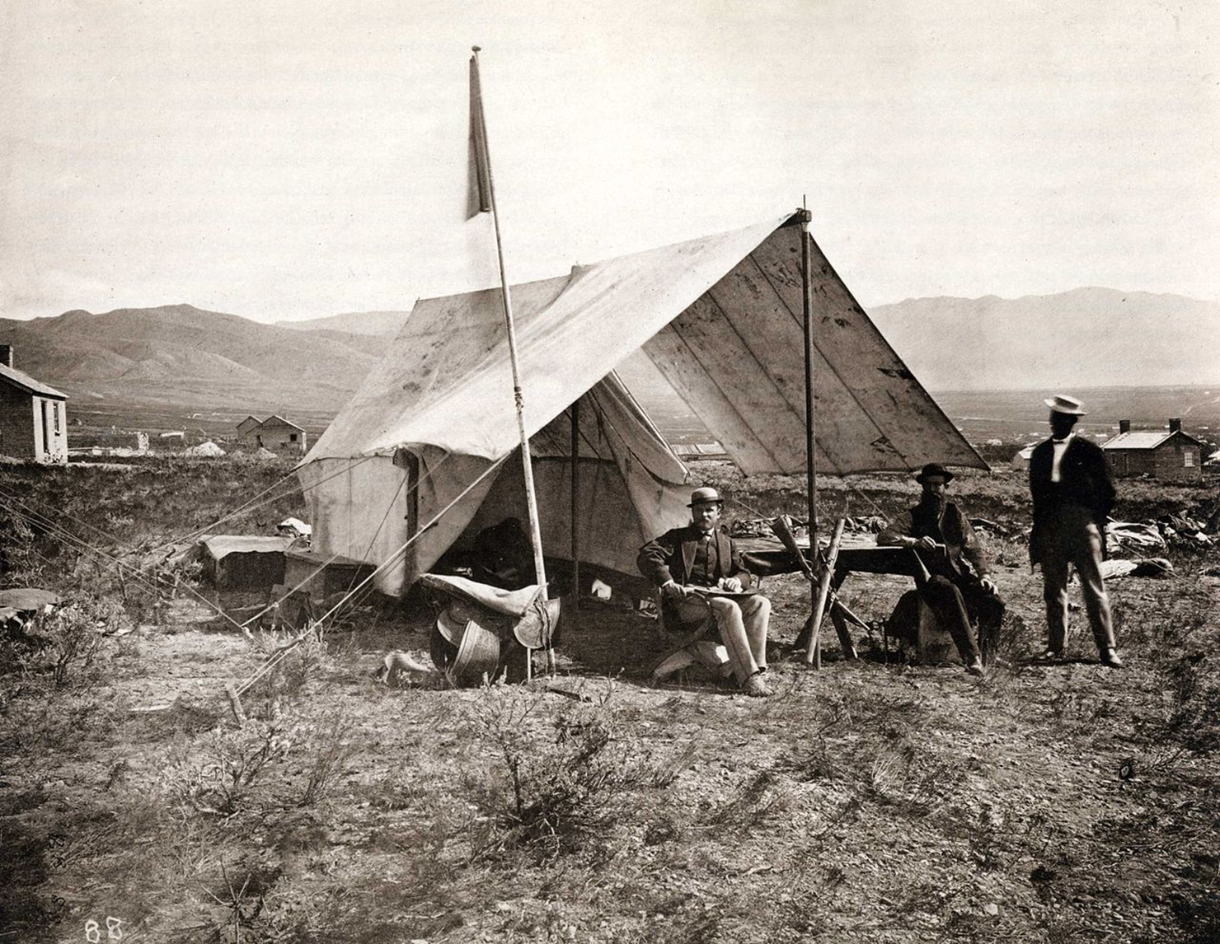
Kingian tectonics in the “Basin Ranges”
King influenced by
The compressional-wrinkling-of-the-crust idea
Rogers’ mapping of the Appalachians in 1850s:
Structure consequence of lateral compression
Physiography related to structure
Basin Ranges:
Several unconformity-bounded stratigraphic sequences
Major orogenic activity: post-Archean, post-Paleozoic, post-Jurassic, post-Cretaceous
Folds, reverse faults in Paleozoic rocks → lateral compression
Mountains are eroded “anticlinals”, valleys are partly filled “synclinals”
Cenozoic shift in tectonic style: Folds are cut by vertical faults….
E-W crustal shortening changes to vertical faulting
King camp near Salt Lake City, 1868
https://www.wikiwand.com/en/Clarence_King

Slide 8
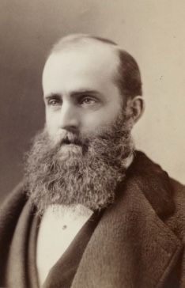
George M. Wheeler
Surveys West of the 100th Meridian
HouseHistree

Slide 9
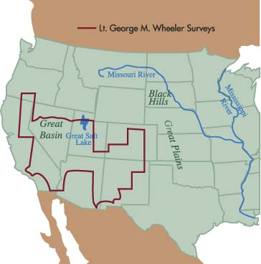
Kansas Historical Socieity

Slide 10
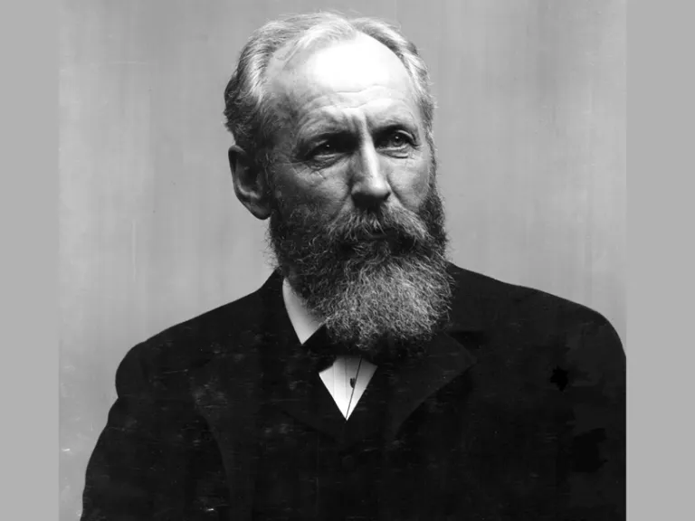
Grove Karl Gilbert
USGS Photographic Library

Slide 11
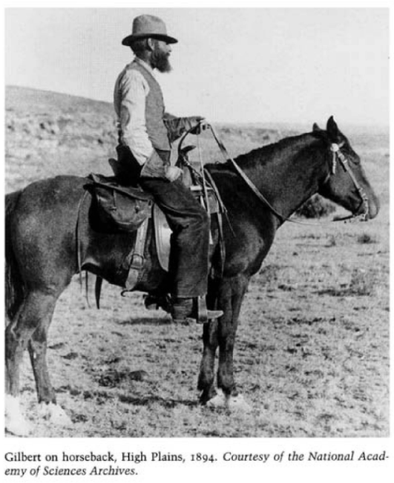

Slide 12
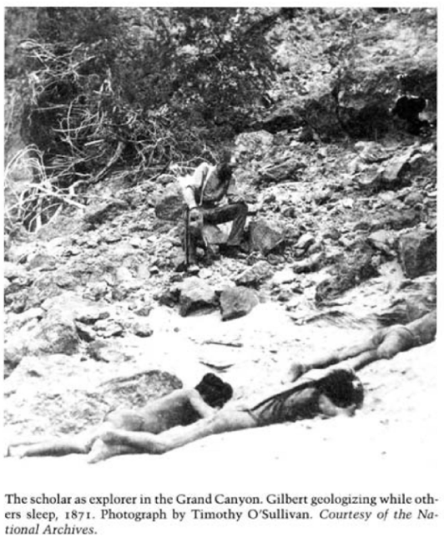

Slide 13
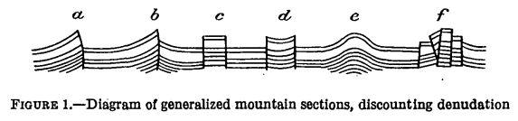

Gilbertian tectonics in the “Basin Ranges”
1874 conclusions:
Earlier compression is not related to present physiography
Ranges are eroded fault blocks vertically uplifted without compression.
Evidence:
Physiography discordant with fold structures
Many ranges have simple base lines which cut fold structures
A whole new way to make mountains
Later visits, particularly in 1901, revealed many faults assumed to be vertical are actually oblique and displacement of fault blocks requires considerable lateral extension (not published), according to Davis, 1925.
Gilbert, 1928

Slide 14
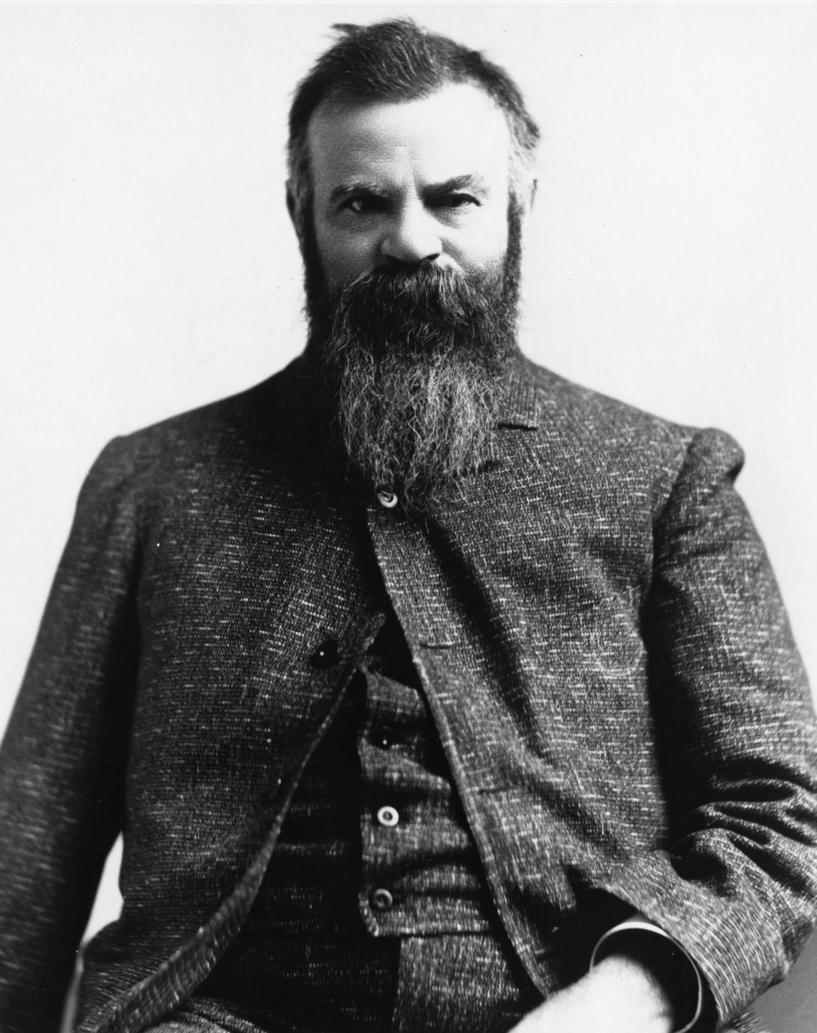
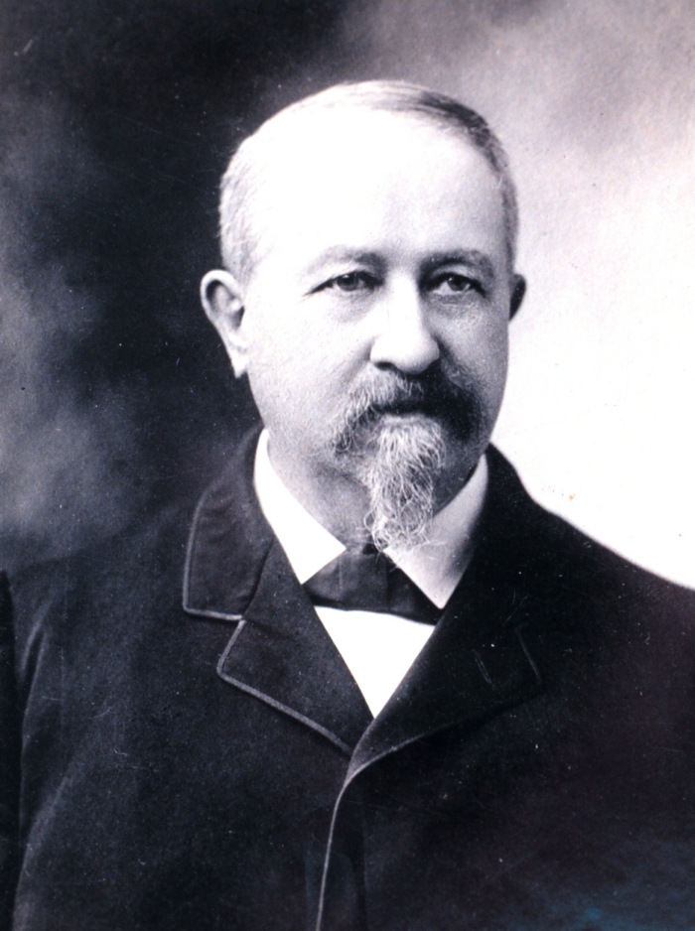
John Wesley Powell
Clarence Dutton
1876
1880
Interval of erosion between compression episode and block-faulting episode

Slide 15
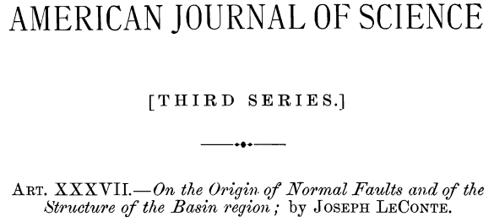
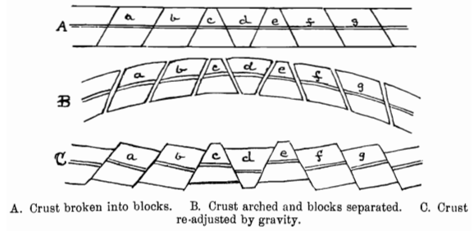
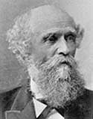

1889
Two kinds of mountains:
a. Formed by lateral compression
b. Formed by adjustment of crust- blocks consequent to uplift
Notes:
There was one more publication in the 1800’s explicitly dealing with block faulting, by Prof. LeConte, who taught at the new Univ of California campus at Berkeley, when there were a total of 40 students in the entire university (good old days). He accepted Gilbert’s block faulting idea, but his own field work indicates most faults were normal faults. ….. But he did not invoke regional extension, crustal extension was not a thing. No one even imagined crustal extension

Slide 16
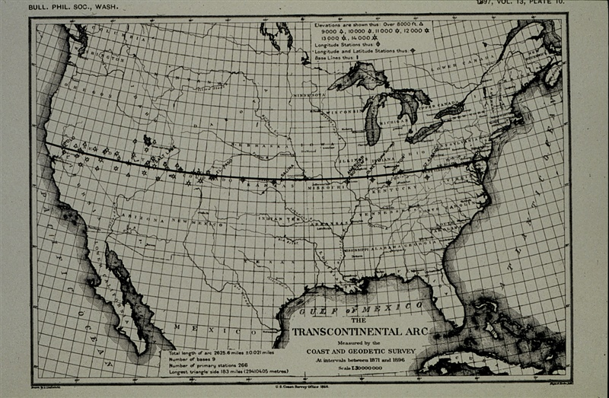
Survey to fix the 39th Parallel on the ground
NOAA Photo Library

Slide 17
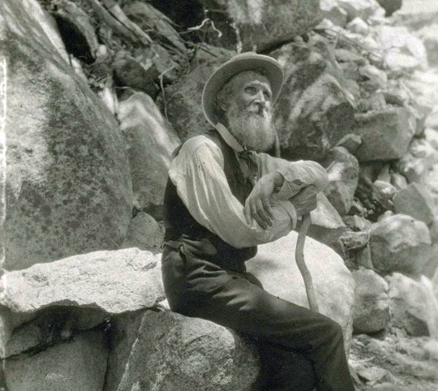
John Muir
U.S. National Park Service

Slide 18
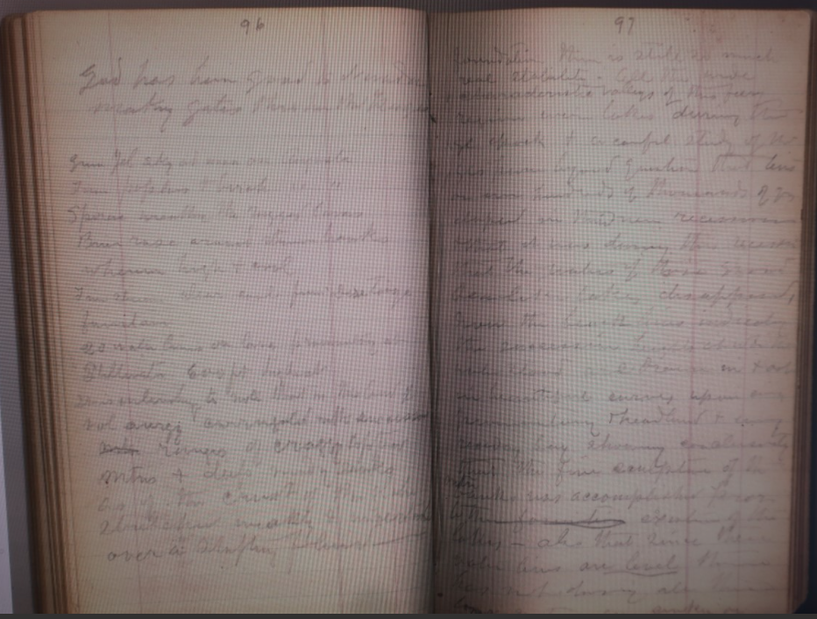

1876 journal

Slide 19
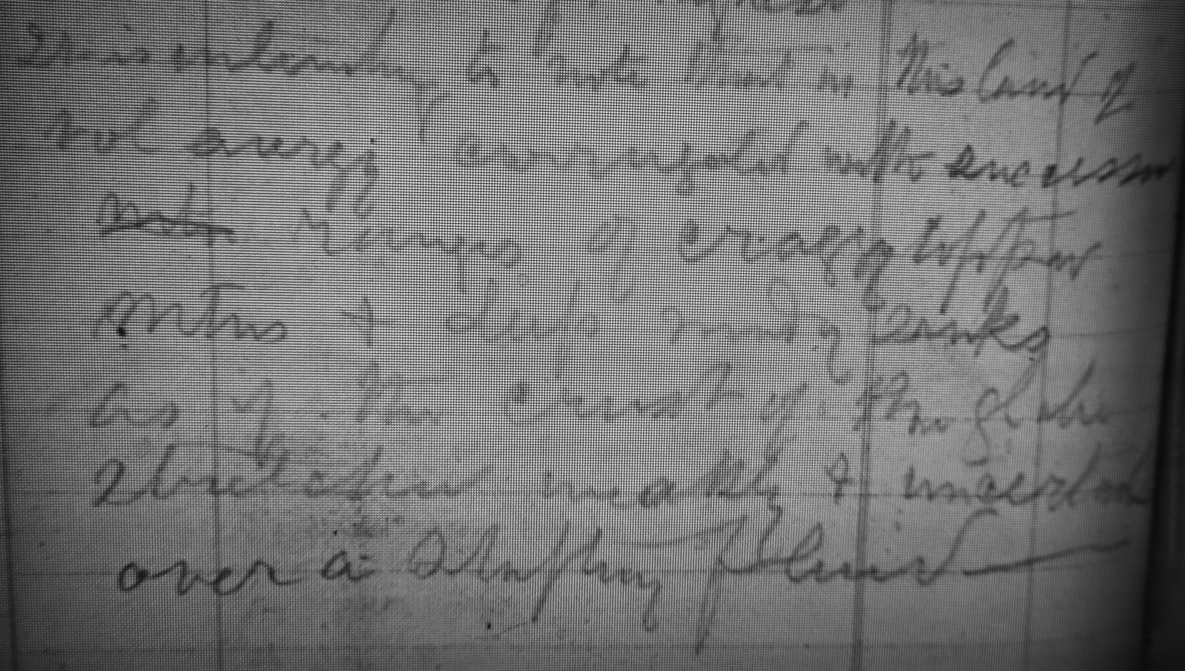

Slide 20
It is interesting to note that in this land of volcanic energy corrugated with successive ranges of craggy-topped mtns and deep sandy sinks as if the crust of the globe stretched weakly & uncertainly over a shifting fluid foundation.

Slide 21

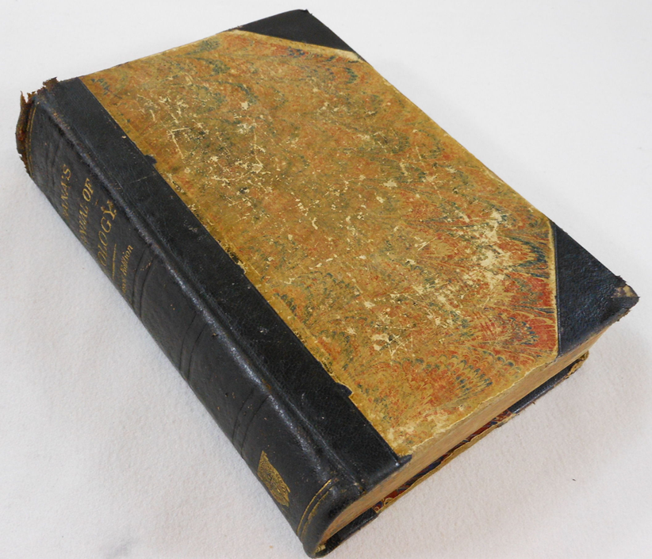
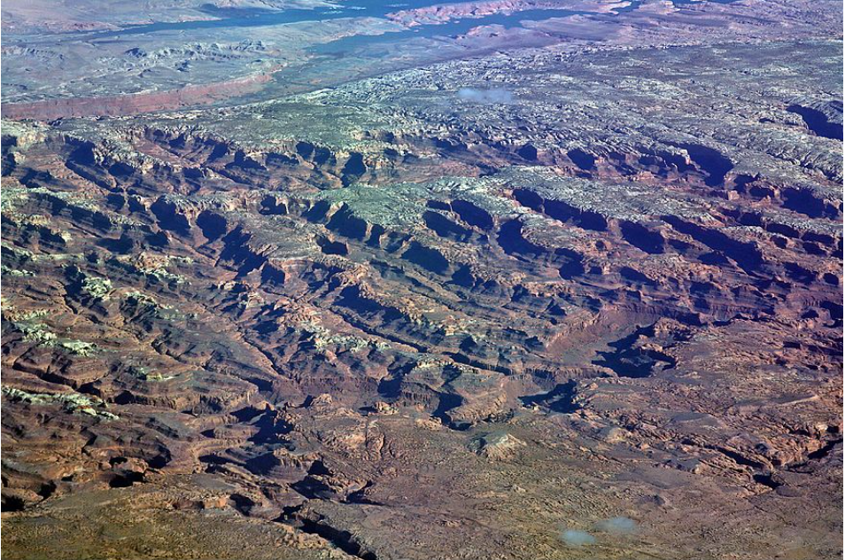
NO GENERAL AGREEMENT OVER BASIN-RANGES TECTONICS
J.D. Dana, Manual of Geology, 4th edition, 1895:
Fault hypothesis of Great Basin ranges is not yet proved.
EMERGING DISSENT
The Basin Ranges not tectonic at all but actually just erosional remnants left after valleys are cut
Fault blocks bounded by reverse faults rather than normal faults

Slide 22

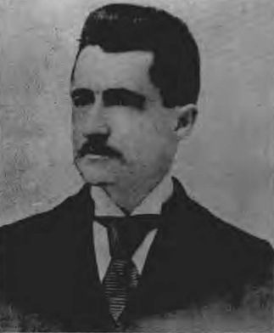

Journal of Geology 1909
Anderson, 1989
“How utterly inadequate is any purely tectonic explanation of the larger relief features of the Western desert region, as they today exist….”
Intermont plains (i.e., basins) are degradational (rock floors), not aggradational
Absence of foothills and distinct waterways: wind erosion

Slide 23
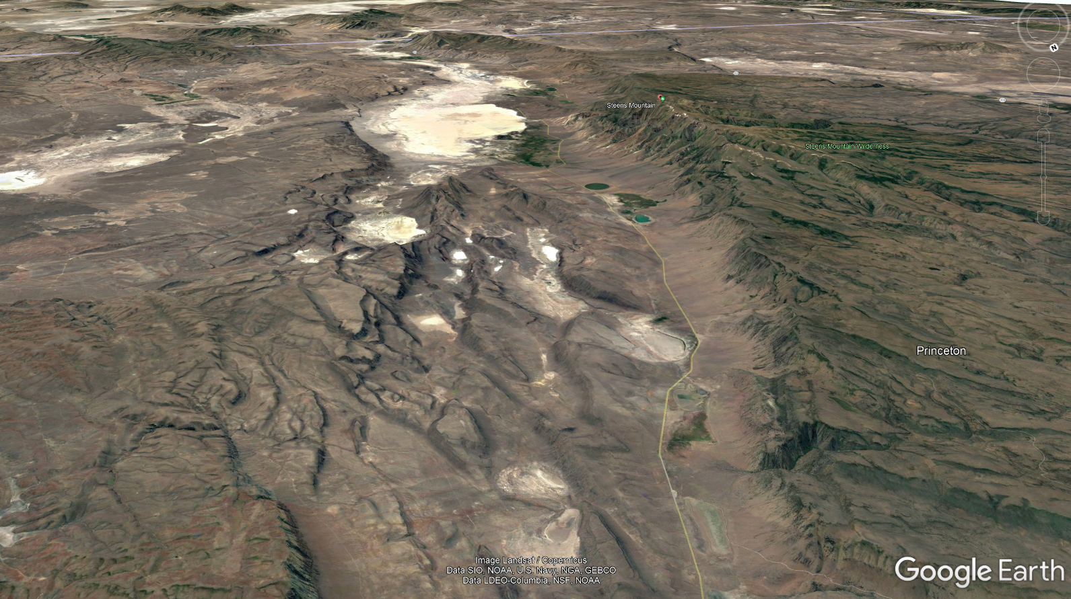
Steens Mountain

Slide 24
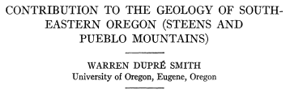
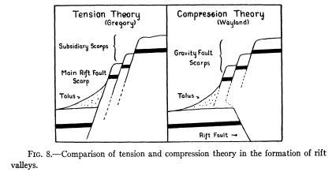
Journal of Geology 35, 1927

Slide 25
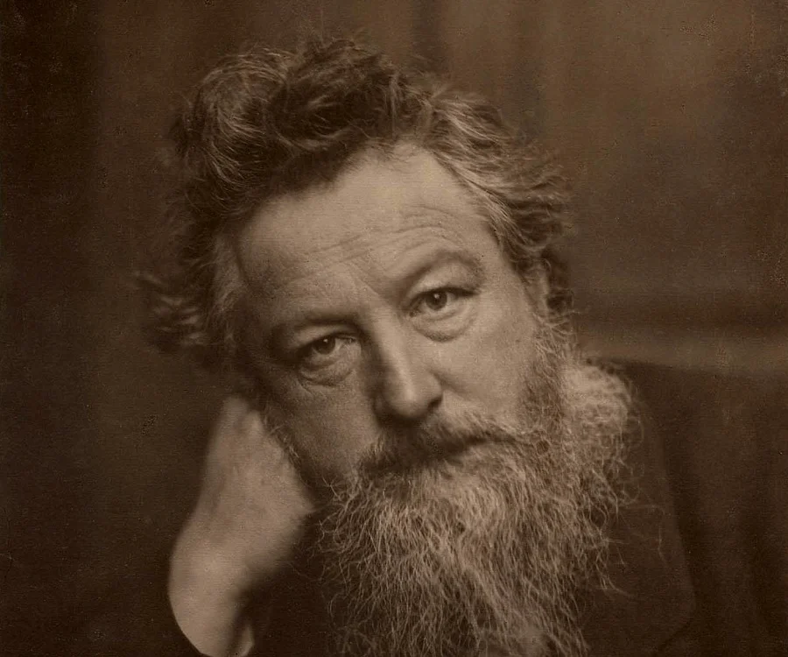
William Morris Davis
“The Basin Range blocks seem to be the irregularly uplifted and diversely tilted blocks of a former lowland of erosion which has suffered a pronounced extension of its former east-west breadth.”
…”there is no generally accepted mechanism…. adequate for the strong extensional dislocation of crustal blocks…to be found in the usual schemes of dynamical geology…”
“…underdrag, as an indirect reaction of a passive exterior crust on an expanding earth interior…”
The value of outrageous geological hypotheses, Science, 1926
Thefamouspeople.com

Slide 26
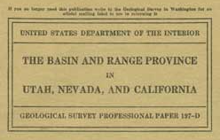
T.B. Nolan, 1943
“The preceding review…. reveals the three main explanations that have been advanced to account for the present topographic relief in the Great Basin. These are:
1. The ranges and valleys are limited by normal faults that are due to tensional forces.
2. They are limited by reverse faults, or by superficial normal faults caused by regional compression.
3. The valleys have been formed by erosion.”
“The Mesozoic and early Tertiary folding and over-thrusting were succeeded closely by the initiation of the block faulting that has been the chief cause, directly or indirectly, of the present relief of the province.”
“The assumed elongation in the crust as a result of the block faulting is likewise not necessarily indicative of tension. The data available are not adequate to prove that elongation in the crust has occurred in the region.”

Slide 27
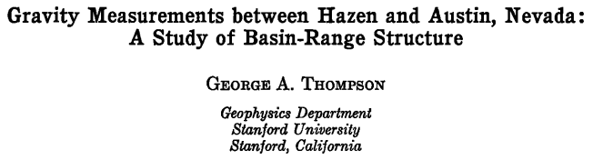
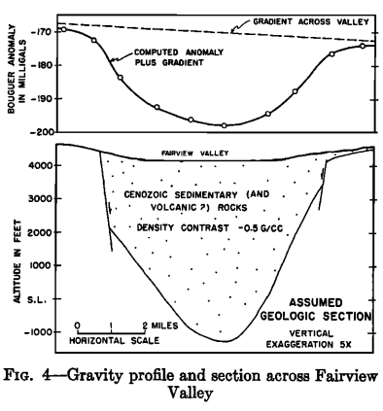
JGR 64, 1959
Horizontal extension of 5 feet in 1954 Dixie Valley earthquake
“The region is expanding in area”

Slide 28

EPILOG
The conflict of theories, leading, as it eventually must, to the survival of the fittest, is advantageous.
G.K. Gilbert

