Slide 1
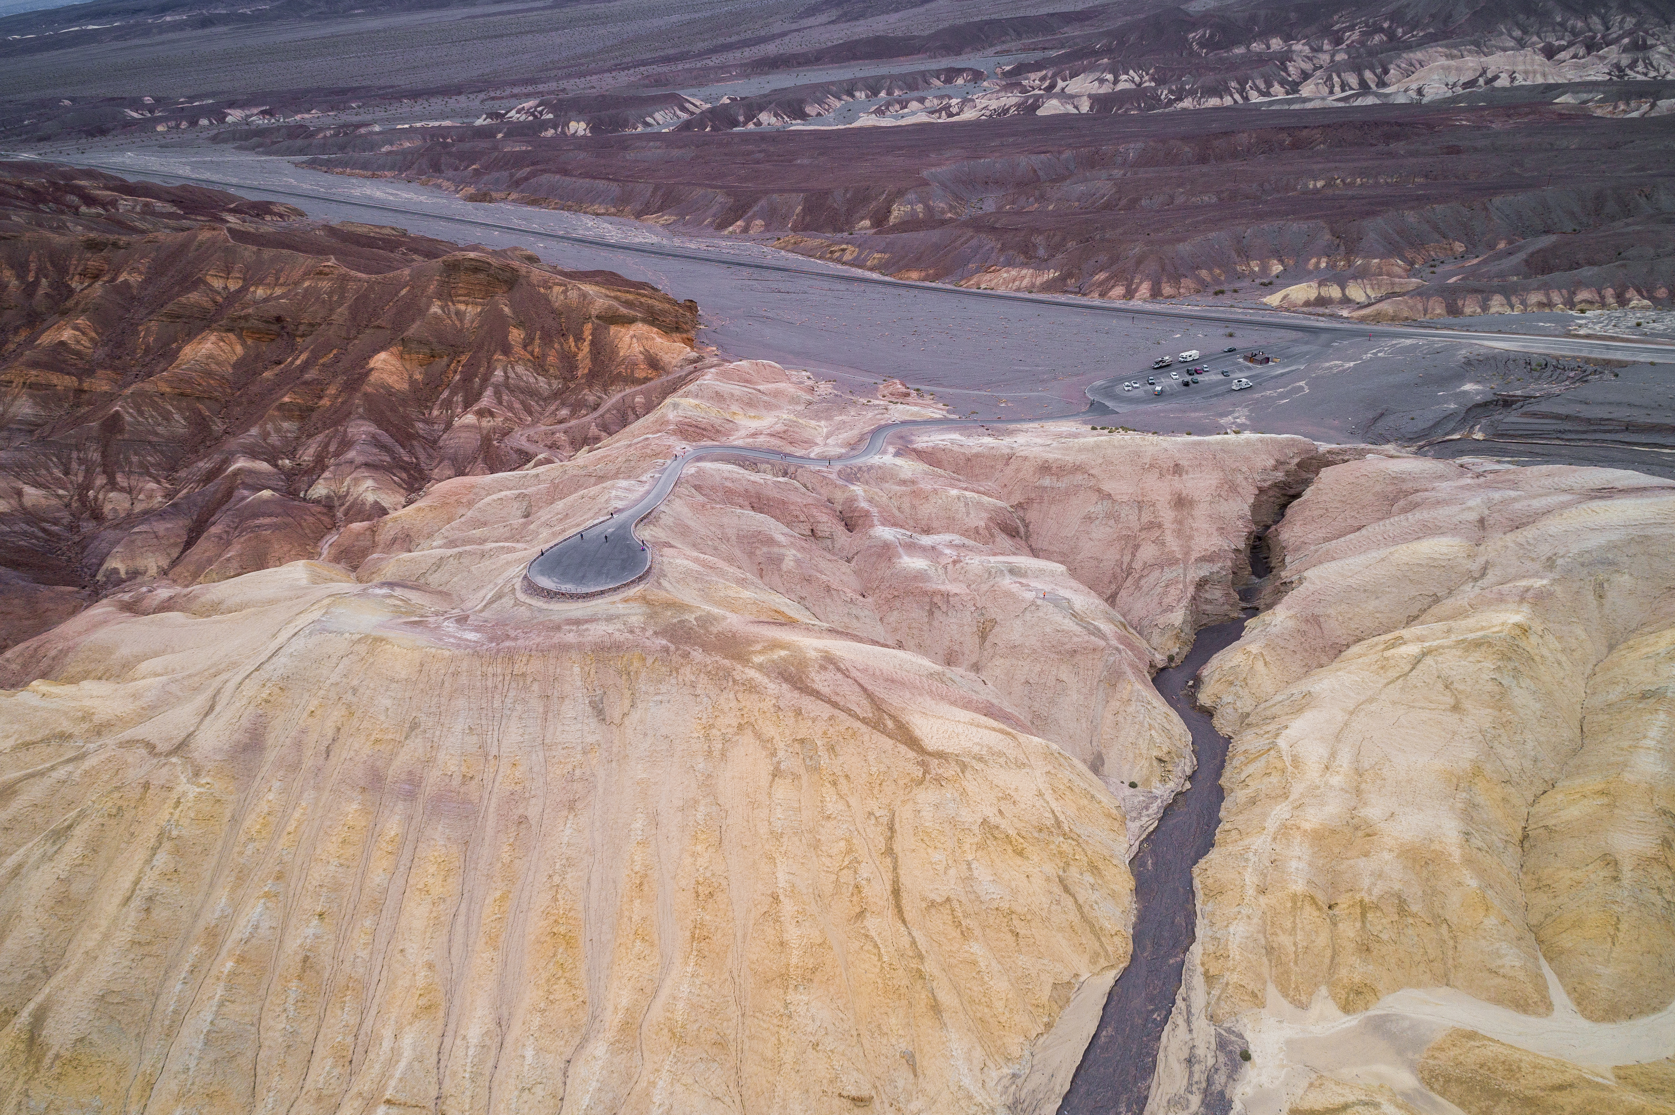
Eighty Years of Erosion and Damage Caused by Diversion of Furnace Creek Wash into Gower Gulch, Death Valley, California
Arthur Sylvester
and
Allen Glazner
March 2022
Notes:
Most of you are probably well acquainted with how FCW was diverted down Gower Gulch in 1941-42 to alleviate the effects of floods on structures at the mouth of FCW, but let’s review the problem from our qualitative observations of the erosional effects and damage in those 80 years.

Slide 2
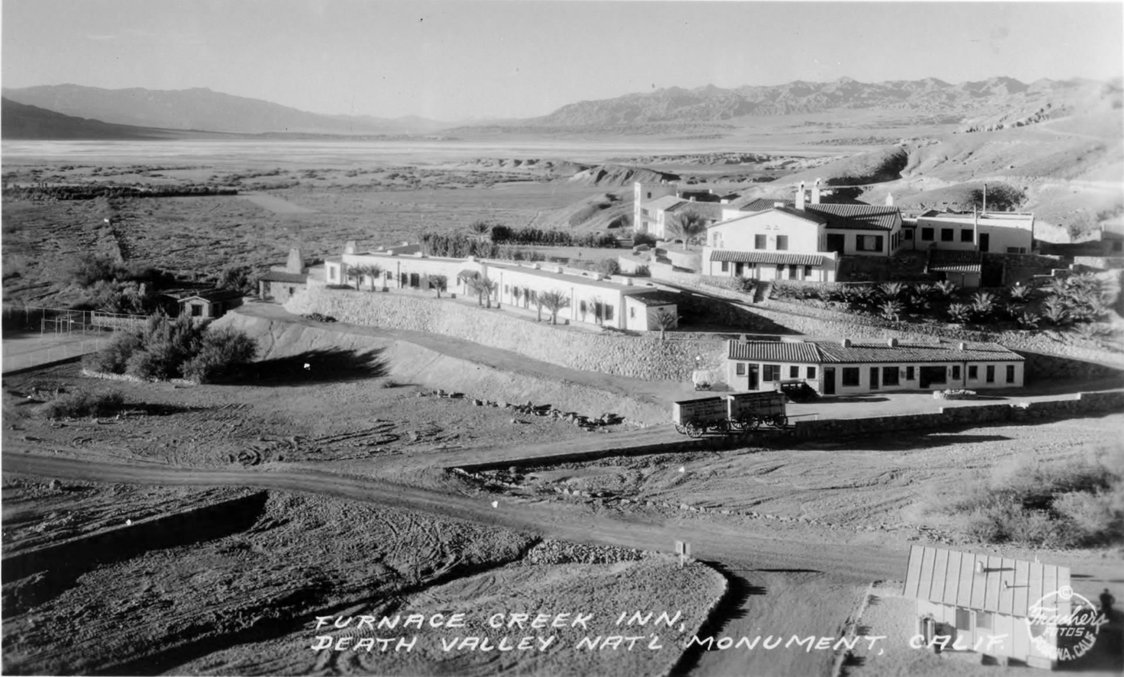
Furnace Creek Inn - 1933
Notes:
Furnace Creek Inn was built in 1933 on a mound or ridge overlooking the mouth of FCW. Flash floods posed little danger to the Inn itself, but these structures here and here are right in the path of the largest floods, and a tunnel from the parking lot to the core of the inn could be flooded.

Slide 3
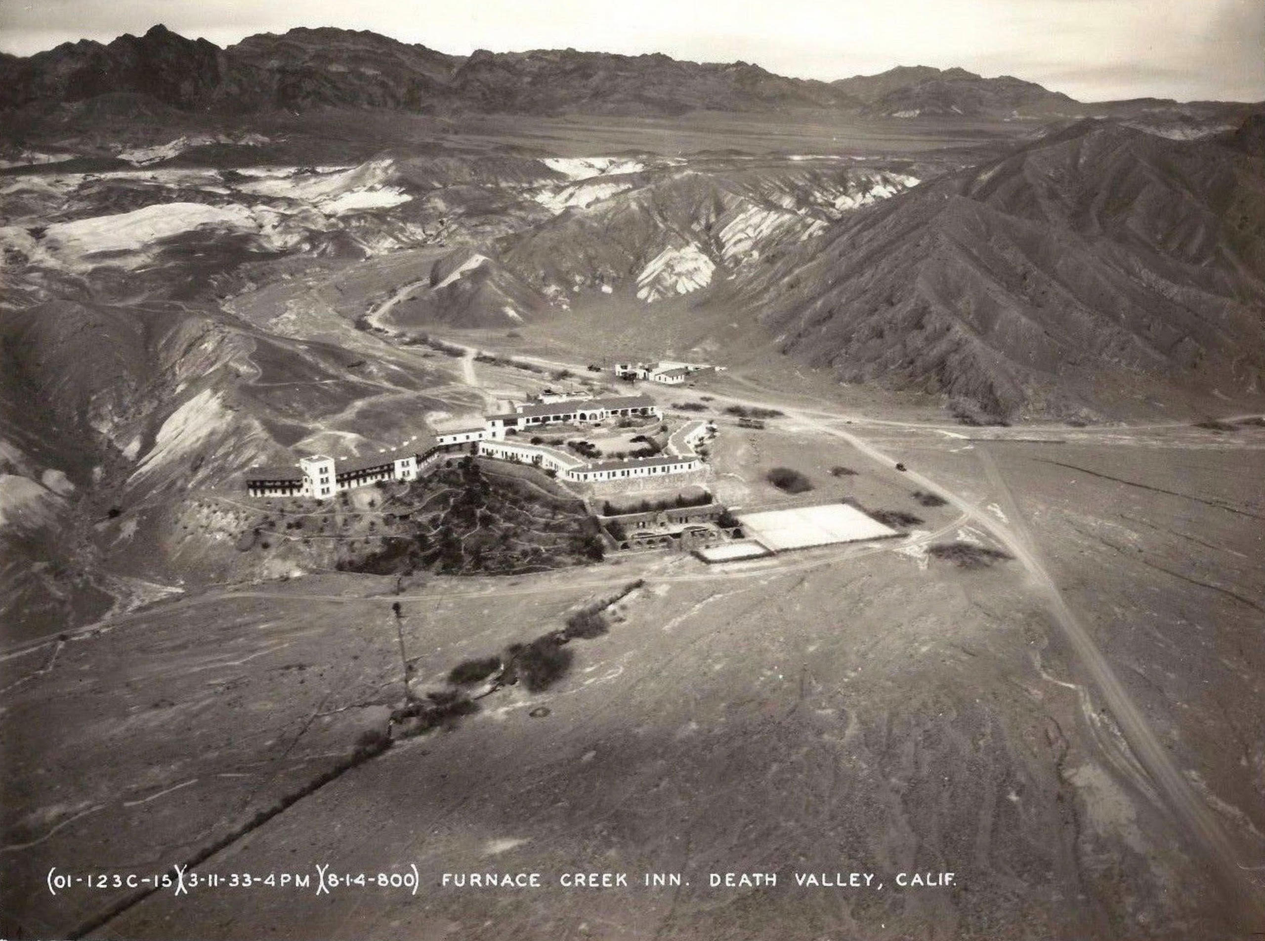
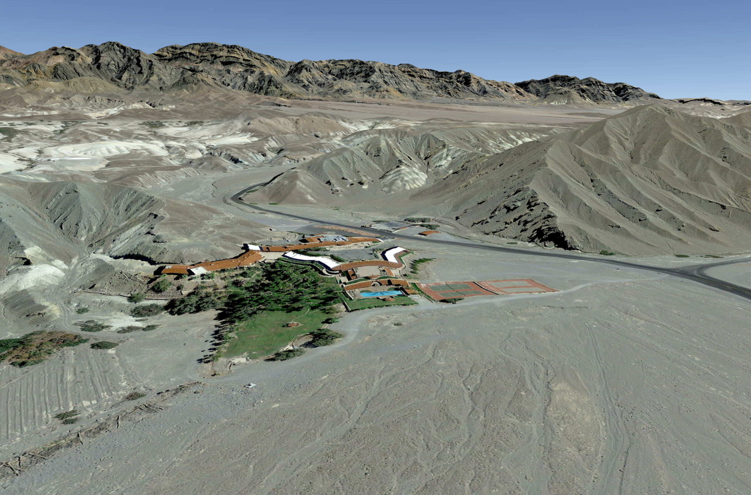
Furnace Creek Inn – 1933-2018 – View SE
1933
2018
Notes:
The view in these two images looks southeast up FCW. Floods would come down FCW and debouch on the alluvial fan, imperiling these structures in their path. Today they would wash over the swimming pool and tennis courts as well as the staff quarters and parking lots, but again leaving the Inn itself alone.

Slide 4
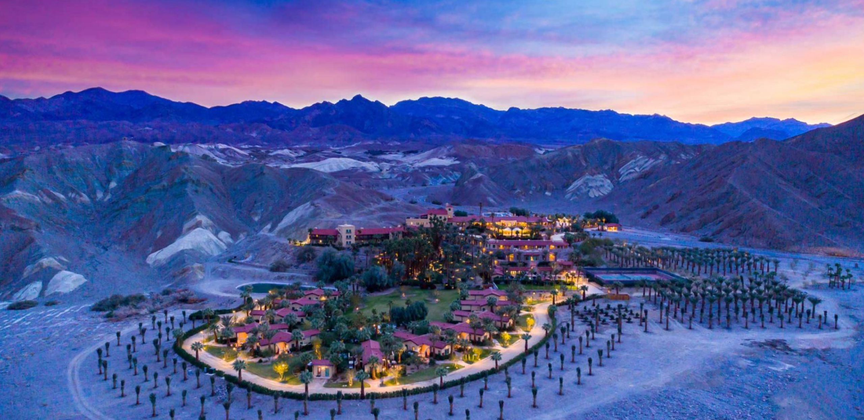
Current Layout of the Oasis at Death Valley
Notes:
Renamed the Oasis at Death Valley, the Inn has added a bunch of ‘casitas’ and palm trees out on the fan. I have not been there since this $100 million project was completed, so I don’t know if the casitas have been built on elevated land on the fan. If so, you can see how some big floods may cause some real problems for some of the casitas someday.

Slide 5
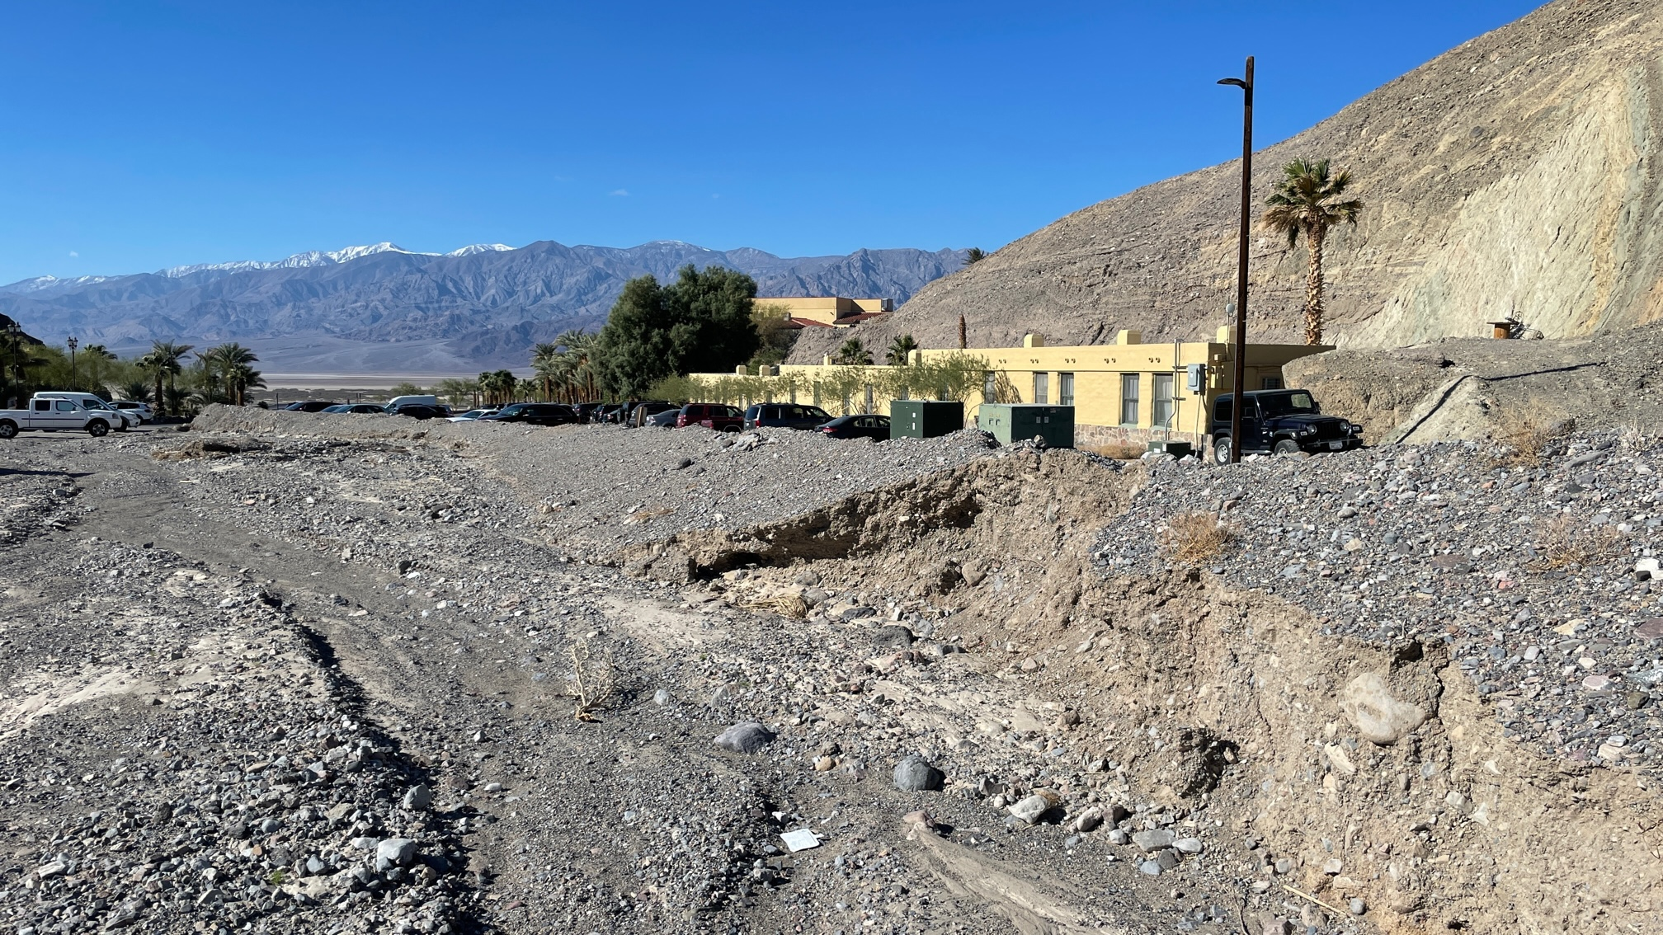
Inn Facilities at Flood Risk
Notes:
A little way up FCW from the Inn are these staff lodgings and the green utility boxes. One of the latest floods tried to cut into the levee that protects these facilities.

Slide 6
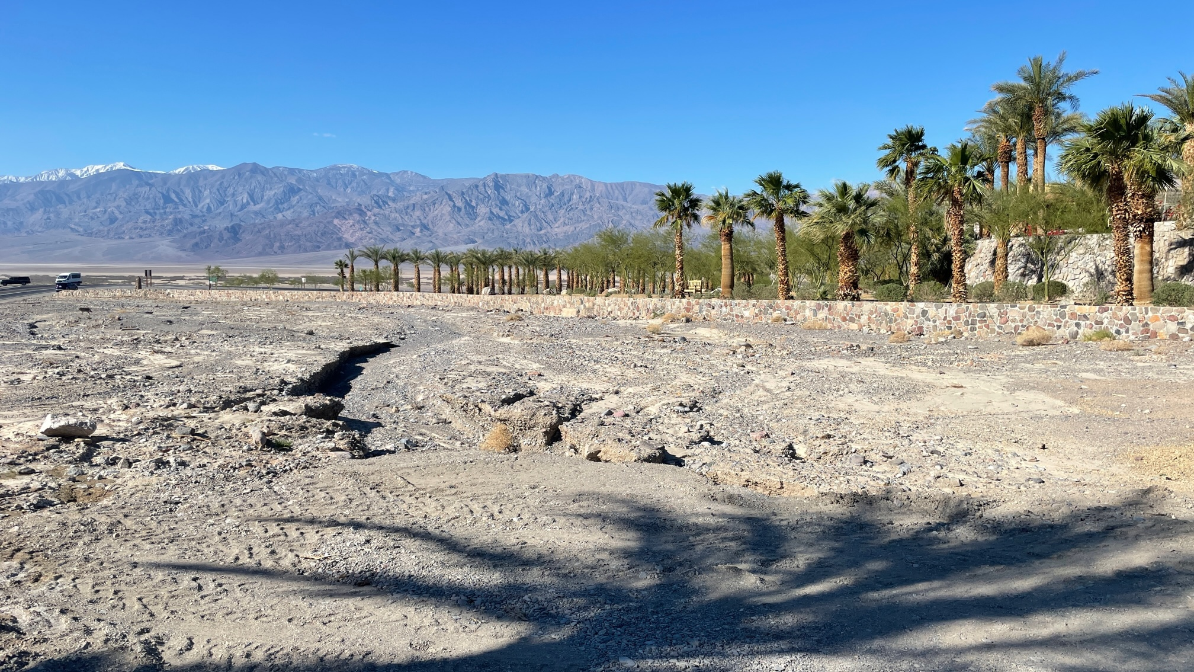
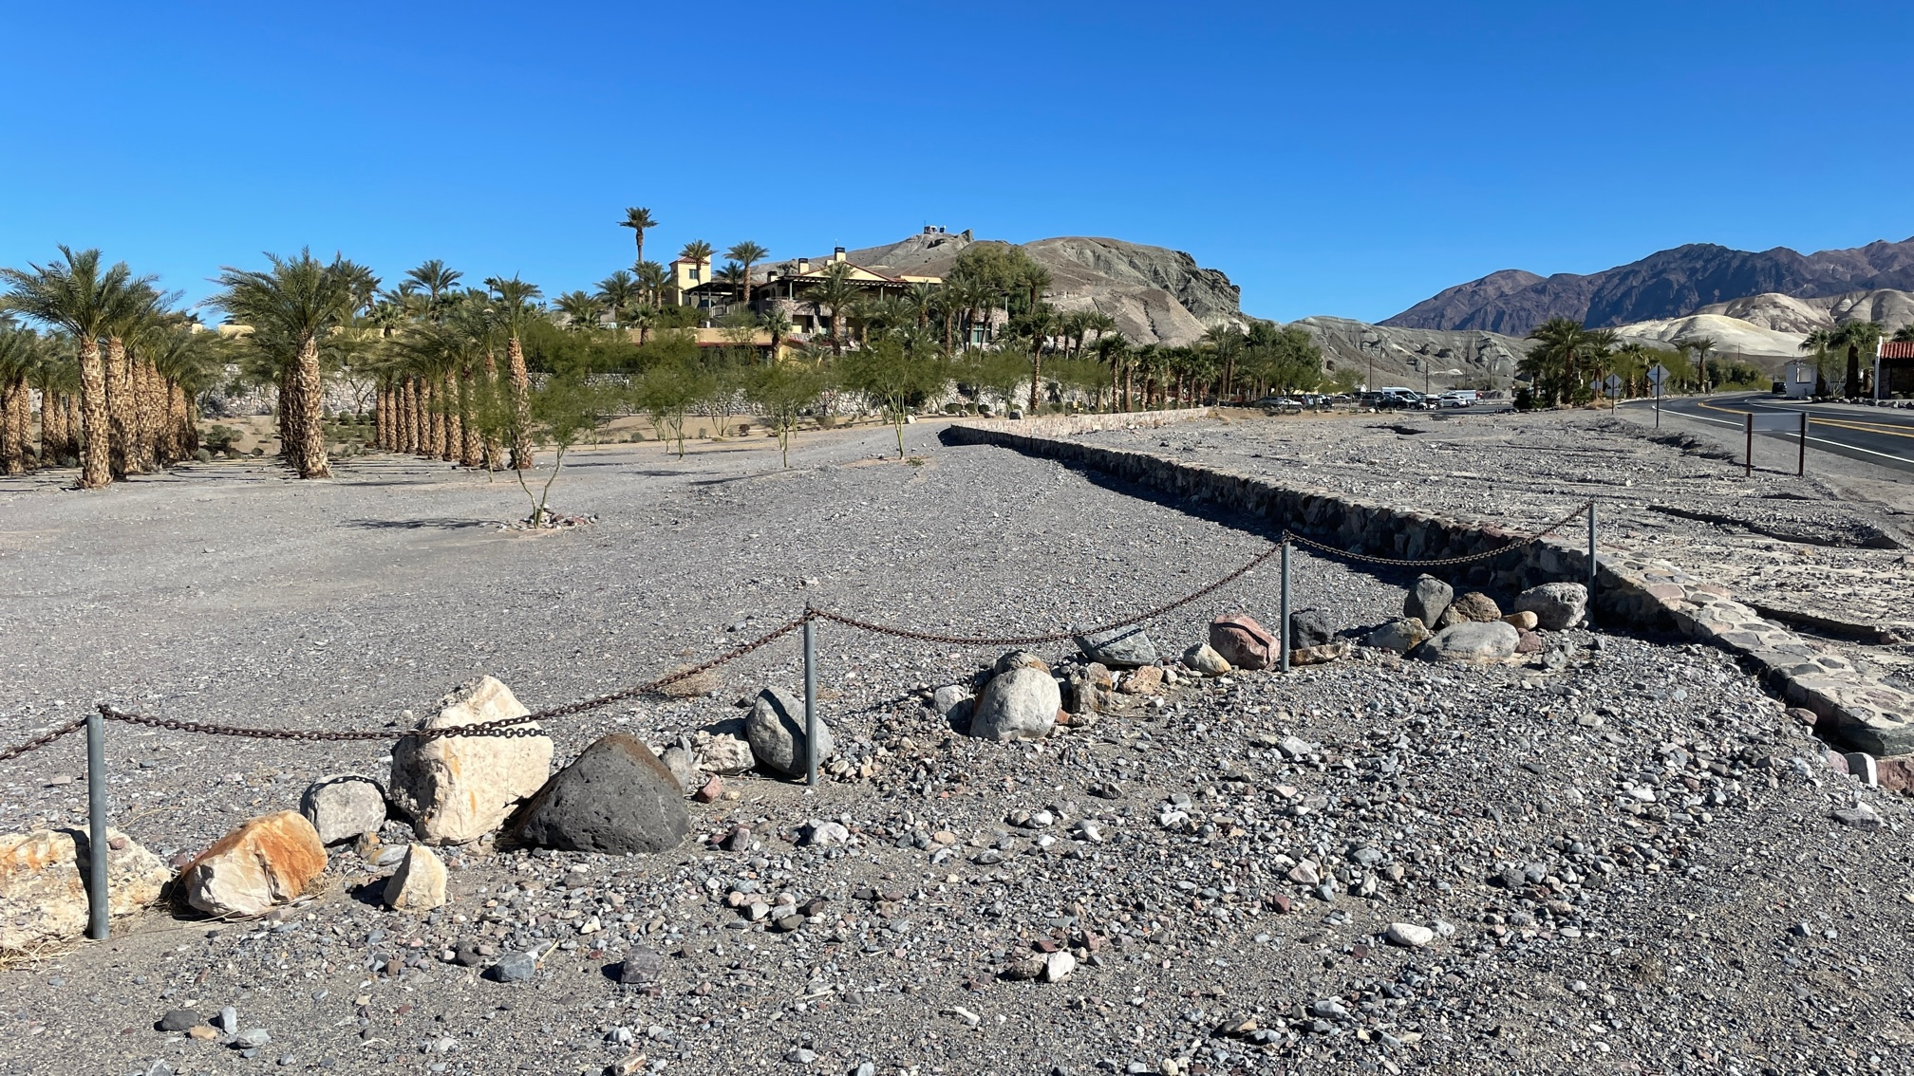
Flood Diversion Wall on Furnace Creek Fan
Notes:
The Inn has constructed a low stone wall on the alluvial fan to channel the flood waters away from its new casitas and other low lying facilities.

Slide 7
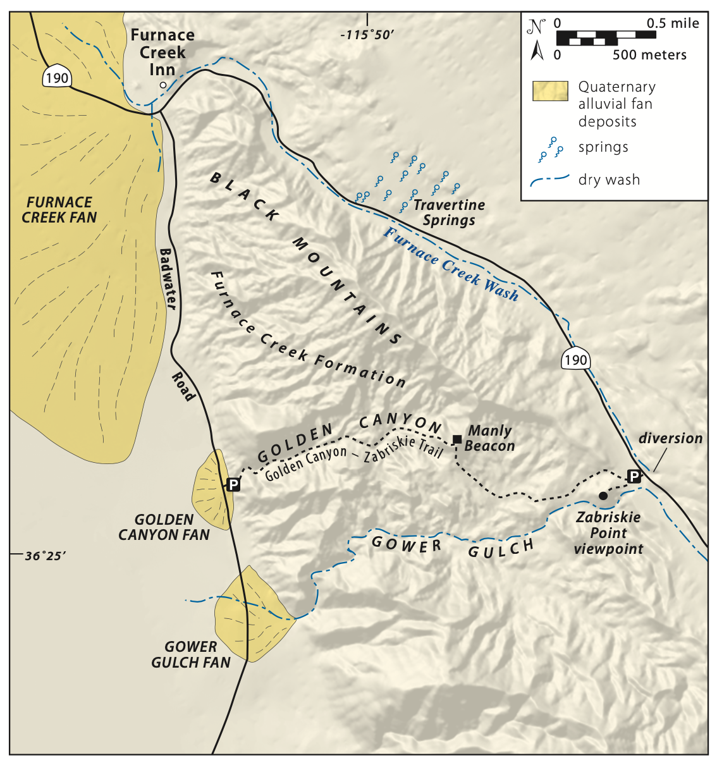
Map of Diversion area in the Black Mountains
Notes:
Before going into detail, let’s pause and look at that part of Death Valley under consideration here. The Inn is situated at the north end of the Black Mountains, at the intersection of California state highway 190 and the Badwater Road, and at the mouth of FCW. Here is the head of Gower Gulch, about 6 km upstream from the mouth of the Wash and the Inn. The diverted waters flow down Gower Gulch to its mouth and alluvial fan in the central part of Death Valley proper.

Slide 8
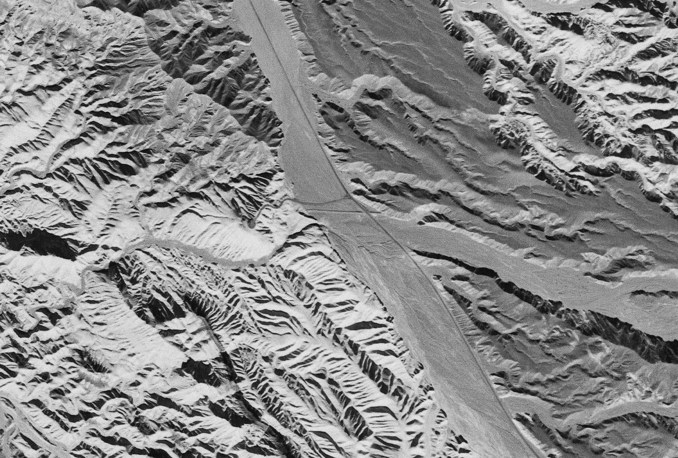
Diversion Berm 1948
Notes:
We came across this remarkable vertical air photo taken in 1948 the berm in FCW upstream of the road to Zabriskie Point overlook and the mouth of this nameless tributary. It looks as though not much diversion has happened between 1941 and 1948. Judging from the light colored sediment in the bottom of Gower Gulch.

Slide 9
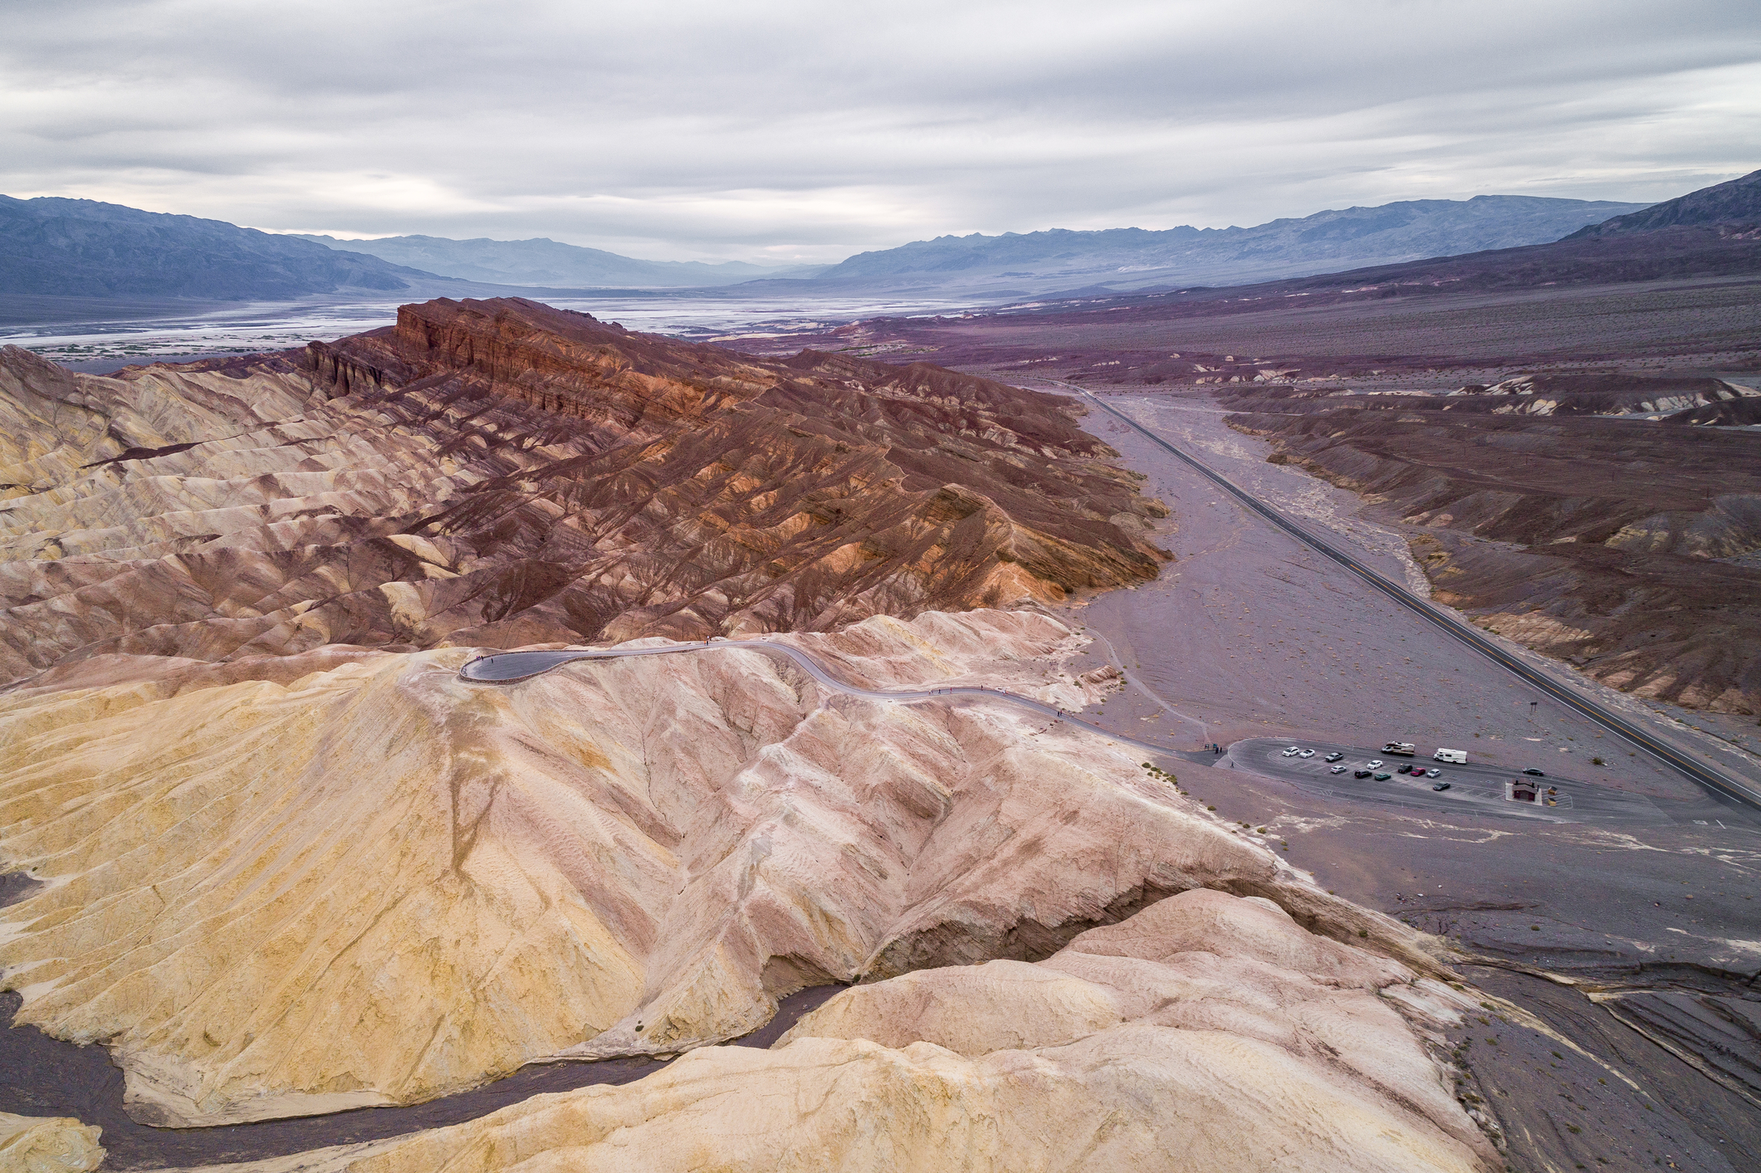
Previous Studies of the Diversion
Troxel, 1974
Significance
Dzurisin, 1975
Slope data
Crippen, 1979
Potential flood damage
Snyder & Kammer, 2008
Update
Notes:
This is an undated but fairly recent oblique aerial view of the diversion, looking downstream toward the Furnace Creek Inn at the mouth of the Wash. Thus prior to the diversion, floods followed the main wash northwestward and covered the floor of Gower Gulch with dark FCW sediment. The head of Gower Gulch is here and would have captured FCW naturally eventually by headward erosion or by aggregation, but the berm was pushed up across FCW in 1941, and a bit of rock was dynamited at the head of the gulch, so that most FCW floods now flow down Gower Gulch. This is quite evident by the color and presence of the dark colored sediment in the gulch. Some floods are estimated to have been in excess of 10,000 cfs .

Slide 10
Present Day Aerial View of the Diversion
Notes:
• Furnace Creek Wash drains 400 sq. km • Sediment primary hard, angular Paleozoic limestone and dolostone cobbles • Gower Gulch is nearly 4 km long and drains 5 sq. km Sediment initially consisted of silt and lesser basalt cobbles Gulch channel now carries Furnace Creek Wash rock types derived from 400 sq. km.

Slide 11
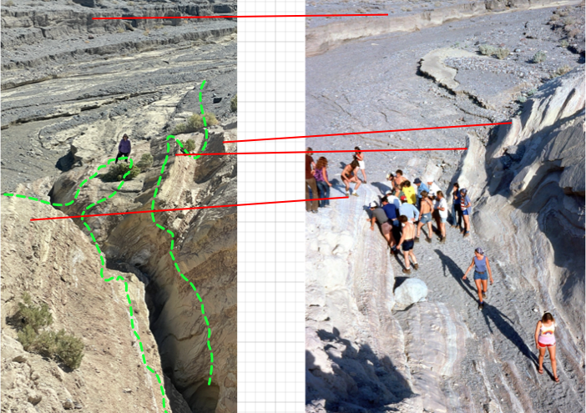
45 Years of Erosion at Gower Gulch Head
Last Friday
1977
Notes:
Erosion at the head of Gower Gulch in the past 45 years is impressive. Students cluster where bedrock was dynamited in 1941-42, and they walk on the bedrock floor of the gulch in 1977. You certainly cannot merely walk down the gulch from FCW now. The dashed green line is an approximation of the contour of the gulch bottom in 1977, and the red lines tie bedrock features extant in 1977 and last week.

Slide 12
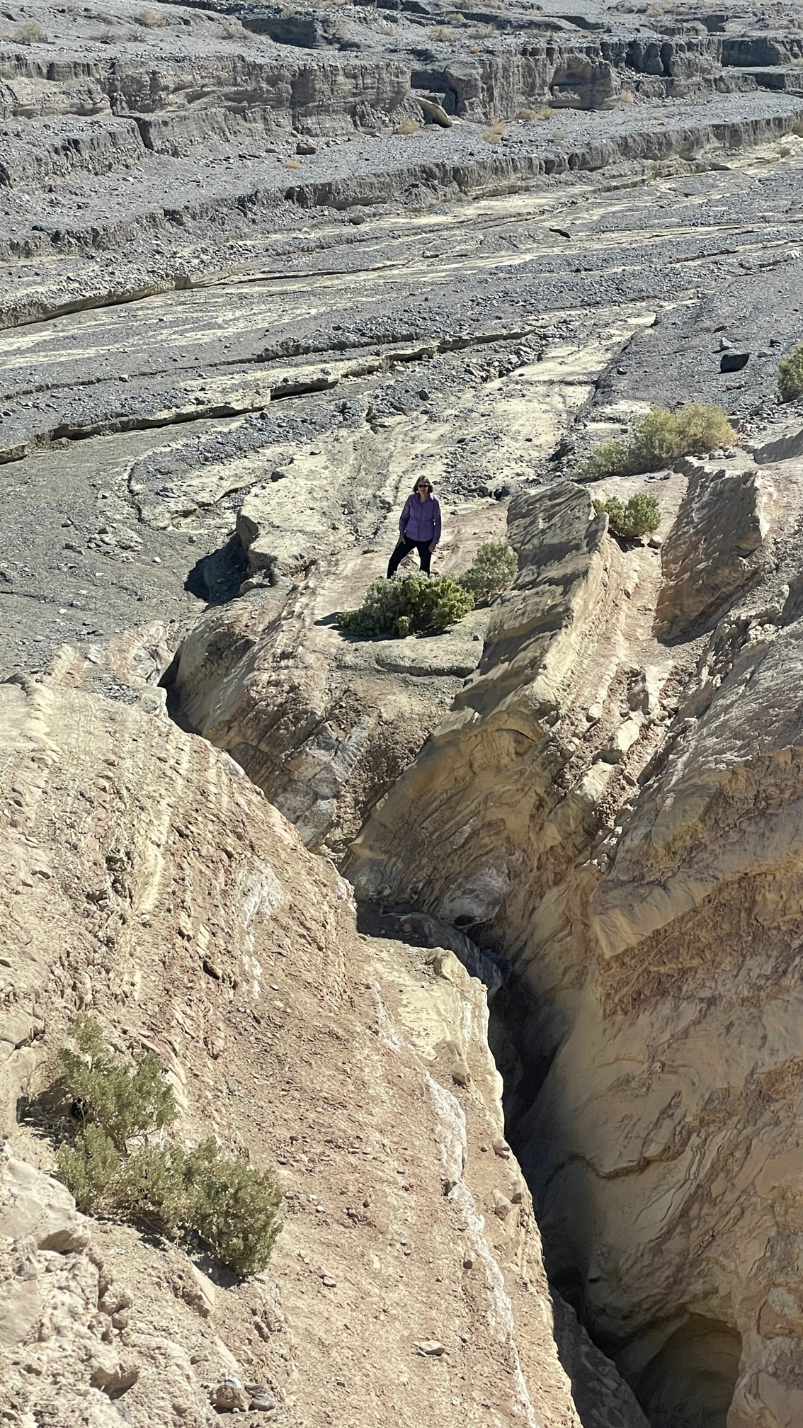
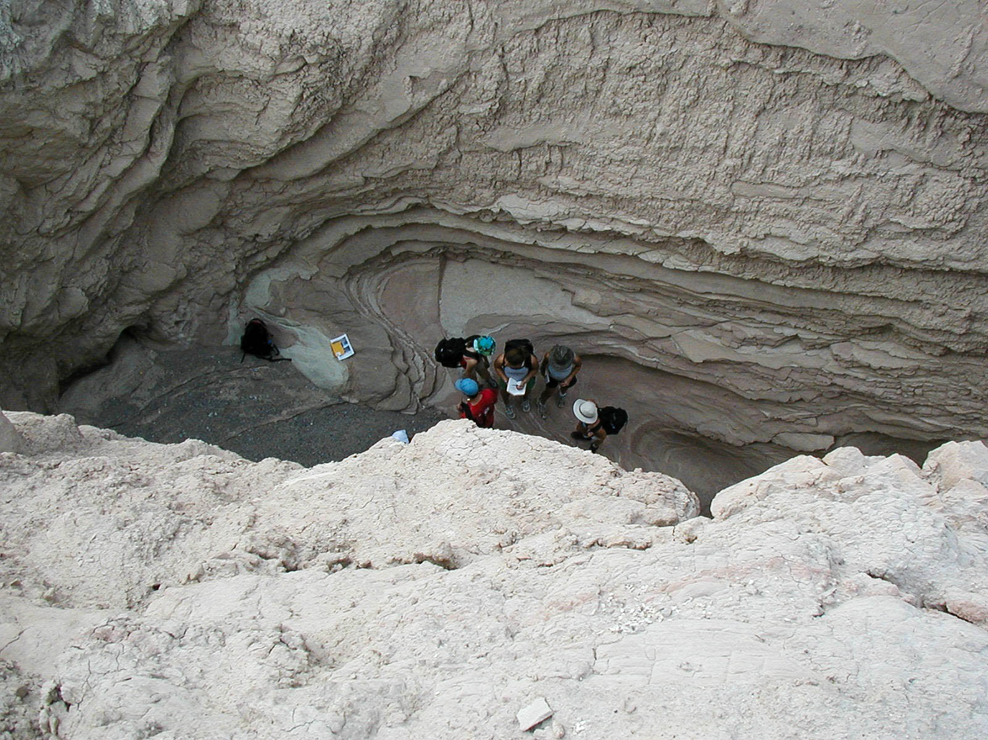
Gulch-head Erosion 2003 - 2022
Last Week
2003
Notes:
We dropped the end of a tape measure from where we estimated the strath terrace before the diversion to the bottom of the gulch bottom a year ago, and measured a depth of 41 feet – in 80 years.

Slide 13
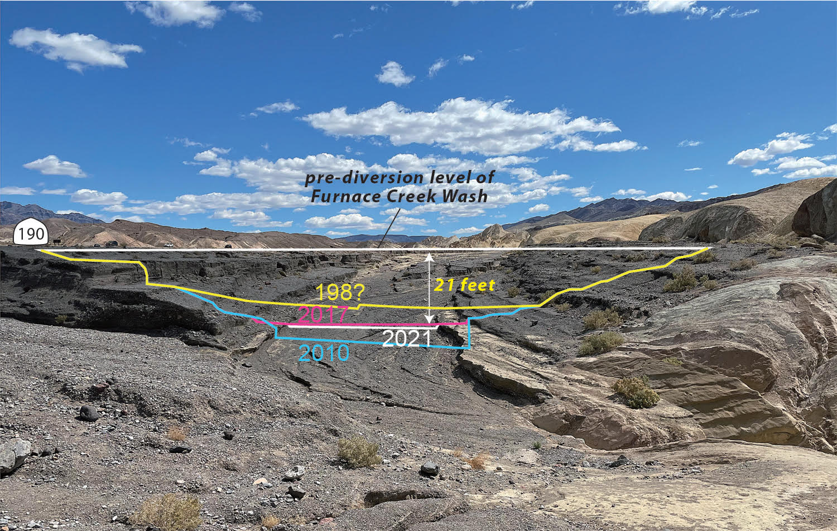
80 Years of Lowering of Furnace Creek Wash
Notes:
This view of FCW looks upstream from the diversion and shows our qualitative measurement of the amount of erosion of FCW since the diversion in 1941.

Slide 14
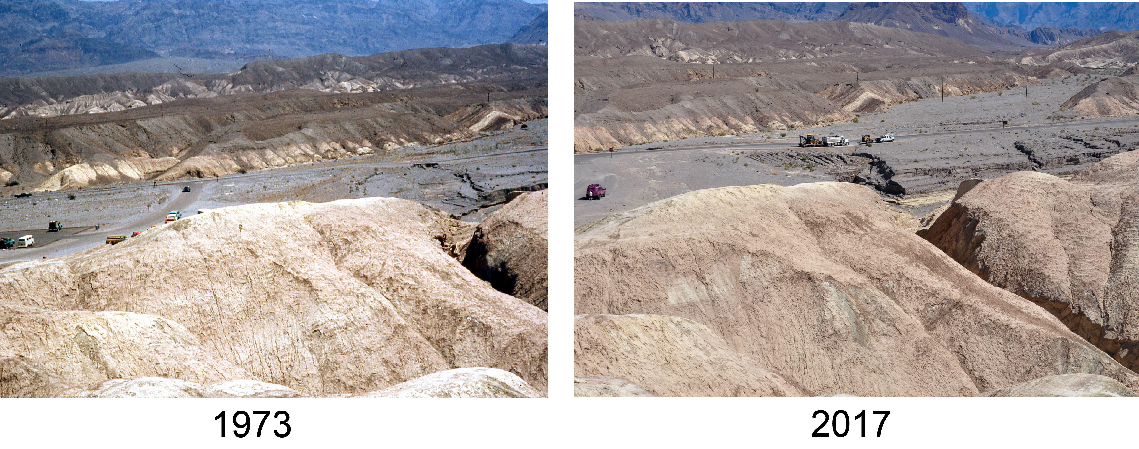
Road Damage at the Diversion
Notes:
As the level of FCW is lowered by erosion, a tributary has damaged Highway 190 by headward erosion, necessitating highway repairs now and then.

Slide 15
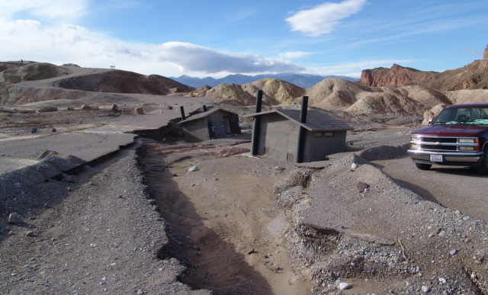
2004 Flood Damage at Zabriskie Parking Lot
Notes:
View of parking lot damage and outhouses from the 2004 flash flood. Photo courtesy of Jeff Knott. The view is west from the Zabriskie Point parking lot to the Zabriskie Point viewpoint.

Slide 16
Diversion Facts • Furnace Creek Wash drains 440 sq. km., 88% larger than Gower Gulch drainage area • Gower Gulch drained 5 sq. km. prior to diversion Sediment initially consisted of silt and lesser basalt cobbles. Gulch channel now carries Furnace Creek Wash rock types. Some floods estimated to be 10,000 cfs • Gower Gulch would have eventually captured Furnace Creek Wash naturally by headward erosion into the Wash or by aggradation of the Wash.
Notes:
This slide summarizes the main points of the diversion story at the diversion. Now let’s see the effects at the mouth of Gower Gulch.

Slide 17
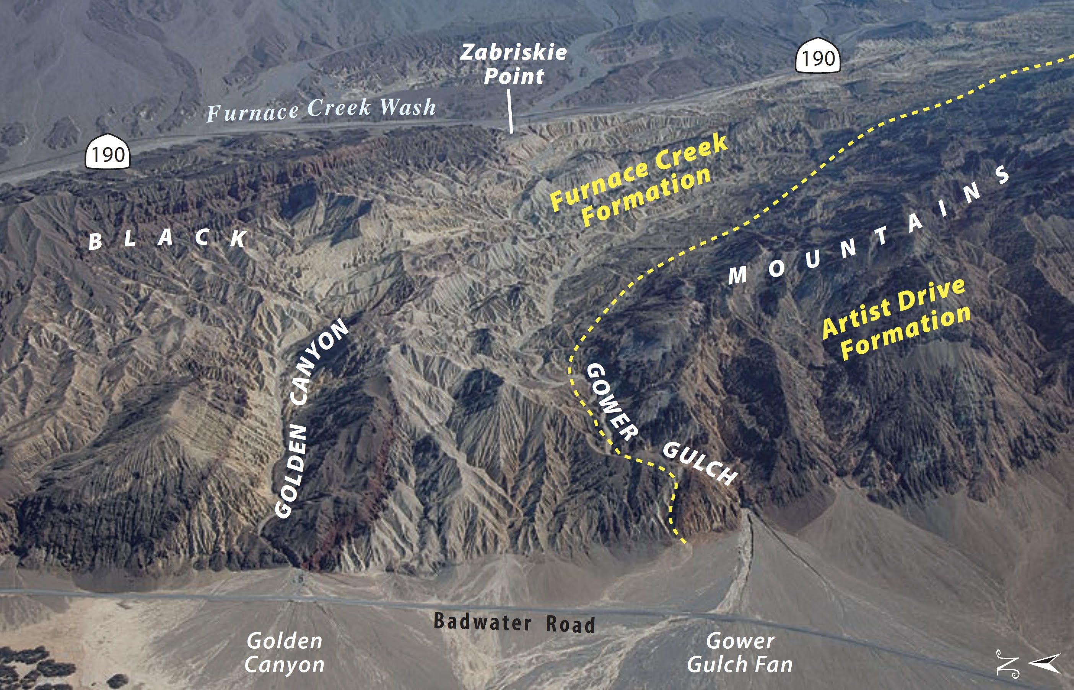
Course of Gower Gulch
Notes:
This aerial view overlooks the course of Gower Gulch from the diversion to its alluvial fan in the valley.
The narrow channel and mouth of Gower Gulch is carved deeply into young siltstone and interlayered basalt flows of the Furnace Creek Formation, but into harder volcaniclastic strata of the Artist Drive Formation at its mouth. A narrow channel of fresh, unvarnished sediment courses down the alluvial fan and across the Badwater Road.

Slide 18
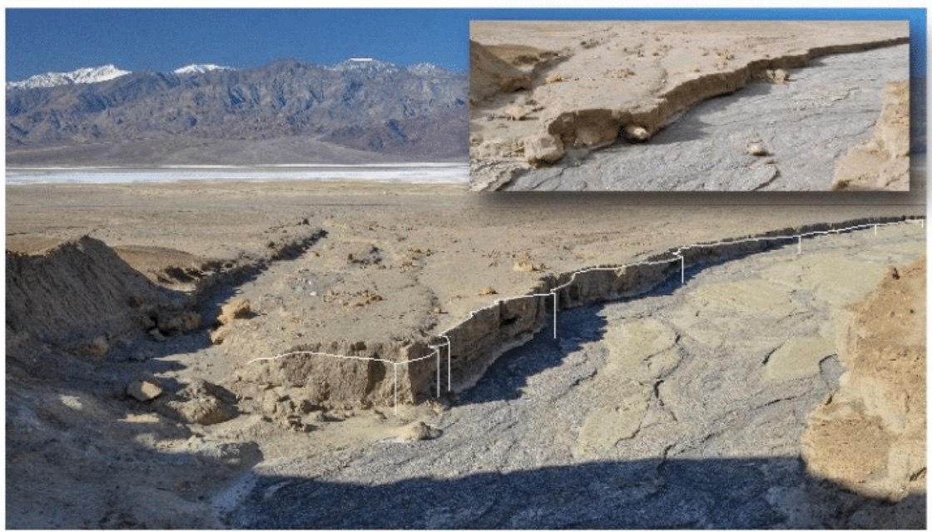
Fan head Channels on Gower Gulch Fan
Oct 2003
March 2017
Notes:
The first few major floods must have flushed out of Gower Gulch and into the Valley like water jetting out of a firehose to carve this deep fan head channel, and bypassing an older one on the left. The channel carries dark gray detritus derived from Furnace Creek Wash, whereas the fan consists of (younger) Furnace Creek Formation detritus. The new channel here is nearly 20 feet deep. The two images attempts to show the amount of channel wall erosion in 14 years.

Slide 19
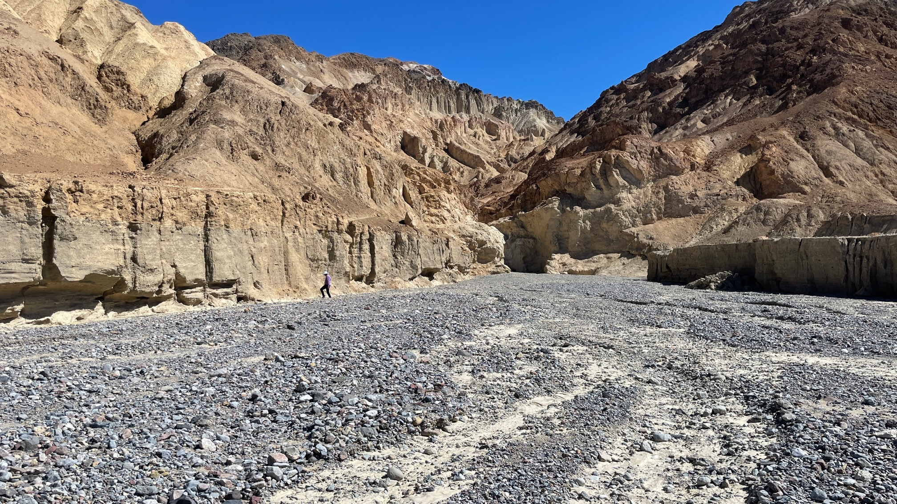
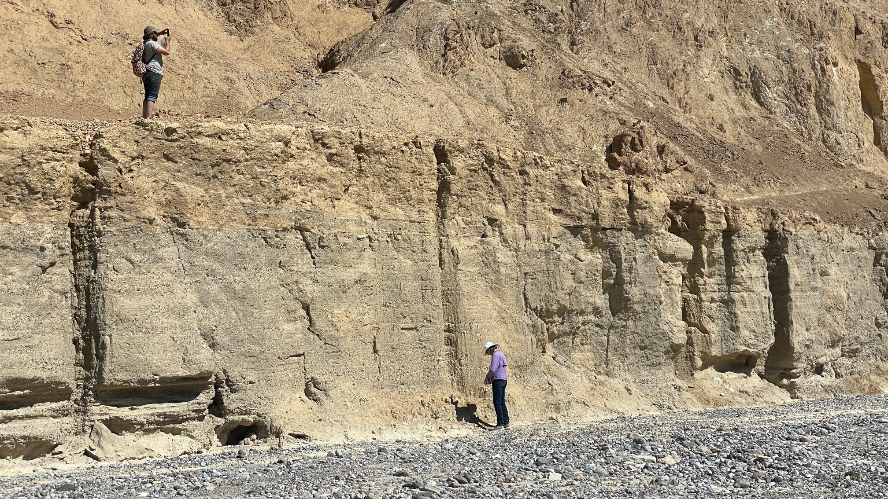
Gower Fan-head Channel
As of Last Week
Notes:
This is a big channel that carries a lot of water. The head of the flat channel terminates abruptly at a cascade and a fault that bounds the mountain front.

Slide 20
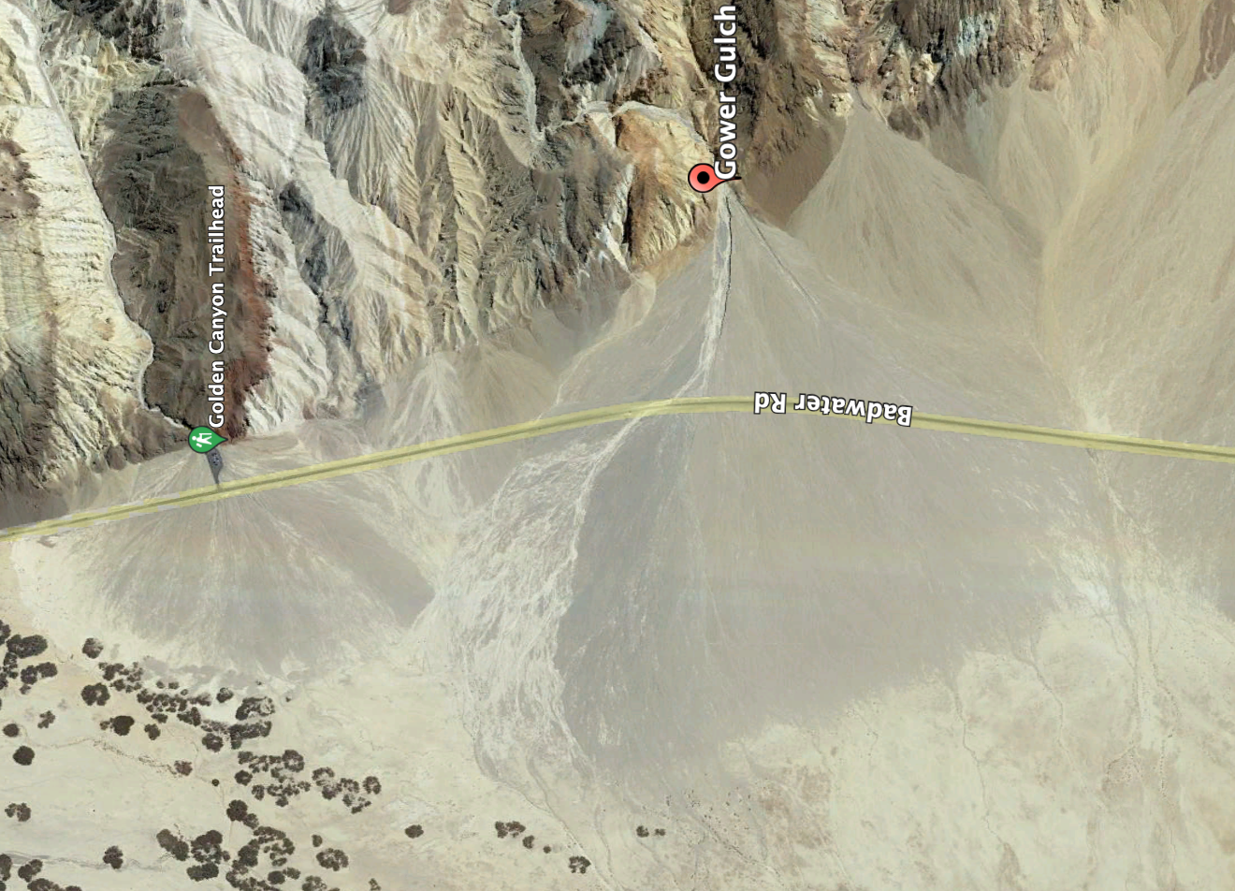
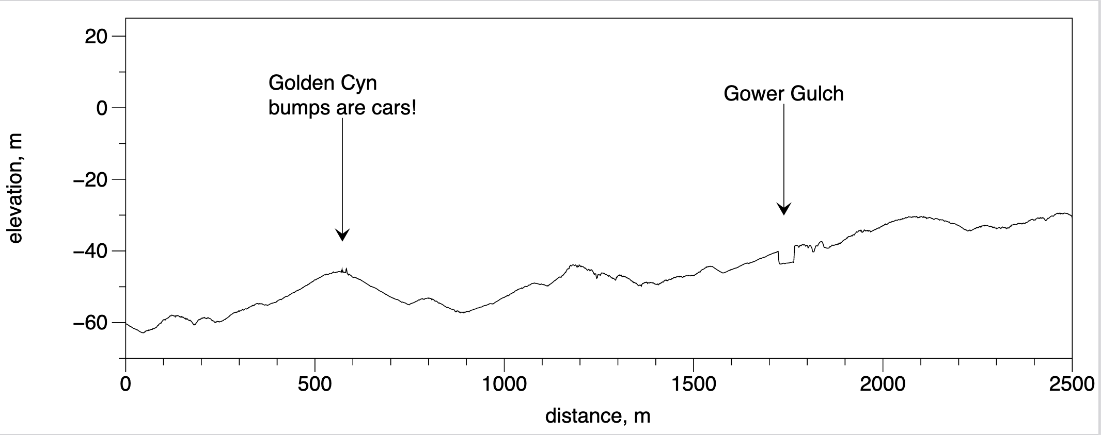
Topographic Profile across Three Alluvial Fans
Notes:
This profile is drawn parallel to the range front and about 50-100 meters from the range front fault. It crosses three alluvial fans: Golden Canyon fan, a very small nameless fan, and Gower Gulch fan. The 80 year-old Gower Gulch channel shows up quite clearly where it has cut through the north side of the fan, whereas the Golden Canyon channel, which drains an area much smaller than Gower Gulch, does not show up in the profile.

Slide 21
Summary
• The diversion occurred 1941-42 to mitigate flood damage downstream.
• The floods are episodic; most of them divert down Gower Gulch, but the large ones bypass the diversion and continue about 6 km down the Wash onto the Furnace Creek alluvial fan. • Gower Gulch would have eventually captured Furnace Creek Wash naturally by headward erosion into the Wash or by aggradation of the Wash.
• Episodic erosion has widened and deepened both Furnace Creek Wash and Gower Gulch by amounts that may be determined quantitively comparing new measurements with those published by Dzurisin in 1977, and will be presented in 2041 on the 100th anniversary of the diversion.

Slide 22
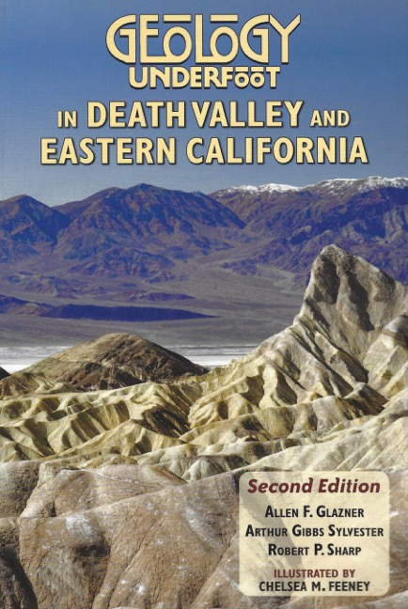
Read More About the Diversion and many other Death Valley and Eastern California Topics
Second Edition now available!
See the authors for an autographed copy!

Slide 24
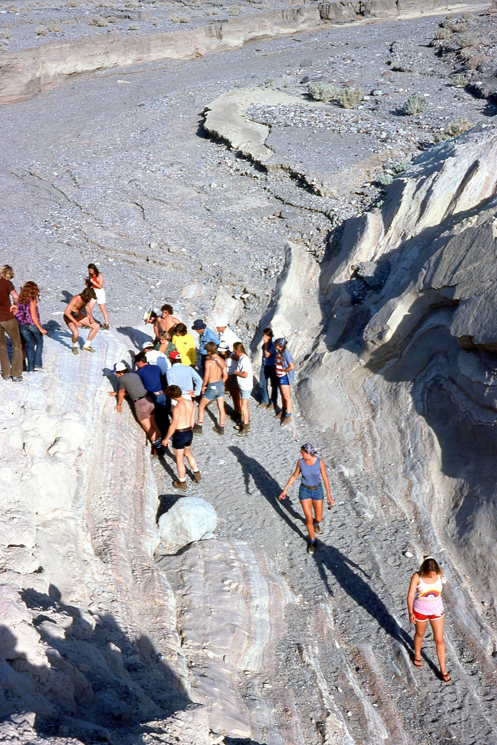
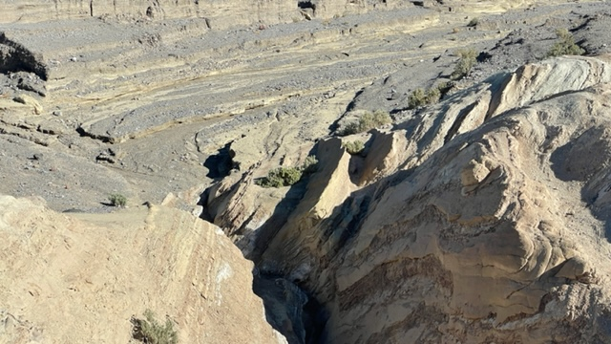
45 Years of Erosion
1977
Last Week

Slide 25
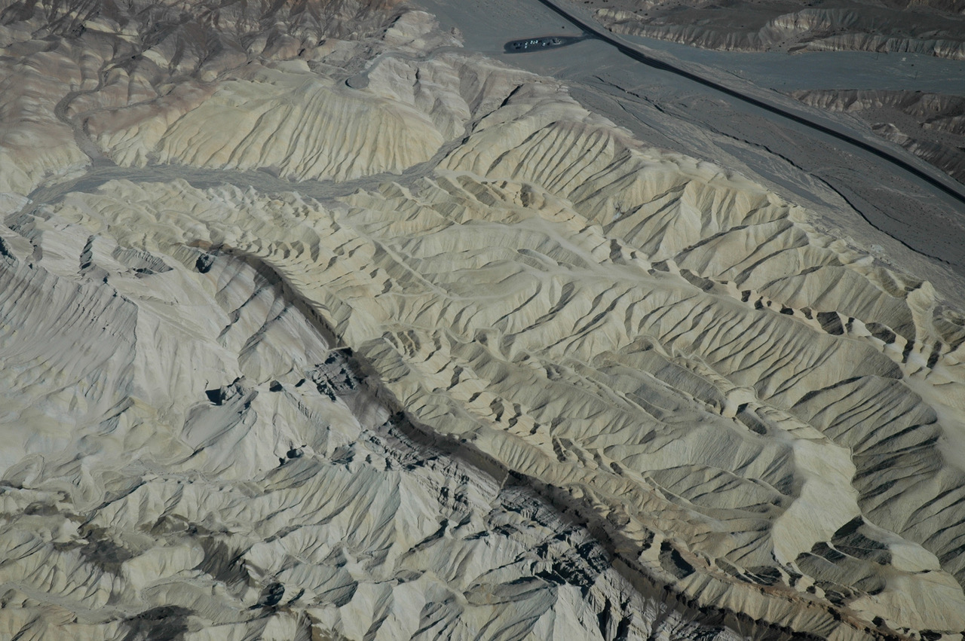

Slide 26
