Slide 1
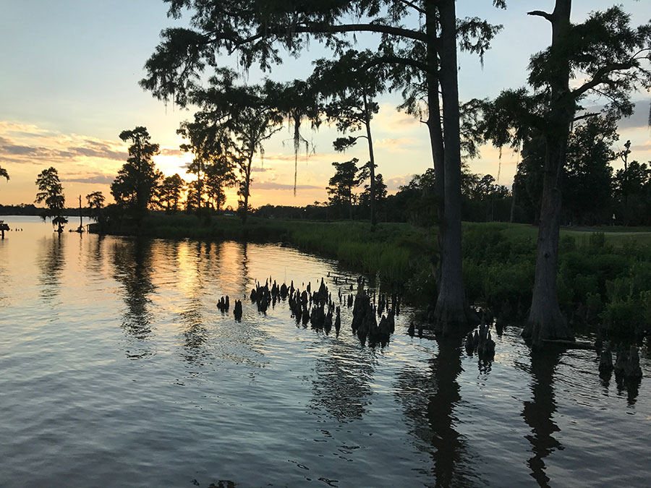
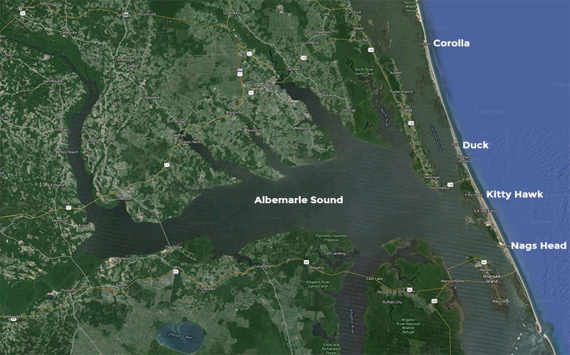
Albemarle Sound, a modern analog for the Ellisdale Fossil Site (Late Cretaceous, Campanian)
Robert K. Denton Jr., CPG, LPSS
Senior Geologist
Terracon Consultants Inc.
Associate Research Scientist
Dept. of Natural History
NJ State Museum

Slide 2
Brief History of the Ellisdale Site
First vertebrate specimens were discovered in August 1980 by Robert K. Denton Jr. and Robert C. O’Neill (aka: “The Bobs”).
Reported in 1985 by David Parris and Robert Denton at the 45th Society of Vertebrate Paleontology Annual Meeting, Rapid City, SD.
Excavated and studied with grant funding provided by the National Geographic Society in 1986 and 1987, included taxonomic, taphonomic and sedimentological investigations.
Prototeius stageri and Parrisia neocesariensis, formally described in the Journal of Vertebrate Paleontology in 1995 and 1998, respectively.
All specimens are housed at the NJ State Museum; both field and lab work continue today.

Slide 3
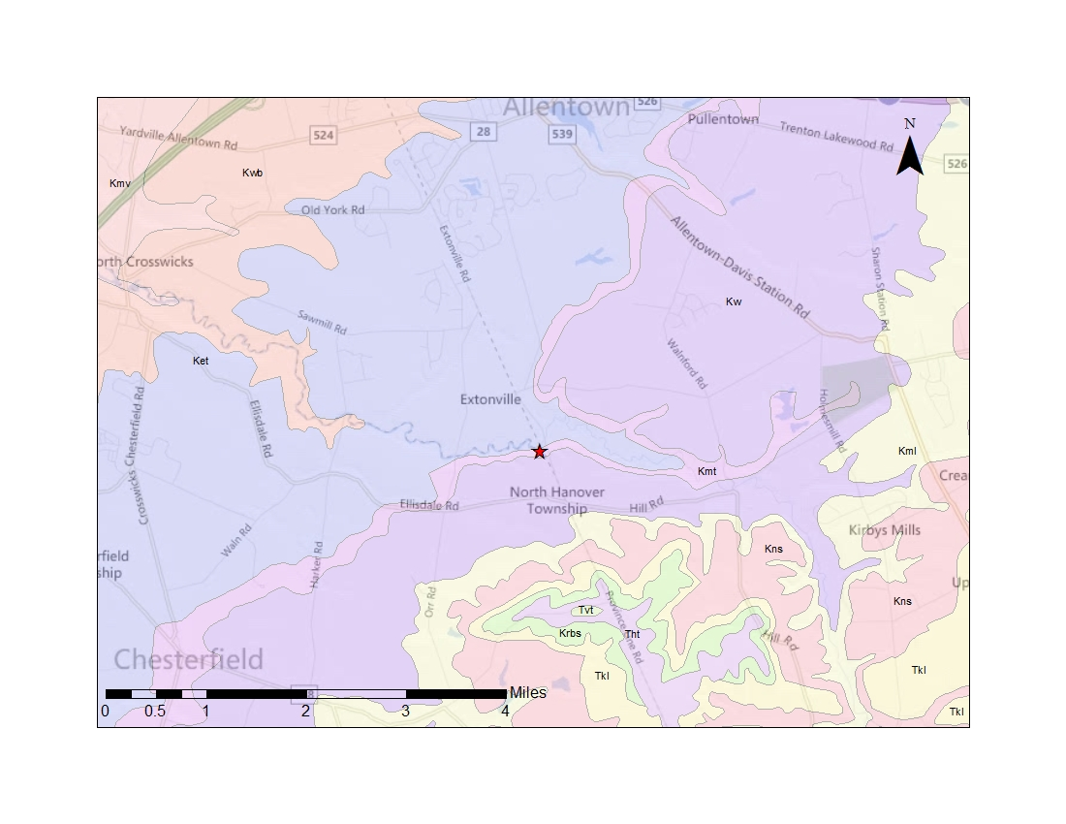
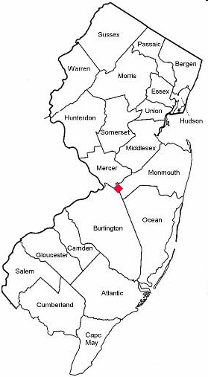
SITE
Kw = Wenonah Fm. (Upper Campanian)
Kmt = Marshalltown Fm. (Upper – Middle Campanian)
Ket = Englishtown Formation (Middle Campanian)
Kwb = Woodbury Formation (Middle - Lower Campanian)

Slide 4
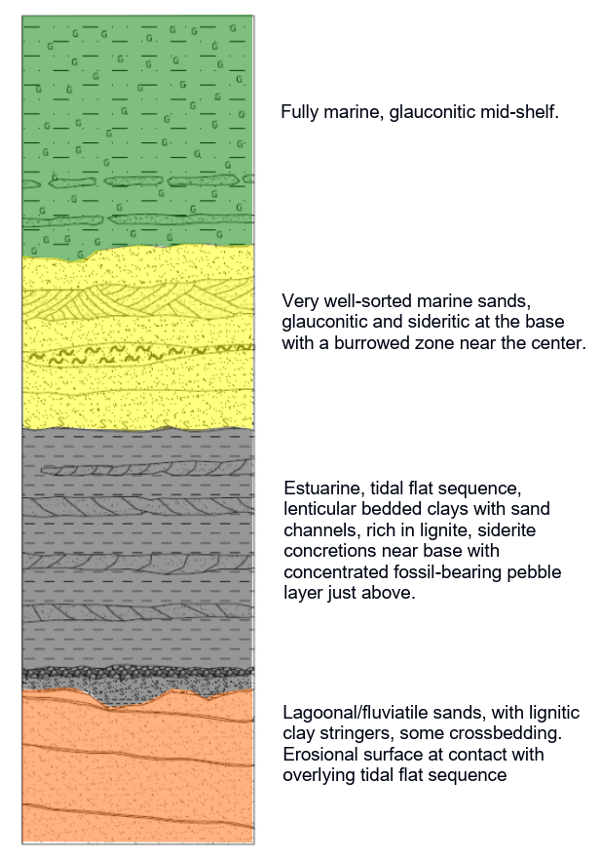
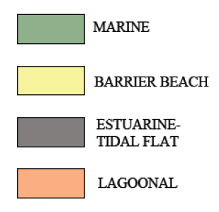
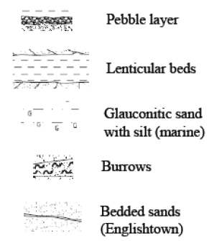
Olsen
NJGS, 1988
Owens & Minard
USGS, 1966
Marshalltown Fm.
Englishtown Fm.
vertebrate fossil layer
Marshalltown Fm.
Englishtown Fm.

Slide 5
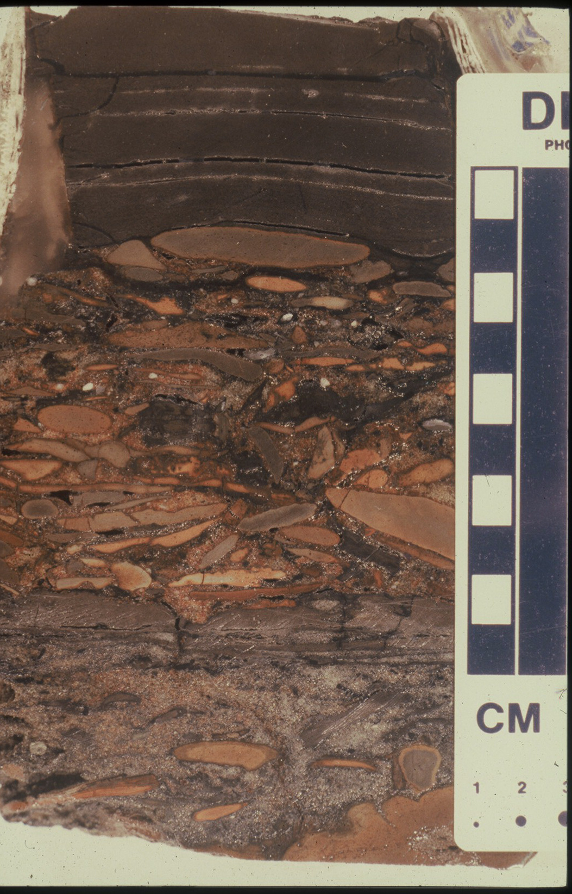
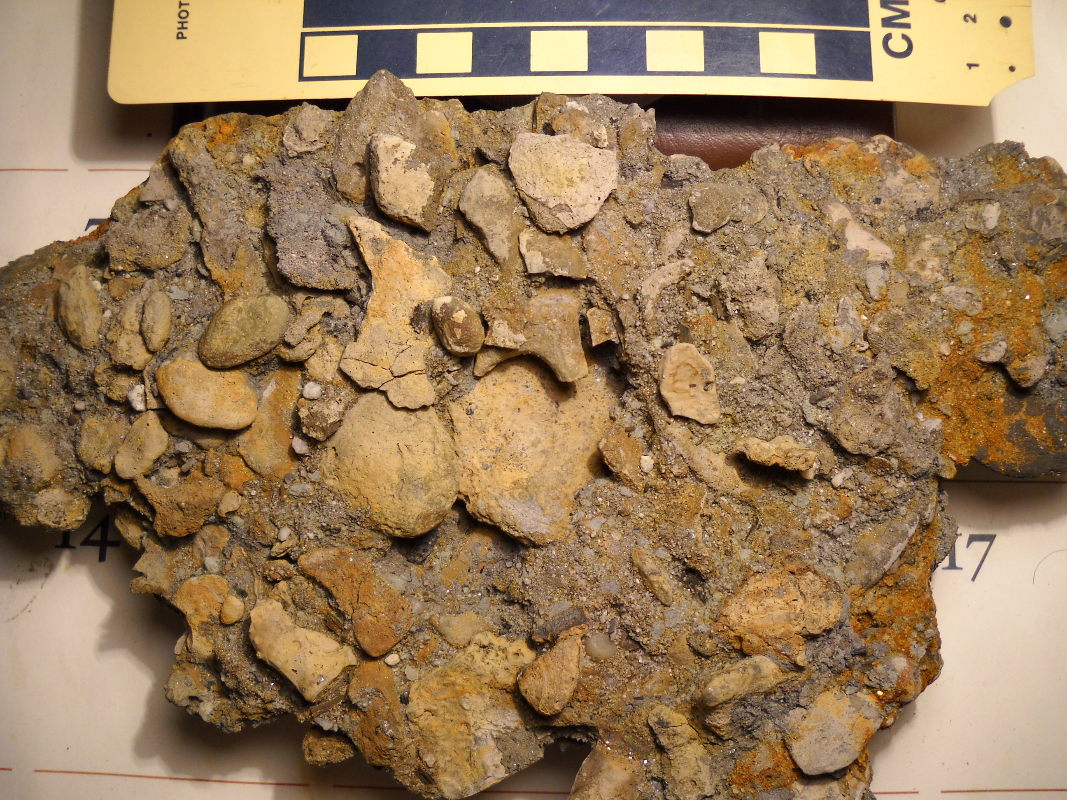


Slide 6
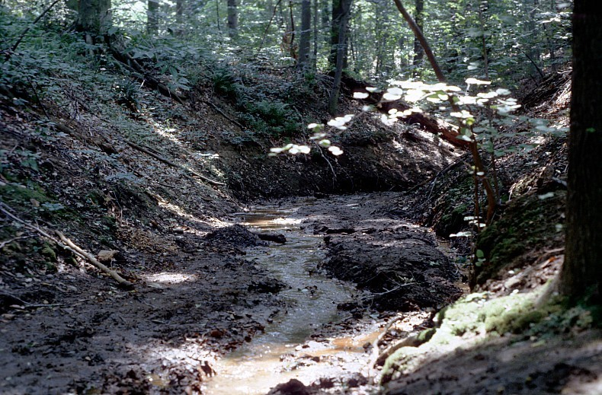
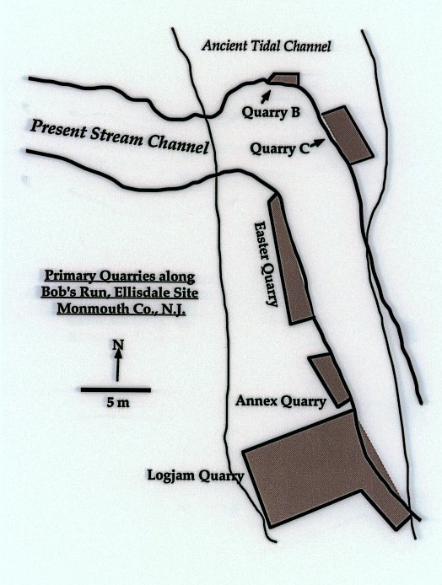
‘92 Pit

Slide 7
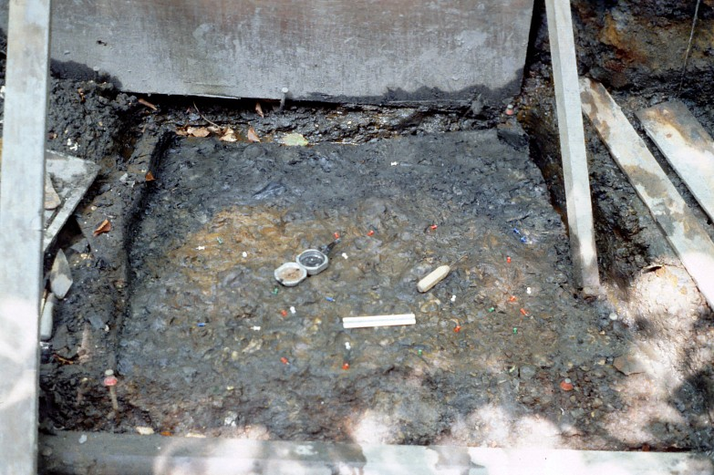
TAPHONOMIC STUDY
(National Geographic Society Grant 1986-1987)
Chaotic orientation of lignitized wood and long bones indicated a tidal regime.
Condition of the fossils showed the presence of a “proximal” faunal component (well-preserved remains of terrestrial and shallow water taxa) and a distal faunal component (worn and abraded remains of inland and open water marine taxa).
Sedimentological analysis performed as part of the taphonomic study suggested that the fossil-bearing “pebble layer” (lag deposit) was the result of a coastal storm during the Marshalltown transgression, resulting in the “mixed” distal and proximal faunal components.

Slide 8
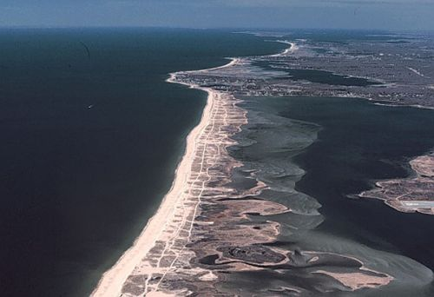
Marine
Back Bay
Tidal Flats
Barrier Beach
Beach

Slide 9
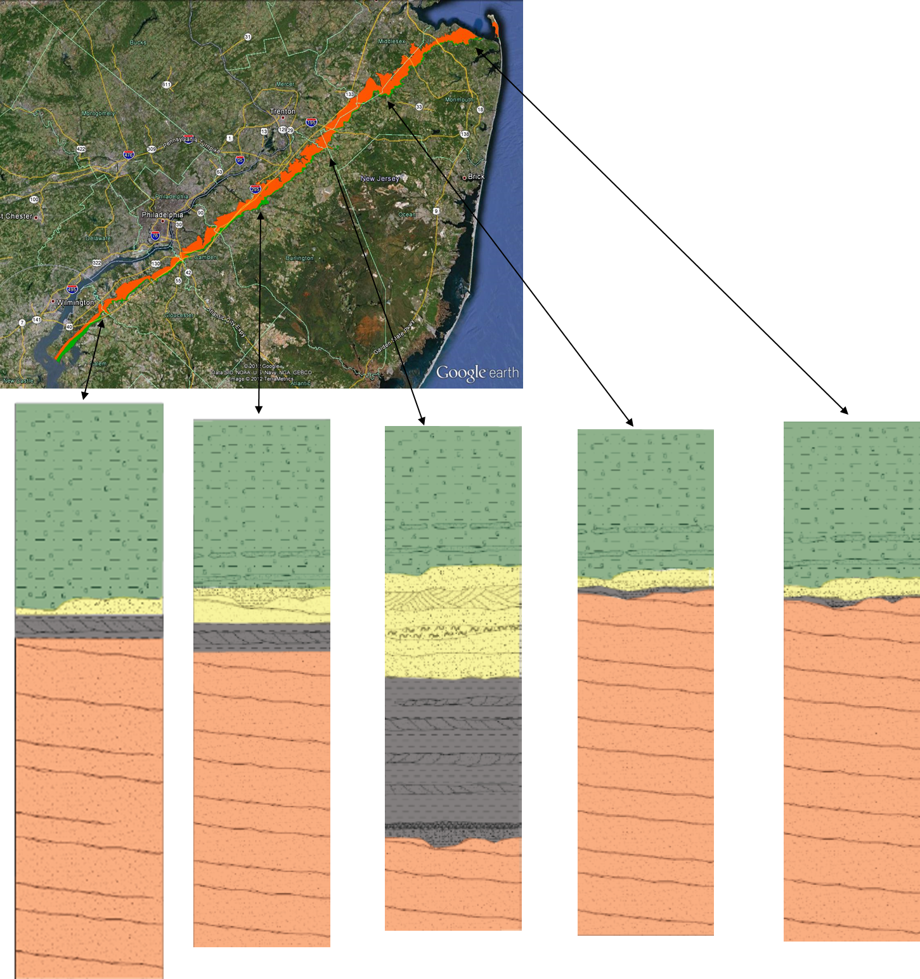


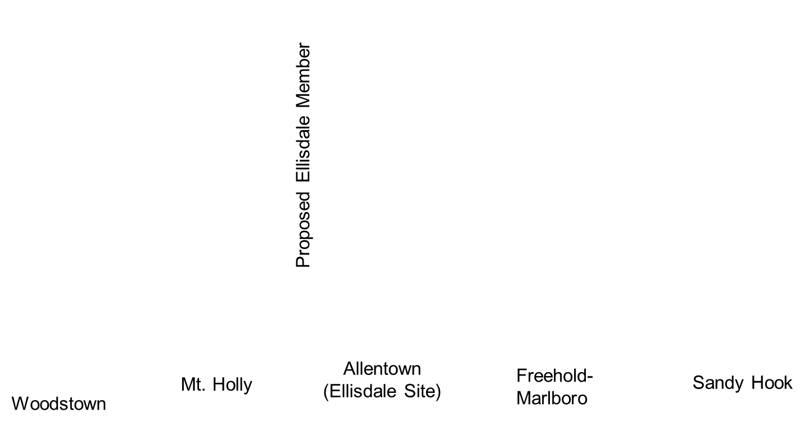
The Englishtown/Marshalltown transgressive lag at Ellisdale is different from previously described sections along the strike. The Crosswicks Creek valley is the only place where the 3.0-meter-thick sequence of bedded clays and a 2.0-meter-thick unit of well-sorted sands are present, which has been informally described as the “Ellisdale Member” of the Marshalltown Formation.
The overall transgressive sequence suggests that the Ellisdale Member was deposited within a stratigraphic low lying between the Raritan Embayment and the southern New Jersey stratigraphic high, with the lenticular beds possibly representing the estuary of a significant Cretaceous river.

Slide 10
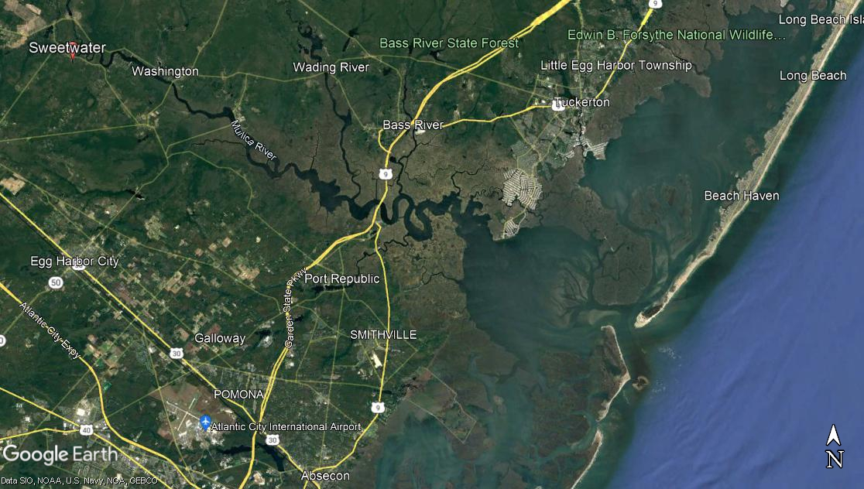
5 miles

Slide 11
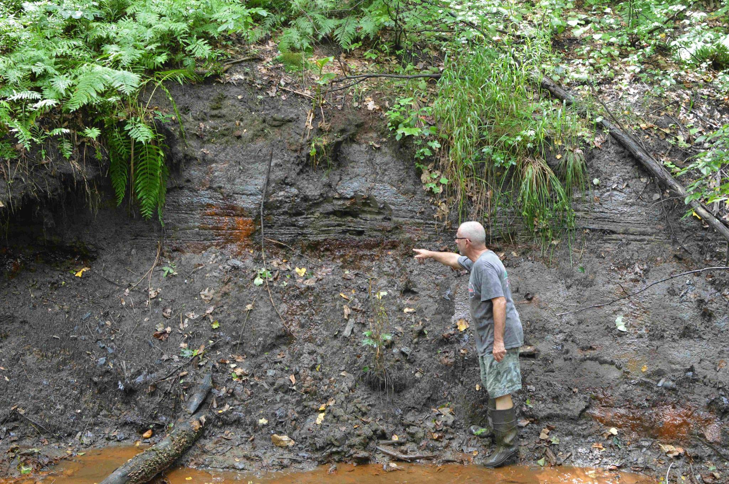

Slide 12
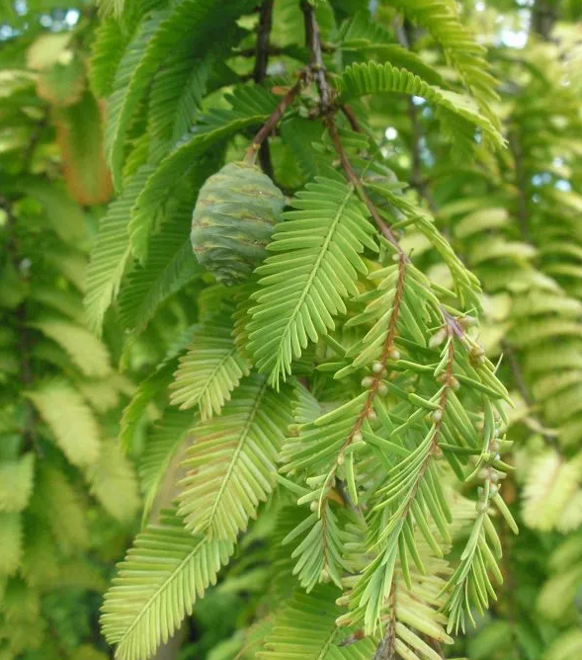
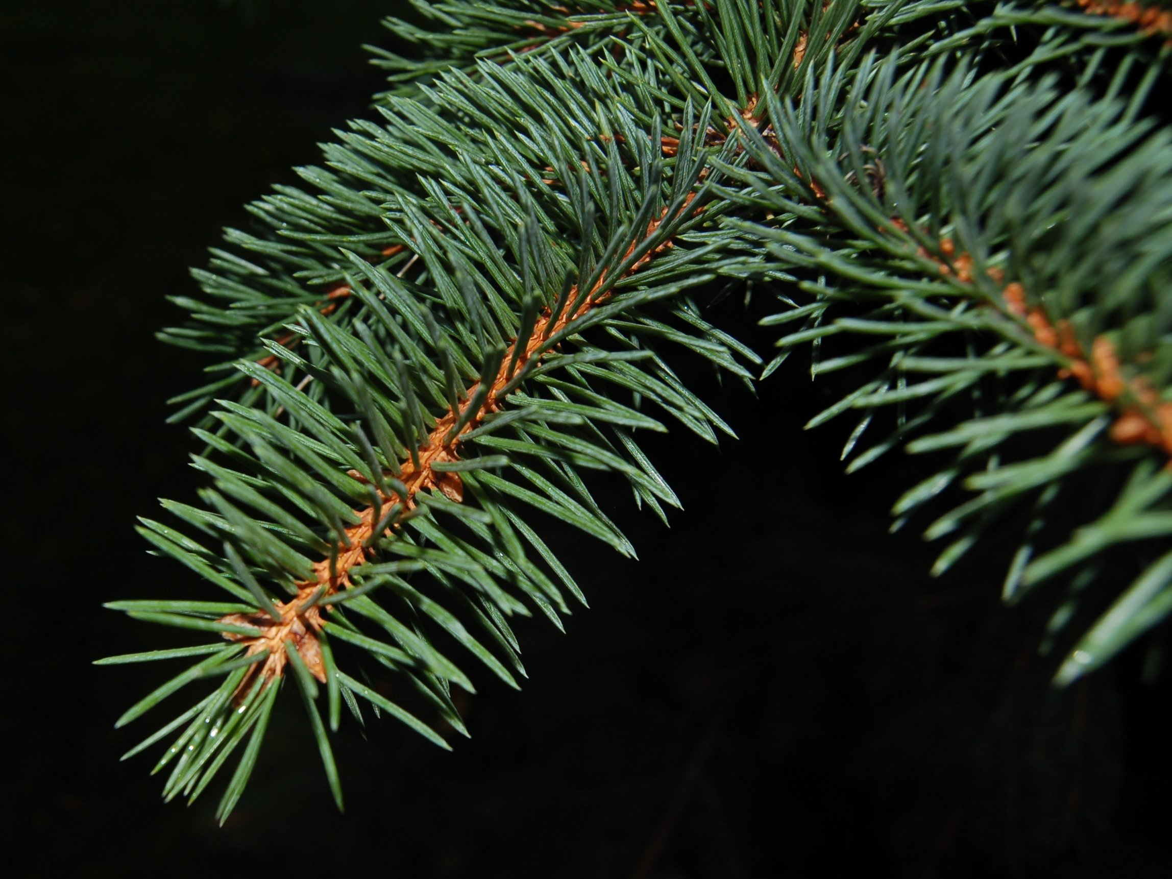
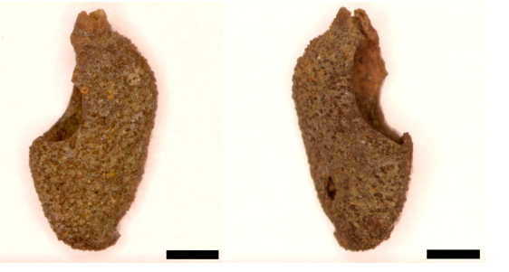
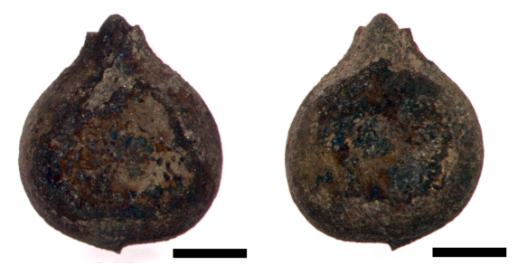
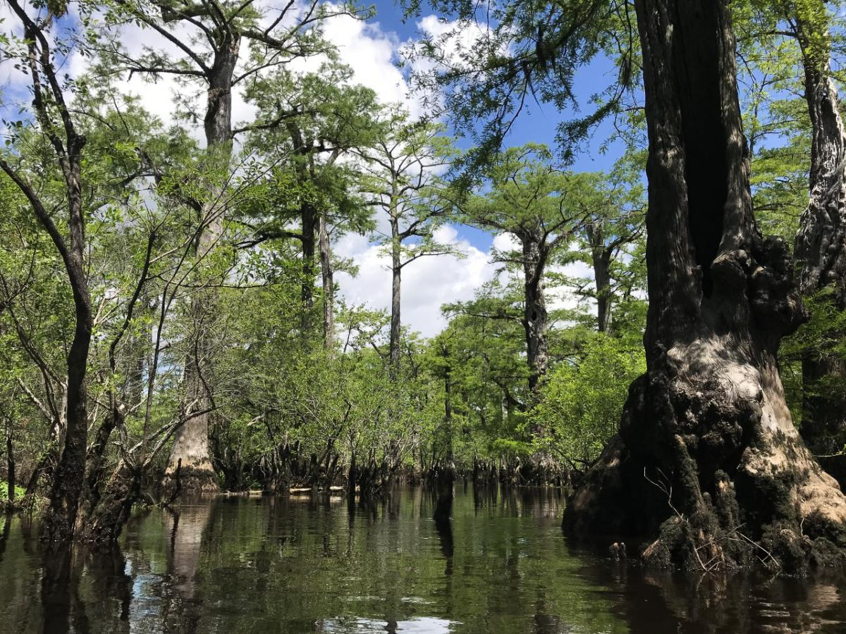
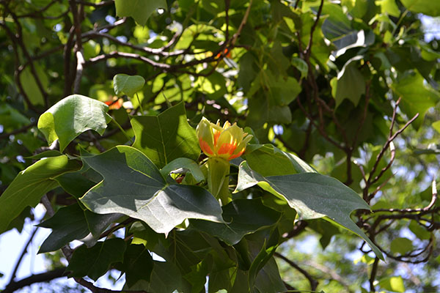
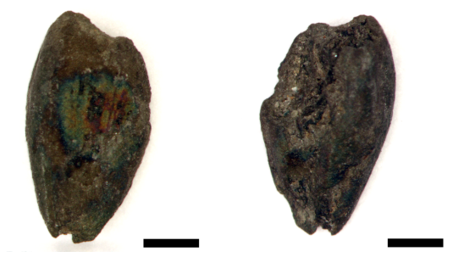
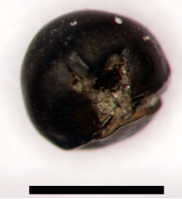
Plants found as macrofossils
Plants found as seeds
Indet.
Picea
Metasequoia
Lycopsid megaspore
Leriodendron
Chamaecyparis

Slide 13
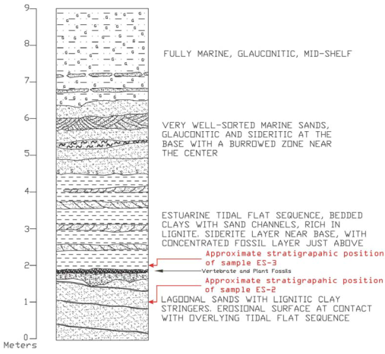
Palynological Analysis
Samples were collected from silty clay layers immediately above and below the vertebrate-bearing pebble stratum.
Palynological analysis performed by Ray Christopher (USGS). All pollen identified as the Normapolles Group.
Correlations with Wolfe’s zonation scheme for the Raritan and Salisbury Embayments established an approximate Middle Campanian age (80.9 – 76.3 Ma).
The pollen assemblage appeared to be most comparable with a non-marine, freshwater terrestrial environment of deposition (i.e.: no marine dinoflagellates)!

Slide 14
Total of Number of Identifiable Specimens (NISP)
(Data compiled by B. Grandstaff – 1995)
Grand Total = 18,816

Slide 15
Terrestrial Microvertebrate Breakdown by NISP

Slide 16
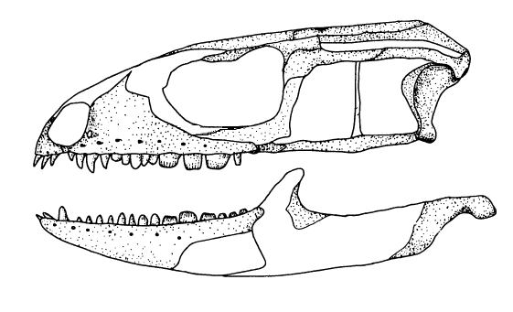
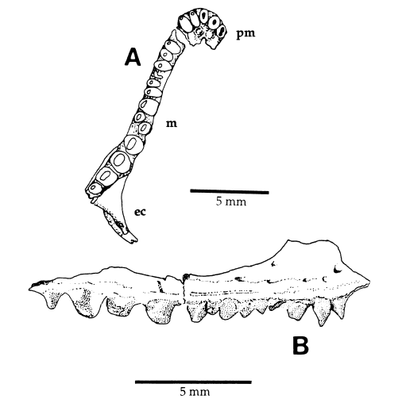
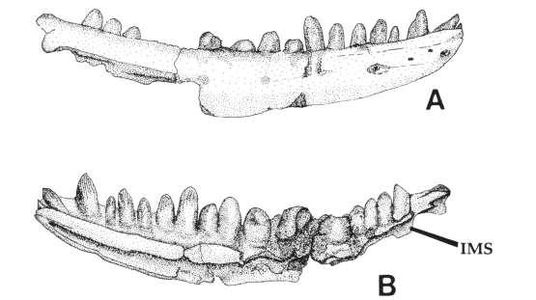
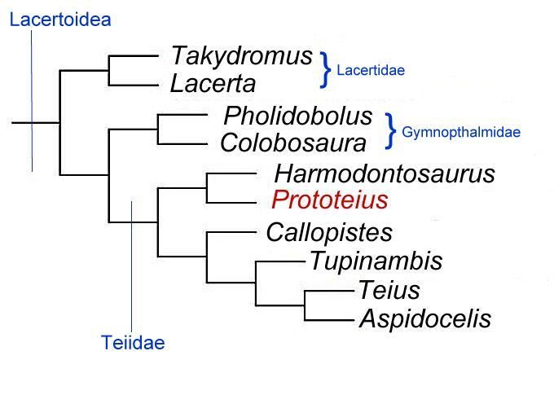
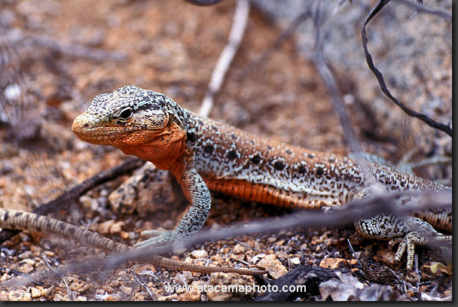
5 mm
Prototeius stageri
Callopistes flavipunctatus

Slide 17
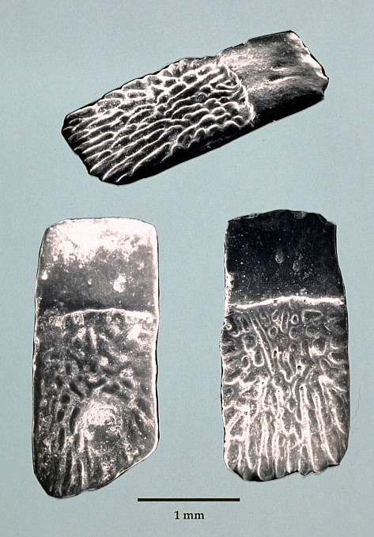
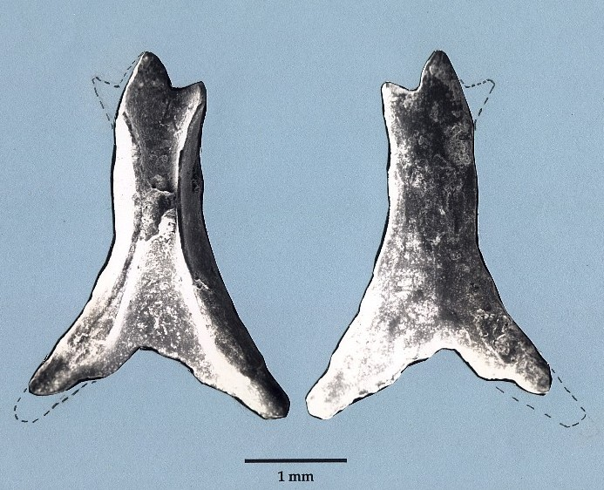
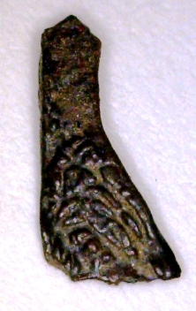
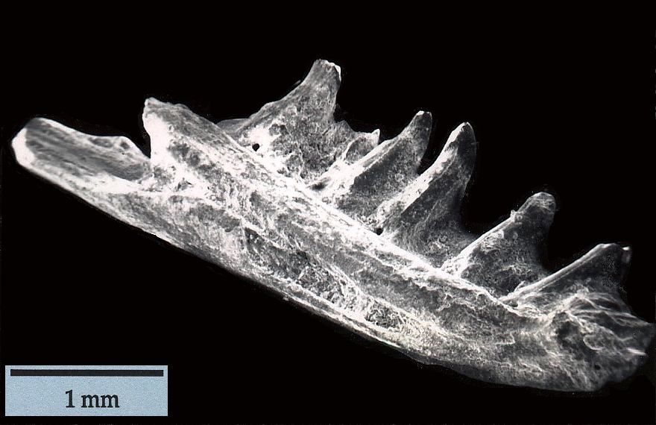
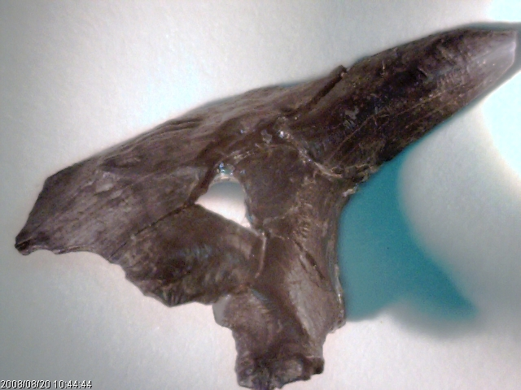
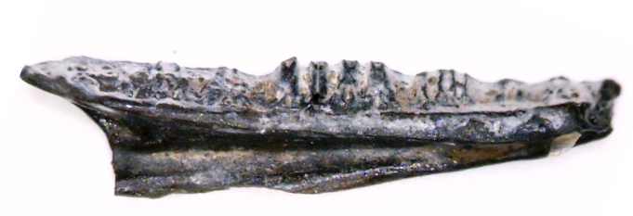
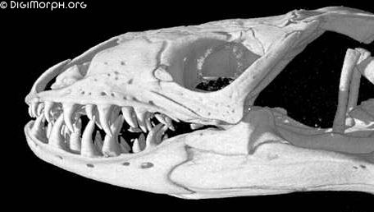
cf. Iguanidae indet.
cf. Anguinae Indet.
cf. Helodermatidae indet.
cf. Xenosauridae indet.

Slide 18
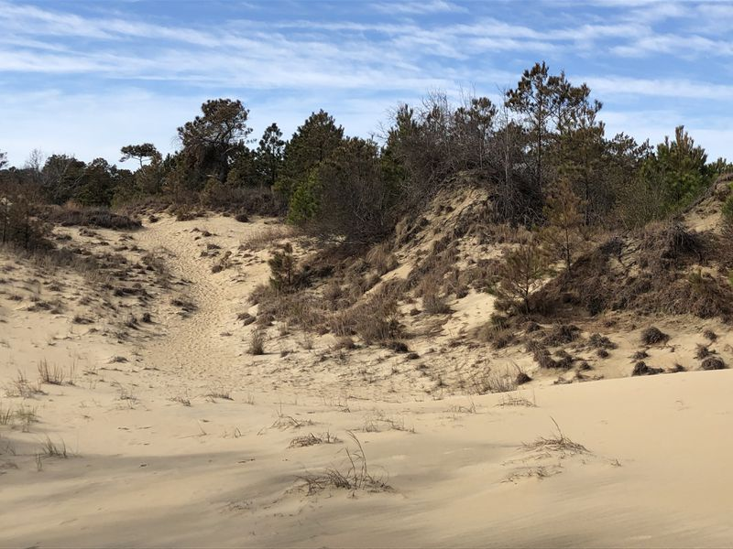
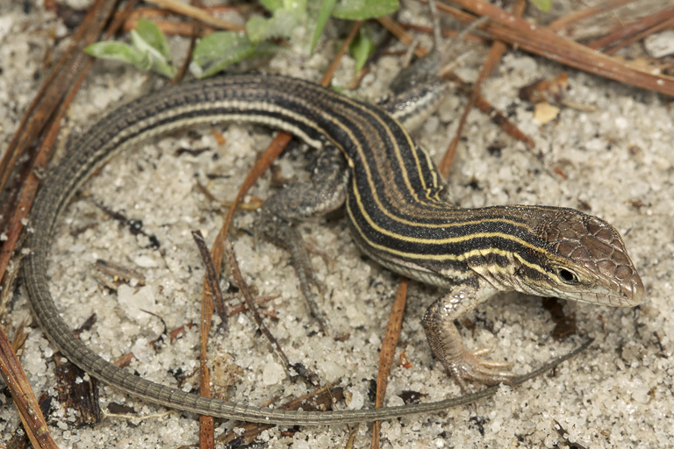
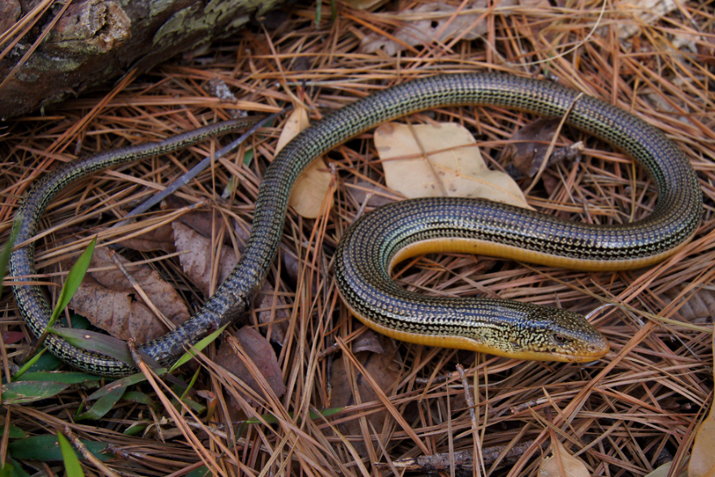
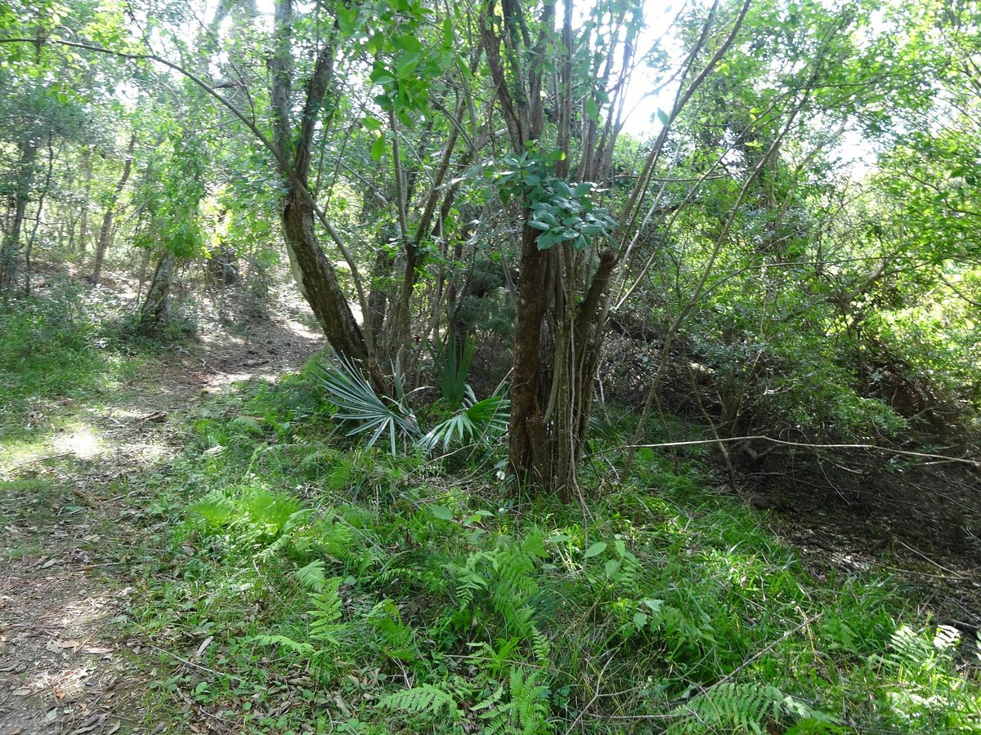
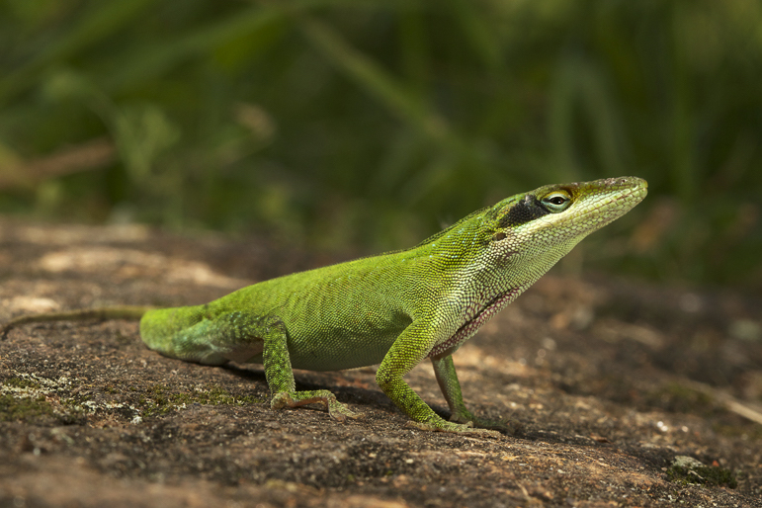
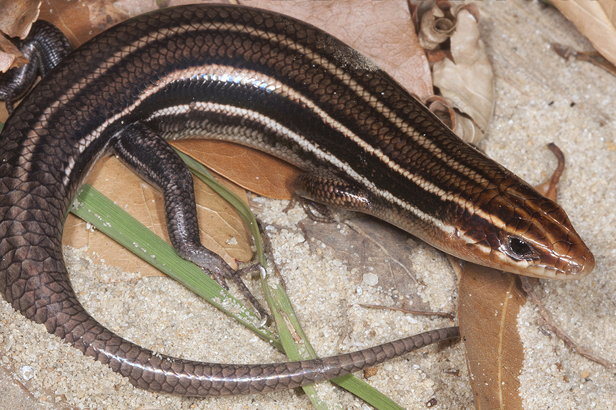
Aspidoscelis sexlineatus
Ophisaurus ventralis
Family | Ellisdale | North Carolina | Barrier Island | Roanoke Island | Mainland
Teiidae | Prototeius | Aspidoscelis | 4 | 1 | 0
Anguidae | Anguinae sp. | Ophisaurus | 10 | 1 | 0
Iguanidae | Iguanidae sp. | Anolis | 4 | 1 | 0
Scincidae | Not represented in fauna | Plestiodon | 5 | 1 | 13
Barrier island dune environment
(from Gaul, R., W. Jr. and Mitchell, J. C. 2007, The Herpetofauna of Dare County, North Carolina, Jour. NC Acad. Sci. 123(2) pp. 65-109)
Anolis carolinensis
Plestiodon inexpectatus
Barrier island maritime forest
Photographs courtesy of Amphibians and Reptiles of NC (https://herpsofnc.org)

Slide 19
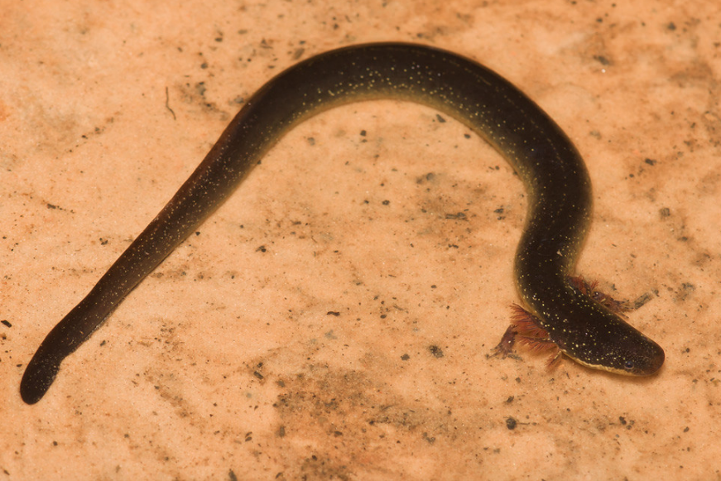
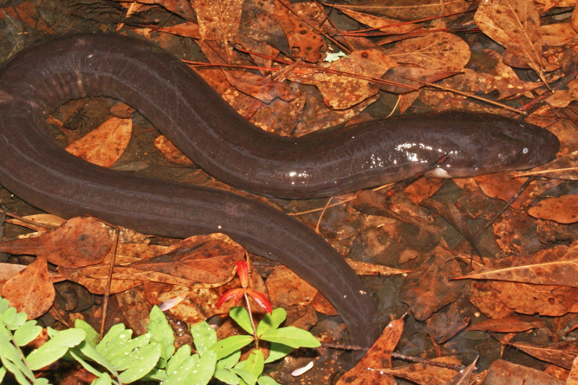
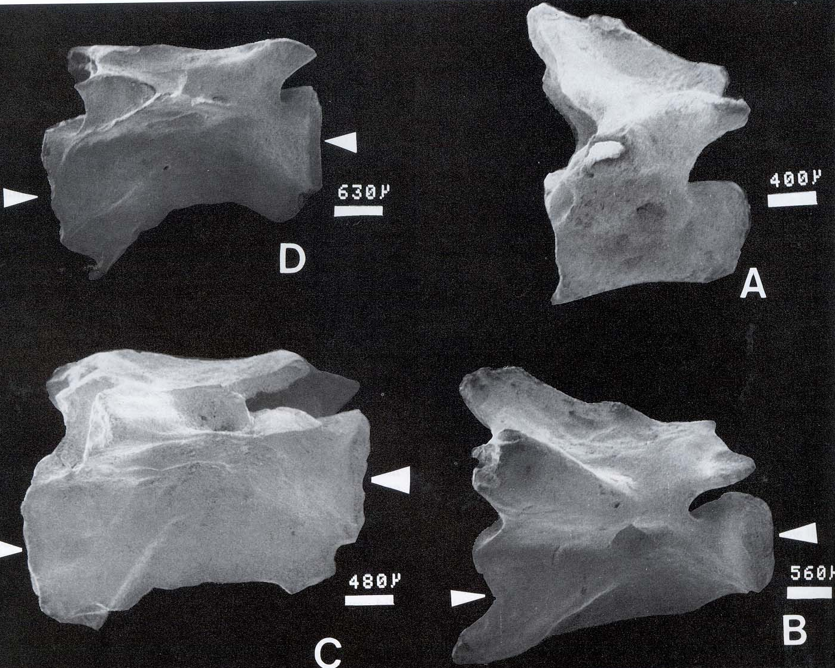
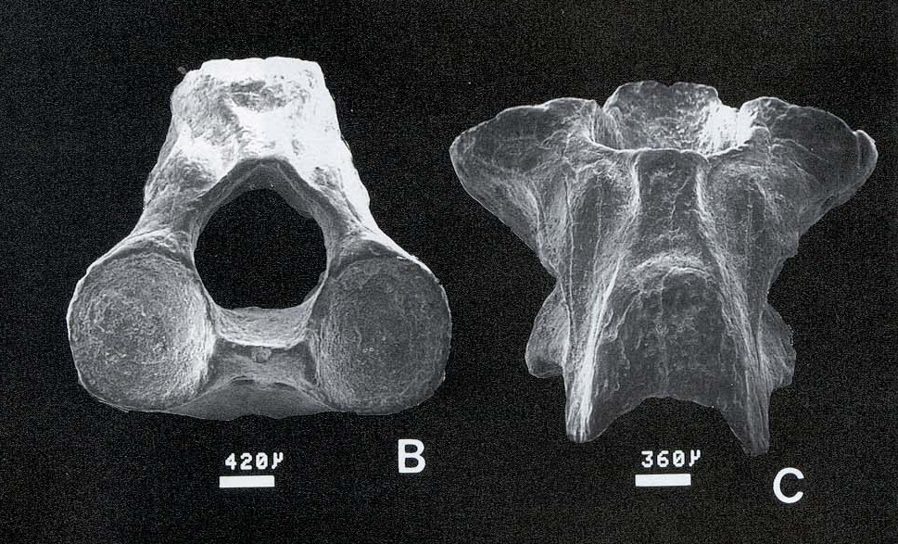
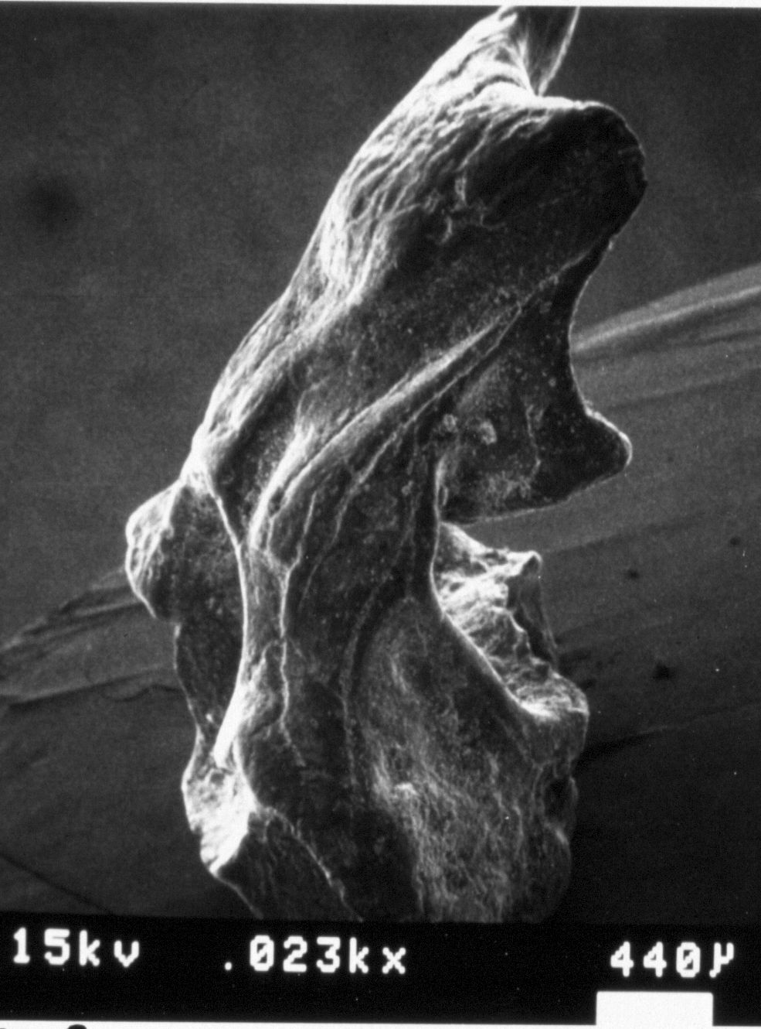
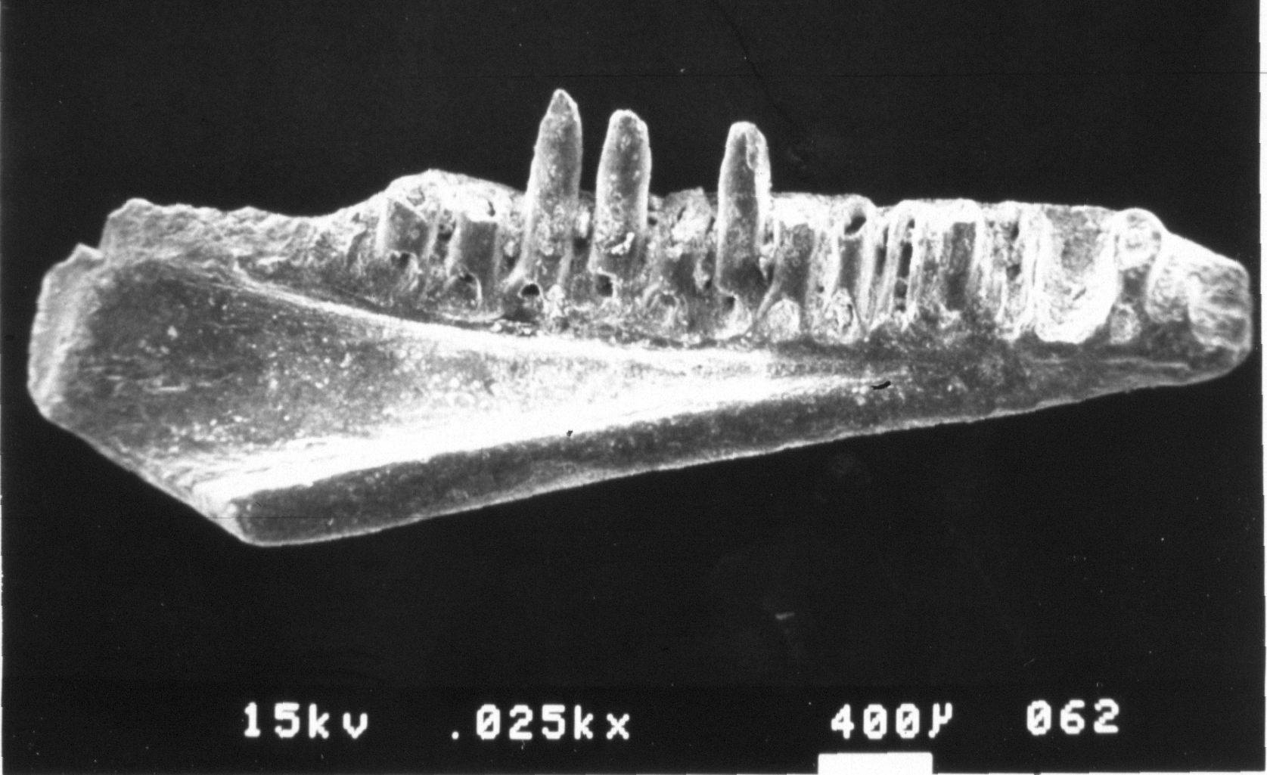

Caudata:
Batrachosauroididae
Photographs courtesy of Amphibians and Reptiles of NC (https://herpsofnc.org)
Siren lacertina
Amphiuma means
Parrisia neocesariensis
dentary
atlas vertebra (holotype)
dorsal vertebrae
Oddly, the remains of Parrisia were among the best preserved microvertebrate specimens…yet salamander remains are incredibly fragile. How could this be possible…?

Slide 20





Anura: Frogs and Toads
ilia
Hylid distal humerus
A. Discoglossid
B. Pelobatid
Hyla cinerea
Scaphiopus holbrookii

Slide 21




Chelonia (Turtles)
Though fragmentary, the remains of at least three taxa of chelonians and with inferred freshwater habitat preferences have been found at Ellisdale, including the earliest chelydroid from the Appalachian subcontinent of the Late Cretaceous.
Pan-Trionychidae

Slide 22
Environment of Deposition: Tidal Freshwater?
Analysis of long bone and wood orientation showed a chaotic current flow, indicative of a tidal regime.
Plant remains were all water-loving but salt-intolerant taxa.
Palynology indicated a complete lack of marine dinoflagellate cysts or other marine elements in the organic component of the sediments strongly suggesting a non-marine, freshwater depositional environment.
The Exquisite preservation of the amphibian fossils suggested that they were “proximal” to the depositional environment. As amphibians are salt-intolerant they would have been unable to survive for long in brackish or salt water.
Most identifiable elasmobranchs (sharks, rays and skates), osteichthyan (bony fish), and chelonian (turtle) fossils from the site were from obligate freshwater and/or estuarine-brackish water taxa.
Presence of in-situ, authigenic siderite (FeCO₃) concretions in the stratum below the pebble layer suggests a low-sulfate (freshwater) environment of deposition.

Slide 23












cf. Lepisosteidae sp.
cf. Amiidae sp.
cf. Acipenseridae sp.
Siren lacertina

Slide 24

Hylid and Ranid frogs
Spadefoot toads
Siren & Amphiuma
Amia
Lepisosteus
Acipenser

Slide 25

A study of the storm surge effects of Hurricane Michael (October 2018) on coastal species in Florida found that there was little effect on populations of anurans (frogs), squamates (lizards and snakes), and chelonians (turtles). However, significant mass mortality was noted among Amphiuma means (Two Toed Amphiuma) an obligate aquatic salamander.
(Walls, et al., 2019, “Seeking Shelter from the Storm”: Conservation and management of imperiled species in a changing climate, Ecology and Evolution, 9:7122 – 7133.)
Ash Wednesday Storm 1962

Slide 26

Ellisdale aftermath by Dhruv Franklin

Slide 27
SUMMARY
The bony fish families Amiidae, Lepisosteidae and Acipenseridae are all represented at Ellisdale and as extant taxa in the freshwater and brackish water sounds of the North Carolina Outer Banks.
Three of the five lizard families known from the Ellisdale site (Teiidae, Anguidae and Iguanidae) are all represented by extant taxa found in the barrier island dune and maritime forest environments. It is of note that the Ellisdale lizard assemblage is dominated by the teiid P. stageri, and that one of the most abundant ground-dwelling lizards found in the dune environment today is the teiid A. sexlineatus.
Snake fossils have yet to be identified at Ellisdale, but the presence of a putative helodermatid lizard in the fossil fauna suggests these relatively large, venomous lizards many have occupied a similar ecological niche to snakes.
Both frogs and salamanders are represented in the Ellisdale fauna, including the neotonous aquatic batrachosauroidid salamander (Parrisia neocesariensis). At least two neotonous aquatic salamanders (Siren, Amphiuma) are present today in the freshwater portions of the Albemarle and Currituck sounds and river estuaries upstream.
The discovery of fragile, yet remarkably well-preserved bones of P. neocesariensis, suggest a mass mortality event may have occurred, possibly the result of a coastal storm that flooded the sounds and estuaries with high-salinity water. The fossil-bearing stratum at the base of the transgressive sequence may have been a result of this storm.

