Slide 1


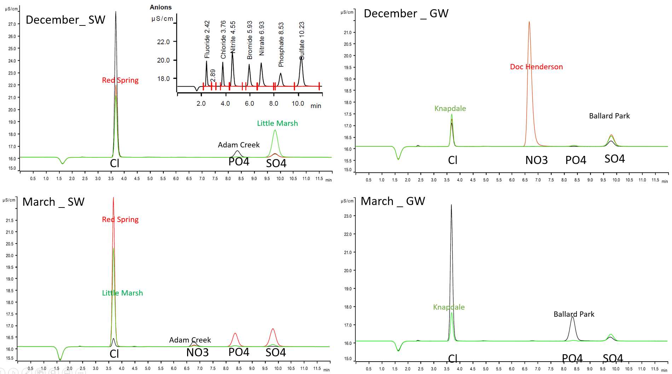
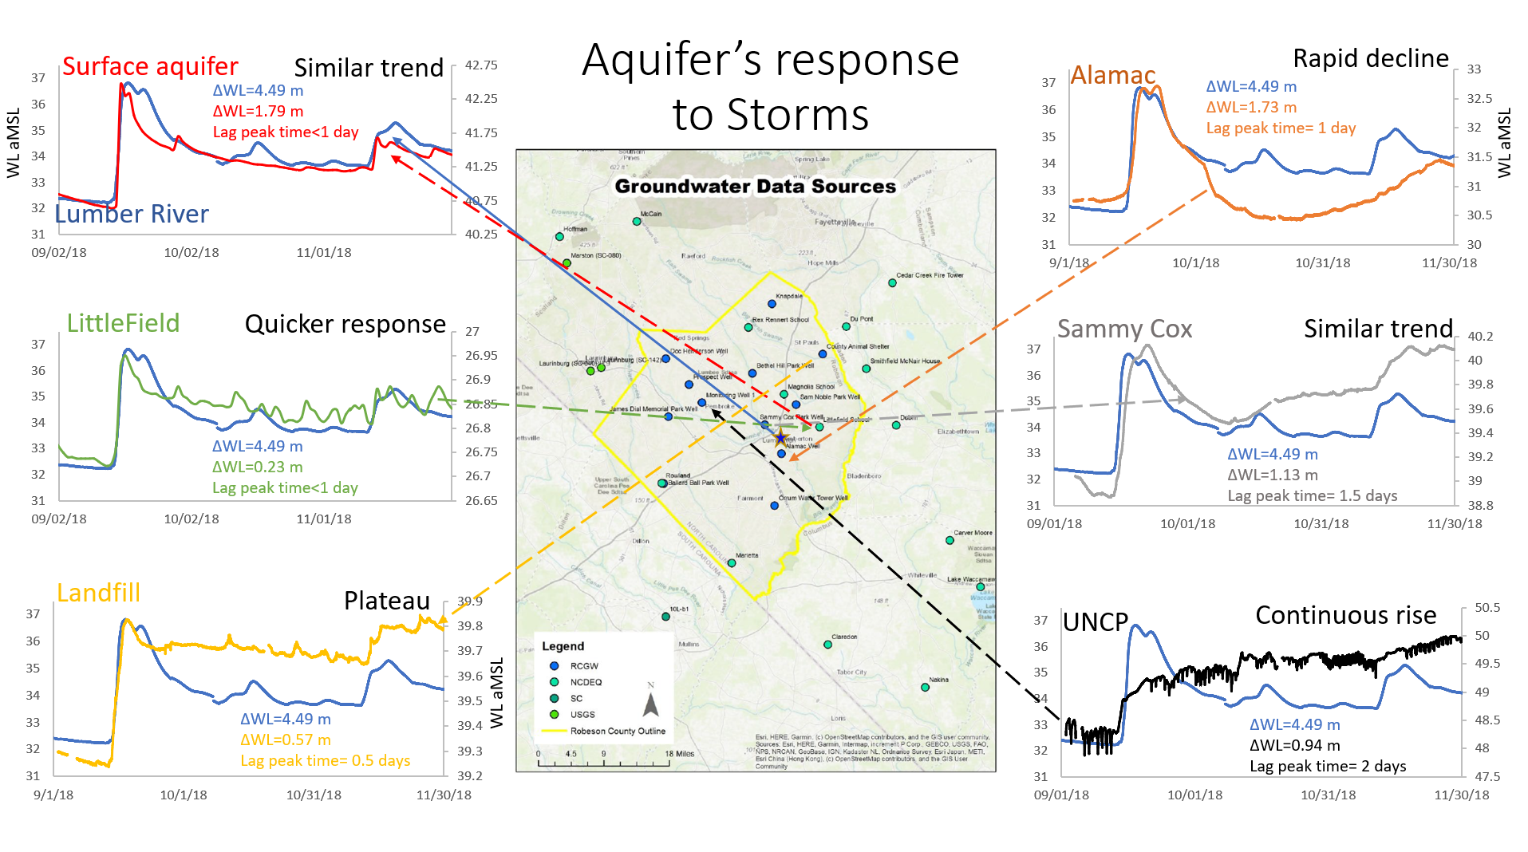
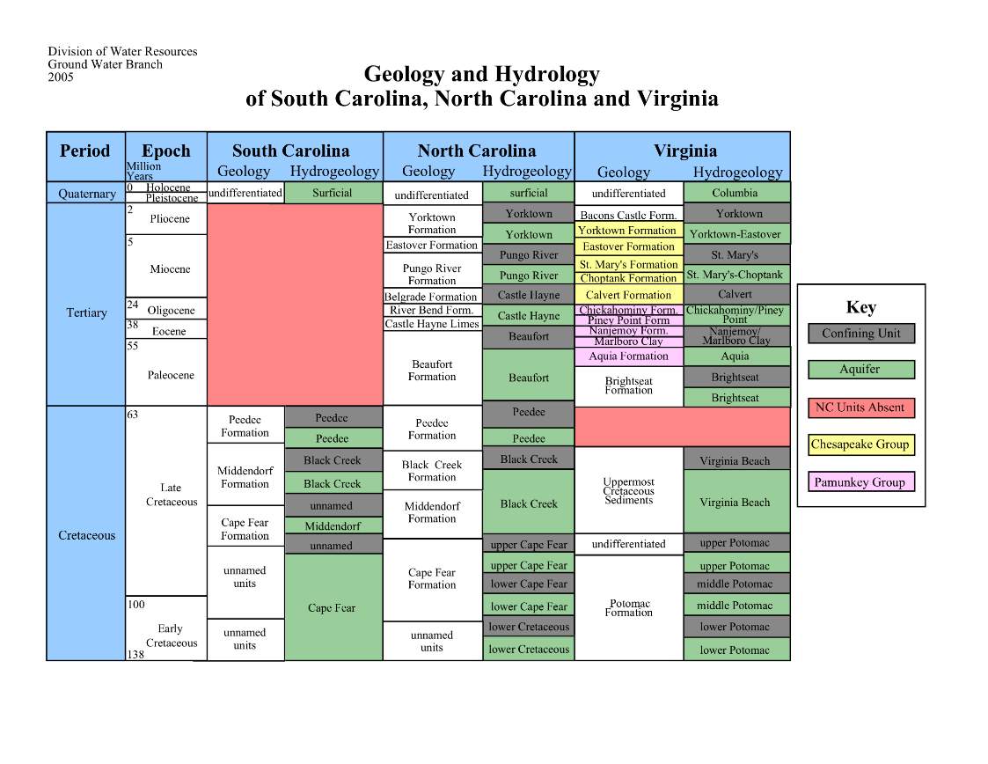
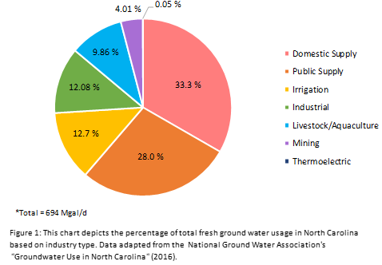
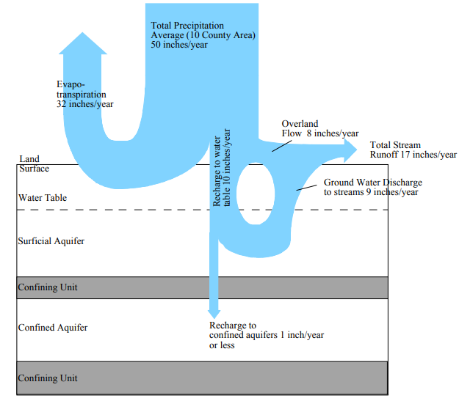
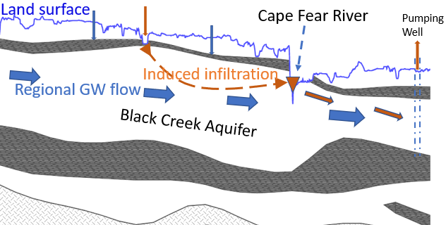
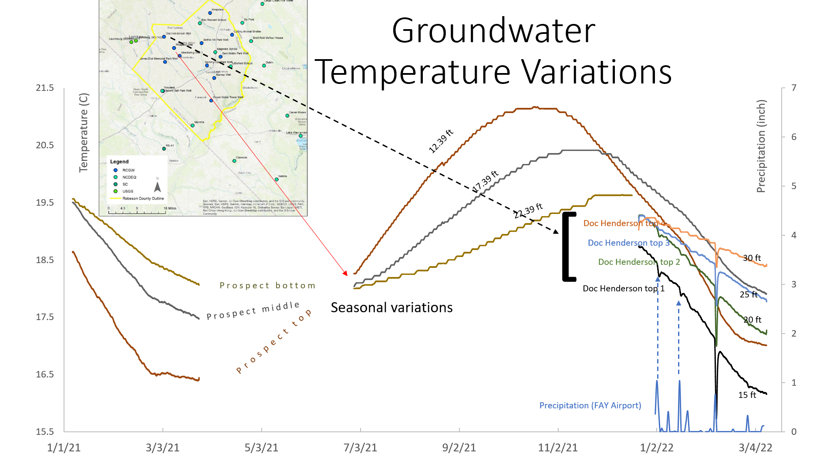
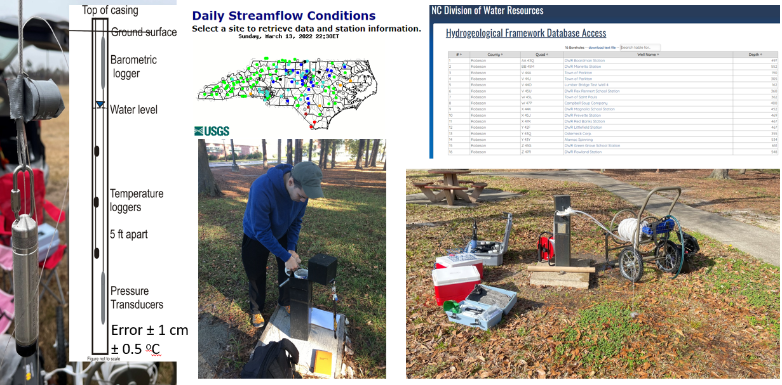
HURRICANE-INDUCED WATER LEVEL CHANGES IN THE BLACK CREEK AQUIFER, ROBESON COUNTY
Madan Maharjan¹, Jesse Rouse¹, and Daren Nelson²
¹University of North Carolina at Pembroke and ²Utah Valley University
ABSTRACT
RESULTS
The Atlantic Coastal Plain aquifer system composed of unconsolidated sediments. These aquifers, especially Black Creek aquifer, are pumped extensively for municipalities, industries, and agricultural water needs. On one hand, groundwater use from the aquifer in NC has increased recently and will increase in the future in response to population growth. On the other hand, low-lying areas in the region have become more frequently flooded for extended periods due to climate change. Hence, it is crucial to understand what impact these flood areas could have on the quality and quantity of water in the aquifer system. We have monitored groundwater levels in Robeson County since December 2017 using a network of 13 monitoring wells that are screened into the Black Creek Aquifer. Well hydrographs show similar signals to the Lumber River following Hurricane Florence for several days. These findings raise the question of whether the aquifer is completely confined. We have studied the influence of hurricanes to the groundwater levels in the aquifer. The objective of this study is to investigate whether the Black Creek Aquifer has been breached. If the aquifer is not confined, there are implications for the public health, the environment, and the economy of the region.
Figure 7. Comparison ground and surface water chemistry.
CONCLUSIONS
INTRODUCTION
Black Creek Aquifer is spatially and temporally varying in its water levels and chemistry as expected.
Both natural (storms) and anthropogenic (pumping) activities have influenced the water level in the aquifer.
The magnitude of influence linked to natural processes are indication of the aquifer having breached especially in low lying areas and along the major rivers.
Source: NC DEQ story map
FUTURE WORK
Hardin, Fine, and Spruill, USGS, 2003
Water Level data
Tease out natural vs anthropogenic signals from water level data
Aquifer responses to storms and its degree of confinement
Temperature data
Collect a long-term data
Estimation of groundwater flow direction and amount
Chemistry data
Run water samples for major inorganic chemistry
Chemical speciation in waters to seek broader understanding of water movement in the aquifer
Figure 1. (a) General hydrogeology, (b) water usages, and (c) Water balance
CONCEPTUAL MODEL
Figure 2. Cross section of Black Creek Aquifer showing breach of the confining layer and potential pathways of water movement in the aquifer.
Figure 4. Comparison of stream hydrograph (Lumber River) with surficial and confined aquifers’ well hydrographs after major hurricanes.
DATA
REFERENCES
Division of Water Resources, Aquifer Characteristics, North Carolina Department of Environment and Natural Resources, https://geodata.lib.ncsu.edu/stategov/gws/2010/Aquifer%20Characteristics.htm.
Harden, S. L., Fine, J. M., & Spruill, T. B. (2003). Hydrogeology and ground-water quality of Brunswick County, North Carolina (Vol. 3, No. 4051). US Department of the Interior, US Geological Survey.
NCGWA, 2016, Groundwater-Use-in-NC.pdf, ncgwa.org, https://ncgwa.org/contento/uploads/2016/08/Groundwater-Use-in-NC.pdf
Strickland, A. G. (2000). Water-level Conditions in the Black Creek Aquifer, 1992-98, in Parts of Bladen, Hoke, Robeson, and Scotland Counties, North Carolina (No. 4138). US Department of the Interior, US Geological Survey.
ACKNOWLEDGEMENTS
Figure 5. Water level rise in the Black Creek aquifer (bottom), correlation between the Lumber River and well hydrographs (middle), and lag times between surface water levels and groundwater level peaks (top) after three major hurricanes in the study area.
Figure 6. Seasonal and event-specific groundwater temperature variations in Prospect and Doc Henderson wells.
Myron Neville, Robeson County Public Utilities (Grantor);
College of Arts and Science, UNCP (Dean’s Research Grant);
Student employees, Robeson County Groundwater Monitoring Project;
Paul Flowers, UNCP (Chemistry and Physics Department).
Figure 3. Data collection methods employed in the field
Notes:
Printing in double size (200%)

