Slide 1


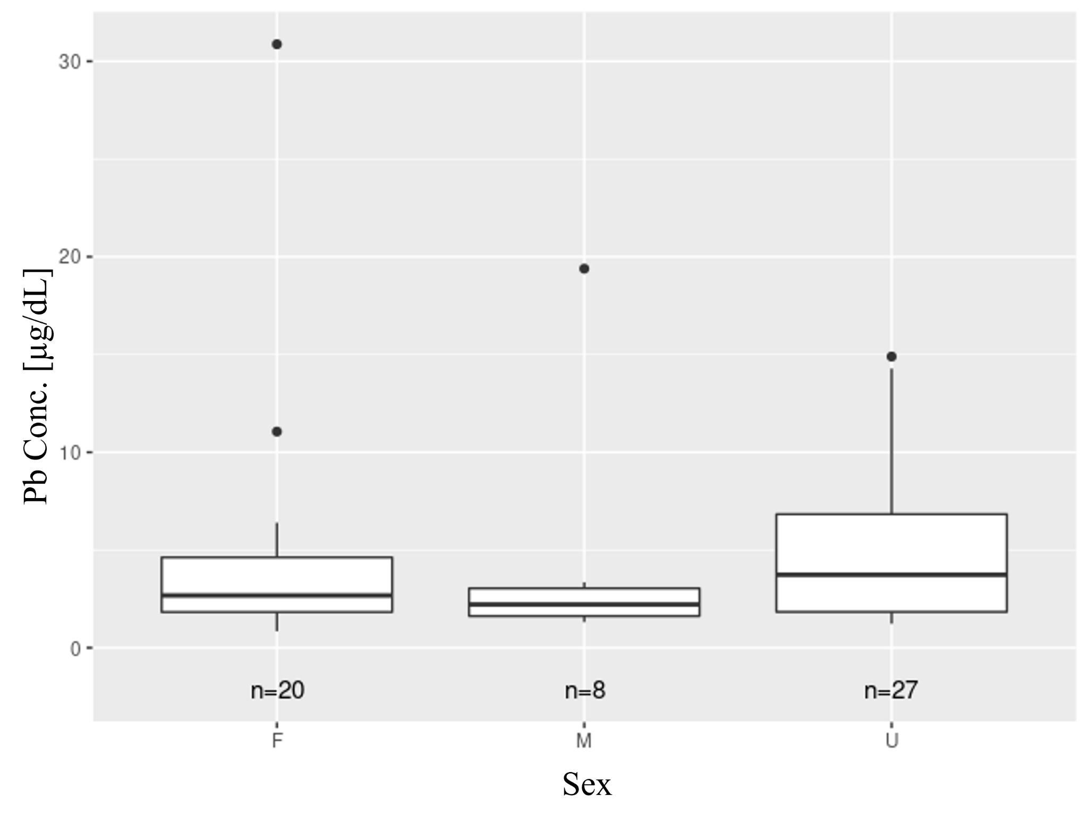
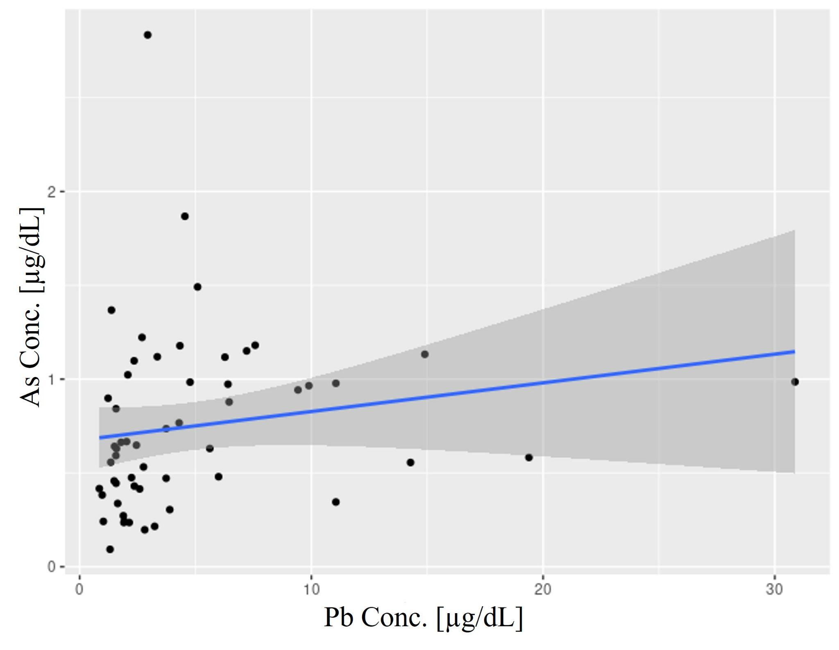
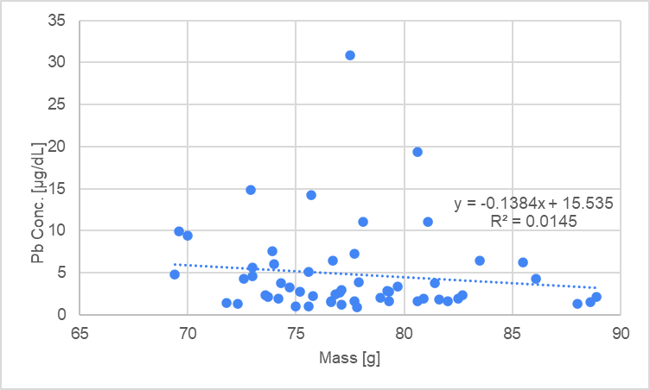
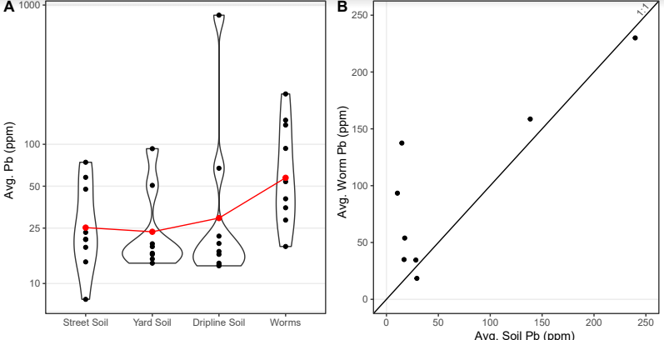
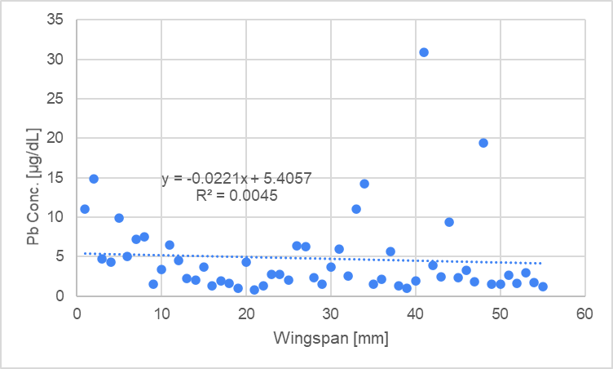
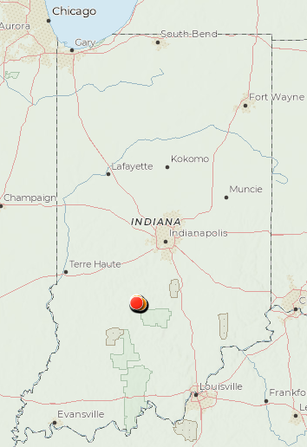
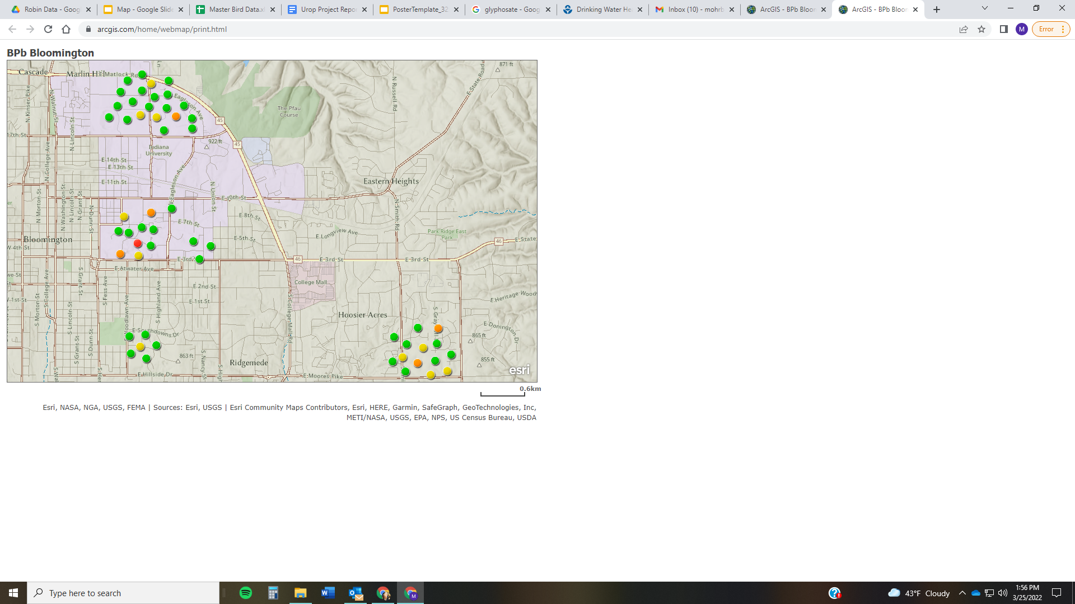
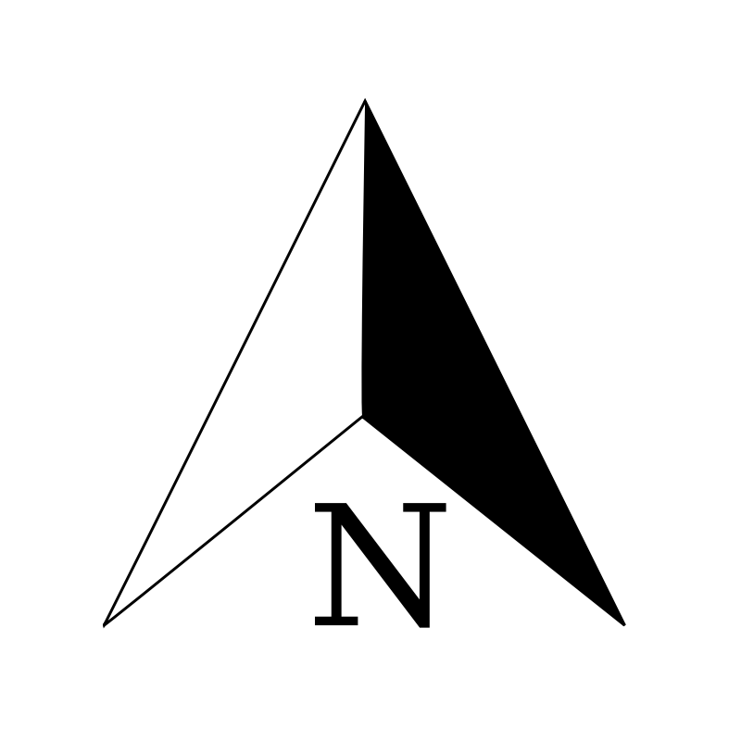
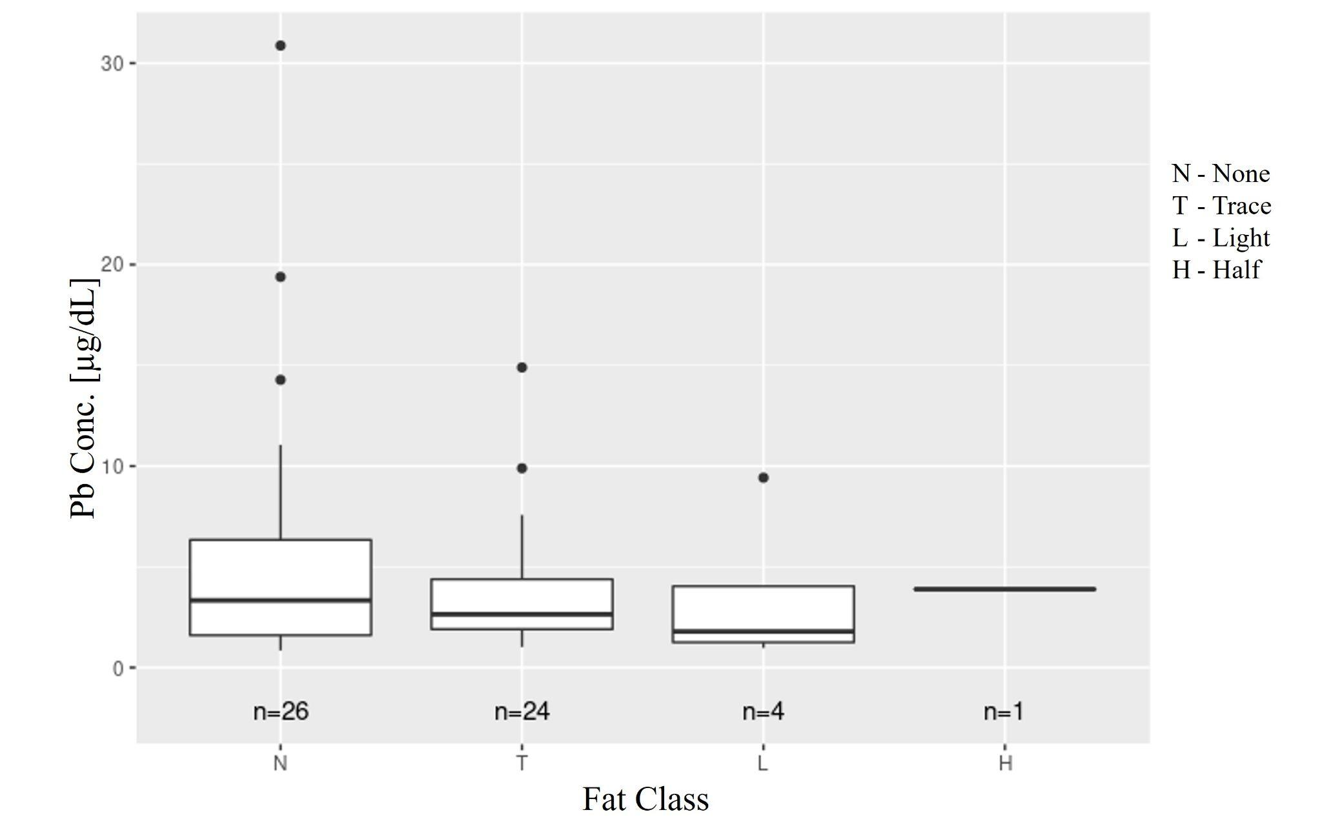
BIOACCUMULATION OF HEAVY METALS IN ROBINS - PROPOSED POLLUTION SOURCES & PATHWAYS
Makayla Ohrberg, Kate Hostetler, Matthew Dietrich, Alex Jahn and Gabriel Filippelli
Indiana University Department of Earth Sciences
Indiana University-Purdue University Indianapolis
Abstract
Materials and Methods
Results continued
Lead pollution remains a prevalent problem in urban soils, posing health risks for humans and wildlife alike, but the pathways leading to disease are poorly understood. This pilot study sought to characterize lead concentration trends in American Robins and identify potential pathways of lead uptake. A sample set (n=55) of American Robins from Bloomington, IN were analyzed for heavy metal content in blood samples, with a particular focus on lead. Robins were profiled based on sex, estimated fat content, wingspan, weight, and capture location. Initial ICP-MS results revealed a wide breadth of blood lead concentrations ranging from 0.85-30.9 μg/dL. Lead concentrations showed no significant relationship with bird sex, wingspan, location, or estimated fat content. While only one bird displayed blood lead levels indicative of lead toxicity accepted by the veterinarian community, increasing evidence suggests lead toxicity is better understood through a spectrum model rather than a categorical model. Thus, the extent of elevated lead observed in American Robins raises concern for urban lead pollution and potential lead toxicity effects magnifying through the food chain. Initial studies indicate elevated lead concentrations can be present in urban soils, providing a likely pathway of lead bioaccumulation through soil-eating worms, which also displayed elevated lead levels. Outcomes of this initial research warrant further work towards the development of a more robust model of lead sourcing and the extent to which lead is impacting urban wildlife.
Captured robins profiled for sex, weight, wingspan, estimated fat content, location, and blood sampled
Acid Digestion of blood for ICP-MS analysis⁵ (Cu, Zn, As, Hg, Pb)
X-Ray Fluorescence for worm and soil data provided by the Bookworms Initiative
Results
Bird sex does not appear to be associated with blood lead concentrations, however, increased sample sizes may reveal different relationships and warrants further investigation.
Conclusions
Mass, sex, and wingspan were not significantly related to blood lead levels but a relationship between fat levels and lead content may exist.
Elevated lead levels suggestive of subclinical toxicity³ were discovered in one bird, and several others had levels approaching the benchmark of 20 µg/dL.
Since less than 10% of a robins diet comes from invertebrates in the winter⁷, summer sampling may strengthen the link between worm consumption and robin blood lead concentrations.
Future research may include spiking soils with heavy metals to explore lead uptake in worms, more extensive bird sampling, isotopic analysis, and strengthening the understanding of lead toxicity values as a spectrum¹.
There is a slightly positive but insignificant relationship between As and Pb. A correlation between As and Pb in bird blood would support the idea of bioaccumulation along trophic chains as positive correlations have been found in soil⁸.
Introduction
Lead can be toxic to humans and wildlife alike, and recent research indicates high lead levels are present in urban areas frequented by American Robins. Previous studies have explored the role of lead in urban birds⁴, worms⁶, and soils² individually, but have yet to characterize a potential lead uptake trend. Understanding lead uptake along this trophic chain is invaluable for developing mitigation strategies. This study sought to answer the question: Are lead levels high in American Robins in Bloomington, IN and, if so, where is the lead coming from?
Lead is shown to bioaccumulate in earthworms and as significant consumers of earthworms, robins may be incorporating some of this lead into their bloodstreams. Collecting similar worm data in the future can help determine rates of accumulation along this specific trophic chain.
Bloomington, IN
Robin Blood Lead Levels
Regression analysis of lead concentration versus bird mass and wingspan both indicate there is no relationship between the variables.
References
<5 µg/dL
Less Fat
More Fat
¹Beyer, W.N., and Sample, B.E., 2017, An evaluation of inorganic toxicity reference values for use in assessing hazards to American robins (Turdus migratorius): Integrated Environmental Assessment and Management, v. 13, no. 2, p. 352–359, doi:10.1002/ieam.1792.
²Filippelli, G.M., Adamic, J., Nichols, D., Shukle, J., and Frix, E., 2018, Mapping the Urban Lead Exposome: A Detailed Analysis of Soil Metal Concentrations at the Household Scale Using Citizen Science: International Journal of Environmental Research and Public Health, v. 15, no. 7, p. 1531, doi:10.3390/ijerph15071531.
³Mayer, J., and Donnelly, T., 2012, Clinical Veterinary Advisor: Birds and Exotic Pets: Missouri, Elsevier Saunders, p. 192.
⁴Scheifler, R., et al., 2006, Lead concentration in feathers and blood of common blackbirds (Turdus merula) and in earthworms inhabiting unpolluted and moderately polluted urban areas: The Science of the Total Environment, v. 371, p. 197-205, doi:10.1016/j.scitotenv.2006.09.011.
⁵Smith, D., 2016, Partial Digestion for Measurement of Metals in Blood with ICP-MS SOP: UCSC Metx Smith Laboratory.
⁶Eastern Ecological Science Center, 2017, A Native Earthworm Accumulates Extraordinarily High Concentrations of Lead: United States Geological Survey.
⁷Wheelwright, N.T., 1986, The Diet of American Robins: An Analysis of U.S. Biological Survey Records: The Auk, v. 103, no. 4, p. 710-725, doi:10.1093/auk/103.4.710.
⁸Yokel, J., and Delistraty, D.A., 2003, Arsenic, lead, and other trace elements in soils contaminated with pesticide residues at the Hanford site (USA): Journal of Environmental Toxicology, v. 18, no. 2, p. 104-114, doi:10.1002/tox.10106.
Acknowledgments: We would like to thank our research partners Dr. Shelby Rader from IU Bloomington, and Bookworms Initiative Leader John Shukle for making this project possible along with funding from the IU Prepared for Environmental Change Grand Challenge and the Undergraduate Research Opportunity Program.
5-10 µg/dL
10-20 µg/dL
>20 µg/dL
Locations have been approximated to protect privacy and improve visualization.
The figure above is an overview of bird location with corresponding blood lead values. with some approaching subclinical toxicity³. Due to the small sample size, no patterns or trends are observed from a geographical standpoint.
Birds with less subcutaneous fat appear to be susceptible to higher levels of blood lead. This finding should be substantiated with additional samples from fatter birds.

