Slide 1
Coastal Management Response to Superstorm Sandy (2012), Rockaway Beach Queens, New York
Samuel Epstein
Peggy Epstein

Slide 2
Dedication
This paper is dedicated to a mentor, and Professor: Gerald M Friedman, master of sedimentology and our inspiration to our clastic coastal processes .

Slide 3
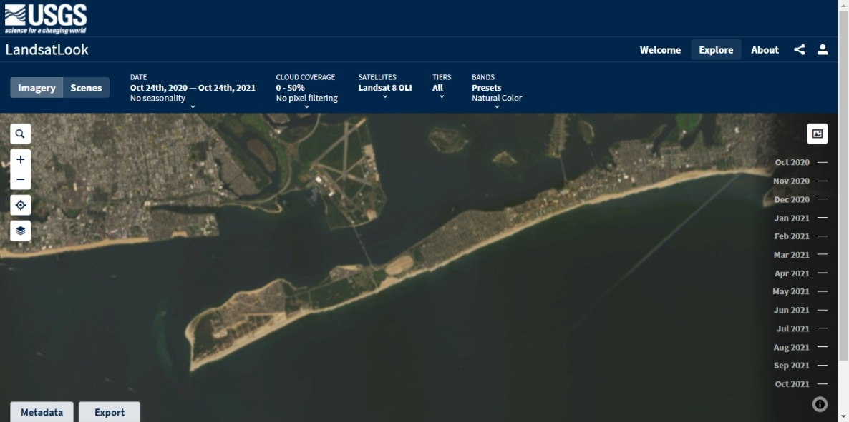
Landsat view of Rockaway Beach Front

Slide 4
Introduction- Preceding Superstorm Sandy(2012)
We began in 2006 with observations of modern of non-indigenous warm water marine life on the New York shallow shelf and coastal waters, with a spot fin butterfly fish migrating from the Gulf Stream , originating offshore Florida habituating offshore Rockaway. We published the implications in the Journal of Northeastern Geology and Environmental Sciences ( volume 28, number 2, 2006).

Slide 5
Purpose of Presentation
The purpose of this presentation
1) Review the affects of Superstorm Sandy (2012) in the context of geologic history
2) Governmental studies ( Bloomberg ) and recommendations for beachfront preservation with regard to potential future rises in sea level with respect to major urban area
3)Recent responses by the US Army Corps of Engineers and New York City with respect to groin and dune construction. The establishment of a reference point with respect to future evaluation to coastal preservation

Slide 6
Geologic U S East Coast Offshore Sea Level Ranges,
Numerous transgression regression fluctuations 240 m ( 750’) reflected in Mesozoic stratigraphy ( Epstein and Friedman 1982)
Young Dryas rise 120 m ( 360 ‘) ( Epstein 2007)
Complete meltdown of Greenland future estimated of 65 m rise (Epstein 2007)

Slide 7
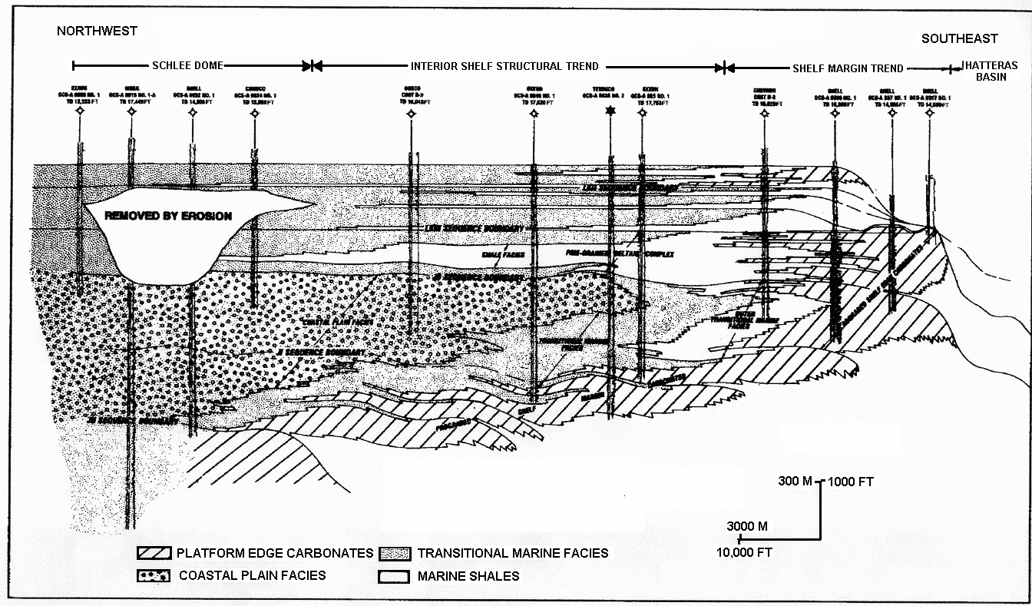
Jurassic – Cretaceous Baltimore Canyon Stratigraphy

Slide 8
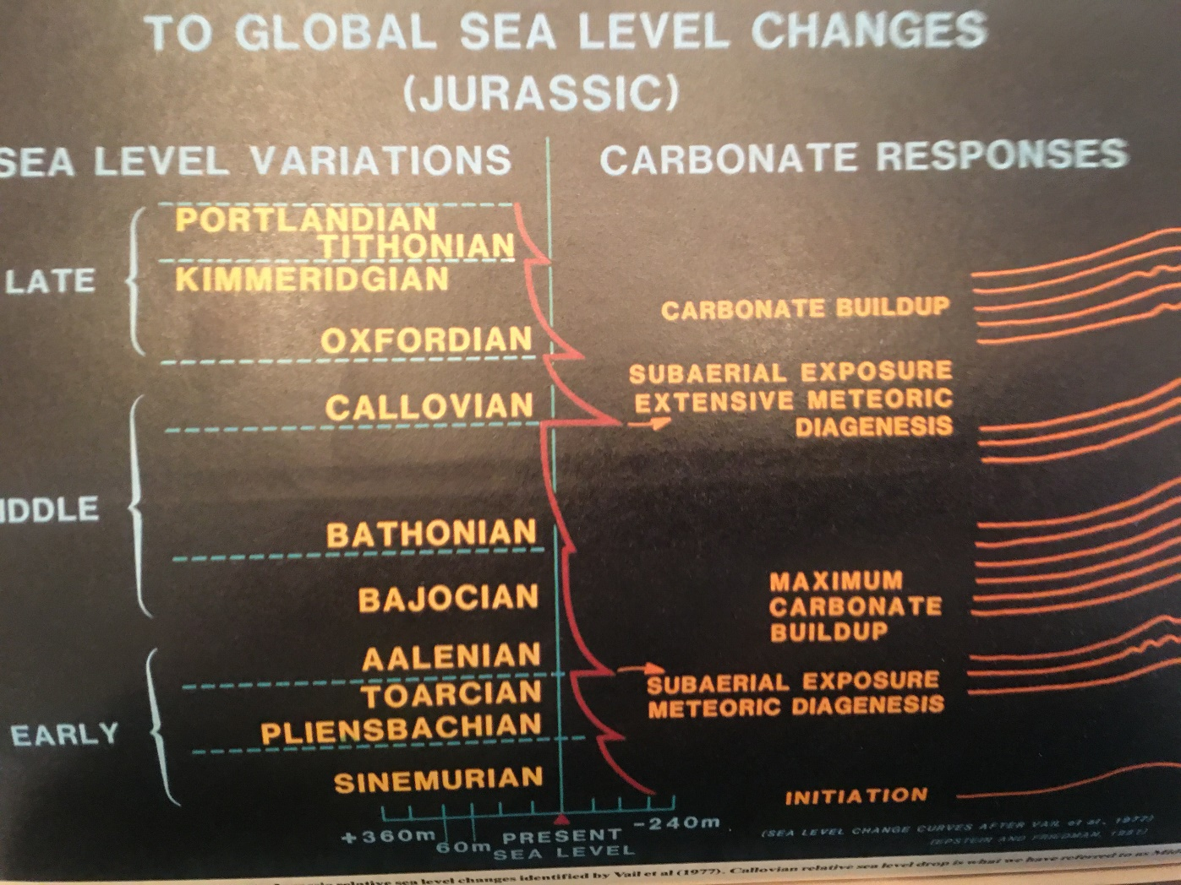
Relative Sea Level Responses Jurassic

Slide 9
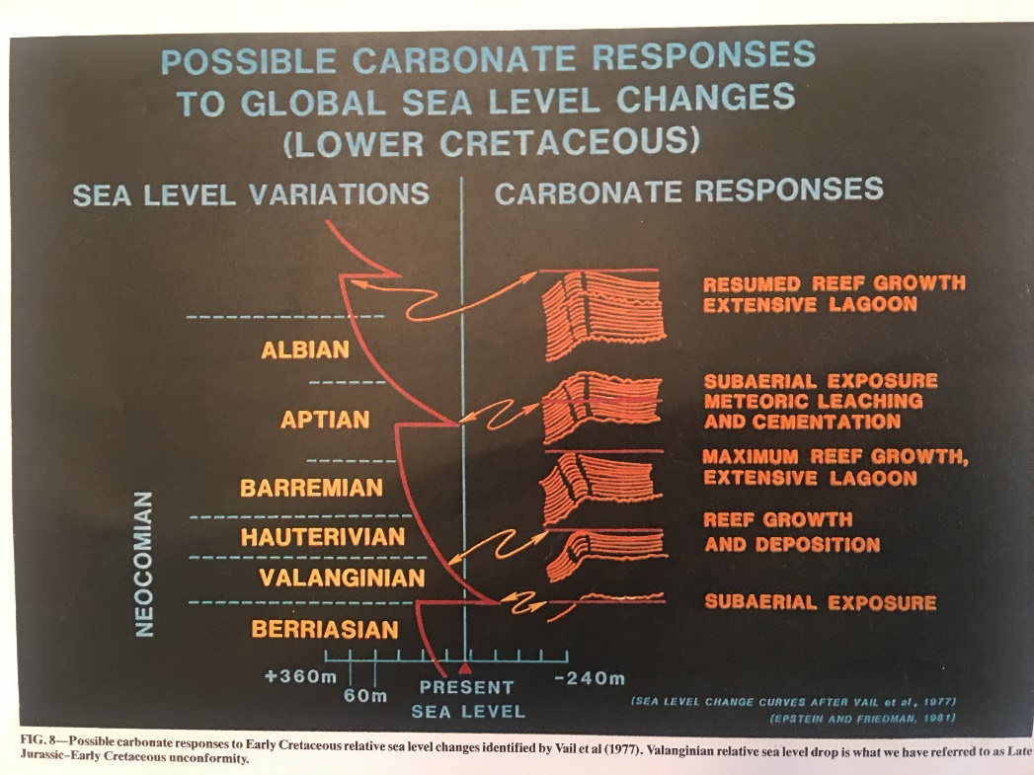
Relative Sea Level Responses Cretaceous

Slide 10
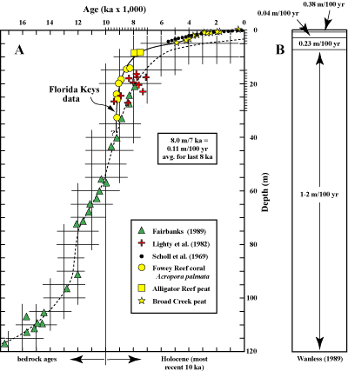
Sea Level Versus Time: Young Dryas. Melting Versus Current Relative Stabilization

Slide 11
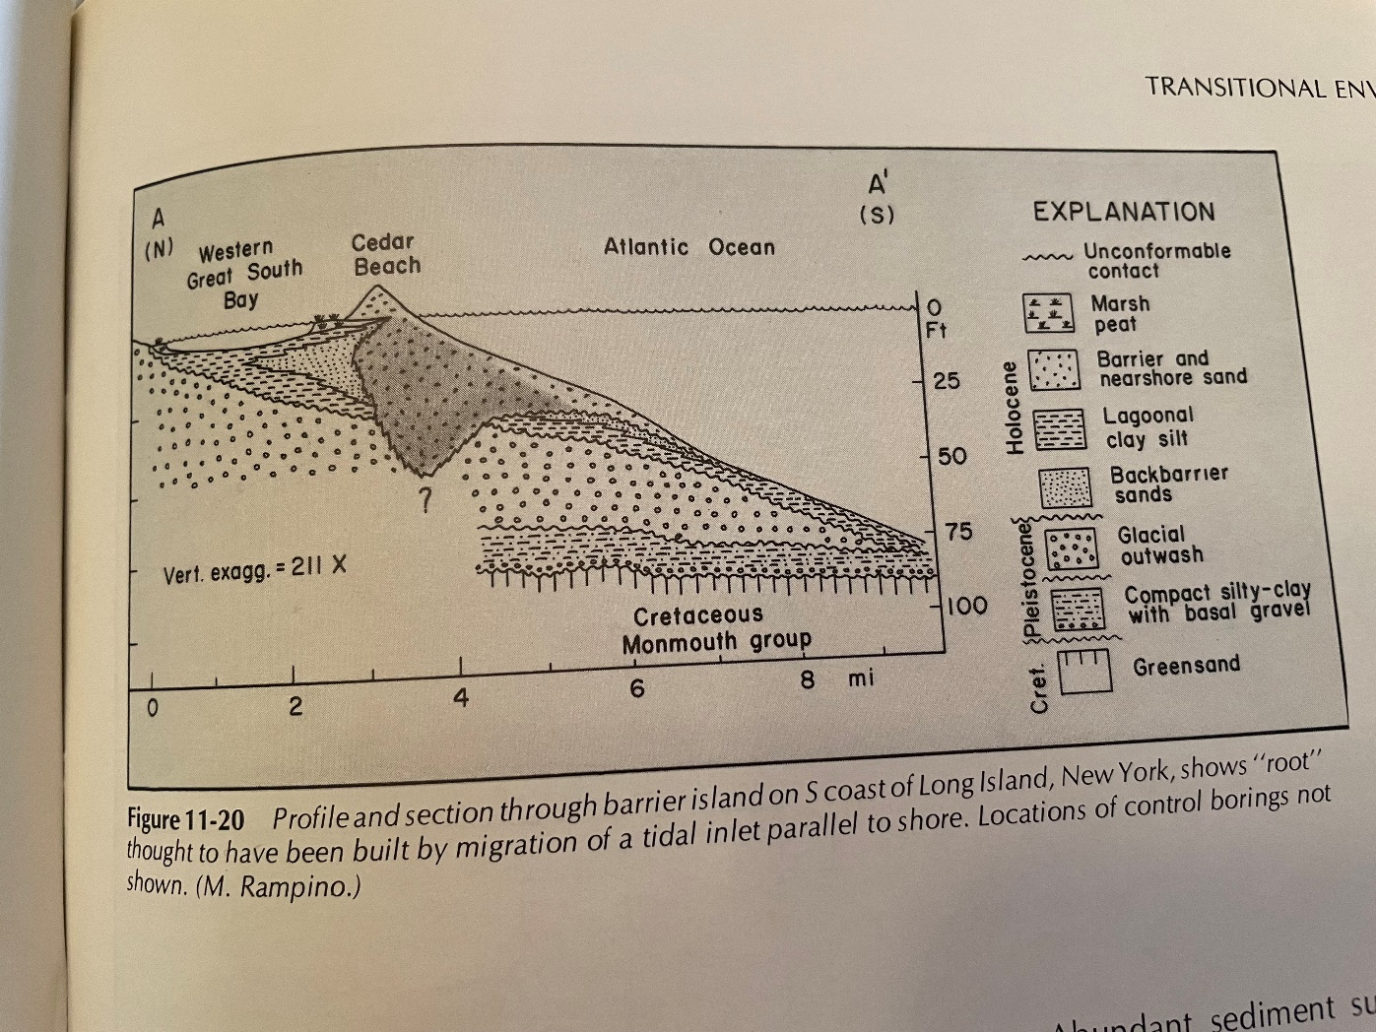
Barrier Bar Cross-section South Shore Long Island Built on Glacial Outwash

Slide 12
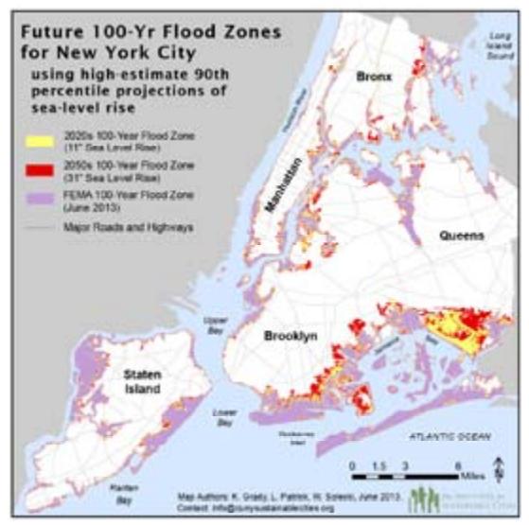
Rockaway Peninsula Queens NY: 100 Year Flood Zone

Slide 13
Sea Level Change Measurements and Predictions 1900-2050: NYC-Bloomberg Climate Study 2013
Overall increase in strength and number( category 4-5)in North Atlantic since early 1980’s
25th to 75th chance probability of 100 year storm surge flood heights 15-15.7’’at the Battery of 1 percent probability 100 year flood
Historic Super Storm Sandy demonstrated Long Island Coastal Tidal surge average 9.5’, and 14.5’ at the Battery

Slide 14
Eustatic Quantification Sea Level Historical Geological Measurements –In Range Current Sea Level Absolute Rises ( Epstein 2007)
Sea Level rates of change masked by the multivariate effects of 1)tectonic plate motion 2)variations in sedimentary processes 3)diagenetic changes and 4) subsidence, on the resultant rock record
Carbonate reef buildups are sensitive to sea level due the aggradation in the photic zone and is a good overall indicator
Carbonate cores taken in the Bahamas and Florida are good sea level indicators
10 to 30 cm/100yr or 4 to12 inches/100yr in a slow-subsidence dominated margin, compared to NYC Climate Change Panel 2013 calculations of 22 to 48 inches of sea level rise for period 2000-2050’s.
Thus The Climate Panel Predicts an Historically rapid sea level rise

Slide 15
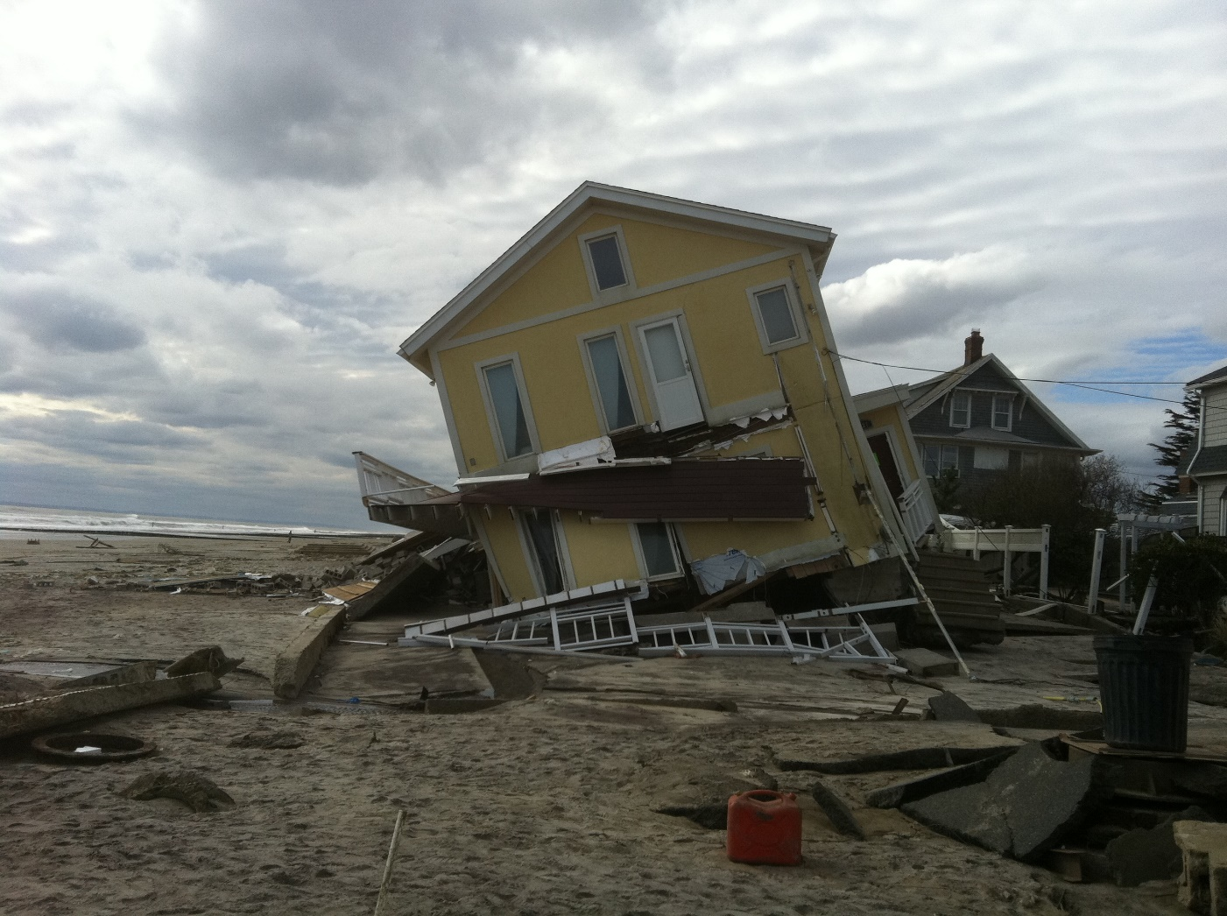
Beachfront Destruction Storm Surge Superstorm Sandy 2012, Rockaway, Queens NY

Slide 16
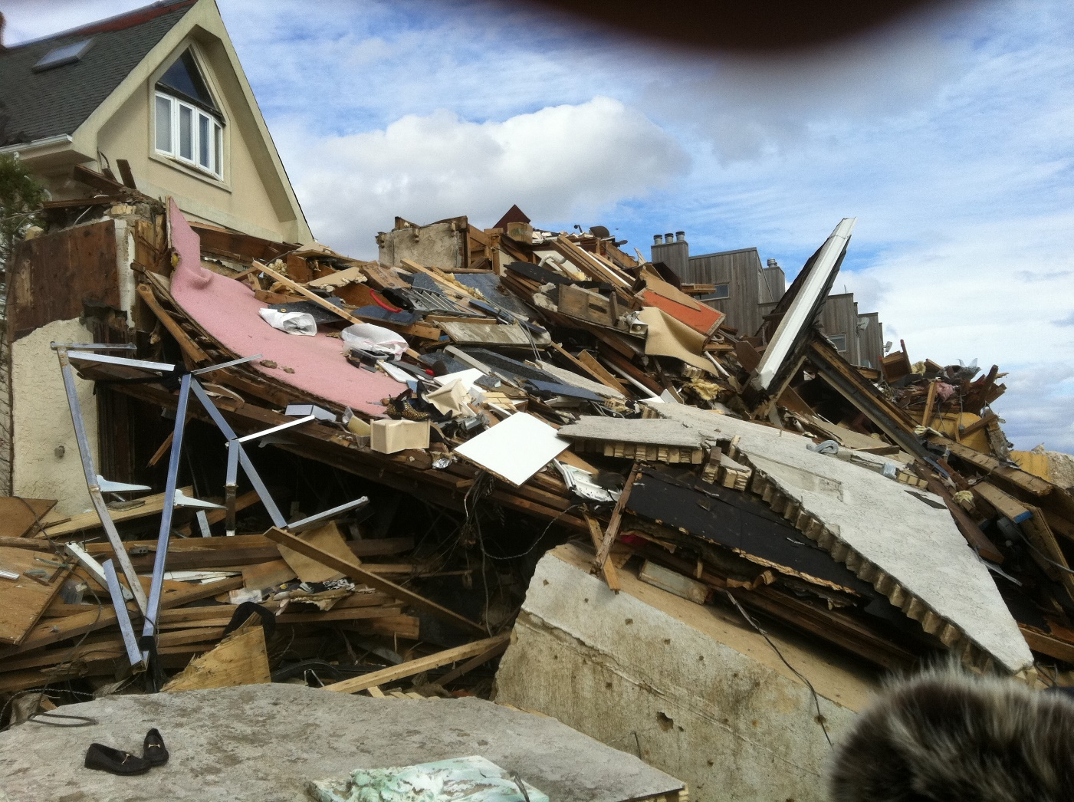
Storm Surge results Superstorm Sandy ( 2012)

Slide 17
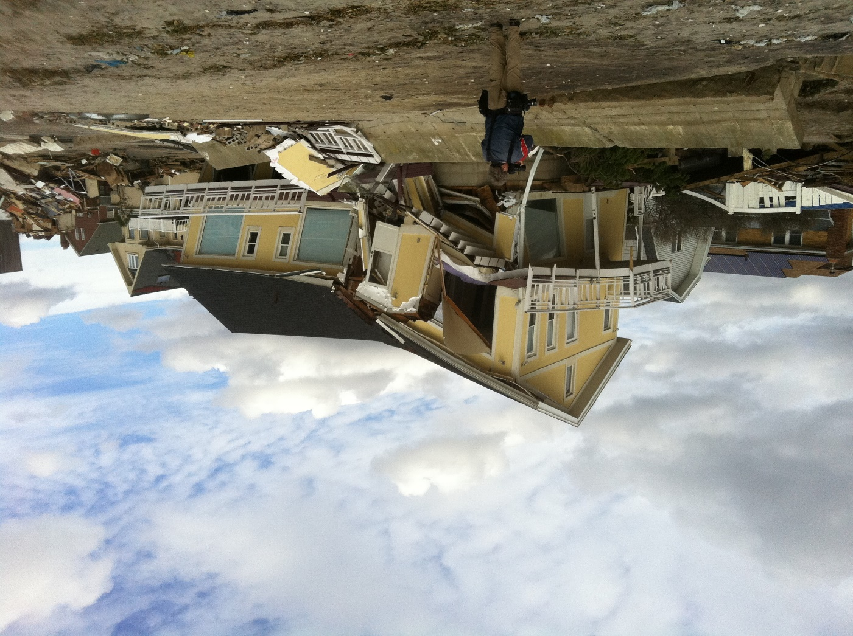
Storm Surge Results; Superstorm Sandy ( 2012)

Slide 18
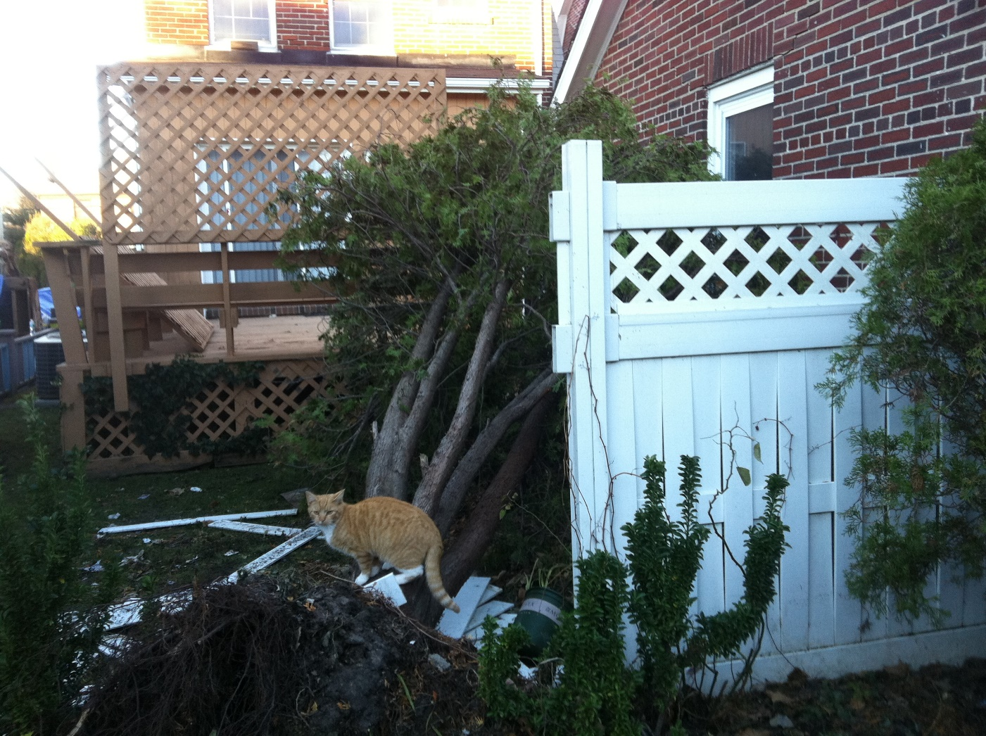
Destruction during Superstorm Sandy-Survival of the fittest

Slide 19
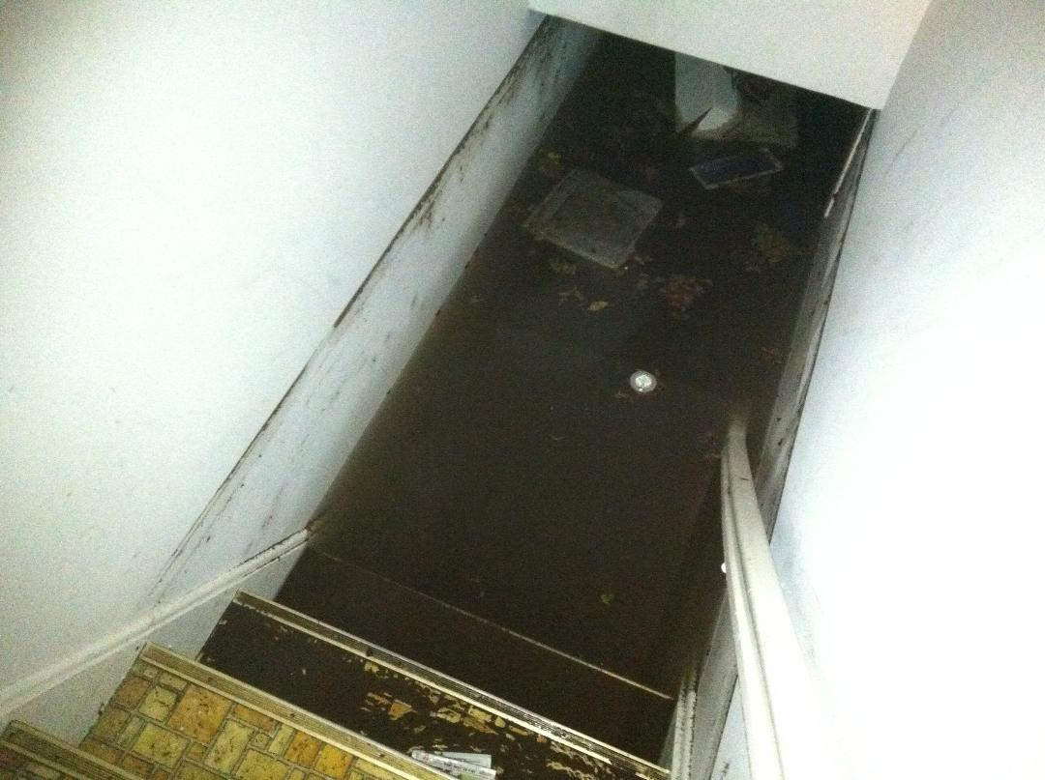
PERITIDAL ZONE DURING SUPERSTORM SANDY, Basement flood, 300m from Beachfront

Slide 20
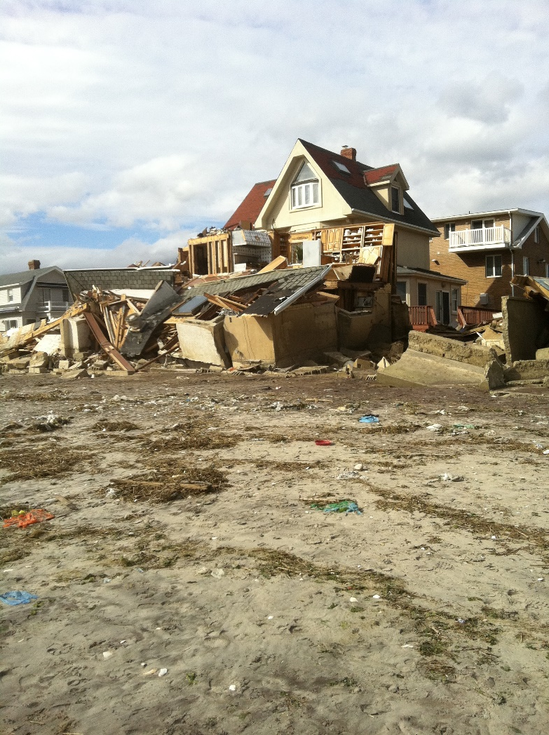
Superstorm sandy (2012) Beachfront Tidal Surge Wave Destruction

Slide 21

Superstorm Sandy Auto Economic Impact (2012)

Slide 22
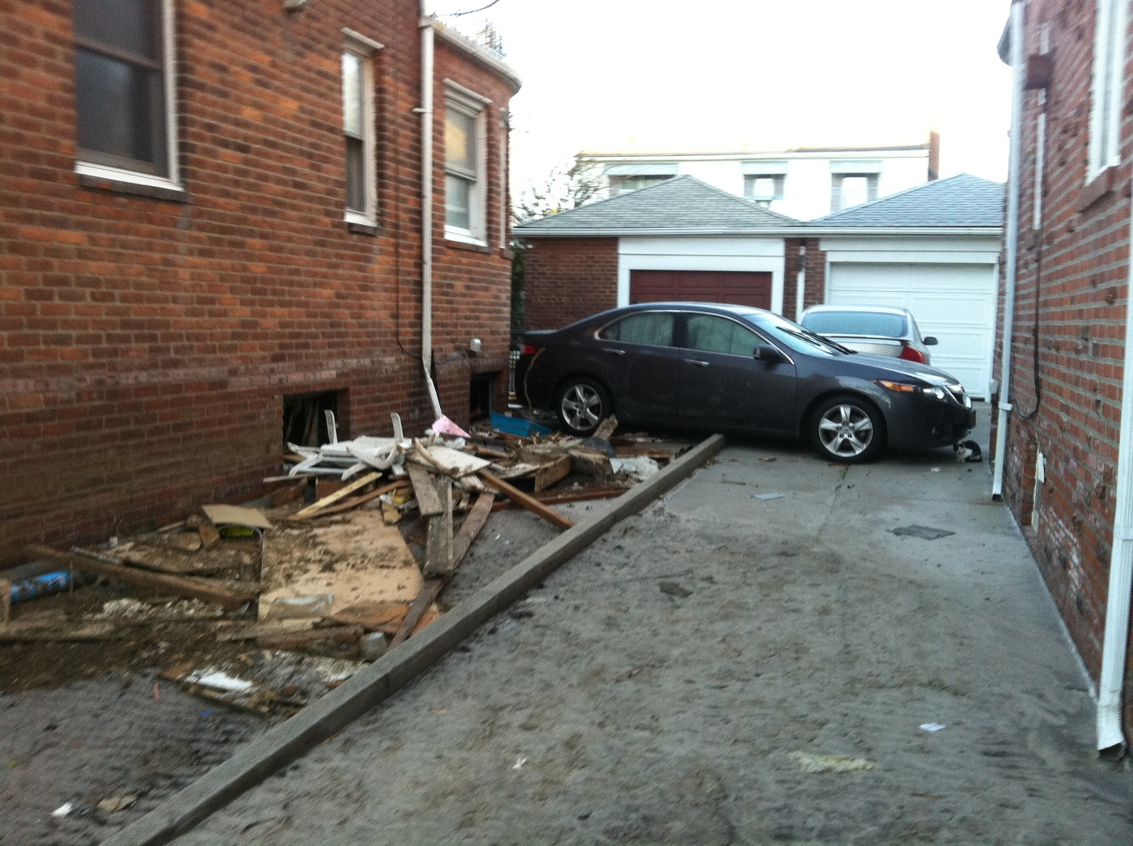
Superstorm sandy 2012 Storm Surge Results

Slide 23
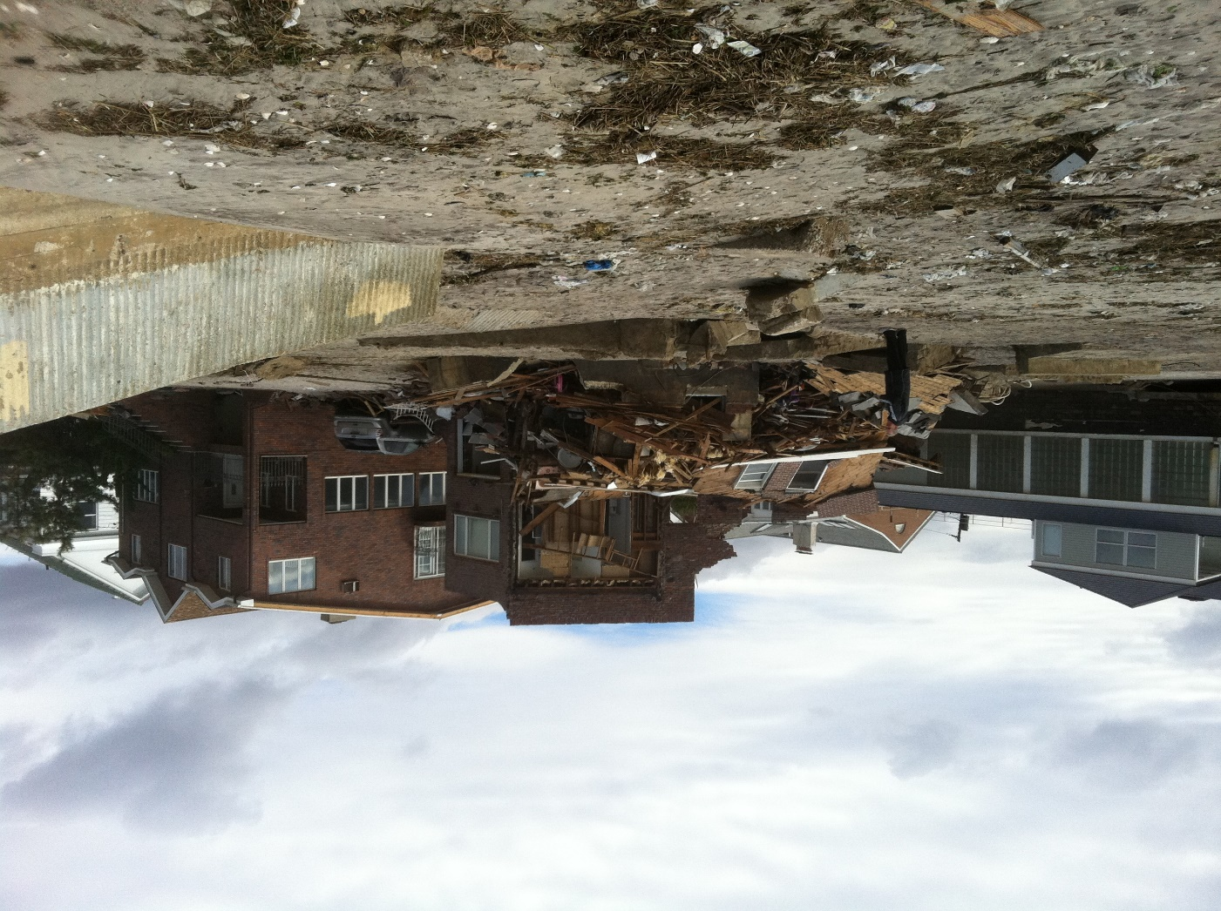
Superstorm Sandy Beach Front Destruction 2012

Slide 24
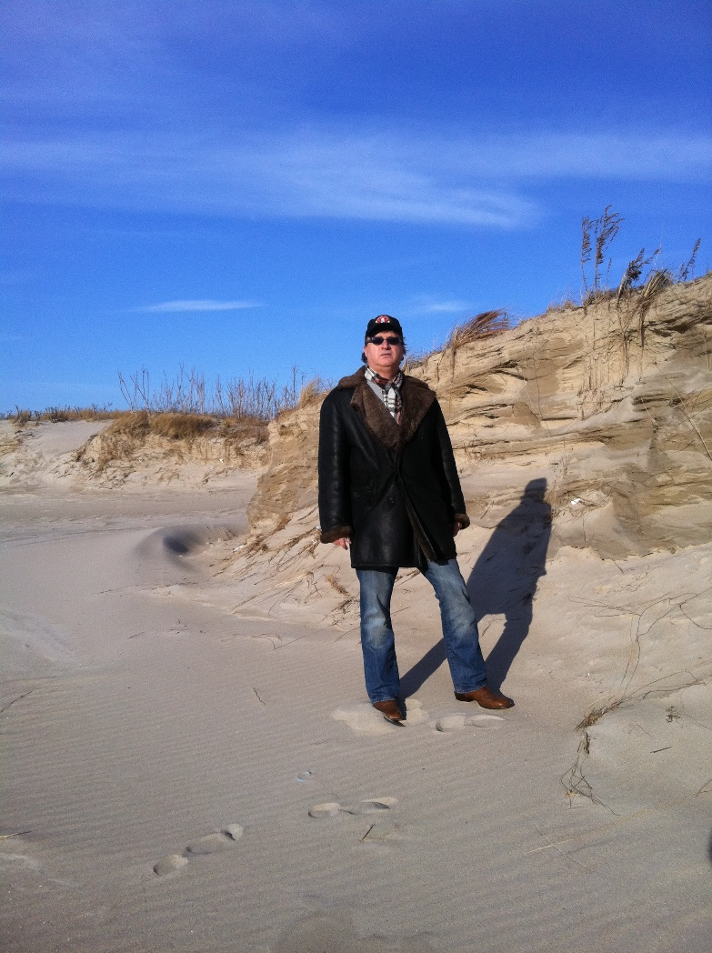
Superstorm Sandy Cross-bedding Sand dunes Rockaway Point 2012

Slide 25
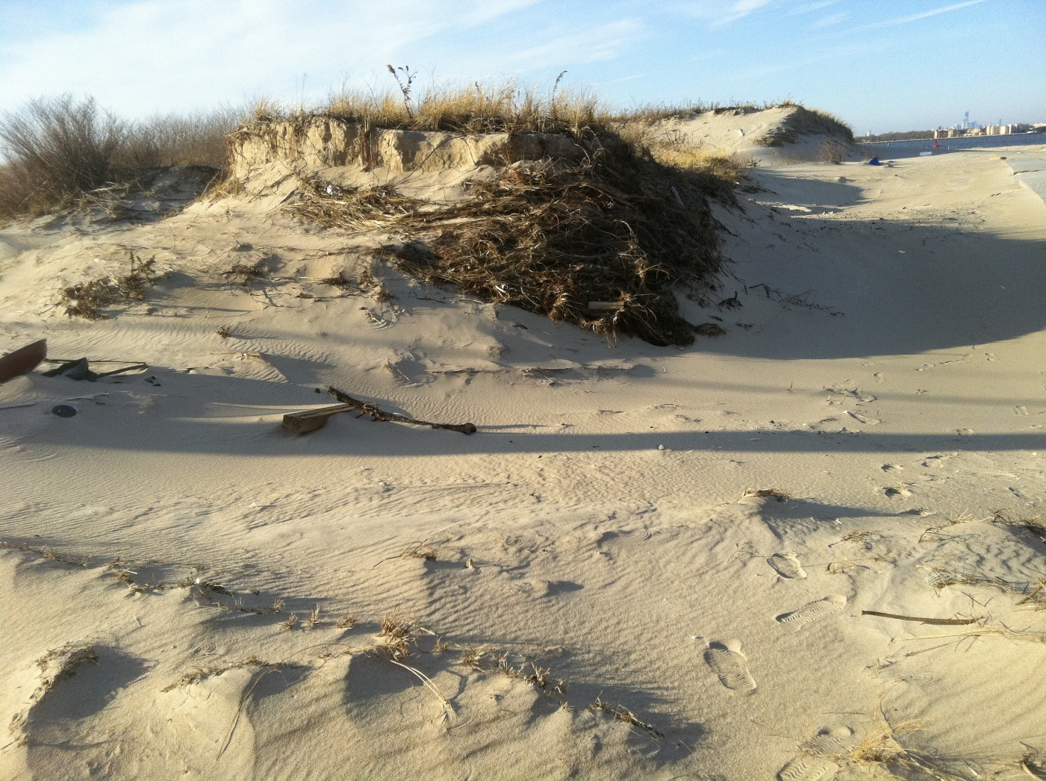
Dune Erosion Post Superstorm Sandy 2012 Rockaway Point

Slide 26
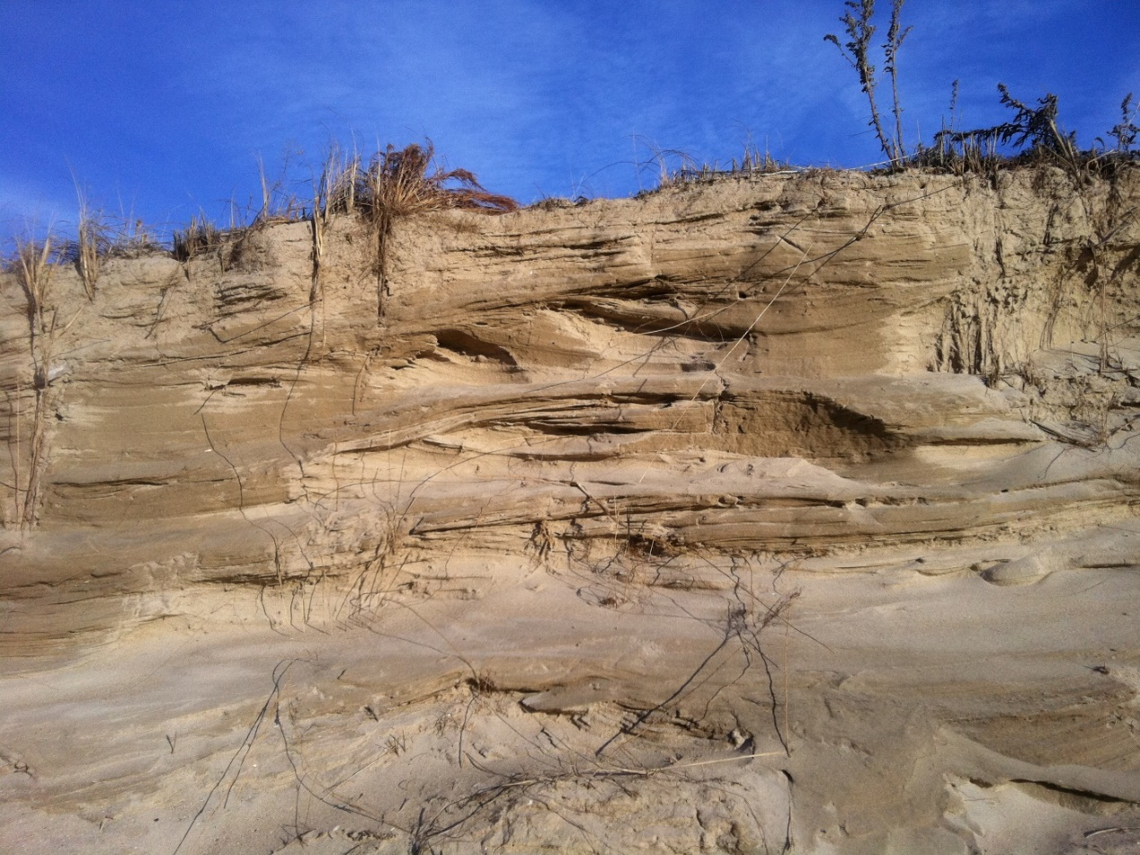
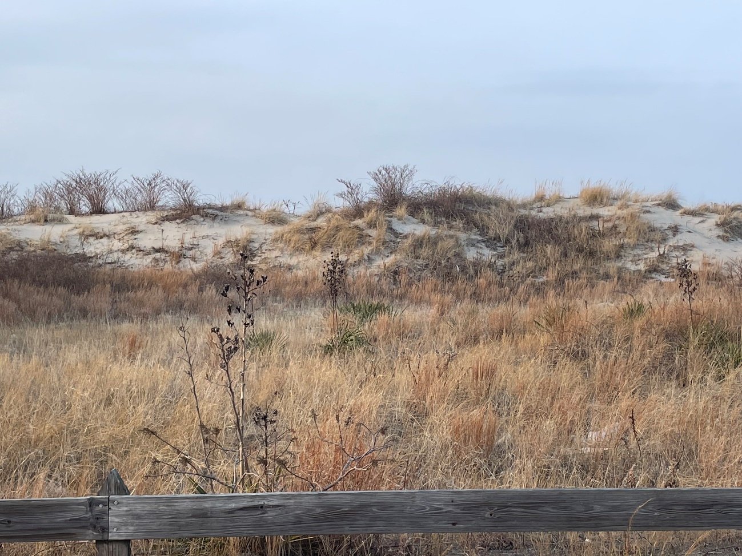
Cross section of Dune Post Superstorm Sandy 2012 Rockaway Point-2022

Slide 27
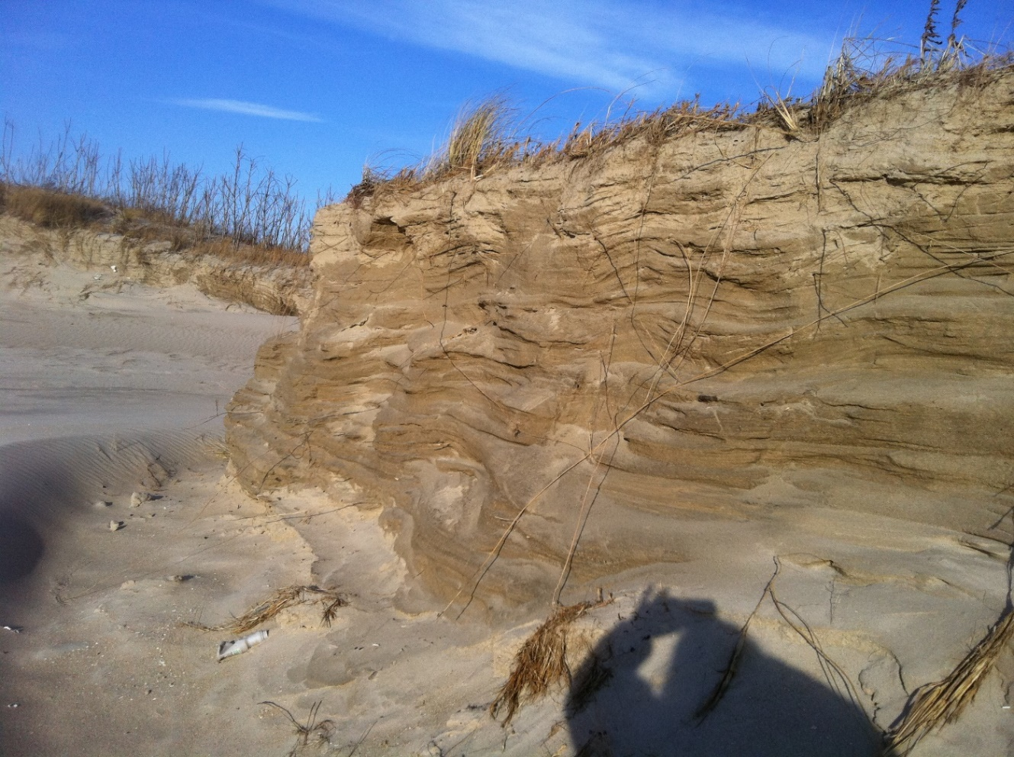
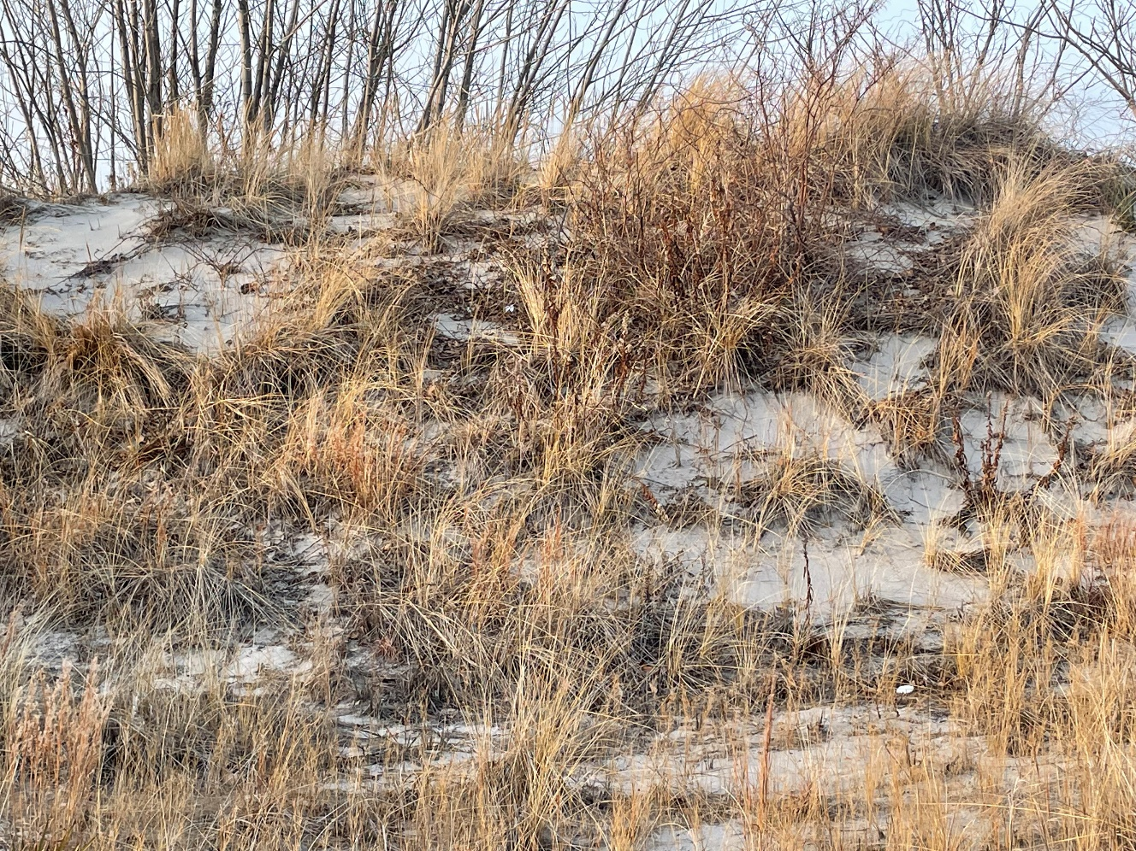
Cross-section Dune Superstorm sandy Rockaway Point 2012-2022

Slide 28
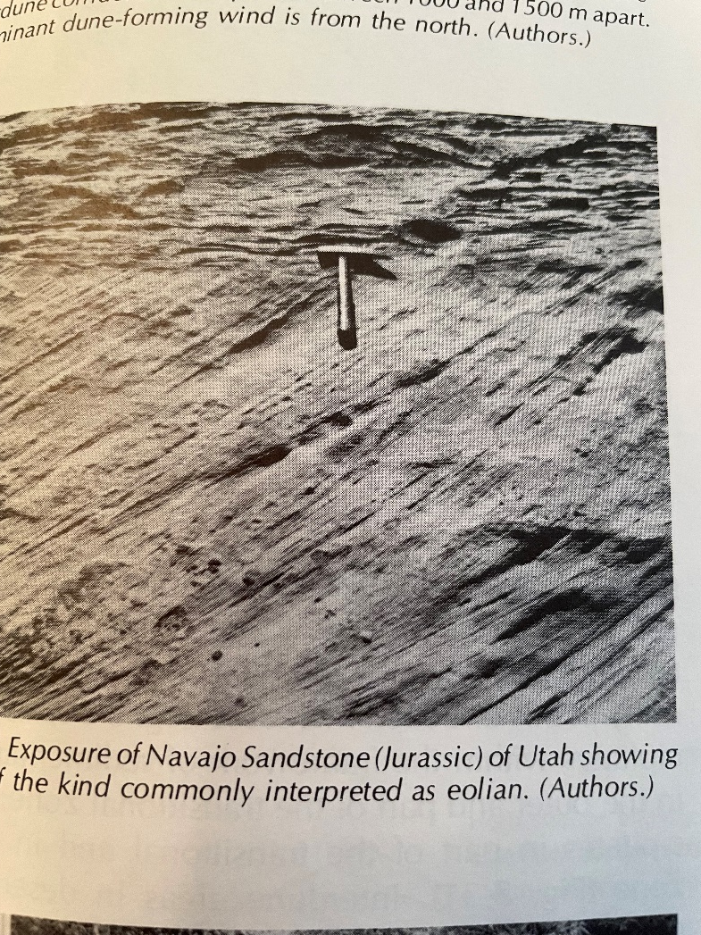
Navajo Sandstone Cross Beds (Jurassic analogue)

Slide 29
Beachfront and Coastal Erosion NYC Focus
Longshore currents from Beach 9th street to 149th street Groin construction
Direct wave front from offshore Atlantic Ocean, dune construction

Slide 30
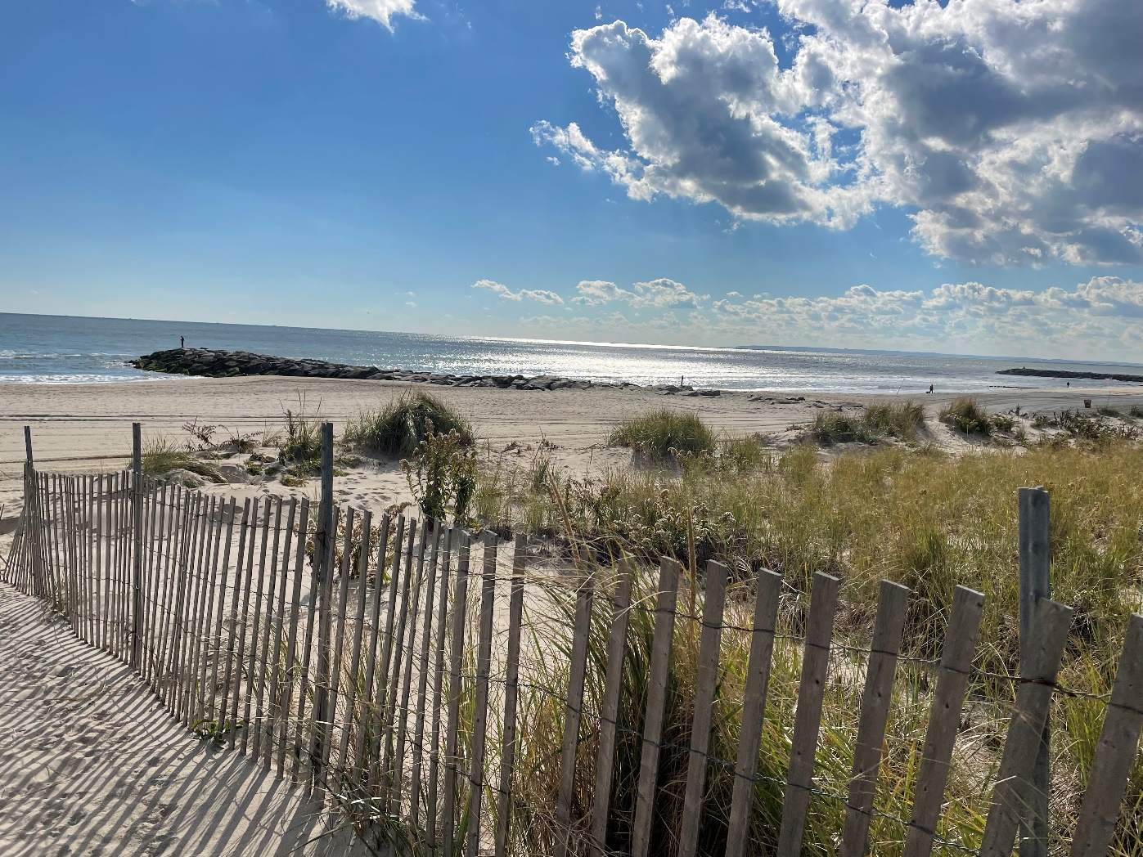
Groin (2021) with Dune (2017) Combination

Slide 31
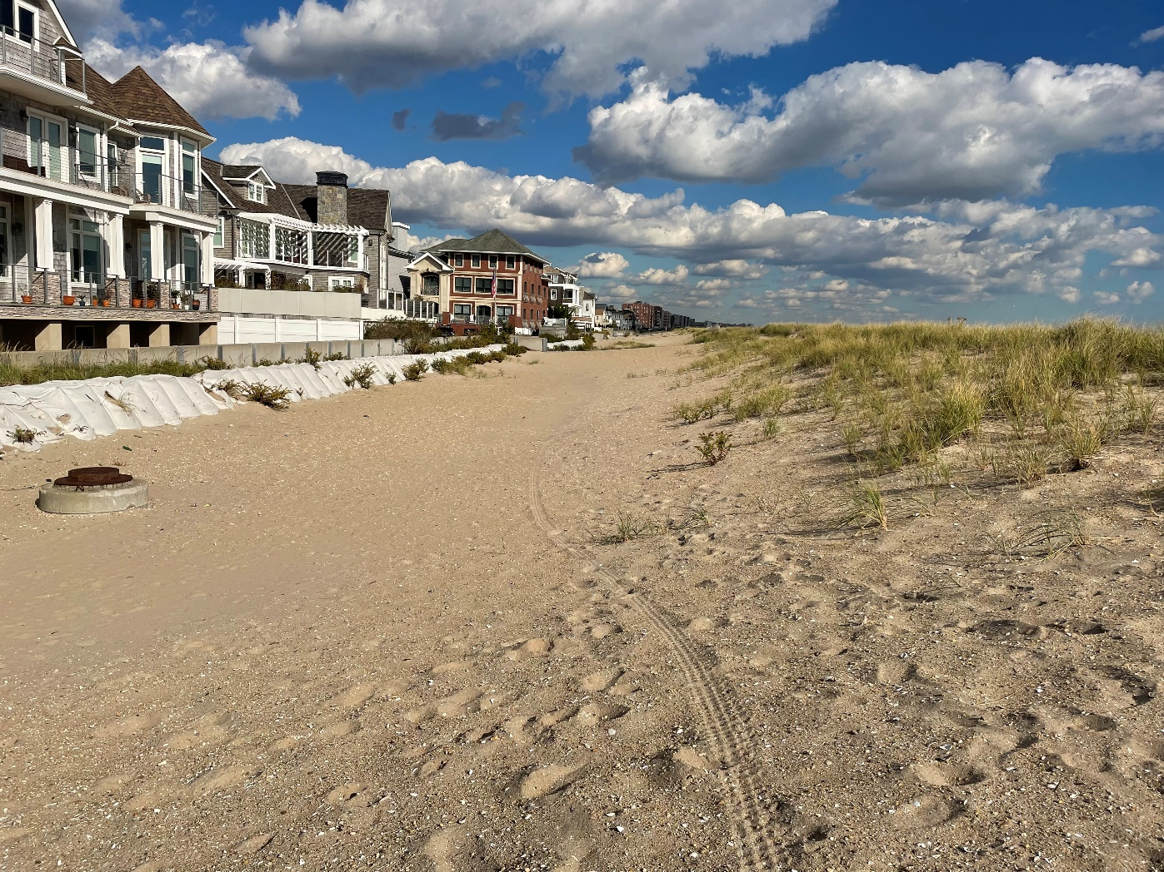
Leeward Side of Dune

Slide 32
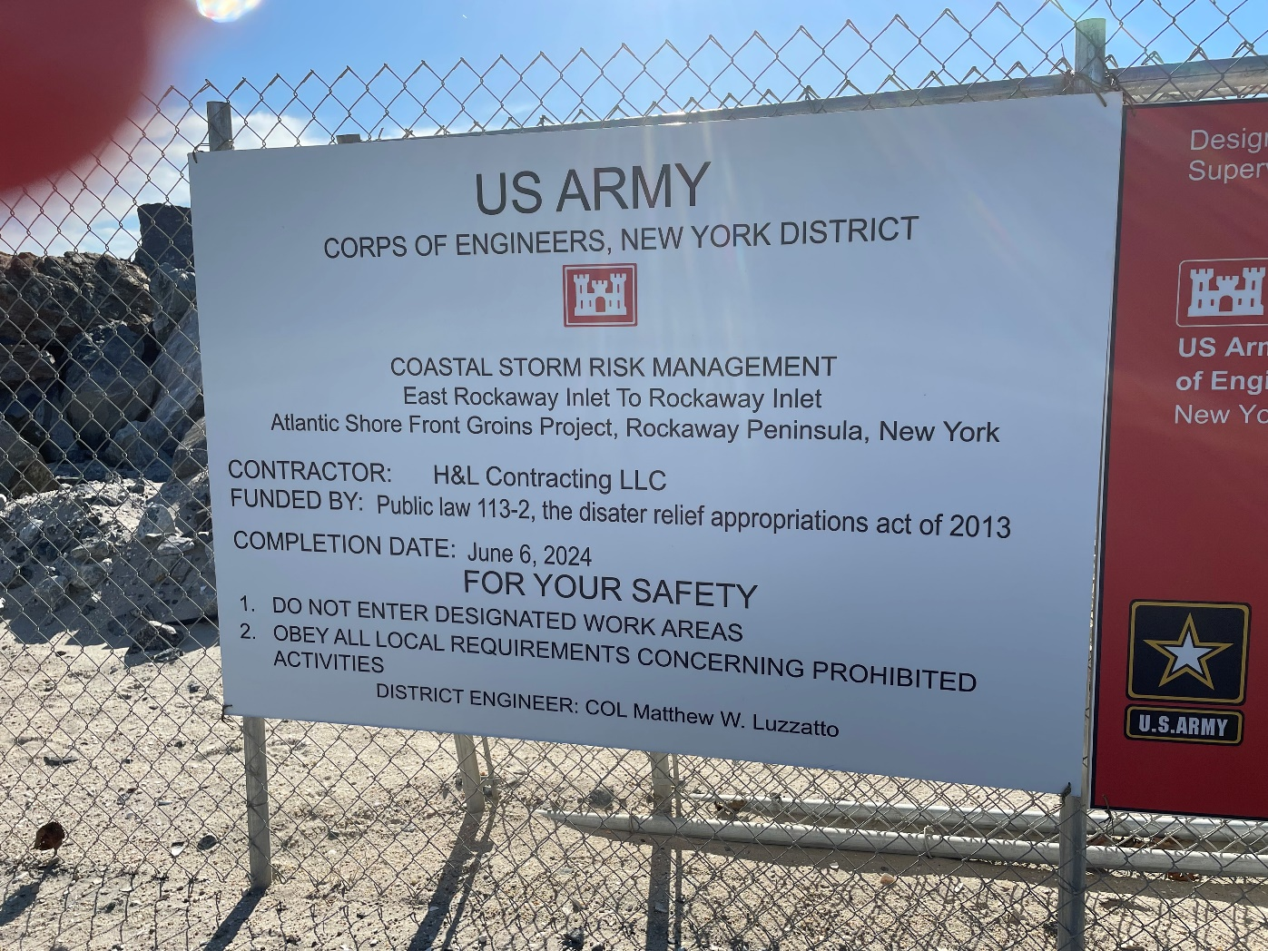
U.S. Army Corp Coastal Preservation Actions

Slide 33
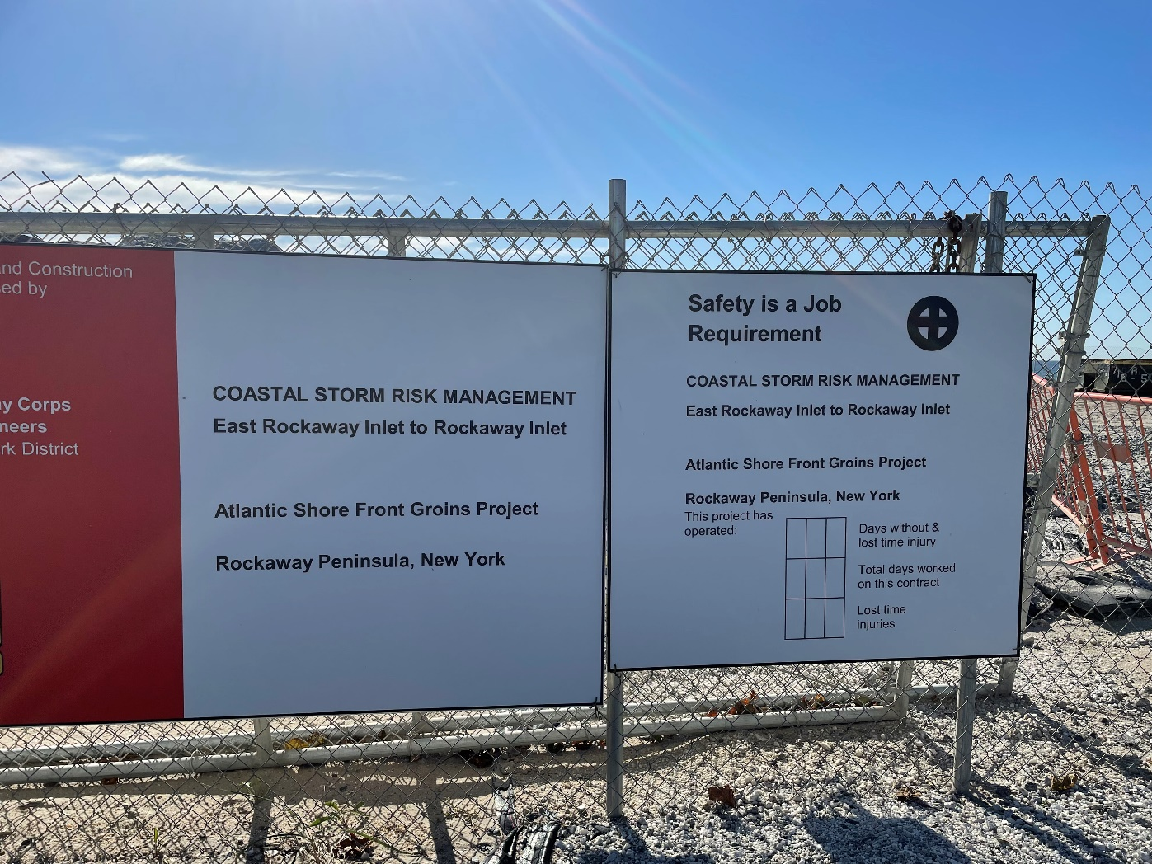
Coastal Storm Risk Management Project

Slide 34
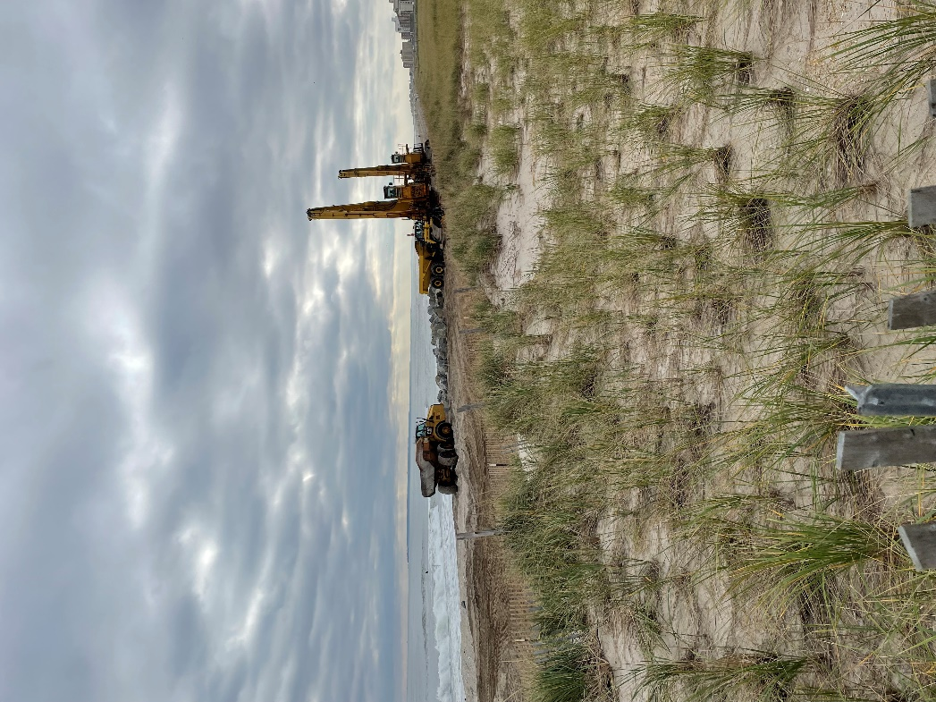
Dune and Groin Inter relationships 2021

Slide 35
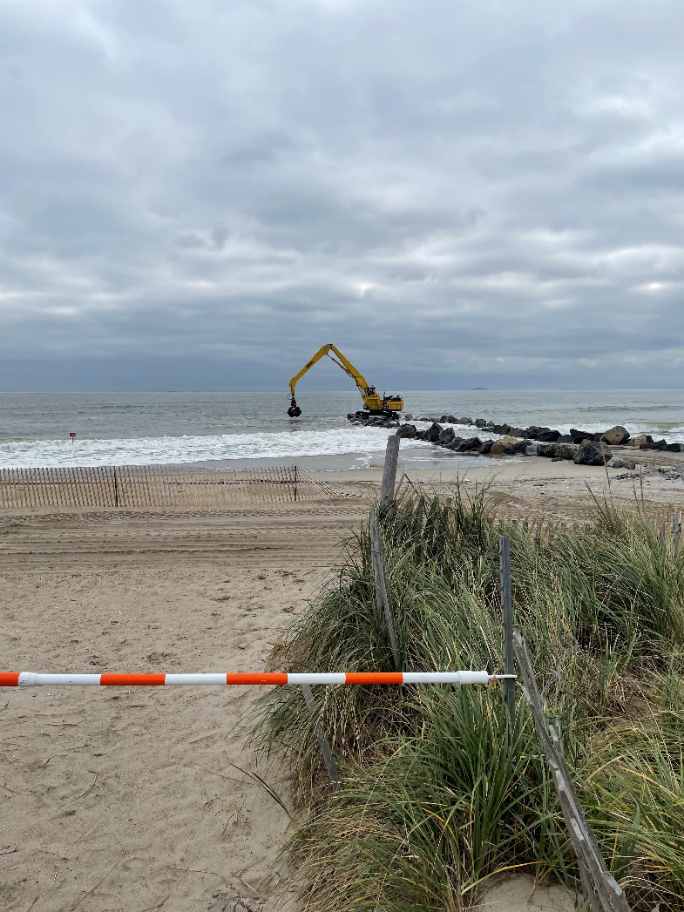
Rockaway Beach Groin Construction 2021, Multi-ton Metamorphic Boulders

Slide 36
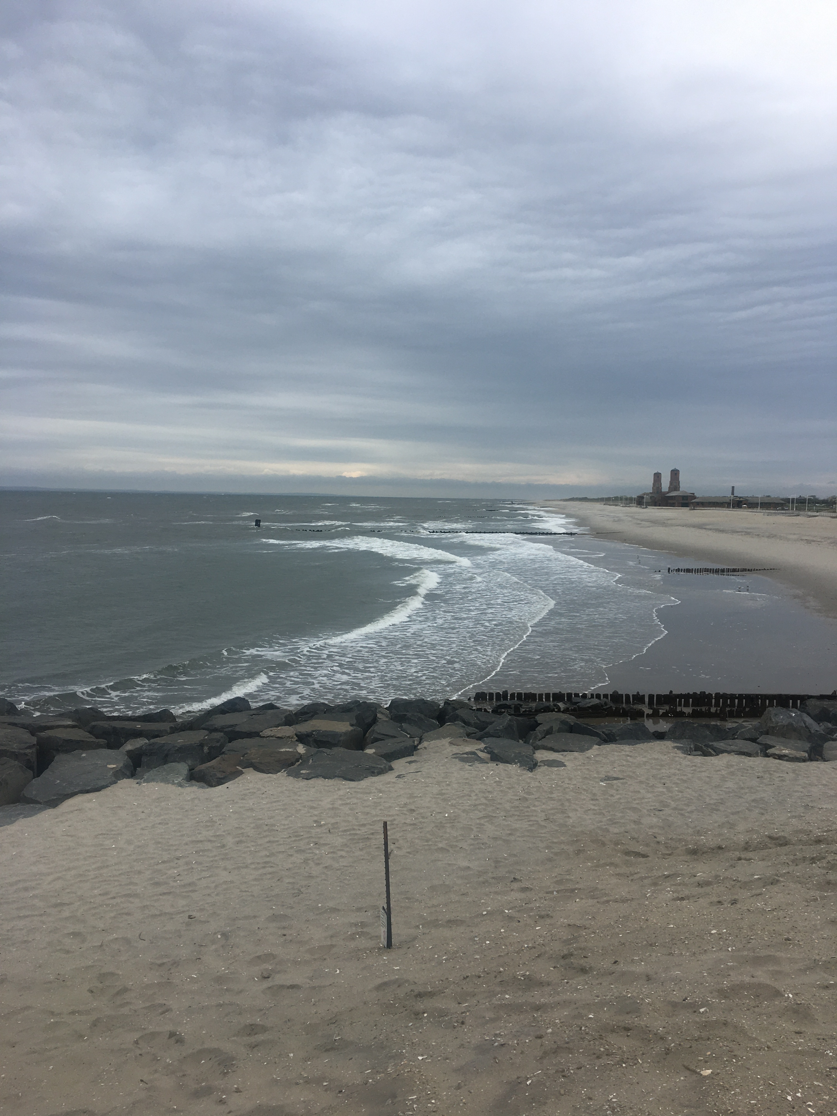
Rock Groin Attempt to Reduce Longshore Current Transportation and Beachfront Erosion

Slide 37
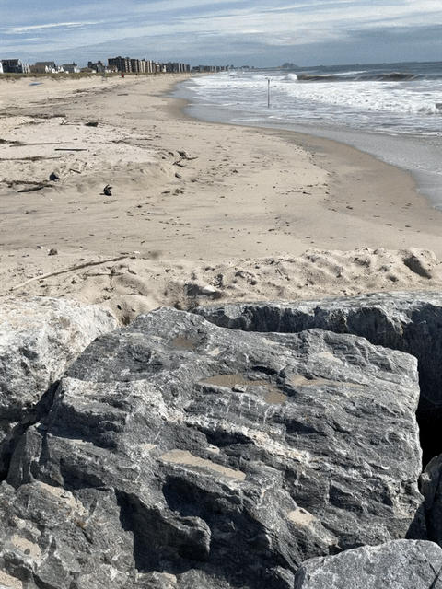
Metamorphic Rocks Imported from Pennsylvania create rock groins

Slide 38
Newly constructed Groin Beach 134th Street

Slide 39
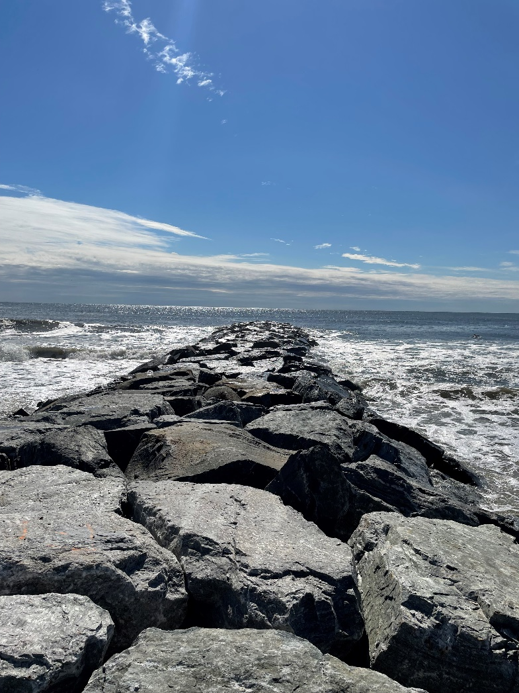
Completed Rock Groin Rockaway Beach, Queens, New York; 100 meters long

Slide 40
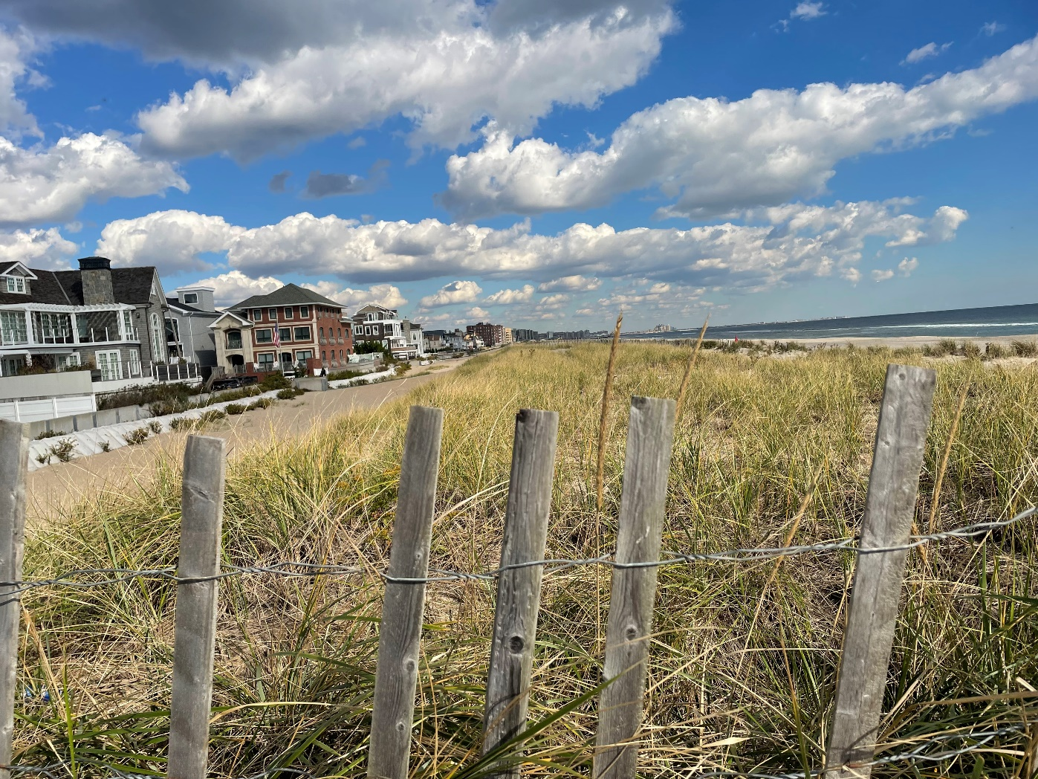
Dune Strike looking West along Beach Front

Slide 41
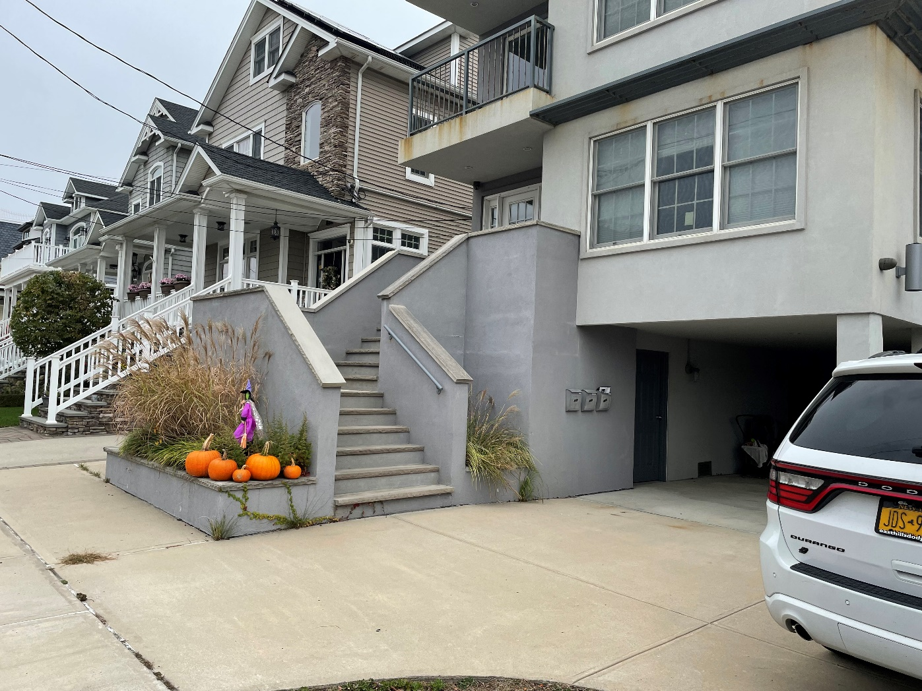
Elevated homes Post Hurricane Sandy

Slide 42
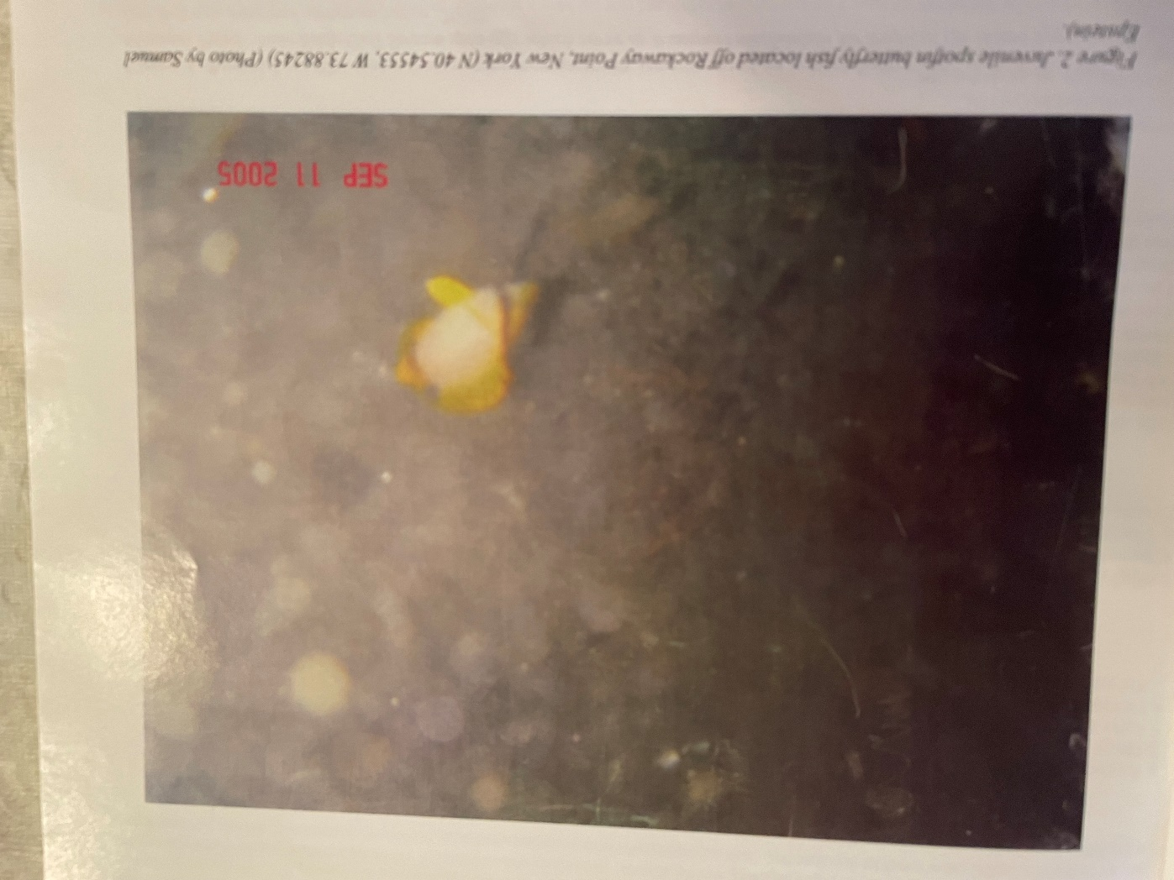
Non-indigenous Spotfin Butterfly fish found off the coast of Rockaway Beach (Epstein, 2006)

Slide 43
Ecological Animal Life Changes Offshore Rockaways Due To Warmer waters and A Cleaner Hudson River
Over the past 5 years significant changes of animal life offshore Rockaway Beach Queens New York
1) The occurrence of numerous humpback whales
2) Reef tipped and spinner sharks
3)Pods of dolphins nearshore
4)Large bait balls of bunker

Slide 44
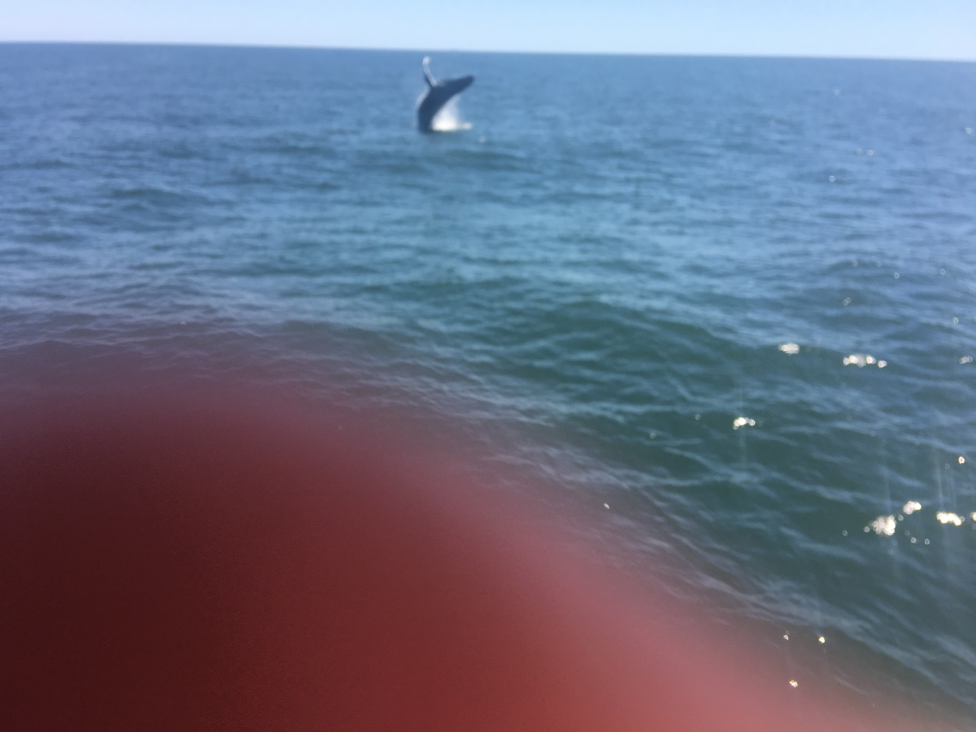
Humpback Whale Breach Offshore Brighton Beach Brooklyn, New York Harbor

Slide 45
Bibliography
Epstein,S.A.,2007, An Attempt To Quantify Eustatic Sea Level Fluctuations – A Geological Perspective. Carbonates and Evaporites. V.22, number 2
Friedman, B. 2012, NYC Member Stayed –Survived Sandy , The First Hand Experience of Samuel Epstein. American Association of Petroleum Geologists Explorer.
Friedman, G.M. and J. Sanders ,1978.Principles of Sedimentology. John Wiley and Sons 792pp.
NYC Panel on Climate Change Risk Information 2013 Observations, Climate Change Projections, and Maps. 38 pp.

Slide 46
Bibliography
Epstein, SA., 2006. The Occurrence of Modern Non-Indigenous Warm Water Marine Life on the New York Shallow Shelf—Implications to the Rock Record. Northeastern Geology, and Environmental Sciences, Vol 28, Number 2, 2006
Epstein, SA., and Friedman, GM 1983. Depositional and Diagenic Relationship between the Gulf of Elat (Aqaba) and the Mesozoic US East Coast Offshore. AAPG Bulletin, v. 67, p. 953-962.

