Slide 1
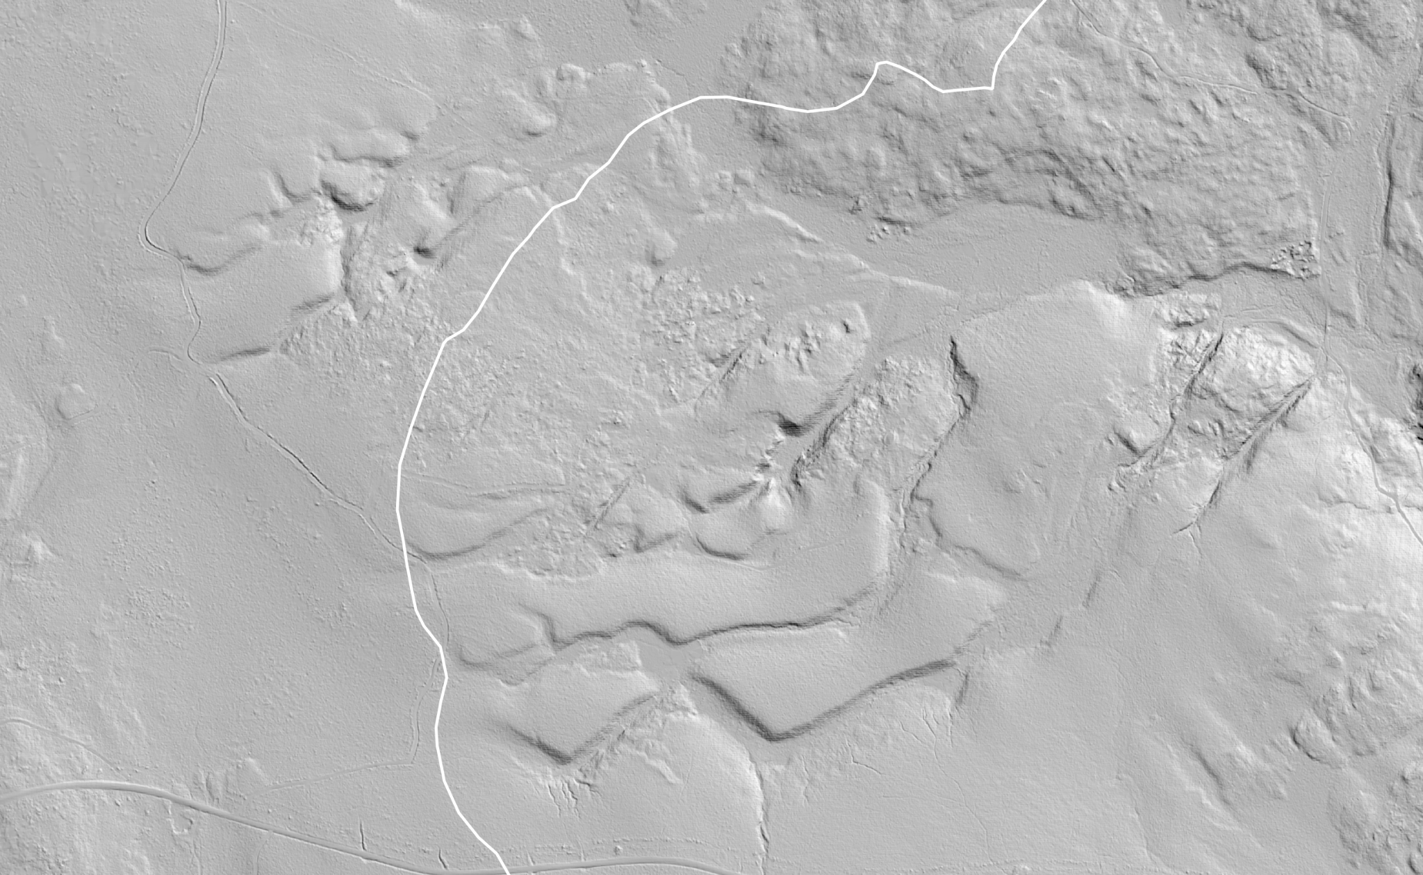
Post-glacial sediment delivery continuum to an impounded valley reach in central Maine: a multi-disciplinary approach
Ian Nesbitt¹, Sean Smith¹, Seth Campbell¹, Bess Koffman², Steven Arcone³, Kristin Schild¹
¹Department of Earth and Climate Sciences, University of Maine
²Department of Geology, Colby College
³Thayer School of Engineering, Dartmouth College
Notes:
I’m here to speak to you today about post-glacial sedimentation in central Maine, a topic that comprises my Master’s thesis.
I’ve been working on this project for over three years now, and even my advisors agree that it probably should have been a PhD in the first place.
I’m going to try to get through these first few slides fairly quickly so that we can spend more time on the interesting stuff.

Slide 2
Problems and Importance
Introduction Location Methods Results Discussion Summary
Sediment delivery studies are critical to understanding landscape evolution, but:
Lack of studies in formerly-glaciated regions
Sediment volume is tricky to measure - lakes are complex & not man made
Sedimentation time is tricky to measure - ice-off age is not well known
Notes:
So before we get to the study area, I’m going to set up the problems

Slide 3

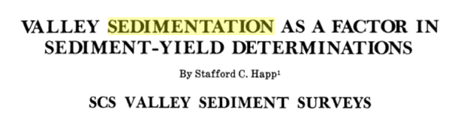
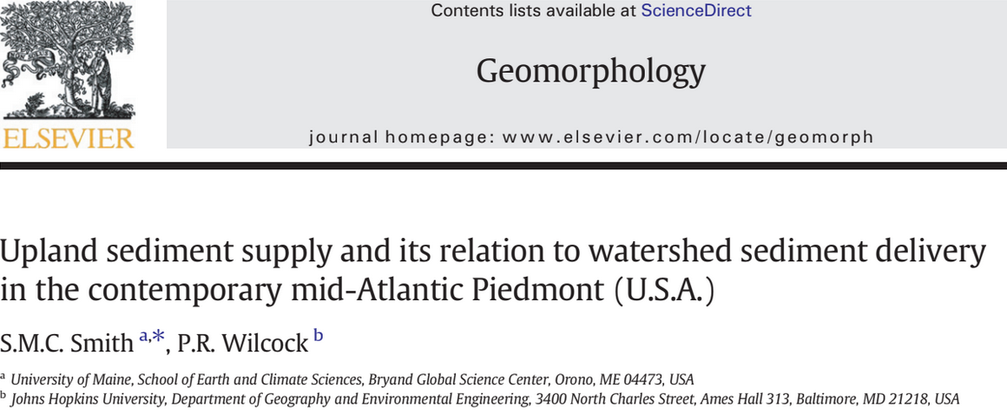
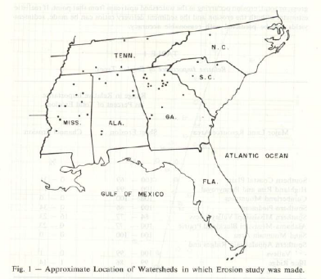
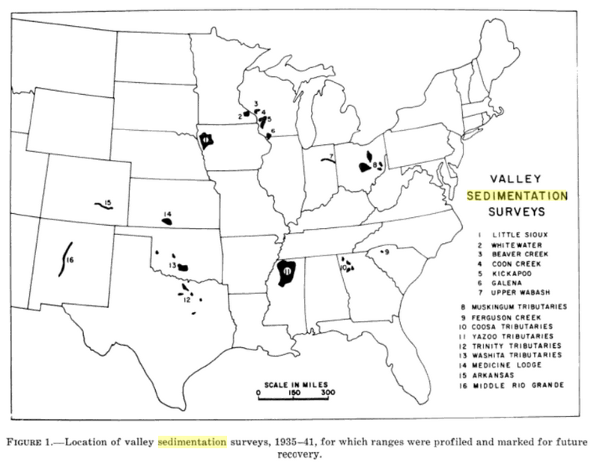
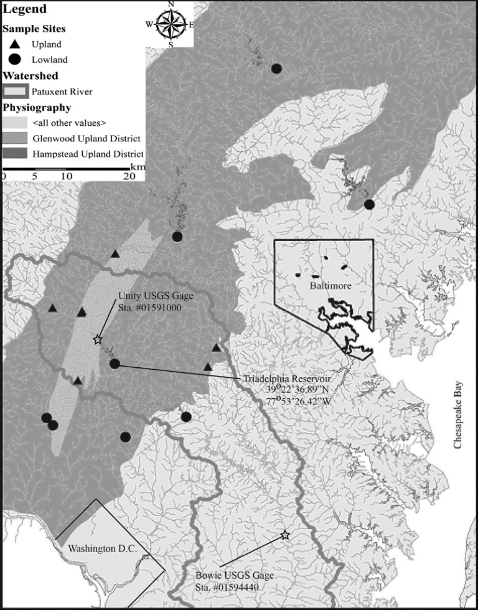
Problem 1
Introduction Location Methods Results Discussion Summary
Sedimentation within the North American glacial limit is under-studied.
Especially compared with other regions (e.g. Roehl, 1962; Happ, 1975; Smith and Wilcock, 2015)
Notes:
One of the reasons for this is that many reservoirs in the midwest and south are artificial, meaning critically that they were surveyed prior to being dammed and filled, so the bathymetric contours were well known prior to construction
This allows for much easier tracking of sedimentation

Slide 4
Problem 1
Introduction Location Methods Results Discussion Summary
Sedimentation within the North American glacial limit is under-studied.
Especially compared with other regions (e.g. Roehl, 1962; Happ, 1975; Smith and Wilcock, 2015)
???
Notes:
In the northeast, that’s not as easy, because there are more natural lake formations and thus fewer reservoirs need to be constructed
Consequently you end up with data gaps in areas that have abundant natural lakes

Slide 5
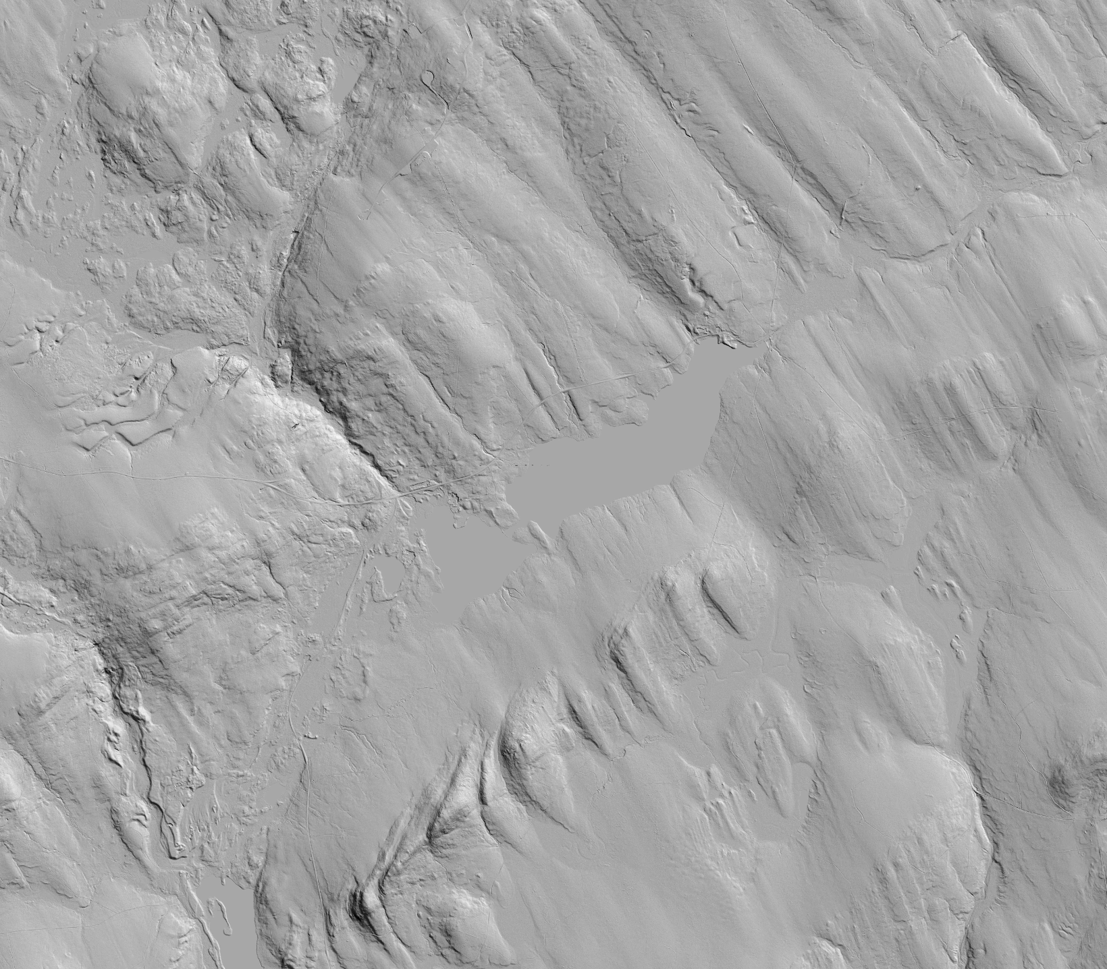
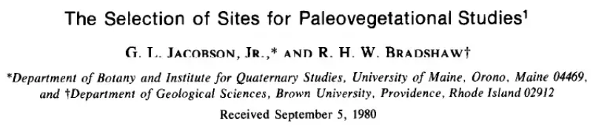
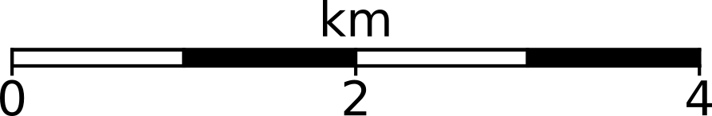
Problem 2
Introduction Location Methods Results Discussion Summary
Most studies use point-source methods (cores, probes) for volume estimates.
Assumes spatial predictability in highly variable landscapes (Jacobson and Bradshaw, 1982)
MEGIS 2015-2016

Slide 6
Problem 2
Introduction Location Methods Results Discussion Summary
Most studies use point-source methods (cores, probes) for volume estimates.
Assumes spatial predictability in highly variable landscapes (Jacobson and Bradshaw, 1982)
???
Need many cores to create a decent volume model here!
MEGIS 2015-2016
Notes:
What does that mean? It means that depending on where you take a core here, you might end up with very different answers for your sediment model
We’ll come back to this LiDAR image in a minute

Slide 7
Objectives
Introduction Location Methods Results Discussion Summary
Use core analysis and geophysics to estimate sediment delivery rate and volume for deglaciated period
Establish a delivery rate continuum
Attempt to use landscape features to help explain events in the continuum
Quantify the effects of human influence (dams, logging, development, etc.)

Slide 8
Study location - selection criteria
Introduction Location Methods Results Discussion Summary
Low-mid Strahler order watershed in western Penobscot
Above marine transgression
Shallow and fresh enough to measure sediment column with radar
Deep enough to be oligotrophic
Dam on lake outlet
Notes:
Western Penobscot headwaters

Slide 9
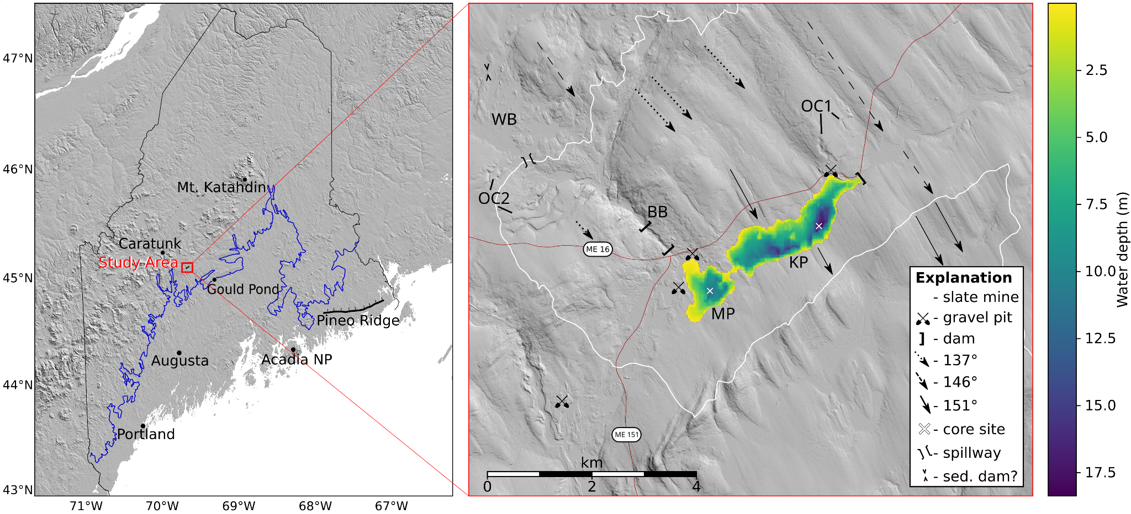
Study location - Kingsbury/Mayfield Ponds (K-M)
Introduction Location Methods Results Discussion Summary
White line = Penobscot-Kennebec watershed boundary
Notes:
With these criteria we ended up here, at Kingsbury Pond in the town of Kingsbury Plantation
As you can see this landscape is complex:
Glacial streamlines
Glacial outwash channels (OC1, OC2)
Gravel pits
Multiple dams
MP = Mayfield
KP = Kingsbury
BB = Bigelow Brook
WB = Whitman Bog
Critically this watershed borders one that presently drains to the Kennebec

Slide 10
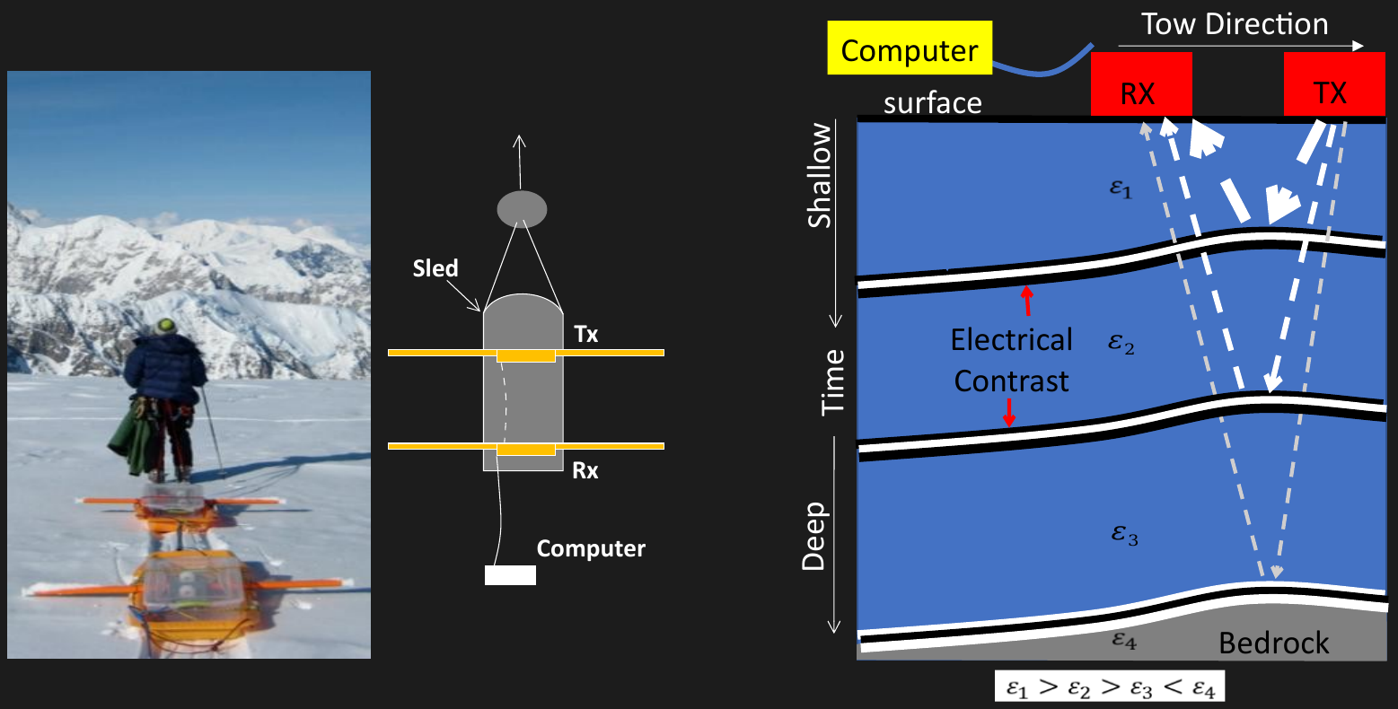
Methods - ground-penetrating radar
Introduction Location Methods Results Discussion Summary

Slide 11
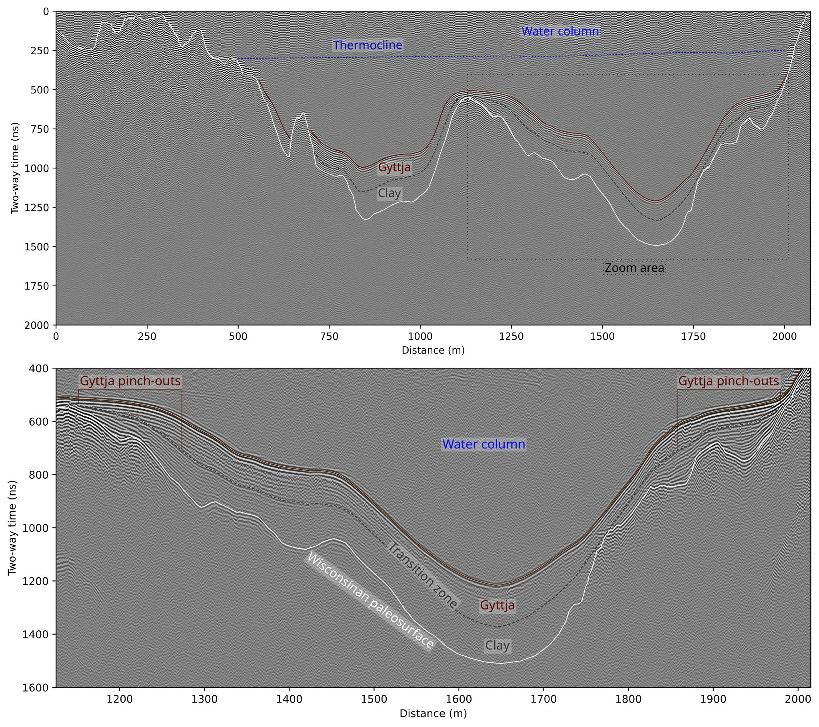
Radar processing & core location selection
Introduction Location Methods Results Discussion Summary
readgssi (Nesbitt et al. 2021) for distance normalization
RADAN 7 for filtering and picking
XYZ of picks to surfaces in QGIS
ε=80, depth=33.5 m
Samples: 2048
Timezero: 233 smp
Distance-normalized
Stacking: 6
BGR window: 75 traces
VT FIR: 75-125 MHz
Gain: 300
Not migrated
Ideal core location
Zoom: 1115m - 2010m
400ns - 1600ns

Slide 12
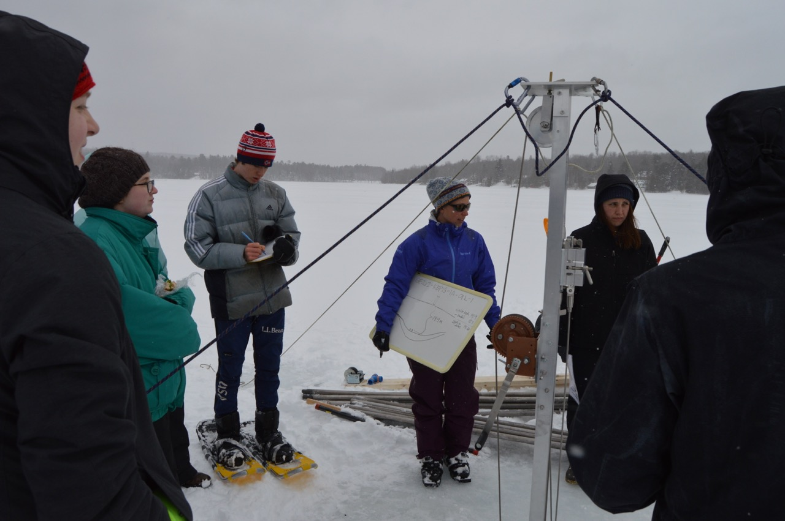
Coring and analysis
Introduction Location Methods Results Discussion Summary
Livingstone (1955) style piston corer (pictured)
Standard core analysis
¹⁴C dates
²¹⁰Pb activity
Matched core features with radar reflections
Notes:
5 cm intervals
Loss on drying
Loss on ignition
Picked for diatoms
Macro organic material sent to DirectAMS for ¹⁴C dates
Top 70cm analyzed for ²¹⁰Pb acrivity

Slide 13
LiDAR
Introduction Location Methods Results Discussion Summary
Key takeaway: complex surface!
MEGIS 2015-2016

Slide 14
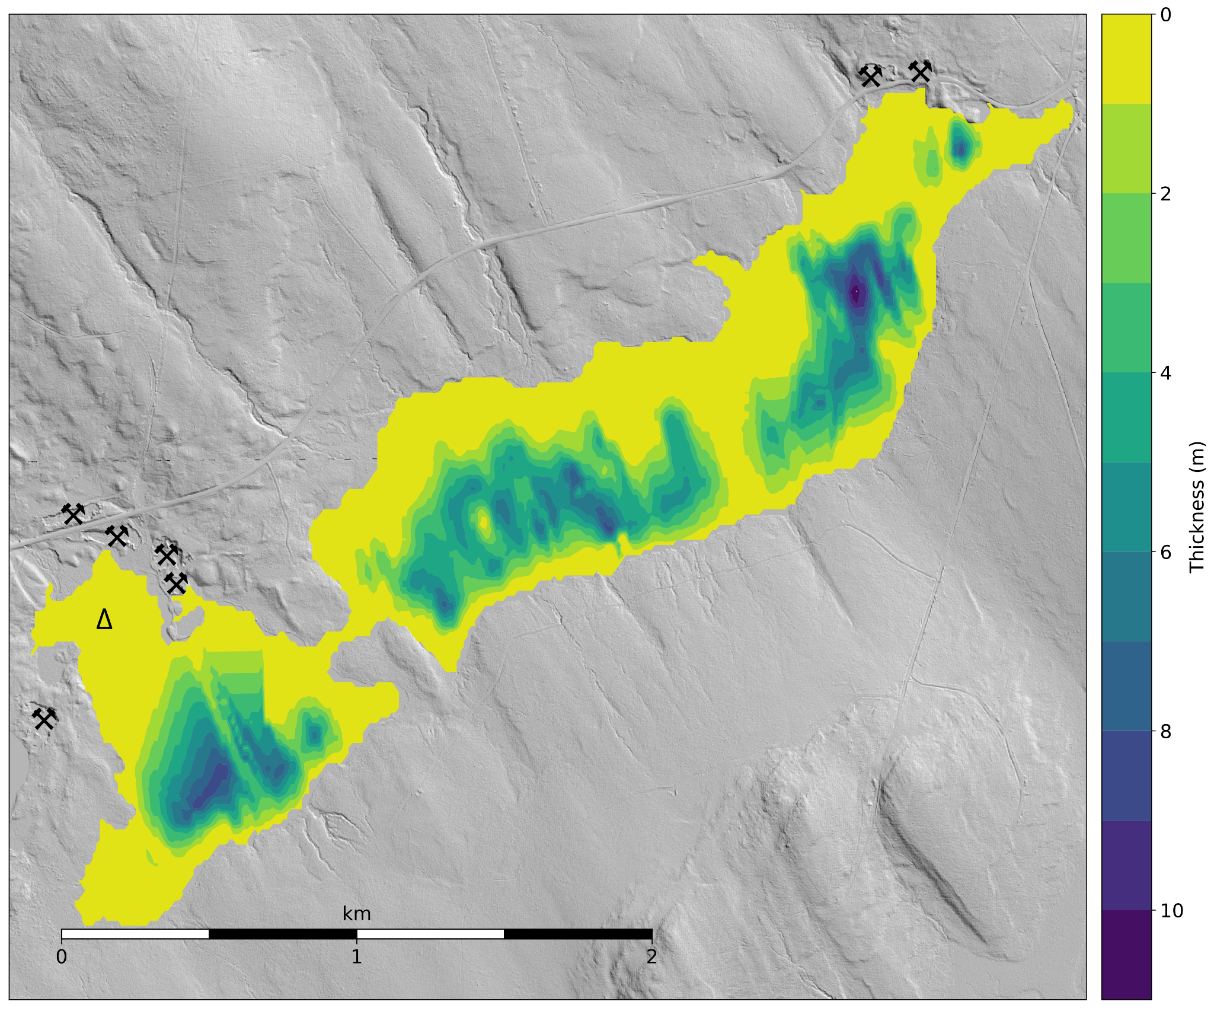
Radar pick analysis
Introduction Location Methods Results Discussion Summary
Key takeaways:
complex surface
+ sediment focusing
= complex sedimentation pattern
Note: Bigelow Brook delta sediments (symbolized as Δ) are too thick to evaluate with radar and are excluded here
Notes:
4.1±0.1 * 10⁶ m³ of clay
2.2±0.1 * 10⁶ m³ of gyttja

Slide 15
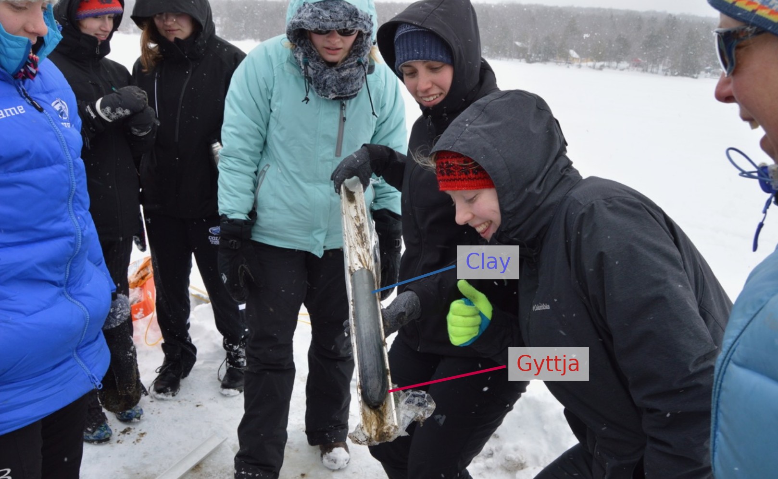
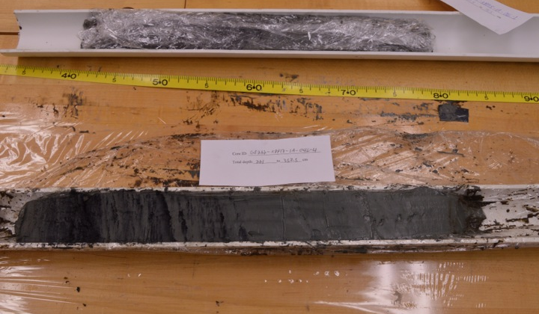
Gyttja-clay transition
Introduction Location Methods Results Discussion Summary
Key takeaway:
Transition zone between gyttja and clay at 2.7-3.1 m

Slide 16
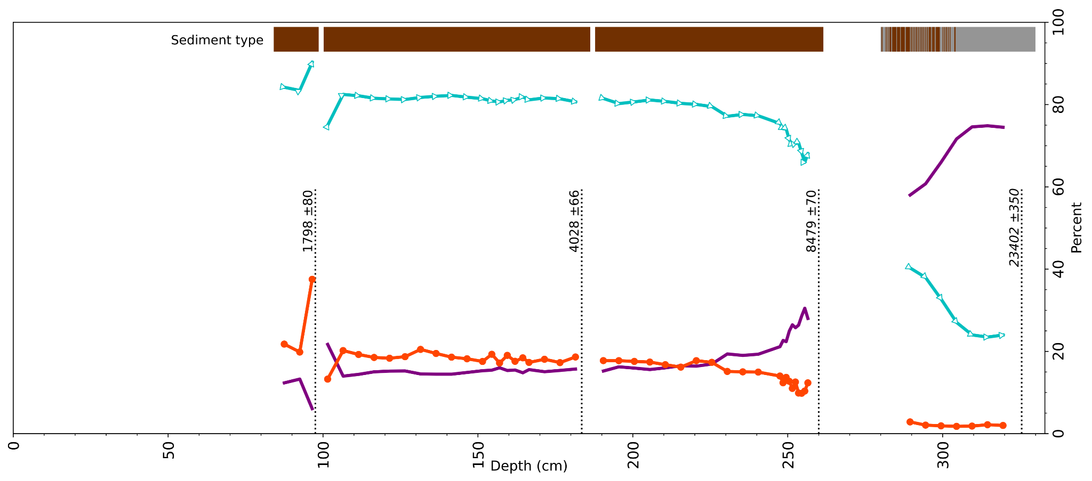
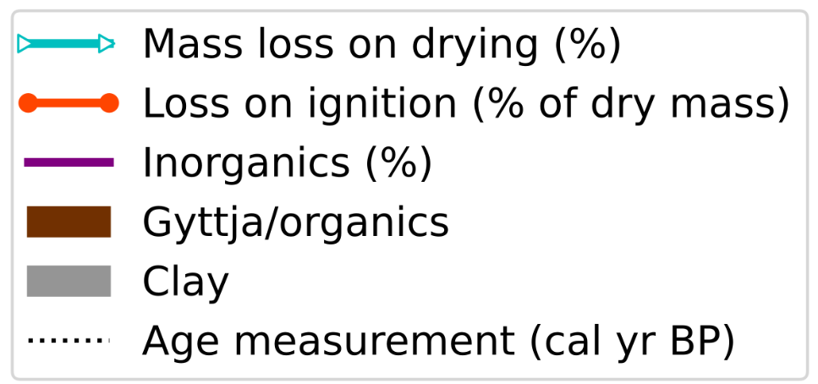
Core results and ¹⁴C
Introduction Location Methods Results Discussion Summary
Key takeaways:
- Major difference in water and organic content between pre- and post-transition
- Transition at around 8500 cal yr BP
Note: oldest date (23402 ±350) is likely from a sample contaminated with old carbon

Slide 17
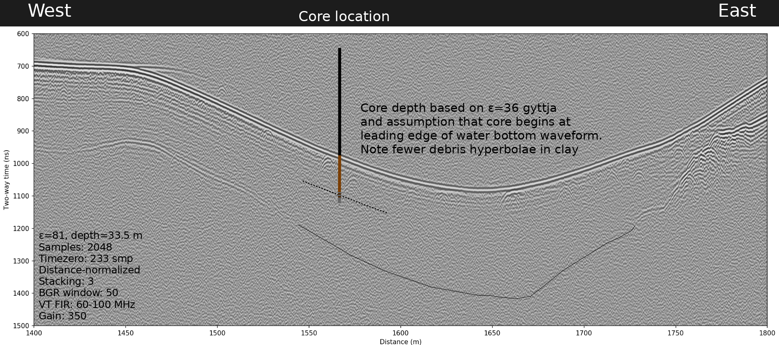
Core-radar comparison
Introduction Location Methods Results Discussion Summary
Key takeaways:
- Core did not reach till surface

Slide 18
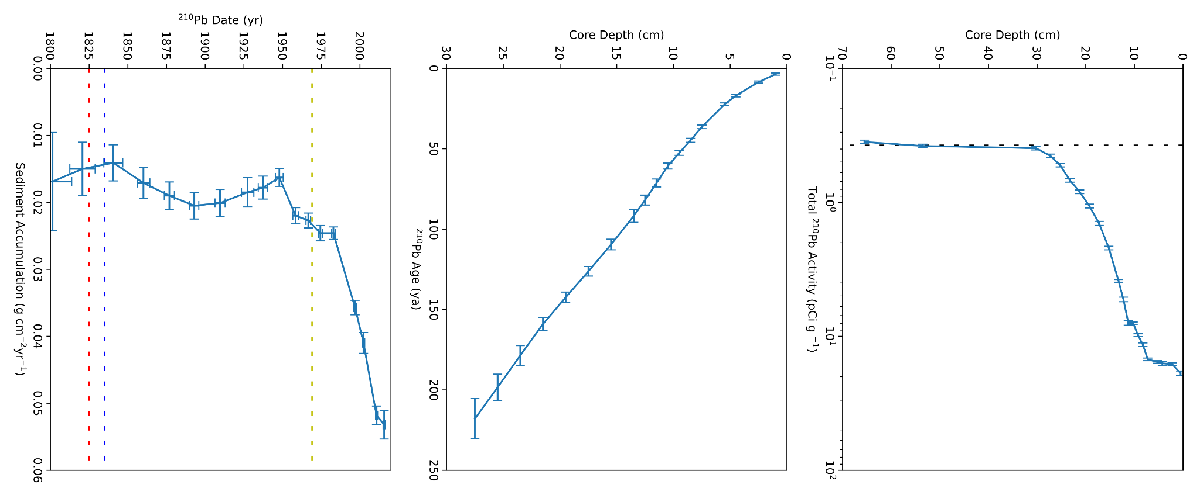
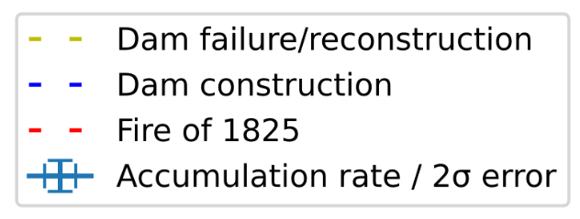

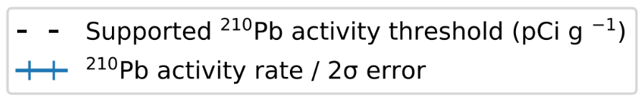
²¹⁰Pb results
Introduction Location Methods Results Discussion Summary
Key takeaways:
- Major increase in sedimentation rate in mid 20th century

Slide 19
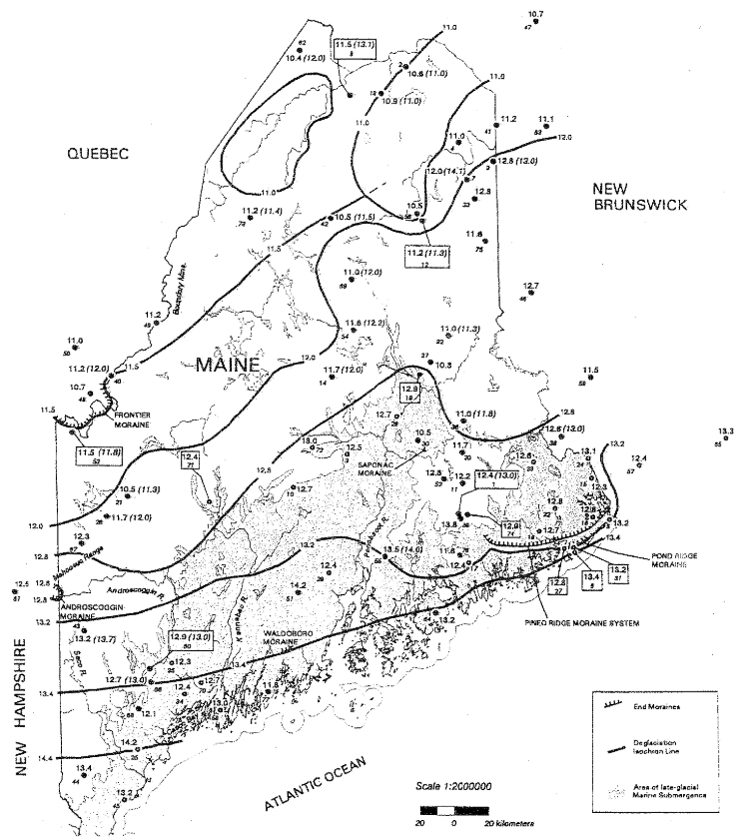
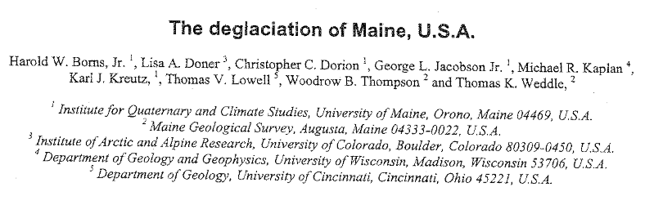
Deglaciation timing
Introduction Location Methods Results Discussion Summary
Deglaciation age is probably between 13.0 and 14.2 cal ka BP
x
X = study location
Notes:
On to addressing one of our problems

Slide 20
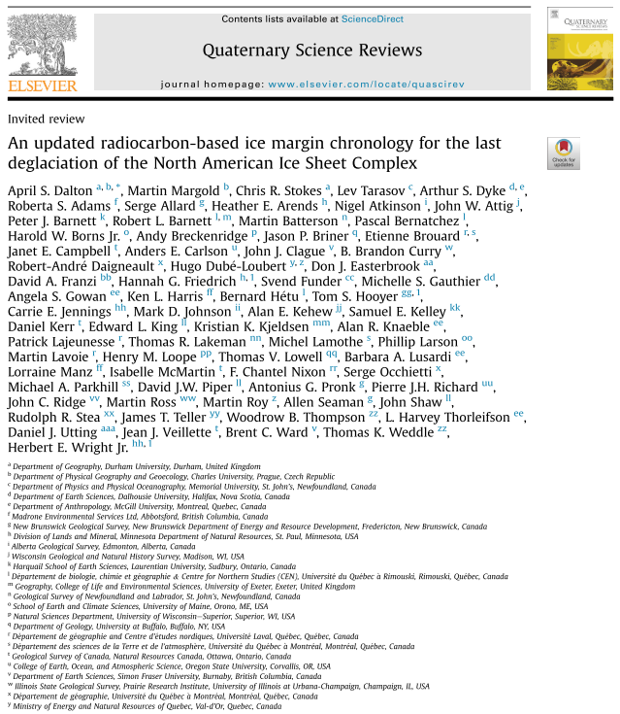
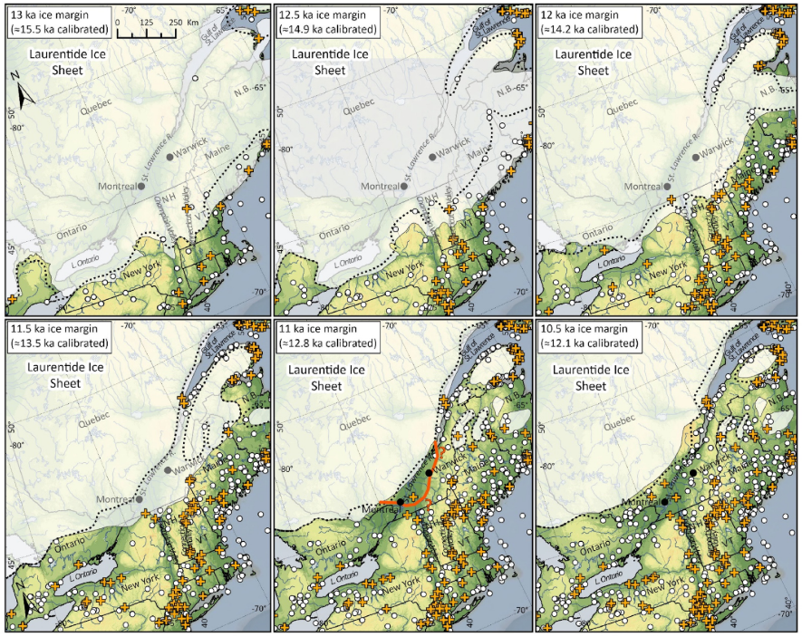
Deglaciation timing
Introduction Location Methods Results Discussion Summary
Deglaciation age is probably between 13.0 and 14.2 cal ka BP
x
x
x
x
X = study location
x
x
x

Slide 21
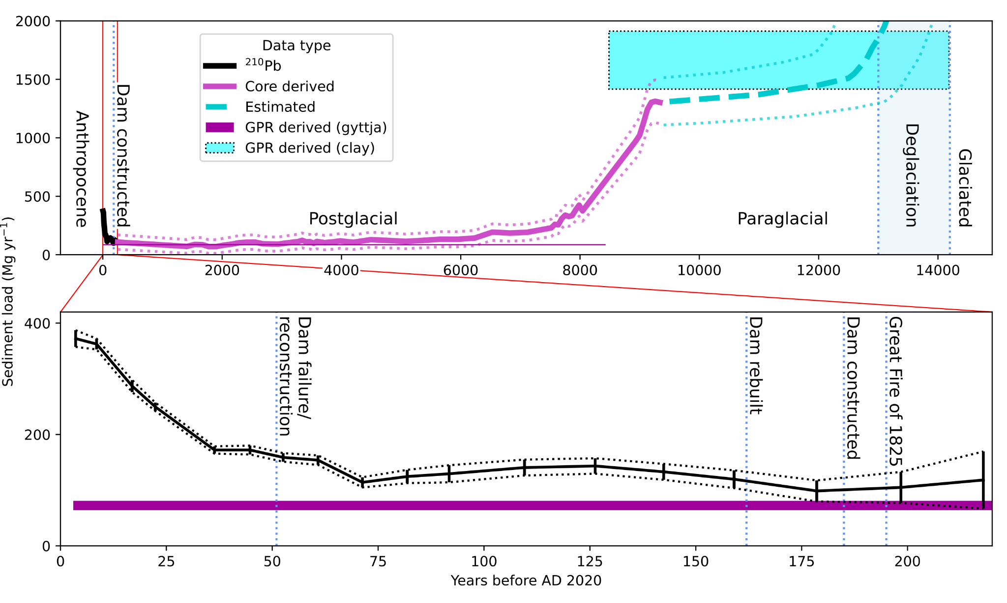
Discussion - sediment delivery continuum
Introduction Location Methods Results Discussion Summary
Key takeaways:
- Sediment mass delivery to K-M decreased by an order of magnitude around 8500 cal yr BP
- Pre-transition sediment mass delivery rate greatly exceeds that of modern
- Modern rates are highest in more than 7000 years
- WEPP sediment delivery estimate for this watershed: 67 Mg/yr (within purple bar)
Note: error ranges are symbolized with dotted lines

Slide 22
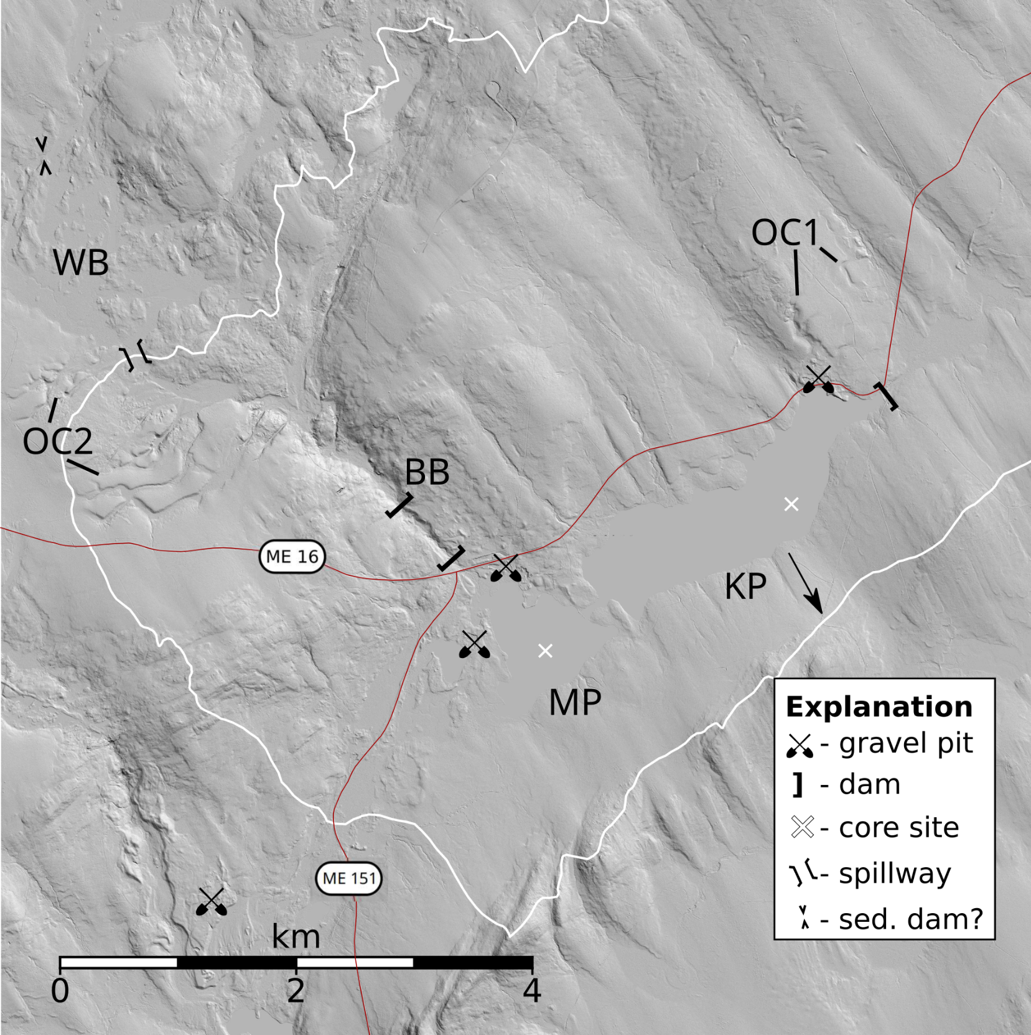
LiDAR analysis
Introduction Location Methods Results Discussion Summary
Key takeaways:
- Outwash channels (OC) exist on both sides of present-day drainage divide (white line)
- Whitman Bog (WB) appears to contain lake deposits
- Apparent spillway from Whitman Bog to Bigelow Brook (BB)
- OC as source of inorganics?

Slide 23
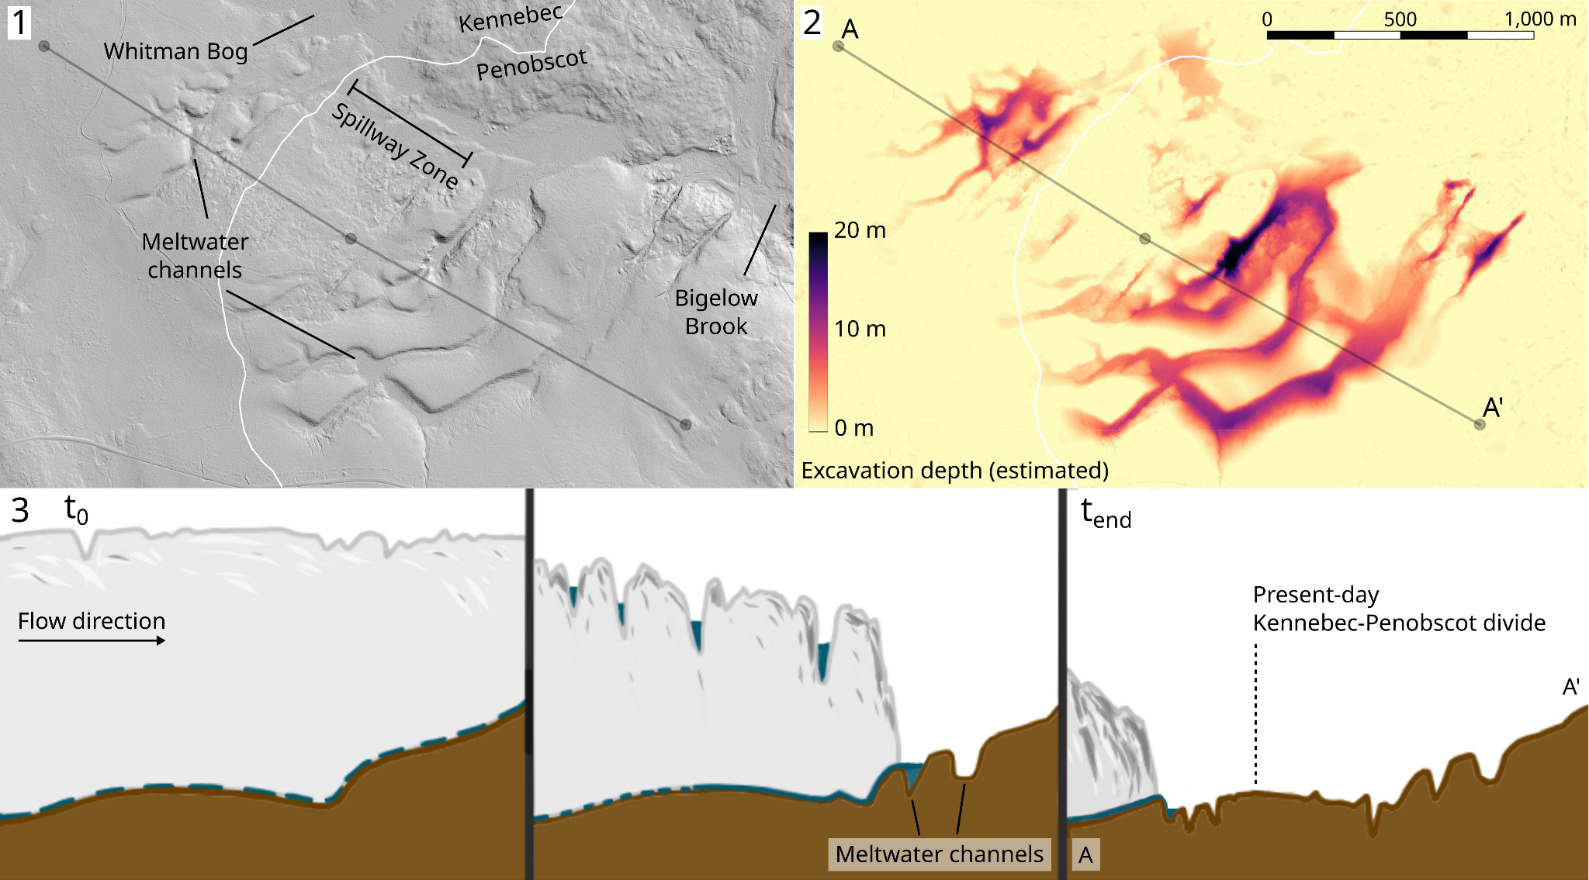
Outwash channels
Introduction Location Methods Results Discussion Summary
Key takeaways:
- Volume of sediment eroded from channels is same order of magnitude as volume of clay in K-M subsurface
- Channel erosion caused by large volume of meltwater from retreating ice sheet (panel 3)

Slide 24
Summary points
Introduction Location Methods Results Discussion Summary
Sedimentation studies can be successful in glaciated regions, but complex!
Sediment focusing makes accurate sediment volume calculation challenging. Radar (or other geophysics) necessary
Continuum curve suggests switch in the K-M sediment dynamics around 8500 cal yr BP
Glacial outwash channels probably major source of sediment in the K-M tributary system, perhaps much of the clay in the subsurface
Modern sedimentation is higher than in past 7000 years, but nowhere near rates seen prior to 8500 cal yr BP

Slide 25
References / questions?
Introduction Location Methods Results Discussion Summary
Arcone, S. A. (2018). Sedimentary architecture beneath lakes subjected to storms: Control by turbidity current bypass and turbidite armouring, interpreted from ground-penetrating radar images. Sedimentology, 65(5), 1413–1446. https://doi.org/10.1111/sed.12429
Borns, H. W., Doner, L. A., Dorion, C. C., Jacobson, G. L., Kaplan, M. R., Kreutz, K. J., Lowell, T. V., Thompson, W. B., & Weddle, T. K. (2004). The deglaciation of Maine, U.S.A. In J. Ehlers & P. L. Gibbard (Eds.), Quaternary Glaciations - Extent and Chronology (Vol. 2, pp. 89–109). Elsevier. https://doi.org/10.1016/S1571-0866(04)80190-8
Dalton, A. S., Margold, M., Stokes, C. R., Tarasov, L., Dyke, A. S., Adams, R. S., Allard, S., Arends, H. E., Atkinson, N., Attig, J. W., Barnett, P. J., Barnett, R. L., Batterson, M., Bernatchez, P., Borns, H. W., Breckenridge, A., Briner, J. P., Brouard, E., Campbell, J. E., … Wright, H. E. (2020). An updated radiocarbon-based ice margin chronology for the last deglaciation of the North American Ice Sheet Complex. Quaternary Science Reviews, 234. https://doi.org/10.1016/j.quascirev.2020.106223
Happ, S. C. (1945). Sedimentation in South Carolina Piedmont valleys. American Journal of Science, 243(3), 113–126. https://doi.org/10.2475/ajs.243.3.113
Jacobson, G. L., & Bradshaw, R. H. W. (1981). The Selection of Sites for Paleovegetational Studies. Quaternary Research, 16(01), 80–96. https://doi.org/10.1016/0033-5894(81)90129-0
Maine Office of Geographic Information Systems. (2016). Maine Elevation DEM 2015, 2016. https://maine.maps.arcgis.com/apps/webappviewer/index.html?id=b40a0b5283244a18907b9dea05769fb7
Nesbitt, I. M., Simon, F.-X., Paulin, T., & Shaw, T. (2018). readgssi: an open-source tool to read and plot GSSI ground-penetrating radar data. Zenodo. https://doi.org/10.5281/zenodo.3261856
Roehl, J. E. (1962). Sediment source areas, and delivery ratios influencing morphological factors. Int. Assoc. Hydro. Sci., 59, 202–213. https://ci.nii.ac.jp/naid/10018179867/en/
Smith, S. M., & Wilcock, P. R. (2015). Upland sediment supply and its relation to watershed sediment delivery in the contemporary mid-Atlantic Piedmont (U.S.A.). Geomorphology, 232, 33–46. https://doi.org/10.1016/j.geomorph.2014.12.036
WEPPcloud, https://wepp.cloud/weppcloud/runs/retired-practicability/disturbed/, accessed September 27, 2021.

Slide 26
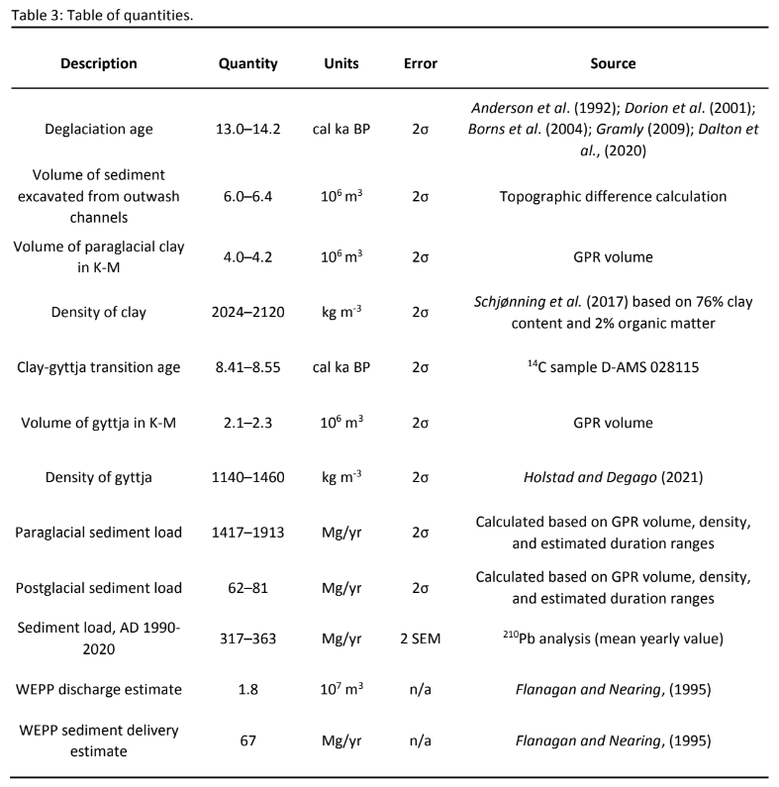
Quantities
Introduction Location Methods Results Discussion Summary
Additional references cited here:
Anderson, R. S., Jacobson, G. L., Davis, R. B., & Struckenrath, R. (1992). Gould Pond, Maine: late-glacial transitions from marine to upland environments. Boreas, 21, 359–371. https://doi.org/10.1111/j.1502-3885.1992.tb00040.x
Dorion, C. C., Balco, G. A., Kaplan, M. R., Kreutz, K. J., Wright, J. D., & Borns Jr., H. W. (2001). Stratigraphy, paleoceanography, chronology, and environment during deglaciation of eastern Maine. In Special Paper 351: Deglacial history and relative sea-level changes, northern New England and adjacent Canada (pp. 215–242). Geological Society of America. https://doi.org/10.1130/0-8137-2351-5.215
Holstad, B., & Degago, S. A. (2021). Strength and deformation characterization of Norwegian organic cohesive soil (gyttja). IOP Conference Series: Earth and Environmental Science, 710(1), 1–11. https://doi.org/10.1088/1755-1315/710/1/012018
Flanagan, D. C., & Nearing, M. A. (1995). USDA-Water Erosion Prediction Project. Hillslope profile and watershed model documentation.

Slide 27
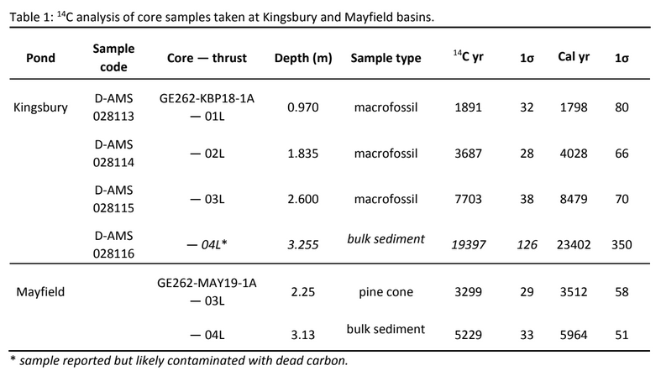
Ages
Introduction Location Methods Results Discussion Summary

