Slide 1


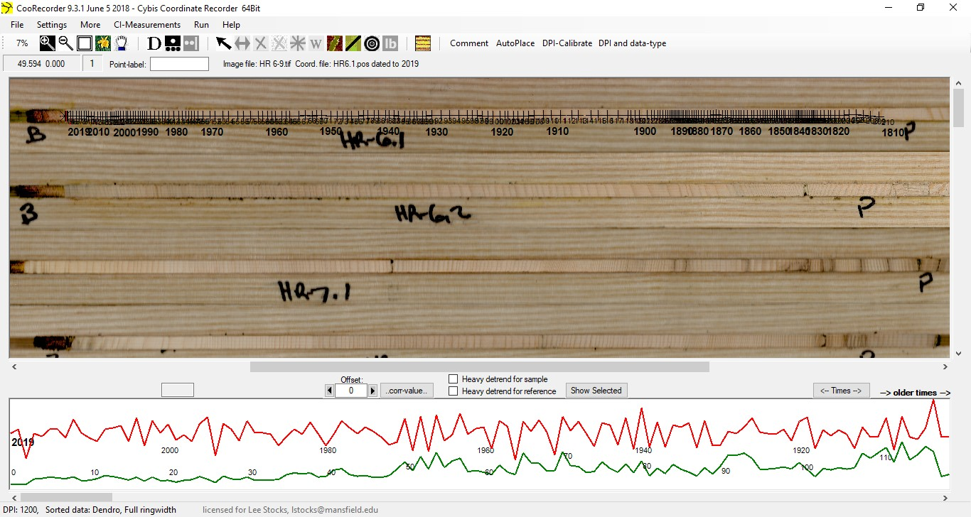
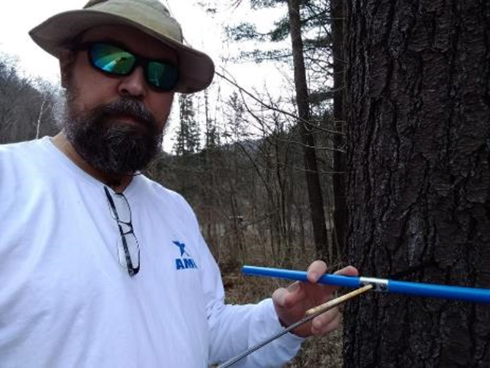
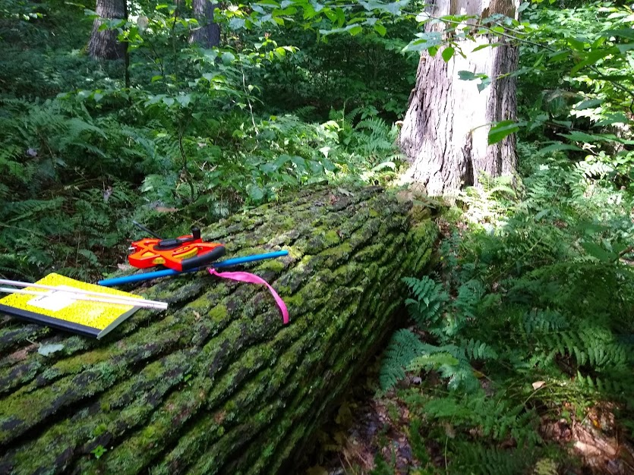
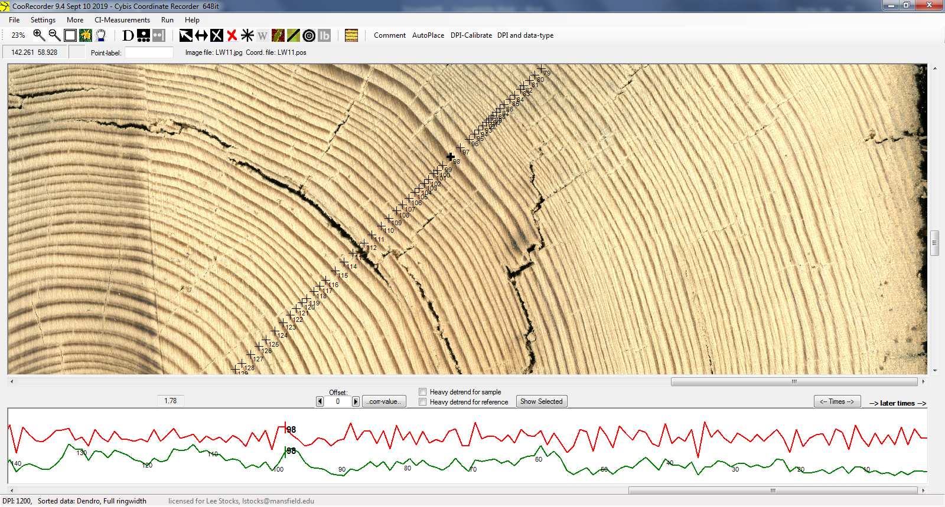
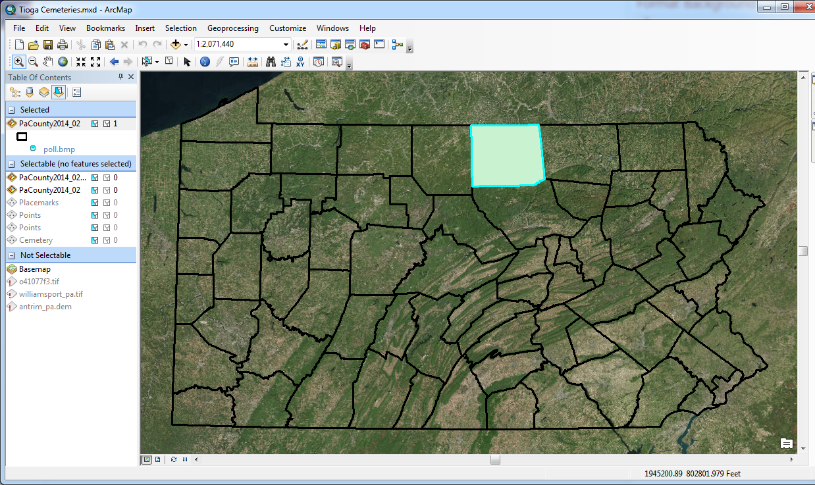
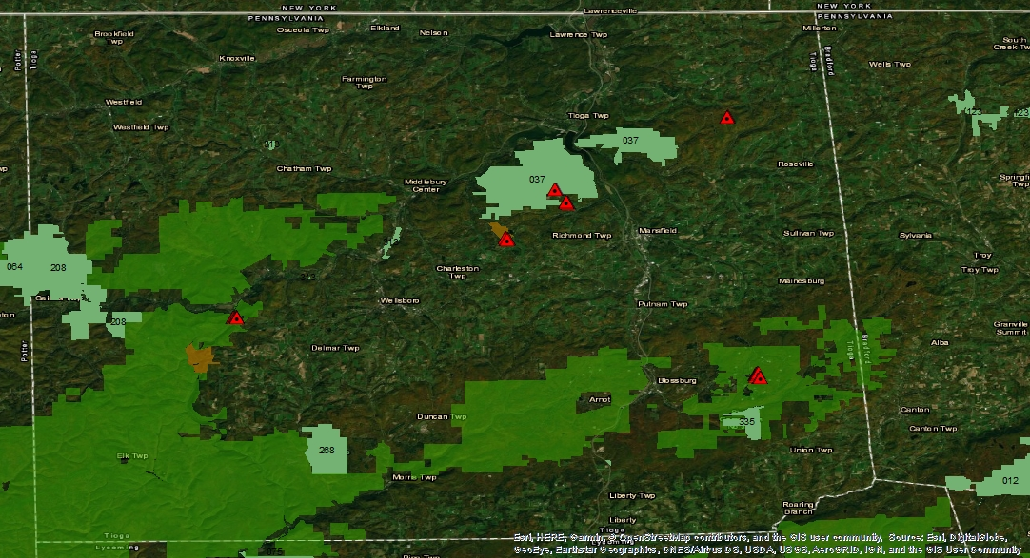
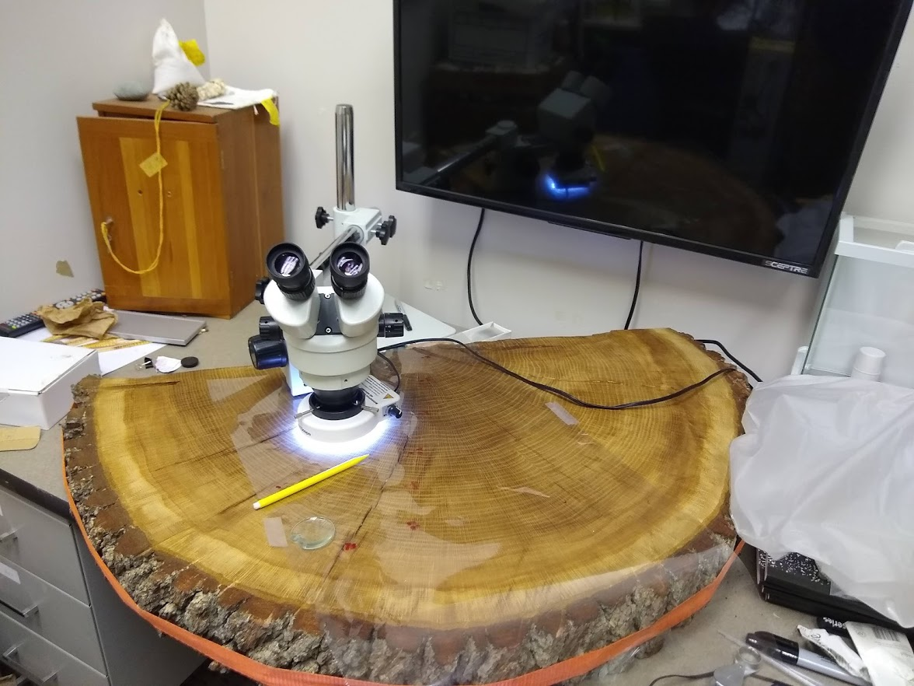
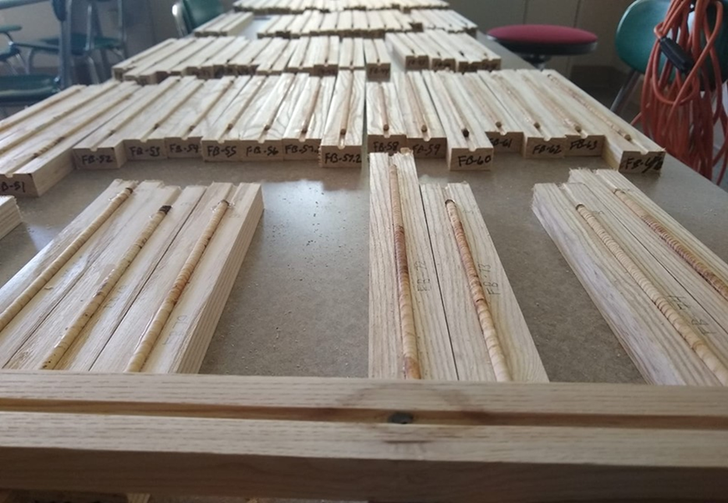
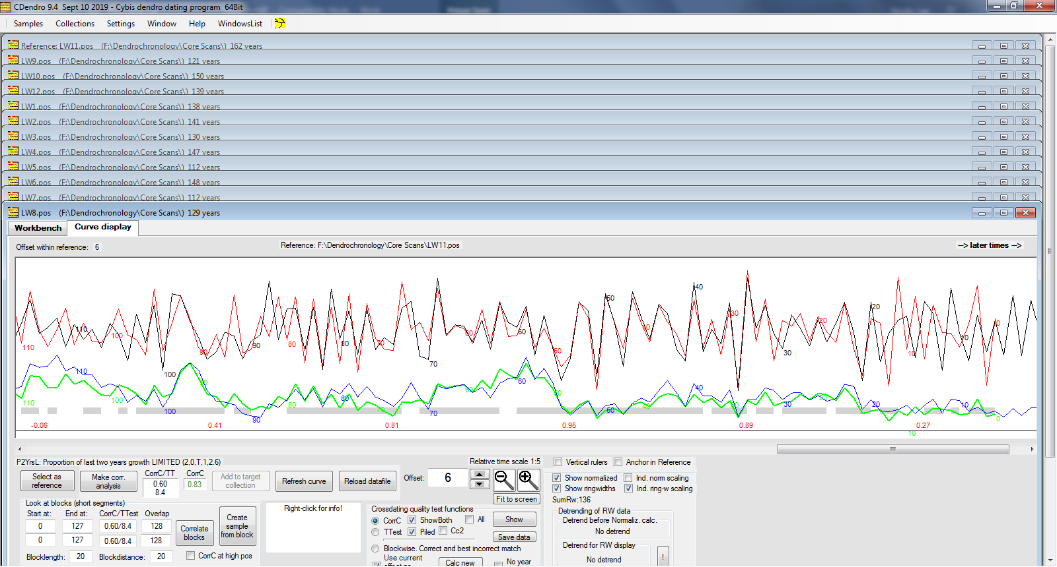
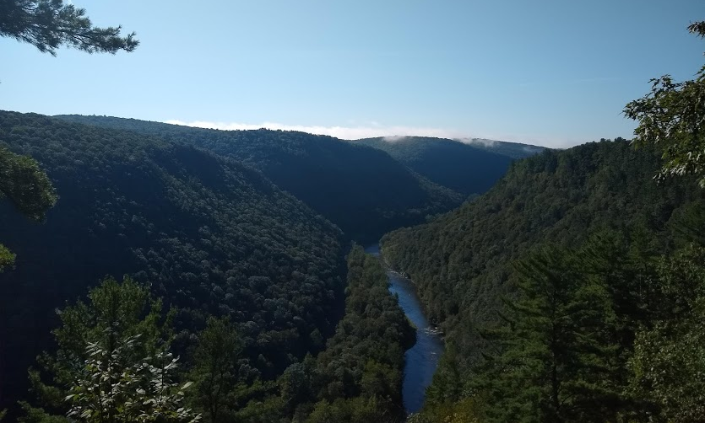
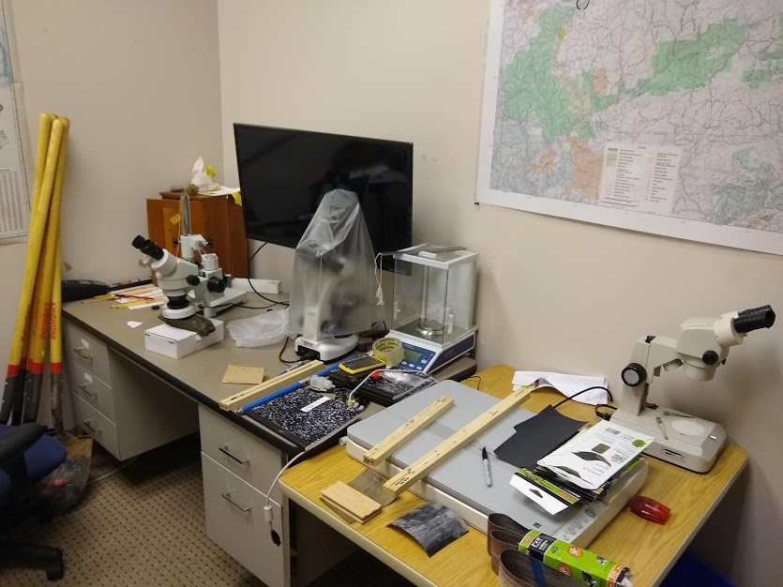
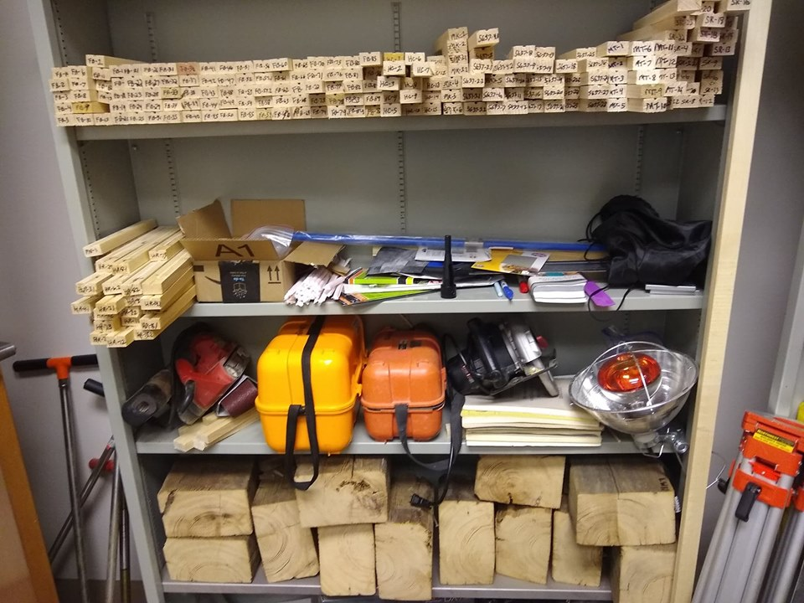
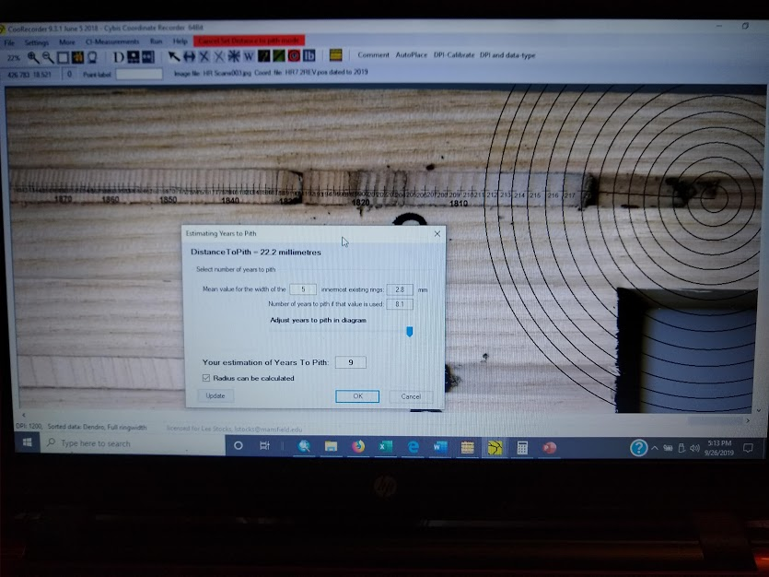
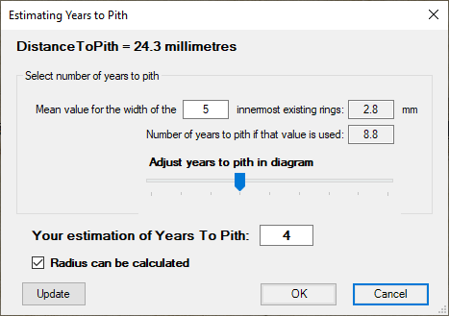
BUILDING A REGIONAL TREE-RING MASTER CHRONOLOGY FOR NORTHCENTRAL PENNSYLVANIA
Dr. Lee Stocks, Jr.
lstocks@mansfield.edu
Department of Natural Sciences, Mansfield University
ABSTRACT
METHODS
COORECORDER AND CDENDRO
Dendrochronology, or tree-ring dating, is a scientific method of matching the pattern of annual tree growth in a sequence of overlapping core samples from various wood sources, to pinpoint ages and analyze regional climate and environmental conditions. Beginning with live tree cores and finding progressively older samples, lengthy chronologies can be compiled. These chronologies allow cross-dating between specimens in a particular region and can extend backwards for thousands of years. This method, initially developed by astronomer A.E. Douglass in the 1920’s, is currently used by many archaeologists, climatologists, and environmental scientists in the temperate forest zones of the world, where trees are responsive to annual variations in climate.
This research addresses the lack of an existing chronology in north-central Pennsylvania, and aims to collect, analyze, and cross-date tree-ring samples within Tioga County to produce a master database for various research applications including climate change, ecological studies, geomorphic applications, and measuring pollution. Research agreements with the Department of Conservation and Natural Resources (DCNR) and State Game Commission (SGC) provide 184,207 acres for sampling. Eastern Hemlocks (Tsuga canadensis) were chosen as they are native to this region of Pennsylvania and they have high potential for matching rings, with a Cross-Dating Index (CDI) rating of two (2). Likewise, the spread of the invasive wooly adelgid and the decline of the eastern hemlock throughout Appalachia provides further rationale. All samples are collected and analyzed according to standard dendrochronological field methods to ensure reliability of samples.
To sample tree rings with minimal damage, an increment borer is used (Figure 4) to extract a small 5.15mm section of core. The borer’s drill bit is placed against a tree and the handle is turned clockwise to extract a sample core. Sample cores were limited to two species: Tsuga canadensis (Eastern Hemlock) and Pinus strobus (Eastern White Pine), as these species provide the best reflection of the tree growth (Grissino-Mayer, 1993) and ring variability preservation. Samples were extracted from both live and dead species including recently downed trees (Figure 5) and older dead trees, which can provide a nice cross-section (Figure 6). After the tree core sample is extracted it is handled and transported according to standard dendrochronological methods (Phipps, 1985). All samples are dried and glued into custom grooved blocks (Figure 7) for preparation. The core is then taken to the workstation (Figure 8) and sanded with progressively finer grits to enhance the ring structure. The sample is then labeled and stored in a dry environment for post-analysis (Figure 9). All samples are scanned on a large format Epsom Expression 10000XL at 2400DPI and saved as TIFF files for post-analysis.
CooRecorder is a program used for registration of coordinates taken from images (in our case cores and cross-sections). Accurate locations are assigned to each ring allowing precise measurement of widths (Figure 10). All core and cross-section sample TIFF images are imported and used to create coordinate registries. This numbers each ring, which can then be crossdated with rings from samples with known ages and produce a ring width curve (Figure 11). Crossdating is a procedure where absolute dates are assigned to each tree ring and then compared to create a master chronology. Cdendro software helps you crossdate wood samples towards each other based on ring variability and widths (Figure 12). It can provide robust statistical comparison on par with the field standard COFEECHA package. Estimate to pith is made when not reached with core sample (Figure 13).
Figure 10: CooRecorder Registering Ring Locations on Core Sample
Figure 4: Using Increment Borer to Extract Core Sample
Figure 5: Core Samples from Downed Logs
Figure 1: Tioga County, PA
Figure 11: CooRecorder Measuring Ring Widths on Cross-Section Sample with Ring-Width Curve
Figure 2: Tioga State Forest, PA with Sampling Sites
Figure 6: Cross-Referencing with Tree Cookie Cross-Sections
Figure 7: Mounted Tree Core Samples
Figure 12: Cross-Dating Sample to Master Chronology
Figure 3: Darling Run and Pine Creek, Ansonia, PA
FUTURE WORK
INTRODUCTION
Figure 8: Mansfield University Dendrochronology Workstation
Figure 9: Core and Cross-Section Storage
With no existing local master chronologies available within the north-central area of Pennsylvania, this research will compile samples to produce a master chronology. Future work will involve analysis of core and production of data and imagery for use in multiple disciplines. Resulting dataset will be uploaded to International Tree Ring Database (IRTB) for inclusion. It is intended this dataset can be used for research in climate, soils, geomorphology, and forest structure and dynamics.
Tioga County (Figure 1) is located in the north central mountains of Pennsylvania. Situated within this rural area is the Tioga State Forest (Figure 2), which has a varied topography and climate, allowing more than 134 native tree species to thrive and prosper. Since tree rings develop the same within all trees sharing the same climate in a region, an accurate signal is preserved in the width variations. After years of large amounts of precipitation tree rings grow wider, representing more growth. Whereas drought years reflect narrower rings, meaning less growth. We can identify these patterns and compare to plots in distant locations. By counting the rings and measuring the width of each year, we can determine the age of the tree and how much it grew each given year. Tree cores and cross-section samples are collected from various sites throughout the study area (Figure 3), to examine climate and growth dynamics.
REFERENCES
Grissino-Mayer, H. 1993. An Updated List of Species Used in Tree-Ring Research. Tree-Ring Bulletin. Vol53, pp. 17-43.
Phipps, R. 1985. Collecting, Preparing, Crossdating, and Measuring Tree Increment Cores. U.S. Geological Survey Water Resources Investigations Report 85-4148.
Figure 13: Estimating Years to Pith on Slabbed Core Mount

