Slide 1




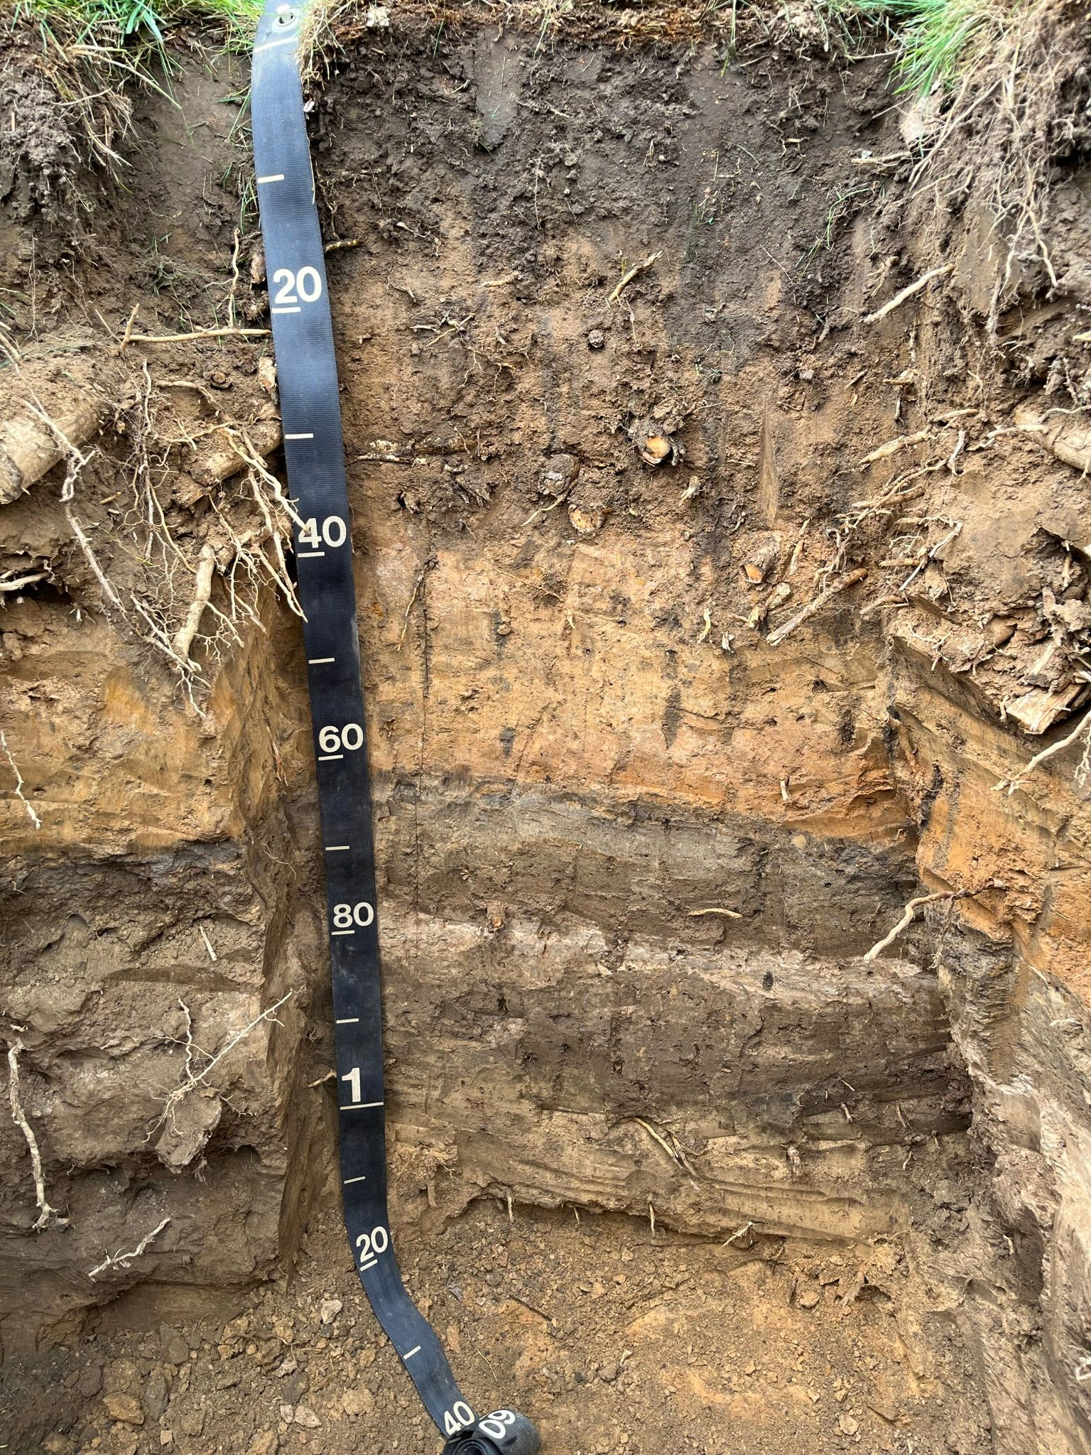
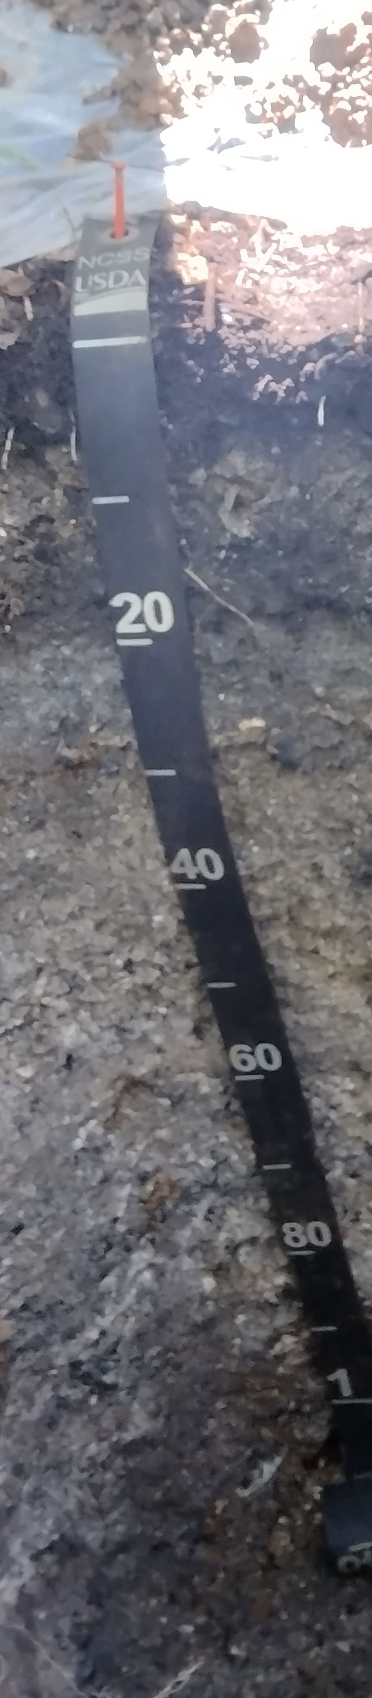
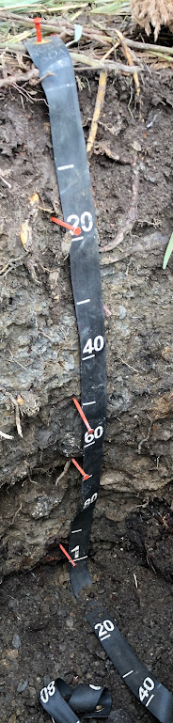
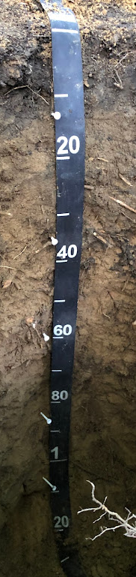
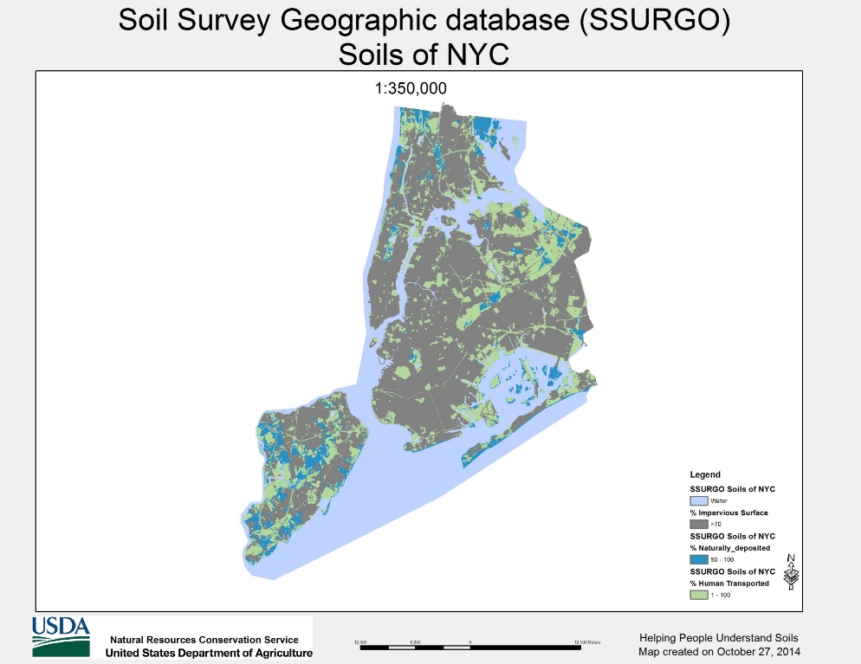
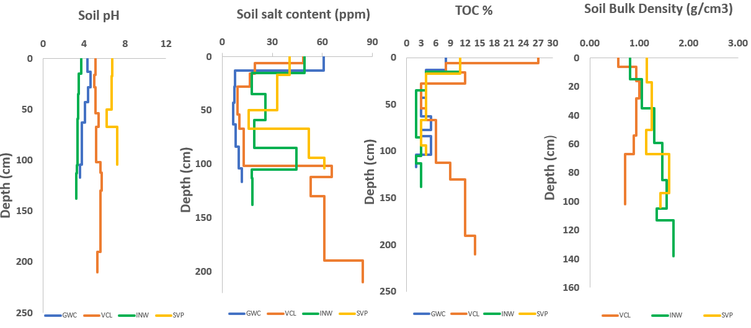
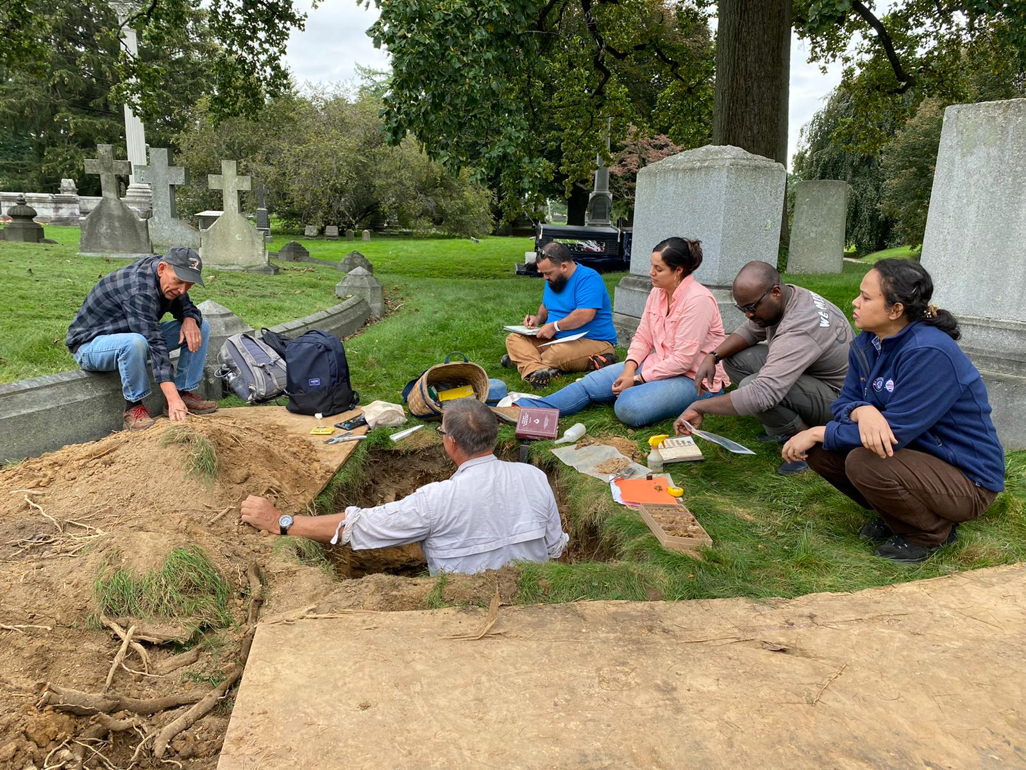
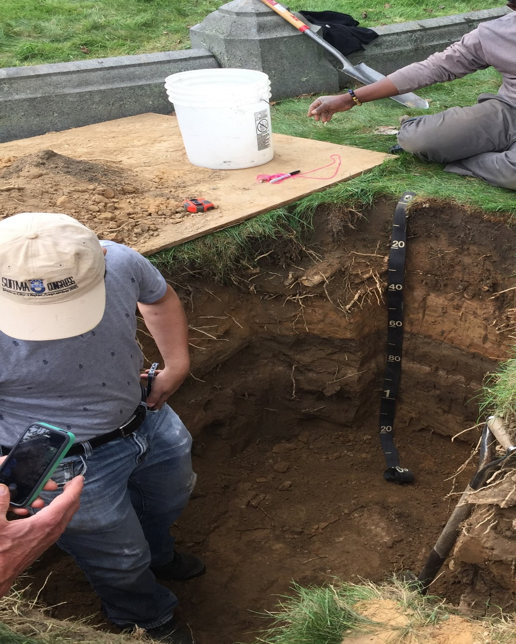
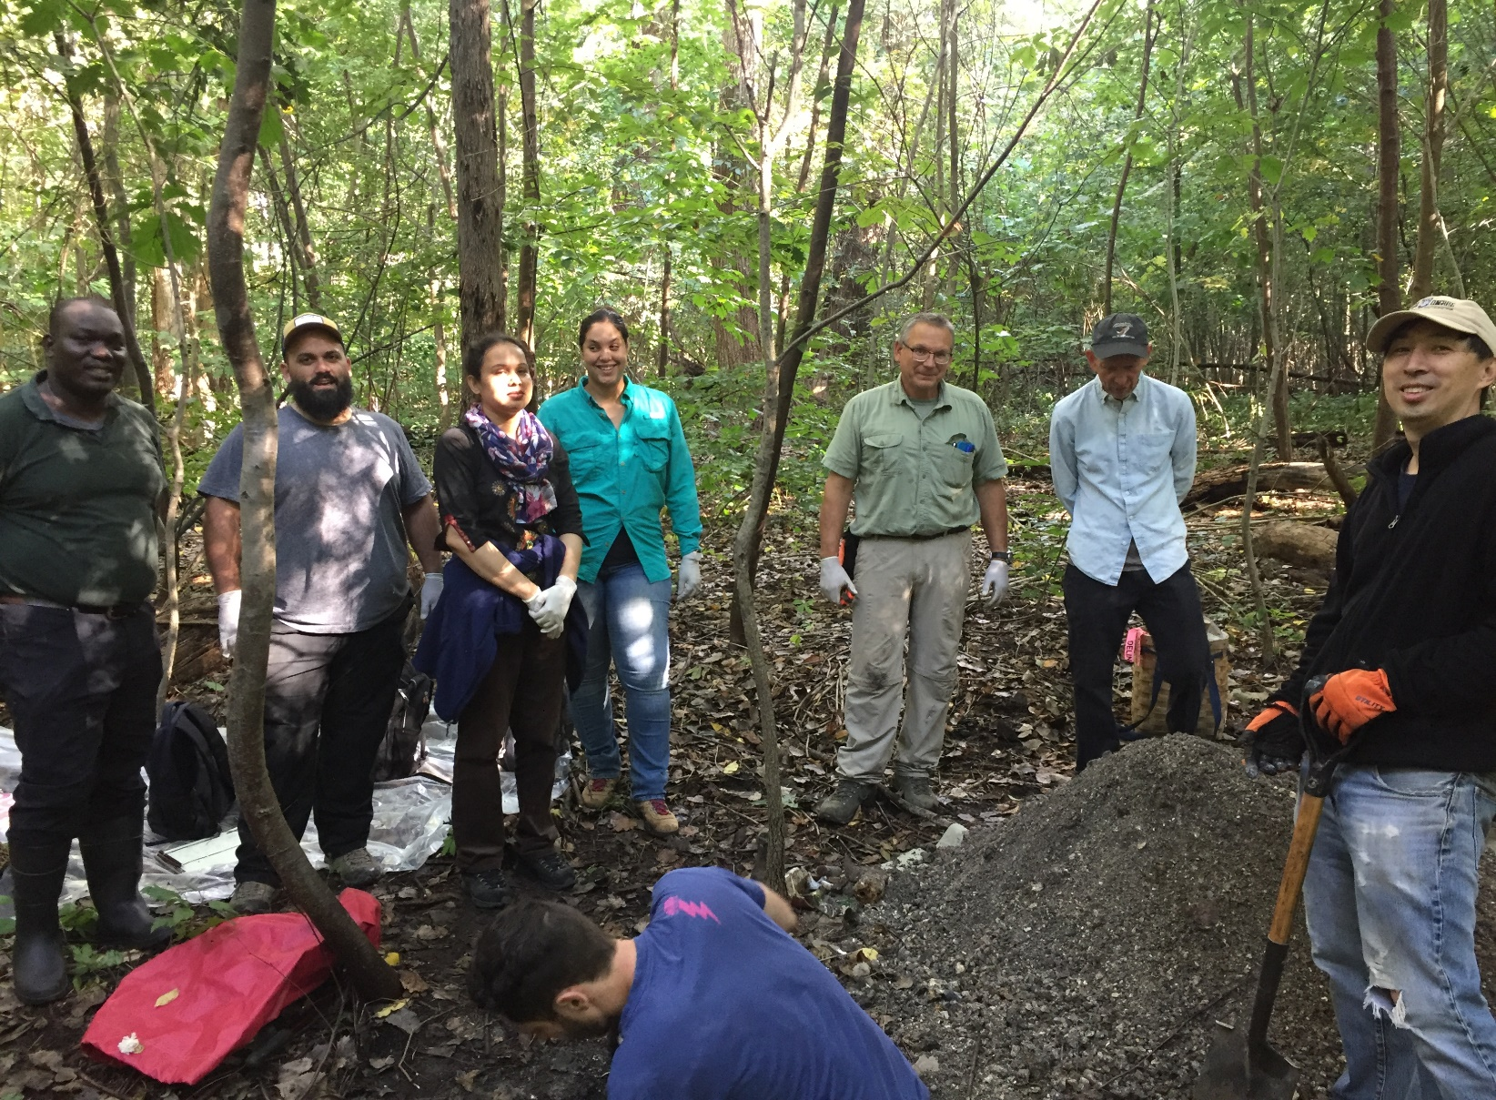
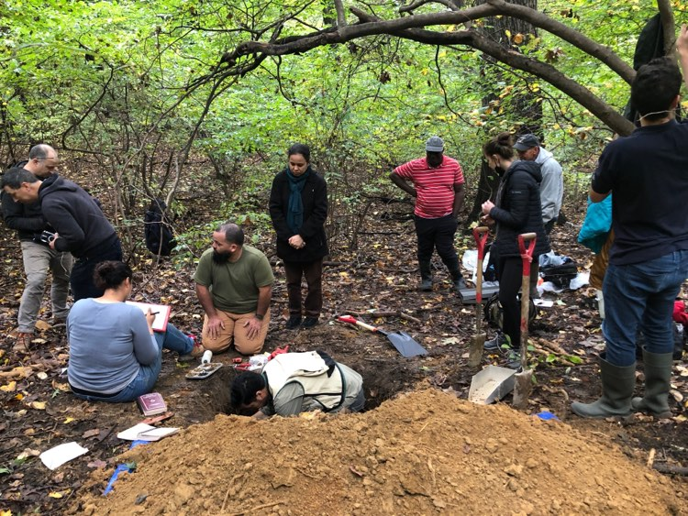
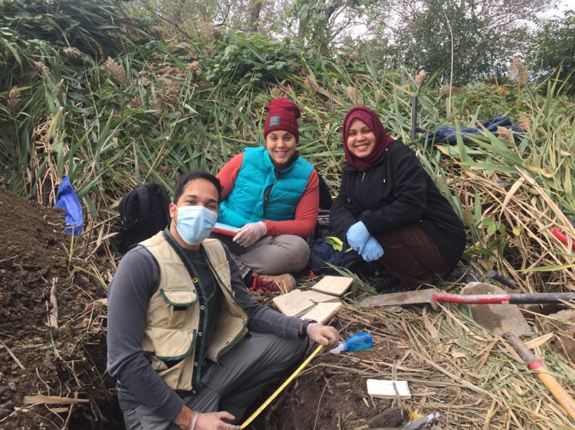
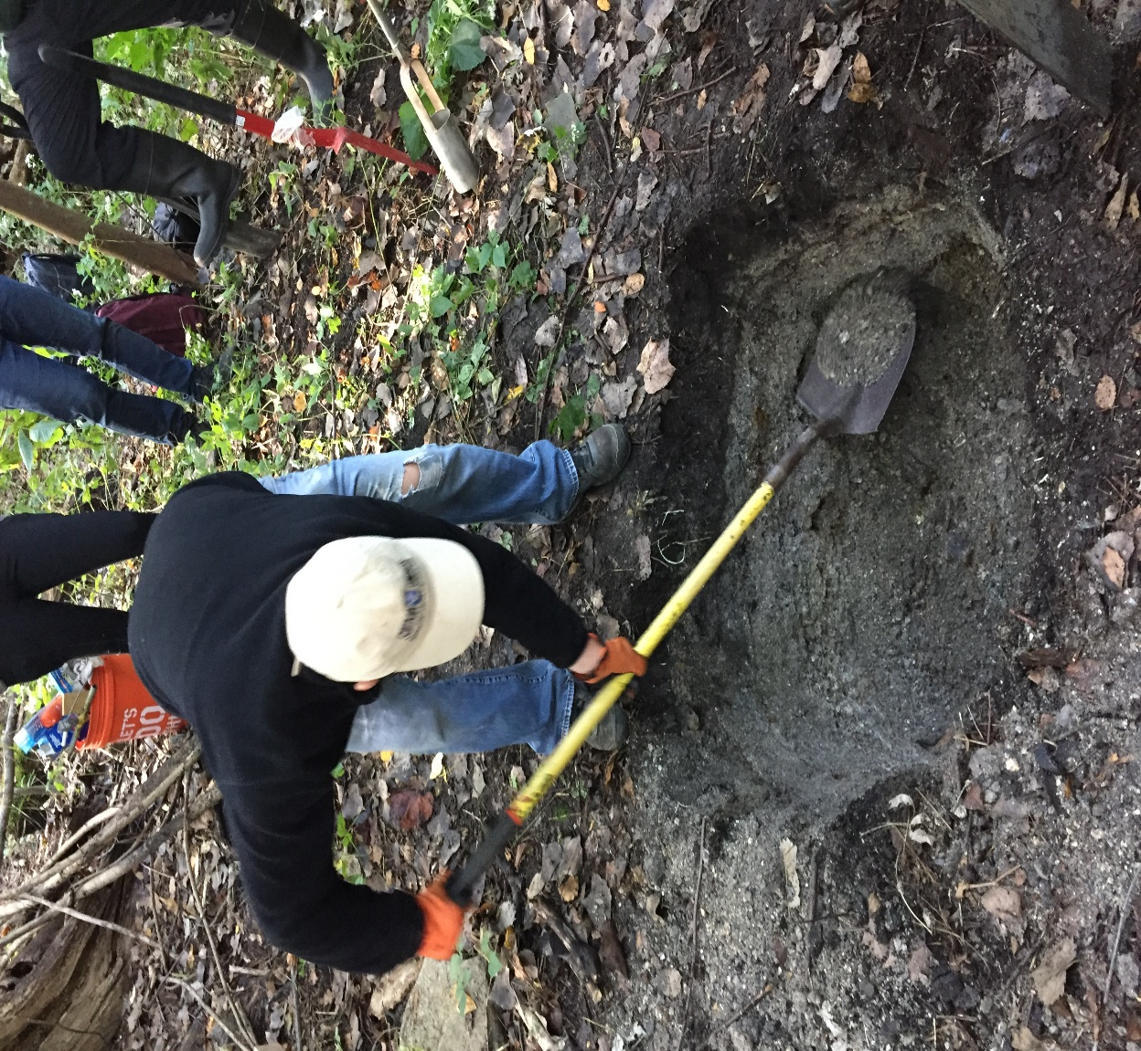
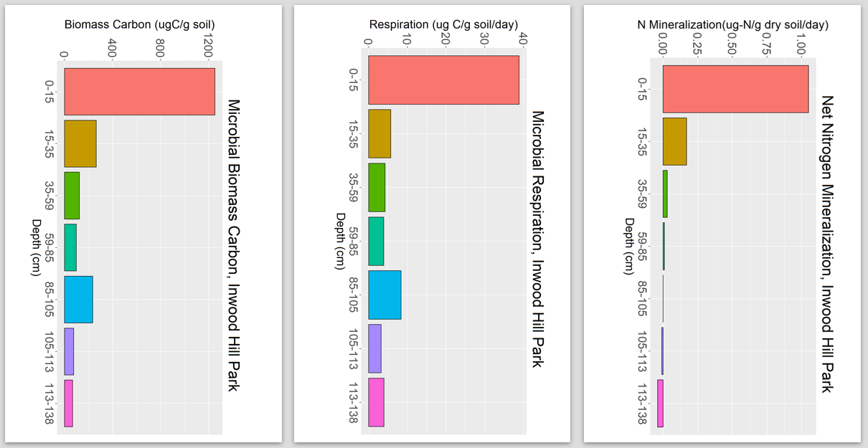
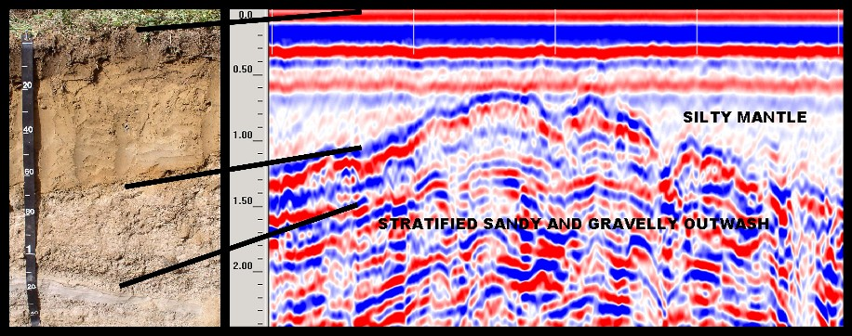
Development of Soil Survey Methods for Urban Areas
BEGUM, Kohinoor^{1,2}, CHENG, Zhongqi², MUTH, Theodore³, GROFFMAN, Peter², GIMENEZ,Daniel⁴, HIRMAS, Daniel⁵, VEGA PIZARRO, Geraldine⁶, VEGA, Milton⁶, VELAZQUEZ, Joxelle⁷, VARGAS, Olga⁸, PARIZEK, Donald⁶ and SHAW, Richard K.² (1) Earth and Environmental Sciences, The CUNY Graduate Center, New York, NY 10016, (2) Department of Earth and Environmental Science, Brooklyn College, 2900 Bedford Avenue, Brooklyn, NY 11210, (3) Department of Biology, Brooklyn College, City University of New York, Brooklyn, NY 11210; Molecular, Cellular and Departmental Biology Program, The CUNY Graduate Center, New York, NY 10016, (4) Department of Environmental Sciences, Rutgers School of Environmental and Biological Sciences, New Brunswick, NJ 08901-8551, (5) Environmental Sciences, University of California Riverside, Riverside, CA 92521, (6) USDA-Natural Resources Conservation Service, Northeast Region, 344 Merrow Road, Suite A, Tolland, CT 06084 – 3917, (7) USDA-Natural Resources Conservation Service, Jackson, MS 39269, (8) USDA-Natural Resources Conservation Service, New York.
Abstract
Study Area
Preliminary Results
Urban soils are the foundation of urban ecosystems and play a vital role in long-term urban sustainability and resiliency. Accurate soil surveys of urban areas should be done at high resolution since extensive human activities often result in urban soils being highly disturbed, and spatially variable. Besides heterogeneity, one of the unique and challenging aspects of urban soil is its nature and properties of organic carbon with a significant percentage of black carbon (a particulate product of incomplete combustion), which is less biologically active. Thus, in order to determine the ability of a soil to support biological activity and supply nutrients for plant growth, the properties of organic carbon need to be assessed. Conventional USDA-Natural Resources Conservation Service (NRCS) methods take considerable time for full characterization of collected soil samples. This limitation could be overcome by geophysical tools such as, ground penetrating radar (GPR) and electromagnetic induction (EMI), which can image large areas in a relatively short time without excavating the soils. These tools can map subsurface features and predetermine the degree of heterogeneity, which can provide useful information for representative site selection. How well these geophysical data correlate with site characteristics, however, has not yet been well established. In this project approximately 14 soil series covering a wide range of soil conditions will be investigated across New York City. From 4 sites, bulk density samples and bulk samples were already collected for laboratory determination of total C/N, black carbon, readily labile C and N, TOC, pH and soluble salts, plant available nutrients, microbial communities, and artifacts using standard protocols in the NRCS Field and Lab Analysis. In addition, GPR and EMI will be used to identify vertical differences in texture, consistence, artifact content, thickness of layers, and depth to the water table or restrictive horizons at each site. The results will be compared with conventional methods to evaluate the feasibility of these new methods to complement traditional approaches. Our findings and the soil survey methods developed will help soil practitioners and decision-makers in protecting, conserving, and managing urban soils for an ever-expanding world population.
This research conducts both field and lab soil characterization in 14 different sites throughout the NYC that represents a wide range of land uses patterns and soil types. Types of soils in NYC and their percentage represented in the map and table below.
Soil Type* % of land area
Sealed soils 62.6
Clean fill 16.4
Artifactual fill 6.0
Dredge fill 2.9
Brown till 2.6
Red till 2.2
Tidal marsh 2.0
Landfill 1.6
Outwash 1.5
Sand dunes 0.3
Coal ash 0.1
Serpentine till 0.1
Figure 5. Soil profiles at four studied sites. From left to right: Greenwood Cemetery (Brooklyn), Van Courtland Park (Bronx), Inwood Hill Park (Manhattan), and Soundview Park (Bronx)
Figure 3. NYC Soils. Gray = sealed soils (impervious surface), Green = soils in human-transported materials, Blue = native soils
Table 1: Soil types and percent land areas in NYC
* Each type (or parent material group) includes one or more soil series (mapping components)
Methods
Both field and lab soil characterization will be conducted, using a range of techniques. The 14 different soil series/sites cover a wide range of land uses and soil characteristics mapped in previous urban soil surveys in NYC. At each site, we will conduct GPR and EMI surveys, in addition to full soil profile characterizations.
Between 200-250 soil core samples and about 500 g of disturbed soil will be collected for measuring hydraulic and structural properties in the soils laboratory at Rutgers. Four intact soil thick sections (45 cm long and 30 cm wide each) from each site will be carefully excavated, constructed and shipped to UC Riverside for scanning to quantify soil structural parameters and determine the distribution of SOC, black carbon, and particulate artifacts. An estimated 56 thick soil sections (4 per site) will be examined. In addition, soil monoliths that span the length of each entire profile will be sampled and prepared for educational use.
At each site, from each horizon bulk samples will be taken for laboratory analysis. The list of parameters to be analyzed includes total C/N, black carbon, readily labile C/N, cation exchange capacity, total organic content, pH and salt, plant available nutrients, microbial activities, microbial community, artifacts, water retention curves, infiltration rate. Standard protocols in the NRCS Field and Lab Analysis manual will be used if available.
Figure 1. Soil survey in the Greenwood Cemetery (GWC), Brooklyn (left and middle) and Van Cortlandt Park (VCL), Bronx (right). Both soil series contains human-altered and human-transported (HAHT) materials.
Figure 6. Soil properties include total organic matter content (TOC), pH, soluble salts, bulk density of sample collected from Greenwood Cemetery (GWC) Greenbelt series, Van Cortlandt Park (VCL) Mosholu series, Sound View Park (SVP) LaGuardia series are formed in human-altered and human-transported materials (HAHT), and Inwood Hill Park (INW) Charlton series formed in naturally deposited materials (ND).
Figure 2. Soil sampling at the Inwood Hill Park (INW), Manhattan (left), Soundview Park (SVP), Bronx (middle), and Van Cortlandt Park (VCL), Bronx (right).
Objectives
Develop soil survey protocols for urban areas that take into consideration the special characteristics of urban soils: their high heterogeneity, the presence of artifacts, the presence of contaminants, and diverse land uses.
Develop relationships between soil survey parameters and the unique properties and functions of urban soils—that is, nitrogen supplying power, denitrification, microbial community composition, black carbon, presence of artifacts, and hydrophobicity.
Assess the potential of selected tools to assist in characterizing soils in urban areas (i.e., GPR, XRF, EMI, MLT, and HSI) with a particular focus on non-invasive methods and proxies that can add new information during soil survey efforts while saving cost and time.
Validate new methods for the measurements of black carbon, hydrophobicity, microbial activity (Solvita test respiration).
Figure 7. Microbial Biomass C, Respiration, Potential Net N Mineralization in Inwood Hill Park, (Brown till parent material, naturally deposited soil), Charlton series.
The authors want to thank Labib Samari for assistance in the field work; Kaitlin McLaughlin and Clare Kohler for help in lab analysis at Brooklyn College and the Advanced Science Research Center of CUNY.
USDA IS AN EQUAL OPPORTUNITY PROVIDER, EMPLOYER AND LENDER
Figure 4. GPR profile (right) shows the outwash interface and stratification in the outwash deposits. Photo (left) is a profile of and Enfield soil series, the outwash contact is at 50 to 55 cm. (http://nesoil.com/gpr/)

