Slide 1

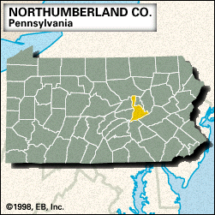
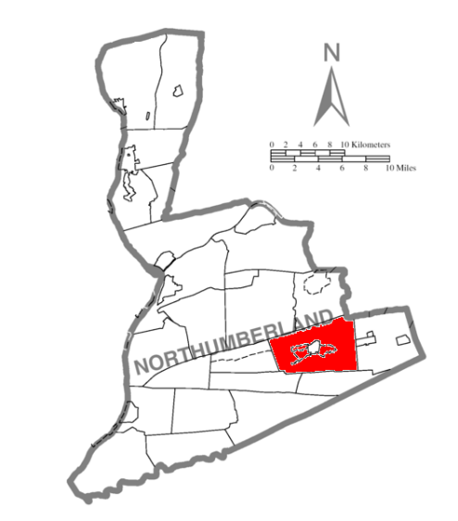
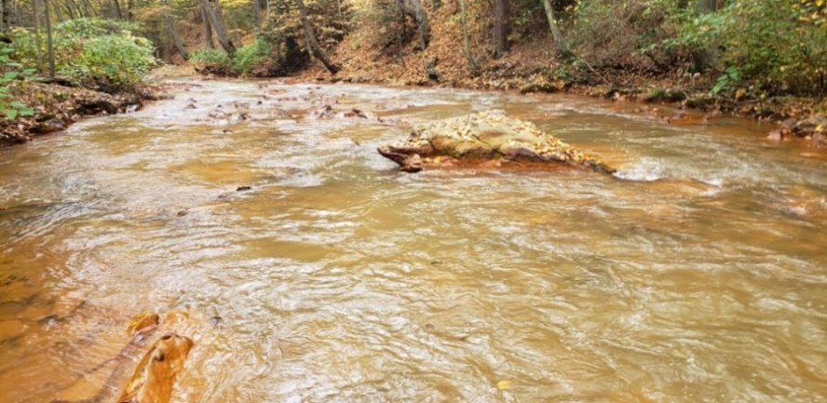
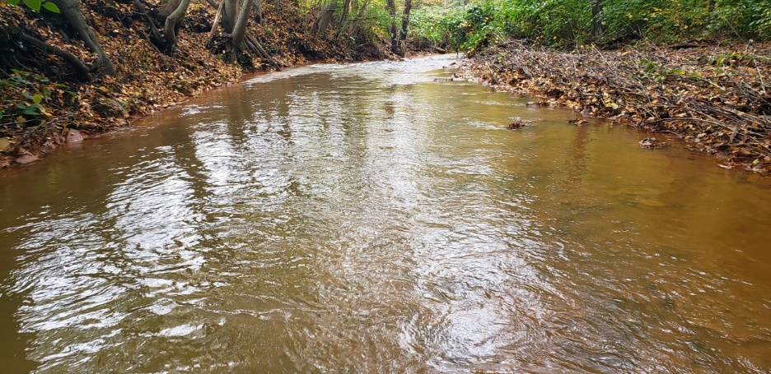
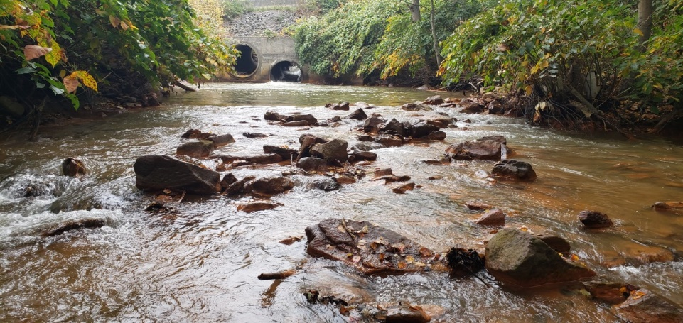
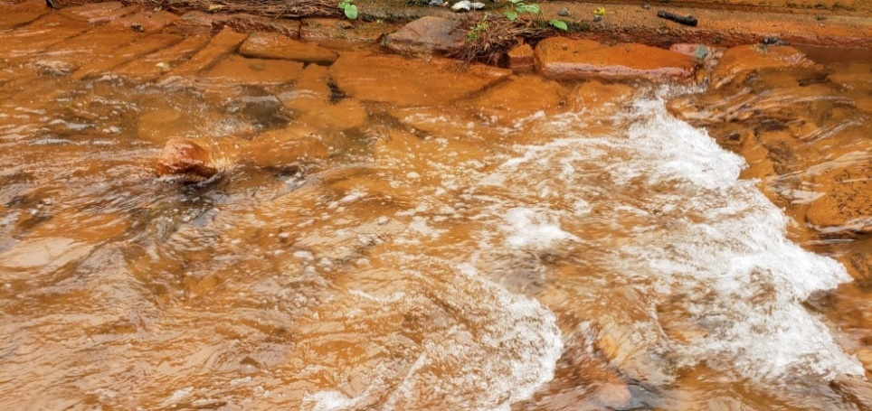
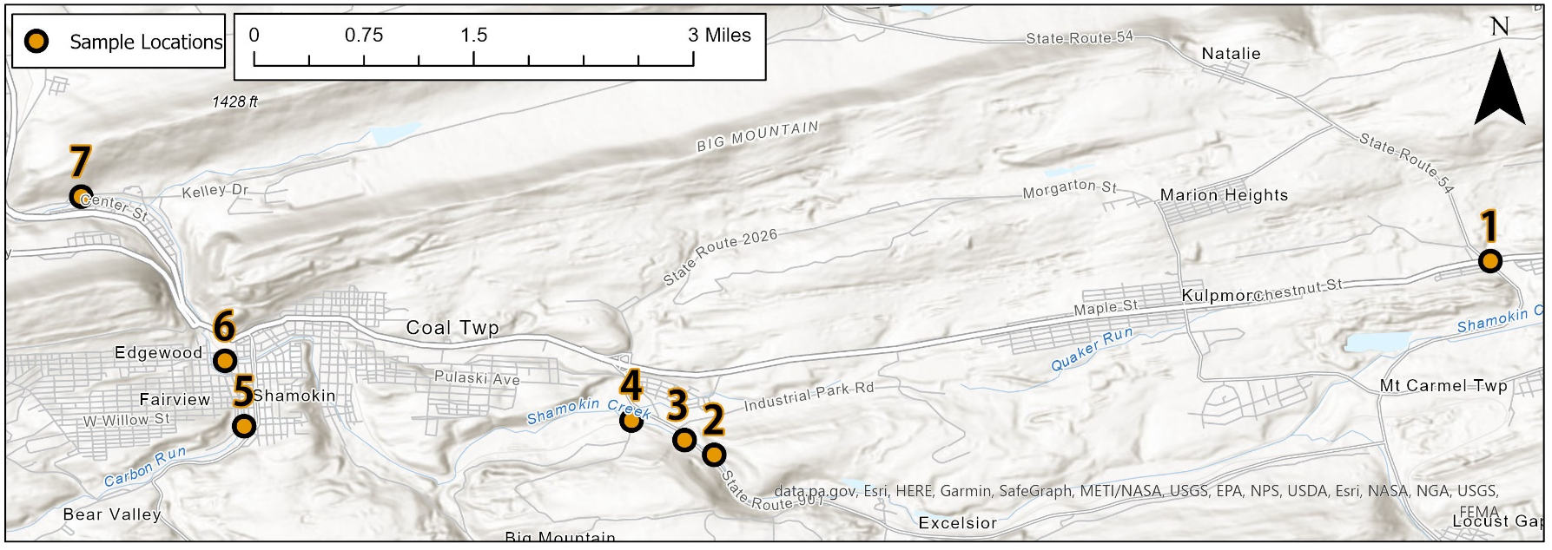
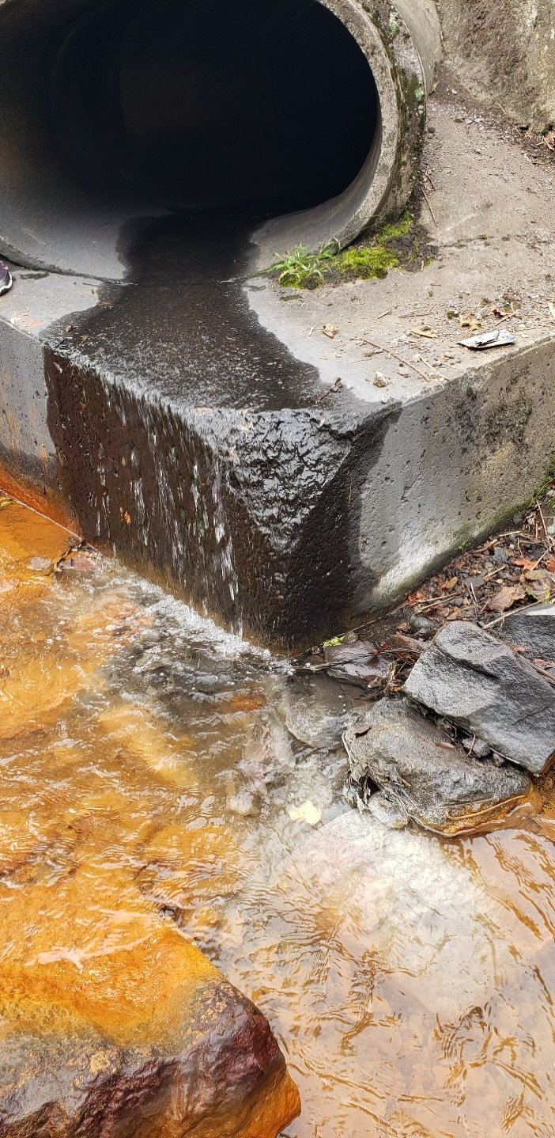
Geochemical Analysis of Shamokin Creek in Northumberland County, PA
FRACE, Johnathan; RENN, Jacob; WHISNER, Jennifer
Department of Environmental, Geographical, and Geological Sciences : Bloomsburg University of Pennsylvania, 400 East 2nd Street., Bloomsburg, PA 17815
Abstract
Metal Results
Results
Shamokin Creek, a tributary of the Susquehanna River, is located in Northumberland County, PA, and is impacted by abandoned mine drainage from various mine workings and mine tailings sites in the western middle anthracite field. A major in-depth study of water quality in the Creek was completed in 2001. This study attempts to determine whether the Creek’s condition has improved or worsened since then. Water samples and in-situ data (temperature, conductivity, dissolved oxygen, and pH) were collected in October of 2021 from seven easily accessible sites distributed across the watershed. The average pH values at all but one site were near neutral (6.7-6.9). Conductivity ranged from 332 to 629 uS/cm, and dissolved oxygen varied from 9.7 to 10.3 mg/L. Lab analyses were conducted to determine turbidity, acidity, and alkalinity. The most alkaline water was sampled downstream from (nearby) limestone riprap and an abandoned mine drainage treatment system. Metal constituents were determined by ICP-OES, and common anions were identified using ion chromatography. Samples were analyzed for Al, As, Ba, Cd, Cr, Cu, Fe, Mn, Ni, Pb, and Zn, but only non-filtered Al (431-1623 ppb), and both filtered and non-filtered Mn (1836-2695 ppb), Fe (7110-11374 ppb), and Ni (59-111 ppb) were detected at concentrations above PA DEP drinking water standards and/or EPA freshwater chronic exposure criteria for aquatic life. Since the 2001 study, conditions appear to have improved somewhat, but a more in-depth study of both stream and mine drains would be beneficial.
IN SITU
Location 5 was the most intriguing based on how different the results were compared to the other sample locations
Lowest Dissolved Oxygen (9.7 mg/L)
Highest Conductivity (629.5 μS/cm)
Highest Alkalinity (567.7) (Other locations ranged from 75 -225 mg/L CaCO₃)
Highest pH (6.88)
All locations were above pH 6 except location 1.
METALS
As, Cd, Cr, and Cu were not detected in either non-filtered or filtered samples
With the exception of location 1, Al was detected only in the non-filtered samples
Iron was detected at concentrations an order of magnitude greater than the EPA Freshwater CCC (criteria continuous concentration) for Aquatic Life at all locations in both filtered and non-filtered samples (approximately 7000 -11,000 ppb).
Manganese was also detected in both the filtered and non-filtered samples at concentrations higher than the EPA Freshwater CCC for Aquatic Life (approximately 1800 - 2800 ppb).
Barium was noticeably different in sample locations 2 and 4 in the filtered measurements from 10/8/21 and 10/14/21
ANIONS
Fluoride, Nitrite, Bromide, and Phosphate were detected at concentrations too low to be quantified.
Chloride was detected around 1 ppm
Nitrate was detectable at locations 2 (0.65 ppm) and 3 (0.7 ppm)
Several samples had a substantial unidentified peak near 11.4 minute retention time. Where present, that ion accounted for 40 – 70 % of the total anions.
EPA proposed drinking water standard = 300 ppb
EPA Freshwater CCC for Aquatic Life = 1000 ppb Fe
PA DEP proposed drinking water standard = 300 ppb
EPA Freshwater CCC for Aquatic Life = 52 ppb Ni
EPA Freshwater CCC for Aquatic Life = 120 ppb Zn
Study Area
Figure 2a. Location 2
Figure 2b. Location 3
Figure 3. Charts showing levels of metal concentrations
Figure 2c. Location 4
Figure 2d. Location 5
In Situ Results
Location 5 Results
Discussion
Most metal concentrations were similar on the two days when samples were collected. Barium concentrations varied more.
Higher Ba concentrations on the first sampling day could potentially be due to an upstream mining operation processing more material.
Ba concentrations may not, however, be reliable, as values in filtered samples were consistently higher than those in non-filtered samples.
In this study, metals of concern (Fe, Mn, Al) were detected at generally lower concentrations than those reported by Cravotta and Kirby (2004).
Cravotta and Kirby (2004) reported high amounts of sulfate in stream samples. It is likely, but not confirmed, that the major unidentified anion we detected was sulfate.
The highest alkalinity was detected downstream from limestone riprap along the stream channel at location 5, and downstream of an AMD treatment site on Carbon Run. The higher pH is consistent with values reported by Trout Unlimited (2017).
Al was detected at lowest concentrations at location 5 most likely because the Al was already precipitated out due to higher pH (likely from Treatment System #42 and/or limestone riprap).
Al was detected at the highest concentration at location 1, which had the lowest pH, and thus highest Al solubility. It is not known why pH increases between locations 1 and 2.
Although iron and nickel were consistently detected at levels higher than EPA criteria supporting aquatic life, and manganese was detected at levels several times the PA DEP proposed drinking water standard, conditions seems to be somewhat improved from 2001.
Our sampling was limited, however, and the watershed would benefit from a more comprehensive look at water quality twenty years later.
Location 5
Figure 4. Map of location where samples were collected
Methods
Figure 6b. Changing pH at location 5
The pH at location 5 on Carbon Run was moderately higher (6.88), than pH at previous locations. Thinking that water from a nearby culvert might be contributing, we tested pH at Spot 1 (Fig. 6a). However, the pH of culvert water was lower than average (Fig. 6b). The question mark in the picture to the left indicates a noticeable whitish coating on the rocks at the bottom of the creek. This may be due to aluminum compounds that precipitated when Al-bearing culvert water mixed with higher pH water in Carbon Run.
Dissolved oxygen, conductivity, pH, and temperature were measured in situ. Water samples were collected in acid-washed 4 L Nalgene bottles which were conditioned before every sample was taken. Samples were stored on ice for transport to the lab.
Spot 1
Discussion
Turbidity was measured on non-filtered samples using a HACH 2100P turbidimeter.
Non-filtered samples were stored at 4ºC until they could be analyzed for metals. Samples were analyzed in triplicate for metals (Al, As, Ba, Cd, Cr, Cu, Fe, Mn, Pb, and Zn) using a Leeman Profile ICP-OES.
Spot 2
Filtered samples were analyzed in triplicate using the Hach methods 8201 and 8202 for acidity and method 8203 for alkalinity.
Filtered samples were then frozen for anion/cation analysis and acidified and stored at 4ºC for metals analysis.
Spot 3
Filtered samples were thawed and analyzed in triplicate for anions using a Dionex ICS 2000 ion chromatograph.
Filtered samples were analyzed in triplicate for Al, As, Ba, Cd, Cr, Cu, Fe, Mn, Pb, and Zn using a Leeman Profile ICP-OES.
Acknowledgments
References
We would like to thank the Aqueous Geochemistry class (2021) for the assistance with collecting and analyzing the samples, as well as Dr. Jennifer Whisner for the suggestions and help with the samples and poster. We would also like to thank the EGGS Departments for the equipment used to collect and process the samples.
Also, thanks to Mr. Troy Prutzman for the assistance with the instruments and to Dr. Chris Hallen, in the Department of Chemistry and Biochemistry for troubleshooting instruments.
Cravotta III, C A., Kirby, C. S, 2004. Effects of Abandoned Coal-Mine Drainage on Streamflow and Water Quality in the Shamokin Creek Basin, Northumberland and Columbia Counties, Pennsylvania, 1999-2001. United States Geological Survey, Water resources investigation Report 03-4311
Pottsville District Mining Office. 2001. Shamokin Creek Watershed TMDL. Pennsylvania Department of Environmental Protection (DEP): Bureau of District Mining Operations.
Trout Unlimited, 2017. Biological Assessment of Carbon Run Treatment System #42. pp 12.
Figure 1. Data charts displaying In Situ data results
Figure 6a. Mine drainage into location 5

