Slide 1


92 - T155. Recent Advances in Soil and Paleosol Science
PALEOPEDOGENESIS IN OVERBANK SEDIMENTS OF SIWALIK GROUP, NW HIMALAYA: WEATHERING AND CLIMATE CHANGE DURING 12 TO 5 MA
Pankaj Srivastava and Abdul Hameed
Department of Geology
University of Delhi, Delhi 110007, India

Slide 2
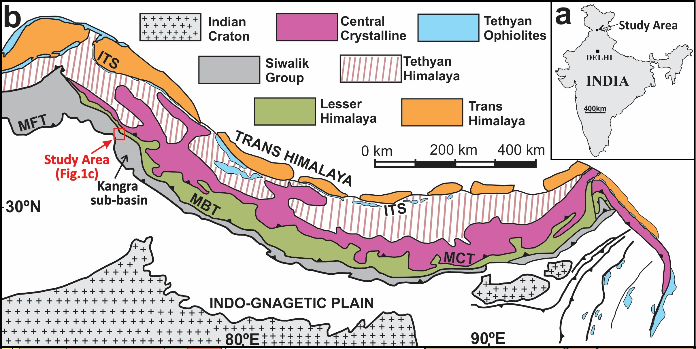

Why Paleosols?
Evolutionary history of the Earth
Ancient weathering front and critical zones
Regulating pCO₂ and climate
Comparable to marine proxy records
Himalayas
Trans Himalayas
Himalayan Foreland Basin
HFB
(Fluvial sequences)
ITSZ
Ophiolite & Cenozoic Sed.
Paleosols
Tethyan Himalayas
Sediments
Fossiliferous Palaeozoic-Mesozoic Sed
IGP (<1 Ma)
Higher Himalayas
Paleosols
Granites
Siwalik Fm (13-1 Ma)
Sediments
MCT
Lesser Himalayas
Upper Dharamsala/
Kasauli Fm (20-13 Ma)
Precambrian-Palaeozoic Sed (Krol-Tal)
Sediments
MBT
HFB
Lower Dharamsala/
Dagshai Fm (~31 Ma)
Himalayas?
Himalayan Foreland Basin
Fluvial successions
Paleopedology of Early Oligocene to Holocene paleosols
Latitudinal control on red and yellow paleosols
Origin and establishment of SW monsoonal conditions
No detailed paleopedological record (Late Miocene Siwaliks)
This work: High-resolution paleopedology of 2.25 km Siwalik sediments (12 to 5 Ma)
Weathering conditions
Paleopedogenic processes
Response to Himalayan orogeny
Link to global climate!!
Sub Himalayas
Paleosols
Subathu, Dagshai, Kasauli, Siwaliks
MFT
Paleosols
Indo-Gangetic Plains
Subathu Fm (57-41 Ma)
Craton
Major objective: Understanding weathering conditions and paleopedogenesis in response to Himalayan orogeny and its feedback to global climate during the late Miocene (Siwaliks 12 to 5 Ma)
Field observations, Micromorphology, Clay Mineralogy, Bulk Geochemistry, and Pedogenic CaCO₃ stable isotopes (2.25 km Katilu Khad section, Kangra Basin, NW Himalaya)

Slide 3
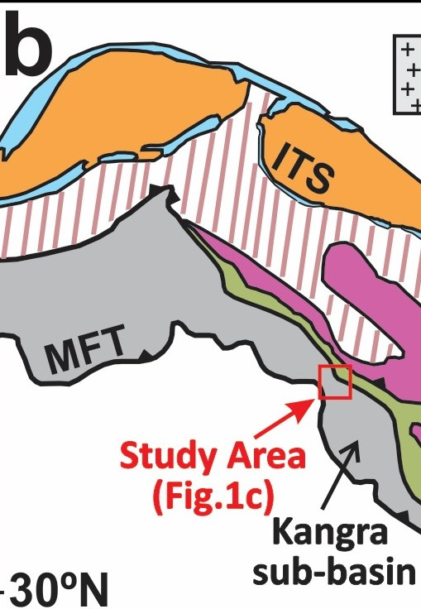
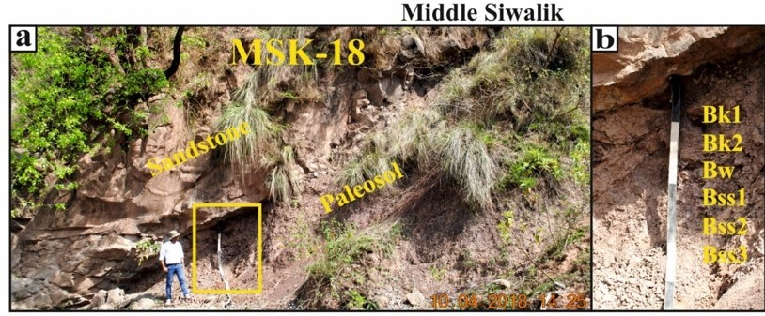
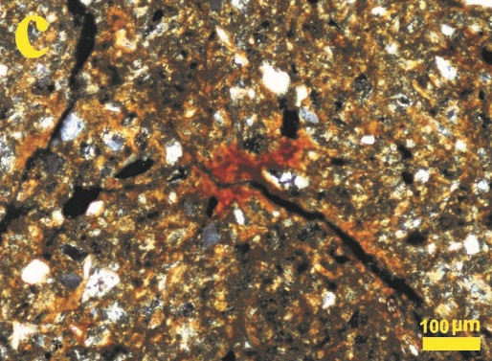
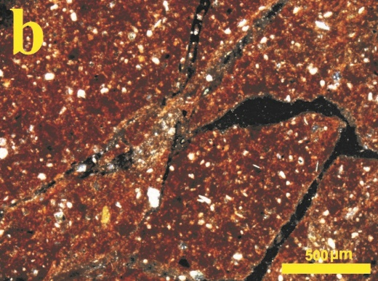
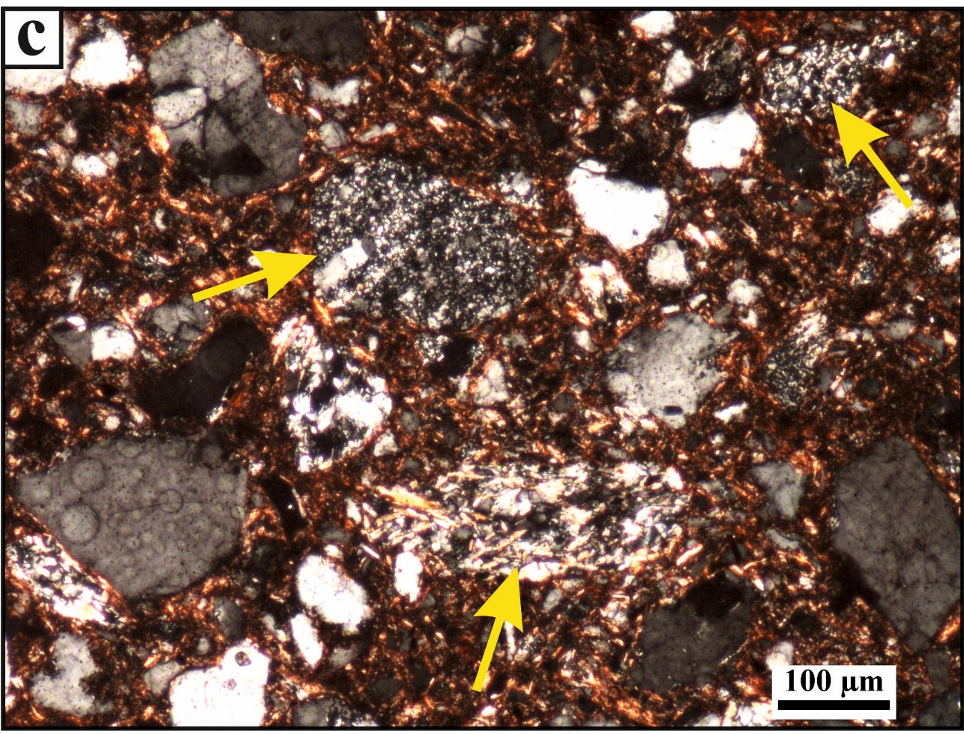
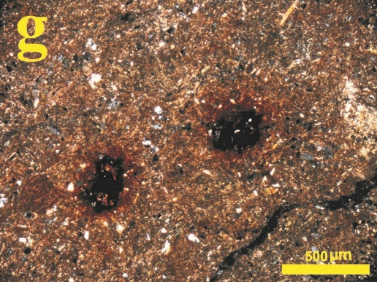
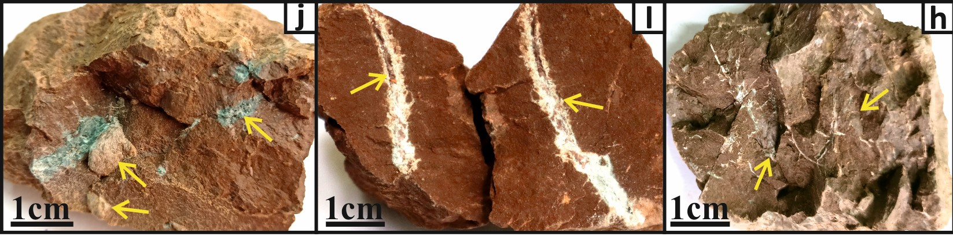
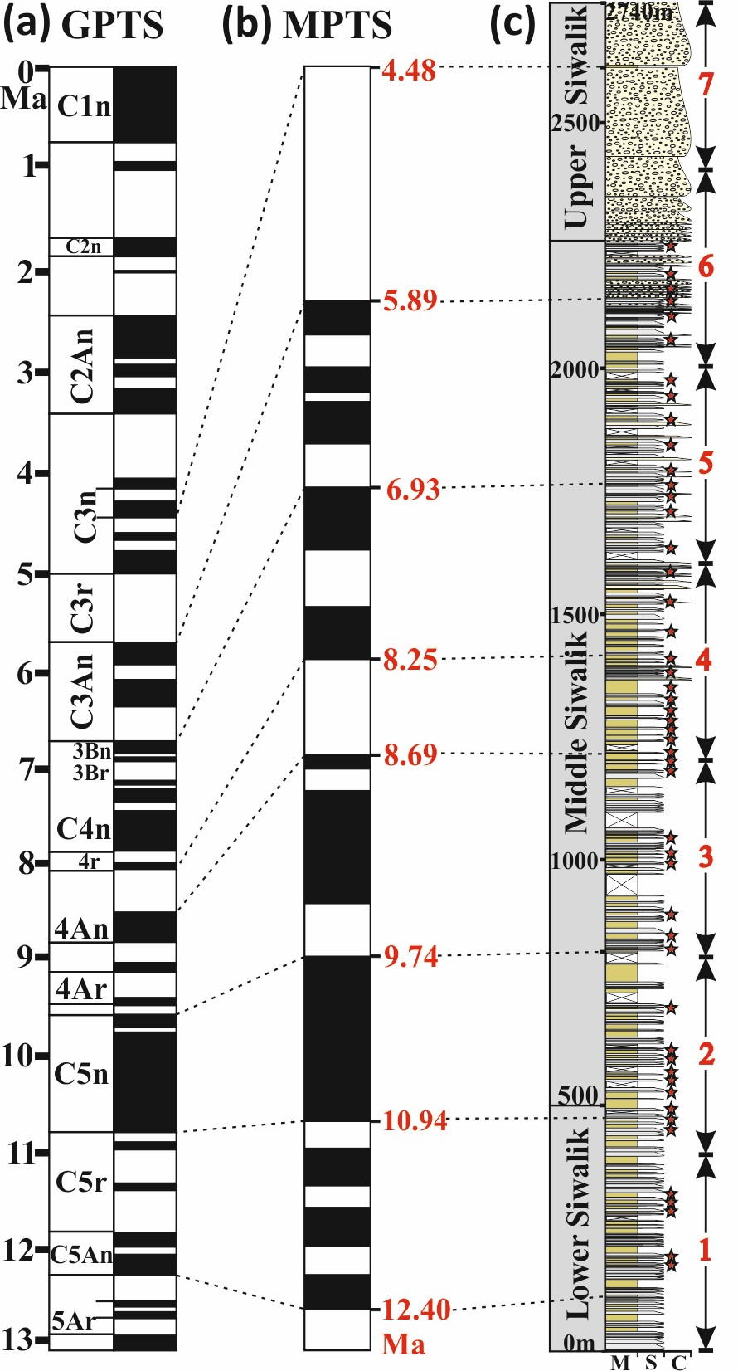
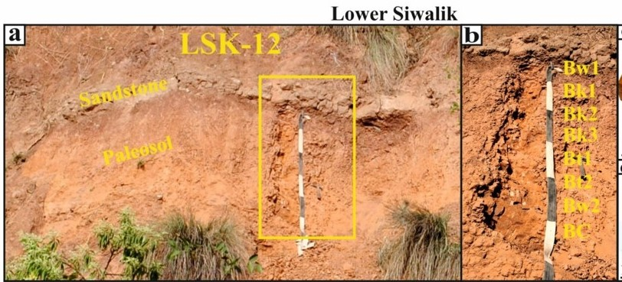
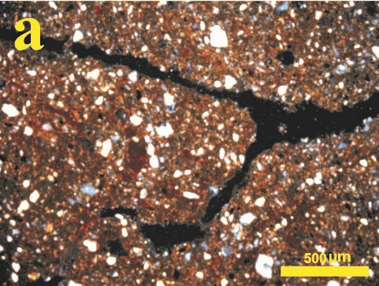
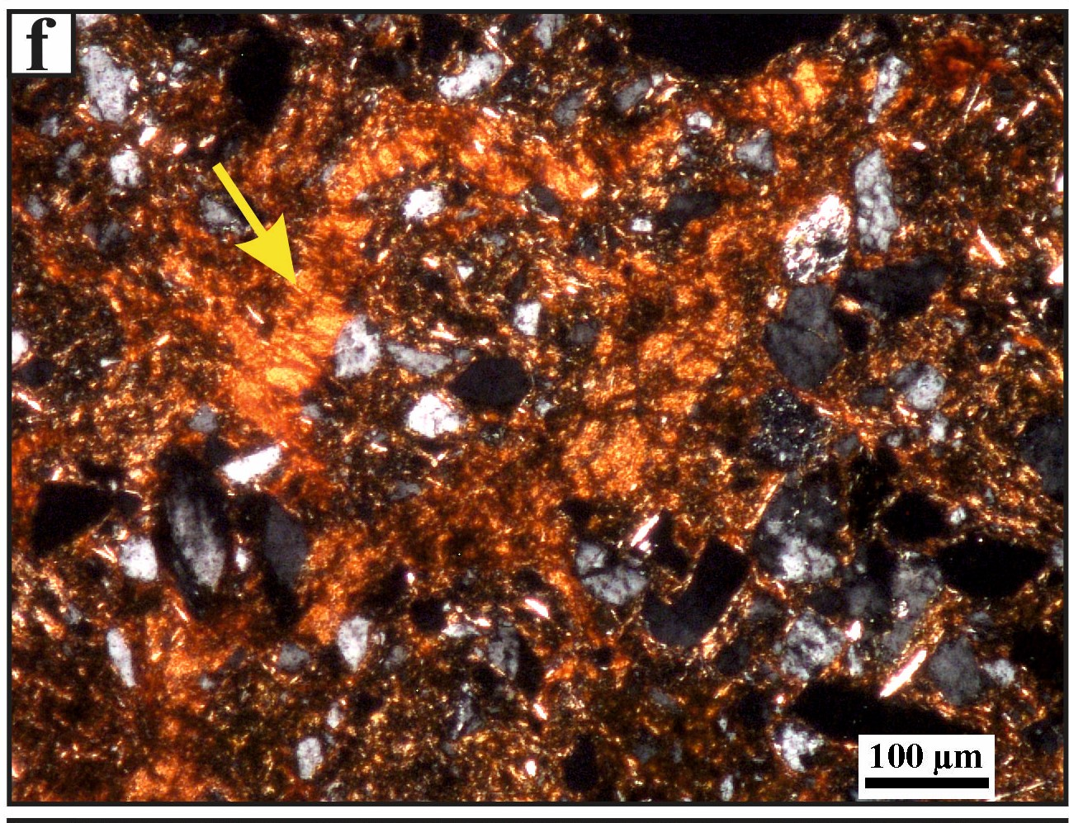
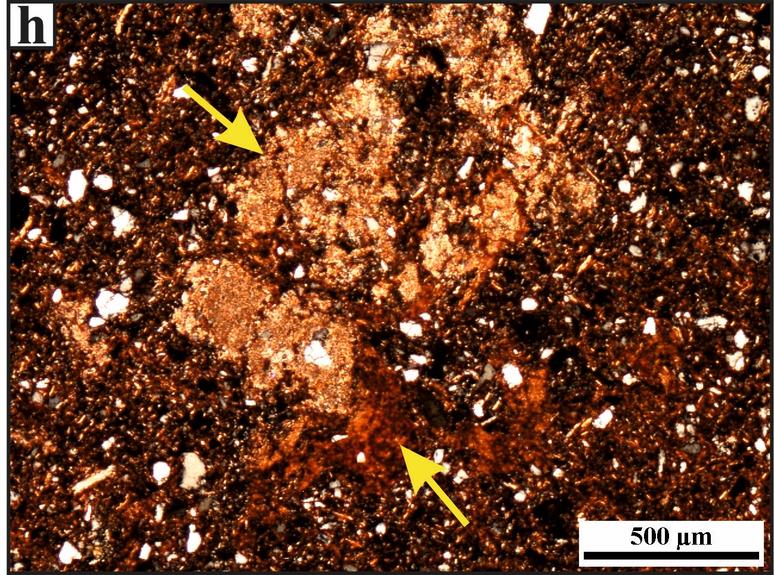
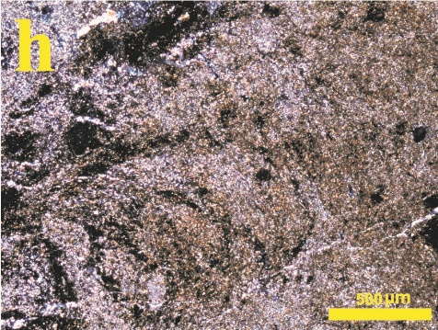
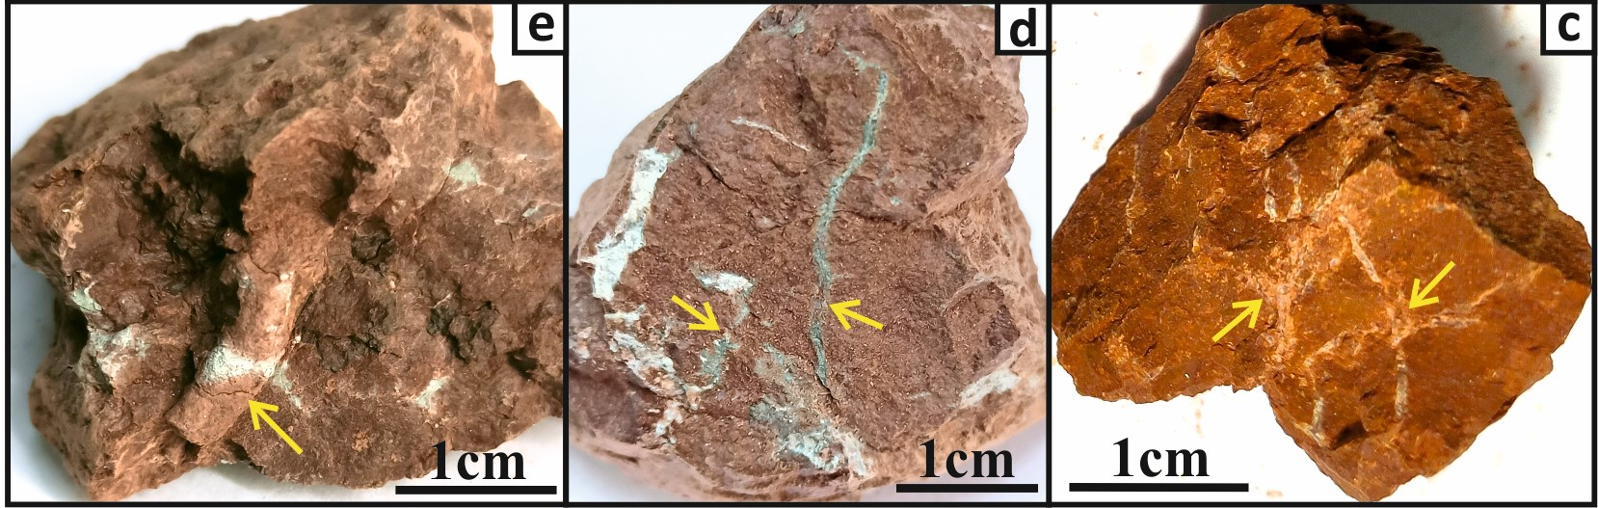
Field observations
(Siwalik Paleosols: 12 to 5 Ma)
Micromorphology
(Siwalik Paleosols: 12 to 5 Ma)
Wedge-shaped peds
Clay pedofeatures
Litho relicts
Fe-Mn mottles & Concretions
Middle Siwalik paleosols (10.9 to 5.4 Ma)
Dominance of moderate- weak paleopedogenic development (Bw/Bss horizons)
Weathering and paleopedogenic development → Type-B Pedofacies
Strong Pedality/
blocky structure
Clay pedofeatures
Pedogenic CaCO₃ + Clay Pedofeature
Bioturbation feature
Lower Siwalik paleosols (12.4 to 10.9 Ma)
Dominance of impure clay coatings, extensive pedogenic CaCO₃, shrink-swell, rhizocretions, and bioturbation features
Dominance of well-developed Bt-horizons (thick clay coatings)
Weathering and paleopedogenic development → Dominance of Type-A pedofacies
Structure, Rhizocretions, Gleying, mottles, PC etc
Field Observations and Micromorphology helped in
defining different pedofacies (Type-A, B, C, D)

Slide 4
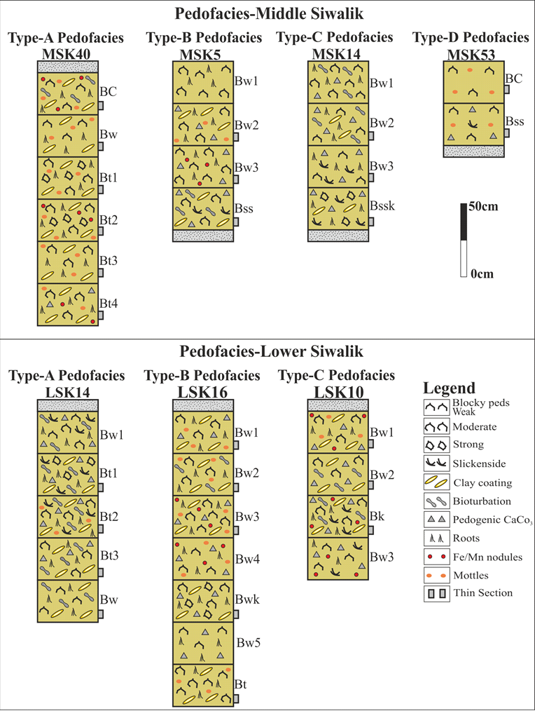
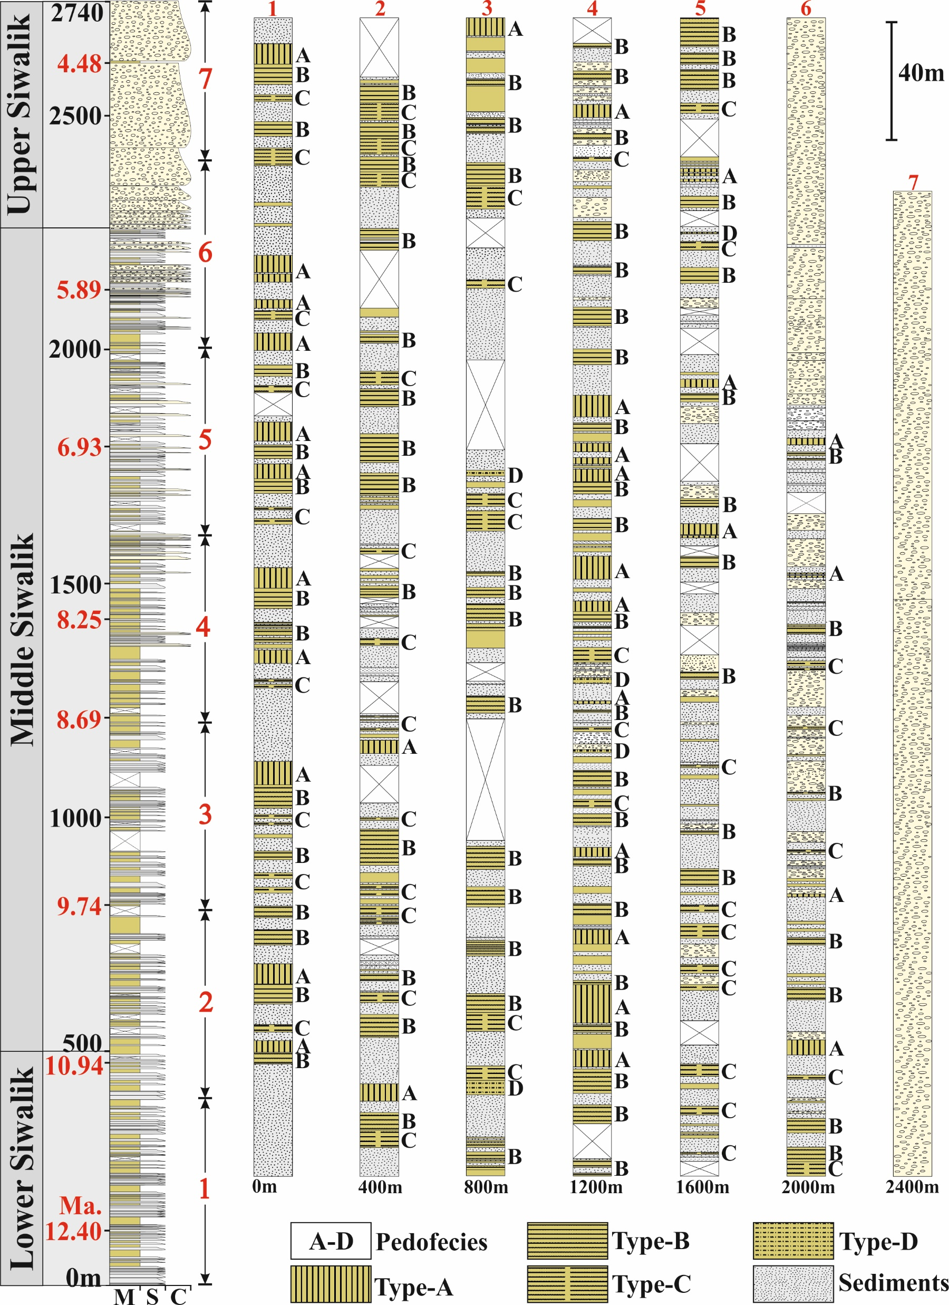
Pedofacies in Siwalik succession:
Based on paleosol development and their association with sediments
Type-A Pedofacies: At least one well-developed paleosol and a few moderately to weakly developed paleosols (Comparable to modern Alfisols)
Type-B Pedofacies: Absence of strongly developed paleosols and dominance of moderately developed paleosols with weak to incipient stages of pedogenesis (Comparable to modern Inceptisols/Vertisols)
Type-C Pedofacies: Absence of any well-developed or moderately developed paleosols but dominance of only weakly developed paleosols with or without incipient stages of pedogenesis (Comparable to modern Inceptisols/Vertisols)
Type-D Pedofacies: Absence of any significant pedogenic activity, except for some incipient stages of pedogenic expression in overbank sediments (Comparable to modern Entisols)
Pedofacies in Siwalik succession:
Lower Siwalik Succession: (Dominance of well-developed paleosols)
Type-A pedofacies ~ 53% (At ~ 30 m interval), Type-B pedofacies ~ 26%, Type-C pedofacies ~ 8%,
Type-D pedofacies ~ 0%
Middle Siwalik Succession: (Dominance of moderately and weakly developed paleosols)
Type-A pedofacies ~ 30% (At 100-120 m interval), Type-B pedofacies ~ 44%, Type-C pedofacies ~ 18%,
Type-D pedofacies ~ 8%

Slide 5
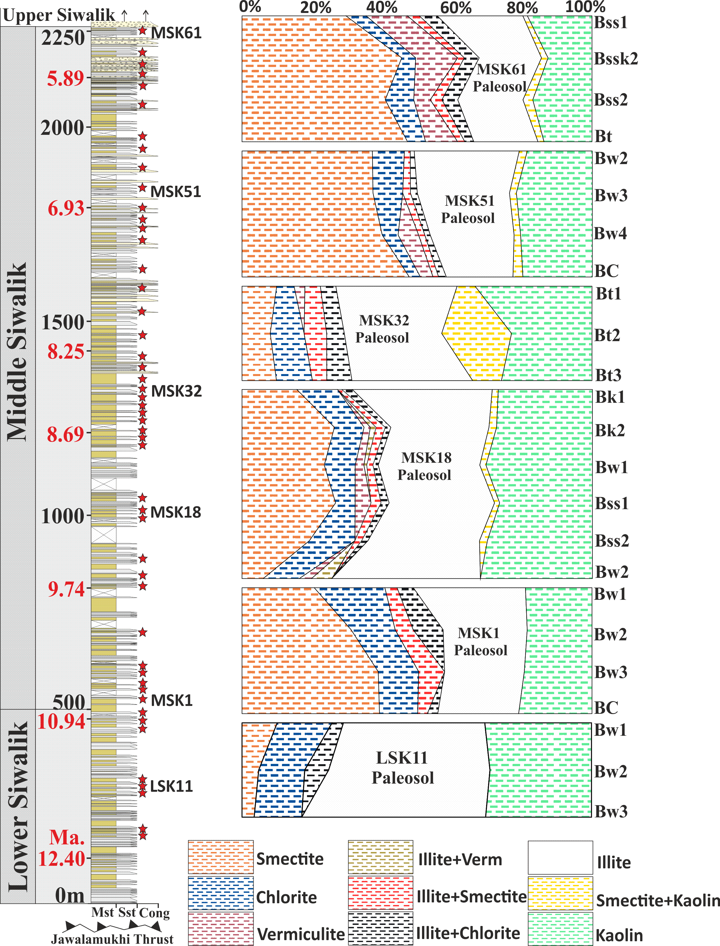
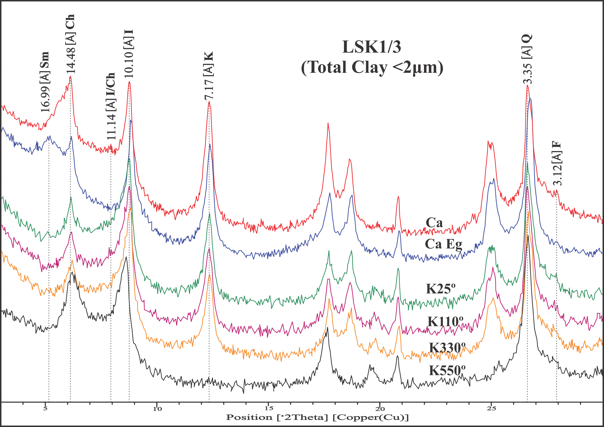
Clay Mineralogy Lower and Middle Siwalik Paleosols
(Total clay <2µm, Fine Clay <0.2µm)
Clay Fractionation of TC and FC, Ca, CaEG, K 25°C, K110°C, K 300°C, K 550°C treatments after Jackson 1979, Identification and semiquantitative estimate after Gjems, 1967, Kapoor 1972
~17Å (Sm) Smectite, ~14Å (Ch) Chlorite, ~11Å (I/Ch) Illite/Chlorite, ~10Å (I) Illite, ~7Å (K) Kaolinite, ~3.3Å (Q) Quartz, ~3.1Å(F)Feldspar

Slide 6
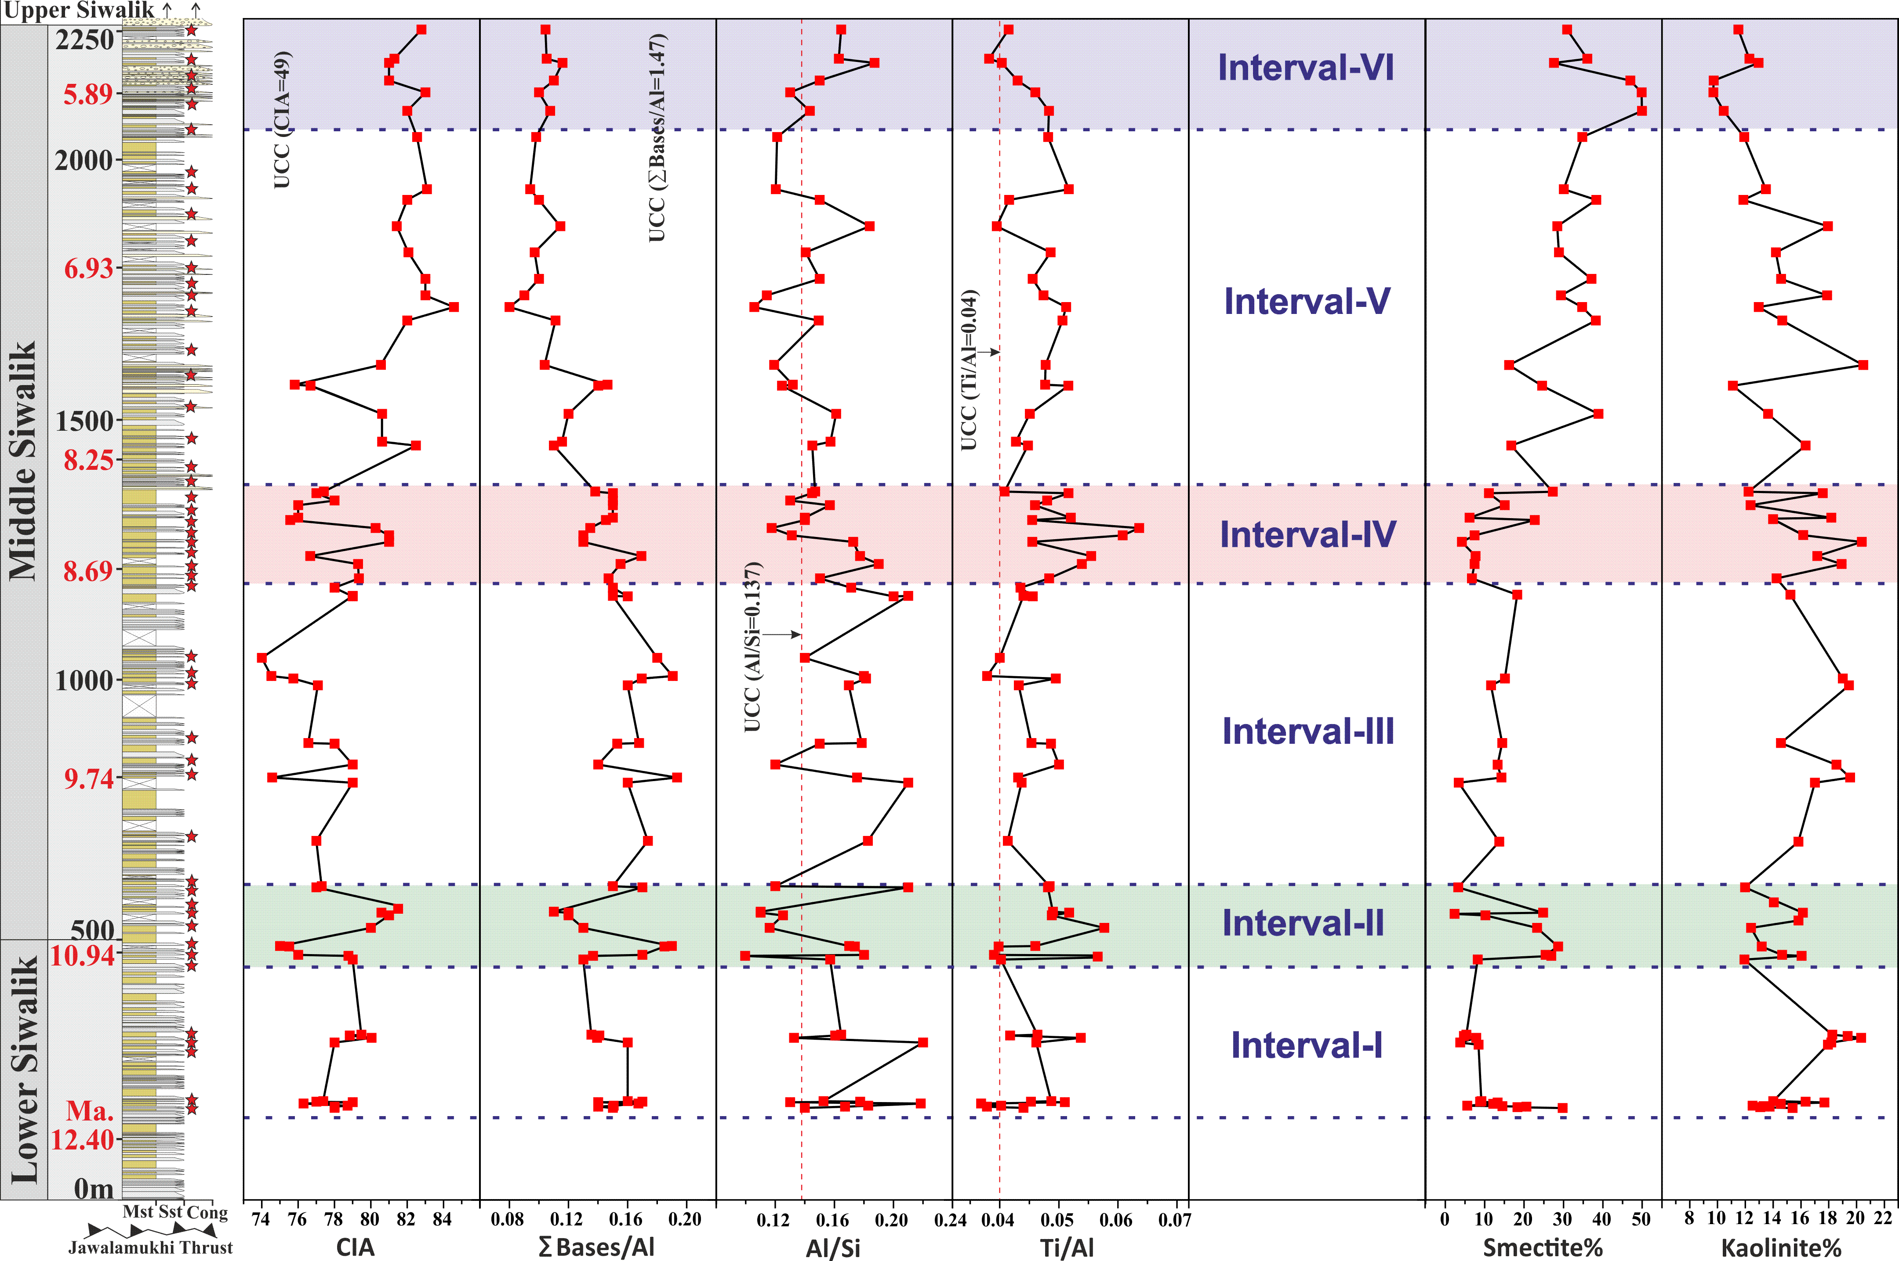
Weathering Indices + Clay Mineralogy
Interval-VI (6.0 Ma to 5.4 Ma ): Abrupt increase of feldspar-rich source rocks, Possible phase of major tectonic activity (MCT), weakly developed paleosols
Interval-V (8.3 Ma to 6.0 Ma): Moderate-weak weathering, gradual increase of feldspar-rich source rock, moderate-weakly developed paleosols
Interval-IV (8.7 Ma to 8.3 Ma): Strong weathering, humid/strengthening of monsoon, well-developed paleosols
Interval-III (10.6 Ma- 8.7 Ma): Moderate weathering, subhumid to semiarid conditions, no major tectonic activity, moderately developed paleosols
Interval-II (11.0 Ma-10.6 Ma): Weak-weathering, Arid/weak monsoon, Abrupt increase in Feldspar rich source, increased sedimentation rate, possible phase of major tectonic activity (MBT), weakly developed paleosols
Interval-I (12.1 Ma-11 Ma): Strong weathering, Humid/strengthening of the SW monsoon, No major tectonic activity, Well-developed paleosols

Slide 7
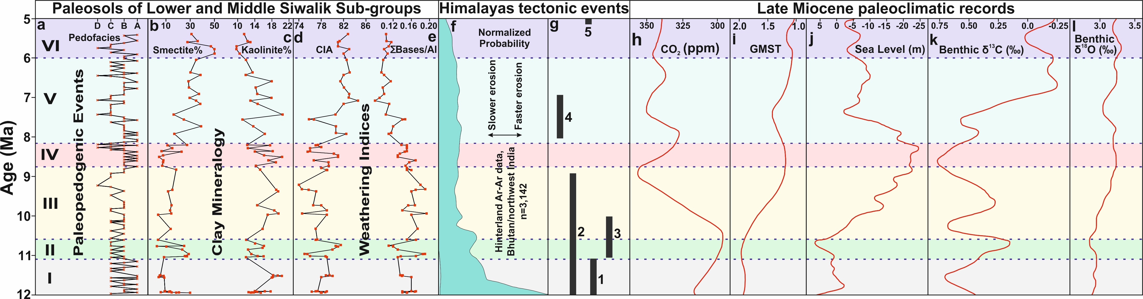
Weathering and paleopedogenesis in overbank sediments of the HFB from 12 to 5.4 Ma and their link to Himalayan Tectonics and Global climatic conditions
Exhumation of the hinterland from 12 to 5.4 Ma (after Clift et al., 2008) and Major tectonic events of the Himalayas from 12 to 5.4 Ma: (1) Onset of normal faulting S. Tibet, (2) Surface uplifting E Tibet, (3) Initial thrusting on MBT, (4) Increased deformation of IOC, (5) Reactivation of MCT (Compiled from Ding et al., 2017; Allen and Armstrong, 2012; Jain et al., 2000)
Global climatic record from 12 to 5.4 Ma: (h) Atmospheric CO₂ record, (i) Global mean surface temperatures, (j) Sea level fluctuations, (k & l) Variation of δ¹³C ‰ and δ¹⁸O ‰ isotope values in benthic foraminifera (after Hönisch et al., 2023; Westerhold et al., 2020; Miller et al., 2020)

Slide 8
Conclusions
The high-resolution paleopedology of the overbank sediments in the Siwaliks (HFB) provides an assessment of weathering and paleopedogenesis during 12-5.4 Ma and their linkage to late Miocene uplift and climatic changes.
The fieldwork, micromorphology, clay mineralogy, and chemical weathering indices confirmed the development of incipient to strongly developed paleopedofeatures corresponding to Entisols, Inceptisols, Vertisols, and Alfisols at different stratigraphic levels of the LS and MS subgroups.
The pedofacies analysis shows the LS subgroup is characterised by the dominance of Type-A pedofacies with well-developed Bt-horizons in contrast to weakly and moderately developed paleosols (Type-B and Type-C pedofacies) in the MS subgroup.
The six major paleopedogenic events (I to VI) identified during 12 Ma to 5.4 Ma are linked to a varied pace of sedimentation, a change of provenance, tectonic activity along major thrust sheets, and climatic changes.
The weathering and paleopedogenesis in the overbank sediments of the LS and MS subgroups show a close correspondence with the late Miocene uplift and exhumation of the Himalayas and its feedback to global climatic conditions.
For example, the increased intensity of weathering and pedogenesis during 12–11 Ma and 10.6–6.0 Ma show a strong correlation with the lowering of pCO2, GMST, and sea level, which suggests late Miocene uplift, exhumation, and weathering in overbank sediments of the HFB played an important role in global climatic conditions.
On the other hand, short intervals at 11–10.6 Ma and 6–5.4 Ma with no significant weathering or pedogenesis correspond to a rise in pCO2, GMST, and sea level at the global level.

Slide 9
Thank You

