Slide 1


Lithology Erodibility and Channel Cross-Sectional Geometry Control the Evolution of Meandering Bedrock Rivers in Uplifted Oregons
Authors: Zhilin Shi (Presenter), Dr. Sarah Schanz, and Dr. Brian Yanites

Slide 2
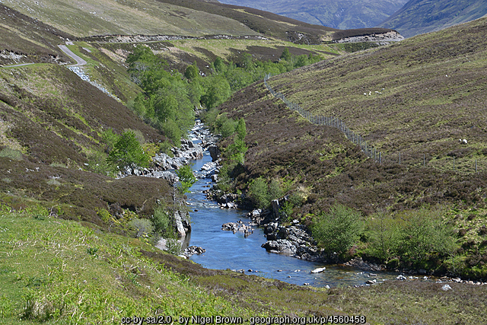
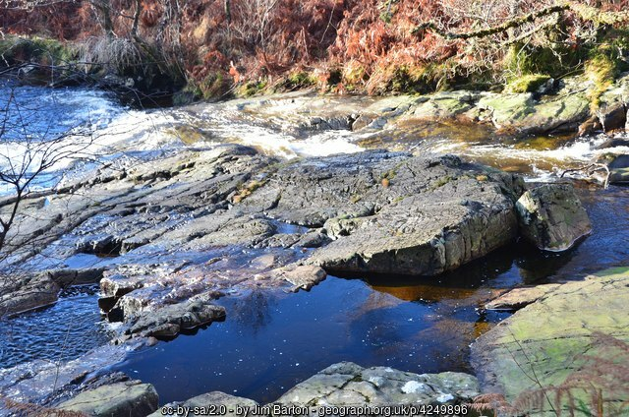
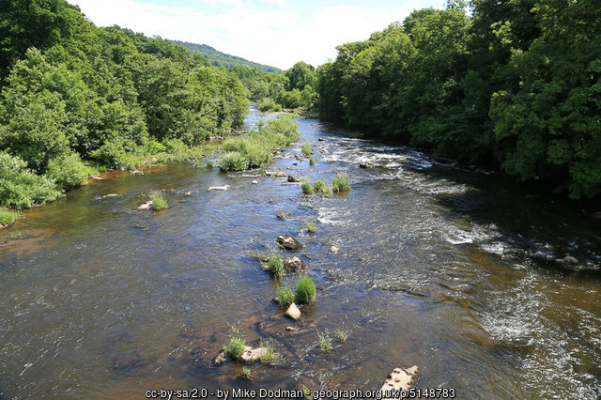
Bedrock River Overview
Observed worldwide in areas with continuous surface flow and distinctive topography
Hold importance in geomorphological, water resource, ecological, recreational, aesthetic, cultural, and historical contexts
Influenced by the erosional and depositional processes

Slide 3
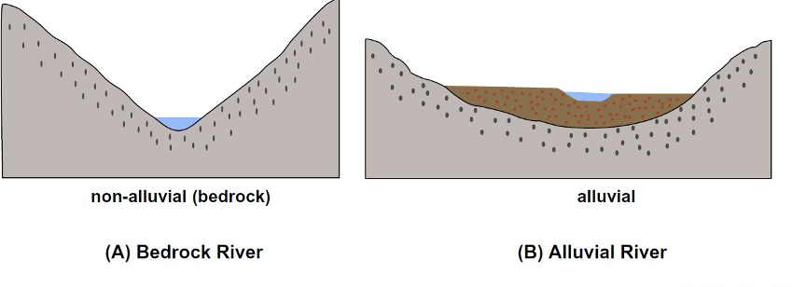
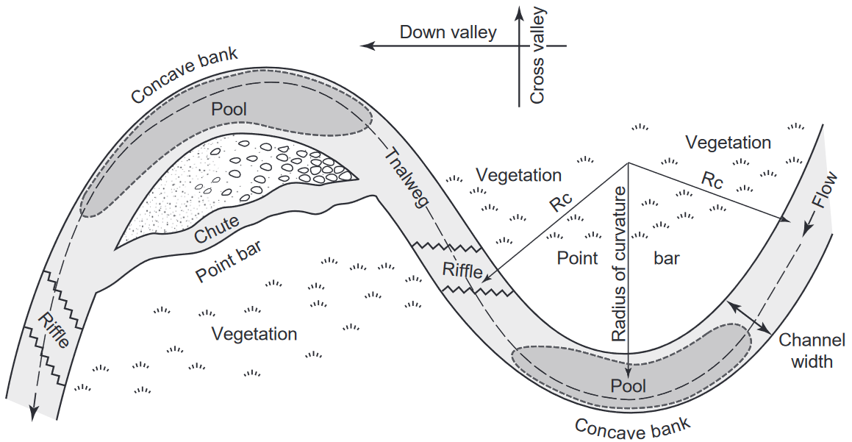
The stability problem of bedrock meandering rivers
Bedrock rivers: supply-limited or detachment-limited
Alluvial rivers: transport-limited
Bedrock rivers are influenced by:
Tectonics (e.g., Yanites et al., 2010);
Climate (e.g., Stark et al., 2010);
Lithology (e.g., Johnson and Finnegan, 2015);
or any combination of these forces
(MIT OCW)
(Hooke, 2013)

Slide 4
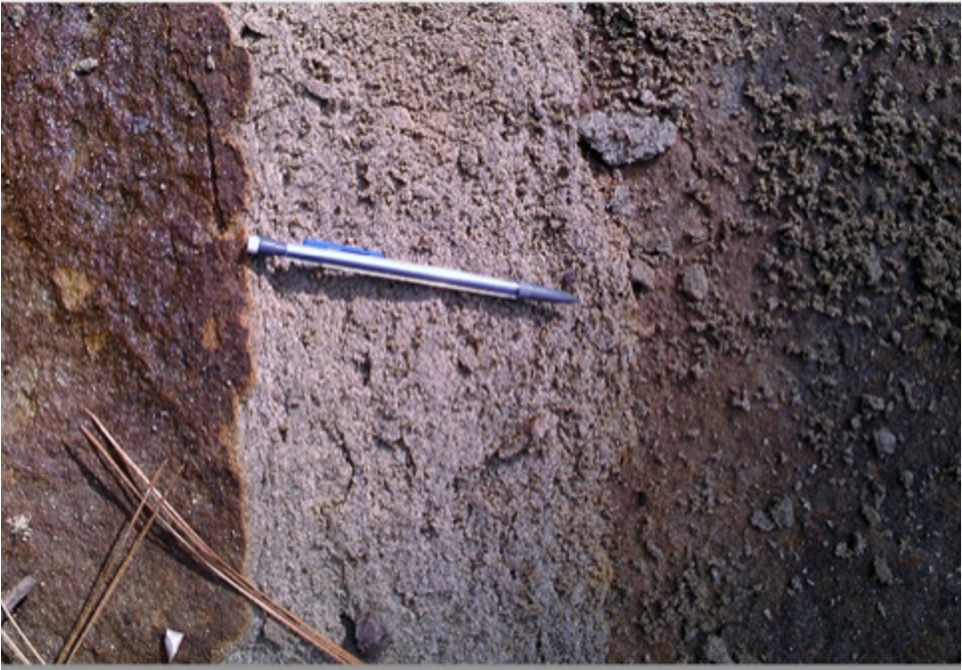
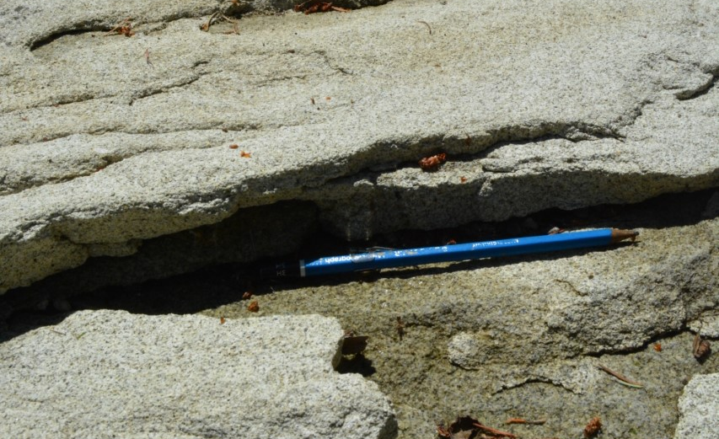
The role of lithology in bedrock river erosion
Lithology and erodibility of bedrock rivers:
Erosion Resistivity (Bursztyn et al., 2015)
River Channel Width Adjustment(Allen et al., 2013).
Slaking – sub-aerial bedrock vs submerged bedrock (Montgomery, 2004; Collins et al., 2016; Inoue et al., 2017)
Slaking bedrock of the Roslyn Formation in central Washington State, USA.

Slide 5
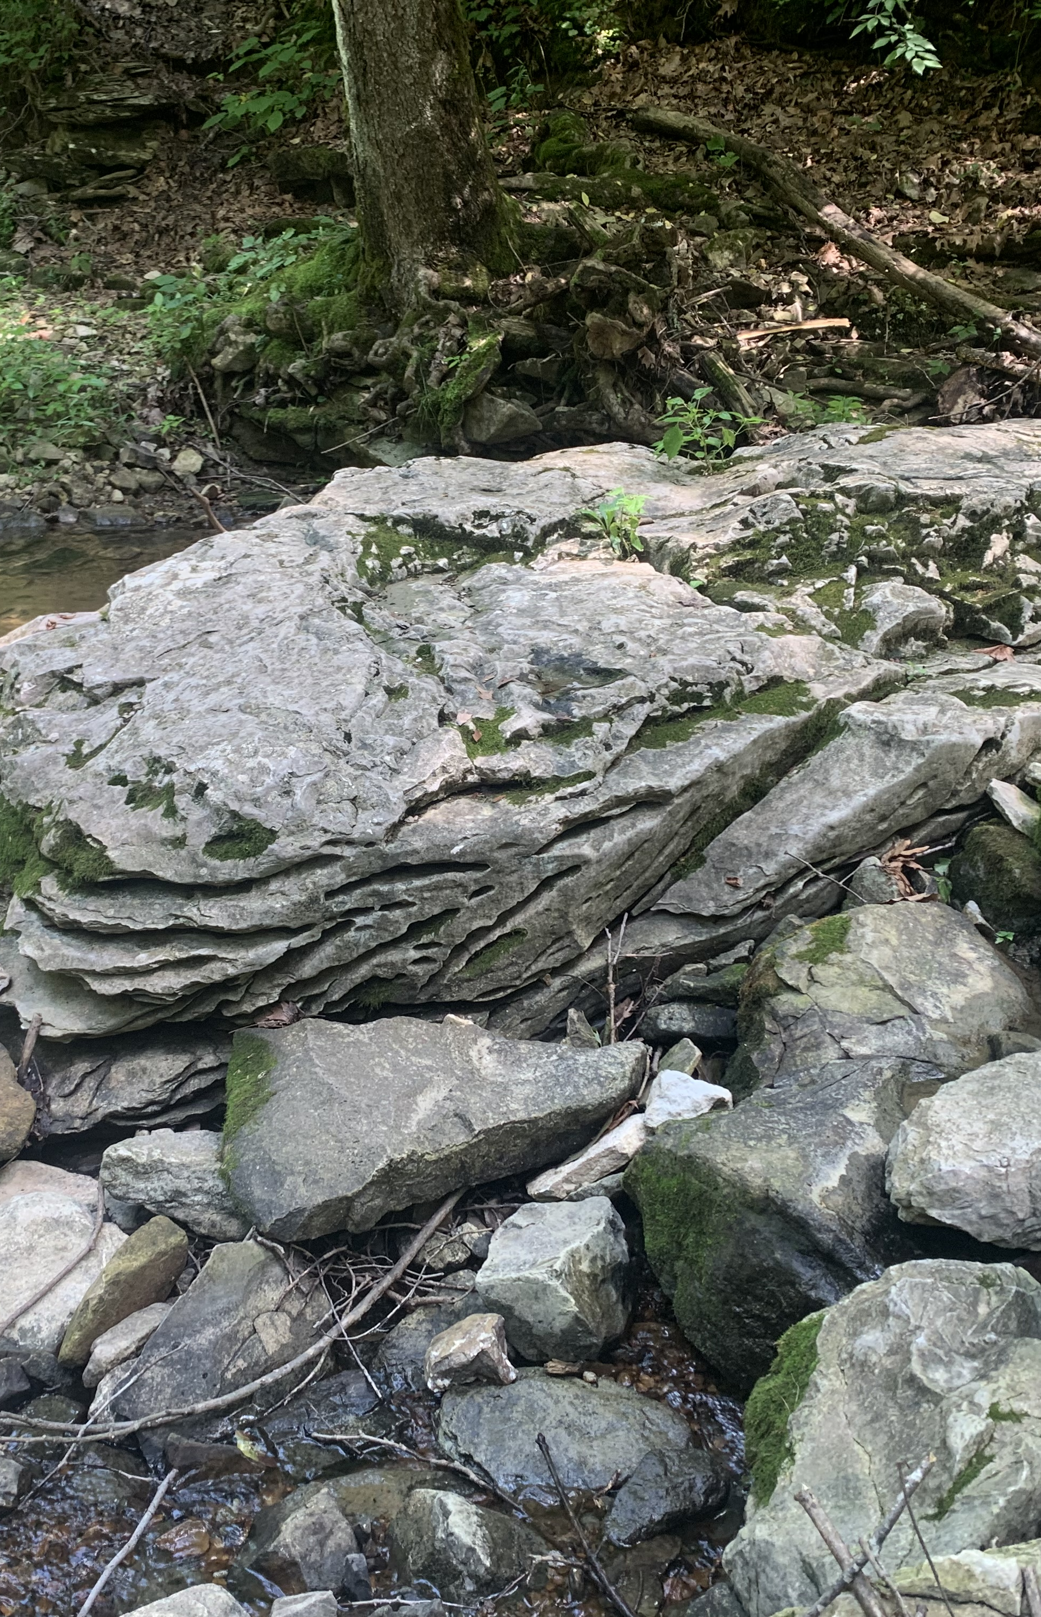
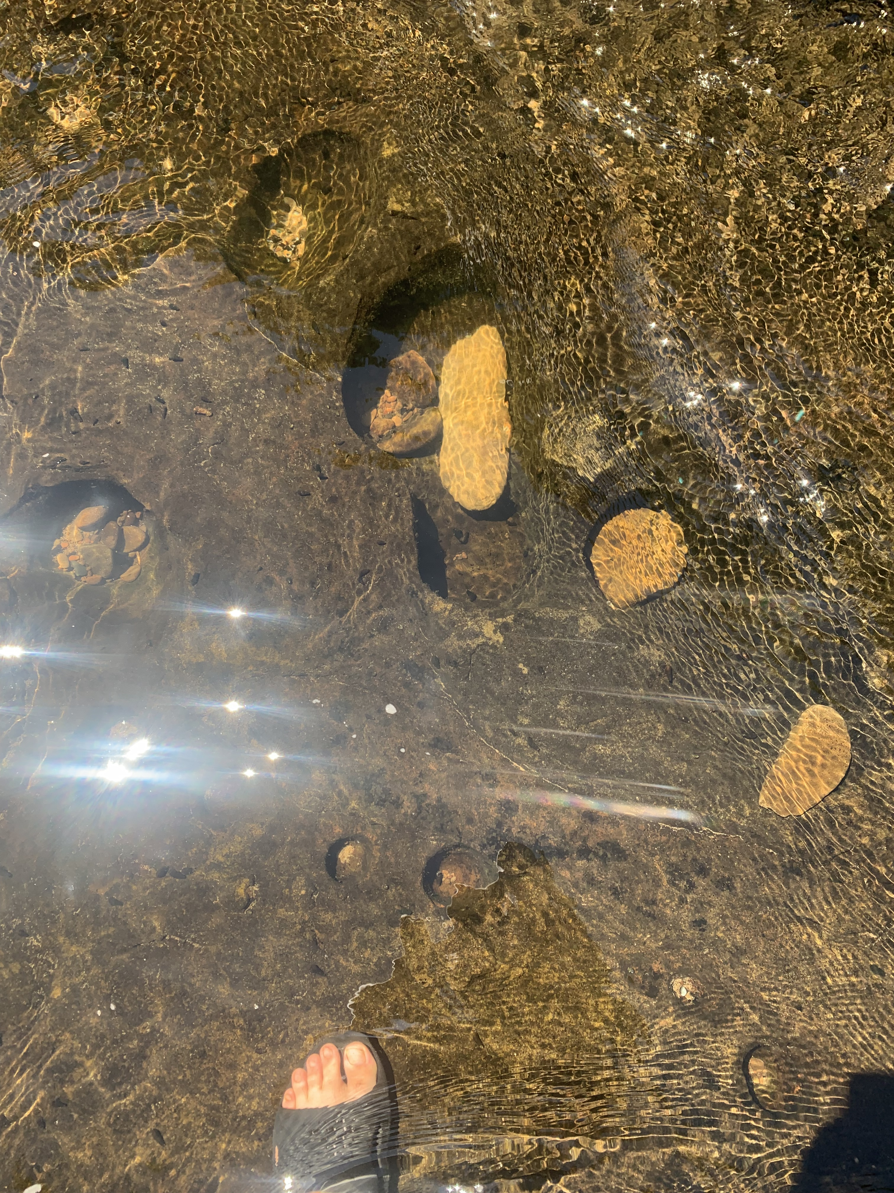
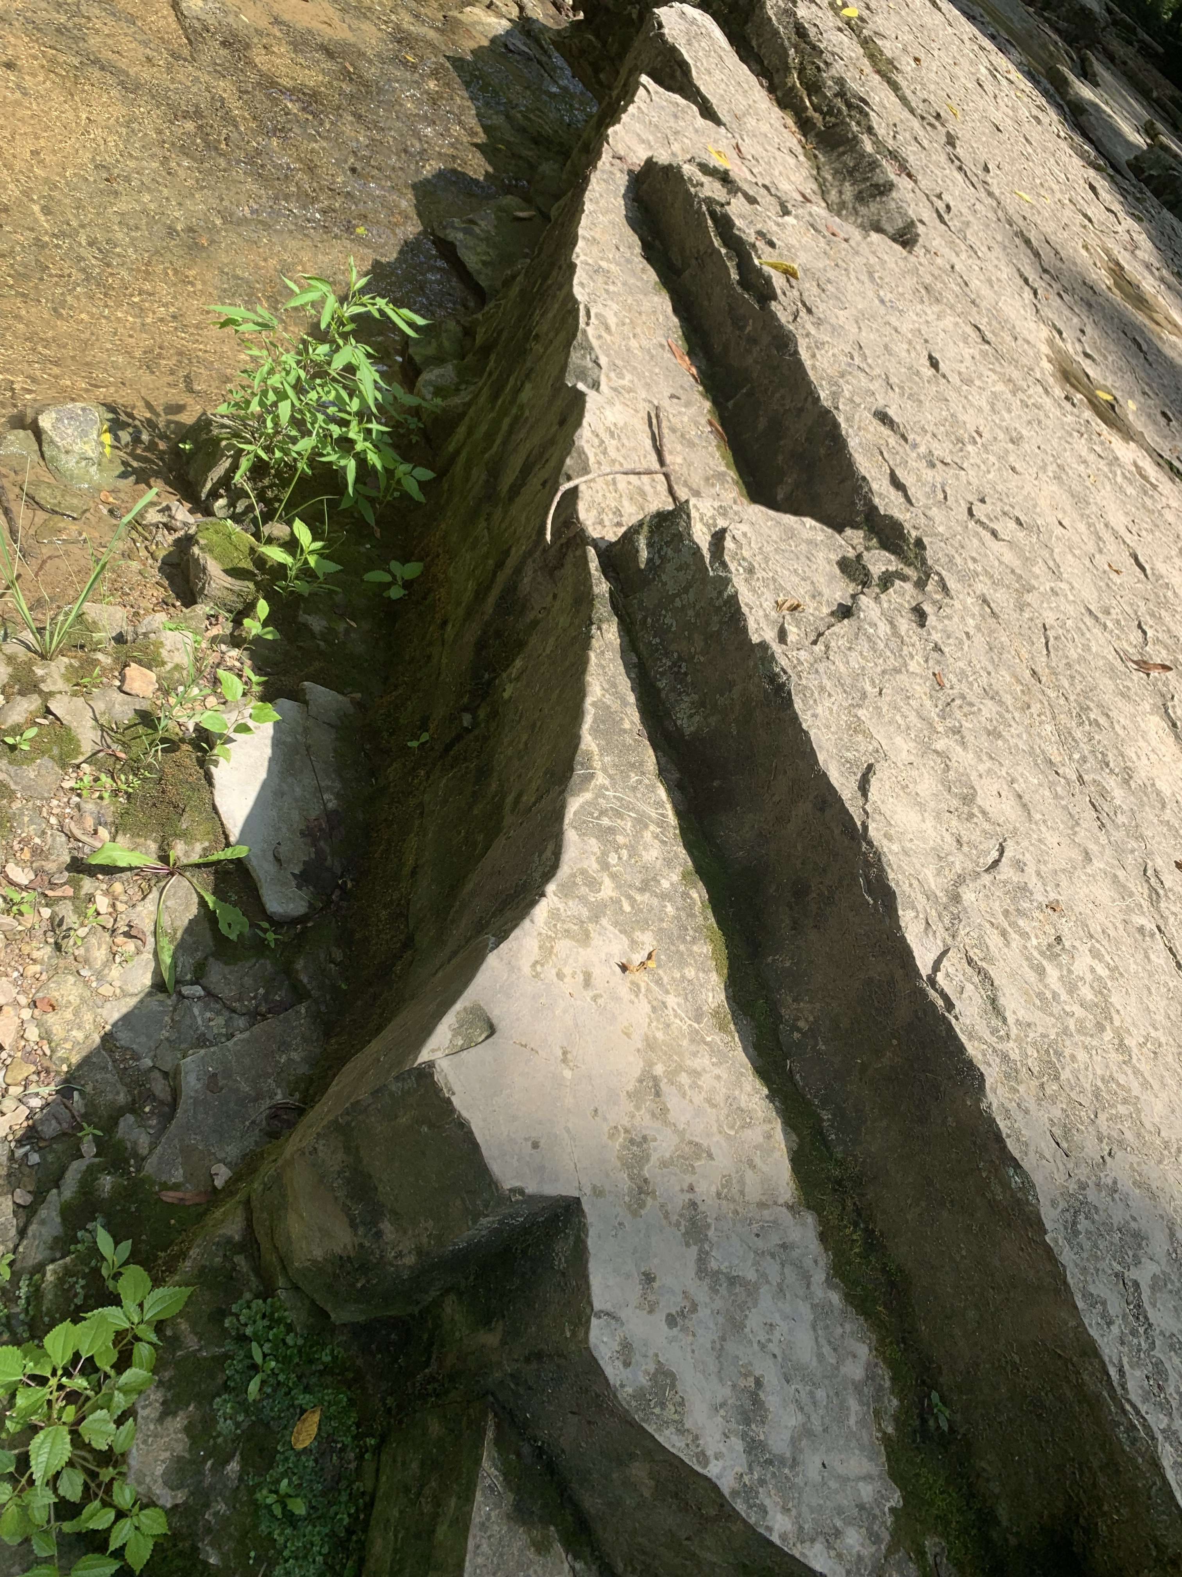
Methods/Approach
A 1-D numerical model is employed (developed by Drs. Sarah Schanz and Brian Yanites)
  Model purpose: Simulate meandering bedrock channels and vary rock uplift rates, bedrock strength anisotropy, and sediment supply/transport capacity.
For my project:
Bedrock Type/Strength
Model variables: kl, kf, and channel type
I used the numerical model to test the sensitivity of bedrock meandering development to lithologic strength differences (kl, kf)

Slide 6
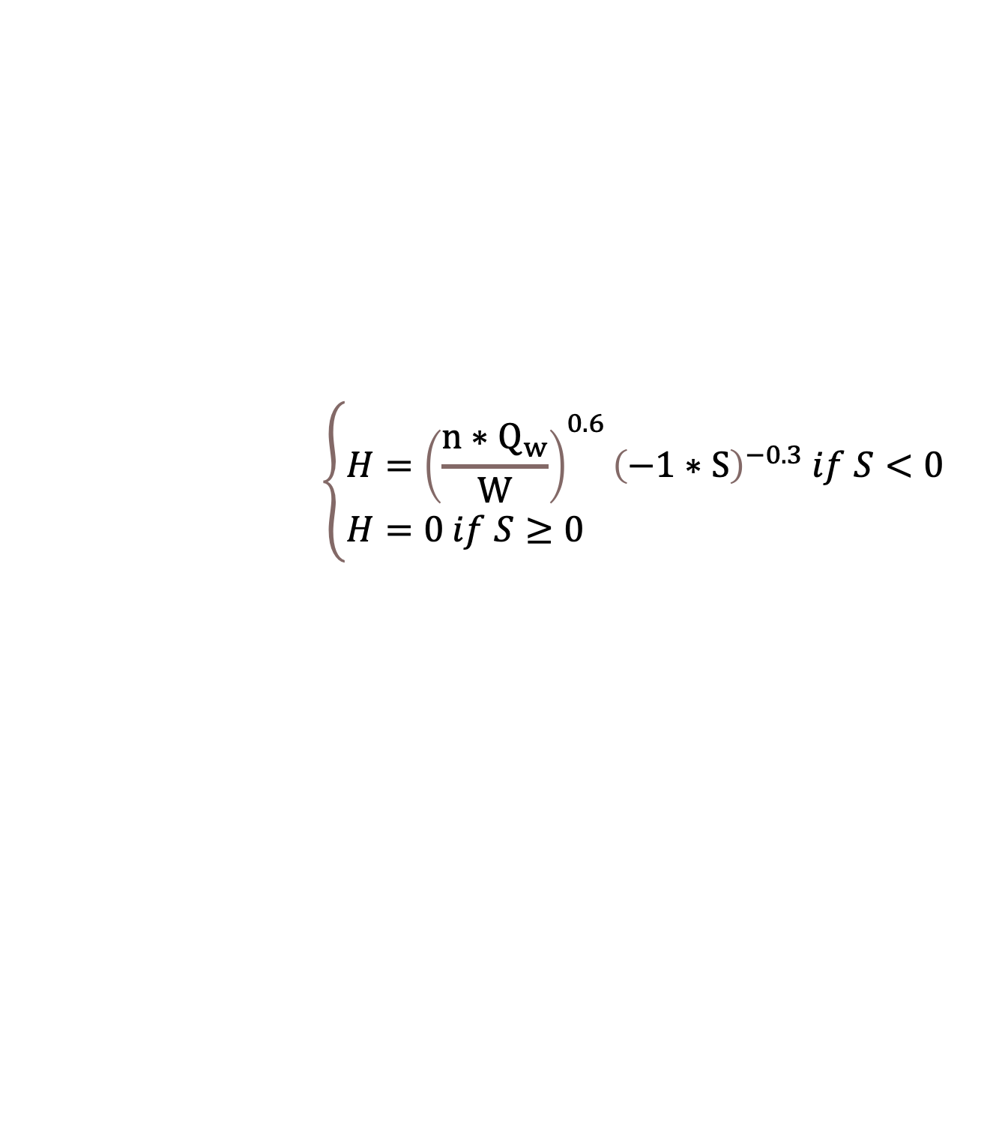

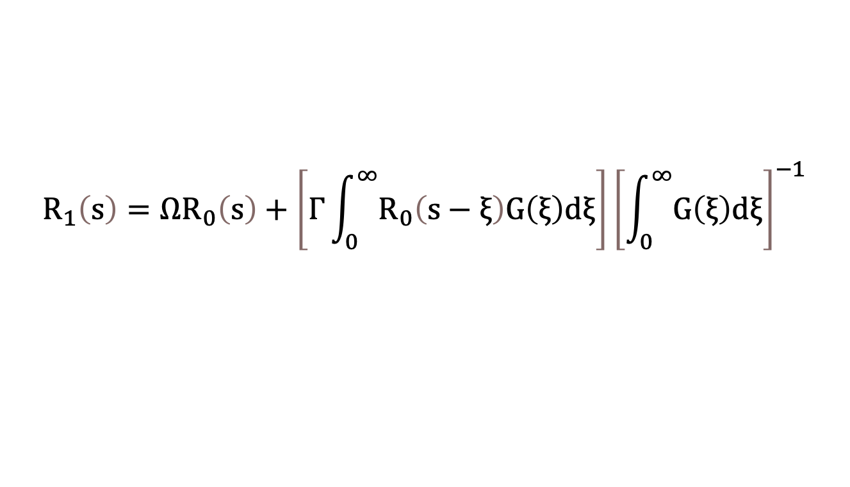

Model Framework: Governing Equations
(1) Water Depth
$$\left\{\begin{aligned}&H={\left(\frac{n∗Q_{w}}{W}\right)}^{0.6}{\left(−1∗S\right)}^{−0.3} if S<0 \\ &H=0 if S≥0\end{aligned}\right.$$
The water depth at bankfull discharge is approximated using the wide channel assumption and estimated with Manning’s equation
(Manning’s equation)
(2) Vertical Erosion
$$E=k_{f}τ_{b}dt$$
(Howard & Kerby, 1983; Whipple & Tucker, 1999; Whipple et al., 2000)
Vertical erodibility
(3) Lateral Migration
$$R_{0}=Wk_{l}c$$
(Nominal Migration Rate)
Lateral erodibility
$$R_{1}\left(s\right)=ΩR_{0}\left(s\right)+\left[Γ\int_{0}^{∞}{R_{0}\left(s−ξ\right)G\left(ξ\right)dξ}\right]{\left[\int_{0}^{∞}{G\left(ξ\right)dξ}\right]}^{−1}$$
(Howard and Knutson, 1984)
Adjusted Migration Rate

Slide 7
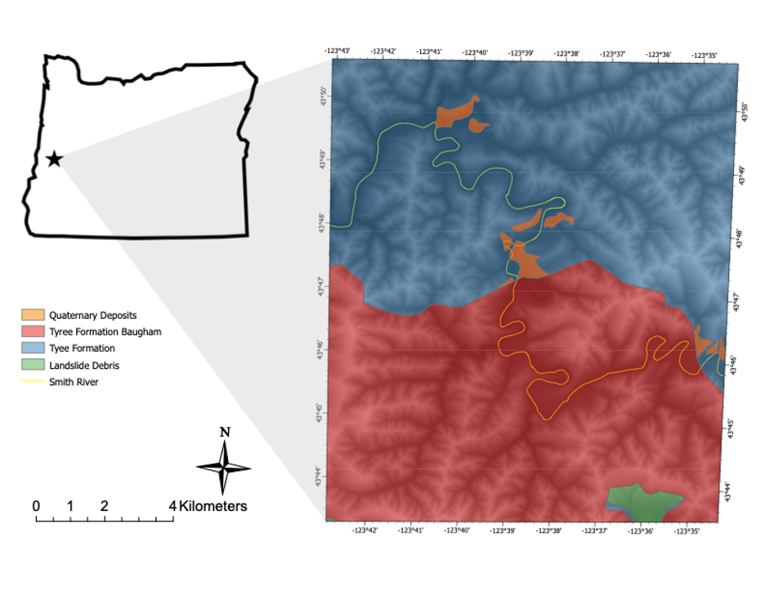
Uplifted Oregon
The Smith River, one of the largest tributaries of the Umpqua River in Oregon State
It has been historically proven to be a single thread meandering bedrock river with thin sediments
Primary Area of Interest

Slide 8
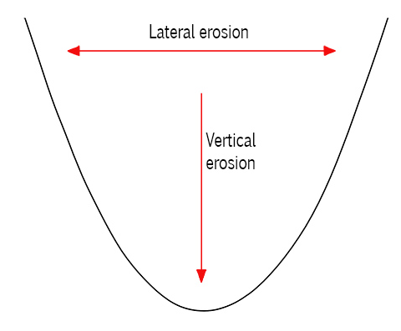
Lateral & Vertical Erodibility (kl & kf)
Lateral and vertical erosion rates vary across meandering channels
How are those values calculated?
  Lateral and vertical erosion depend on the lateral and vertical erodibility, or susceptibility to erosion
What are lateral (kl) and vertical (kf) erodibilities?
  Empirically derived

Slide 9
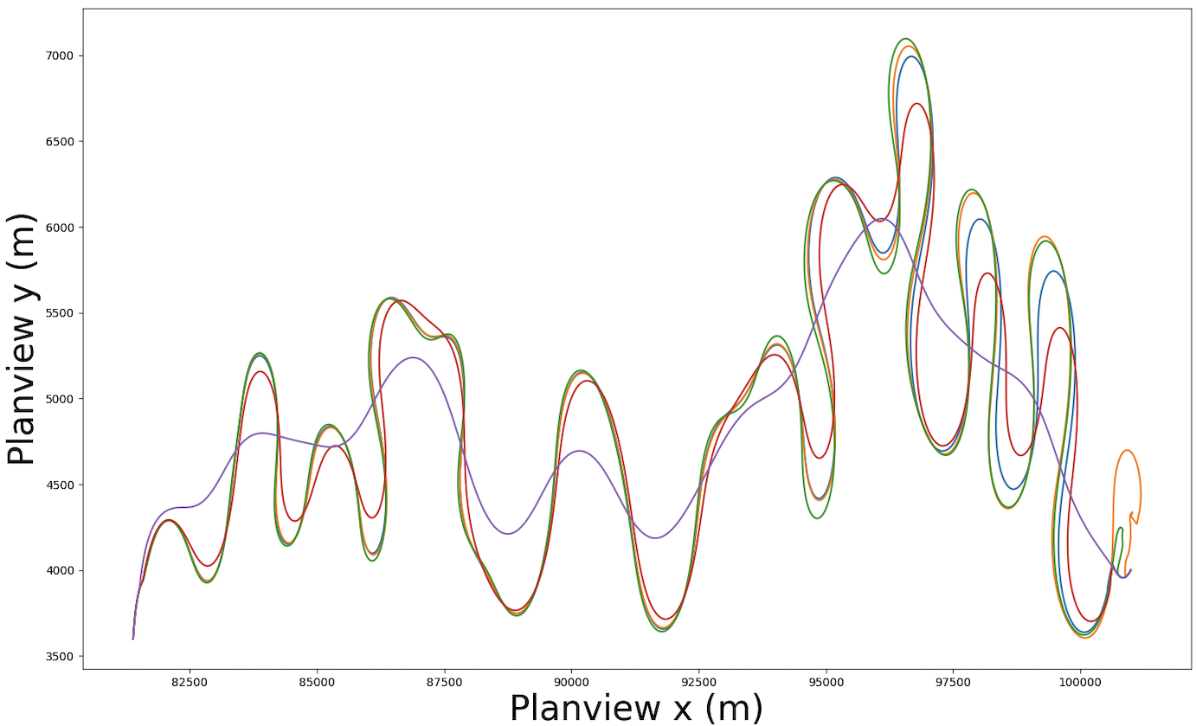
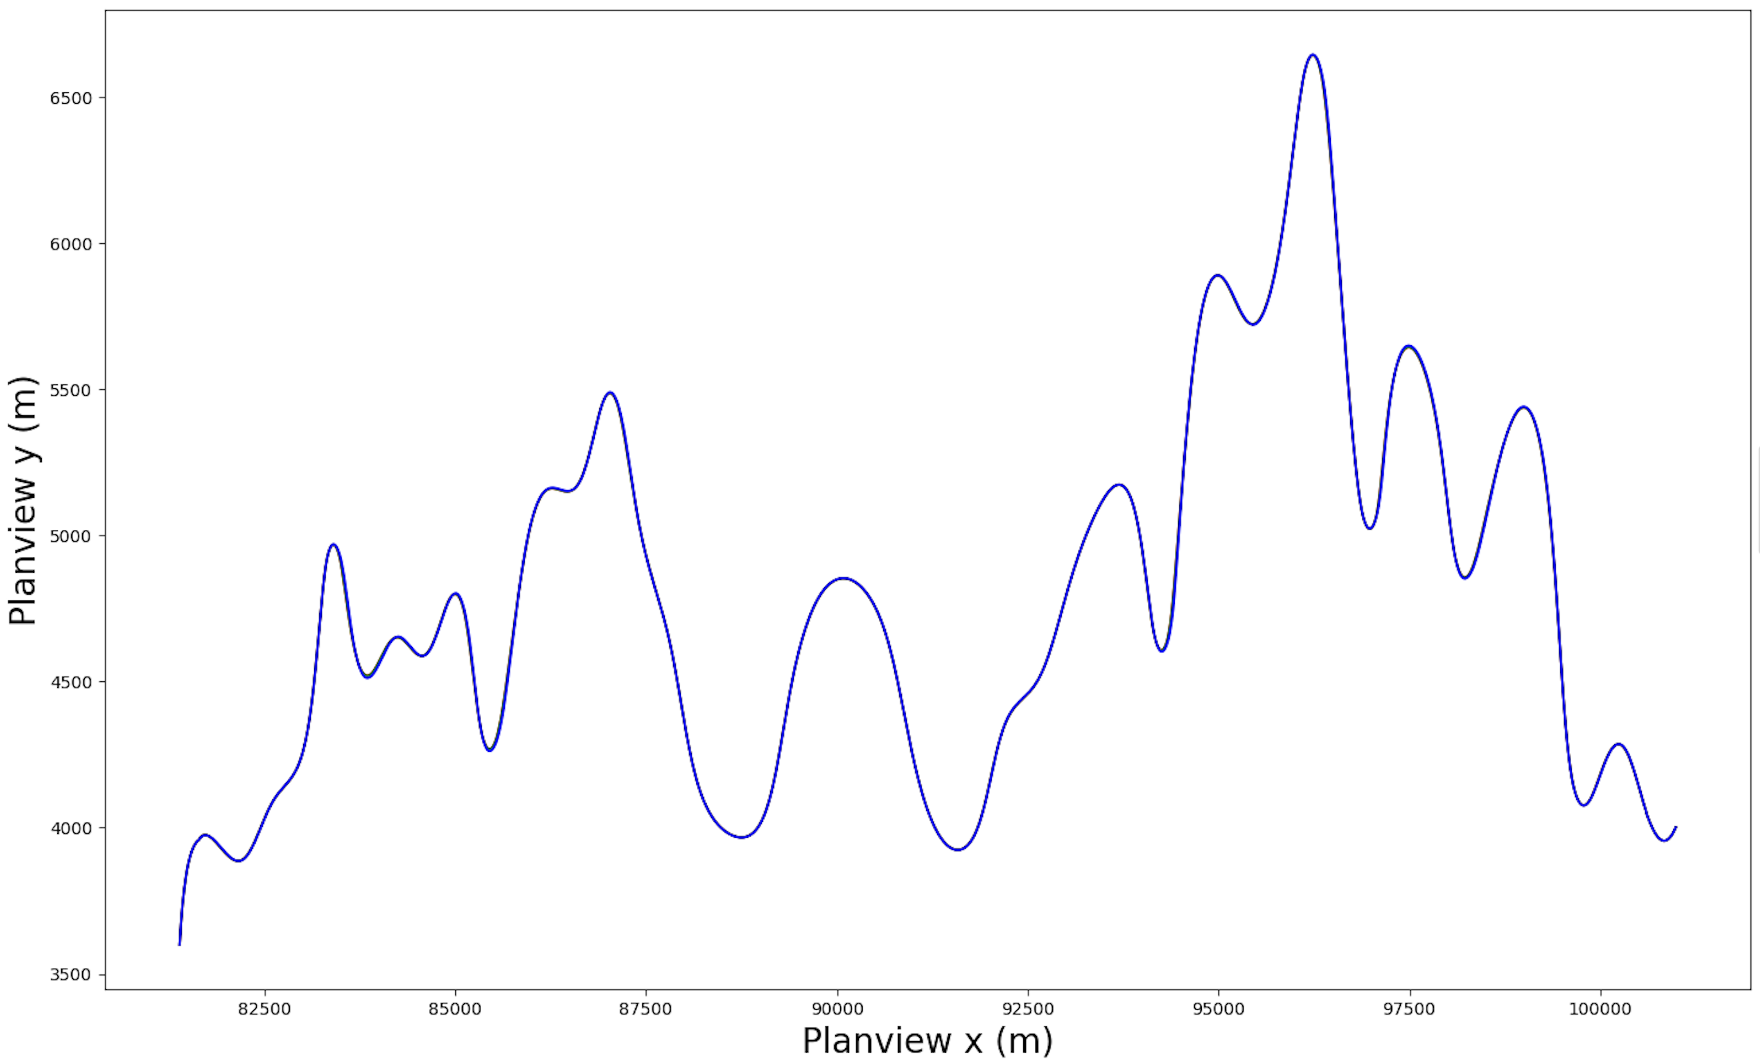
Independent Variables
After 100,000 model years
Initial Conditions of the channel:
Sinuosity: 1.42

Slide 10
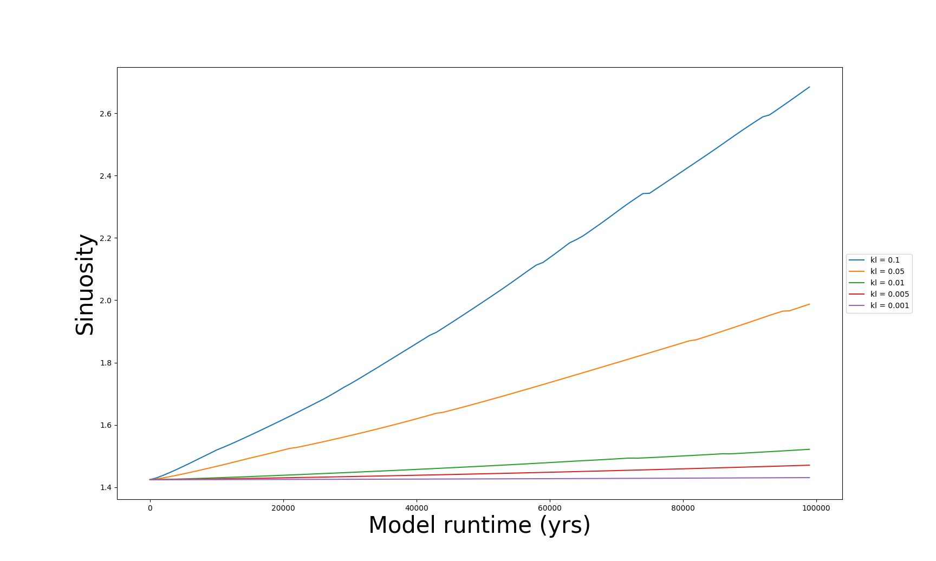
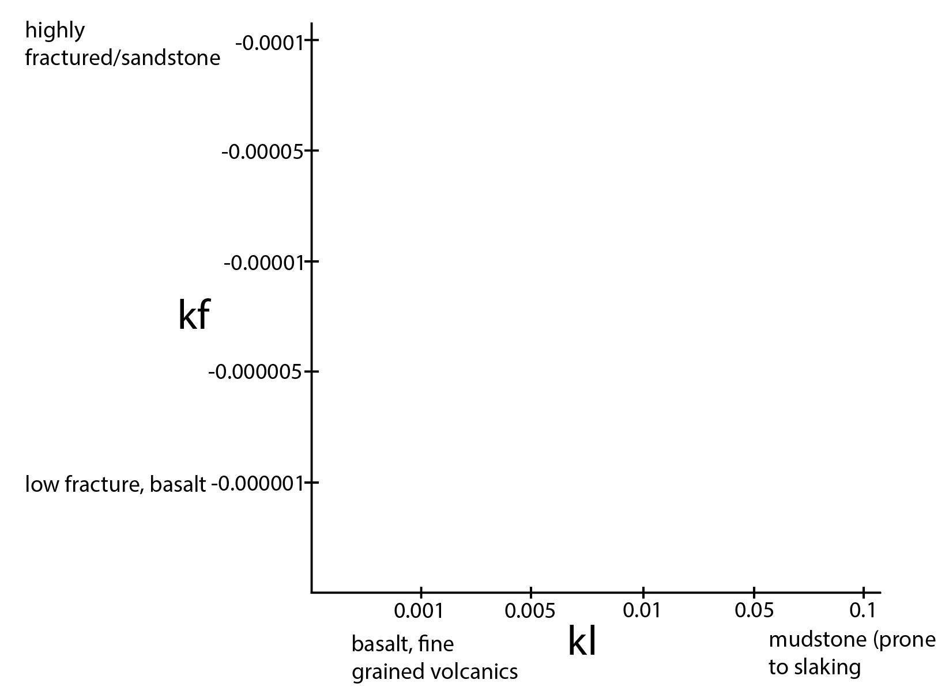
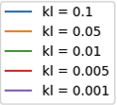
Variable 1: Lateral Erodibility (kl)
When kf is set to -0.000001 (low vertical erodibility), high lateral erodibility channels get very sinuous:
2.68
kl = 0.1, 0.05 (high lateral erodibility)
(Lateral Erodibility)
1.99
kl = 0.01, 0.005, 0.001
(low lateral erodibility)
1.52

Slide 11
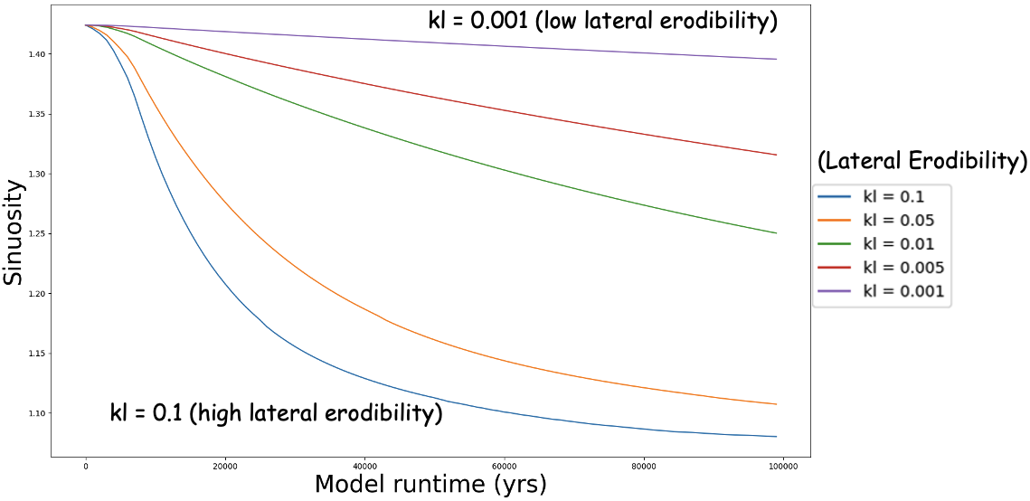
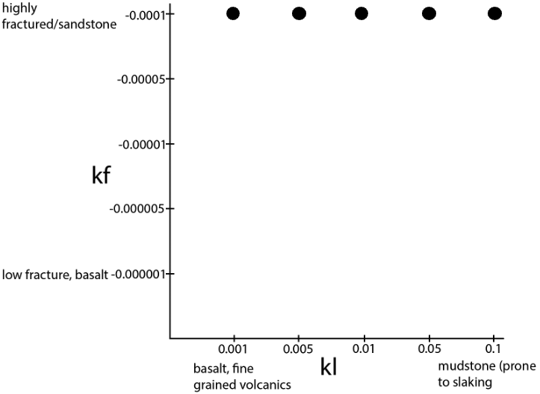
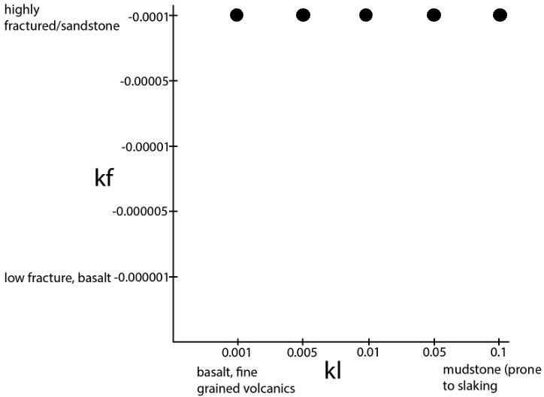
BUT: when kf is set to -0.0001 (high vertical erodibility), those same high lateral erodibility channels become straight

Slide 12
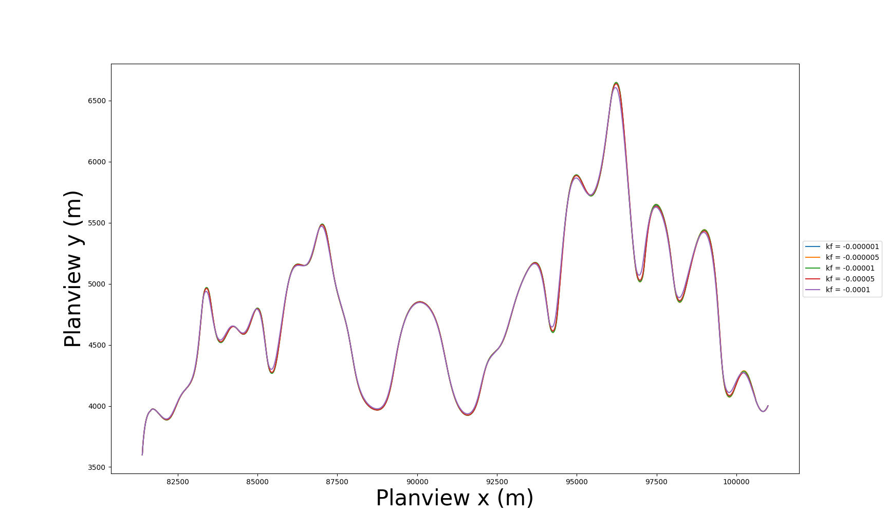
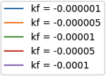
Variable 2: Vertical Erodibility (kf)
When kl is set to 0.001 (low lateral erodibility), vertical erodibility has no effect on channel form.
(Vertical Erodibility)
Notes:
lowest

Slide 13
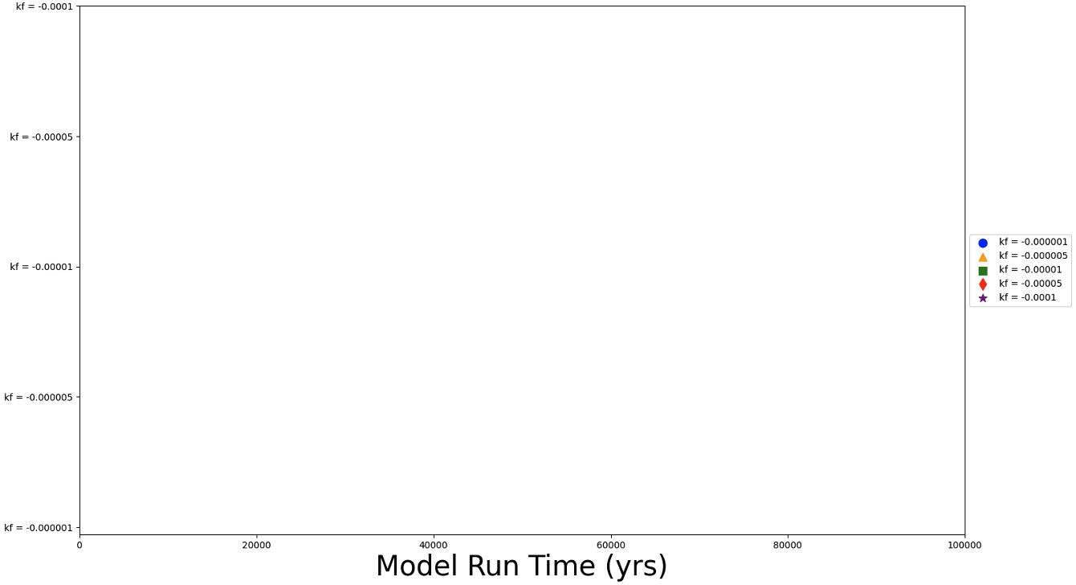

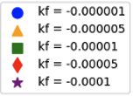
And there are no cutoffs! Channels are highly stable
Low Lateral Erodibility kl = 0.001
Vertical Erodibility (kf)
(Vertical Erodibility)

Slide 14
Channel Type
No Change
Rectangular
Trapezoidal
Constant width and height
Only channel width will grow with any lateral erosion
Based on slaking bedrock model proposed by Finnegan and Balco (2015)
Channel width and height will grow with both lateral and vertical erosion
Time 1
Time 1
Time 1
Time 2
Time 2
Time 2

Slide 15
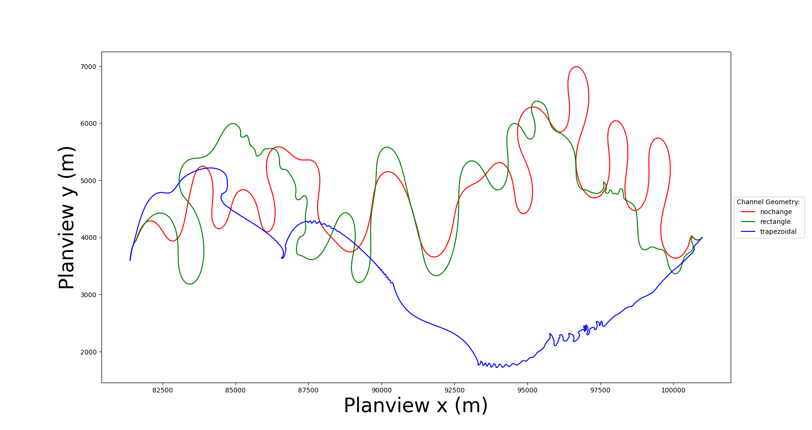
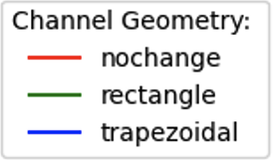
Variable 3: Channel Geometry
When kl = 0.05 (high lateral erodibility), kf = -0.000001 (low vertical erodibility), the trapezoidal channel shape becomes braided!
Braided channels: high frequency, low amplitude meanders with frequent cutoffs!

Slide 16
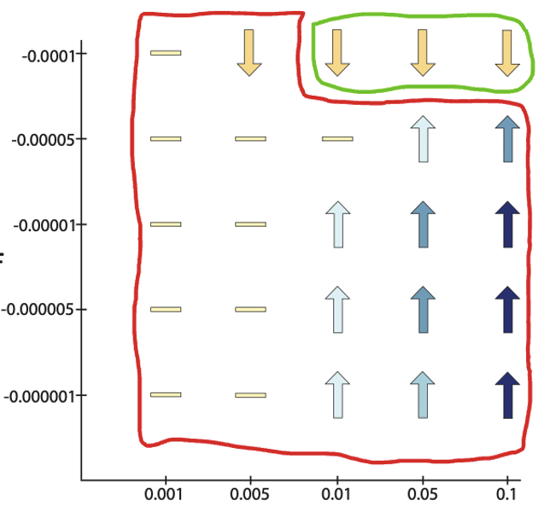
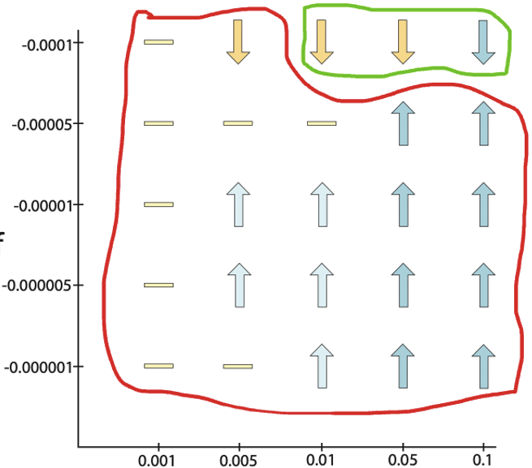
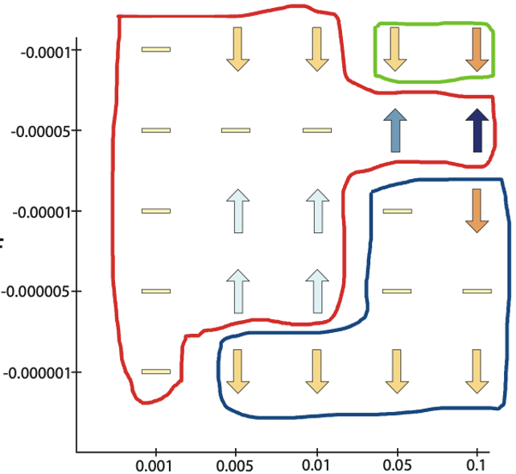
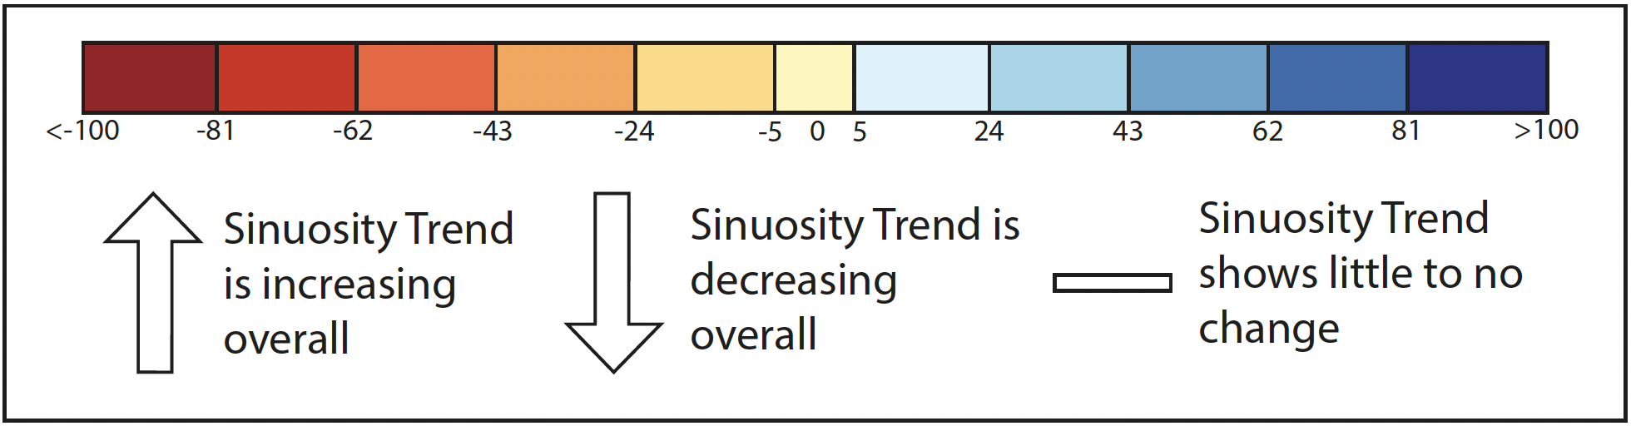
nochange
rectangle
trapezoidal
Vertical Erodibility
Vertical Erodibility
Vertical Erodibility
Lateral Erodibility
Lateral Erodibility
Lateral Erodibility
Straight: dependent on vertical erodibility
Meandering: ratio of vertical to lateral erodibility
Braided: dependent on simulated channel type
Notes:
These three graphs show the overall sinuosity patterns at 100 kys.
Channels evolved to be a straight channel have a very high vertical erodibility
Meandering river channels maintained a certain ratio of vertical to lateral erodibility. As you can see from this graph, most of them are meandering.
In order to form a braided river channel, it is dependent on the simulated channel type.
what type of rock might have high lateral erodibility but low vertical – slaking rocks commonly show this property

Slide 17
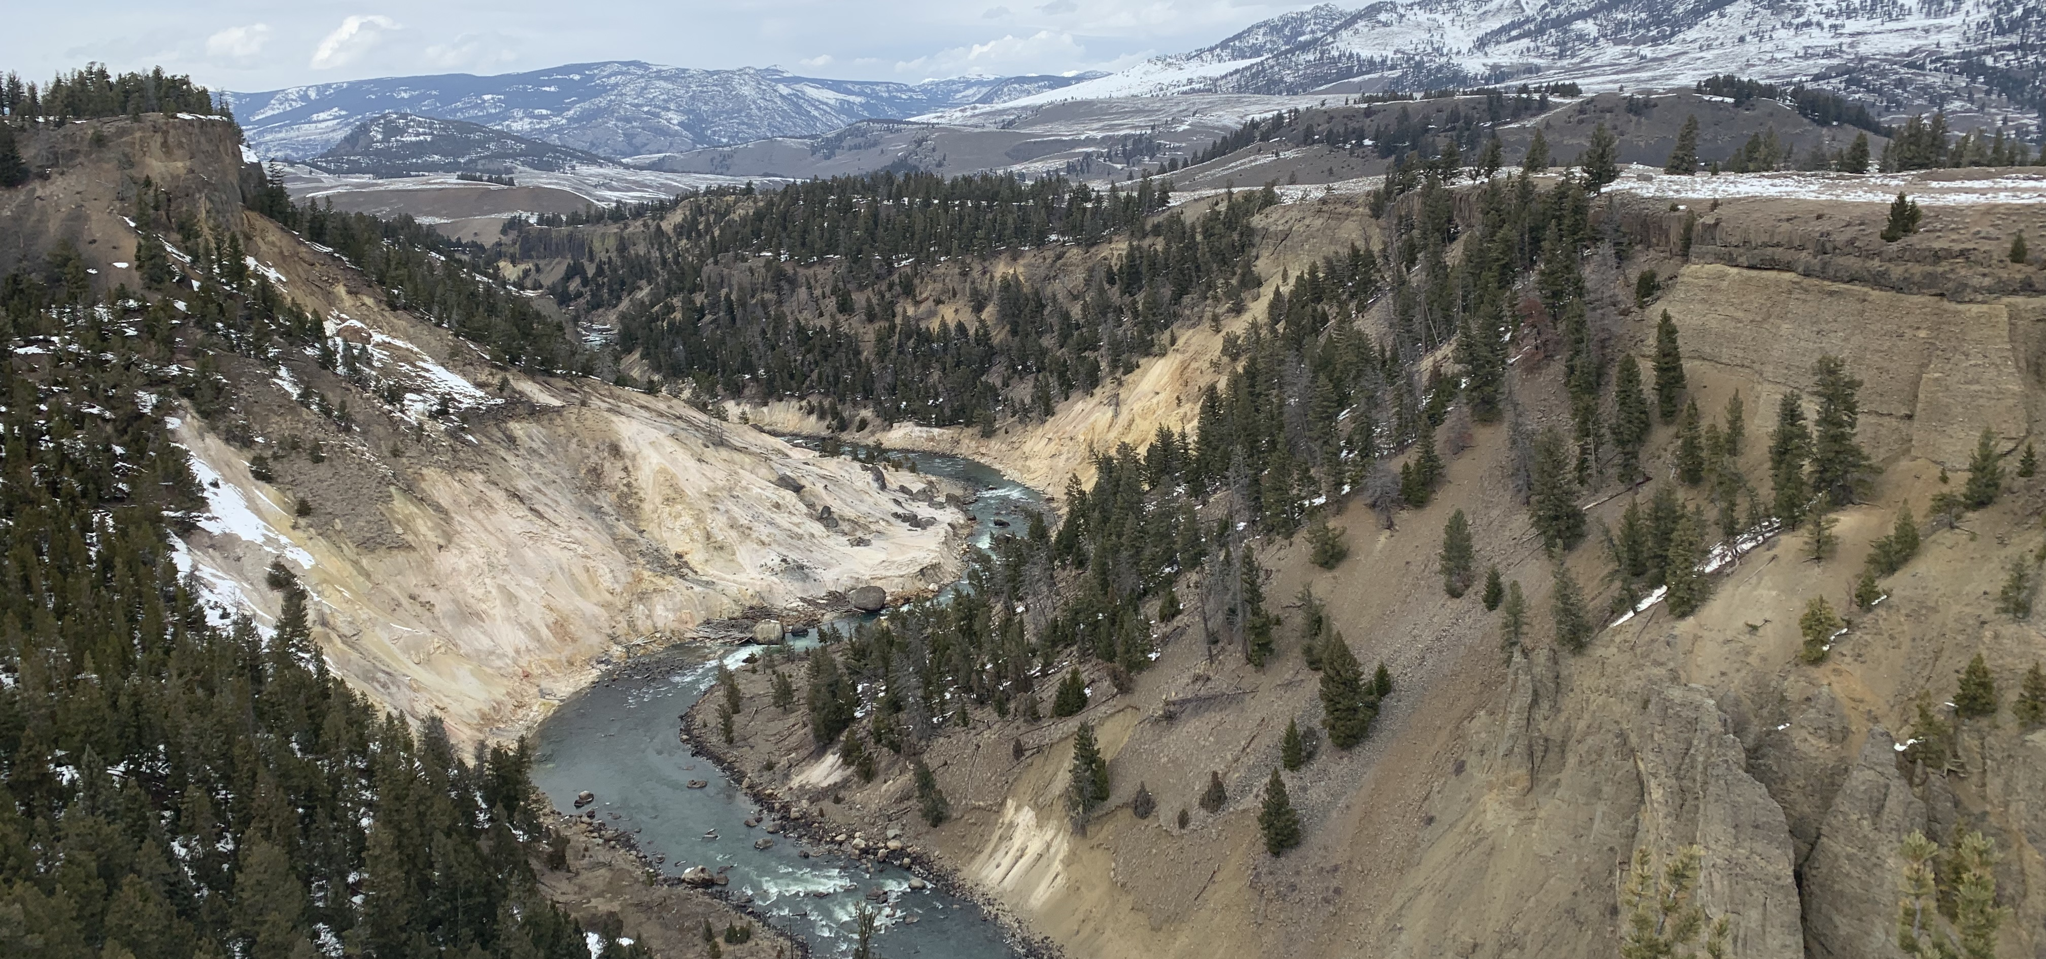
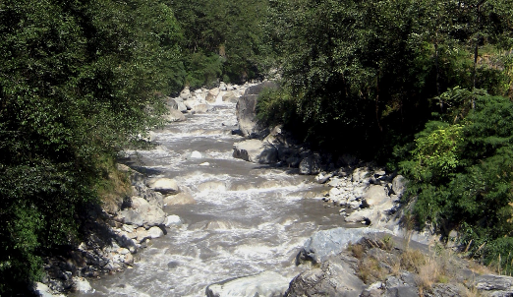
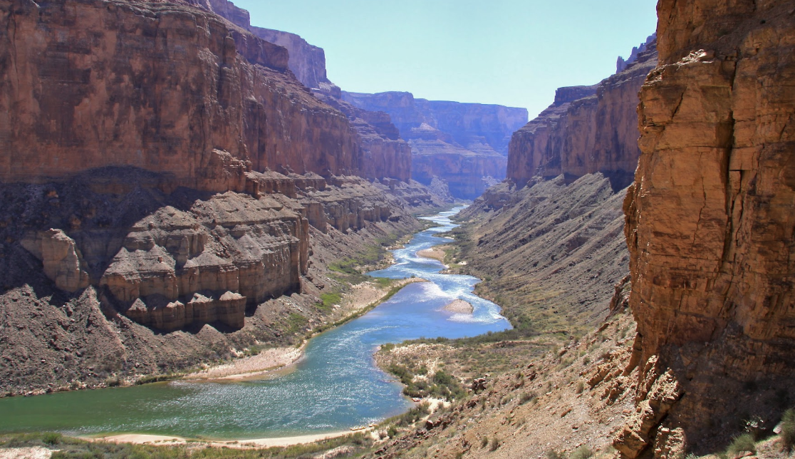
Lithologic Anisotropy
1. Stable meandering (has cutoffs but still has an increased sinuosity)
2. Straight channels (high kf/decreasing trend in sinuosity/few cutoffs)
3. Braided River Channels (low sinuosity/too many cutoffs/ unable to maintain meander stability)
Yellow Stone River
Kali Gandaki Gorge (Nepal)
Grand Canyon - Colorado River

Slide 18
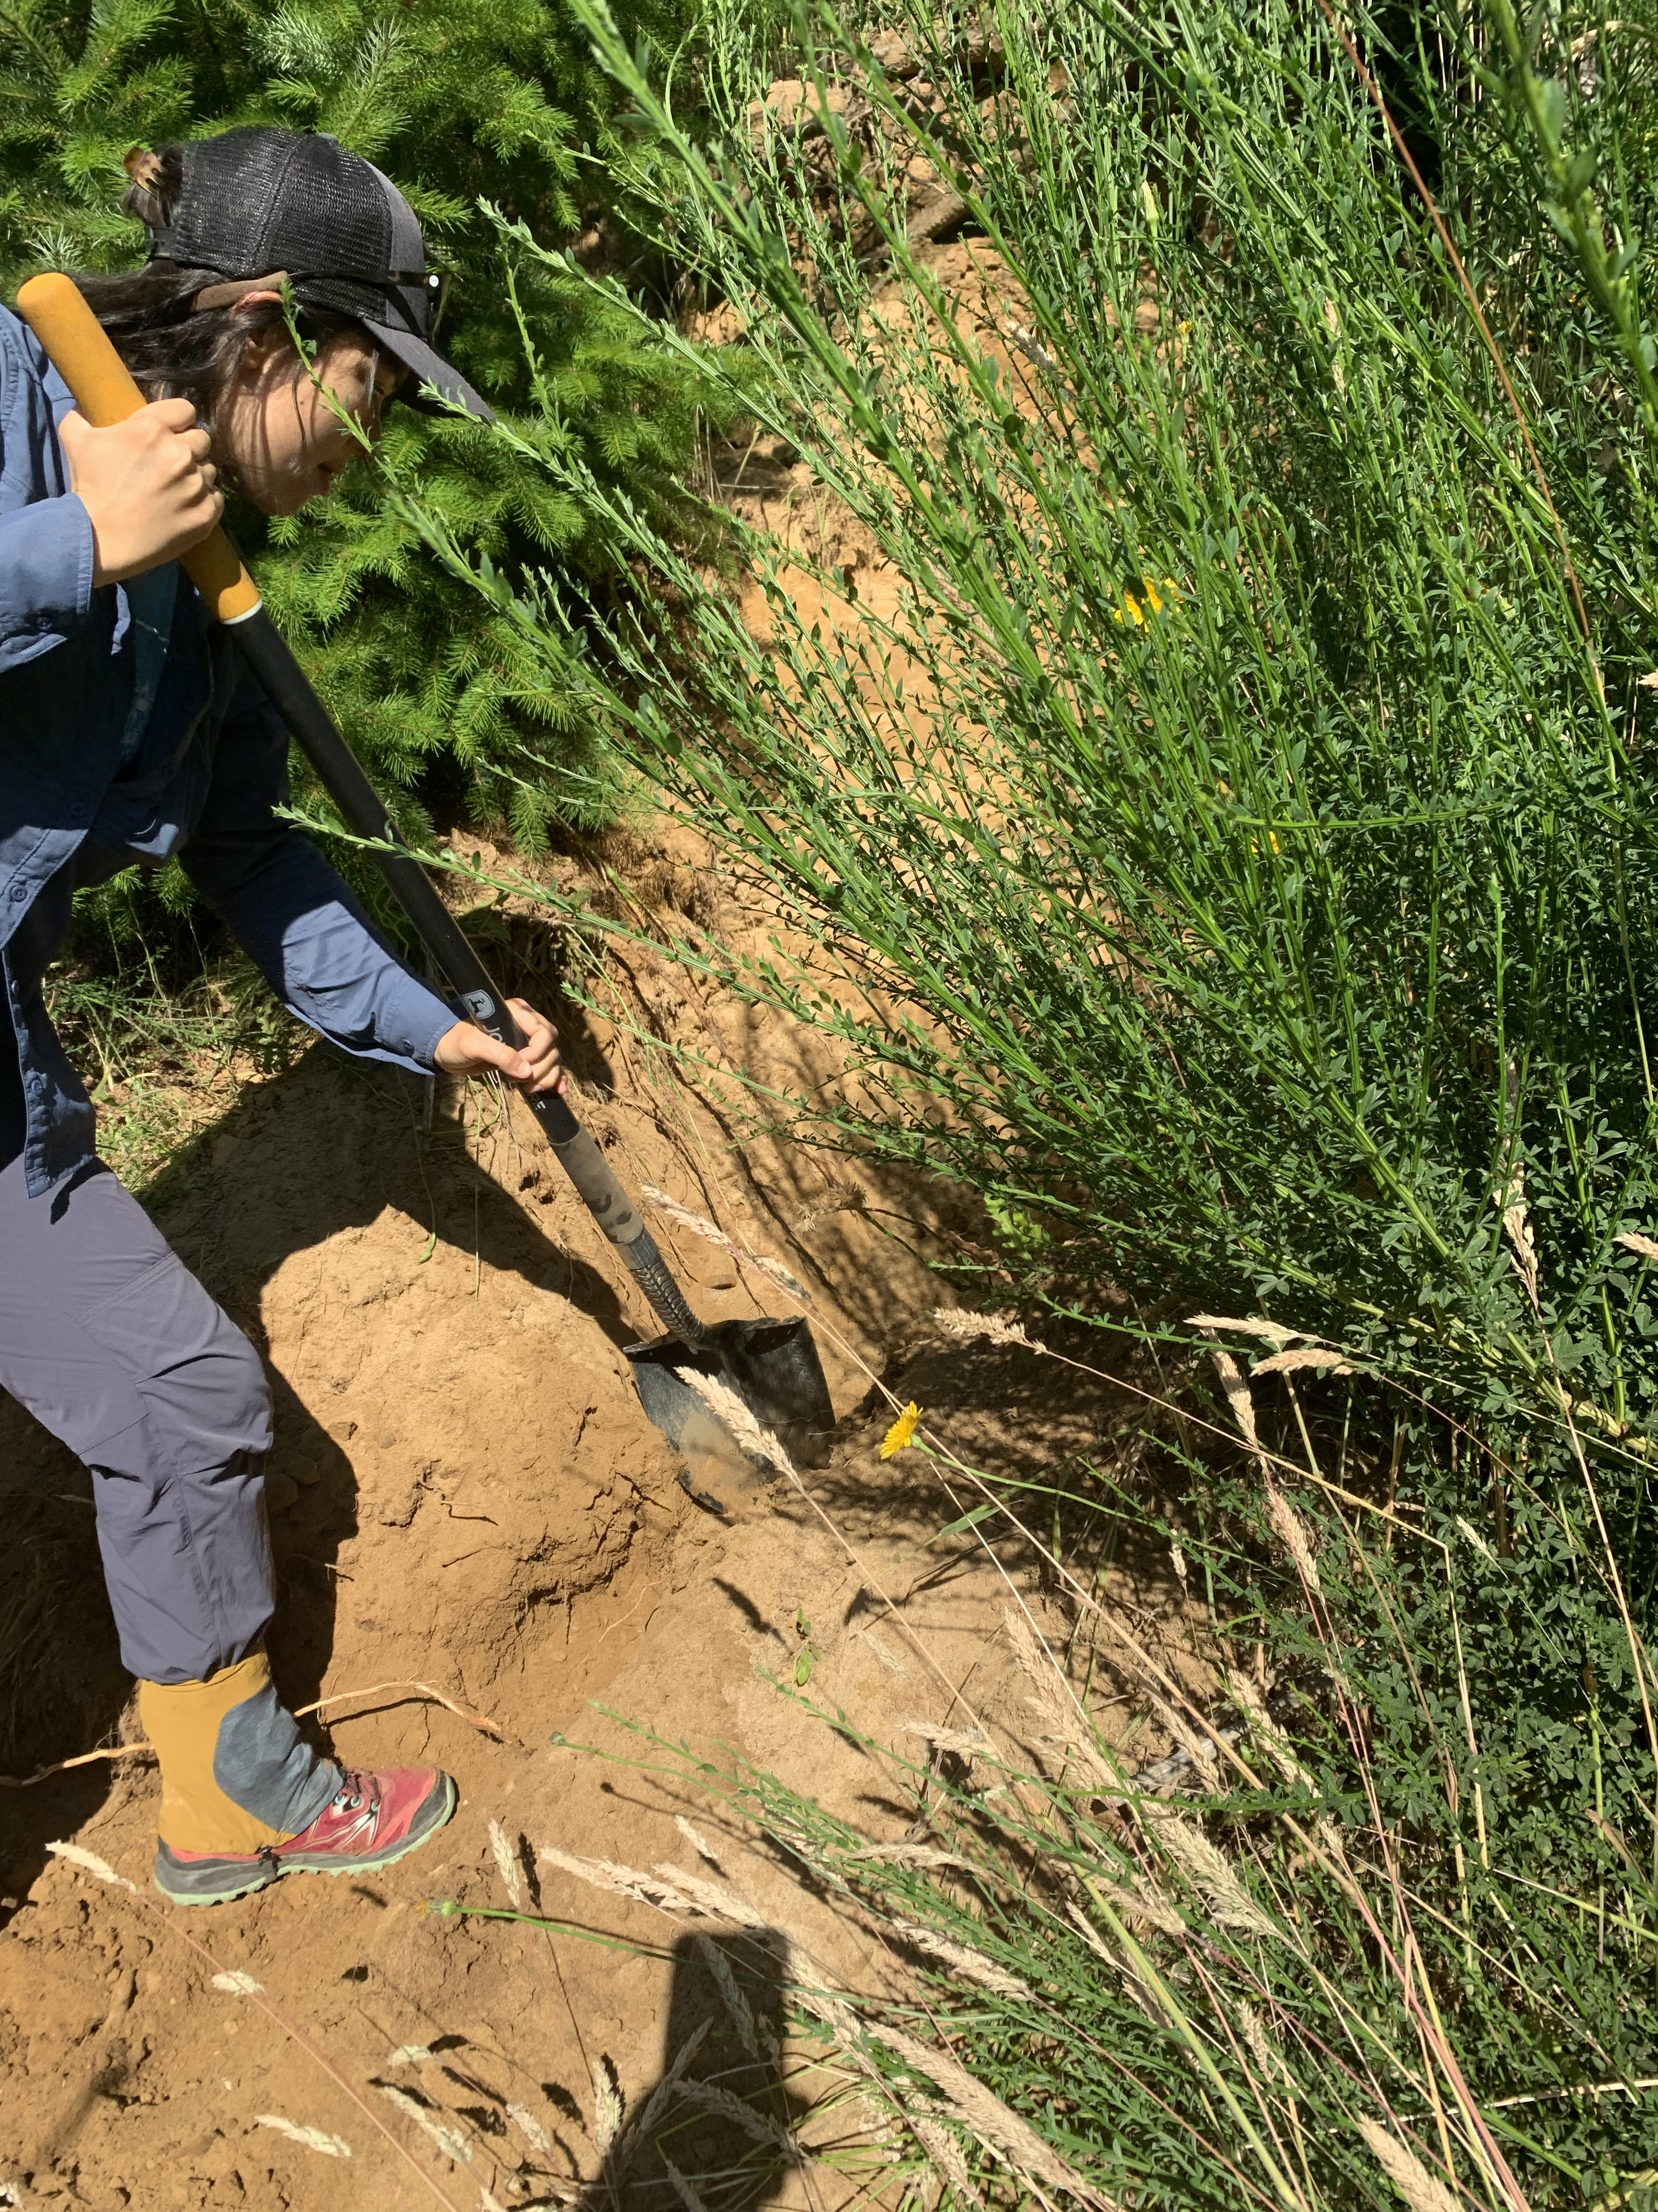
Acknowledgements

Slide 19
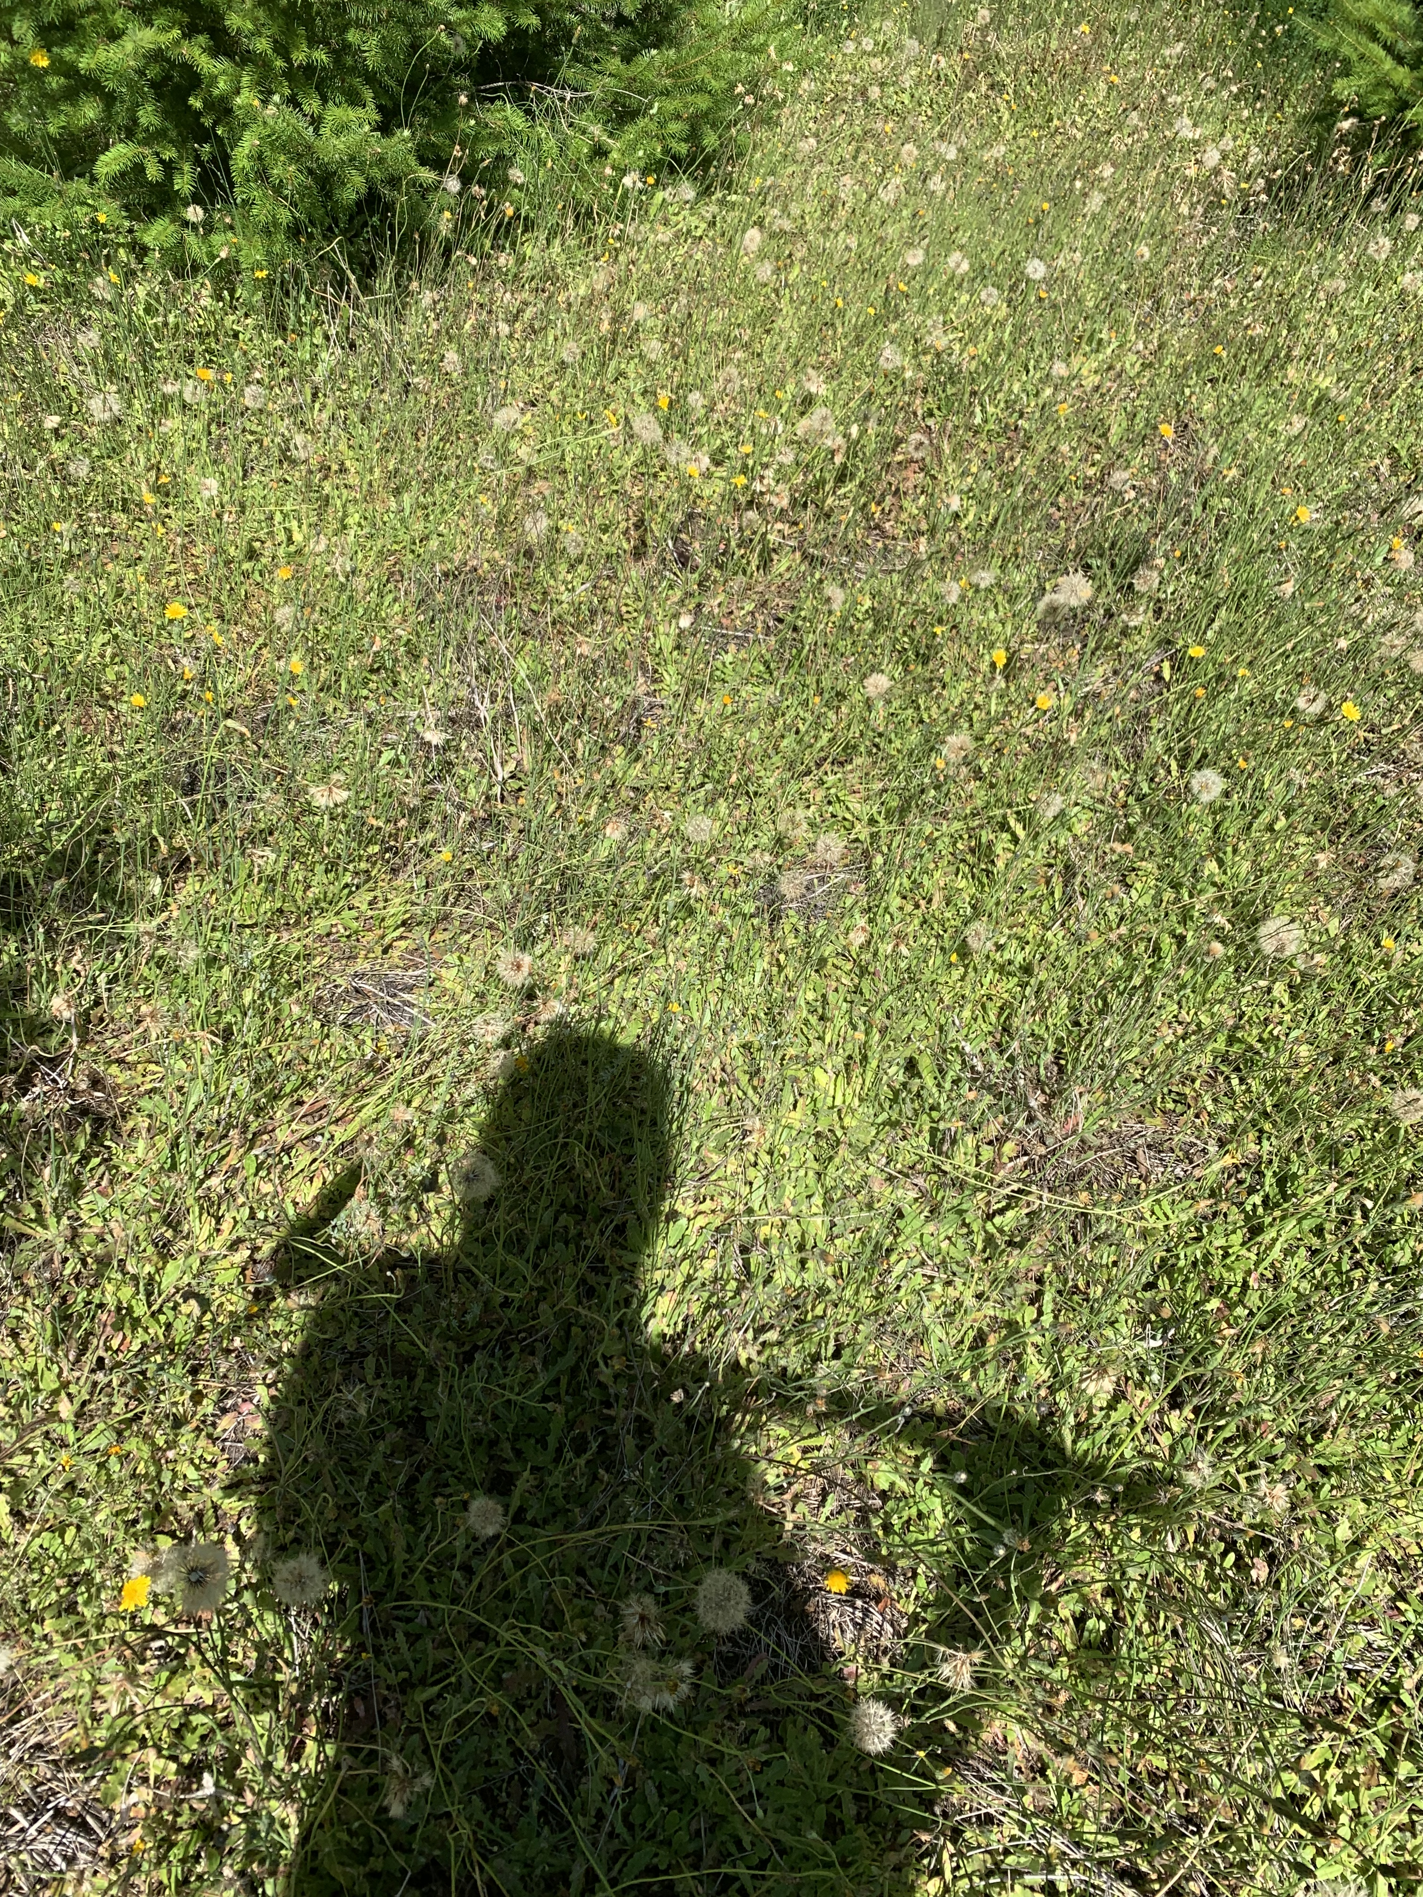
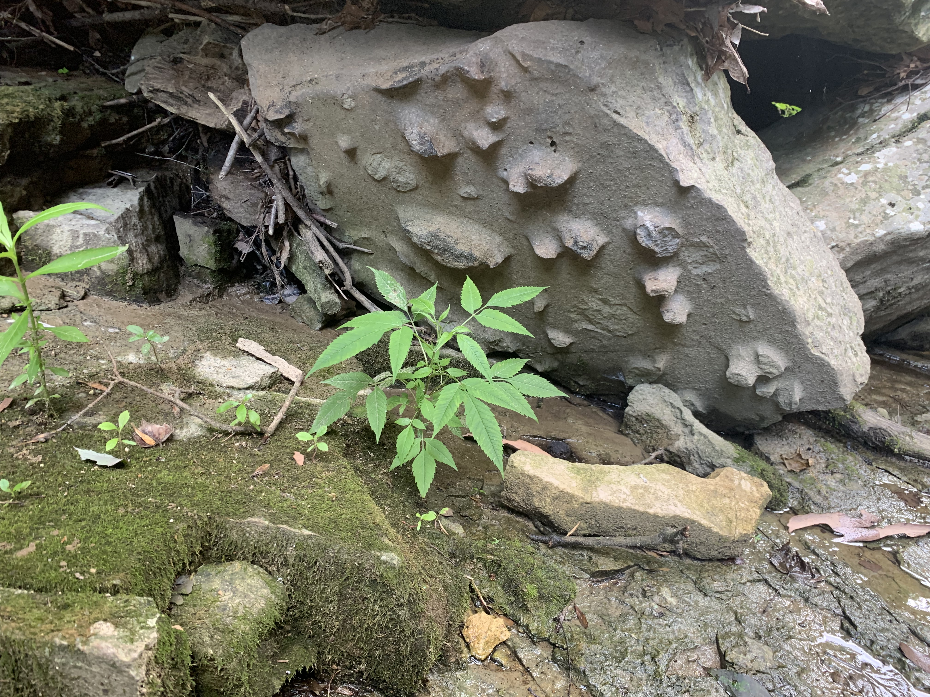
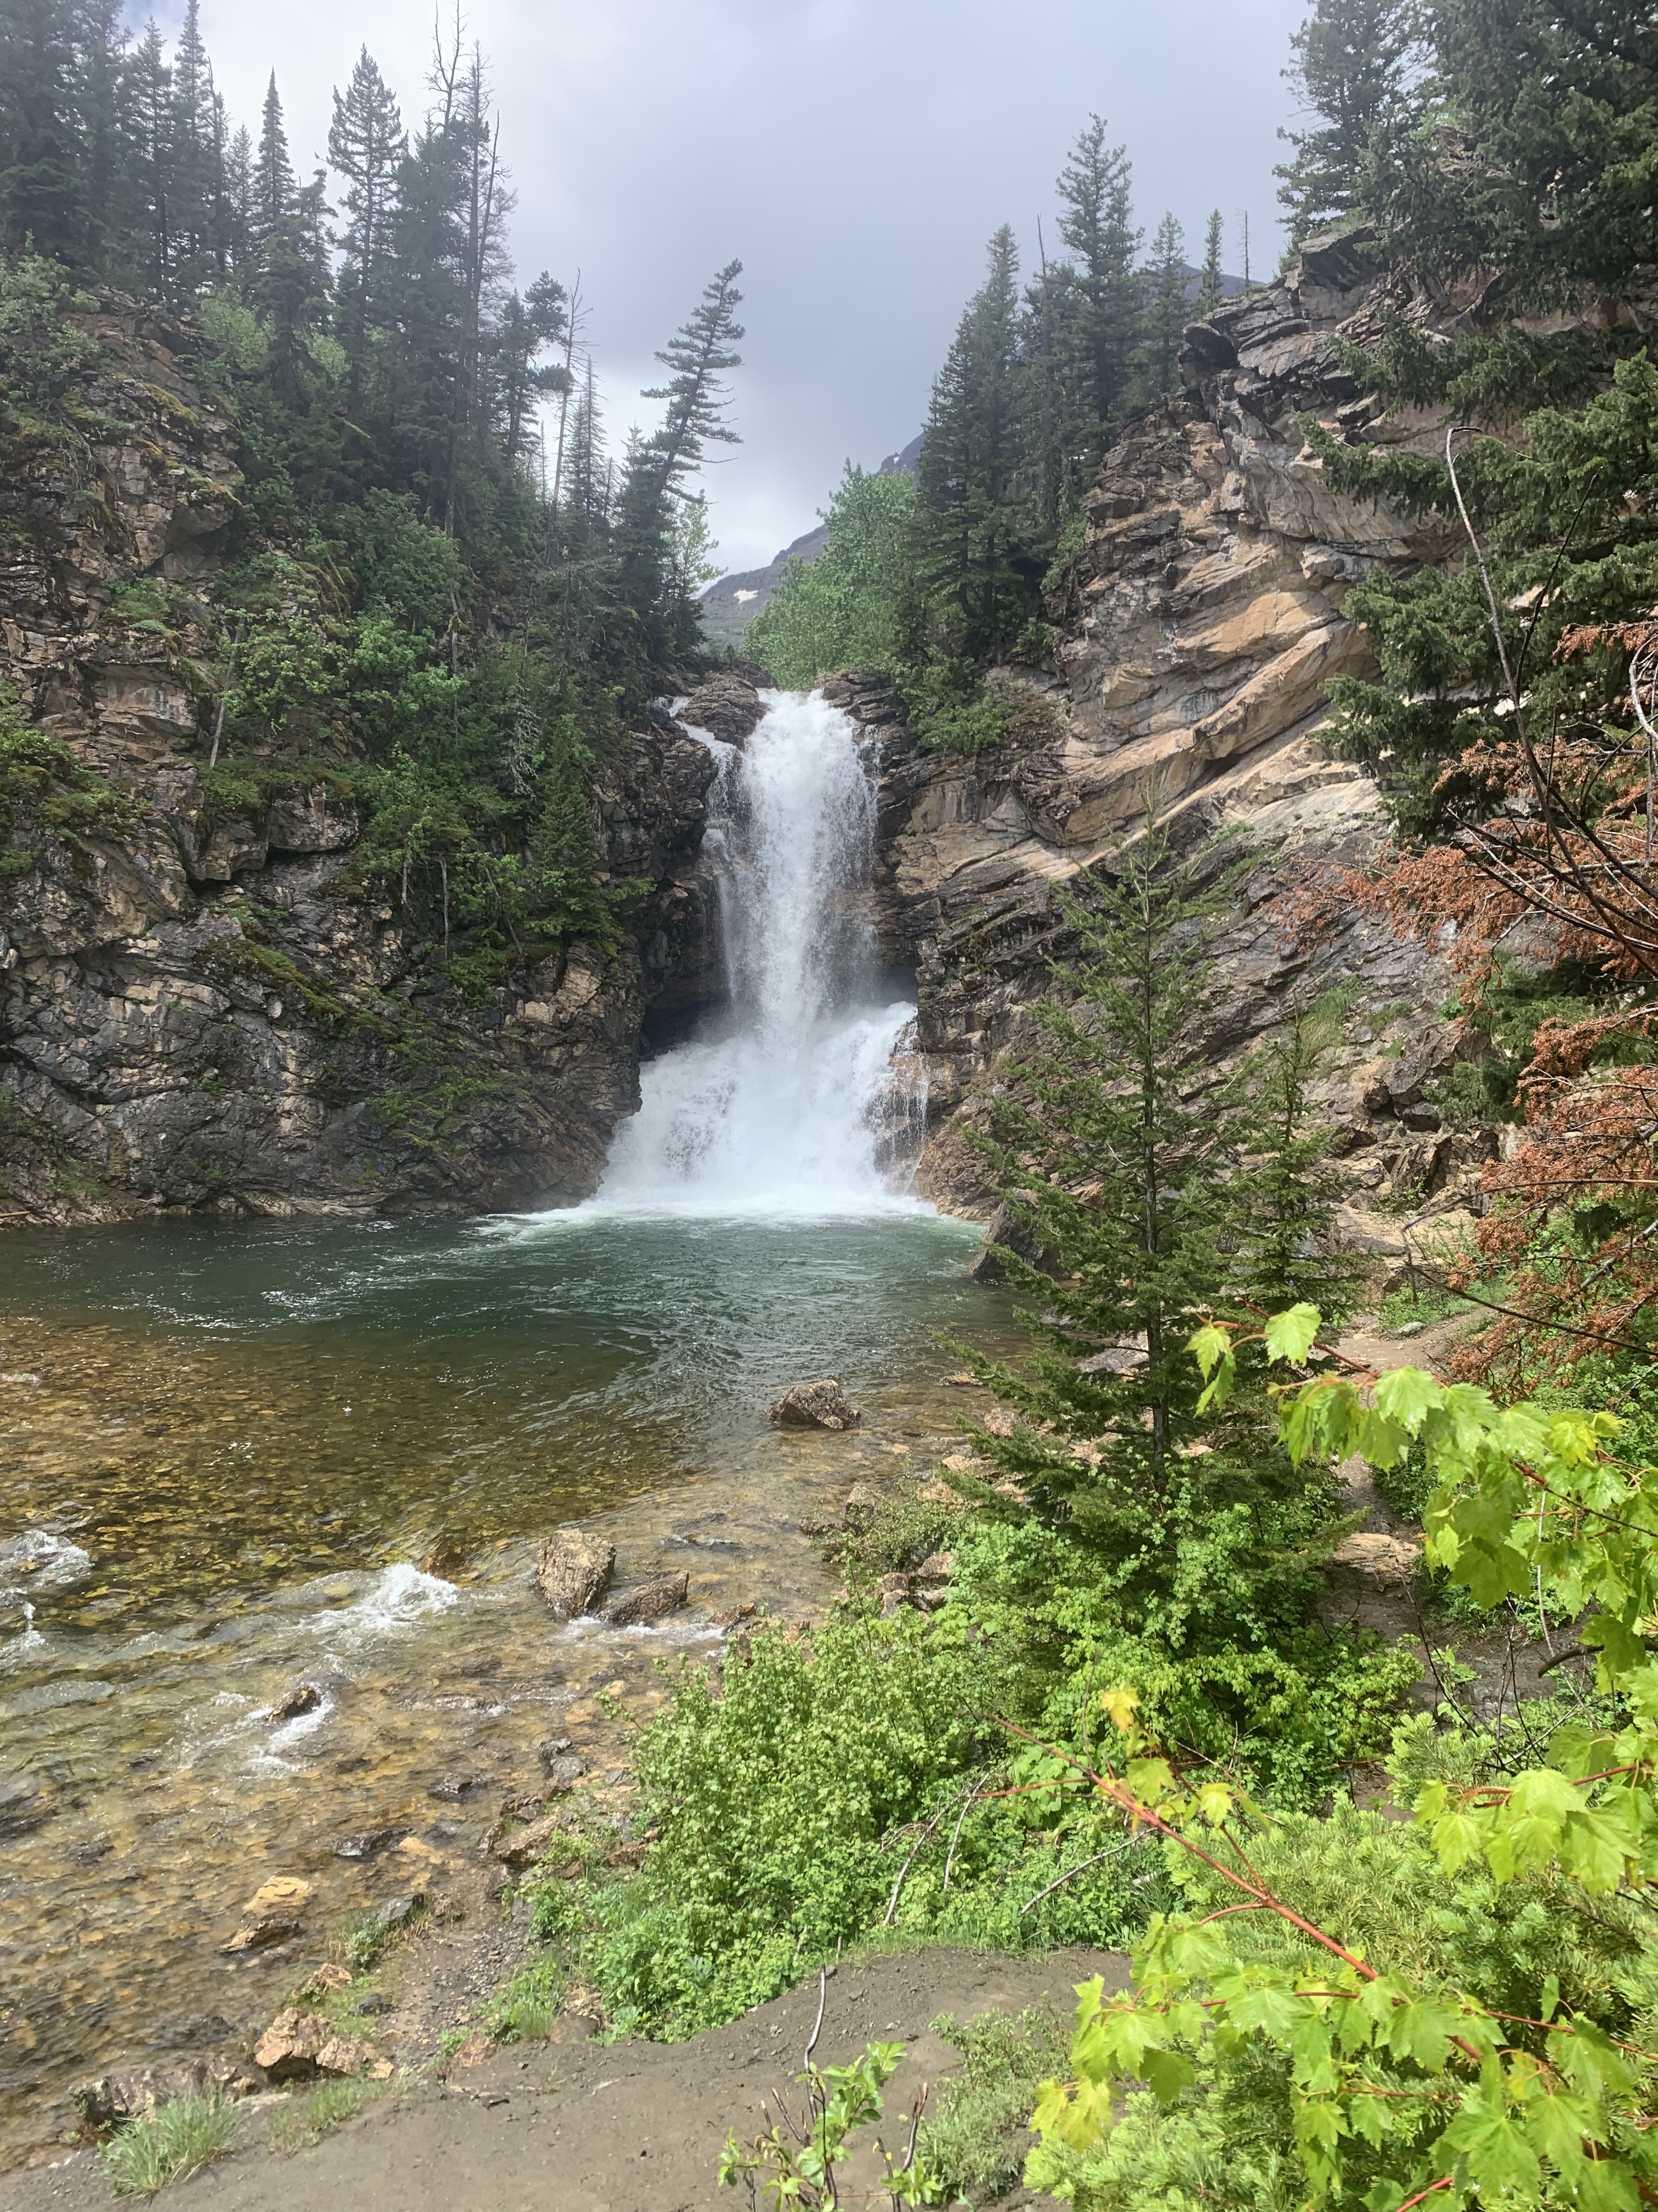
Questions?

