Slide 1
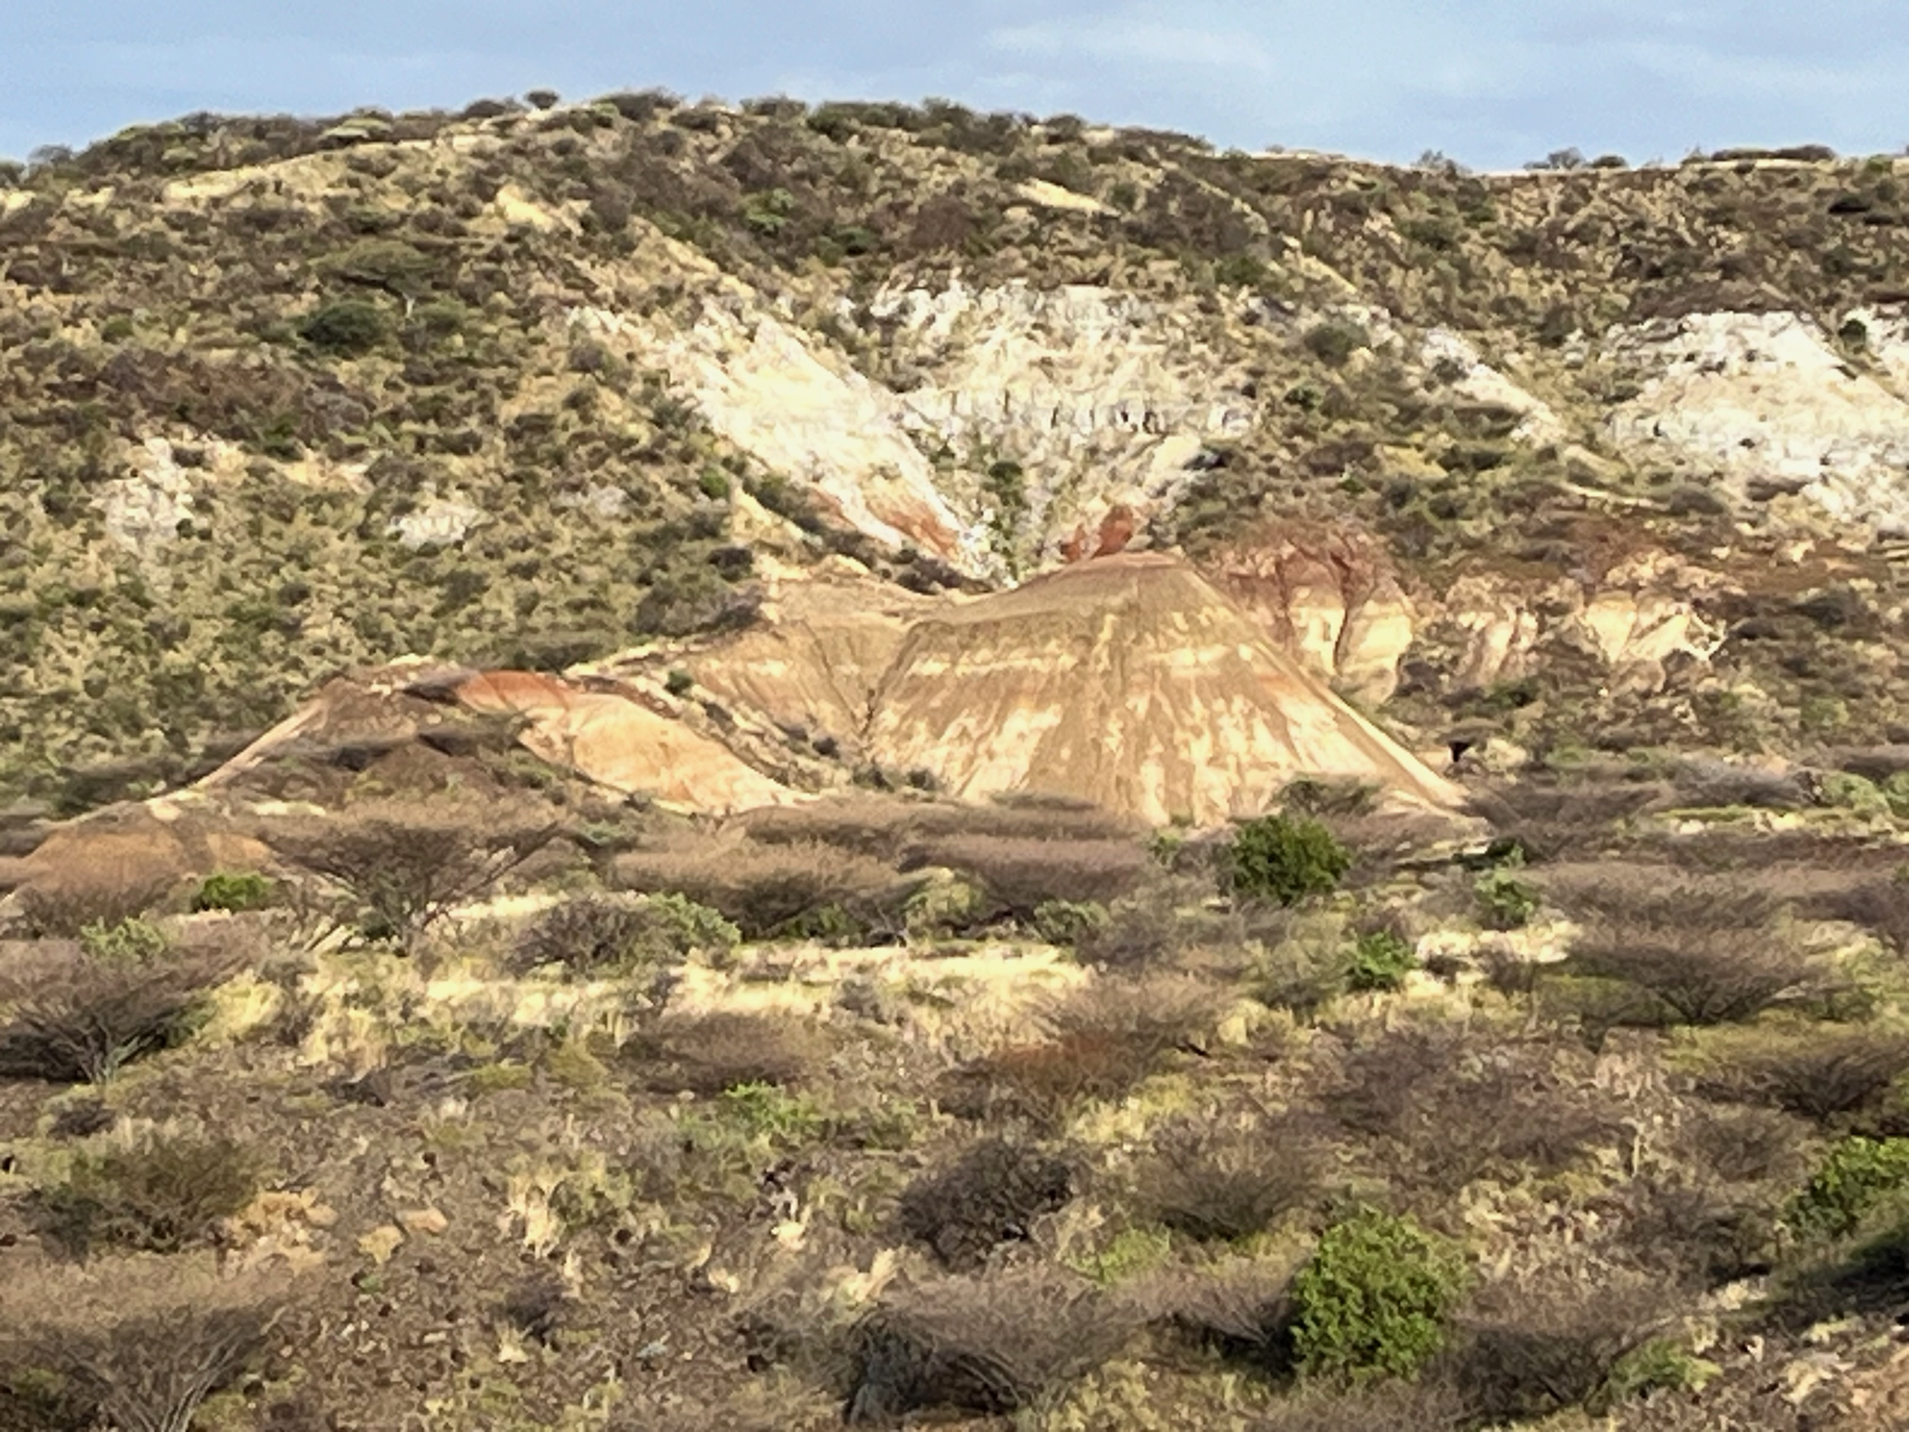
STRATIGRAPHIC EVOLUTION OF THE TURKANA BASIN, EASTERN AFRICA
Robert G. Raynolds
Denver Museum of Natural History
Craig S. Feibel
Rutgers University
Part 1
130 Years of Research in the Turkana Basin, Kenya: Insights into Earth, Climate, and Life in Eastern Africa
Notes:
The Turkana Basin preserves a record of rift-related accumulation dating back to the Mesozoic Central African Rift System (CARS), but primarily associated with the development of the Cenozoic East African Rift System (EARS). Over 50 years of outcrop investigations have documented volcanic and sedimentary stratigraphy, often closely associated with the spectacular paleontological and archaeological discoveries of the region. Extensive subsurface work has been undertaken as part of petroleum exploration, including seismic profiling and boreholes. Limited scientific drilling has recovered high-resolution records of environmental proxies. The modern Turkana Basin provides a living laboratory through which to examine interactions among tectonic, volcanic and sedimentary systems, climate dynamics, and the responses of modern communities to various aspects of change.
Basin fill includes some 7 km of rift-related volcanics (basalts, phonolites, rhyolites) along with a diverse array of sedimentary strata reflecting lacustrine and fluvial depositional systems. CARS strata are composed of coarse alluvial deposits in a non-volcanic rift setting. EARS accumulation is dominated by early rift volcanic strata, which in late Oligocene through Miocene times are punctuated by thick lacustrine packages (Lokichar Basin) and scattered fluvial sequences that preserve important vertebrate fossil assemblages. The modern configuration of the basin developed in early Pliocene times, and hosted a complex fluvio-lacustrine system that persists to the present day. The latter is notable for abundant distal silicic tephra providing markers for correlation and age control. Legacy and on-going geologic mapping, outcrop and subsurface investigations provide a detailed record of the spatial and temporal dynamics in this long-lived archive of geologic history.

Slide 2
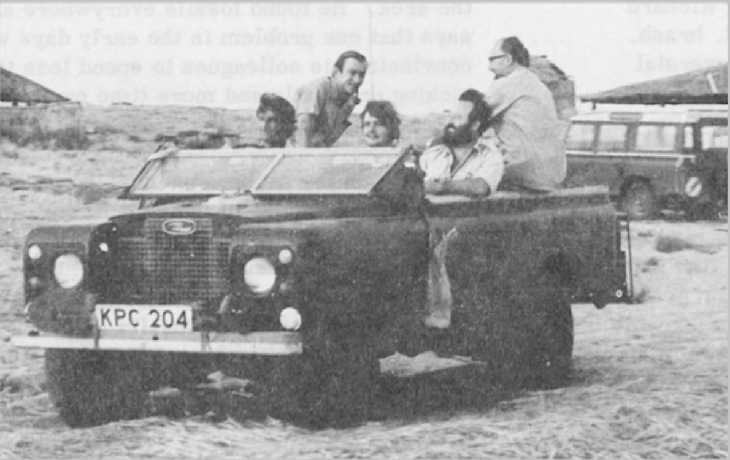
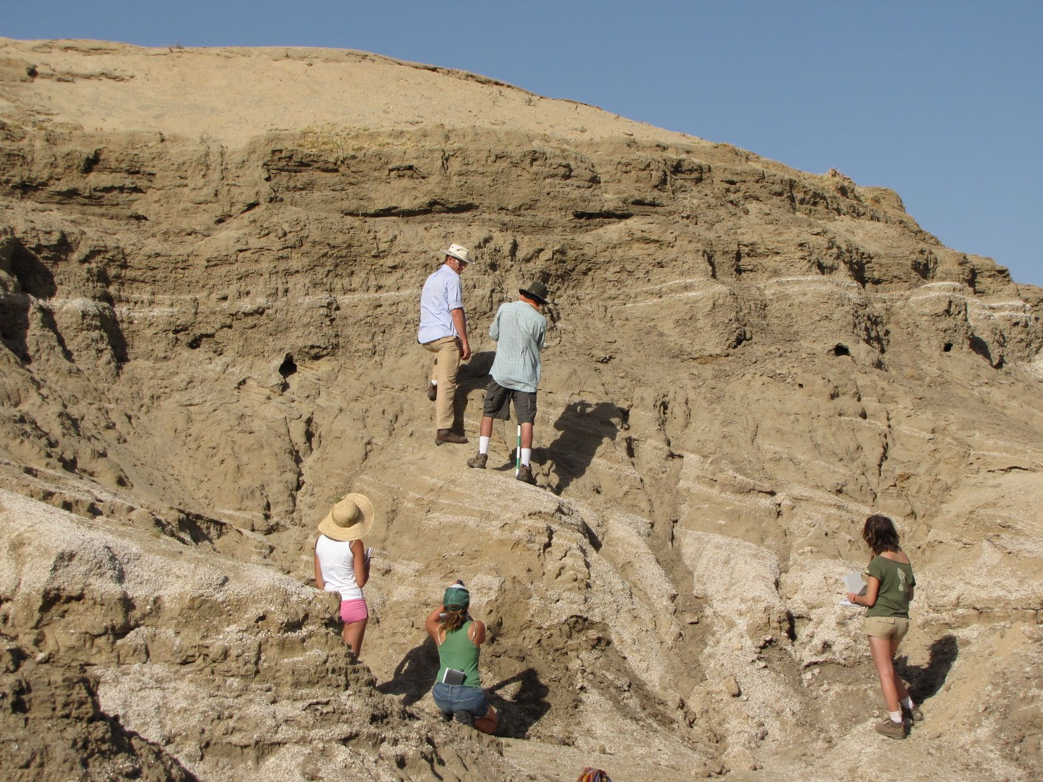
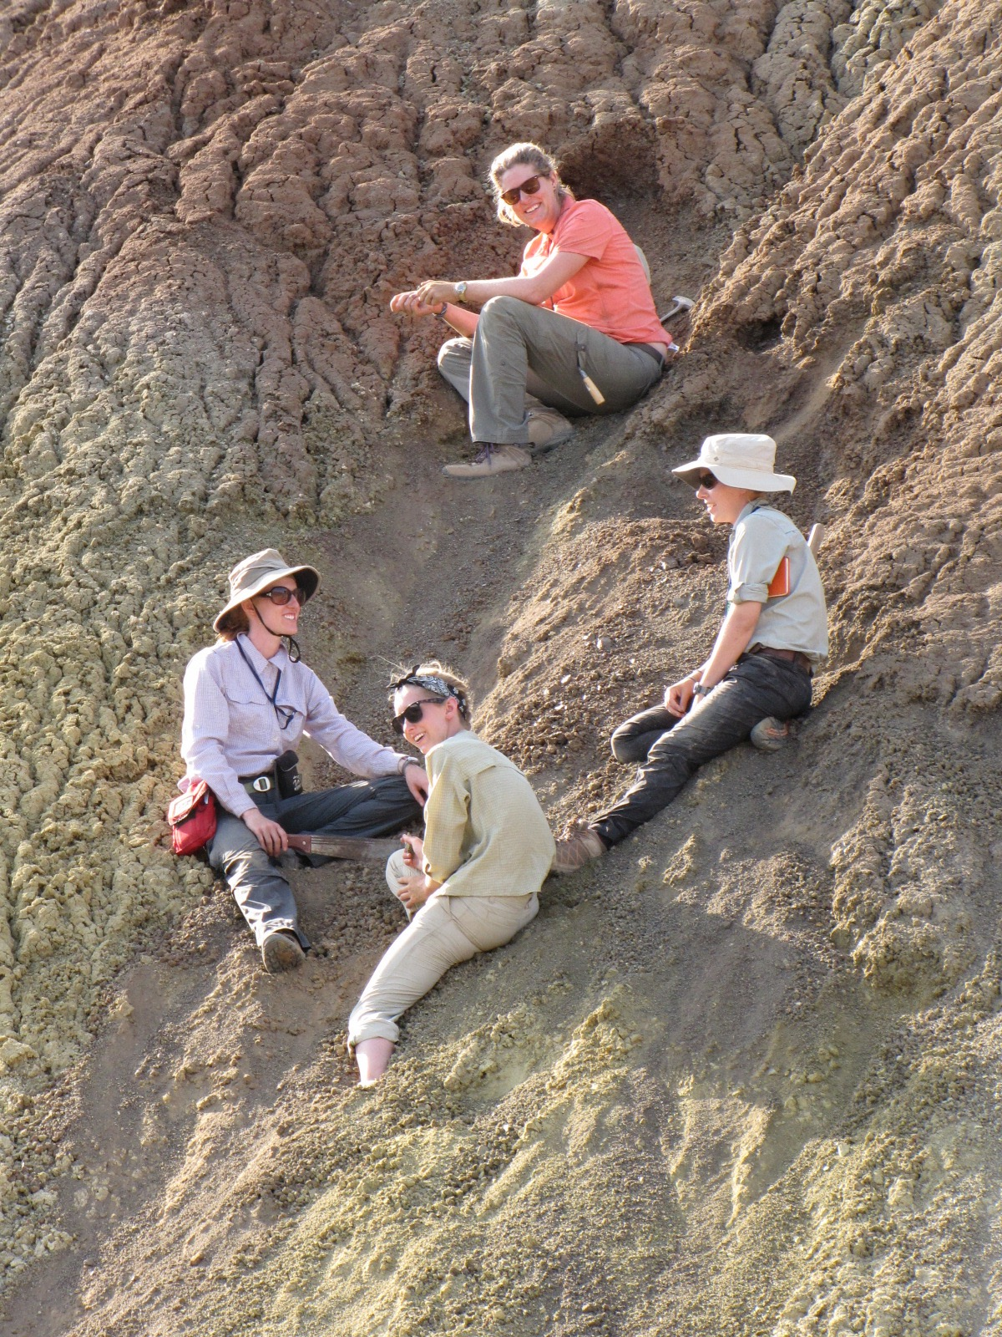
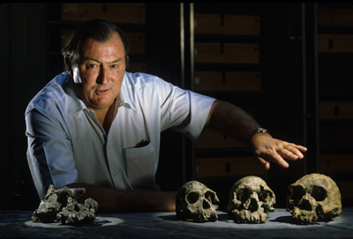

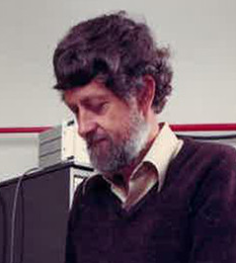
130 Years Of Research in the Turkana Basin
Teamwork
the field geologists
the students
Richard Leakey
the future
Frank Brown
Ian McDougall

Slide 3
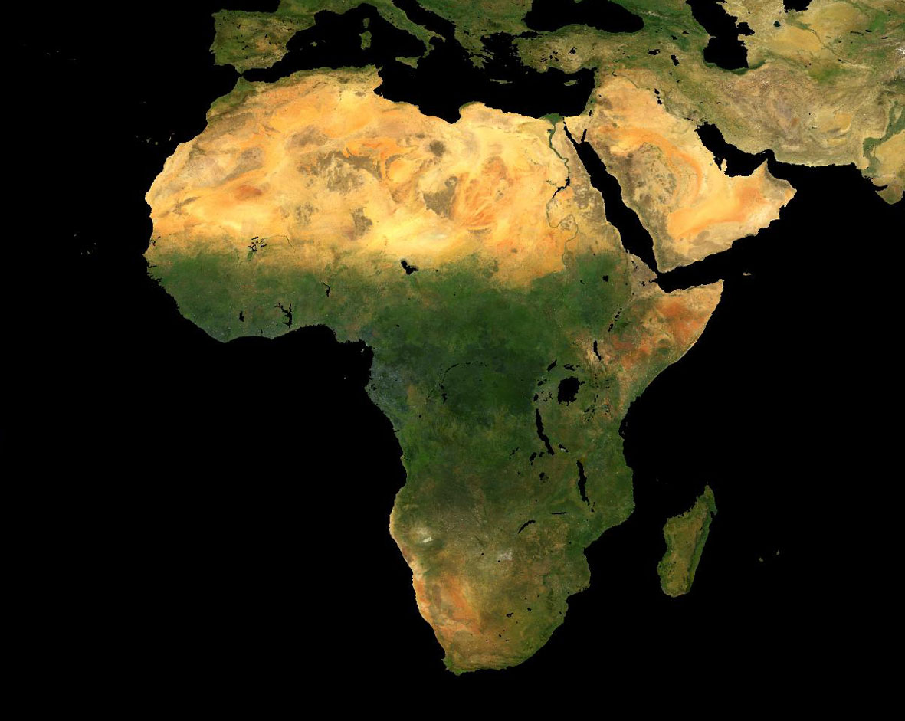
Turkana Basin

Slide 4
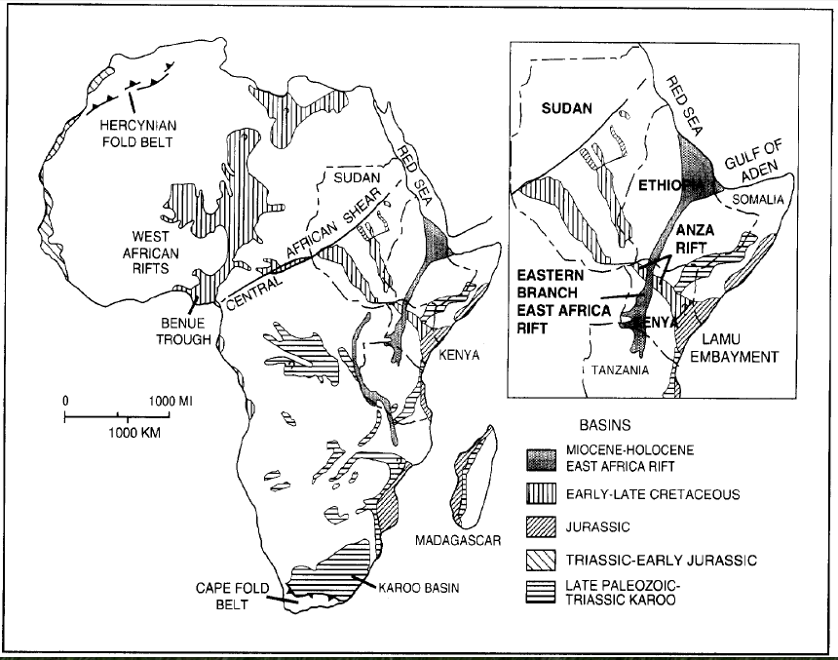
The Present-Day
Turkana Basin
occupies the depression at the intersection of the Mesozoic Central African Rift System (CARS) and the Cenozoic Eastern African Rift System (EARS)
Winn et al 1993 Fig 1.

Slide 5
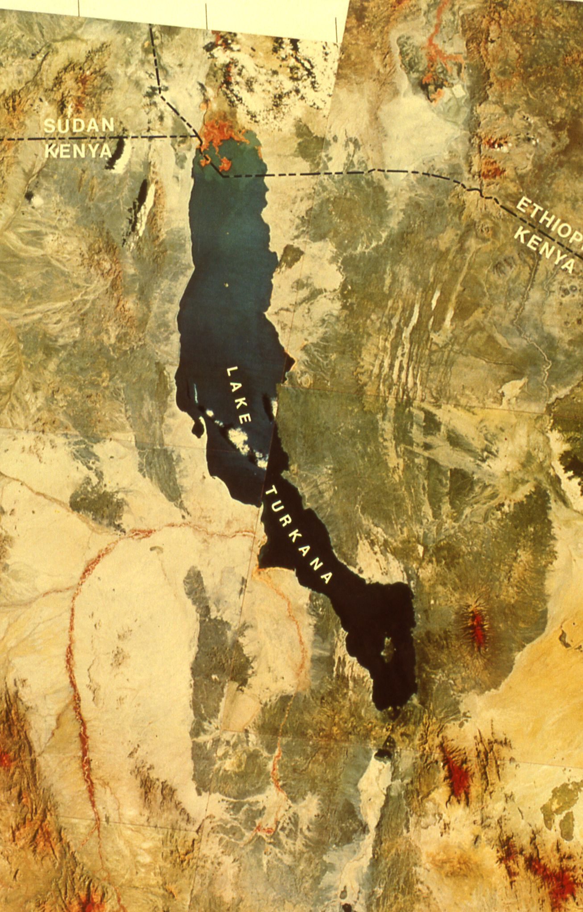
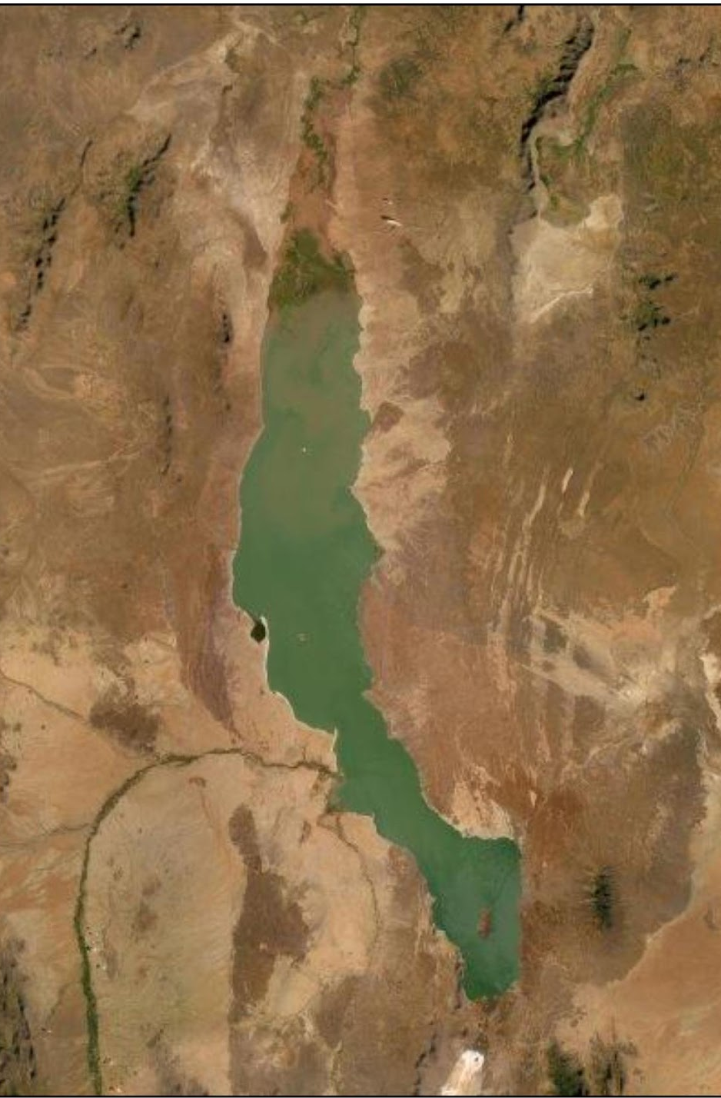
Omo River
Turkwel River
Kerio River
Landsat mosaic
false color
26 January 1978

Slide 6
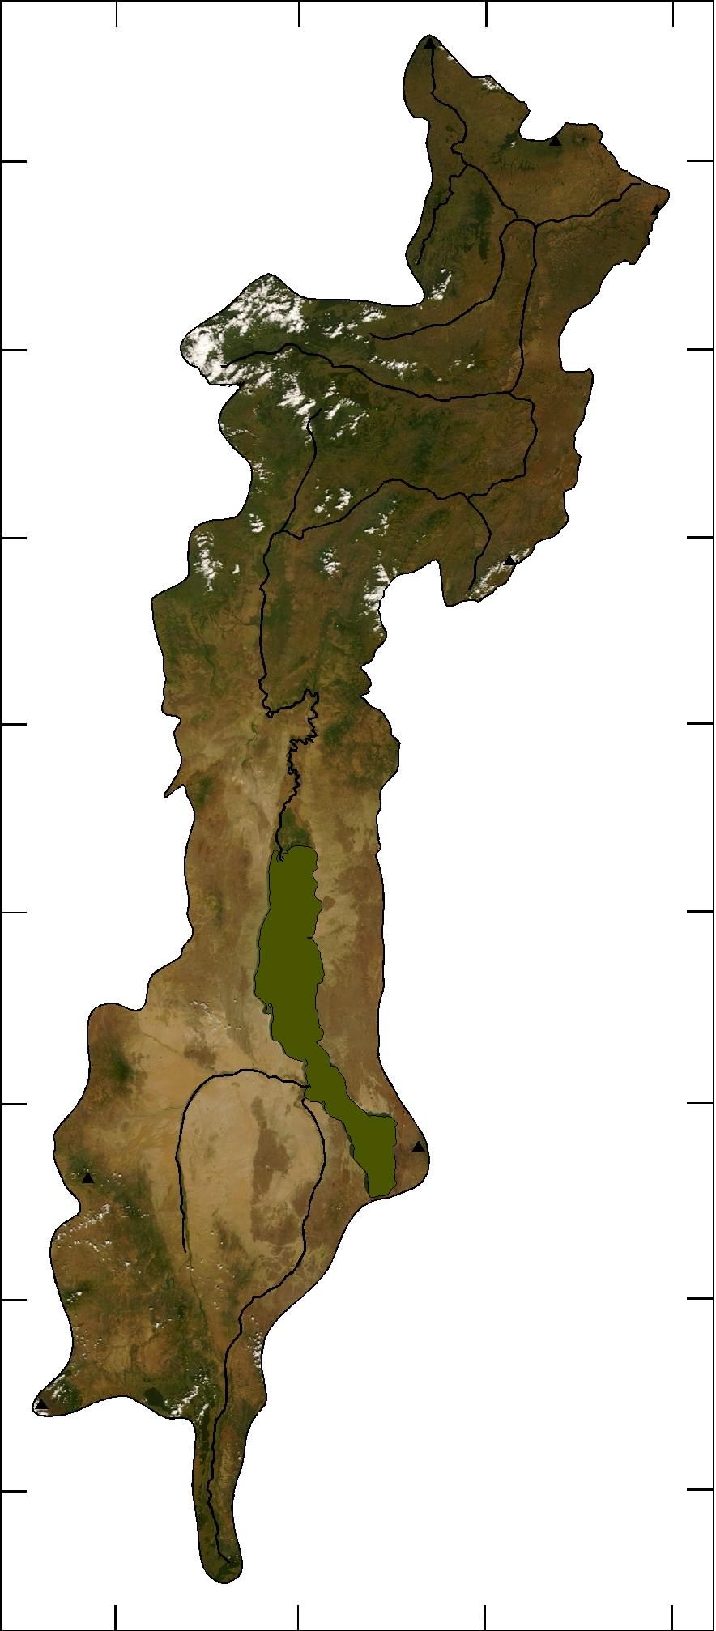
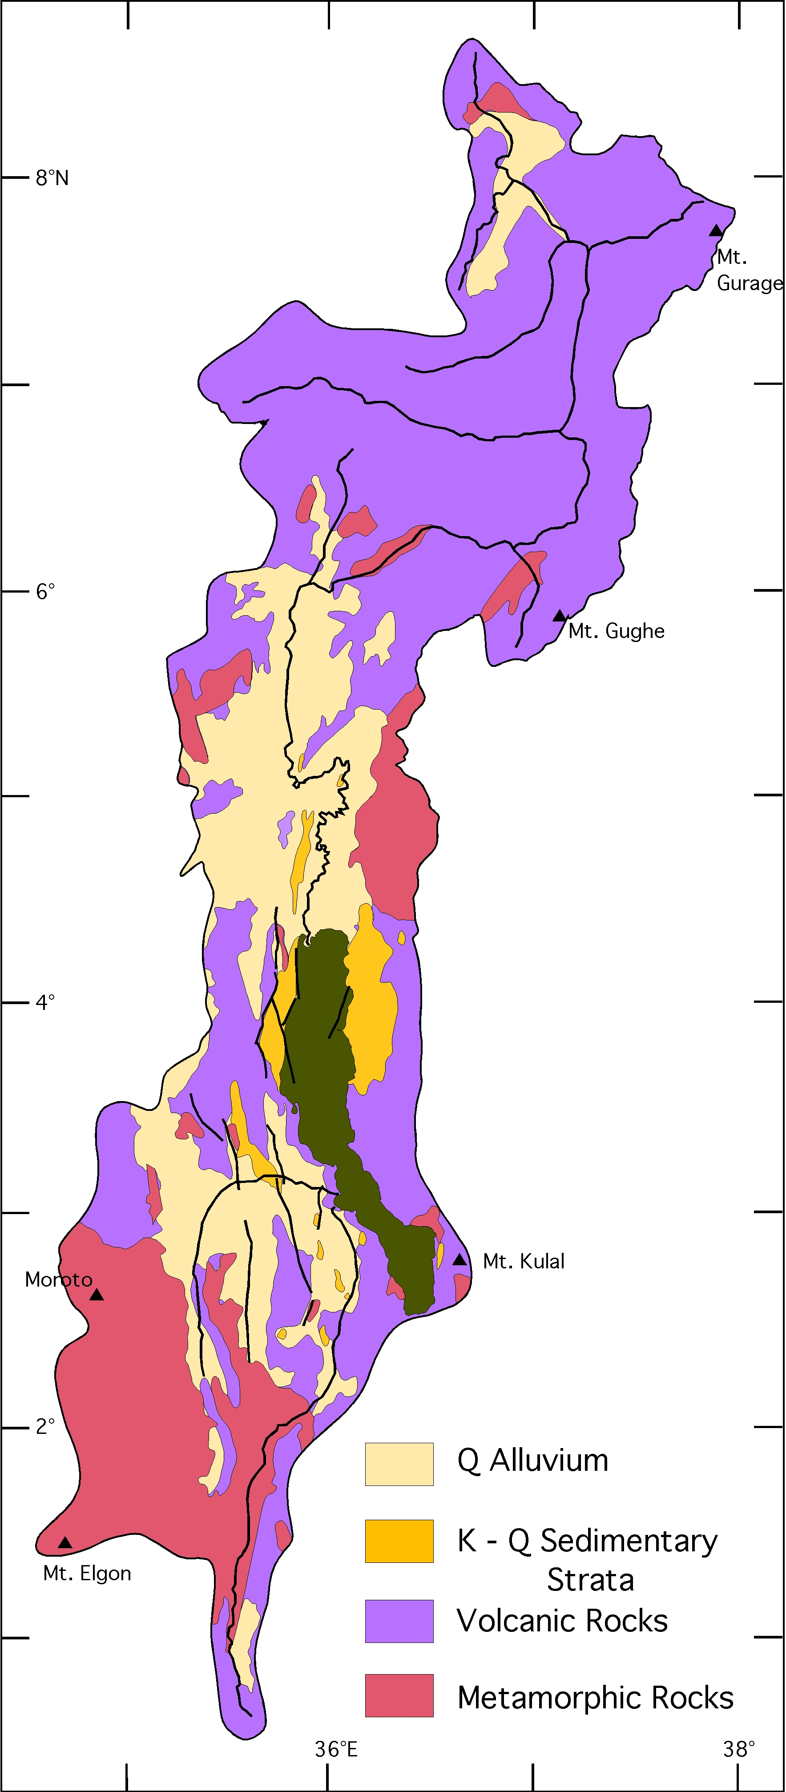
Hydrographic
Map of the
Turkana Basin
Geological
Sketch Map of the
Turkana Basin
from Feibel 2011

Slide 7
Mesozoic Central African Rift System (CARS)
Southern Main Ethiopian Rift (sMER)
Paleo
Hydrographic
Map of the
Turkana Basin
Suguta – Baringo Basins

Slide 8
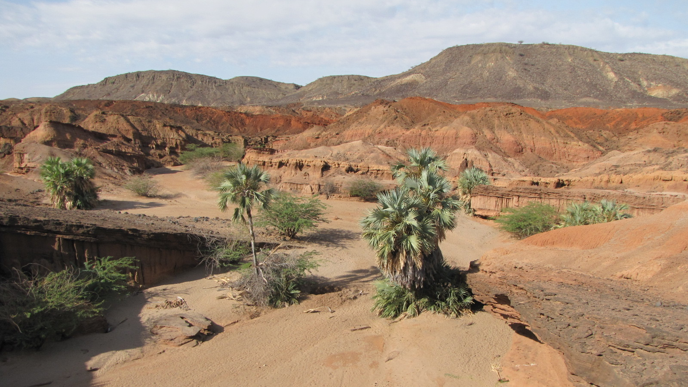
Lothagam The Gateway 2022

Slide 9
Deposode 4
Turkana Group and modern Lake Turkana
tectonic reorganization
Deposode 3
Plio-Pleistocene Omo Group
tectonic reorganization
Deposode 2
Eo-Oligo-Miocene Volcanics, volcaniclastics and sediments
initiation of EARS
Deposode 1
Late Cretaceous Lapur Sandstone
CARS infill

Slide 10
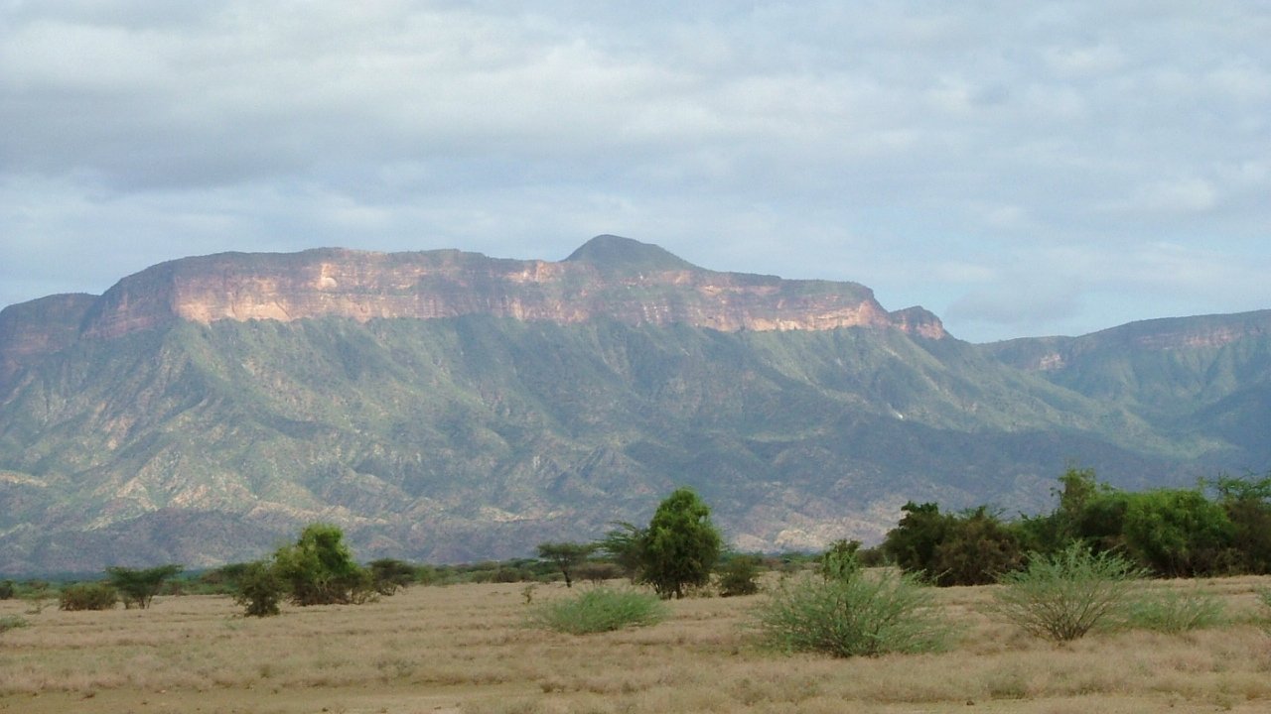
Cretaceous Lapur Sandstone
Lapur
West Turkana
photo by J. -J Tiercelin

Slide 11
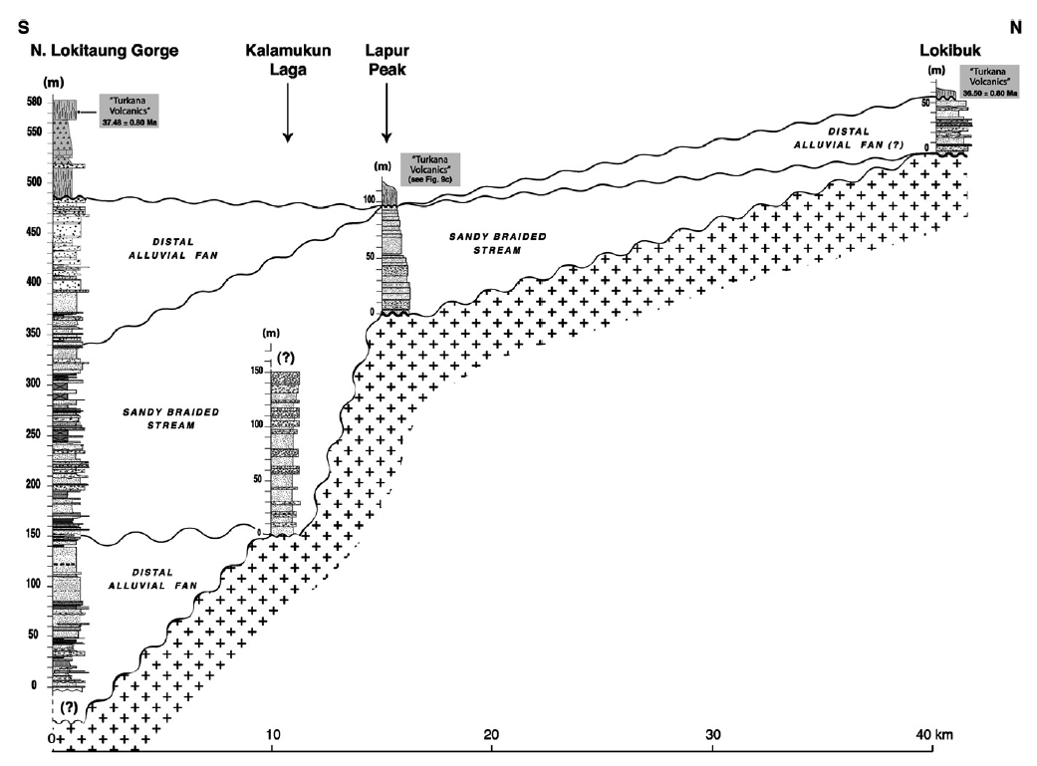
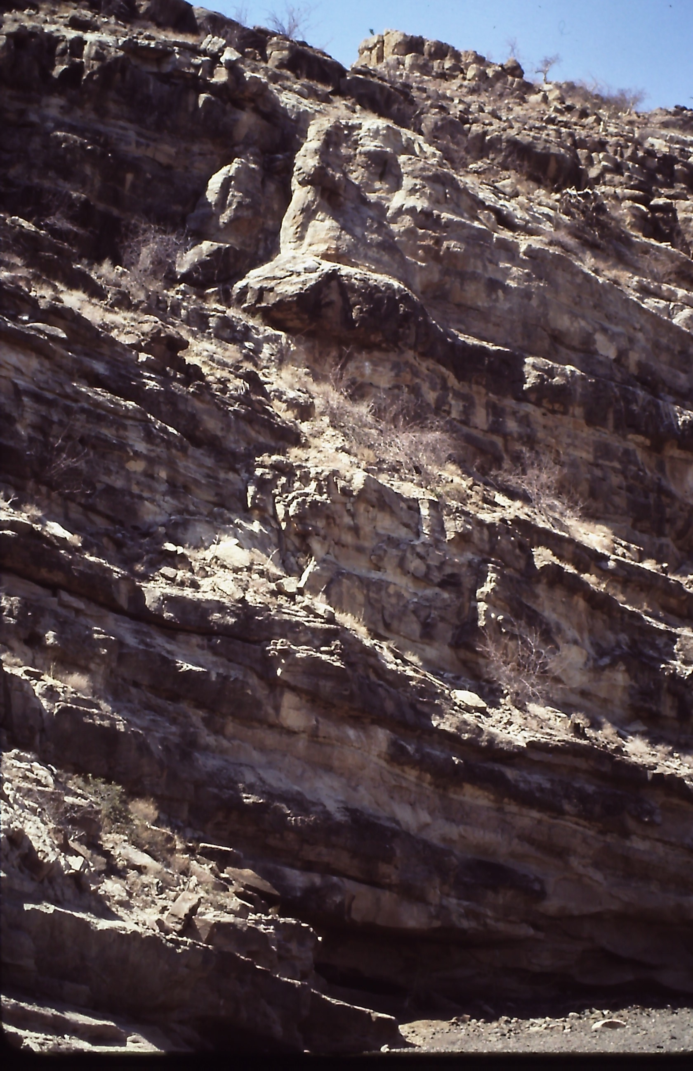
Lapur Sandstone
>500 m of Late Cretaceous
sandstones and pebble conglomerates
Lapur Sandstones
in Lokitaung Gorge
from Tiercelin et al 2012

Slide 12
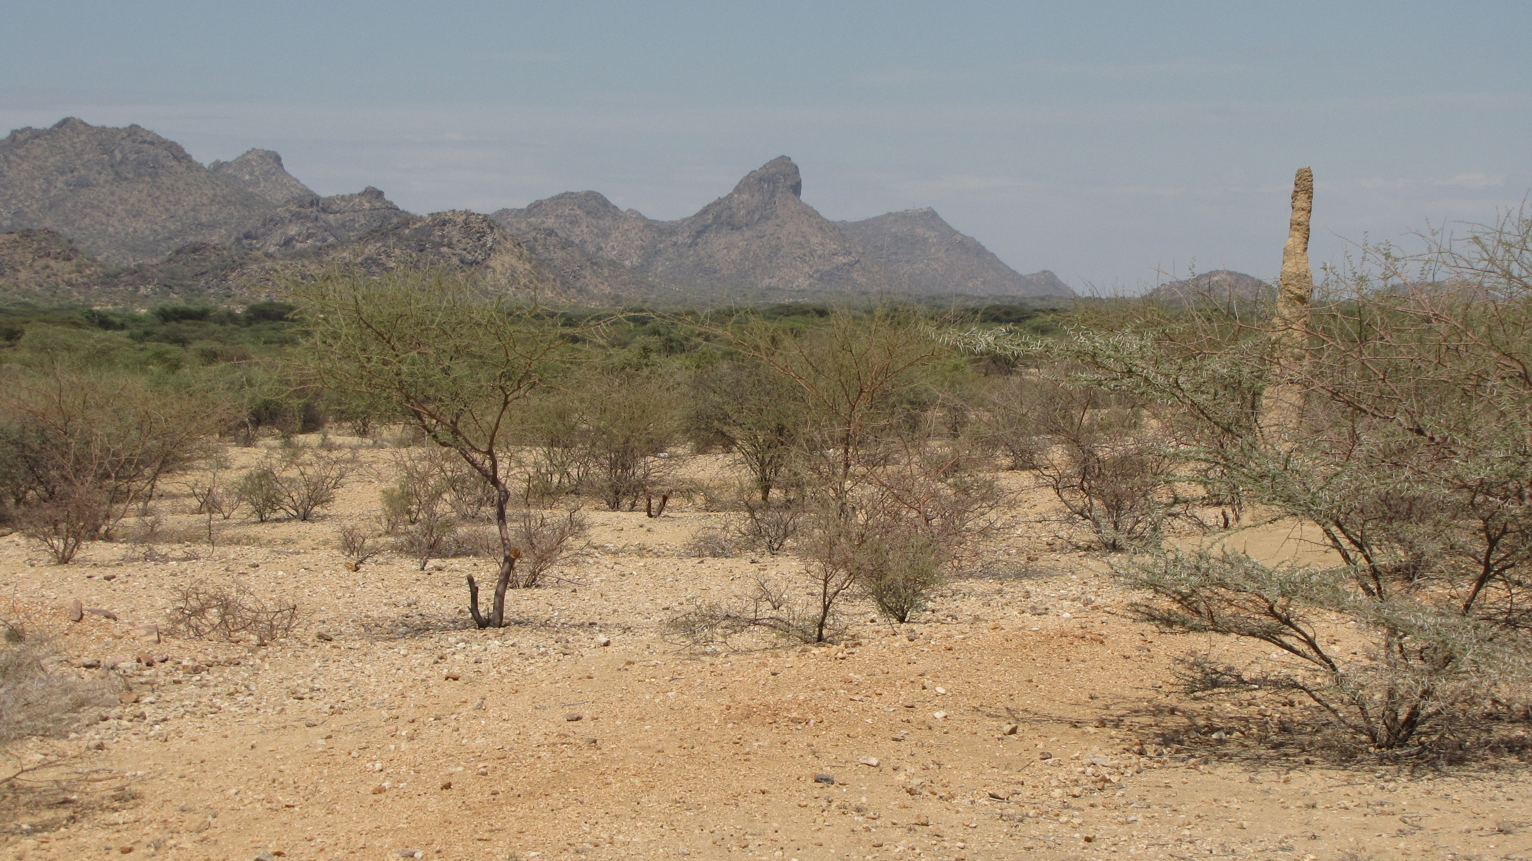
from ca. 90 – 40 Ma the region experienced erosion and beveling with no tectonic activity or volcanism recorded
South Turkana desert

Slide 13
Plio-Pleistocene Sedimentation
ca. 1 km of fluvio-lacustrine deposits with abundant fossils
Thickness (m)
Deposode 3
0
P-P
Miocene Volcanism
ca. 1 km of basalts and rhyolites with increasing fluvial deposition and fossil occurrences
♾️
Miocene
Age (Ma)
Deposode 2
Late Paleogene Volcanism
ca. 5 km of basalts and rhyolites with rare fossil occurrences
… Lokichar Basin
isotopic age
O
unconformity
E
age and thickness data loosely adapted from McDougall and Brown (2011)]
Notes:
Viewed in the same way, the Turkana record is longer, spanning nearly 40 my, and thicker (more than 7 km of strata), but again quite discontinuous, with most of the age control coming from volcanic units between the sedimentary strata. This perspective suggests three very distinct episodes in basin evolution: early (Eocene-Oligocene) voluminous volcanism in the north, with intense rift subsidence in the southwest; Miocene localized volcanism with through-flowing alluvial systems; and the Plio-Pleistocene (plow-zone) broadly integrated sedimentary basin.

Slide 14
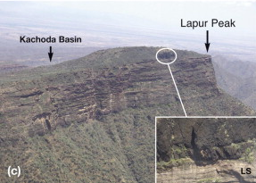
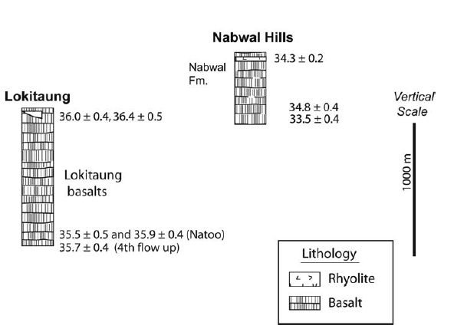
Eocene Volcanics
> 1 km of latest Eocene
basalts
from Tirecelin et al 2012
from Brown & McDougall 2011

Slide 15
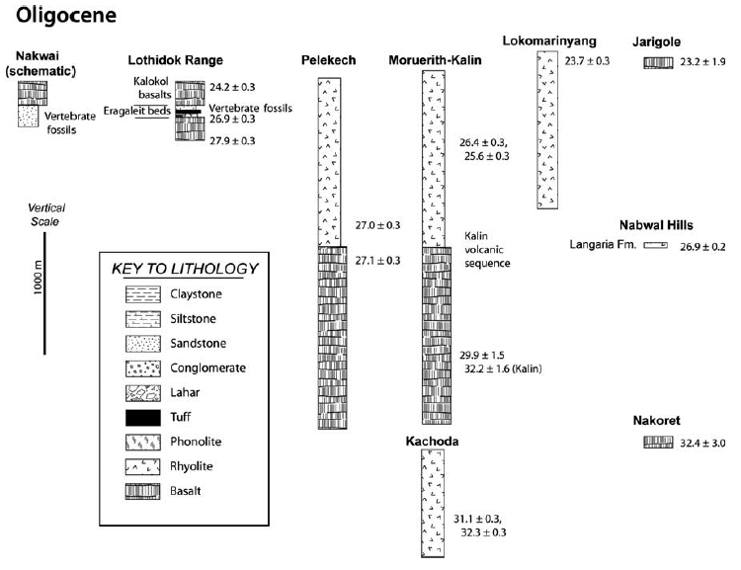
Oligocene Volcanics
ca 4 km of Oligocene
basalts and rhyolites
with associated fossils
Topernawi
29.5
Vertebrate fossils
from Brown & McDougall 2011

Slide 16
Topernawi
29 Ma
Oligocene Volcanics
pyroclastics and agglomerates
with associated fossils

Slide 17
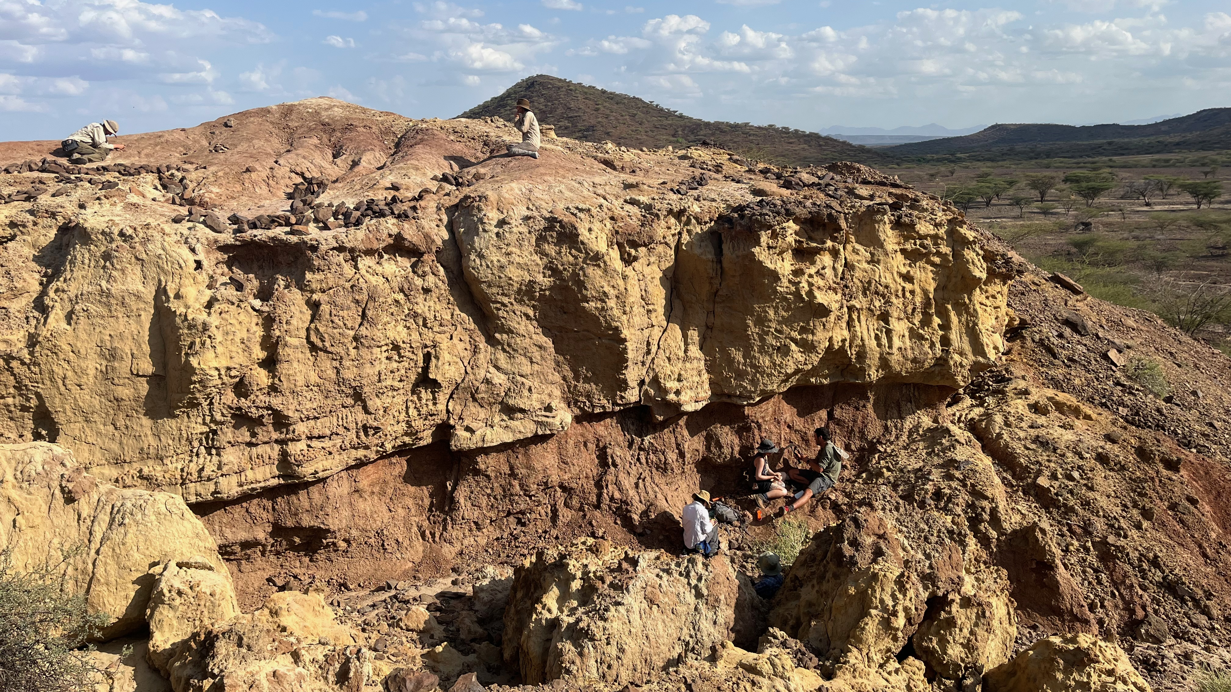
Nakwai
Oligocene - Miocene fluvial strata with associated basalts
rich vertebrate fossil assemblage

Slide 18
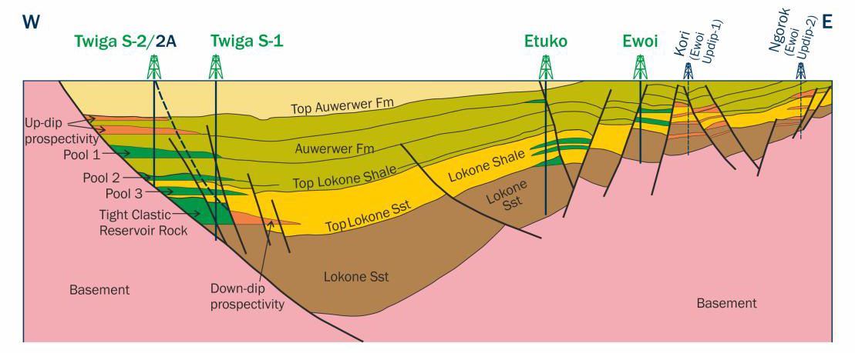
Lokichar Basin Petroleum Exploration
Nakwai - hinge margin exposure
Oligocene Rift Basin
thick lacustrine package with hinge-margin fluvial strata
from Tullow Oil 2014

