Slide 1
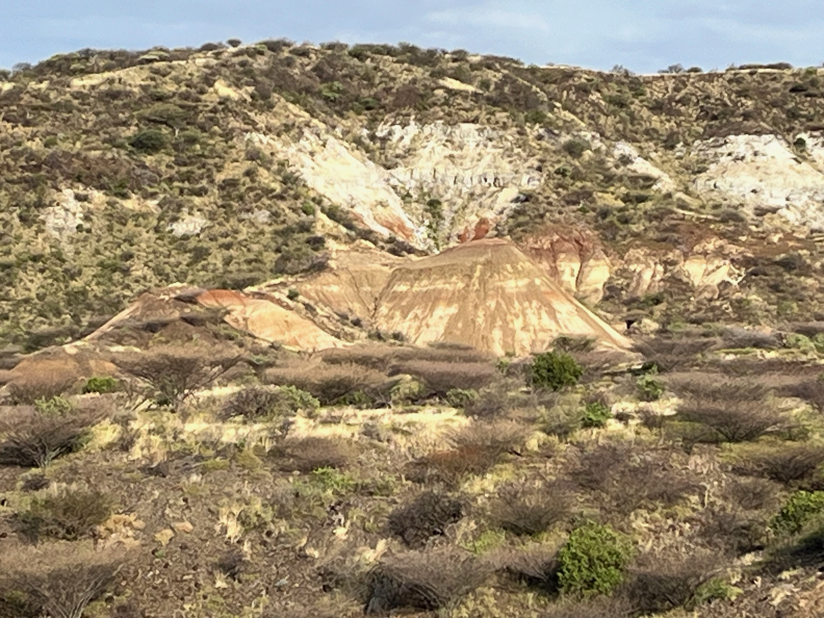
STRATIGRAPHIC EVOLUTION OF THE TURKANA BASIN, EASTERN AFRICA
Robert G. Raynolds
Denver Museum of Natural History
Craig S. Feibel
Rutgers University
Part 2
130 Years of Research in the Turkana Basin, Kenya: Insights into Earth, Climate, and Life in Eastern Africa
Notes:
The Turkana Basin preserves a record of rift-related accumulation dating back to the Mesozoic Central African Rift System (CARS), but primarily associated with the development of the Cenozoic East African Rift System (EARS). Over 50 years of outcrop investigations have documented volcanic and sedimentary stratigraphy, often closely associated with the spectacular paleontological and archaeological discoveries of the region. Extensive subsurface work has been undertaken as part of petroleum exploration, including seismic profiling and boreholes. Limited scientific drilling has recovered high-resolution records of environmental proxies. The modern Turkana Basin provides a living laboratory through which to examine interactions among tectonic, volcanic and sedimentary systems, climate dynamics, and the responses of modern communities to various aspects of change.
Basin fill includes some 7 km of rift-related volcanics (basalts, phonolites, rhyolites) along with a diverse array of sedimentary strata reflecting lacustrine and fluvial depositional systems. CARS strata are composed of coarse alluvial deposits in a non-volcanic rift setting. EARS accumulation is dominated by early rift volcanic strata, which in late Oligocene through Miocene times are punctuated by thick lacustrine packages (Lokichar Basin) and scattered fluvial sequences that preserve important vertebrate fossil assemblages. The modern configuration of the basin developed in early Pliocene times, and hosted a complex fluvio-lacustrine system that persists to the present day. The latter is notable for abundant distal silicic tephra providing markers for correlation and age control. Legacy and on-going geologic mapping, outcrop and subsurface investigations provide a detailed record of the spatial and temporal dynamics in this long-lived archive of geologic history.

Slide 2
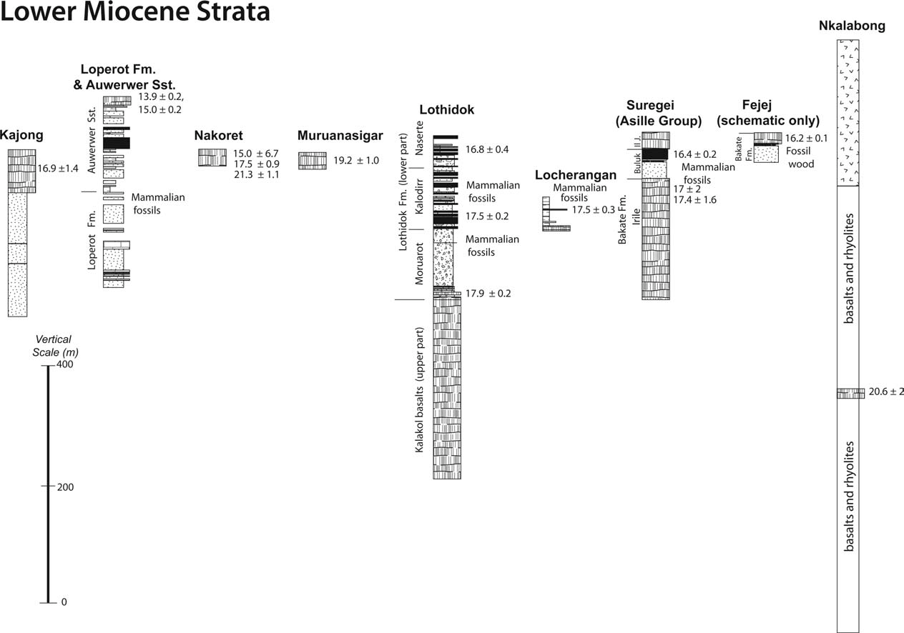
Lower Miocene
Buluk
16.0
Vertebrate fossils
17.2
fossil-bearing intervals
from Brown & McDougall 2011

Slide 3
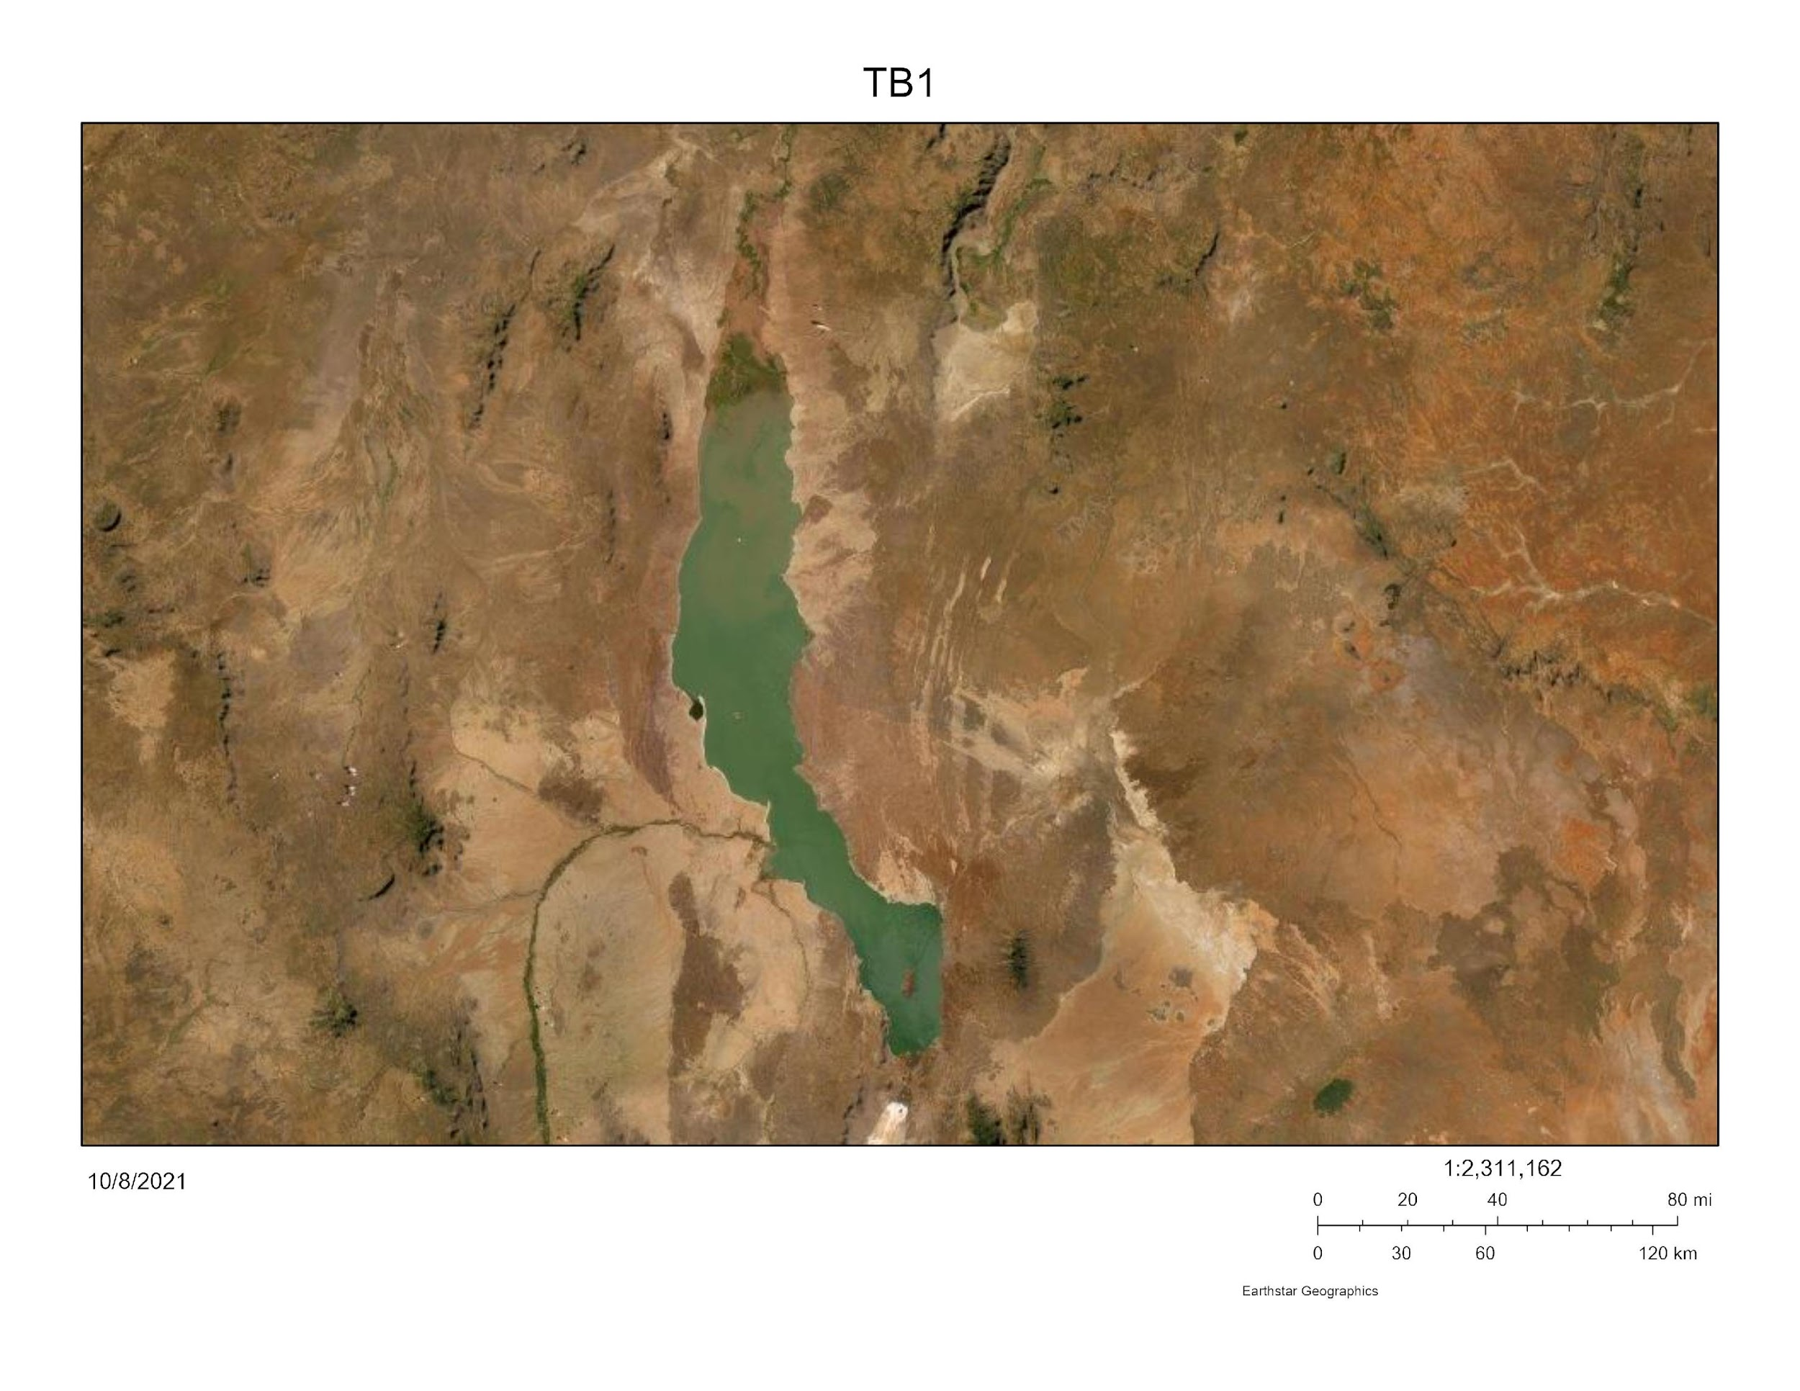
Buluk
16 Ma
50 m sedimentary sequence capped by tephra, both preserving N→S paleoflow indicators
? early southern Main Ethiopian Rift

Slide 4
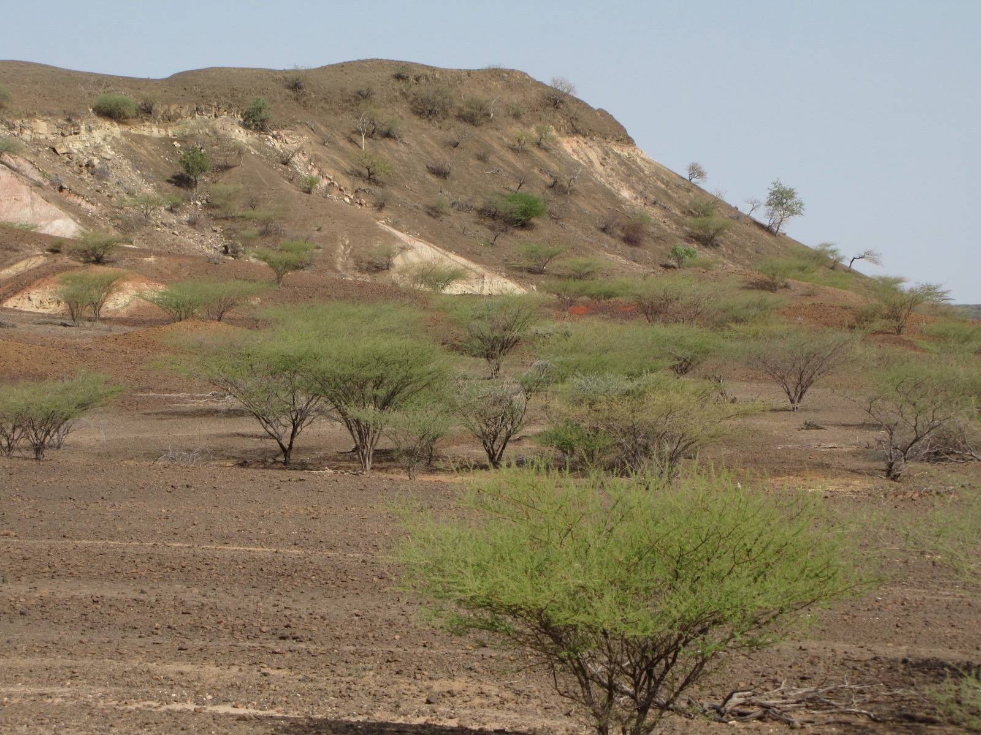
120 m fluvio-lacustrine sequence capped by basalts, preserving S→N paleoflow indicators
? early Kerio River
Loperot
17 Ma
LpM4 Stratigraphy after Liutkus et al. (2019) and Beck et al.

Slide 5
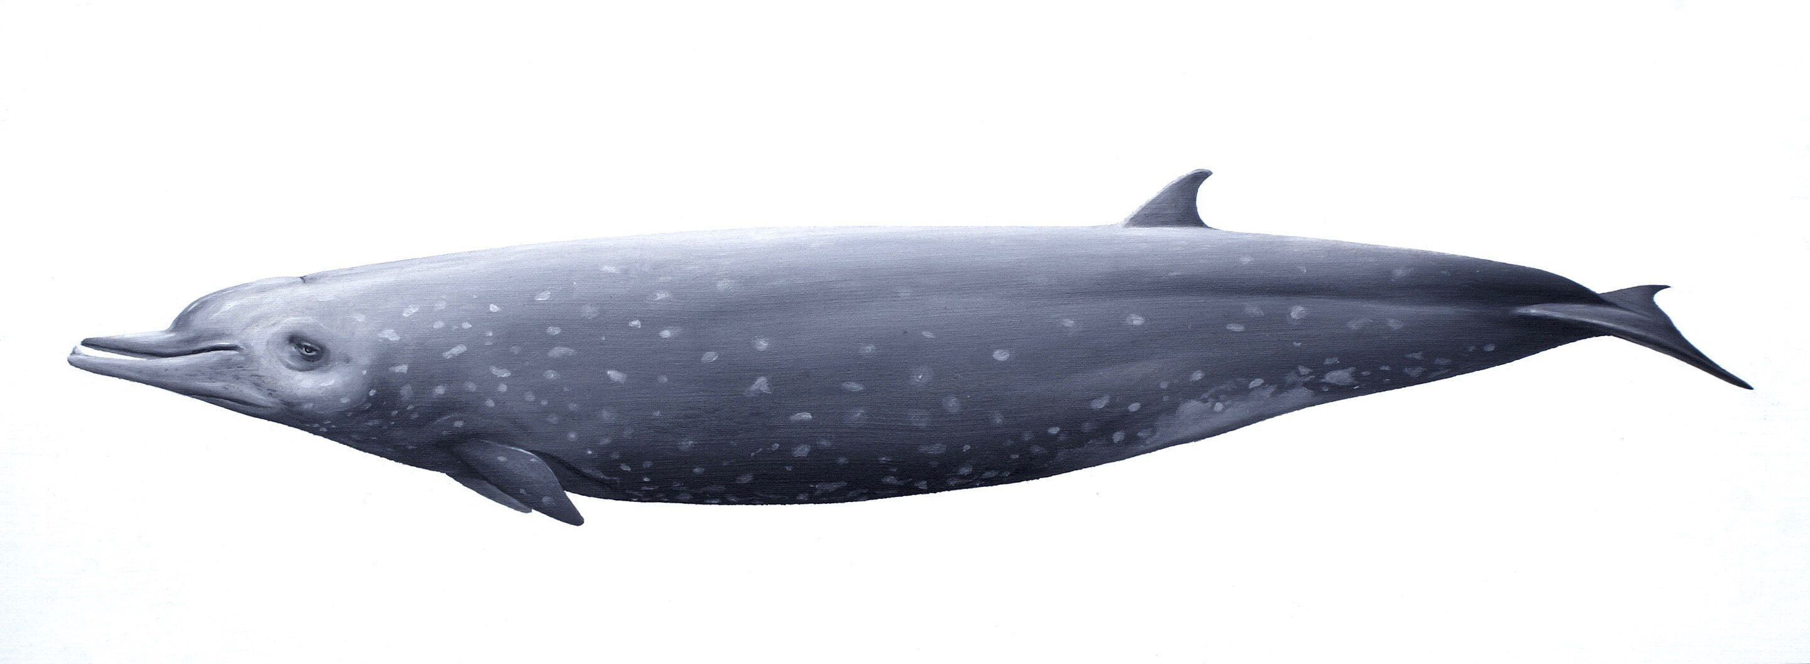
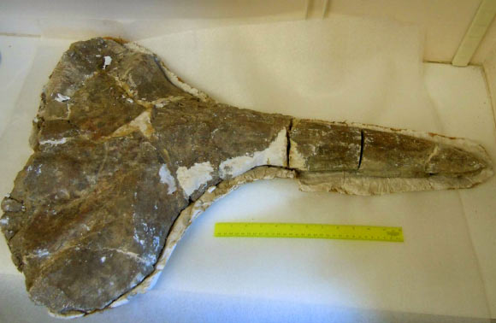
The Loperot Whale… at 17 Ma
Miocene integration of major fluvial systems
KNM-LP 52956

Slide 6
Early Miocene Integration
Buluk River System
Kalatum River System
Turkwel River System
Kajong River System
Lothagam River System
Indian Ocean
Connection
Loperot River System
Nakwai River System

Slide 7
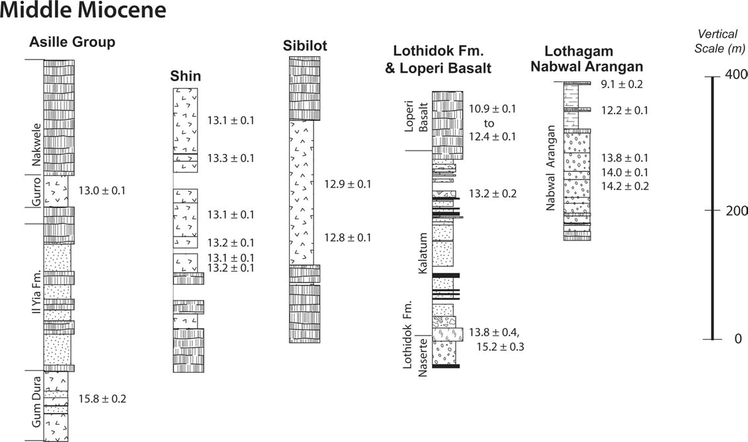
Middle Miocene
Napudet
Emunyan
13.3
fossil-bearing intervals
after Brown & McDougall 2011

Slide 8
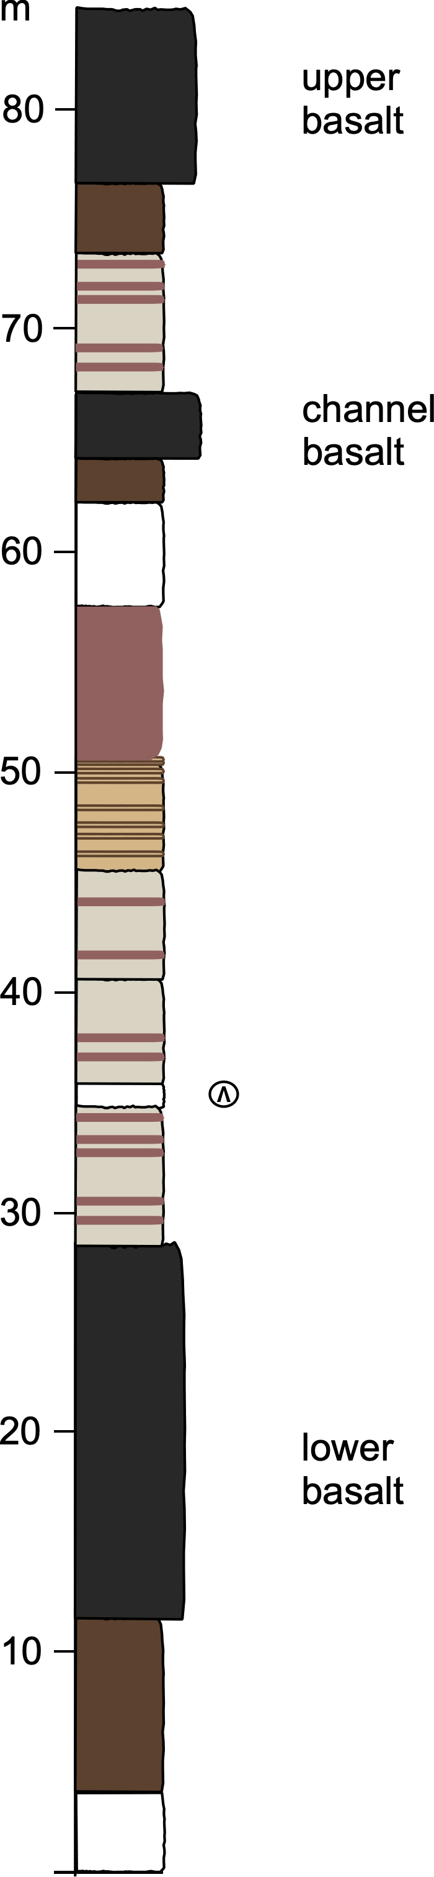
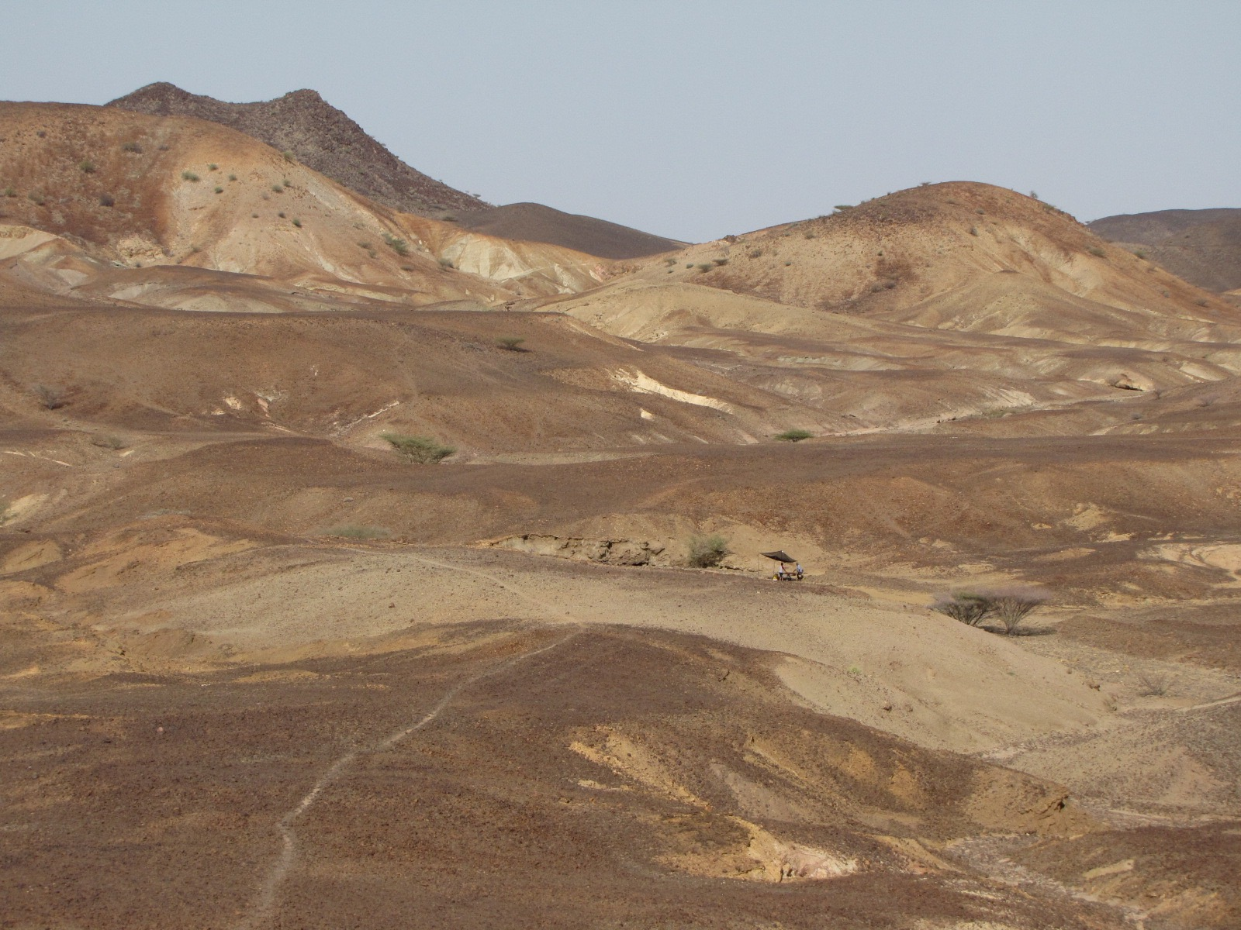
Napudet, Kenya
Middle Miocene
13 Ma
Miocene Volcanics
pyroclastics and paleosols
with associated fossils

Slide 9
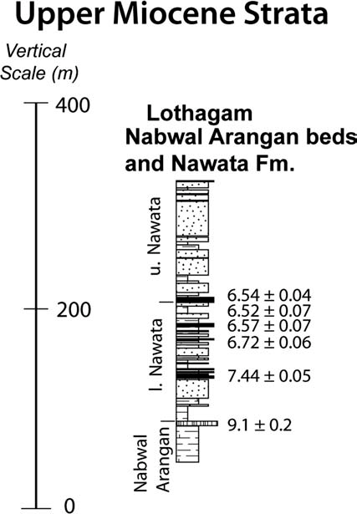
Upper Miocene
from Brown & McDougall 2011

Slide 10
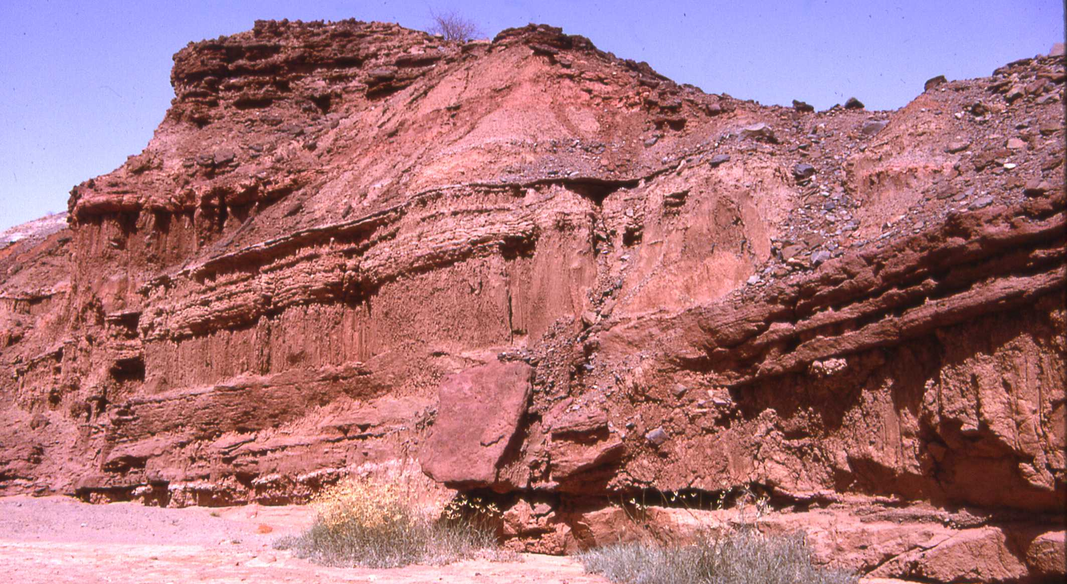
Miocene fluvial strata with abundant tephra
rich vertebrate fossil assemblage

Slide 11
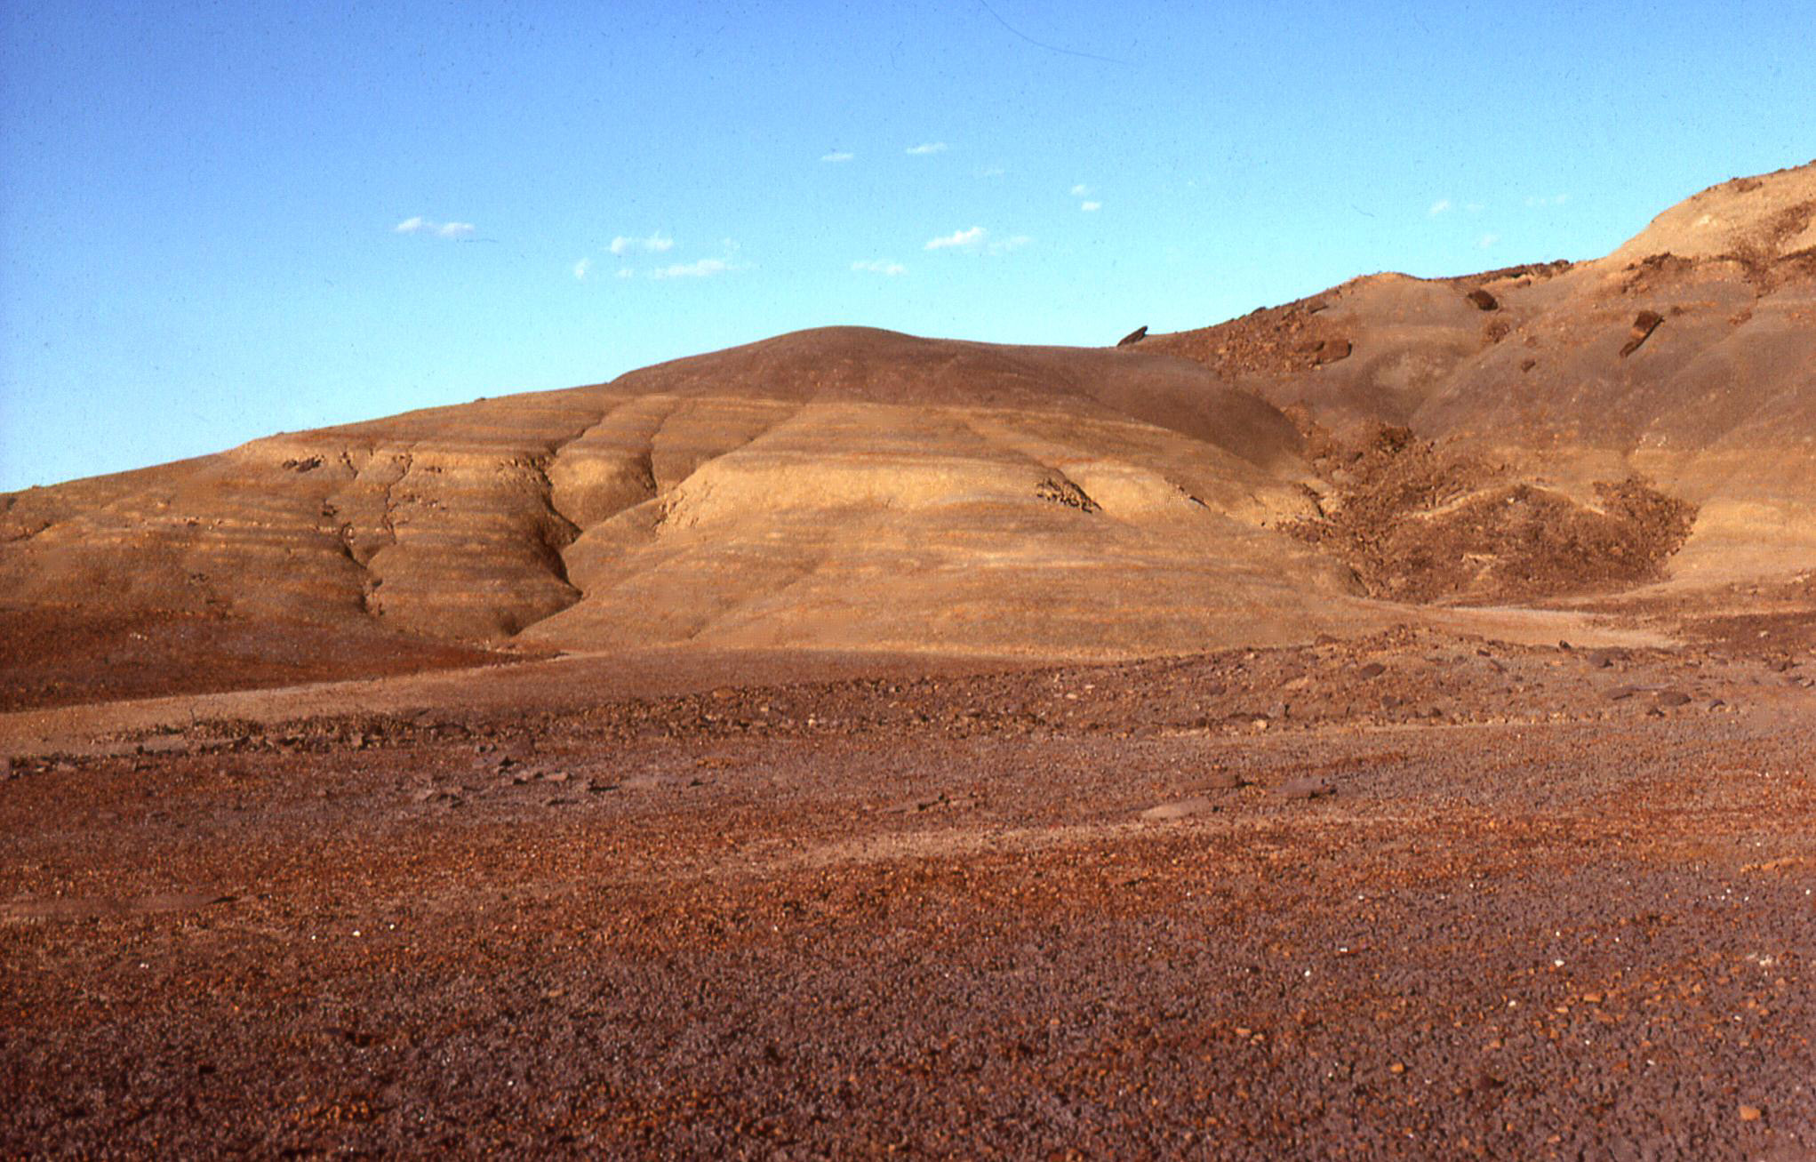
Deposode 3: The Plio-Pleistocene Omo Group
Fluvial and lacustrine strata with abundant tephra
very rich vertebrate fossil assemblage
upper Burgi Member
Area 102, Koobi Fora

Slide 12
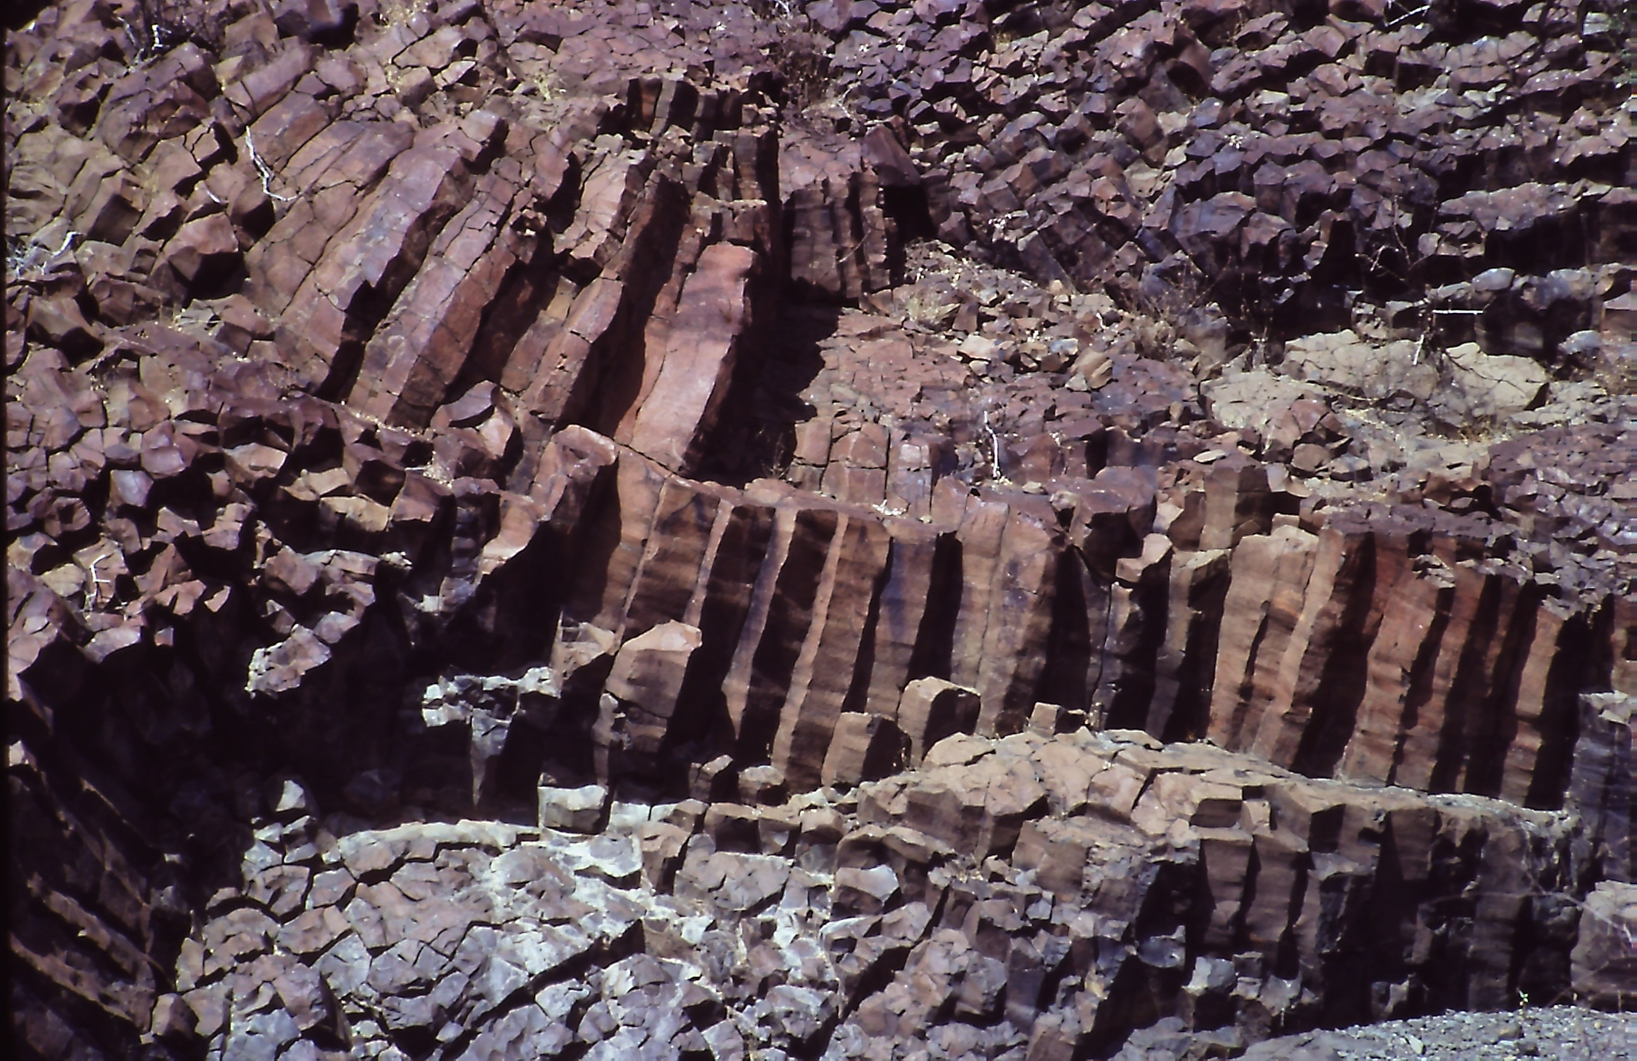
Gombe Group
Karsa basalt
basin-wide basaltic outpouring

Slide 13
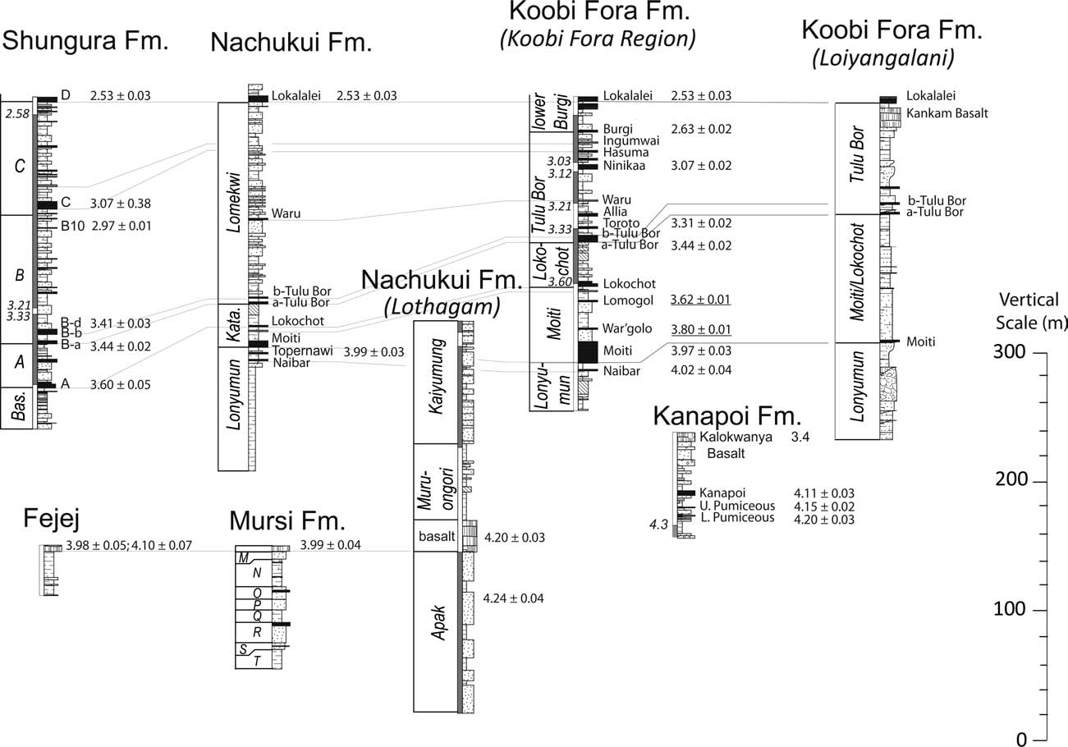
Omo Group tephrostratigraphy – high resolution correlation and age control
from Brown and McDougall 2011

Slide 14
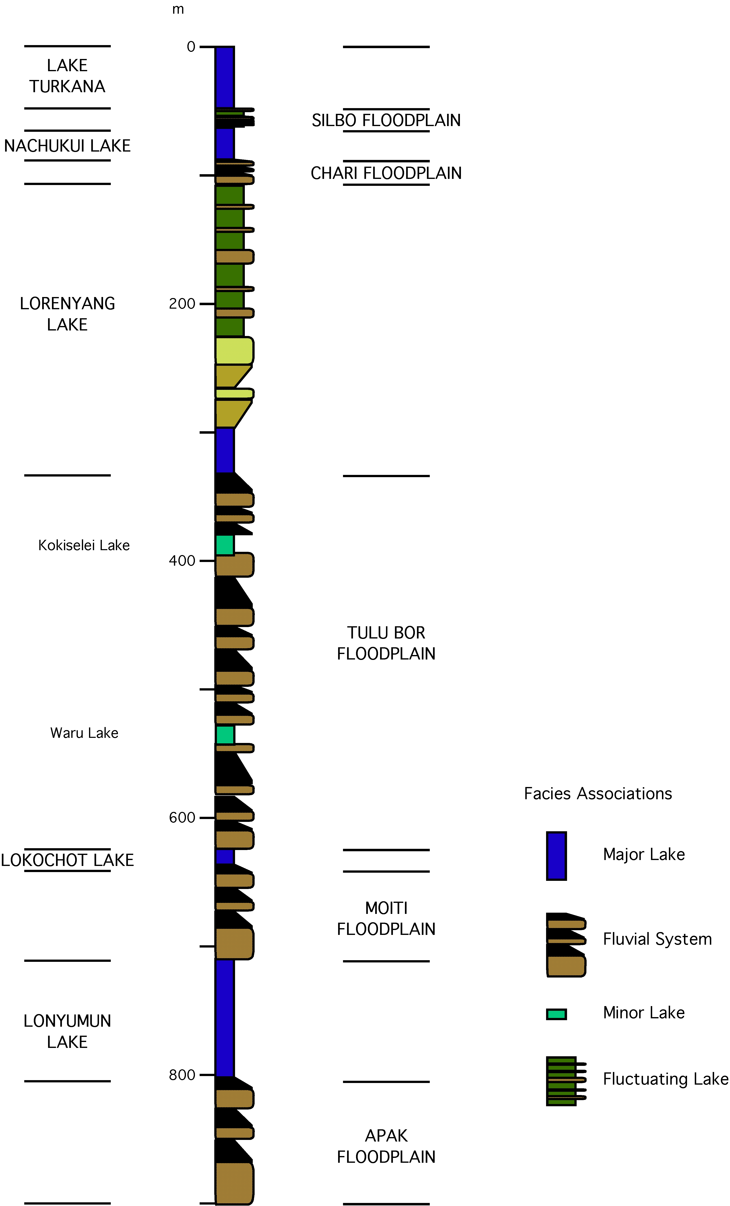
Stratigraphic
Evolution
of
Plio-Pleistocene
Omo Group
Deposits
from Feibel 2012

Slide 15
130 Years Of Research in the Turkana Basin
Contribution of Unconformities
Upper Chari Unconformity
Burgi Angular Unconformity
Lokochot Onlap Unconformity
Lonyumun Onlap Unconformity

Slide 16
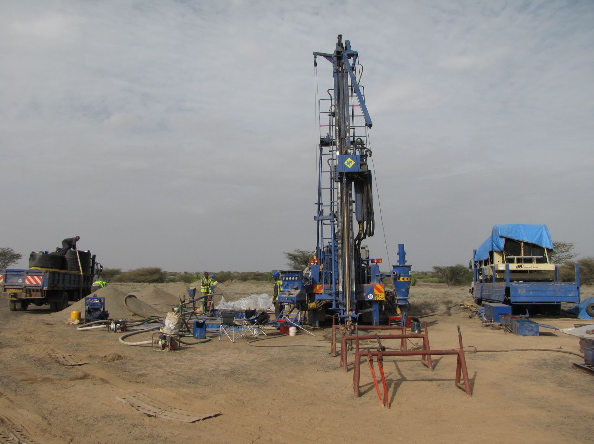
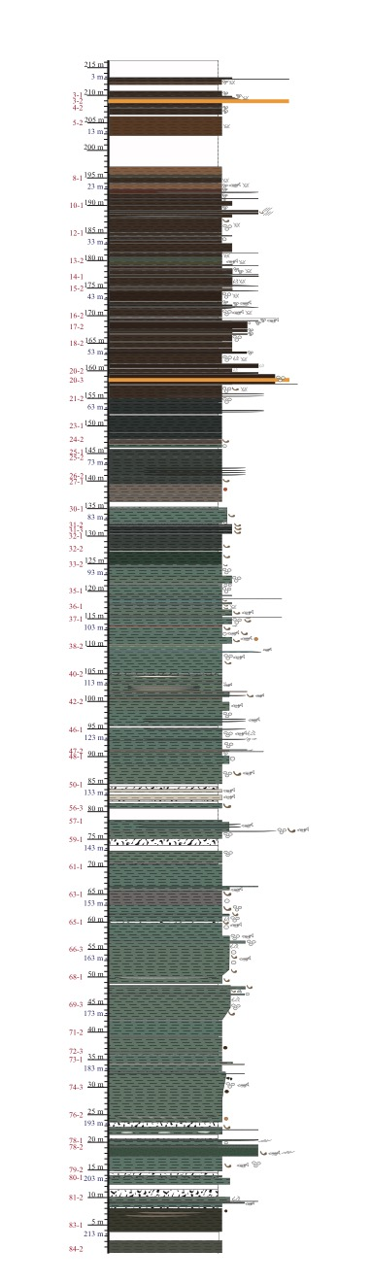
HSPDP - WTK13
Kaitio Core – 216 m

Slide 17
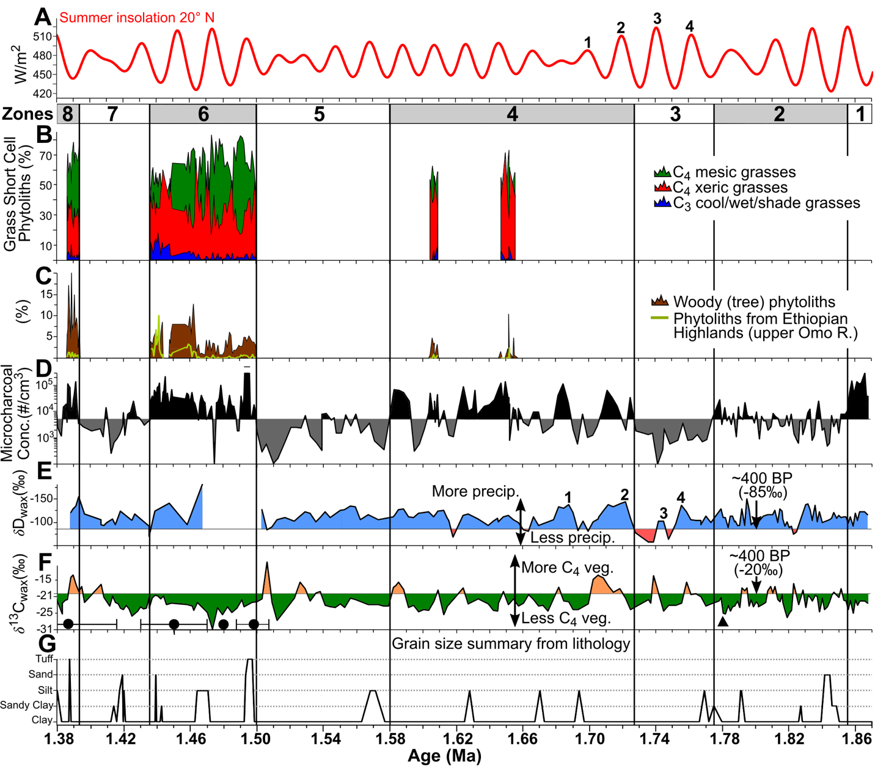
Summary phytolith and microcharcoal datasets and leaf wax d¹³C and dD datasets
Abrupt Climate Change - rapid onset of humid conditions < 200 y
from Yost et al., 2021
Lupien et al., 2018

Slide 18
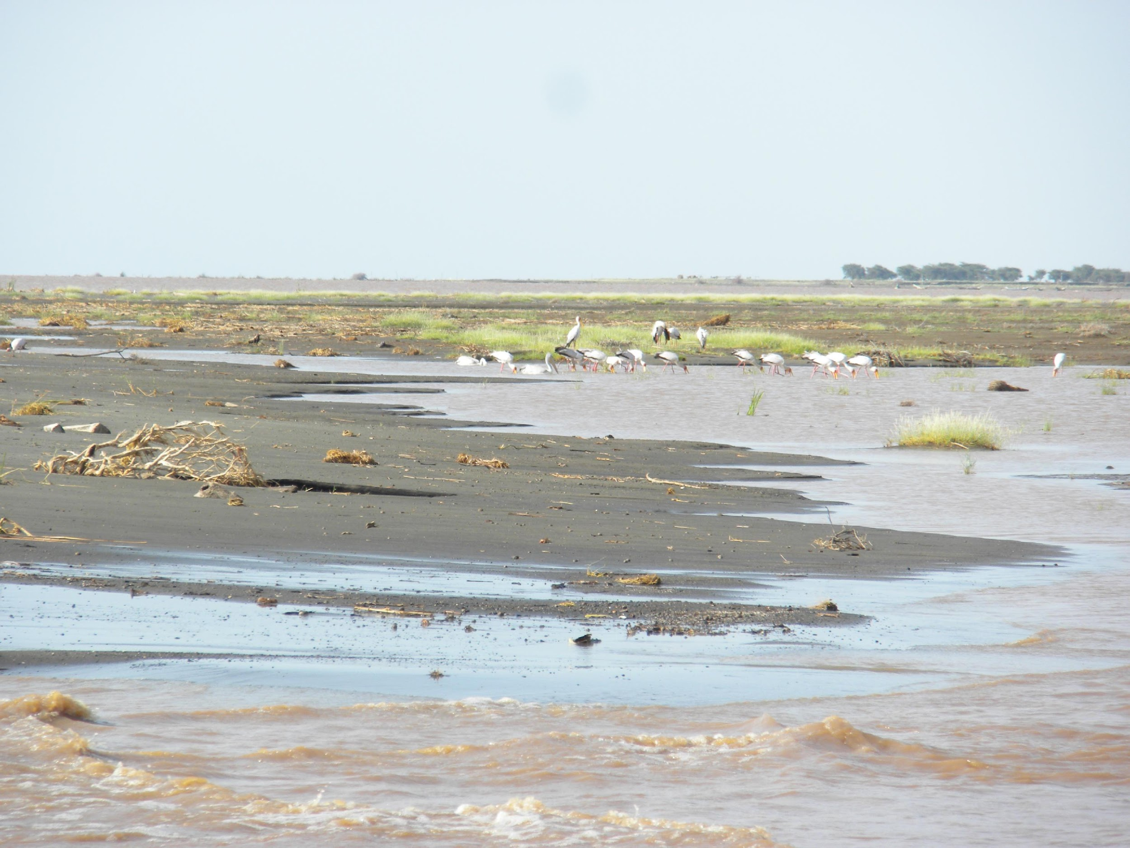
Deep Drilling in the Turkana Basin
Nairobi Drilling Workshop 11-14 July 2022
2 Phase Drilling Plan
Phase 1- Onshore transect from south to north on West Side
Phase 2- Lake core from Central Basin of modern Lake Turkana
Notes:
Craig recording

Slide 19
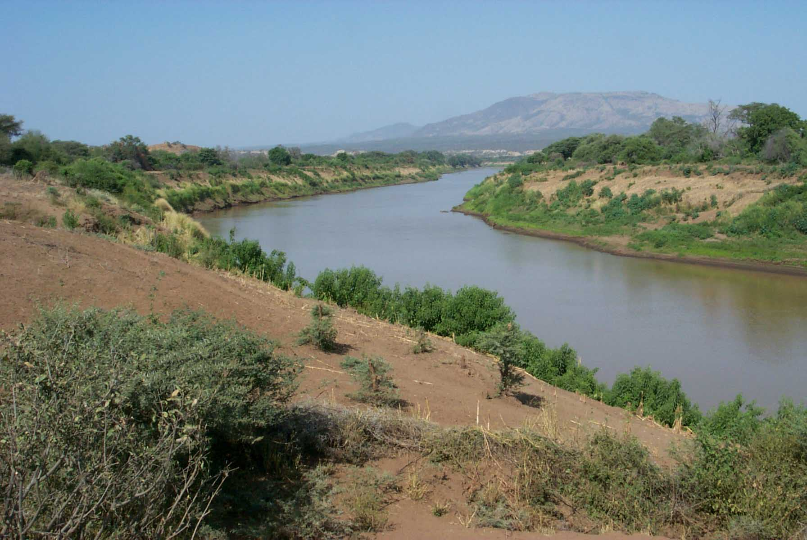
Insights into Earth, Climate, and Life

Slide 20
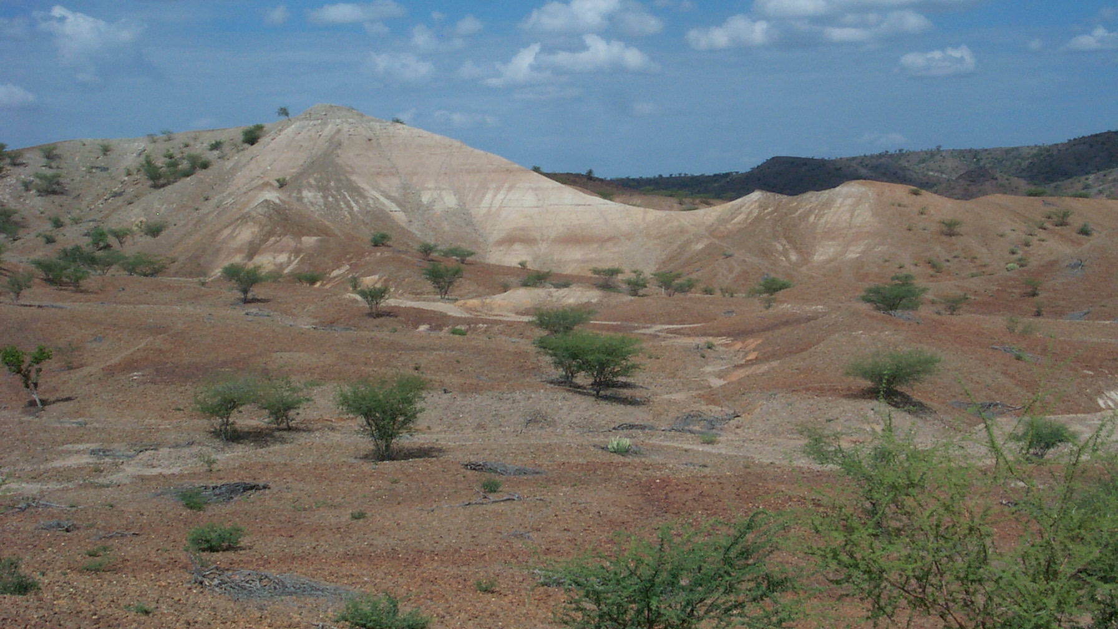
Thank You!

