Slide 1



Utilizing Social Network Analysis to Visualize Student Interactions in Multidisciplinary Course-Based Undergraduate Research Experiences
Abby Boyd¹,
Heather Vance-Chalcraft²,Joi Walker³
Department of Chemistry and Biochemistry, University of Mississippi
Department of Biology, East Carolina University
Department of Chemistry, East Carolina University
This material is based upon work supported by the National Science Foundation under Grant No. 2013358

Slide 2
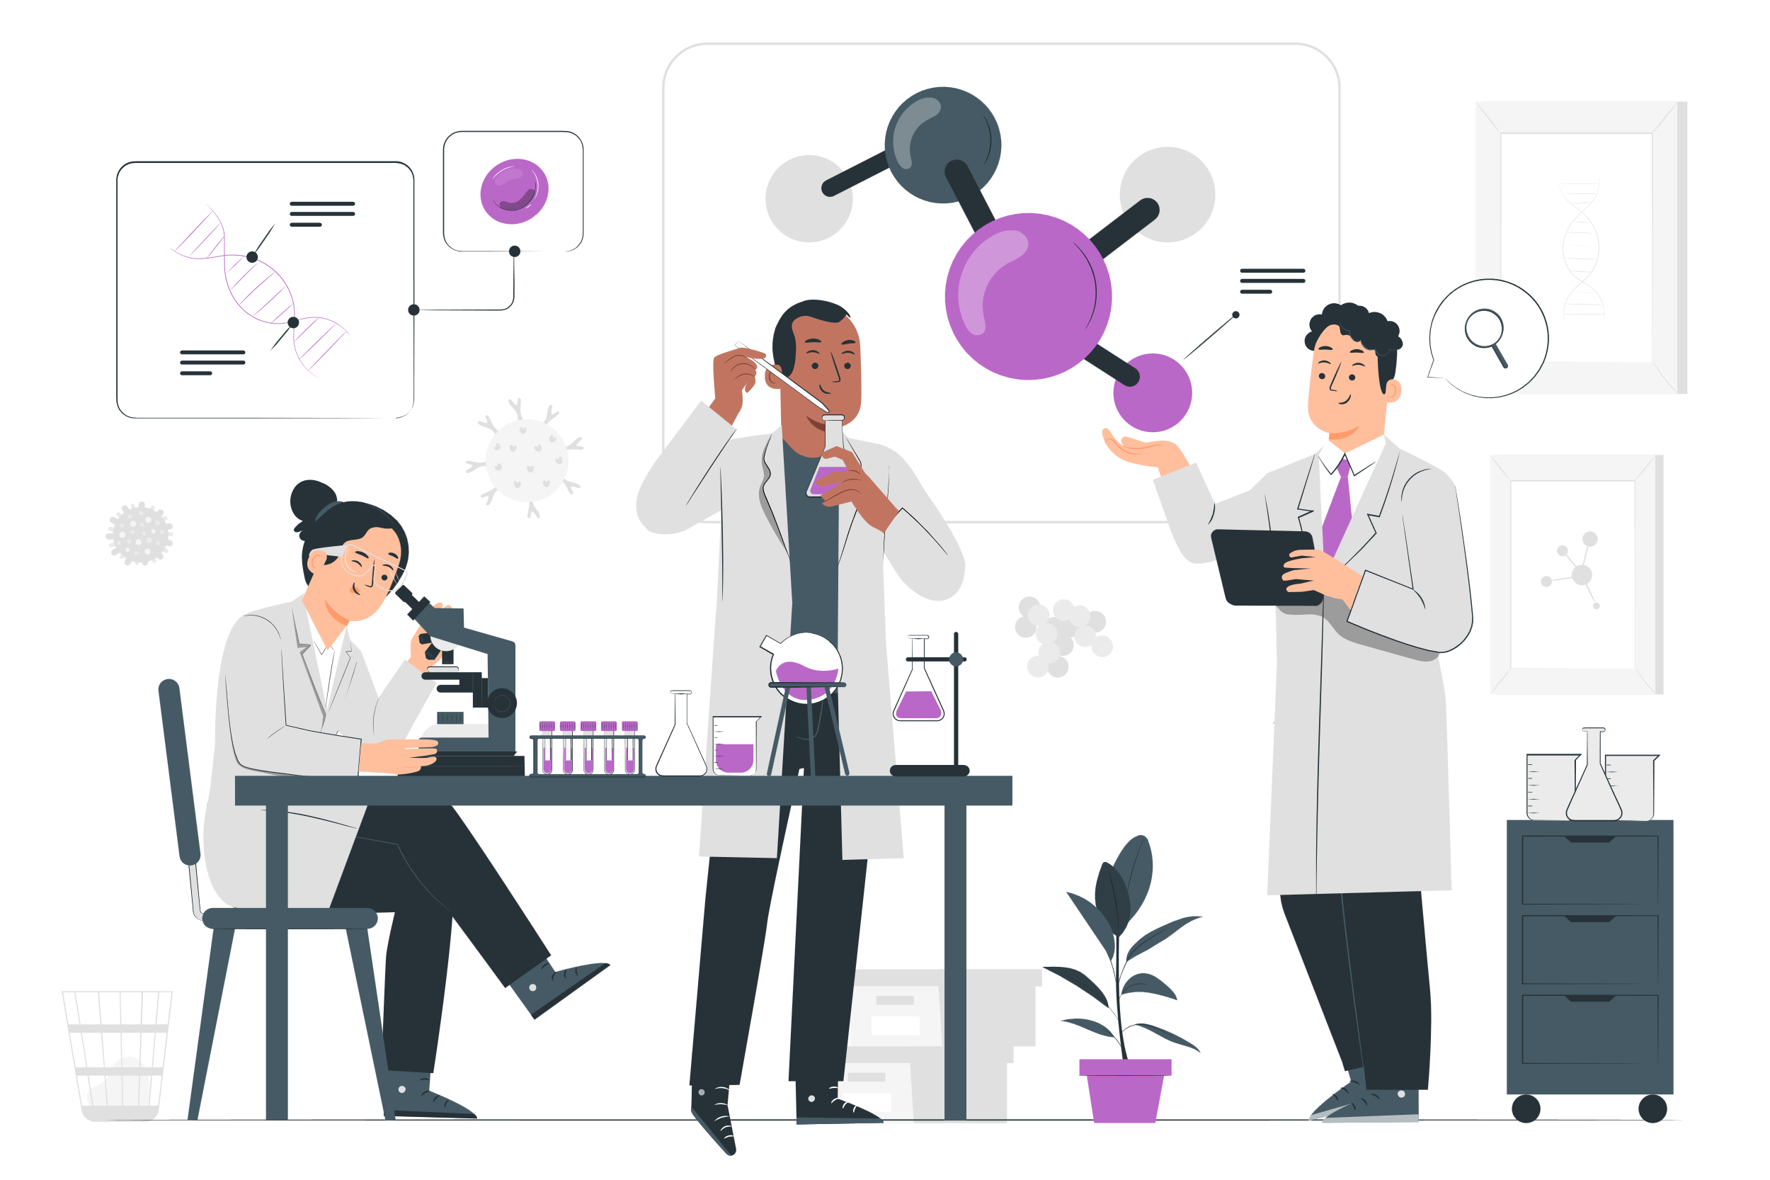
Team Science
A collaborative effort to address a scientific challenge that leverages the strengths and expertise of professionals trained in different fields
(Börner et al., 2010)
2

Slide 3
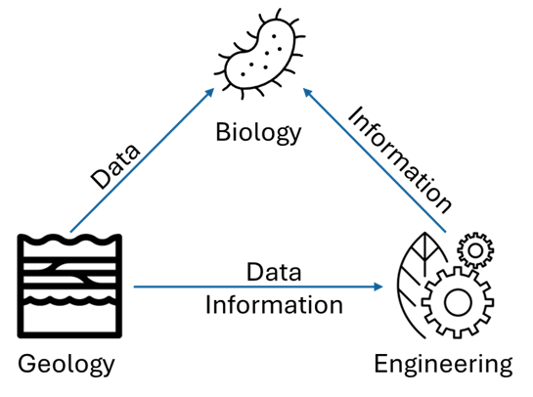
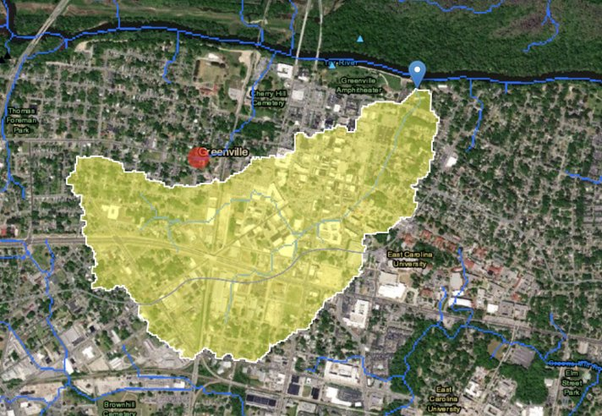
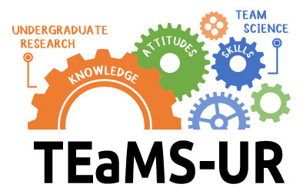
The MD-CUREs
3 Linked Course-based Undergraduate Research Experiences (CUREs)
Hydrogeology and the Environment (Geology)
Groundwater Hydrology (Environmental Engineering)
Microbial Ecology (Biology)
The overarching research focus for all three CUREs was to evaluate how the microbial community and hydrology impacted the effectiveness of a regenerative stormwater conveyance as a sediment and nutrient treatment best management practice
CUREs each worked towards their own discipline specific student learning objectives but teams depended on those from other disciplines for sharing of data and information
Student generated watershed map
3

Slide 4
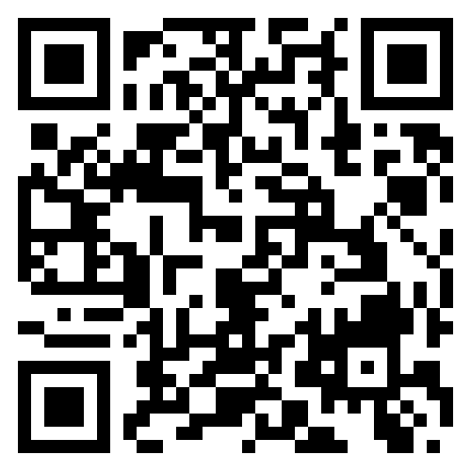
Team Science Infusion in the CUREs
Instructors and Graduate Teaching Assistants:
Team Science Workshops - Some of the content available at: https://digitalmarket.ecu.edu/teamscience/
Students in the CUREs: Team building activities, Team science instruction, Creation of communication and research plans
Team Science
Workshop Materials
(Vance-Chalcraft et al., 2023)
4
Notes:
General Principles is primarily a thought exercise to get them talking. We provide materials
Communication modes, can be specific – text about meetings, documents via email or other on LMS
Frequencies and response times
We particularly ask the TA’s to look at the conflict resolution plans. Example 1 – excellent….then the scary ones. Example 2 Lord of the Flies?
TA’s mphasize that this is a living document and can be revisited and revised.

Slide 5
Research Question:
How connected are the network of teams in these linked CUREs, both within and between disciplines?
Participants - 39 students in 9 teams
2 Geology, 3 Engineering, 4 Biology
Demographics approximately matched those of the institution
5
Notes:
Does embedding Team Science instruction in Chemistry lab CUREs cultivate learning and trust networks?

Slide 6
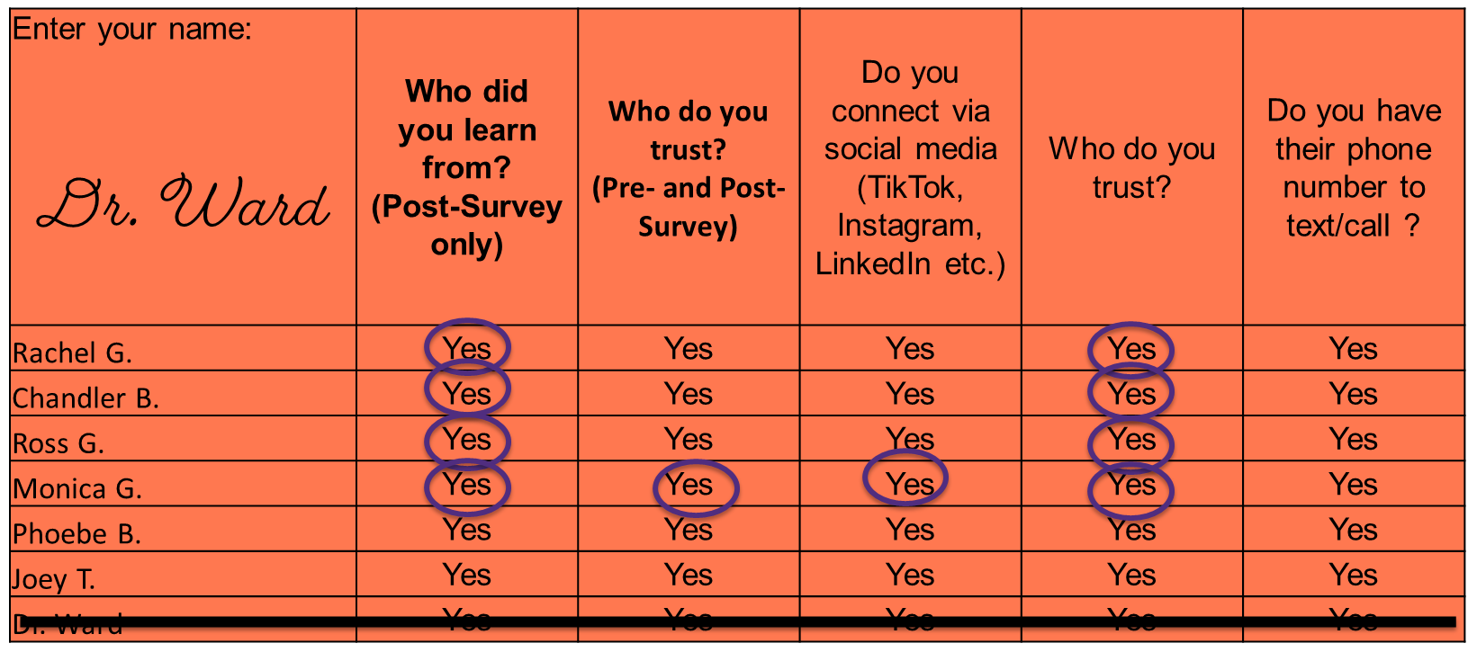
Methodology
Social Network Analysis was conducted with pre/post surveys. Networks were developed using UCINet
Faction analysis with 3 factions applied. Multidisciplinary factions indicate large amount of multidisciplinary interactions
(Borgatti et. al, 2002)
6
Notes:
Team Science Training:

Slide 7
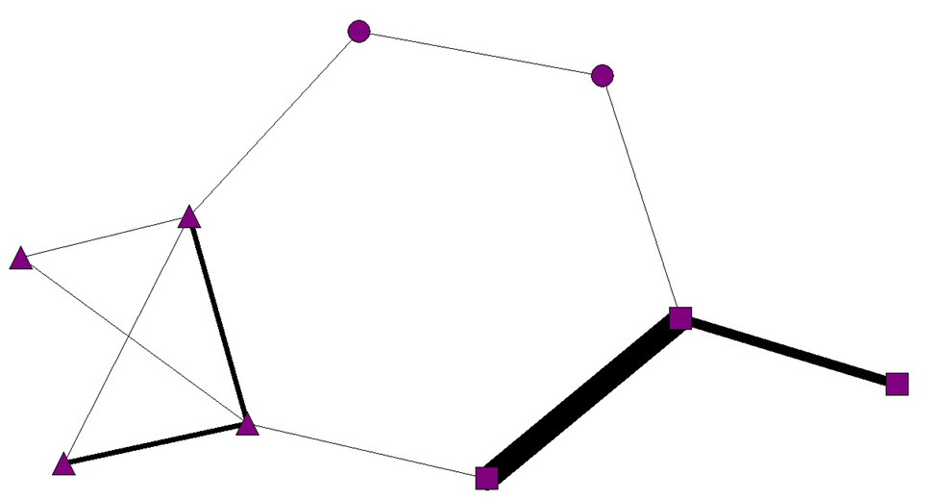
How to read the network
Nodes – Represent Teams of participants. Shape indicates discipline. Circle – Geology, Square - Engineering
Triangle - Biology
Tie – represents connections. Thicker ties mean more connections between those nodes.
Factions -
Groups of nodes separated by how many similar ties they have.
Density - The “fullness” of the network. How many ties exist versus how many are possible
7

Slide 8
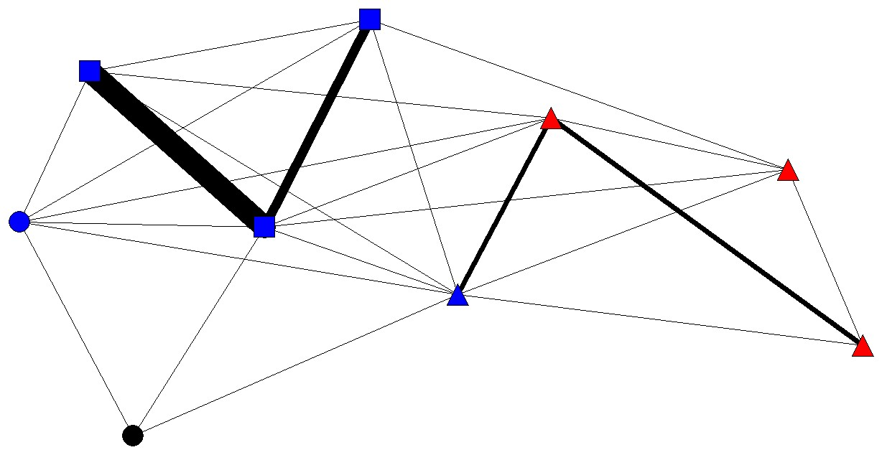
Who do you trust?
Pre-Survey Trust
9 Nodes
Density: .250
Density not large enough to apply faction analysis
Post-Survey Trust
9 Nodes
Density: .440
Faction Fitness: 22
Colors represent faction dispersion
Faction 1 – Blue, Faction 2 – Red,
Faction 3 - Black
8

Slide 9
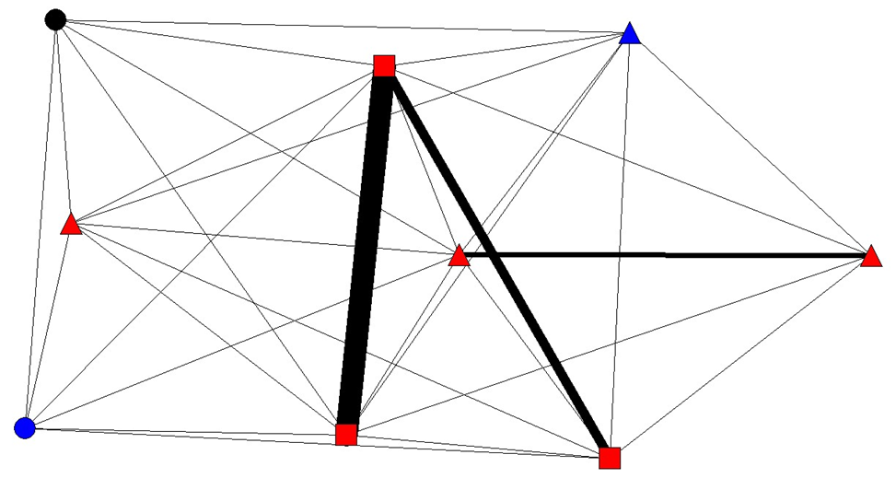
Who did you learn from?
Post-Survey Learn
9 Nodes
Density: .597
Faction Fitness: 30
Colors represent faction dispersion
Faction 1 – Blue, Faction 2 – Red,
Faction 3 - Black
9

Slide 10
Summary of Results
When both Pre- and Post-Survey networks were analyzed, density nearly doubled
Students are building trust relationships in these CUREs
Faction analysis reveals multidisciplinary trust and learn interactions, more learn than trust
Post- Survey Trust
Post- Survey Learn
10

Slide 11
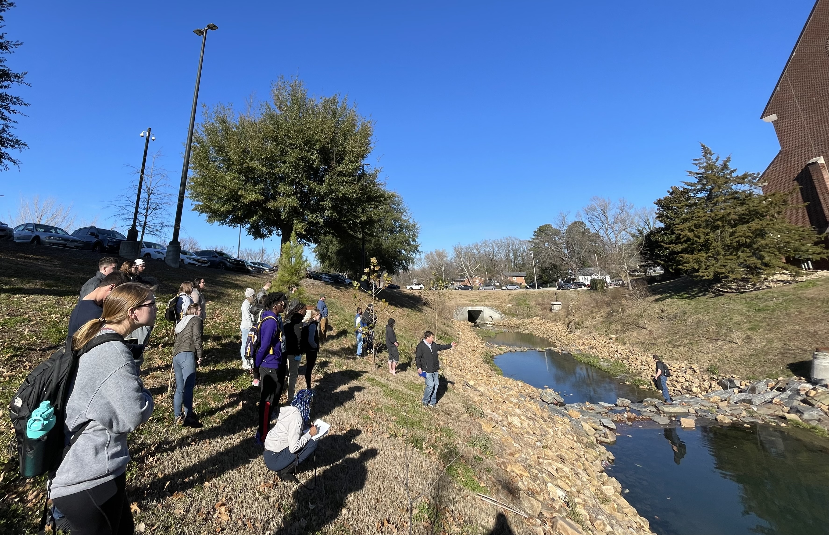
Implications
Consider implementing team science into courses – This can be done with examples, instruction, activities, etc.
Encourage multidisciplinary interaction – Show students that science is done by teams of individuals from many backgrounds that think in unique ways!
11

Slide 12
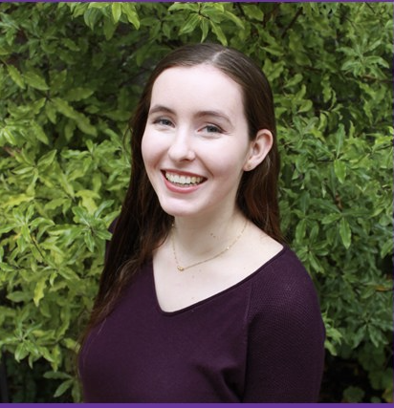
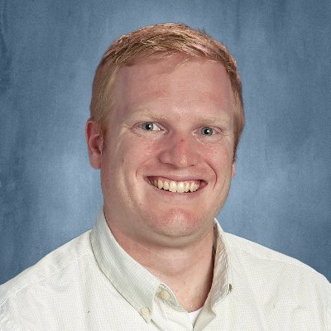
Acknowledgements
Questions after today?
Contact us!
Abby: eaboyd@olemiss.edu
This work was supported by National Science Foundation Grant No. 2013358
Students, Faculty, and Administrators
TEaMS-UR Education Research Graduate Students: Fiona Freeland, Clark Andersen
Fiona Freeland
Clark Andersen
12

