Slide 1

The value of complementary research instruments in supporting and documenting change in undergraduate science teaching
Anne E. Egger and Leighanna Hinojosa
Central Washington University
GSA Connects, September 22-25, 2024, Anaheim, CA
Abstract 272-9, Session T69. Making Sense of Methodologies and Theoretical Frameworks in Geoscience Education Research

Slide 2
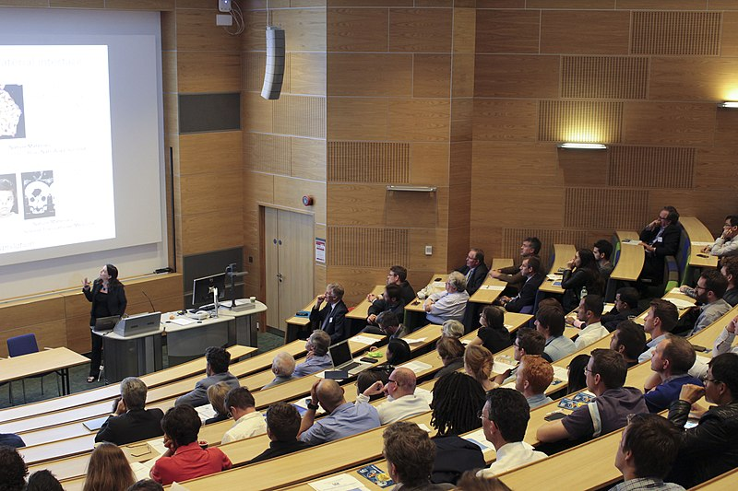
Why is it so hard to change introductory courses?
The easy answers: Not enough time. Teaching isn’t valued. My colleagues won’t agree. Scheduling won’t let us.
Yes, and…
…. There are complex interactions between instructors’ beliefs and practices and between students’ beliefs and practices that need to be acknowledged and explicitly addressed.

Slide 3
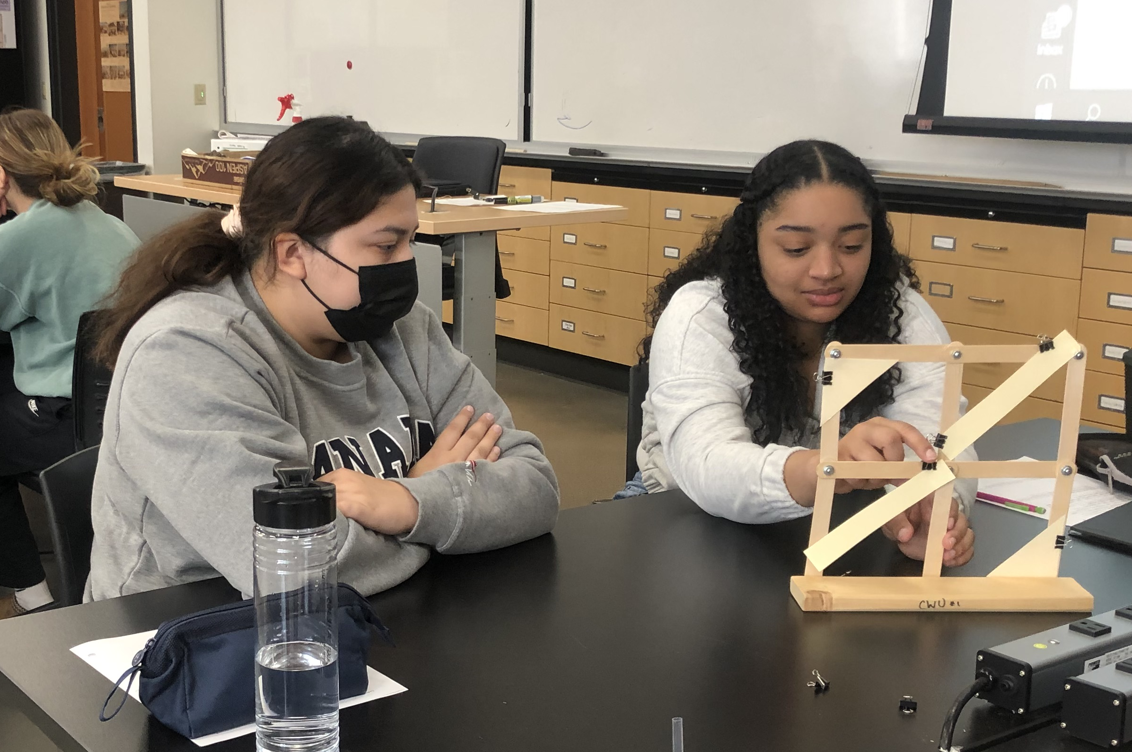
What kind of changes do we want to see?
The vision of the TIDeS project is that future teachers will learn science as undergraduates the way we expect them to teach science in their K–12 classrooms.
More active engagement of students in all the practices of science
More genuine discussion, questioning, actively building understanding through following curiosity
More comfort with developing a science identity, building a sense of belonging within a course or discipline
Notes:
Add picture

Slide 4
How can we support change?
The backward design process… | …applied to the curricular materials design process
Identify desired outcomes | Identify project guiding principles
Determine assessments that will show outcomes have been met | Create a rubric that outlines the criteria for meeting the guiding principles
Design activities that lead to success | Offer professional development aligned with rubric Review materials and observations and provide feedback
Notes:
Rubrics, observation and feedback
Use a backward design process:
Identify desired outcomes
Determine assessments that will show outcomes have been met
Design activities to support success

Slide 5
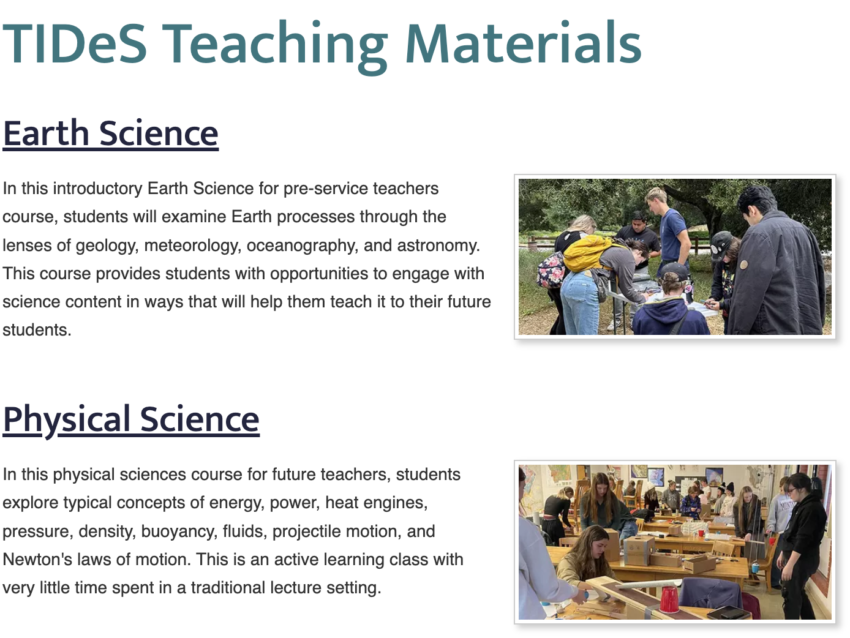
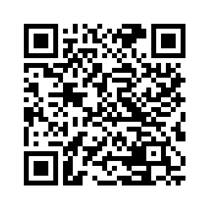
Evidence of support
New curricular materials that implement our guiding principles:
Students will engage in scientific investigation and engineering design to deepen their understanding of core ideas.
Faculty and the curricular materials they use will cultivate an equitable learning environment where all students have equal access to learning and feel valued and supported in their learning.
Students will address questions and solve problems that are relevant to their lives.
Students will engage in authentic and meaningful scenarios that make use of real data and models and reflect the actual practice of science and engineering.

Slide 6
How can we document change?
 | Teaching beliefs |  | Teaching practices |  | Student beliefs | Student practices
 | Survey | Interview | Syllabus analysis | Observations | Pre-/post- surveys | Observations
Prior to materials development | x | x | x | x | x | x
During first implementation |  |  | x | x | x | x
After first implementation |  | x
During second implementation |  |  | x | x | x | x
After final revision of materials | x | x
 | Likert-scale responses, more reformed to more traditional | Open-ended, coded into five categories | Rubric for learner-focused, transitional, content-focused | COPUS, coded to student behaviors SDI coded to frequencies | Likert-scale responses of agreement, Confidence scale | COPUS, coded to student behaviors SDI coded to frequencies
Notes:
Need to look at both beliefs and practices of both instructors and students
Changes in beliefs:
Pre-/post- surveys: Easy for participants to complete, straightforward to compare
Repeat interviews: Time-consuming for both participants and researchers, but allows for deeper probing
Changes in practices:
Repeat observations using a protocol: Time-consuming for researchers, but straightforward to analyze for change
Repeat assessment against a rubric:

Slide 7
Instructor beliefs and practices: Before
 | BELIEFS |  |  |  |  |  |  | PRACTICES
 | Survey | Interview |  |  |  |  |  | Syllabus | COPUS |  | Discursive forms
 | Likert | Trad | Inst | Tran |  | Resp | Ref | Style | Cluster | Profile | Ask | Press | Link
1 | More reformed |  | xxxxxx |  |  |  |  | Content-focused | 2,3,4 | Didactic (1); Interactive (2) | 3.5 | 2 | 2.5
2 | More reformed |  | xxxx |  | xx |  |  | Learning-focused | 3,5,6 | Interactive (1); Student-centered (2) | 1 | 1 | 2
3 | More reformed |  | xxx |  | xxx |  |  | Content-focused | 1,3 | Didactic (1); Interactive (1) | 2.5 | 1.5 | 2
4 | More reformed |  | /xx |  | xxx | / |  | Learning-focused | 4 | Interactive (2) | 3 | 3 | 4
13 | More reformed |  | xxx |  | xxx |  |  | Transitional | 3 | Interactive (1) | 4 | 4 | 3.5
14 | More reformed | x | xxx |  | xx |  |  | Transitional | 1,3,6 | Didactic (1); Interactive (2); Student-centered (1) | 1 | 1.5 | 1.5

Slide 8
Instructor beliefs and practices: Before
 | BELIEFS |  |  |  |  |  |  | PRACTICES
 | Survey | Interview |  |  |  |  |  | Syllabus | COPUS |  | Discursive forms
 | Likert | Trad | Inst | Tran |  | Resp | Ref | Style | Cluster | Profile | Ask | Press | Link
1
2
3
4
13
14
Notes:
More reformed beliefs when responding to statements (know what you should do)
Harder to articulate beliefs to open-ended questions
Practices are not in the same place as beliefs: sometimes doing things but not believing they are working, sometimes believing something but not doing it

Slide 9
Instructor beliefs and practices: After
 |  | BELIEFS |  |  |  |  |  | PRACTICES
 | Survey | Interview |  |  |  |  |  | Syllabus | COPUS |  | Discursive forms
ID | Likert |  | Trad | Inst | Trans | Resp | Ref | Style | Cluster | Profile | Ask | Press | Link
1
2
3
4
13
14
Notes:
More practice doing things may help change beliefs
Opportunity to iterate and implement something more than once is important for making lasting change

Slide 10
Instructor beliefs and practices: After
 |  | BELIEFS |  |  |  |  |  | PRACTICES
 | Survey | Interview |  |  |  |  |  | Syllabus | COPUS |  | Discursive forms
ID | Likert |  | Trad | Inst | Trans | Resp | Ref | Style | Cluster | Profile | Ask | Press | Link
1 | More reformed |  |  | xx | xxxxx |  |  | Content-focused | 6,4,5,5 | Interactive (3); Student-centered (1) | 2.3 | 2.0 | 3.3
2 | More reformed |  |  | xx | xx | x | xx | Learning-focused | 7,3,3,3,3 | Interactive (4); Student-centered (1) | 3.2 | 2.0 | 3.0
3 | More reformed |  |  | / | /xxx/ | xx | / | Transitional | 6,3,7,3,7,6,6 | Interactive (2); Student-centered (5) | 2.0 | 2.8 | 3.3
4 | More reformed |  |  | x | xxxx | / | x/ | Learning-focused | 6,6,3,6,6 | Interactive (1); Student-centered (4) | 1.3 | 2.0 | 4.0
13 | More reformed |  |  | xx | xx | xx | x | Learning-focused | 3,3,3,3,3,3,3,3 | Interactive (8) | 3.4 | 2.4 | 3.8
14 | More reformed |  |  | x | xxxx | x | x | Learning-focused | 3,3,3,7,6,7 | Interactive (2); Student-centered (1) | 3.3 | 2.3 | 2.7

Slide 11
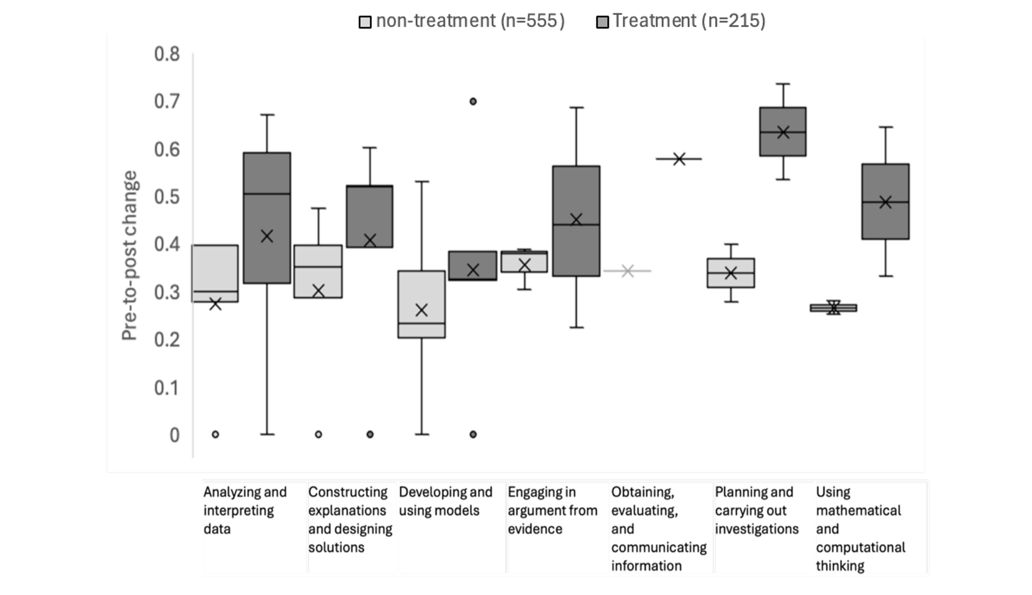
Student beliefs (self-efficacy)

Slide 12
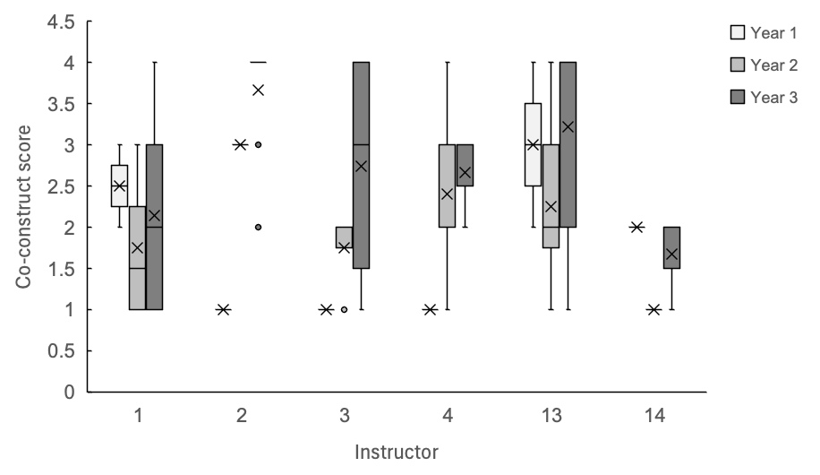
Student practices (discourse)

Slide 13
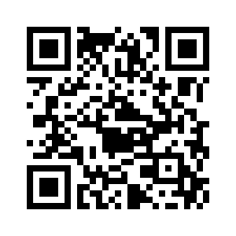
Summary: Why use so many instruments?
Results from any one instrument may be equivocal, especially after only one iteration.
Observed changes using one instrument may be small, and difficult to attribute to the intervention.
Complementary instruments take substantial time and effort to implement, but have the power to show that:
  All the small changes are happening in the same direction
  Change is more likely to be sustained if both beliefs and practices have evolved
Read more about the instruments and download reports with the data
Notes:
Add picture

Slide 14
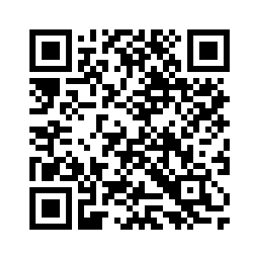
Learn more about the new materials:
Register for our October 21 webinar
Check them out!
Complete Earth and physical science courses
Interested in revamping your introductory course?
Get in touch: Anne.Egger@cwu.edu

