Slide 1

Why Should I Learn This? Improving Geoscience Knowledge by Emphasizing Its Relevance in an Out-of-School Program
Kim A. Cheek, Department of Teaching, Learning, and Curriculum, Elizabeth Brown, Department of Psychology, Ryan Shamet, School of Engineering, and Tamara Reeves, Department of Teaching, Learning, and Curriculum

Slide 2
Background and Theoretical Foundation
Informal Science Education
Little consistent science instruction in elementary schools, especially for students from minoritized groups (Banilower, 2018)
Informal science education (ISE) can improve understanding of core ideas and positively impact motivation (Habig & Gupta, 2021; King & Pringle, 2019)
Expectancy Value Theory
Expectations for success and perceived utility value are important multiplicative determiners of motivation (Eccles & Wigfield, 2002).
Utility value better predictor of what students choose to learn (Brown et al., 2015)
Minimal research on utility value perceptions of elementary school students (Shin et al, 2019; Thomas & Strunk, 2017)

Slide 3
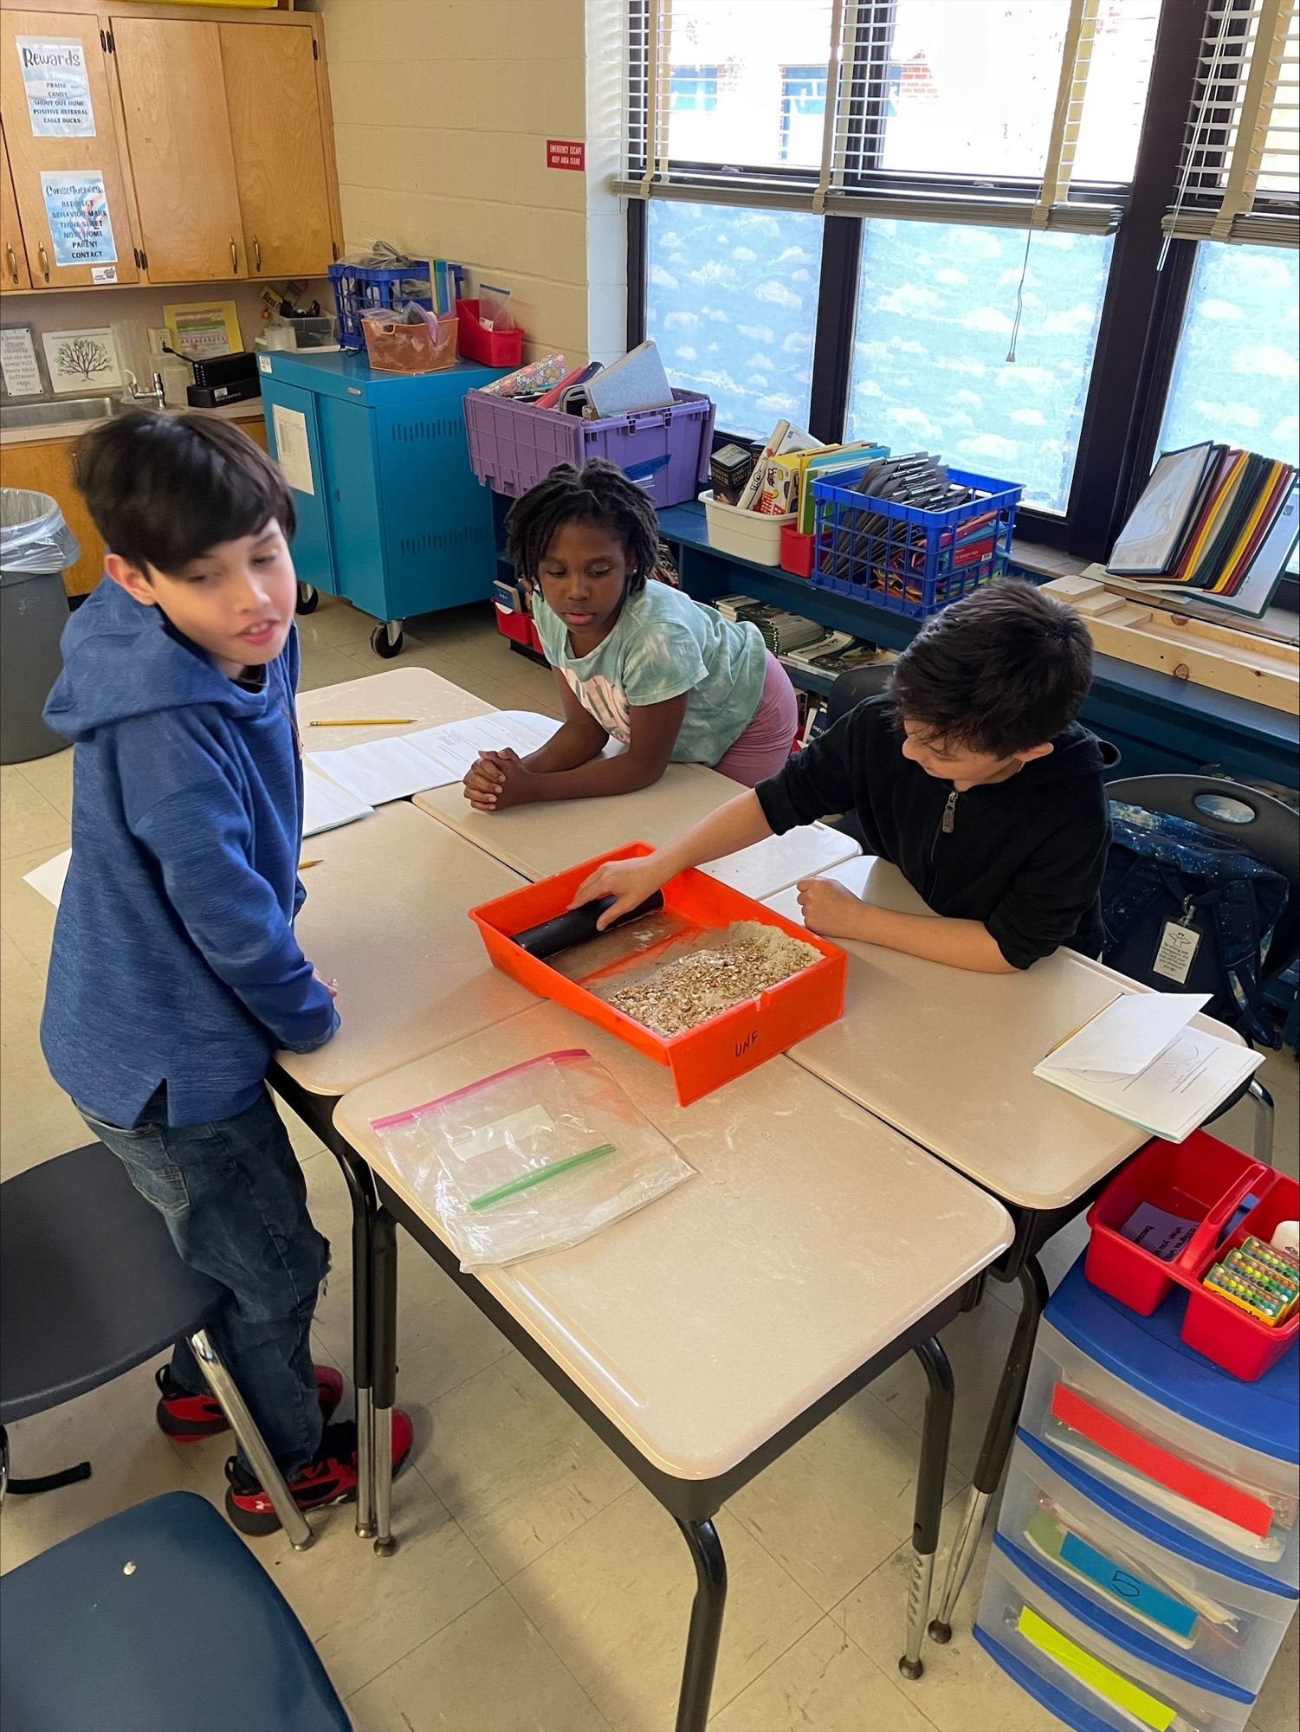
Research Questions
How does 4th and 5th graders’ geoscience content knowledge differ before and after participating in an informal science education program on geoscience issues?
How does 4th and 5th graders’ perceived utility value for learning geoscience differ before and after participating in an informal science education program on local geoscience issues?

Slide 4
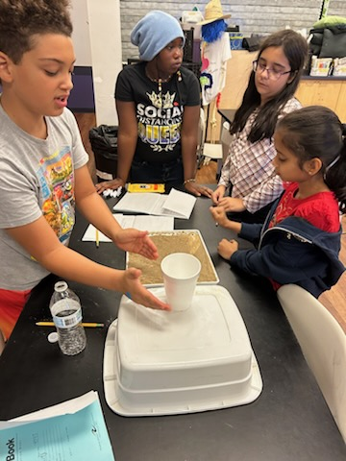
Methods
Context:
City bordered by ocean and bisected by major river
School A: Title I school, 65% minoritized background, free after-school program near end of school year
School B: public charter school, free week-long STEM camp two weeks after school ended, 54% minoritized background
Took place at school site
Sample:
47 4th and 5th graders, median age = 10
51% girls, 36% boys, 13% did not report

Slide 5
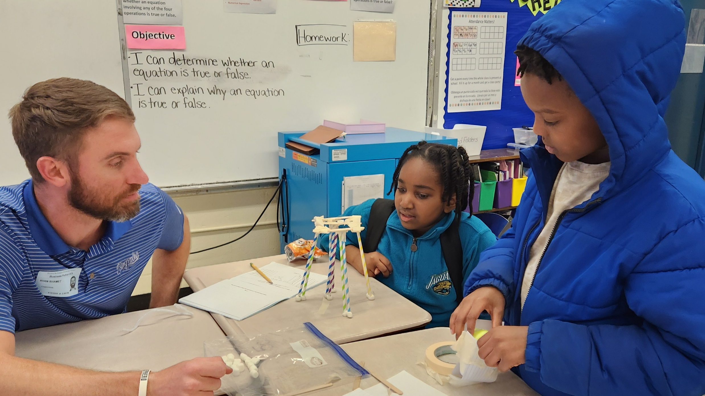
Session 1: Pretest, Mechanisms of physical weathering
Session 2: Physical properties of common minerals
Session 3: Fluvial erosion and deposition
Session 4: Coastal erosion
Session 5: Aeolian erosion and planning for engineering design task
Session 6: Engineering design task, Posttest

Slide 6
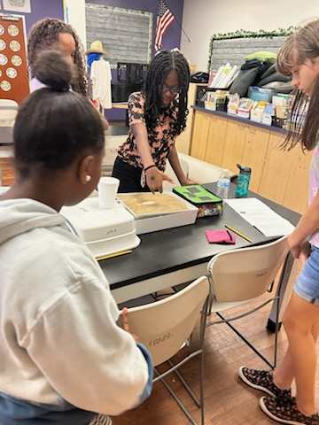
Methods (contd.)
Intervention aligned with NGSS and State Science Standards
Pre/post-test (read aloud):
Four multiple choice knowledge items with explanations for answers
Five 7-pt. Likert scale utility value items
2 x 2 ANOVAs with test as repeated measure

Slide 7
Knowledge Items (RQ 1)
F(1, 22)=37.89, p<.001,
η 𝜂
￼²=0.633
47 scorable pretests, 29 scorable posttests
Observed power 1.00.
F(1, 22)= 27.39, p<.001, partial η²=0.6
F(1, 22)= 37.89, p<.001, partial η²=0.633
Notes:
F(1, 22)=37.89, p<.001,
η 𝜂
￼²=0.633

Slide 8
Utility Value Items (RQ2)
Observed power ranges from .95-.9988
F(1, 22)= 3.89, p=.061, partial η²=0.150
F(1, 22)= 3.99, p=.058, partial η²=0.154

Slide 9
Conclusions and Recommendations
Learning gains at both schools despite relatively short intervention with strong effect sizes
Perceptions of utility value improved marginally, but non-significantly at both schools—needs further exploration
Even though schools started at different points on both measures, both increased from pre- to posttest
Data supports value of pairing authentic scientific investigation with opportunity to reflect on the usefulness of what students are learning

Slide 10
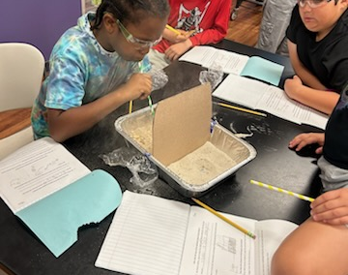
Questions?
k.cheek@unf.edu

Slide 11
Selected References
Banilower, et al. (2018). Report of the 2018 NSSME+. Horizon Research Inc.
Brown, E.R. et al. (2015). From bench to bedside: A communicate utility value to enhance students’ biomedical science motivation. Journal of Educational Psychology, 107(4), 1116-1135.
Eccles & Wigfield (2002). Motivational beliefs, values, and goals. Annual Review of Psychology, 53(1), 109-132.
Habig, B. & Gupta, P. (2021). Authentic STEM research, practices of science, and interest development in an informal science education program. International Journal of STEM Education, 8(1), 1-18.
King, N.S. & Pringle, R.M. (2019) Black girls speak STEM: Counterstories of informal and formal learning experiences. Journal of Research in Science Teaching, 56(5), 539- 569.
Shin, D.D. et al. (2019). Science for all: Boosting the science motivation of elementary schools students with utility value intervention. Learning and Instruction, 60, 104- 116.
Thomas, J.A. & Strunk, K.K. (2017). Expectancy-value and children’s science achievement: Parents matter. Journal of Research in Science Teaching, 54(6), 693-712.
Notes:
I will only show this slide if someone asks for it during Q&A.

