Slide 1


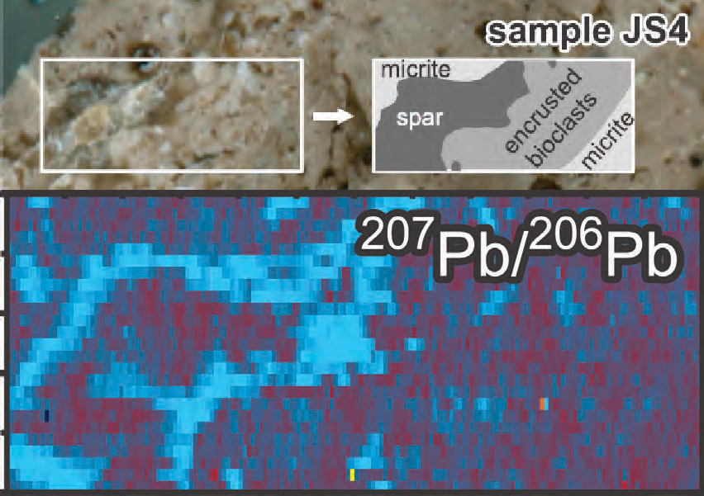
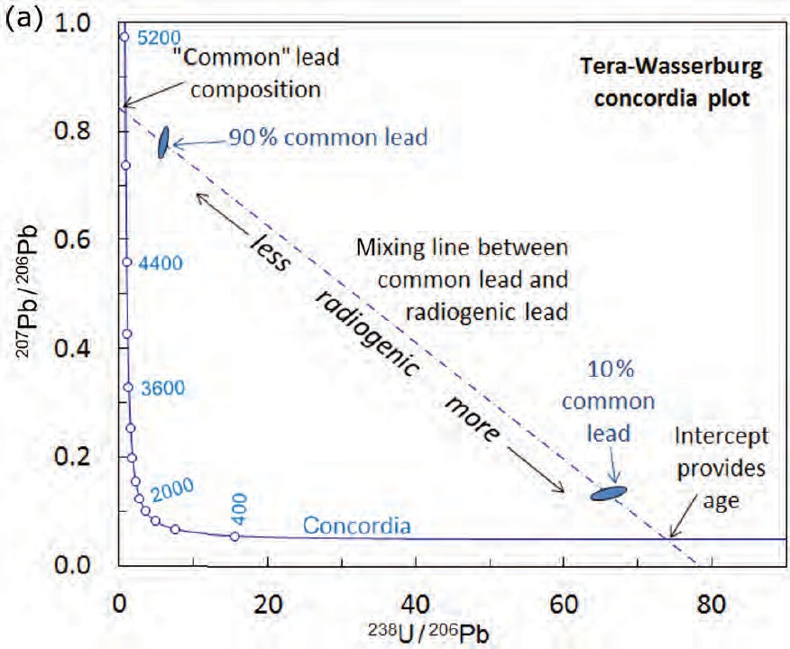

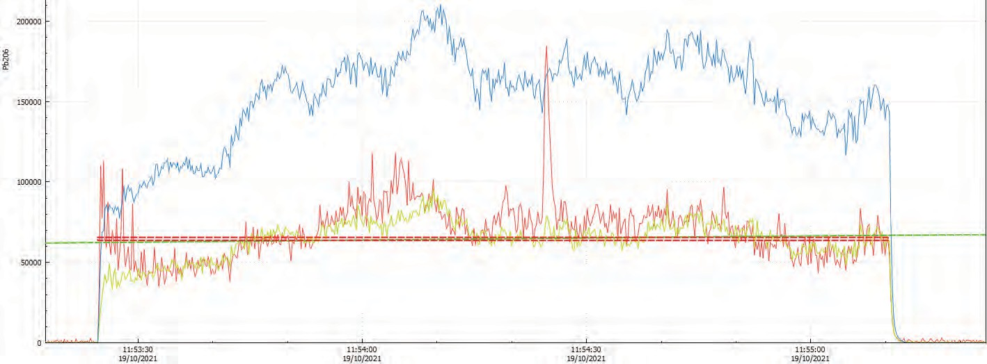
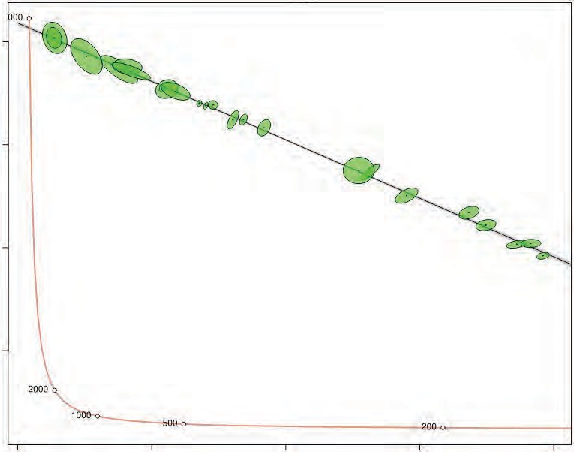

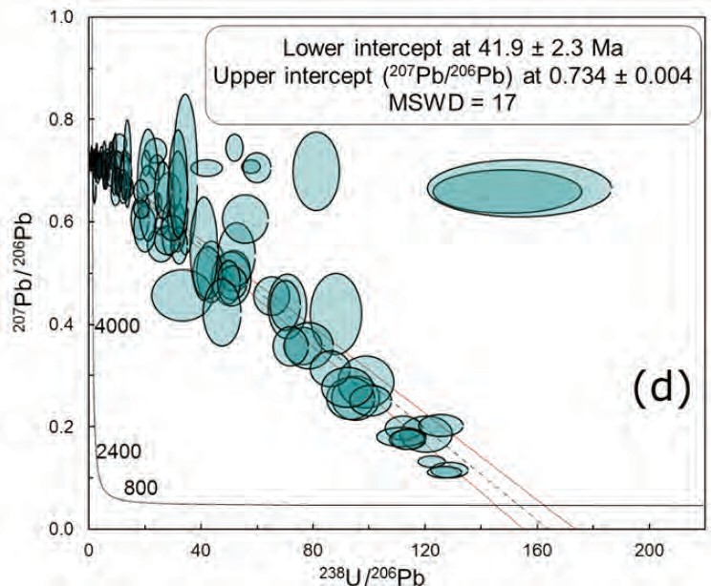
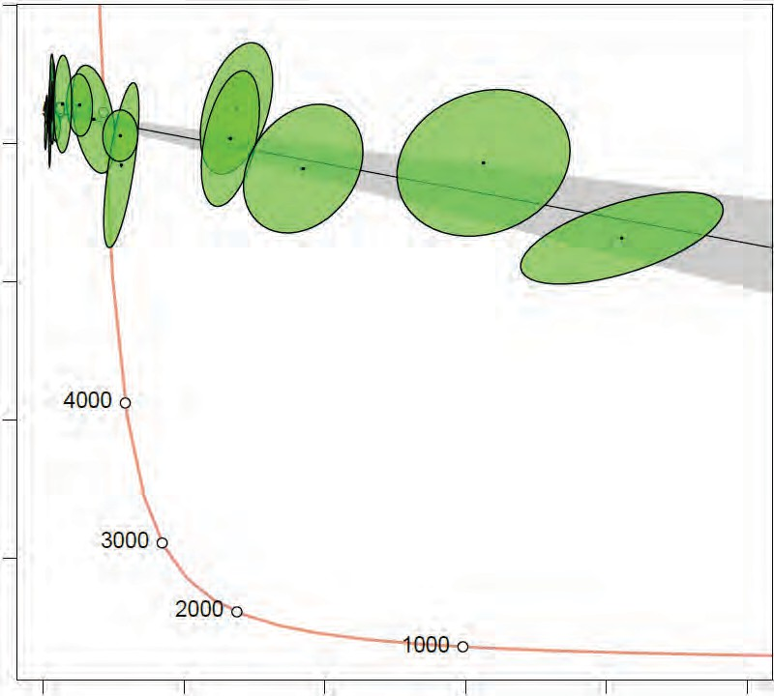
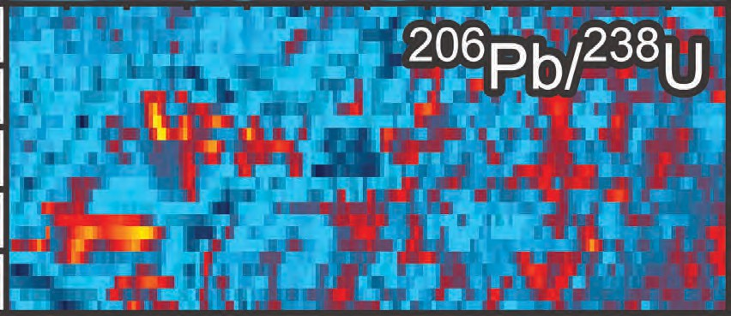

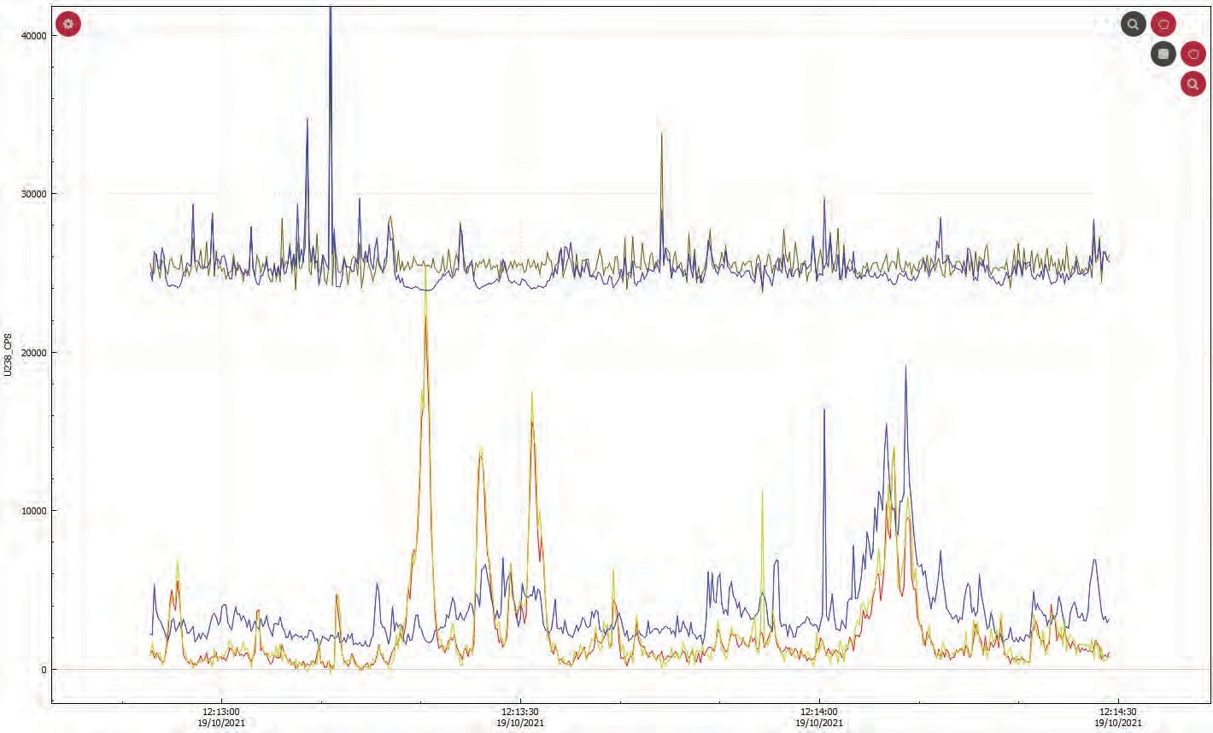
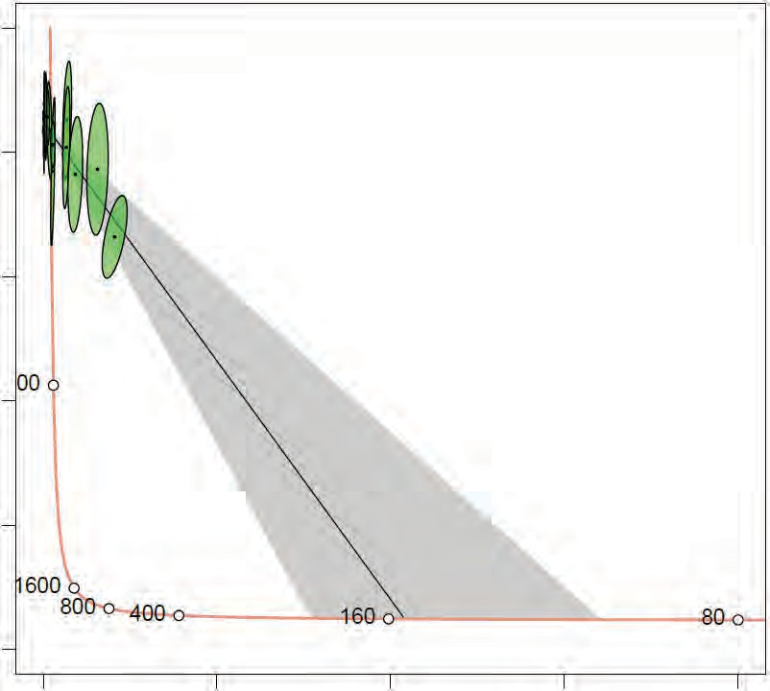
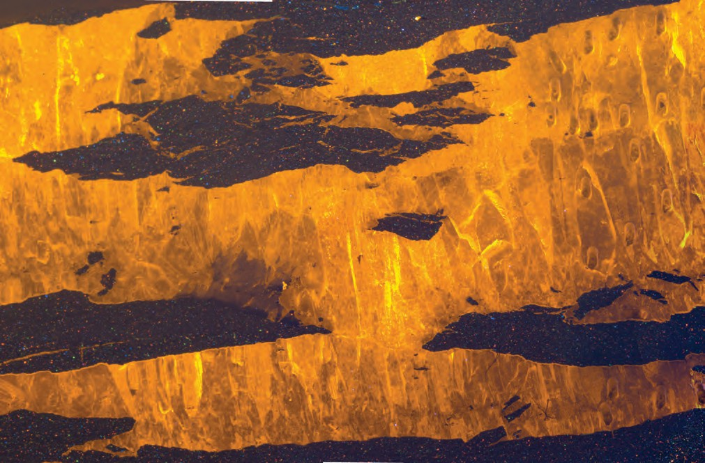
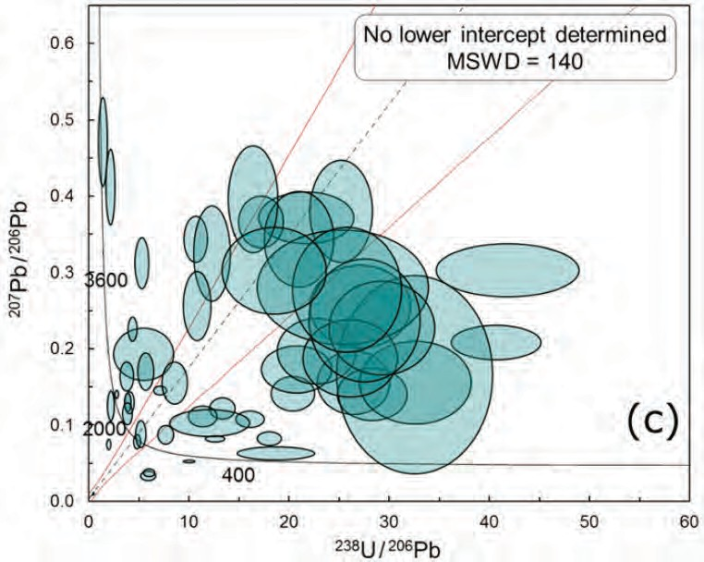
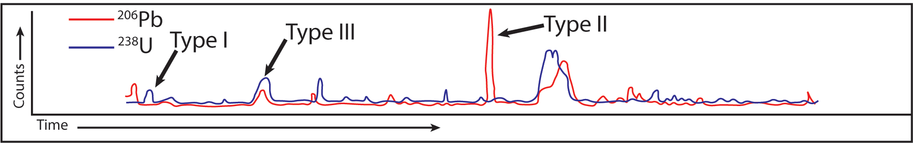
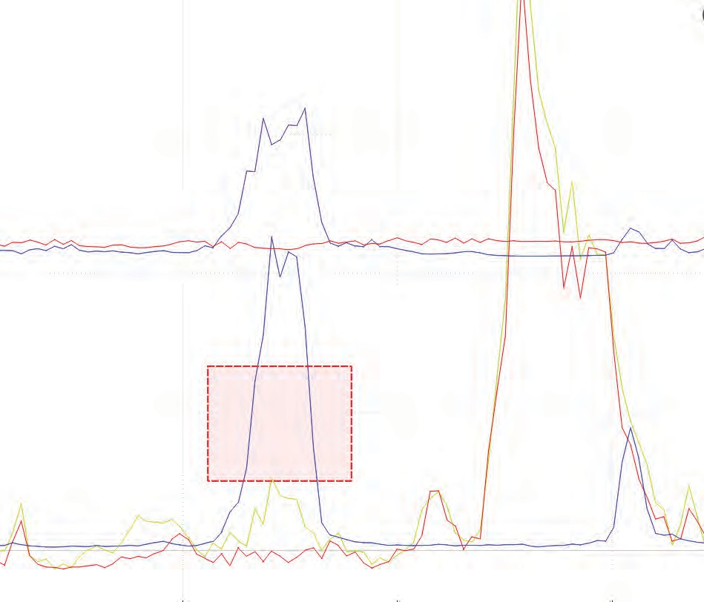
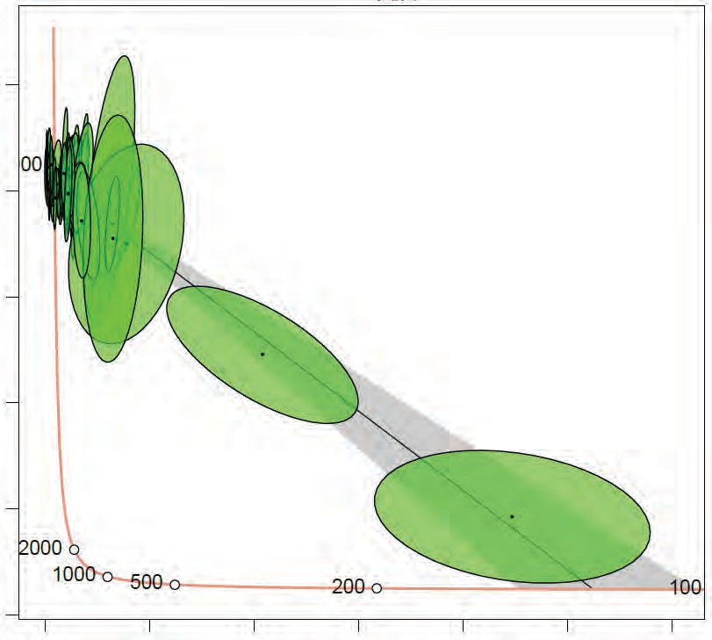
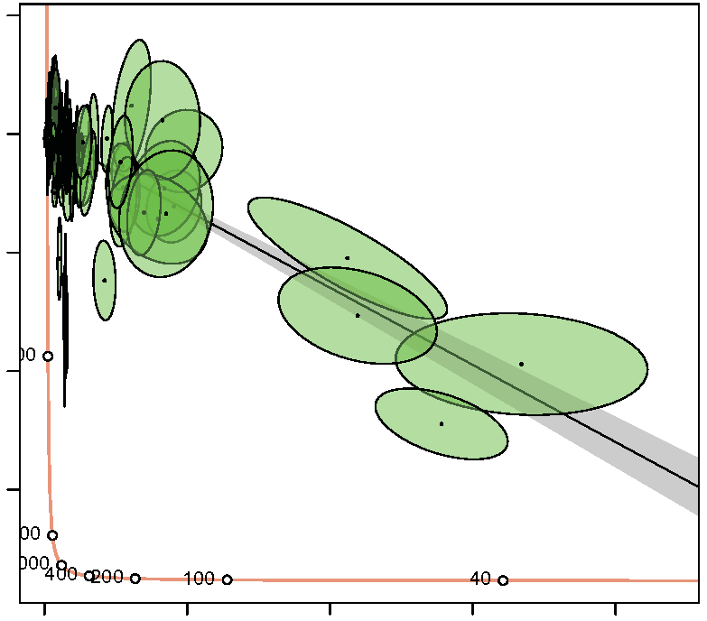
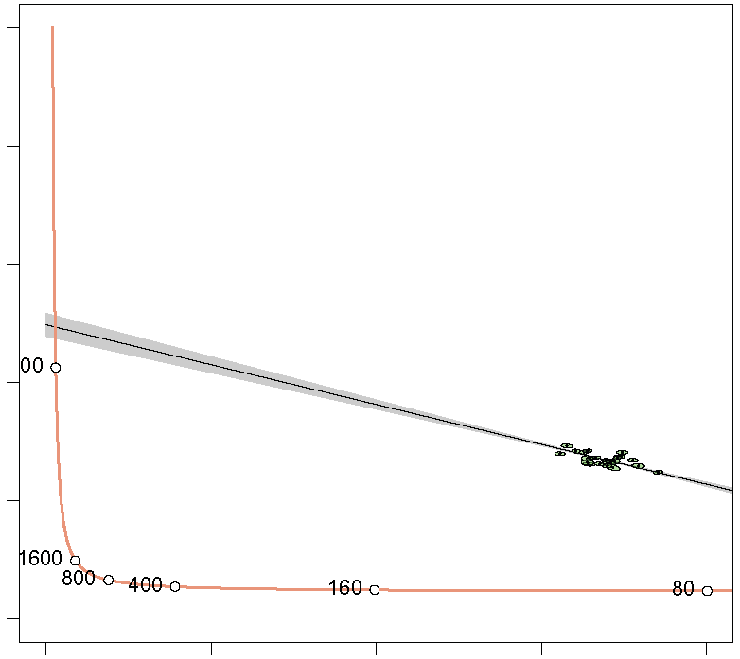
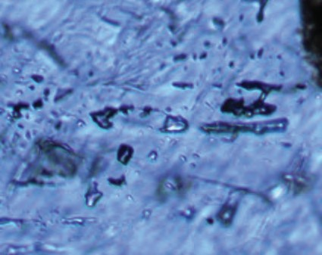
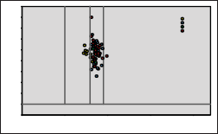
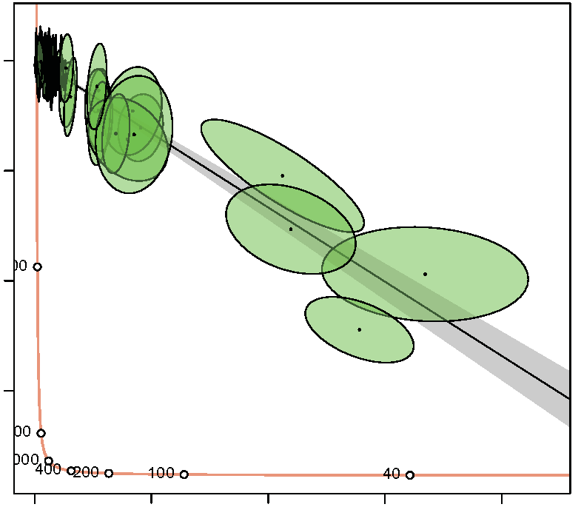

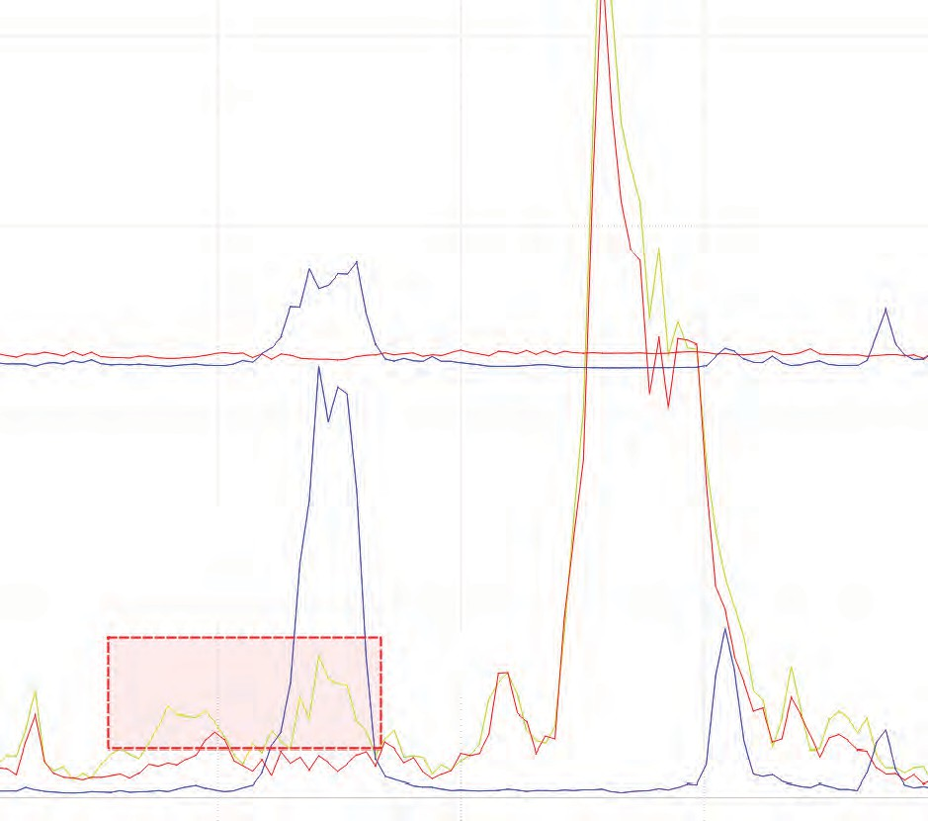
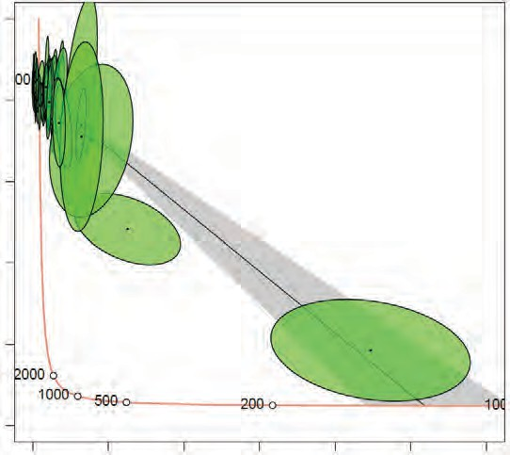

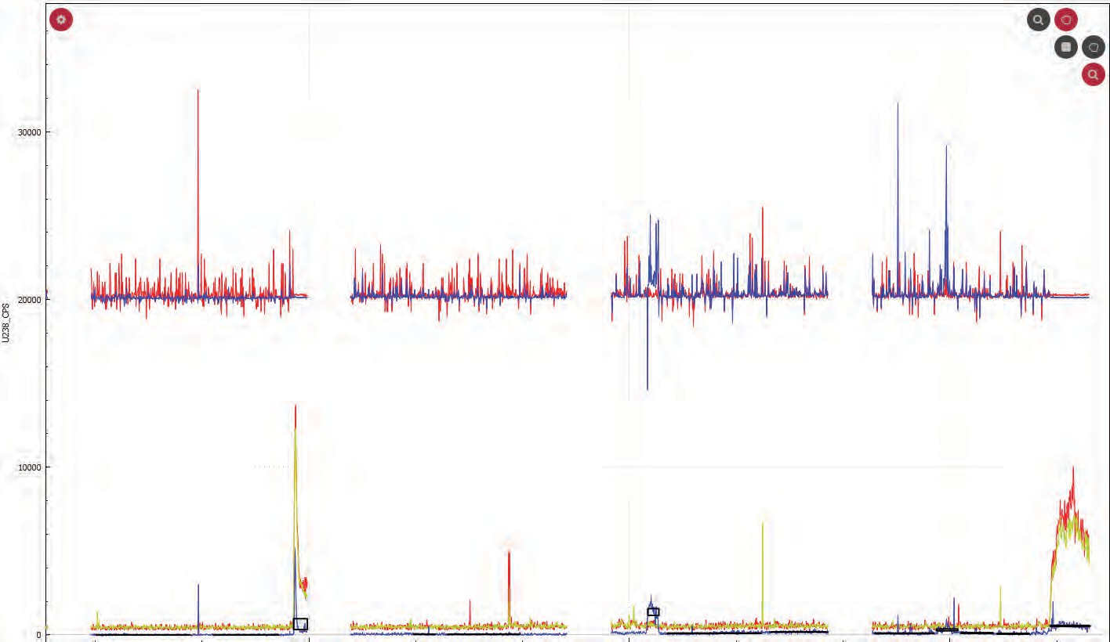
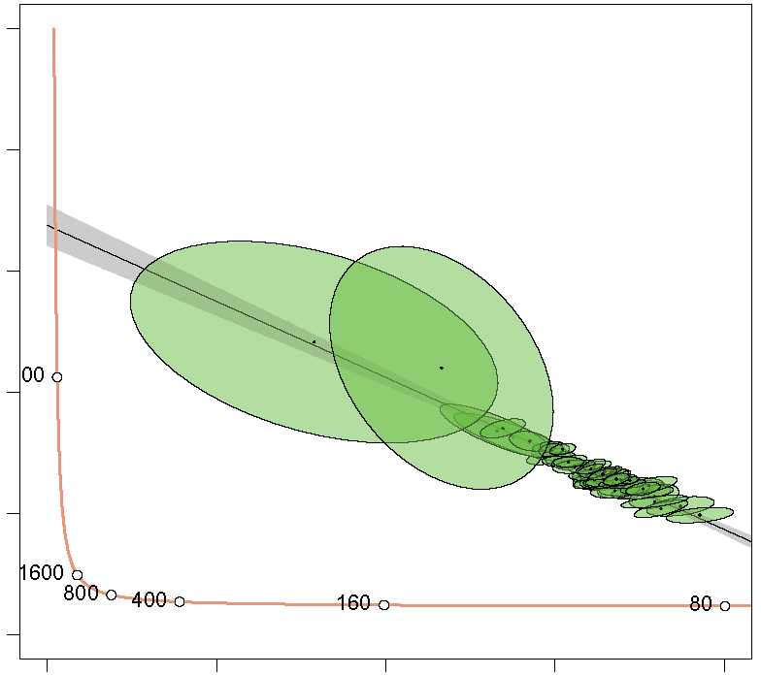
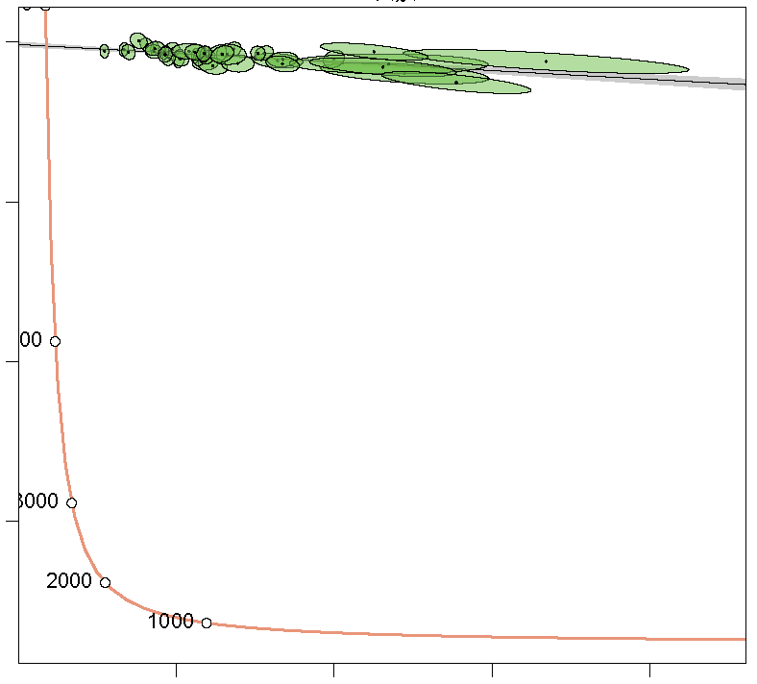
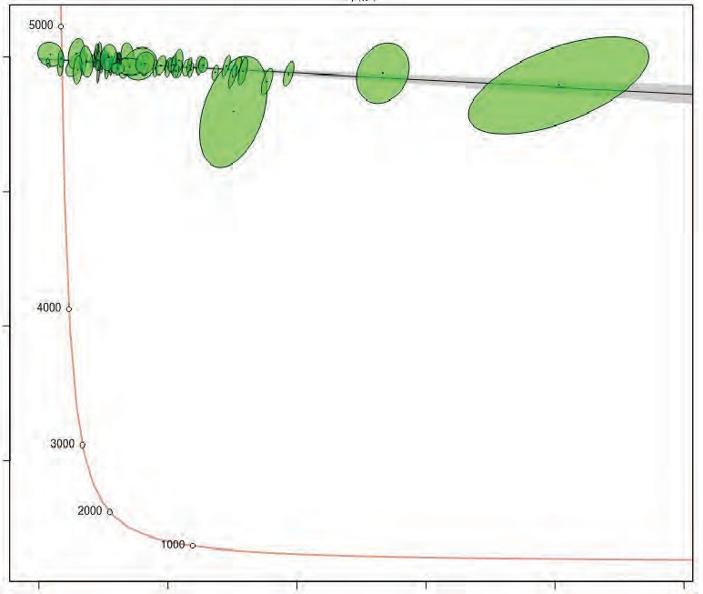
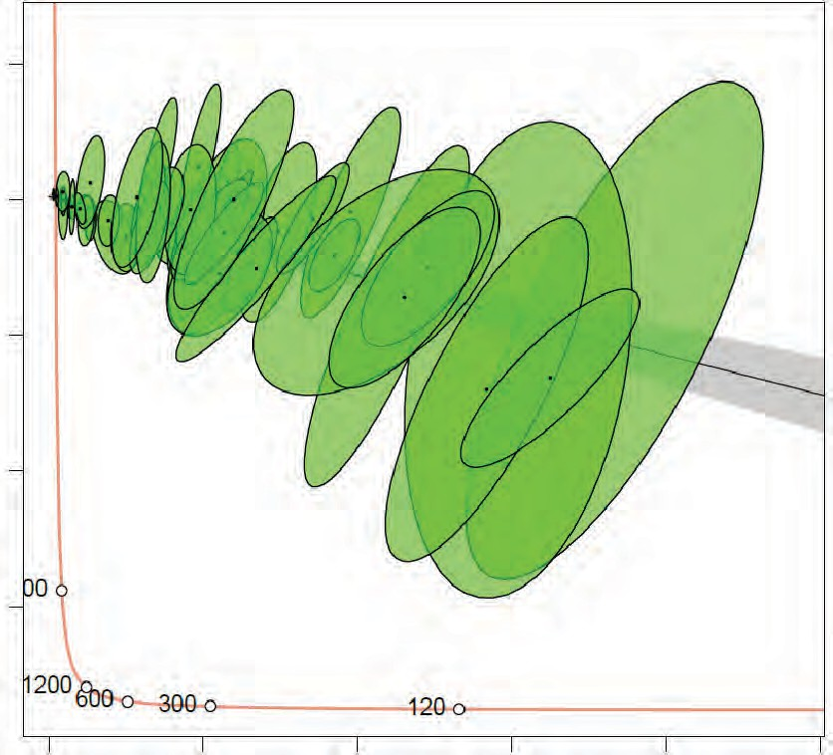
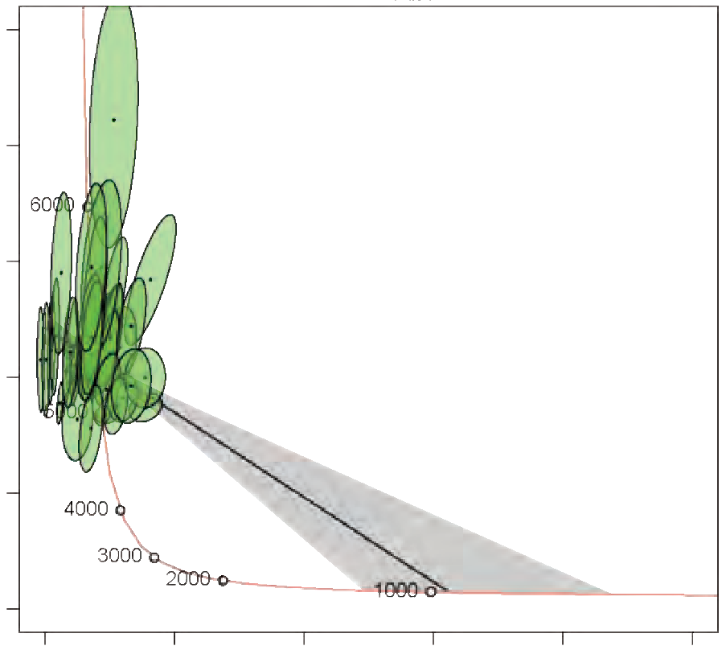
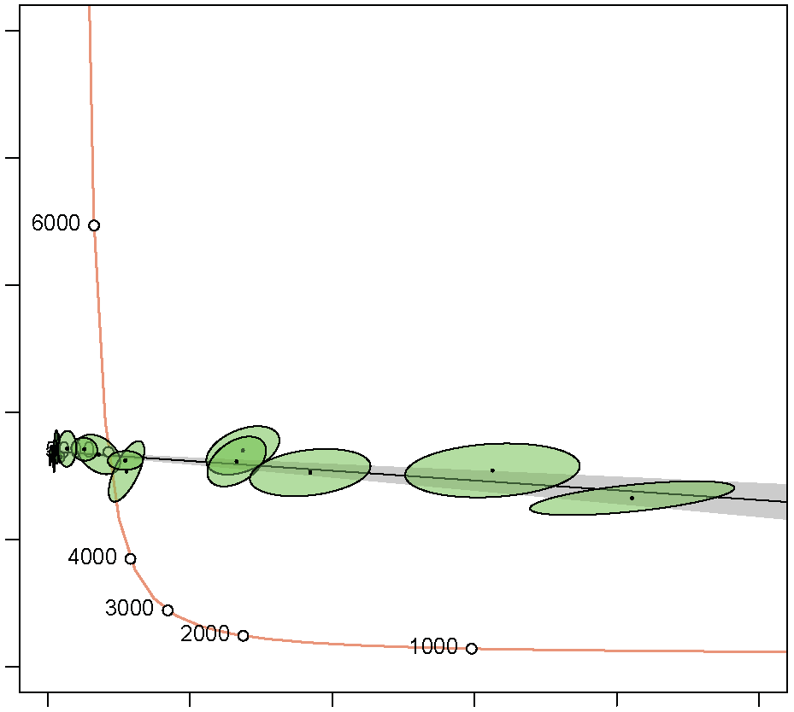
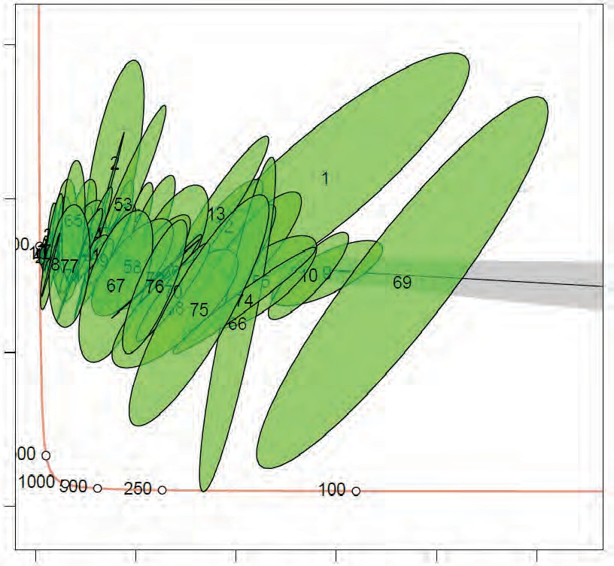
A Proposed Methodology for LA-ICP-MS Data Reduction for U-Pb Calcite Geochronology
Alex M Washburn¹, Paul J. Sylvester²
¹University of Kentucky, Kentucky Geological Suvey, Lexington, KY; ²Texas Tech University, Department of Geosciences, Lubbock, TX
Introduction
Calcite is a ubiquitous mineral in subsurface and surficial geologic systems whose precipita- tion may be directly related to significant geologic events. For this reason, calcite is a valuable candidate for geochronology.
Recent research has focused on utilizing laser ablation mass spectrometry (LA-ICP-MS) to
date calcite with the U-Pb radiogenic system. This methodology is plagued by difficulties inher- ent to calcite such as sub-millimeter scale U and Pb heterogeneity, high abundance of Pb in com- parison to U resulting in lack of spread on isochron plots, and the susceptibility of calcite to dis- solution, reprecipitation, and alteration that make relating ages to events difficult. High failure rates and imprecise ages are common in attempting calcite U-Pb geochronology. Furthermore, detailed descriptions of data reduction methodology for U and Pb signal interval selection are often lacking in manuscripts with calcite ages, thus leaving out information potentially vital to the reproducibility of results.
The purpose of this presentation is to offer a potential method for U and Pb interval selection for time-resolved U-Pb signals from LA-ICP-MS using the popular Iolite software platform to:
decrease uncertainties on precision for calcite U-Pb ages; and
decrease researcher bias and develop a consistent methodology to maximize the potential ac- curacy and reproducibility of results.
Development of this methodology took place by analysis of calcite veins from six sedimenta- ry units, including the Green River Formation of the Uinta Basin, UT; the Wolfcamp formation of the Delaware Basin, TX; the Carrizo Formation of the East Texas Basin, TX; the Maness For- mation of the Eagle Ford Basin, TX; the Heath Formation of the Central Montana Trough, MT; and the Kiowa Formation of Central Kansas.
U-Pb geochronology was accomplished using an ESI NWR193 laser ablation system paired to a Nu AttoM magnetic sector single-collector ICP-MS. Samples were analyzed using 6.0 J/cm2, a 10 Hz laser repetition rate, and spot sizes ranging from 60-120 μm analyzed in time-re- solved line scans moving at 2 μm/ to eliminate laser-induced fractionation effects.
1 Issues in Interpreting Calcite U-Pb Ages 2
Signal Observations
Incorporation of U & Pb into Calcite:
Alteration and U-Pb Open System Behavior:
Calcite in high temperature (> 300° C) is susceptible to solid-state diffusion of Pb (Cherniak,
1997; Roberts et al., 2020).
Alteration that affects the U-Pb system is most likely fluid-assisted.
U is more soluble than Pb, so interaction with oxidizing fluids is more likely to remove U than Pb. However, Pb is less favorable in calcite structure. Thus, mobility of Pb and U should be considered possible.
Spatial Variability of U-Pb in Calcite:
Data Reduction Scheme:
Figure 6 [Below] - [A] Time resolved MS signal from sample
U and Pb replace Ca²⁺ in the calcite crystal lattice dependent on numerous environmental factors.
Calcite usually has very low abundances of U, with somewhat higher amounts of common Pb, from ppb to low ppm.
Figure 1 - From Roberts et al., (2020), demonstrates U-Pb
Tera-Wasserburg isochron plot typically used for calcite U-Pb geochronology.
Due to little or no Th and modest abundances of Pb, common lead corrections using measurements of ²⁰⁸Pb and ²⁰⁴Pb, respectively, cannot be made.
Instead, common Pb mixing lines in Tera-Wasserburg space are used, wherein the y-intercept defines the common lead ratio of 207Pb/206Pb and the intercept of the mixing line with the concordia defines the U-Pb age. (note: the ages are projected on the concordia, assuming they are concordant)
Figure 4 - From Drost et al. (2018) demonstrating the spatial variability of the U-Pb system in a lacustrine limestone and the use of isotope mapping to determine separate age domains.
Spatial variability may be controlled by:
Variations in rate of calcite crystallization in relation to rates of fluid evolution by migration, fluid-rock interactions, etc.
Episodic or multi-generational growth
Localized issolution/reprecipitation of calcite
U and/or Pb-bearing inclusions
In Iolite v.4.8, the VisualAge UComPbine data reduction FW4415 (Washburn et al., 2024a). Similar signal characteristics are scheme is used with primary (WC-1 and NIST614) and sec- observed in the six calcite vein sets included in this study.
ondary standards (JT-1, DBT64, Ash-15).
[B] Diagrammatic representation of three distinct signal characteristics. Type I describes a rise in U signal with no corresponding rise in Pb. Type II describes a rise in Pb signal with no corresponding rise in U. Type III describes a corresponding rise in both U an Pb signals.
Hypothesis: A data reduction process using discrete portions of enriched U-Pb signals of these three types will produce more precise and potentially accurate U-Pb ages. This assumes U and Pb may be decoupled in calcite but not on the scale of the total length of the line traverses made for the sample.
Blue = ²³⁸U Red = ²⁰⁷Pb Green = ²⁰⁶Pb
Standard WC-1
0.8
Pb Mixing?
152.9 ± 53.1 Ma (n=25)
MSWD = 1.2
A B
U Addition
207_{Pb/}206_{Pb}
0.6
0.4
0.2
Figure 5 [Above] - Time-resolved mass spectrometer signal from LA-ICP-MS analysis of carbonate standard WC-1.
During data reduction of known standards, the full time-resolved mass spectrometry signal from analyses of standards is used (with or without trimming masks) as displayed above.
During data reduction of unknown samples, most authors do not describe whether they use the full, averaged signals for U and Pb (as is the convention for other mineral systems such as zircons) or discrete portions of the signal to produce favorable results.
Issue: When performing data reduction on unknown samples, should the full U-Pb mass spectrometry signal be selected, or just specific portions?
Blue = ²³⁸U/²⁰⁶Pb Green = ²⁰⁷Pb/²⁰⁶Pb
0 10 20
30 40
A
1.0
152.9 ± 53 Ma (n=25)
MSWD = 1.2
238_{U/}206_{Pb}
Figure 2 - Tera-Wasserburg plot of un- published data from calcite vein.
Low U/Pb ratios are common in cal- cite, leading to “clumping” of data sets near y-intercept.
Large errors result, typically ~30-60%.
Some dates with these or larger (up to 95%) errors have been published, or presumably remain unreported.
Figure 3 - [A] and [C] Modified from Roberts et al (2020), [B] Figure 5 - Cathodoluminescent image
0.8
unpublished data, example plots with possible alteration from Wolfcamp Formation calcite vein,
C
System-wide U-Pb Alteration?
identified.
from Washburn et al., (2024a).
Blue = ²³⁸U Red = ²⁰⁷Pb Green = ²⁰⁶Pb
207_{Pb/}206_{Pb}
0.6
- Currently, all open-system behavior has been identified - Presence of barite along vein edge may
through isotopic data itself, not from independent datasets.
indicate replacement of calcite.
- [A] U mobility may be identified by sub-horizontal trends in ^{- Brighter}
CL activation in vertical
0.4
the data
lineaments may be from microfractures.
- [B] Pb mixing between reservoirs might appear as ^{- Microfractures}
and replacement of
0.2
subvertical trends (gain or loss of Pb will not change the
²⁰⁷Pb/²⁰⁶Pb ratio and will not produce any trend on the y-axis)
- [C] System-wide alteration of U and/or Pb will produce significant scatter on U-Pb plots
calcite with barite may indicate localized alteration of U-Pb system by fluid interaction.
B
0.0
0 20 40 60
238_{U/}206_{Pb}
80
3 Advantages of Discrete Selections
Low overall U and Pb abundance in calcite can produce averaged data points with low U/Pb spread when full signals are averaged. Plotting discrete portions of the signal as data points on isochron plots allow researchers to select separate domains of high ²³⁸U/²⁰⁶Pb or ²⁰⁷Pb/²⁰⁶Pb that produce greater spread.
More data points can potentially produce a more well-defined isochron
Can account for potential issues such as alteration, domains of various ages, or contamination by U- and Pb-bearing inclusions by avoiding averaging heterogeneous intervals with homogenous intervals.
May be able to identify problematic areas or domains of separate ages without having to do extensive, time-consuming isotope mineral mapping by laser ablation
Figure 7 - Time-resolved signals from LA-ICP-MS analysis of Wolfcamp Formation vein WC10514 (Washburn et al., 2024b). [A] Low overall U-Pb signal produced low U/Pb ratios and a geologically impossible age when averaging full signals. Discrete selections allowed definition of an age. [B] Discrete signal selections produce a resonable age.
4
A
Risk of Bias
121.8 ± 19.2 Ma (n=77) Figure 8 [Left] - Demonstration of
^{MSWD = 0.91} discrete selections of MS U-Pb data.
[A] A discrete signal selection targeting the large U peak with smaller associated Pb peak in which the full breadth of the peaks are captured. [B] The data ellipse associated with the
5
Figure 9, Step 1 - Full signal 2
assessment to determine if the resulting age is geologically reasonable. Large scatter or geologically unreasonable ages may indicate analyses are from multiple age domains, have low average U/Pb signals, or have been locally or systematically altered. Example from Carrizo Formation vein, with reasonable geologic age but large MSWD that suggests sample U-Pb heterogeneity.
Proposed Workflow
Figure 9, Step 2 - Selection of all discrete portions of signal that correspond to one of the three types described in section 3 under the assumption that each signal domain type corresponds to a discrete, closed U-Pb system. Example shows improved age and precision, but maintains high MSWD.
6
Age Validation
B
1.0
22.2 ± 1.8 Ma (n=285)
MSWD = 3
Figure 9, Step 4 - Optionally, omit dates with large uncertainties but absolute ages that are reproduced by more precise dates.
4
22.9 ± 1.9 Ma (n=221)
A
1.0
48.2 ± 2 Ma (n=23)
MSWD = 32
A
_{B} 1
C
0
20
40
60
80
100
120
140
Carb. Permian Triassic Jurassic L Cret. U Cret. Cenozoic
Deposition of Wolfcampian Sample between 286 and 285 Ma
1.0
0.8
0.6
0.4
0.2
0.8
0.6
0.4
0.2
0.8
KEROGEN CONVERSION (PI)
0.9
0.8
0.7
Immature
Oil Zone
Gas Zone
Wolfcamp S Wolfcamp A Wolfcamp B Wolfcamp C
Temperature (°C)
Default Thermal History
207_{Pb/}206_{Pb}
0.6
40 µm
^{0.6} Stained or Contaminated
0.5
Sample present temperature 80 °C
207_{Pb/}206_{Pb}
207_{Pb/}206_{Pb}
25
Fluid Inclusion Analysis
0.4
Condensate Zone
Deviations from Default
Thermal History
0.4
20
2908
Host Calcite Fluid Inclusion
0.3
0.8
MSWD = 1.3
Intensity
15
2875
2889
0.2
^{0.1} Low-Level Conversion
0
380 430
480 530
580
>145 °C from VRE allowed by AFTA prior to 160 Ma
300 250 200 150 100 50 0
Time (Ma)
0.0
0 10 20 30 40 50 60 _{selection.}
[C] Expansion of the
0.2
10
2943
^{MATURITY (based on T}max ^{(°C))}
0.6
5
C
D
selection to include more signal outside
207_{Pb/}206_{Pb}
0
0
1.0
-5
123 ± 22 Ma (n=77)
0.4
0.2
20
40
238_{U/}206_{Pb}
2700 2750 2800 2850 2900 2950 3000 3050 3100
Raman Shift (cm ⁻¹)
Blue = ²³⁸U/²⁰⁶Pb Red = ²⁰⁷Pb/²⁰⁶Pb
Blue = ²³⁸U Red = ²⁰⁷Pb Green = ²⁰⁶Pb
0.8
0.6
0.4
0.2
0.0
^{MSWD = 0.98} of the peak area. [D] Altering the selection significantly changes the location and error of the resulting ²³⁸U/²⁰⁶Pb vs ²⁰⁷Pb/²⁰⁶Pb elipse. If done with enough selections, the isochron may be changed significantly to
0
50 100 150 200
238_{U/}206_{Pb}
B
0
60
80
Paleozoic
Carb. Permian Triassic
₀ Penn. Cisuralian Guadalupian Lop. Lower Middle Upper
Lower
Jurassic
Middle
Mesozoic
Upper
Lower
Cretaceous
Upper
Cenozoic
Paleogene Neogene ^{Q} Paleocene Eocene Oligocene Miocene Pl P
207_{Pb/}206_{Pb}
1
Figure 9, Step 3 - Detailed analysis of individual data points to remove data determined to be erroneous. Erroneous data includes signals that incorporate multiple radiogenic age domains, low U or Pb signals with prohibitively large analytical errors, signals that are suspected of alteration and U or Pb mobility, or signals that may represent contamination by U- and Pb-bearing inclusions.
1.0
64.0 ± 1.8 Ma (n=59)
MSWD = 1.3
0.8
3
0.8
22.9 ± 1.9 Ma (n=221)
MSWD = 1.3
0 50 100 150 200
238_{U/}206_{Pb}
0.8
Rustler
Rio Grande ⁵⁰
Rifting
0
10 20 30 40 50 60 produce a different age.
238_{U/}206_{Pb}
A
24.79 ± 4.77 Ma (n=77)
0.6
18.7 ± 3.5 Ma (n=40)
MSWD = 3.2
0.8
207_{Pb/}206_{Pb}
0.6
Depth Subsurface (km)
2
Marathon- Ouachita Orogeny
Passive/Thermal Subsidence
Gulf of Mexico
Rifting
Erosion/ Unroo ng
Laramide Orogeny
0.6
0.4
0.2
0.4
Delaware Mountain Group
Temperature (C)
X
0.6
17.77 ± 5.33 Ma (n=72)
MSWD = 1
Avalon
100
1.0
MSWD = 1.3
Sample
207_{Pb/}206_{Pb}
0.4
207_{Pb/}206_{Pb}
207_{Pb/}206_{Pb}
0.2
4
WC10514
152.9 ± 53.1 Ma
154.8 ± 15.9 °C
Bone Springs
Figure 9 [Right] - Two widely different ages produced from the same sample, a calcite vein from the Green River Formation. Variations in age are brought about by signal forcing, as described above, and by biased exlusion of data points.
Thus, it is demonstrated that researcher bias may easily influence the outcome of calcite U-Pb geochronology.
0.4
Wolfcamp
A
2.5
WC10514 Full Averaged Signal
958± 245 Ma (n=40)
^{(207Pb/206Pb)}c^{= 1.212 ± 0.067}
MSWD = 5.9
^{B} WC10514 Discrete Signal Peak Selection
^{2.5} 152.9 ± 53.1 Ma (n=25)
^{(207Pb/206Pb)}c^{= 0.8482 ± 0.0065}
_{2.0} MSWD = 1.2
1.5
1.0
0.5
0.0
0 2 4 6 8 10
²³⁸U/²⁰⁶Pb
0.8
FDS7986
0.2
0
0 20
40 60 80
238_{U/}206_{Pb}
Cline
2.0
1.5
1.0
0.5
0.0
0.2
Figure 10 - Isochrons from LA-ICP-MS of the Long Point limestone (DBT64; Drost et al., 2018), which was run as a secondary standard alongside all samples used in this study. This sample has an age constrained by ID-MC-ICP-MS to be 64.04 ± 0.67 Ma (2s). [A] Ages
produced by averaging full LA-ICP-MS U-Pb signals in this study never produce the appropriate age for this standard. [B] when applying the workflow described in section 5, the accepted age is able to be produced. However, this alone does not verify the overall accuracy of this methodology.
300 280 260 240 220 200
Strawn
150
²⁰⁷Pb/²⁰⁶Pb
²⁰⁷Pb/²⁰⁶Pb
207_{Pb/}206_{Pb}
0.6
B
8.01 ± 3.07 Ma (n=77)
MSWD = 1.3
5
10 15 20
238_{U/}206_{Pb}
0
50 100 150 200
238_{U/}206_{Pb}
0
5
10 15 20 25
238_{U/}206_{Pb}
180 160 140 120 100 80 60 40 20 0
Age (Ma)
0.4
1.5
Figure 11 - From Washburn et al., (2024b), U-Pb ages of calcite veins from the Wolf- camp Formation of the Delaware Basin were validated through analysis and interpreta- tion of other contextual data. [A] Single-phase fluid inclusions of methane, some with condensate, indicated precipitation during gas generation in the Wolfcamp. Tempera- ture of vein formation from clumped isotope thermometry was ~160 °C agree with in- clusion maturity. [B] Pyrolysis of organic matter indicate vein precipitated at maximum burial temperature. [C] Burial history constrained by apatite fission-track data paired with sedimentation history suggested maximum burial in the Mesozoic. [D] U-Pb age of calcite veins in the Mesozoic agreed with all contextual evidence. Similar age vali- dation was accomplished in Washburn et al (2024a).
0 2 4 6 8 10
²³⁸U/²⁰⁶Pb
0.2
207_{Pb/}206_{Pb}
1.0
Selected References
Drost, K. et al., 2018. An Image Mapping Approach to U‐Pb LA‐ICP‐MS Carbonate Dating and Applications to Direct Dating of Carbonate Sedimentation. Geochemistry, Geophysics, Geosystems,
19(12): 4631-4648.
Rasbury, E.T., Cole, J.M., 2009. Directly dating geologic events: U‐Pb dating of carbonates. Reviews of Geophysics, 47(3).
Roberts, N.M. et al., 2020. Laser ablation inductively coupled plasma mass spectrometry (LA-ICP-MS) U-Pb carbonate geochronology: strategies, progress, and limitations. Geochronology, 2(1): 33-61. Washburn, A.M., Sylvester, P.J., Poros, Z., Snell, K.E., 2024a. Thermal maximum and overpressure of the Wolfcamp Formation in the Delaware Basin of Texas and New Mexico through age and tempera-
ture of beef calcite veins. AAPG Bulletin: 1-20.
Washburn, A.M., Sylvester, P.J., Snell, K.E., 2024b. A record of overpressure and Sevier tectonics within beef calcite of the Heath Formation, Central Montana Trough. Geochemistry, 84(1): 126073.
0
20
40
60 80 100
0.5
0.0
0 20 40 60 80 100
238_{U/}206_{Pb}

