Slide 1
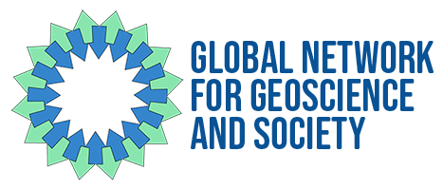
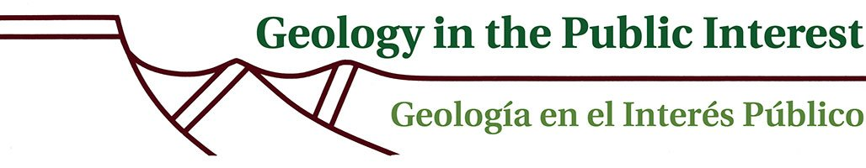
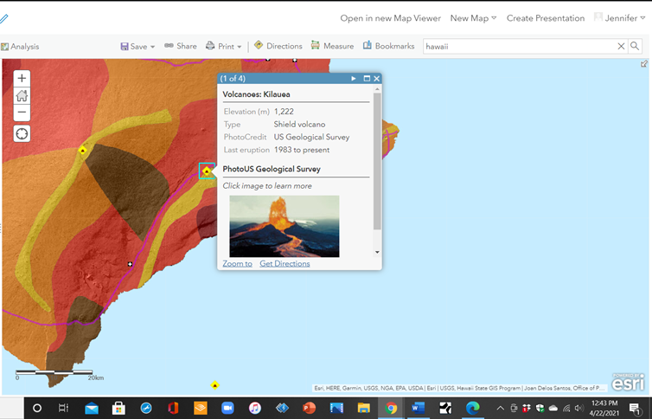
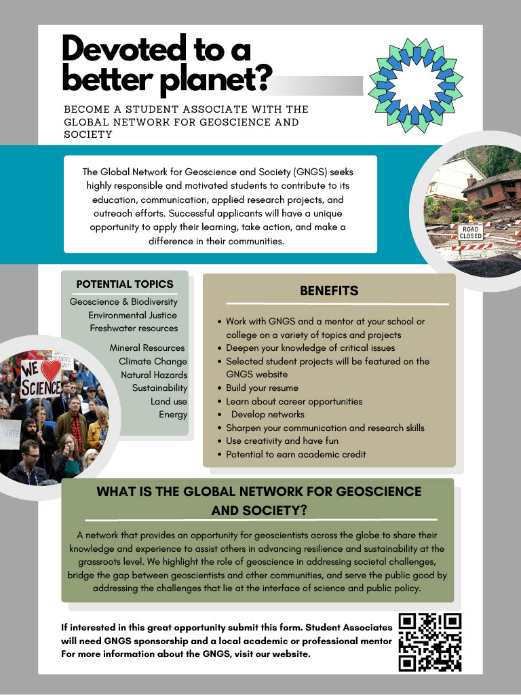
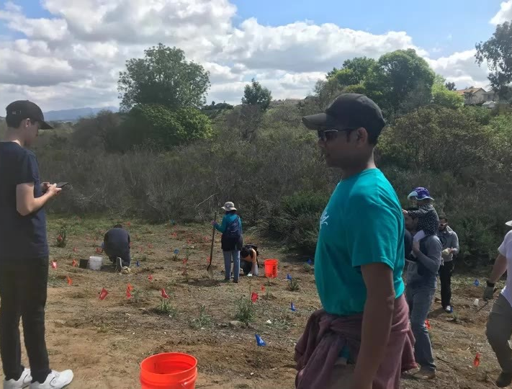
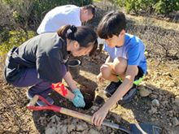

GNGS Student Associate Program
  Lisa Chaddock San Diego City College
  Jeffrey Greenberg Wheaton College
  Ellen Metzger San Jose State University
  Tricia R. Sears Washington Geological Survey
Abstract
Method
Project Topics and Types
The geosciences play a vital role in addressing sustainability challenges related to climate change, resource management, and natural hazards, yet the geosciences are underrepresented in global sustainability initiatives. The Global Network for Geoscience and Society (GNGS) provides an opportunity for geoscientists across the globe to share their knowledge and experience to assist others in advancing resilience and sustainability at the grassroots level. We highlight the role of geoscience in addressing societal challenges, bridge the gap between geoscientists and other communities, and serve the public good by addressing the challenges that lie at the interface of science and public policy.
In recognition that students are the single most important demographic needed to sustain the effectiveness of its outreach, the GNGS has established a Student Associate Program. This program seeks highly responsible and motivated students to contribute to its education, communication, and outreach efforts. GNGS Student Associates will work with the GNGS and a mentor at their school or college on their choice of topics and projects. Project types include 1) collaboration with schools and teachers, parks, state geological surveys, and others; 2) communication and education via social media, videos, art, or information summaries on specific topics; and 3) community-based projects including outreach events, citizen science, and applied research.
Participation in this program offers students personalized attention and opportunities to deepen their knowledge of critical issues, learn about career opportunities, develop networks, sharpen their communication and research skills, use creativity, and have fun. Professors and other professionals serve as valuable mentors, providing students with guidance, support, and insights into the practice of geology. Mentorship plays a pivotal role in guiding and inspiring students along their academic and professional journey. Selected student projects will be featured on the GNGS website.
● Geoscience & Biodiversity
● Climate Change
● Energy
● Land use
● Environmental Justice
● Natural Hazards
● Mineral Resources/Mining
● Freshwater resources
● Sustainability
● Collaboration with schools and teachers, parks, state geological surveys, and others
● Communication & Education via social media, videos, art, and information summaries on specific topics
● Community-based Projects including outreach events,
citizen science, and applied research
Conclusion
The benefits of this program are wide-reaching for both students and mentors. The outcomes include:
Working with a scientific mentor and meeting others in the geoscience field
Earning academic credits
Building a professional network for employment after graduation
Learning about wider career opportunities in geosciences
Inviting the community to participate in geosciences
Using creative methods and having fun
0
Introduction
To attract students to the geosciences, the Global Network for Geoscience and Society (GNGS) education committee set out to create a program that would encourage and invite students to participate in geological research and outreach by creating mentoring opportunities at a local level. It was determined that there was a need for a more diverse and inclusive outreach to students while incorporating rigor and creativity.
Throughout a year of investigating methodologies, the educational committee decided upon a method that would invite students to participate in real-world projects. The committee chose to include academic research in the form of project-based learning (Krajcik , et al 2006; Brandt, 1998; Prince, 2007) and community-based learning opportunities to offer a wider scope of learning and experience than classroom work alone (Alvarez, 2021; Wang, 2013). Furthermore, the committee included STEAM techniques to give students a creative introduction and outlet in communications and outreach to their community for science generally (Weiss, 2021; Gagliano et al, 2021; Hamilton, et al, 2021) while focusing on geosciences specifically.
The GNGS’s Student Associate Program is now looking for students and mentors who want to participate in this innovative program.
References
Alvarez, Rafael (2021) Turning on the Lights: Using Learning Culture to Increase Student Success. https://www.turning-on-the-lights.com/
Brandt, R. (1998). Powerful learning. Alexandria, VA: Association for Supervision and Curriculum Development.
Gagliano, Gina, Jill Gerber, and Steenz Adam Ebert (Video Comic-Con 2021). Yes, They’re Teaching with These Now: Creating and Publishing Comics with The Lesson Plan in Mind
Hamilton, Sydney, Myria Perez, Dr. Samantha Thi Porter, and Dr. Erika Hamden, Xyla Foxlin (mechatronics engineer). (Video Comic-Con 2021) The Science of Art.
Krajcik, Joseph S and Phyllis C. Blumenfeld . R. Keith Sawyer (ed). (2006). Project-Based Learning. In: The Cambridge Handbook of the Learning Sciences Cambridge University Press
Prince, Michael and Felder Richard (March/April 2007) The Many Faces of Inductive Teaching and Learning. Journal of College Science Teaching
Wang, Xueli. October 2013. Why Students Choose STEM Majors: Motivation, High School Learning, and Postsecondary Context of Support American Educational Research Journal, Vol. 50, No. 5 (October 2013), pp. 1081-1121
Weis, Bob, President of Walt Disney Imagineering. (2021) Imagineering (website), “Our Impact: Outreach and Inspiration”
If you are interested, check our website for more information, inquire with a teacher or mentor in your school or community, or contact us at info@thegngs.org

