Slide 1
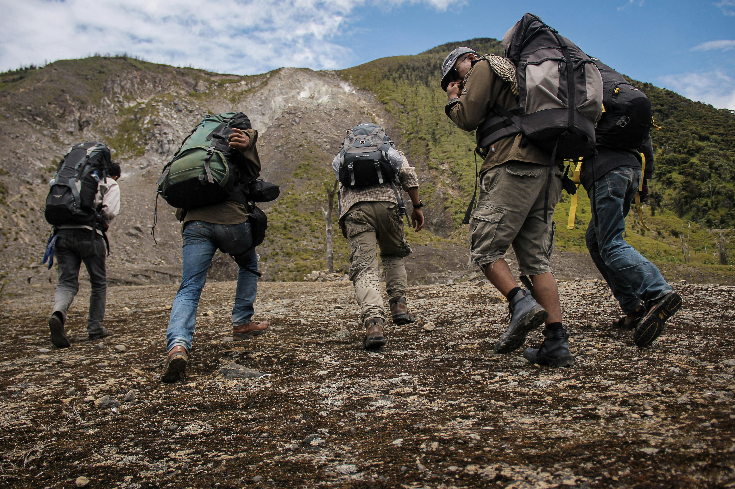

Project Based Learning And Mentoring Program Proposals For Engaging And Attracting Students To Geology
cc: stanzebla - https://www.flickr.com/photos/92823399@N07
Prof. Lisa Chaddock, San Diego City College

Slide 2


Establishing a Student Associate program that facilitates student involvement in GNGS through community projects supervised by local teachers and mentors, sponsored by GNGS.

Slide 3
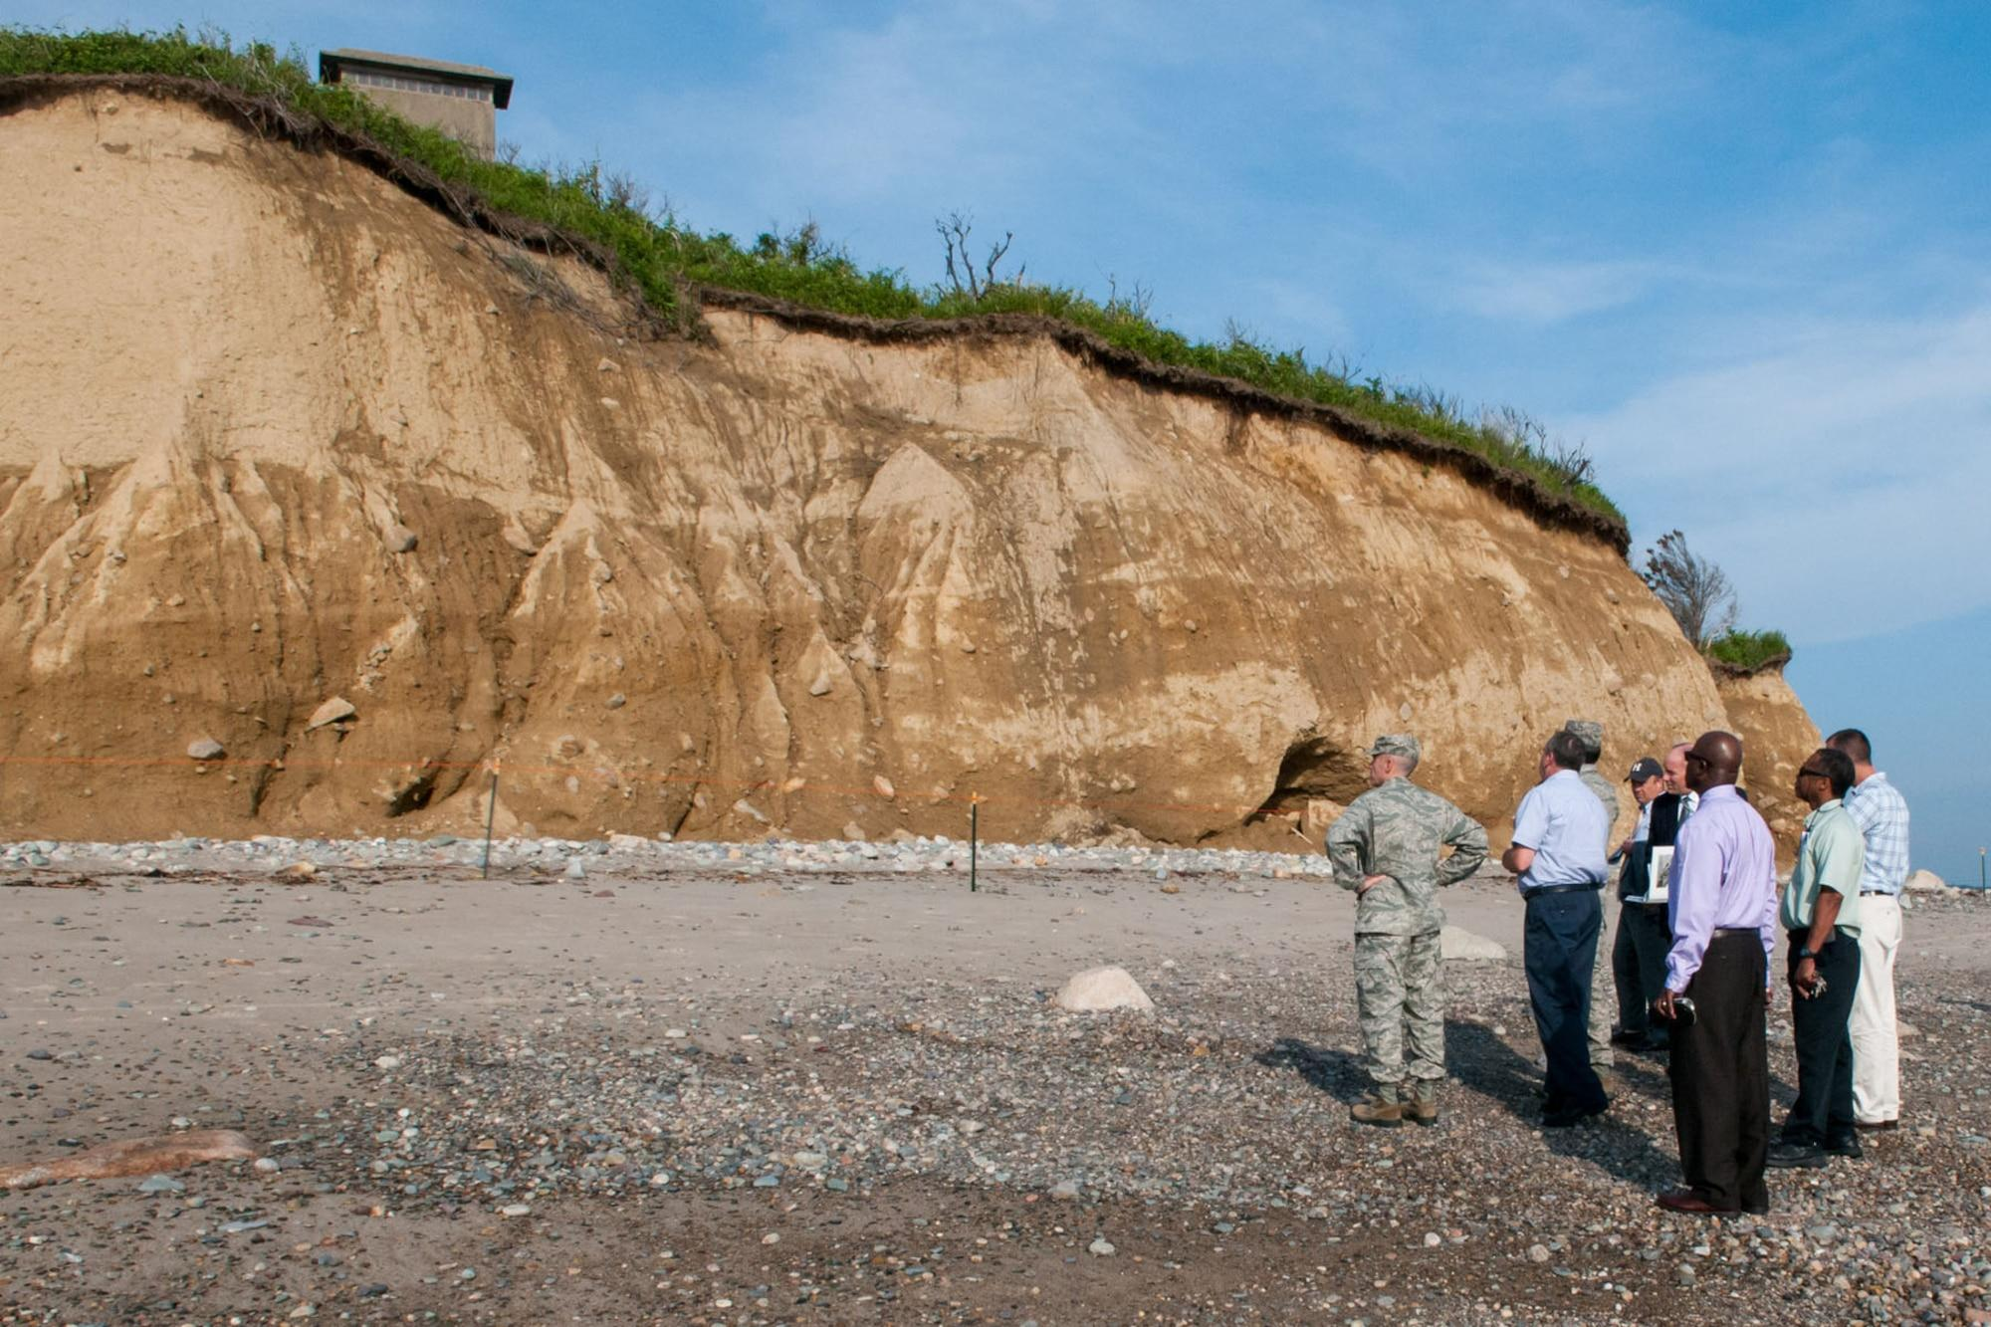
cc: benjami - https://www.flickr.com/photos/85124698@N00
Why Project Based Learning?
Universal Design and organization
Mentoring

Slide 4
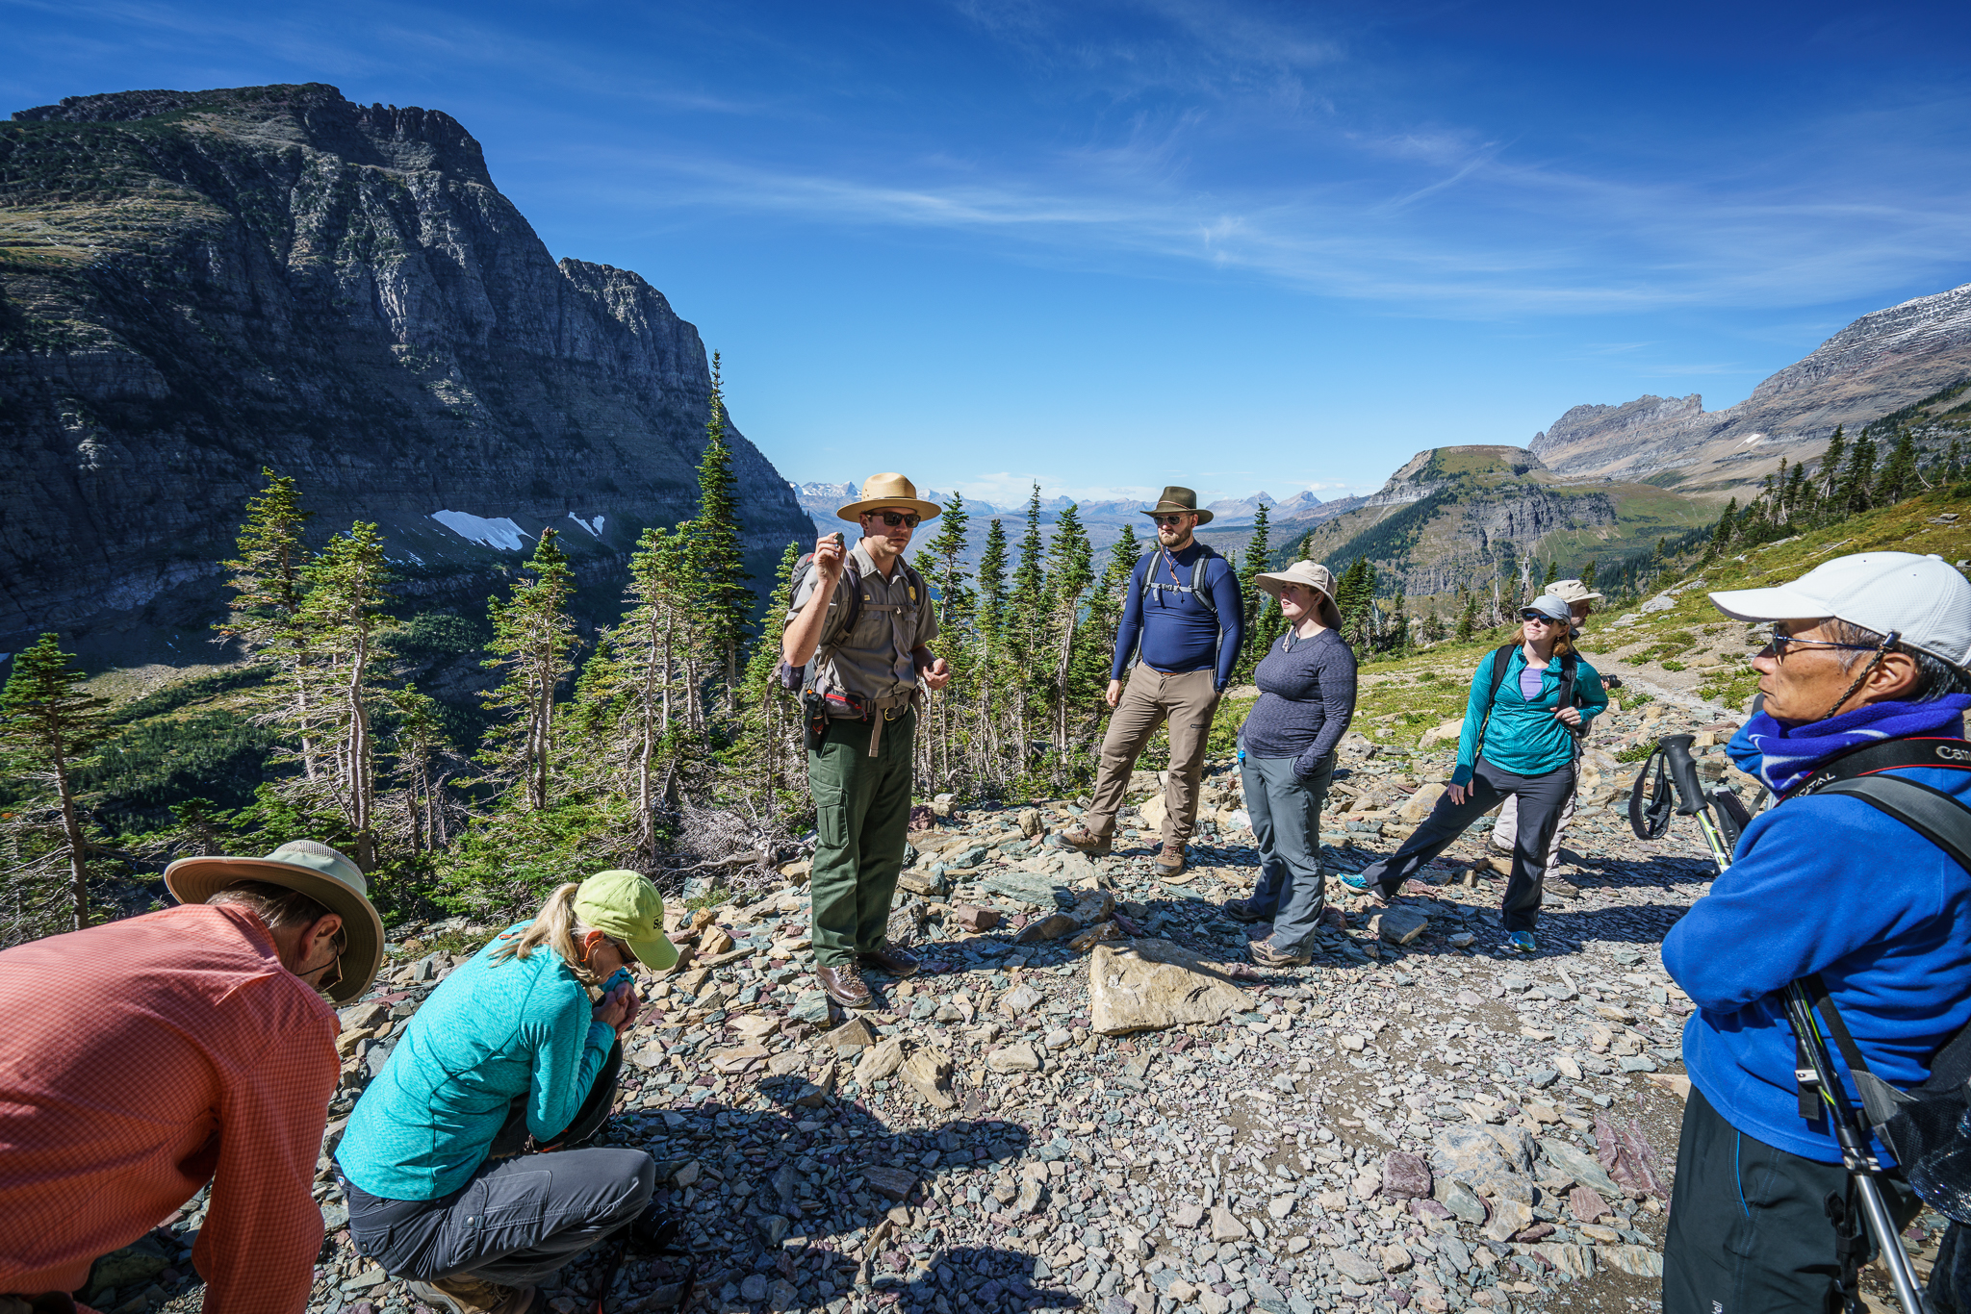
A program to include more students in research, sustainability and growth in Geosciences
This Photo by Unknown Author is licensed under CC BY-SA-NC
cc: the blowup - https://unsplash.com/@theblowup?utm_source=haikudeck&utm_medium=referral&utm_campaign=api-credit

Slide 5
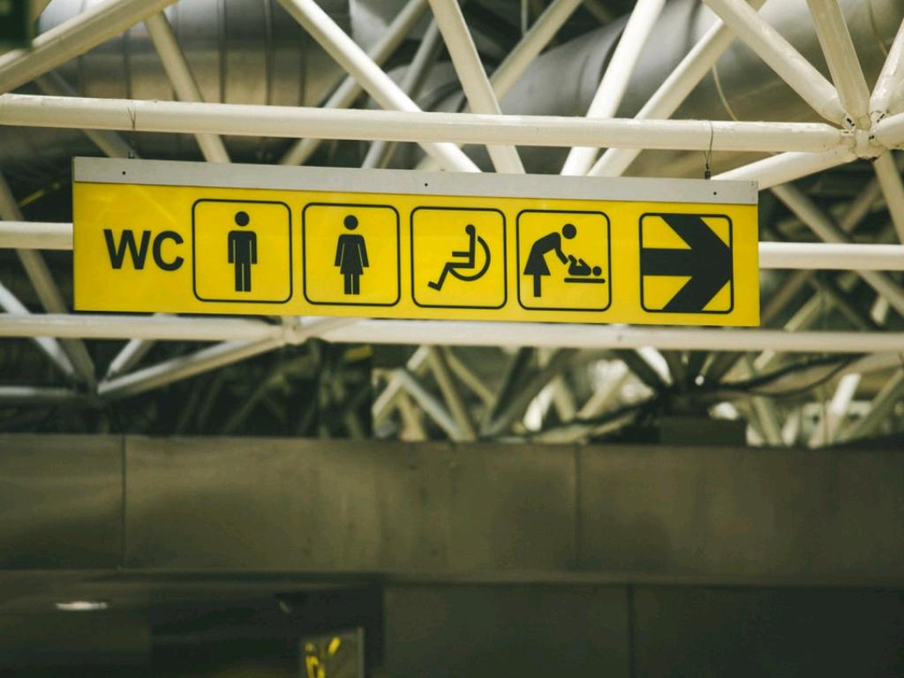
Universal Design
cc: Paul Green - https://unsplash.com/@pgreen1983?utm_source=haikudeck&utm_medium=referral&utm_campaign=api-credit

Slide 6
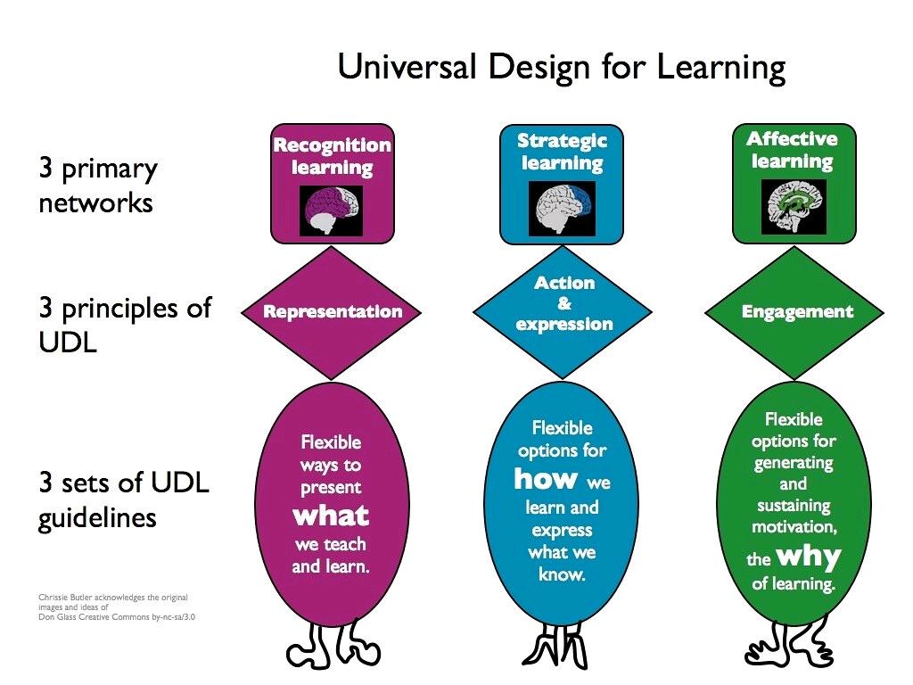
cc: chrissie_butler - https://www.flickr.com/photos/36224492@N06

Slide 7
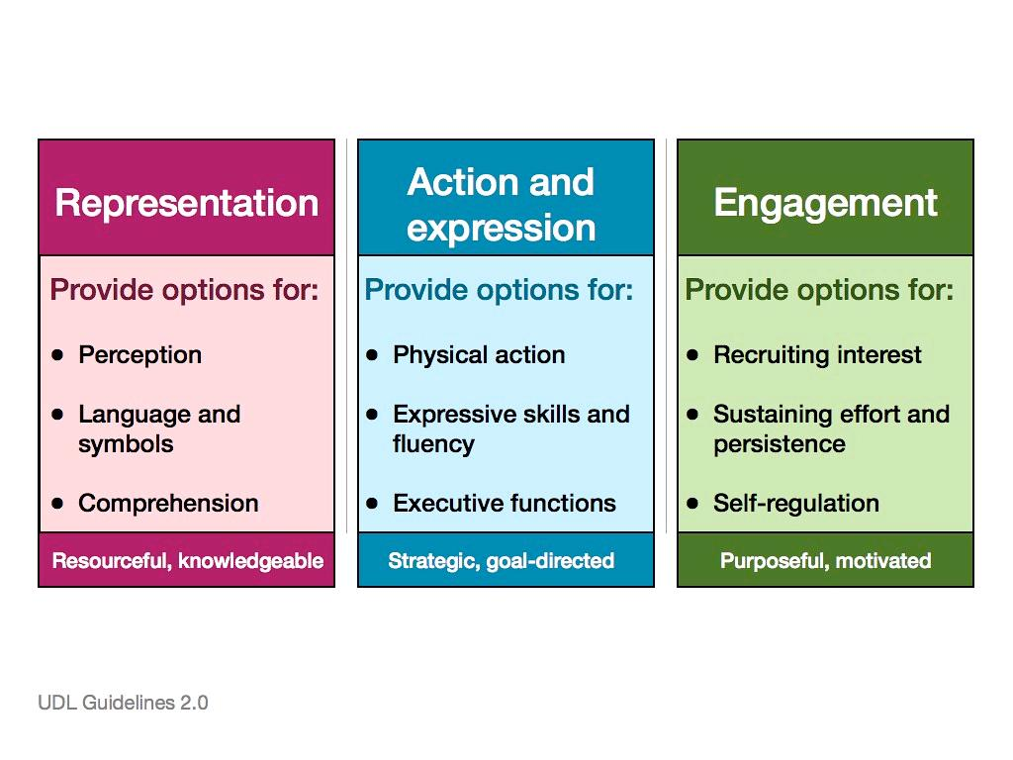
cc: chrissie_butler - https://www.flickr.com/photos/36224492@N06

Slide 8
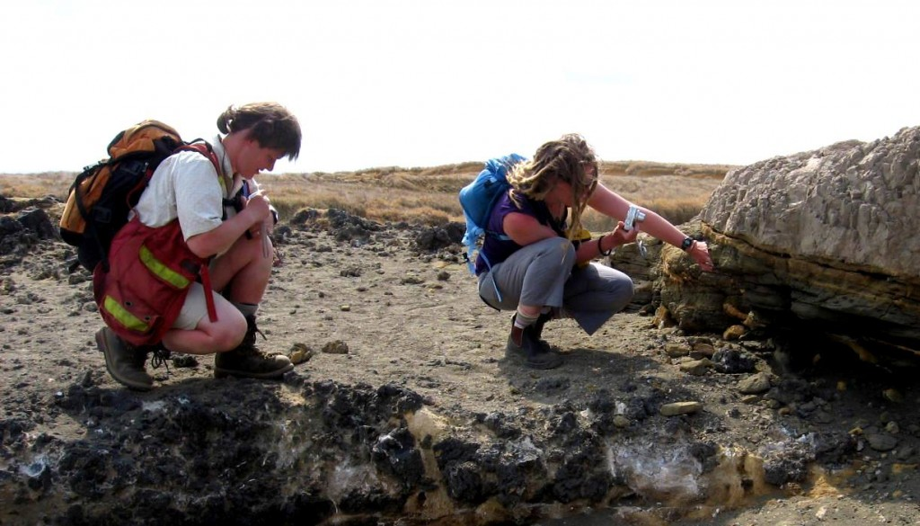
Research Mentoring
Project planning session
Journaling self-evaluation
Pathways to careers
This Photo by Unknown Author is licensed under CC BY
cc: Peggy Anke - https://unsplash.com/@instagramfotografin?utm_source=haikudeck&utm_medium=referral&utm_campaign=api-credit

Slide 9

Students of all abilities show that they can do something meaningful with learned information, including sharing with the community.
cc: Belinda Fewings - https://unsplash.com/@bel2000a?utm_source=haikudeck&utm_medium=referral&utm_campaign=api-credit

Slide 10
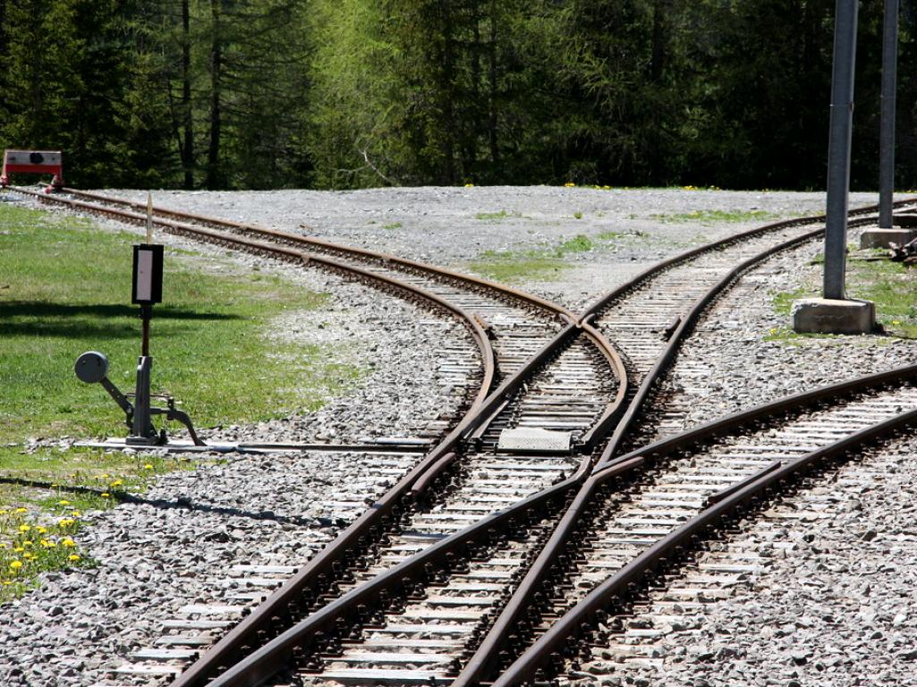
Project Based Learning OPTIONS
cc: marfis75 - https://www.flickr.com/photos/45409431@N00

Slide 11

Essential Question or Hypothesis
cc: Med Badr Chemmaoui - https://unsplash.com/@medbadrc?utm_source=haikudeck&utm_medium=referral&utm_campaign=api-credit

Slide 12
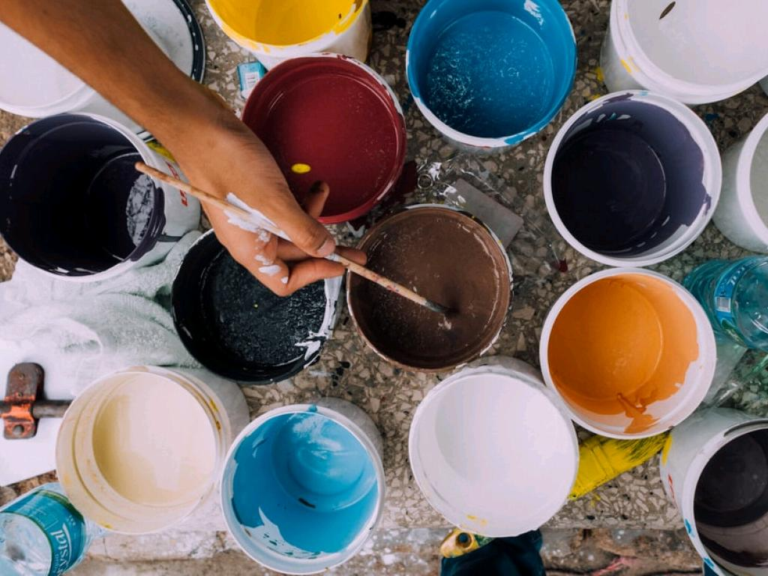
Explore options
cc: russn_fckr - https://unsplash.com/@russn_fckr?utm_source=haikudeck&utm_medium=referral&utm_campaign=api-credit
Museum, Mineral and Gem club, or other Geoscience focused community group.
Scientific research assistant
Video, Podcasts, Coding a Game
Comic book about geoscience topic
Start a club on campus
Design an event for the campus and community
STEAM - Artwork, songwriting, performance
Service learning

Slide 13
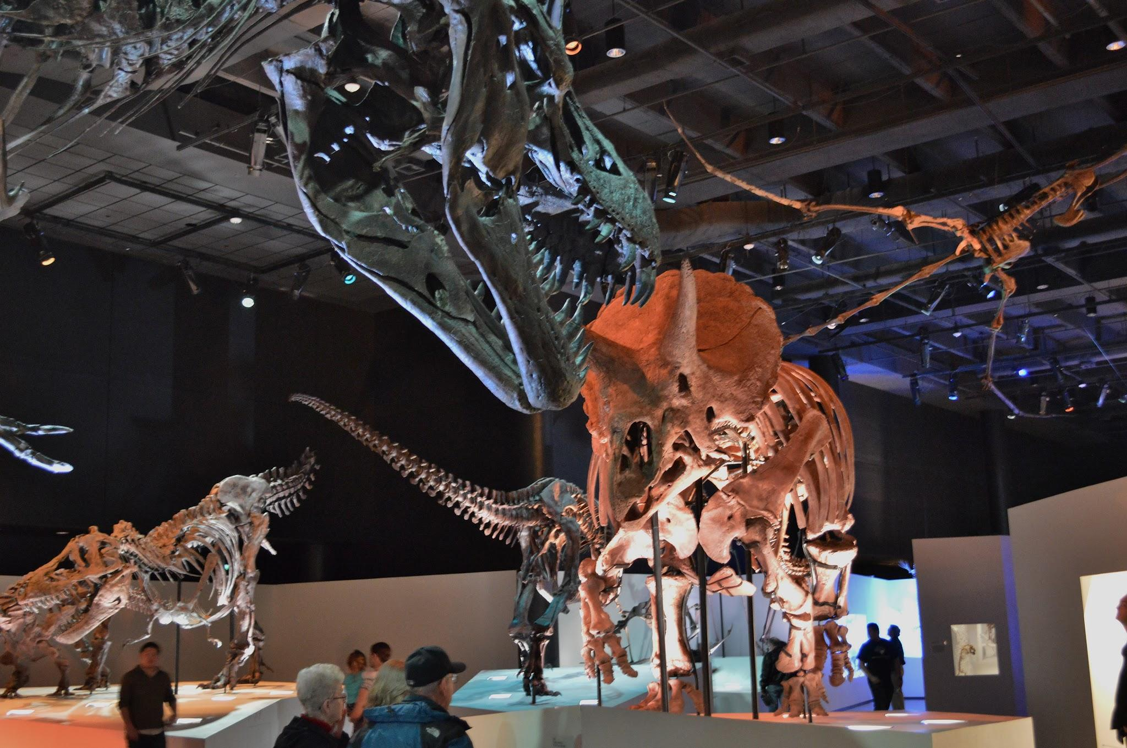
Mentoring in the community.
cc: National Cancer Institute - https://unsplash.com/@nci?utm_source=haikudeck&utm_medium=referral&utm_campaign=api-credit

Slide 14

Students plan due dates
Mentor gauges progress
cc: Ralf Appelt - https://www.flickr.com/photos/35723892@N00

Slide 15
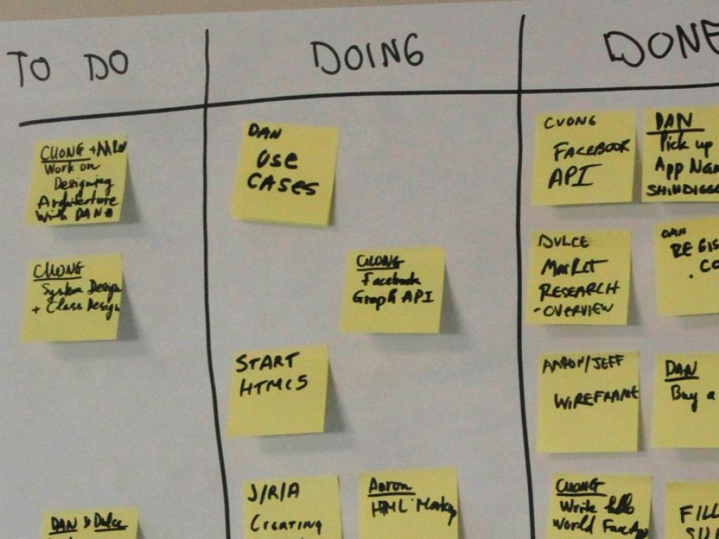
Scrum Board
cc: sarah.e.binder - https://www.flickr.com/photos/88158446@N02

Slide 16

Scrum Software
Works on mobile devise
cc: Zan - https://unsplash.com/@zanilic?utm_source=haikudeck&utm_medium=referral&utm_campaign=api-credit

Slide 17
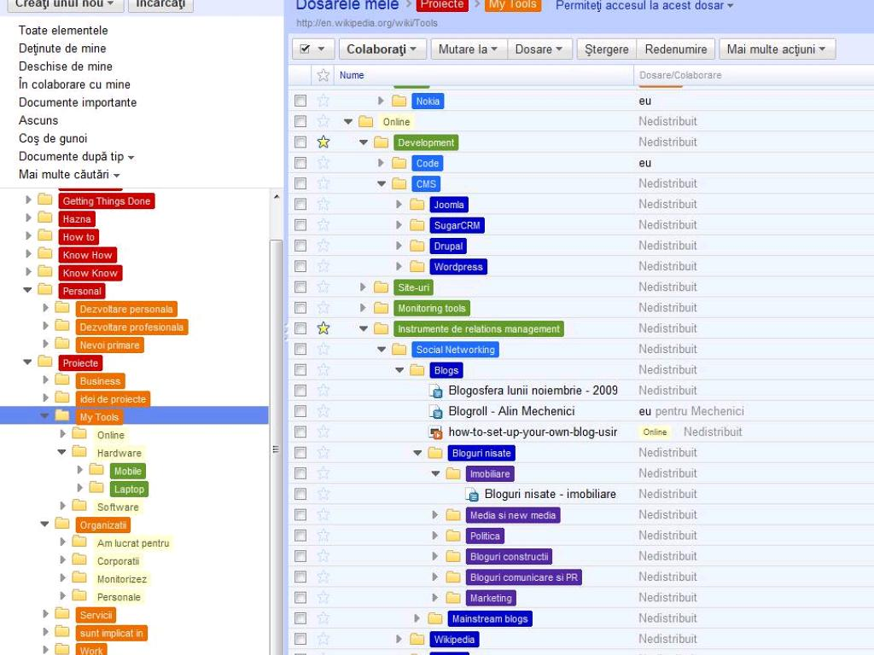
Google Docs
Group collaboration that you can see
cc: AlinMechenici - https://www.flickr.com/photos/8266010@N05

Slide 18
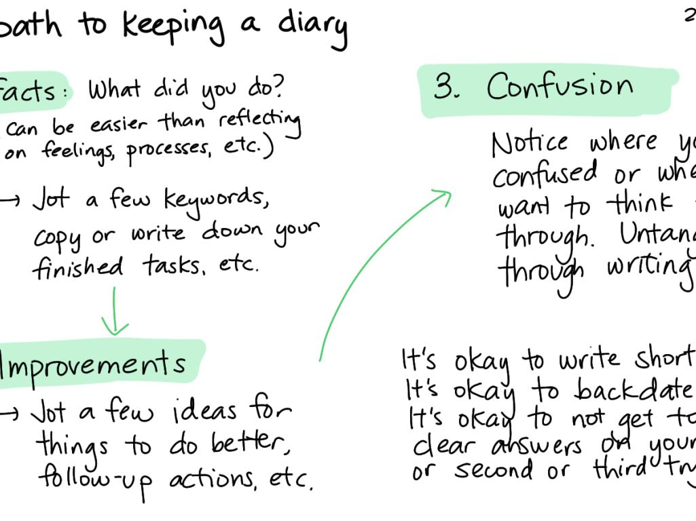
Self-assessment
Students journal their journey
Build self-awareness - not excuses
Increases confidence as they see the pieces come together.
cc: sachac - https://www.flickr.com/photos/65214961@N00

Slide 19
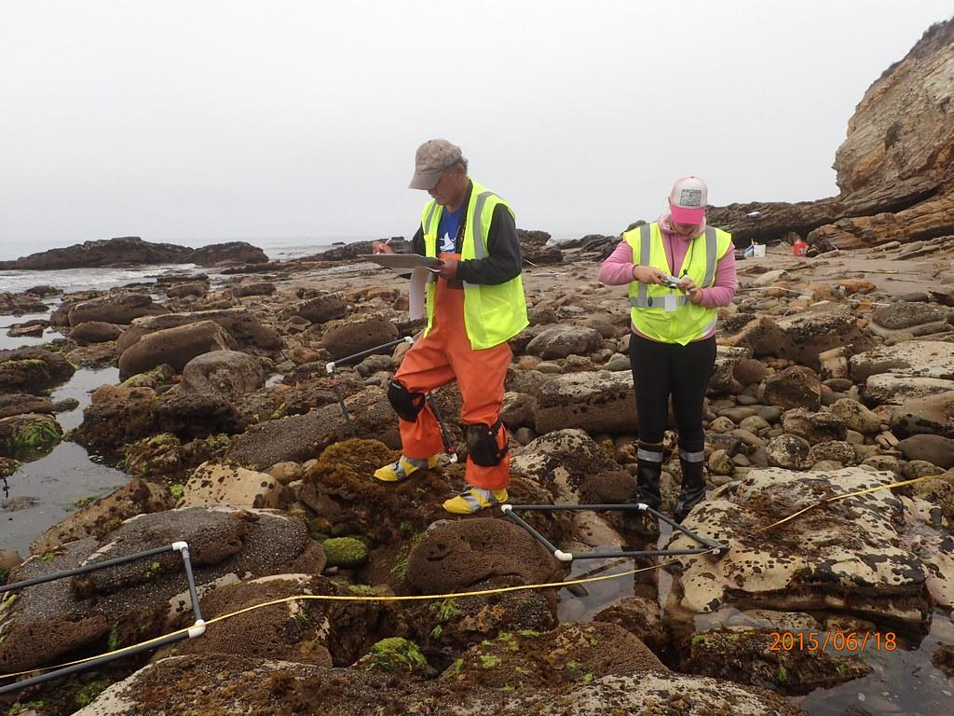
Learning group organization
future workplace skills
cc: Proxyclick Visitor Management System - https://unsplash.com/@proxyclick?utm_source=haikudeck&utm_medium=referral&utm_campaign=api-credit

Slide 20
Establishing a Student Associate program that facilitates student involvement in GNGS through community projects supervised by local teachers and mentors, sponsored by GNGS.

