Slide 1












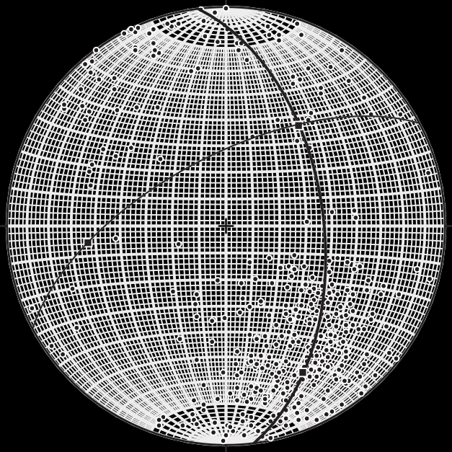
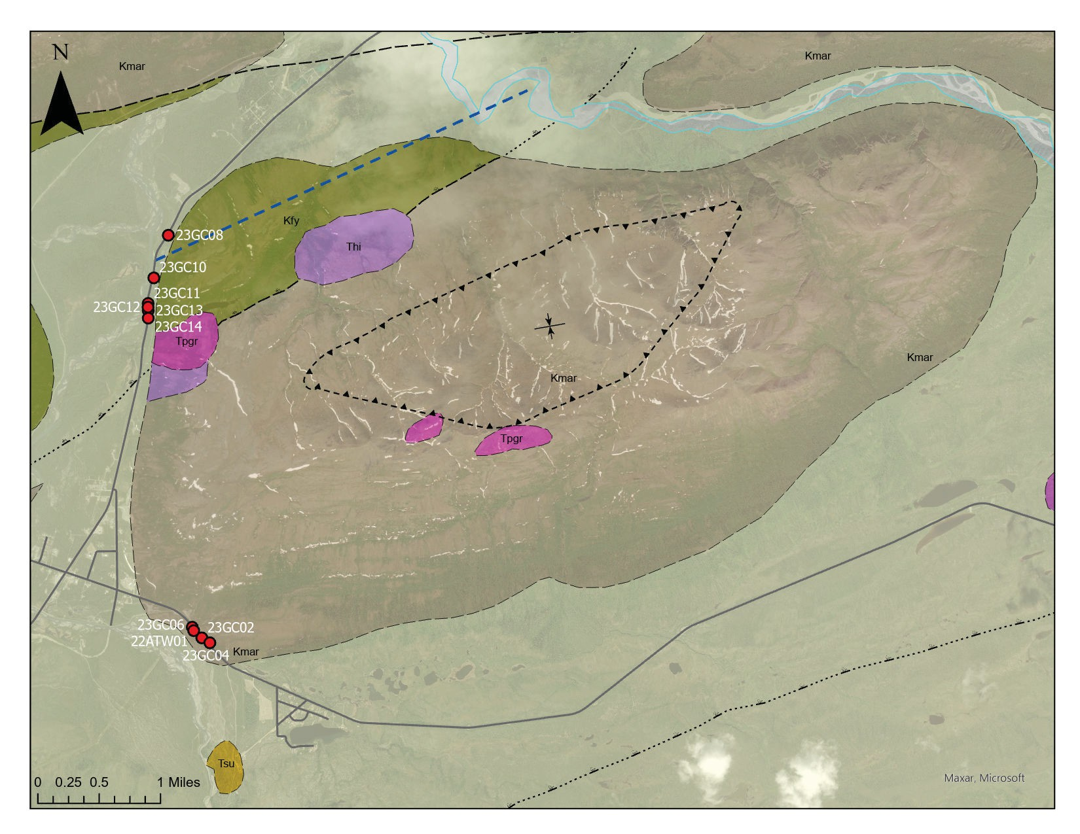
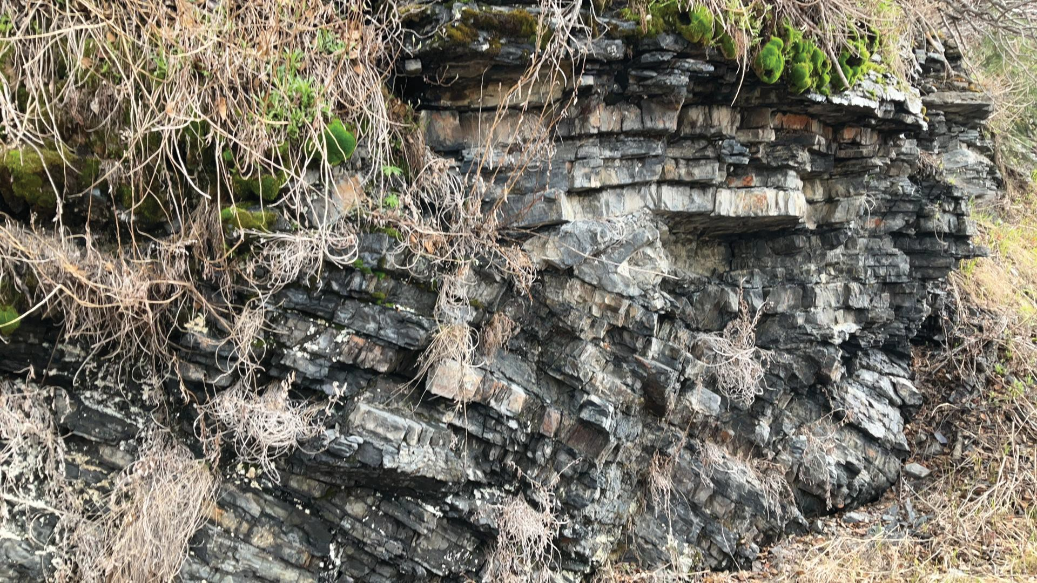
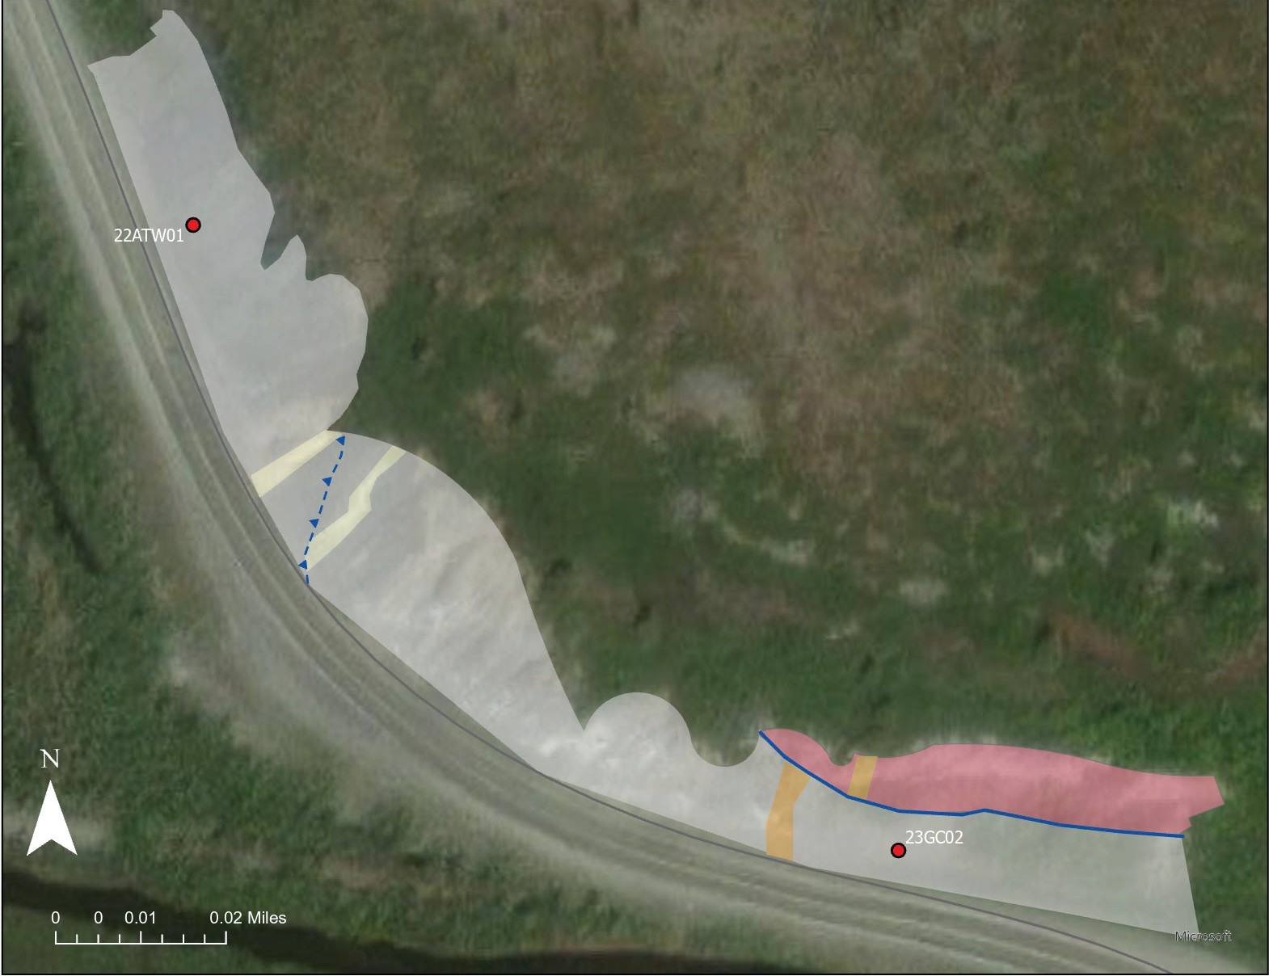
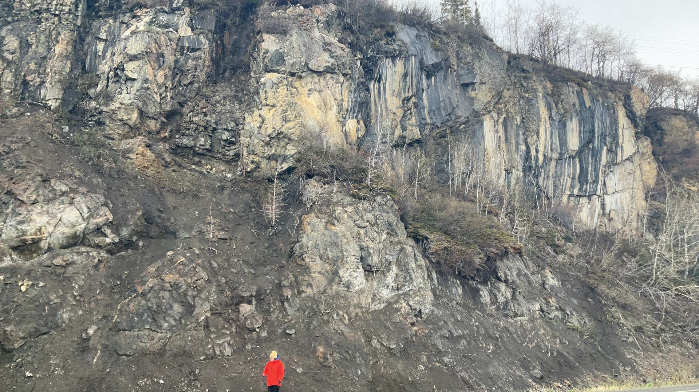
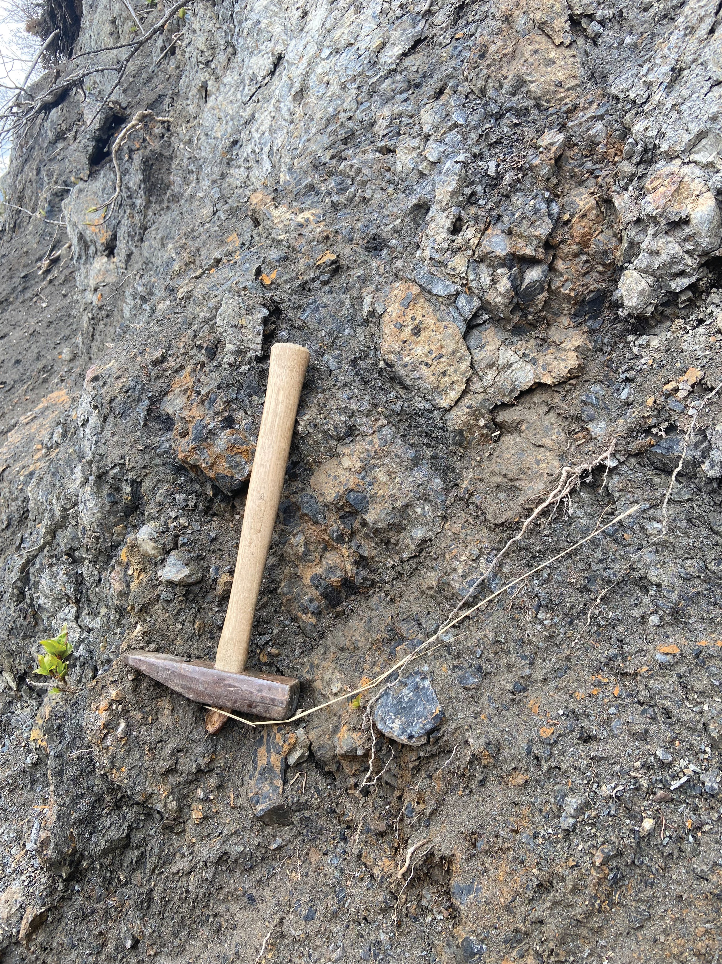
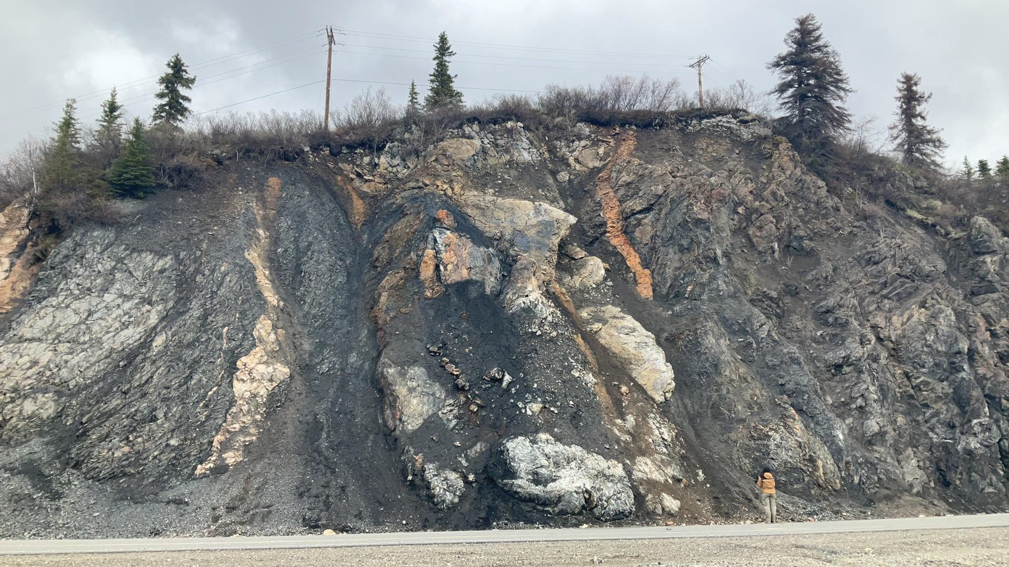
New Interpretations on the Reindeer Hills Mélange Using Structural and Geochronological Data
Gillian M. Clark¹ and Trevor Waldien¹
¹Department of Geology and Geological Engineering, South Dakota School of Mines and Technology, Rapid City, SD
Motivation
ARSZ
(ARSZ)
Figure 1: Terrane map of south-central Alaska modified from Gilman et al. (2009). Terranes are represented by different colors: Yellow- Yukon-Tanana composite terrane (YCT) made up of the Yukon-Tanana terrane (YTT) and the Stikine terrane; Light blue- Wrangellia Composite terrane (WCT) made up of the Wrangellia, Alexander, and Peninsular terranes; Dark blue- Kahiltna assemblage; Dark grey- Other accretionary terranes of southern Alaska; Dots- Other basin deposits of southern Alaska; Light grey- Other rocks younger than accretion related to the ARSZ; Star- The Reindeer Hills Mélange which is the focus area of this study.
Alaska Range Suture Zone (ARSZ) is a product of accretion related to assembly of the North American Cordillera
Reindeer Hills Mélange (RHM) within the central ARSZ is interpreted to be a result of subduction around 100 Ma
Low-grade shear fabrics and Cenomanian ammonite fossil (Bier 2010; Csejtey et al., 1986; Jones et al., 1986)
Valdez Creek Shear Zone of the eastern ARSZ experienced collision- related shortening after 85 Ma (Waldien et al., 2021)
Di erence in timing of ocean basin closure within the ARSZ presents the following questions:
Was there prolonged subduction or multiple subduction zones throughout the ARSZ?
When did subduction related to the RHM occur, and what was the orientation of subduction?
Can the RHM provenance uniquely identify the arc system associated with subduction?
Results
Cleavages
Conclusions
Two distinct age assemblages within the RHM
Southern RHM is Paleozoic and related to Baltica terranes (Alexander terrane and Farewell terrane)
Paleozoic MDAs suggest that Paleozoic fossils previously interpret- ed as redeposited during subduction (Csejtey et al., 1986) may represent the depositional age of the southern RHM
Early Devonian MDAs and distinct Precambrian sources provide link with Alexander, or other Baltica-related terranes
Northern RHM has mixed provenance derived from Mesozoic Cordilleran arcs located both inboard and outboard
Ages match previous DZ studies on the Kahiltna Assemblage (Hampton et al, 2010; Hults et al., 2013)
Both age assemblages share N-dipping deformation fabrics and thus likely experienced deformation at the same time
DZ MDAs and dikes bracket cleavage formation to120-70 Ma
Subsidiary post-70 Ma structures likely related to the Denali Fault
RHM likely represents 120-70 Ma south-vergent imbrication of the Kahiltna assemblage and the Alexander (?) terrane during terrane accretion
Definitive evidence of subduction remains enigmatic
N
n=374
Cleavage measurements imported into Stereonet to assess clustering
330
30
300
60
North-dipping shear cleavage orientations in the RHM indicate South-vergence, with average orientation of 242/64° NW
2
e
g
a
Figure 4 (left): Stereonet of all poles to cleavages and cylindrical best fit great circle for all 374 cleavage orientations measured throughout the Reindeer Hills (sites 23GC04-23GC08).
v
W
a
E
e
l
C
e
3
g
a
r
e
v
A
240
1
120
AX/FT
(Baltica)
22ATW01 n=297
MDA: 416.34 ± 3.7 Ma
210
S
150
AX/FT
(Baltica)
23GC02 n=78
MDA: 395.11 ± 8.6 Ma
Southern RHM (22ATW01-23GC04) is Devonian and likely sourced from the Alexander terrane, the Farewell terrane, or Baltica
AX/FT
(Baltica)
23GC04 n=45
MDA: 426.53 ± 2.8 Ma
Northern RHM (23GC10 and 23GC11) is Jurassic-Early Cretaceous and likely originated
from Stikine terrane or Mesozoic arcs built on the Wrangellia terrane
Figure 5 (right): Detrital zircon U-Pb Kernal Density Estimate age populations for the five samples collected throughout the Reindeer Hills (blue). Samples 23ATW01-23GC04
were taken from the RHM. Samples 23GC10 and 23GC11 were taken from the Kahiltna assemblage. Possible provenance locations and MDAs for age populations are noted above peaks.
Stikine
23GC10 n=33
MDA: 178.93 ± 2.2 Ma
WR
Stikine
23GC11 n=305
MDA: 117.11 ± 0.9 Ma
WR YTT
0 0.2 0.4 0.6 0.8 1.0 1.2 1.4 1.6 1.8 2.0 2.2 2.4 2.6 2.8 3.0 3.2
Detrital zircon age (Ga)
Acknowledgments
Many thanks to the GSA Graduate Student Research Grant Comittee for helping fund this project, the Arizona LaserChron Center for their assistance in data collection, and the GSA Cordilleran and Rocky Mountain Sections. Additional thanks to Breauna Murray, Thomas Merendino, Willa Obringer, and Liam Fry for their help with field work and lab work.
One new fault in Kahiltna assemblage north of Broad Pass Fault based on structural observations (sheared vs. bedded)
PARKS HIGHWAY
NENANA RIVER
Methods
Outcrop-scale mapping and structural measurements in the field using FieldMove Clino to determine the orientation of structures within the RHM
23GC08
NORTH
Two new faults at 23GC02:
Lst-Br fault younger than Triassic
Juxtaposes Paleozoic rocks against other Paleozoic rocks
A small-scale Riedel shear related to the Denali Fault?
Oblique thrust fault younger than Cretaceous
Fault
Units from Wilson et al. (2015)
References
Bier, S.E., 2010, Structural Geology and kinematics associated with the collision of the Wrangellia Composite Terrane and North America, South-Central Alaska [Ph.D. Thesis]: Pennsylvania State University, pp. 148
Csejtey, B., Jr., Mullen, M., Cox, D.P, and Stricker, G.D., 1986, Geology and Geochronology of the Healy Quadrangle, south-central Alaska: U.S. Department of the Interior, U.S. Geological Survey, p. 1-63
Fasulo, C.R., Ridgway, K.D., and Trop, J.M., 2020, Detrital zircon geochronology and Hf isotope geochemistry of Mesozoic sedimentary basins in south-central Alaska: Insights into regional sediment transport, basin development, and tectonics along the NW Cordilleran margin: Geosphere, v. 16, no. 5, p. 1125–1152
Gilman, T., Feinemen, M., and Fisher, D., 2009, The Chulitna terrane of south-central Alaska: A rifted volcanic arc caught between the Wrangellia composite terrane and the Mesozoic margin of North America: GSA Bulletin, v. 121, p. 979-991
Hampton, B.A., Ridgway, K.D., and Gehrels, G.E., 2010, A detrital record of Mesozoic island arc accretion and exhumation in the North American Cordillera: U-Pb geochronology of the Kahiltna basin, southern Alaska: Tectonics, v. 29, p. 1-21
Herriott, T.M., Crowley, J.L., Schmitz, Warles, M.A., and Gillis, R.J., 2019, Exploring the law of detrital zircon: LA-ICP-MS and CA-TIMS geochronology of the Jurassic forearc strata, Cook Inlet, Alaska, USA: Geology, v. 47, p. 1044-1048
Hults, C.P., Wilson, F.H., Donelick, R.A., and O’Sullivan, P.B., 2013, Two ysch belts having distinctly different provenance suggest no stratigraphic link between the Wrangellia composite terrane and the paleo-Alaskan margin: Lithosphere, v. 5, no. 6,
p. 575-594
Jones, D.L., Silberling, N.J., and Coney, P.J., 1986, Collision tectonics in the Cordillera of western N America examples from Alaska in Coward M.P. and Ries A.C., eds., Collision Tectonics: Geological Society Special no. 19, p. 367-387
Kamb W.B., 1959, Ice Petrofabric Observations from Blue Glacier, Washington, in Relation to theory and Experiment: Journal of Geophysical Research, v. 64, p. 1981-1909
Manselle, P., Brueseke, M. E., Trop, J. M., Benowitz, J. A., Snyder, D. C., and Hart, W. K., 2020, Geochemical and stratigraphic analysis of the Chisana Formation, Wrangellia terrane, eastern Alaska: Insights into Early Cretaceous magmatism and tectonics along the northern Cordilleran margin, Tectonics, v. 39
Waldien, T.S., Roeske, S.M., Benowitz, J.A., Twelker, E., and Miller, M.S., 2021, Oligocene-Neogene lithospheric-scale reactivation of Mesozoic terrane accretionary structures in the Alaska Range suture zone, southern Alaska, USA: GSA Bulletin, v. 133,
p. 691-716
Wilson, F.H., Hults, C.P., Mull, C.G, and Karl, S.M, comps., 2015, Geologic map of Alaska: U.S. Geological Survey Scientific Investigations Map 3340, pamphlet 196 p., 2 sheets, scale 1:1,584,000
A
6m
NORTH
Kmar
RHM
_{Tpgr} Undivided
Granitic Rocks
Detrital zircon U-Pb geochronology to determine MDAs (Herriott et al., 2019) and provenance for the rocks within the Reindeer Hills
Figure 2 (top): Field photos representative of the Kahiltna assemblage taken at site 23GC08.
Kahiltna
Kfy
Undivided
^{Tsu} Sedimentary Rocks
Assemblage
7
Hypabyssal
^{Thi} Intrusions
Previously Mapped Structures (Bier, 2010; Csejtey et al. 1986; Wilson et al., 2015)
Thrust faults
Fold Axis
n=1
Fold Axis
7
Lithologies
Limestone
DENALI HIGHWAY
0 0.5 1 mi
Syncline
B
0.5m
Breccia and Sandstone
This Study
Field Sites/ Sample Locales
Inferred Fault
23GC02
Triassic Gabbro (Wilson et al., 2015)
70 Ma Rhyolite (Wilson et al., 2015)
Structures
Right-lateral _{Thrust}
Strike-slip _{Fault} Fault
Other
Field Sites/Sample Locales
A) Image of sheared Kahiltna. Fault and kinematics in yellow, cleavage orientations in white. B) Image of bedded and folded Kahiltna. Fold outline in blue, fold axis highlighted as white dashes.
Figure 3 (bottom): Field photos representative of the RHM taken at site 23GC02. A) Image of fault juxtaposing the limestone (Lst) unit of 23GC02 on top of the breccia unit (Br). B) Image of fault zone containing limestone blocks that crosscut 70 Ma dikes
(Wilson et al., 2015). Slickenline orientations in red. C) Image of cleavage orientations (white) within the breccia of 23GC02, hammer for scale.
23GC02
Triassic Gabbro
Lst
Figure 6 (above): Map of the Reindeer Hills in south-central Alaska including geologic units according to Wilson et al. (2015) and previously mapped structures (Bier 2010; Csejtey et al., 1986). Map also features field sites/sample locales for this study, as well as a new fault based on structural observations made in the field. Inset (red box) represents the location of Figure 7.
D U
Oblique thrust
3m
Br
NORTH
A
Rhyolite
Rhyolite
Figure 7 (left): Map of site 23GC02 within the RHM showing the lithologies and geologic relationships, as well as the location of DZ sample 22ATW01. The cross-cutting relationships evidenced in the
various lithologies at this outcrop suggest the presence of new structures (blue). A right-lateral strike- slip fault juxtaposes the limestone unit of the RHM on top of the breccia unit, and is younger than the Triassic because it cross-cuts the Triassic gabbro dikes present within the outcrop. A previously unmapped oblique thrust fault is present within the breccia unit, and is likely younger than the Cretaceous based on its cross-cutting relationship with the 70 Ma rhyolite dikes.
Fault Zone
Lst
Rhyolite
Breccia and Sandstone
Denali Riedel?
Limestone
Rhyolite
Lst
Gabbro
Gabbro
6m
NORTH
B
NORTH C

