Slide 1
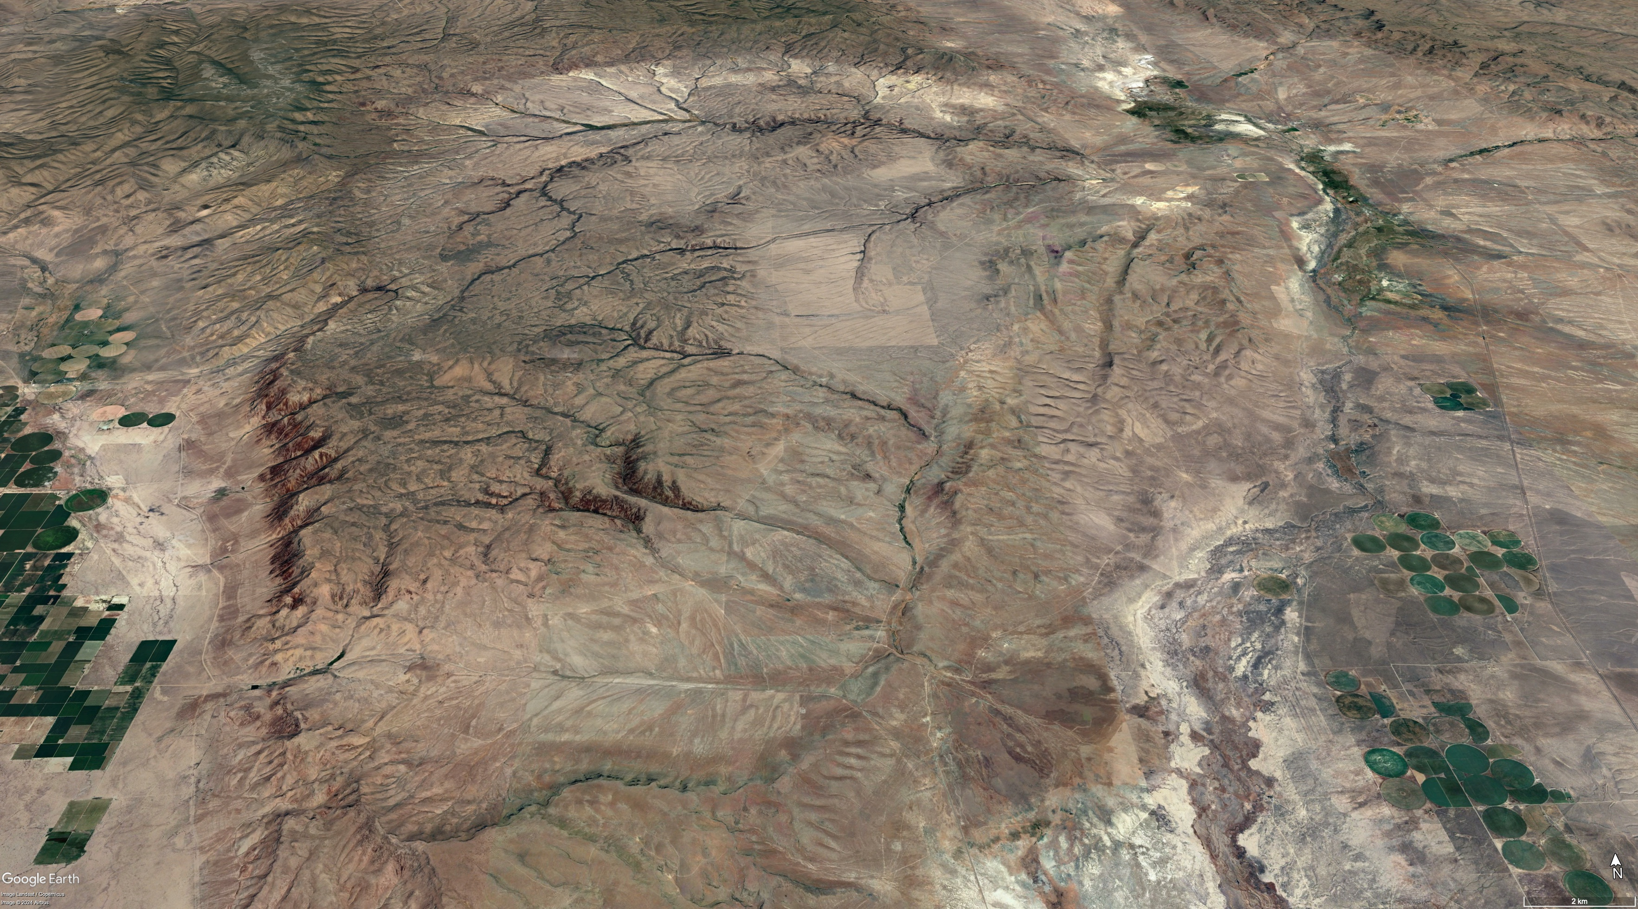
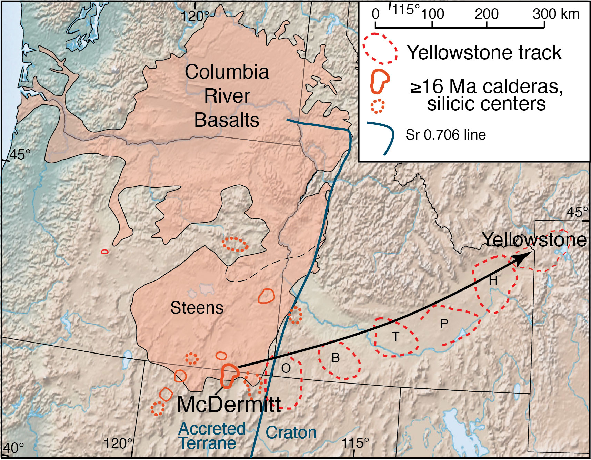

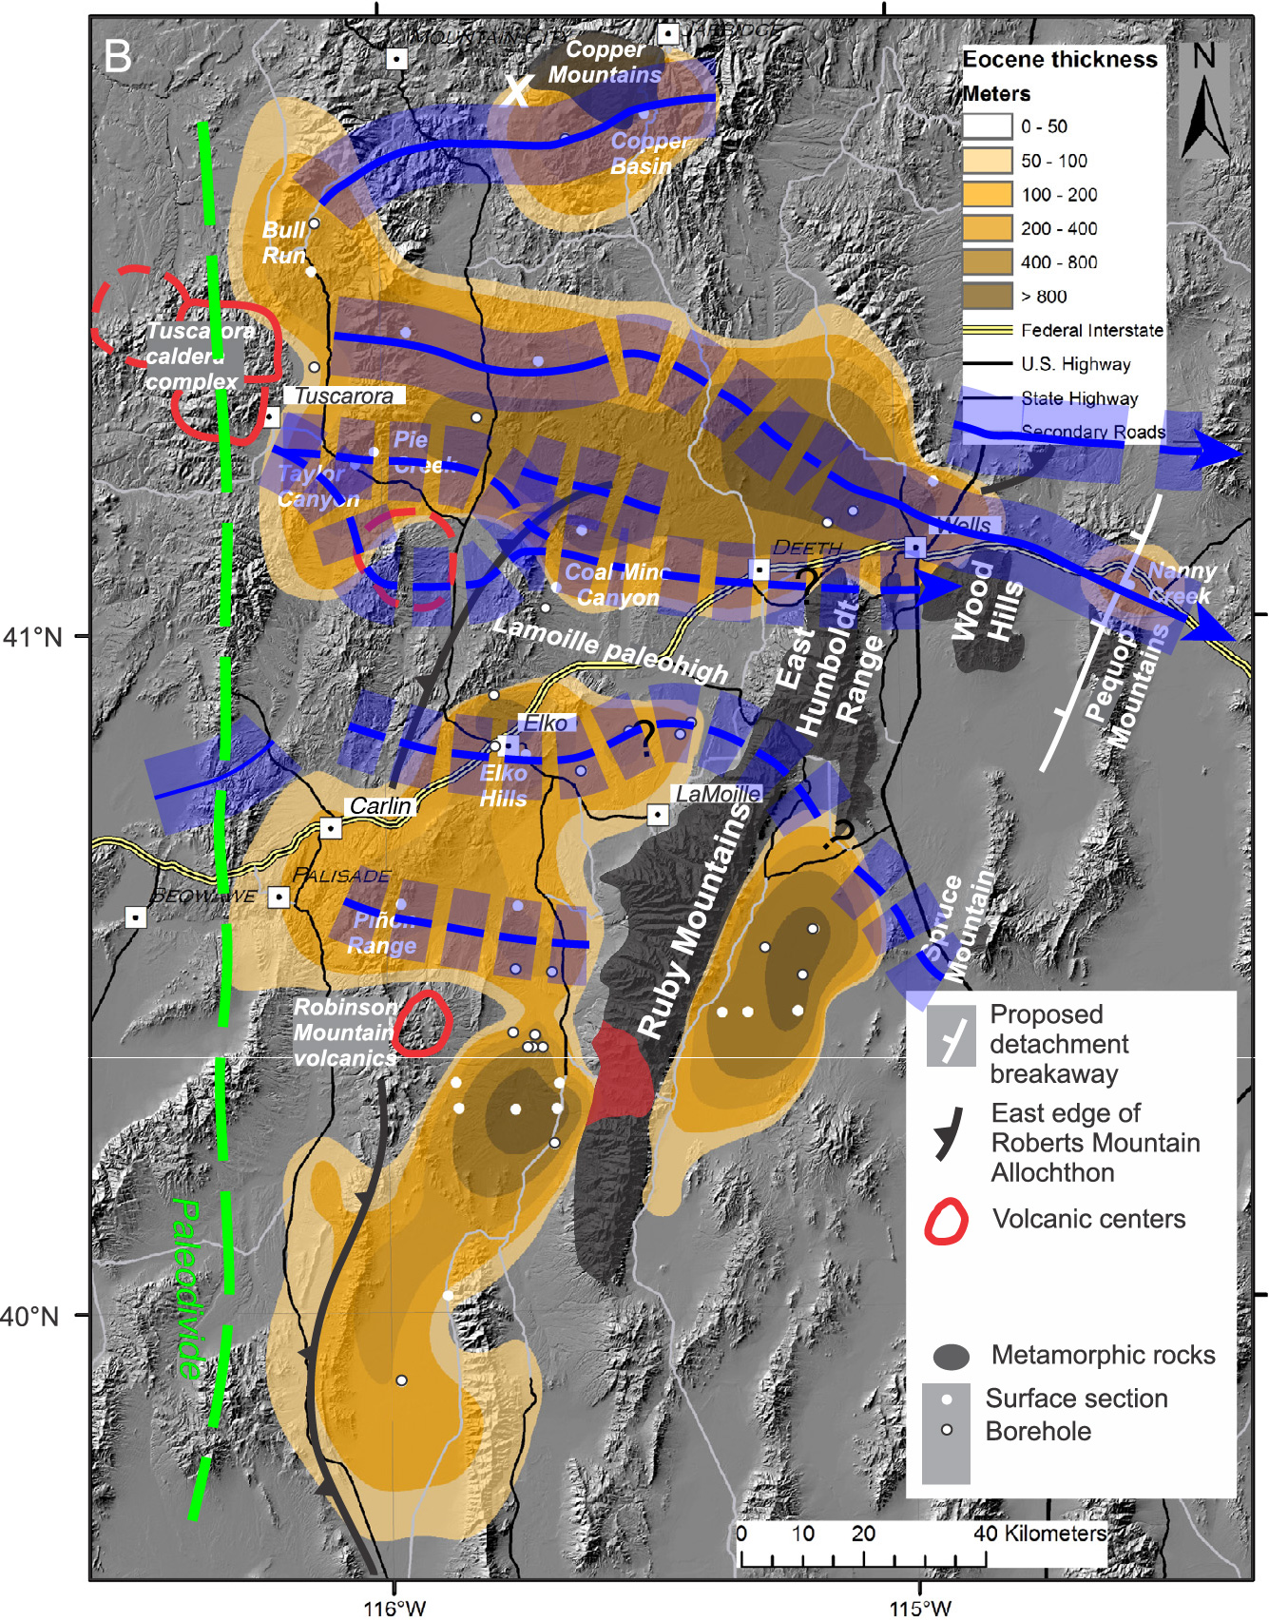
Lithium Clay Deposits in the McDermitt Caldera, Nevada - Oregon:
Characteristics and Contributions from Closed-Hydrologic System Diagenesis and Possible Hydrothermal Activity
Chris Henry
Nevada Bureau of
Mines and Geology
University of Nevada, Reno
McDermitt Caldera
Thacker Pass
Notes:
McD = large middle Miocene caldera, part of Yellowstone hotspot. Site of very large Li clay deposits, probably world’s largest
Review geology, describe the Li deposits, and what is and isn’t known about their origin
All in post-collapse, intracaldera rhyolitic tuffaceous sediments. Two clay types. Lower grade Li smectite throughout caldera; higher grade Li illite only known in southern, Thacker Pass part AND SUPERPOSED ON SMECTITE
Now broadly accepted Li smectite results of CHSD. Origin of Li Illite, CHSD vs “hydrothermal”, and the total sources of Li are uncertain and controversial.

Slide 2
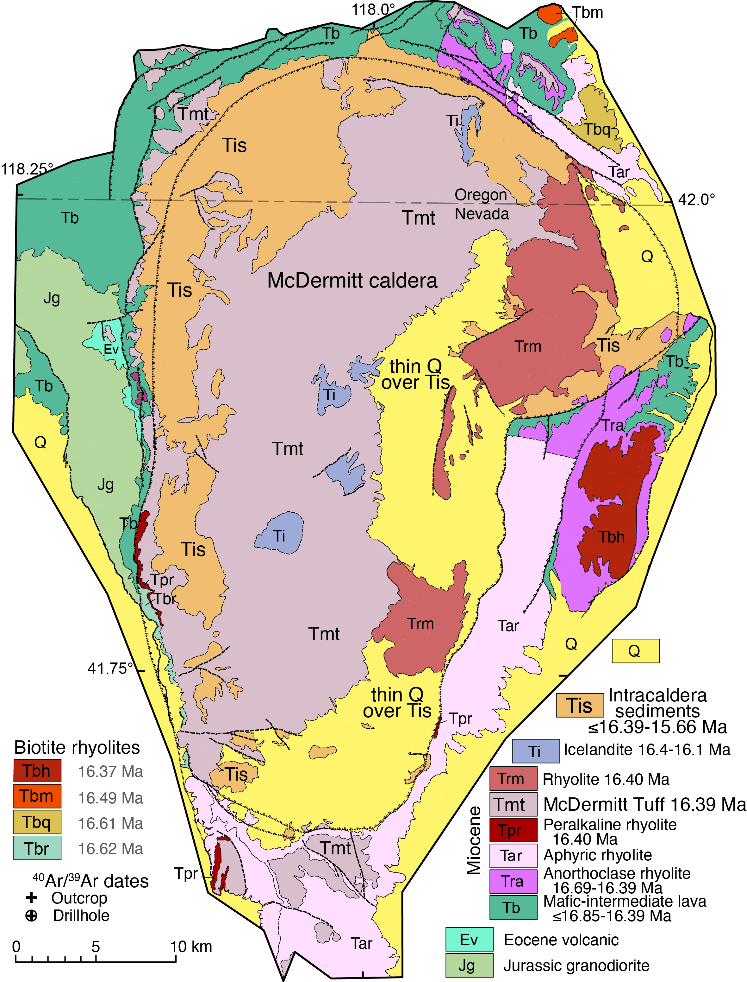
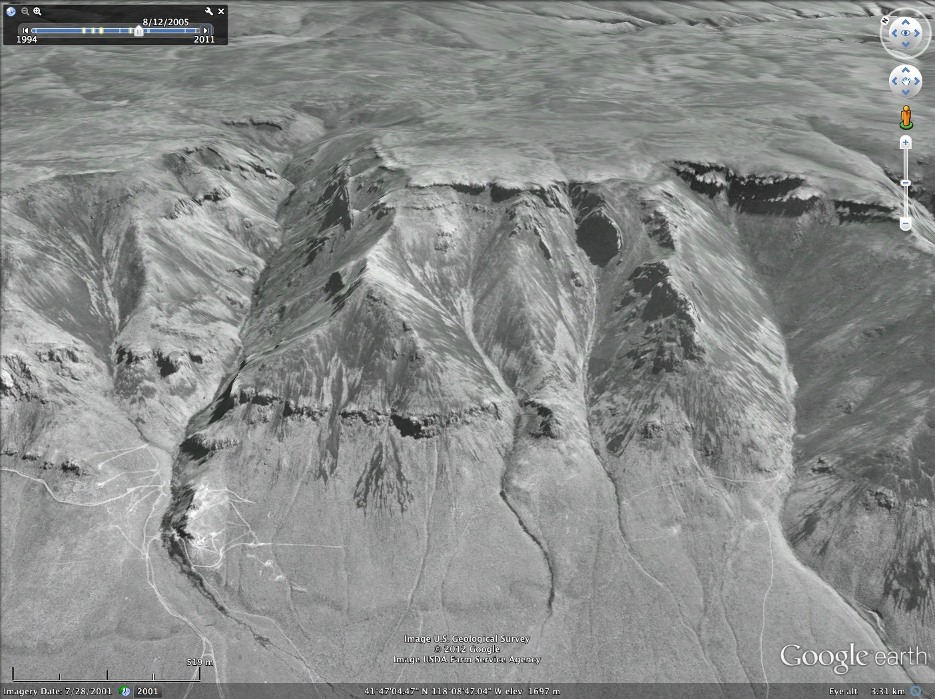
McDermitt caldera evolution:
<17.0 Ma, eruption of Steens Basalt.
16.7-16.4 Ma, progressively more silicic eruptions, including peralkaline and biotite rhyolites.
16.39±0.02 Ma, eruption of ~1000 km³ of
McDermitt Tuff (Tmt), caldera collapse.
16.39-~15.7 Ma, Caldera lake filled with rhyolitic
tuffaceous sediments (Tis).
Between 16.39-~16.1 Ma, late icelandite volcanism
and resurgence. Caldera magmatism ceased.
16.39-14.9(?) Ma, closed hydrologic system diagenesis
(CHSD) of intracaldera rhyolitic tuffaceous sediments.
Li clay deposits entirely in rhyolitic tuffaceous sediments.
Intracaldera tuffaceous sediments
Intracaldera McDermitt Tuff
Notes:
Steens, more silicic, peralkaline and biotite
McDermitt Tuff

Slide 3
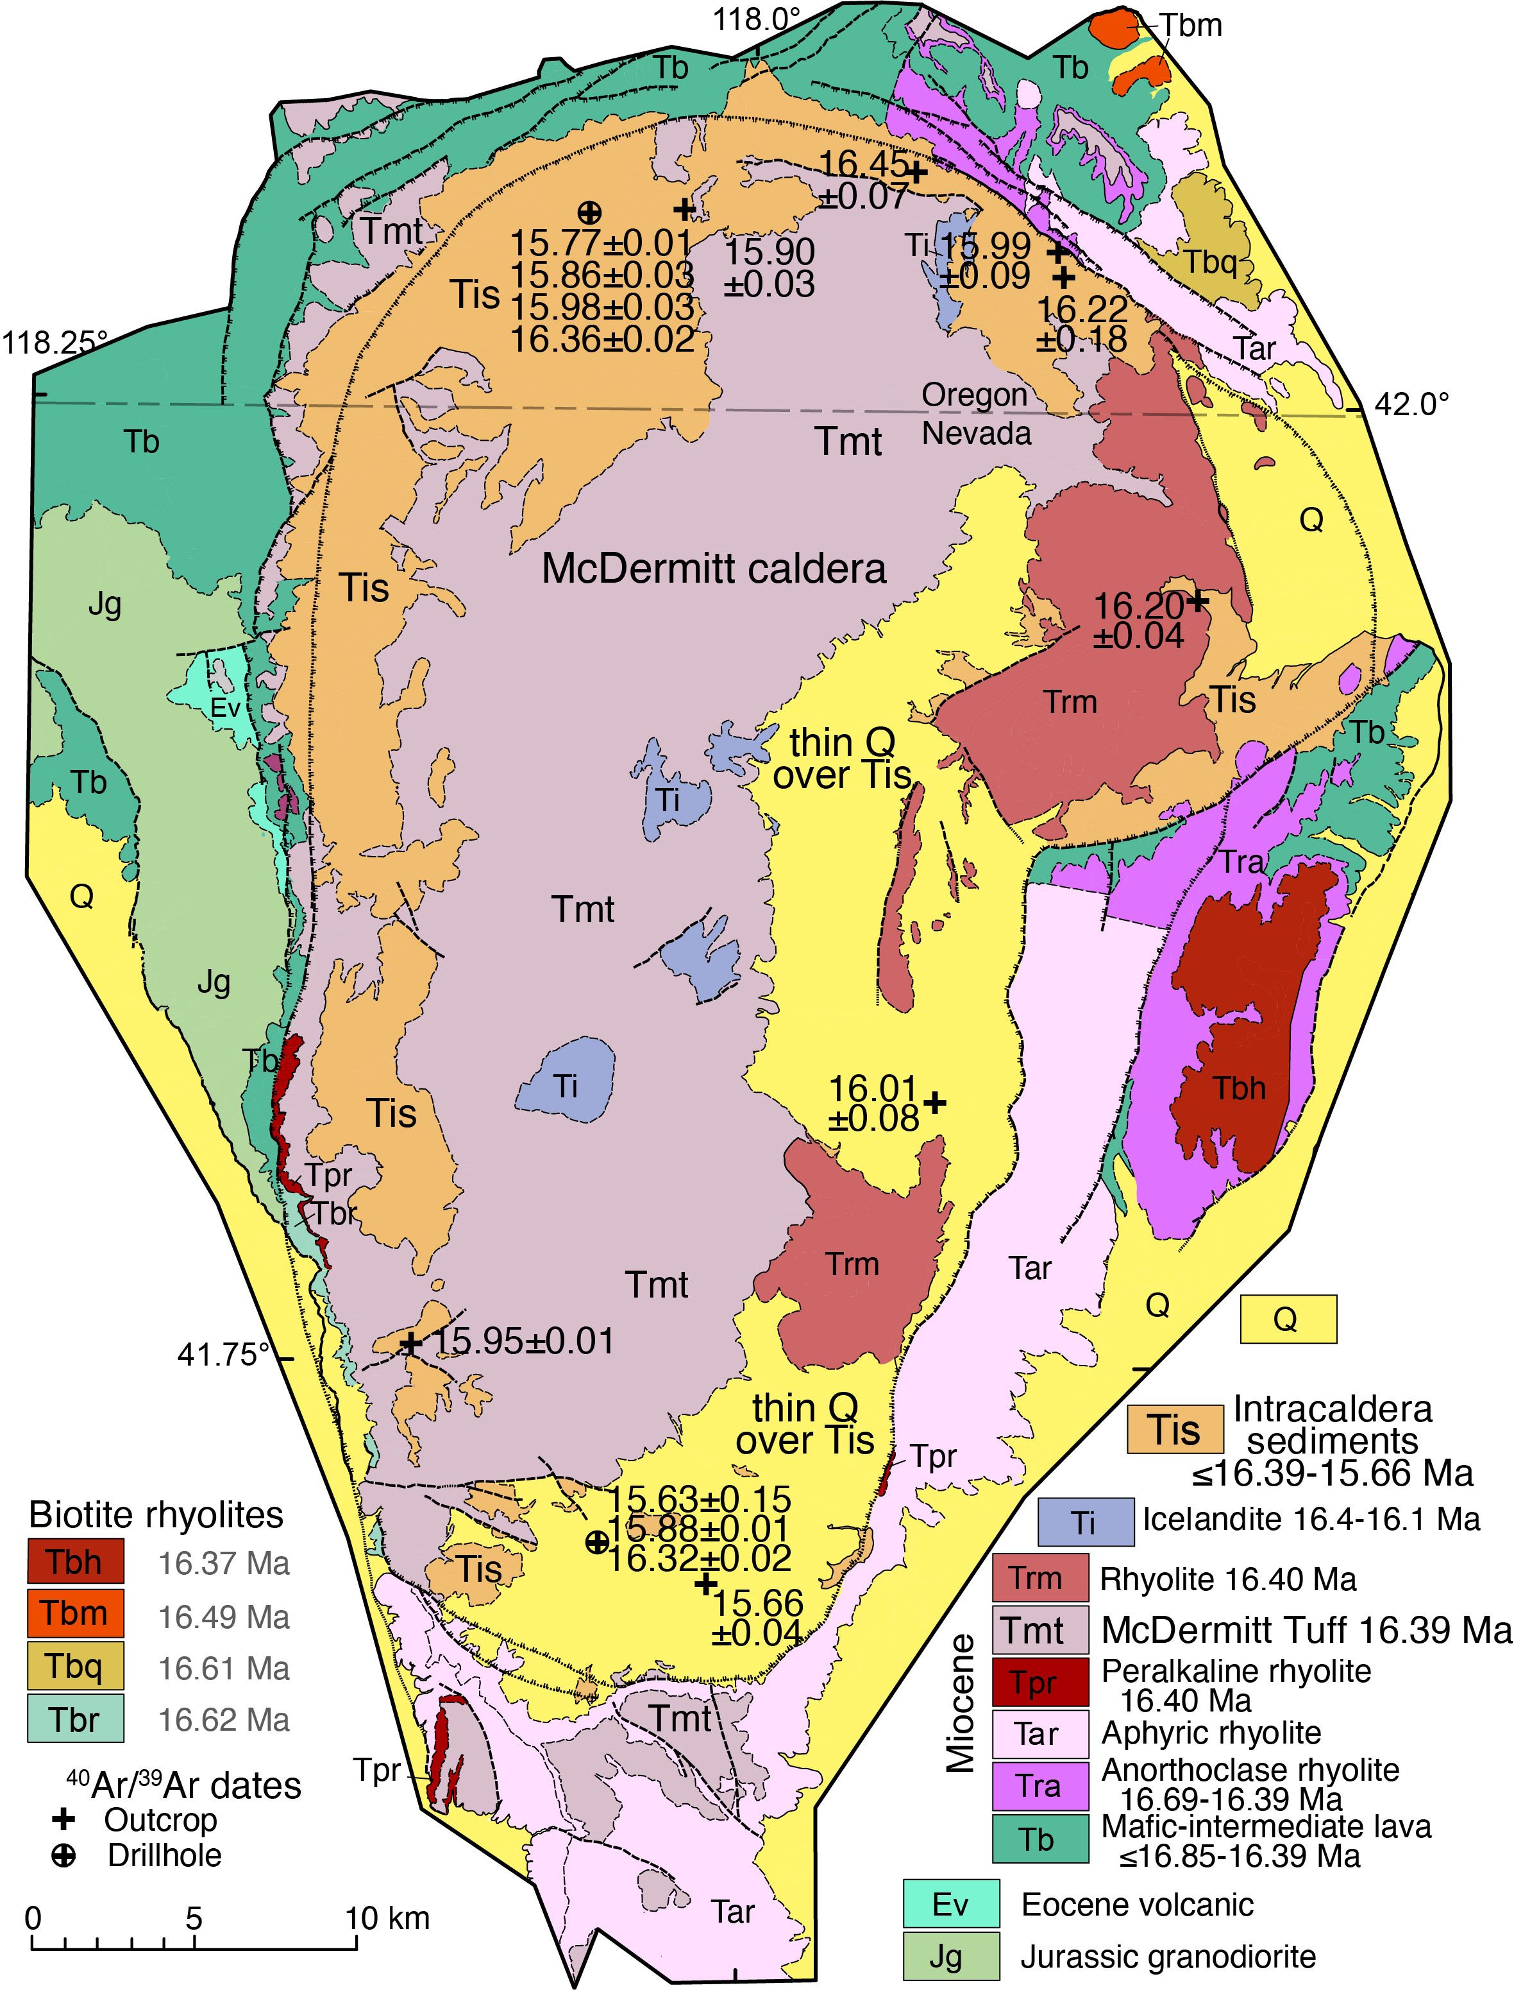
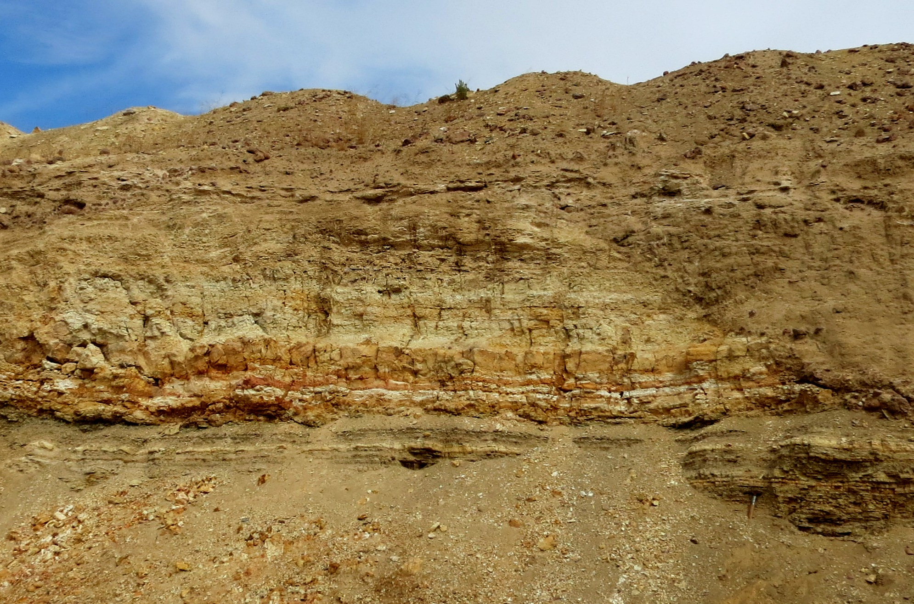
McDermitt caldera evolution:
<17.0 Ma, eruption of Steens Basalt.
16.7-16.4 Ma, progressively more silicic eruptions, including peralkaline and biotite rhyolites.
16.39±0.02 Ma, eruption of ~1000 km³ of
McDermitt Tuff (Tmt), caldera collapse.
16.39-~15.7 Ma, Caldera lake filled with
rhyolitic tuffaceous sediments (Tis).
Between 16.39-~16.1 Ma, late icelandite
volcanism and resurgence. Caldera
magmatism ceased.
16.39-14.9(?) Ma, closed hydrologic system diagenesis
(CHSD) of intracaldera rhyolitic tuffaceous sediments.
Li clay deposits entirely in rhyolitic tuffaceous sediments.
High-grade Lithium Ore
Notes:
Timing of Tis. Outcrop and core N and S, Thacker Pass. 16.4 - 15.7 (15.6).
Youngest caldera-related magmatism, late icelandites = 16.4-16.1 Ma.

Slide 4
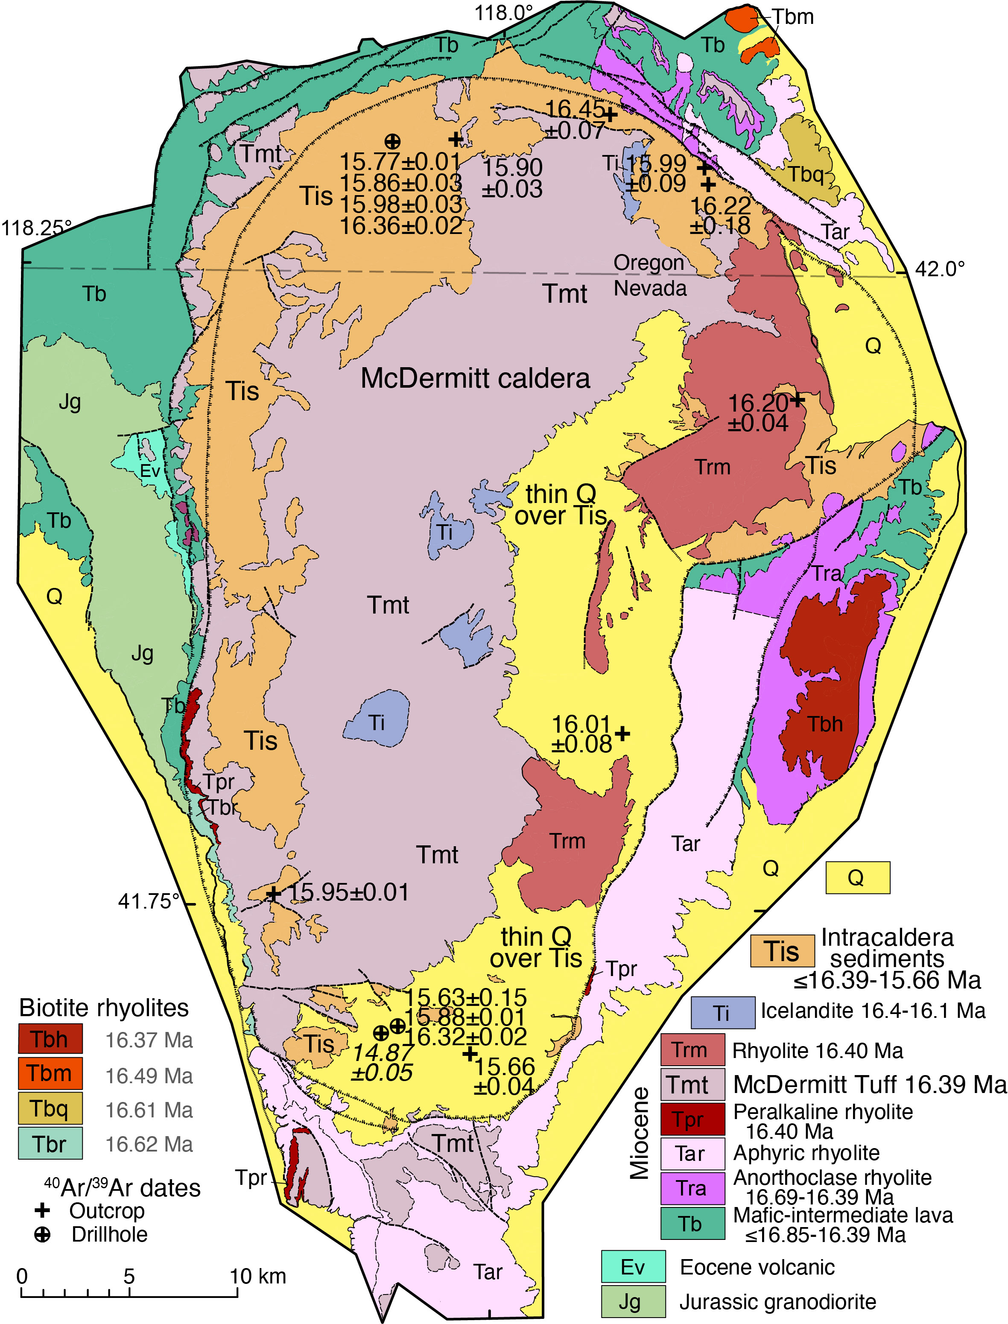
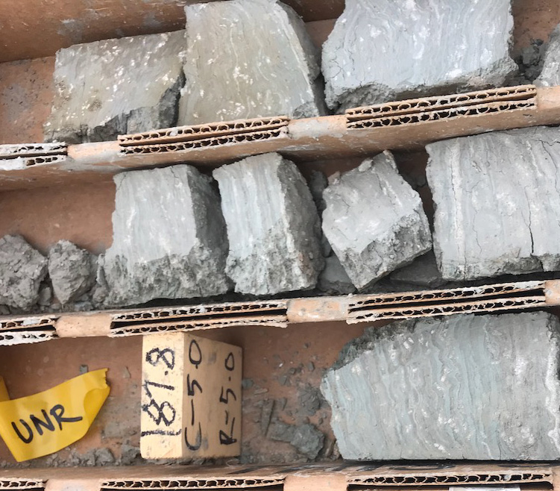
McDermitt caldera evolution:
16.39-~15.7 Ma, Caldera lake filled with rhyolitic
tuffaceous sediments (Tis).
Between 16.39-~16.1 Ma, late icelandite volcanism and
resurgence. Caldera magmatism ceased.
16.39-14.9(?) Ma, closed hydrologic system
diagenesis (CHSD) of intracaldera
tuffaceous sediments (Tis).
Li clay deposits entirely in intracaldera
sediments.
Entire section is mineralized so
mineralization must have continued at least
to 15.7 Ma.
Authigenic Kspar in illite zone = 14.87±0.05 Ma,
suggests illite late.
Long postdates caldera magmatism.
Attempting to date illite.
More high-grade Lithium Ore
Notes:
Entire section mineralized, which says mineralization began post-16.4 and extended beyond 15.7 Ma.

Slide 5
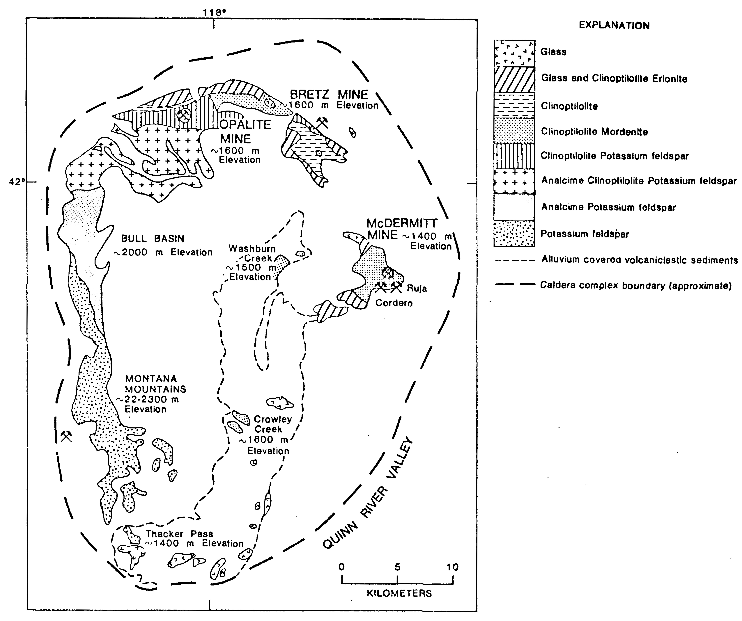
Glanzman and Rytuba 1979
recognized CHSD of
intracaldera sediments,
Li mineralization, including
Li smectite, but provided
no data.
Modern work by many confirms the general
mineralogy, especially Li smectite, zeolites
(e.g., clinoptilolite, analcime), authigenic Kspar.
Typical assemblage of CHSD.
Li illite, higher grade, overprints smectite and
only known in southern caldera, Thacker Pass.
Recent paper interprets illite to be hydrothermal,
related to caldera magmatism during resurgence.
Notes:
CHSD. Pore water dissolves unstable glass; generates saline, alkaline pore water containing everything in glass, including Li;
Progressive CHSD makes progressively more alkaline, saline; enhanced by evaporation.
Glanz – Rytuba recognized basics long ago, including Li mineralization and Li smectite .
Origin of Li illite and total source of Li uncertain – controversial.
Mineralogy demonstrates tuffaceous sediments have undergone CHSD. That’s an obvious source of Li.

Slide 6
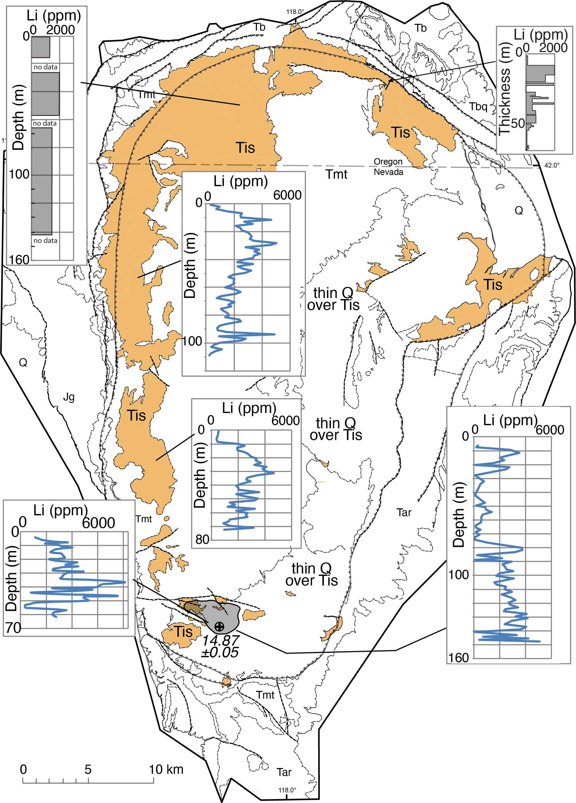
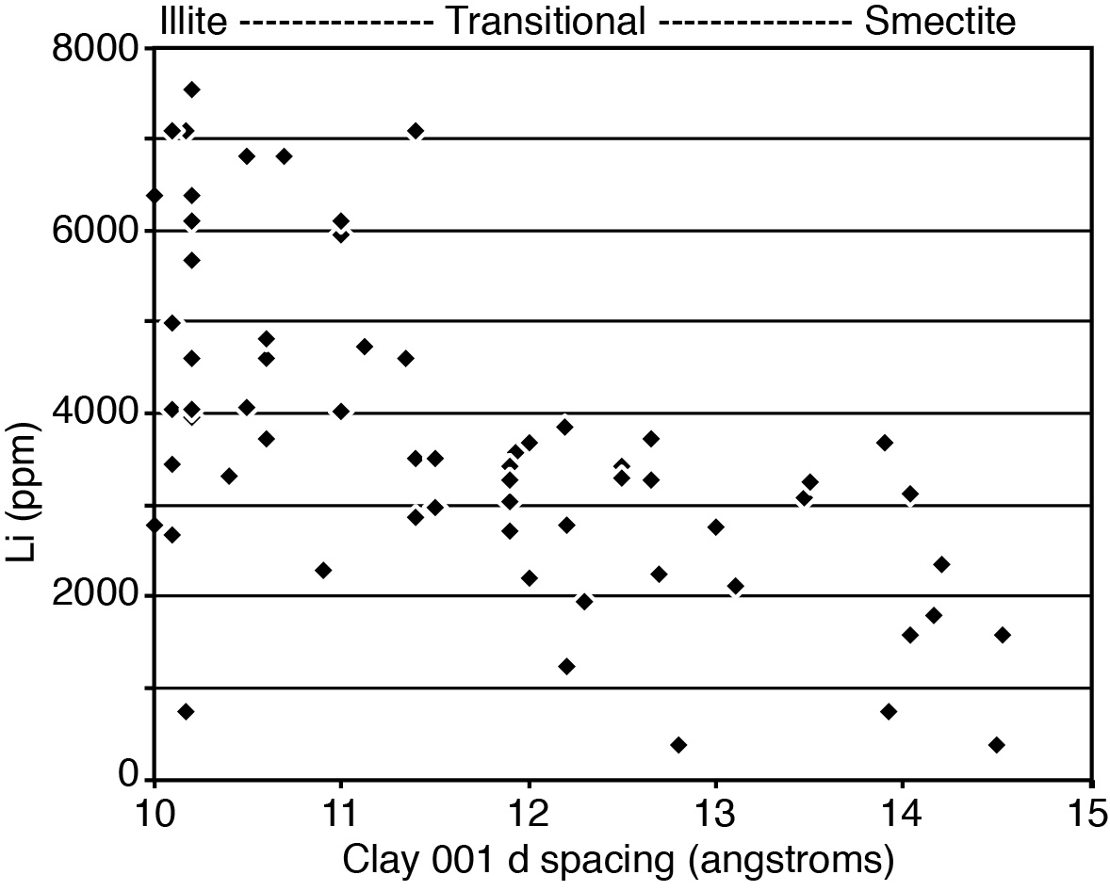
Modern work by many confirms the general mineralogy,
especially Li smectite, zeolites (e.g., clinoptilolite
analcime), Kspar, and that they were produced by CHSD.
Li illite, higher grade, only known in southern caldera,
Thacker Pass. Origin?
Castor and Henry, 2020
Drilhole data from Lithum Americas
and Jindalee
Notes:
Data from LiAmericas, Jindalee, outcrop = Rytuba et al (79-541)
Li grades of bulk samples, most ≤4000 ppm. Thacker Pass with Illite up to 8000-9000 ppm.
LNC-034

Slide 7
McDermitt caldera evolution:
16.39-~15.7 Ma, Caldera lake filled with rhyolitic
tuffaceous sediments (Tis).
Between 16.39-~16.1 Ma, late icelandite volcanism and
resurgence. Caldera magmatism ceased.
16.39-14.9(?) Ma, closed hydrologic system diagenesis (CHSD) of intracaldera tuffaceous sediments (Tis).
Entire intracaldera sedimentary section is
mineralized so mineralization must have
continued at least to 15.7 Ma.
Authigenic Kspar in illite zone = 14.87±0.05
Ma, suggests illite late, consistent with
overprinting smectite.
Long postdates caldera magmatism.
Hydrothermal heat source???
Attempting to date illite.
More high-grade Lithium Ore
Notes:
Entire section mineralized, which says mineralization began post-16.4 and extended beyond 15.7 Ma.
One date on authigenic Kspar in Li illite zone = 14.87±0.05 Ma. Just one date but suggests Illite very late, which overprints smectite, long postdates caldera magmatism, which mostly ceased ~16.3, entirely by 16.1 Ma.
This = an example of problems with hydrothermal origin: what would be the heat source for hydrothermal system after 16.1.
Attempt to date illite.

Slide 8
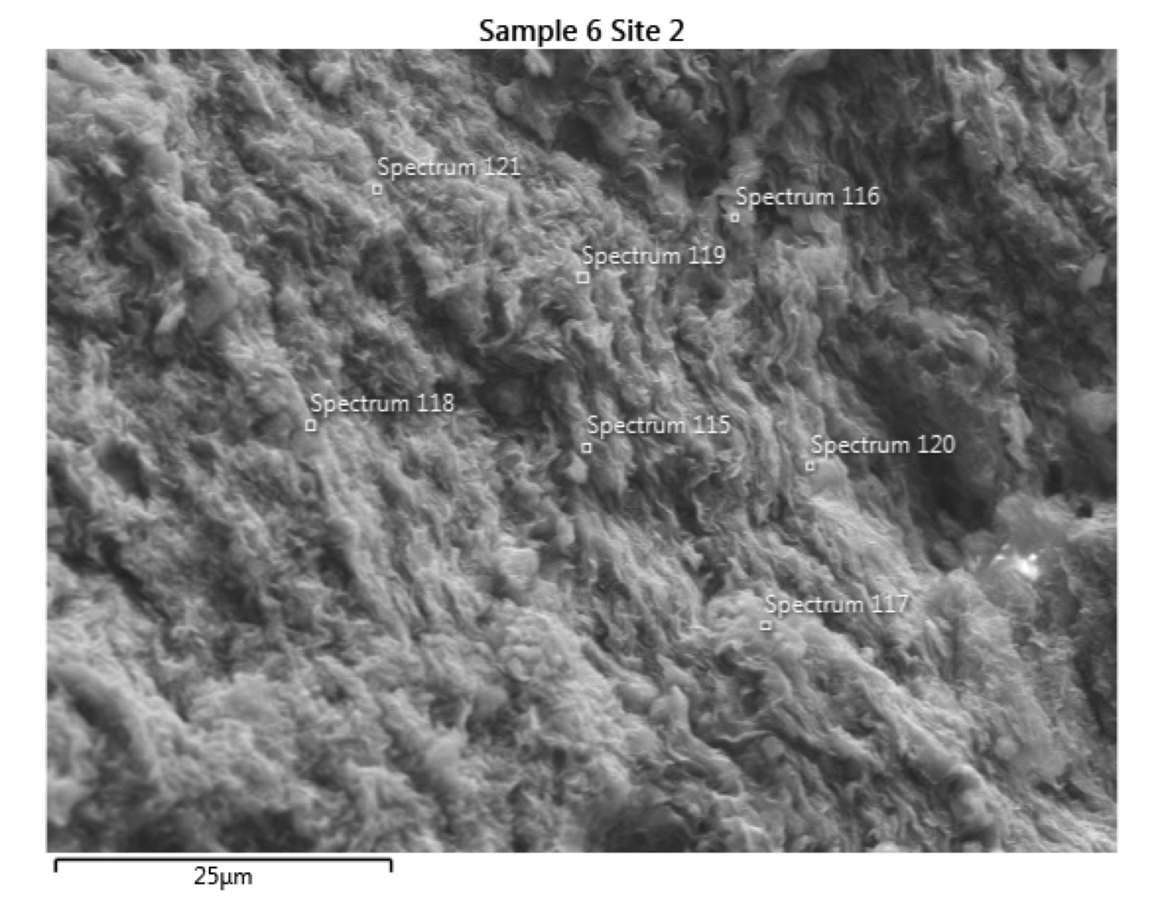
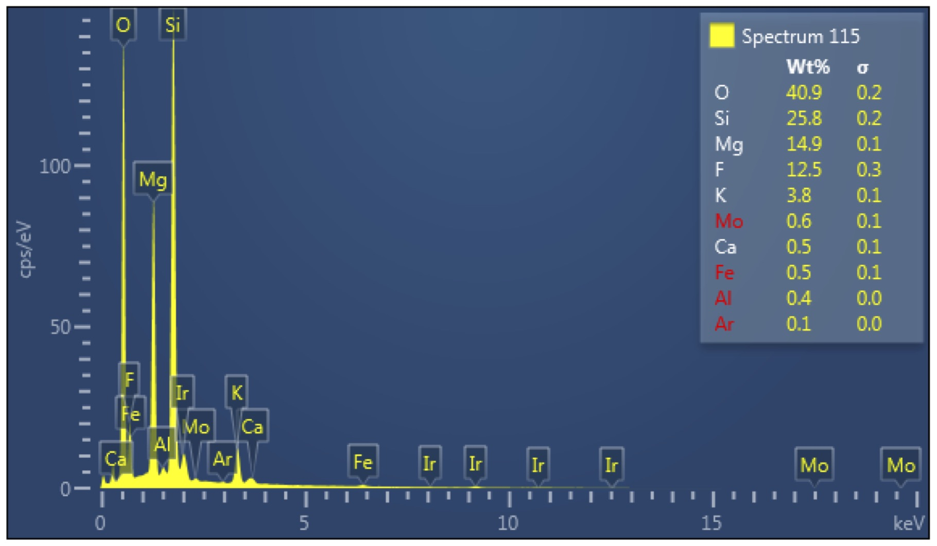
Li smectite (hectorite)
(Na_{0.3}(Mg,Li)₃Si₄O₁₀(F,OH)₂)
SEM cannot analyze for Li
Note high Mg, F, mod K
25 µm
Notes:
SEM, can’t do Li
Smectite, lower K than illite, but also high Mg, F
WLC071 315’ 6380 ppm Li

Slide 9
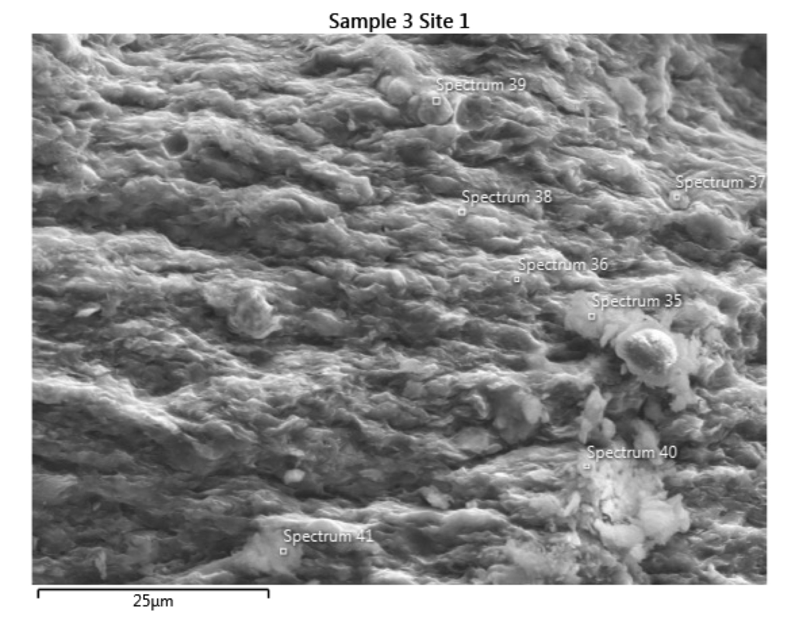
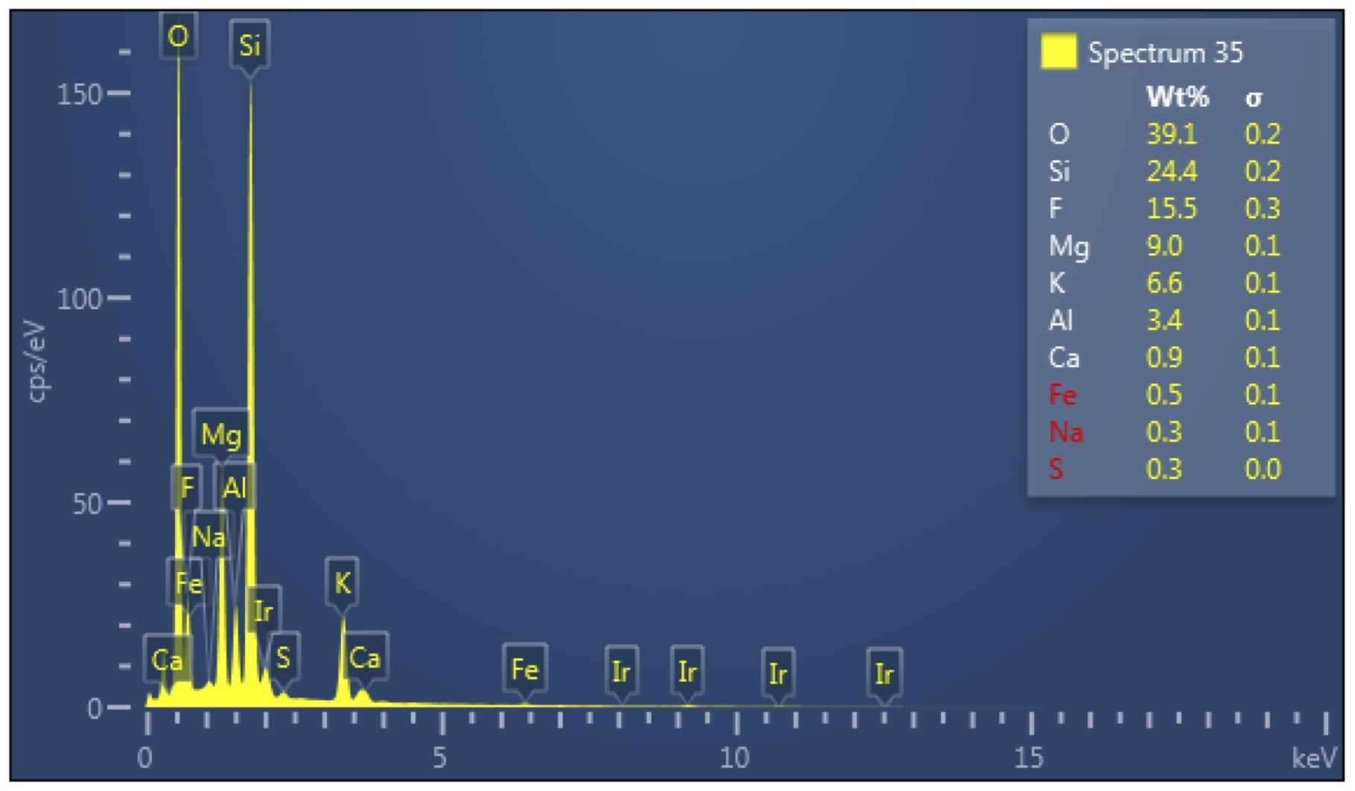
Li Illite (tainiolite?)
(KLiMg₂Si₄O₁₀F₂)
Lower Mg, higher F
Higher K
25 µm
Notes:
Illite, note Mg, F rich. SEM no Li.
Bulk WLC140 175’ 8850 ppm Li

Slide 10
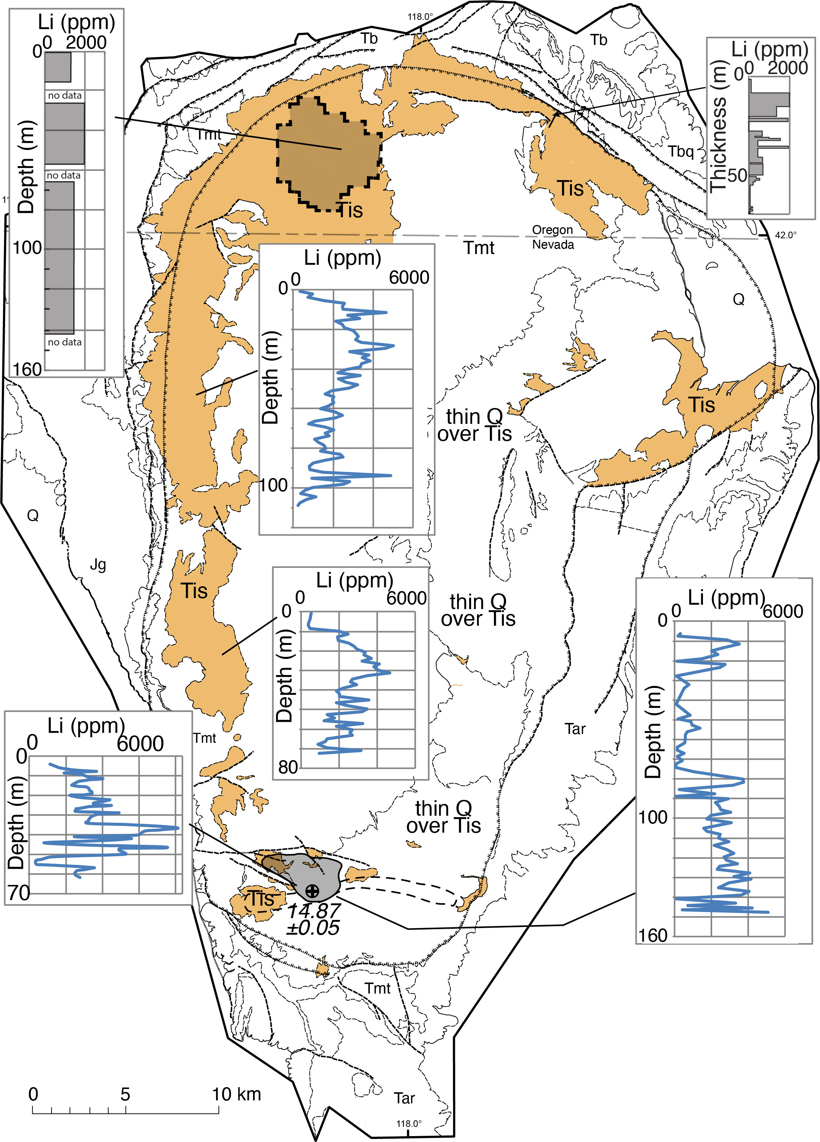
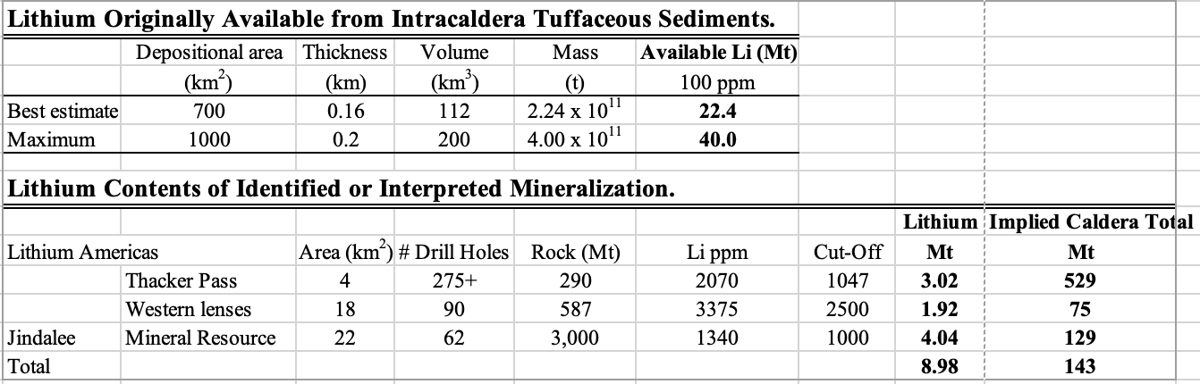
What is the Li source?
Li in glass in tuffaceous sediments probably insufficient to provide all the Li in caldera today.
Additional source seems needed. What is it?
Notes:
Intracaldera sediments are known to be enriched in Li everywhere anyone has looked.
Can tuffaceous sediments supply all Li by release during diagenesis – dissolve glass and its contained Li, create alkaline, saline, Li-enriched pore water, enhance through evaporation, then solidify as Li deposits?
Very rough calculation (C&H, 2020) updated slightly and simplified here, suggests NO.
Combine known geology, inferences, assumptions: Total Li in tuffaceous seds 22-40 Mt
Li resourcs reasonably well estimated. LiAmericas, Jindalee. Amount of Li in deposit areas. Extrapolate to whole caldera. Thacker Pass illite too high. Jindalee resource, although not as detailed as LiAmer, maybe more representative of caldera. 129 Mt >> 22-40 Mt. 3 to 5 X. Unless some geology, inferences, assumptions really wrong, NEED ANOTHER SOURCE.
If all mineralized, what was depleted to provide Li?

Slide 11
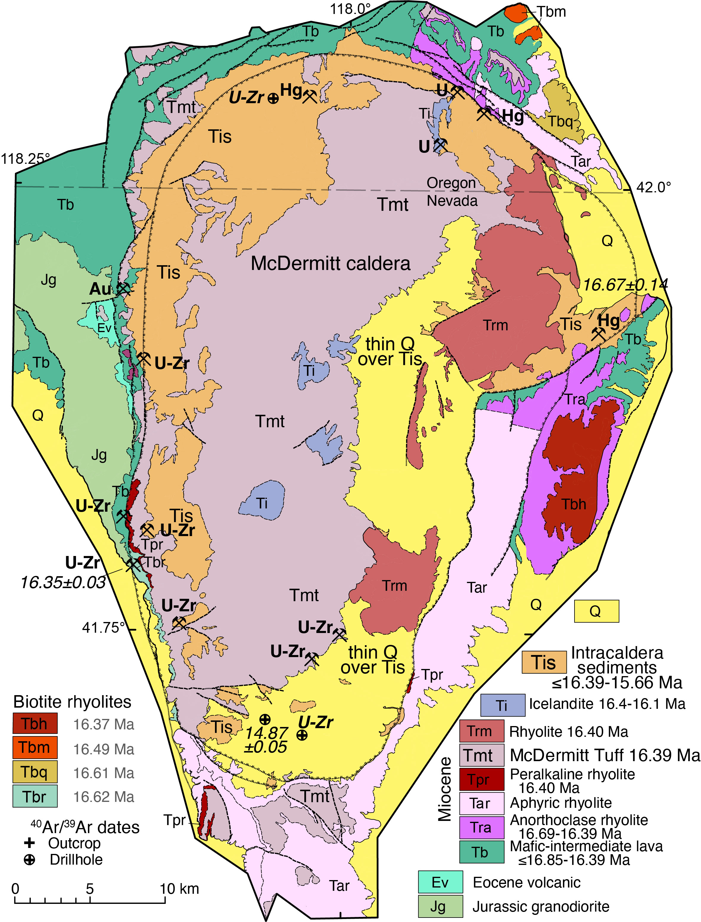
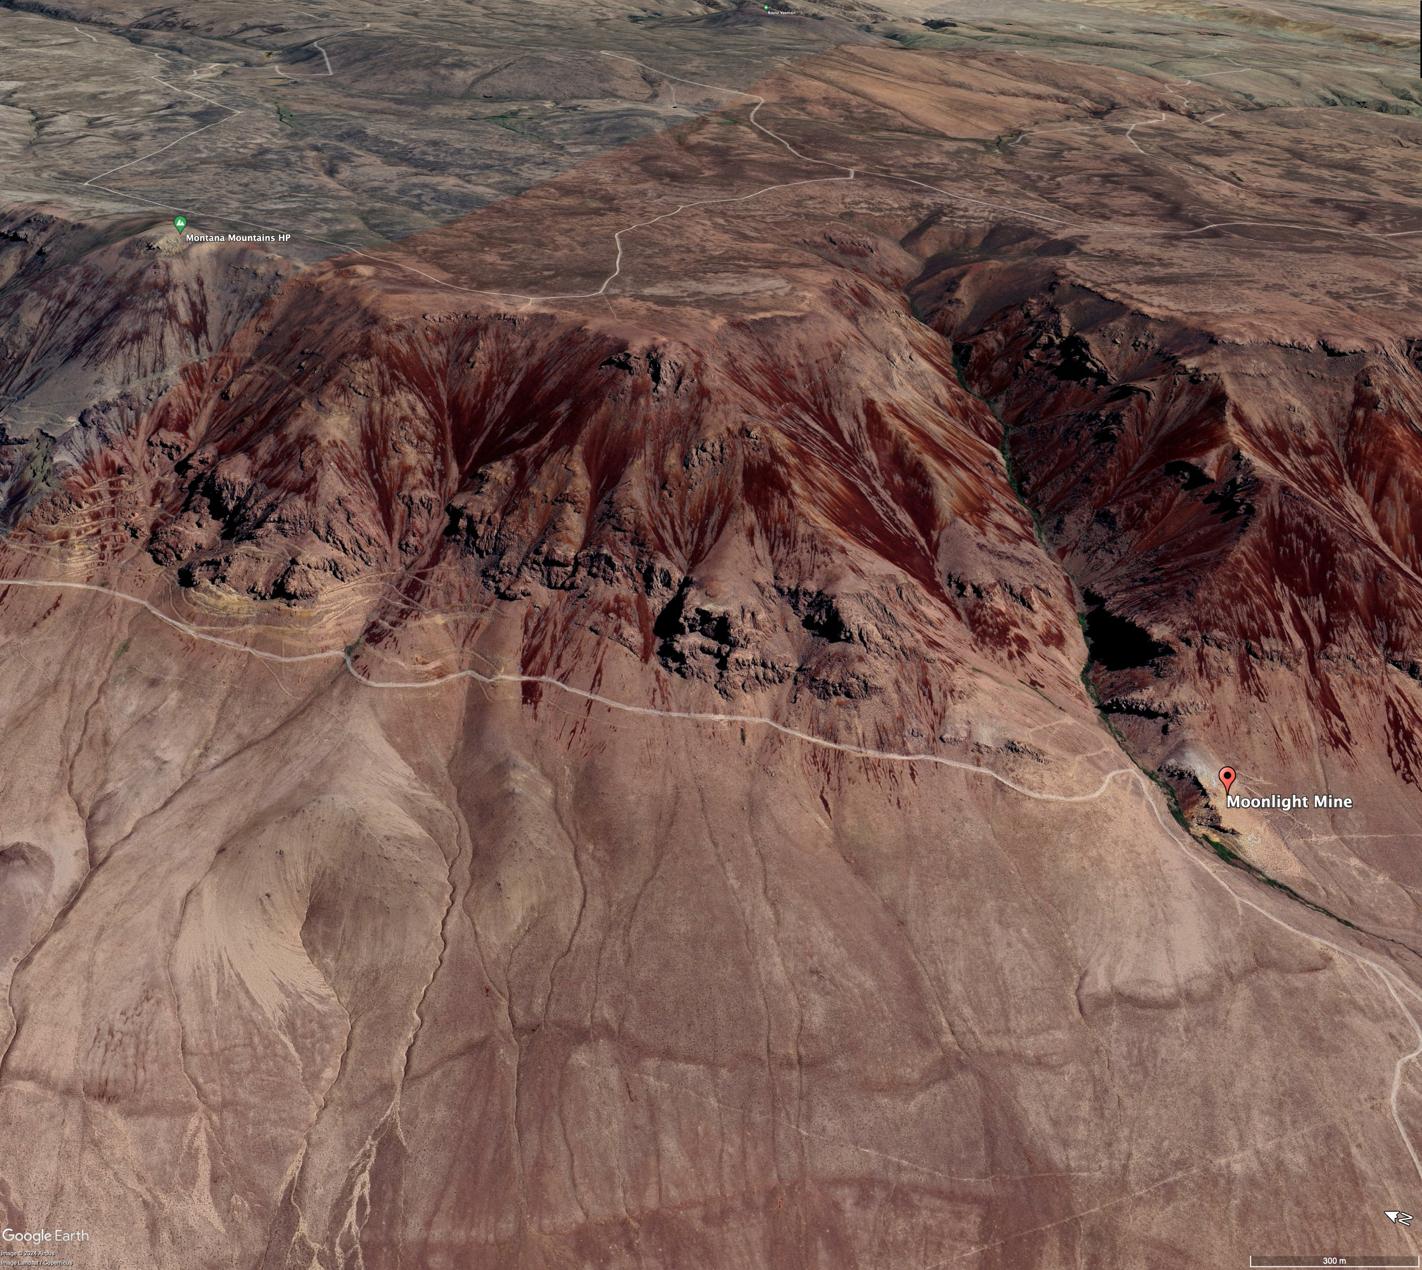
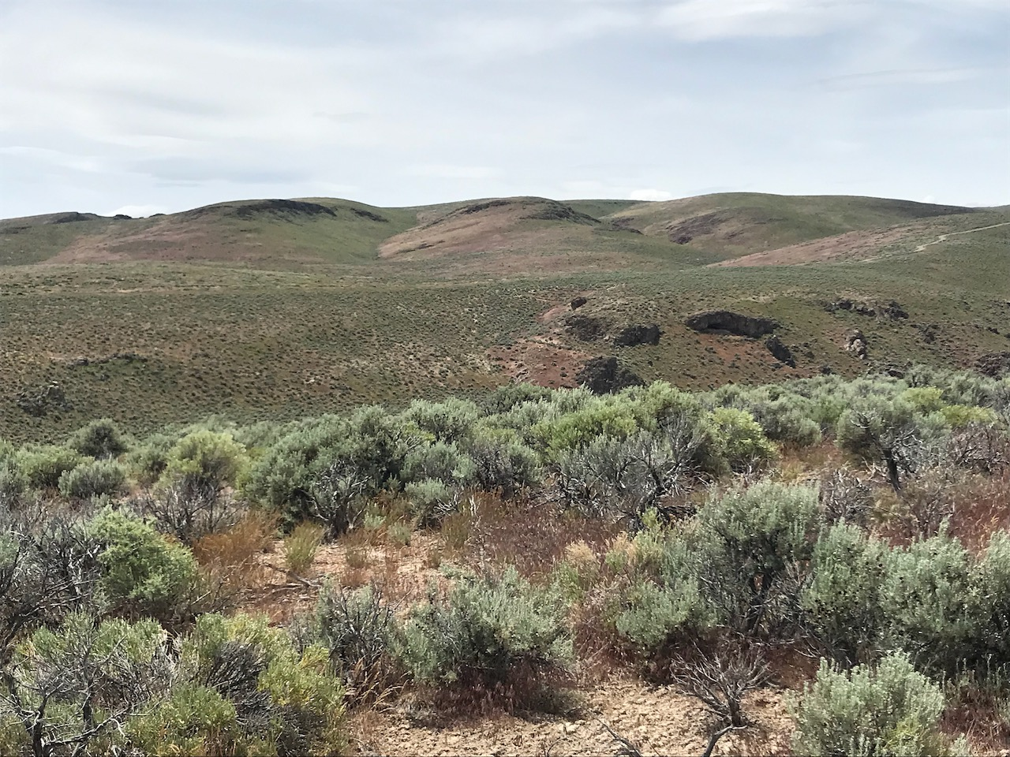
U-Zr: Tmt\Sediment contact
U-Zr
U-Zr
U-Zr
U-Zr: Ring-fracture
U-Zr
Moonlight Mine
16.35±0.03 Ma
adularia
U-Zr
Tmt
Tis
U-Zr: Tmt\Sediment contact
Notes:
A recent pub calls on hydrothermal origin of illite during resurgence.
McD distinctive among Yellowstone hotspot centers in having a lot of hydrothermal mineralization. Hg, U, U-Zr. Note, none of these enriched in Li (10s ppm)
Use widespread U-Zr as example of potential source.
2 Settings: A. Moonlight, Horse Creek U-Zr along caldera ring fault. 40/39 adularia 16.35±0.03. Setting and timing = hydrothermal related to caldera magmatism.
B. Numerous small U-Zr “pods" in top Tmt, base Tis, including in subsurface by drilling. Hot Pond Zone Thacker Pass. MDD010 Jindalee.
Restricted to top Tmt, base Tis says shortly post-collapse. Suggest possibly degassing of Tmt during devitrification. ~~ a hot spring environment, but igneous heat.
Both early and contemporaneous with igneous activity = heat source.
Authigenic Kspar in illite zone = 14.87±0.05, much younger, and long after end of magmatism. What would heat source have been for hydrothermal at this time?

Slide 12
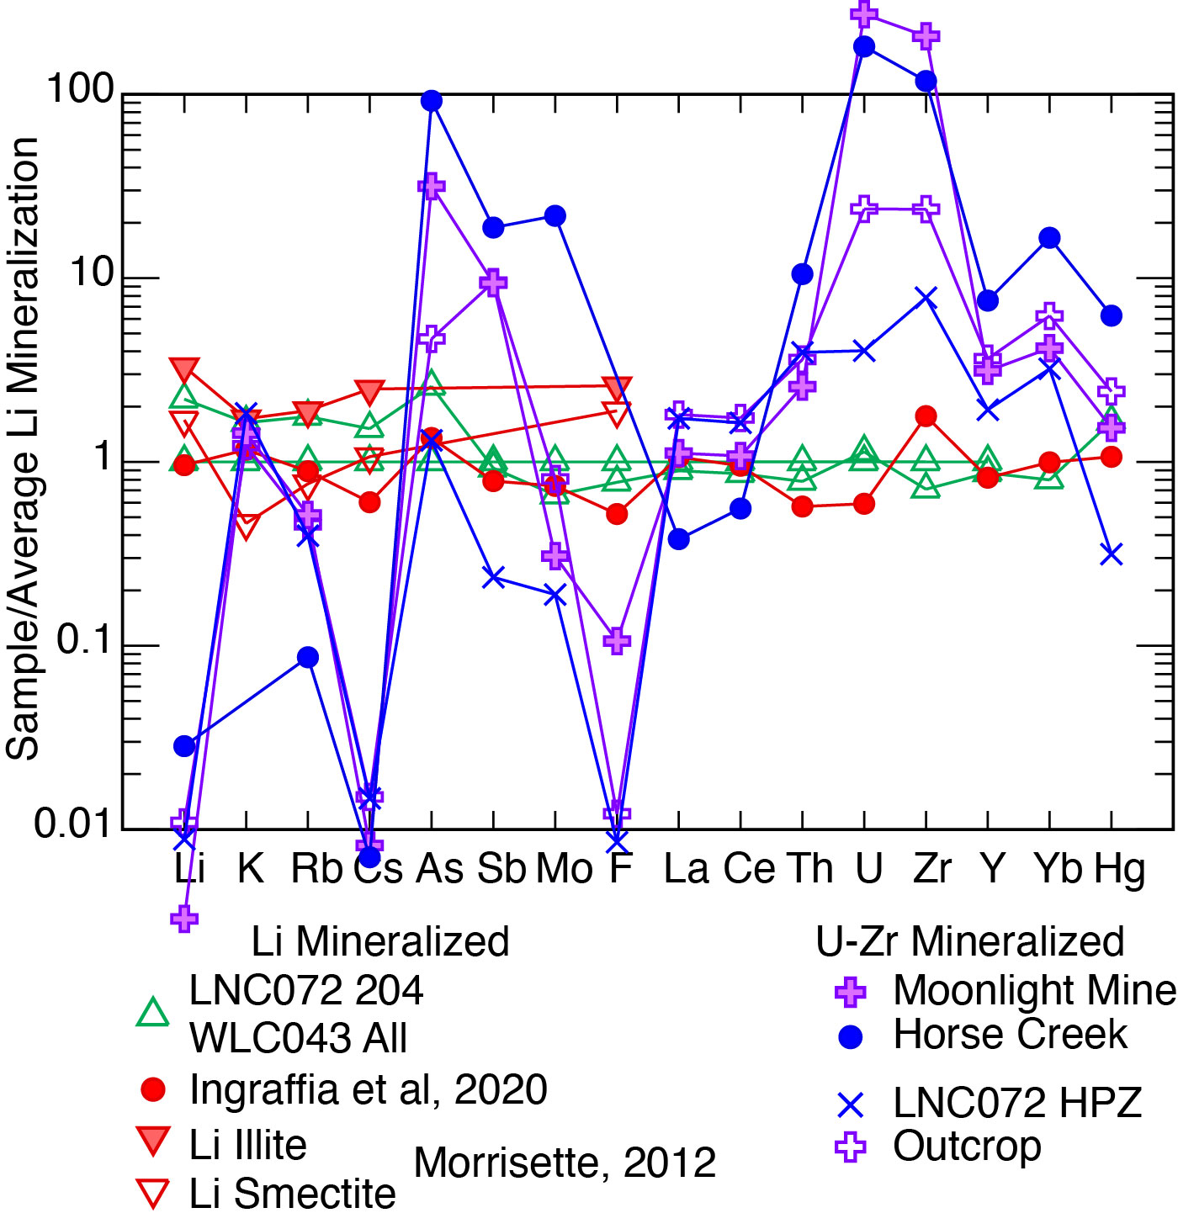
Compare: Li vs U-Zr mineralization
Geochemically very different:
2 U-Zr setting, geochemistry:
A. Ring fracture zone:
higher U, Zr: hydrothermal
B. Tuff\sediment contact
lower U, Zr: tuff degassing?,
Li in both <100 ppm and in
all McDermitt hydrothermal
Notes:
UZr and Li, some overlap As, Sb, Mo, but U-Zr very low in Li, Rb, Cs, F, enriched in Li deposits. U-Zr very enriched in U, Zr, Th, Y, Yb. U-Zr type hydrothermal system did not directly make Li deposits.

Slide 13
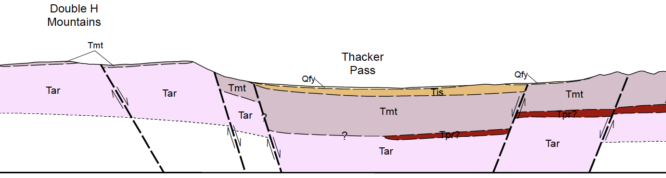
POSSIBLE additional source of Li,
whether needed or not
Low-grade U-Zr from degassing –devitrification of intracaldera McDermitt Tuff
U-Zr
High grade U-Zr from hydrothermal fluid
related to residual magma
Hydrothermal fluids and devitrification/vapor
phase discharge into intracaldera lake;
probably contained significant Li, Rb, Cs, F
as well as U, Zr.
“Immobile” elements precipitated with U-Zr;
“Mobile” elements (Li, Rb, Cs, F soluble in
cold, saline surface water) continued into –
were trapped in – lake or groundwater,
ultimately to form late, low-T Li clay deposits.
Burt and Sheridan (1981, U, Li, Be, Sn deposits). Ingraffia et al (2022, devitrification of
McDermitt Tuff)
Yellowstone today (Balistrieri et al, 2007, USGS
Prof Paper 1717). Discharge ~530 tonne
Li/year into Yellowstone Lake.
Yellowstone Lake is not a closed basin, so Li
lost to outflow.
Notes:
One possible source of Li is discharge of U-Zr hydrothermal fluid or McDermitt Tuff degassing. Don’t know that this has Li in it, but several studies of melt inclusions indicate magmas, including some around McDermitt, have much more Li than retained in solidified rocks. Tmt average 29 ppm Li. No reliable melt inclusion data for Tmt. Much Li lost during devolatization during eruption, but some retained in glass and lost during devitrification.
Would only be early, during igneous activity and devitrification of Tmt.
Discharge as hot springs. U, Zr, etc deposit along ring fracture = Moonlight Mine; discharge as hot springs and make small U-Zr “pods” at Tmt – Tis contact.
More mobile elements, Li, Rb, Cs would go into lake water. No outlet to the lake, so trapped forever and only increased because of evaporation.
Balistrieri paper, and the statement “These concentrations indicate strong enrichment of Cl, Si, B, Li, Na, K, Rb, As, Ge, Mo, Sb, and W in sublacustrine hydrothermal vent fluids.”. I envision McDermitt hydrothermal discharge being somewhat analogous to the Yellowstone hydrothermal fluids. Table 4 of Balistrieri indicates a “predicted .. deep thermal reservoir fluid” with 510µM Li (~3.9 mg/kg), and other fluids have up to 1400µM (~9.7 mg/kg). These numbers are similar to those reported by Fournier (1989; Annual Reviews). Balistrieri also says “The flux of hydrothermal source fluid into the lake is about 8 x 10⁹ kg of water per year, based on mass-balance calculations for Cl. If the concentration of Cl in deep reservoir fluid, rather than in hydrothermal source fluid, is used, then the flow is calculated to be 1.5x10¹⁰ kg of water per year. Using the latter estimate, sublacustrine vents in Yellowstone Lake account for ~10 percent of the total flux of deep, thermal reservoir water in the Park, as estimated from Cl in streams (Friedman and Norton, 2000, this volume). ” Using 8x10⁹ kg/year = more than 28 metric tonnes Li discharge/year, 1.5x10⁹ = 53 tonne. If 53 tonne is ~10% of total flux, then annual Li discharge to YL alone is ~530 tonne. Much more hydrothermal in Yellowstone.
Our extreme estimate of total Li in tuffaceous sediments in the McDermitt caldera is 130Mt (million tonnes). At 530 t/year, all that could be discharged in 226000 years (I hope I didn’t slip one or more decimals in any of these calculations). Obviously, these calculations are barely more than arm waving, but they suggest hydrothermal discharge into an early lake at McDermitt could provide all the Li there.

Slide 15
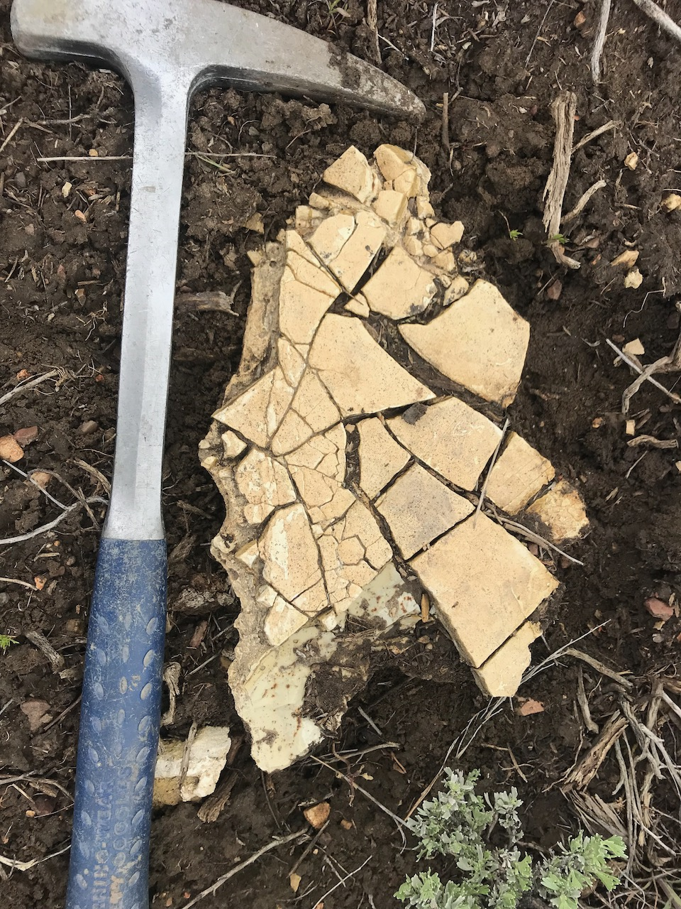
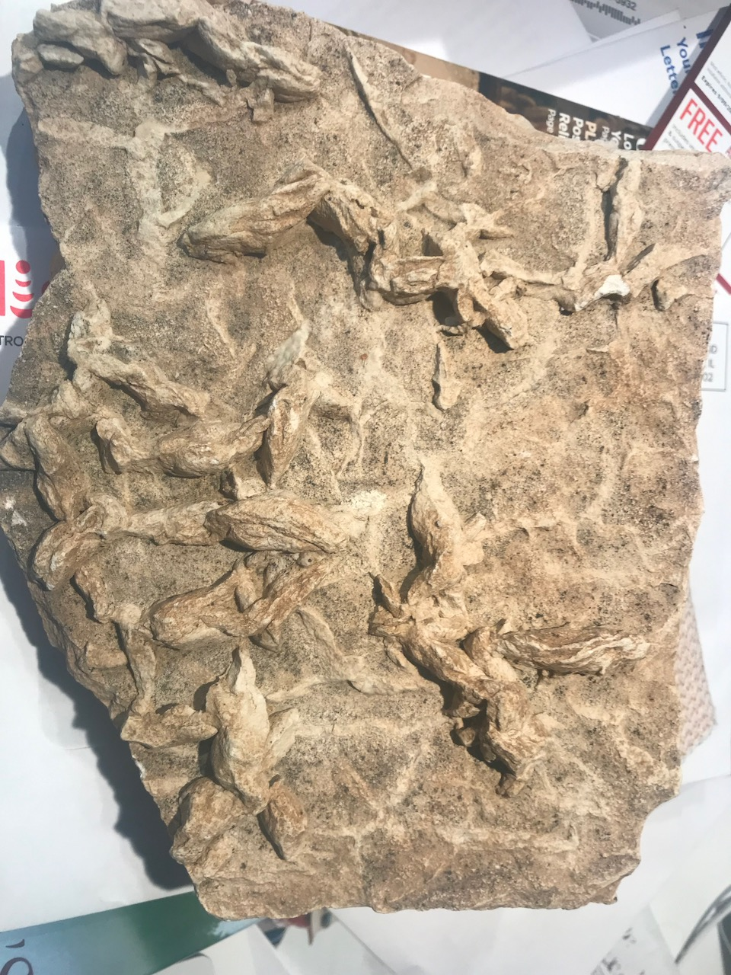
Notes:
Mudcracks, left photo.
Syneresis cracks???, right photo

