Slide 1
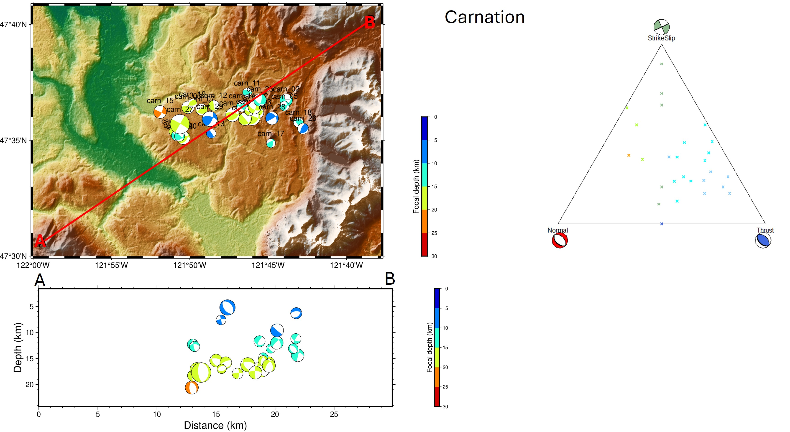
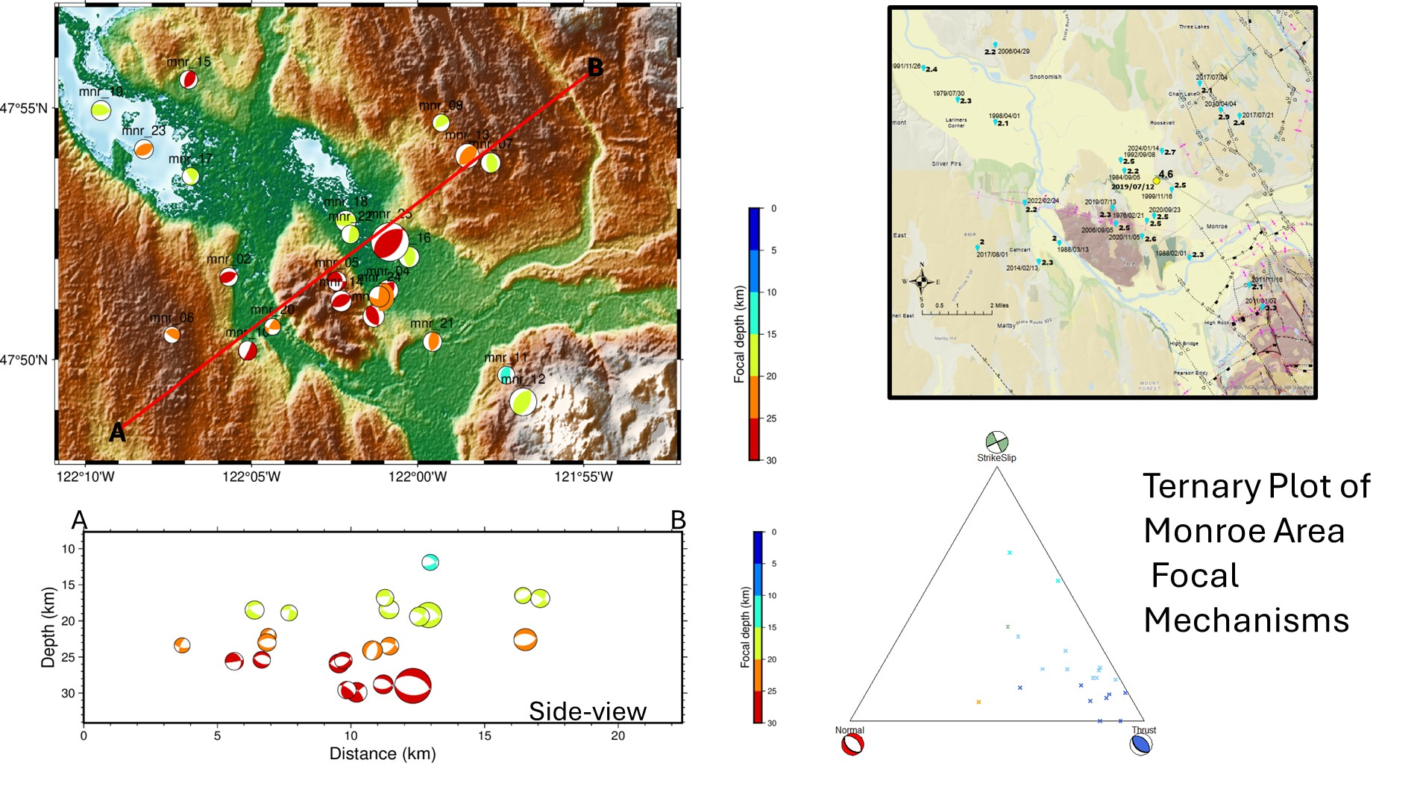
EXTRA FIGURES
TWO EXTRA FIGURES NOT INCLUDED IN THE POSTER. THE FOCAL MECHANISMS FOR MONORE AND SNOQUALMIE QUAKE GENERAL AREAS AND MADE AFTER FINAL PLOT OF THE POSTER. NOTE THAT THE AREAS FOR THE FOCAL MECHMISMS FOR BOTH QUAKE AREAS ARE BROAD AND LIKELY INCLUDE QUAKES OUTSIDE OF THE TOKUL CREEK, CHERRY CREEK AND MORNOE FAULTS
CARNATION AREA ADDITIONAL DATA
MONROE AREA ADDITIONAL DATA

